Slide 1
FFAs for Acceleration in a Muon Collider
J. Scott Berg, Brookhaven National Laboratory
Colliders of Tomorrow, Fermilab
July 16, 2024

Slide 2
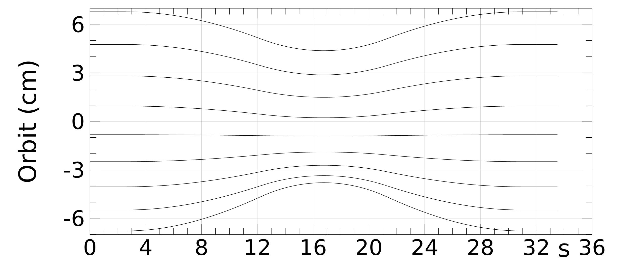
What is an FFA?
Fixed Field Alternating gradient accelerator
Large energy range (e.g., factor of 2) in a single beamline
Magnet fields do not vary with time
Each energy follows a different orbit
Alternating gradient focusing in
compact cells for small orbit
excursion

Slide 3
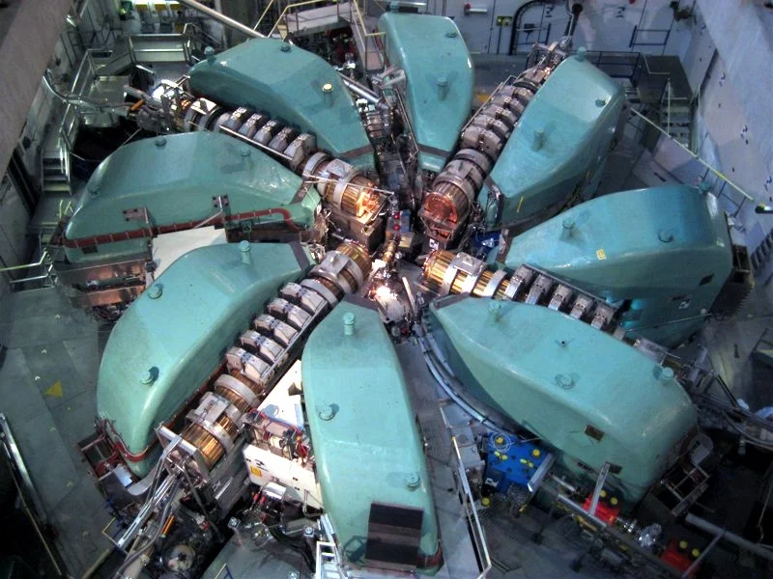
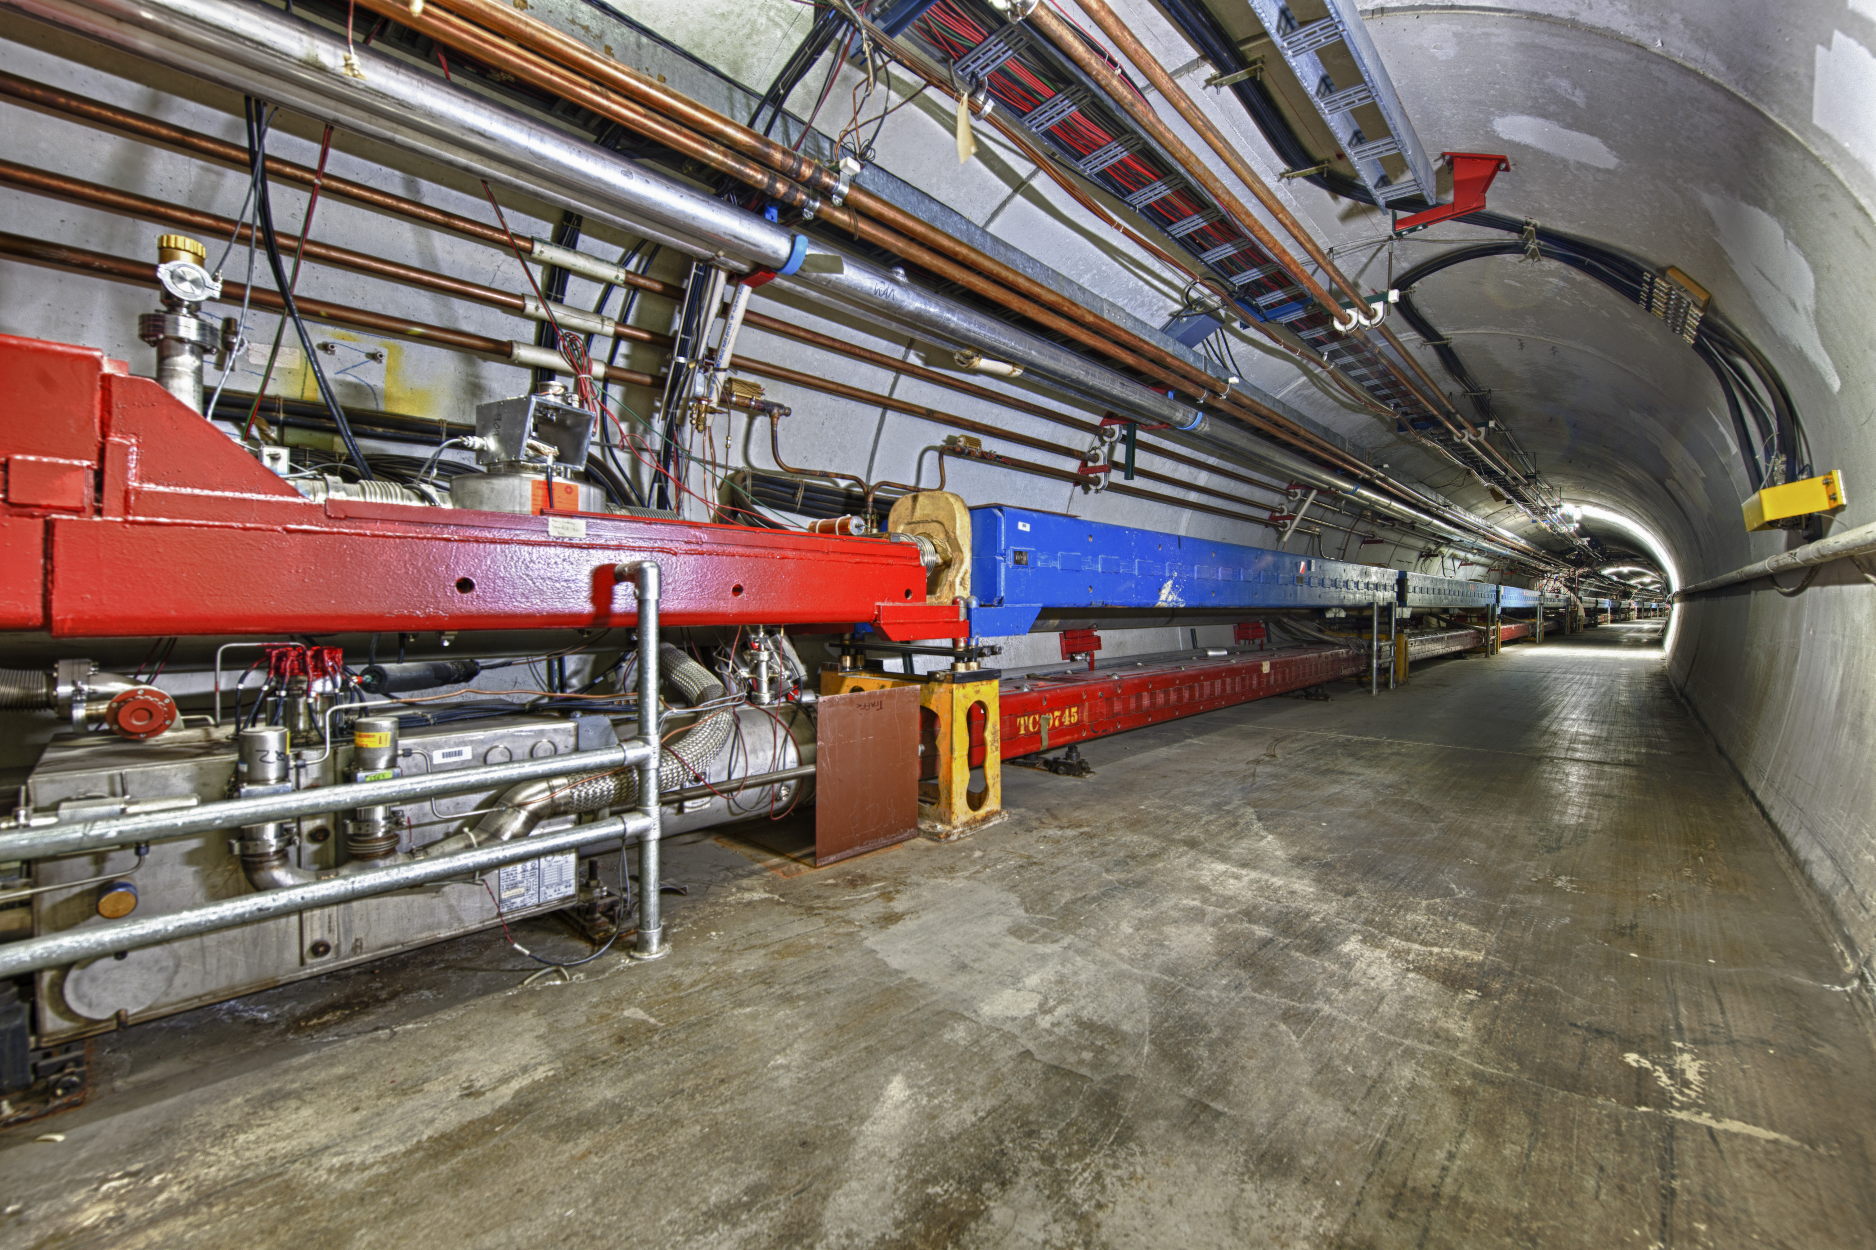
FFAs Compared to Other Accelerators
Cyclotrons
  Magnet fields don’t change while accelerating
  Rely on intrinsic focusing from dipoles and their edges,
  potentially with a small gradient (weak focusing)
  Require large magnets
Synchrotrons
  Magnet fields change proportional to beam
  momentum
  Alternating gradient focusing, small beams
  Compact magnets
  Small energy acceptance

Slide 4
FFAs Compared to Other Accelerators
FFAs are like cyclotrons:
  Fields in FFA magnets do not vary during acceleration
  The beamline accepts a wide range of energies
FFAs are like synchrotrons:
  Alternating gradient focusing to keep orbit
  excursion and beam size small
FFAs are between the two:
  Magnets are more compact than for
  cyclotrons, but larger than for
  synchrotrons

Slide 5
A Brief, Incomplete History of FFAs

Slide 6
The First FFAs: MURA
FFAs (nee FFAGs) first described in 1954 at MURA in Wisconsin, with contemporaneous development in Japan and Russia
Three FFAs were operated at MURA in 1956, 1957, and 1959–1961, accelerating electrons

Slide 7
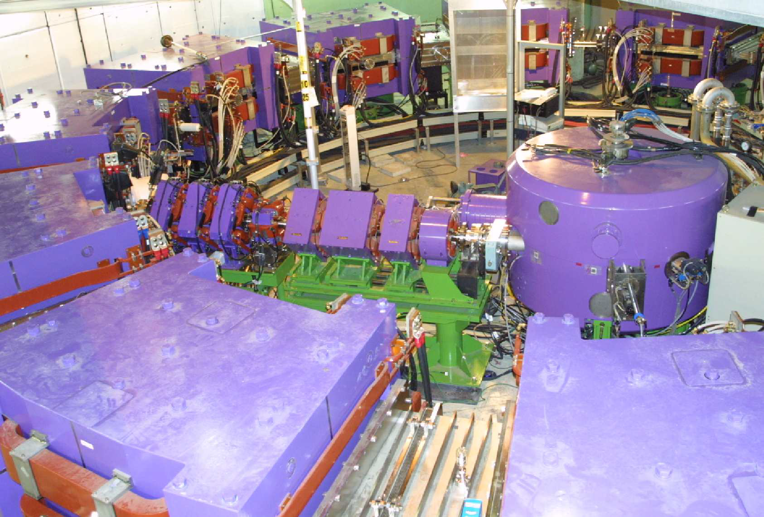
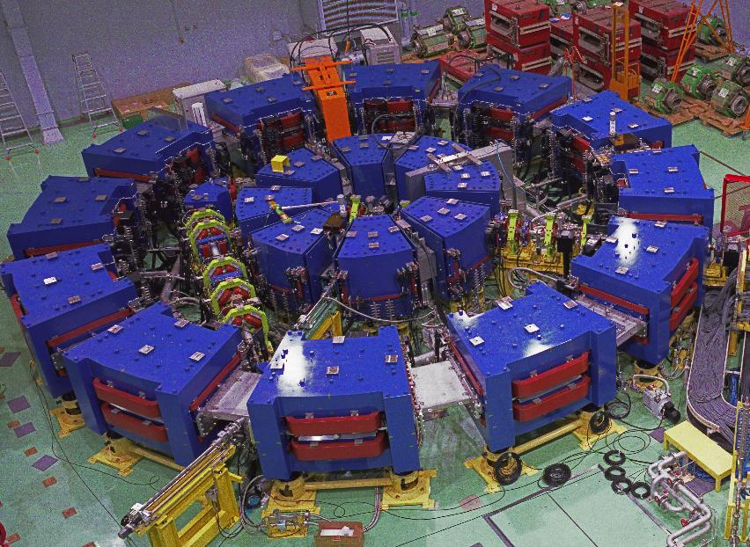
Proton FFAs in Japan
In 2000, a group led by Mori began building proton FFAs, first at KEK, later at KURRI
In 1999, they began a series of FFA workshops that continues to this day
A strong interest in FFAs in Japan continues to this day, including accelerators built at universities

Slide 8
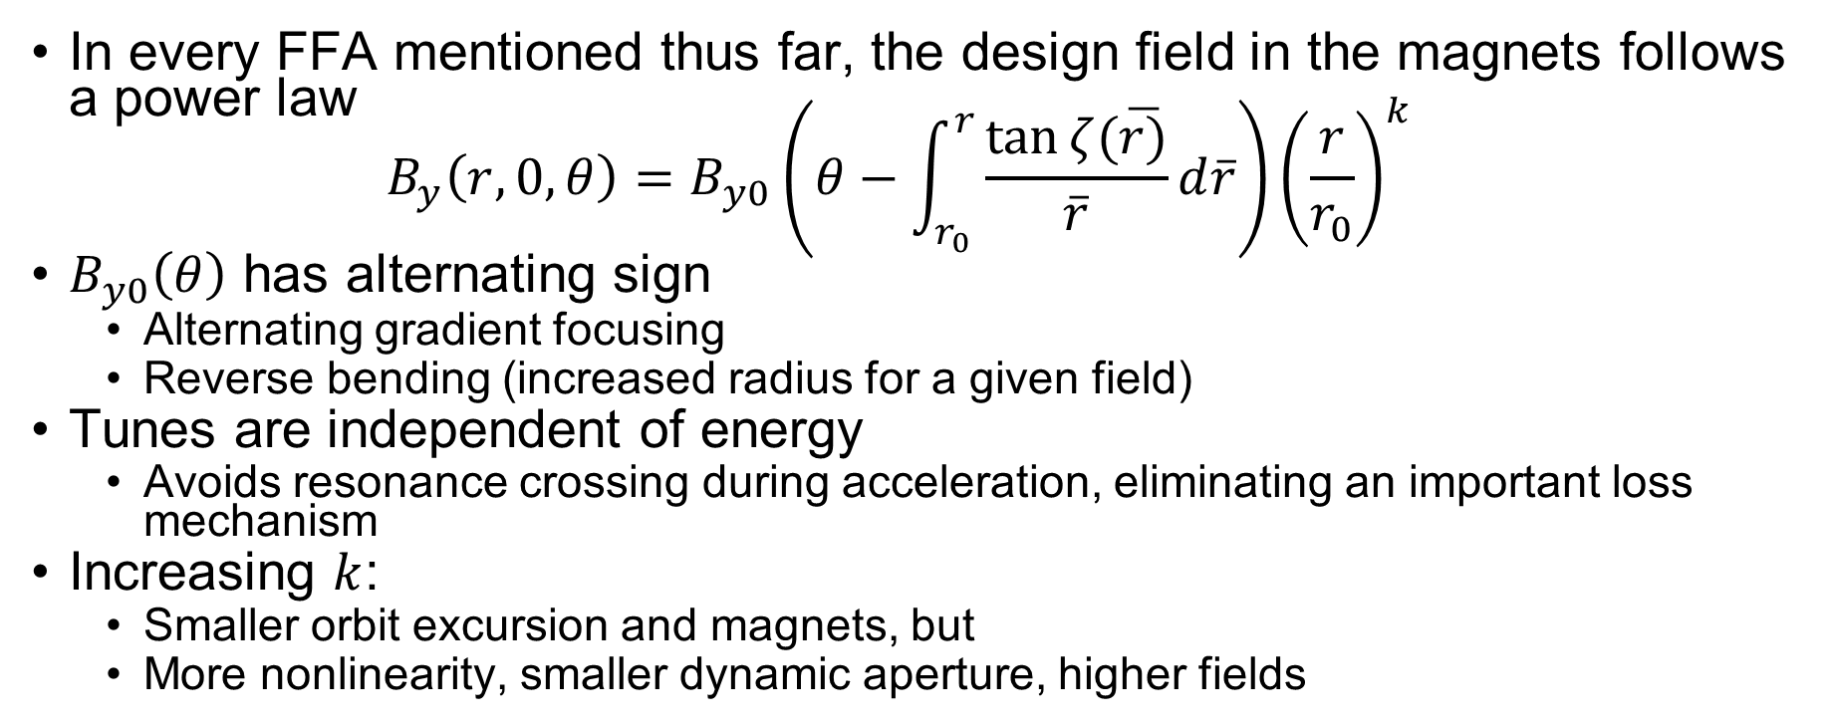
A Detour: “Scaling” FFAs
In every FFA mentioned thus far, the design field in the magnets follows a power law
$B_{y}\left(r,0,θ\right)=B_{y0}\left(θ−\int_{r_{0}}^{r}{\frac{\tan{ζ(\overline{r)}}}{\overline{r}}}d\overline{r}\right){\left(\frac{r}{r_{0}}\right)}^{k}$
$B_{y0}\left(θ\right)$ has alternating sign
  Alternating gradient focusing
  Reverse bending (increased radius for a given field)
Tunes are independent of energy
  Avoids resonance crossing during acceleration, eliminating an important loss mechanism
Increasing $k$:
  Smaller orbit excursion and magnets, but
  More nonlinearity, smaller dynamic aperture, higher fields

Slide 9
Non-Scaling FFAs
In 1999, Johnstone and Mills propose non-scaling FFAs, using linear magnets for the purpose of accelerating muons
  Linear magents to give large dynamic aperture
  Less reverse bending
  Orbits and magnets more compact
But: tunes vary with energy
  Linear magnets avoid nonlinear resonances
  Need high periodicity to avoid linear resonances
2001: Berg demonstrates you can accelerate in a non-scaling FFA without varying the RF frequency: serpentine acceleration

Slide 10
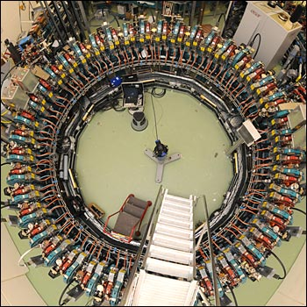
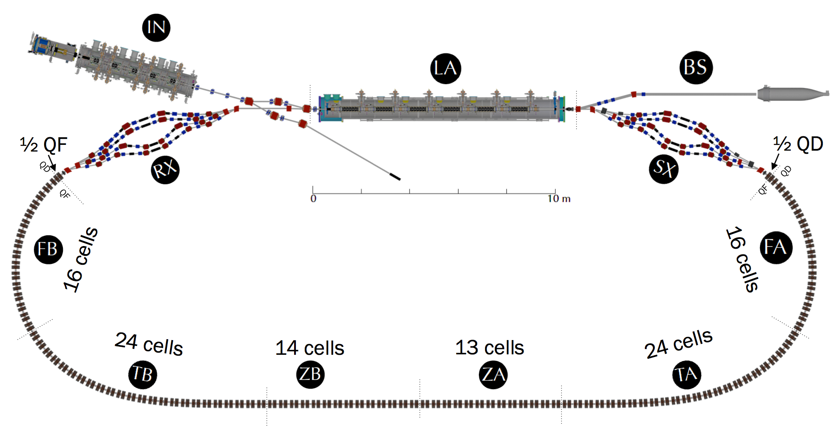
Non-Scaling FFAs
From 2007–2011 the EMMA ring at Daresbury
  Linear non-scaling FFA, similar a low-energy muon
  accelerator
  Confirmed expected behavior, serpentine acceleration
CBETA at Cornell University
  ERL with a single FFA return arc covering
  4 energies, 42–150 MeV
  Successfully operated 4-pass ERL

Slide 11
Vertical FFAs
For previous examples, closed orbits for each energy are in a common plane
In 1955, FFAs with closed orbits vertically displaced for different energies were first discussed (Ohkawa), with more detailed work by other authors in from 1959–1962.
Brooks rediscovered the idea in 2009, and there has been interest in applying it in the UK and Japan
Because orbits are displaced vertically, they can have identical lengths at all energies, avoiding RF synchronization problems at high energy

Slide 12
When to use FFAs

Slide 13
Comparing to Synchrotrons
Synchrotrons won over FFAs
Synchrotrons have no reverse bending, FFAs usually require it: machine is shorter for a given maximum field
Synchrotron magnets only need to be large enough to pass a single beam; FFA magnets need aperture for both the beam size and the orbit variation with energy
At low energy, both machines need to vary RF frequency as the beam accelerates; at high energy, that variation is small in a synchrotron, larger in the FFA
In a synchrotron, magnet fields must be varied during acceleration

Slide 14
When to use FFAs
You primarily use FFAs when you are in a big hurry to accelerate
  Very high repetition rates
  Unstable particles!
Linacs accelerate quickly, but are very expensive. So an FFA can save you money
  Multpass RF must give sufficient savings over more expensive magnets
  And FFAs generally require lower frequency RF than the corresponding linac would have
You can manage any required RF frequency variation
  Possibly with phase space tricks: e.g., serpentine acceleration

Slide 15
Muon Acceleration

Slide 16
General Principles for Muon Acceleration
Acceleration must be fast to avoid muon decays
RF drives costs and power consumption
  Make multiple passes through RF, as many as possible
    Use a ring or RLA where possible
    More time for magnet and RF manipulations at higher energies
  Use high RF frequencies
Keep decays reasonably low
  High average accelerating gradient
  High average bend field in recirculating machines, to get more passes
Avoid emittance growth and losses

Slide 17
Stages of Muon Acceleration
Low energy just after cooling
  The cooling channel, somewhat reversed, without absorbers
Initial superconducting linac to a couple GeV
  Once beam is small enough
Low energy recirculating acceleration
  No time for changing magnet fields, adding power to RF to replace stored energy, shift phase
High energy acceleration

Slide 18
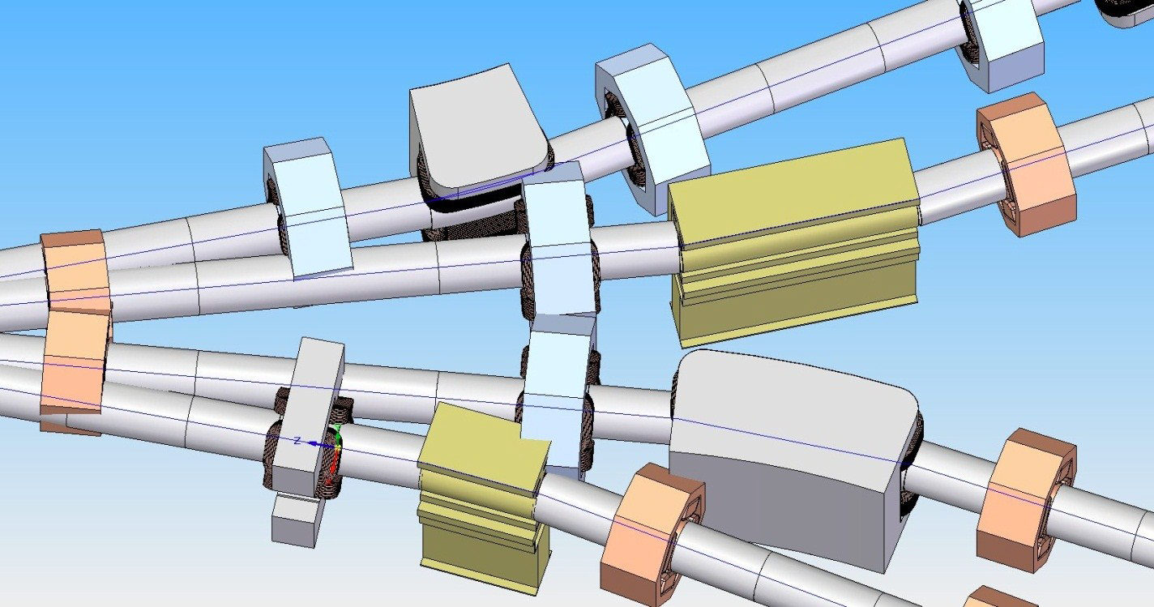
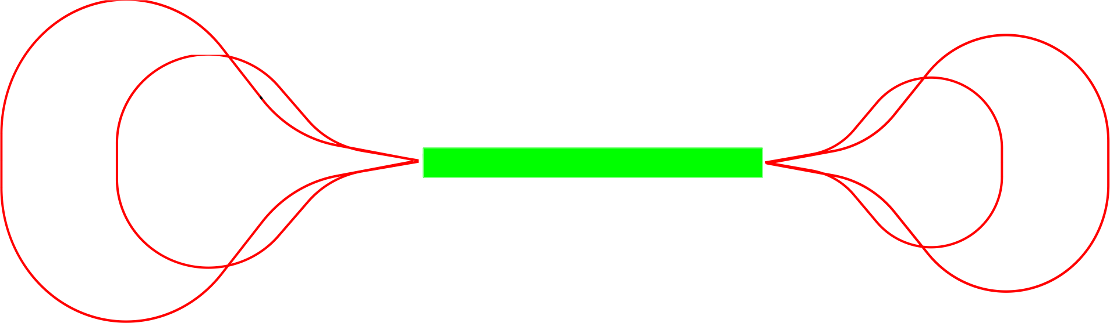
Low Energy Conventional Acceleration
Recirculating linear accelerator (RLA)
“Dogbone” configuration for efficiency
Baseline: acceleration to around 63 GeV,
in multiple stages
Challenge: limited number of passes
  Complexity in the switchyard area
  Large beam size,
  particularly driven
  by longitudinal

Slide 19
High Energy “Conventional” Acceleration: Pulsed Synchrotrons
Once we reach high energy, we have time to change magnet fields
  Use a synchrotron: magnet fields increase with beam energy
  Repetition rate is low (5–10 Hz)
  Acceleration times are short: < 1 ms at lower energies, a few ms at higher energies
Only iron-dominated magnets can ramp on these time scales
  Iron field limited to about 1.8 T
  Such a low average bend field means either a low average accelerating gradient and thus lots of decay, or a small number of turns and thus a high RF voltage

Slide 20
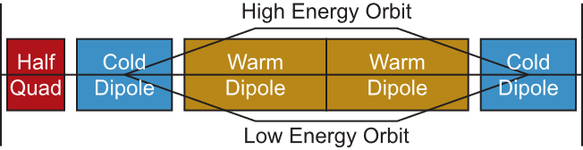
The Hybrid Synchrotron
Increase the average bend field while using pulsed iron magnets by interleaving fixed field superconducting dipoles, and bipolar pulsed iron magnets
The catch: even for infinitely high superconducting magnet fields, average bend field is bounded by a number depending only on the energy gain factor and the iron magnet field!
  E.g., factor of 2 energy
  gain, 1.75 T iron
  magnets, average bend
  is 5.1 T

Slide 21
Powering Pulsed Magnets
Pulsed magnet power supplies are a significant cost
  Delivering GW of power to magnets
  Energy is recovered and stored in capacitors, but need to watch efficiency
There are unavoidable losses in iron, plus conductors
  Can be kept down to a few MW
  Water cooling of magnets is required

Slide 22
Accelerating to High Energy on the Fermilab Site
Goal is to accelerate to 5 TeV per beam in a 16.5 km tunnel
Current designs envision 2 (or even 3) acceleration stages in that tunnel
  Last stage may only accelerate from 4.2 to 5 TeV
  Stage before that unlikely to even cover a factor of 2
  This will only get worse as we make the designs more realistic
We are unlikely to reach 5 TeV with pulsed synchrotrons on the Fermilab site, but we will get close
Could FFAs let us reach higher energies?

Slide 23
Replacing Conventional Muon Acceleration with FFAs

Slide 24
Replacing Acceleration with FFAs
The aforementioned “conventional” acceleration techniques should work for low and high energy acceleration
But I’ve pointed out issues that
  Make them costly
  Limit their possible efficiency
  Limit their capabilities in some circumstances
Could replacing these accelerators with FFAs address some of these issues and ultimately be a better choice?

Slide 25
Basic Structure of a Muon FFA
(Linear) non-scaling FFA
Simple cells with a “long” drift for an RF cavity
  Most cells have an RF cavity: adiabatic orbit shifts
  Some drifts will replace that with injection/extraction hardware
Have muon beams circulating in both directions
  Use a reflection symmetric cell structure: triplets
Generally small factors (2–3) in energy gain
  Magnet apertures grow quickly for large factors

Slide 26
FFA Design Principles
Compact cells to reduce orbit excursions and apertures
Use combined function magnets: both bending and focusing
Strong horizontal focusing most important, since orbit excursion is horizontal
  Generally keep vertical focusing weak to make best use of magnet focusing

Slide 27
Why a non-Scaling FFA Rather than Scaling
Less reverse bending, so better average bend fields
Smaller apertures
Nonlinear fields in scaling FFAs grow much more quickly at larger apertures, leading to higher required magnet fields
Scaling FFAs require lower frequency RF
  Large beam excursion
  Large time of flight range
NufactJ studies (2001) of scaling FFA neutrino factory to 20 GeV
  A rough cost comparison indicated the scaling FFA solution was significantly more expensive than a non-scaling solution

Slide 28
Why a non-Scaling Rather Than a Vertical FFA?
Orbit lengths independent of energy make vertical FFAs an attractive solution
  Other solutions must adjust RF frequency make design compromises to enable needed longitudinal phase space dynamics for acceleration (e.g., serpentine acceleration)
Vertical FFA magnets appear to be very complex to make
Vertical orbit excursions are larger than horizontal excursions in non-scaling FFAs. Require large RF apertures, lower frequencies.
Ongoing work in UK and Japan trying to address these issues

Slide 29
Low Energy FFAs
Characteristic defining “low” vs. “high” is that at low energies, there is insufficient time to replace stored energy or shift phase in RF cavities
  Primary limitation is input power coupler
  Discussed mechanical and other methods to rapidly change RF frequency, nothing appeared viable
Stored energy in cavities must be sufficient to accelerate for all turns
  Requires low frequencies (e.g., 325 MHz)
Serpentine acceleration to accelerate with varying orbit period

Slide 30
Why FFAs for Low Energy Acceleration?
Switchyard limits number of passes
  FFA has no real limit on number of passes
  But the FFA will have a cost optimal number
  of passes
Have a single arc rather than several
  But magnets in FFA arc are more expensive

Slide 31
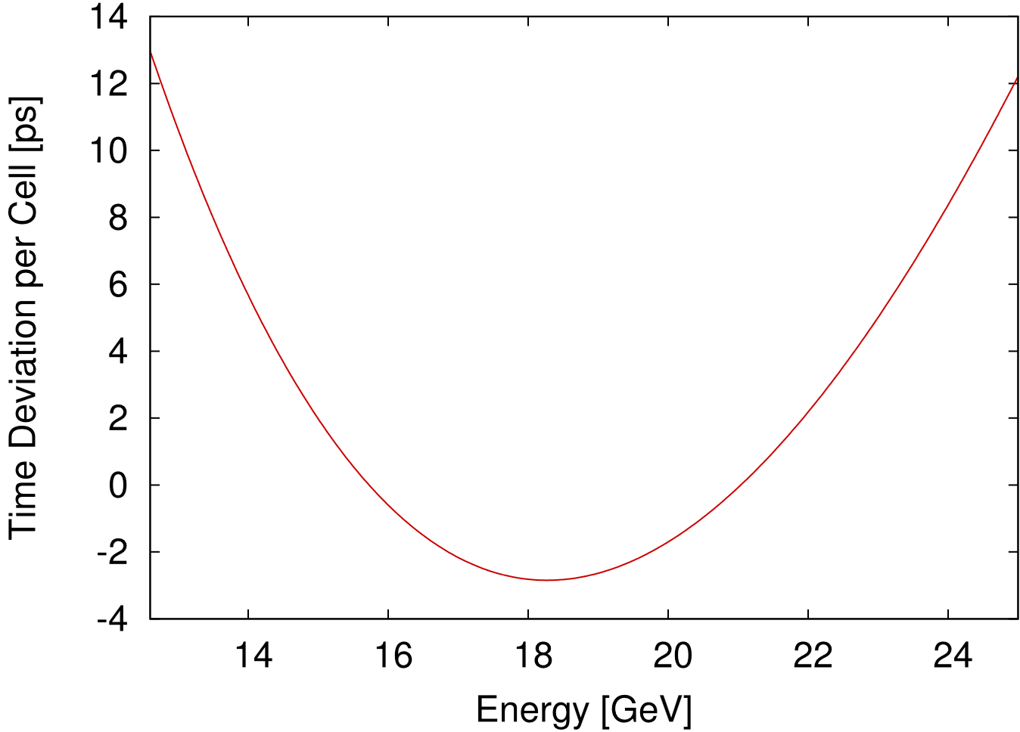
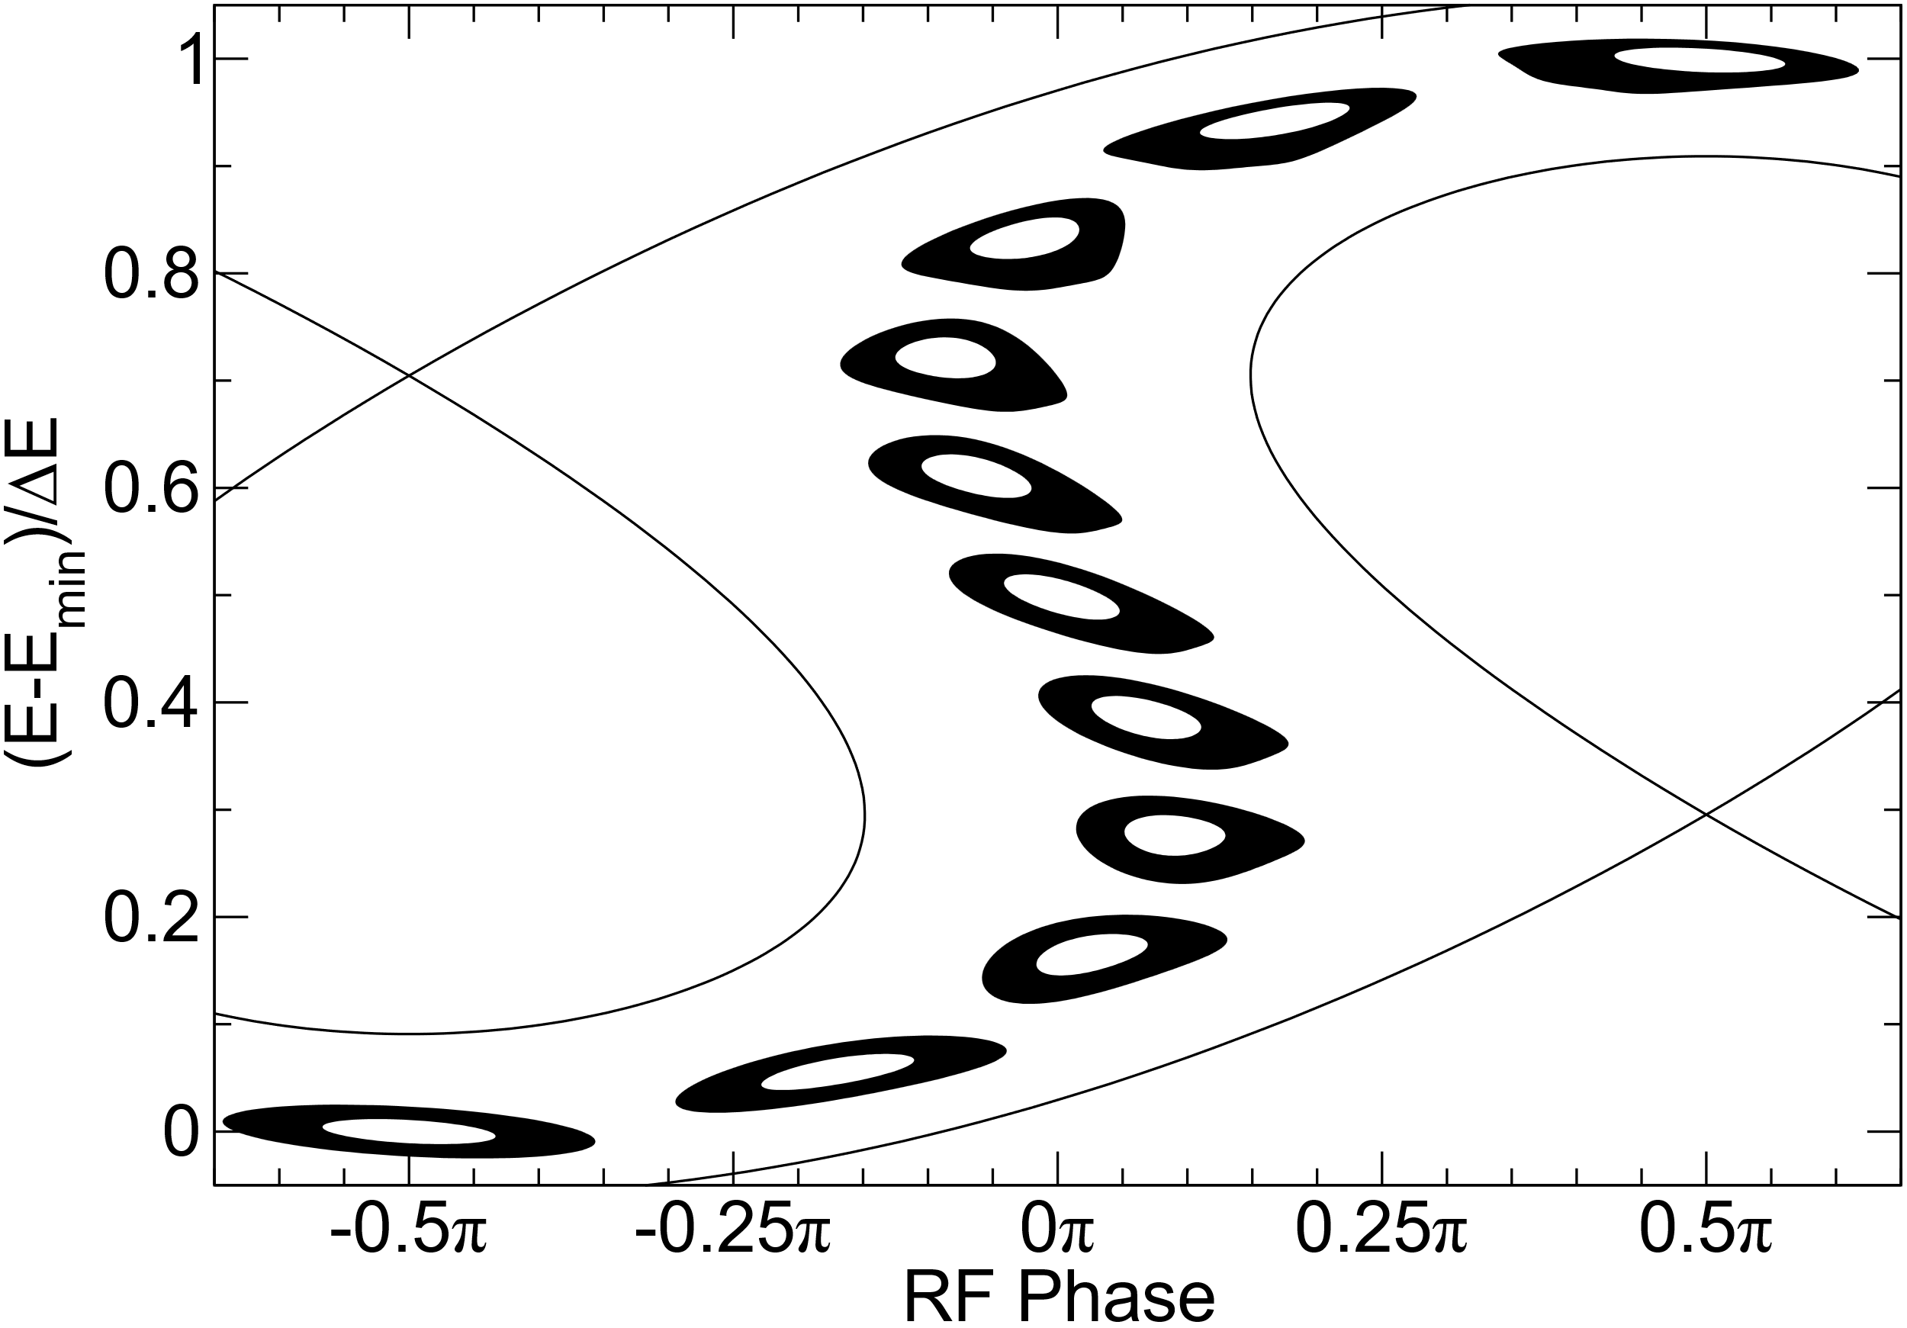
Serpentine Acceleration
Time of flight vs. energy can be adjusted to be
parabolic-like
  Results in higher peak magnetic fields
Acceleration in serpentine channel
  RF frequency doesn’t change
  Time of flight synchronized to RF for two energies
  RF crest is crossed 3 times
  Bunch passes through channel between two
  separatrices
EMMA experiment used serpentine acceleration

Slide 32
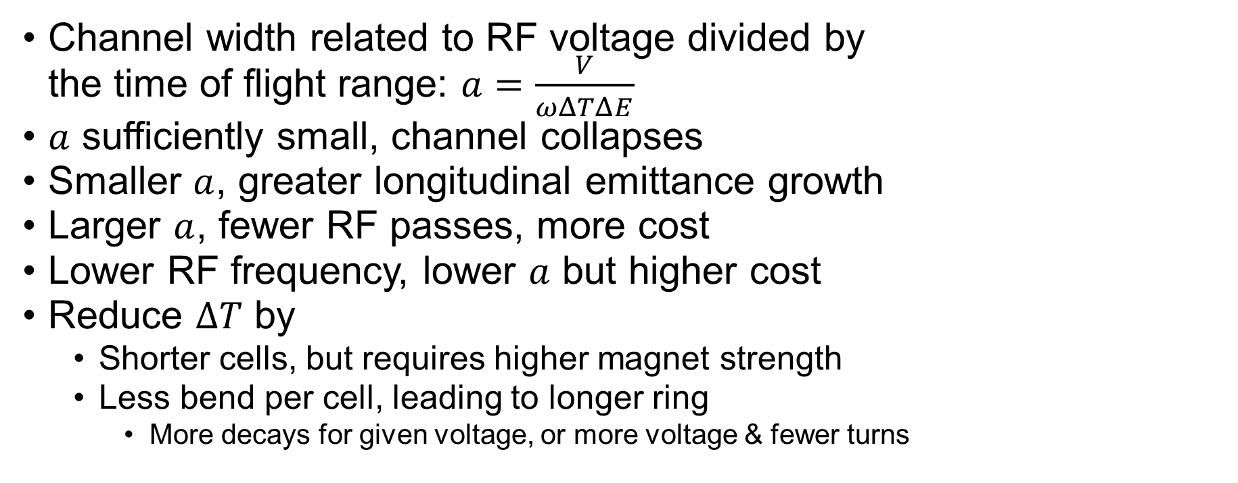
Serpentine Acceleration
Channel width related to RF voltage divided by
the time of flight range: $a=\frac{V}{ωΔTΔE}$
$a$ sufficiently small, channel collapses
Smaller $a$, greater longitudinal emittance growth
Larger $a$, fewer RF passes, more cost
Lower RF frequency, lower $a$ but higher cost
Reduce $ΔT$ by
  Shorter cells, but requires higher magnet strength
  Less bend per cell, leading to longer ring
    More decays for given voltage, or more voltage & fewer turns

Slide 33
Conclusions from Earlier Studies
FFAs studied for neutrino factory muon acceleration, to 5 or 10 GeV
  Larger transverse emittance but smaller longitudinal emittance than for a muon collider
  A neutrino factory was considered a first stage of a muon collider facility; unclear if there is currently physics interest for this
Did not appear to have a cost advantage
  Longitudinal emittance preservation forced FFAs to relatively few turns
  Transverse beam size gave magnets large aperture
  More FFA rings than RLA stages required

Slide 34
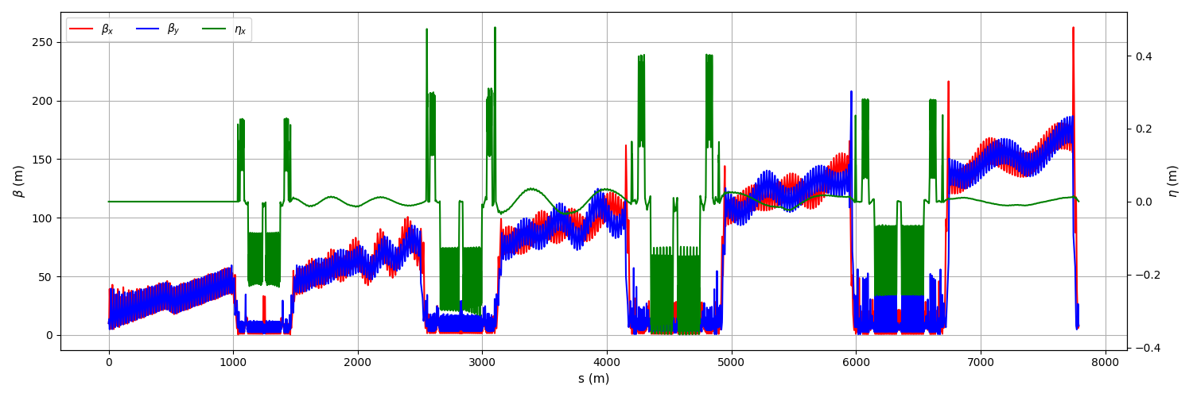
Should FFAs for Low Energy Acceleration be Revisited?
After MAP, studies by Berg and IMCC designs indicated that RLA arcs become long and complex for emittance preservation
With smaller transverse and larger longitudinal emittance for collider beams, the design tradeoffs are different
  In particular, problems related to large transverse emittance and chromaticity would be
  reduced significantly
A. Aksoy, IMCC/MuCol Annual Meeting, 2024

Slide 35
Should FFAs for Low Energy Acceleration be Revisited?
Could nonlinear fields help?
  Nonlinear fields may increase energy range or improve serpentine acceleration channel width
  Even small nonlinearities gave dynamic aperture problems for neutrino factory beams, but probably OK for muon collider emittances
Nonlinear fields were simply added to non-scaling FFAs in earlier studies, no attempt to consider any cost impacts from higher fields

Slide 36
FFAs for High Energy Muon Acceleration
Acceleration times are long enough that RF manipulations could be possible
  Less power required into input coupler to shift phase and replace stored energy in cavities
  Higher frequency RF may be possible
May not be constrained to use serpentine acceleration
  Can optimize design for lower magnet fields, important for reaching high energies
Energy reach of a given footprint proportional to achievable superconducting magnetic field, unlike hybrid synchrotrons

Slide 37
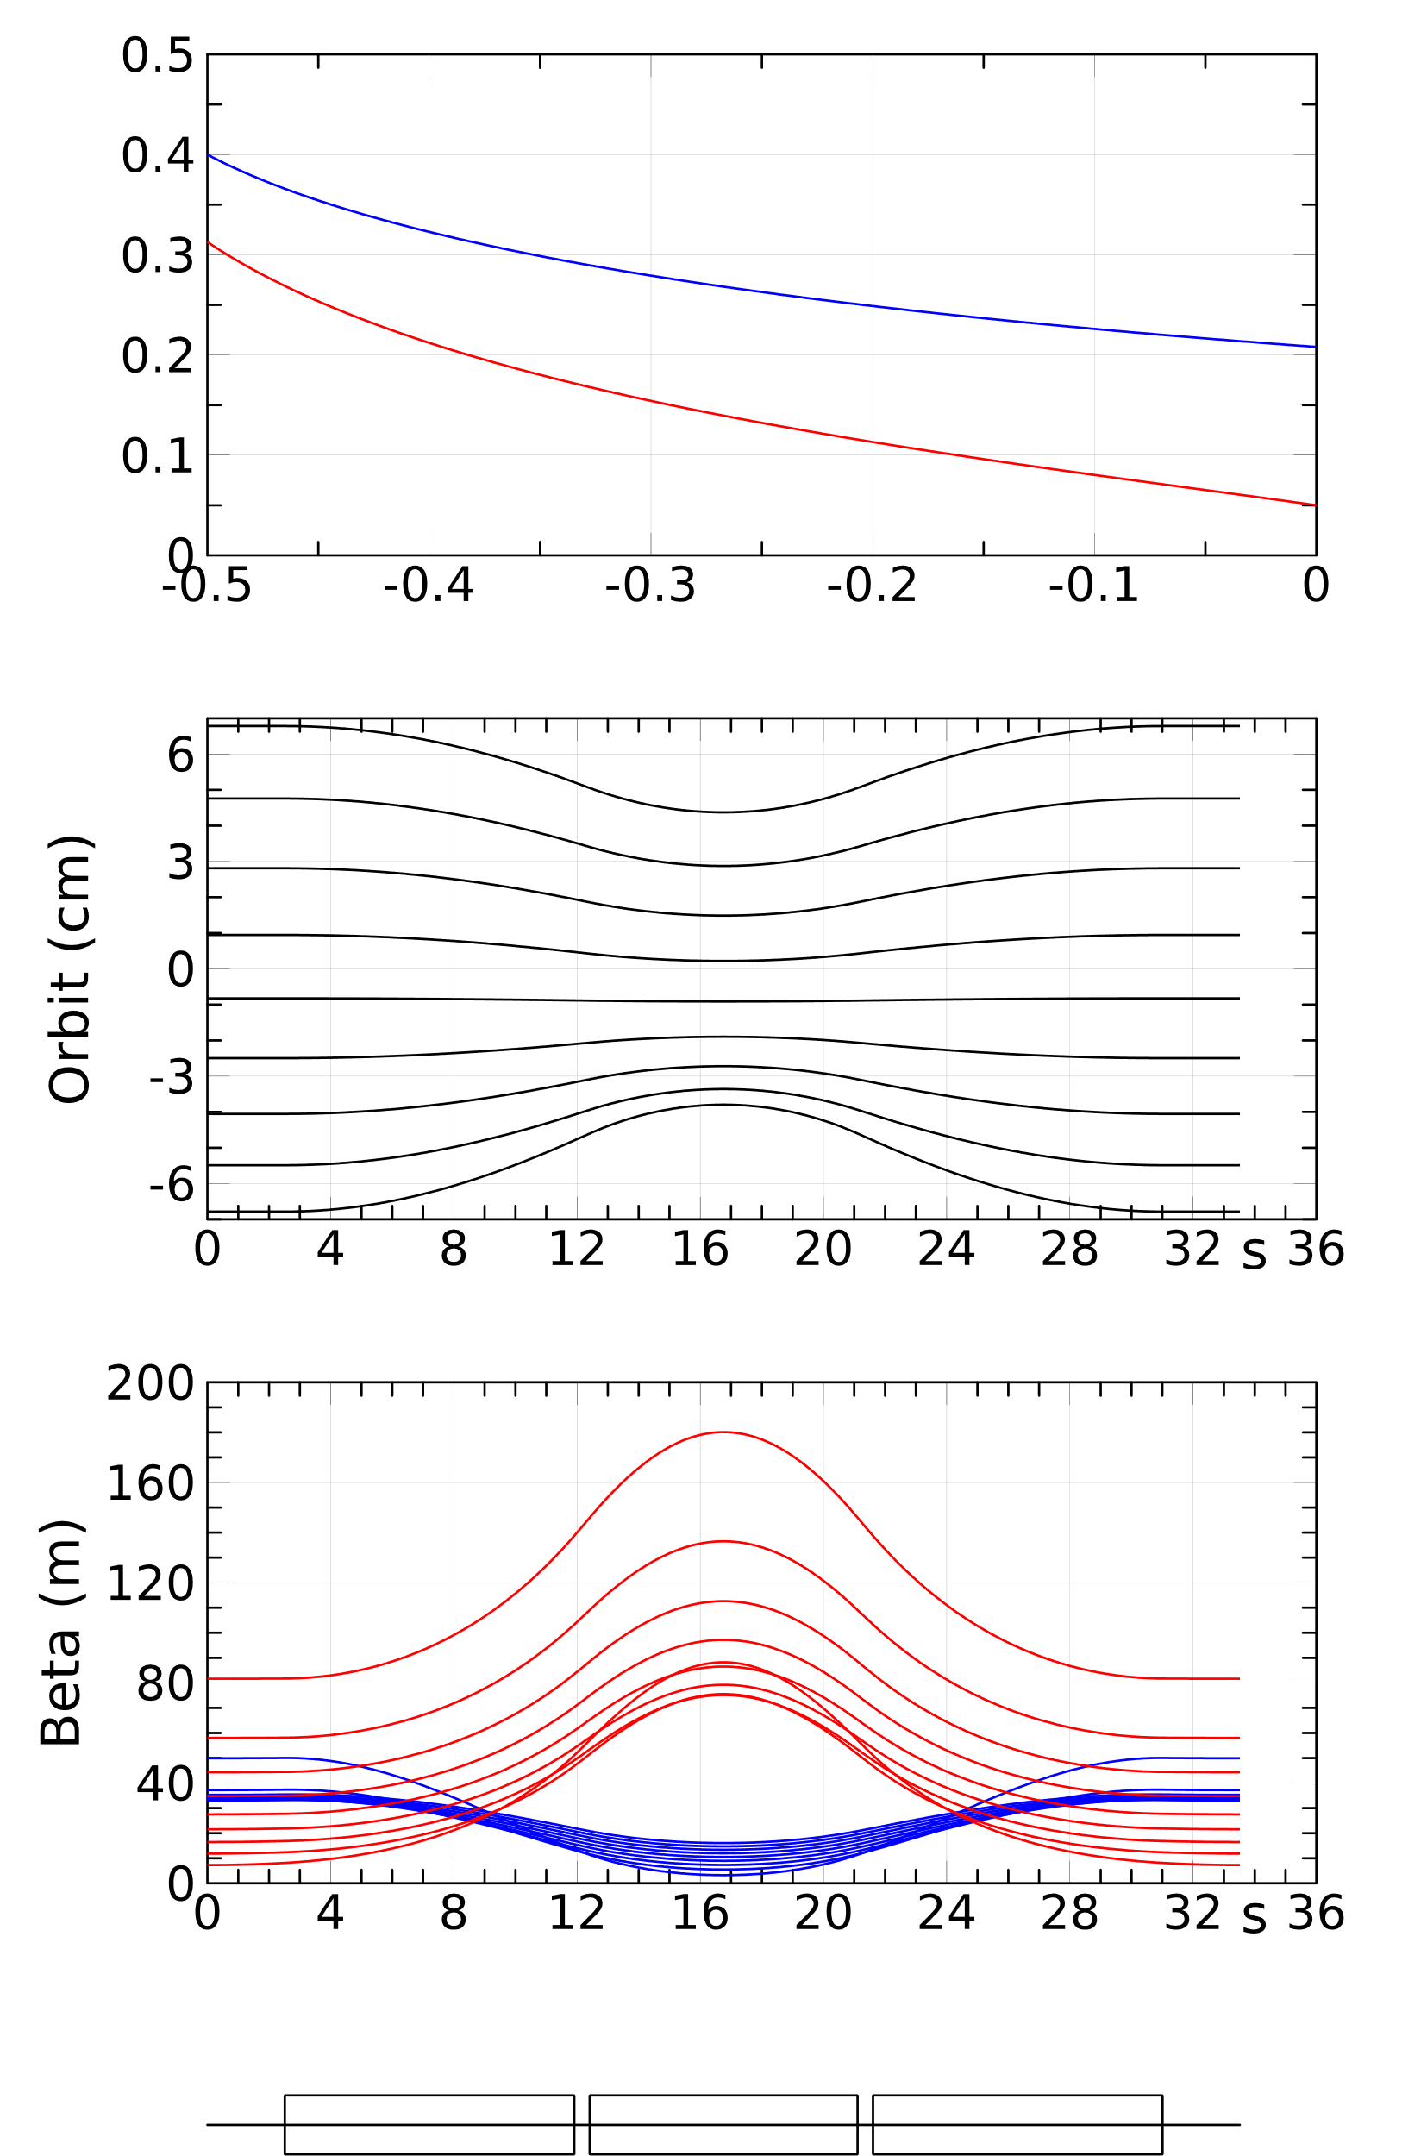
First Study of High Energy FFA Acceleration
Ring that just fits on Fermilab site
3.5 MV/m average accelerating gradient
Minimize maximum field at magnet coil
  Trying to get maximum energy reach
  Defined so that 4.5σ beam is at 2/3 coil radius
Optimizing for maximum field produces designs that differ from what has been found for past studies (neutrino factory, EMMA, CBETA, etc.)

Slide 38
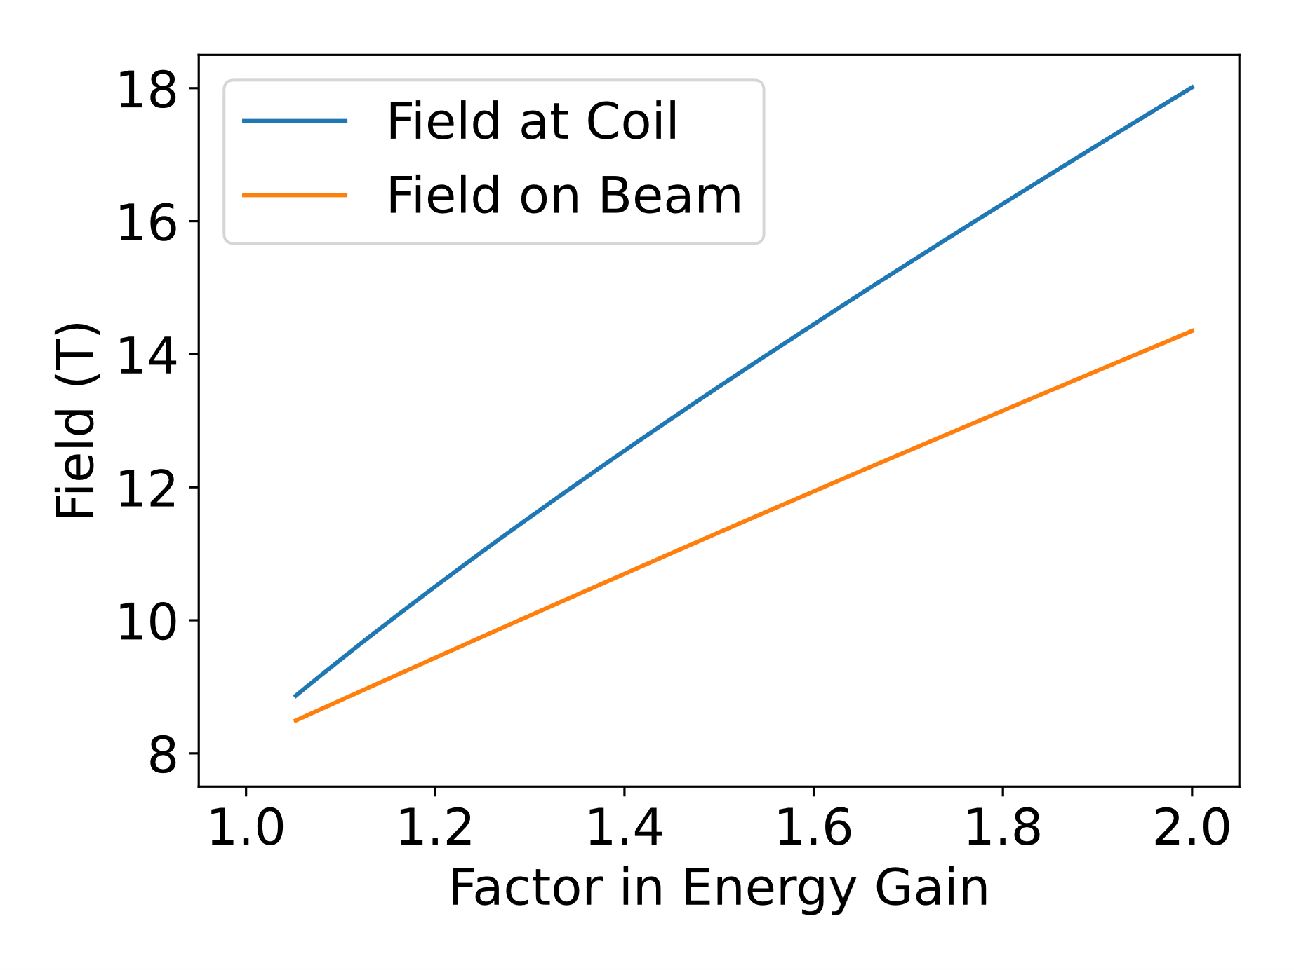
Field and Energy Range
Assume maximum energy of 5 TeV
Magnet field depends on minimum
energy
Plot shows field at coil, at 1.5 times
beam radius, and field at beam
Factor of 2 energy gain possible, but
high fields
Limitations similar to pulsed synchrotron
  Minimum energy 3.1–3.6 GeV for 5 TeV max for
  12.5 T max
  Factor of 2, maximum energy 3.5–4.4 TeV for 12.5 T max
Similar to (somewhat better than?) pulsed synchrotron numbers

Slide 39
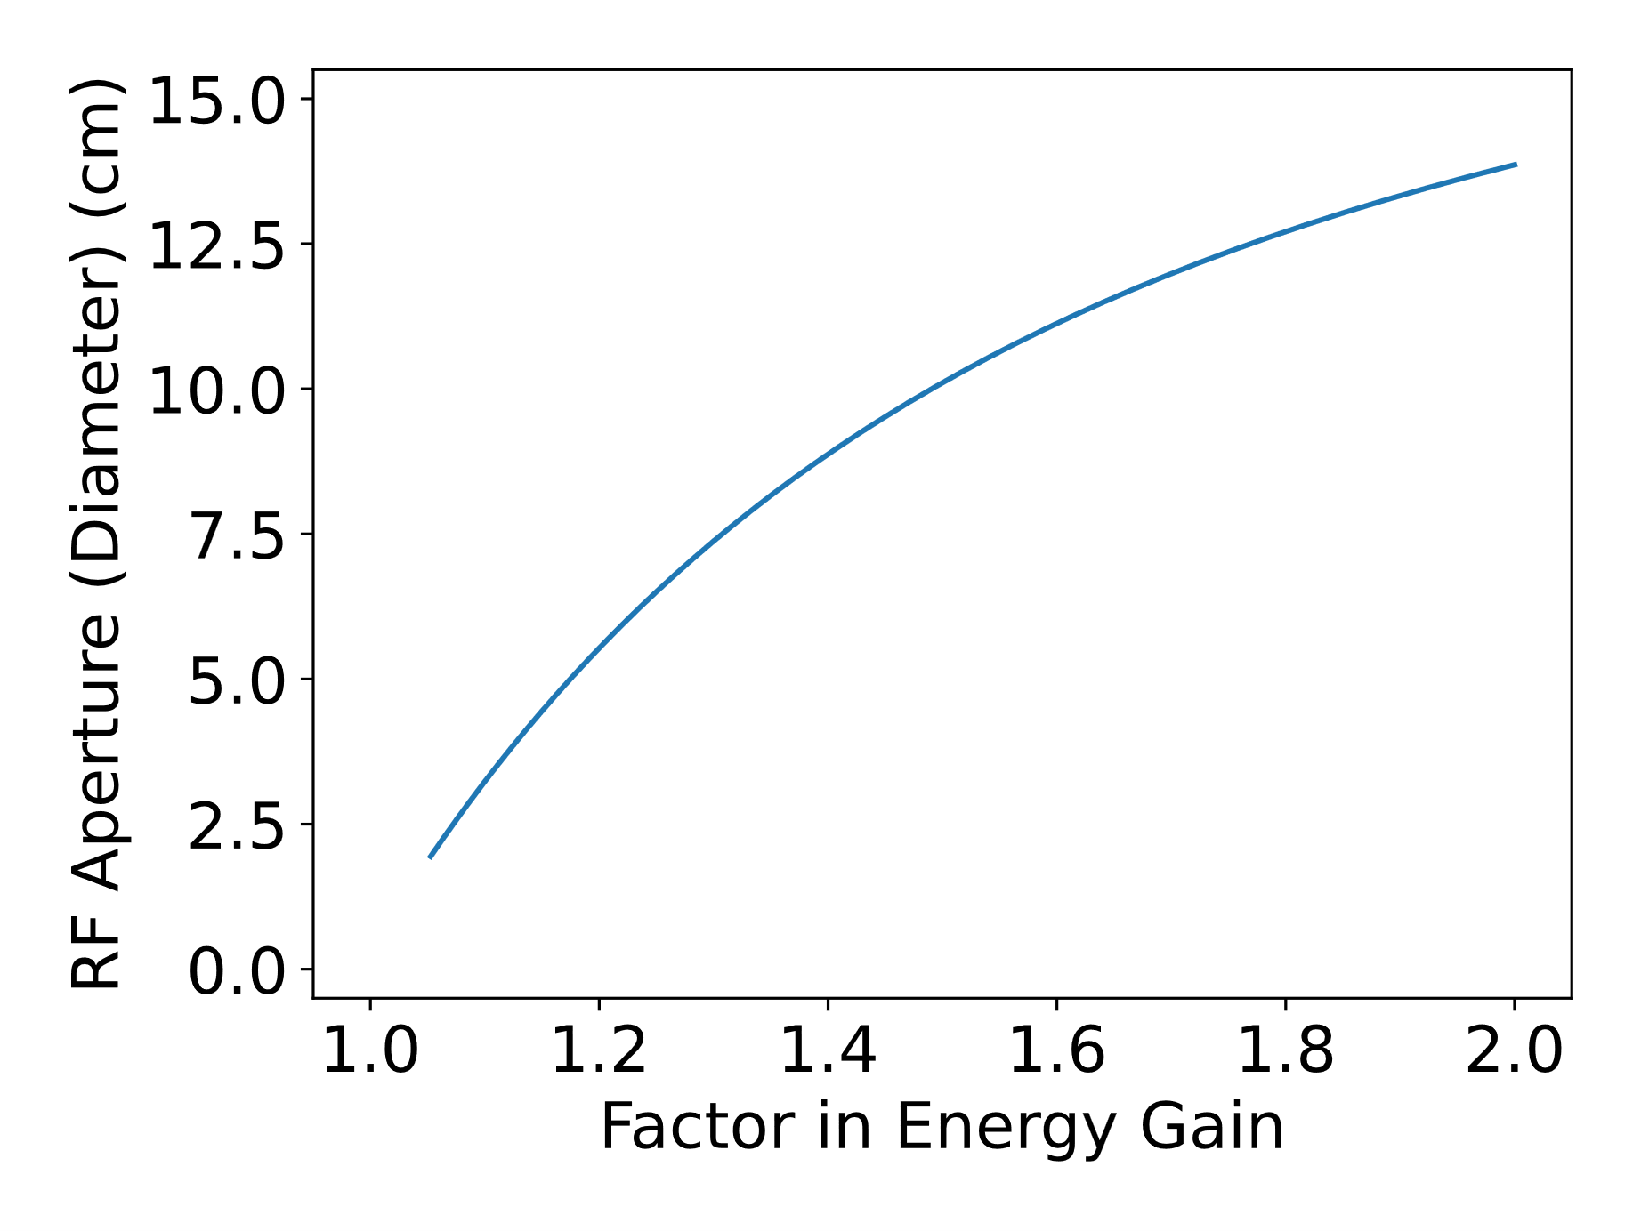
Required Aperture, RF Consequences
For factor of 2 acceleration, beam too
large for Tesla cavity aperture
650 MHz probably possible, but gradient
may be reduced
Large apertures for superconducting
magnets

Slide 40
Injection/Extraction
Take advantage of orbit position dependence on energy
For 0.2 T kickers, about 3 straights for extraction
Challenge is extraction septum
  High energies require high fields
  Straights are short, and have to clear superconducting magnet cryostat
  Ideas to manage:
    Generate angle and position at septum
    Pipe penetrating into aperture
    Special magnets with larger apertures (higher fields!)
    Longer straights: maybe taper straight length (oval shaped ring)

Slide 41
Conclusions and Future Directions

Slide 42
Conclusions
FFAs are an alternative to more conventional acceleration techniques for muon acceleration that can address issues with those conventional solutions
In particular FFAs may achieve greater energy reach on the Fermilab site as superconducting magnets become capable of reaching higher fields, while pulsed synchrotrons could not take advantage of those advances
At lower energies, FFAs could provide a less costly alternative for acceleration
There are still issues to address in FFA designs, in particular injection and extraction at high energies

Slide 43
Future Directions
Oval shaped FFAs for high energy acceleration
  Adiabatically transition to longer cells that leave more space for injection/extraction
Revisit FFAs at lower energies, using muon collider beam emittances, and comparing to latest RLA designs
Incorporating nonlinearities in non-scaling designs
  Improve energy range and/or longitudinal machine dynamics at lower energies
  At high energies, only small nonlinearities expected to help, due to field limitations
Most studies are very preliminary, more detailed work needed

