Slide 1




Low Voltage Power Supply Quality Control with Machine Learning for ATLAS Tile-Calorimeter
Optimization of Reliability in High-Luminosity Environments
On behalf of Tile Calorimeter
Presenter: Chuene Mosomane
Notes:
Good morning everyone, My name is Chuene Mosomane and I am tremendously excited to be here, talking to you on behalf of Tile Cal about the quality control of low voltage power supply for ATLAS TileCal with machine learning. The goal is to improve the reliability of the low voltage power supply in high luminosity environments.

Slide 2
Outline
Phase-II Upgrade Overview
ATLAS Hadronic Tile Calorimeter
Lower Voltage Power Supply & TileCal LVPS Phase-II Upgrade
Production of LVPS & Quality Control
Test Bench Station & Machine learning
Data Visualisation & Results
Conclusion
Notes:
We will first start with a brief overview of the Phase-II Upgrade and then explain the TileCal in ATLAS and then I will move on to explain the LVPS and why it is important to upgrade it. Next, I will dive deep in how the LVPS works and its improvement, and secondly, I will talk about the production and the quality control of the LVPS. Before i end this talk i want to finish by talking about how we use data analysis and machine learning to model the data and the conclude.

Slide 3
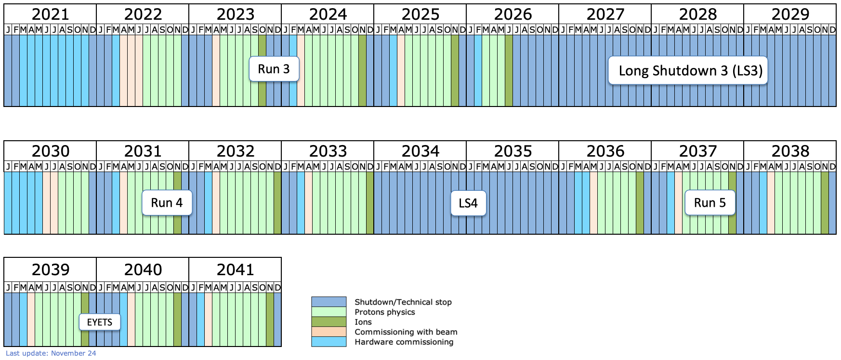
HL-LHC Timeline
Notes:
The LHC is preparing for a phase-II upgrade which means that the integrated luminosity will be 4000fb^-1 and this will result in more radiation and pileups. The motivation to is to explore beyond the standard model physics. Therefore, it is necessary to upgrade the detector so not to put a huge strain on the electronics.
The HL LHC is coming online and it will be producing way more particles and it will put a huge strain of the detector. The current electronics isn’t built for the increase radiation and intensity.

Slide 4
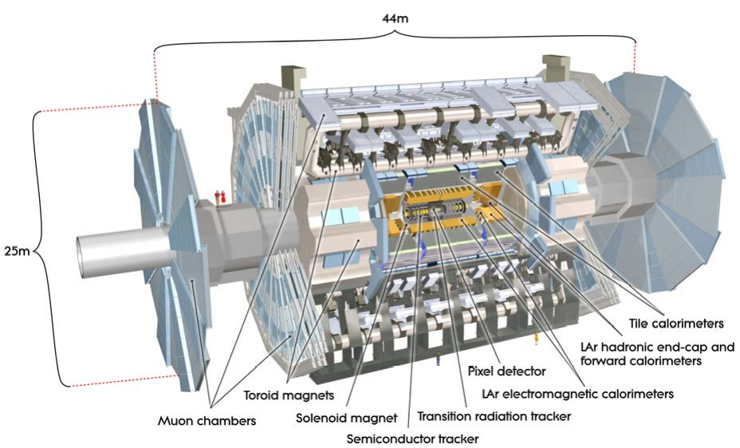
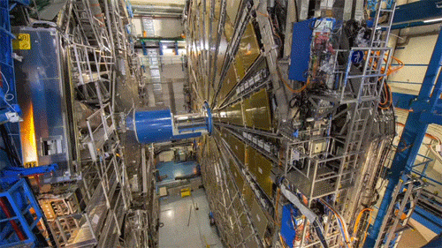
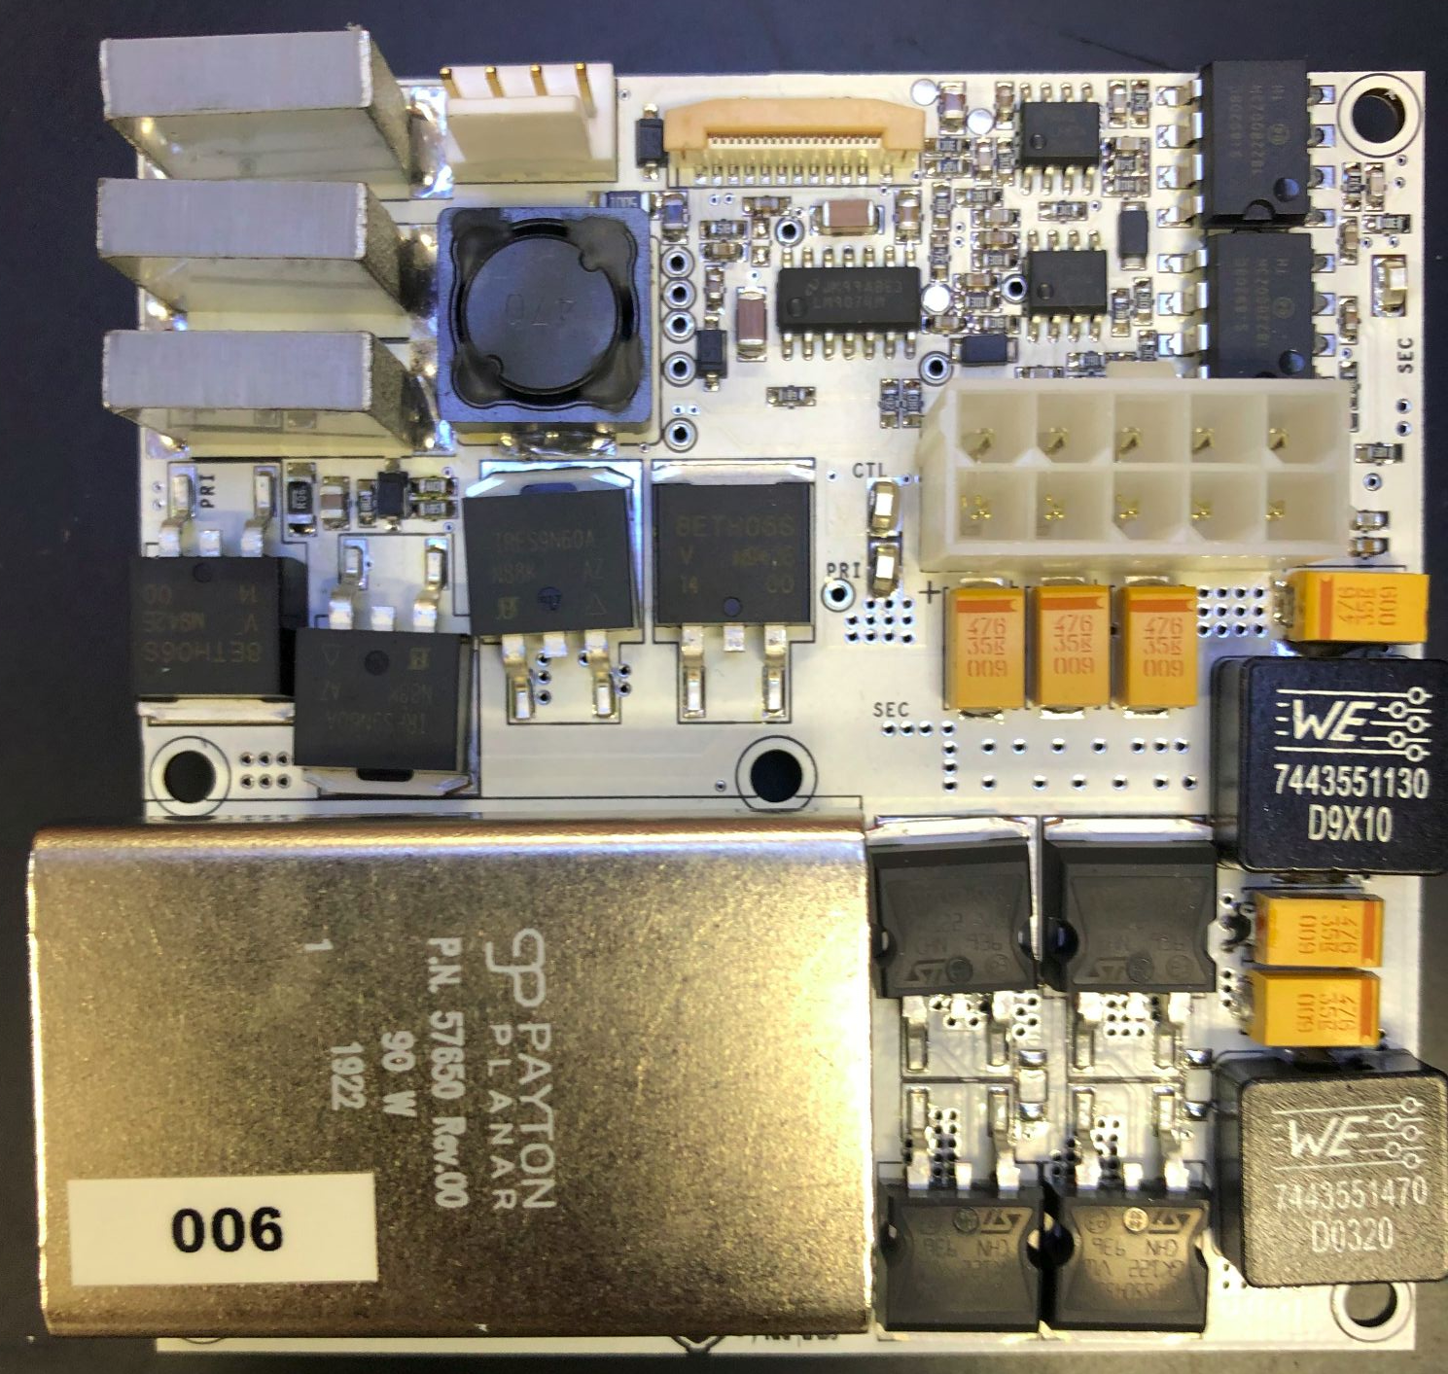
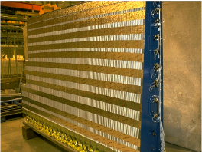
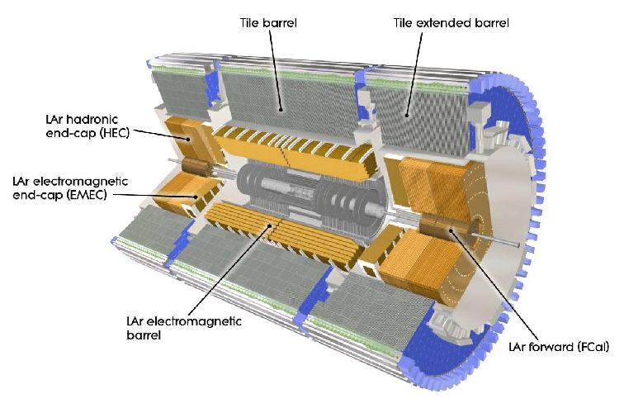
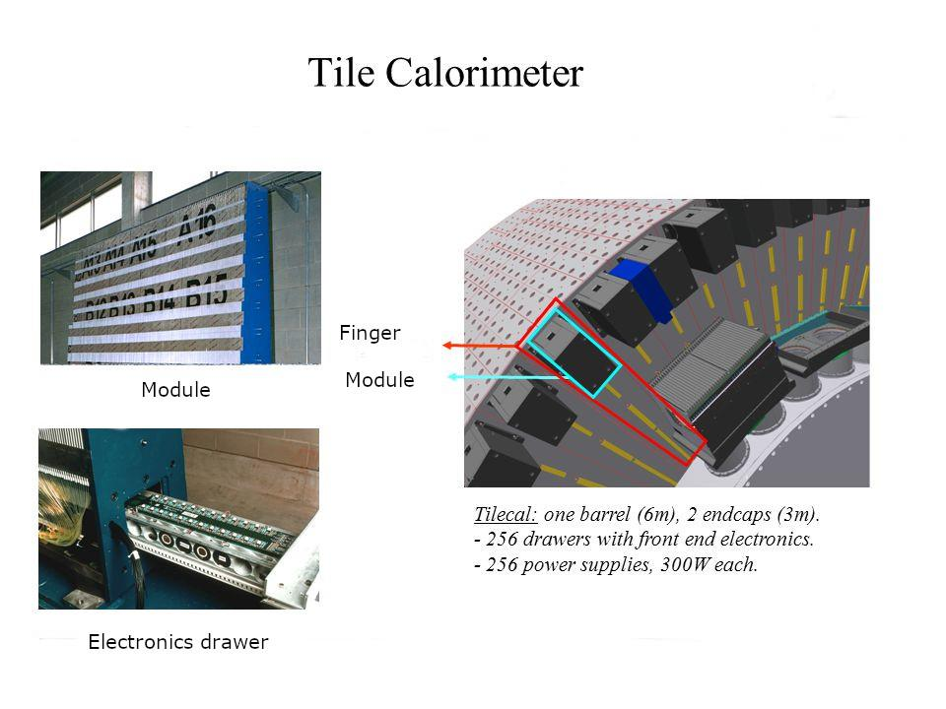

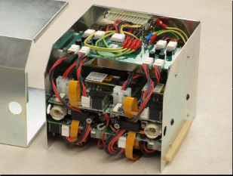
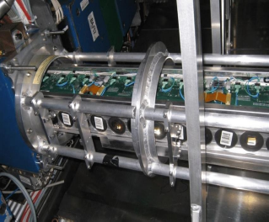
ATLAS Tile Calorimeter (TileCal)
Central hadronic TileCal in ATLAS
256 modules in detector, ~10,000 readout channels.
Iron as absorber and plastic scintillator as active material.
ATLAS detector
ATLAS Cavern
Rad Tolerant power supply
TileCal barrel
Tile Calorimeter architecture
Notes:
ATLAS which is part of the LHC is composed of many systems and one of them is the hadronic tile calorimeter and it is responsible for measuring the energy of the particles after the collision. The tile cal is is composed of 256 modules with about 1000 readouts channels, all using iron to capture energies from the particle showers and plastic scintillator to produce light . The LVPS Box sits inside the barrel and is composed of 8 LVPS. Replacing these LVPS will never be the same as fixing a light bulb. Given the difficult access to the ATLAS detector, the reliability of all the components are paramount.

Slide 5
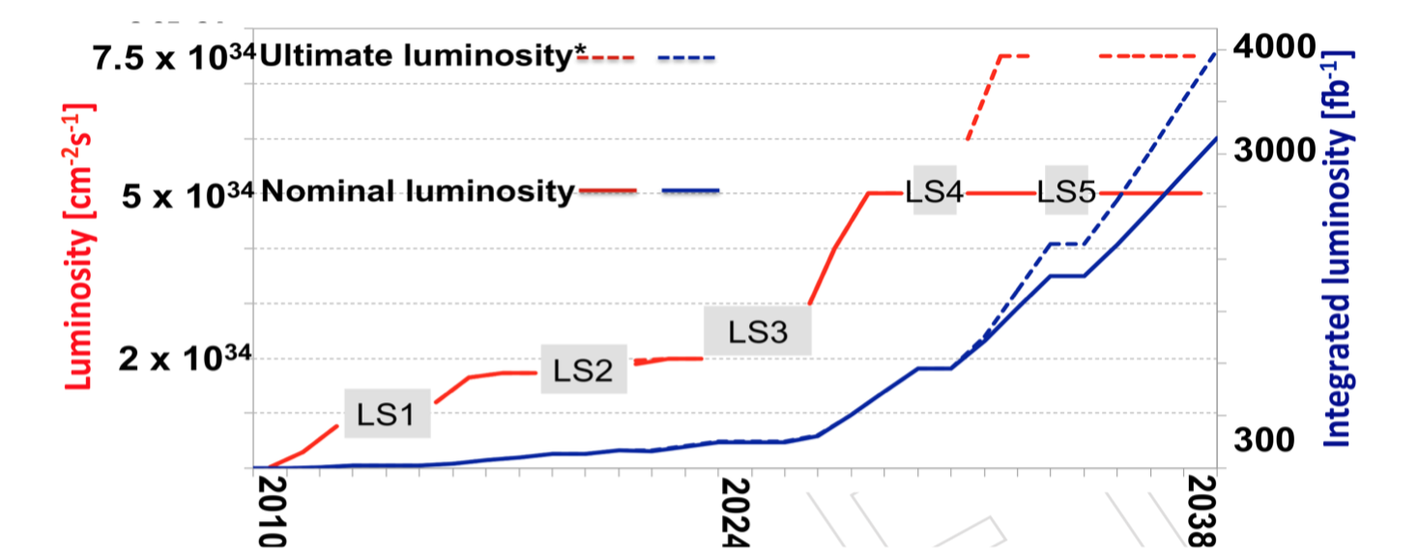

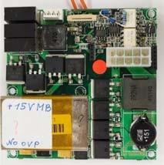
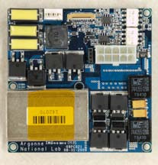
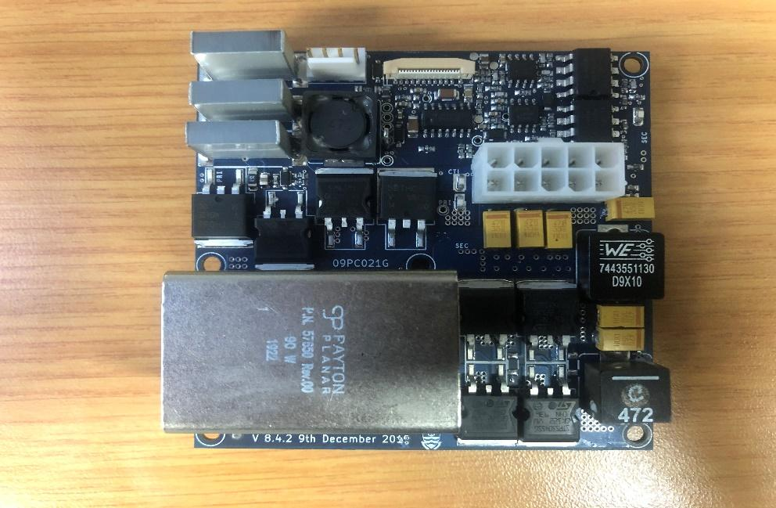
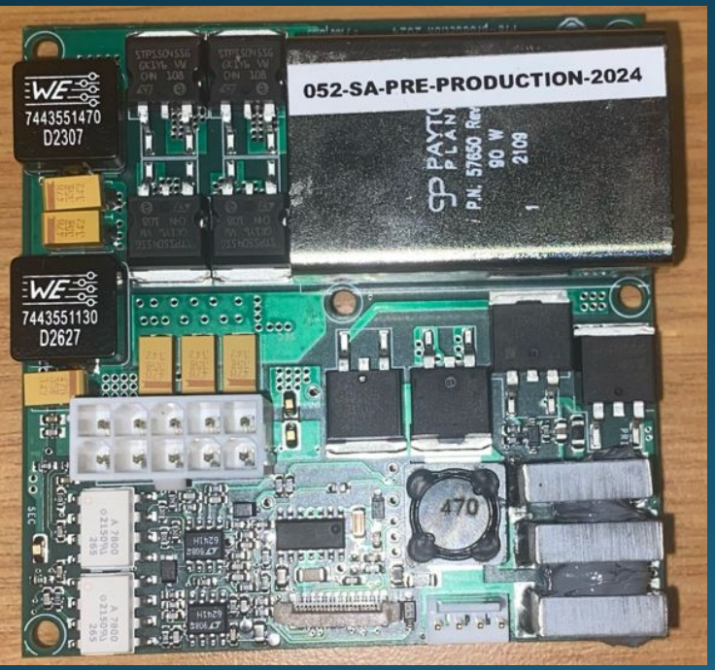
TileCal LVPS Phase-II Upgrade
Motivation
  To replace all electronics because of long‐term reliability with increased luminosity
  Involves replacing all electronics and increasing the radiation hardness for handling a maximum total integrated radiation dose
  Require efficient, low-ripple, stable and reliable with the increased luminosity
Features:
  Customly built, compact
  Water cooled using Al2O3 components
  10 V bricks, 2.3 A
  Environment: Magnetic field; Radiation tolerant
  Efficiency target: 75%
Original bricks to latest design
6.5.1 Original Brick
Reliability is important, difficult access to detector!
Old 8.1.0 WITS Prototype
Latest WITS Prototype
v 7.5 ANL brick
ATLAS Tile Calorimeter Phase-II Upgrade Technical Design Report : https://cds.cern.ch/record/2302628/
Upgrade of Tile Calorimeter of the ATLAS Detector for the High Luminosity LHC Journal of Physics, DOI:10.1088/1742-6596/928/1/012024,2017.
Notes:
The current electronics will not survive the harsher radiation environments of the HL-LHC, It is not about increasing the power output, it is about building something that can withstand the extreme conditions. This upgrade focuses on radiation hardening and enhance reliability.
Features:
Customly built, compact
Water cooled using Al2O3 components
10 V bricks, 2.3 A
Environment: Magnetic field; Radiation tolerant
Efficiency target: 75%

Slide 6
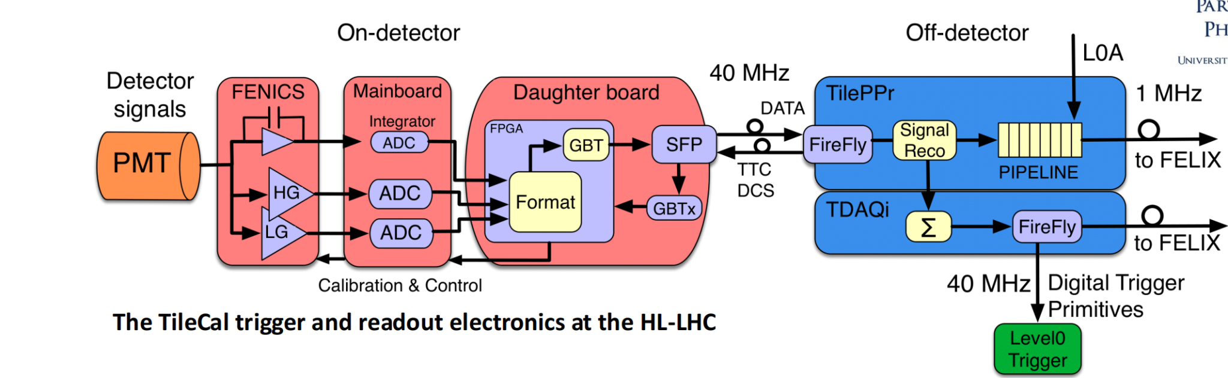
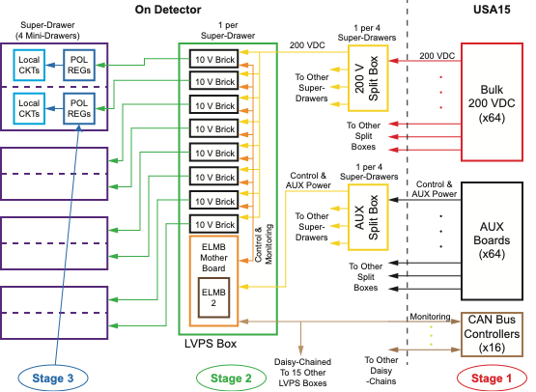
Low Voltage Power Supply
What is the minimum number of power stages that will do the job?
Upgrade from a 2-stage to 3-stage power powering system distribution system to accommodate the FE upgrades.
  Front‐end power supplies all +/‐10V
  New: Point‐of‐load regulators
Converts 200 V DC to 10 V DC to provide power to front-end electronics.
All bricks have the same 10V output in opposite to existing Legacy LVPS.
DCS monitoring system based on ELMB(Embedded local monitoring board) is now used for LEGACY Tilecal
Notes:
The low voltage power supply is a complete overhaul, it moves from a 2 stage to a 3 stage power system to incorporate a point of low regulators, this is all about efficiency and minimising power loss, by having 3 stage power system with low regulators, we can deliver power precisely where it is needed reducing wasted energy and heat. Remember heat is the enemy in a sensitive and confine environment like the tile calorimeter. it is responsible for power the front end electronics of the tile calorimeter. It takes 200 V DC input and it converts it into a stable 10 V DC output.

Slide 7
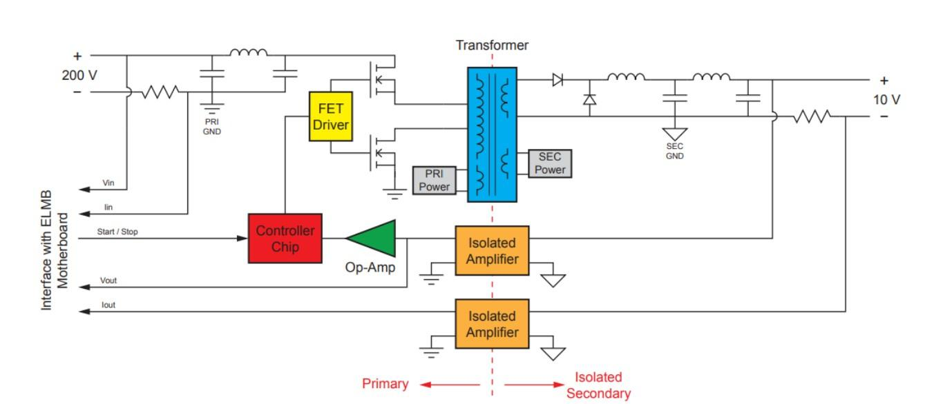
LVPS principle of operation
Transformer coupled buck convertor (Forward converter).
Controller chip LT1681 (Heart of design) is used to provide switching at frequency of ~ 300 kHz
FET’s: When conducting current flows to the primary windings of the transformer which transfers energy to the secondary windings.
Parameter | Value
Threshold for Stable Load | < 2 A
Over Voltage Protection | 11.5 – 12.5 V
Overcurrent Protection | 6.75 – 10.75 A
Output Voltage Ripple @ NL | < 0.5 V (p2p)
Duty Cycle @ NL | 30 – 40 %
Frequency @ NL | 280 – 320 kHz
Efficiency @ NL | > 65%
Input Power (Current) @ NL | 48 W (0.24 A)
Output Voltage Change | < 20 mV/A
Over Temperature Protection | 70 Degrees C
Opto-Isolators: Provide voltage feedback.
Shunt Resistor: For measuring the output current.
Protection circuitry: Overcurrent Protection , Over Voltage Protection, Over Temperature Protection.
Notes:
The core of the LPVS is a transformer buck converter and it a much clever way to step down voltage. We have the LT1681 controller chip, this chip acts like the brain of the operation, rapidly switching the transistor on and off hundreds and thousands per second, so the electricity doesn’t flow continuously, it is like a super fast switch creating pulses of energy, these pulses combined with the

Slide 8
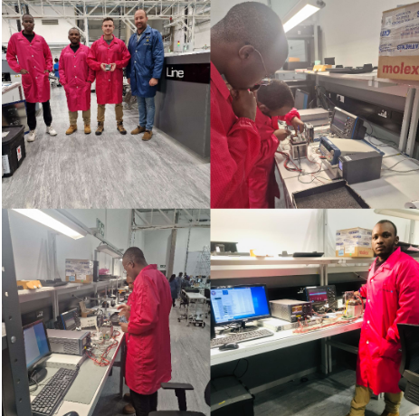

Production of the LVPS boards
Pre Production : 104 LVPS power supplies slated for production
Production: 1032 LVPS boards
Location and process (SA)
SA contribution: 50%
Notes:
South Africa is playing a crucial role in this upgrade, it is responsible for producing 50% of the tile calorimeter modules and are leading the development of the new lvps. This is a fantastic example of bringing academia and industry together.

Slide 9
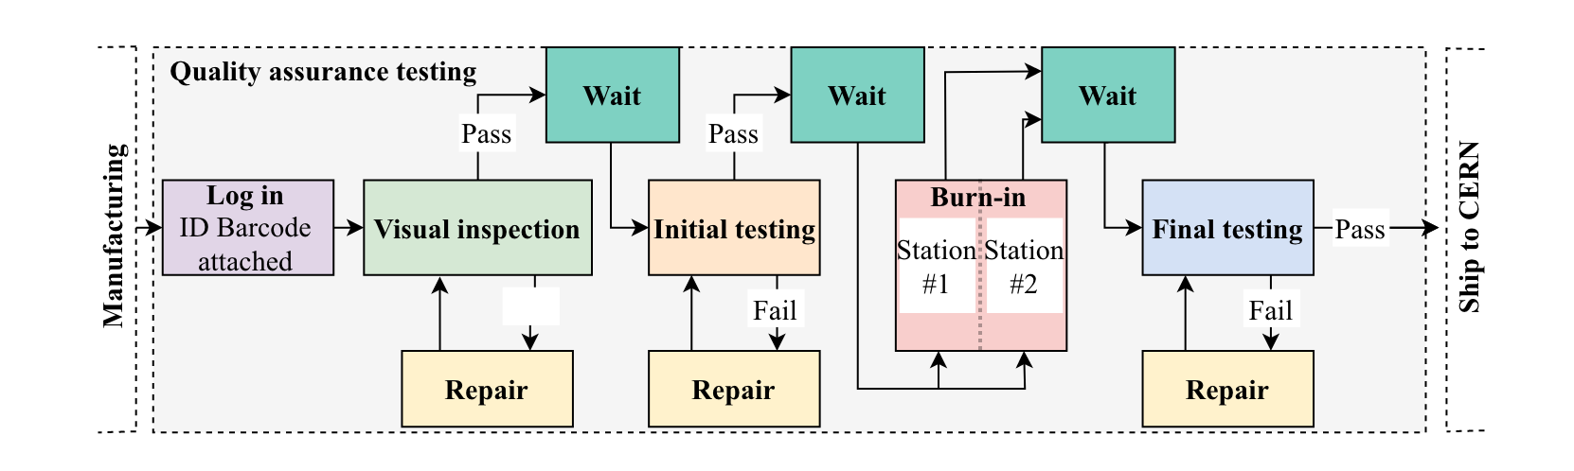
Quality Control Testing
Quality Control test benches developed and operational at Wits electronics Lab and Jemstech.
Functions to initiate a trip of the brick if specific operating parameters fall out of a nominal range ensuring isolation of failures.
We perform visual inspection and then test with the burn-in station and test again on the second test bench station.

Slide 10
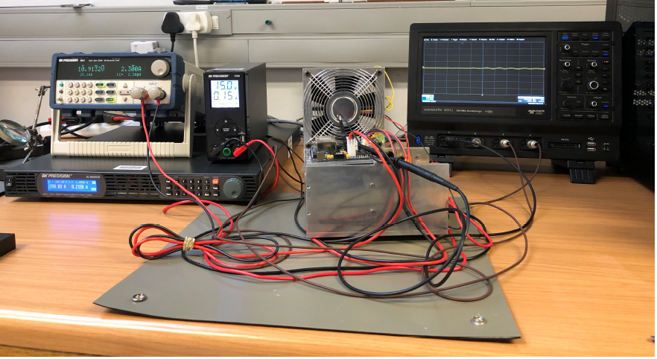
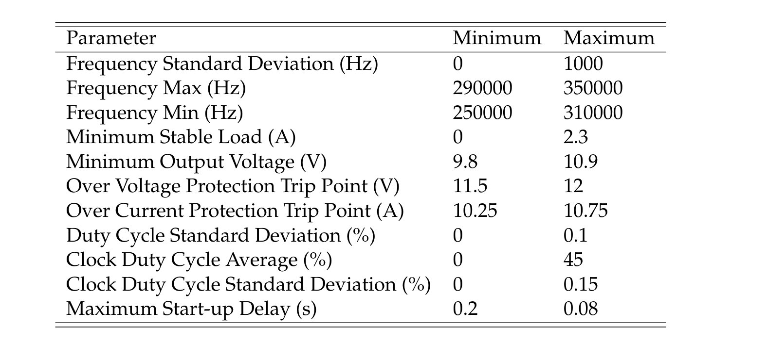
Test Bench Station
We take 11 tests for each brick
All the tests have to pass
If one test fails then the brick fails
Notes:
Talk about the apparatus and how they are connected and how we do the testing

Slide 11
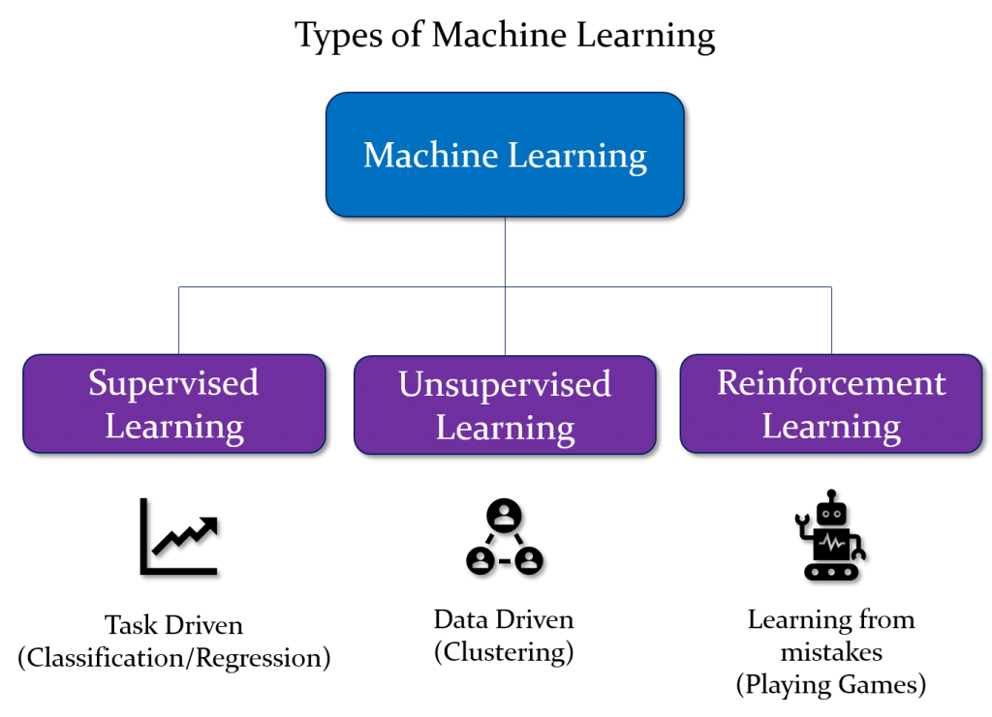
Introduction to Machine Learning
Supervised Learning needs labeled data
Unsupervised Learning need unlabeled data
Reinforcement learning the agent interact with the environment to optimize a specific goal
Notes:
Talk about how I created labels. Introduces DNN and why we choose to use it(mention the objective is to build an early failure detection inside quality control process to enhance realibility)

Slide 12
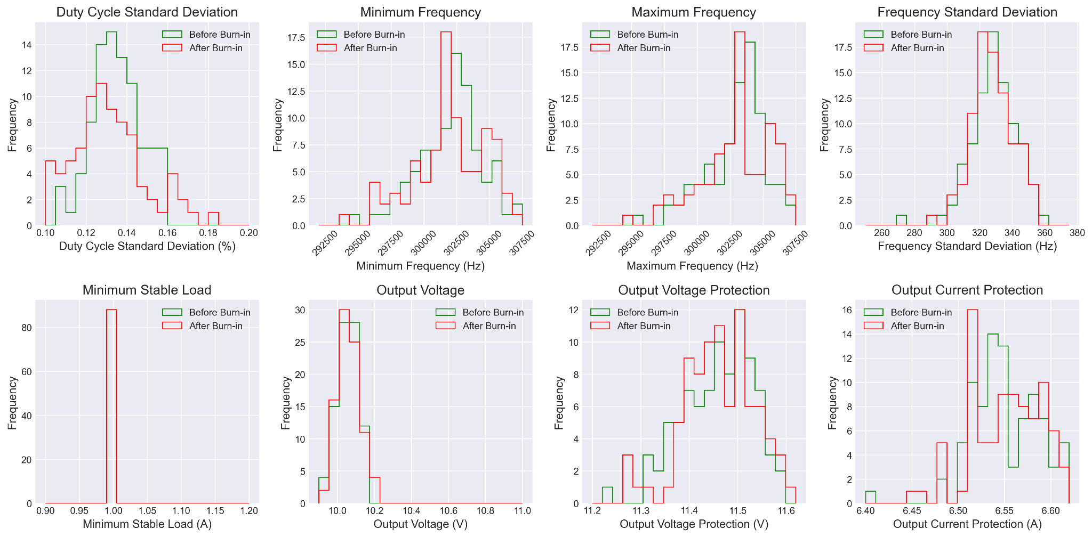
Data Visualisation of the Functional Parameters
-
Bounded functional Parameters
Before Burn-In: Distribution of the first test bench station
After Burn-In: Distribution of the second test station

Slide 13
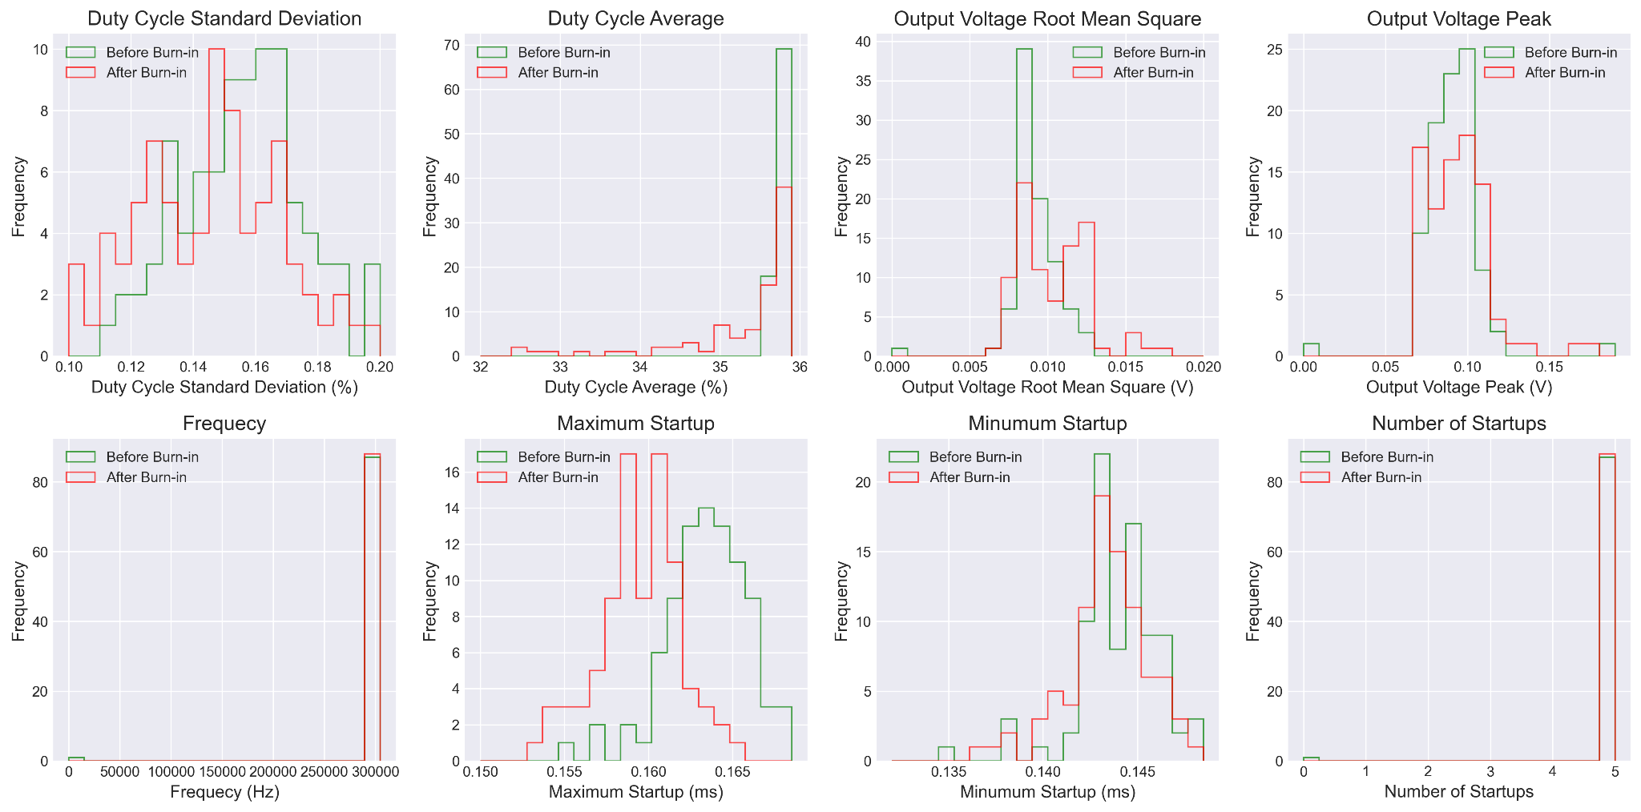
Data Visualisation of the Functional Parameters
Bounded functional Parameters
Before Burn-In: Distribution of the first test bench station
After Burn-In: Distribution of the second test station

Slide 14
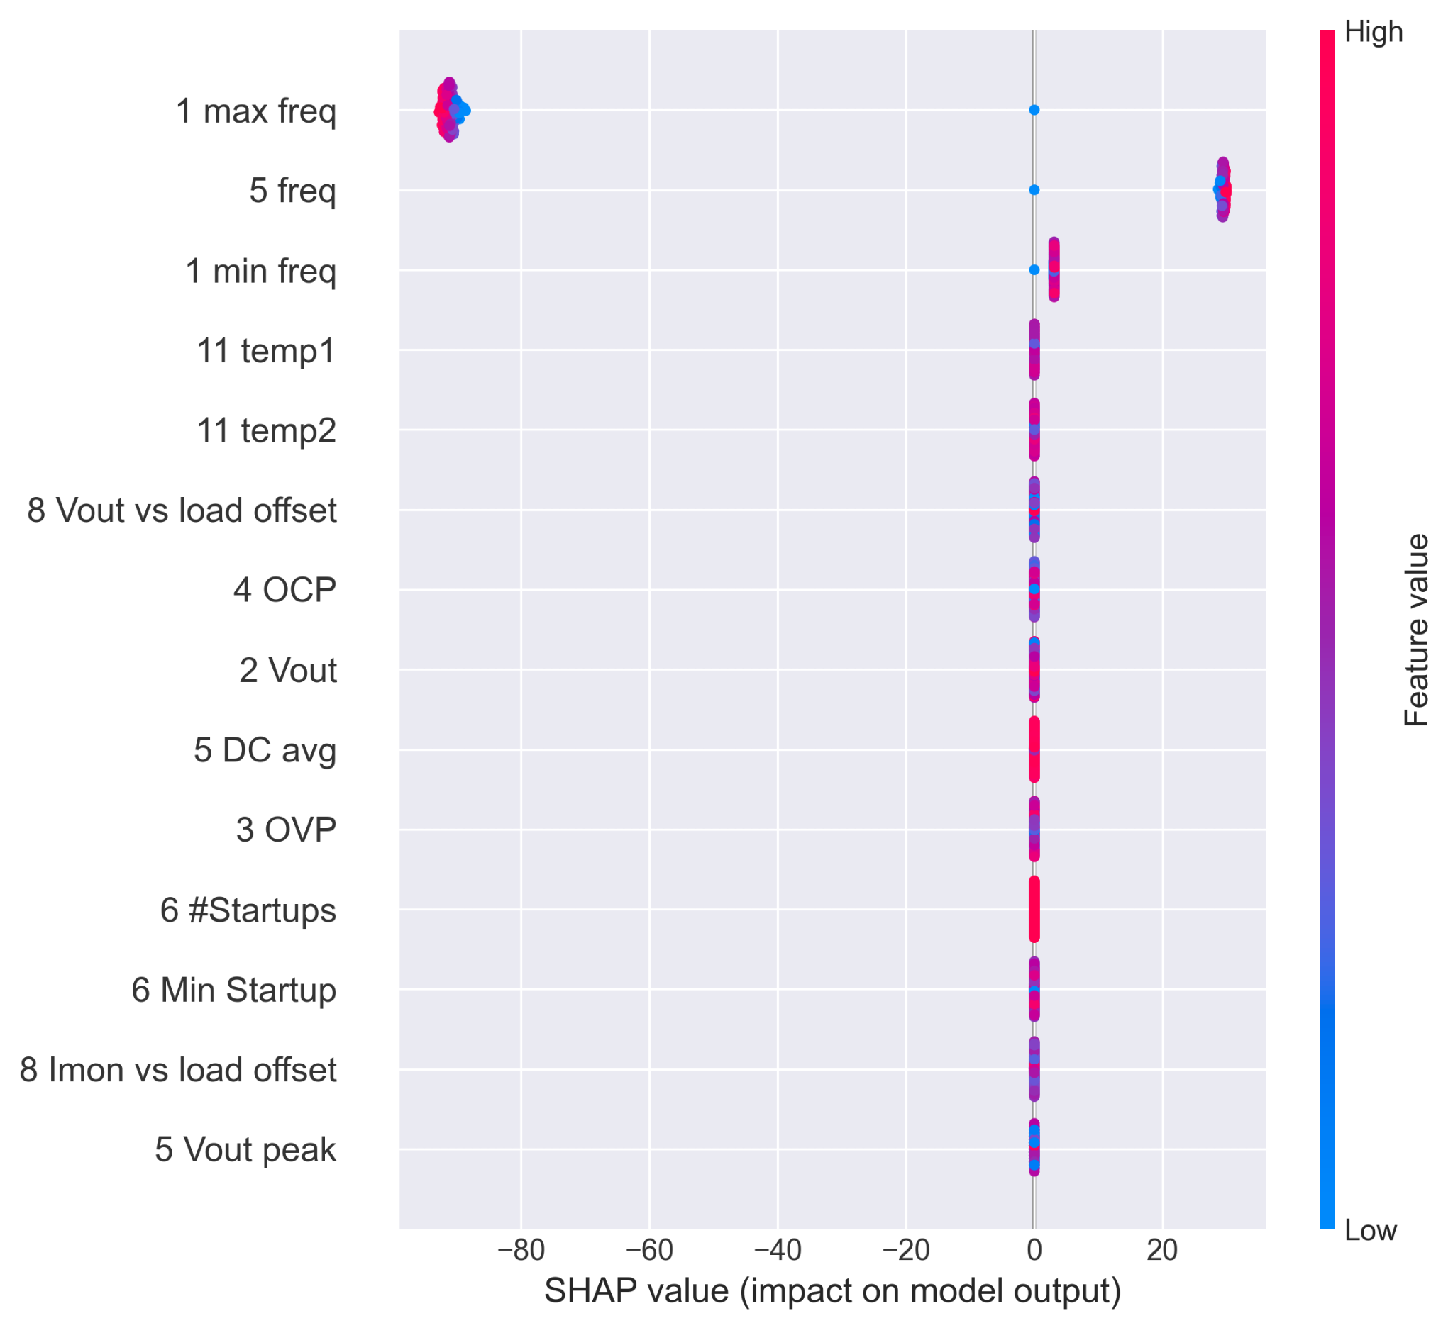
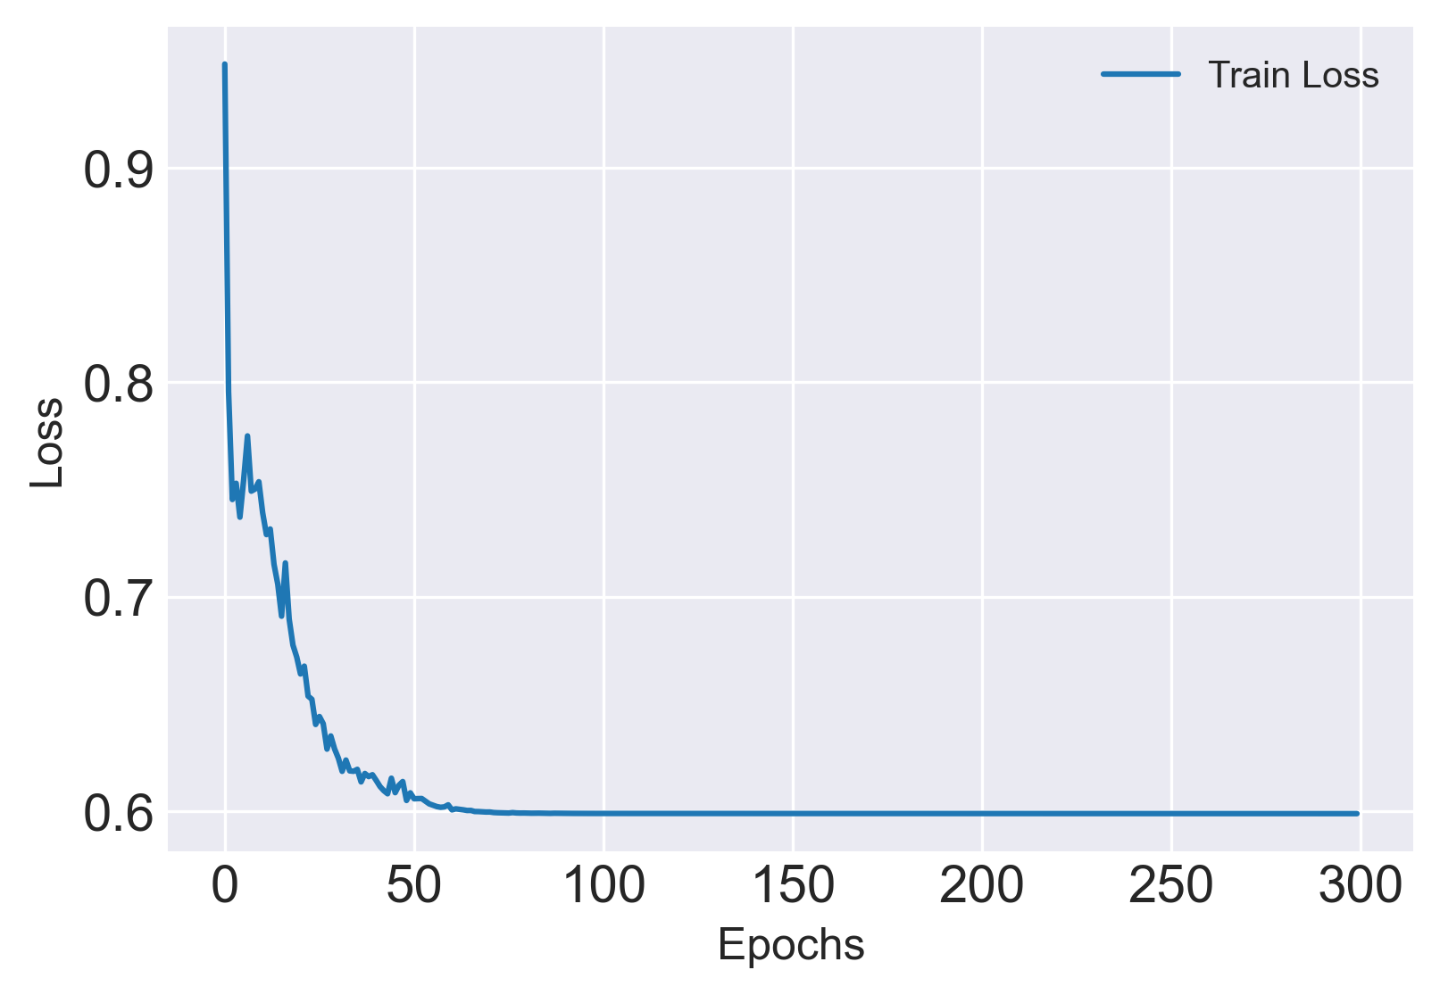
Machine learning Training Results
We used SHAP method to calculate feature importance
NB: pre-production data is small 88 passed LVPS bricks and we used all for training

Slide 15
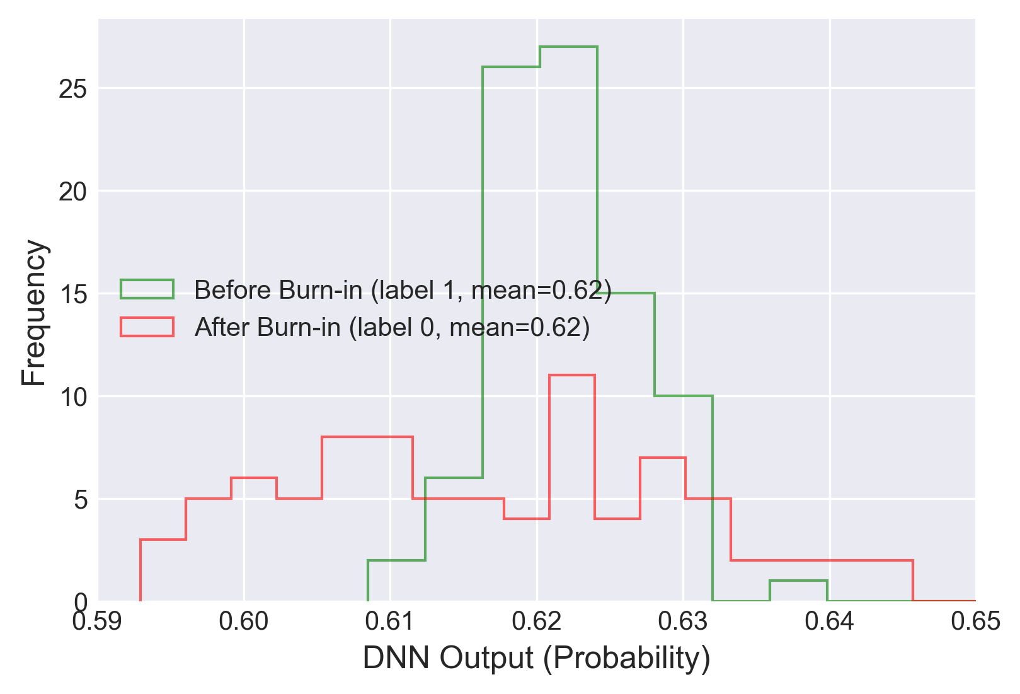
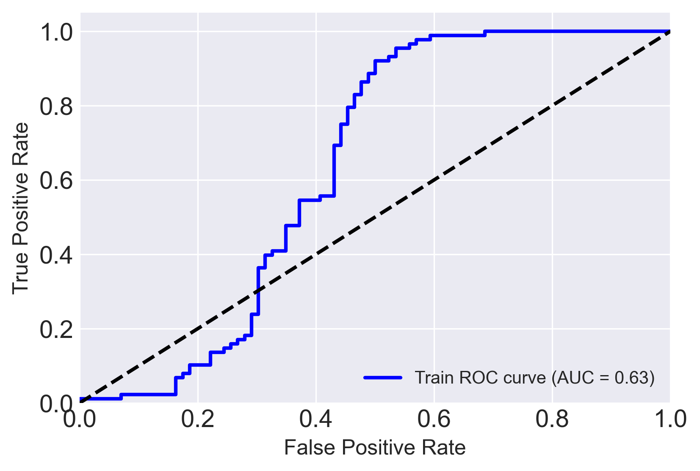
Machine learning Evaluation Results
The DNN is unable to separate before and after burn-in
The ROC evaluates the DNN

Slide 16
Conclusion
We performed visual inspections, tested with test bench station, tested
We classified the test bench datasets using DNN
We used pre-production test bench dataset to validate that DNN can make deployment of LVPS more stringent to CERN
We had small dataset to train the DNN model
With production test bench dataset the DNN will be improve accuracy

Slide 17
Thank YOU !!!!

Slide 18



Software & Implementation
Tools and tech used
To train: Split the data and train the model with train data with good boards only
Evaluate the model with good boards and bad boards
LabView for data data collection
Python for analysing data and building models
1

Slide 19
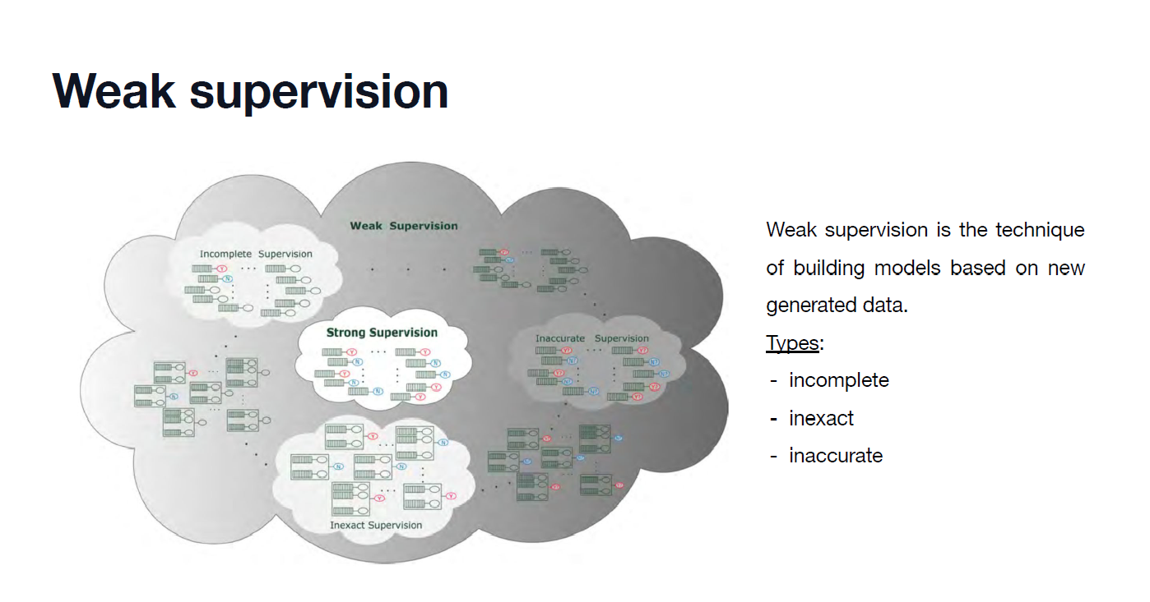
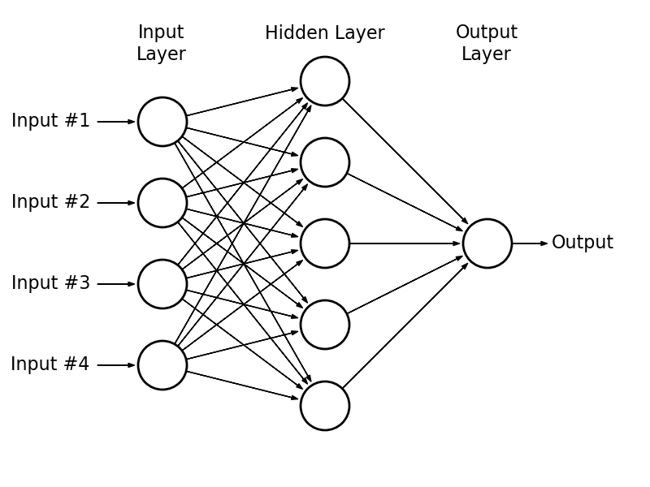
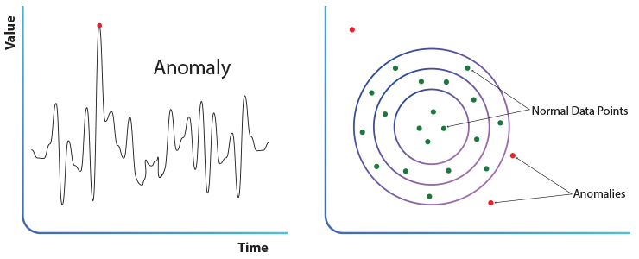
Training a Neural Network
Fully connected Neural Network
Weak supervision
In anomaly detection, the goal is to identify outliers (in this case, "bad" data) that differ significantly from the majority of the data (the "good" data). This is useful when you have a large amount of "good" data and very few "bad" instances.
2

Slide 20
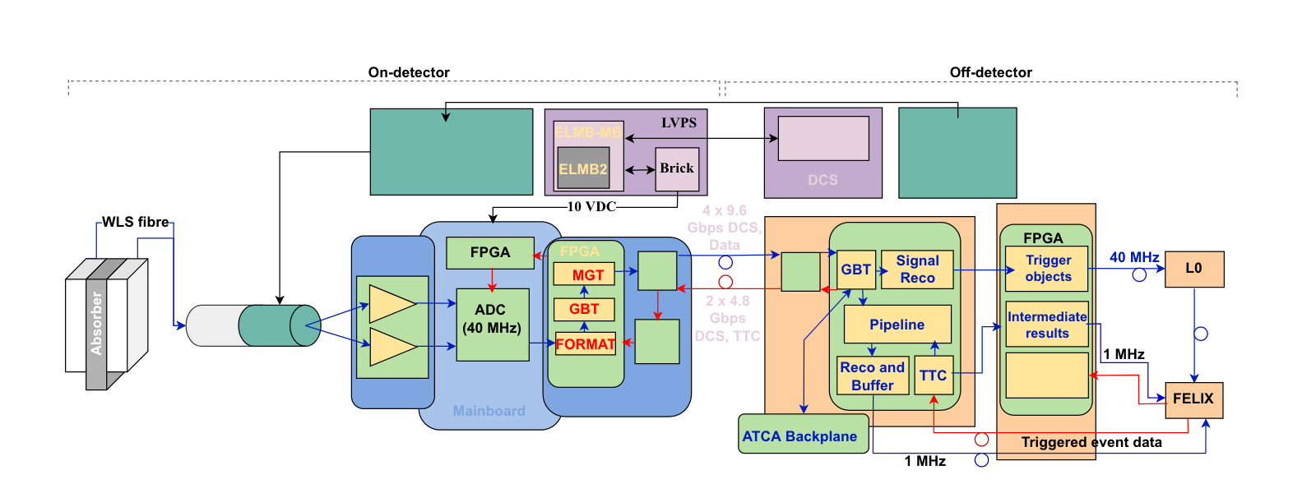
Phase-II Upgrade electronics diagram
3

Slide 21
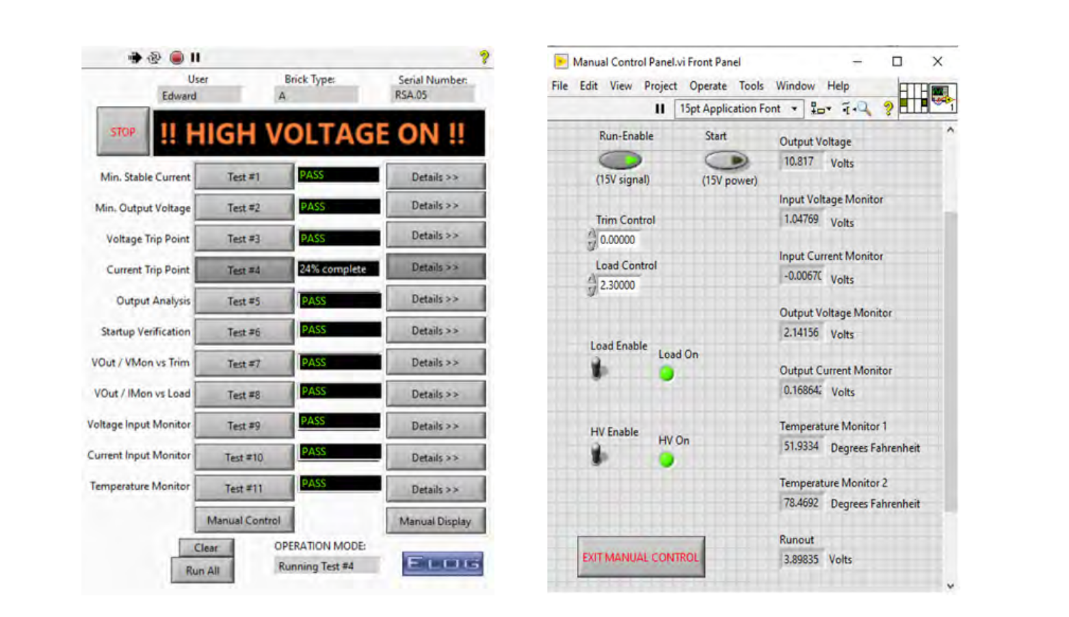
Test panel to perform various tests (left) and
the manual control feature on a graphical user interface (right)
4

