Slide 1

Automatic differentiation for Balitsky-Kovchegov equation
Tomasz Stebel
Institute of Theoretical Physics,
Jagiellonian University, Kraków
In collaboration with:
Florian Cougoulic, Piotr Korcyl and Truong My Hau LE
based e-Print: 2411.12739 and work in progress
XXXII International Workshop on Deep Inelastic Scattering and Related Subjects (DIS2025)
25.03.2025
Project is supported by National Science Centre, grants no. 2021/43/D/ST2/03375.

Slide 2
Outline
Motivation
Automatic Differentiation
Benchmarks/numerical results

Slide 3
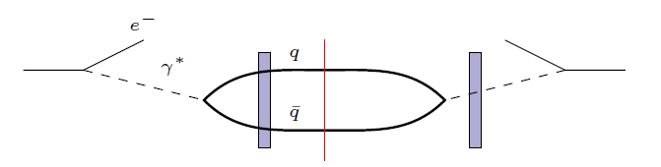
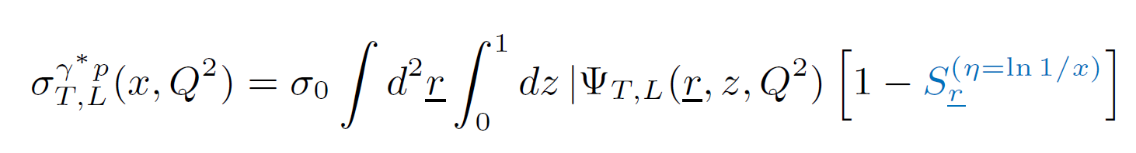
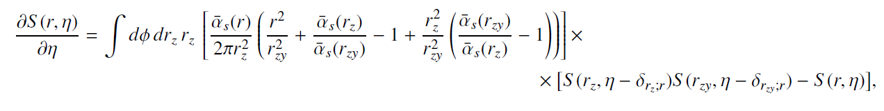
Motivation 1: fitting initial condition for BK
Inclusive DIS cross-section at small-x (dipole picture):
$r$
Photon wavefunction (calculate perturbatively)
E.g. solution of small-x evolution equation by Balitsky-Kovchegov
(running coupling & kinematically constrained version of BK)

Slide 4
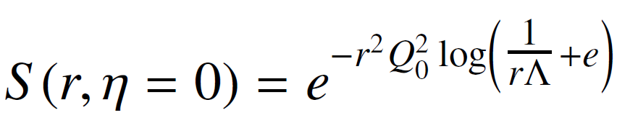

Motivation 1: fitting initial condition for BK
Initial condition for BK evolution equation need to be assumed, for example by McLerran-Venugopalan (MV) model:
With free parameters $Q_{0}$, $Λ$ fitted to data.
One construct some $χ^{2}$ measure:
which is minimized. For each set of initial condition parameters, one needs solve BK equation.
Time consuming.
One needs derivatives w.r.t. initial condition parameters to minimize $χ^{2}.$

Slide 5
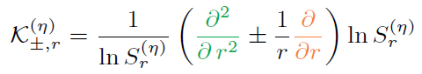

Motivation 2: transverse momentum distribution (TMD) from BK
Weizsäcker-Williams TMD at small-x:
Where $V$are Willson lines. After several simplifications:
One can calculate WW TMD using BK equation
Derivatives w.r.t. dipole size $r$are needed.

Slide 6


Automatic Differentiation (AD)
In our code we use implementation of AD based on dual numbers.
One promotes real numbers into pairs of real numbers:
$$x∈ℝ$$
$$(x,1)∈ℝ^{2}$$
Second component is a derivative.
For example, we define:
$$\sin\left(x,y\right)≔(\sin{x,y\cos{x}})$$
One defines algebra for each elementary transformation and function:
e.g.
$$\left(x_{1},y_{1}\right)∗\left(x_{2}, y_{2}\right)≔(x_{1}x_{2}, x_{1}y_{2}+x_{2}y_{1})$$
We provide our own implementation of AD since standard packages are not suitable (e.g. due to integration on the grid).
https://bitbucket.org/piotrekkorcyl/bk_with_ad/src/main/

Slide 7
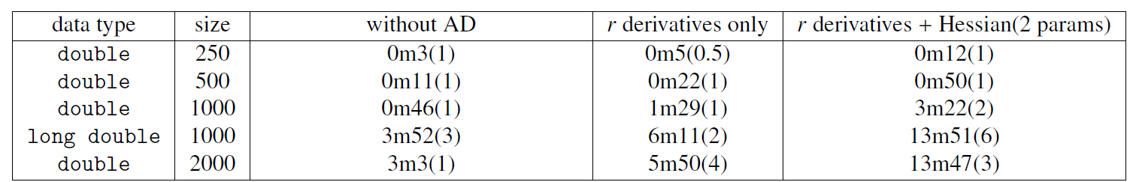


Timings (10 steps of evolution)
1st and 2nd derivative w.r.t. dipole size $r$
1st and 2nd derivative w.r.t. initial cond. params.
1) AD for $r$ derivatives slows down the code ~2 times.
2) AD for $r$ derivatives & initial cond. params slows down the code ~4-5 times.
Numeric derivatives (n.d.):
$$\frac{df}{dx}≈\frac{f\left(x+δ\right)−f\left(x\right)}{δ}$$

Slide 8
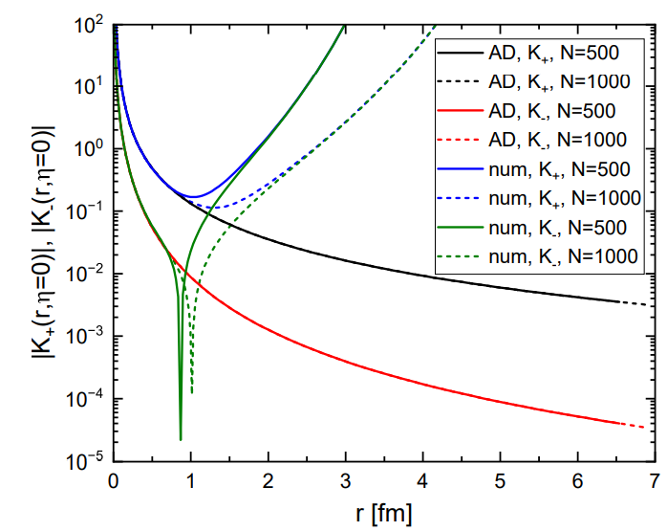



Weizsäcker-Williams TMD
$K_{±}$ are hard to calculate at large r:
but
$$K_{+}\left(r\right)\sim \frac{1}{r^{2}}$$
$$S\left(r\right)\sim \exp{(−Q_{0}^{2} r^{2})}$$
Numerical derivatives are unstable
Finer grid helps only a bit
AD is stable

Slide 9
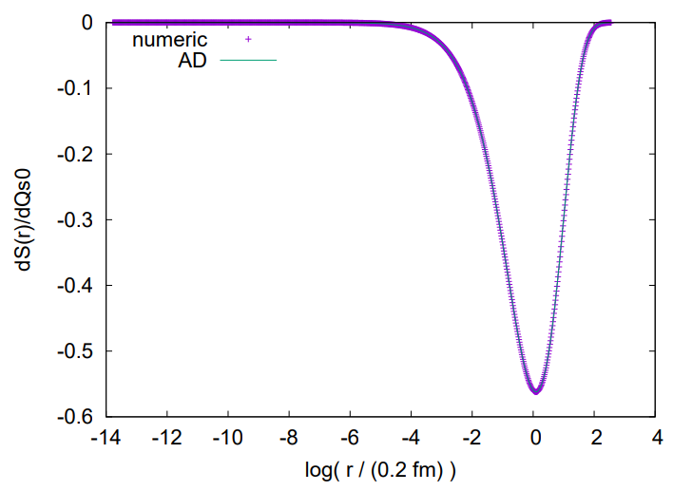
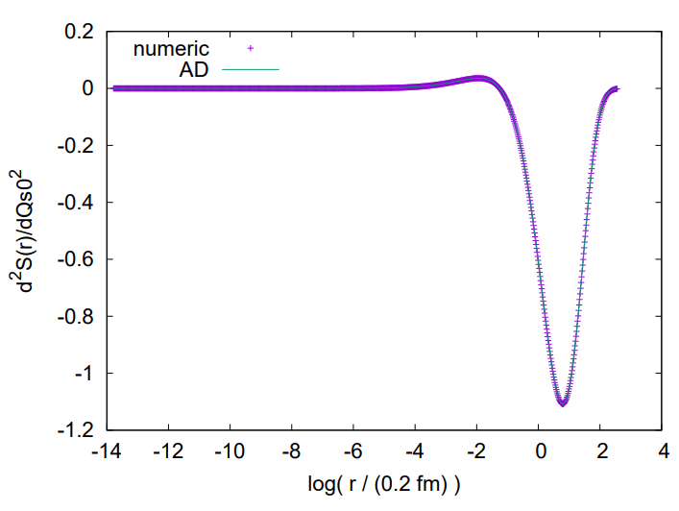


Derivatives w.r.t. initial condition parameters
$$\frac{dS}{dQ_{0}}$$
$$\frac{d^{2}S}{dQ_{0}^{2}}$$
Perfect agreement between AD and numerical der.

Slide 10

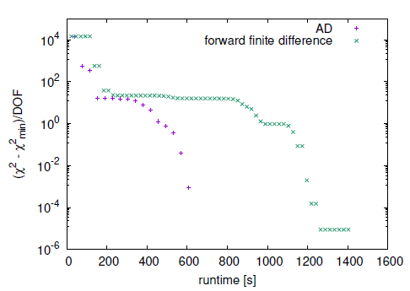
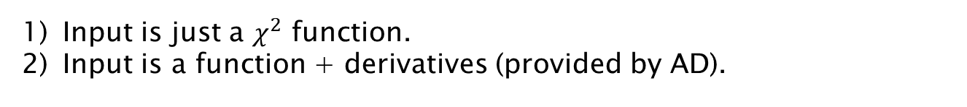
Fits to data
PRELIMINARY
We use H1 and ZEUS combined data for inclusive DIS, 271 data points.
We use Levmar
(Levenberg-Marquardt nonlinear least squares algorithms in C/C++)
in two setups:
Both give the same:
Input is just a $χ^{2}$ function.
Input is a function + derivatives (provided by AD).

Slide 11
Summary
Balitsky-Kovchegov (BK) is the very often used evolution equation in small-x community.
Automatic differentiation (AD) allows to calculated semi-analytical derivatives and:
allows to calculate derivatives with better precision (useful for TMD extraction)
speeds up the fitting.
and Outlook
Fitts using more data - going beyond inclusive DIS.
AD version of JIMWLK evolution equation (implemented, need to be tested).
Thank you

