Slide 1
Radiation Hard embedded FPGA – Programmable Logic Array IP
2nd DRD7 Workshop CERN
Michael Karagounis
25.09.2023

Slide 2
Motivation
State of the art chip-design methodology in HEP is based on hardwired non-programmable logic
Advantage
optimized hardware for specific application case
High resource efficiency in terms of power and area consumption
Disadvantage
no flexibility
bug fixes require costly design iteration
reuse of chips in different projects and applications difficult
Embedded FPGA / Programmable Logic Array IP
allow reprogramming/reconfiguration of logic for bugfixes and project adaption

Slide 3
Collaboration Partners & Ressources
Imperial College London, Andrew Rose
1 FTE, 1 MPW ASIC production
FH Dortmund, Michael Karagounis
0.5 FTE 2024-2027, 1 Mini-Asic MPW production
BMBF (applied, evaluation is still pending)
0.5 FTE 2024-2025, 2 Mini-ASIC MPW production

Slide 4
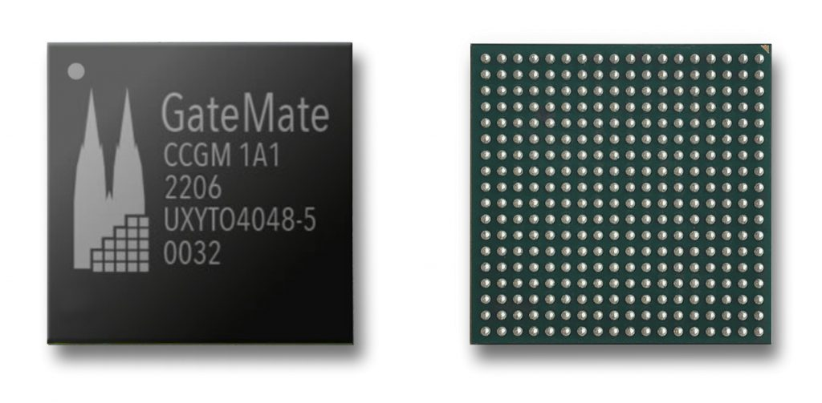
FHDO FPGA Development Background
Collaborating with Cologne Chip AG in design and characterization of the Gatemate FPGA
Design is supported by EU (IPCEI) Important Projects of Common European Interest
SRAM based FPGA in Globalfoundries 28 nm CMOS
radiation characterization in cooperation with CERN, Salvaore Danzeca & Rudy Ferraro
design and implementation of innovative architectures in TSMC 7 nm
Parameter | Detail
Logic Cells | 20,480 CPE correspond to * 20,480 8-Input-LUT trees or * 40,960 4-Input-LUT trees with * 40,960 FF/Latches
Block RAM | Total 1,280 Kb 20Kb blocks: 64 40Kb blocks: 32
PLLs | 4
SerDes 5 Gb/s | 1
I/Os | single-ended: 162 differential: 81 1.2V to 2.5V

Slide 5
Plans
FHDO
Study OpenFPGA and/or FABulous framework
XML-to-Prototype Flow
FPGA architecture is described in XML
Backend flow creates “production ready” layouts
FABulous offers partial reconfiguration
Add radiation hardening features
Error Detection & Correction in the Configuration Memory
Scrubbing
Reconfiguration
Imperial
Support either Logic Array IP from industrial partner or develop own IP
Develop software & infrastructure for synthesis and mapping of user-code

Slide 6
Status
Project has been put on hold by steering committee
Call for participation of additional interested institutes

