Slide 1
EXTREME ENVIRONMENTS
WP7.4b: Radiation Resistance of Advanced CMOS Nodes
DRD7: AN R&D COLLABORATION ON ELECTRONICS AND ON-DETECTOR PROCESSING
3rd WORKSHOP
Giulio Borghello (CERN EP-ESE-ME)
giulio.borghello@cern.ch

Slide 2
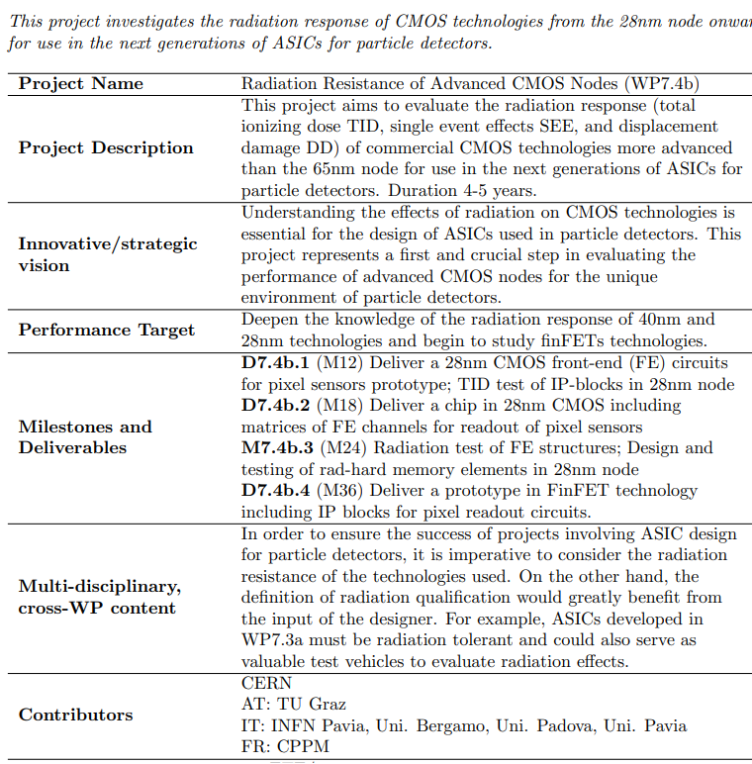

Slide 3





7.4.b: EXTREME ENVIRONMENT AND LONGEVITY - RADIATION HARDNESS
Project: radiation resistance of advanced CMOS nodes
EP-R&D WP5.1
[CH]
[AU]
[FR]
+
[IT]

Slide 4
7.4.b: EXTREME ENVIRONMENT AND LONGEVITY - RADIATION HARDNESS
Project: radiation resistance of advanced CMOS nodes
EP-R&D WP5.1
[CH]
[AU]
[FR]
+
[IT]

Slide 5
EP-R&D WP5.1
vast experience on radiation-effects on CMOS technology
  250nm, 130nm, 65nm, 40nm 28nm, 22FDSOI
2 X-ray machines (AsteriX and ObeliX)

Slide 6
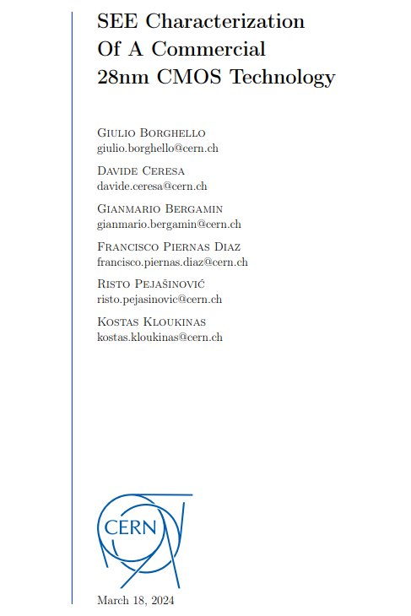
EP-R&D WP5.1
~50 pages of report on SEE in 28nm technology
  2 chips (EXP28:SEE, EXP28:ANA)
  Heavy ions and proton tests
    SRAM
    DFF
    SET detector
    SEL detector
      SBU
      MBU
      SET
      SEL
https://asic-support-28.web.cern.ch/tech-docs/assets/radtol_reports/SEE_characterization_of_a_commercial_28nm_CMOS_technology.pdf

Slide 7
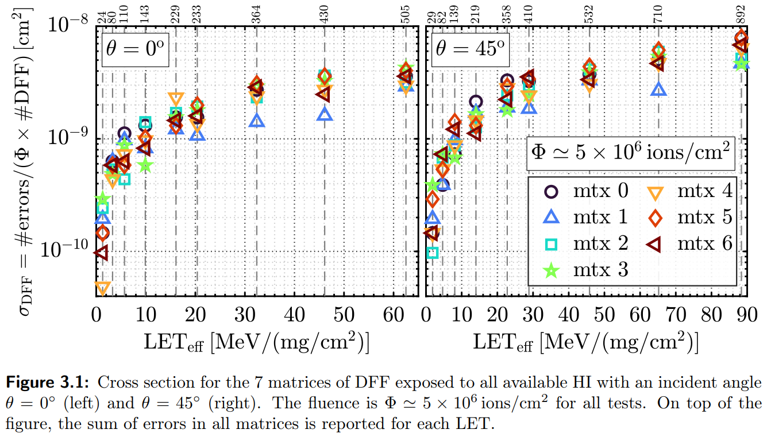
EP-R&D WP5.1
https://asic-support-28.web.cern.ch/tech-docs/assets/radtol_reports/SEE_characterization_of_a_commercial_28nm_CMOS_technology.pdf

Slide 8
EP-R&D WP5.1
~50 pages of report on SEE in 28nm technology
  2 chips (EXP28:SEE, EXP28:ANA)
  Heavy ions and proton tests
    SRAM
    DFF
    SET detector
    SEL detector
      SBU
      MBU
      SET
      SEL
It will be soon updated with new data collected this June.
(SEL only measured for VDD > 1.8V)
https://asic-support-28.web.cern.ch/tech-docs/assets/radtol_reports/SEE_characterization_of_a_commercial_28nm_CMOS_technology.pdf

Slide 9

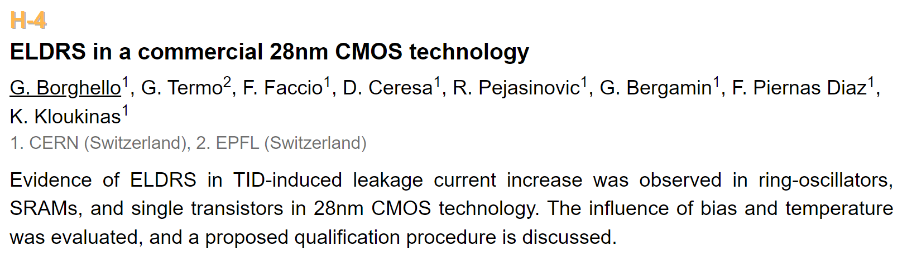
EP-R&D WP5.1
low-dose-rate tests on 28nm CMOS technology

Slide 10
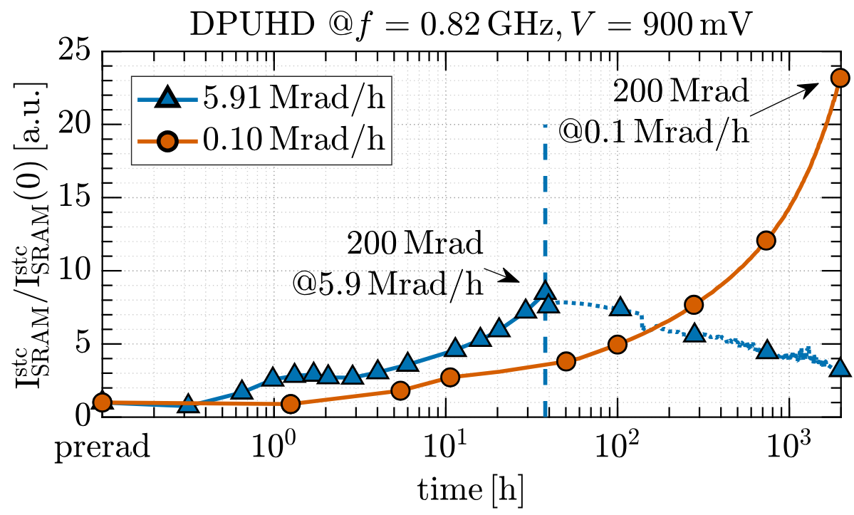
EP-R&D WP5.1
low-dose-rate tests on 28nm CMOS technology

Slide 11
EP-R&D WP5.1
TID effects on ESD protections
TID effects on PN junction
Simulations (and measure) on dose-enhancement effect
….
chip to submit in October 2024

Slide 12
7.4.b: EXTREME ENVIRONMENT AND LONGEVITY - RADIATION HARDNESS
Project: radiation resistance of advanced CMOS nodes
EP-R&D WP5.1
[CH]
[AU]
[FR]
+
[IT]

Slide 13

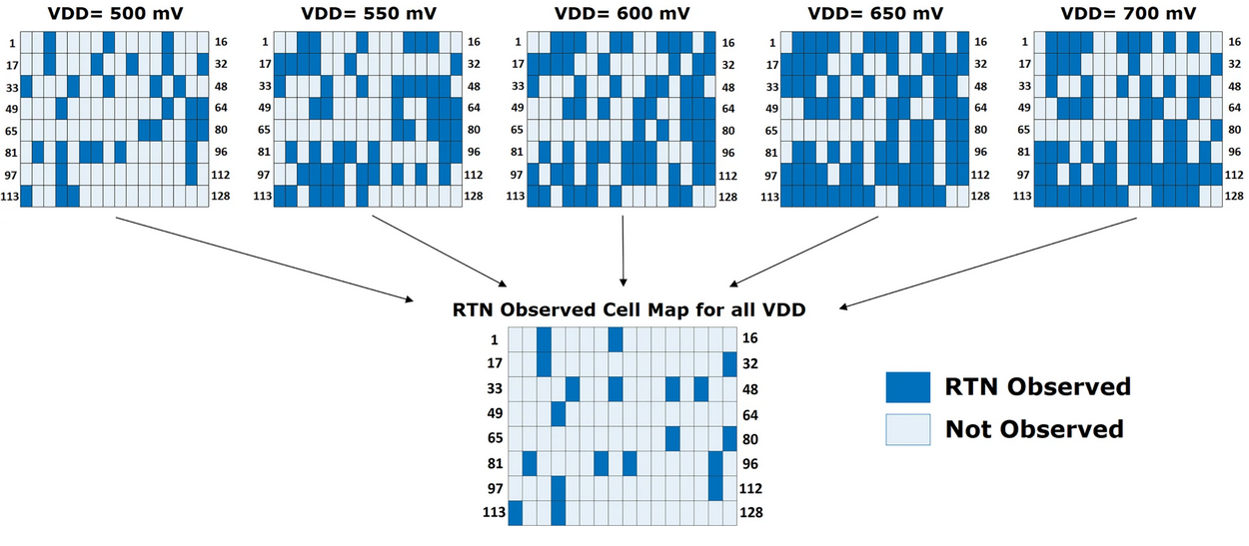
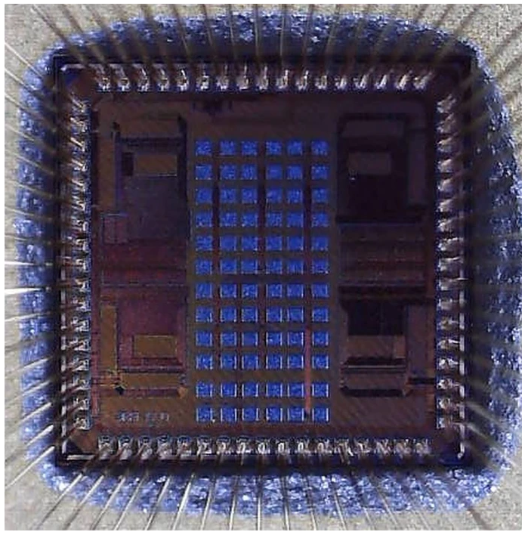
40nm CMOS technology
Statistics of RTN evolution with TID
Test Setup: Characterization of 128 differential inverter-based Ring Oscillators (ROSCs) under TID exposure up to 100 Mrad for power supply levels 600 mV … 800 mV.
Monitoring Set: RTN tracked in 24 preselected ROSCs at each TID increment.
Samples: 72 ROSCs analyzed across three chip samples (24 ROSCs per sample).
Final Characterization: Re-assessment of full chip post-100 Mrad across power supply levels (600 mV to 800 mV).
SIRENS40
Study based on 40 nm testchip with ring oscillator arrays
Design: Semih Ramazanoglu

Slide 14
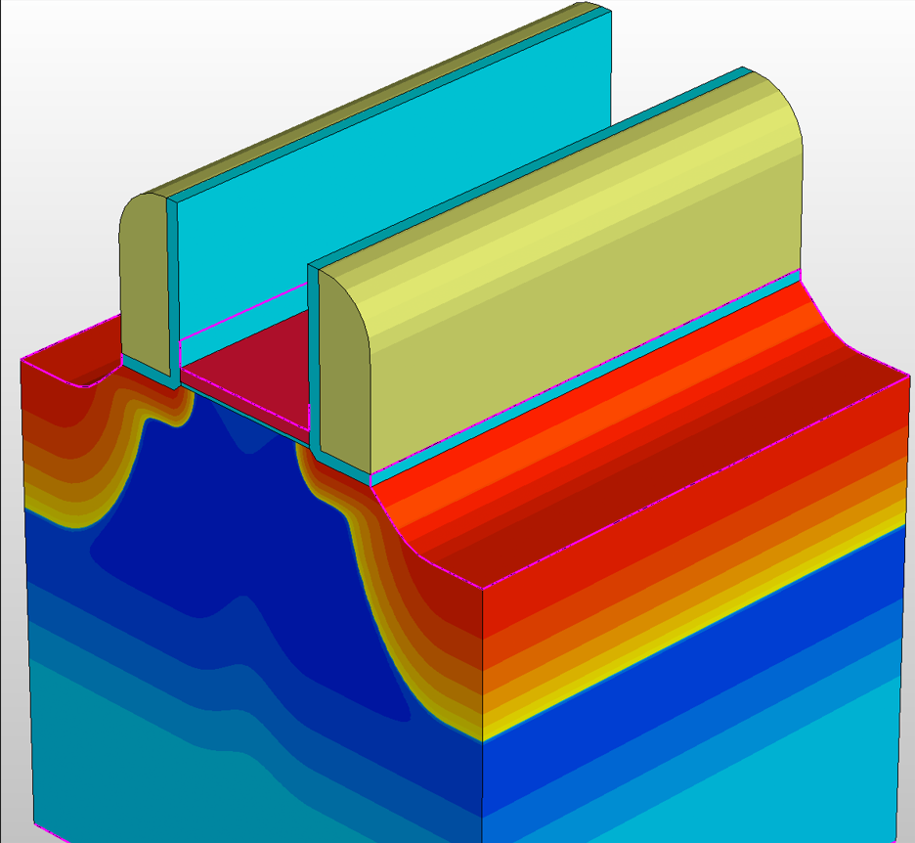
TCAD modelling of radiation effects
Good fit with 28nm measurements, with special attention to subthreshold
Modelled effects of individual traps
Working on extension towards radiation effects

Slide 15
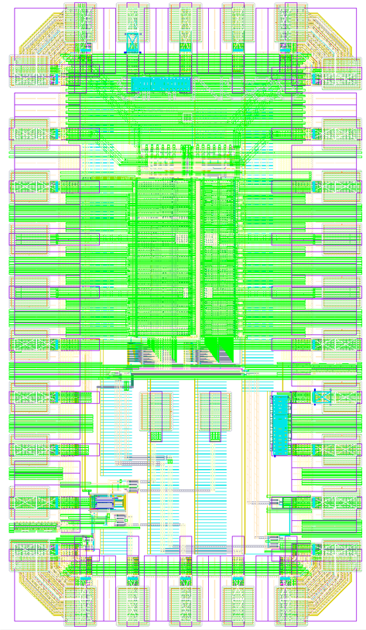
Single device – noise under TID
SIRENS28
Measurements TID influence on noise – single devices
Transistors array (multiple identical transistors) submission to July 2024 run
Working on extension to statistical results (noise and RTN) on single-devices
Top Design: Semih Ramazanoglu
And Alicja Michalowska-Forsyth

Slide 16
7.4.b: EXTREME ENVIRONMENT AND LONGEVITY - RADIATION HARDNESS
Project: radiation resistance of advanced CMOS nodes
EP-R&D WP5.1
[CH]
[AU]
[FR]
+
[IT]

Slide 17



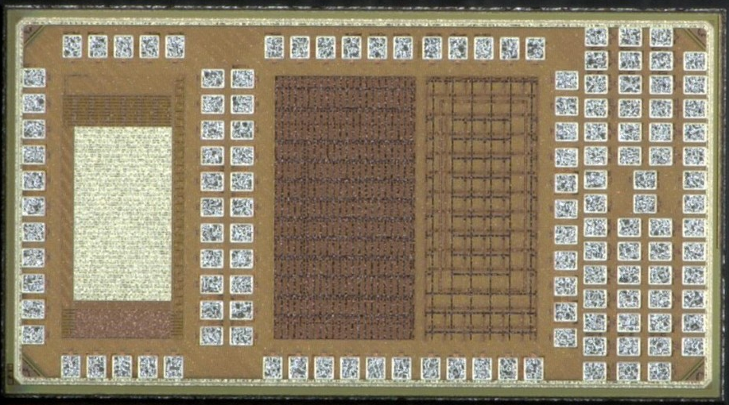
CPPM 28 nm chip design
R&D on hybrid pixels
  Process qualification in terms of performance for analog, low-power and low-noise circuits
  Architecture studies
    Fast charge amplifier array
Mini@sics of 2×1 mm2 received June 2023, consisting of 4 main blocks
Array of 12×36 pixels (432 pixels)
  Analog pixel array with Fast charge amplifiers for high time resolution
  Only the analog part is implemented (25×12 µm²)
SET test structures
  Measure the SET pulse width with a good
  resolution < 20 ps
Ring Oscillators for TID tests on digital standard cells
Test structures for TID tolerance studies
Single
devices
Pixel array
SET
RO - TID
Collaboration and exchange between CPPM and Graz University on various aspects of design and testing

Slide 18
CPPM 28 nm chip design
R&D on hybrid pixels
  Process qualification in terms of performance for analog, low-power and low-noise circuits
  Architecture studies
    Fast charge amplifier array
Mini@sics of 2×1 mm2 received June 2023, consisting of 4 main blocks
Array of 12×36 pixels (432 pixels)
  Analog pixel array with Fast charge amplifiers for high time resolution
  Only the analog part is implemented (25×12 µm²)
SET test structures
  Measure the SET pulse width with a good
  resolution < 20 ps
Ring Oscillators for TID tests on digital standard cells
Test structures for TID tolerance studies
Single
devices
Pixel array
SET
RO - TID
Collaboration and exchange between CPPM and Graz University on various aspects of design and testing

Slide 19
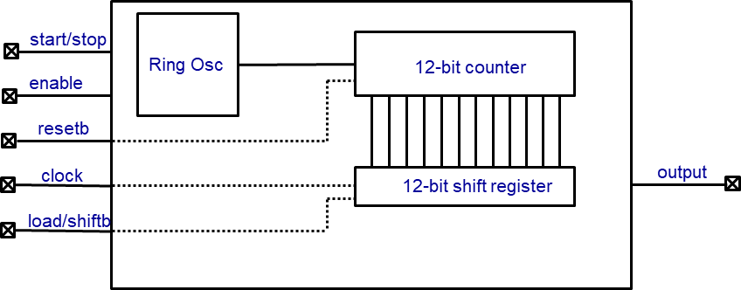
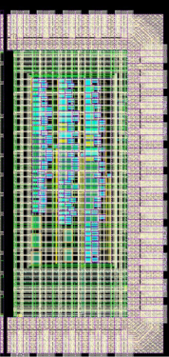
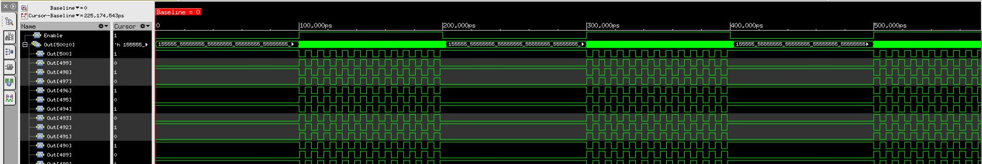
Study of the effect of TID on the performance of digital standard cells
Timing of combinatorial or sequential cells
Leakage currents and static power
Effects of device size on TID tolerance
Design based on the digital flow
96 Rosc sub-bloc
  Cell size (7T, 9T,12T)
  Driving (D0, D2, D4)
  SVT, LVT, HVT
ROsc sub-bloc synoptic
Basic cells | Frequency (MHz)
INVD0 | 154
INVD2 | 222
NAND0 | 118
NAND2 | 143
NOR0 | 111
NOR2 | 139
Simulation

Slide 20
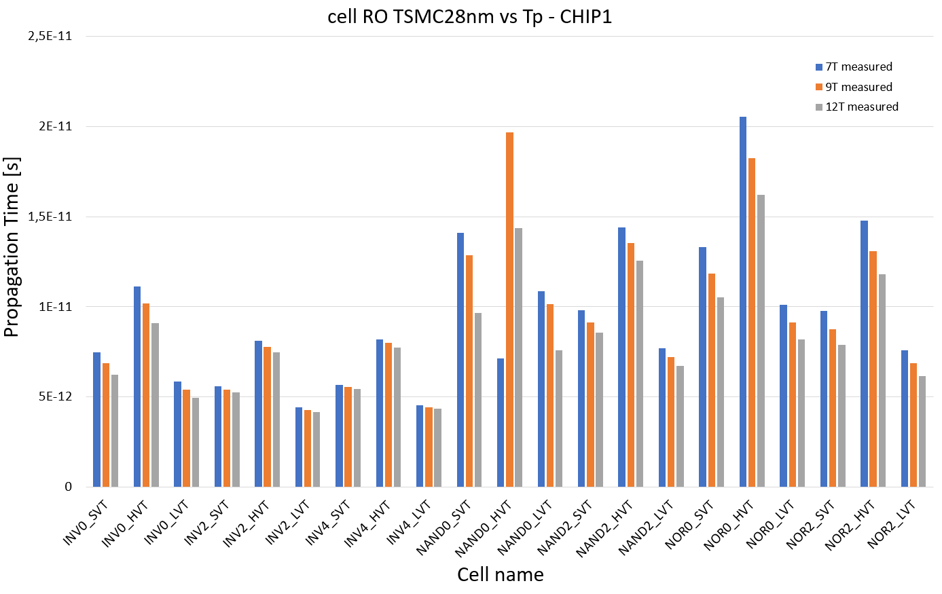
First results
2 chips tested
  Similar results
Results seems coherent
  12T cell faster than 7T
  LVT faster than HVT
Issue observed on NAND0
  check for the firmware and test set-up
Propagation delay versus Cell

Slide 21
7.4.b: EXTREME ENVIRONMENT AND LONGEVITY - RADIATION HARDNESS
Project: radiation resistance of advanced CMOS nodes
EP-R&D WP5.1
[CH]
[AU]
[FR]
+
[IT]

Slide 22
Contributors: Luigi Gaioni¹, Massimo Manghisoni¹, Valerio Re¹, Elisa Riceputi¹, Gianluca Traversi¹, Lodovico Ratti², Simone Gerardin³
  1 University of Bergamo and INFN Pavia
  2 University of Pavia and INFN Pavia
  3 University of Padova
Area of competence: design of analog front-end circuits and IP blocks for radiation detectors; study of noise and radiation effects in electronic devices and circuits; nanoscale CMOS technologies.

Slide 23
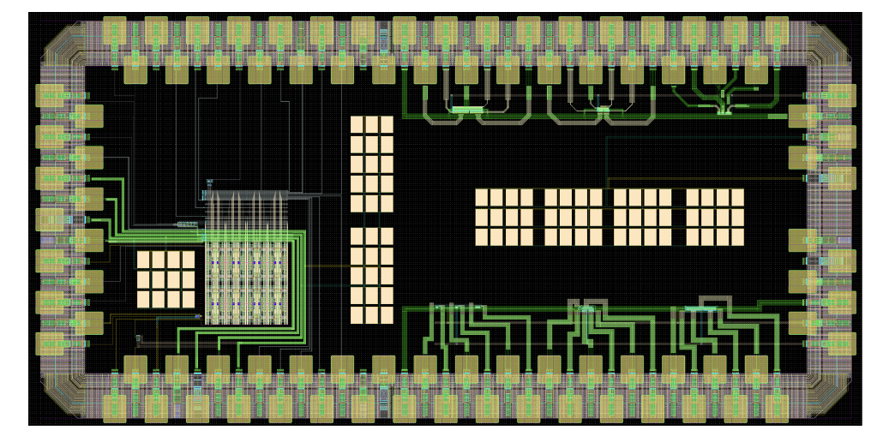
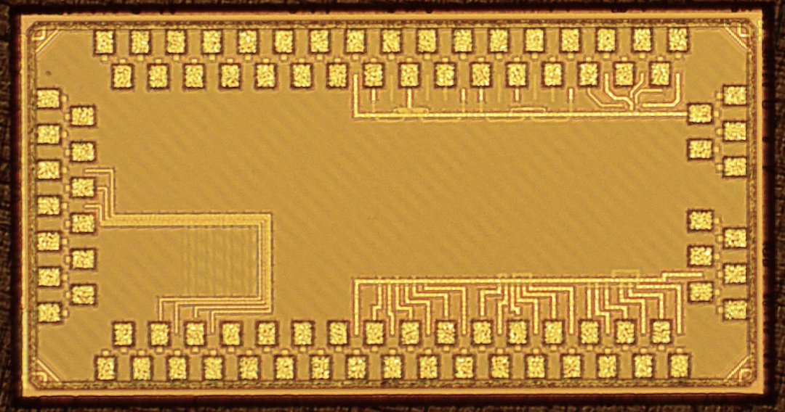
1st submitted prototype
Includes:
  standalone NMOS and PMOS transistors for static and noise characterization
  a standalone charge sensitive amplifier (CSA) for the evaluation of main analog performance parameters
  a 4x8 pixel readout matrix featuring simple digital configuration and readout (shift registers)

Slide 24

TID effects on 28nm MOS transistors
Investigated devices irradiated up to 3 Grad(SiO₂) total dose with X-rays (5.5 Mrad/h dose rate)
MOSFETs biased during irradiation in the worst-case condition
Slight increase in drain leakage current after irradiation
Limited threshold voltage changes (depending on MOS polarity and geometry)
Up to 1 Grad, NMOS and PMOS do not feature significant change in their noise properties after irradiation

Slide 25
Charge sensitive amplifier design
  Auxiliary circuits (not shown in the figure) were integrated to emulate the presence of detector capacitance and leakage current
  Regulated cascode gain stage + source follower
  Two independent feedbacks, one for the discharge of the feedback capacitor and the other for the detector leakage compensation.

Slide 26
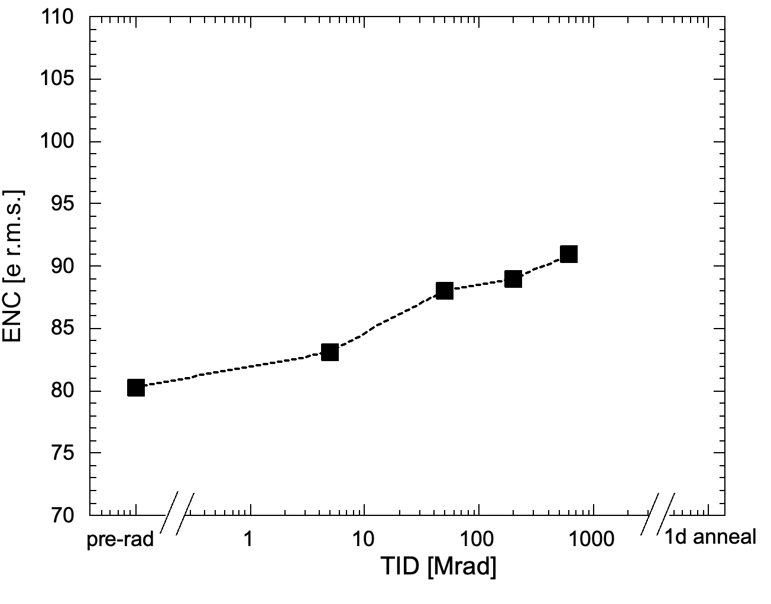
Charge sensitive amplifier design
  An irradiation campaign has been performed with a target TID of 1 Grad
  Irradiation at room temperature, with a dose rate of 5.4 Mrad/h
  No dramatic effects observed:
    Slight increase in the ENC
    Moderate variation of the discharge current associated with a threshold change in the MF feedback transistor
  1 Grad data
  coming soon

Slide 27
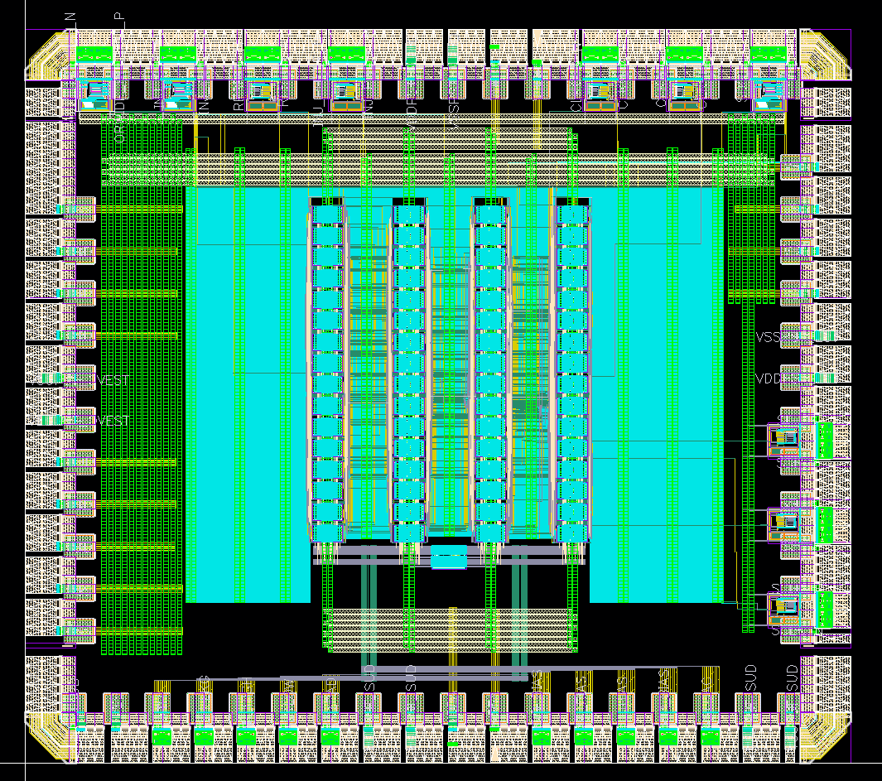
ToT-based front-end: chip layout
8x32 matrix of readout channels
100 x 25 µm² pixels
Shared 8-bit Time of Arrival Counter (640 MHz)
Shared 5-bit Time-over-Threshold Counter (40 MHz)
SPI controller
Submitted in July

Slide 28
7.4.b: EXTREME ENVIRONMENT AND LONGEVITY - RADIATION HARDNESS
Project: radiation resistance of advanced CMOS nodes
EP-R&D WP5.1
[CH]
[AU]
[FR]
+
[IT]

Slide 29
BACKUP SLIDES

Slide 30
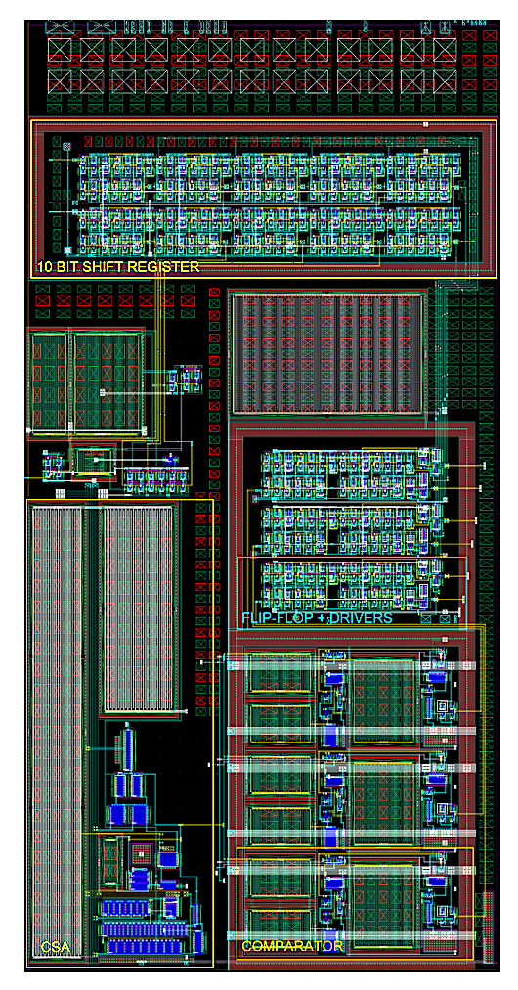
Flash ADC based front-end
Preamp (regulated cascode) two independent feedbacks
Ancillary blocks for detector emulation
  AC coupled, auto-zeroed comparators, operated with 40 MHz clock, implementing a 2-bit flash ADC. The design is ideally insensitive to device threshold voltage mismatch → threshold tuning DAC not required
  Overall current consumption: 5.4 uA → 4.9 µW power consumption @ V_{DD}=0.9 V
  Elementary cell size: 25 x 50 µm² (analog+digital)
  Submitted in a 8x4 matrix

Slide 31
Flash ADC front end - Test results
Test @ f_{CLK} = 10MHz
Threshold dispersion ≈ 24 e r.m.s.
ENC ≈ 63 e r.m.s.
Counts
Threshold [e-]
Counts
ENC [e r.m.s]

Slide 32
ToT-based front-end
A front-end architecture (optimized for very low threshold) is being developed, based on Time-over-Threshold (ToT) → preamp + DC coupled comparator + threshold tuning DAC
Self-cascode preamp gain stage
Differential comparator architecture to improve the immunity to interferences
2 µA
1 µA
1 µA

Slide 33
Future steps
Development of the test setup for the characterization of the ToT-based front-end
Characterization and radiation qualification of the ToT-based front-end
Design and characterization of a 28 nm front-end for X-ray imaging applications (ToT conversion with a bi-linear input/output characteristics)
Development of prototype chip(s) including single devices and IP-blocks with a FinFET technology

Slide 34
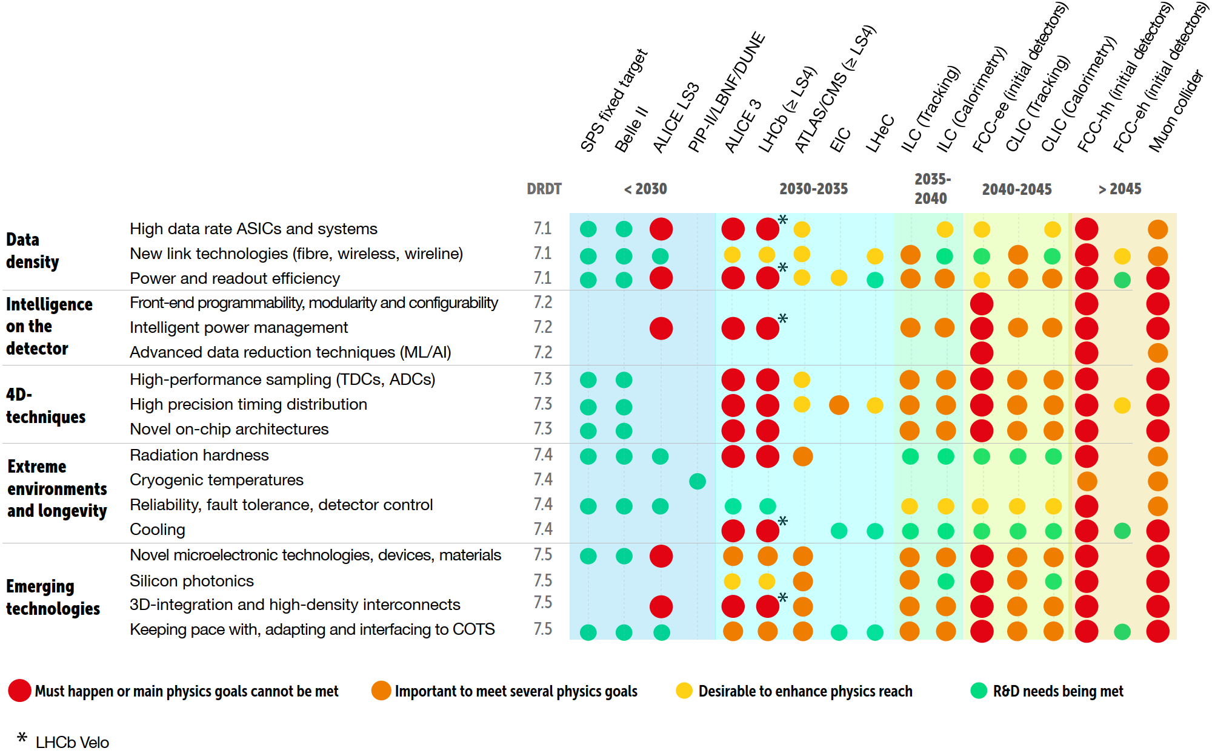
THE 2021 ECFA DETECTOR RESEARCH AND DEVELOPMENT ROADMAP
2 very different time horizons!
2 very different radiation levels!
TID ~1-3 Grad
fluence ~few 10¹⁶ n_{eq}/cm²
(challenging but possible with the technology we know)
TID ~tens (hundreds?) of Grad
fluence ~10¹⁸ n_{eq}/cm²
(NO known CMOS technology survives these levels of radiation)
EDRRP Group. The 2021 ECFA detector research and development roadmap. Tech. Rep. CERN-ESU-017, Geneva, 2020. (https://cds.cern.ch/record/2784893)

Slide 35
THE 2021 ECFA DETECTOR RESEARCH AND DEVELOPMENT ROADMAP
TID ~1-3 Grad
fluence ~few 10¹⁶ n_{eq}/cm²
(challenging but possible with the technology we know)
EDRRP Group. The 2021 ECFA detector research and development roadmap. Tech. Rep. CERN-ESU-017, Geneva, 2020. (https://cds.cern.ch/record/2784893)

Slide 36
> 10 years
first studies on 65nm CMOS technology: 2012
chip production in 65nm for HL-LHC: now
[S. Bonacini et al 2012 JINST 7 P01015]
chips ready for 2030 - 2035
the study on radiation effects should have already been started…
... and it was!
TID tests on 28nm CMOS technology started in 2014!
TID tests on 65nm imaging technology for monolithic started in 2022!
DCDC GaN, iPOL, etc…
research on commercial CMOS technologies is essential!

Slide 37
THE 2021 ECFA DETECTOR RESEARCH AND DEVELOPMENT ROADMAP
TID ~tens (hundreds?) of Grad
fluence ~10¹⁸ n_{eq}/cm²
(NO known CMOStechnology survives these levels of radiation)
EDRRP Group. The 2021 ECFA detector research and development roadmap. Tech. Rep. CERN-ESU-017, Geneva, 2020. (https://cds.cern.ch/record/2784893)

Slide 38
data from:
https://www.tsmc.com/english/dedicatedFoundry/technology/logic/l_3nm
https://irds.ieee.org/editions/2022/more-moore

Slide 39
7.4.b: EXTREME ENVIRONMENT AND LONGEVITY - RADIATION HARDNESS
Project: radiation resistance of advanced CMOS nodes
More specific projects are expected to form around:
Specific nodes (e.g., 7nm finfets, 3nm LGAA, etc.)
Specific effects (e.g., low-dose-rates at ultra-high-doses, NIEL scaling, noise, etc.)
Other possible projects:
  “new” or different technologies (e.g., GaN, InGaAs, etc.)
  facilities (how to irradiate to tens of Grad in a reasonable amount of time)
  qualification (how to qualify chips for ultra-high doses)
difficulties: technology accessibility, facility accessibility

