Slide 1
DRD7 3rd workshop closeout
A. Rivetti - INFN
On behalf of the DRD7 steering committee*

Slide 2
To start with….
This was the first workshop after the official DRD7 approval on June 5!
From project proposal to project implementation
Workshop organised along DRD7 philosophy: keep the formal part as light as possible and concentrate on scientific and technical challenges
More than 100 participants
Many thanks to all the WP conveners to put together a very stimulating program!

Slide 3
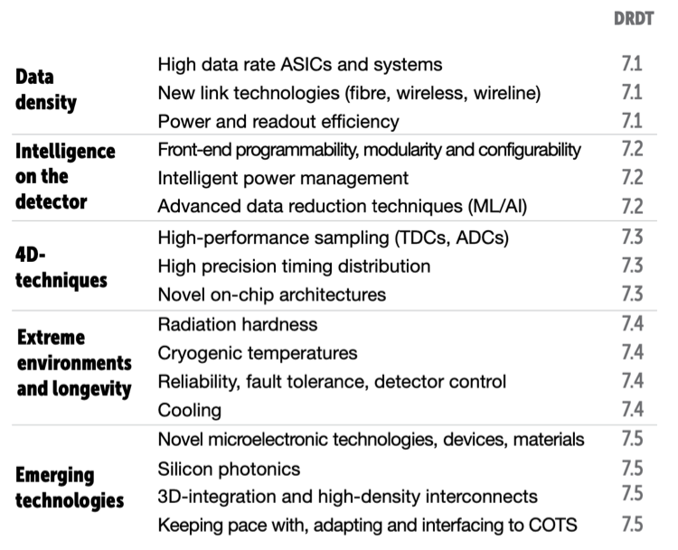
DRD7: a project-based R&D on electronics

Slide 4
Some (very personal) highlights

Slide 5
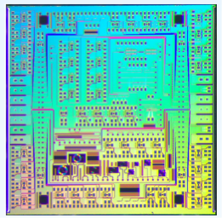
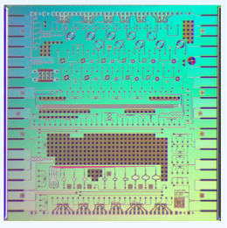
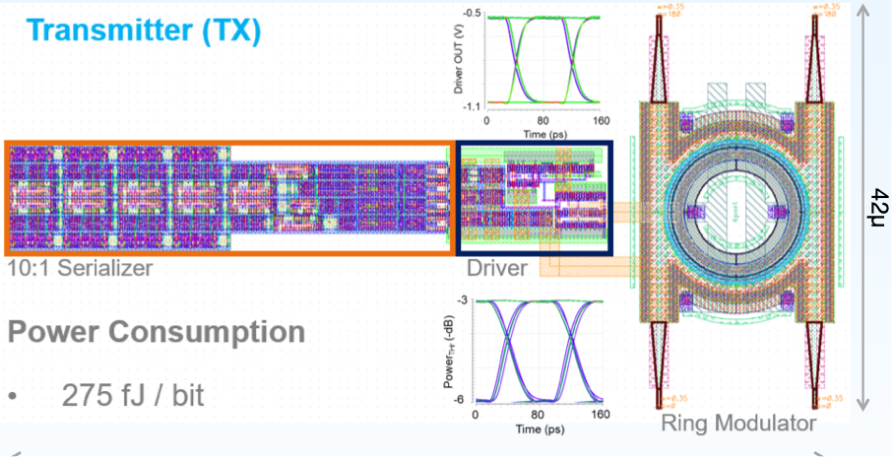
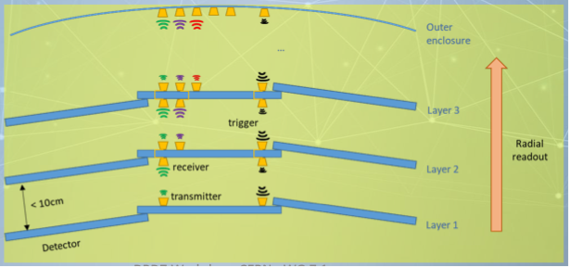
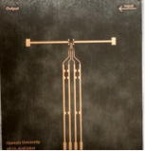
Toward 100 Gb/s link…and beyond

Slide 6
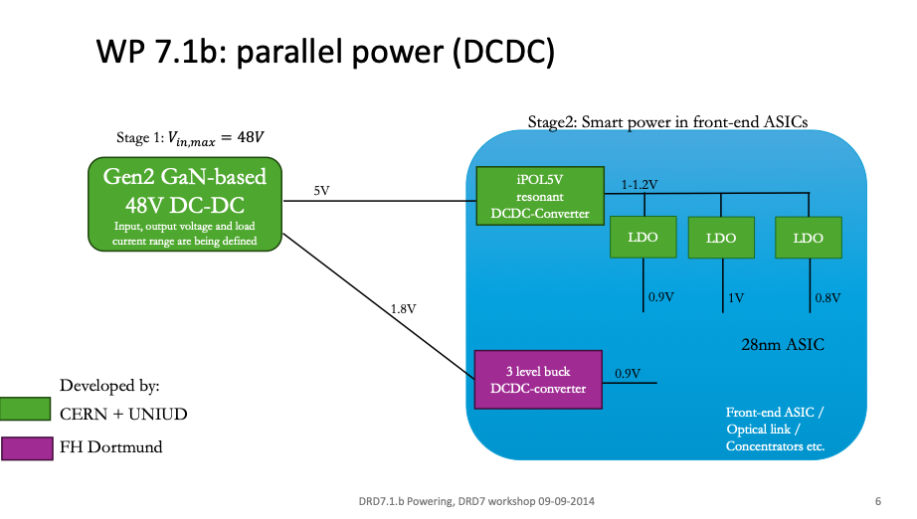
Beyond current mirror bias…

Slide 7
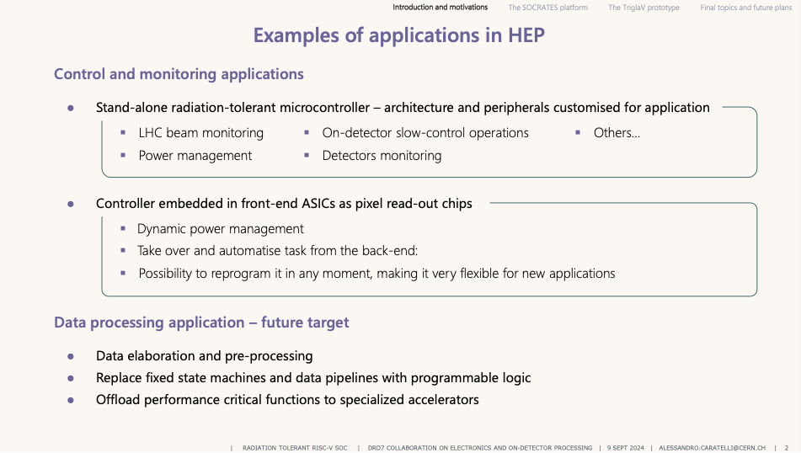
More standardization
How much intelligence on the front-end?

Slide 8
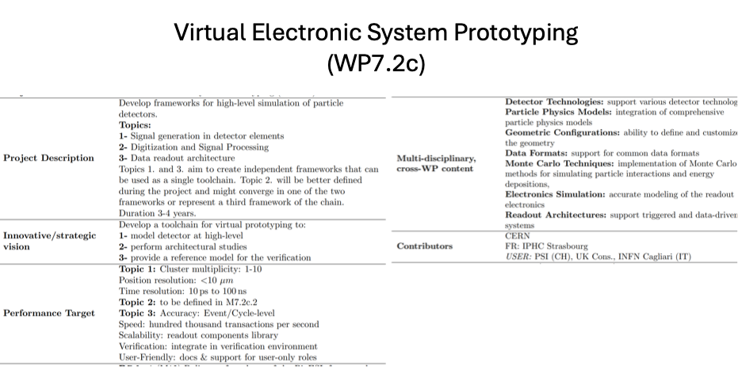
Physical design on reliable specs
…or avoid excessive safety factors and duplications!

Slide 9
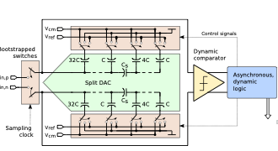
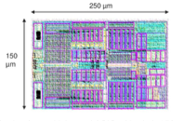
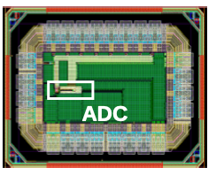
High performance IPs
Many interesting developments going on
How to we manage sharing of IPs
Encourage even closer collaborations

Slide 10
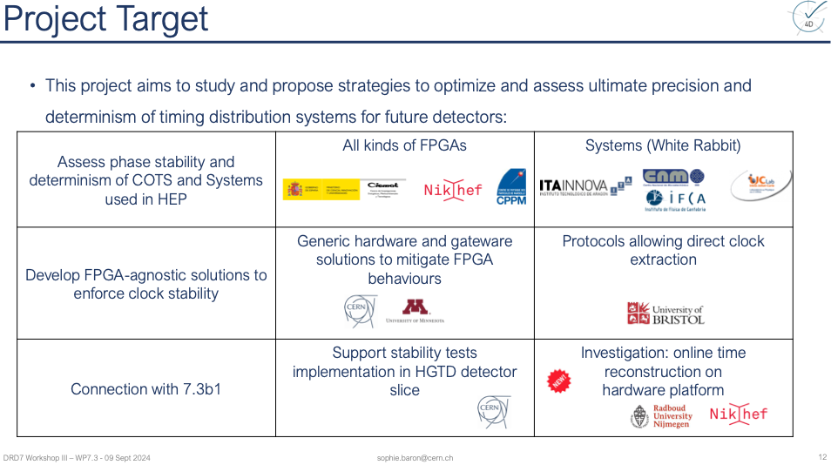
Even more precise timing…

Slide 11
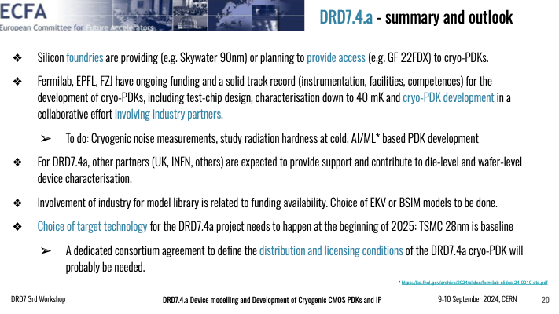
Going to the extremes: very cold

Slide 12
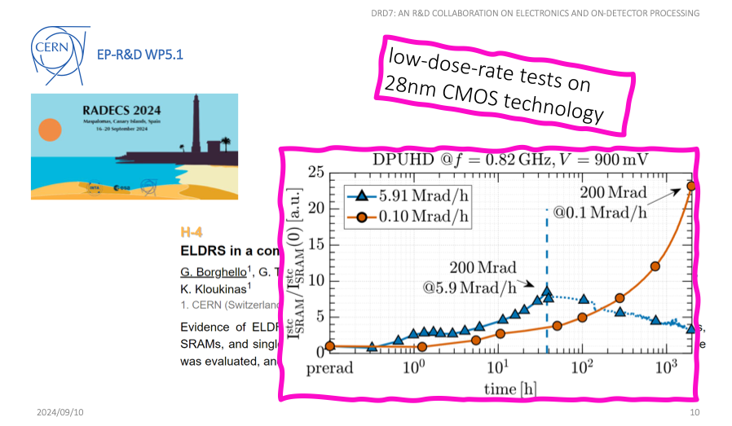
Going to the extremes: radiation
Irradiation in more realistic conditions
Radiation-aware PDK

Slide 13
Going to the extremes
How we combine both?

Slide 14
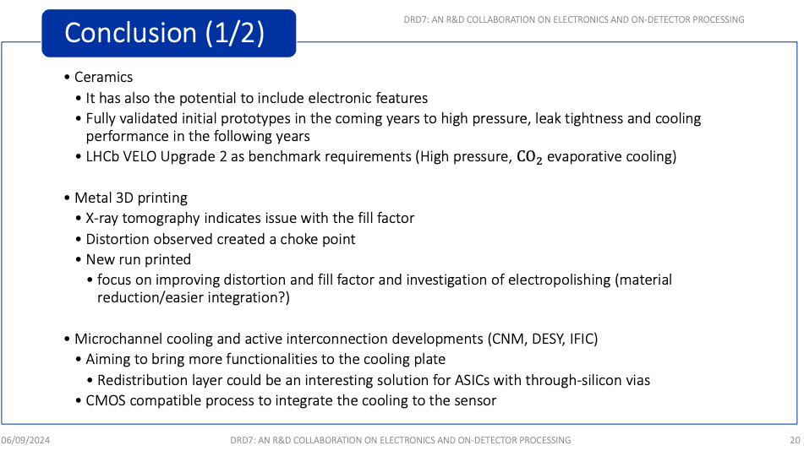
Electronics needs cooling

Slide 15
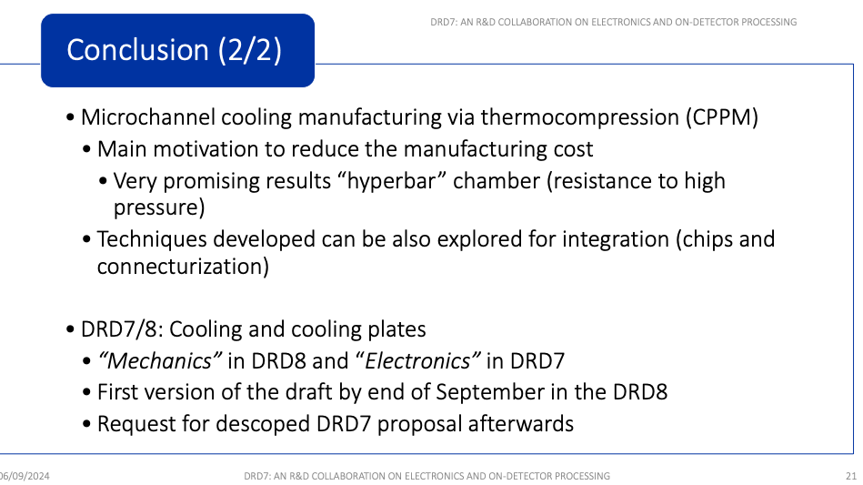
Electronics needs cooling

Slide 16
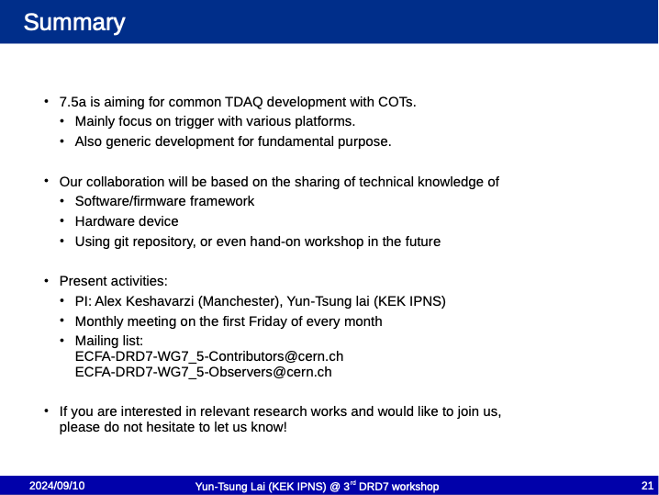
Trigger and DAQ
FPGA, GPU, ML, HLS

Slide 17
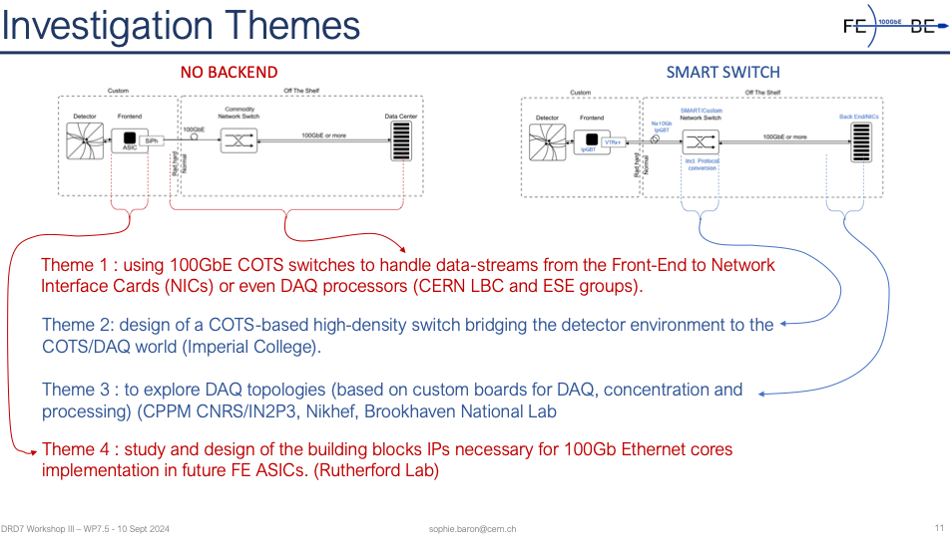
Front-End to Back-End @ 100 Gb/s
Evolutionary, visionary…transformative!

Slide 18

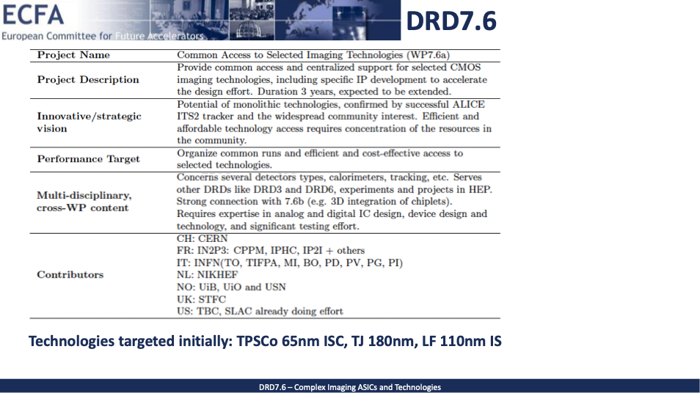
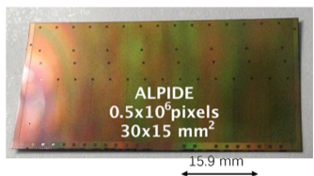
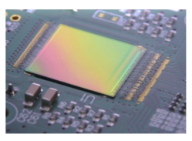
CMOS technologies for sensors

Slide 19
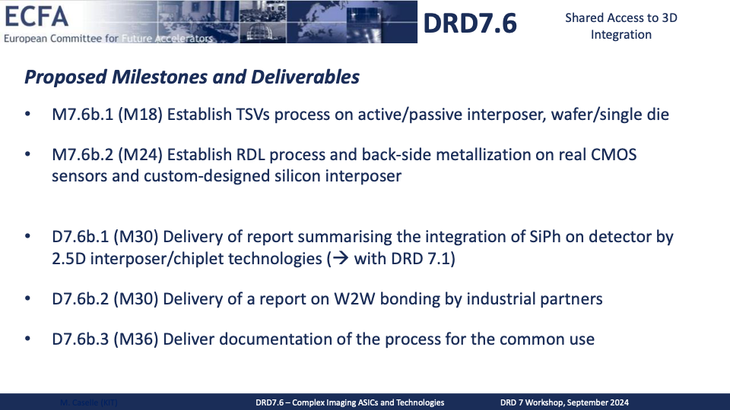
Shared access to 3D integration

Slide 20
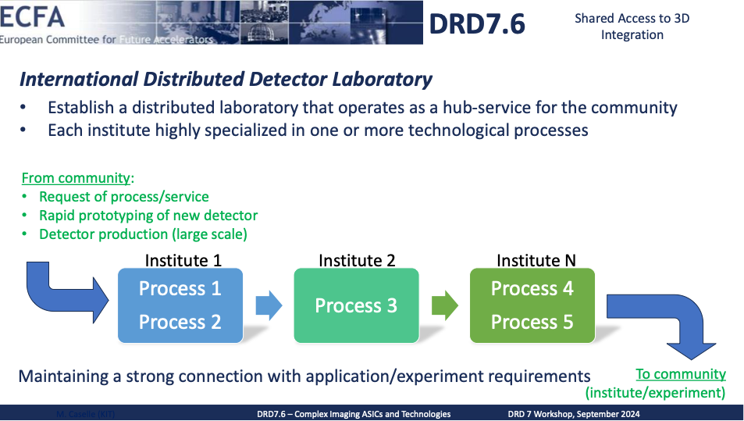
Shared access to 3D integration

Slide 21
Maximizing efficiency

Slide 22
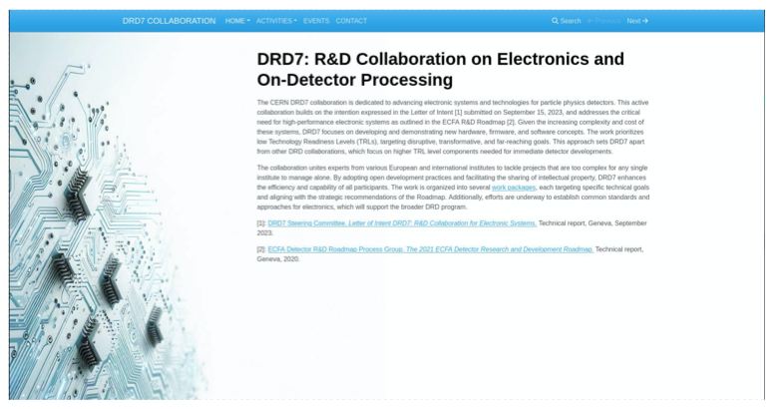

Last, but not least…
We have a website: do not forget to populate it!

Slide 23
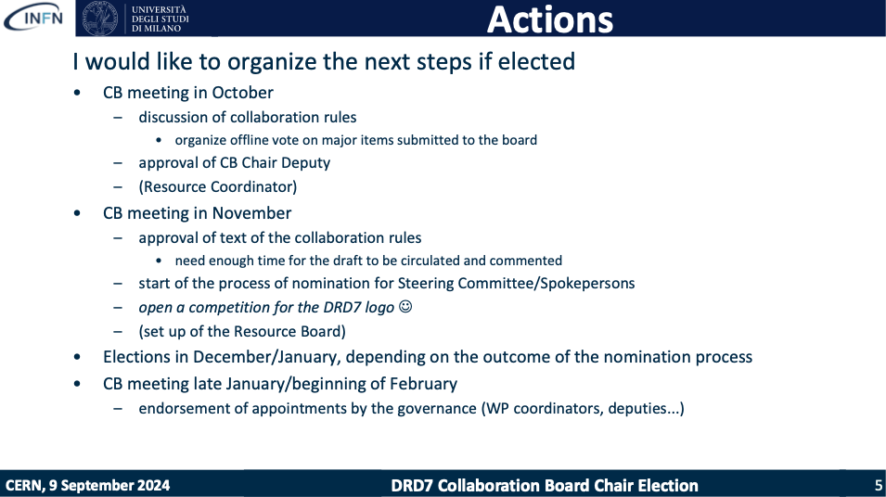
Last, but not least…
Do not forget to cast your ballots for the CB chair election!

Slide 24
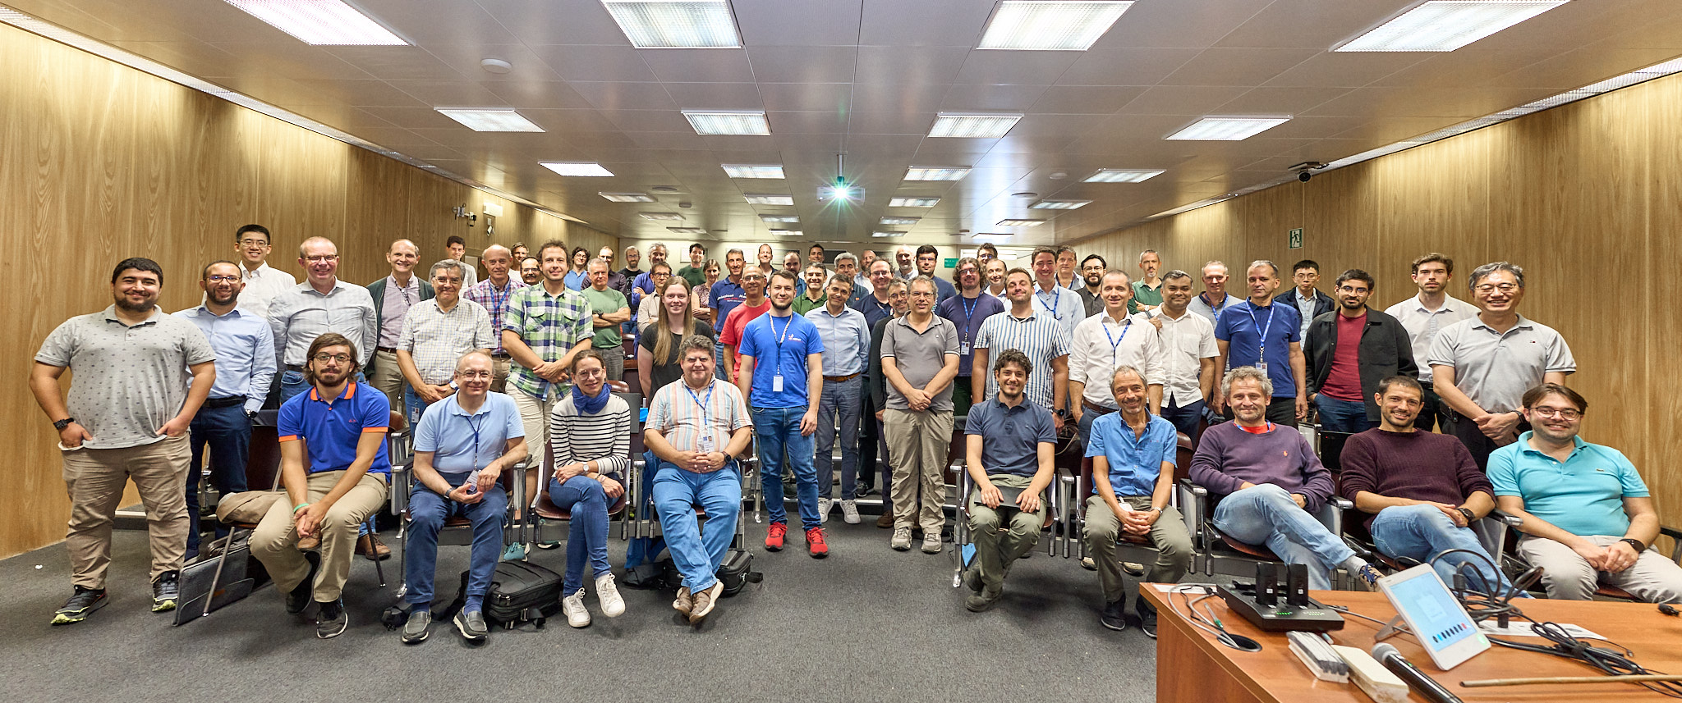
Here we are…

Slide 25
See you at the next workshop!

