Slide 1
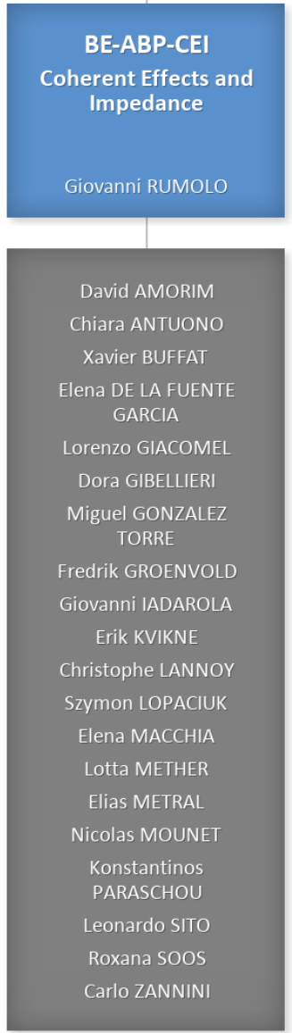
Coherent Effects and Impedances section (CEI) – general information
Giovanni Rumolo
CEI Section Meeting, 25/07/2024
Scientific secretary: Roxana Soos
https://indico.cern.ch/event/1437002/
Notes:
02

Slide 2
Arising matters
Some logistical changes for the future CEI section meetings
  We will start the CEI section meetings at 13:30 on Thursdays as of September 2024,
    Avoid overlap with FCC meetings at 15:30 for those who need to be there and with HL-LHC TCC
  As of January 2025, CEI section meetings will move to 6-2-004 (larger room, window, air conditioned, finally properly equipped for Zoom meetings), same time slot
  Aim at round table meeting (1 slide per person per minute) every ∽3 months
Upcoming farewells ☹
  Erik Kvikne will end his 11-month technical studentship to go back to Norway to complete his master studies – Luigia @Meyrin on Friday 26 July for those available!
  Elena Macchia will end her 6-month traineeship to go back to Rome and complete her master studies – restaurant on Wednesday 31 July for those available!

Slide 3
Arising matters
Radiation dosimeter request (email from Richard and bulletin article)
  New procedure and change of location as of 1 August
  If you need a dosimeter or wish to request a dosimeter for a third party, whatever the CERN status and the type of dosimeter needed, you need to complete and submit the ServiceNow form online. After your request will be processed, you will be informed that the dosimeter is ready for collection at Building 33 (no longer 55!). The form may also be accessed via the CERN Campus App, under “Campus Life”, “Dosimetry”.
  If you already own a dosimeter, you will keep receiving annual email reminders to exchange it.
Heat waves (mail from Stéphanie)
  Please note that the room 6/2-004 has been booked on all afternoons in which it was available following the CERN “Heatwave Action Plan”, which allows anyone to be able to go to this room and benefit from air conditioning
  As a reminder, access to the conference rooms is with your CERN card, which needs to be reactivated once per month at a Lock Activation Card Reader (there is one behind the building 6 cafeteria).

Slide 4
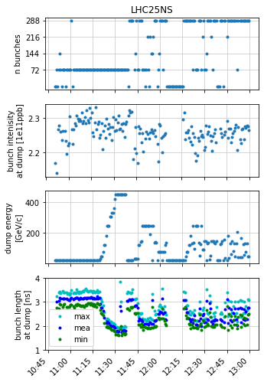
IPP meeting last Friday 19 July
Discussion on intensity limitation for LHC beam MDs in the injectors following the 930 MHz HOM coupler in cavity 3 on 11 July (Giulia’s slides)
  Breakage did not occur at top intensities seen in the SPS: In fact, when
  the coupler broke we had not even accelerated 4x 72b to flat top
  23h total downtime beam-to-beam
  For caution, a limit to 2e11 p/b has been enforced on LHC beams in
  the SPS thereafter
  This limit strongly impacts LIU ramp-up (potentially 3d next week),
  HiRadMat run (in two weeks), LHC MDs (in three weeks)
  We will likely learn more with some visual inspection of other HOMs
  and EM simulations (takes weeks)
  Request to lift the limit has been made and is being evaluated

Slide 5
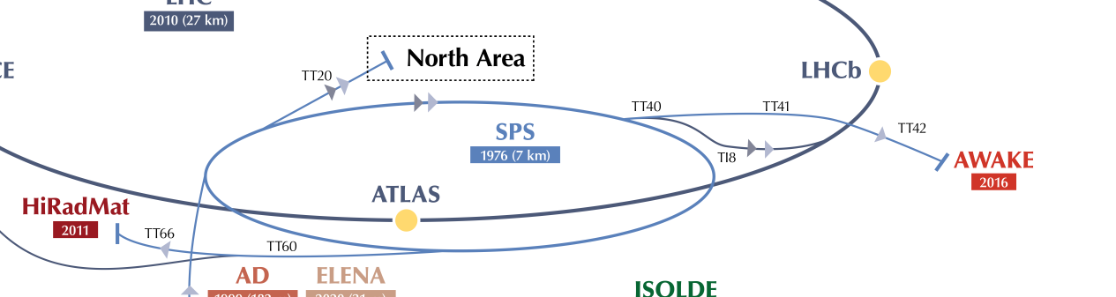
IPP meeting last Friday 19 July
AWAKE future plans and beam requests

Slide 6
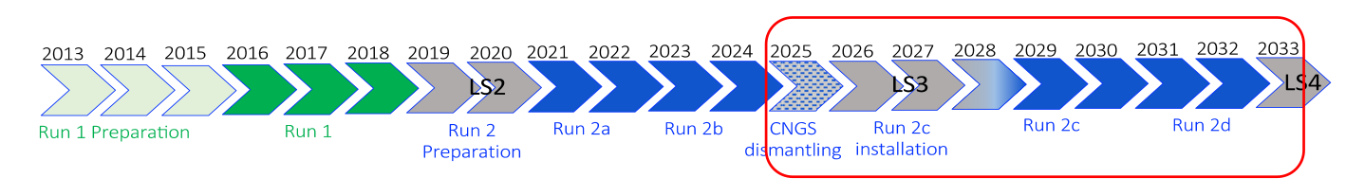
IPP meeting last Friday 19 July
AWAKE future plans and beam requests
  AWAKE Run 2c/d has been approved in this year’s MTP, while CNGS dismantling was already approved in 2022
  AWAKE Run 2 (2021 – 2033) and further
    Accelerate an electron beam to high energies (gradient of 0.5-1GV/m)
    Control the electron beam quality (~10 mm-mrad emittance, 10% energy spread)
    Demonstrate scalable plasma source technology
    Post-LS4: Develop particle physics case for first application of the AWAKE-like technology

Slide 7
IPP meeting last Friday 19 July
AWAKE future plans and beam requests
  AWAKE Run 2c/d has been approved in this year’s MTP, while CNGS dismantling was already approved in 2022
  AWAKE Run 2 (2021 – 2033) and further
    Accelerate an electron beam to high energies (gradient of 0.5-1GV/m)
    Control the electron beam quality (~10 mm-mrad emittance, 10% energy spread)
    Demonstrate scalable plasma source technology
    Post-LS4: Develop particle physics case for first application of the AWAKE-like technology
  Beam requests:
    12 weeks per year, in blocks of 2-3 weeks, separated by several weeks (2/3 shifts)
    >1400 extractions/day (same target today, but rarely achieved)
    Shorter proton bunch length: 1 sigma ~ 100 ps (now 175 ps)
    More protons: 0.5 – 4 x 10¹¹ protons/bunch (now 0.5 – 3 x 10¹¹ protons/bunch)
    Shorter cycle? 6 s cycle length
    Stable beam conditions for several hours, no interruptions!

Slide 8
IPP meeting last Friday 19 July
AWAKE beam status in the injectors
  Longitudinal instability at PS transition crossing prevents reaching 4 x 10¹¹ protons/bunch with the target longitudinal emittance of 0.35 eVs
  Reducing longitudinal impedance in PS (shielding of pumping ports) is expected to alleviate this limitation
  In the SPS the lowest theoretically achievable bunch length for 𝟒 × 𝟏𝟎^{𝟏𝟏} is 0.5 ns, compatibly with post-LS4 AWAKE requests
    Instability at voltage drop before extraction has been successfully suppressed in operation with double voltage step

Slide 9
2024 injectors schedule v2.1
Next week 3 full days for dedicated MDs in the SPS due to NA intervention
  No extraction to NA possible, so users will basically be COLDEX and LIU ramp-up
WS 51638H stuck (37H operational) at 2.3 rad
  Large heating observed
  Finally wire got burnt during Q22 cycle set-up

Slide 10
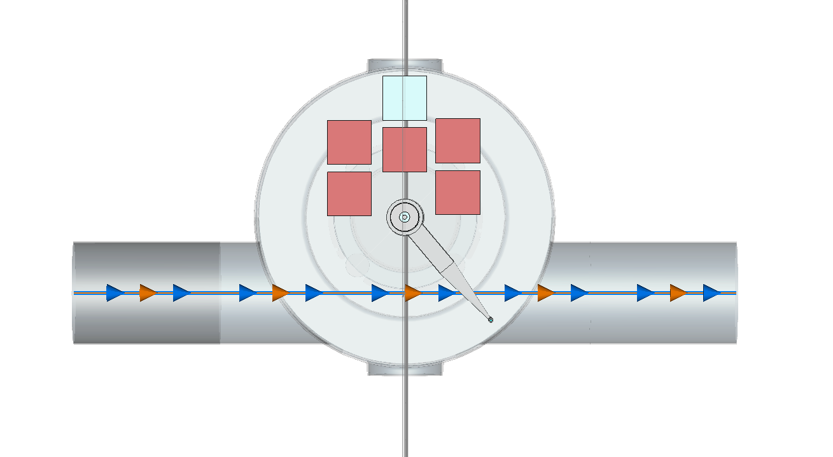
WS 51638H issue in SPS
Position of wire – fortunately not directly in beam however grazing beam halo and closing loop around beam

Slide 11
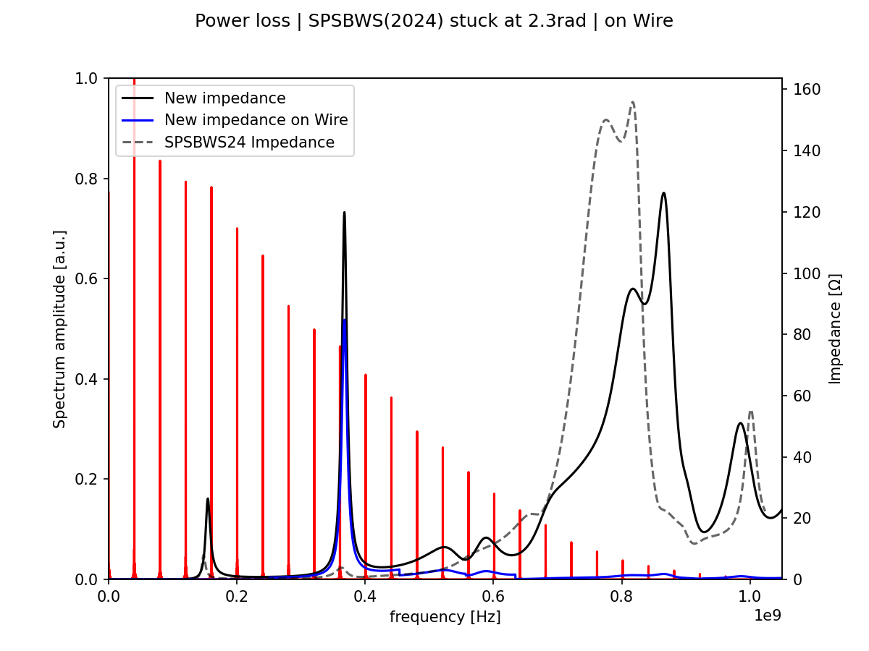
WS 51638H issue in SPS
Position of wire – fortunately not directly in beam however grazing beam halo and closing loop around beam
Impedance in this position shows that a
large power is dissipated on the wire,
reaching potentially damaging values for
large beam intensity and not specially
short bunches – thanks Elena and Leo for
the quick feedback!
Indeed the power loss, already close to
threshold for wire burning with LHC OP
beam (3x 36b, 1.6e11 p/b, 1.55 ns), became
intolerable with 4x 72b 1.8e11 p/b, >2 ns
→ Wire burnt Tuesday night

Slide 12
2024 LHC schedule v2.0
Physics production with still increasing availability, which leads us closer to the target integrated lumi curve

Slide 13
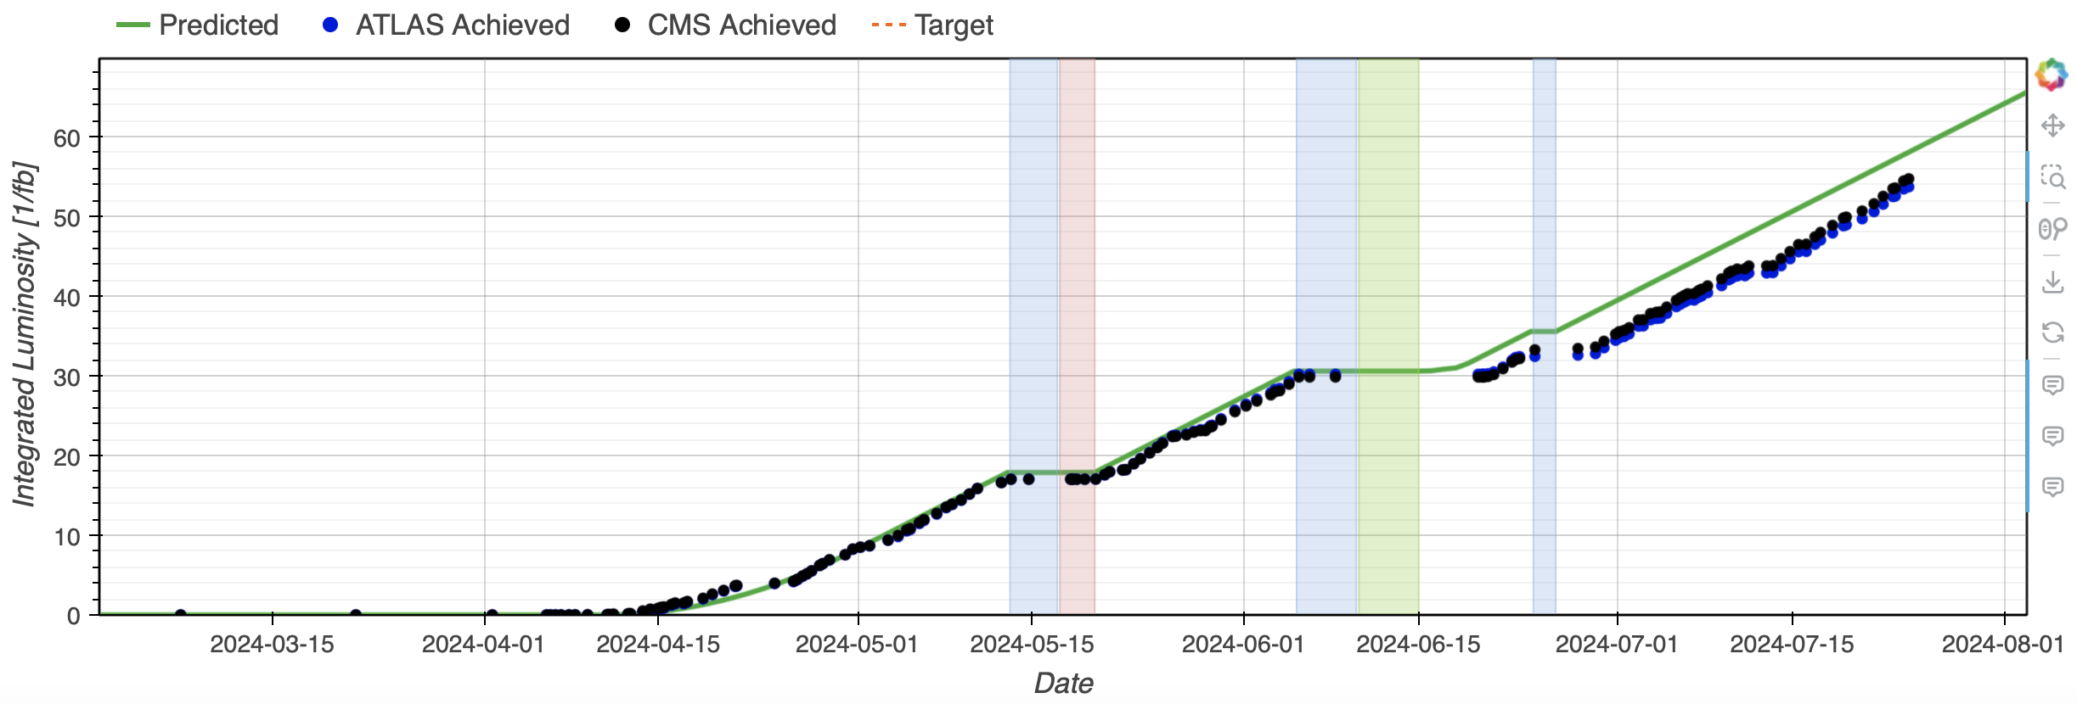
LHC Lumi
LHC integrated lumi still falling behind target by few days, seemed to be recovering with high availability till yesterday morning, then we lost almost 24h on access and miscellaneous problems (PSB, QPS intervention in sector 23)

Slide 14
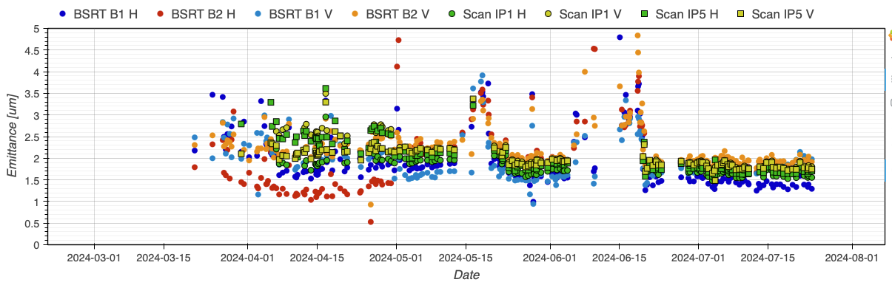
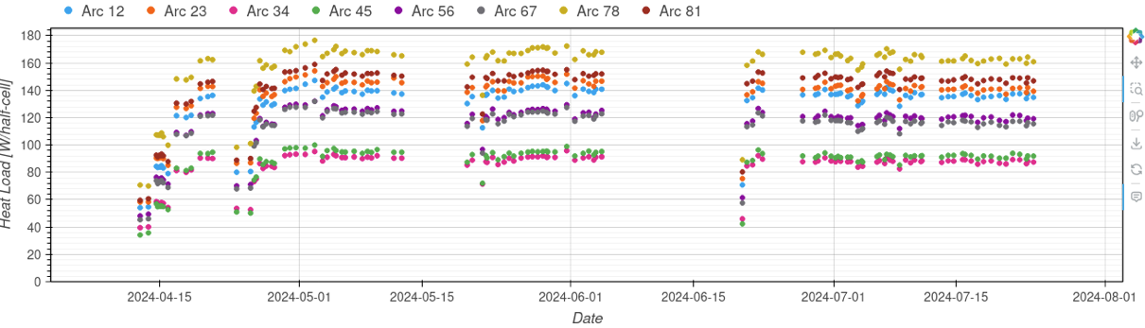
LHC beam parameters
New brighter variant of BCMS planned to be taken before the weekend

