Slide 1

CMS – FGR TESTS UPDATE
Damiano (11/07/2024)

Slide 2
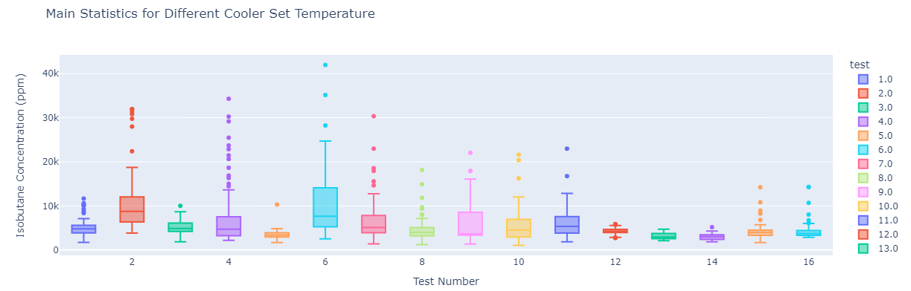
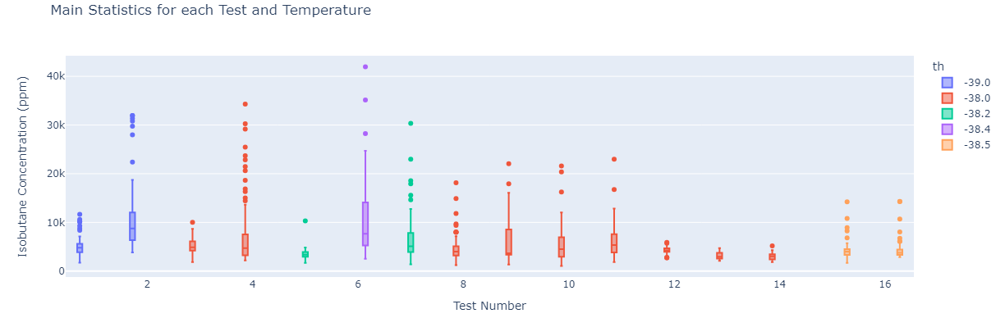
SUMMARY
SO?
The starting goal of the tests was to analyze the influence of thermal conditions on the product quality.
Unfortunately, the system was not stable at all, thus the noise created by the high variability of the quality made impossible to highlight the influence of the chiller/heater temperatures
The data for the tests have been merged (vertical concatenation) to visualize the behavior of different columns and column combinations.
Upper Extreme
75%
Median (50%)
Outliers
25%
Lower Extreme

Slide 3
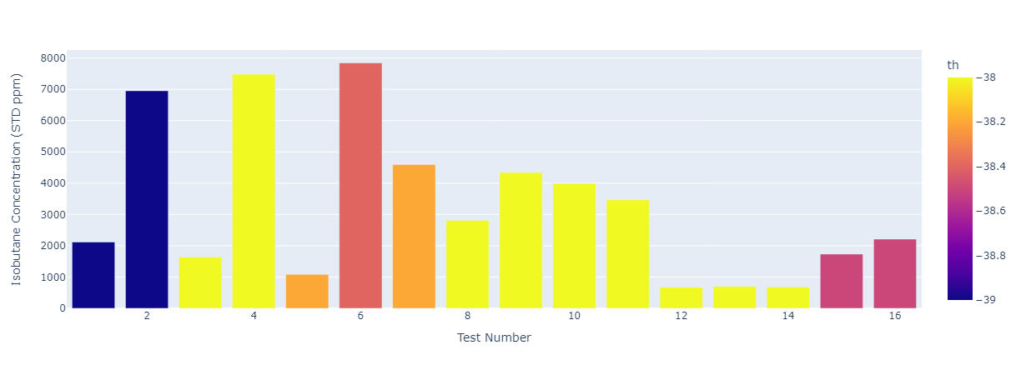
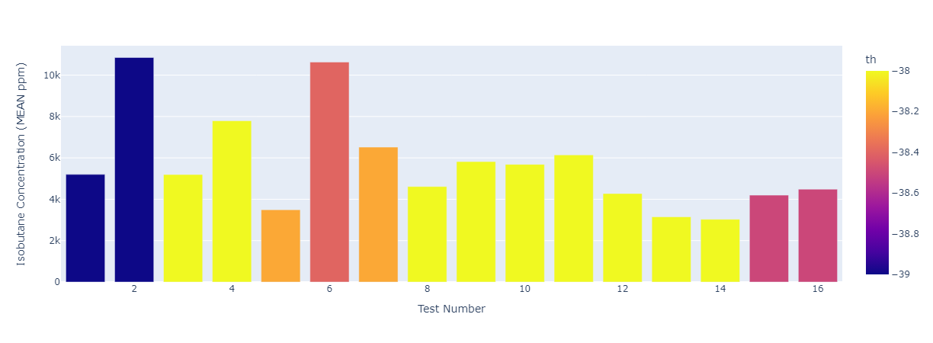
TEMPERATURES… STILL NOT USEFUL

Slide 4
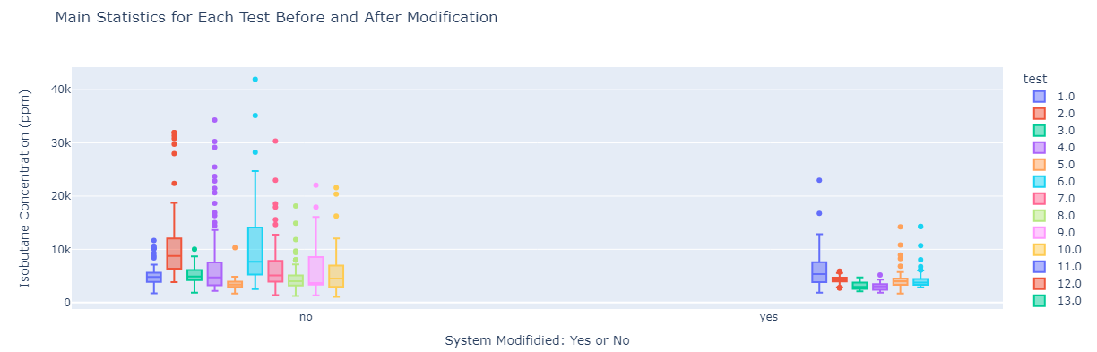
IMPROVEMENTS: KEY POINTS
- Then we modified the system to guarantee a parallel configuration during extraction mode.
- Even if this change did not stabilize the system, it gives us the chance to regulate the extraction flow of single columns.
- Reducing the extraction flow of critical columns (C1 and C2) stabilizes the system and improves the quality
How much?

Slide 5
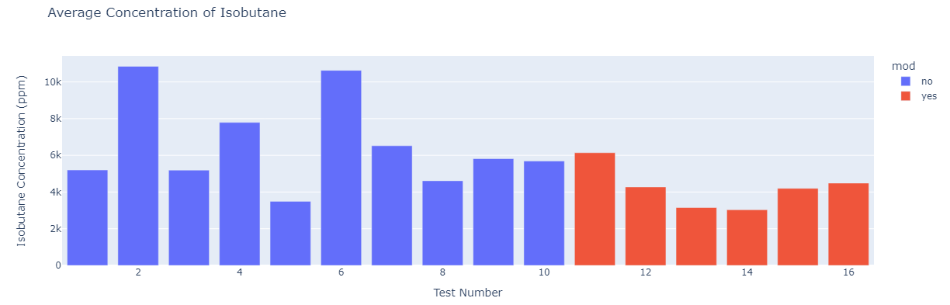
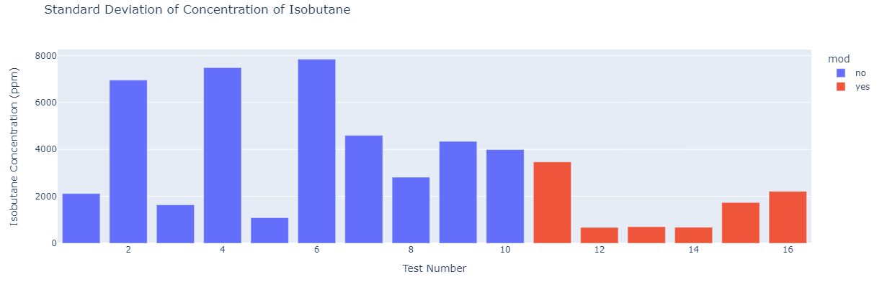
IMPROVEMENTS: MEAN and STD
HHHH LHHH LLHH
Grouping the data by test and aggregating by mean and STD of isobutane concentration confirms that the modification itself is not enough
H = 650 L/h & L = 450 L/h

Slide 6
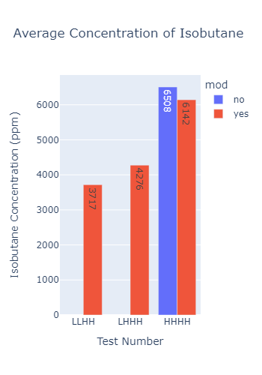
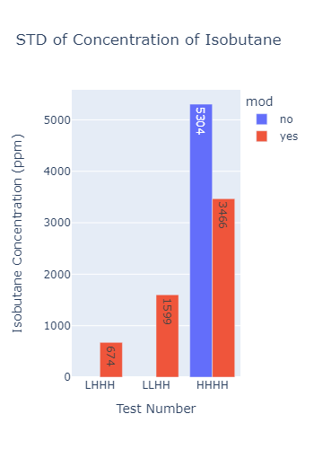
IMPROVEMENTS: KEY DATA
SO?
- The modification does not influence the average quality
- Reducing the extraction flow is key to dump this metric
The modification improves the stability (decreases STD)
The major reduction is associated with the reduction of the extraction flow of C1

Slide 7
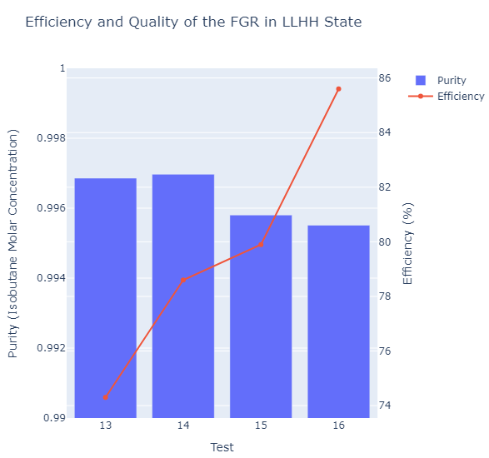
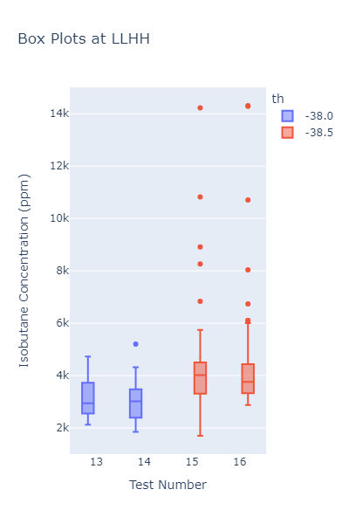
PURITY, EFFICIENCY AND STABILITY
Peaks due to C1 – C2 instabilities occurred at -38.5. This must be addressed and checked with more data

Slide 8
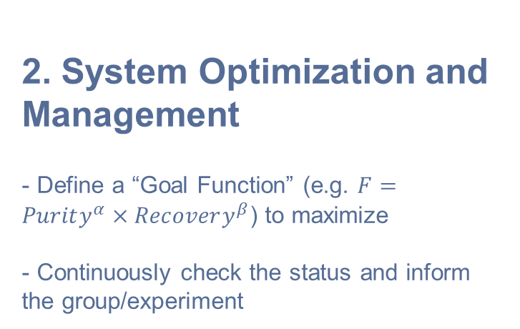
NEXT STEPS
SO?
1. Systematically change Temperature to check:
- Average and STD of Isobutane Concentration
- Stability Optimum (a.k.a. keep dumping the peaks)
2. System Optimization and Management
- Define a “Goal Function” (e.g. $F=Purity^{α}×Recovery^{β}$) to maximize
- Continuously check the status and inform the group/experiment
The data for the tests have been merged (vertical concatenation) to visualize the behavior of different columns and column combinations.

