Slide 1


UPDATE: 11/07/2024
PRESENTER:
AMIN BOUZAIENE
Politecnico di Torino - CERN| EP-DT-FS Group

Slide 2
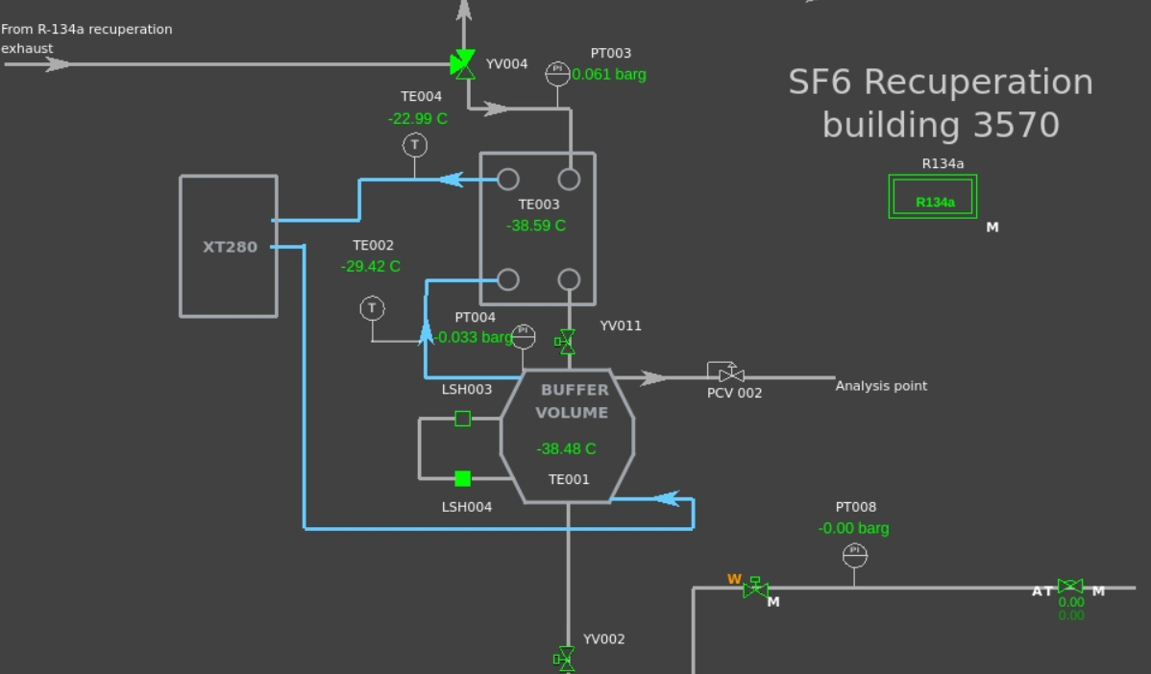
SF6 RECUPERATION
Parts fixed:
Exhaust line of the GC separated from the exhaust line of the R134a
Dead band of sensor corrected
Other intervention needed ?
Mechanical :
While trying to do one analysis with the feed gas intake closed pressure is not sufficient all volume of gas is sucked in one analysis -> need to do analysis when gas intake is opened
Software:
Detection head reading need to be placed -> to check with Gianluca
CERN| EP-DT-FS Group

Slide 3
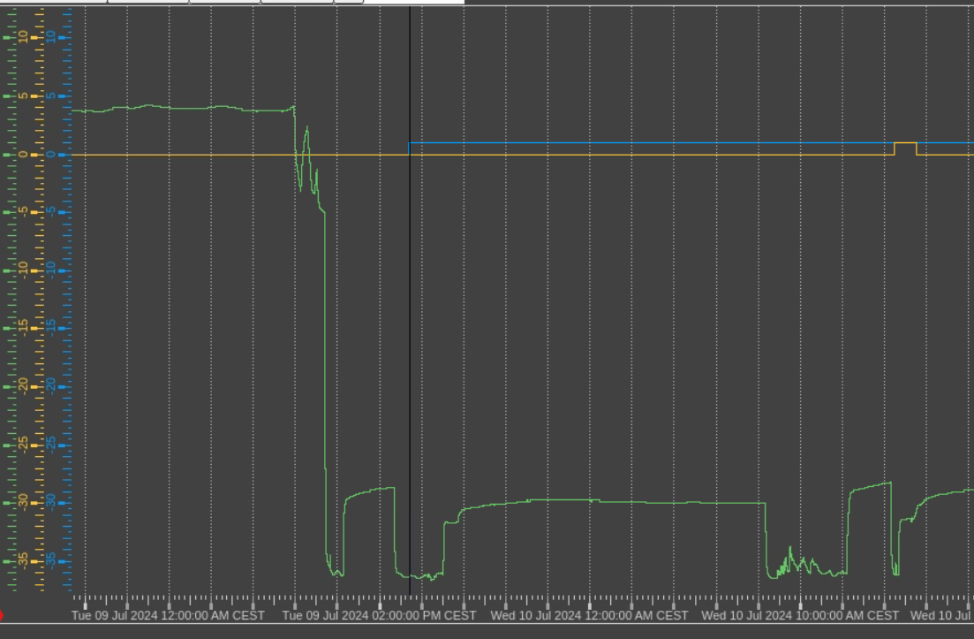
SF6 RECUPERATION
Liquefying time : 8 hours
Lsensor opened after : 2 hours
HL sensor after: 7 hours
CERN| EP-DT-FS Group

Slide 4
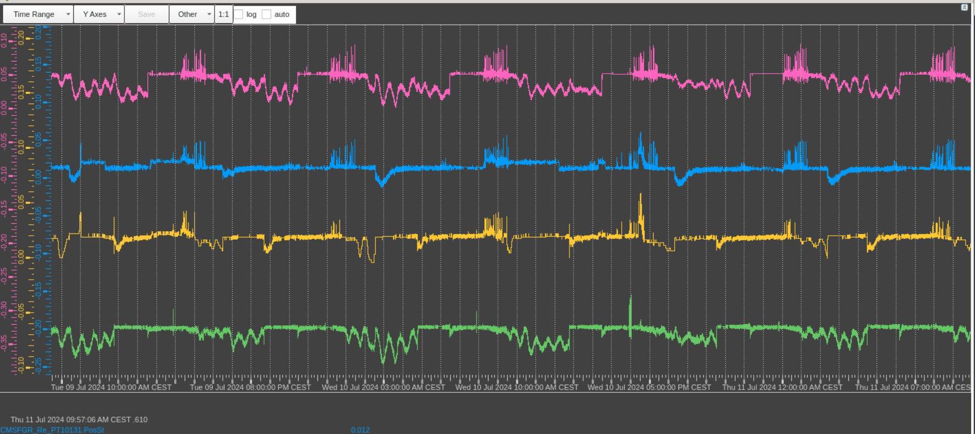
SF6 RECUPERATION
Pressure of the 4 buffers of the R134a
seem stable over the liquifying time of the SF6
CERN| EP-DT-FS Group

