Slide 1
uLoop update

Slide 2
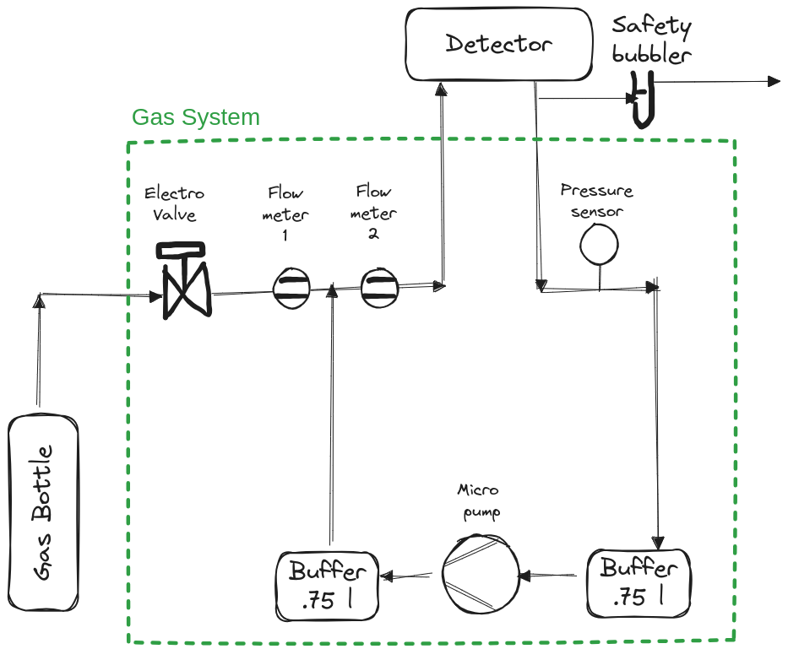
Components
Or safety valve
OMRON 0.1 l/m
Prepared for the addition of a purifier
Xavitech P200-B5C24V
Festo CRVZS-0.75

Slide 3
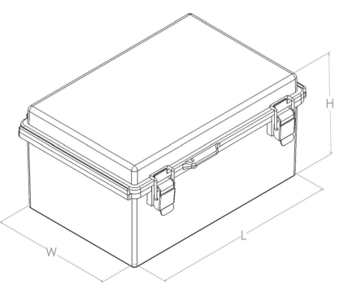
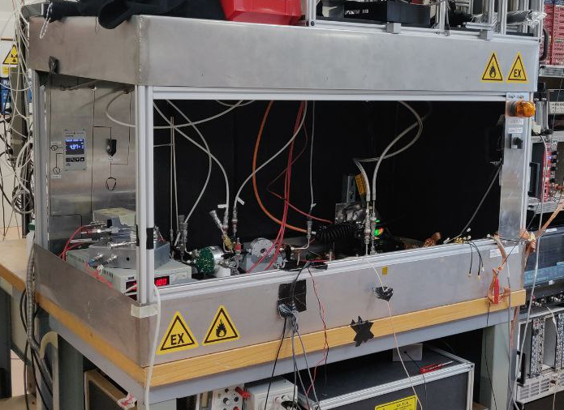
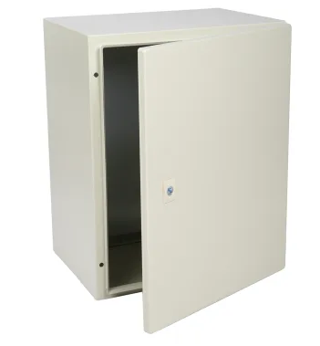
Boxes
No need for ATEX boxes
75 cm
500x400x300mm
Steel
https://fr.rs-online.com/web/p/coffrets-muraux/8428447?gb=s
500x400x200mm
Polycarbonate
With or without clear lid
https://www.farnell.com/datasheets/3966125.pdf
70 cm
120 cm
Or a panel with Bosch profile

