Slide 1
Goal Setting
Turning Projections into Projects
September, Fusion Point 2023
Ole Werner, Laëtitia Pedroso

Slide 2
Do you already know what you want to do when you finish university ?

Slide 3
First Hand Experience

Slide 4
The importance of goal setting…
A man stopped at an intersection, pointed and asked a person standing there: “Where does this road take me?”
The answer was: “Where do you want to go?”.
The man replied: “I don’t know.”
The response was: “Then take any road, because what difference does it make?”
This applies to life, love, work, projects, sports, art, watching TV… essentially to anything!

Slide 5
Did you ever think about why your eyes point in the same direction as your feet?
So that we can see where we are going
So that we can reach a goal (you have to see/know what you want to reach)

Slide 6
What is goal setting?
Planning something that you want to achieve.
What is the purpose of goal setting?
It gives you direction and focus.
What kind of goals can you set?
Personal vs. Professional goals
Fixed goals (time limit) vs. Flexible goals (no time limit)
Long term (years-life-time)
Medium term (months-3 years)
Short-term (days-weeks)

Slide 7
Why do we NOT set goals? (even if it could help)
Typical avoidance reasons
Seeing Pitfalls instead of possibilities.
  I see what is missing not what I can do –> Preparation without action
Personal value system as the pitfall to a fulfilled life.
  Negative self-image, lacking emotional support, “want to be spontaneous”
I do not know how to set goals for myself…
I fear that I will be rejected because of my (choice of) goals?!
  If you want to become a millionaire, dare to say it out
If I don’t set goals, I don’t feel pressure.
I fear that I will fail in achieving my goals?!
Missing knowledge about the mechanics of goal setting.

Slide 8
Why can Goal Setting help?
Taking control: increase self-reliance and self-management. ‘Making a decision feels good’.
Better ability to distinguish between important and less important things in life or career.
Focus sets priorities on resources so tasks can be finished. (also, friends reminding you)
Completing tasks creates a feeling of achievement. You are now ready for the next step.

Slide 9
Why goals sometimes fail
Goals are not goals unless you have written them down.
Achieving the goal does not bring you a reward.
The goals is so general, that achieving/not-achieving cannot be measured anyway.
The goal is so low that achieving it does not mean much.
There is no commitment to achieving the goal.
Goals are constantly changed.
Nobody knows about your goals, so you do not have any support.
The goal is not supported by a plan/idea on what is needed in resources or time.

Slide 10
Why goals sometimes fail
Goals are not goals unless you have written them down.
  Writing Goals down increases commitment
Achieving the goal does not bring you a reward.
  Writing down/ Telling others are ways to create rewards (cognitive dissonance)
The goals is so general, that achieving/not-achieving cannot be measured anyway.
  Less concrete goals are easier to “tweak”
  (comfort the status quo instead of giving direction)
The goal is so low that achieving it does not mean much.
There is no commitment to achieving the goal.
Goals are constantly changed.
Nobody knows about your goals, so you do not have any support.
The goal is not supported by a plan/idea on what is needed in resources or time.

Slide 11




Pitfall: Unrealistic Goals
My Internship at the European Commission (didn’t happen)
Obligatory Internship during my masters (Behavior Change)
CCoBI takes interns every year (also from my master’s program)
“Please apply >1 year prior to starting date”

Slide 12
What makes Goals unrealistic/meaningless?
When they are untimely (not achievable within the time(-frame)
When you do not have (enough) resources
When you have not defined your goal clearly enough
Risks when you set unrealistic goals:
feelings of failure
lower self-image
low self-esteem
Risk on creating a negative cycle of not wanting to set new goals at all!

Slide 13

What Goal Setting can archieve
- Rihanna told InStyle magazine in August 2008 about her plans to take over the airwaves – at a time before she released her hits with the likes of Calvin Harris and Drake.
- In that same 2008 interview, she said that within 10 years she wanted to have some businesses of her own, including a fashion line and a make-up line.
Her Savage X Fenty lingerie line continues to thrive, with annual Victoria’s Secret-style fashion shows screened on Amazon Prime.
Robyn Rihanna Fenty officially reached billionaire status in 2017 (age:30)!!!!!

Slide 14
Good Goals

Slide 15


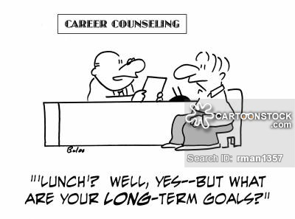
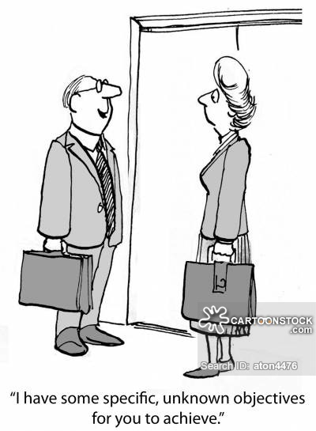
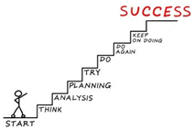
is
when setting goals
Setting only short/medium-term goals leads to fragmentation.
A long-term vision is crucial to setting relevant, measurable and achievable short/medium-term goals.

Slide 16
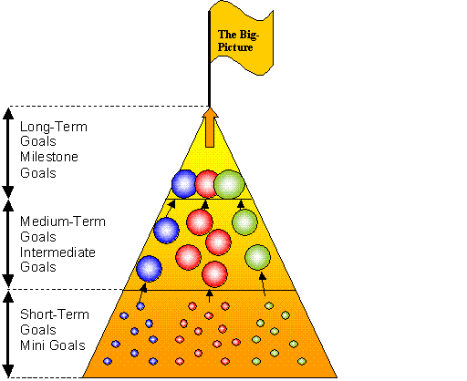
Three Layers of Goals
For Example:
- Poster
- Prototype
- Pitch
…
- Storyline
- Materials (analog)
- Materials (digital)

Slide 17




10 Steps in Goal setting
3. Set objectives (short-term goals)
4. List obstacles
1. Identify a (new) goal
2. List benefits
of the goal
7. List other factors you could influence + check past successes
6. Identify support + feedback loops
5. List your skills & identify needs
9. Develop a realistic plan (actions)
10. Contribution to the long-term goal
8. List the benefits of the achievement

Slide 18







The Stoic’s guide against frustration
(or when goal setting can help)
Can you change what frustrates you?
Why are you upset then?
(cant change it anyway)
Change it! ☺
(goal setting can help)
Can you Identify smaller part of the problem that you CAN change?
Ask
yourself

Slide 19
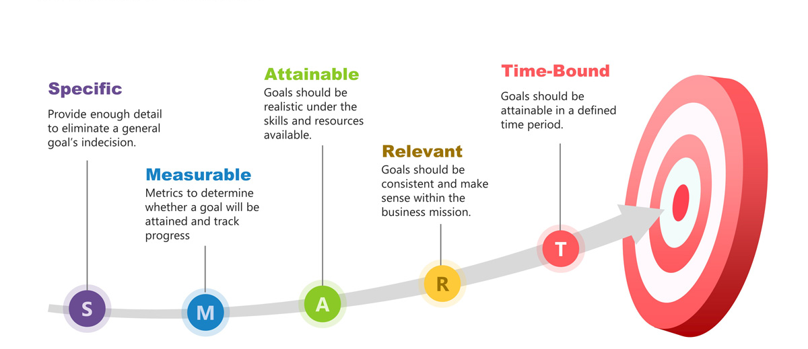
SMART Goals (Doran, Miller, Cunningham, 1981)

Slide 20
S
M
A
R
T
E
R
About identifying SMART(ER) Goals
Specific
Measurable
S
M
A
R
T
Specific
Attainable
Measurable
Realistic
Beware: SMART is often used by managers simply to push productivity, not personal/professional development
Attainable
Time-bound
Realistic
Ethical
Time-bound
Record & Revise

Slide 21
Take-aways
“Plans are nothing; Planning is Everything”
- Dwight D. Eisenhower
-> To tackle big projects, planning is needed
-> A Plan has multiple layers; short-, mid-, and long-term
-> A good plan aims to be done before delivery (this case: 25th evening)
-> A good plan has room for errors (more realistic)

Slide 22
Final Sprint
Looking at the schedule on indico, create a SMART(ER) timeline from today, 21.07, until the 26.07
- Include the materials/ressources you will need
- Include “error margins”
- Divide & conquer: You are more than just 1 ☺

Slide 23
S
M
A
R
T
E
R
Specific (What & why)
Not just state what you want, but also the reason for wanting it, how and by when
Measurable (How do we know how it is going?)
What is the exact delta improvement you want to achieve (progress based on numbers!)
Attainable
Just out of reach, but not out of sight (visible at the horizon)
Realistic
Must be within your capacity to achieve (with help, with new skills, with support, in time) and still tied to your long-term goal
Time-bound Set yourself a start and target end-date
Ethical
Make sure the short/mid-term goals remain within your moral compass
Record & Revise
Write goals down, so other can verify and it is easier to monitor progress.
Also: check if long-term goal remains constant and short/medium-term goals are (still) relevant

Slide 25
Exercise 1
Try to describe yourself as a person 10 years from now.
Who are you?
What do you imagine your life will look like?
What are you doing professionally?
Where will you live/work?
Who will be around you?
Time: 10 Minutes + 10 Minutes discussion

Slide 26
Exercise 2
Describe for yourself:
What needs to have happened to achieve your vision in 10 years?
What will you need to have done to get there?
What skills will you need to learn to get there?
Who will you need to have met and develop relationships with?
What are (other) factors that you can influence to achieve your vision?

