Slide 1



EXSO Training
Pilot session in October 2024

Slide 2
Complete EXSO training
The new EXSO training is now available at the CERN Safety Training centre
The total duration is 1 day and half, classroom
The format is the following:
  Classroom (4h) – Safety Management Principles
  Classroom (8h) – EXSO module

Slide 3
Complete EXSO training
The new EXSO training is now available at the CERN Safety Training centre
The total duration is 1 day and half, classroom
The format is the following:
  Classroom (4h) – Safety Management Principles
  Classroom (8h) – EXSO module
Core module, common to different Safety Officers trainings

Slide 4
Complete EXSO training
The new EXSO training is now available at the CERN Safety Training centre
The total duration is 1 day and half, classroom
The format is the following:
  Classroom (4h) – Safety Management Principles
  Classroom (8h) – EXSO module
Core modules, common to different Safety Officers trainings
Specific module for EXSOs, animated by the EP Safety Office and HSE-OHS

Slide 5
Safety Management Principle module
  Safety Management Principles module – treated topics:
CERN Safety Policy
CERN Safety Rules & European Directives/Host States regulations
Safety Roles: HSE Unit, DSOs, LEXGLIMOS, Safety Officers
Responsibilities in terms of safety
Risk Management: hazard VS risk, risk evaluation, safety measures, etc.
Safety Incident Management: SIM rule, incident declaration and workflow
Safety Culture

Slide 6

EXSO module
  EXSO module – treated topics:
Experiments at CERN
Role of the EXSO
EP Safety Validation Process
Experiments Safety File
EXSO and Specific Hazards
Extended Functions

Slide 7
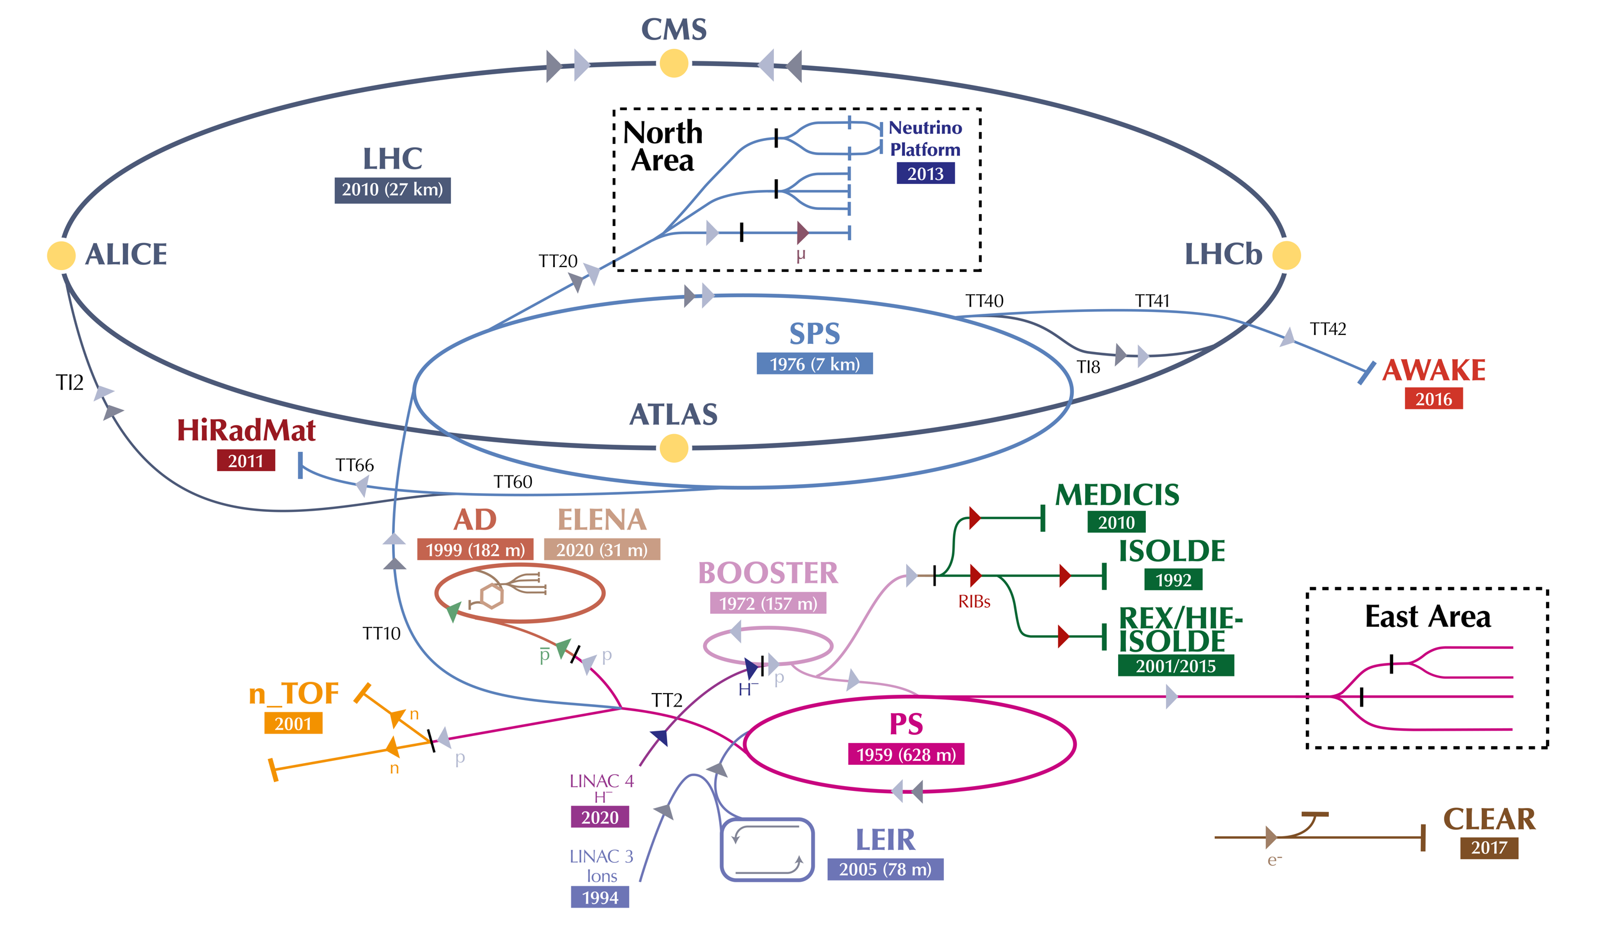
EXSO module – Experiments at CERN
Overview of the Experiments’ classification in:
  Large
  Medium
  Small/Temporary

Slide 8
EXSO module – Experiments at CERN
Overview of the Experiments’ classification in:
  Large
  Medium
  Small/Temporary

Slide 9
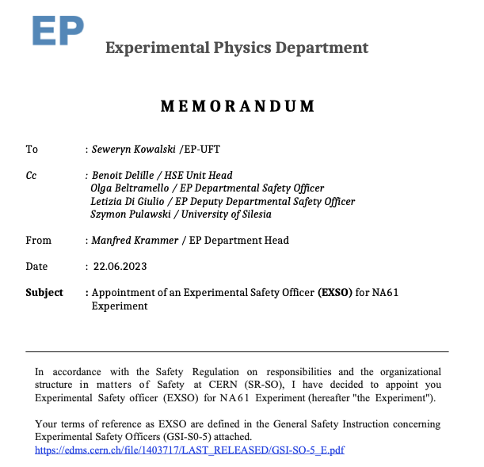
EXSO module – Role of the EXSO
Explanation of the EXSO role and of the related tasks:
  Position of EXSO within CERN Experiment’s organigramme
  EP Safety Correspondent supporting role
  Specific tasks following the GSI-SO-5
  Appointment, knowledge and means

Slide 10
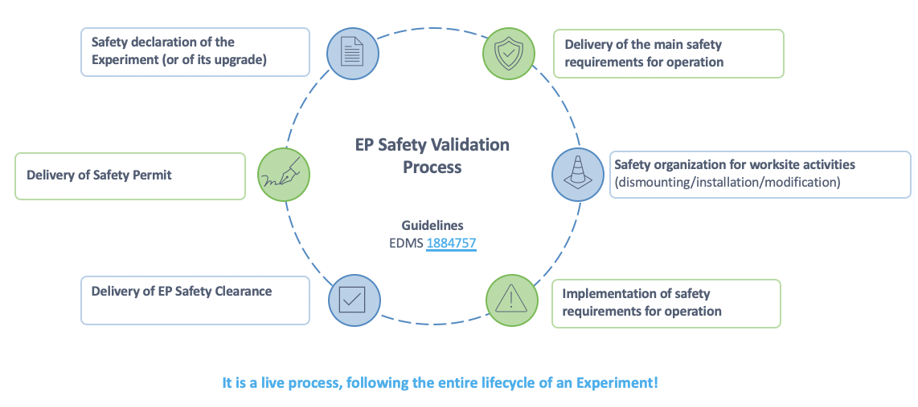
EXSO module – EP Safety Validation Process
Overview of the EP Safety Validation Process cycle:
  Explanation of each phase of the cycle, with the related documentation
Notes:
Safety for worksite activities:
Role and responsibilities (i.e. role of the Work and Services Supervisor/Activity Responsible)
Safety aspects of installation works
Documents needed (i.e. prevention plan, list of trainings qualifications)
Joint Inspection Visit (VIC)
EROS Team

Slide 11
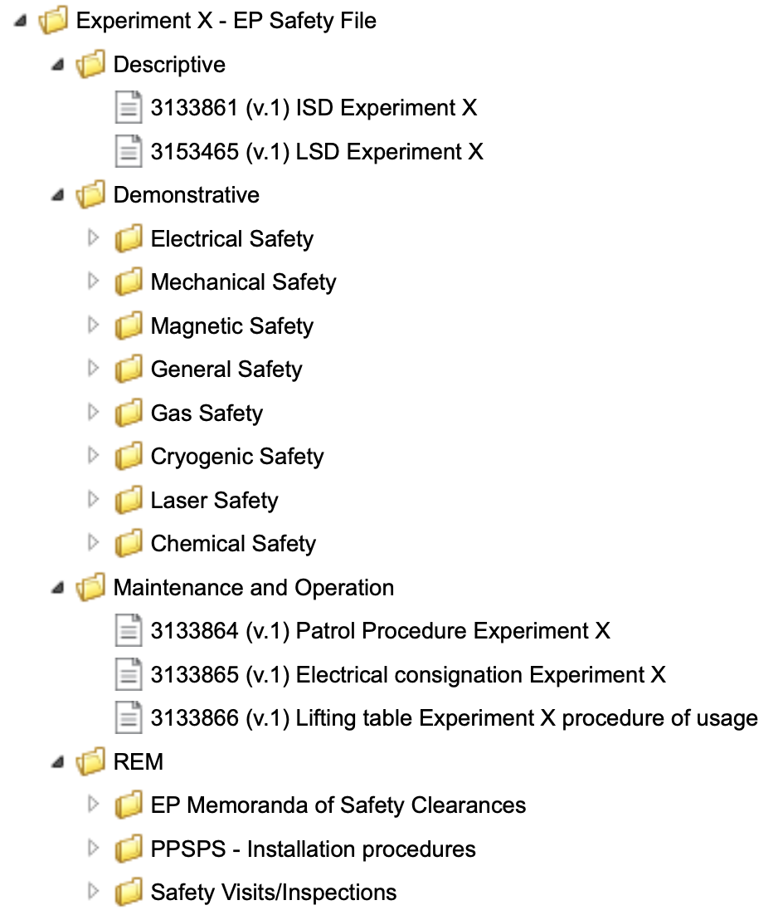
EXSO module – Experiments Safety File
Explanation of the Experiments’ EDMS Experiment Safety File:
  Structure of a safety file and how to fill each folder:
    Descriptive
    Demonstrative
    Maintenance and Operation
    REM

Slide 12





EXSO module – Specific hazards
Overview of the main hazards, giving key information:
    RP (patrol procedure, TREC, etc.)
    Electrical (existing procedures, trainings and habilitation, etc.)
    Chemical (safe storage, general practices, lead, etc.)
    Flammable Gas (documentations needed, etc.)
    Cryogenics
    Lasers (Laser Safety File, LSSO, etc.)

Slide 13



EXSO module – Extended Functions
Explanation of the EXSOs Extended Functions, as:
  Awareness about laboratories and workshops, and their status
  Role in planned evacuations
  Periodic safety visits/tours of the Experiment
  Support in finding Emergency Guides and First Aiders for the Experiment

Slide 14

Complete EXSO training – Pilot session
A pilot session is organised for the 9th – 10th October 2024
This session will include both modules (Safety Management Principles + EXSO Training)
Some of you are already enrolled for this pilot session – thank you for volunteering!
For the other ones, do not worry. Many additional sessions will come!
Objective: all experienced/new EXSOs and Deputy will be trained during the year 2025

Slide 15
Thank you for your attention!
Any question?

