Slide 1


Batteries and UPS in experiments: Hazards and risks

Slide 2
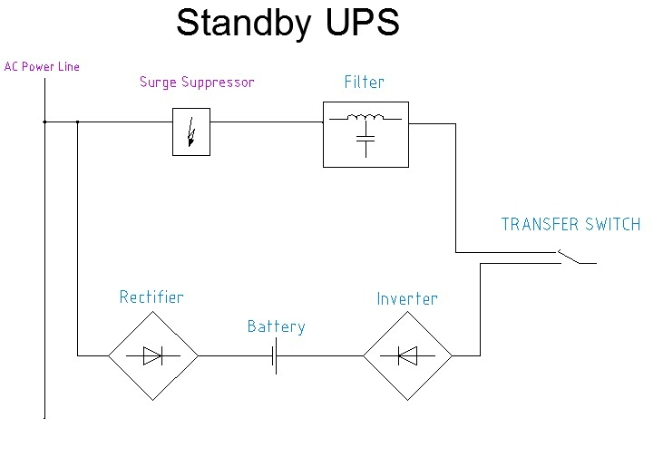
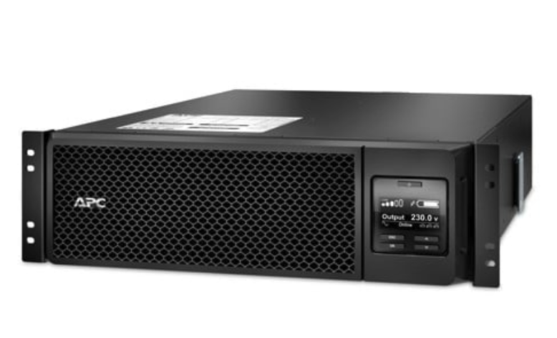
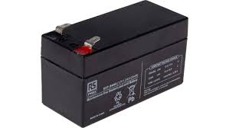
Batteries and UPS: General information
An Uninterruptable Power Supply (UPS) is a device which stores electrical energy locally to keep critical equipment running during a power cut.
The current generation of commercial UPS devices use sealed lead acid batteries to store electrical charge until it is needed.
The size of UPS deployed by experiments varies from 200VA (ISOLDE & GIF++) to 2MVA (ATLAS)
A typical lead acid UPS battery
12Ah, 7.2V
Rack mount UPS

Slide 3
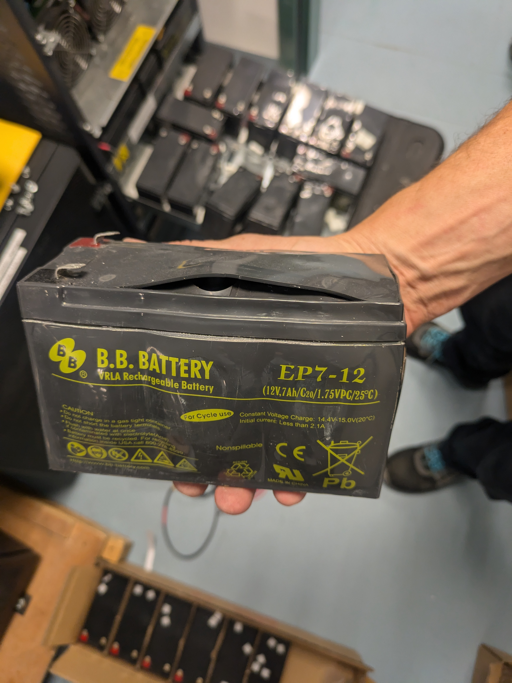
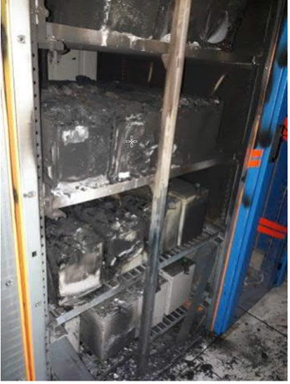
Why are we talking about this?
Old batteries in an experiment owned UPS in building 508
(Type C radioactive lab) failed earlier this year.
We were very lucky to escape a fire.
Damaged batteries in 508
UPS battery fire in CMS control room in 2019

Slide 4
What are the consequences?
We will be prohibiting UPS from Type C labs as soon as practical (ISOLDE hall + 508).
The main risk is from larger UPS (floor standing), as they have more batteries; higher risk of a failure and higher consequences when a failure occurs.
There is also a risk from smaller rack-mounted UPS. We will address this in 2025 via a full inventory and phased transition to central UPS provision.
Provisional! Still to be fully agreed
between EP, BE, HSE and EN/EL
Avoid dedicated experiment UPS.
Shared central infrastructure instead.

Slide 5
What does this mean for experiments?
If you have your own (non-EN/EL maintained) UPS, please discuss with me or your EP Safety Office correspondent.
I will organise with each affected experiment to transfer their critical loads to a central UPS.
There will be installation costs, but the maintenance and battery replacement of central UPS are handled by EN/EL (cheaper + more efficient running costs for everyone).
For smaller rack mount UPS, these can be replaced with a dedicated power strip from a central UPS supply.
Provisional! Still to be fully agreed
between EP, BE, HSE and EN/EL
Upfront cost to install new cables.
No maintenance costs + transparent interventions.
Approval from EP department will be required for new UPS.

Slide 6
Questions?

