Slide 1
Reaching maturity
What have we achieved after 3 years ?
T. Stora – CERN - coordinator

Slide 2
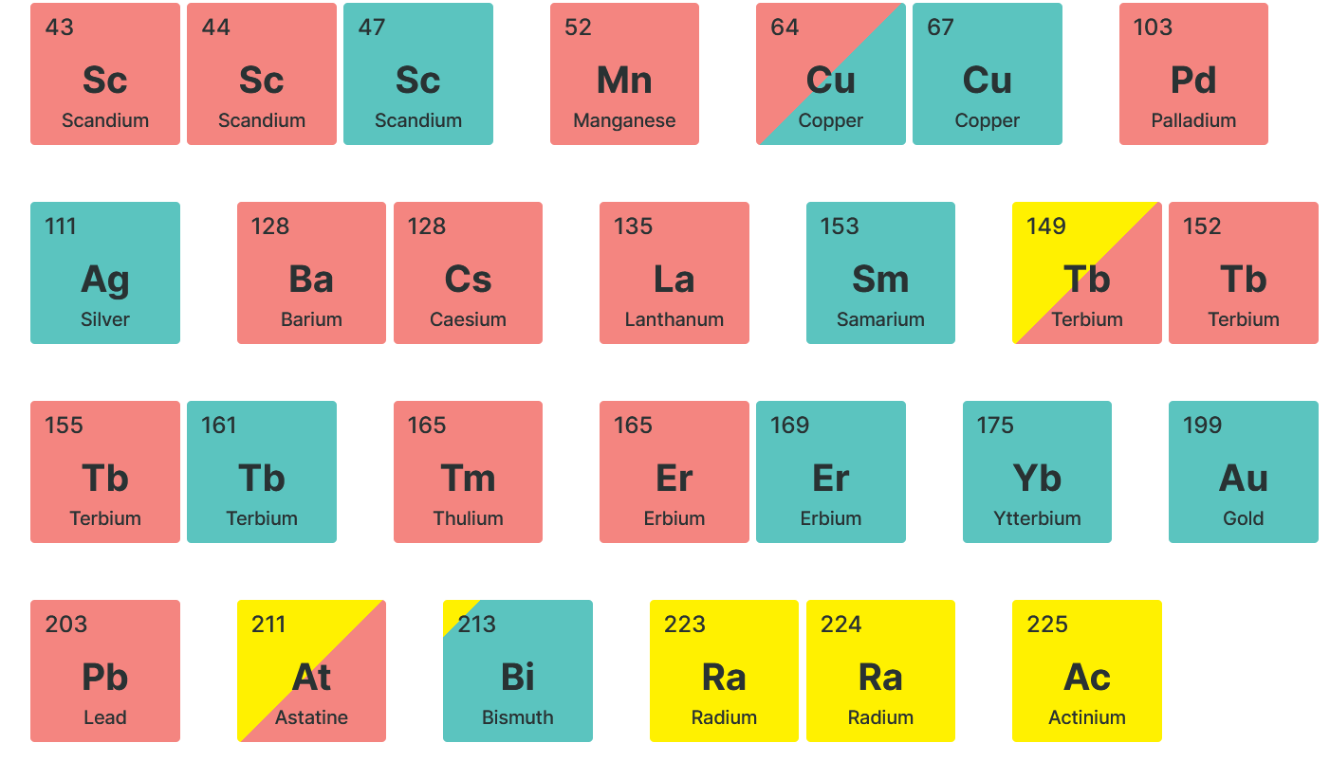
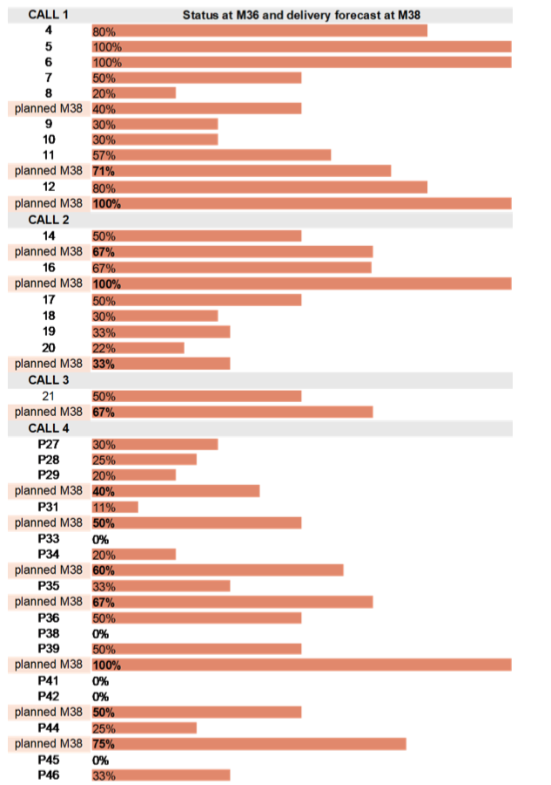
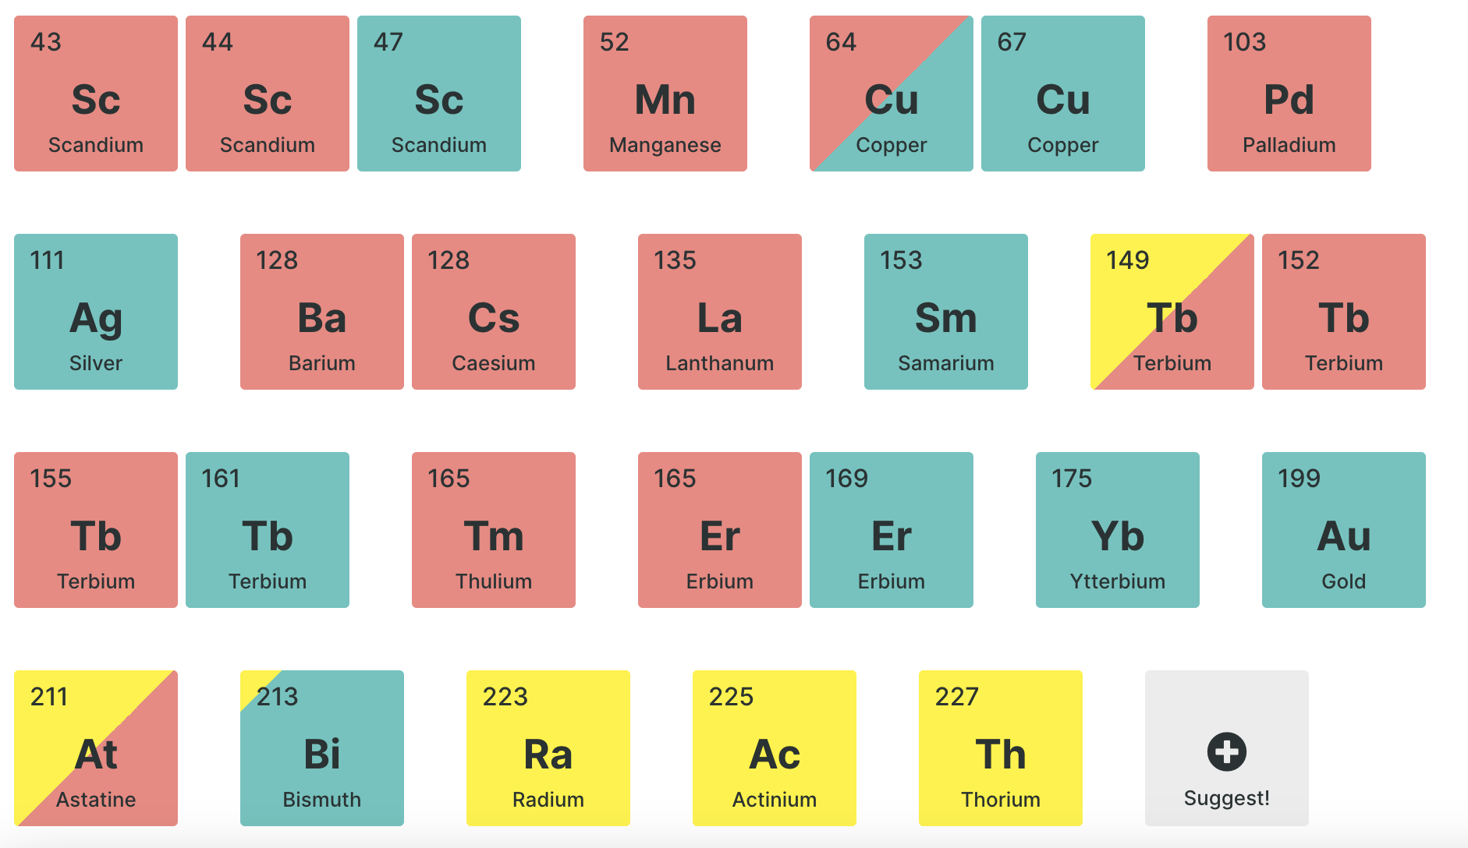

PRISMAP on track
32 projects from 4 calls
  https://www.prismap.eu/access/user-projects/
>60 deliveries of 15 different radionuclides
for 28 projects
Technical manager hired
Helpdesk in place
5 projects completed
2 projects published already
One abstract highlighted as oral presentation at EANM’23 congress

Slide 3
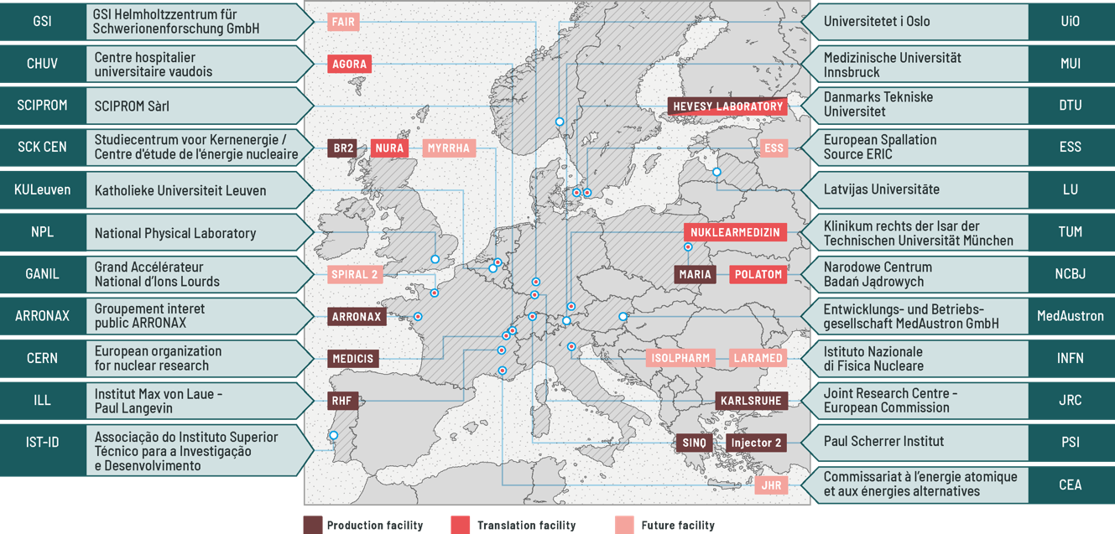
1. Provide access to new radionuclides and new purity grades for medical research
  Holzleitner, N. et al.; Preclinical Evaluation of Gastrin-Releasing Peptide Receptor Antagonists Labeled with ¹⁶¹ Tb and ¹⁷⁷Lu: A Comparative Study; Journal of Nuclear Medicine jnumed.123.266233 (2023). doi: 10.2967/jnumed.123.266233
  Sevenois, M. B. et al.; Optimised solid-phase extraction of ²¹¹At: Activity balance of ²¹¹At, ²¹⁰At and ²¹⁰Po after wet chemistry target dissolution; Radiation Physics and Chemistry 225, 112146 (2024). doi: 10.1016/j.radphyschem.2024.112146
Example of different user research units:
Imaging and Pathology
KU Leuven
USA
AU
Radiopharmaceutical Cancer Research
Dresden (/CZ)
SE
Radiochemistry
Hopital Frederic Joliot
Orsay
Last call #5 in Oct 2024
RO
UK
DK
Fondazione IRCCS
Istituto Nazionale dei Tumori
Milano
NL
BE
DE
PL
Dep Molecular Biotechnology Health Sciences,
Torino
CZ
FR
CH
Radiochemistry unit,
Hospital Gregorio Marañón
Madrid
IT
ES
Biomedical Engineering and Imaging Science
London
GR
PT
https://www.prismap.eu/access/user-projects/

Slide 4
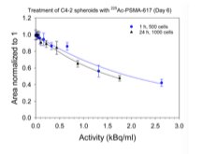

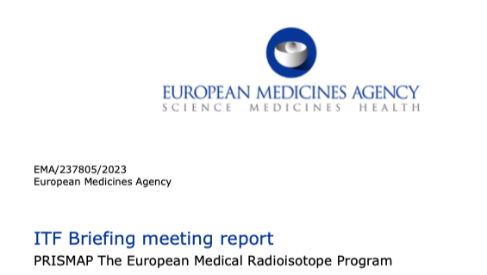
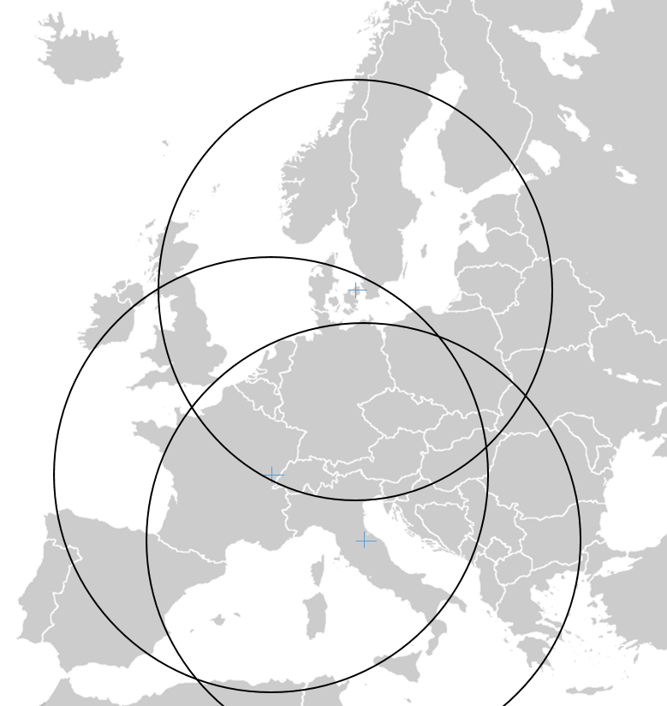
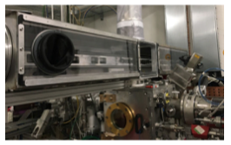
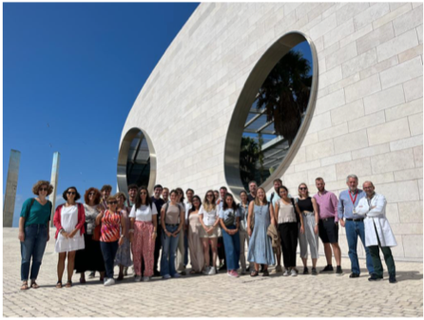
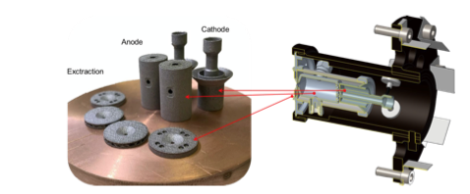

The development of the services
Ac-225 radioconjugate
chologenic testing
CCRI-RTWG Consultative Committee for Ionising Radiation - Radionuclide Therapy and Quantitative Imaging Working Group,
PRISMAP request to EMA
4 hours door-to-door delivery
by small aeroplanes
10 kW high power target
for At-211
(M38)
Commissioning beam
at SPES future facility
Training in Lisbon
Ion source
Produced by additive
Manufacturing (INFN)
Policy workshop
at JRC

Slide 5
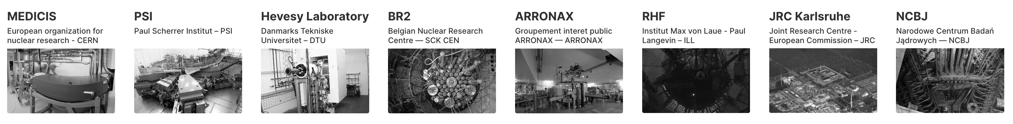
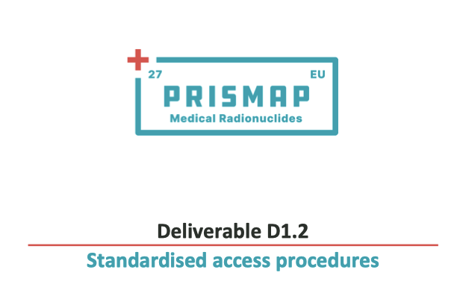
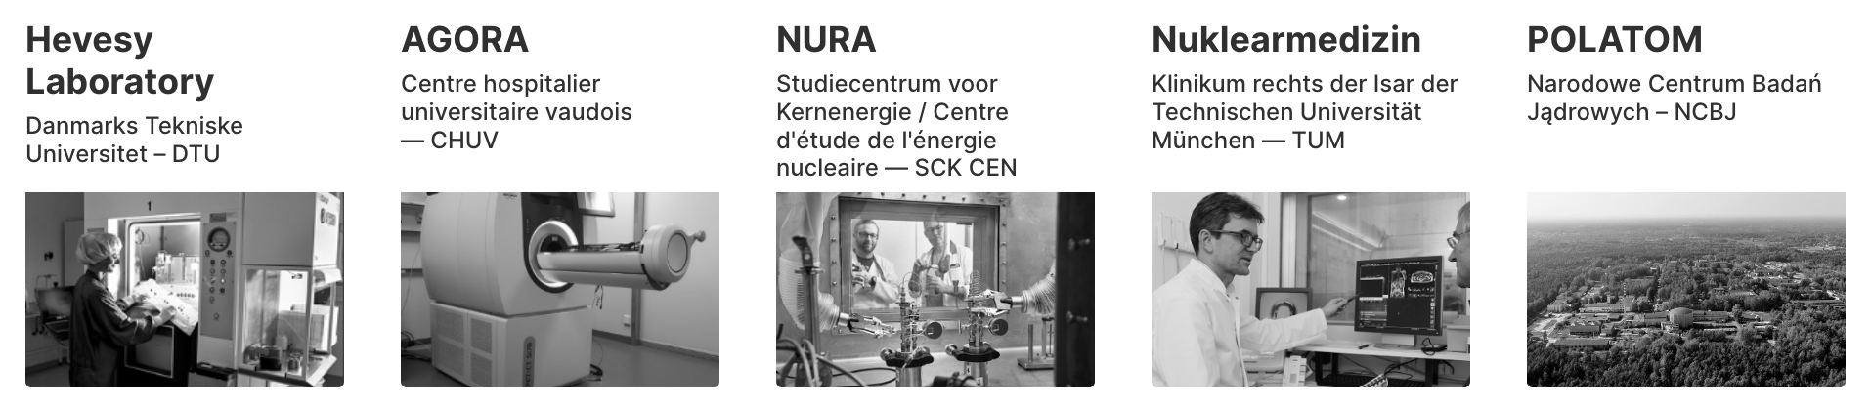
2. Create a common entry port and web interface for the starting research community
User forum becomes the PRISMAP Community – Chair K. Muylle – Scientific secretary S. de Schepper
Call # Projects hosted in our biomedical nodes Country of origin & TNA3 Node
1 | Selective oncological theragnostic based on radioactively labeled exosomes (TheragnEso) | Spain TUM (Germany)
1 | Dual 152Tb/149Tb radiolabeling and preclinical validation of an AAZTA-FAPi ligand for diagnostic and theranostic applications Italy TUM (Germany)
2 | ScandAL: Scandium-43 Antibody-fragment Labelling | France CHUV (Switzerland)
3 | In vitro and in vivo validation of new chelators for Ac-225 targeted alpha-therapy | Italy TUM (Germany)
4 | Impact of Tb-156 pollution on image quality and quantitative accuracy of gamma camera imaging with Tb-155 | France CHUV (Switzerland)
4 | Tb-155-immunoSPECT, Metallation kinetics, Complex stability, N,O-ligands, Ligand topology, SK-BR-3 cells | France CHUV (Switzerland)

Slide 6
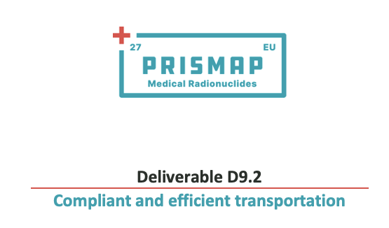
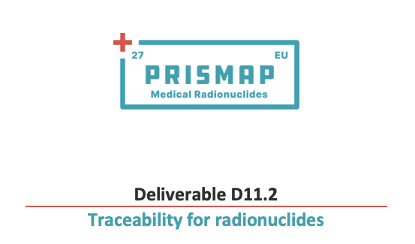
3. Enhance clarity and regulatory procedures to promote research with radiopharmaceuticals

Slide 7
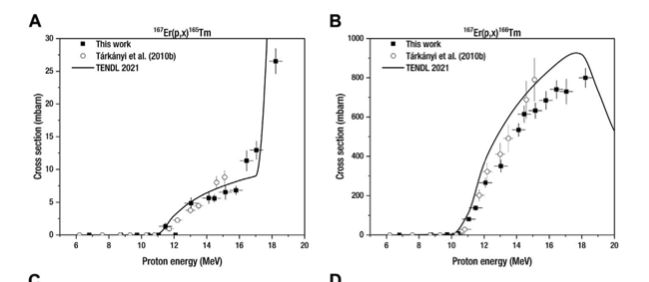
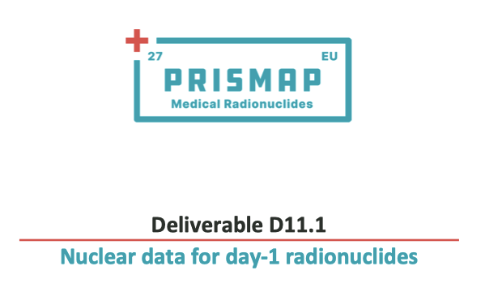
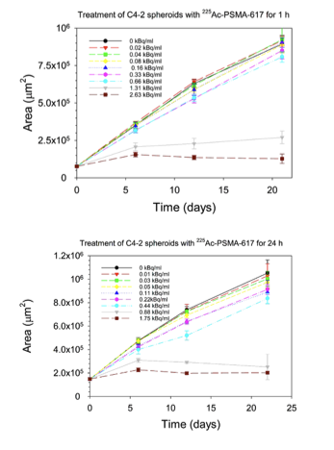
4. Unlock the biomedical research through better data on radionuclides
Other ongoing activities
eg in WP10-JRA2 and WP12-JRA4

Slide 8
5. Ensure the long-term sustainability of PRISMAP
2 projects aim at performing first-in-human and phase-0 pilot clinical trials
P4 Towards 161Tb-PSMA cell targeting treatment of prostate cancer biochemical recurrence: Comparison with 177Lu-PSMA | Tb-161 | Dr. M. Kirienko | Italy
P31 203/212Pb-mcp-D-PSMA for an improved tumor therapy: Preclinical evaluation, automatisation and translation to clinical application | Pb-212/Pb- 203 | Dr. M. Pretze | Germany

Slide 9
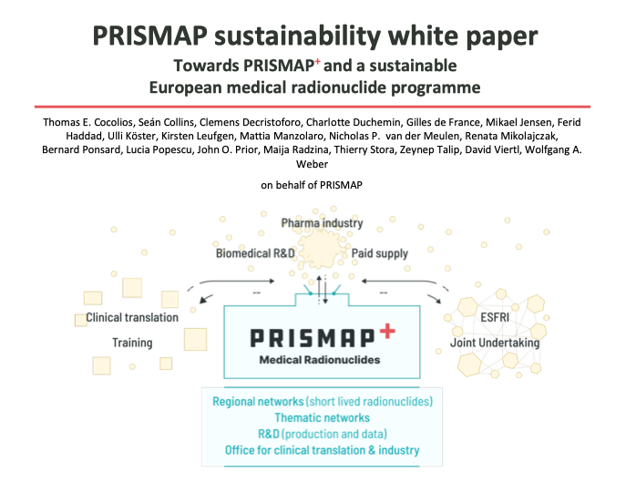
What do we miss for PRISMAP+

Slide 10
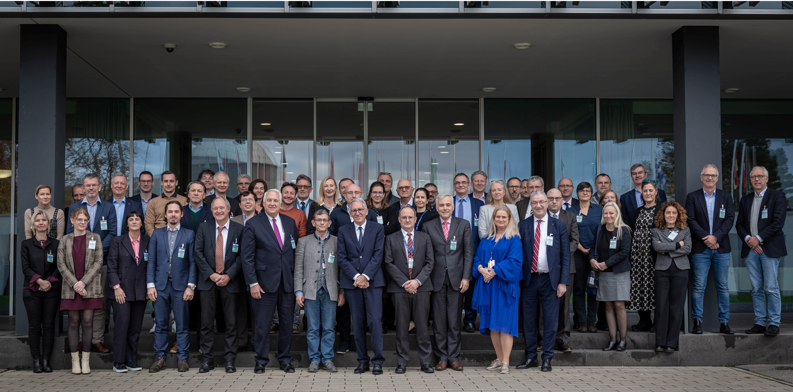
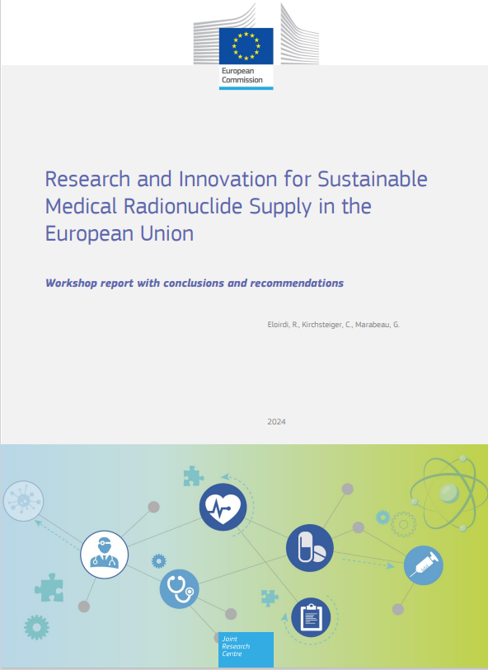


Medical isotope policy actions
The European Economic and Social Committee issued an opinion in Spring 2024 about Europe’s Beating Cancer Plan, the SAMIRA Action Plan, and in particular the European Radioisotope Valley Initiative (ERVI)
The Council of the European Union has taken up that opinion to recommend the ERVI programme and the consolidation of PRISMAP into a next phase (PRISMAP +, ?).
https://www.consilium.europa.eu/en/press/press-releases/2024/06/17/radioisotopes-for-medical-use-council-approves-conclusions/
PRISMAP (CERN-coord) input to EU policy shaping
PRISMAP CM7 - PRISMAP + meeting – Sept 2024

Slide 11
Onboard for prismap+ ?

