Slide 1
PRISMAP sustainability white paper : considerations for PRISMAP⁺
Ferid Haddad, ARRONAX & Ulli Köster, ILL
PRISMAP+, 19 September 2024

Slide 2
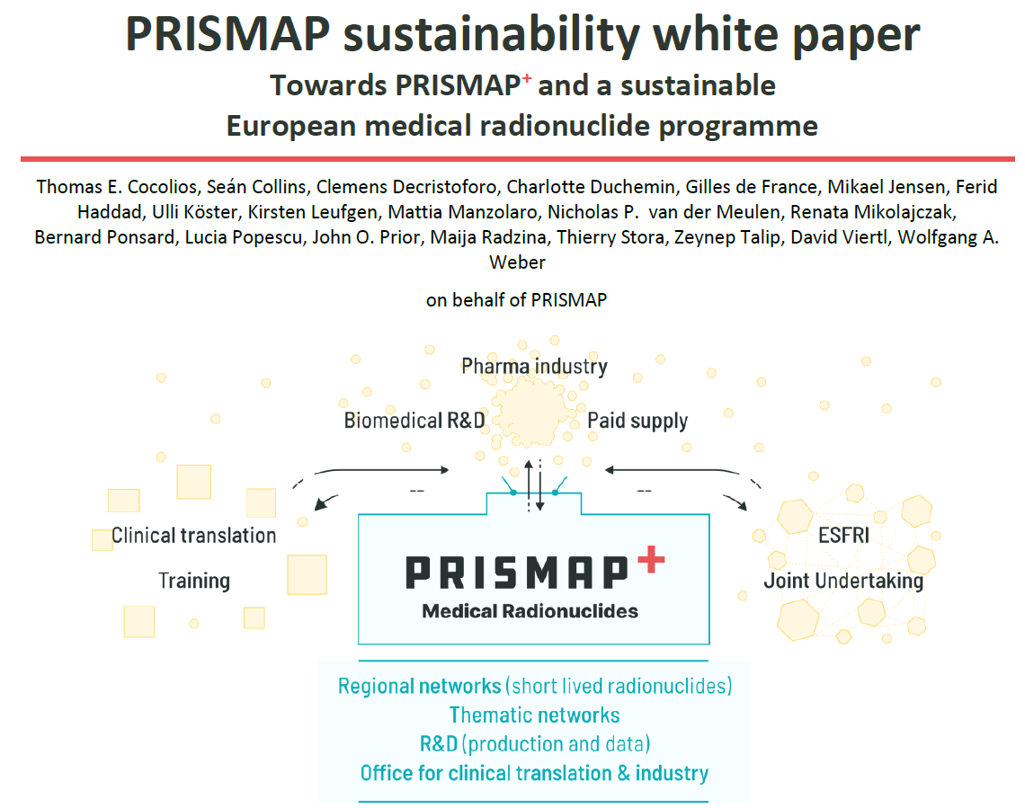

Slide 3
Roadmap towards a sustainable service hub: PRISMAP⁺
Which radionuclides
  Capitalize on development work
  Auger-electron therapy
  Nuclear imaging for non-radioactive pharmaceuticals
Inclusion criteria: thematic nodes and geographic nodes
User access
  Remote access versus transnational access
  Excellence and training
  Academic and industry
  Bench to bedside translation

Slide 4
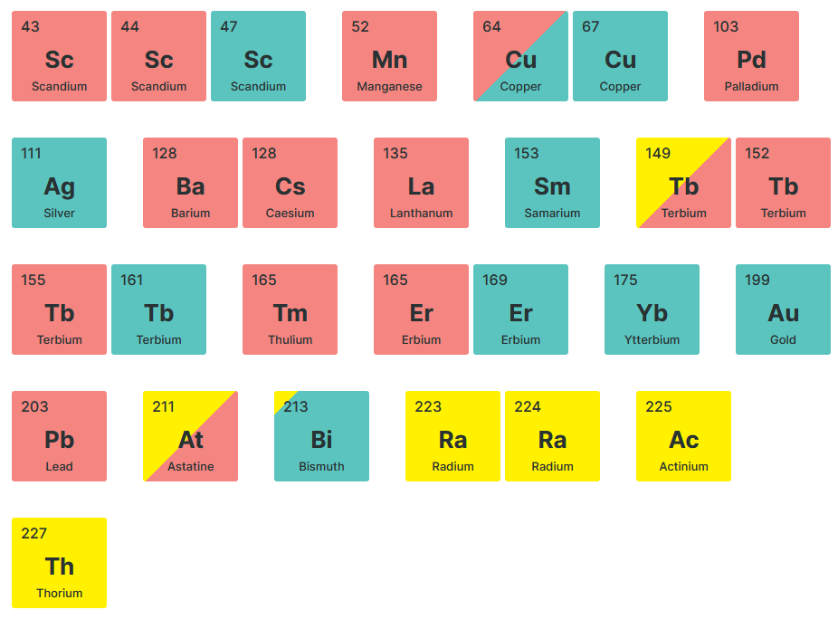
Towards PRISMAP⁺ portfolio
Analysis/monitoring of user needs
PRISMAP Community Working Groups
Capitalize on development work
Evolutionary adjustment of portfolio
Enhance specifications for clinical use
Additions based on user input

Slide 5
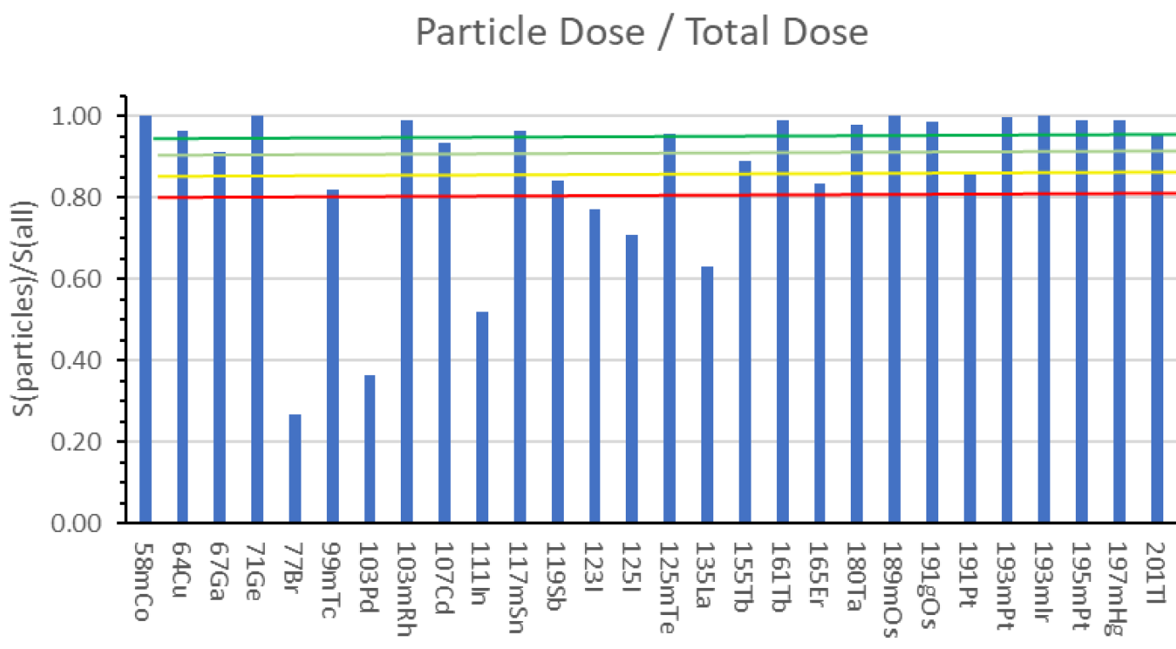
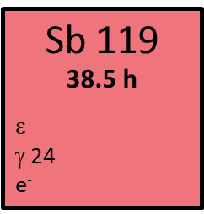
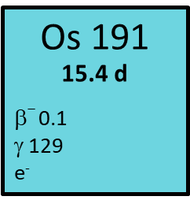
Towards PRISMAP⁺ portfolio : thematic node Auger e⁻ emitters
High LET Auger electron emitters as logic follow-up of α-emitters
Some Auger e⁻ emitters with promising properties are not yet available
Ge-71, As-73, Sb-119, Os-191, Hg-197...
J. Bolcaen et al., JNM 2023;64:1344.

Slide 6
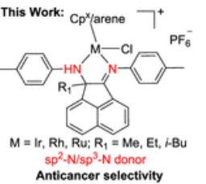
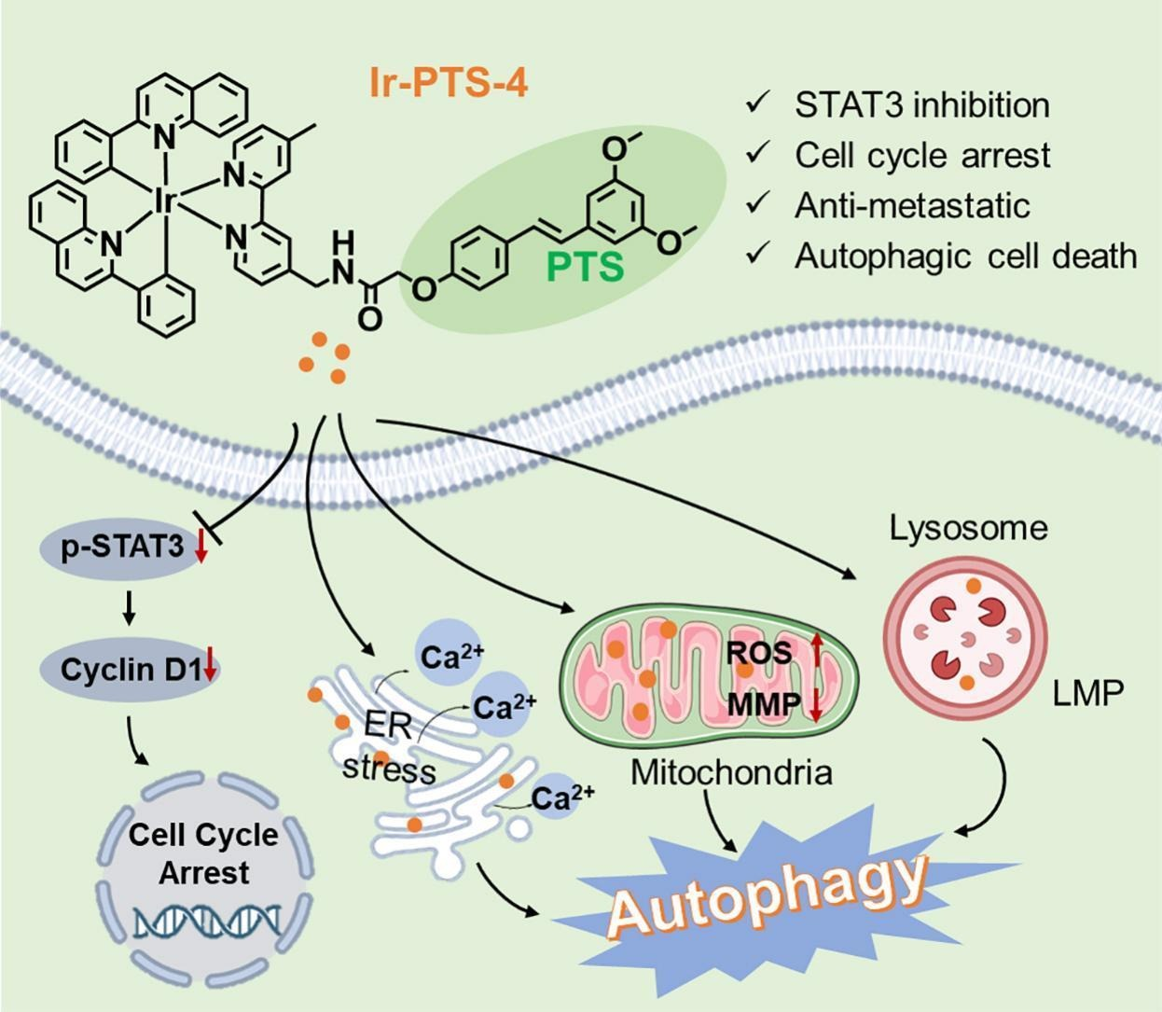
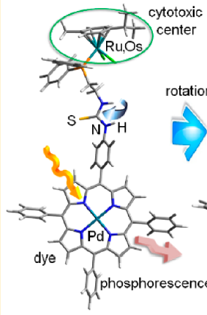
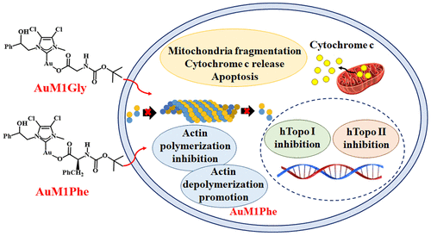
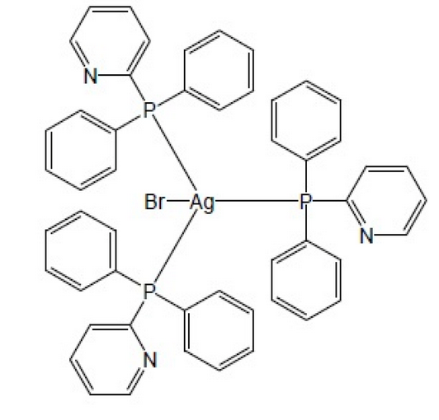
Towards PRISMAP⁺ portfolio: thematic node “noble” metals
Many novel organometallic drugs lack radiotracers for pharmacokinetics studies
⇒ develop adequate radionuclides
Ti-45, Ru-97, Ru-103/Rh-103m, Ag-111, Os-191,
Ir-194, Pt-191, Pt-193m, Pt-195m, Au-199...
New user community !

Slide 7
Geographic coverage of production network
Geographic coverage depends on half-life:
> 3 days (e.g. Tb-161) ⇒ centralized, but high redundancy requirement
6 hours – 3 days (e.g. Cu-64) ⇒ regional
< 6 hours (e.g. Sc-44) ⇒ decentralized production network
Production capacity: preclinically >0.1 GBq, clinically >GBq (less for α-emitters)
Product purity: molar activity & radionuclidic purity

Slide 8

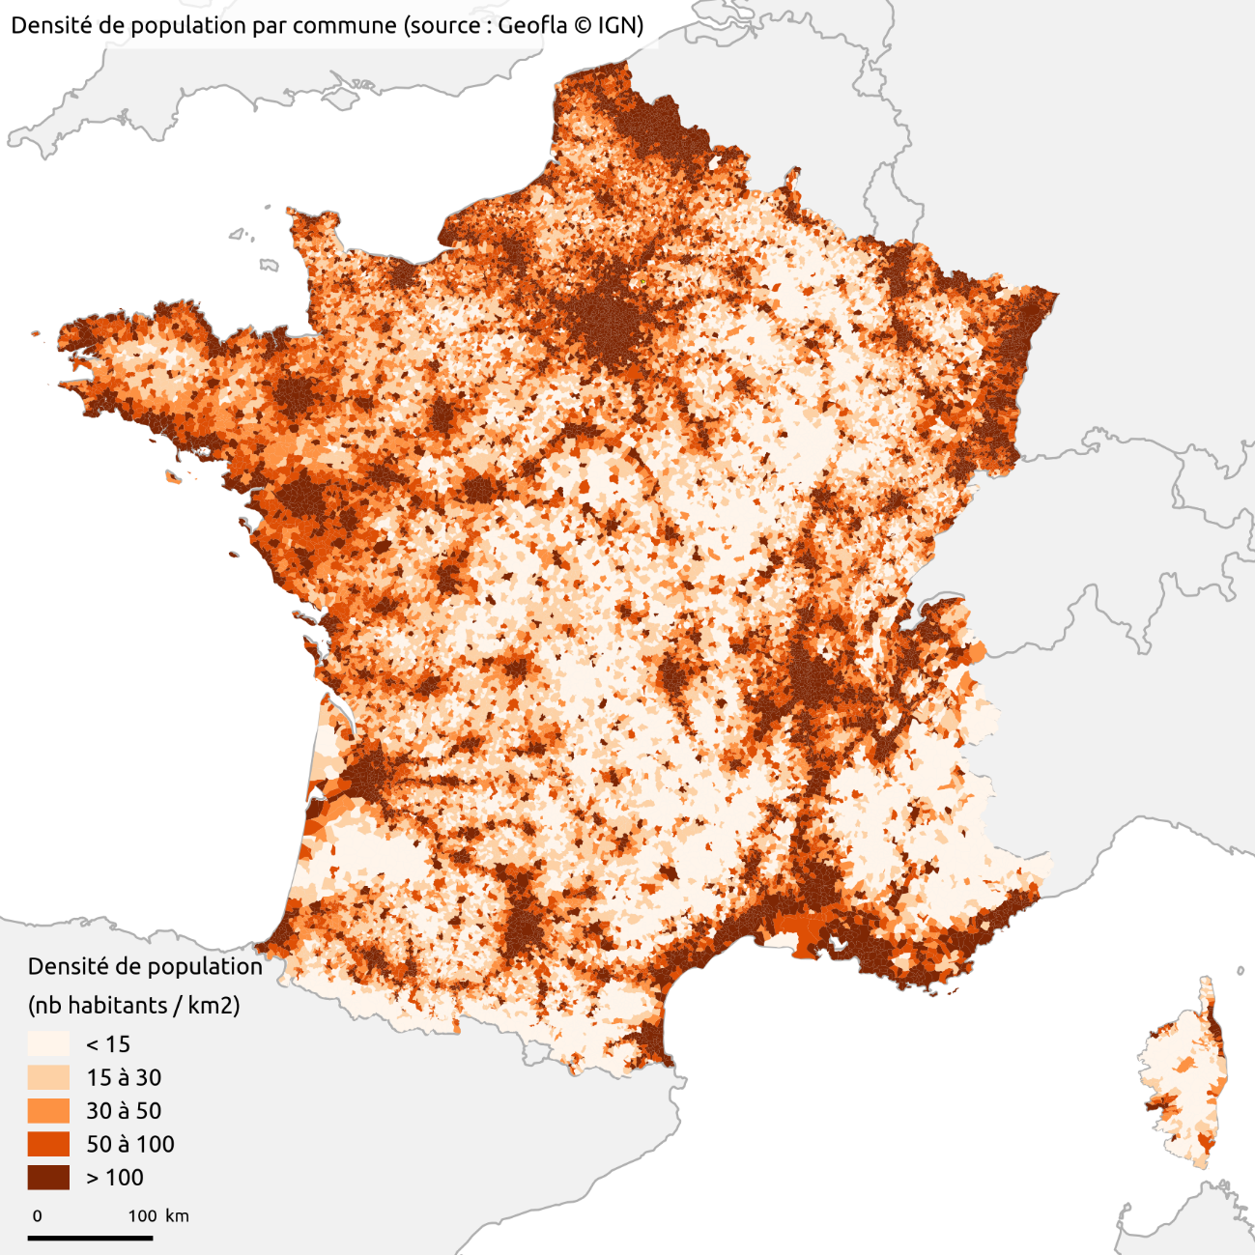
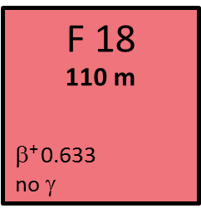
Example: Logistics of ¹⁸F production in France
Distributed cyclotron network providing local/regional production.

Slide 9
Classification of facilities
Core facilities: versatile facilities with multiple research radionuclides available and/or strong research activities – mixed funding with recurrent funding and batch produced.
Production facilities (funded per batch produced) for the development of novel radionuclides.
Emerging facilities on maturation stage benefiting from all training and services from PRISMAP⁺ to further join the network.
Research laboratories or entities delivering services will be supported according to service provided.

Slide 10
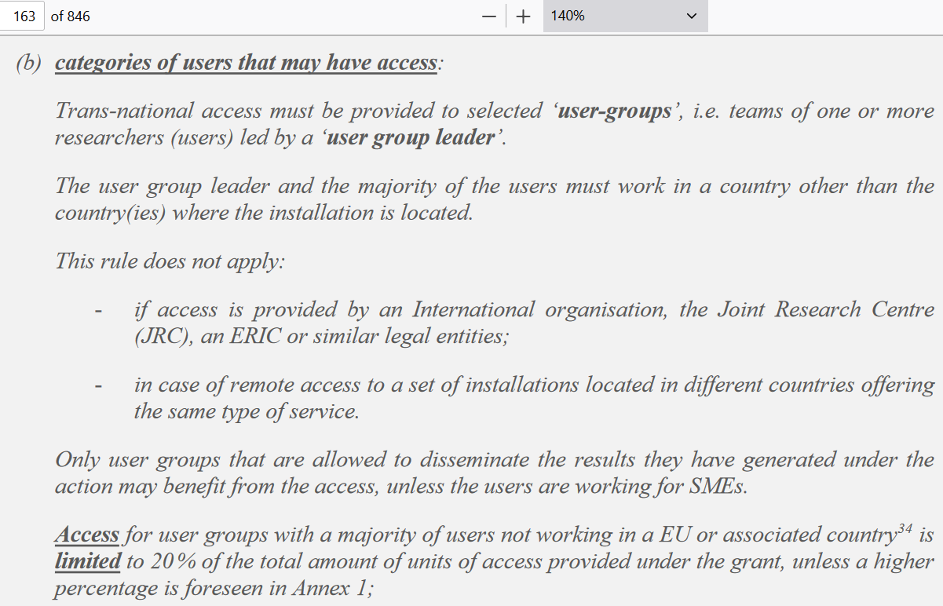
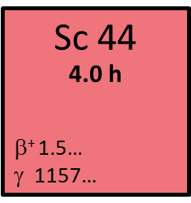
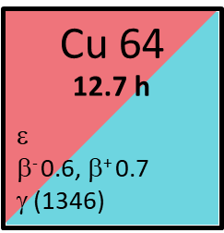
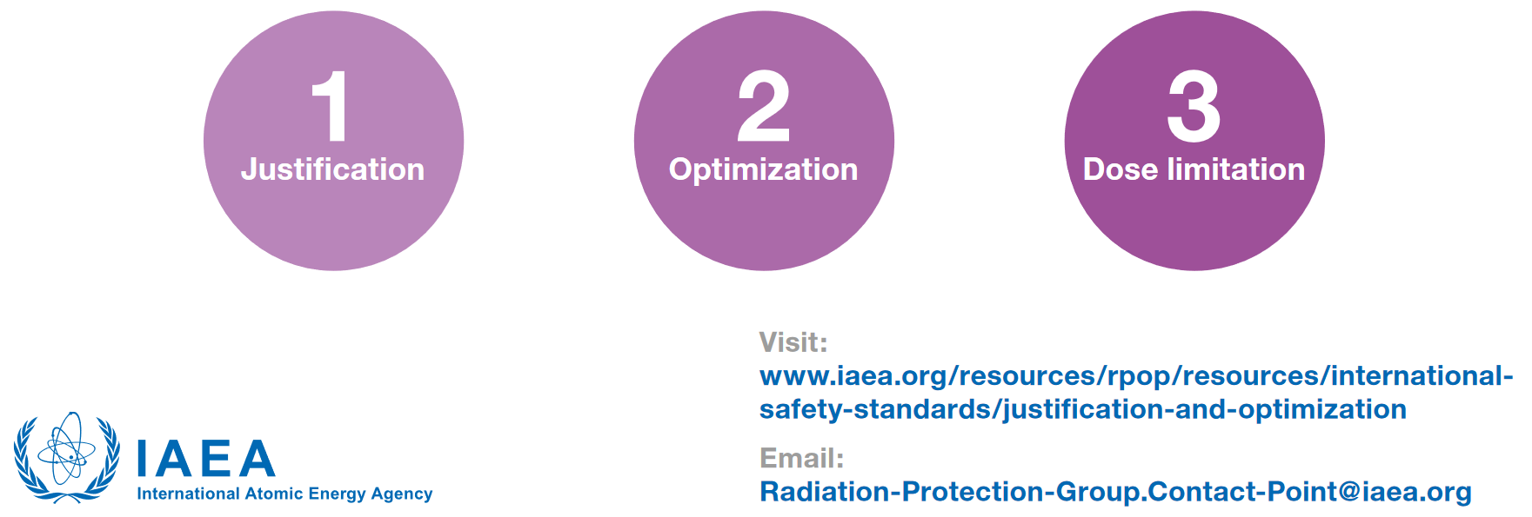
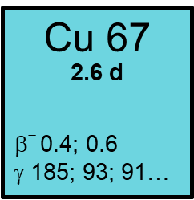
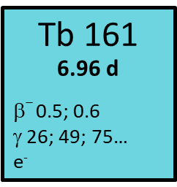
Remote access more suited than transnational access

Slide 11


Suggested new services in PRISMAP⁺
Radionuclide deliveries for training of NM professionals in innovative radionuclides’ use
“Travelling chefs” ? PRISMAP specialist supports experiments at user lab for few days
“Travelling cows” ? Ti-44/Sc-44 (59 a), Os-194/Ir-194 (6 a), Ac-225/Bi-213 (10 d)
(legal framework to be considered)
International relations:
  NIDC (US), JRIA (JP), NFRF-T (CA), MRIP (UK)
Promote collaborations with industry

Slide 12




Actions towards sustainability: from bench to bedside
WP4 input to and interactions with EANM, EMA, Pharma Directive, EDQM, IAEA to reduce hurdles for emerging radionuclides and radiopharmaceuticals
Clinical trial office ⇒ see next presentation

Slide 13
Thank you for your attention!

