Slide 1
7th CONSORTIUM MEETING
WP4 – NA1 – Harmonisation and Standardisation
ARRONAX (Nantes, France)
Day 1 – Tuesday, 17 September 2024

Slide 2
Outline
Achievements on Quality Data of PRISMAP radionuclides: Cu-64 ILC study and monograph development
Regulatory activities with EMA and pharmaceutical legislation
Standardization – NMES study
Work planned for the final period

Slide 3
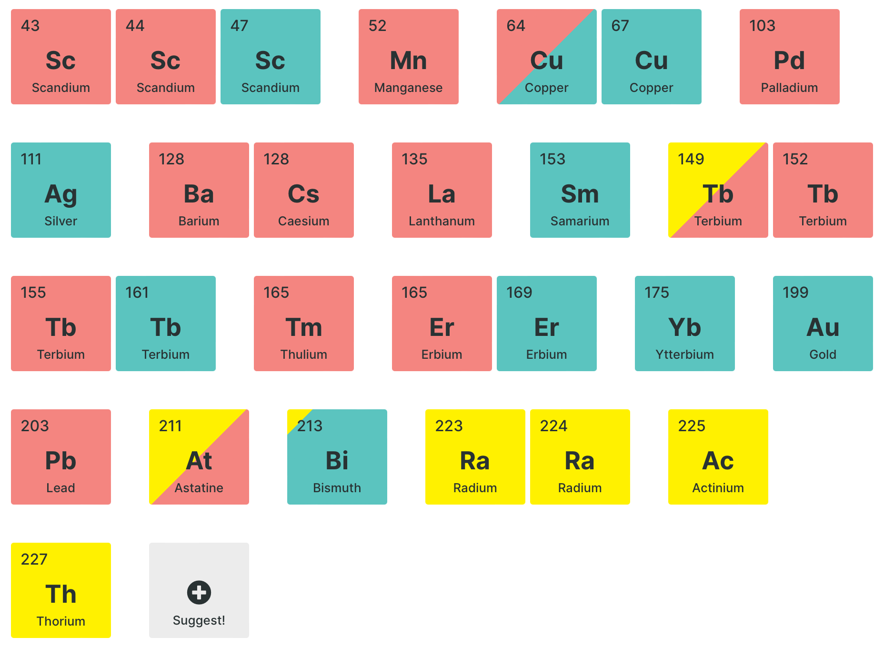




Achievements on Quality Data of PRISMAP radionuclides: Cu-64 ILC study
Task 4.2 on Quality of novel radionuclides and radiopharmaceuticals:
Cu-64: Finalisation of the Inter-laboratory Comparison (ILC) study with Cu-64
- Samples received and tested
- Final report written
- To be distributed to partners and reviewed
Next steps
Publication planned
Compiling dataset for EDQM in support of monograph development, EDQM informed about support from PRISMAP

Slide 4

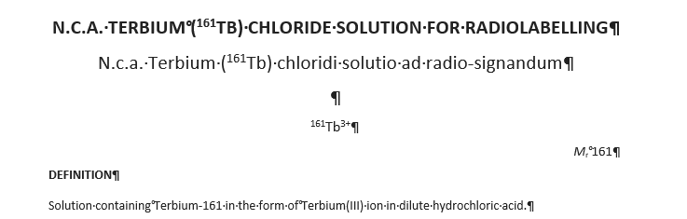



Achievements on Quality Data of PRISMAP radionuclides: monograph development
Task 4.2 on Quality of novel radionuclides and radiopharmaceuticals:
Tb-161:
- Monograph (SCK CEN, PSI, NCBJ) developed based on standardised analytical methods
- currently reviewed by PSI
- Publication planned
Ac-225: Intensive contacts with the European Directorate for the Quality of Medicines & HealthCare (EDQM) to draft a dedicated chapter on Ac-225 (JRC)

Slide 5

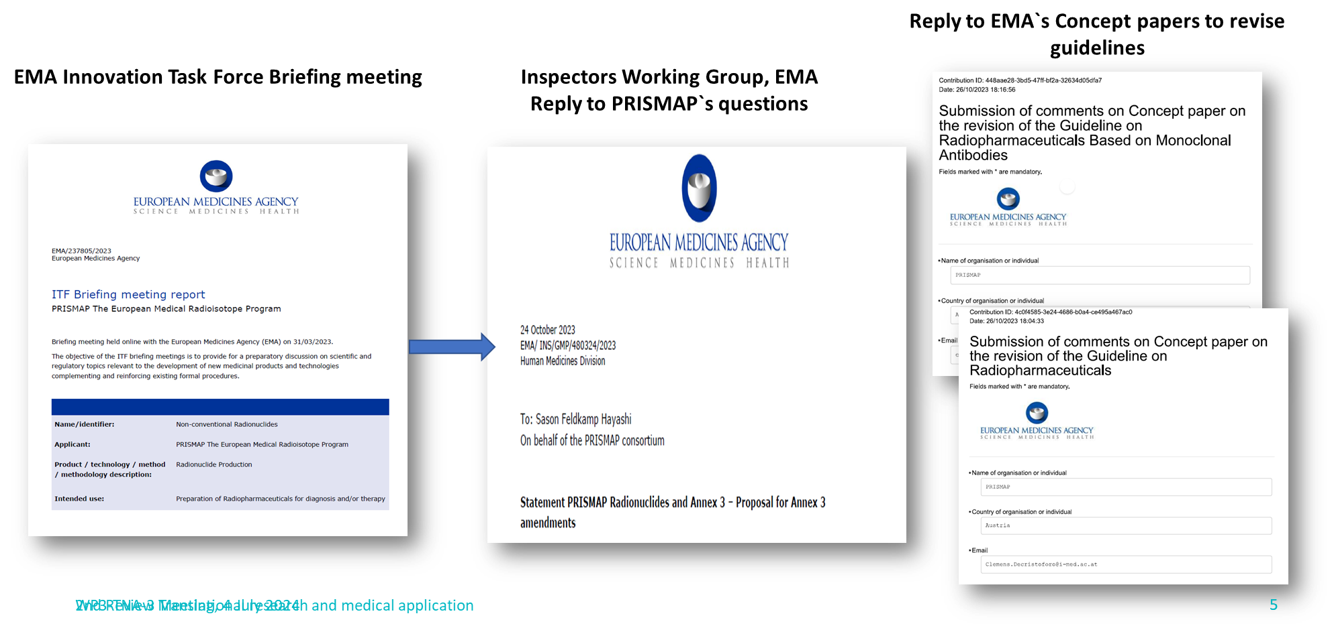
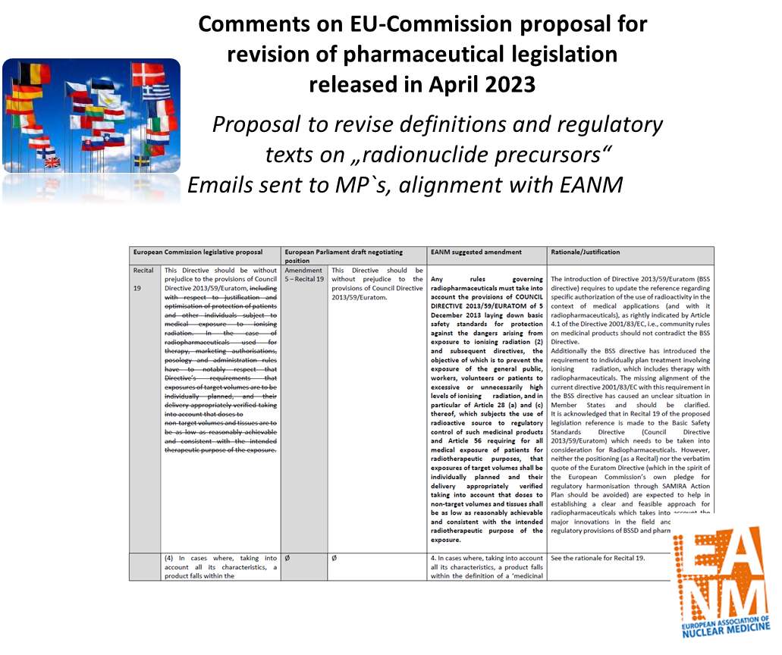
Regulatory Activities with EMA and regulatory bodies
Revision of
EU Pharma regulation
EMA
PRISMAPs opinion raised
PRISMAP acknowledged stakeholder
EMA`s turn to move
Revision in the hands of Council (i.e. memberstates)
EANM activities to be heard

Slide 6

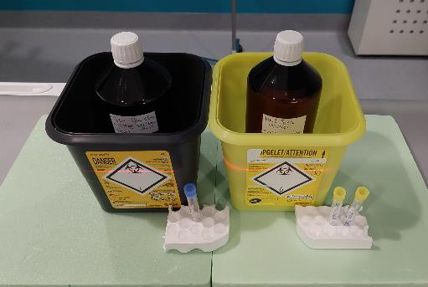
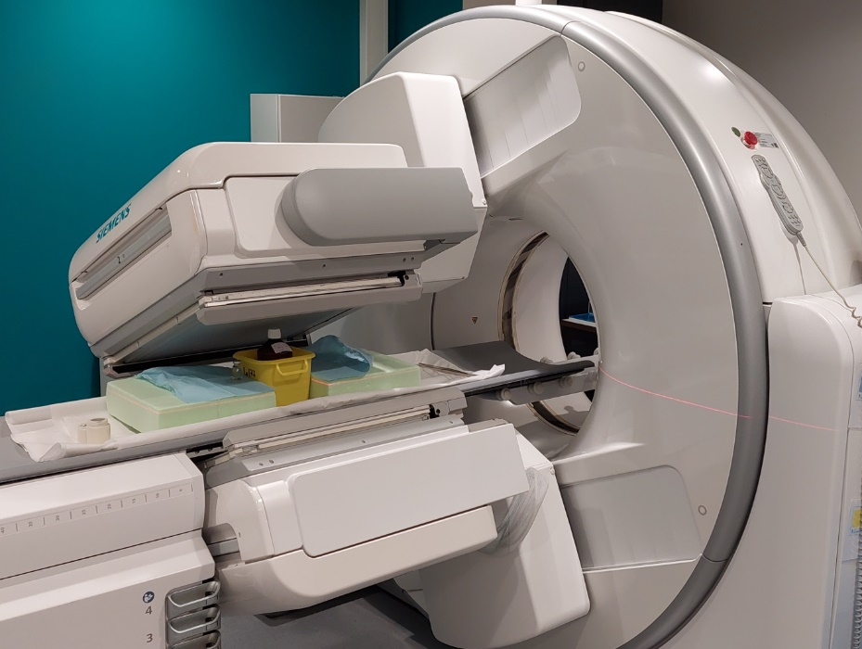
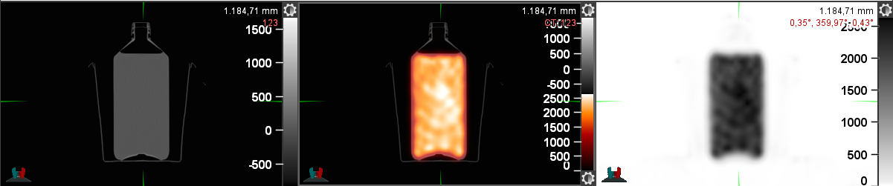
Stzandardization - NMES study and current activity for Tb-161
June 2024 – calibration @ UZ Leuven with SCK
onsite calibration & verification of multiple activity meters
standard reference vial and secondary geometries (SV-25A vial, Huayi)
investigated radionuclides: Zr-89, Lu-177, and Ga-68
general workflow rehearsal for the Tb-161 exercise
Tb-161 – provided by SCK end of June 2024
activity traceable to the secondary standard (Fidelis)
planned verification of previous calibration exercises
planned gamma camera and quantitative SPECT analysis

Slide 7

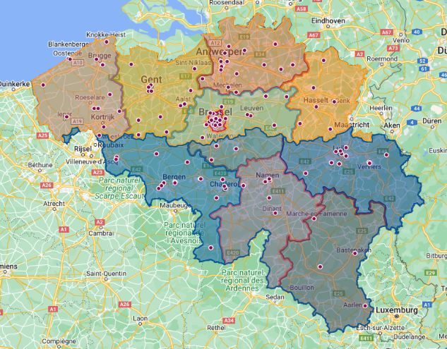

Work planned for next period
participation to a Belgian action plan for radioligand therapy
regulations – input from PRISMAP WP4 for internal dosimetry, optimization and therapy planning and verification
RLT clinical framework – input from PRISMAP WP4 for end-to-end metrology, medical physics, harmonization and standardization
pursue a national metrology campaign in Belgium
discussed with NM & MPE associations and regulator
try to obtain funding with FPS Health
metrology service provided by SCK for NM community
designation by FPS Economy and BELAC accreditation
planned MSc thesis @ KU Leuven about the calibration of activity meters and the influence of recipient geometry

Slide 8
Work planned for the final period
T4.2 on Quality of novel radionuclides and radiopharmaceuticals:
Finalise ILC report on Cu-64
Finalise Tb-161 monograph with potential publication
Continue Involvement in EDQM Chapter on Ac-225 development
Collecting quality data from PRISMAP`s radionuclides, format to be defined in next WP meetings
Regulatory Activities:
Further response to the proposals within the currently changing regulatory landscape:
EMA: Guidelines, Annex 3 (waiting for release of EMA`s proposals)
European Pharmaceutical legislation policies – link to EANM
European Pharmacoipoiea regarding novel radionuclides
Supporting IAEA in a Technical Working Group on Radiopharmaceutical Regulations (2024-2028)
T4.3 on Safety data on novel radionuclides and radiopharmaceuticals:
NMES:
Involvement of WP4 in Radioligand Therapy Action Plan (medical physics, metrology)
finalizing Tb-161 excercise (Gamma Camera, SPECT..)
Master thesis on activimeter calibrations, other radionuclides (Ac-225)
Collecting safety data and standards from PRISMAP´s radionuclides, format to be defined in next WP meetings

Slide 9
Thank you for your attention!

