Slide 1


Slide 2
From PRISMAP to PRISMAP⁺
SPES @ INFN-LNL is one of the main PRISMAP emerging facilities.
Phase 1 of the on-line commissioning completed in April 2024 (natural Zn target irradiated with protons at 50 MeV, which allowed the observation of the gamma-decay of the theranostic radionuclide Cu-67).
Phase 2 of the on-line commissioning foreseen within the end of 2024 (ISOL facility and SiC ISOL target irradiated with protons at 40 MeV for the production of Al-26m).
In the context of PRISMAP⁺, SPES will move from the status of an emerging facility to that of a production facility. This change will happen gradually.
INFRASTRUCTURE
ISOL facility equipped with a low resolution mass spectrometer.
Irradiation chamber for direct production and cross section measurements.
MANPOWER
Two INFN experts for the ISOL facility and two INFN experts for the irradiation chamber / direct production could be involved in PRISMAP⁺ activities.
BUDGET
An appropriate budget should be defined to support the production of medical radionuclides at low intensities. The intensities available for the users will be increased gradually during PRISMAP⁺.

Slide 3
Phase 1 completed with beam delivered for experiment (30 April-3 May 2024)
3
3
3
3
3
3

Slide 4
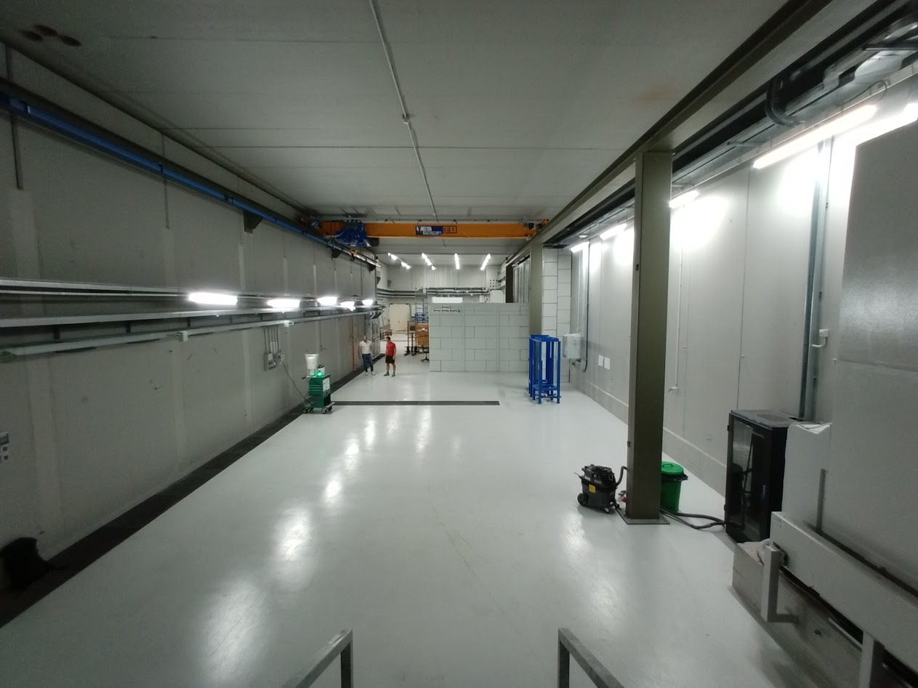
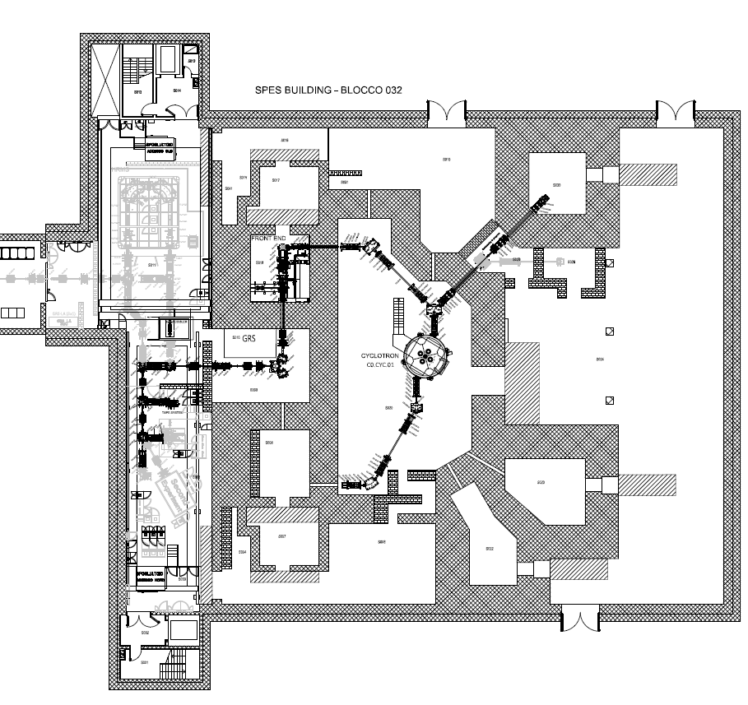
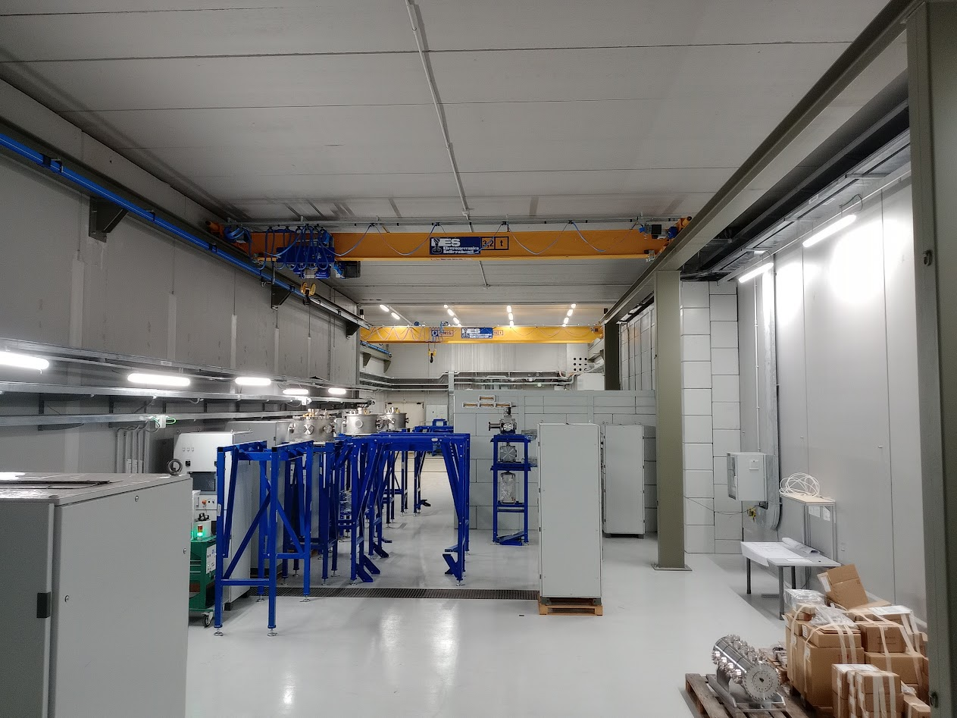
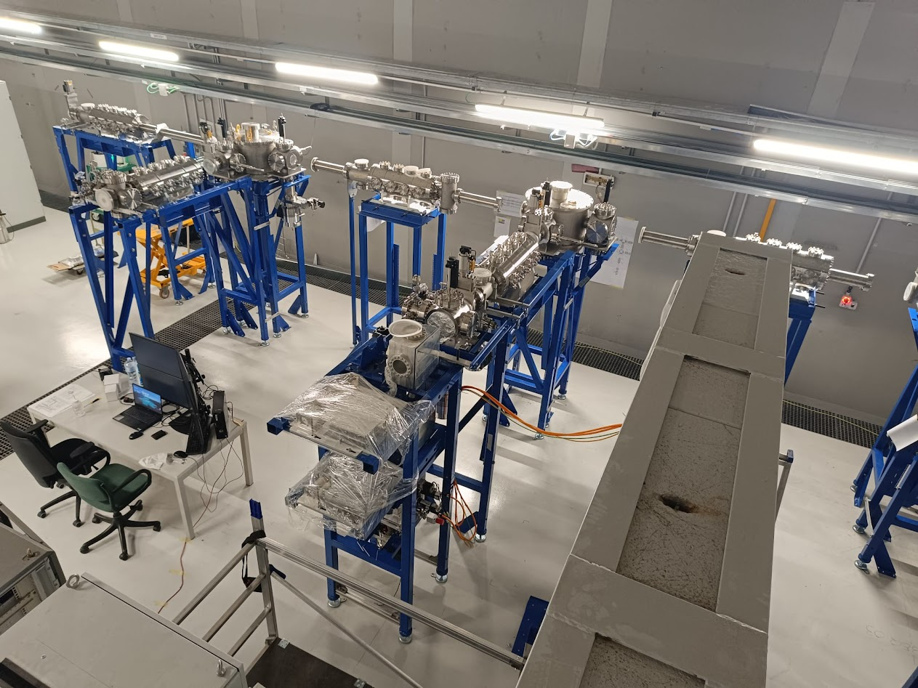
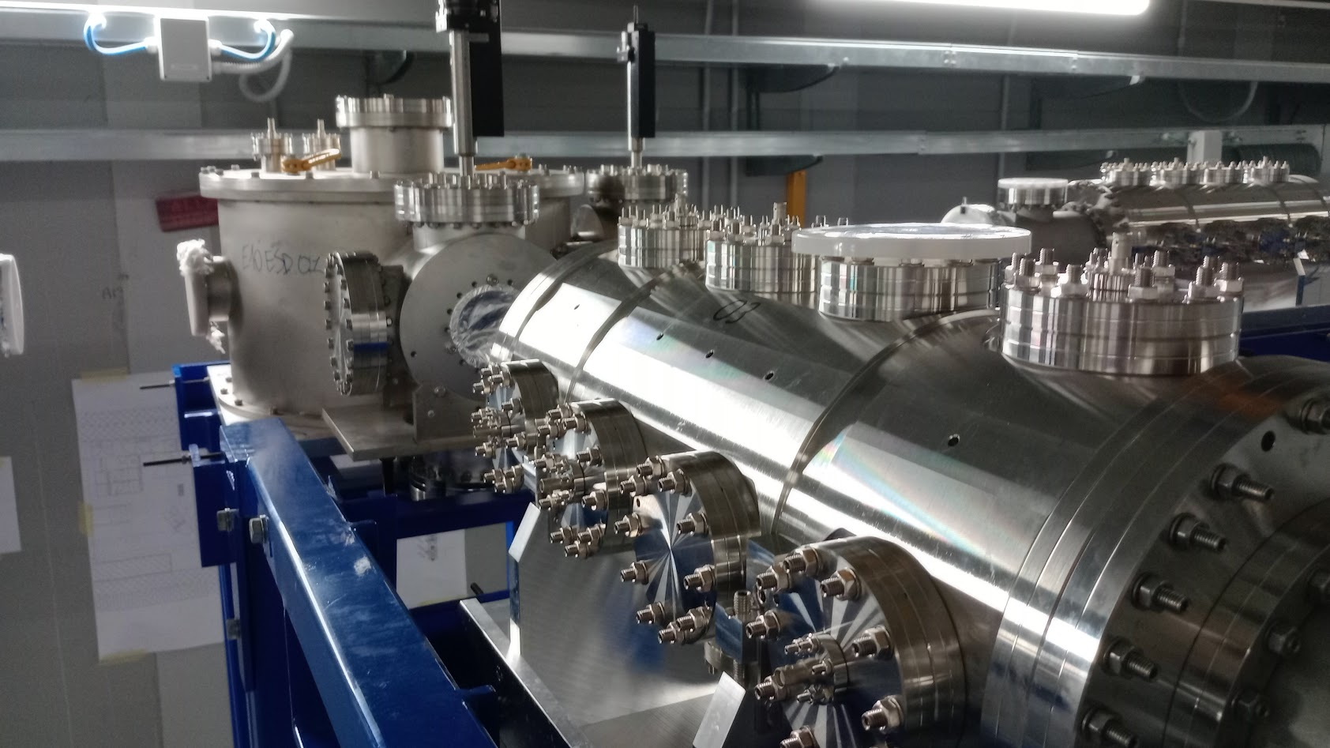
Phase 2 – The Low Energy Radioactive Ion Beams commissioning (end 2024)
Phase 2
TIS
May 2024
40 keV exp hall
June 2024
July 2024
4
4
4

