Slide 1



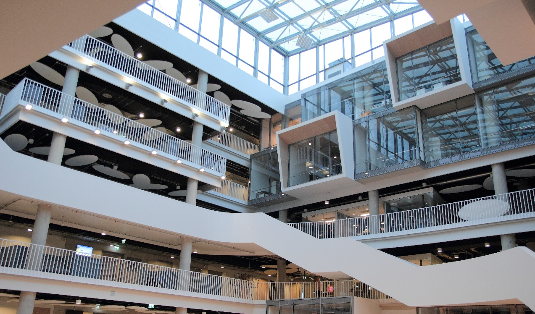

Slide 2


LU was a PRISMAP consortium member among 23 institutions from 13 countries

Slide 3



LU possible offer for PRISMAP+:
Medical Insight – to Foster Academic PreClinical/Clinical research
Joint projects
Medical feasibility studies (~300k budget)
Identifying end-user needs
Networking informative/educational/research activities:
With medical community/researchers
With industry, small and medium size enterprises (SMEs), pharmaceutical and biotechnology companies
Latvia can offer:
Cell cultures
Clinical cases (patients)
Regional representation in Baltics

Slide 4
Industry
Webinars
Portfolios
Joint Research projects/Grants
Clinical
PreClinical/Clinical Research
Advisory/Regulatory
Second line supply support for national grants
Advisory
Education/Visitations
PRISMAP+
CLINICAL OFFICE
Notes:
SCK-CEN, POLATOM, Biomedical facilities avaialble for preclinical evaluation
show preclinical developments, including radiopharmaceuticals
Coordinators of trials within hospitals, stories of success.

