Slide 1






IFMIF-DONES at PRISMAP
Santiago Becerril-Jarque, Fernando Mota

Slide 2
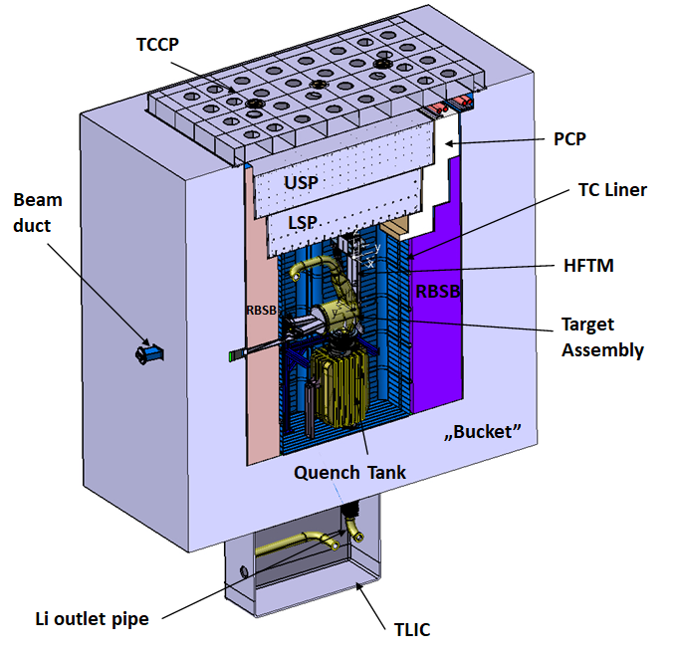
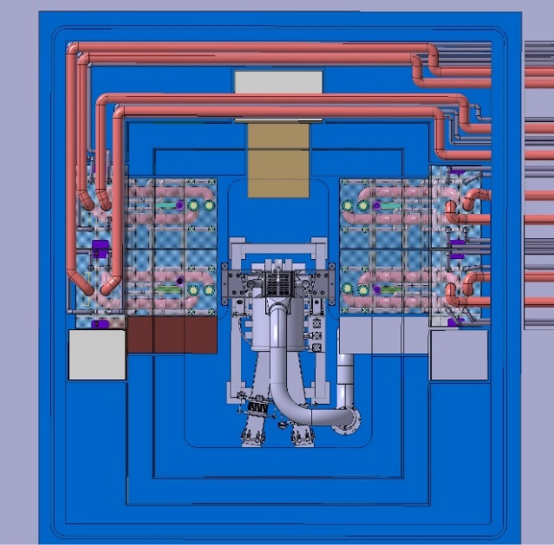
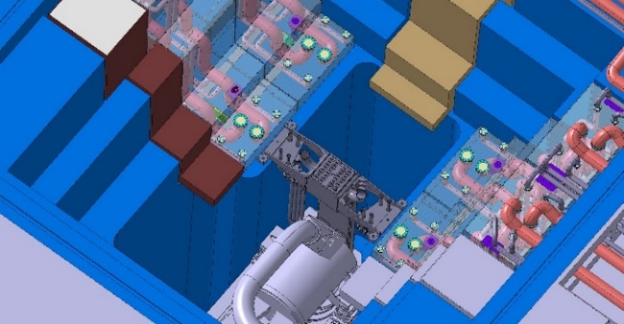
The Test Cell
Envelope available for modules to be irradiated inside the Test Cell
  1.3 - 1.5 m behind the Li target
  1.5 m (width)
  5.8 m (height)
Dedicated Piping and Cabling Plugs (PCP) for cabling and fluid service to the modules to be irradiated in the Test Cell
Vacuum vessel confines the in-vessel components
Removable Shielding Blocks (RBSBs) procure appropriate shielding outwards the TC.
PCP
PCP
PCP
PCP
HFTM
Target Assy
Core irradiation facility in IFMIF-DONES!!
D+ beam

Slide 3
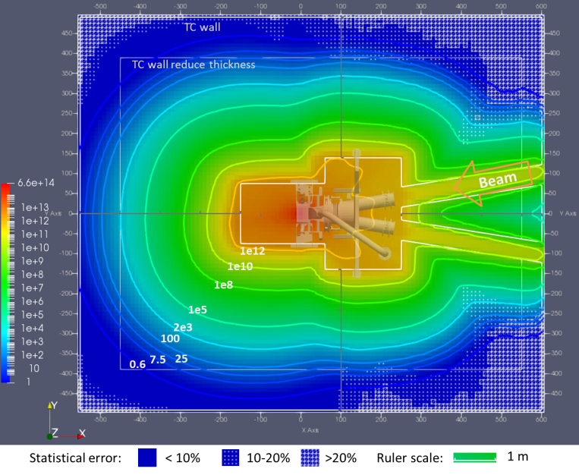
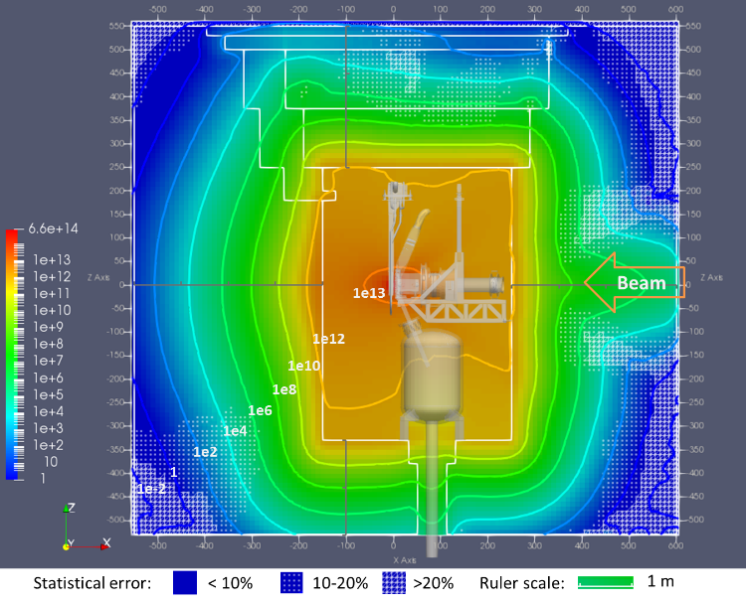
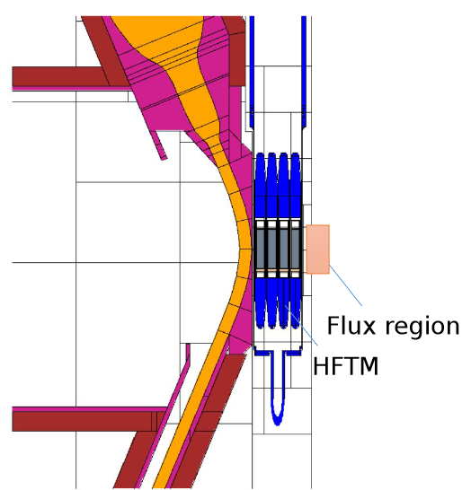
Neutron flux in the Test Cell
  Behind the HFTM → Around 3·10¹³ n/(cm²·s)
  The entire TC cavity (60 m³) is over 10¹² n/(cm²·s)

Slide 4
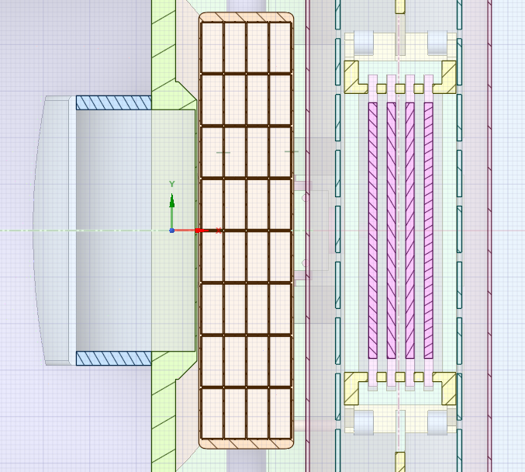
⁹⁹Mo assessment production: Radioisotope Production Devide (RIPD) behind HFTM
1 2 3 4
The dimensions of each plate is 0.9x27.5x11.4 cm³. (V=282.15 cm³)
⁹⁹Mo activity obtained in each plate after 6 days of irradiation using an average neutron fluence rate in each plate.
Enriched MoO₃ (95% ¹⁰⁰Mo) | SPECIFIC ACTIVITY GBq/g ¹⁰⁰Mo | ACTIVITY (TBq)
Plate 1 | 24.14 | 21.59
Plate 2 | 20.85 | 18.65
Plate 3 | 17.81 | 15.93
Plate 4 | 15.24 | 13.63
TOTAL |  | 69.80
Under these conditions, it is possible to produce ~ 69.80 TBq de ⁹⁹Mo/^{99m}Tc, per week
Considering that one ^{99m}Tc generation has about an activity of 46 GBq, which could be equivalent to considering a 100 GBq just before taking out the sample.
It means that we could obtain about 700 generators per week
Taking into account that a hospital could need 2 generators per week, we could supply to 350 hospitals.

Slide 5
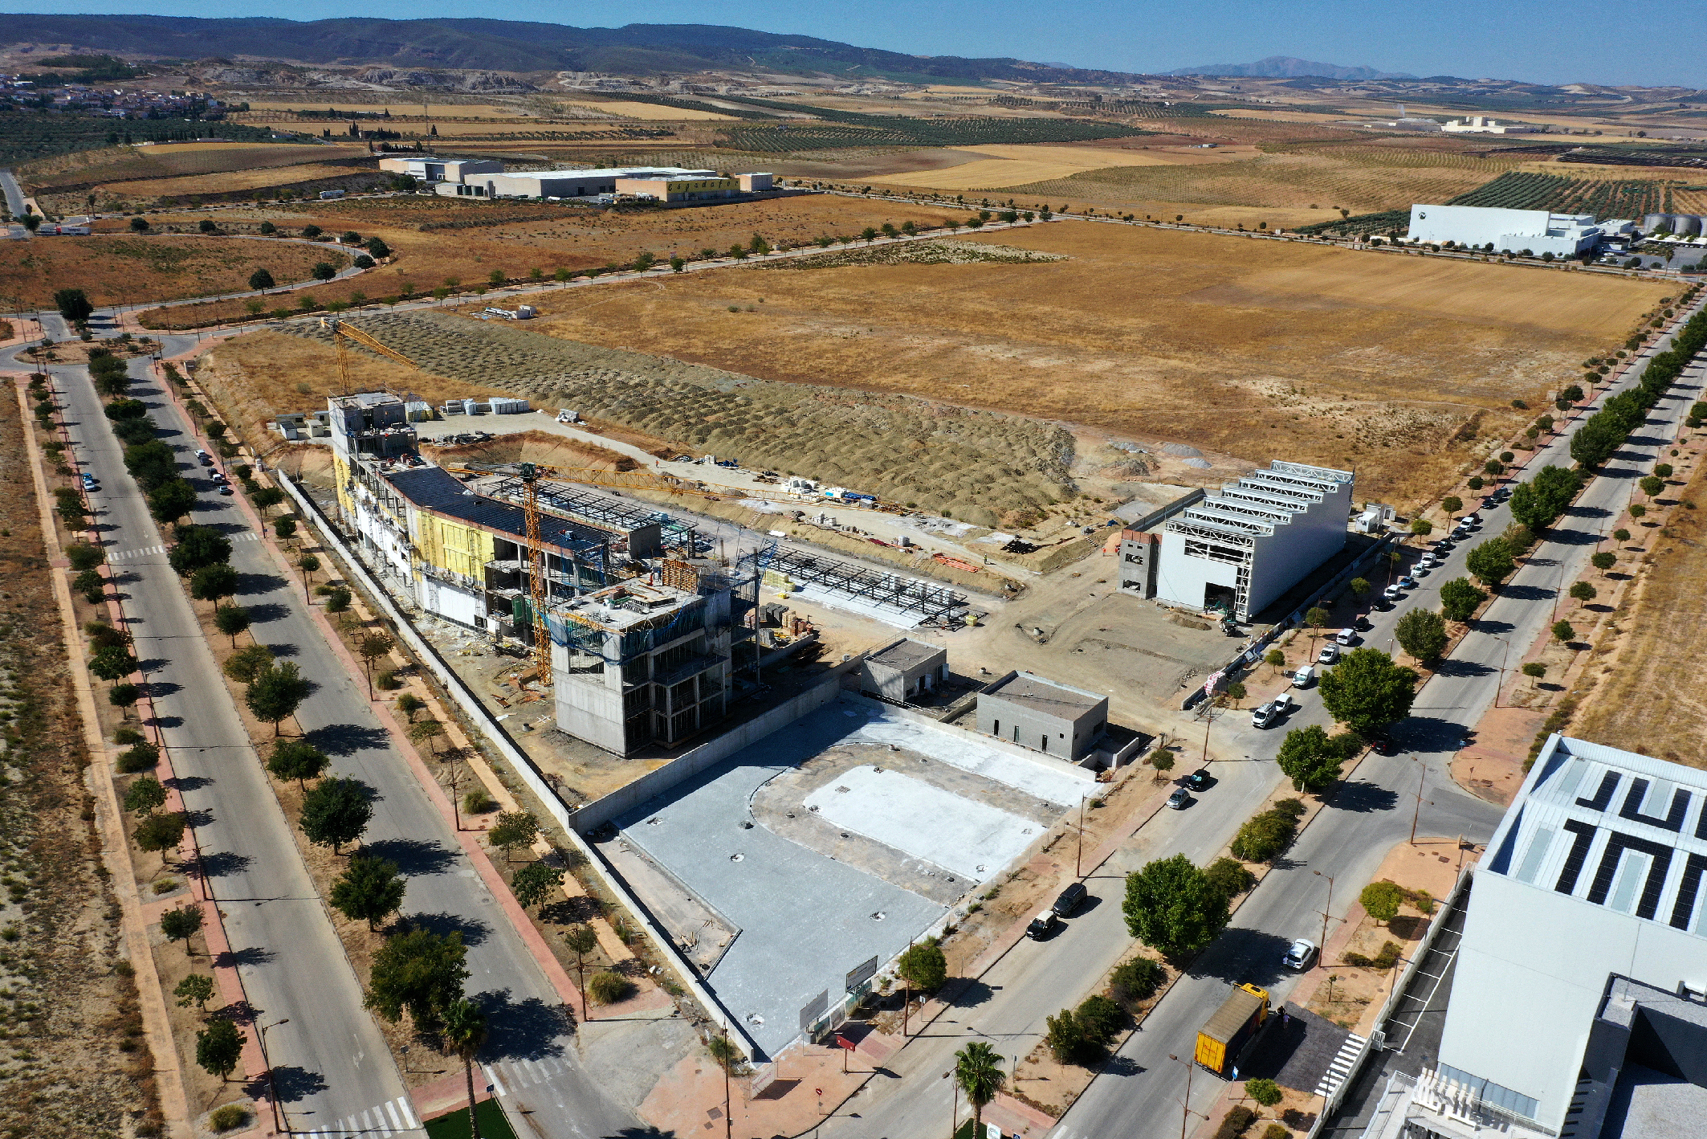
IFMIF-DONES construction ongoing
Thank you!!

