Slide 2
Coil Composite Working Group
1st meeting – 10-stack studies
11.09.2024

Slide 3
To be discussed today
Small topics from last meeting
  Activity matrices
  Literature database
10-stack activities
  Who
  Why
  How

Slide 4
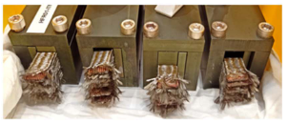
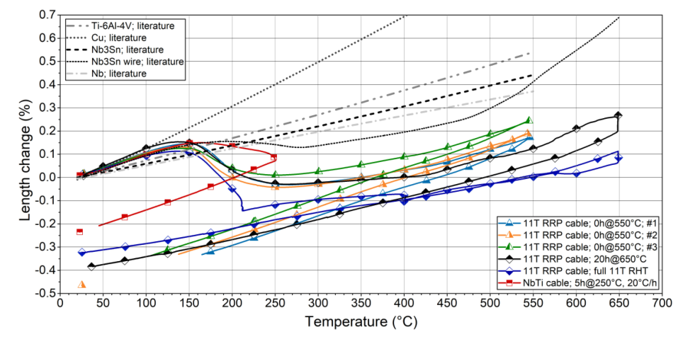

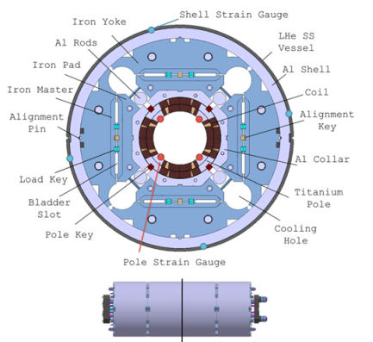
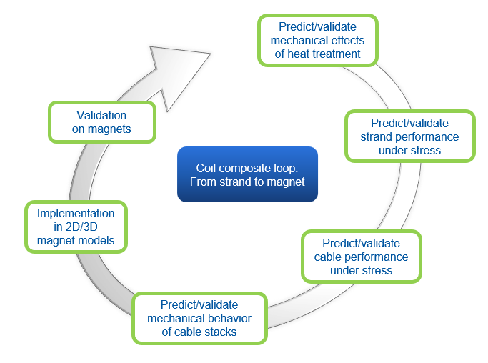
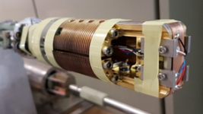
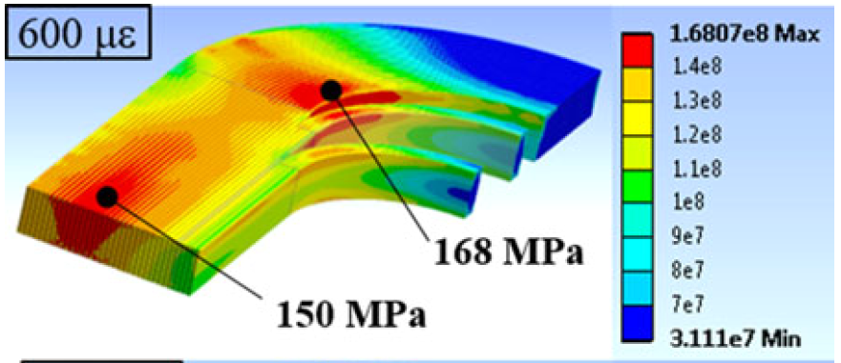


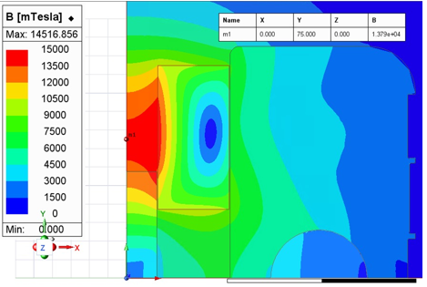

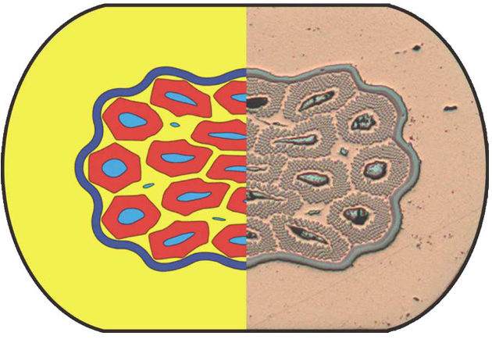
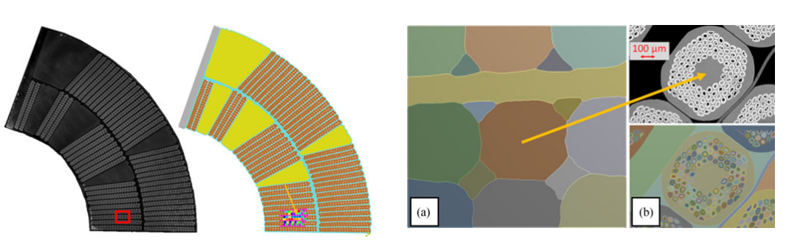
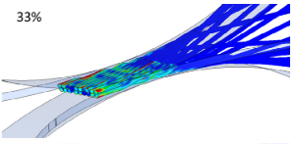
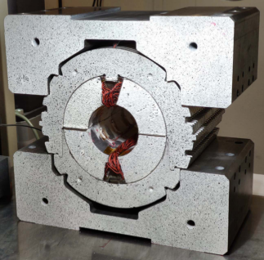
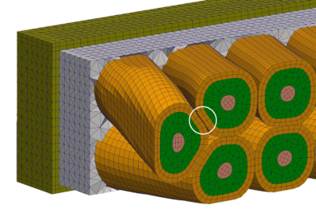


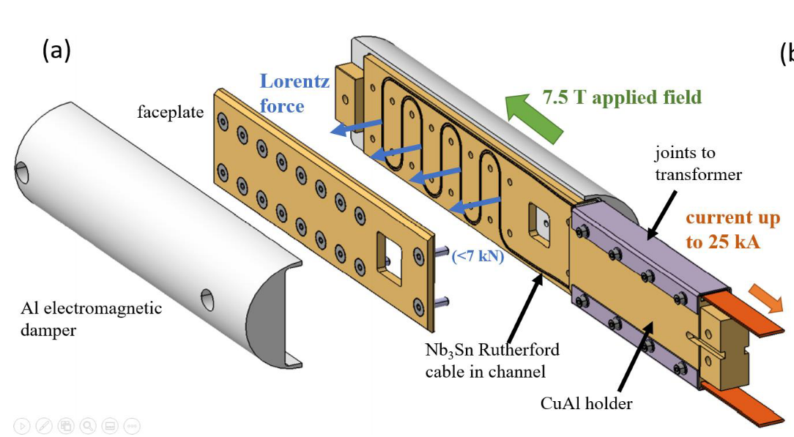


CERN / CEA
Mechanical characterization and model for heat treatment
Closing the loop!
CHART WireChar
Mechanical limits of Nb₃Sn wires and Mechanisms behind critical current degradation
CERN Magnet programs
11T, MQXF, SMC
CIEMAT ISAAC program
Asses mechanical issues in Common coil
CERN / INFN / UNIGE
Model for strand deformation under stress
CERN - 11T / MQXF design
CERN / CEA
Cabling simulations
CERN
Methodology for testing and modelling
CEA Cocascope
Multiscale models
CERN
Thermomechanical characterization of 10-stacks
CHART MagComp
Mechanical Modelling and Failure identification of impregnated Nb3Sn Rutherford cable stacks
PSI – Box program
Assess degradation and training in cables

Slide 5
Activity matrices
 | Strand | From strand to cable | Cable | From cable to coil | Stack / Coil | Multiscale models for magnet design | Validation in Magnet | Heat treatment
CEA | Material prop. Modelling (CoCaSCOPE) | Modelling (CoCaSCOPE) | Modelling (CoCaSCOPE) |  | Mechanical prop. Modelling (CoCaSCOPE) |  |  | Dim. changes
CERN | Material prop. Modelling | Modelling | Under stress exp. | Winding process | Volume fraction Mechanical prop. Therm. contraction Modelling | MQXF/S 11T | MQXFS 11T SMC | Phase transition Dim. changes Modelling
CIEMAT
INFN | Modelling (NED) | Modelling (NED)
PSI / CHART | Material prop. Under stress exp. (WireChar) | Modelling (MagNum2) | MagComp? | Impregnation (BOX) | Impregnation (Big BOX)

Slide 6
References (Strand)
Strand – Material properties
J. Bussiere et al., Young's modulus of polycrystalline Nb3Sn between 4.2 and 300 K, J. Appl. Phys. 51, 1024 (1980)
S. Bray et al., Tensile Measurements of the Modulus of Elasticity of Nb3Sn at Room Temperature and 4 K, IEEE Trans. Appl. Supercond. 7, 1451 (1997)
M. Hojo et al., Direct measurement of elastic modulus of Nb3Sn using extracted filaments from superconducting composite wire and resin impregnation method, Physica C 445-448, 814 (2006)
A. Devred et al., Overview and status of the Next European Dipole Joint Research Activity, Supercond. Sci. Technol. 19, S67 (2006)
C. Scheuerlein et al., Elastic anisotropy in multifilament Nb3Sn superconducting wires, IEEE Trans. Appl. Supercond. 25, 8400605 (2015)
M. Dylla et al., Fracture Strength Distribution of Individual Nb3Sn Filaments, IEEE Trans. Appl. Supercond. 26, 6001907 (2016)
N. Cheggour et al., Precipitous change of the irreversible strain limit with heat-treatment temperature in Nb3Sn wires made by the restacked-rod process, Sci. Rep. 8, 13048 (2018)
N. Cheggour et al., Implications of the strain irreversibility cliff on the fabrication of particle-accelerator magnets made of restacked-rod-process Nb3Sn wires, Sci. Rep. 9, 5466 (2019)
G. Lenoir et al., Mechanical Behavior Laws for Multiscale Numerical Model of Nb3Sn Conductors, IEEE Trans. Appl. Supercond. 29, 8401706 (2019)
L. Gamperle et al., Determination of the electromechanical limits of high-performance Nb3Sn Rutherford cables under transverse stress from a single-wire experiment,
Phys. Rev. Research 2, 013211 (2020)
Strand - Modelling
N. Mitchell, Finite element simulations of elasto-plastic processes in Nb3Sn strands, Cryogenics 45, 501 (2005)
D. Boso, A simple and effective approach for thermo-mechanical modelling of composite superconducting wires, Supercond. Sci. Technol. 26, 045006 (2013)
T. Wang, A novel modelling to predict the critical current behavior of Nb3Sn PIT strand under transverse load based on a scaling law and Finite Element Analysis, Cryogenics 63, 275 (2014)
X. Wang et al., Tensile Behavior Analysis of the Nb3Sn Superconducting Strand with Damage of the Filaments, IEEE Trans. Appl. Supercond. 26, 6000304 (2016)
A. Cattabiani et al., A 3D Finite Element Model of the Reversible Critical Current Reduction Due to Transverse Load in Nb3Sn Wires, IEEE Trans. Appl. Supercond. 30, 8401006 (2020)
D. Baffari et al., Effect of the Sub-Elements Layout on the Electro-Mechanical Properties of High Jc Nb3Sn Wires Under Transverse Load: Numerical Simulations,
IEEE Trans. Appl. Supercond. 32, 6001306 (2022)

Slide 7
References (Strand)
Strand - Properties under stress
J. W. Ekin, Effect of transverse compressive stress on the critical current and upper critical field of Nb3Sn, J. Appl. Phys. 62, 4829 (1987)
B. Seeber et al., Transport properties up to 1000 A of Nb3Sn wires under transverse compressive stress, IEEE Trans. Appl. Supercond. 17, 2643 (2007)
L. Muzzi, Direct observation of Nb3Sn lattice deformation by high-energy x-ray diffraction in internal-tin wires subject to mechanical loads at 4.2K, Supercond. Sci. Technol. 25, 054006 (2012)
B. Bordini et al., An exponential scaling law for the strain dependence of the Nb3Sn critical current density, Supercond. Sci. Technol. 26, 075014 (2013)
C. Scheuerlein, Stress distribution and lattice distortions in Nb3Sn multifilament wires under uniaxial tensile loading at 4.2 K, Supercond. Sci. Technol. 27, 044021 (2014)
C. Calzoialo et al., Electro-mechanical properties of PIT Nb3Sn wires under transverse stress: experimental results and FEM analysis, Supercond. Sci. Technol. 28, 055014 (2015)
X. Wang et al., Mechanical behaviors of multi-filament twist superconducting strand under tensile and cyclic loading, Cryogenics 73, 14 (2016)
P. Ebermann et al., Influence of transverse stress exerted at room temperature on the superconducting properties of Nb3Sn wires, Supercond. Sci. Technol. 32, 095010 (2019)
J. Troitino Ferradas et al., Effects of the initial axial strain state on the response to transverse stress of high-performance RRP Nb3Sn wires, Supercond. Sci. Technol. 34, 035008 (2021)
T. Bagni et al., Formation and propagation of cracks in RRP Nb3Sn wires studied by deep learning applied to x-ray tomography, Supercond. Sci. Technol. 35, 104003 (2022)
C. Senatore et al., Degradation of Ic due to residual stress in high-performance Nb3Sn wires submitted to compressive transverse force, Supercond. Sci. Technol. 36, 075001 (2023)
From strand to cable – Cabling process
S. Farinion et al., Finite element model to study the deformations of Nb3Sn wires for the next European Dipole (NED), IEEE Trans. Appl. Supercond. 17, 1136 (2007)
S. Farinion et al., Nb3Sn wire layout optimization to reduce cabling degradation, IEEE Trans. Appl. Supercond. 18, 984 (2008)
P. Mallon et al., Mechanical material characterization and finite element modelling of unreacted Nb3Sn PIT wires under transverse pressure, IEEE Trans. Appl. Supercond. 23, 8400804 (2013)
E. Rochepault et al., Analysis and modelling of damage in RRP Nb3Sn wires during cabling, IEEE Trans. Appl. Supercond. 25, 8800905 (2015)
J. Cabanes et al., Simulation of the cabling process for Rutherford cables: An advanced finite element model, Cryogenics 80, 333 (2016)

Slide 8
References (Cable)
Cable Modelling
T. Wang, Finite element analysis of Nb3Sn sub-cables under transverse compression with different approaches, IEEE Trans. Appl. Supercond. 23, 8400705 (2013)
P. Manil et al., A numerical approach for the mechanical analysis of superconducting rutherford-type cables using bimetallic description, IEEE Trans. Appl. Supercond. 27, 4803006 (2017)
G. Vallone et al., Computation of the Reversible Critical Current Degradation in Nb3Sn Rutherford Cables for Particle Accelerator Magnets, IEEE Trans. Appl. Supercond. 28, 4801506 (2018)
J. Zhao et al., Analytical and Numerical Methods to Estimate the Effective Mechanical Properties of Rutherford Cables, IEEE Trans. Appl. Supercond. 30, 8400808 (2020)
F. Nunio et al., CoCaSCOPE-Mesh Generator: A Tool to Generate 3D Numerical Models of Rutherford Cables, IEEE Trans. Appl. Supercond. 34, 4904005 (2024)
Cable - Performance under stress
H.H.J. ten Kate et al., Critical current degradation in Nb3Sn cables under transverse pressure, IEEE Trans. Appl. Supercond. 3, 1334 (1993)
E. Barzi et al., A device to test critical current density sensitivity of Nb3Sn cables to pressure, Adv. Cryog. Eng., V. 48A 45 (2002)
E. Barzi et al., Sensitivity of Nb3Sn Rutherford-type cables to transverse pressure, IEEE Trans. Appl. Supercond. 15, 1541 (2005)
E. Barzi et al., Effect of Transverse Pressure on Brittle Superconductors, IEEE Trans. Appl. Supercond. 18, 980 (2008)
B. Bordini et al., Critical current measurements of high-Jc Nb3Sn Rutherford cables under transverse compression, IEEE Trans. Appl. Supercond. 24, 9501005 (2014)
G. Vallone et al., Computation of the Reversible Critical Current Degradation in Nb3Sn Rutherford Cables for Particle Accelerator Magnets, IEEE Trans. Appl. Supercond. 28, 4801506 (2018)
J.E. Duvauchelle et al., Critical current measurements under transverse pressure of a Nb3Sn rutherford cable based on 1 mm RRP wires, IEEE Trans. Appl. Supercond. 28, 4802305 (2018)
P. Ebermann et al., Irreversible degradation of Nb3Sn Rutherford cables due to transverse compressive stress at room temperature, Supercond. Sci. Technol. 31, 065009 (2018)
F. Wolf et al., Characterization of the stress distribution on Nb3Sn rutherford cables under transverse compression, IEEE Trans. Appl. Supercond. 28, 8400106 (2018)
G. De Marzi et al., On the mechanisms governing the critical current reduction in Nb3Sn Rutherford cables under transverse stress, Sci. Rep. 11, 7369 (2021)
G. Vallone et al., Measurement and Computation of Nb3Sn Rutherford Cables Strength Under Multi-Axial Loading Conditions, IEEE Trans. Appl. Supercond. 34, 8400105 (2024)

Slide 9
References (Cable stack)
Cable stack – Mechanical behavior
M. Reytier et al., Characterization of the thermo-mechanical behavior of insulated cable stacks representative of accelerator magnet coils, IEEE Trans. Appl. Supercond. 11, 3066 (2001)
F. Wolf et al., Effect of Epoxy Volume Fraction on the Stiffness of Nb3Sn Rutherford Cable Stacks, IEEE Trans. Appl. Supercond. 29, 8401006 (2019)
F. Wolf et al., Effect of Applied Compressive Stress and Impregnation Material on Internal Strain and Stress State in Nb3Sn Rutherford Cable Stacks,
IEEE Trans. Appl. Supercond. 29, 8400605 (2019)
Cable stack - Model
F. Nunio et al., 3-D Mechanical Finite Element Analysis of Impregnated Rutherford Cable Stacks, IEEE Trans. Appl. Supercond. 29, (2019)
C. Fichera et al., New Methodology to Derive the Mechanical Behavior of Epoxy-Impregnated Nb3Sn Cables, IEEE Trans. Appl. Supercond. 29, 8401912 (2019)

Slide 10
References (Coil)
From cable to coil
D. Pulikowski et al., Testing Mechanical Behavior of Nb3Sn Rutherford Cable during Coil Winding, IEEE Trans. Appl. Supercond. 27, 4802105 (2017)
D. Pulikowski et al., Windability Tests of Nb3Sn Rutherford Cables for HL-LHC and FCC, IEEE Trans. Appl. Supercond. 28, 4003905 (2018)
M. Daly et al., BOX: An efficient benchmark facility for the study and mitigation of interface-induced training in accelerator type high-field superconducting magnets,
Supercond. Sci. Technol. 34, 115008 (2021)
M. Daly et al., Improved training in paraffin-wax impregnated Nb3Sn Rutherford cables demonstrated in BOX samples, Supercond. Sci. Technol. 35, 055014 (2022)
S. Otten et al., Training Curves of Nb3Sn Rutherford Cables With a Wide Range of Impregnation Materials Measured in the BOX Facility, IEEE Trans. Appl. Supercond. 33, 4003605 (2023)
Mechanical behavior of coils
C. Scheuerlein et al., Residual strain in the Nb3Sn 11 T dipole magnet coils for HL-LHC, Supercond. Sci. Technol. 30, 125002 (2017)
M. Daly et al., Multiscale approach to the mechanical behavior of epoxy impregnated Nb3Sn Coils for the 11 T Dipole, IEEE Trans. Appl. Supercond. 28, 4007706 (2018)
C. Scheuerlein et al., Direct measurement of Nb3Sn filament loading strain and stress in accelerator magnet coil segments, Supercond. Sci. Technol. 32, 045011 (2019)
J. L. Fernandez et al., Characterization of the Mechanical Properties of Nb3Sn Coils, IEEE Trans. Appl. Supercond. 29, 8401205 (2019)
P. Ferracin et al., Mechanical Analysis of the Collaring Process of the 11 T Dipole Magnet, IEEE Trans. Appl. Supercond. 29, 4002705 (2019)
S. Balachandran et al., Metallographic analysis of 11 T dipole coils for High Luminosity-Large Hadron Collider (HL-LHC), Supercond. Sci. Technol. 34, 045011 (2021)
A. Moros et al., A Metallurgical Inspection Method to Assess the Damage in Performance-Limiting Nb3Sn Accelerator Magnet Coils, IEEE Trans. Appl. Supercond. 33, 4000208 (2023)
S. Holl et al., Study on the Thermal Contraction Behavior of State-of-the-Art Nb3Sn Superconducting Magnet Coils in the Longitudinal, Azimuthal, and Radial Direction,
IEEE Trans. Appl. Supercond. 34, 4003006 (2024)

Slide 11
References (Magnet)
Implementation on 2D/3D magnet models
G. Vallone et al., Mechanical Design Analysis of MQXFB, the 7.2-m-Long Low- β Quadrupole for the High-Luminosity LHC Upgrade, IEEE Trans. Appl. Supercond. 28, 4003705 (2018)
C. Loffler et al., Finite Element Analysis of the Mechanical Conditions of the Nb3Sn Cable of the 11 T Dipole Magnet during Operation, IEEE Trans. Appl. Supercond. 28, 4008105 (2018)
G. Vallone et al., A methodology to compute the critical current limit in Nb3Sn magnets, Supercond. Sci. Technol. 34, 025002 (2020)
G. Vallone et al., Magnetic and Mechanical Analysis of a Large Aperture 15 T Cable Test Facility Dipole Magnet, IEEE Trans. Appl. Supercond. 31, 9500406 (2021)
G. Vallone et al., Computation of the Strain Induced Critical Current Reduction in the 16 T Nb3Sn Test Facility Dipole, IEEE Trans. Appl. Supercond. 33, 4001306 (2023)
A. Bertarelli et al., A Combined Testing and Modelling Methodology for the Mechanics of High-Field Superconducting Magnets, IEEE Trans. Appl. Supercond. 34, 4004611 (2024)
Validation on magnets
H. Felice et al., Performance of a Nb3Sn Quadrupole Under High Stress, IEEE Trans. Appl. Supercond. 21, 1849 (2011)
J.C. Perez et al., Performance of the Short Model Coils Wound With the CERN 11-T Nb3Sn Conductor, IEEE Trans. Appl. Supercond. 25, 4002805 (2015)
G. Vallone et al., Mechanical Performance of Short Models for MQXF, the Nb3Sn Low-β Quadrupole for the Hi-Lumi LHC, IEEE Trans. Appl. Supercond. 27, 4002906 (2017)
G. Vallone et al., Mechanical Analysis of the Short Model Magnets for the Nb3Sn Low-β Quadrupole MQXF, IEEE Trans. Appl. Supercond. 28, 4003106 (2018)
H. Bajas et al., Advanced Nb3Sn Conductors Tested in Racetrack Coil Conﬁguration for the 11T Dipole Project, IEEE Trans. Appl. Supercond. 28, 4008605 (2018)
C. Scheuerlein et al., Direct measurement of Nb3Sn filament loading strain and stress in accelerator magnet coil segments, Supercond. Sci. Technol. 32, 045011 (2019)
S. Izquierdo Bermudez et al., Performance of a MQXF Nb3Sn Quadrupole Magnet Under Different Stress Level, IEEE Trans. Appl. Supercond. 32, 4007106 (2022)
A. Moros et al., A Metallurgical Inspection Method to Assess the Damage in Performance-Limiting Nb3Sn Accelerator Magnet Coils, IEEE Trans. Appl. Supercond. 33, 4000208 (2023)

Slide 12
References (Heat treatment)
Heat treatment
D.R. Dietderich et al., Dimensional Changes of Nb3Sn, Nb3Al and Bi2Sr2CaCu2O8 conductors during heat treatment and their implication for coil design, Adv. Cryog. Eng. B 44 1013 (1998)
M. Michiel et al., Phase transformations during the reaction heat treatment of powder-in-tube Nb 3 Sn superconductors , Supercond. Sci. Technol. 20, L55-L58 (2007)
C. Scheuerlein et al., On the formation of voids in internal tin Nb3Sn superconductors, Appl. Phys. Lett.. 90, 132510 (2007)
C. Scheuerlein et al., Phase transformations during the reaction heat treatment of internal tin Nb3Sn strands with high Sn content, IEEE Trans. Appl. Supercond. 18, 1754 (2008)
L. Thilly et al., Nb3Sn nucleation and growth in multifilament superconducting strands monitored by high resolution synchrotron diffraction during in situ reaction, Appl. Phys. Lett.. 99, 122508 (2011)
D. Bocian et al., Measurements of Nb3Sn conductor dimension changes during heat treatment, Adv. Cryog. Eng. B 1435 193 (2012)
D.M. McRae et al., Dimensional changes of Nb3Sn conductors and conduit alloys during reaction heat treatment, IEEE Trans. Appl. Supercond. 23, 9000404 (2013)
E. Rochepault et al., Dimensional Changes of Nb3Sn Rutherford Cables During Heat Treatment, IEEE Trans. Appl. Supercond. 26, 4802605 (2016)
C. Scheuerlein et al., Thermomechanical Behavior of the HL-LHC 11 Tesla Nb3Sn Magnet Coil Constituents during Reaction Heat Treatment, IEEE Trans. Appl. Supercond. 28, 4003806 (2018)
M. Michels et al., Length Changes of Unconfined Nb3Sn Rutherford Cables During Reaction Heat Treatment, IEEE Trans. Appl. Supercond. 29, 6000605 (2019)
C. Scheuerlein et al., Effect of the fabrication route on the phase and volume changes during the reaction heat treatment of Nb3Sn superconducting wires, Supercond. Sci. Technol. 33, 045011 (2020)
E. Fernandez Mora et al., Longitudinal and Transverse Dimensional Changes during Heat Treatment of the Nb3Sn Cables for R2D2, IEEE Trans. Appl. Supercond. 34, 8800505 (2024)

Slide 13
10-stack activities at CERN
Why?
  Non comprehensive list of unsolved questions in a general context
  More accurate definition of the stress limit on conductor (3D)
  Model and experimental data are not in phase during cooldown and requires fine tuning (loss of prestress at cold)
  Local structural effect (peak stresses)
  Stress during reaction
Our objective: Provide harmonized and model adapted experimental data of the coil pack (ID card for each coil)
Main persons involved: Elena Fernández Mora, Ariel Haziot, Oscar Sacristan

Slide 14
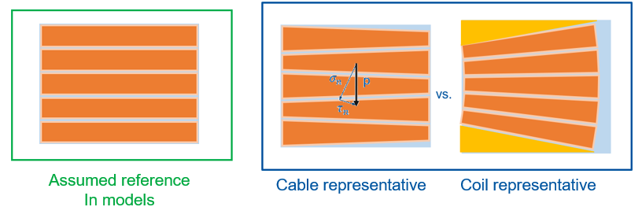
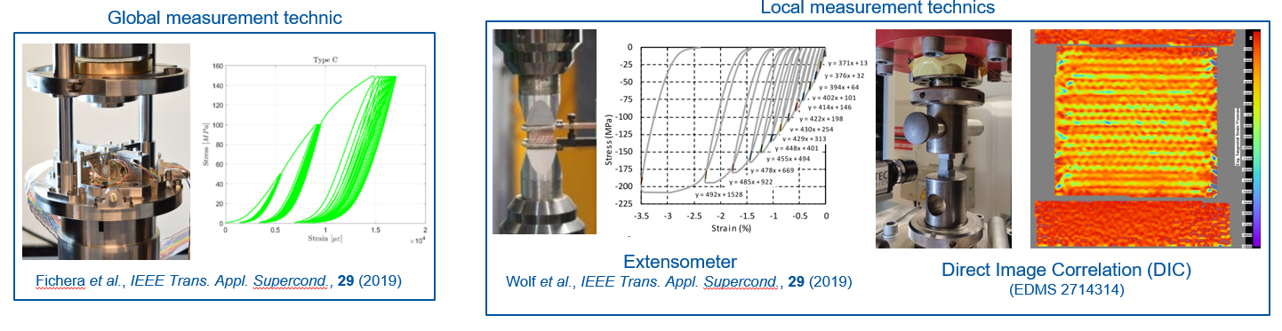
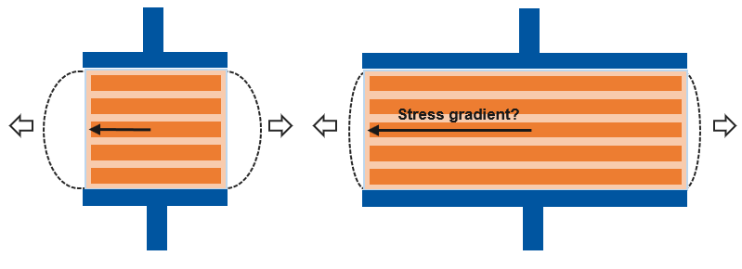
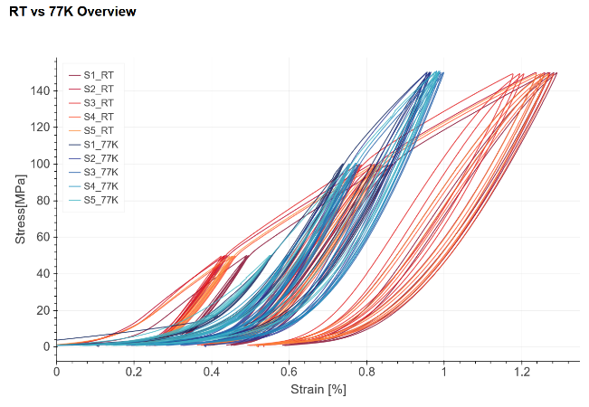
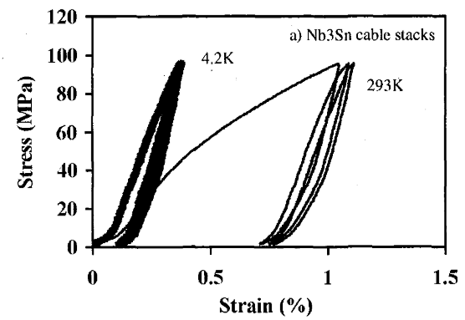
10-stack activities at CERN
Phase 1: Resolve some open questions
  Relevant sample configuration
  Stress/strain measurements methods: global vs local
  Influence of sample’s length
  Effect of surface
  Load effect on CTE
Phase 2: Only then
  Characterize and compare 10-stack for different magnets/coils
  Investigate impact of resin fraction
  Investigate new fiber,
  …
sitting effect
M. Reytier et al., IEEE Trans. Appl. Supercond., 11 (2001)

Slide 15
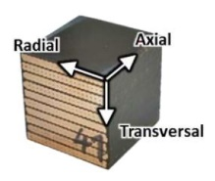
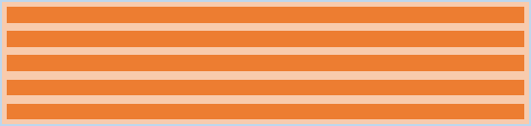
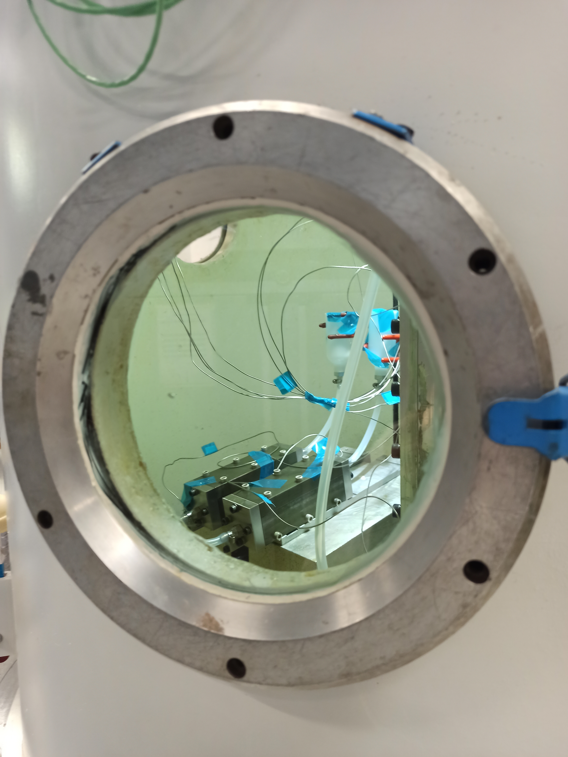
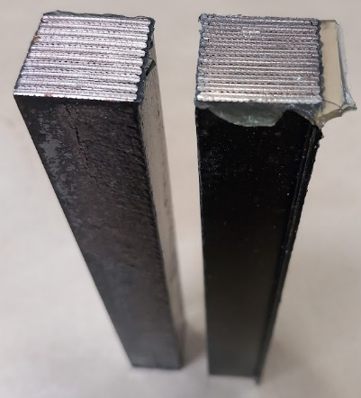
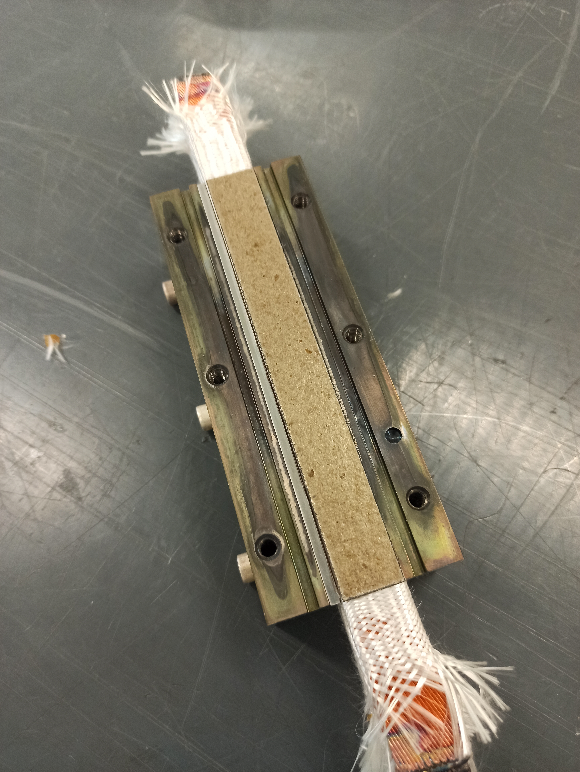
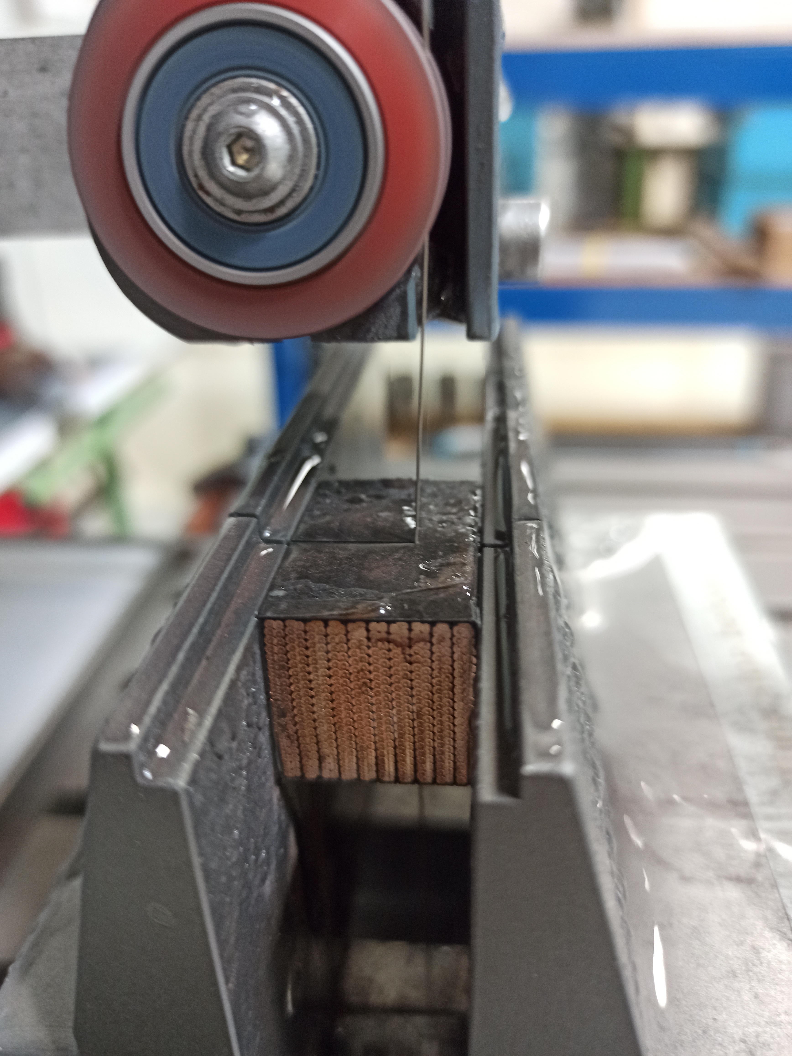
Tests to be performed on each samples
10-stack activities at CERN
Mechanical test (MT) - Stress-Strain curves:
1st campaign
  Validate fabrication reproducibility
  Validate measurement reproducibility
  Start to answer some questions
  (local vs global, length,…)
S1
S4
S7
15
15
25
15
50
15
15
Sample preparation
  Study case cable: Flat MQXF
  3x 150 mm long samples were manufactured
Length impact (LI) + DIC tests:
axial
S2
S3
S5
transversal
15
15
25
15
50
15
15
CTE measurements:
S6
HT preparation
Impregnation
Impregnated samples
Cutting samples
Ongoing. Results at the end of September
15
15
25
15
50
15
15

