Slide 1
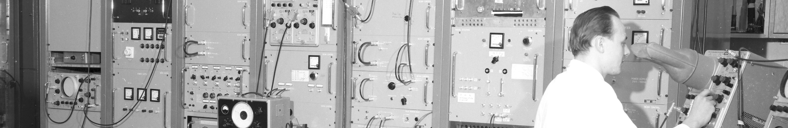
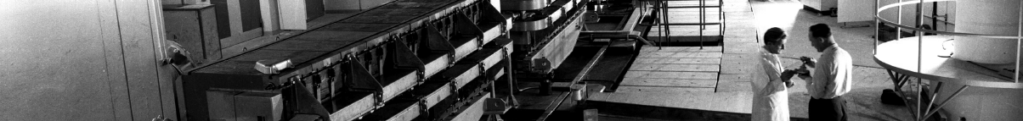
PS Report week 28/29
Many thanks
to the PS OP and coordination teams as well as all equipment experts and support teams!

Slide 2
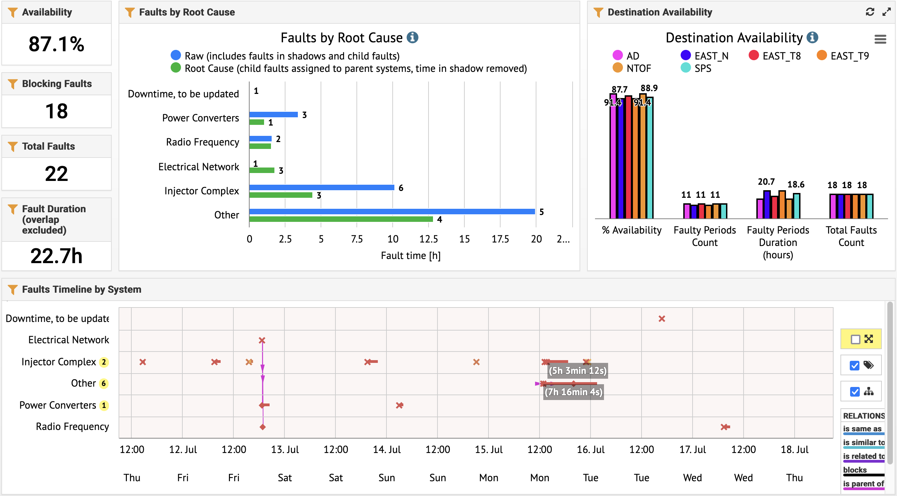
Beam availability Thu 9am – Thu 9am

Slide 3
Main Points
  Four main issues:
    Electrical glitch Friday evening; bending in EAST transfer line required piquet intervention
    2.5h downtime due to Booster injection kicker issue (R3) Saturday evening
    Monday early afternoon 18 kV trip early afternoon due to emergency button destroyed in b358 during a handling accident while dismantling the old PS rotating machine
    → Multiple piquet and specialist interventions.
    → First beams back around 20h (TOF, LHCINDIV), followed by AD and SFTPRO
    → EAST_T8 beam back around 23h, T9/T10 only early Tuesday morning (cooling problem)
    1.5h beam stop Wednesday morning for C10-46 amplifier exchange
    Main progress last days:
    Losses reduced for EAST beam extraction
    PSB-to-PS energy matching and trajectories updated for all beams
    Cycle checked for SFTPRO intensity increase tomorrow
    New optics adjustment to be scheduled (Yann) before using BIG parasitic TOF cycle on EAST

Slide 4

W28 coordinator: Y. Dutheil
W29 coordinator: B. Mikulec
W30 coordinator: Y. Dutheil
Questions and Comments?
09:30 on Mondays: PS-MPC
Zoom link to follow the meeting on remote: https://cern.zoom.us/j/62700463149?pwd=VWdOd1U1UGgrQVlCc2xNRkMwcFFoQT09
09:00 Wed and Fri: PS morning meetings
Zoom link to follow the meeting on remote: https://cern.zoom.us/j/9372114100?pwd=L29BcmlHUENCdFBRSytXYVcrM1B4Zz09
Meeting ID : 937 211 4100
Passcode: 525463

