Slide 1


Updates from STFC
Designing the AAI for SKA
Toward a UK National AAAI Infrastructure
Tom Dack & Ian Collier
Notes:
The abstract pattern can be removed or repositioned if required. Be careful to ‘Send to Back’ so that it does not obscure any important information.

Slide 2
Designing the
AAI for SKA
Notes:
The abstract pattern can be removed or repositioned if required. Be careful to ‘Send to Back’ so that it does not obscure any important information.

Slide 3
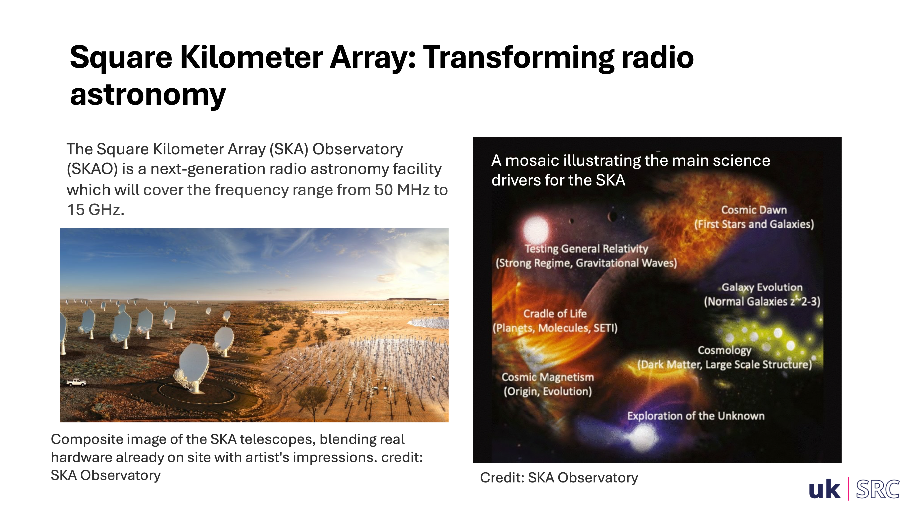

Slide 4
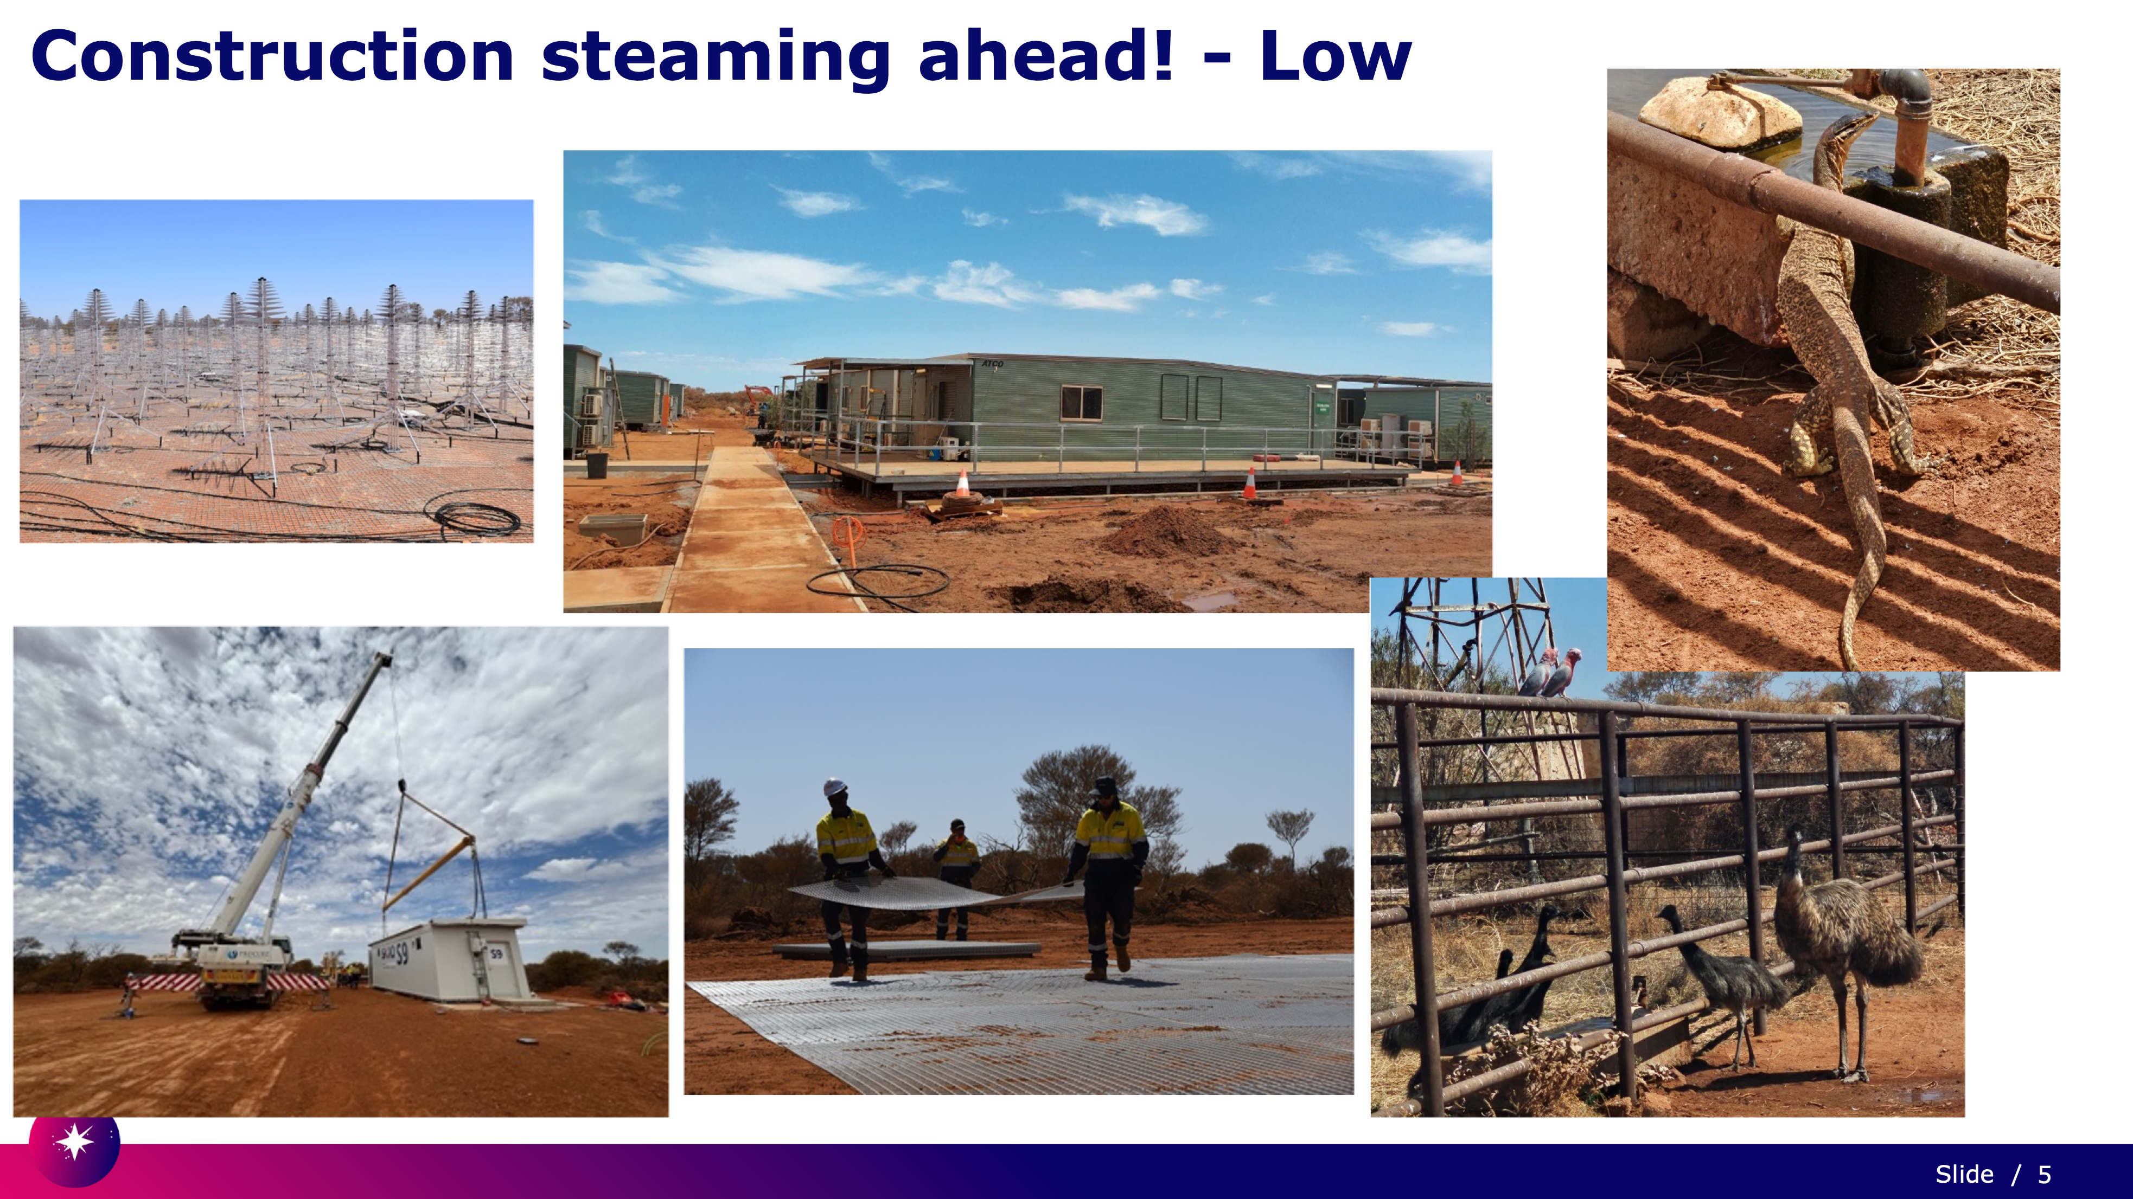

Slide 5


Slide 6
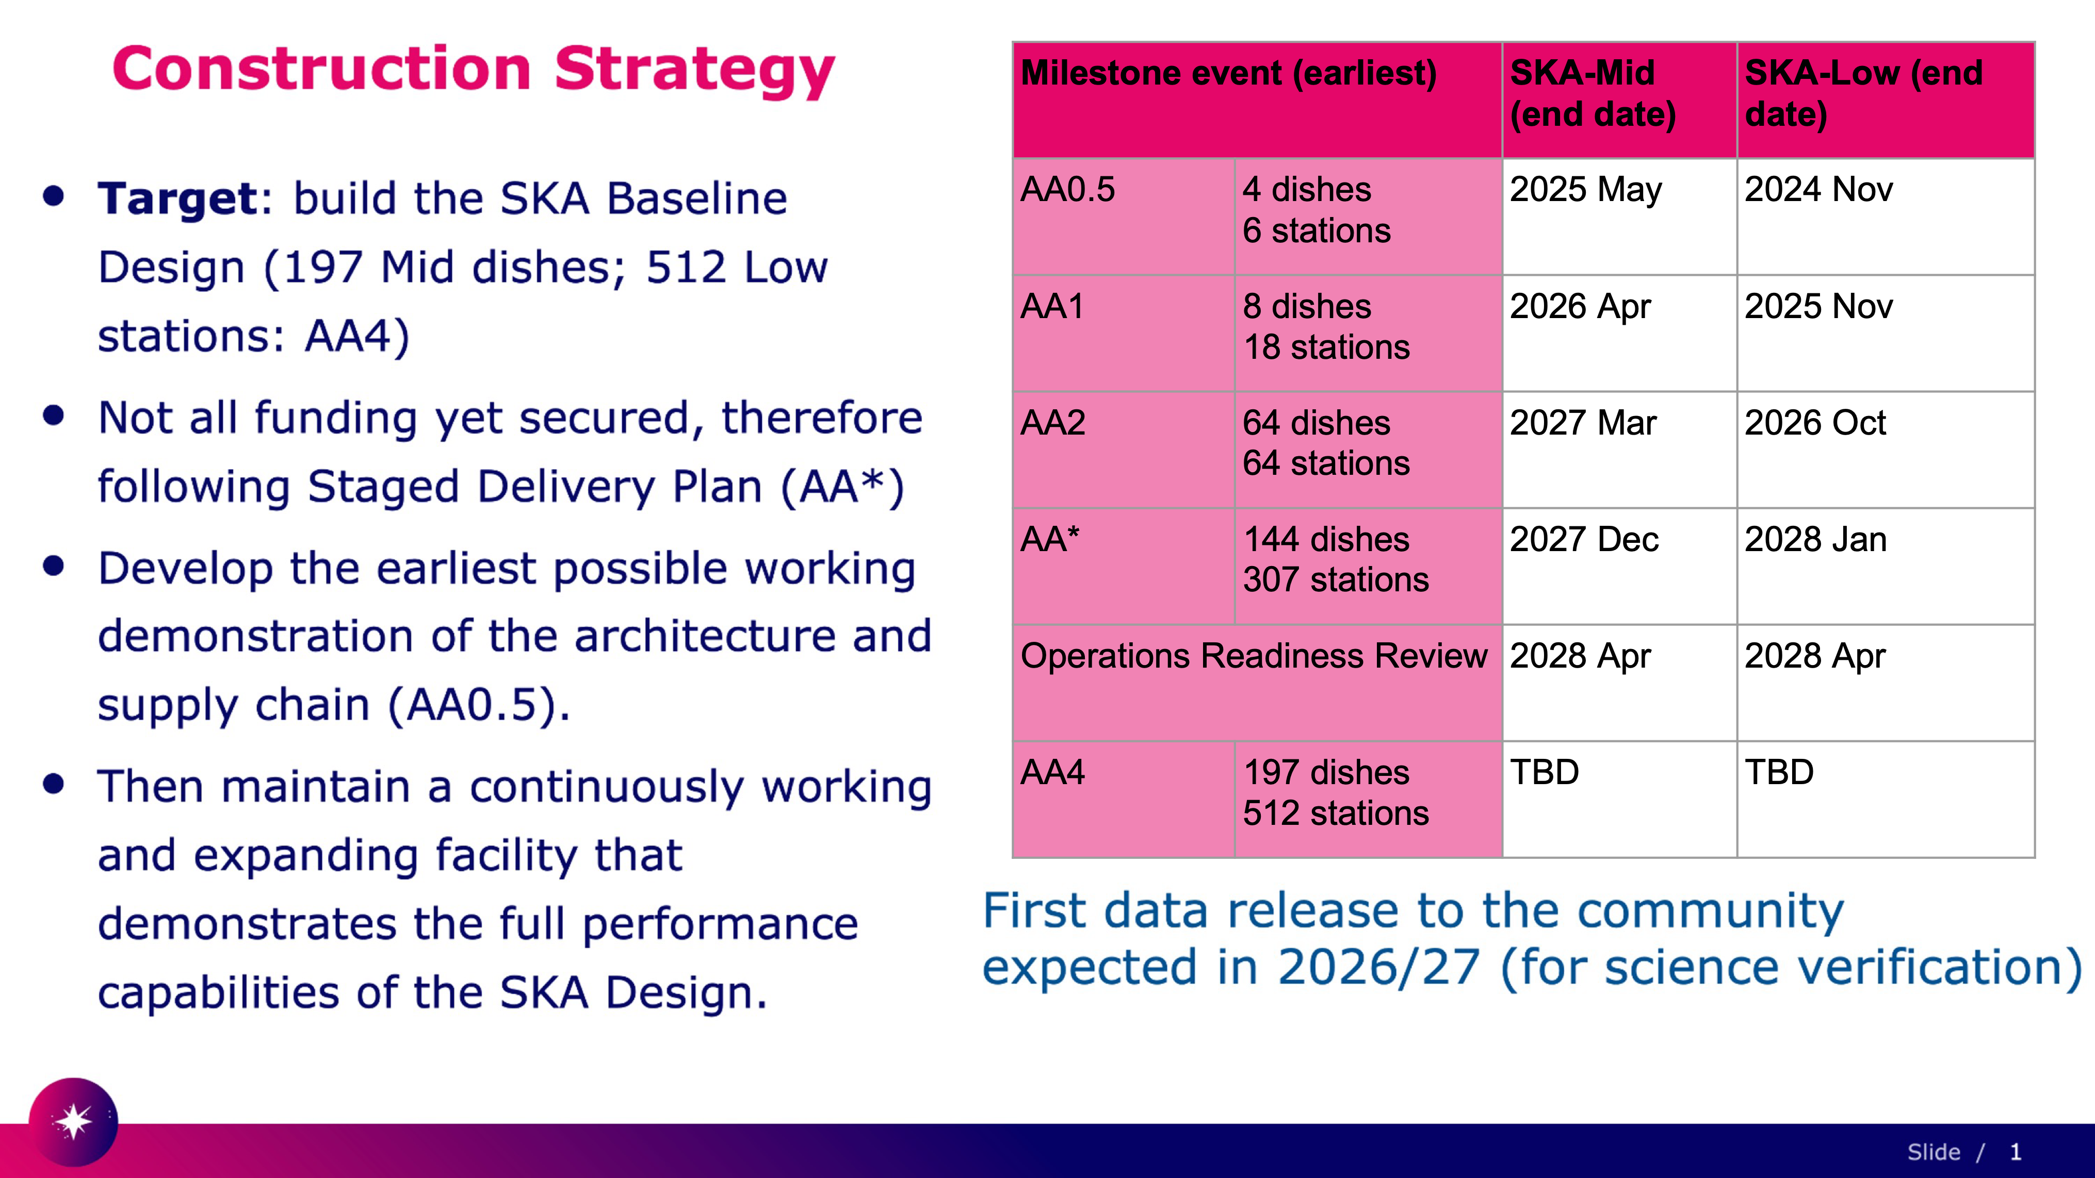

Slide 7
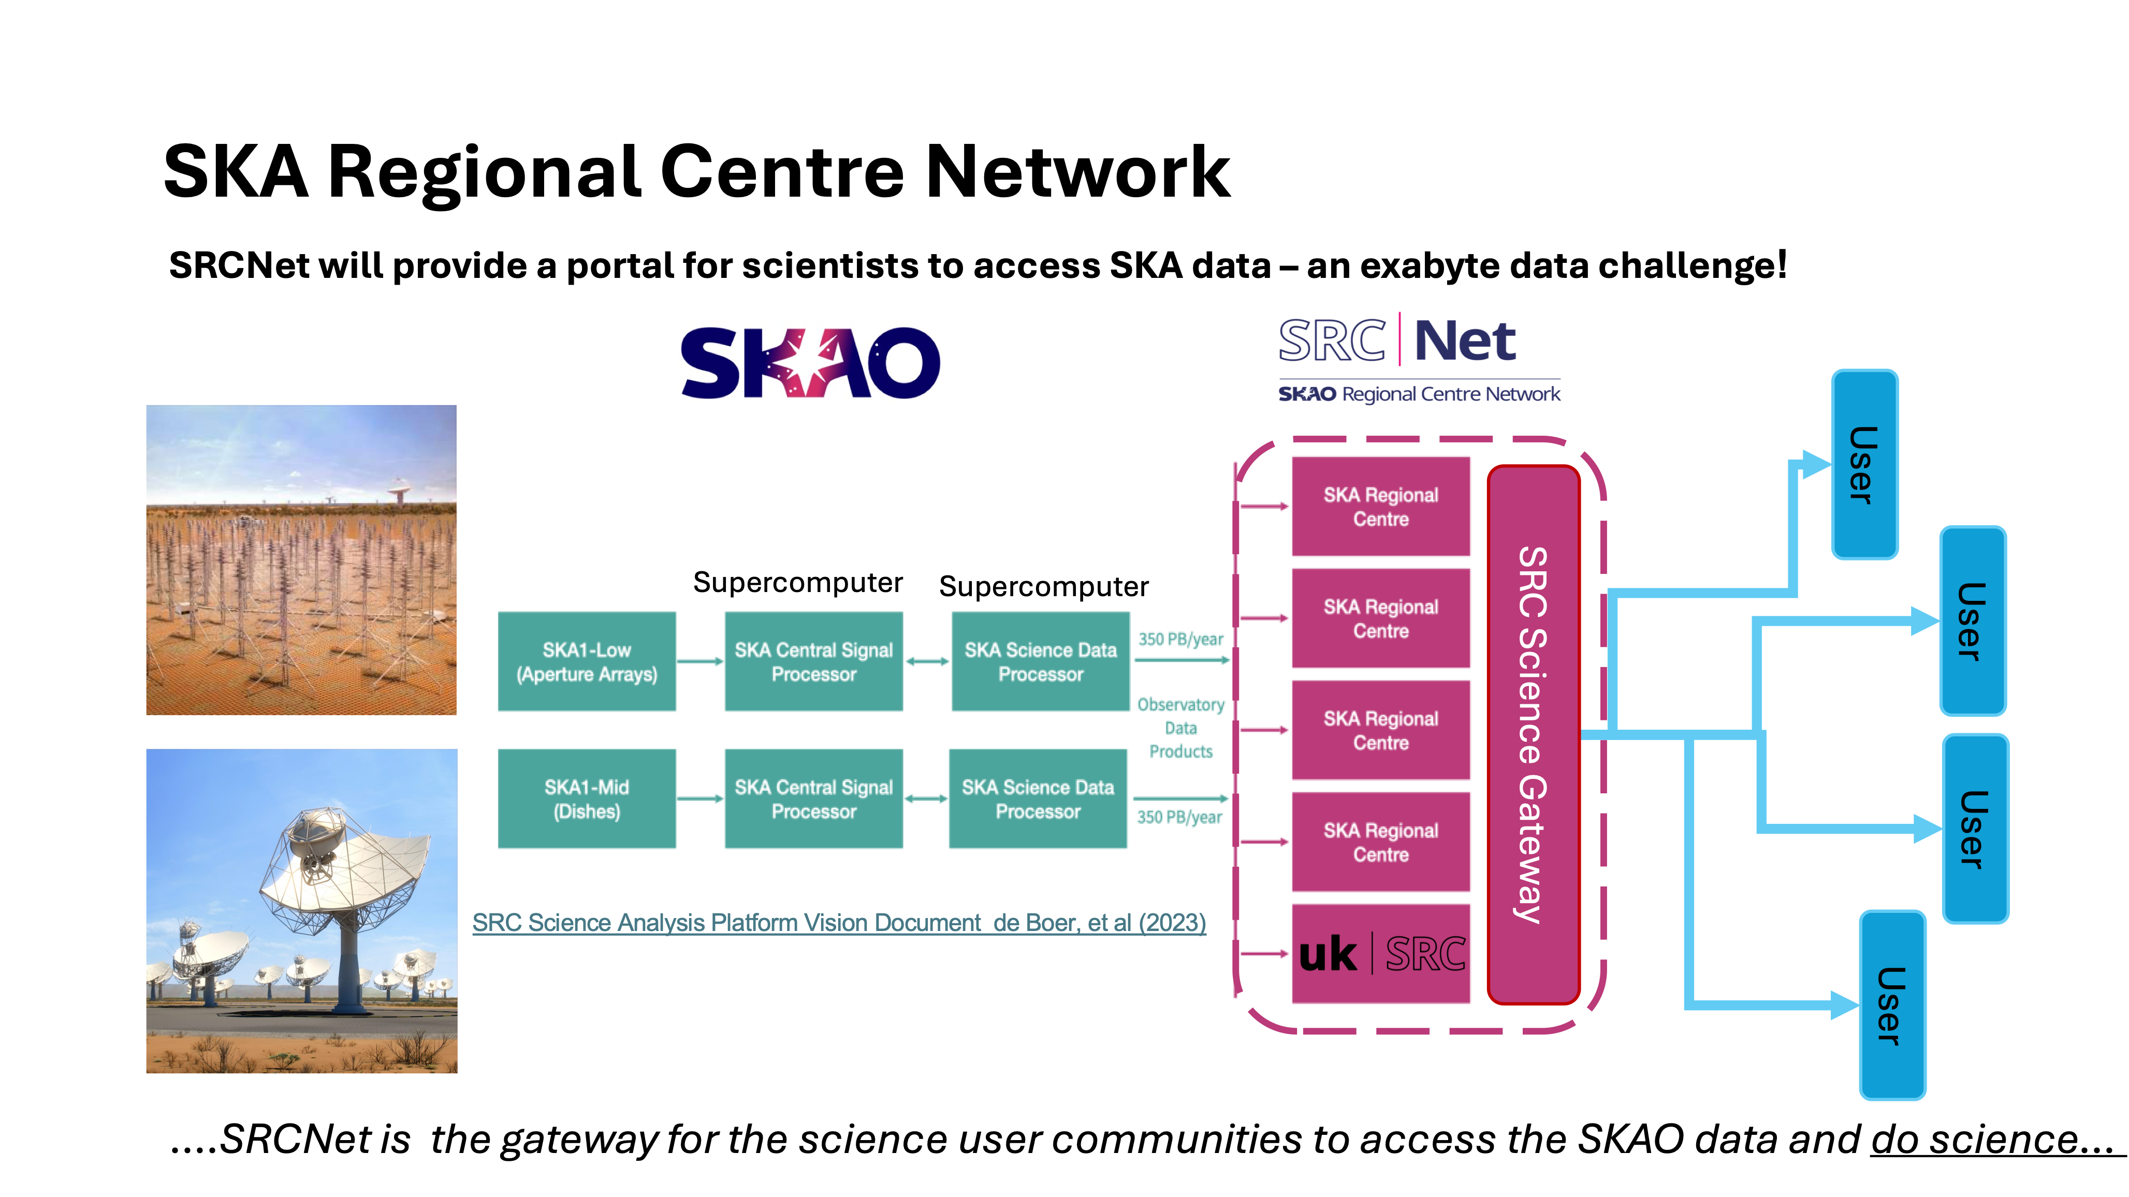

Slide 8
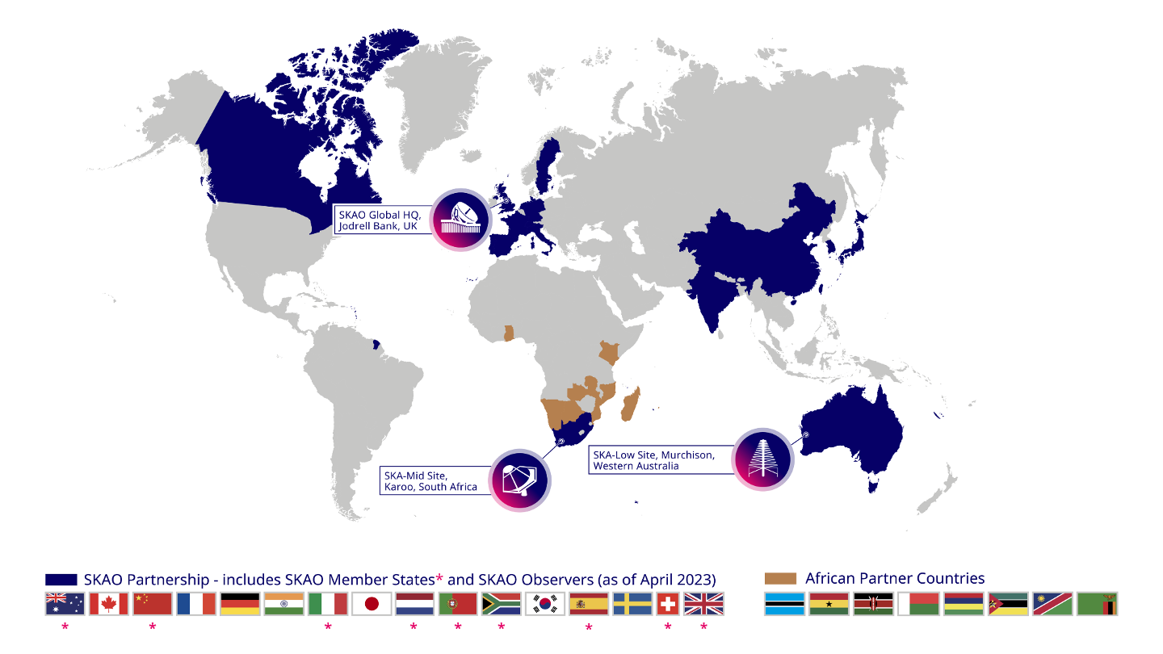
The SRC Network (SRCNet)
The need for a network of SKA Regional Centres (SRCs) formed around ~ 2016:
  Distributed compute, storage and expertise to store, process and disseminate data to the communities
We will develop and deploy a collaborative and federated network of SKA Regional Centres, globally distributed across SKA partner countries, to host the SKA Science Archive. The SRC Network will make data storage, processing and collaboration spaces available, while supporting and training the community, to maximise the scientific productivity and impact of the SKA.

Slide 9
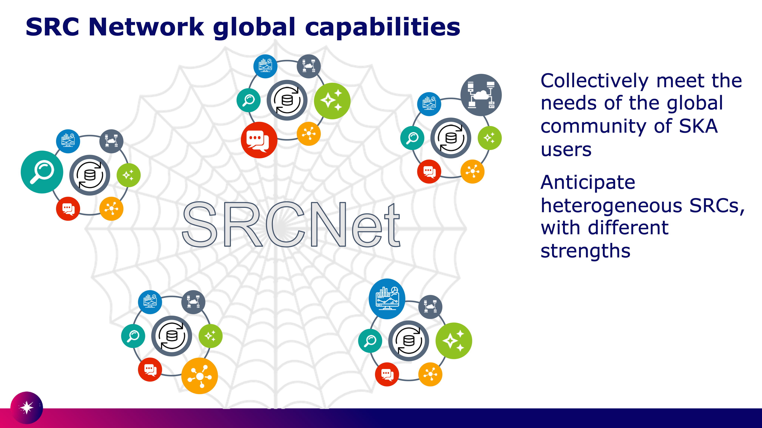

Slide 10
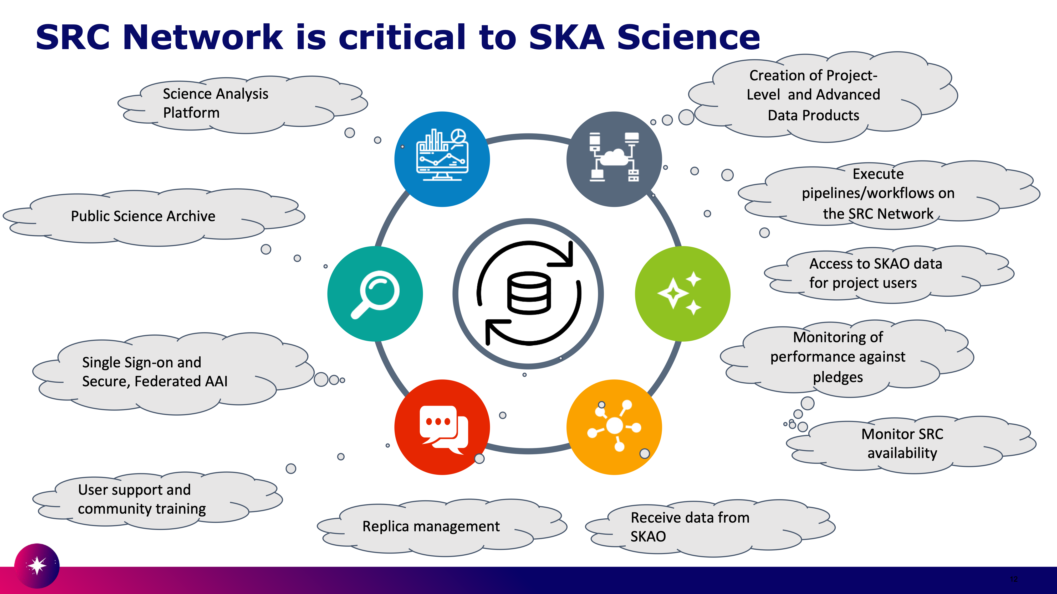

Slide 11
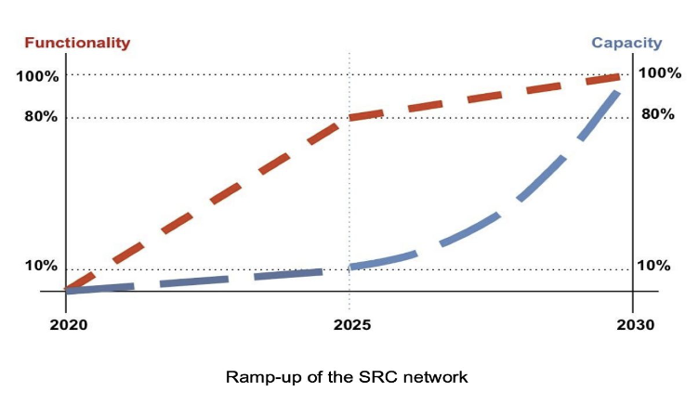
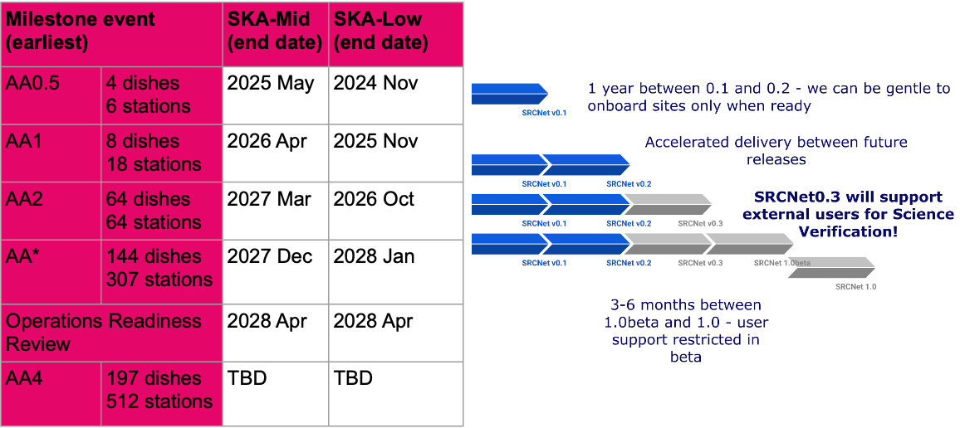
SRCNet Timeline
SRCNet timeline as mapped to the construction roadmap.
  Increased capabilities; then scale out

Slide 12
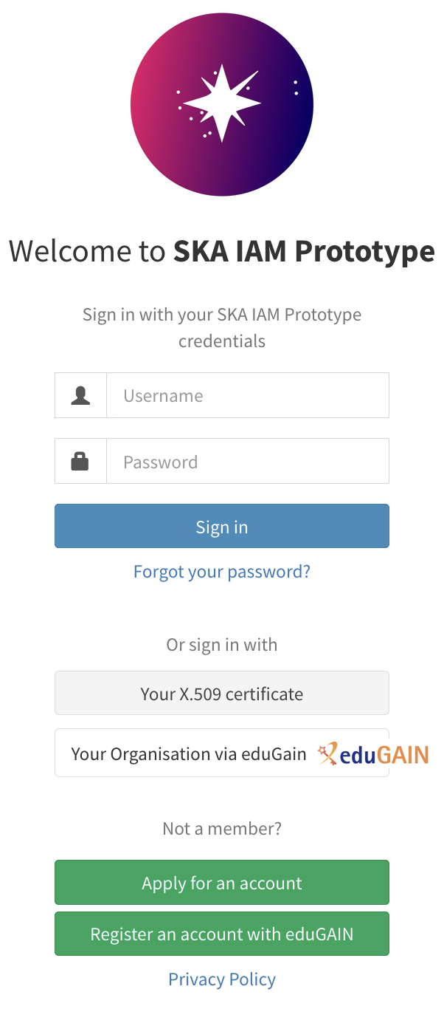
AAI Design - Prototyping
The AAI design for SRCNet is being led by Tom Dack, Ian Collier, and Jens Jensen, in collaboration with SRCNet Architecture & international SRCNet partners
AAI Prototyping
Exploiting prior experience and established infrastructure, the UK has been running a dedicated SRCNet instance of INDIGO IAM.
  This has facilitated early adoption of token workflows into service & infrastructure prototyping
  Also assisted in understanding use cases and needs for the different regional centres
  SKA-IAM has been assessed to meet the AAI needs of SRCNet-0.1

Slide 13
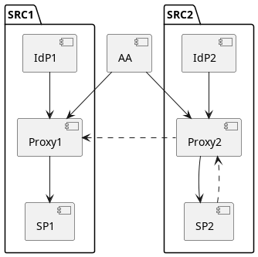
AAI Design – Infrastructure Design
Proposed Design:
Inter-federation of SRCs, which are in turn federations
Network of (appropriately highly available) IdP/SP (Identity Provider/Service Provider) proxies, (more or less) one per SRC
The premise relies upon SRCNet having a single Attribute Authority for Group Management and Identities.
This information is then cached at the SRC level within Community AAIs – maintaining connection to the single SKAO identity
Proxies equipped to trust one another’s tokens
  Off line verification with trust anchors installed for all the proxies they trust (eg the proxies from all the other SRCs – to support “exchange” of work)
  Proxy token introspection (calling out to issuer) as fallback
The SPs only need to know about their “local” proxy and follow their standard OIDC flows
  SP2 can validate tokens issued by Proxy 1, following the dashed arrows

Slide 14
AAI Design – Next Steps
Initial discussions to understand hosting and technologies are underway, both with
  SKAO central IT
  INFN CNAF (to understand current capabilities of IAM)
Further socialisation of the AAI Design Principles within SRCNet, in order to communicate requirements and identify user stories
Group Schemas for SRCNet are under discussion
  Groups will need to be communicated from AA to Community AAIs
  Differing group requirements across SRCs
SRCNet 0.1 will take place using SKA-IAM, but future SRCNet releases should investigate a prototype deployment.

Slide 15


Notes:
The abstract pattern can be removed or repositioned if required. Be careful to ‘Send to Back’ so that it does not obscure any important information.

Slide 16
Toward a UK National AAAI Infrastructure
Notes:
The abstract pattern can be removed or repositioned if required. Be careful to ‘Send to Back’ so that it does not obscure any important information.

Slide 17
Toward a UK National AAAI Infrastructure
Vision Statement -
That any eligible and authorised researcher in the UK can:
access any research data, computational or experimental system or other resource, whether in the UK or elsewhere …
in a straightforward, controlled and consistent way that enables access …
whether she or he works in industry, in academe, in the public or the third sector, or is acting as a private individual; and that this …
provides the assurance and security legitimately required by the owners and providers of those resources, in fulfilment of their missions, and in compliance with their legal, contractual and regulatory obligations.
New opportunity in UK
Part of UK Research and Innovation’s developing idea/ambition for a coherent UK Digital Research Infrastructure
White paper published in 2019 setting out then state of the art, requirements and benefits
Tom and Ian ”invited” to create a proposal to pick this up ☺
  Landscape has changed
    Many services around the world to learn from
      We will be speaking to you
    UK user community has changed

Slide 18
Notes:
The abstract pattern can be removed or repositioned if required. Be careful to ‘Send to Back’ so that it does not obscure any important information.

Slide 19


scd.stfc.ac.uk
@SciComp_STFC
Notes:
The abstract pattern can be removed or repositioned if required. Be careful to ‘Send to Back’ so that it does not obscure any important information.

