Slide 1


Optimization of the Muon Tight WP for the ATLAS experiment
Yongwen Zheng
Kevin Nelson
30 July 24

Slide 2
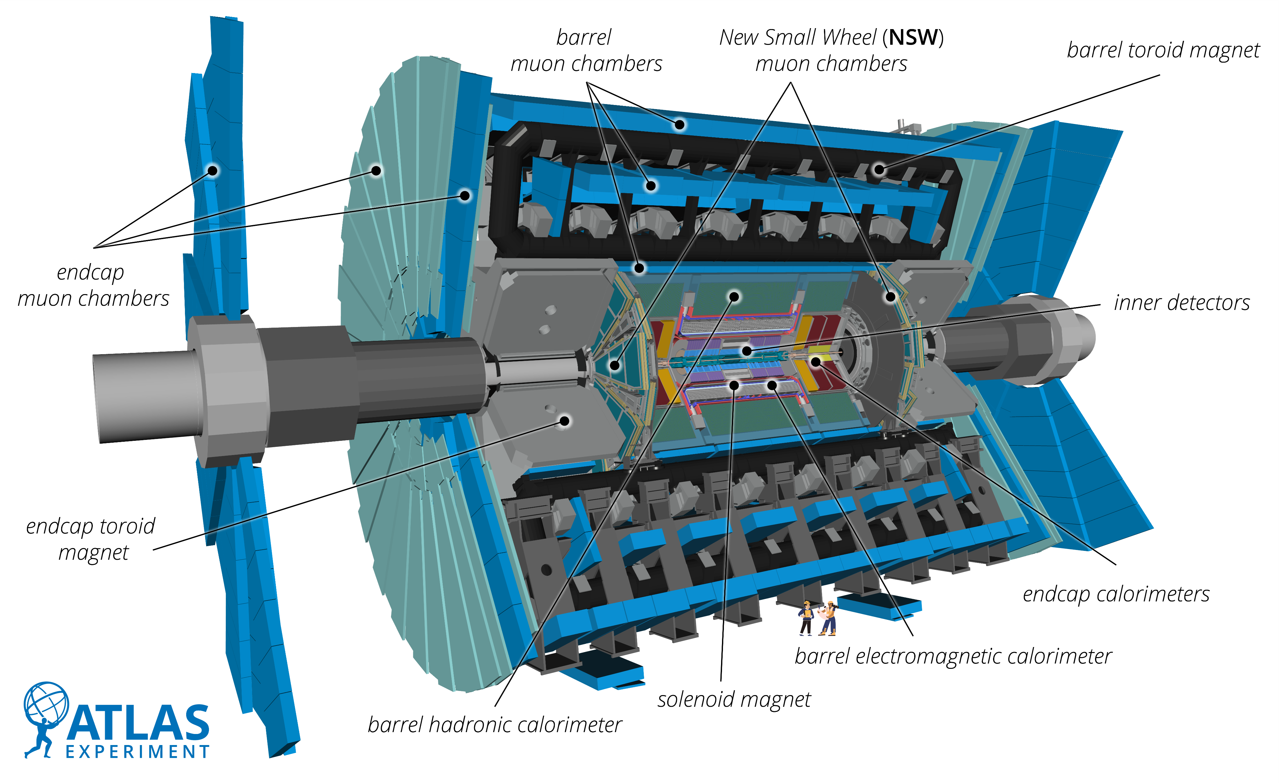


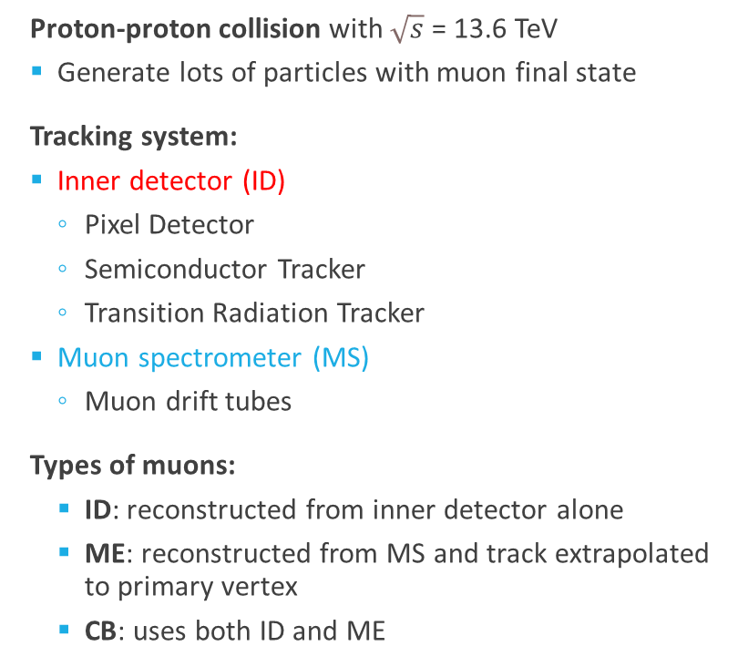
The ATLAS Detector in Run 3
0 < $\text{η}$< 1.05
  Proton-proton collision with $\sqrt{s}$ = 13.6 TeV
  Generate lots of particles with muon final state
  Tracking system:
  Inner detector (ID)
    Pixel Detector
    Semiconductor Tracker
    Transition Radiation Tracker
  Muon spectrometer (MS)
    Muon drift tubes
  Types of muons:
    ID: reconstructed from inner detector alone
    ME: reconstructed from MS and track extrapolated to primary vertex
    CB: uses both ID and ME
$\text{η}$> 1.4
Notes:
Draw arrows

Slide 3
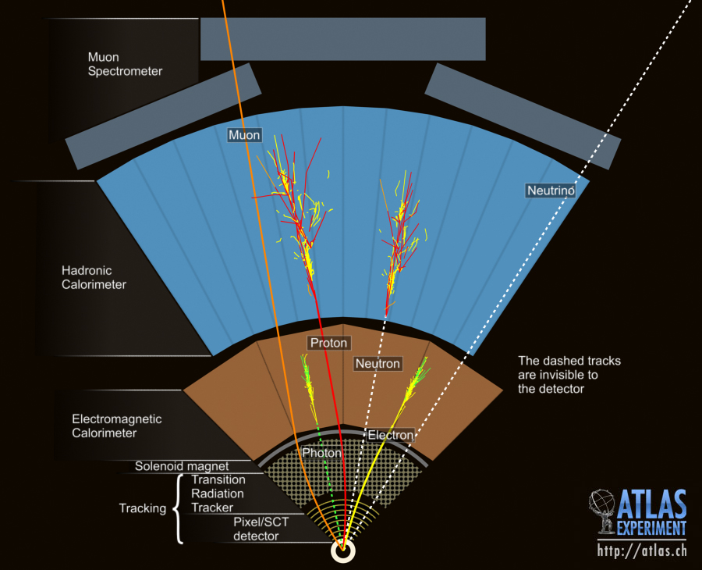
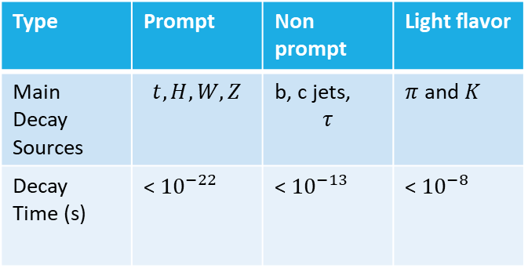
Muon Identification Motivation
Type | Prompt | Non prompt | Light flavor
Main Decay Sources | $$t, H, W, Z$$ | b, c jets, $$τ$$ | $π$ and $K$
Decay Time (s) | < ${10}^{−22}$ | < ${10}^{−13}$ | < ${10}^{−8}$
  Want to study heavy particles (H, t) and increase pure sample of prompt muons
  Increase prompt muon acceptance and light flavor rejection
  Separating prompt and nonPrompt is work for isolation workgroup (not mine🙃)
Notes:
Particles get produced at the collision point and some decay into muons. Depending on the source, the muons are classified.
For prompt and nonprompt, the decay happens early enough so the majority of the track recorded by the detector is a muon.
However, for light flavor, pion and kaon track can be up to 10 meters long. The track is not purely muonic.

Slide 4
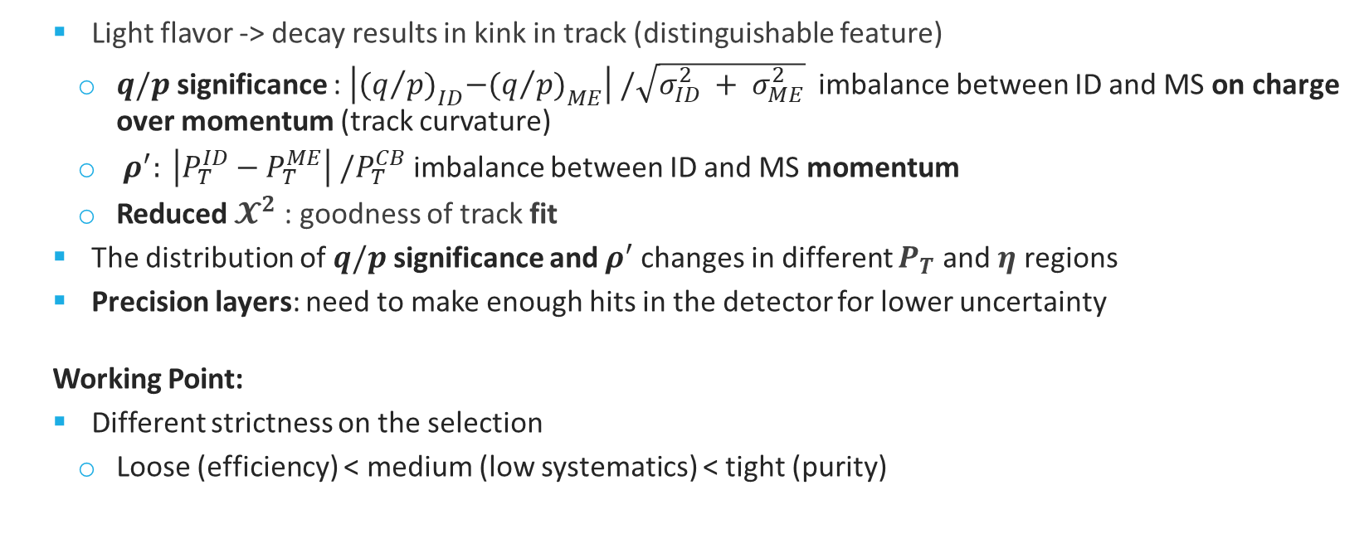
Important Variables for Cuts
  Light flavor -> decay results in kink in track (distinguishable feature)
    $q/p$ significance : $\left|{(q/{p)}}_{ID}−{(q/{p)}}_{ME}\right| /\sqrt{σ_{ID}^{2} + σ_{ME}^{2}}$ imbalance between ID and MS on charge over momentum (track curvature)
    ${ ρ}^{′}: \left|P_{T}^{ID}−P_{T}^{ME}\right|{ /P}_{T}^{CB}$ imbalance between ID and MS momentum
    Reduced $𝓧^{2}$ : goodness of track fit
  The distribution of $q/p$ significance and $ρ^{′}$ changes in different $P_{T}$ and $\text{η}$ regions
  Precision layers: need to make enough hits in the detector for lower uncertainty
  Working Point:
  Different strictness on the selection
    Loose (efficiency) < medium (low systematics) < tight (purity)

Slide 5
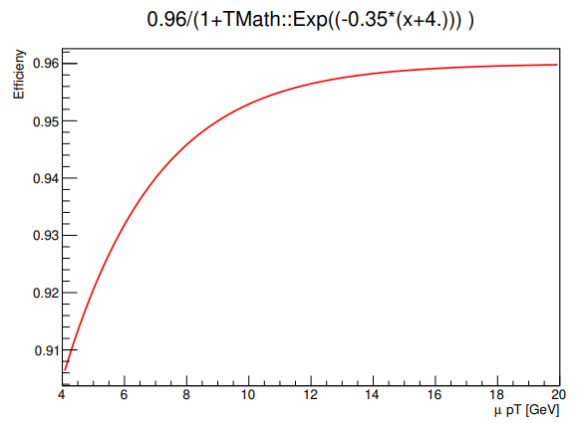
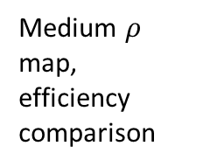
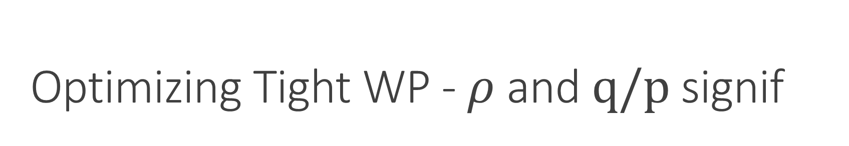
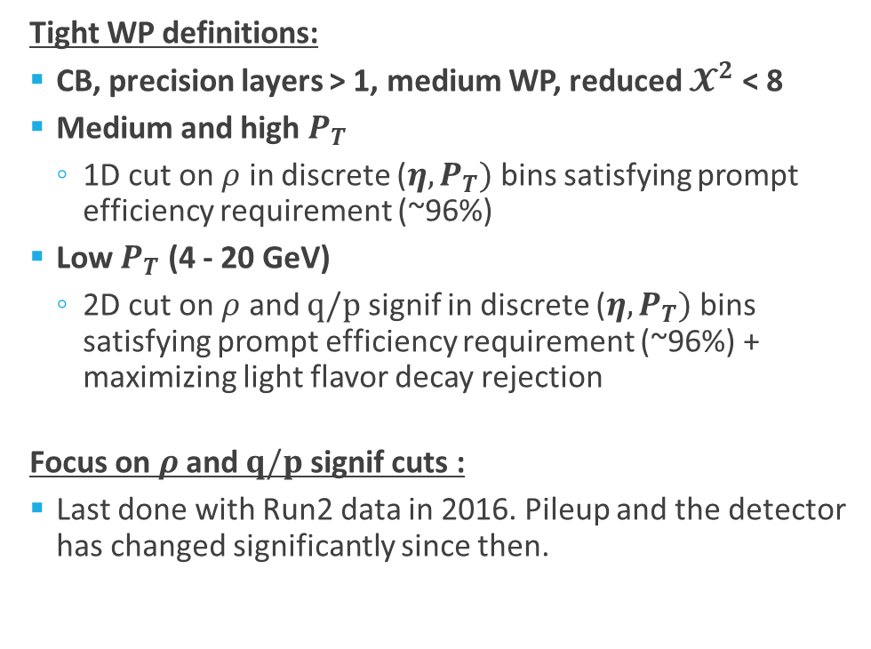
Optimizing Tight WP - $ρ$ and $q/p \text{signif}$
  Tight WP definitions:
  CB, precision layers > 1, medium WP, reduced $𝓧^{2}$ < 8
  Medium and high $P_{T}$
    1D cut on $ρ$ in discrete ${\text{(}\text{η},P}_{T})$ bins satisfying prompt efficiency requirement (~96%)
  Low $P_{T}$ (4 - 20 GeV)
    2D cut on $ρ$ and $q/p$ signif in discrete ${\text{(}\text{η},P}_{T})$ bins satisfying prompt efficiency requirement (~96%) + maximizing light flavor decay rejection
  Focus on $ρ$ and $q/p$ signif cuts :
  Last done with Run2 data in 2016. Pileup and the detector has changed significantly since then.
Medium $ρ$ map,
efficiency comparison
Prompt muon efficiency requirement
New approach for L.F.,
efficiency
From WP internal note

Slide 6
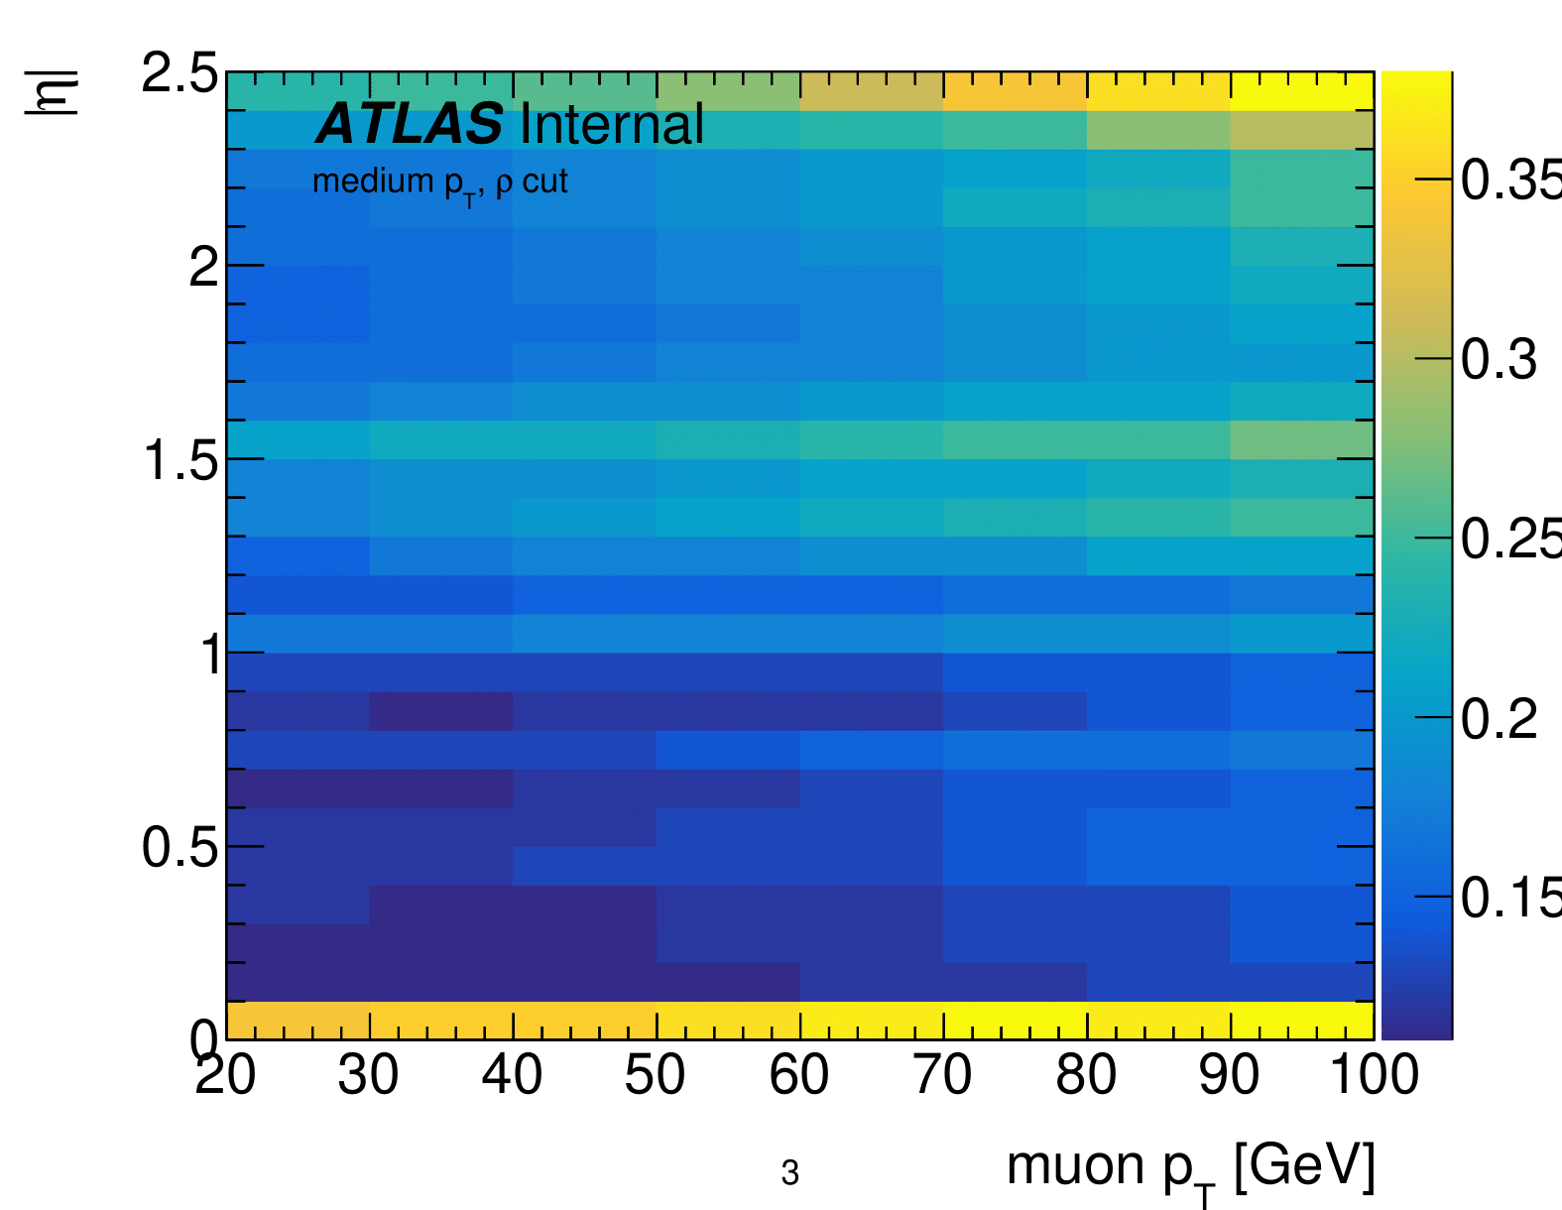
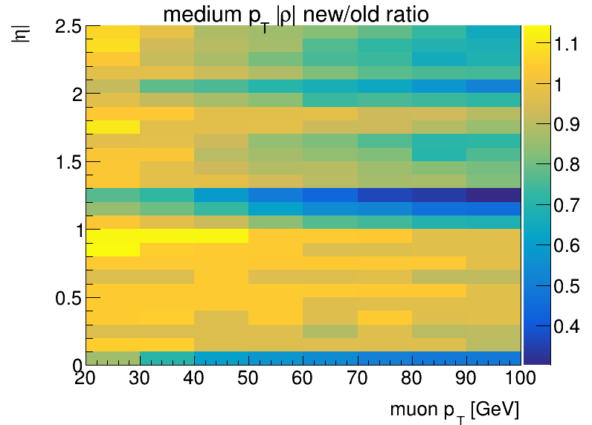
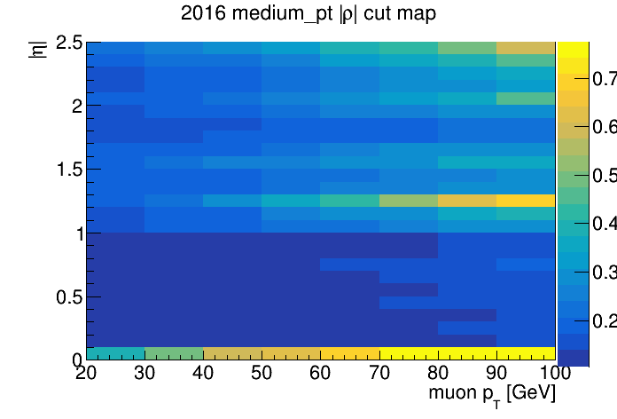

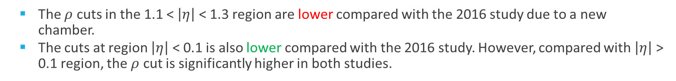
Medium $P_{T}$ - $ρ$ Map
  The $ρ$ cuts in the 1.1 < $\left|η\right|$ < 1.3 region are lower compared with the 2016 study due to a new chamber.
  The cuts at region $\left|η\right|$ < 0.1 is also lower compared with the 2016 study. However, compared with $\left|η\right|$ > 0.1 region, the $ρ$ cut is significantly higher in both studies.
Notes:
Remember to explain meaning of the map

Slide 7
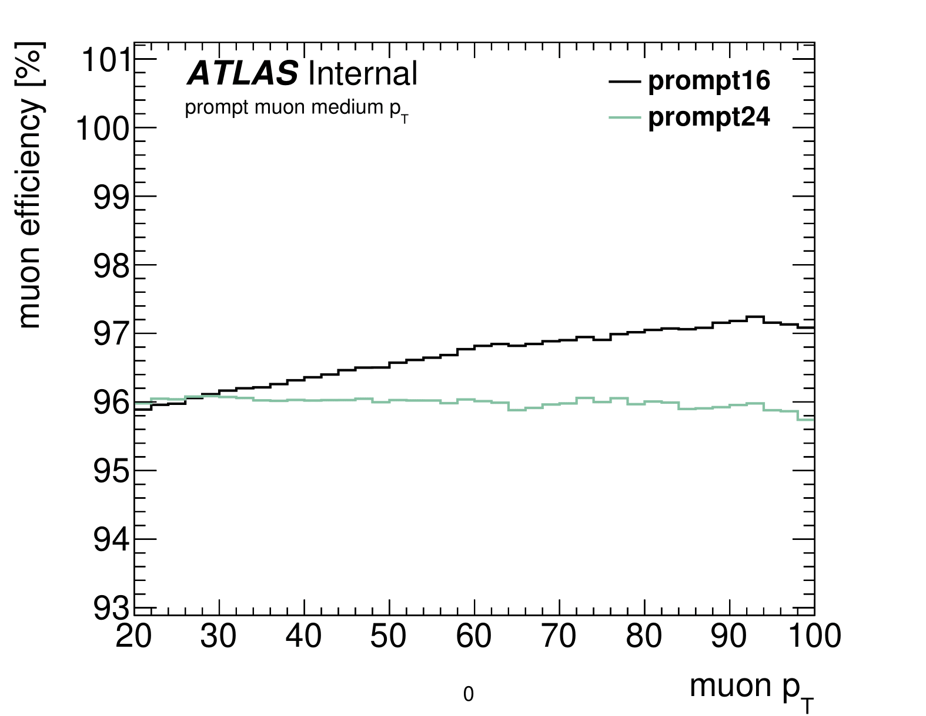
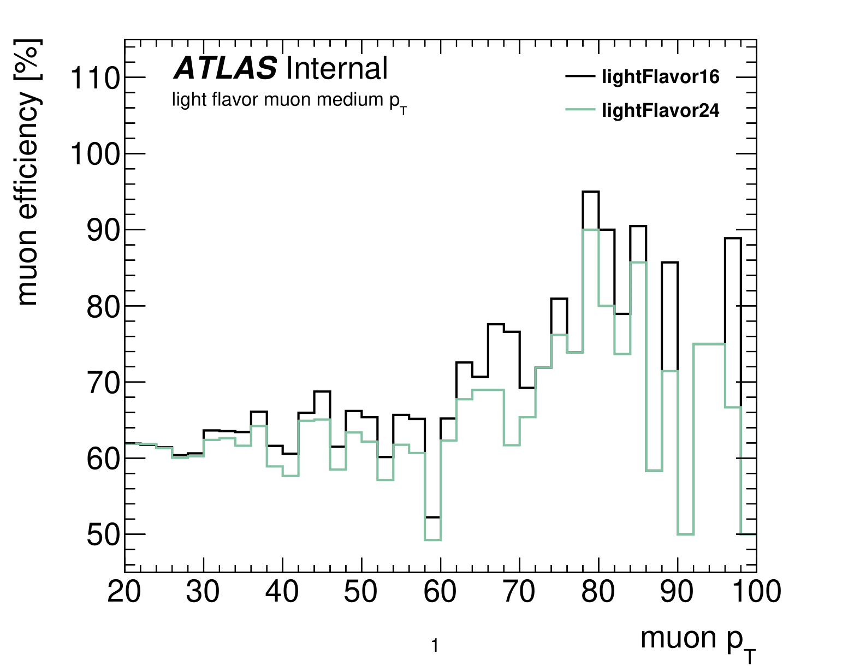

Medium $P_{T}$ - efficiency by $P_{T}$
Efficiency := # of tight muons / # of medium muons
  ~1% loss of efficiency in prompt acceptance
  Significantly better in L.F. rejection

Slide 8
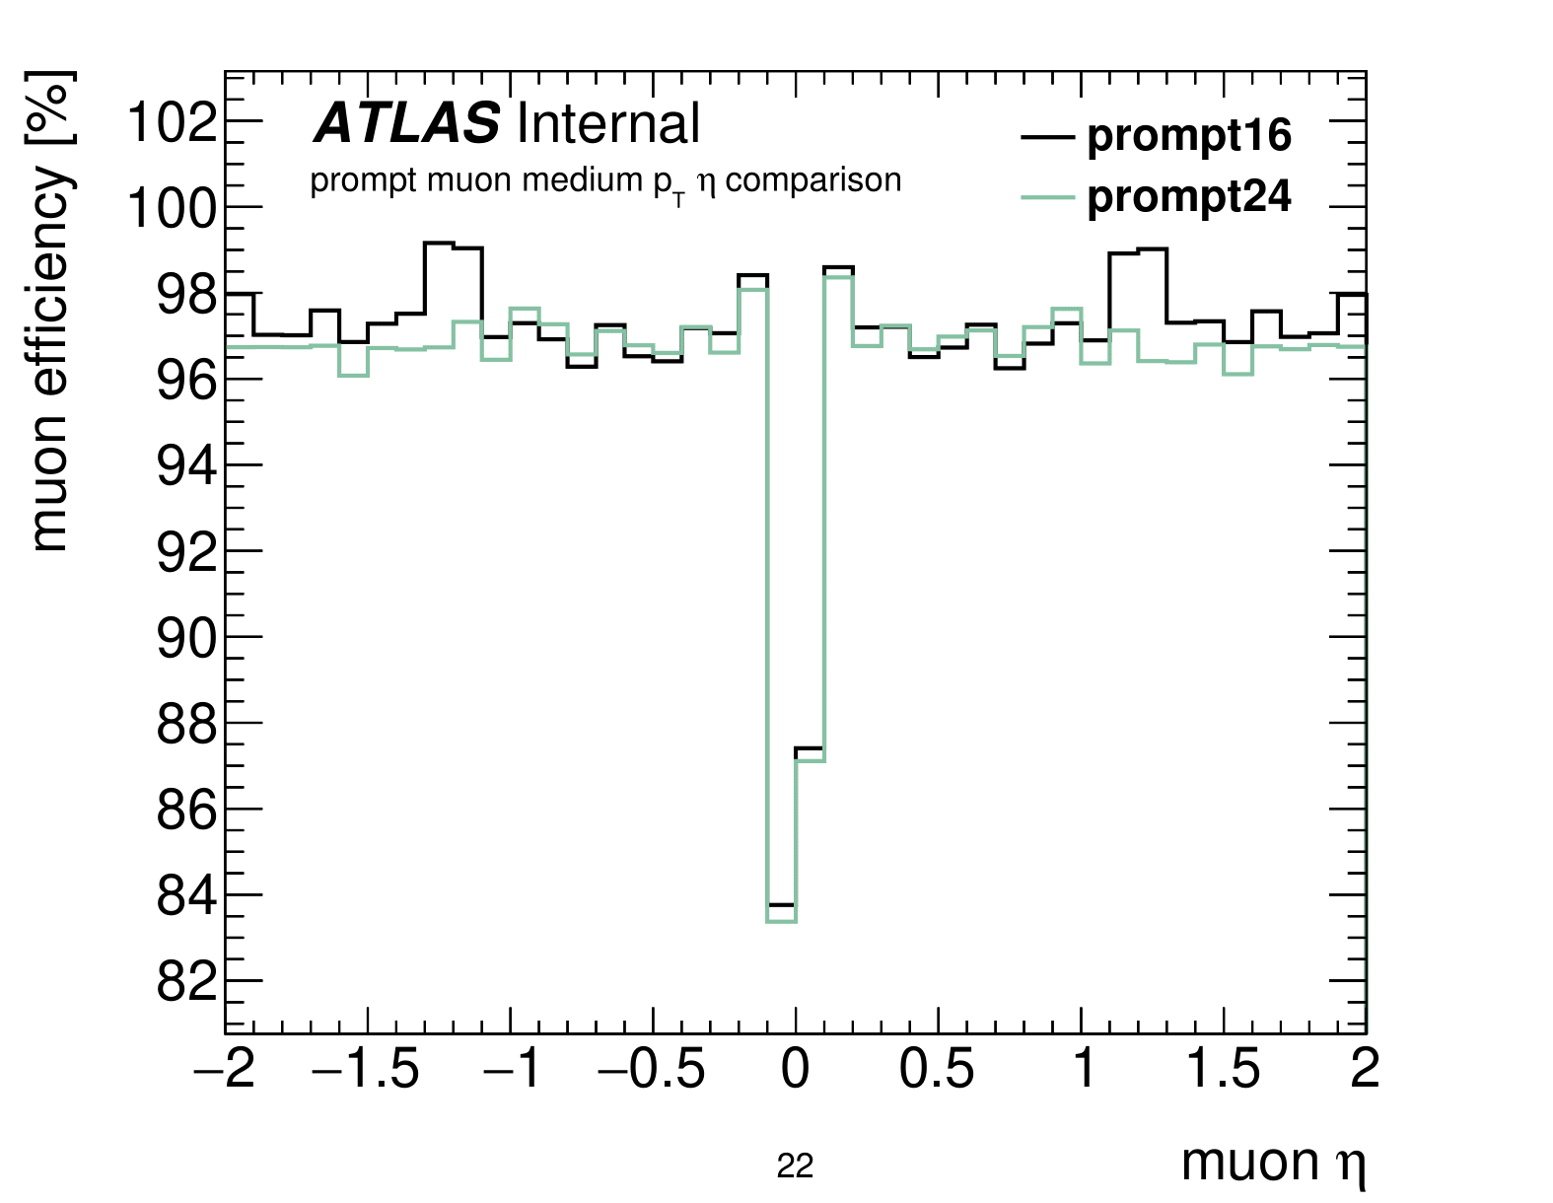
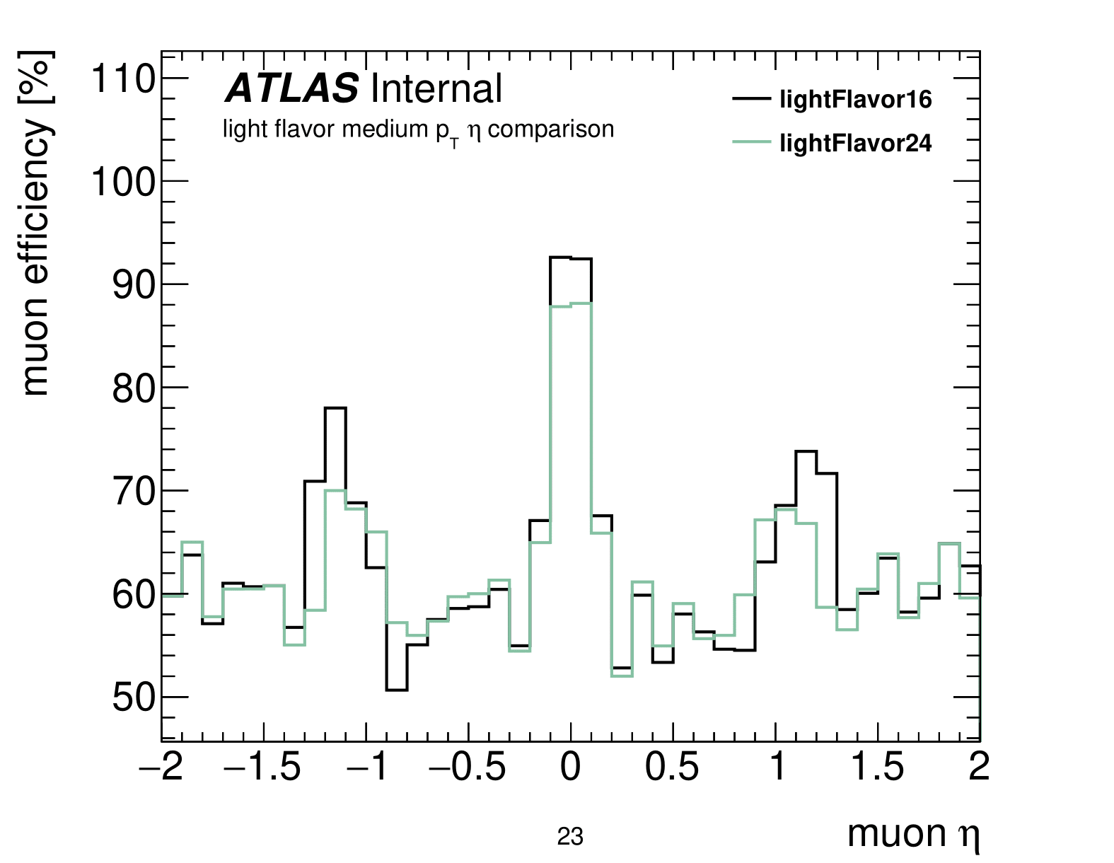

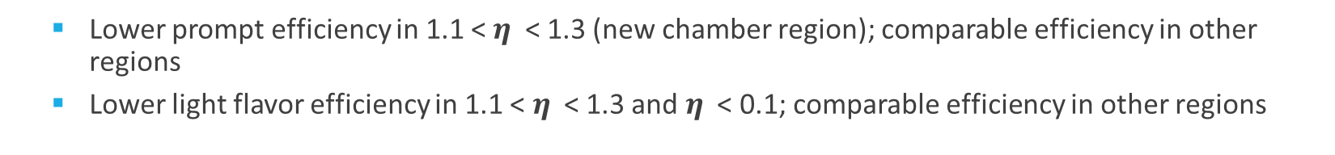
Medium $P_{T}$ - efficiency by $\text{η}$
  Lower prompt efficiency in 1.1 < $\text{η}$ < 1.3 (new chamber region); comparable efficiency in other regions
  Lower light flavor efficiency in 1.1 < $\text{η}$ < 1.3 and $\text{η}$ < 0.1; comparable efficiency in other regions

Slide 9
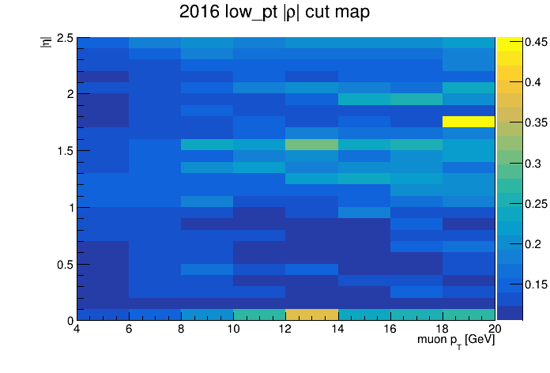
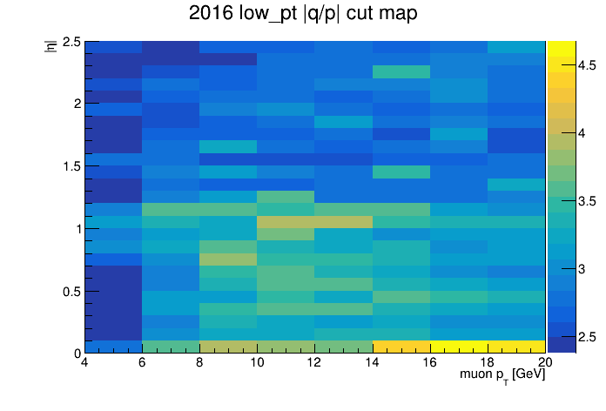
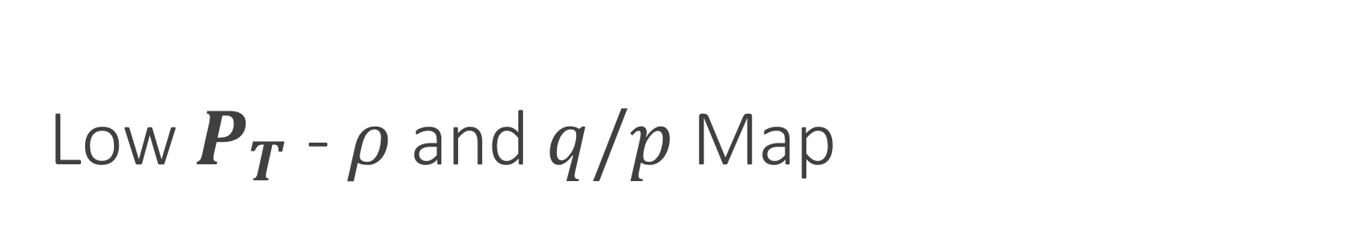
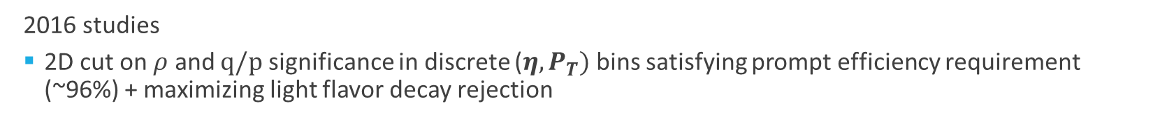
Low $P_{T}$ - $ρ$ and $q/p$ Map
Average ~0.17
Average ~3.3
  2016 studies
  2D cut on $ρ$ and $q/p$ significance in discrete ${\text{(}\text{η},P}_{T})$ bins satisfying prompt efficiency requirement (~96%) + maximizing light flavor decay rejection

Slide 10
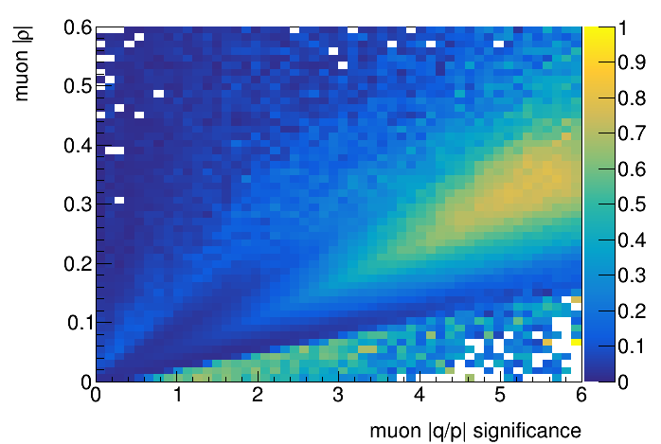
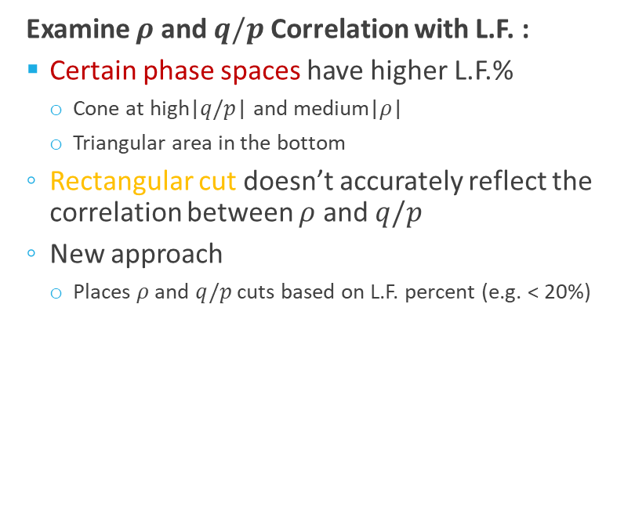
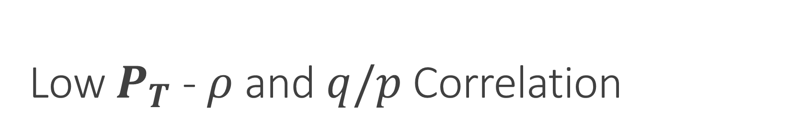

Low $P_{T}$ - $ρ$ and $q/p$ Correlation
  Examine $ρ$ and $q/p$ Correlation with L.F. :
  Certain phase spaces have higher L.F.%
    Cone at high|$q/p$| and medium|$ρ$|
    Triangular area in the bottom
  Rectangular cut doesn’t accurately reflect the correlation between $ρ$ and $q/p$
  New approach
    Places $ρ$ and $q/p$ cuts based on L.F. percent (e.g. < 20%)
Percent Light Flavor
All eta, 4 < $P_{T}$ < 20 GeV

Slide 11
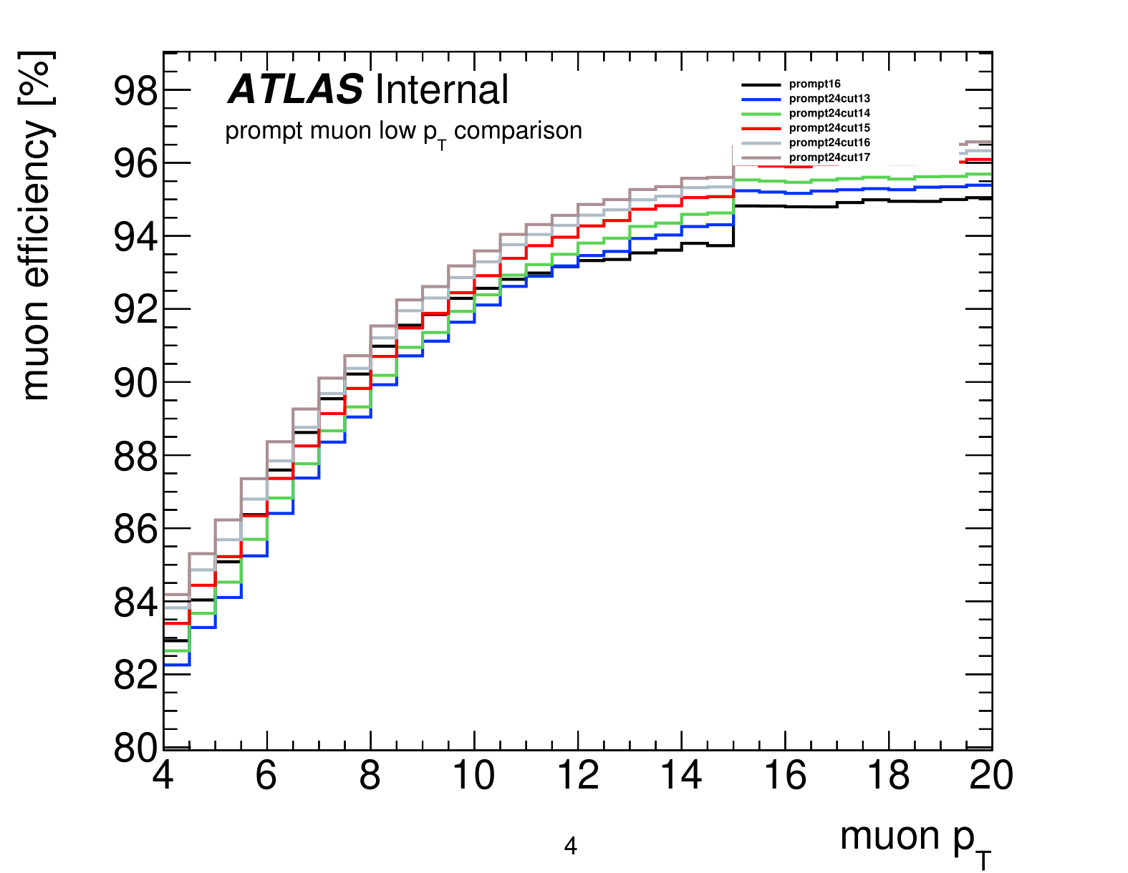
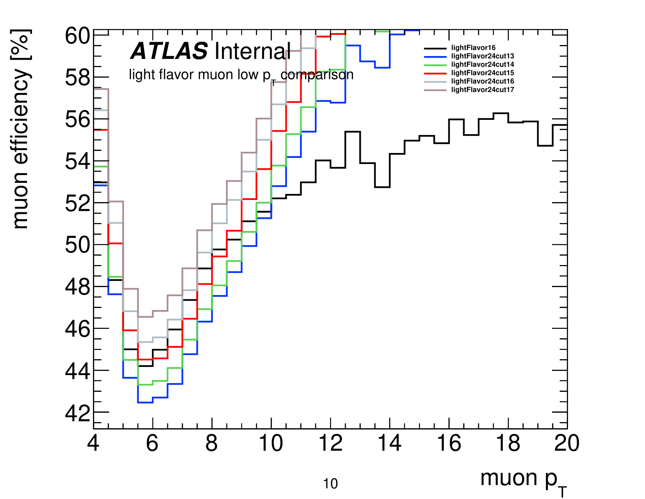
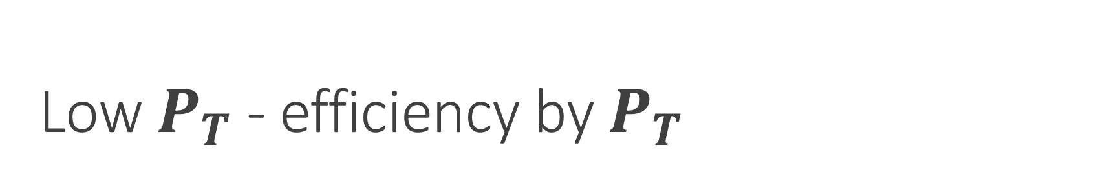
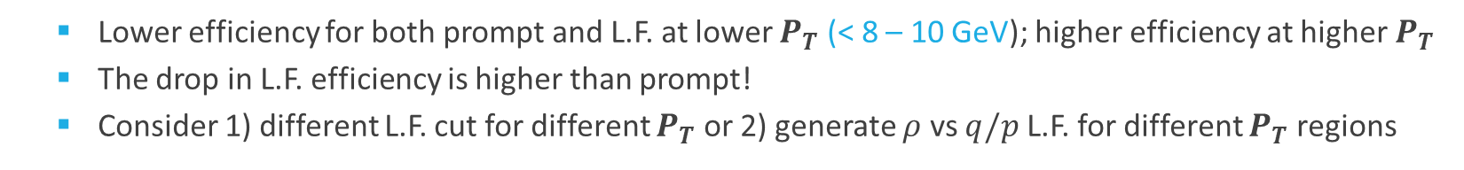
Low $P_{T}$ - efficiency by $P_{T}$
  Lower efficiency for both prompt and L.F. at lower $P_{T}$ (< 8 – 10 GeV); higher efficiency at higher $P_{T}$
  The drop in L.F. efficiency is higher than prompt!
  Consider 1) different L.F. cut for different $P_{T}$ or 2) generate $ρ$ vs $q/p$ L.F. for different $P_{T}$ regions

Slide 12
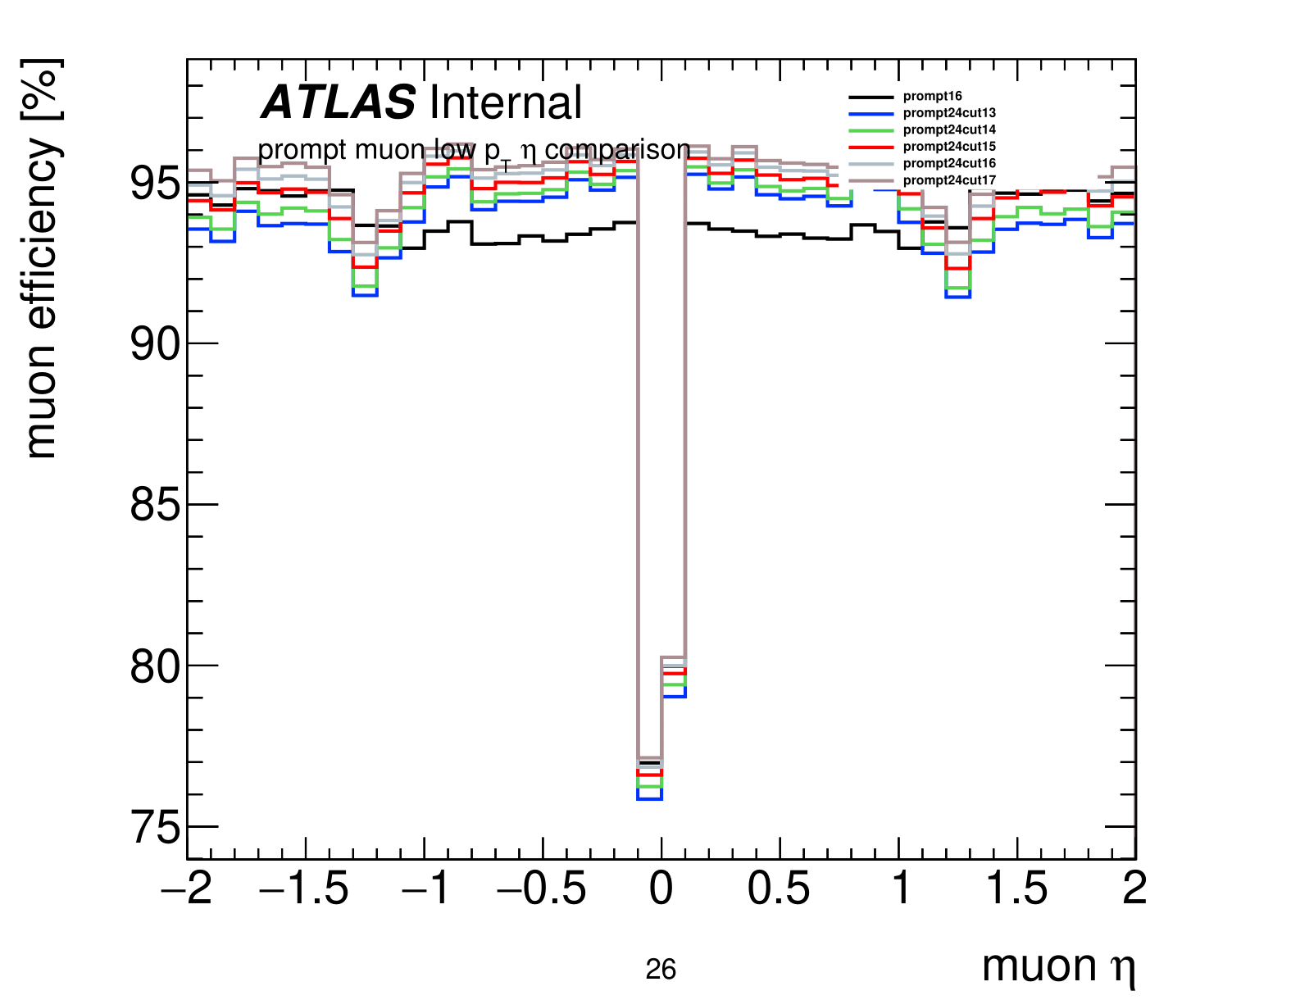
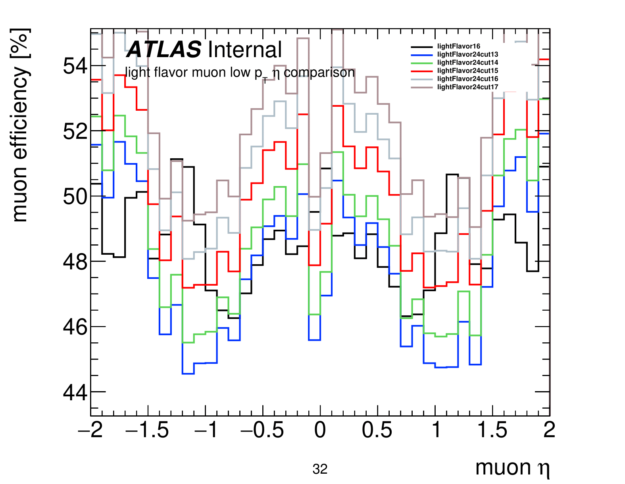
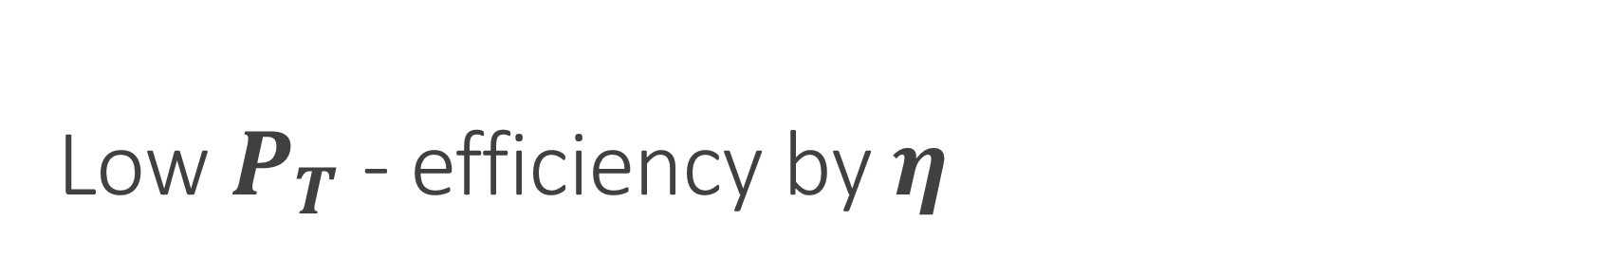

Low $P_{T}$ - efficiency by $\text{η}$
Transition
barrel
End cap
End cap
barrel
  Barrel: Better prompt efficiency and comparable L.F. rejection
  Transition: Comparable in L.F. rejection
  Further study in end cap -> Need binning in $\text{η}$

Slide 13

Next Steps
  Generate 2D $ρ$ vs $q/p$ light flavor percent maps changes for different $P_{T}$ and $\text{η}$ regions
  Uses different L.F. cuts for different region of the detector (barrel, transition, endcap)

Slide 14


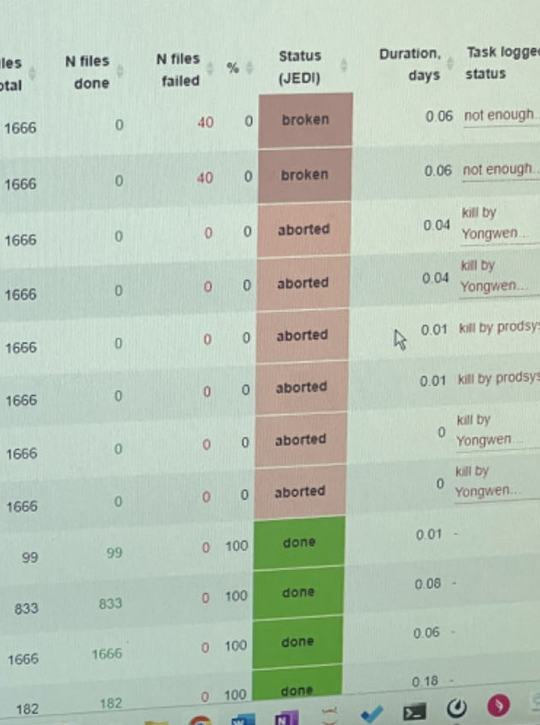



Fun Time

Slide 15
Back Up

Slide 16
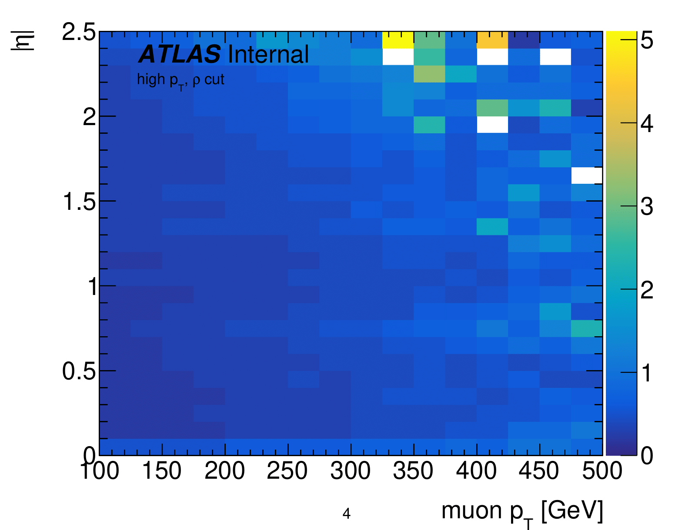
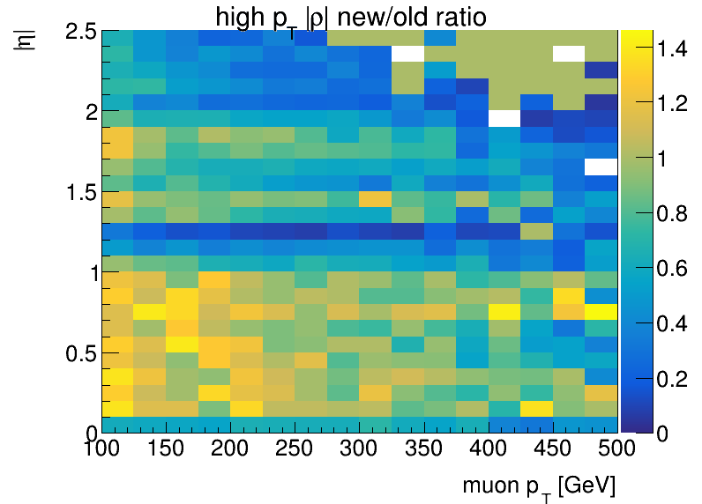
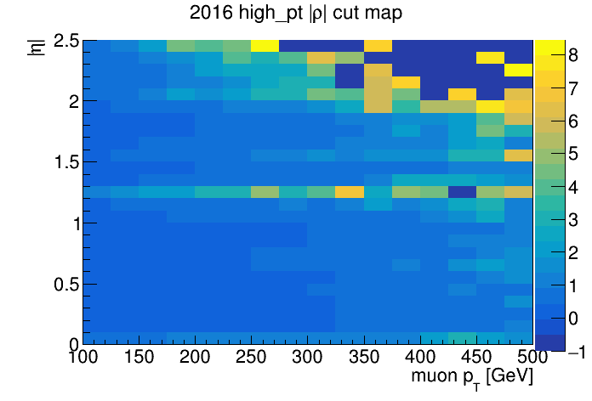
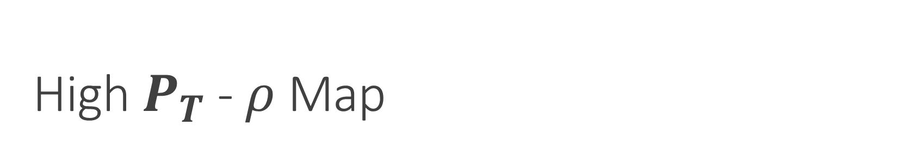
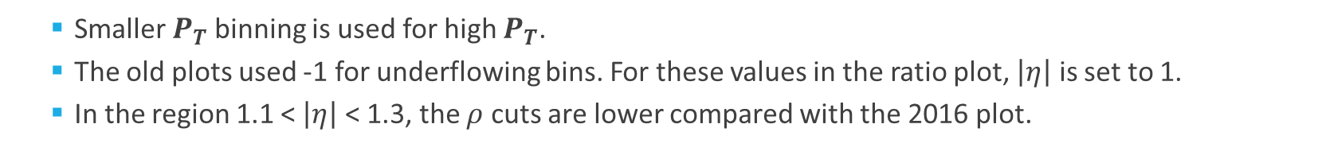
High $P_{T}$ - $ρ$ Map
    Smaller $P_{T}$binning is used for high $P_{T}$.
    The old plots used -1 for underflowing bins. For these values in the ratio plot, $\left|η\right|$ is set to 1.
    In the region 1.1 < $\left|η\right|$ < 1.3, the $ρ$ cuts are lower compared with the 2016 plot.

Slide 17
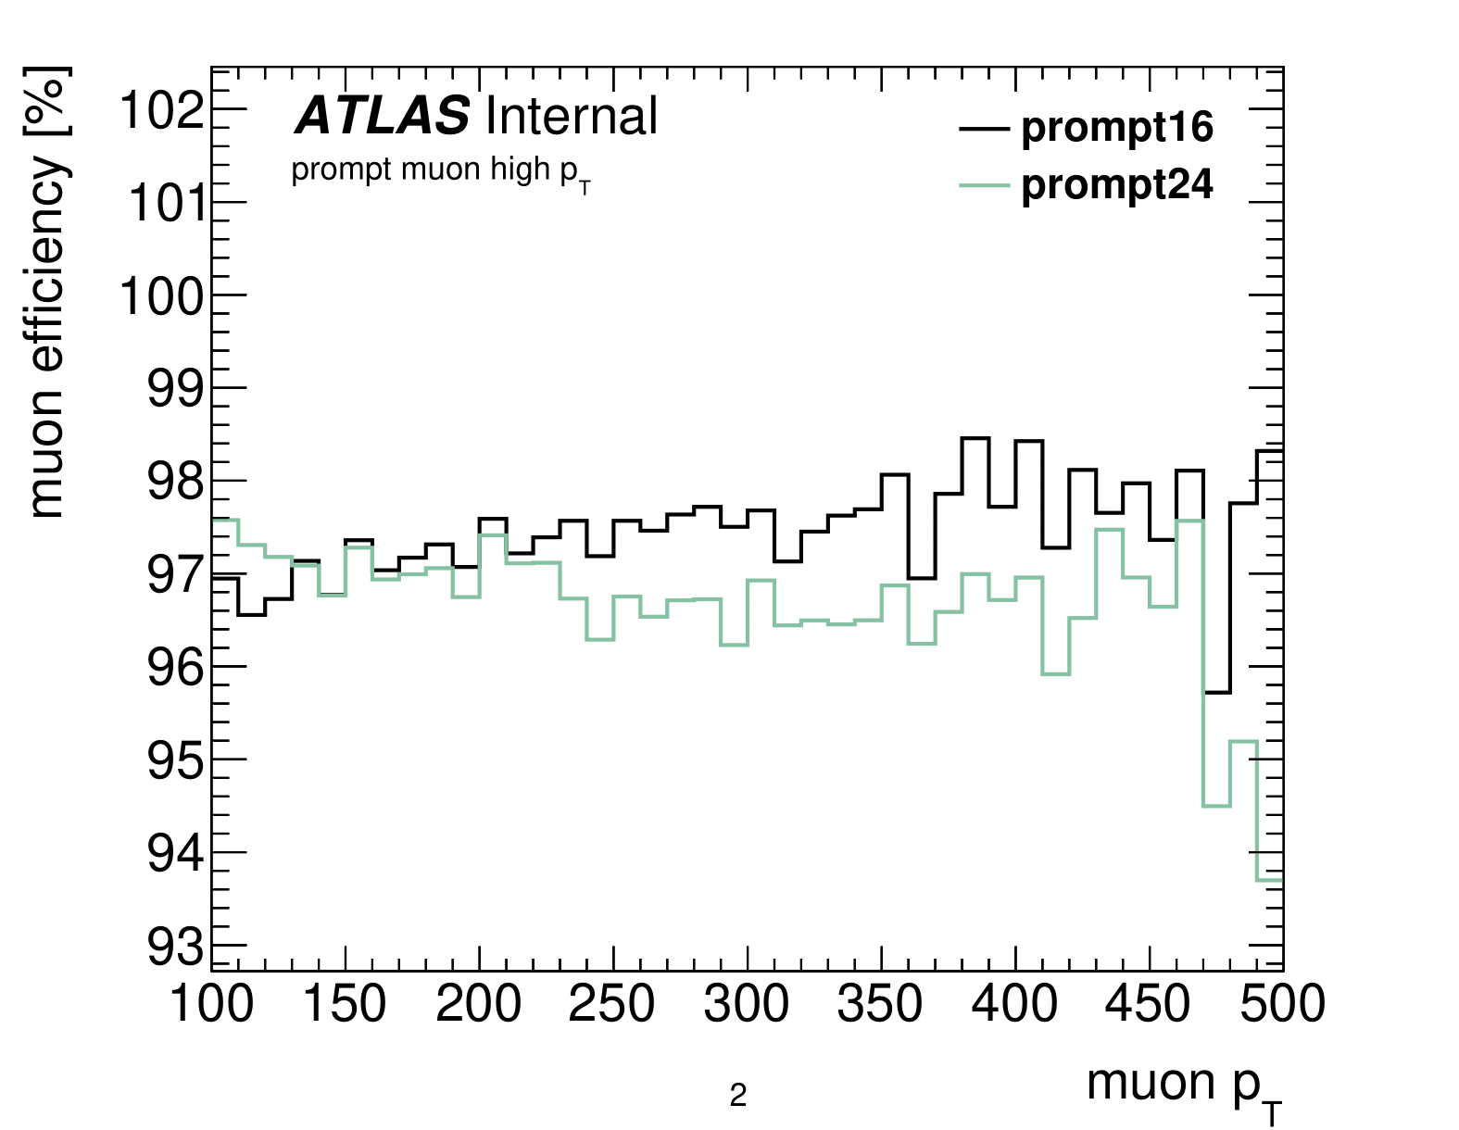
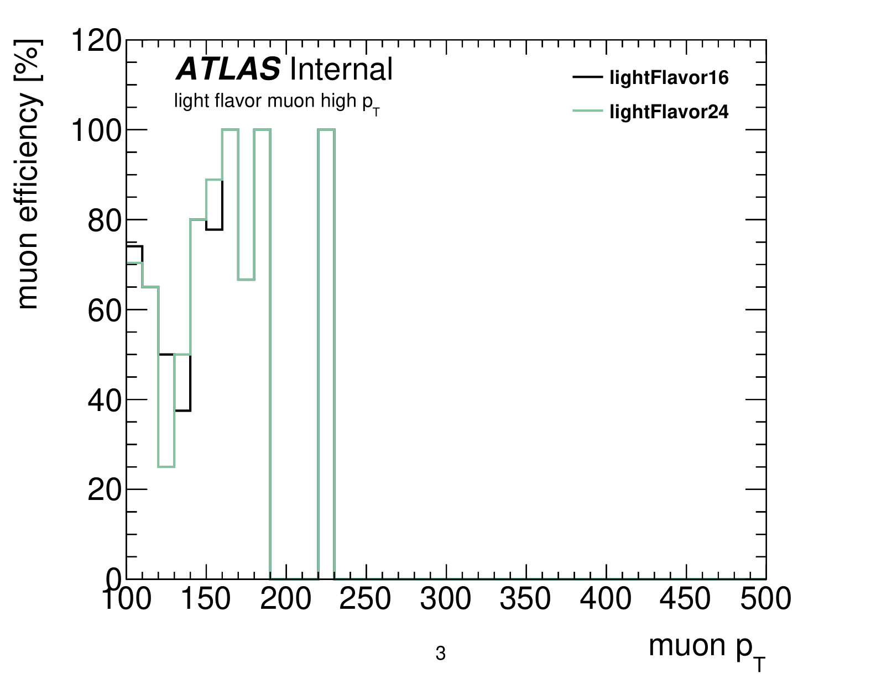
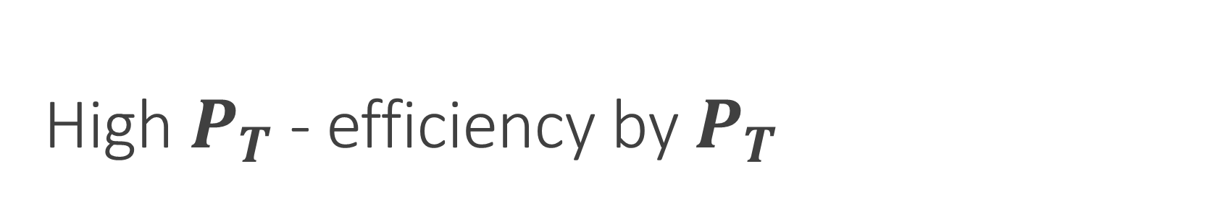
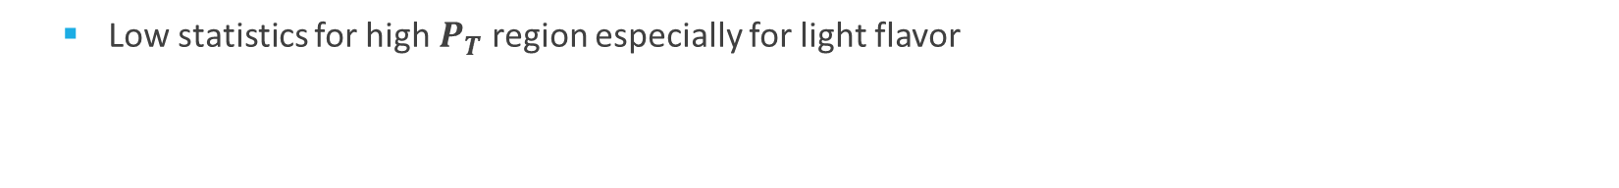
High $P_{T}$ - efficiency by $P_{T}$
  Low statistics for high $P_{T}$ region especially for light flavor

Slide 18
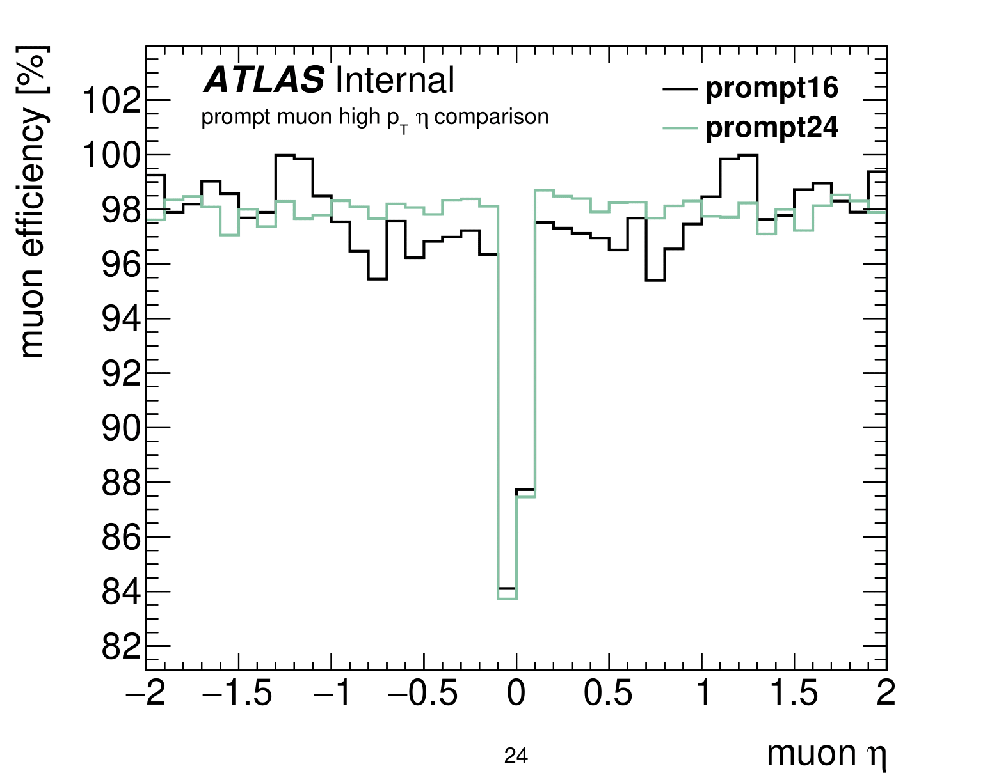
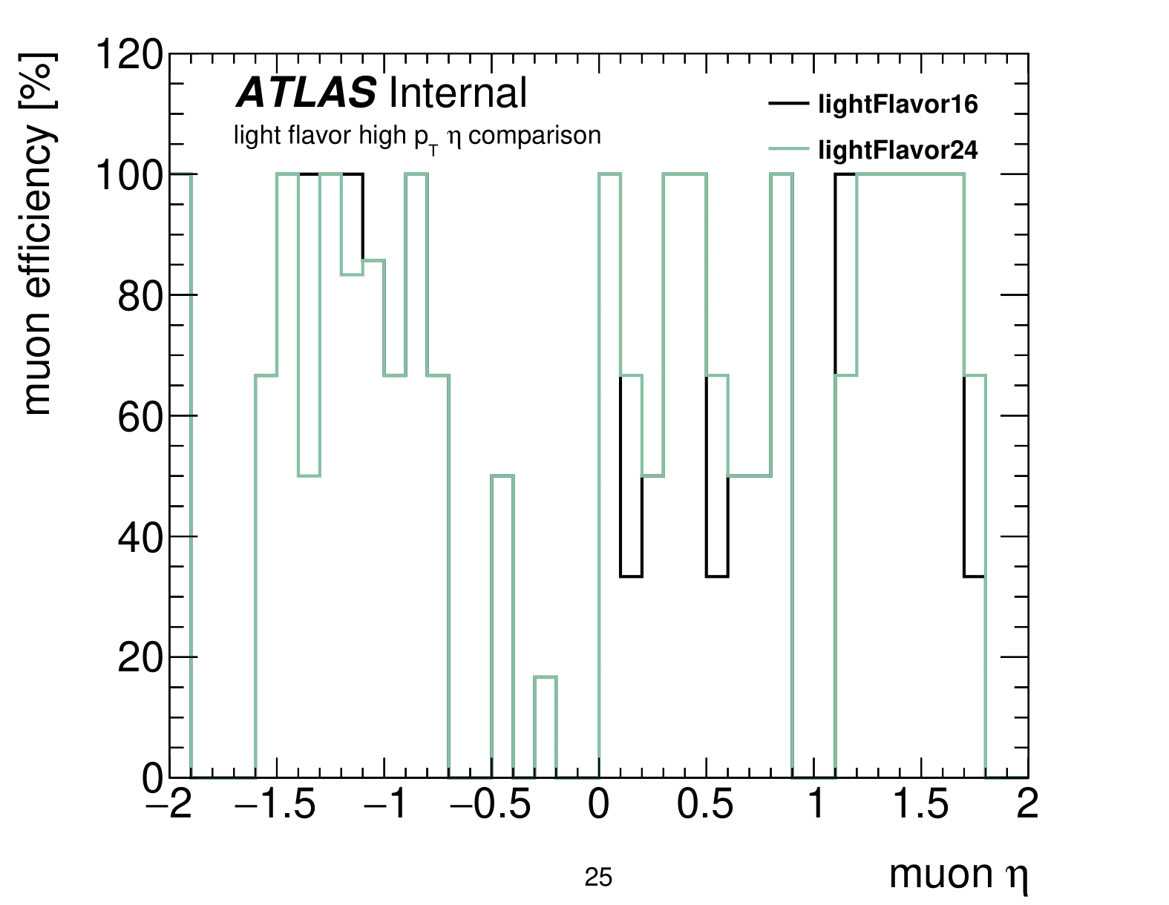
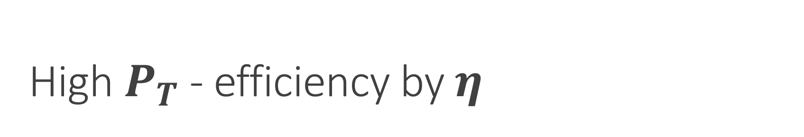
High $P_{T}$ - efficiency by $\text{η}$
  Higher efficiency for prompt
  Low stats for light flavor

