Slide 1
Study of Single Crystal Readout for the Development of Dual-Readout Calorimetry in Future e+/e- Collider Experiments
Jessaly Zhu
University of Michigan
30 July 2024

Slide 2
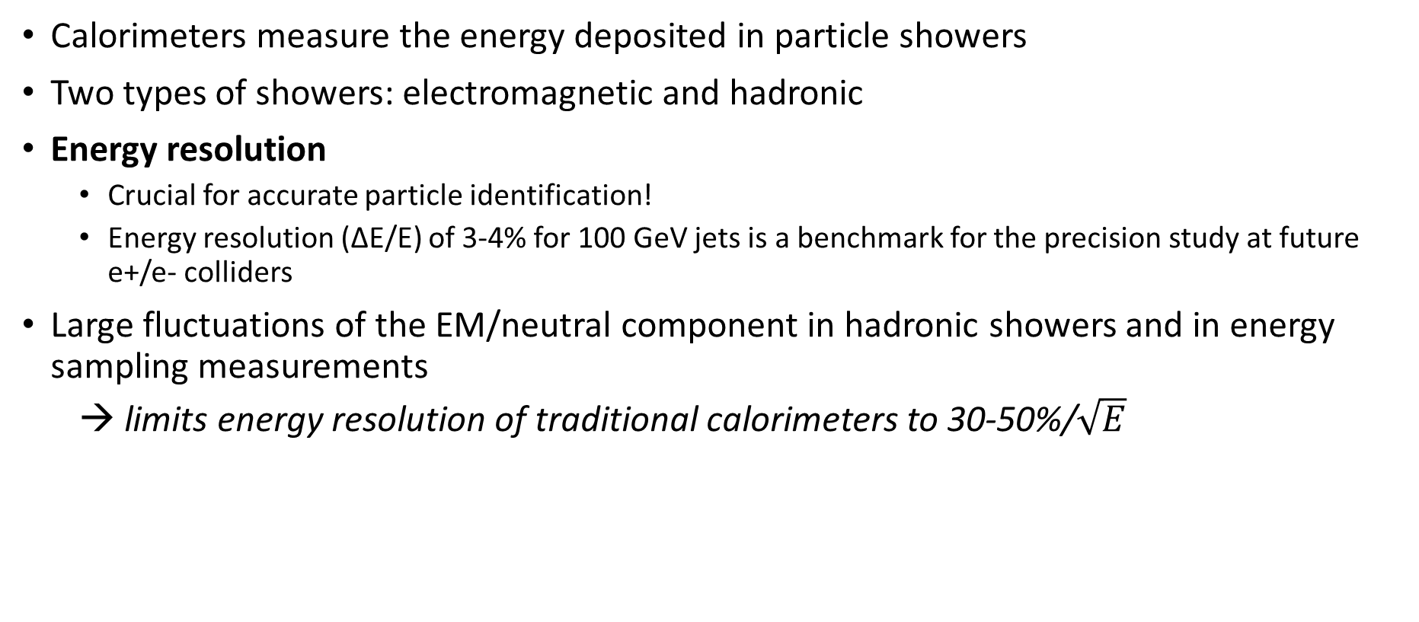
Energy Resolution of Calorimeters
Calorimeters measure the energy deposited in particle showers
Two types of showers: electromagnetic and hadronic
Energy resolution
  Crucial for accurate particle identification!
  Energy resolution (ΔE/E) of 3-4% for 100 GeV jets is a benchmark for the precision study at future e+/e- colliders
Large fluctuations of the EM/neutral component in hadronic showers and in energy sampling measurements
  → limits energy resolution of traditional calorimeters to 30-50%/$\sqrt{E}$

Slide 3
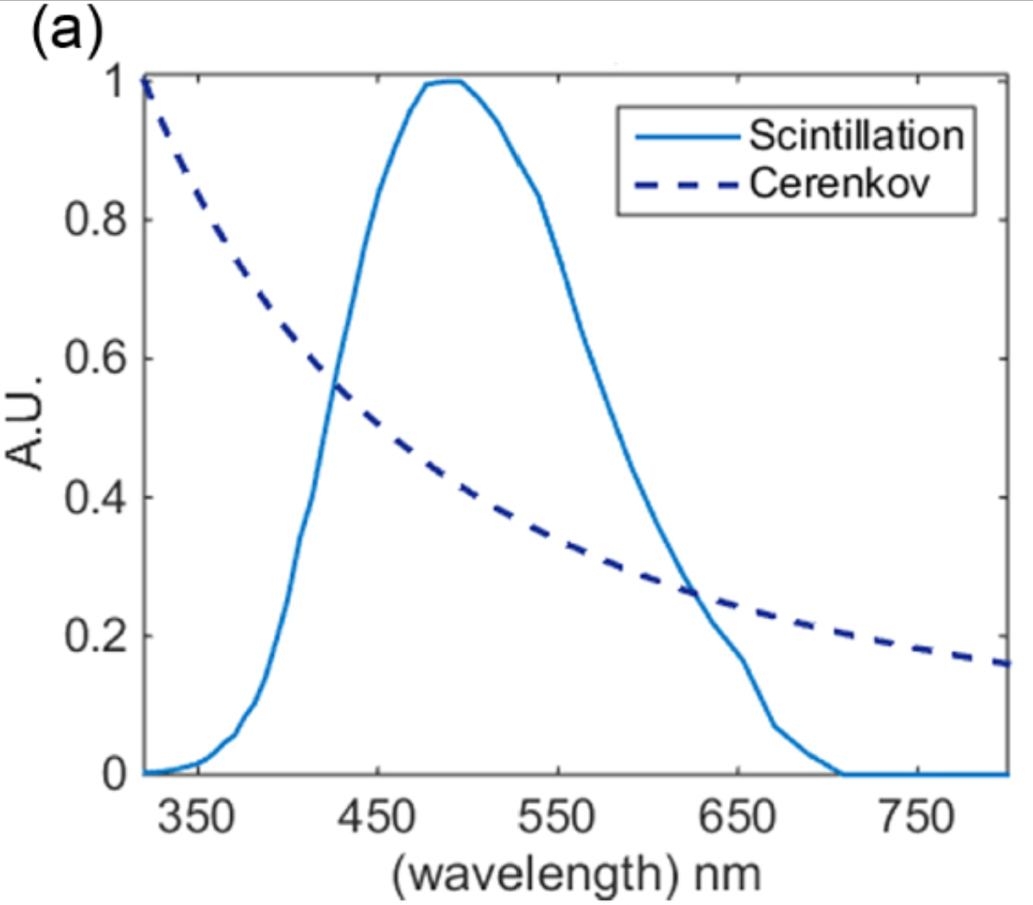
How to improve energy resolution?
Dual-Readout Calorimetry:
  Simultaneous scintillation and Cherenkov measurements
  Ability to compensate for large variations and non-linear response from the invisible energy in hadronic showers
  → better energy resolution ☺
Scintillation Radiation | Cherenkov radiation
Photons emitted due to relaxation of excited particles Isotropic: propagates in all directions Time delay in emission | Photons emitted due to relativistic particles with v>c polarizing the medium Directional Instantaneous
Emilie Roncali et al 2019 Biomed. Phys. Eng. Express 5 035033

Slide 4
The Calvision Project
A collaboration aiming to develop a crystal-based dual-readout electromagnetic calorimeter to complement a precision hadronic calorimeter.
For more information, visit CalVision | Detector R&D (fnal.gov)

Slide 5
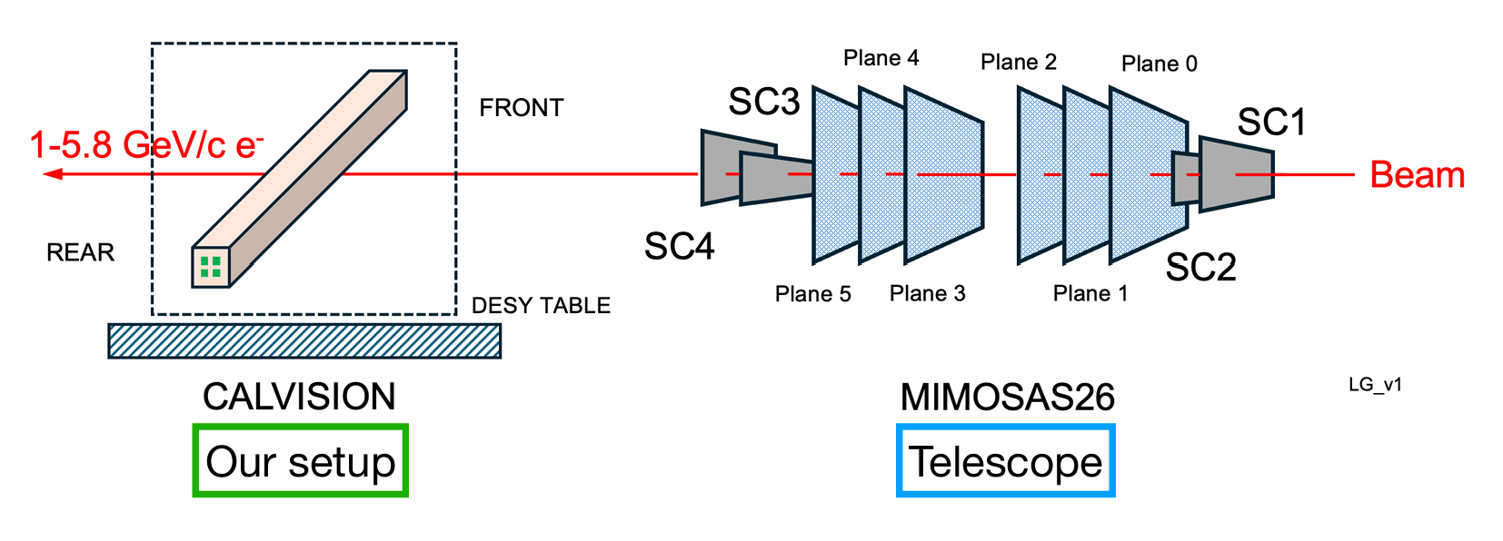
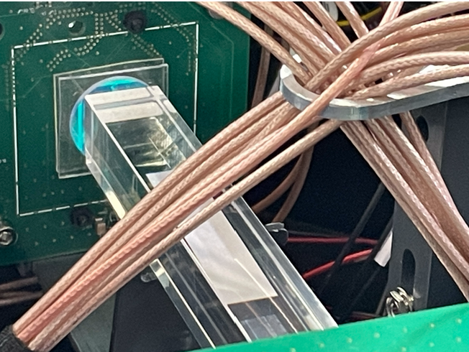
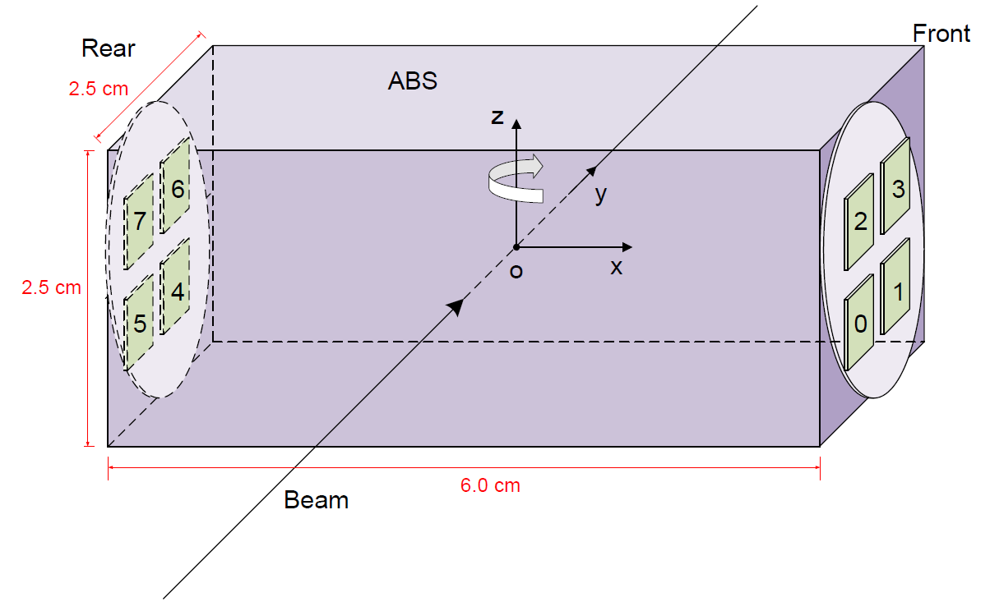
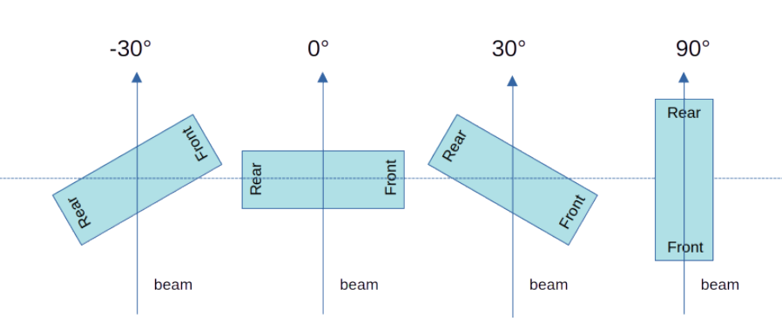
April 2024 Test Beam Setup at DESY
Naming
convention:

Slide 6
April 2024 Test Beam Setup at DESY
Relevant components:
Crystals analyzed:
PWO (Lead Tungstate)
  Produces scintillation and Cherenkov
  Filter in the rear
  Used to study separation of scintillation and Cherenkov
PbF2 (Lead Fluoride)
  Produces only Cherenkov
  No filters
  Used to extract Cherenkov properties
optical coupling
glue or silicone cookie
filter
crystal
Silicone photomultiplier (SiPM)
6
Goals of Test Beam
Perform angular scan
SiPM over-voltage scan
Test different crystals and filters

Slide 7
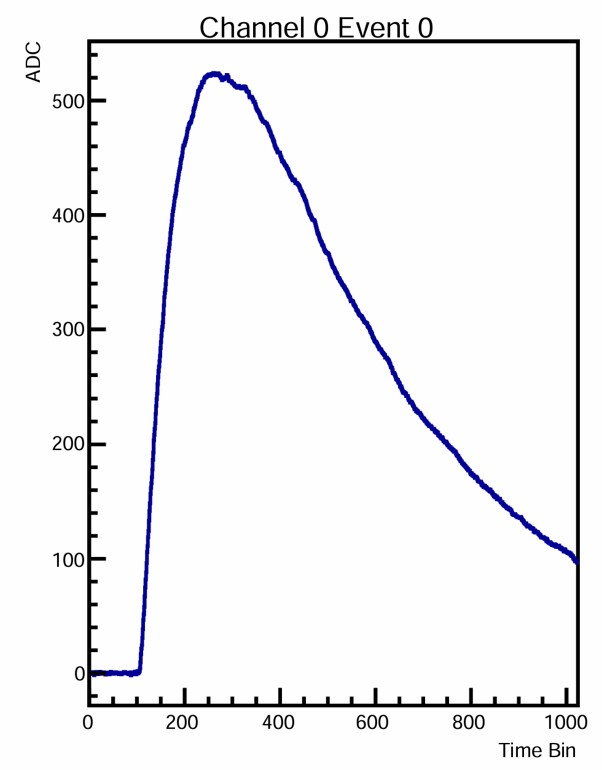
Objectives
Perform noise stability analysis
Angle, crystal, and filter affects on amplitude and rising edge
Telescope Tracking Reconstruction
amplitude
rising edge

Slide 8
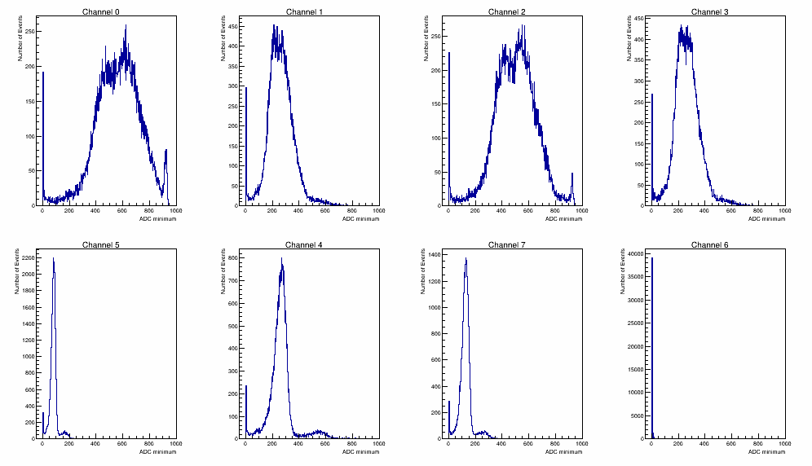
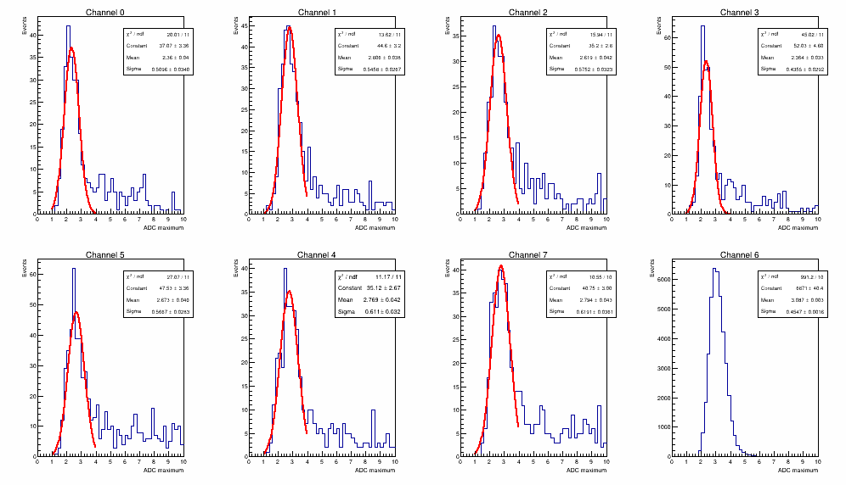
Noise Stability
Procedure:
  Take peak of each waveform and plot amplitude distribution
  Should see 2 distinct peaks: noise and signal fluctuations
  Fit a Gaussian to noise fluctuations
  Extract sigma
  Repeat for all angles and both crystals
dead channel

Slide 9
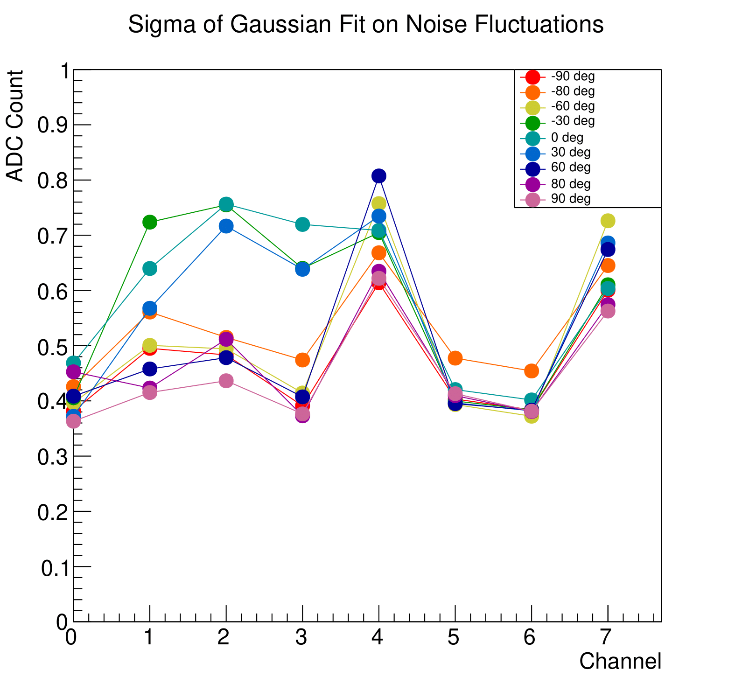
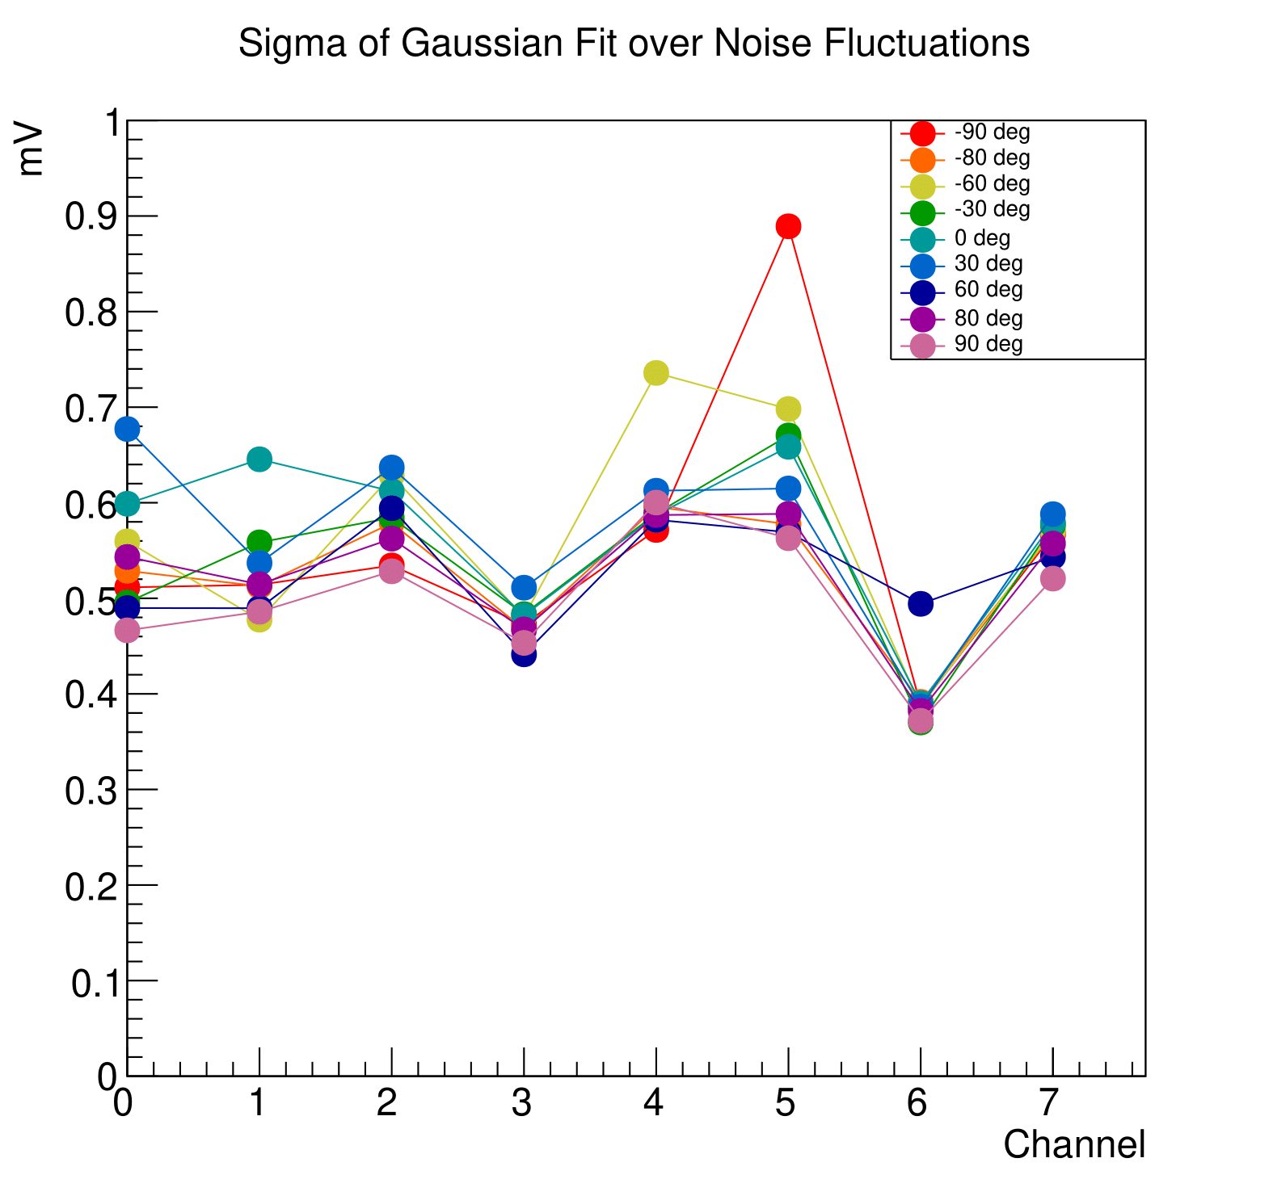
Noise Stability
PWO with filter
PbF2 no filter
Noise is below 1 ADC/mV and stable
Independent of crystal, angle, and presence of filter

Slide 10
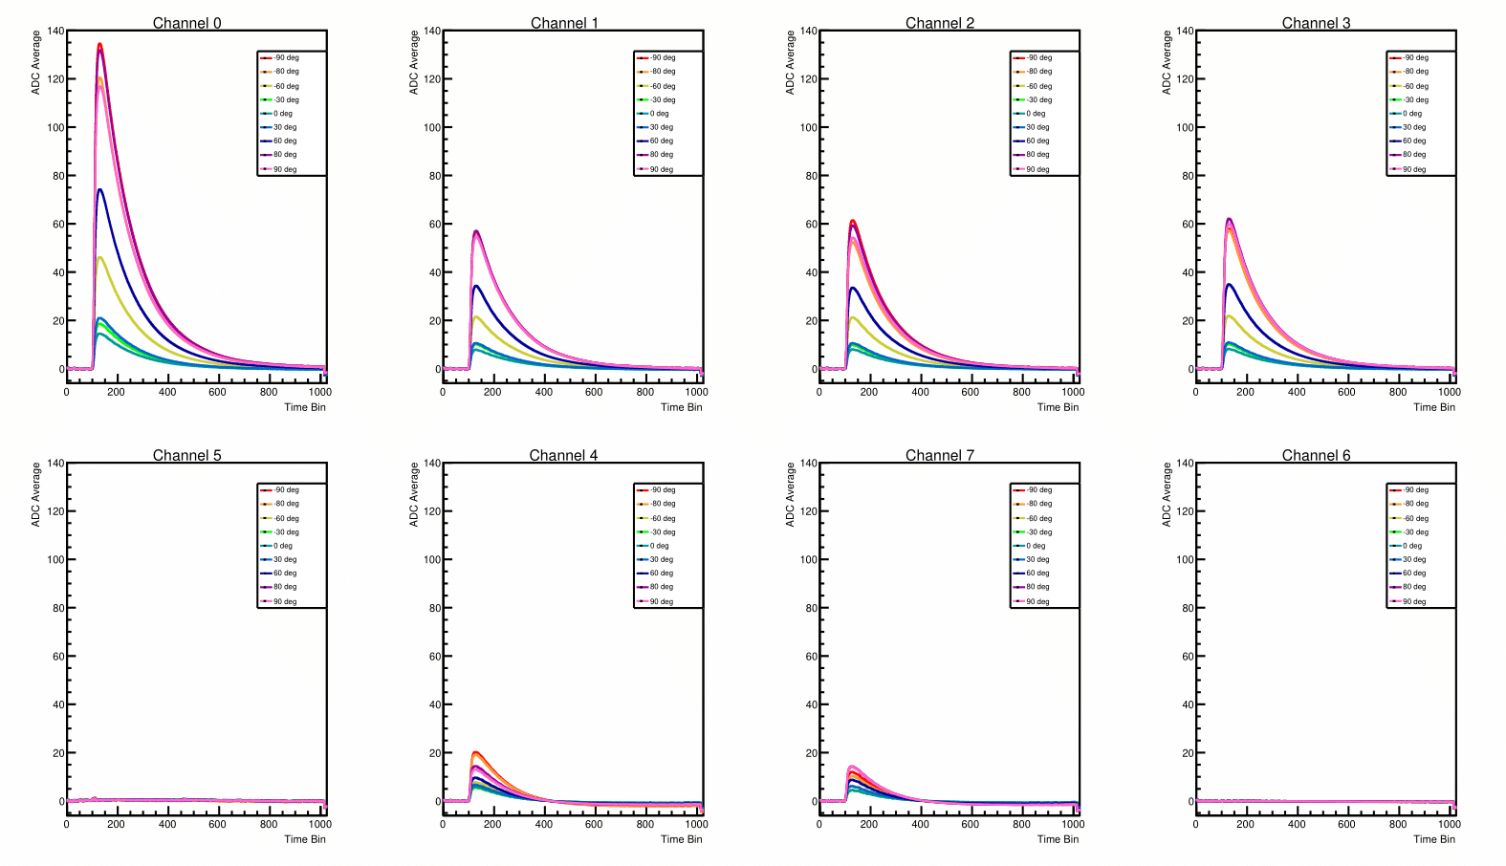
Averaged Waveforms: PWO with filter in rear
Slow rising edge due to time delay of scintillation emission
See angle dependence in amplitude
Filtered reduced signal by about 1/3
Channel 0 has double the signal than other front channels
dead
dead
*Noise events removed except channels 5 and 6

Slide 11
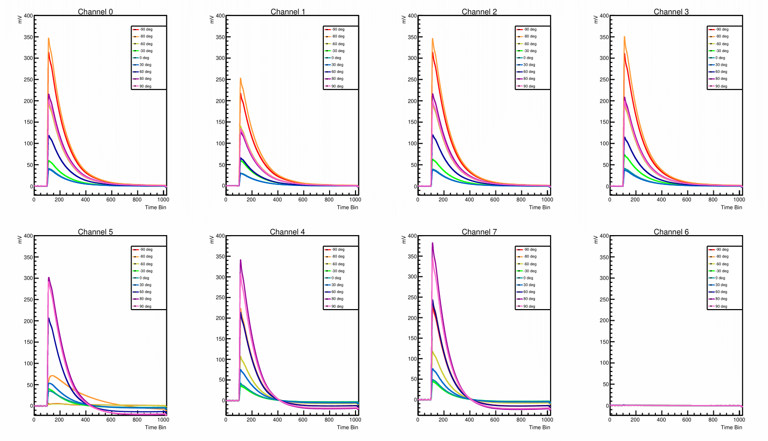
Averaged Waveforms: PbF2 no filter
Cherenkov is instantaneous -> sharp rising edge
Due to directionality of Cherenkov: front end has larger signals at negative angles and back end has larger signals at positive angles
Channel 1 has overall smaller signals compared to other front channels
dead
*Noise events removed except channel 6

Slide 12
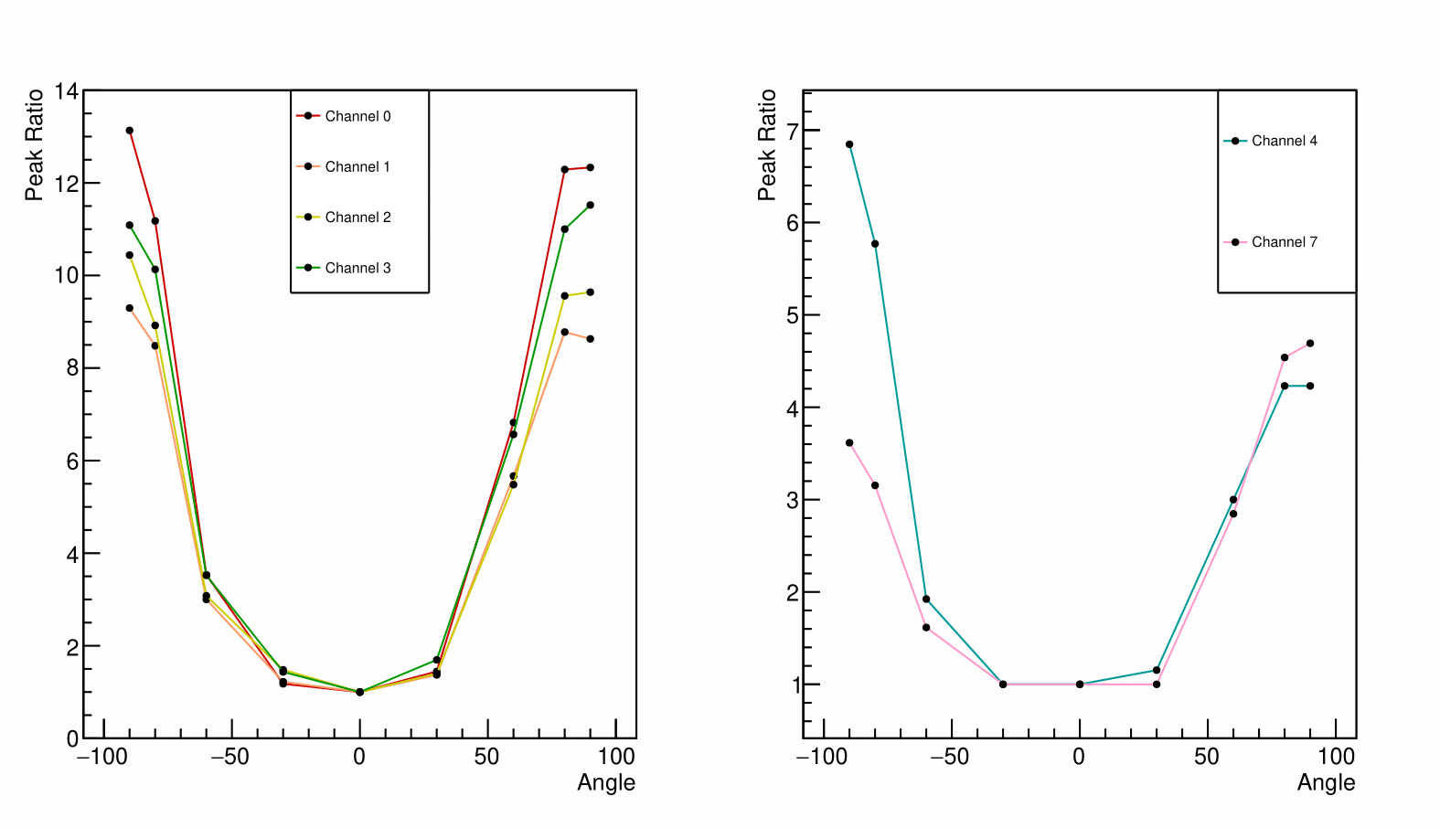
Angle Dependence: PWO with filter in rear
The peak value of signal fluctuations in amplitude distribution is taken at each angle
Normalized by the value at 0 deg
Front End (no filter side)
Symmetric due to no directionally from dominant scintillation component
Back End (filter side)
Asymmetry observed
Possible contributing factors
  Cherenkov directionally
  Photon loss due to coupling and transmission loss
Further analysis needed
Front End (no filter side)
Back End (filter side)

Slide 13
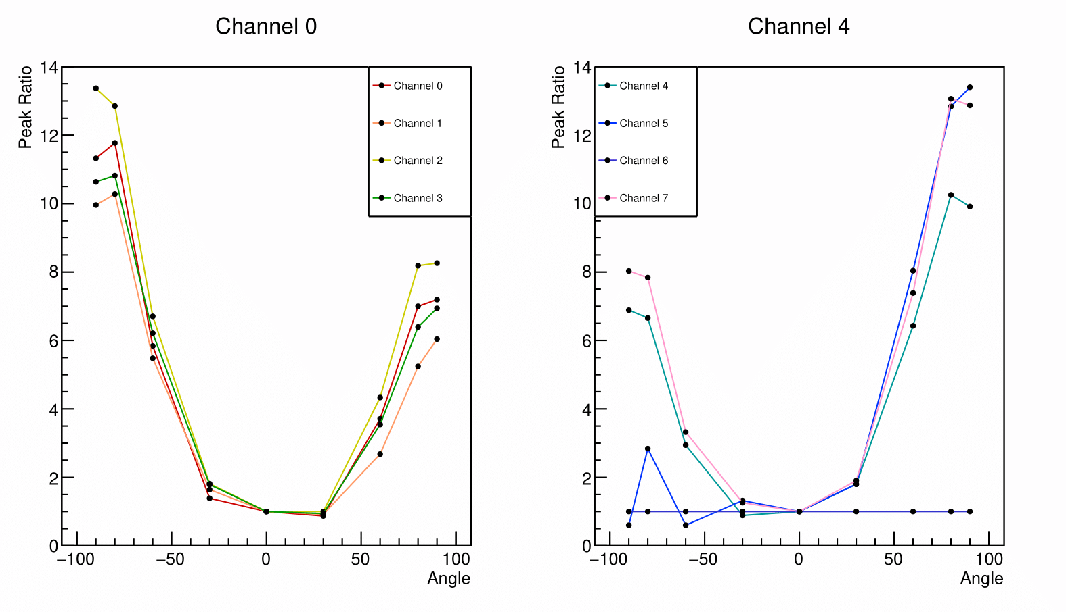
Angle Dependence: PbF2 no filter
Front end
Back end
Observations:
Asymmetry between positive and negative angles due to Cherenkov directionality
Consistent with expectations

Slide 14
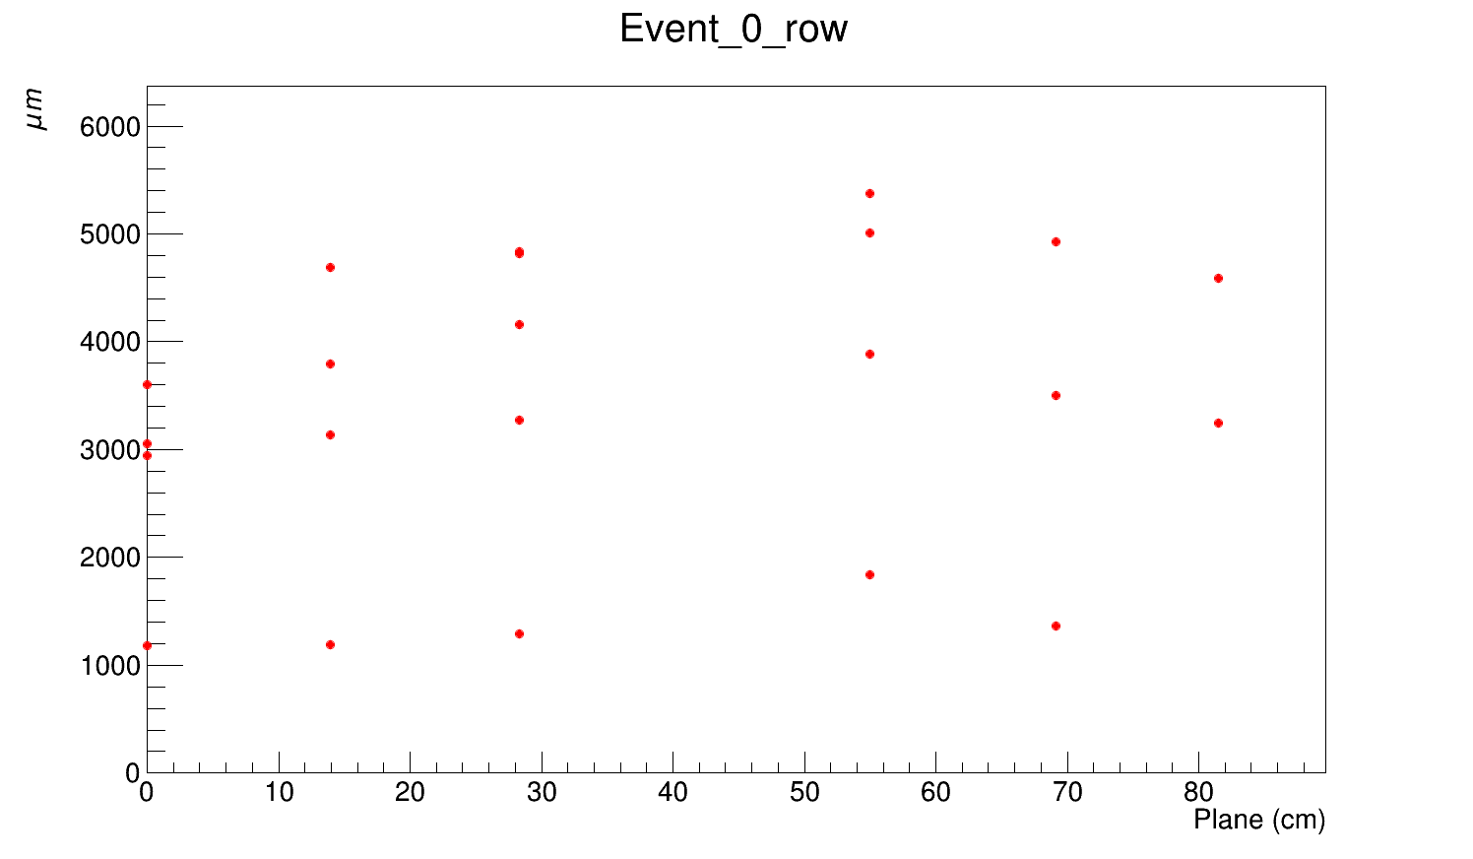
Telescope Tracking
Si-telescope used to track position of electron beam
Essential for understanding any position dependence on shower development and response of SiPMs
Made up of 6 planes (0-5) divided into 18.4 micron size pixels
Challenges:
  Misalignment between planes
  Multiple scattering and beam divergence effects
  More than 60% of events have more than 1 track
  due to large sampling window
  Noise needs to selected and filtered out
Goal:
  Assuming non-rotational misalignment,
  reconstruct tracks using chi-square minimization

Slide 15
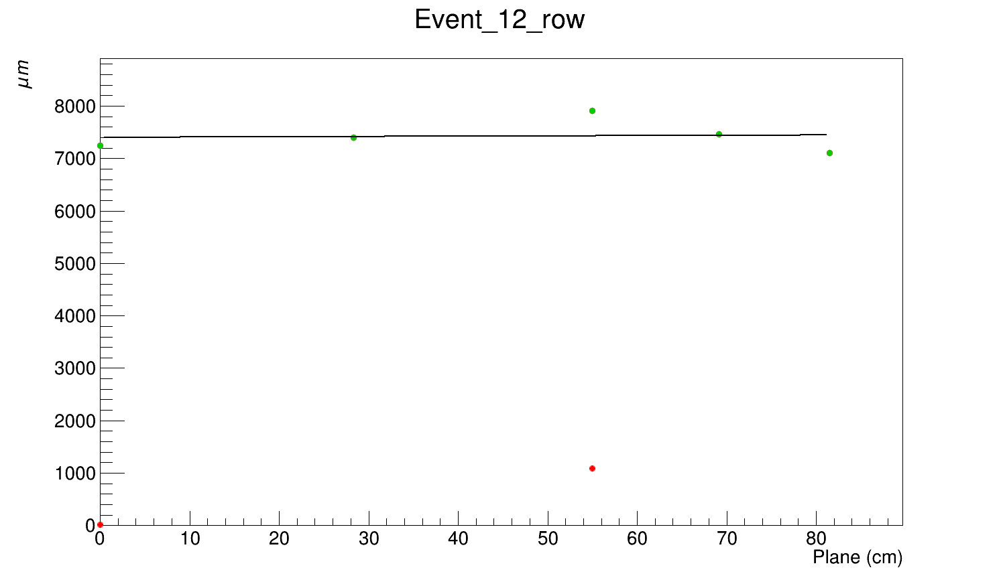
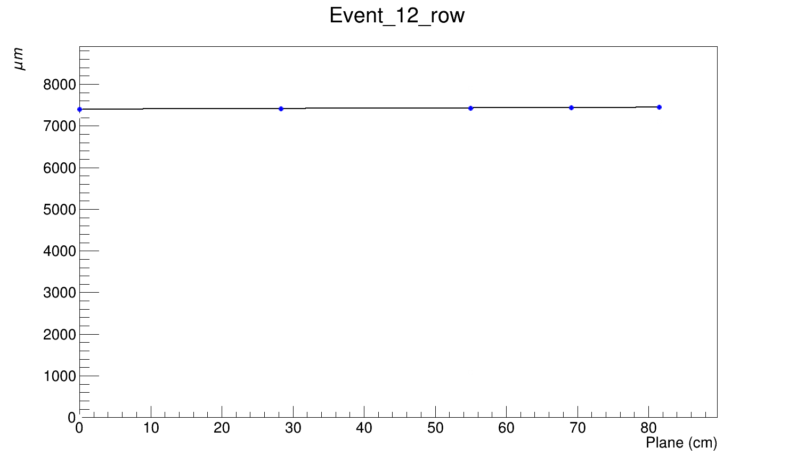
Telescope Tracking
Selected single track events
Filtered out noise hits
Performed linear fit
Before realignment
After realignment
In progress:
Find residual between fit and hits
Extract beam divergence and multiple scattering effects

Slide 16
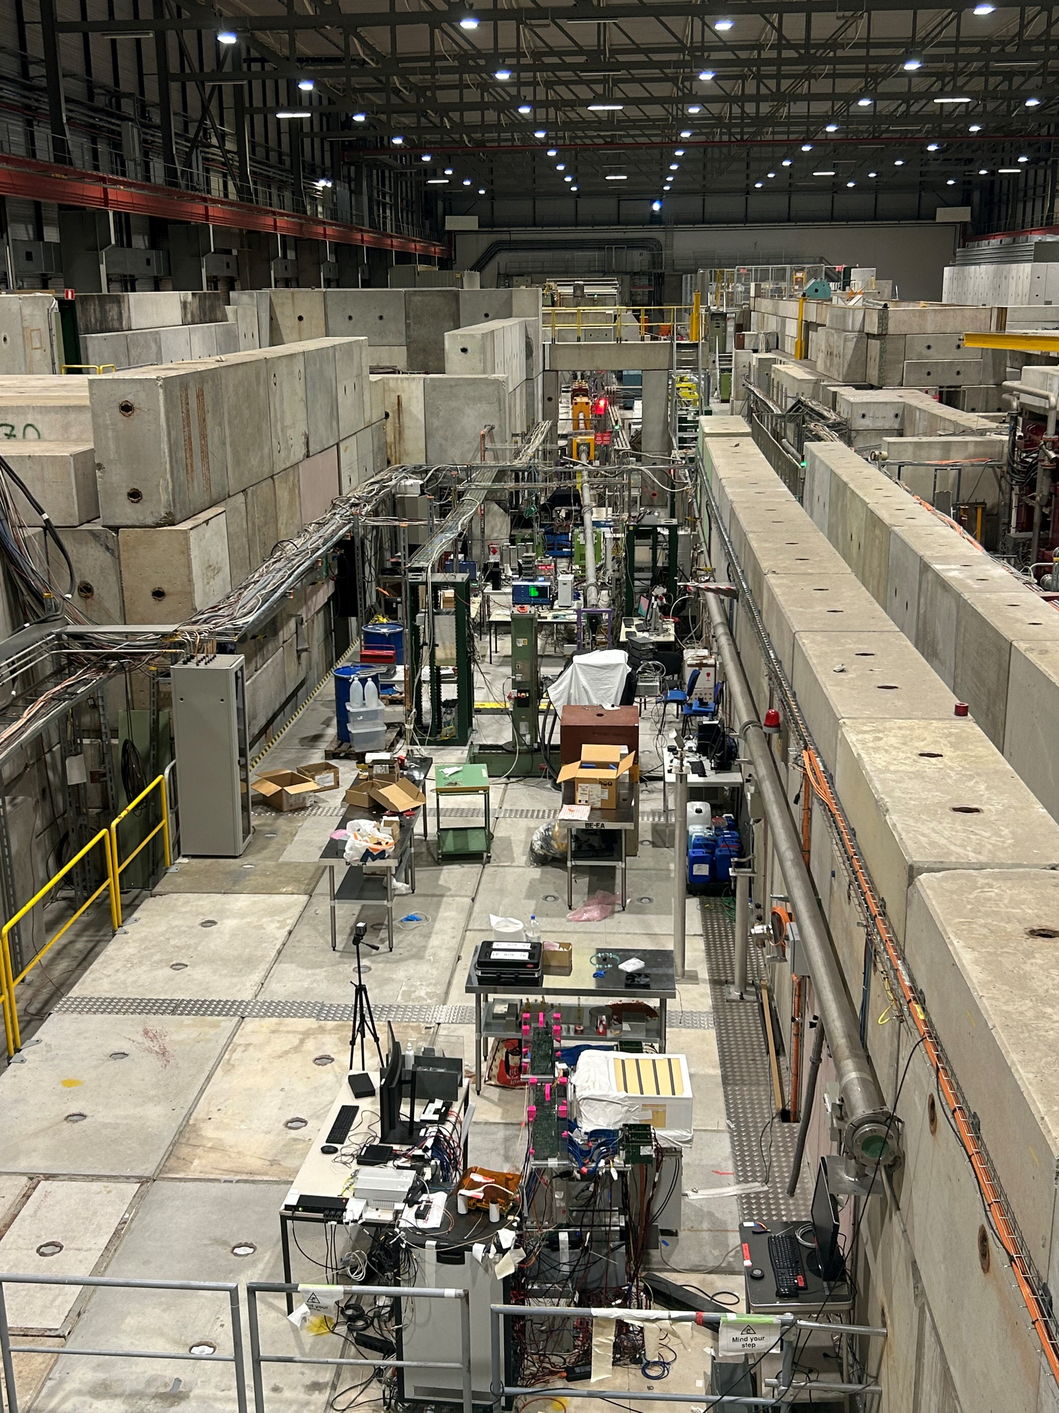
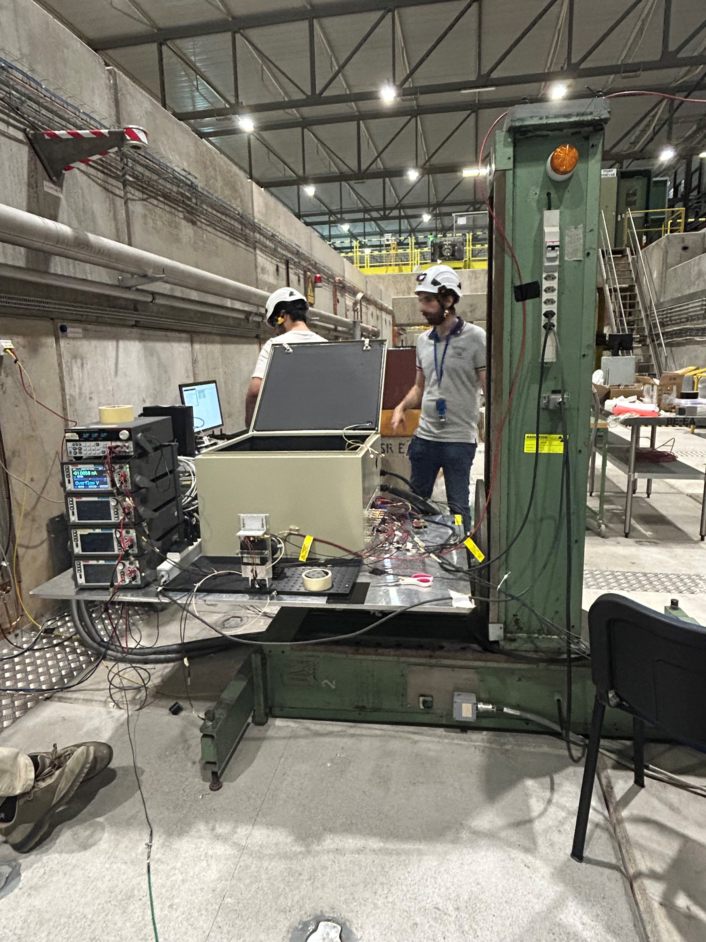
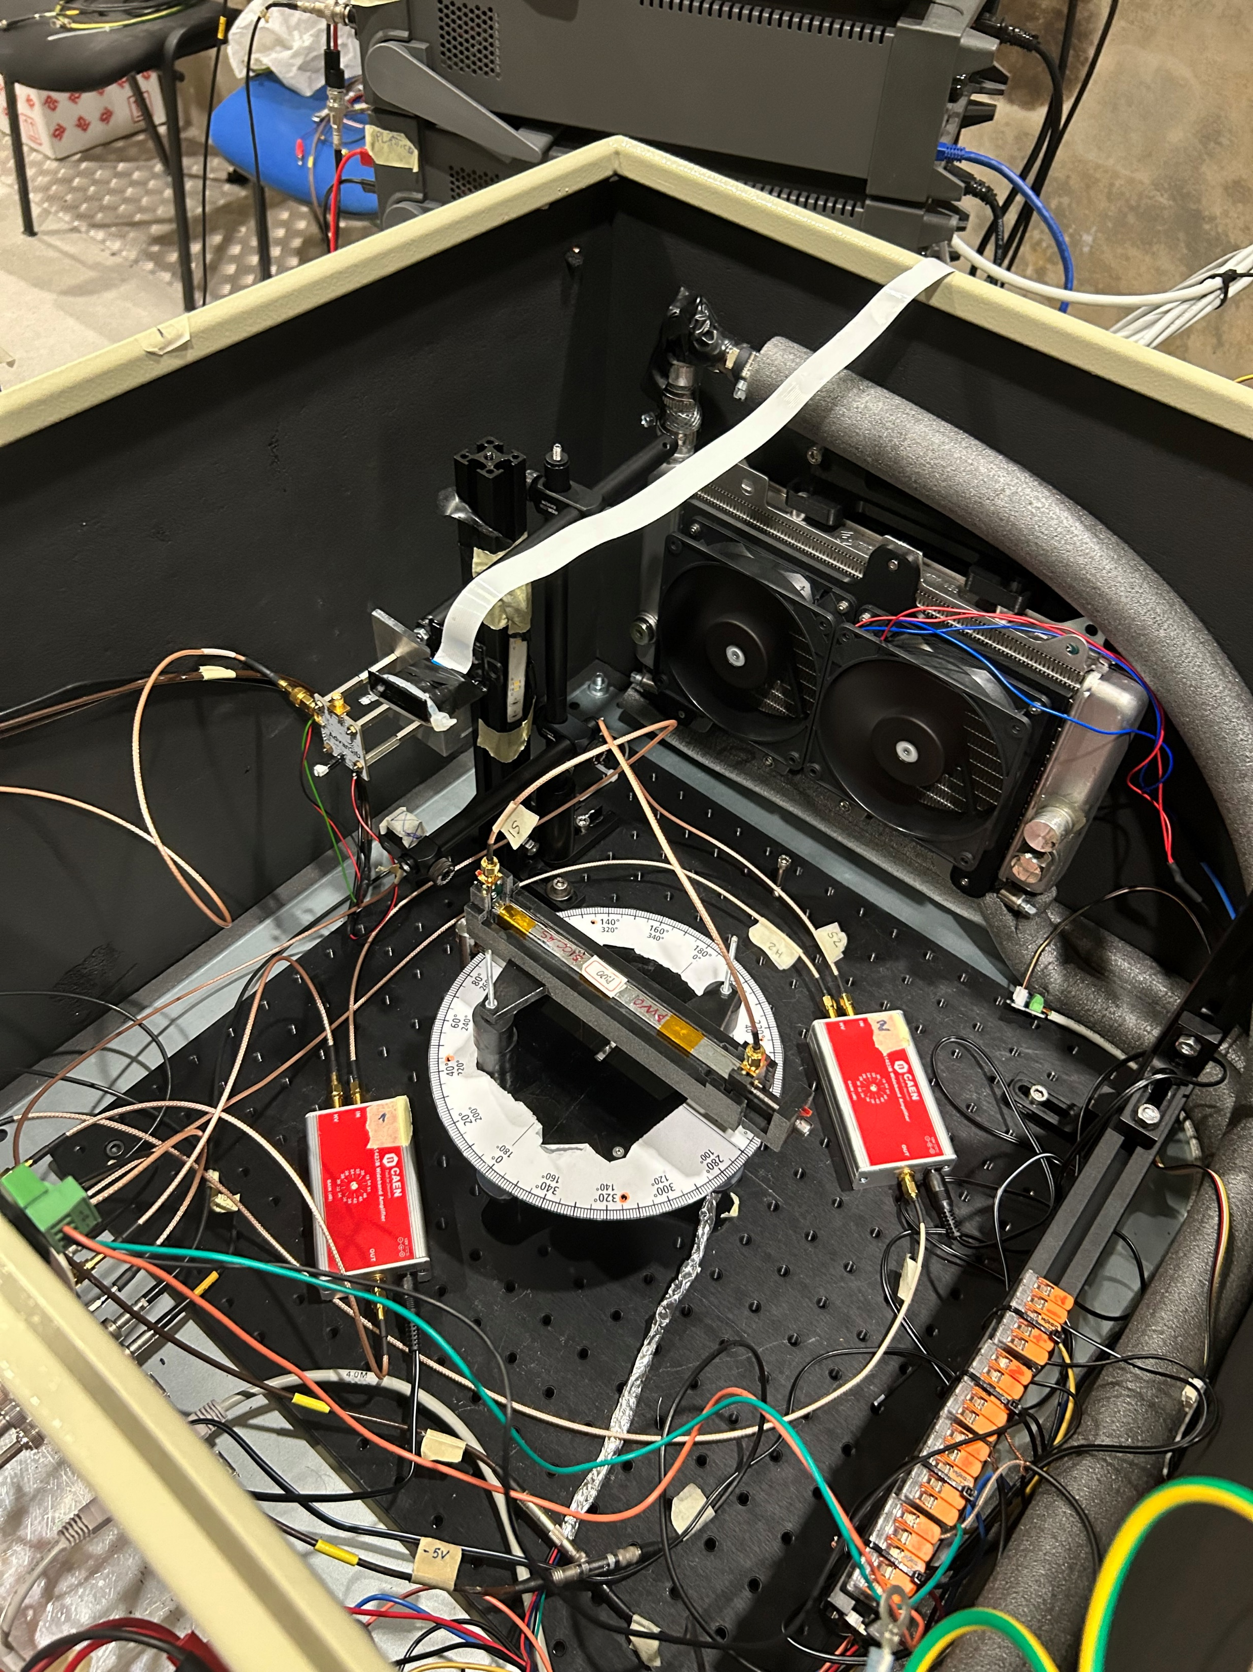
July 2024 CERN Test Beam
Participated in beam test
  Set up
  Data-taking shifts

Slide 17
Next steps
Continue with tracking reconstruction
Compare PWO from DESY with Fermilab data to understand the differences caused by the use of different SiPMs

Slide 18
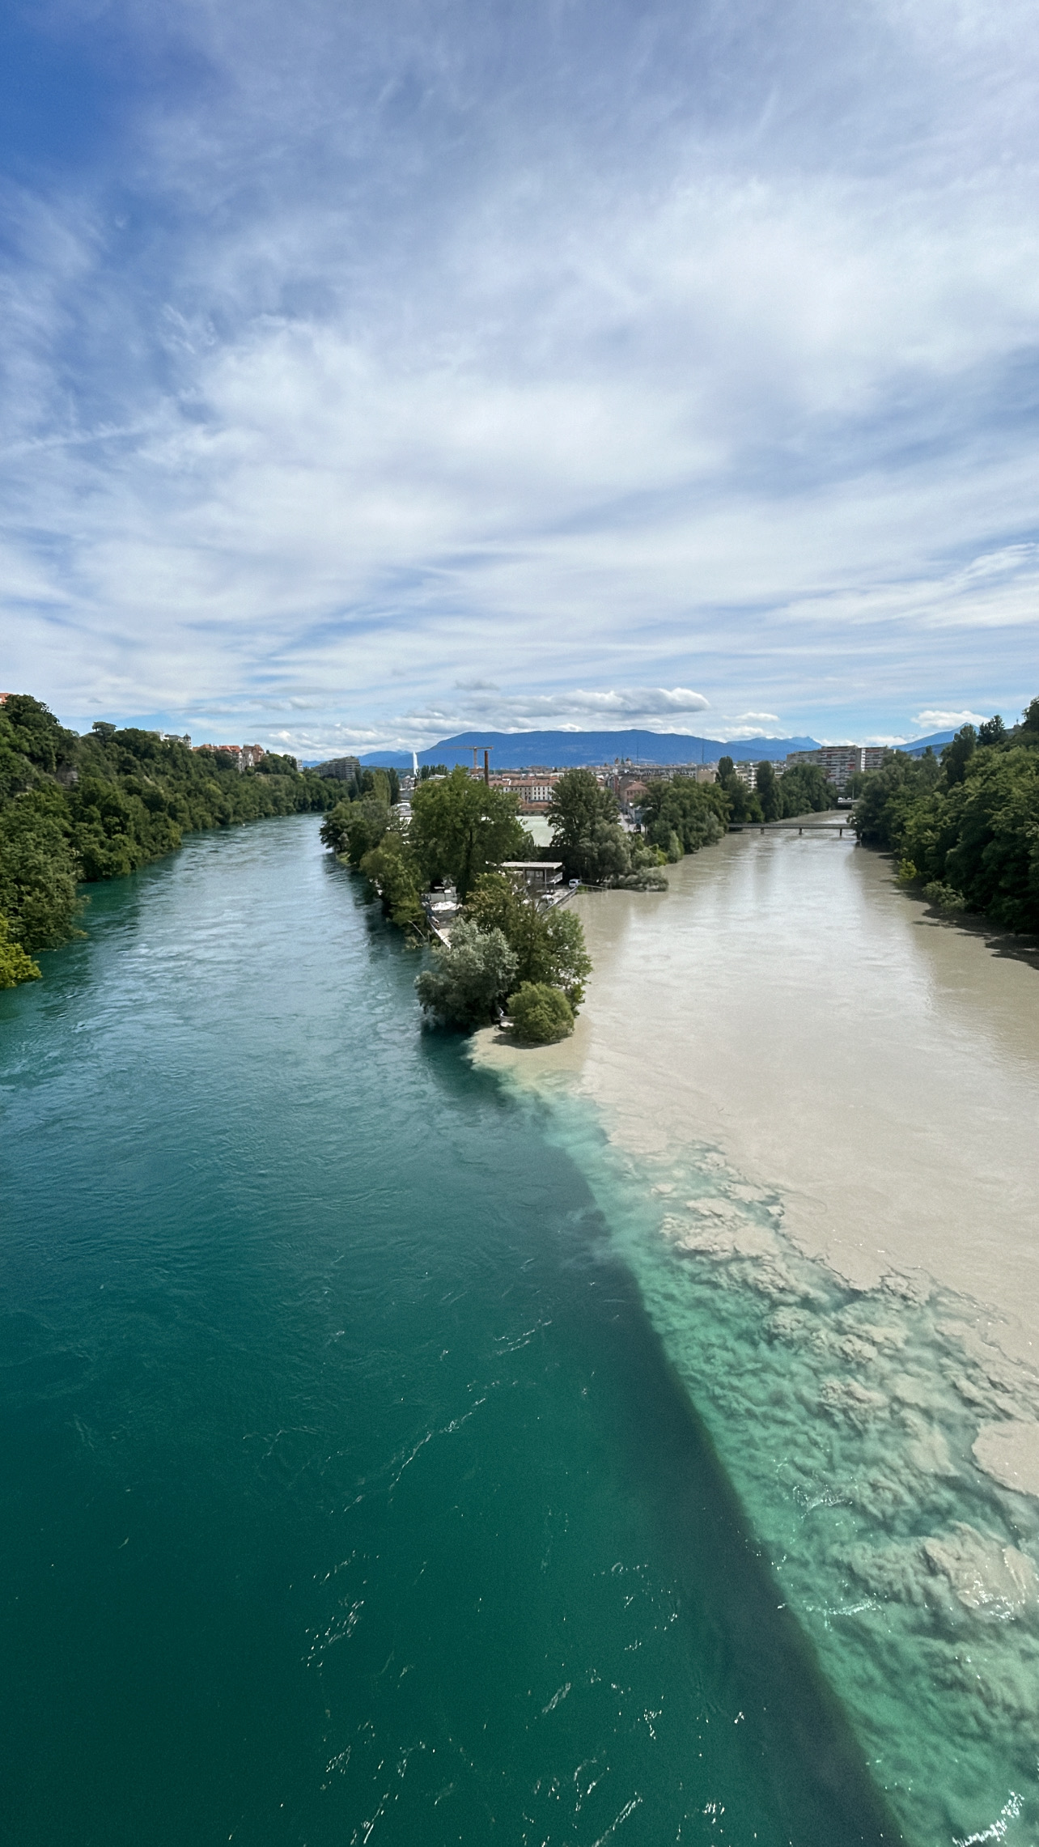

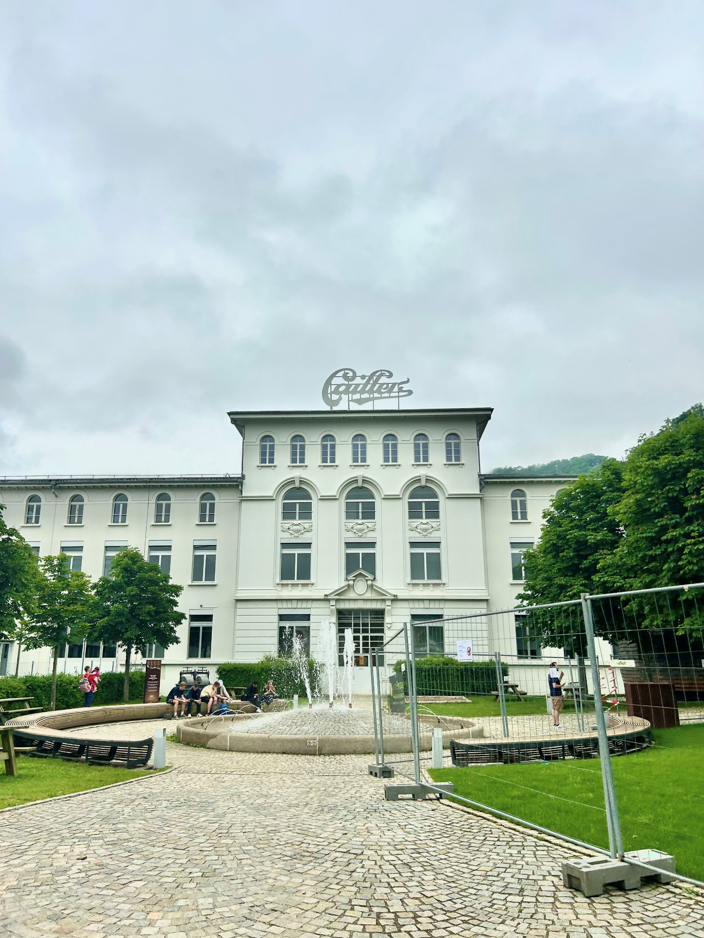
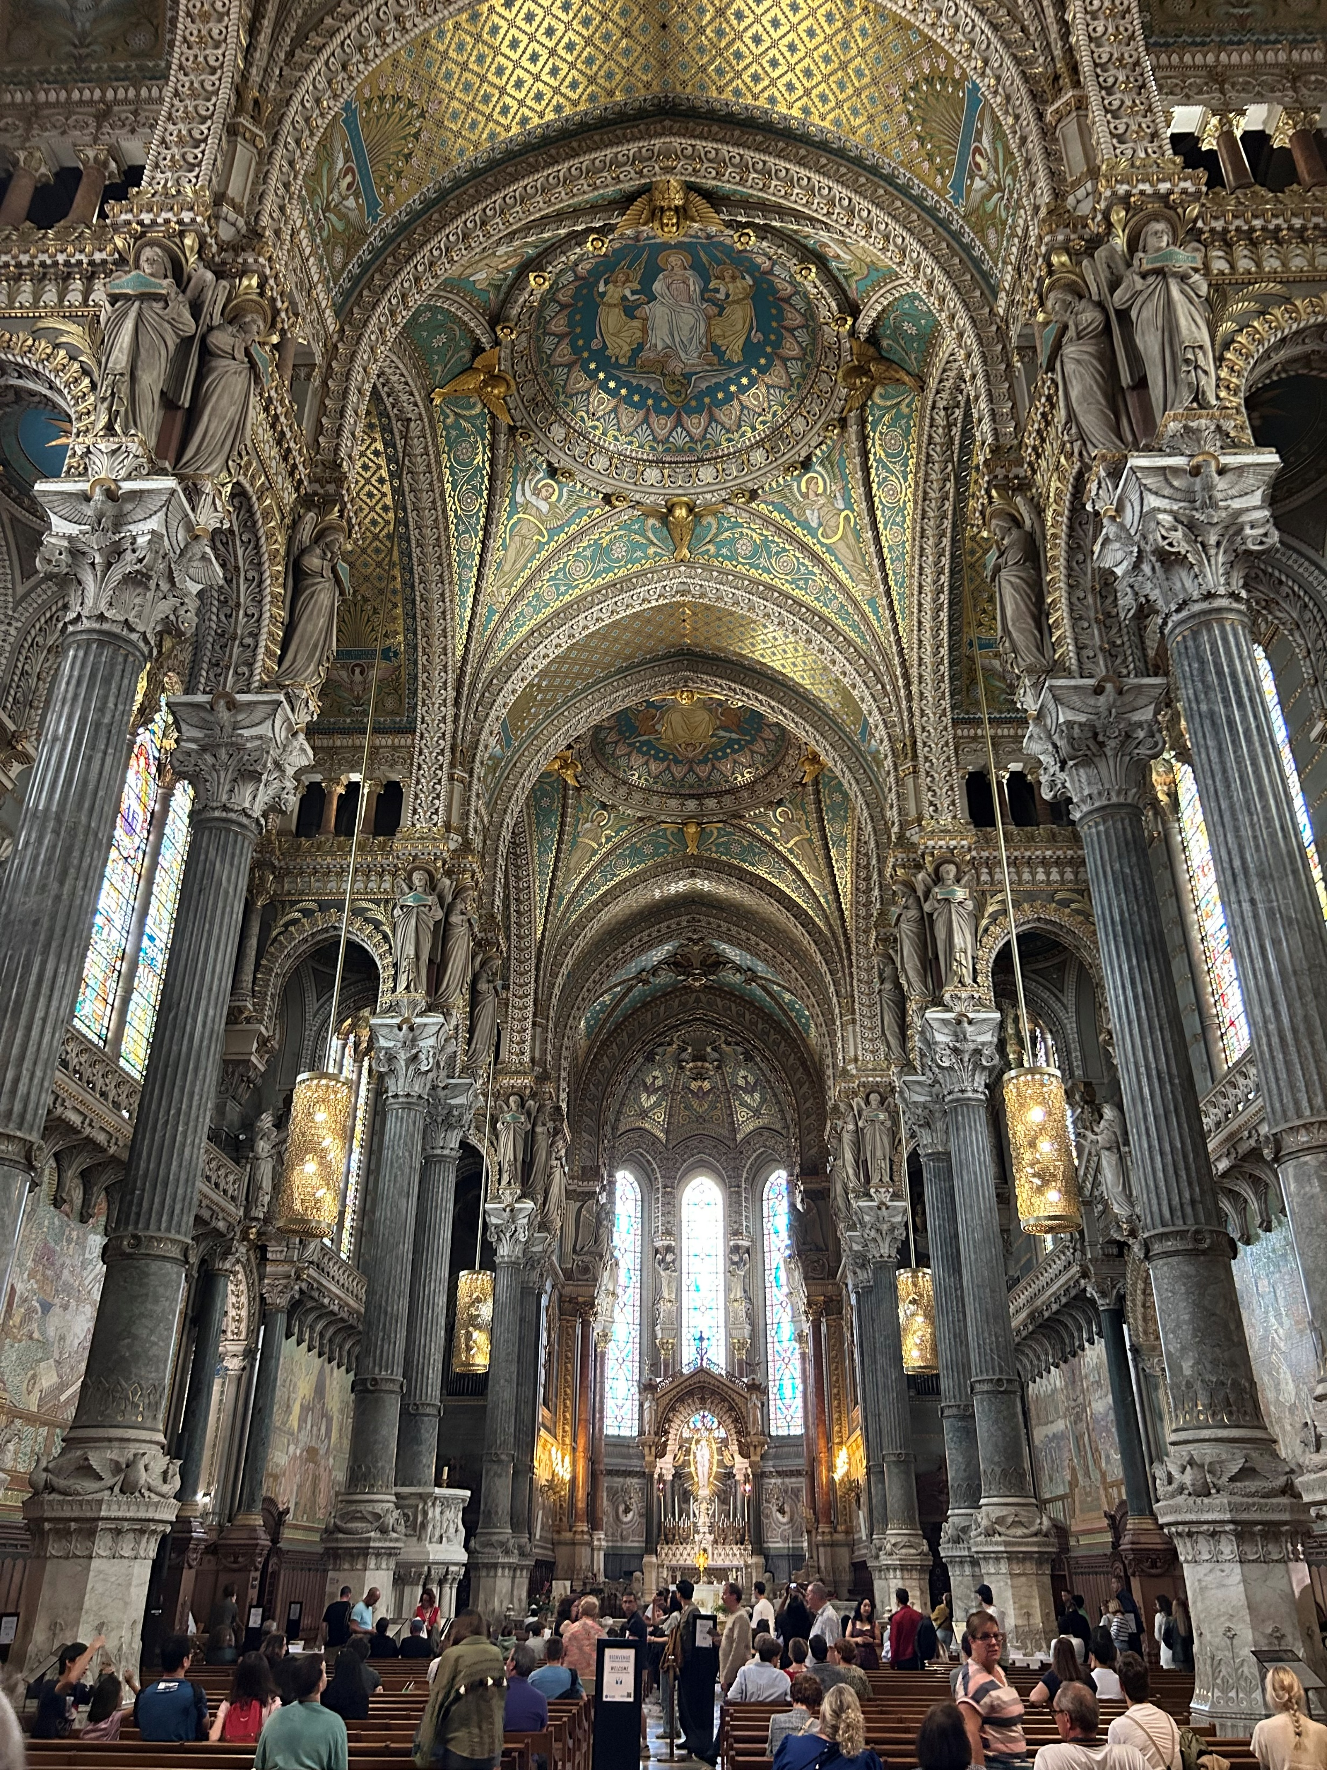
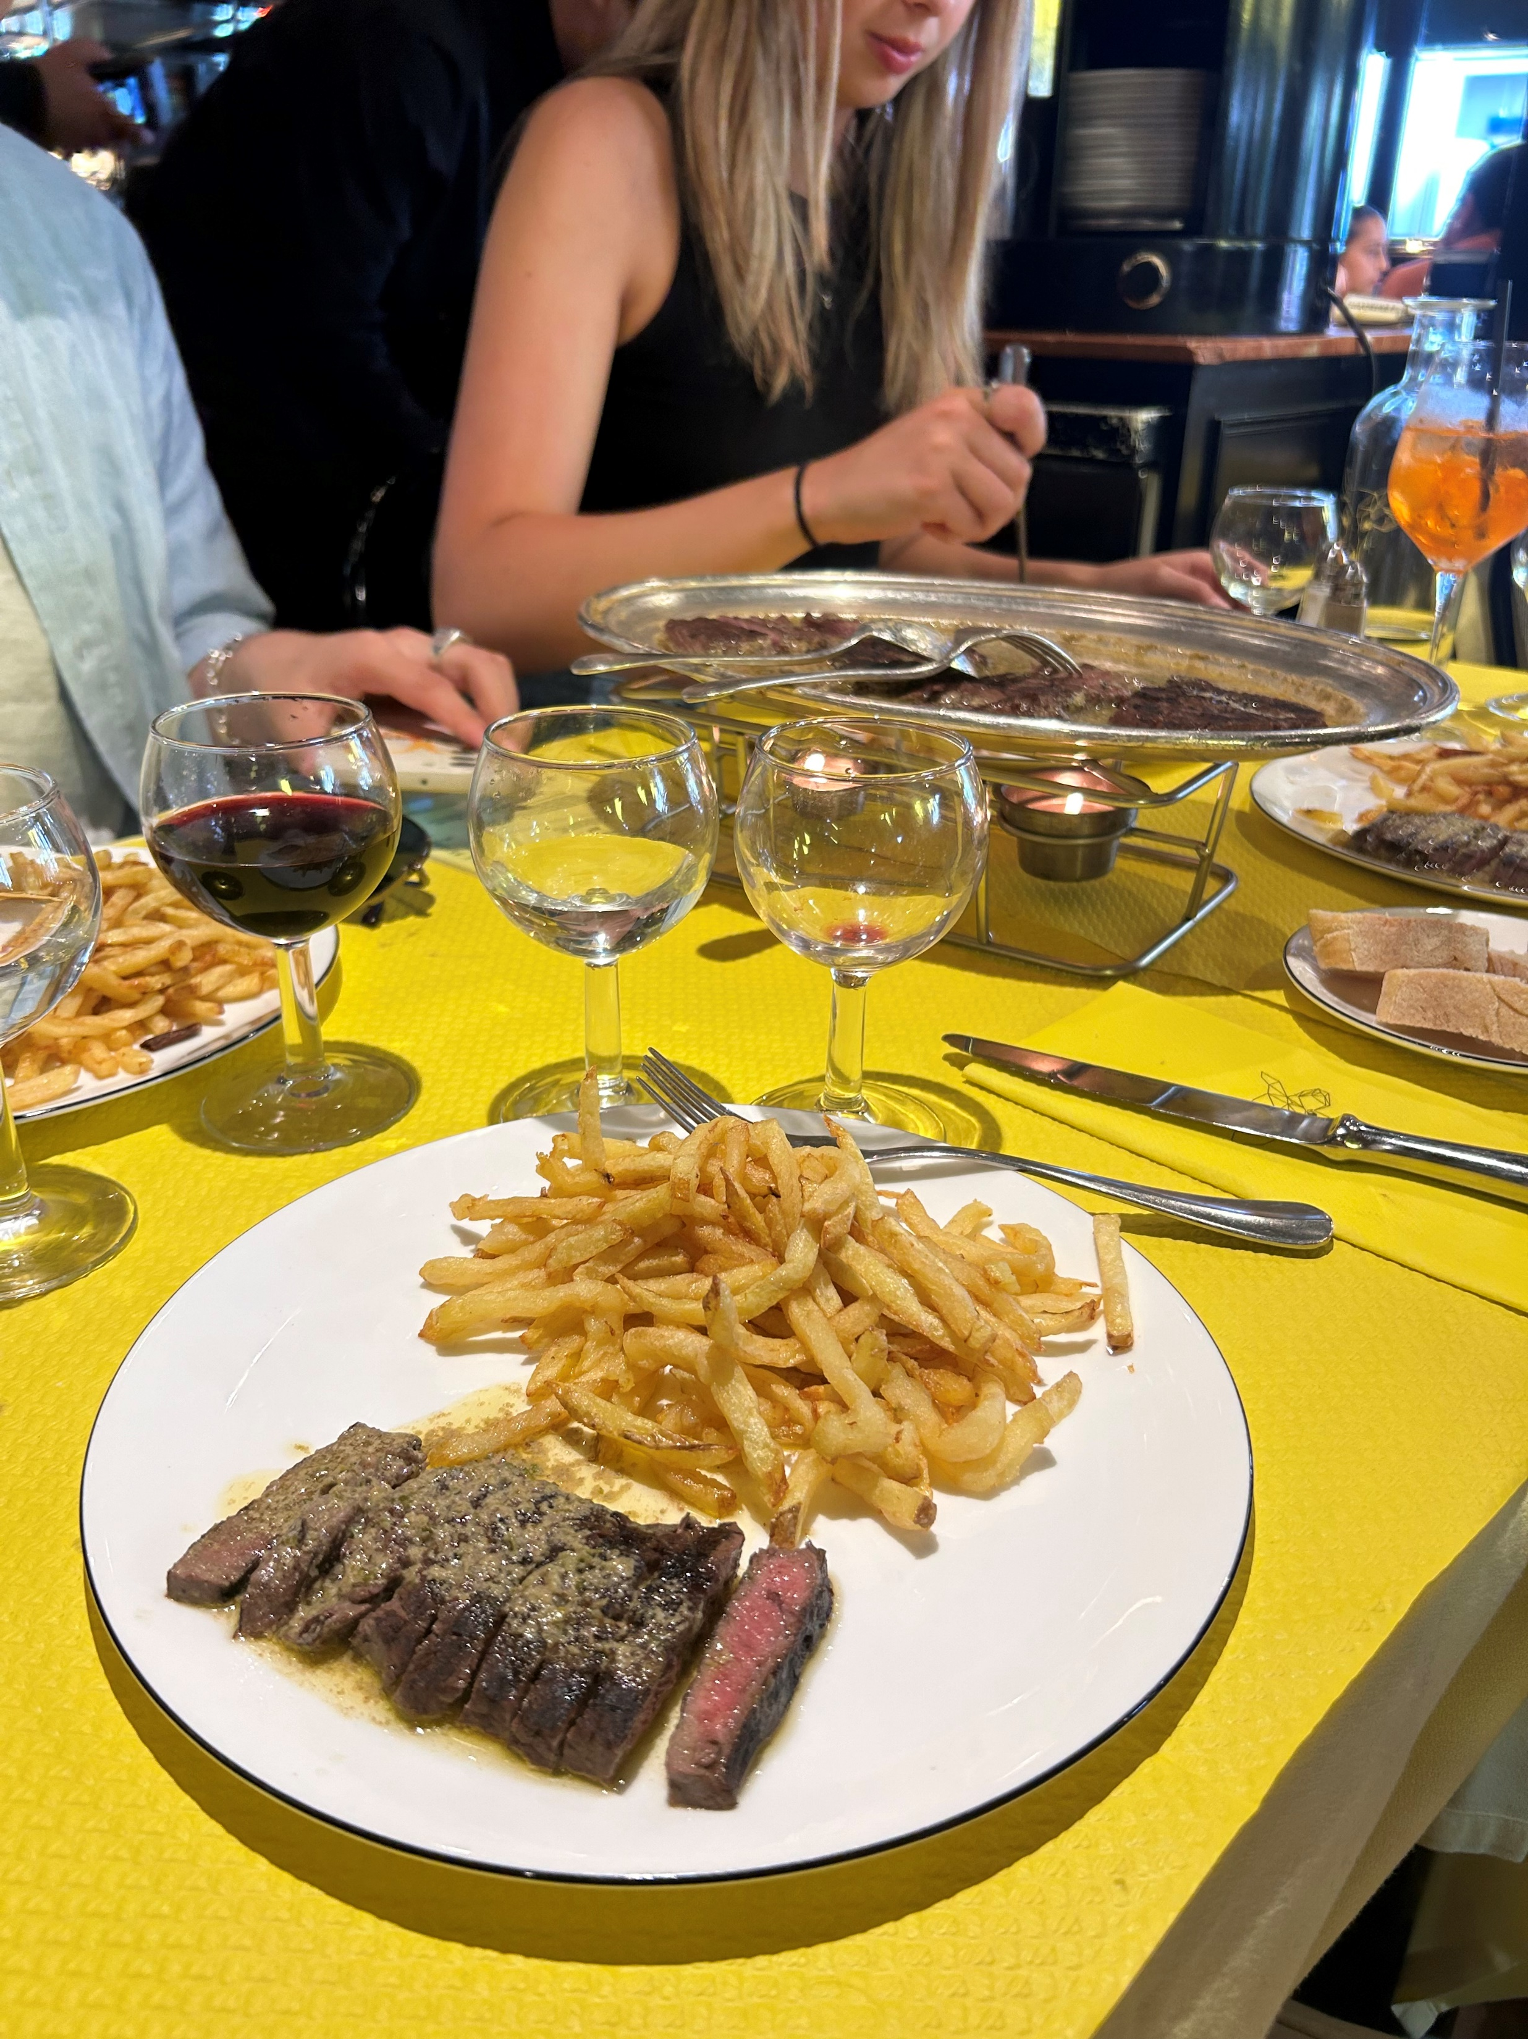
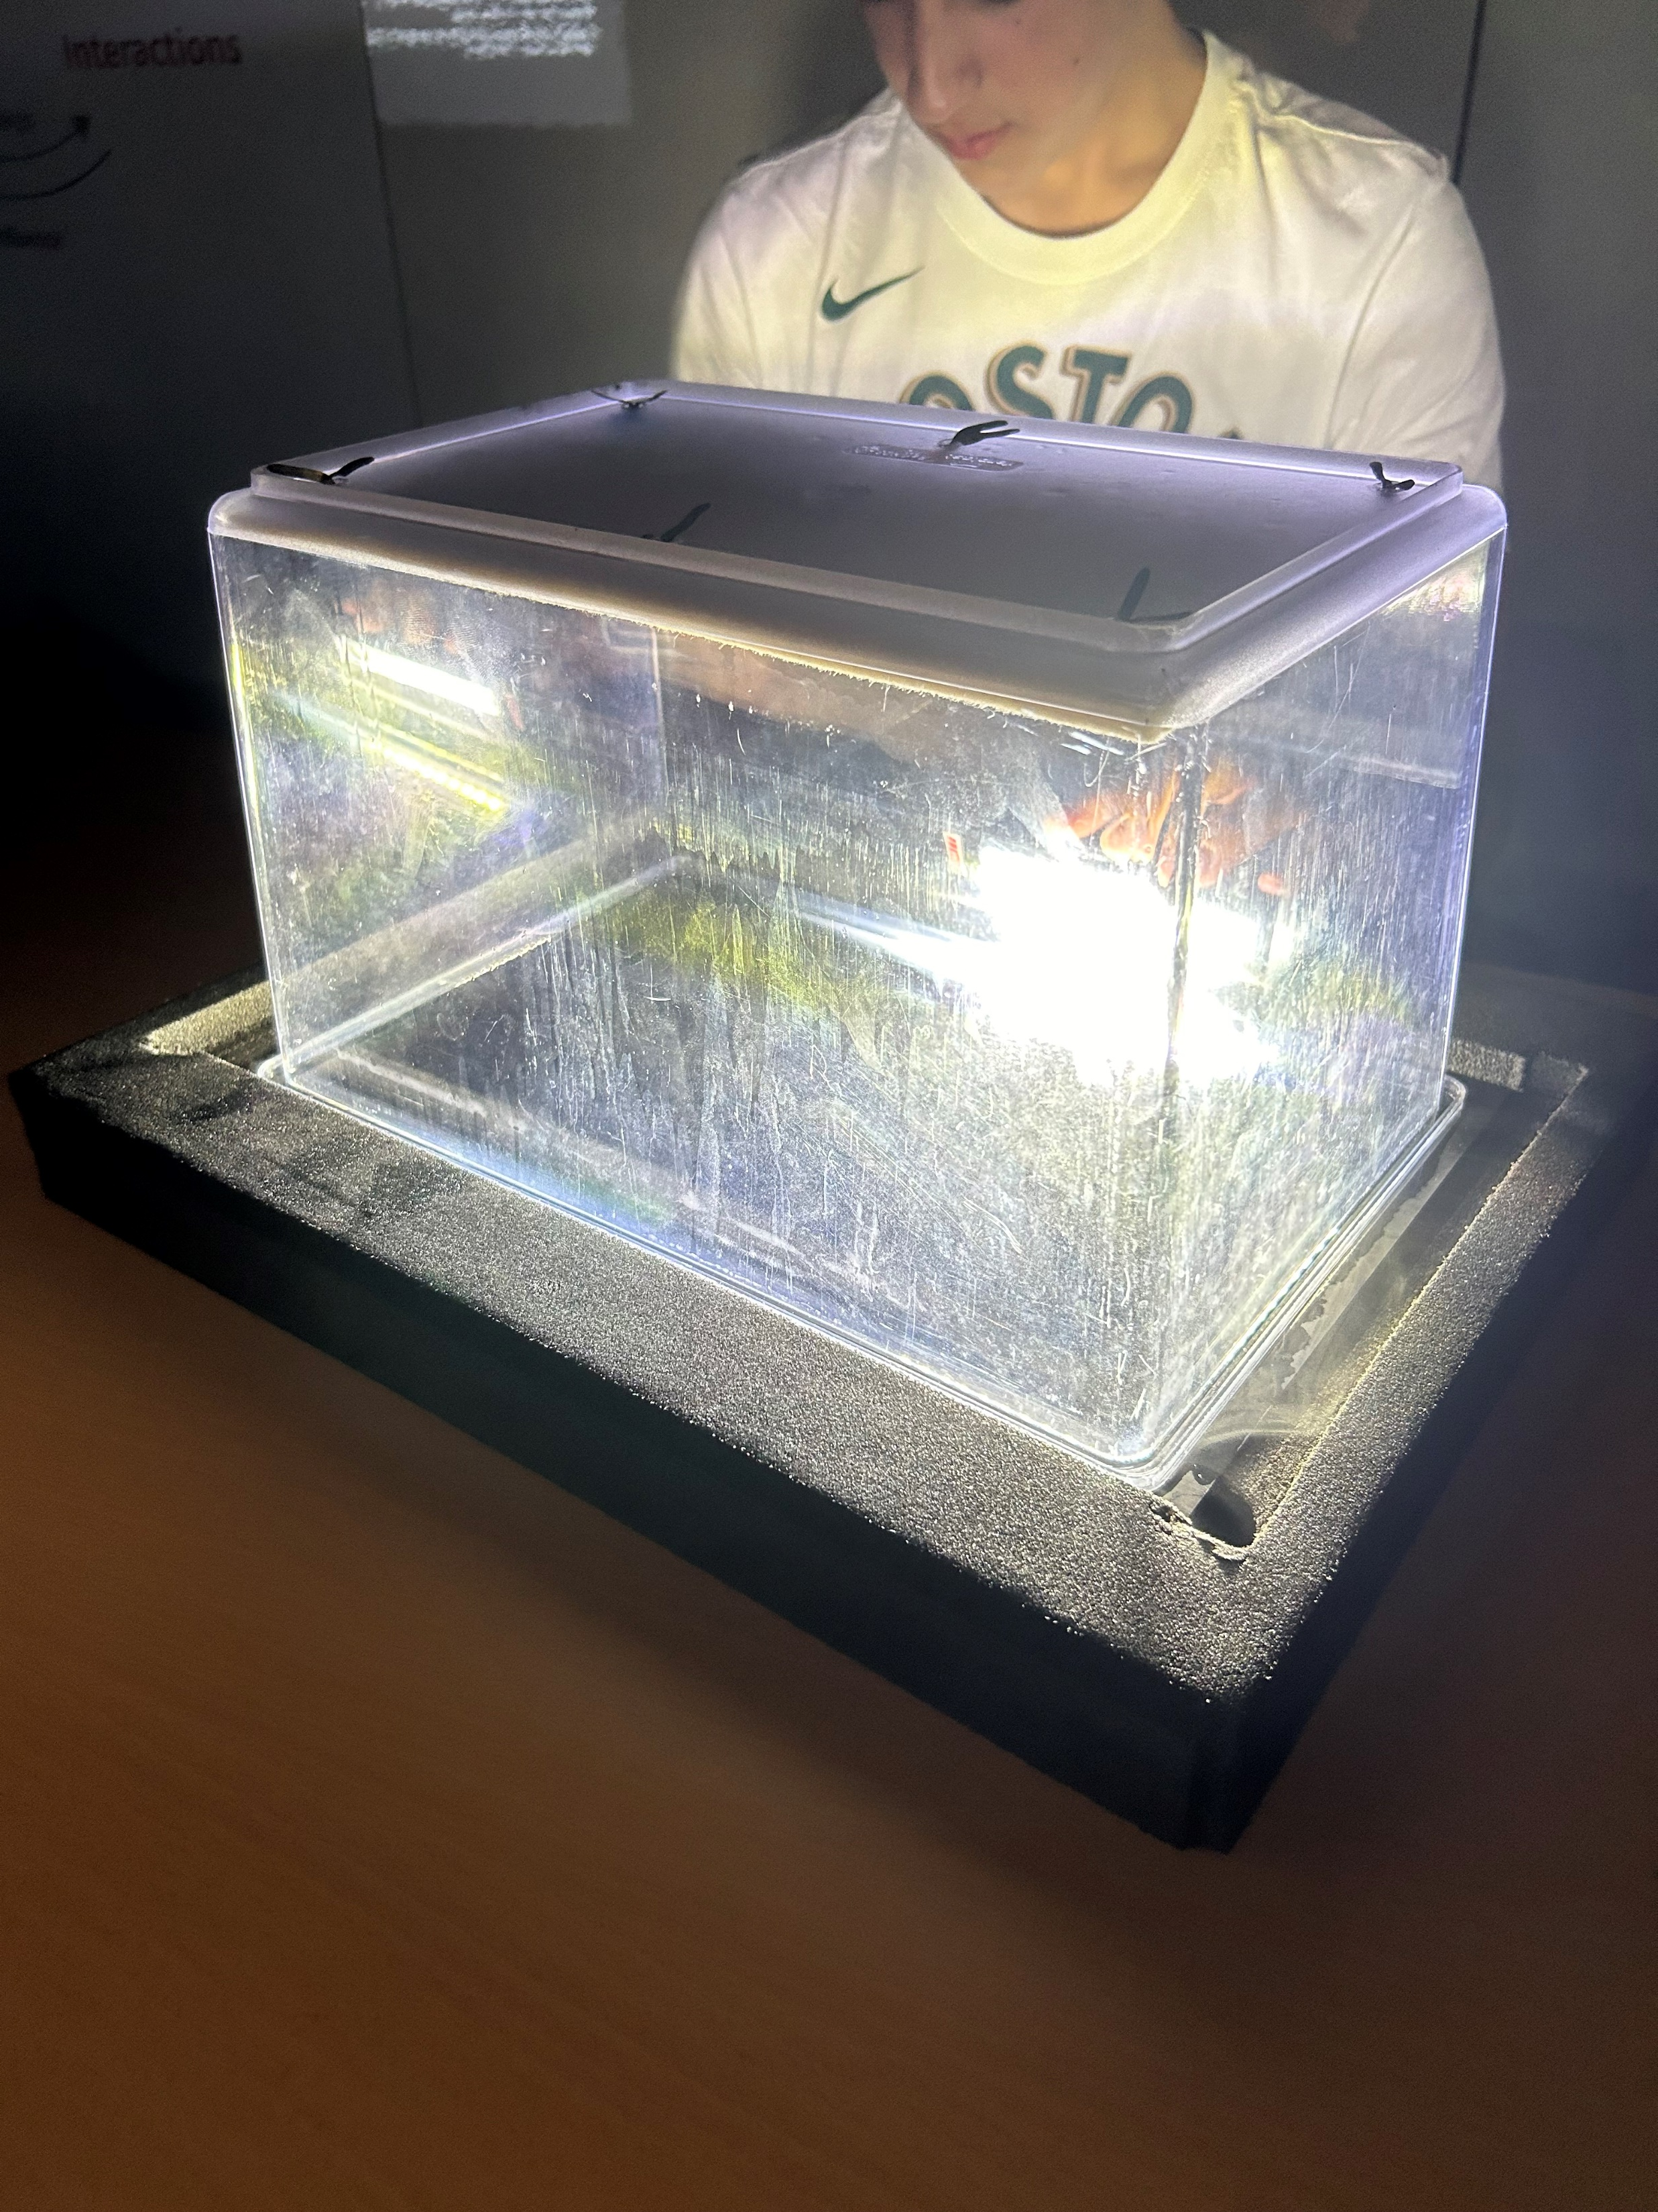

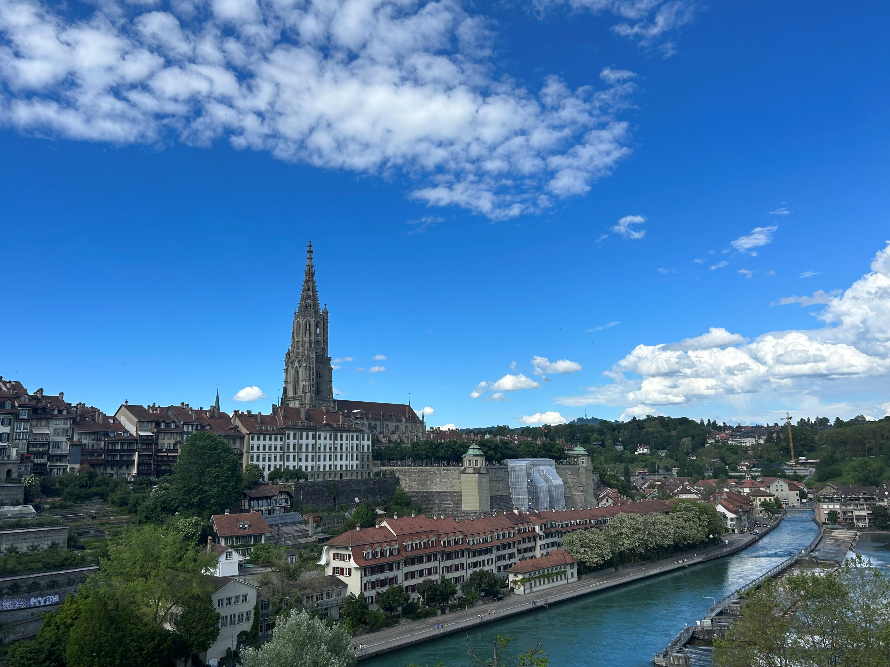

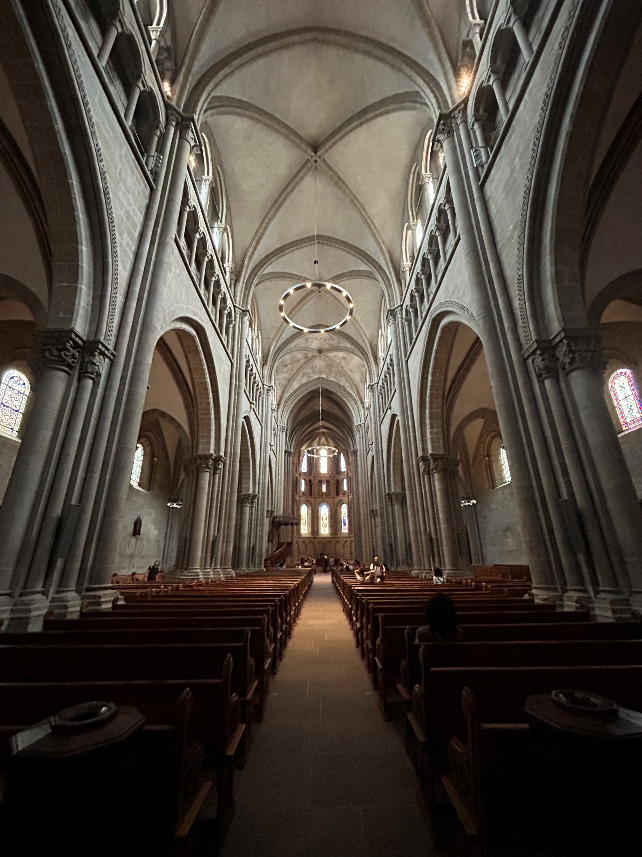
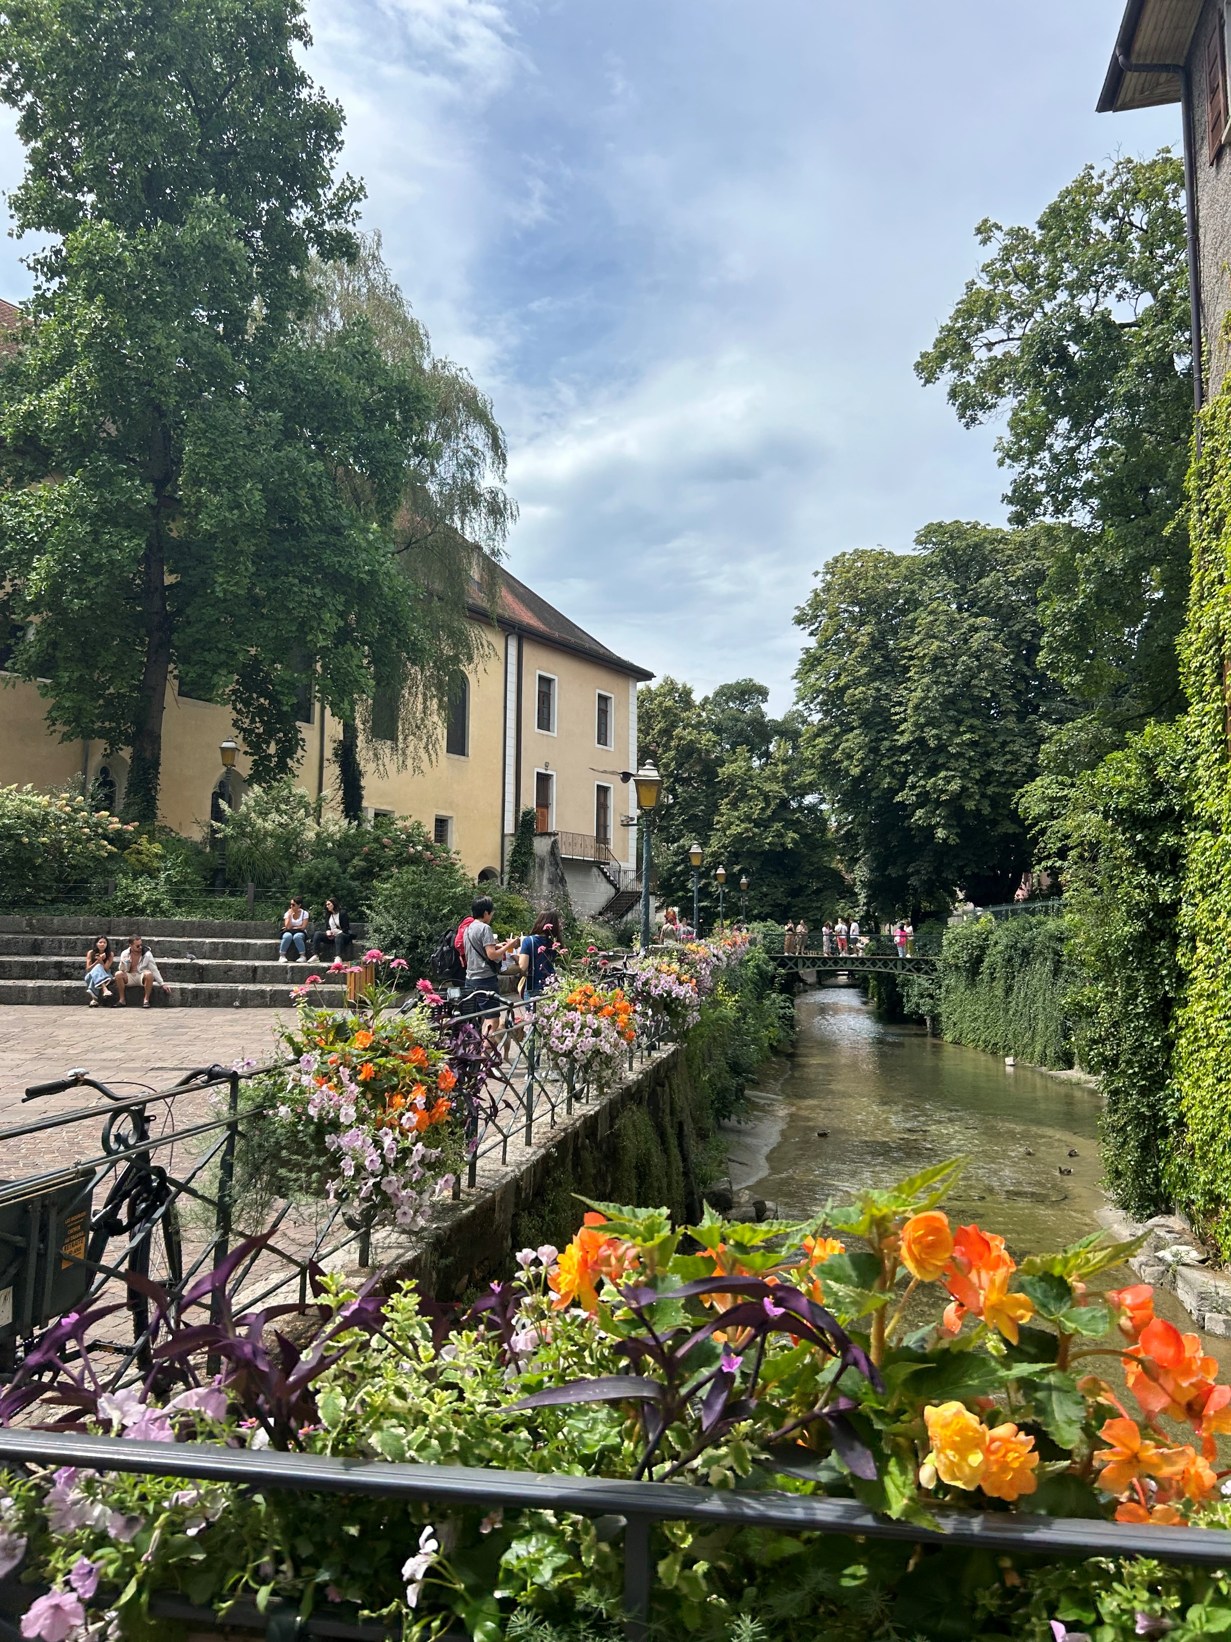
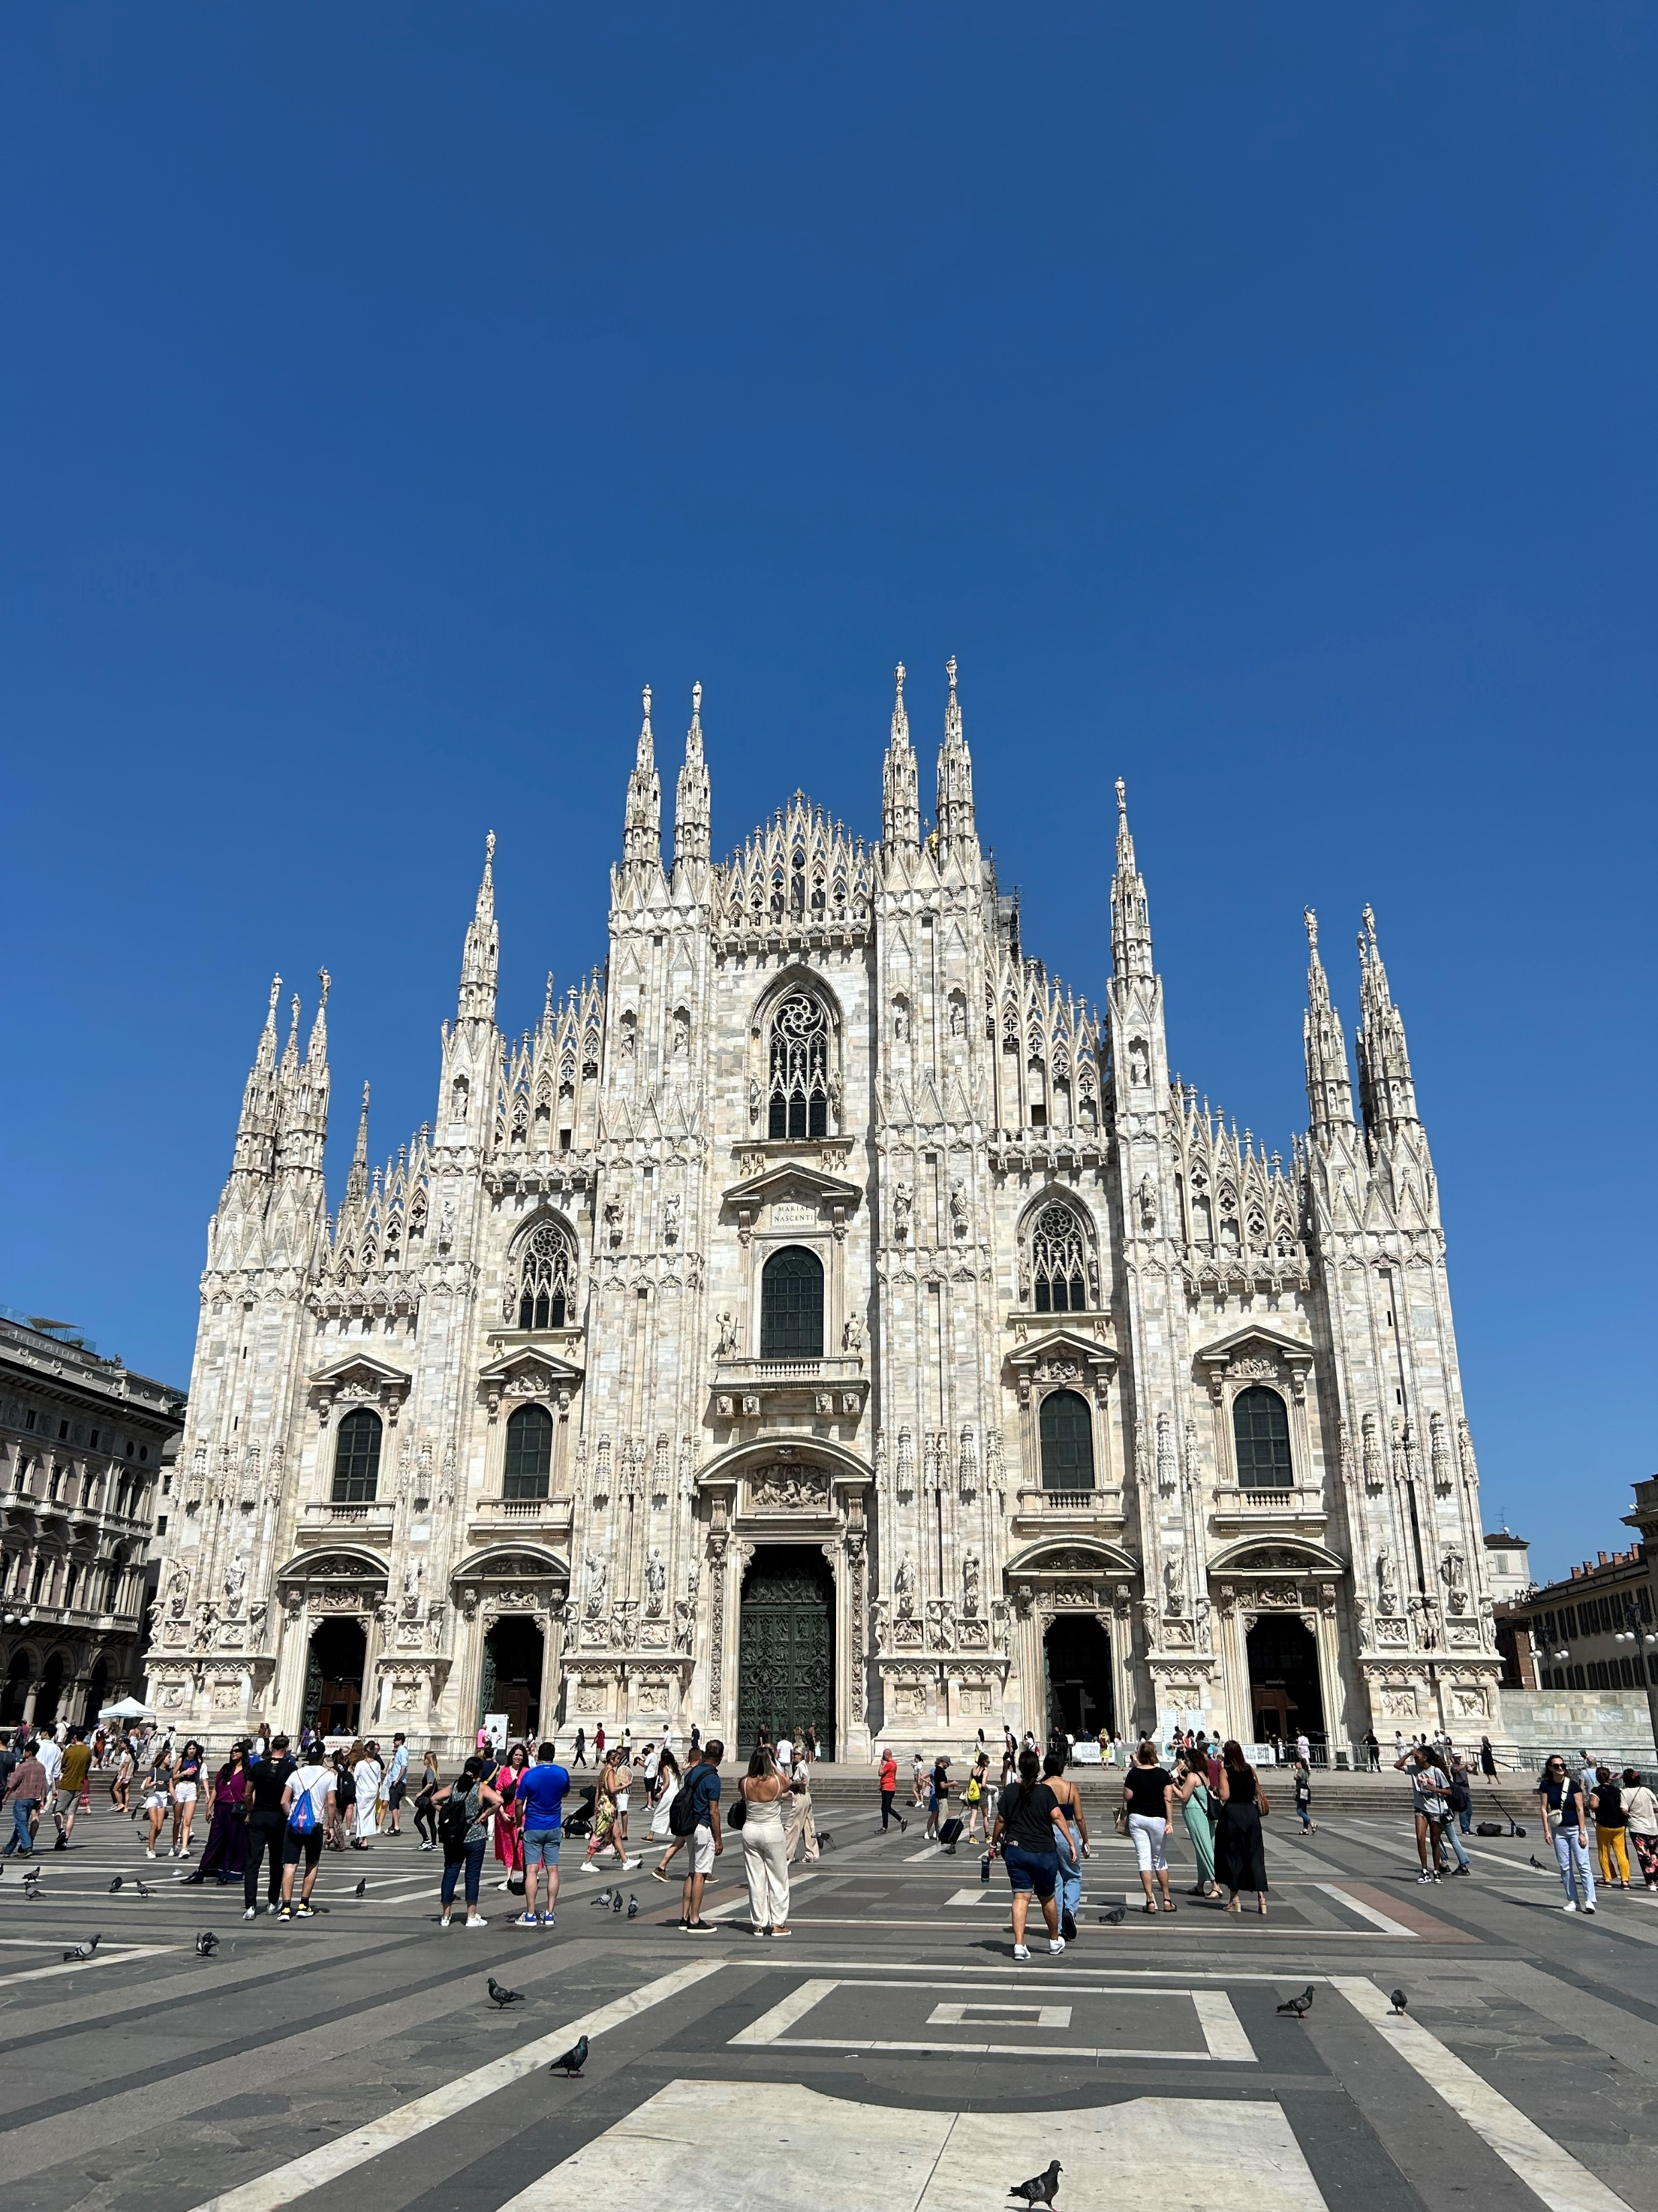
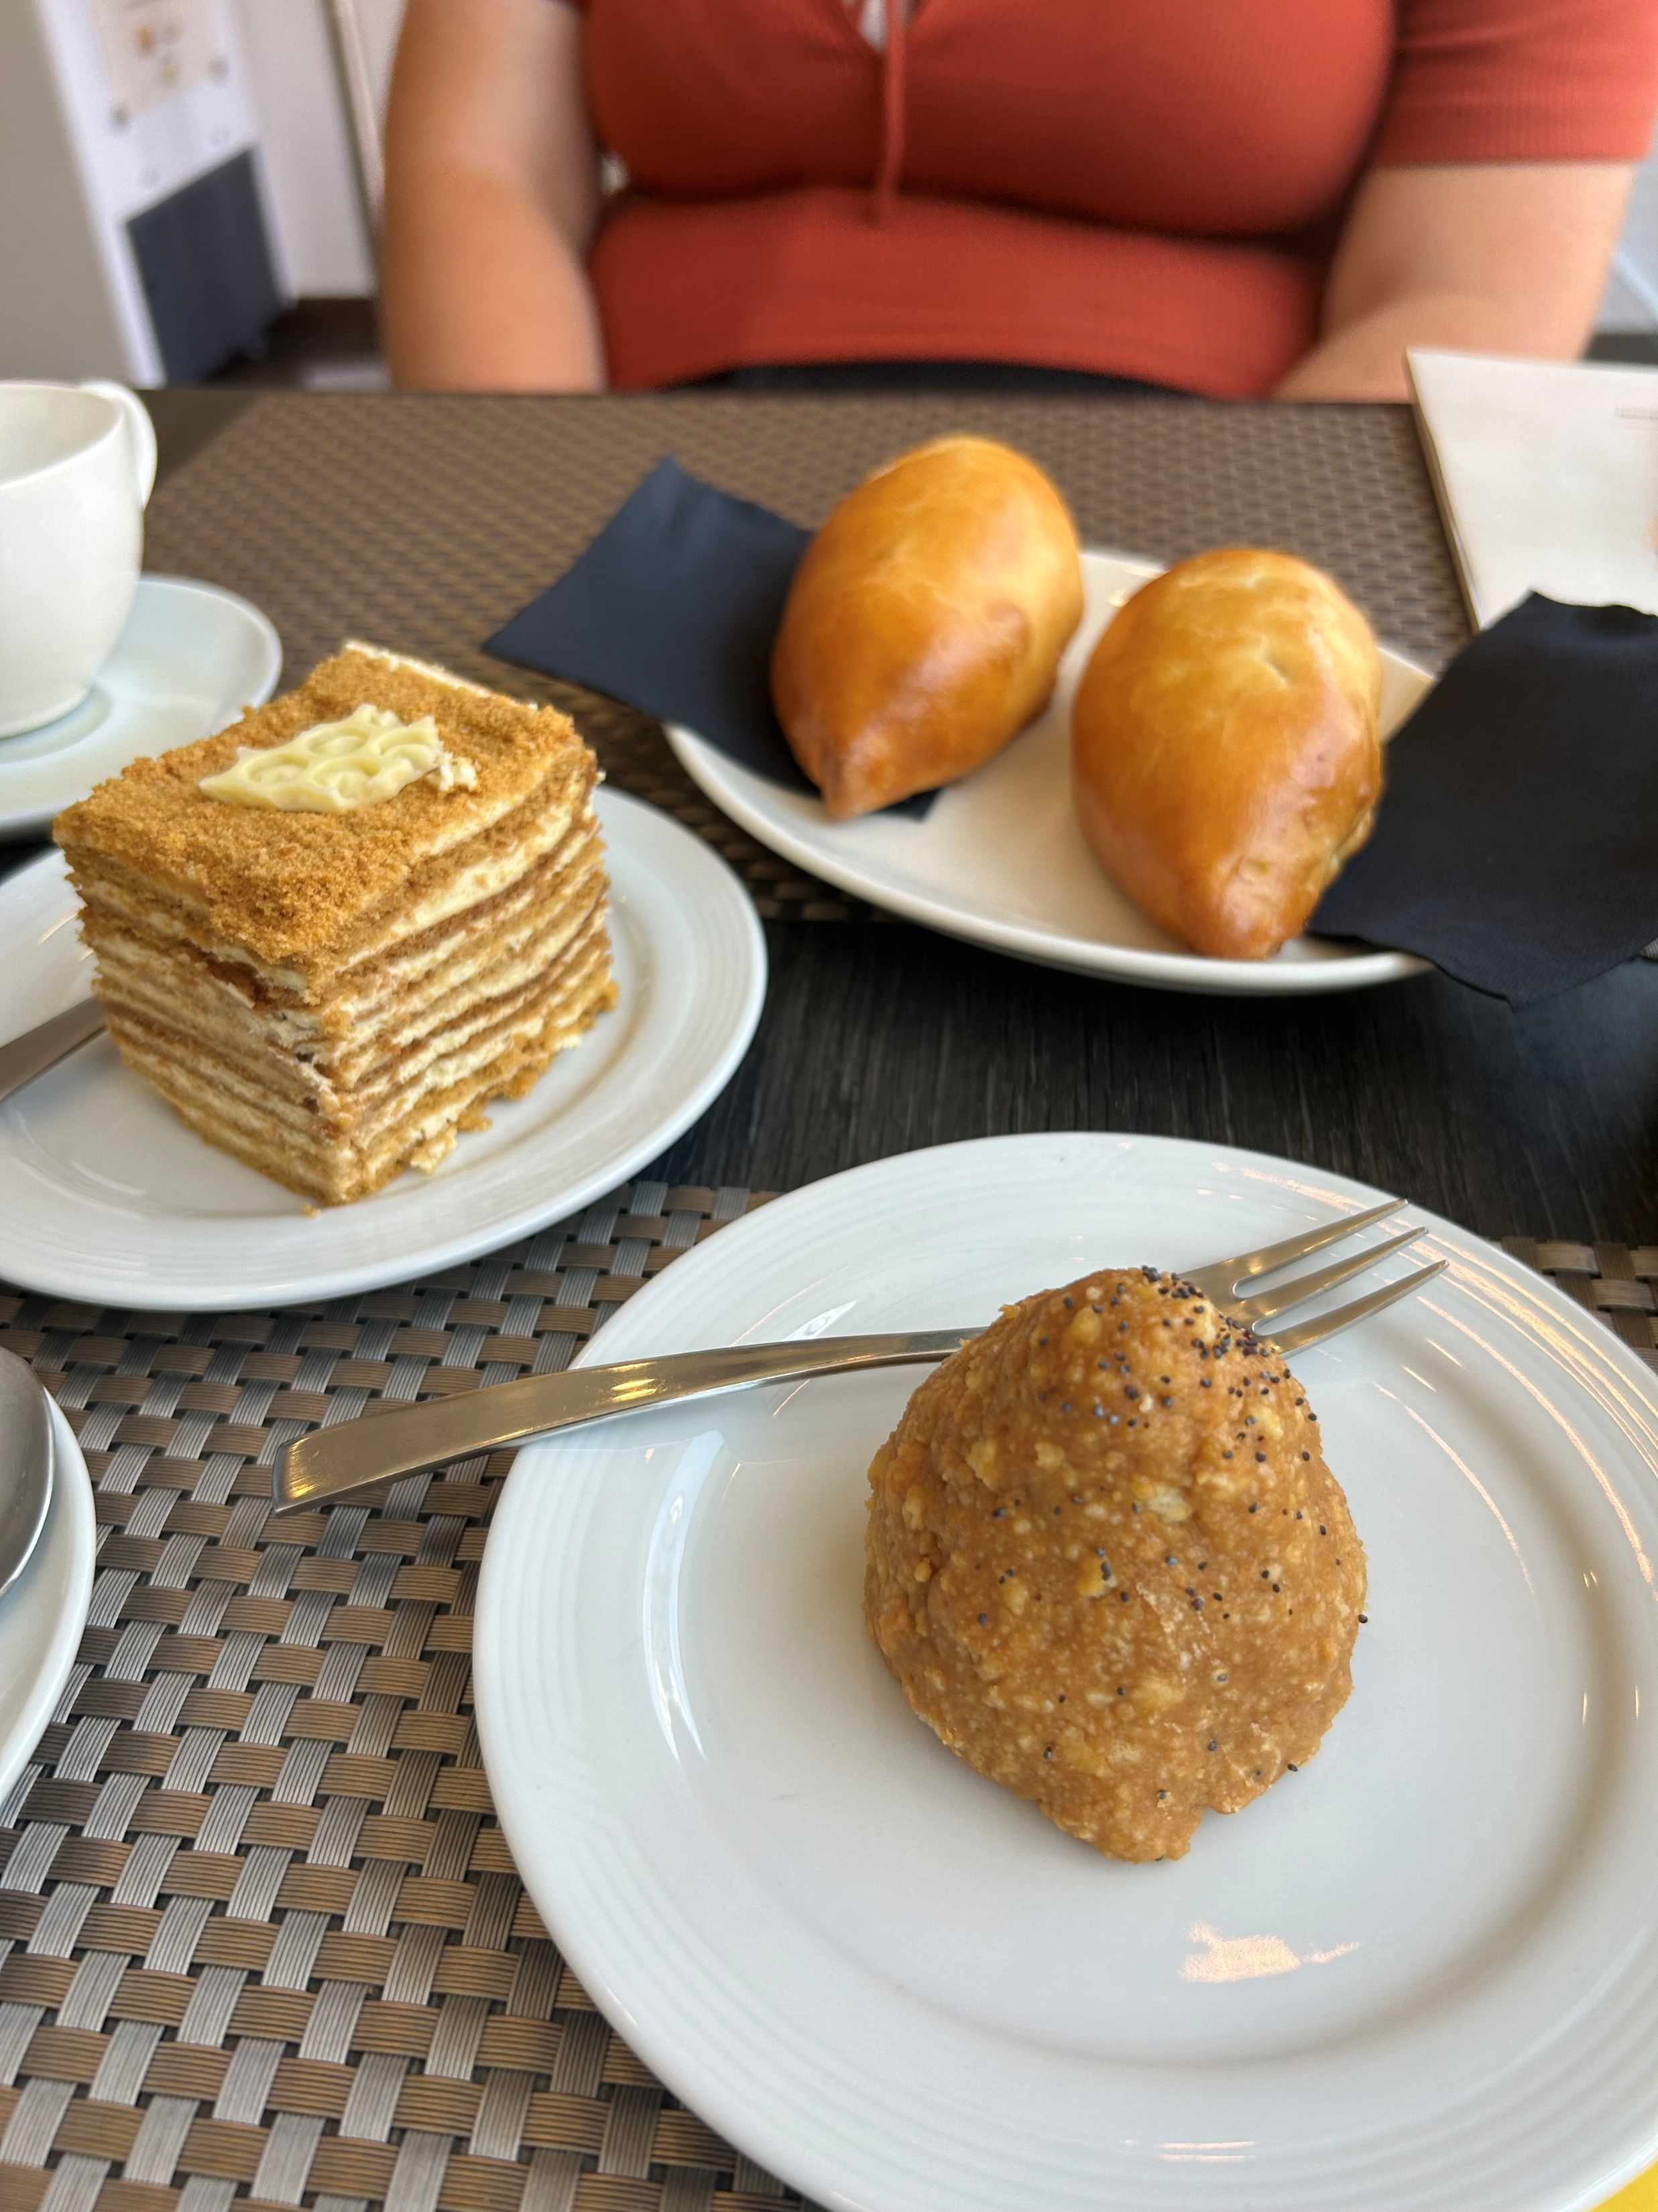
la jonction
lyon: basilica
villa del balbianello
cailler chocolate factory
cloud chamber workshop
steak frites
bern
st pierre cathedral
annecy
lake como
milan
russian food
18

