Slide 1

LGCReport Feedback Report
D. Wassmer for BE-GM-APC
15.07.2024

Slide 2
Overview
Performance investigations
Specifications feedback
Future steps
Goals of the presentation:
Transparency on the development
Continuous conversation about software needs
Feedback – both ways

Slide 3
Performance investigations
From last feedback session: Performance one of the central issues
Questions:
  What factors noticeably influence performance?
    Framework
    Histograms, 3D displays
    File size
    System specs
  How does the framework within SurveyPad work?
  Which tools are available to improve performance?
    Update framework – improve code
    Lazy loading
    Investigate multiple open projects performance loss

Slide 4
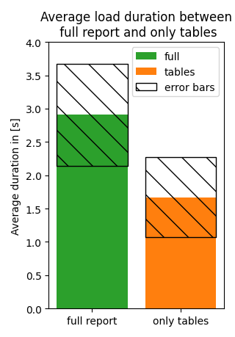
Performance investigations
Framework: QtWebEngine
No visible changes in performance when updating from Qt5.15 to Qt6.5
Page loaded when tab is selected in SurveyPad:
  possibility to load in background?
  Keeping WebWidget alive between loads?
Use lazy loading and omit loading heavy elements from the beginning
Observed performance loss when multiple projects are open

Slide 5
Performance investigations
Lazy loading for nonvisible components (starting from measurements table) (Quicker display, generally longer to fully load)
Collapsible elements + Lazy loading (Faster)
Lazy loading – Scrolling (starting from histograms) (Quicker display)

Slide 6
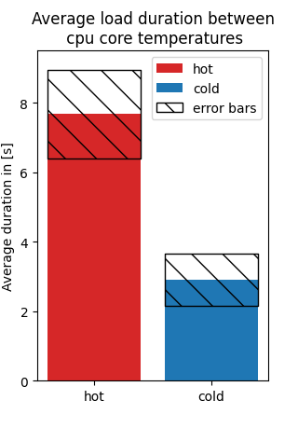
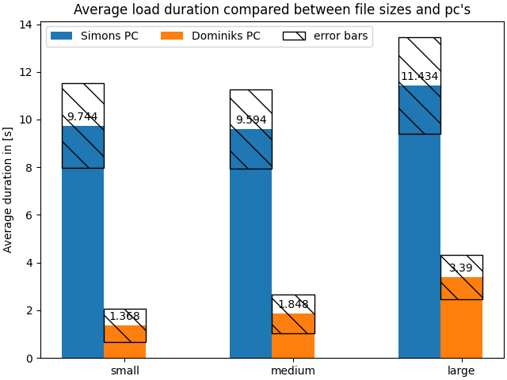
Performance investigations
Smaller files only minimally impact performance
Performance can vary between systems
Performance also impacted by cpu temperature

Slide 7
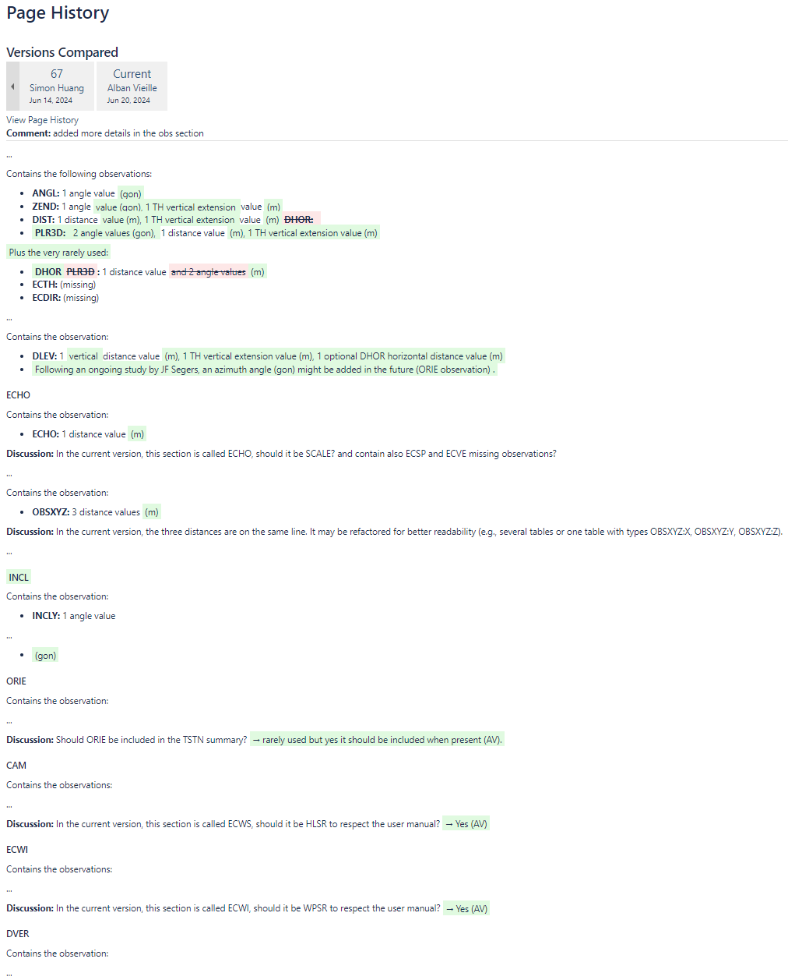
Specifications feedback
Thanks to Alban Vieille for participating to the document
Further input always appreciated
If unsure about possible additions you can talk to us
Page history always available -> no harm done
We likely ask for more input once development is picked up more intensely (more related info in section about Future steps)

Slide 8
Future steps
Due to current priorities and task on SurveyPad Qt migration and PyRabot development -> likely next to no development in the next month
All further development focused on improving performance first
  This includes potentially improving performance from disabling columns by default
  Additional features like, returning to same spot in the document after reload, after performance is improved
Next steps for development on LGCReport:
  Addition of lazy loading (expected difficulty: easy)
  Improving loading within SurveyPad (keeping widget alive, preloading in background;
  expected difficulty: high)

