Slide 1
RD-MR
Co-development Workshop
29th August 2024
Ole Werner & Catarina Batista

Slide 2
IdeaSquare
The Innovation Space at CERN
Collaborative methodologies;
Access to CERN expertise;
Cross-connectivity to ideate solutions for the future of humankind.
IdeaSquare is a place where people have the license to dream!

Slide 3
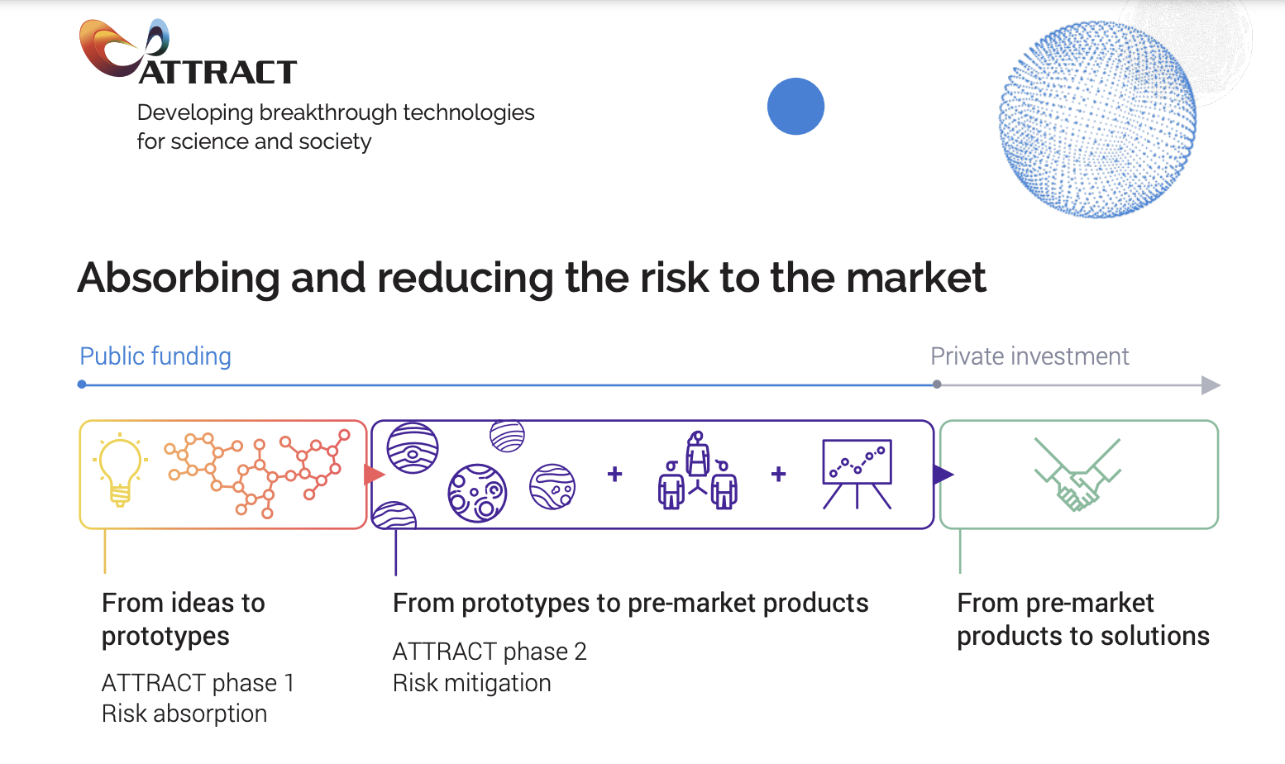
Notes:
TEXT MISSING!
LINK TO IMAGE!

Slide 4
Intersecting societal challenges with deep tech
Societal needs (UN SDGs)
+22 active program collaborations;
Universities from 8 different countries;
Multidisciplinary teams of students: business, design, engineering, social sciences…
CERN researchers who act as technological coaches.
i2
Futures thinking
Exponential thinking
Speculative design
Behavioral design
Deep tech
(detection & imaging, criogenics…)

Slide 5
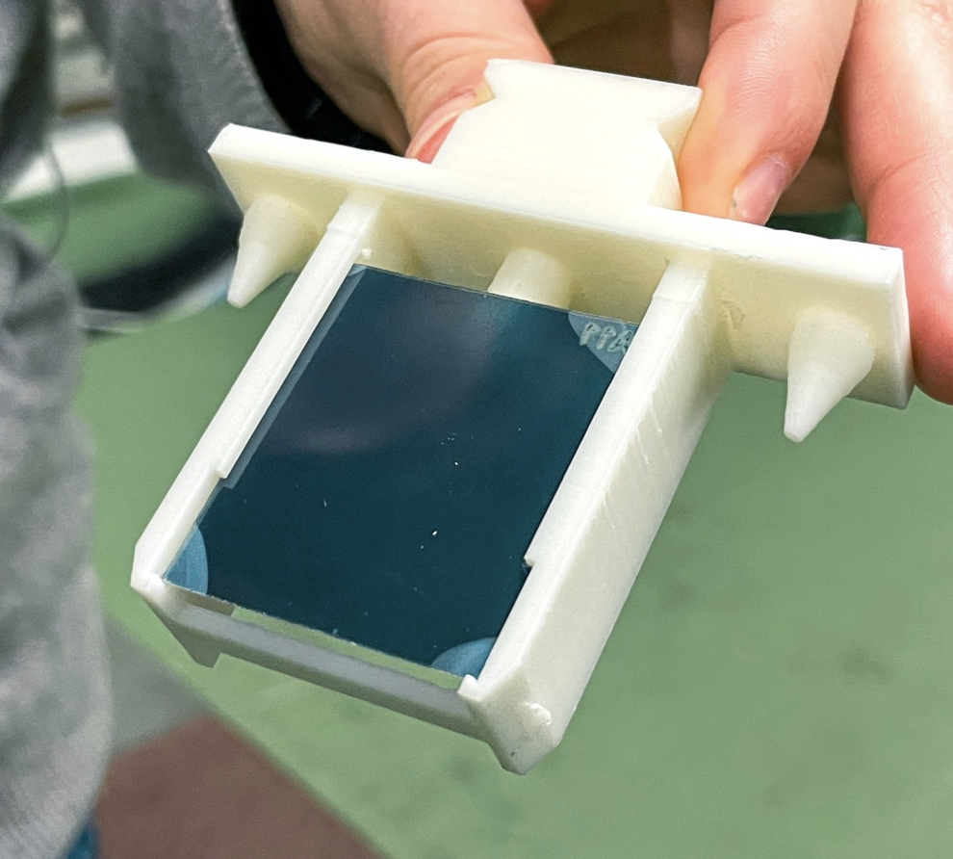
Prototyping
CLEAR primary focus is on general accelerator R&D and component studies for existing and possible future machines
Prototyping and validation of accelerator components, and studies of high-gradient acceleration methods.
Radiation hardness of electronic components for space and high-energy physics;
Dosimetry for medical applications (cancer therapy).
CLEAR Experiment - https://home.cern/science/accelerators/clear AND https://pkorysko.web.cern.ch/C-Robot.html
Notes:
CLEAR is doing research in medical radiation therapy. Put very simply they research the impact of doing radiation therapy in short, intense bursts, compared to the conventional way of giving small doses of radiation over a longer period of time.
In order to test this they have built a robot which picks up a sample and places it in front of their beam, since they cannot be in the room while the beam is running. The collaboration with IdeaSquare consisted mostly of prototyping parts for the robot. Many different iterations of the sample holders were tested before a final design was chosen. The holders were 3D printed, along with the gripper of the robot. The laser cutter was also used to cut radiation sensitive film, which could not be cut with conventional tools.
VIDEO: https://pkorysko.web.cern.ch/C-Robot.html

Slide 6
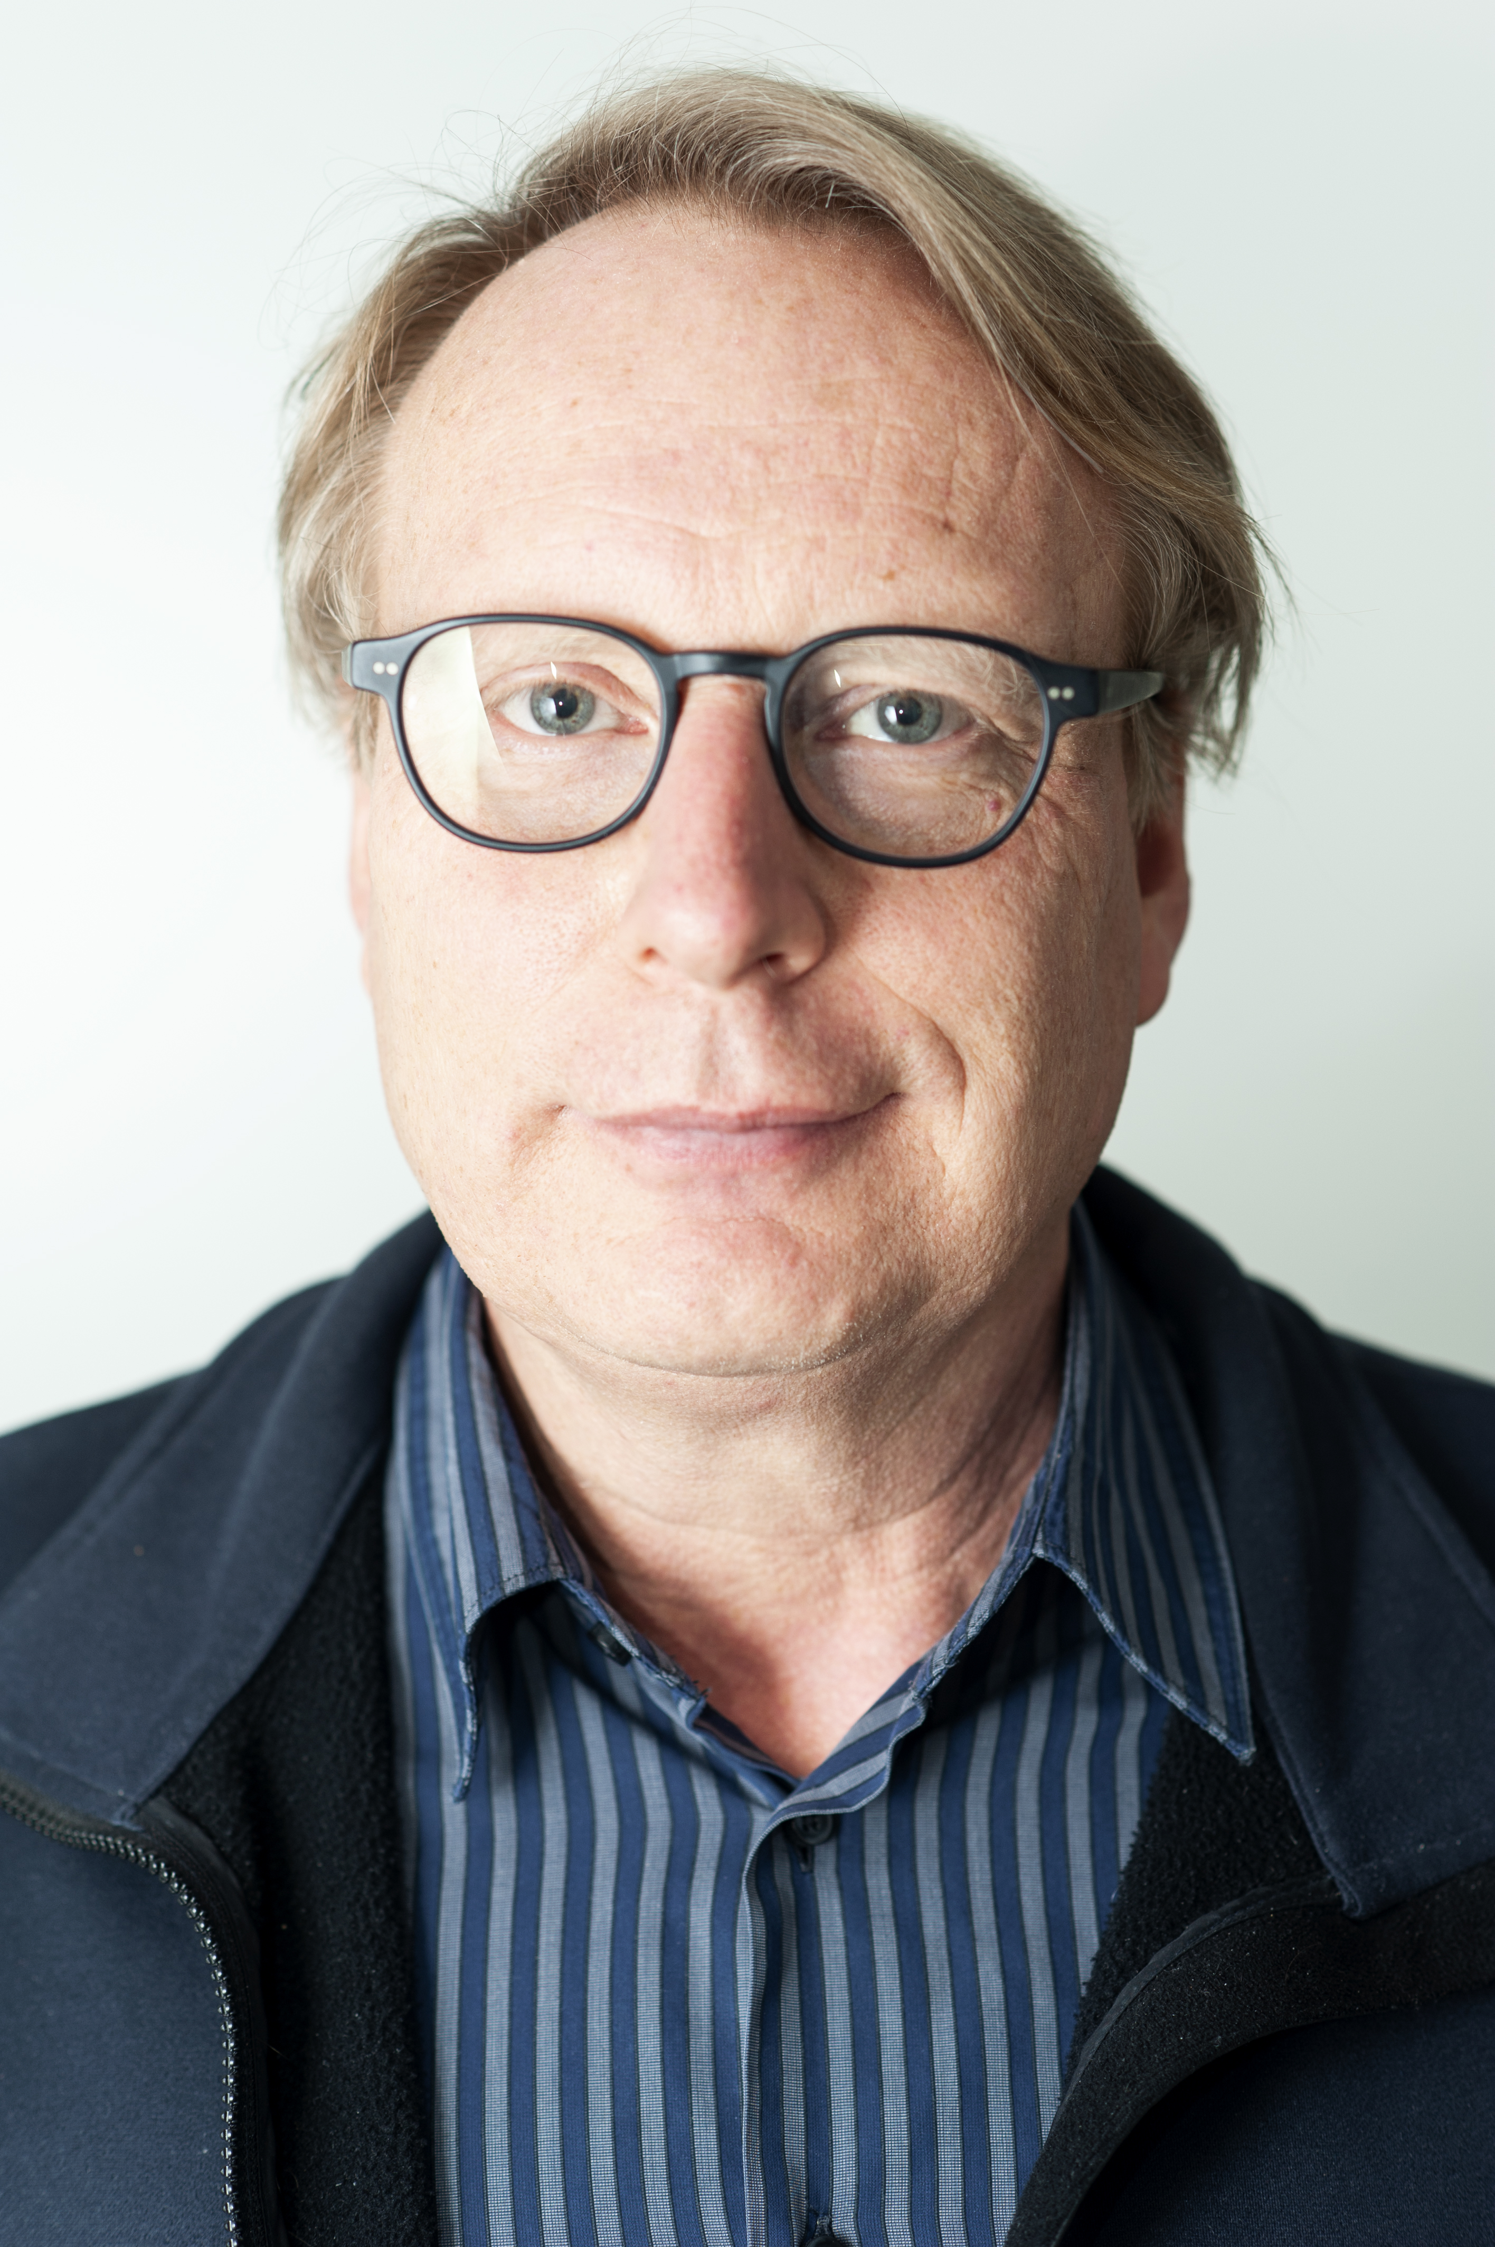
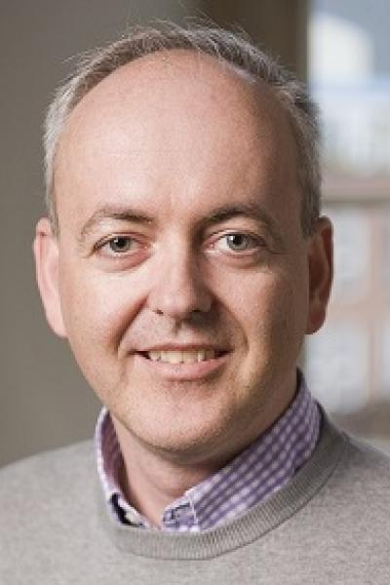
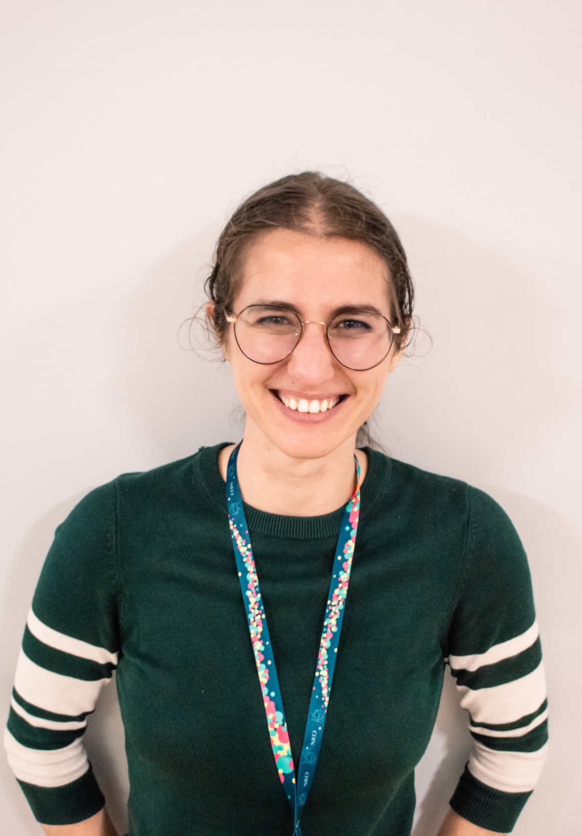
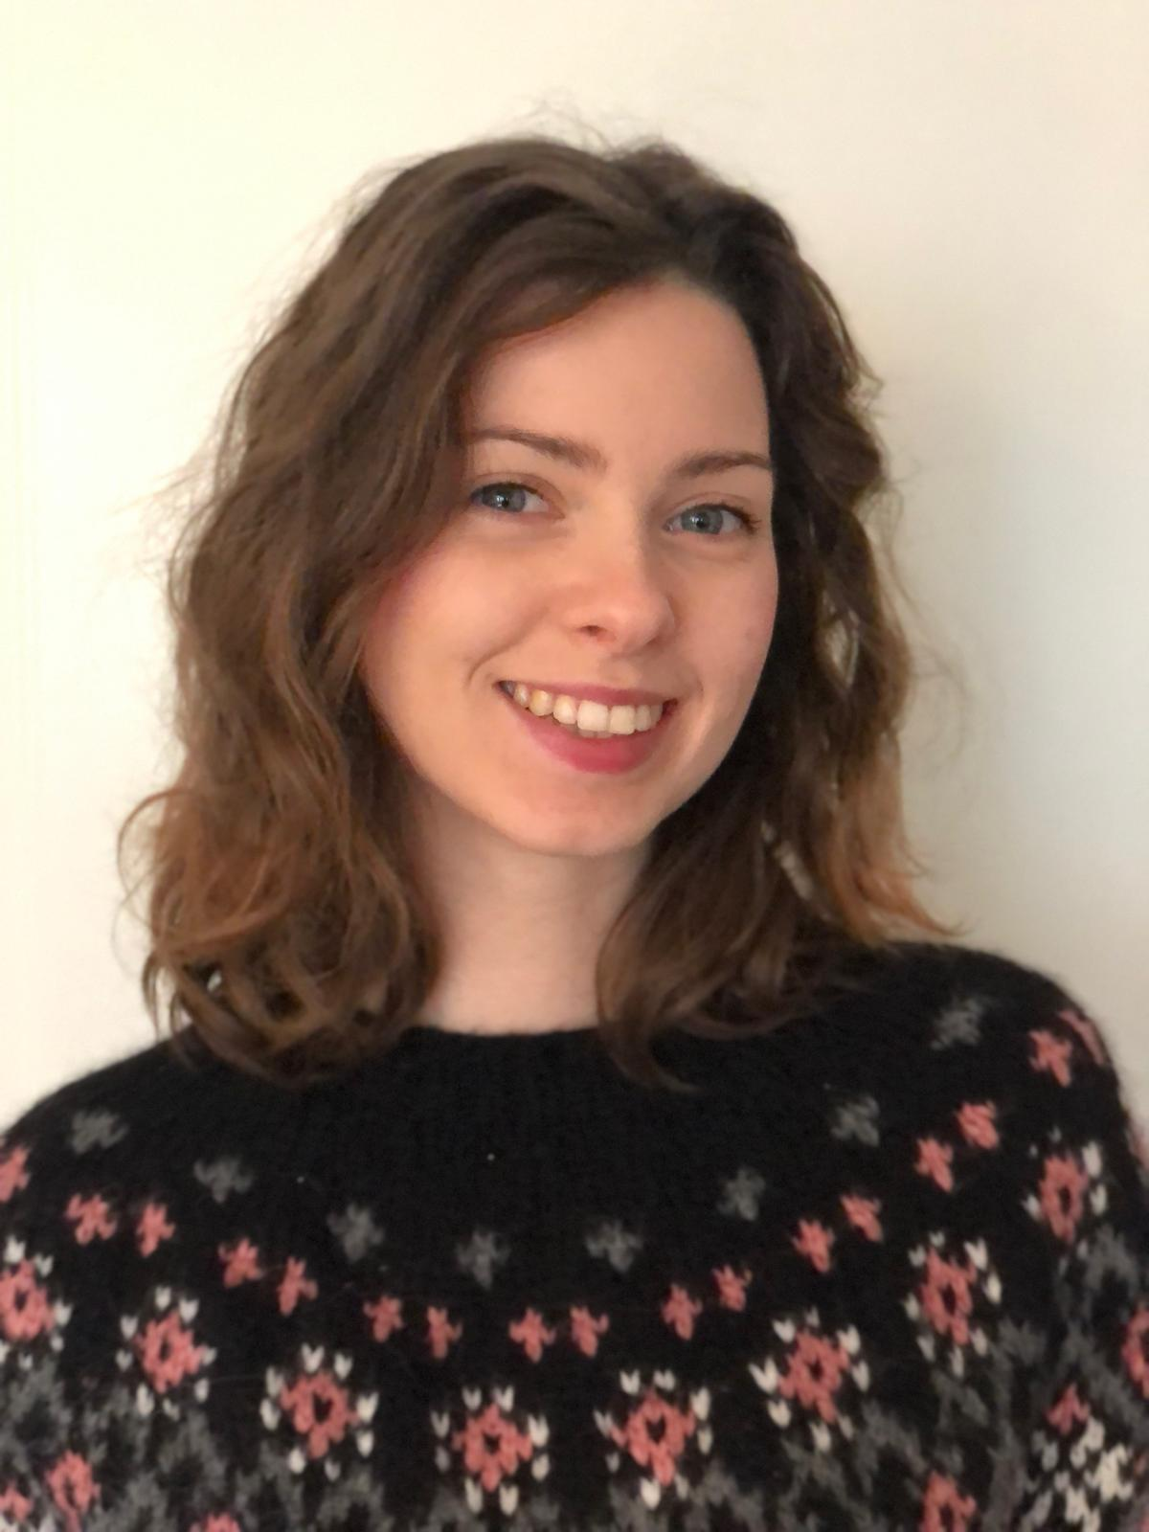
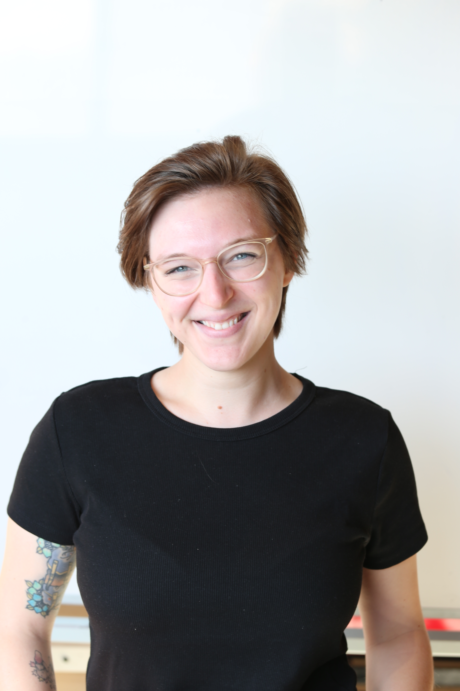
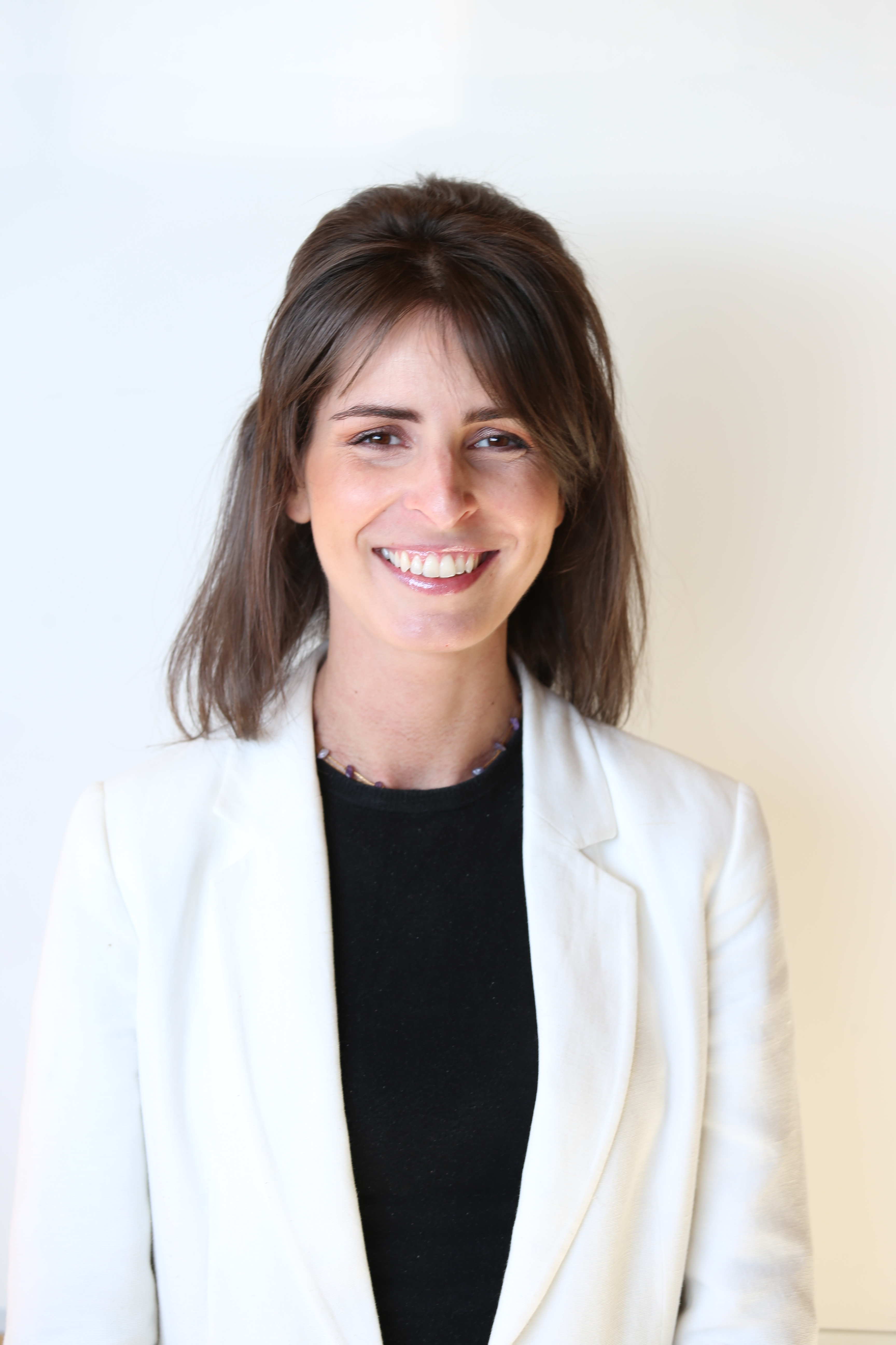
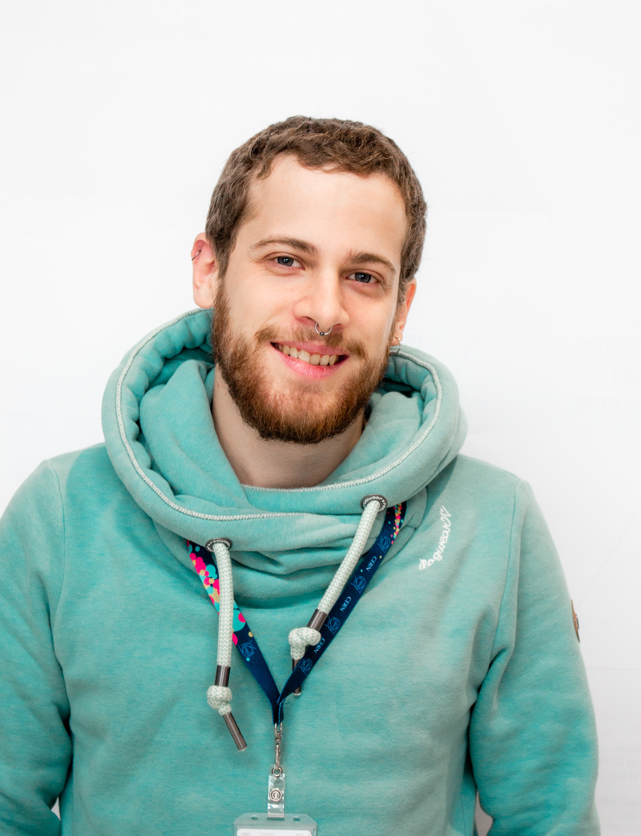
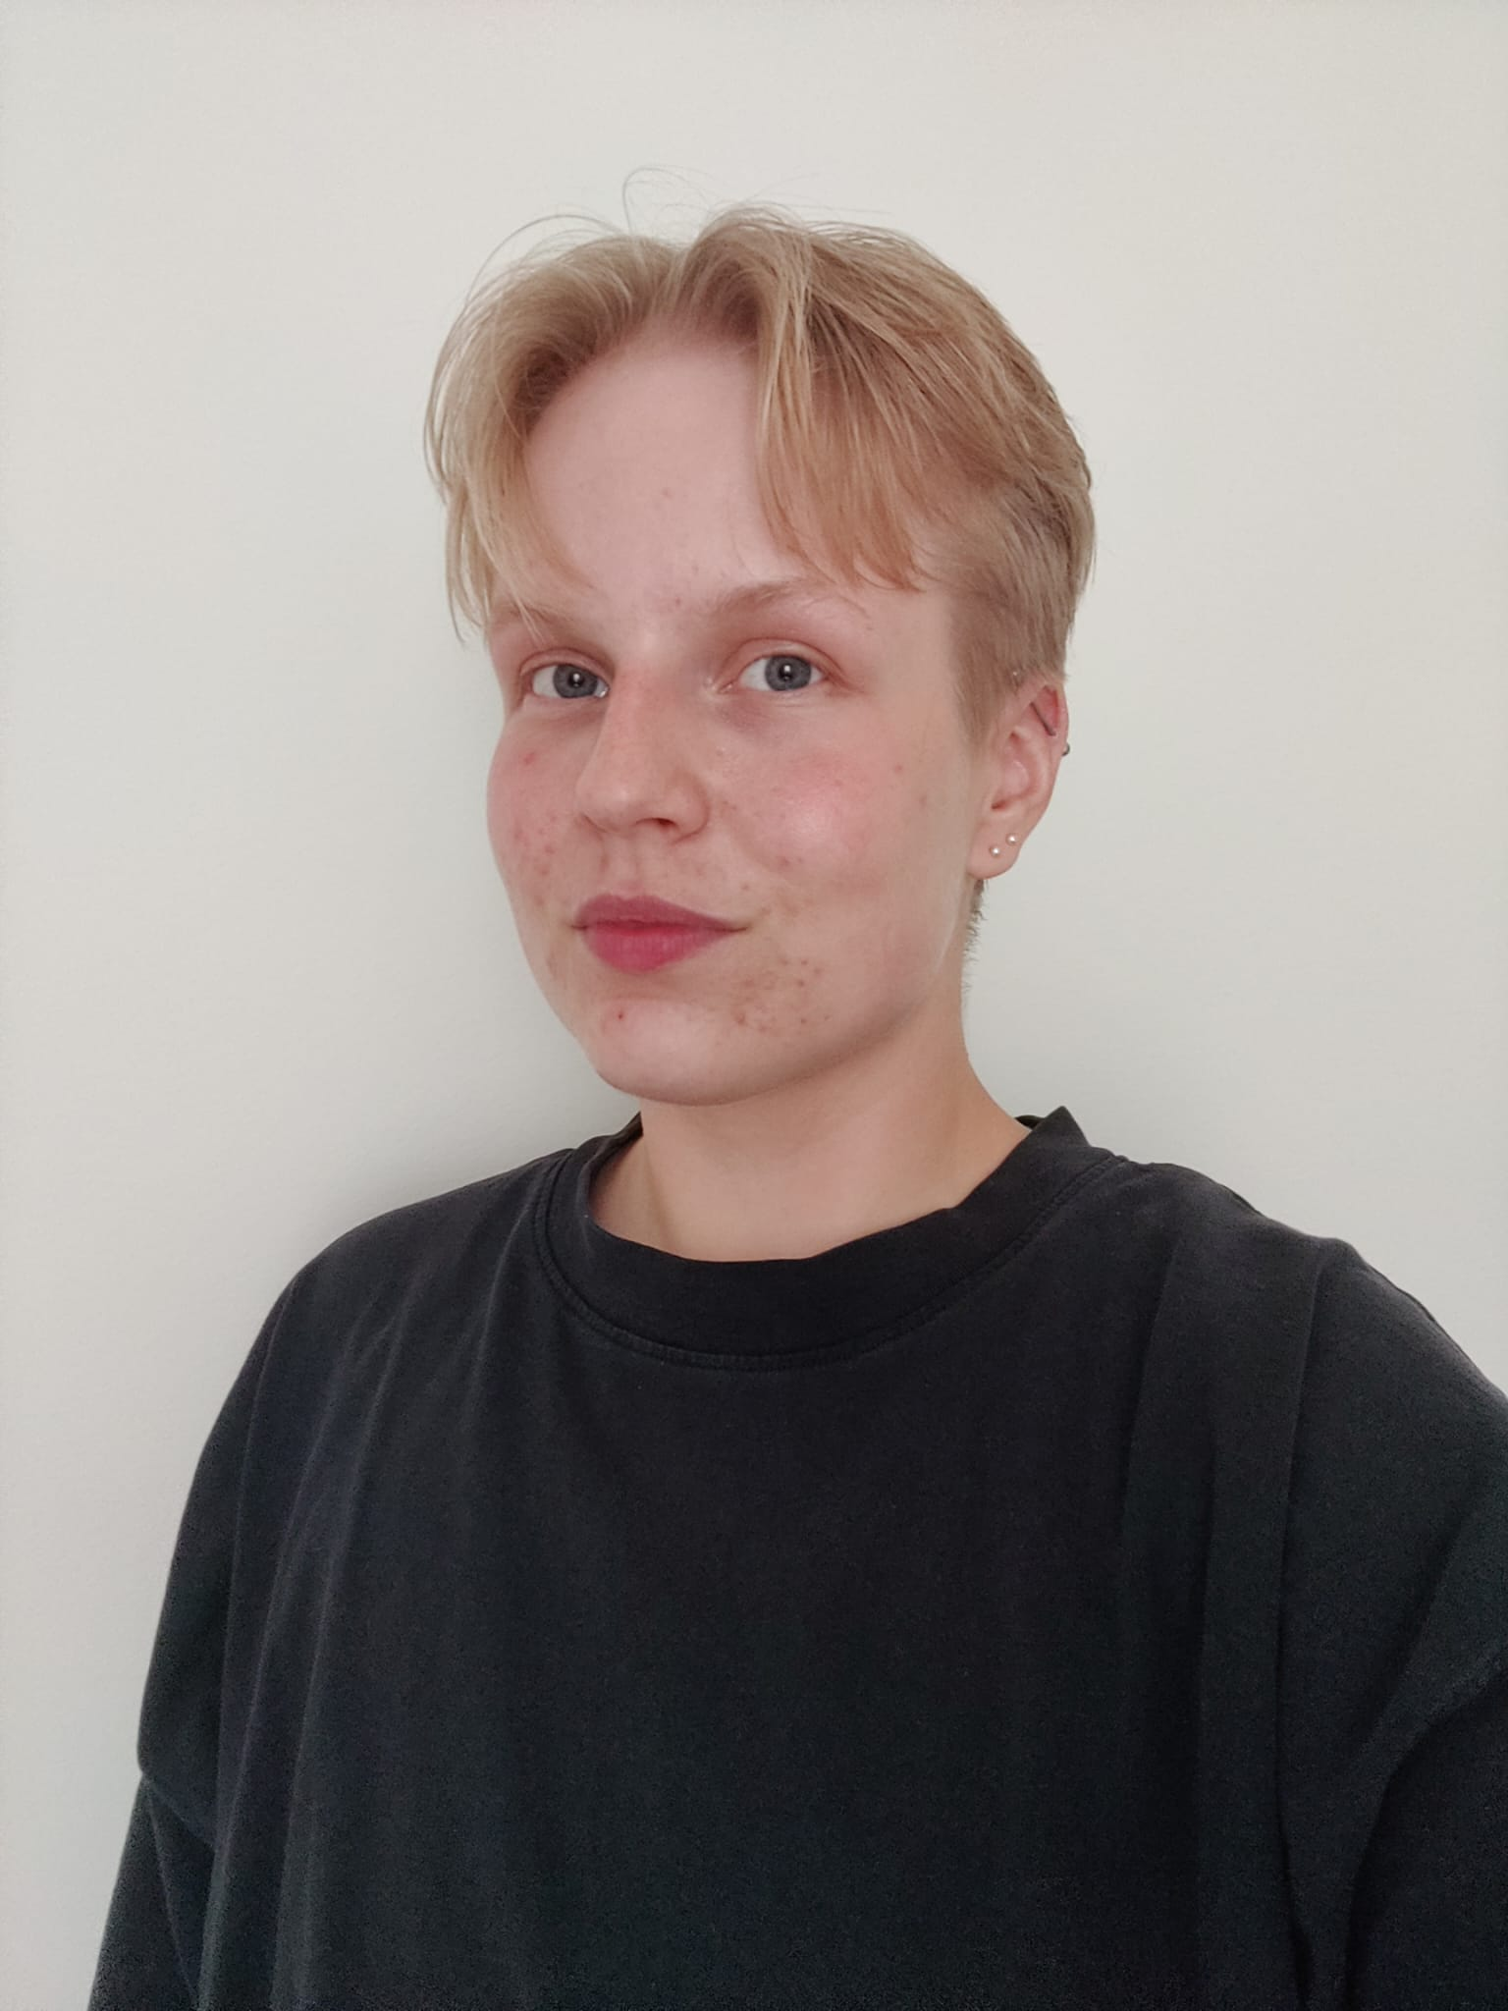
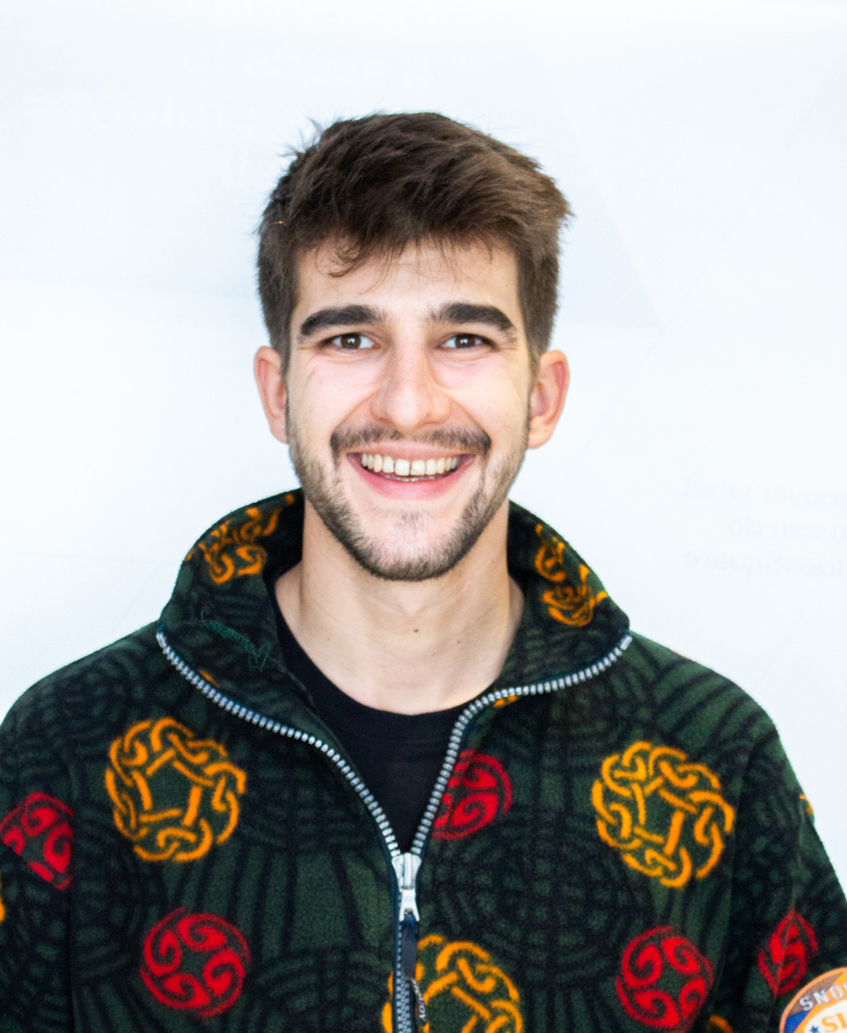
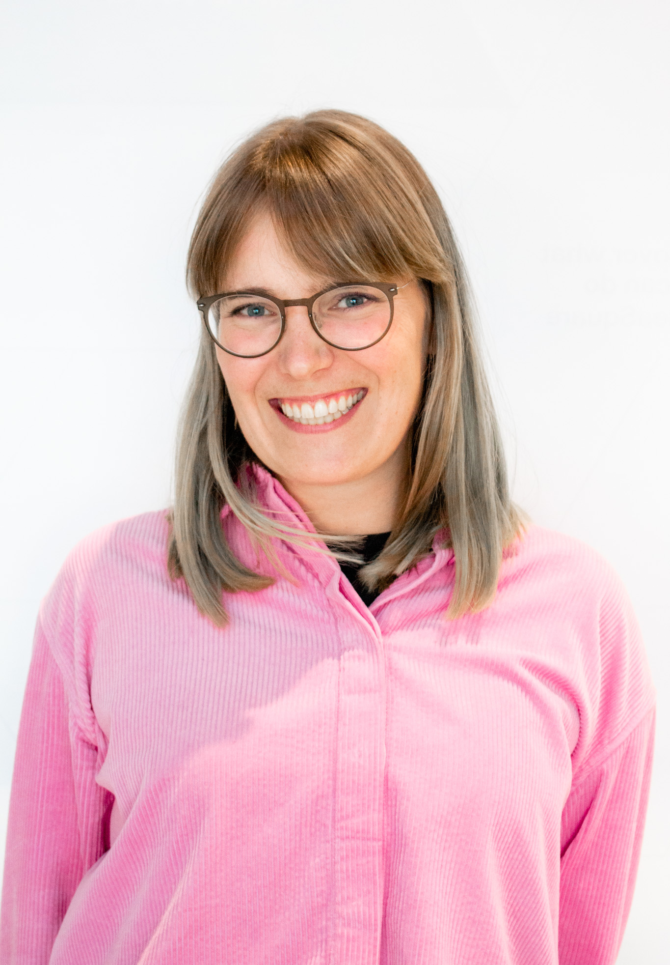
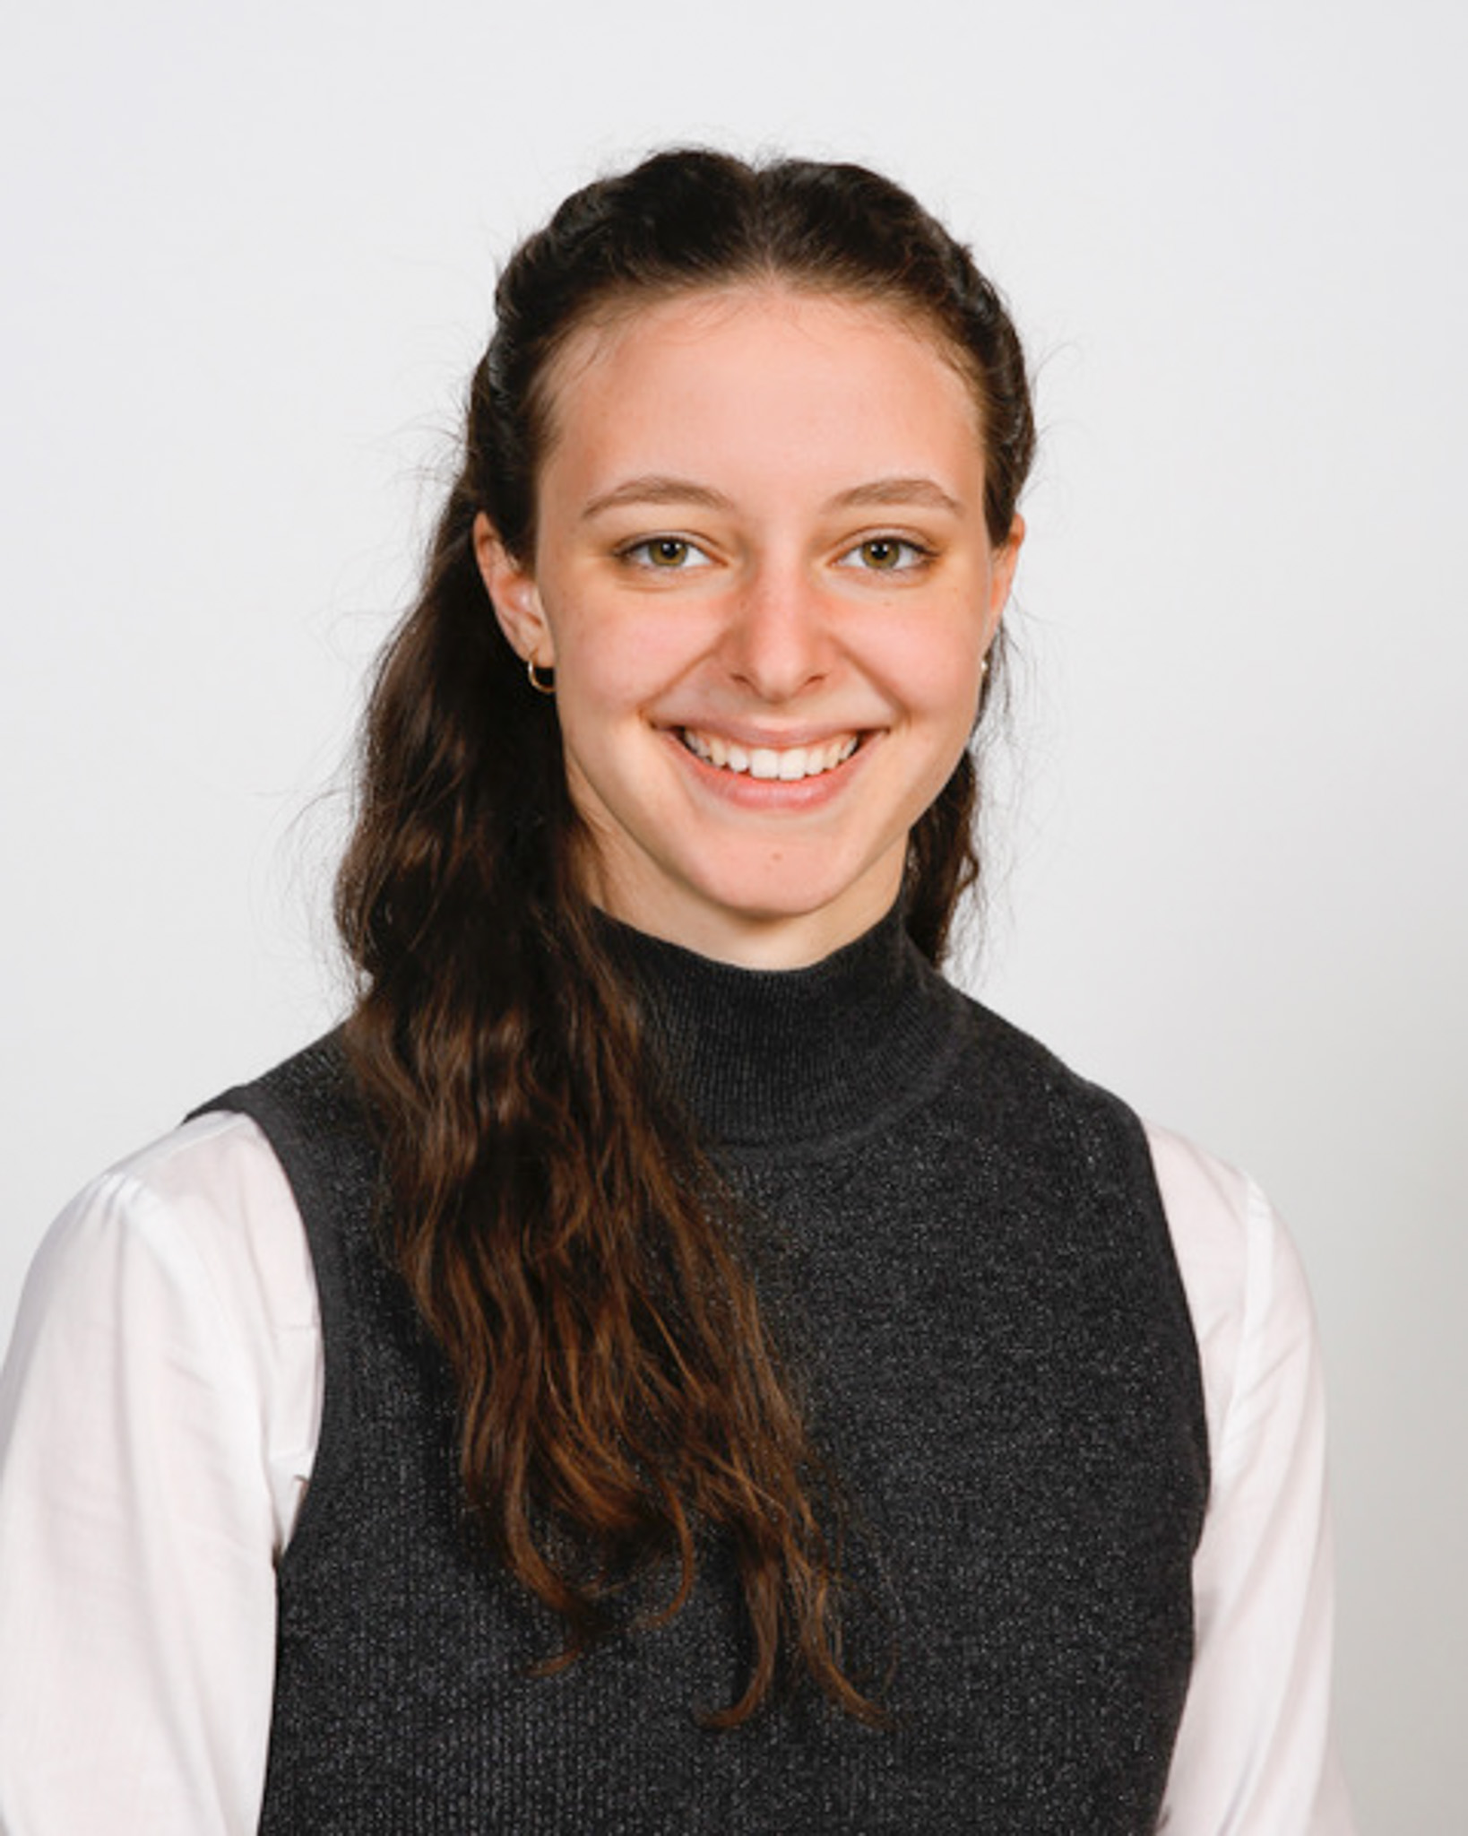
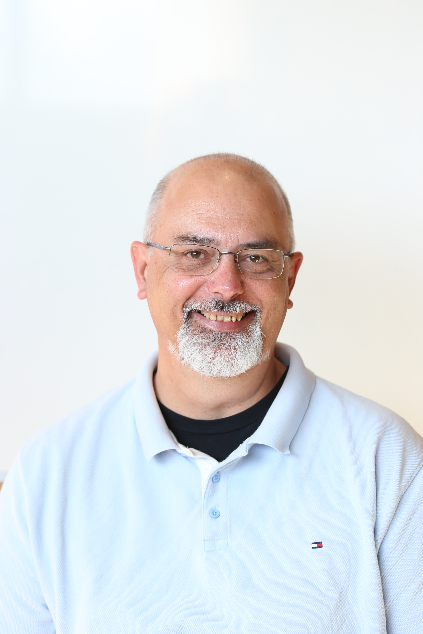
The People
Mirabelle Breidvik
Coomunications
Catarina Batista
Edu programmes
Markus Nordberg
IdeaSquare Manager
Laëtitia Pedroso
Events
Roy Pennings
EU Projects and Finance
Giulia Gaddi
People watcher
Jimmy Poulaillon
Communications
Pablo Garcia Tello
EU Projects
Lauri Valtonen
CIJ
Ole Werner
Edu Programmes
Laura Wirtavuori
Edu programmes
Dina Zimmermann
Prototyping
Notes:
CHANGE DESCRIPTIONS

Slide 7
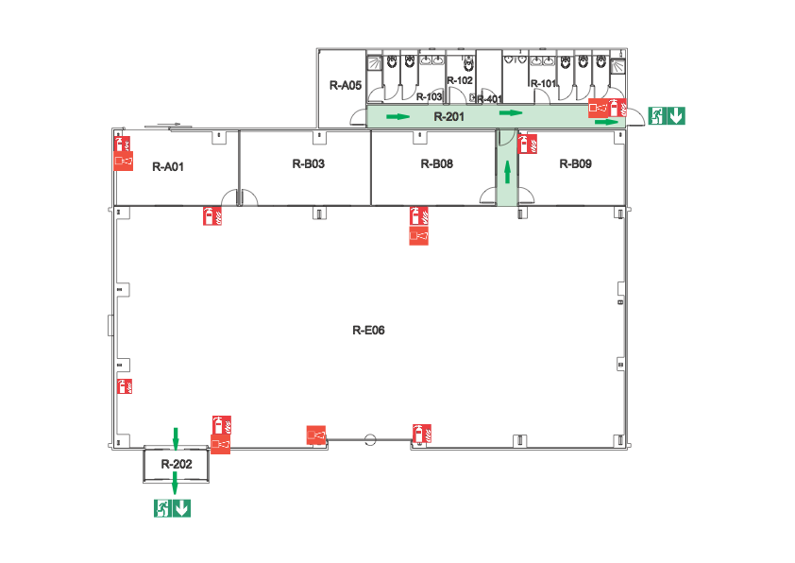
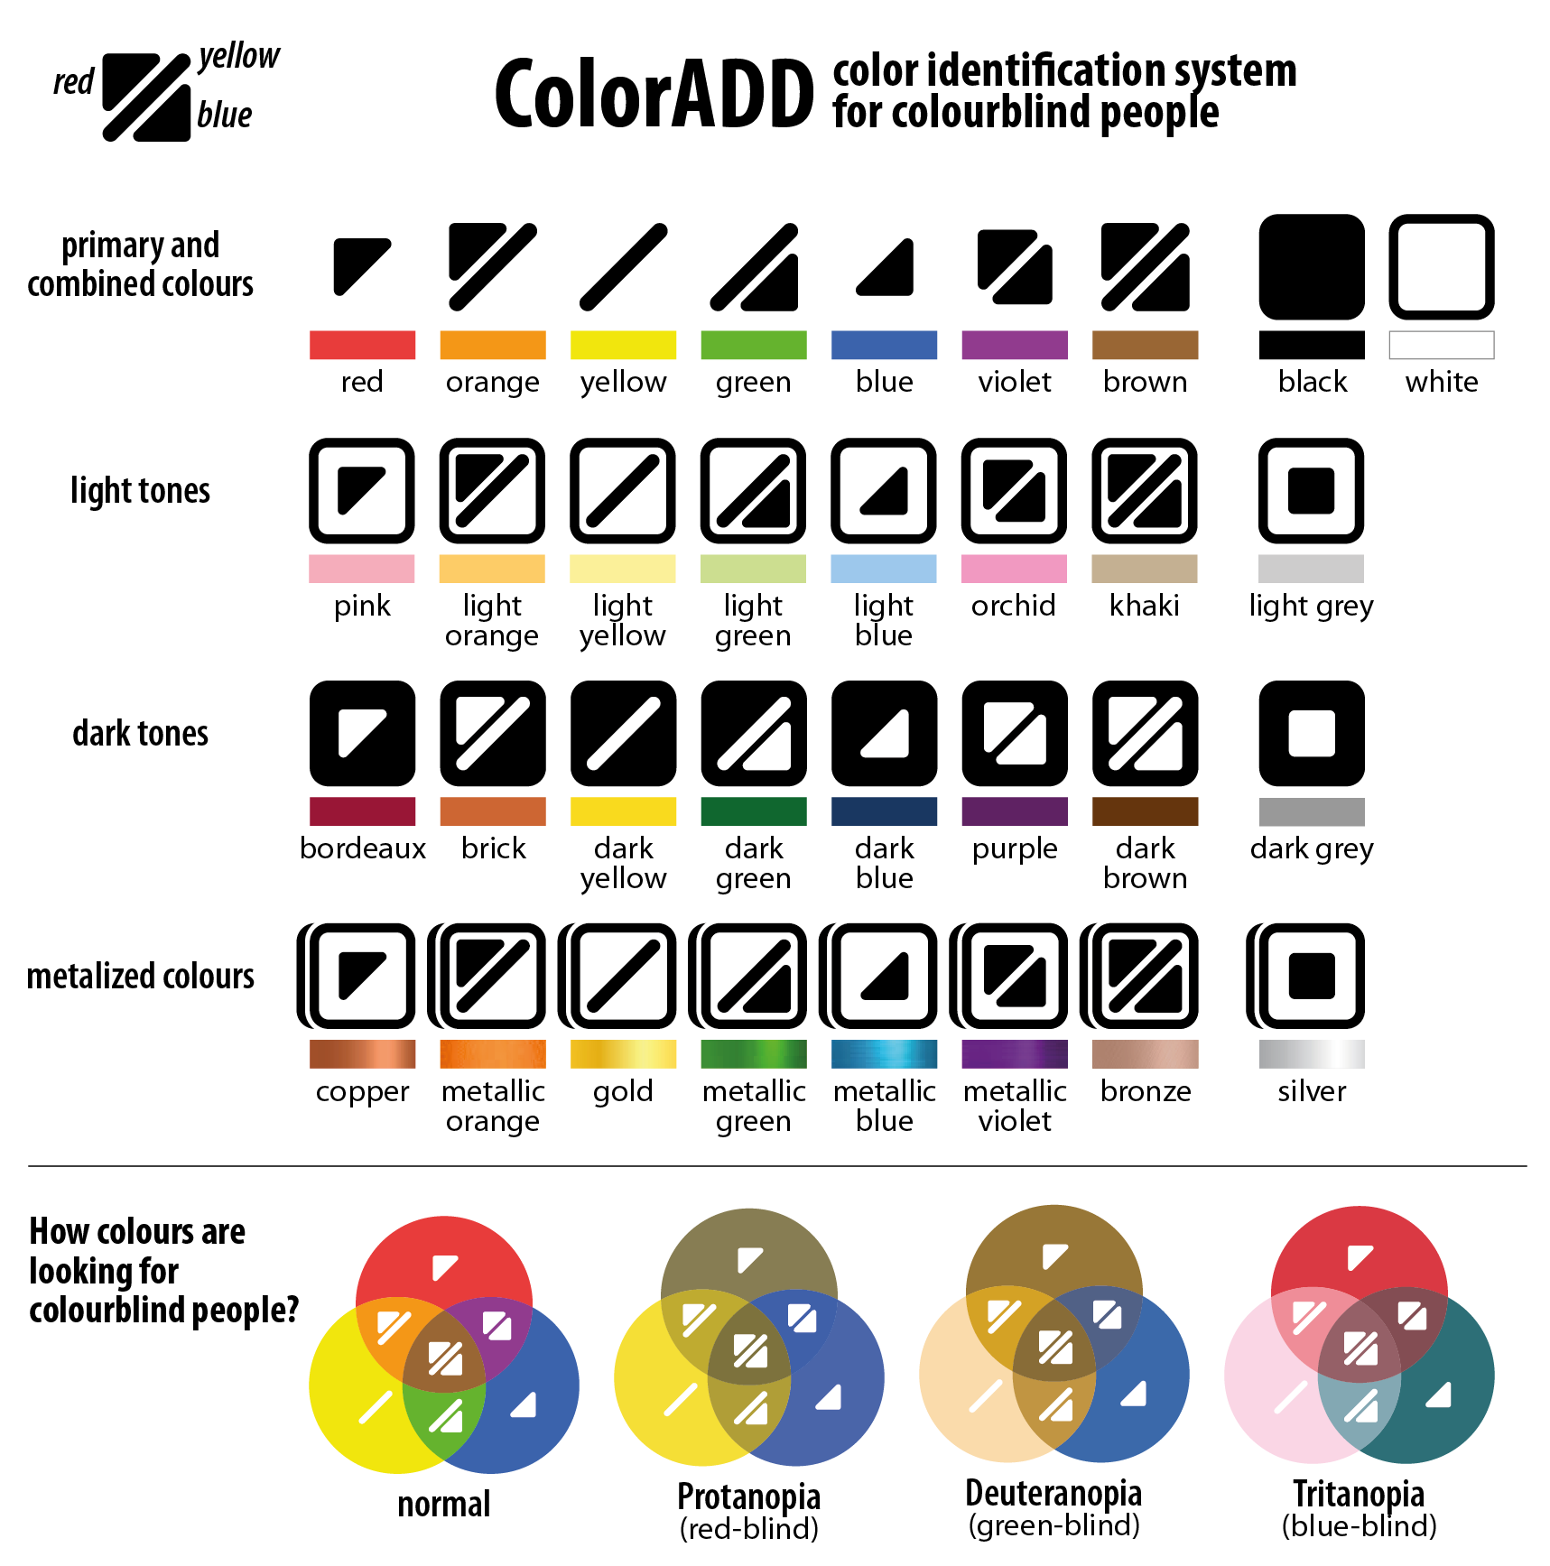



The Space
Machineshop
Electroshop
Light Lab
Kitchen
Free to use
1-D01
3D Studio
(2nd floor)
Work under
supervision
You are here
Restricted area
Main Area

Slide 8
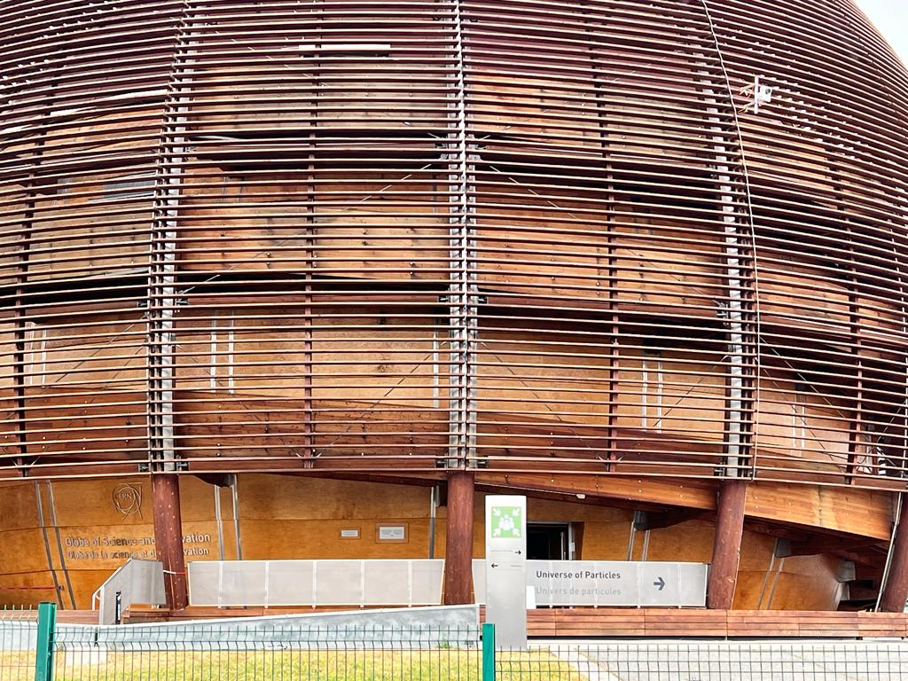

In case of an emergency
While evacuating, always go away from the danger!
Do NOT return to collect your belongings
Wait at the assembly point until counted and released by the TSO/DSO or the Fire Brigade.
Walk quickly and calmly to your building’s designated assembly point or as advised by an Emergency Guide or Fire Brigade personnel
Give to the Fire Brigade all the information they need! +41 22 767 44 44

Slide 9
General Rules
The Space is self-managed – the ones using it are the ones cleaning it. Please help one another.
When in doubt, find it out! The IdeaSquare team can be found upstairs and is happy to answer any questions and help you.
Be open, this is a place where people have the licence to dream so respect each other and dare to dream ☺️

Slide 10
Warming up
Notes:
Human Bingo

Slide 11
Team allocation
Team Bohr
Team Curie
Valentin Schimpf
Stefan Popescu
David Brunner
Thomas Müntener
Pauline De Pellegar
Francesco Blasi
Kosma Szutkowski
Team Heisenberg
Team Newton
Angelo Bifone
Maciej Kozak
Daniel Häussinger
Wojciech Bal
Benno Meier
Karel Kouril
Zaher Salman
Notes:
Each team takes one card, there will be one member of each team per tech, so everyone will have a deeper understanding of at least 1-2 tech.

Slide 12
Tech in Brief
Demystifying the technology, getting comfortable with its capabilities.

Slide 13
Core abilities of RD-MR:
What does RD-MR need to work? (from basic to sophisticated)
RD-MR
How would you explain RD-MR to an 80 year old?
What similar, older technologies do you know and how does RD-MR differ from them?
Park premature thoughts here

Slide 14
Exploring Domains
Diverging in possible (or not) fields of application.

Slide 15
Domains and Fields
Domains/Fields
Ideate about possible domains that this technology could be used in.
  e.g: dentistry, airport security, fashion…
Write each idea on an individual sticky note and place them on the large whiteboard in the back of the room.
Let your mind wander!
Arts and culture
Cities and infrasutructure
Satellites / navigation
(Bio)medical imaging
Airport Security
Notes:
15min - functions and domains mapping. 15min - present tech unbundling

Slide 16
Coffee Break

Slide 17
Exploring Problems
Identifying needs, pain points and opportunity areas within the domain you chose.

Slide 18
What are some of the needs/pain points present in this field? Who experiences them?
What are some key requirements in this field?
Chosen Domain
Why are these challenges persisting? Are there any dead-ends in this field?
If you could enhance/change any aspect in this field. What would be the dream?

Slide 19
Lunch Break

Slide 20
Exploring Future Paths
Intersecting the capabilities of the tech, with the pains identified in the market.

Slide 21
Curiosity cards
I am interested in exploring RD-MR‘s potential
contribution to ______________________, in the context of ________________, due to its capability to ____________________________.
solve need /enhance feature
domain/industry
core capability/unique feature

Slide 22
Presenting

Slide 23
Wrapping up

