Slide 1
Radiation-detected magnetic resonance
RD-NMR and RD-MRI
Magdalena Kowalska
CERN, Switzerland
kowalska@cern.ch

Slide 2
Principles of RD-NMR

Slide 3
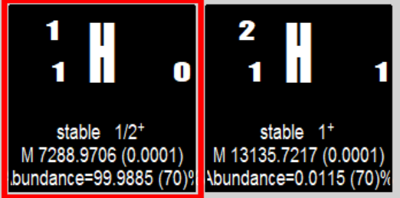
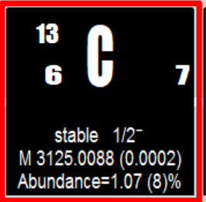
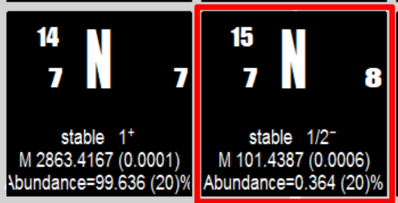
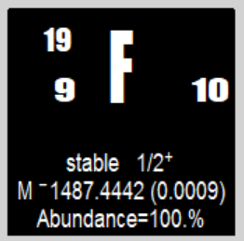
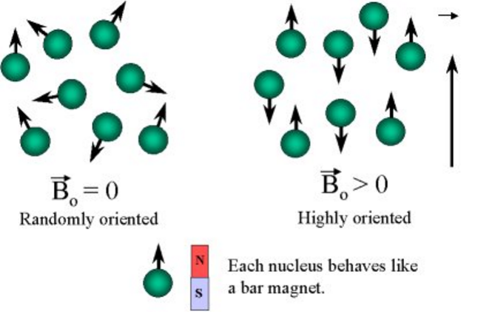
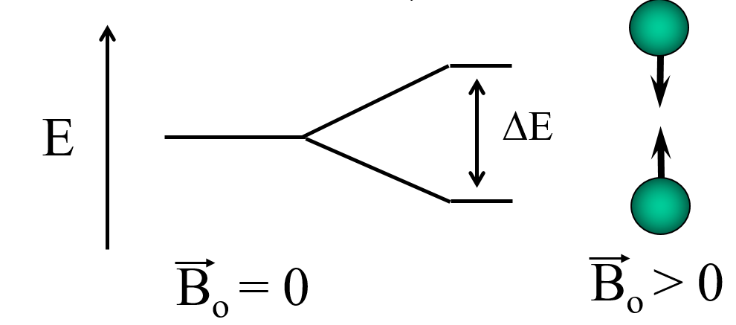
Conventional NMR and MRI: principle
NMR/MRI elements:
  Stable probe nuclei with spin different from 0
  Sample/ environment containing these nuclei (liquid or solid)
  Strong static magnetic field (several Tesla)
  Weaker magnetic field oscillating at radio-frequency (MHz)
Principle:
  Perturb spins of probe nuclei (with oscillating field or other means)
  record resonance frequency and pace of response -> info about local environment
B
Radiofrequency

Slide 4
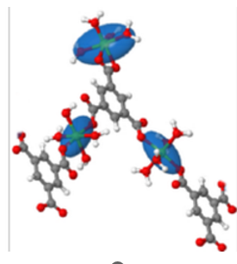
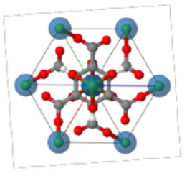
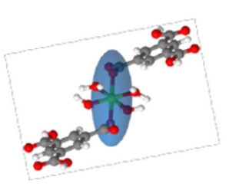
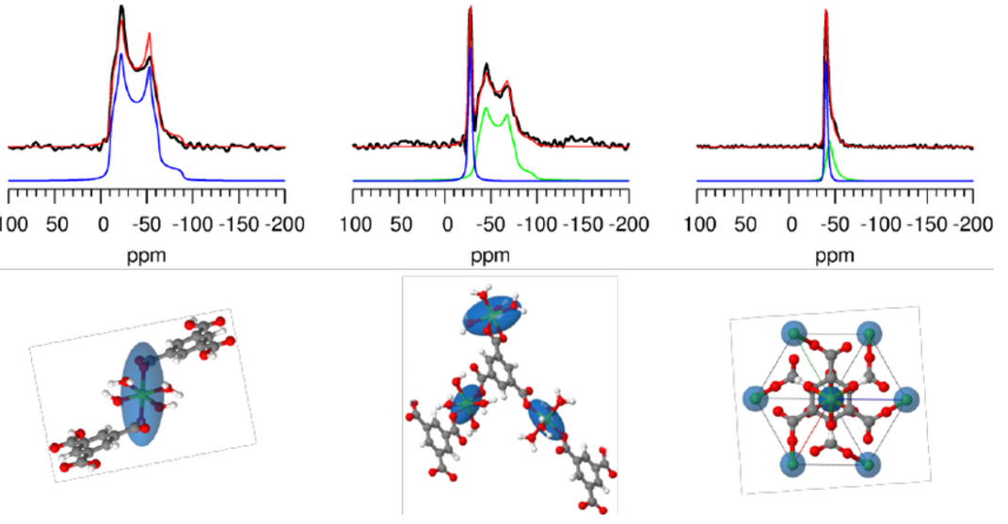
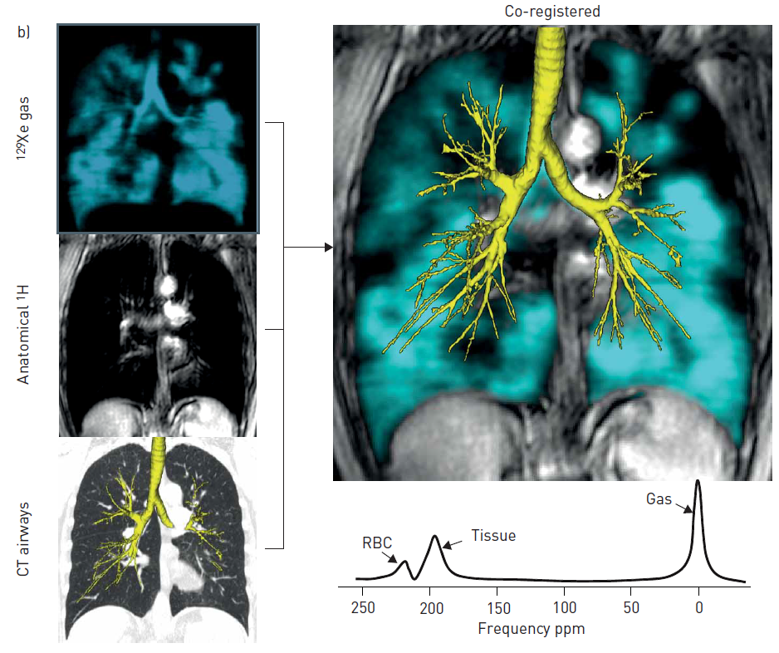
Conventional NMR and MRI: applications
NMR Spectroscopy
  static magnetic field very homogenous: no spatial resolution
  100s of micro-liters of samples needed for good signal
  studies of structure and dynamics of compounds, in physics, chemistry & biology
MRI Imaging
  Static magnetic field with a strong gradient in 1-3 dimensions: < mm spatial resolution
  Space-resolved studies of materials; medical diagnosis via anatomical information
25Mg NMR
radiofrequency

Slide 5
Conventional NMR/MRI: challenges
Very low sensitivity:
  Small degree of spin ‘polarization’ (relative difference in spins up and down; 10⁻⁵)
  Inefficient detection (inductive pickup)
Limited number of nuclei with good NMR properties:
  Many nuclei with spin 0 (no signal) or > ½ (broad resonances)
  Small spin polarization due to nuclear properties
High magnetic field required -> heavy and expensive superconducting magnets
Limited gradient of magnetic field
Result:
Many probe nuclei (10¹⁶-10¹⁷) , large samples (100s of microliters)
Long measurement time (minutes) – on samples and patients
Limited resolution: rather mm than micrometers or below
Large, non-portable and expensive setups
Our reply to these challenges => radiation-detected NMR/MRI:
  (Hyper)polarisation of spins of unstable nuclei + detection of asymmetry in decay radiation
ISOLDE-CERN: central laboratory for technique development

Slide 6
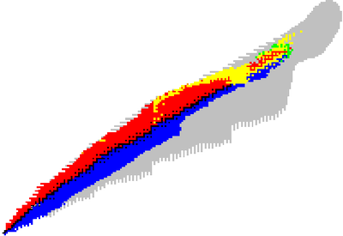
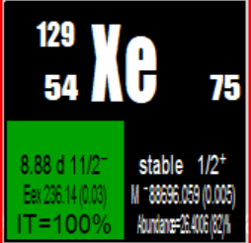
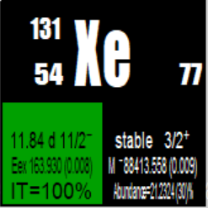
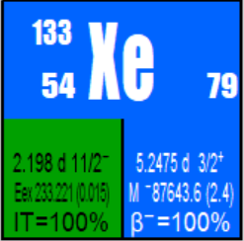
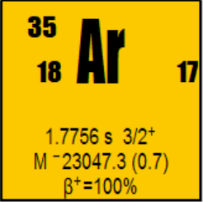
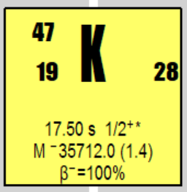
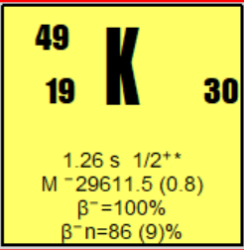
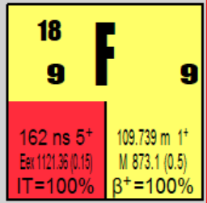
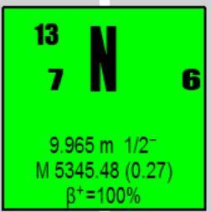
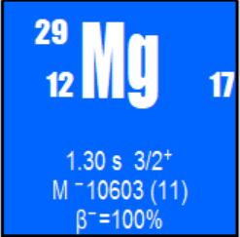
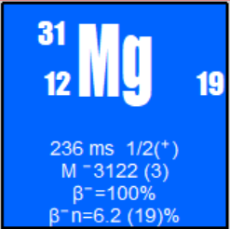
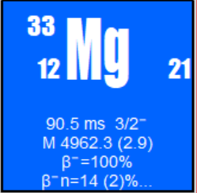
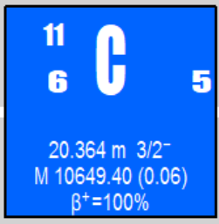
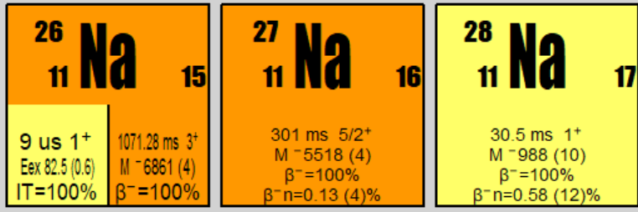
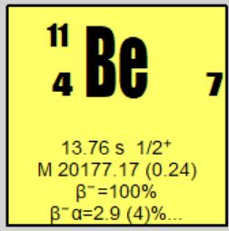
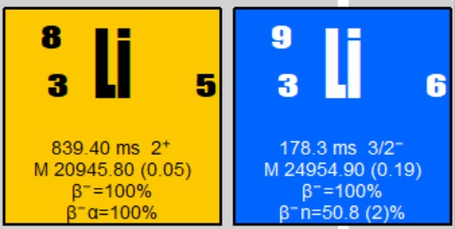
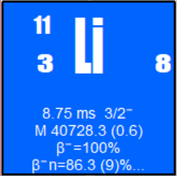
Present RD-NMR probe nuclei
300 stable isotopes, over 3000 known unstable isotopes
Our past and upcoming RD-NMR probes
gamma-NMR/MRI
beta-NMR/MRI
protons
neutrons

Slide 7
Radiation-detected NMR: hyperpolarisation
Criteria (element-dependent) :
  Speed and degree of polarisation
  Type of production facility
Optical pumping:
laser
Spin Exchange Optical pumping
(SEOP): laser + atomic collisions
Capture of polarised neutrons
Short-lived nuclei
(t1/2 = ms to s):
In-beam polarisation at production side
Long-lived nuclei (t1/2 = min to day):
polarisation decoupled from production
Low temperature (mK) nuclear orientation
Production mechanism
(heavy-ion reactions)
being explored:
‘Chemical’ methods
(pH₂, DNP)

Slide 8

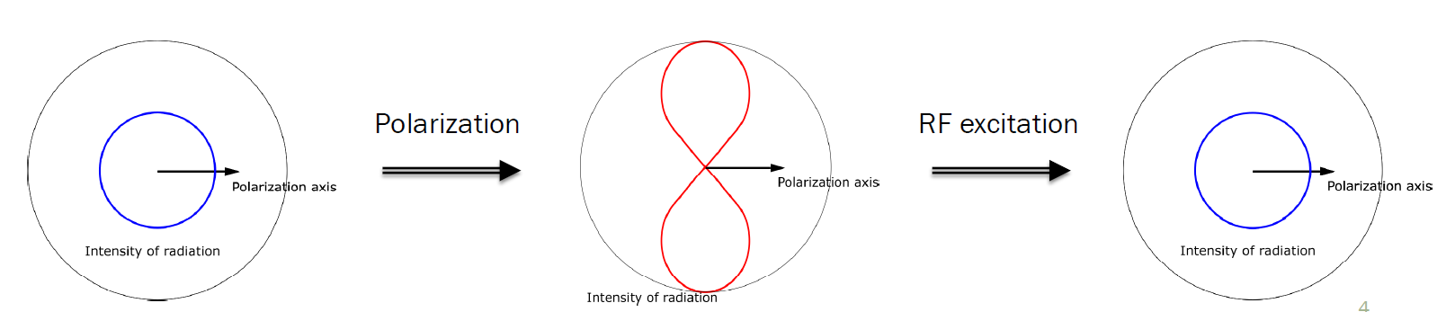

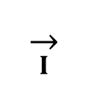

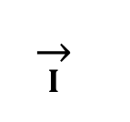
Radiation-detected NMR: decay asymmetry
β detector
Decay anisotropy
$$\overset{→}{I}$$
Gamma decay,
spin >1/2
$$\overset{→}{I}$$
Beta decay
spin >0
γ detector
$$β$$
B₀
$$γ$$
γ detector
β detector
beta-NMR/MRI
gamma-NMR/MRI
Stopped in mm’s of material: 1-2D studies
Can pass cm’s of material: 1-2D studies
Procedure (RD-NMR):
L. Dupond

Slide 9
Examples

Slide 10
Use of polarised unstable nuclei
Material science
?
Chemistry
  Nuclear structure
Biology
Spin and parity of
nuclear states connected by
emitted radiation
Spin relaxation and
beta-NMR
Polarised
radioactive
nuclei
β decay
γ decay
  Decay asymmetry parameter:
  Unitarity of CKM
  quark mixing matrix
beta-MRI
gamma-MRI
  Fundamental interactions
Cell on a chip, preclinical studies,
medical diagnosis

Slide 11
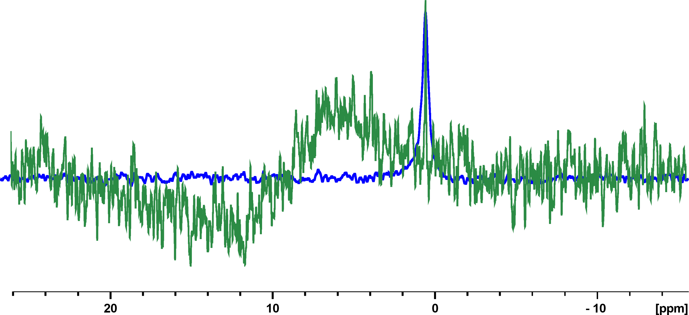
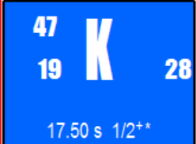
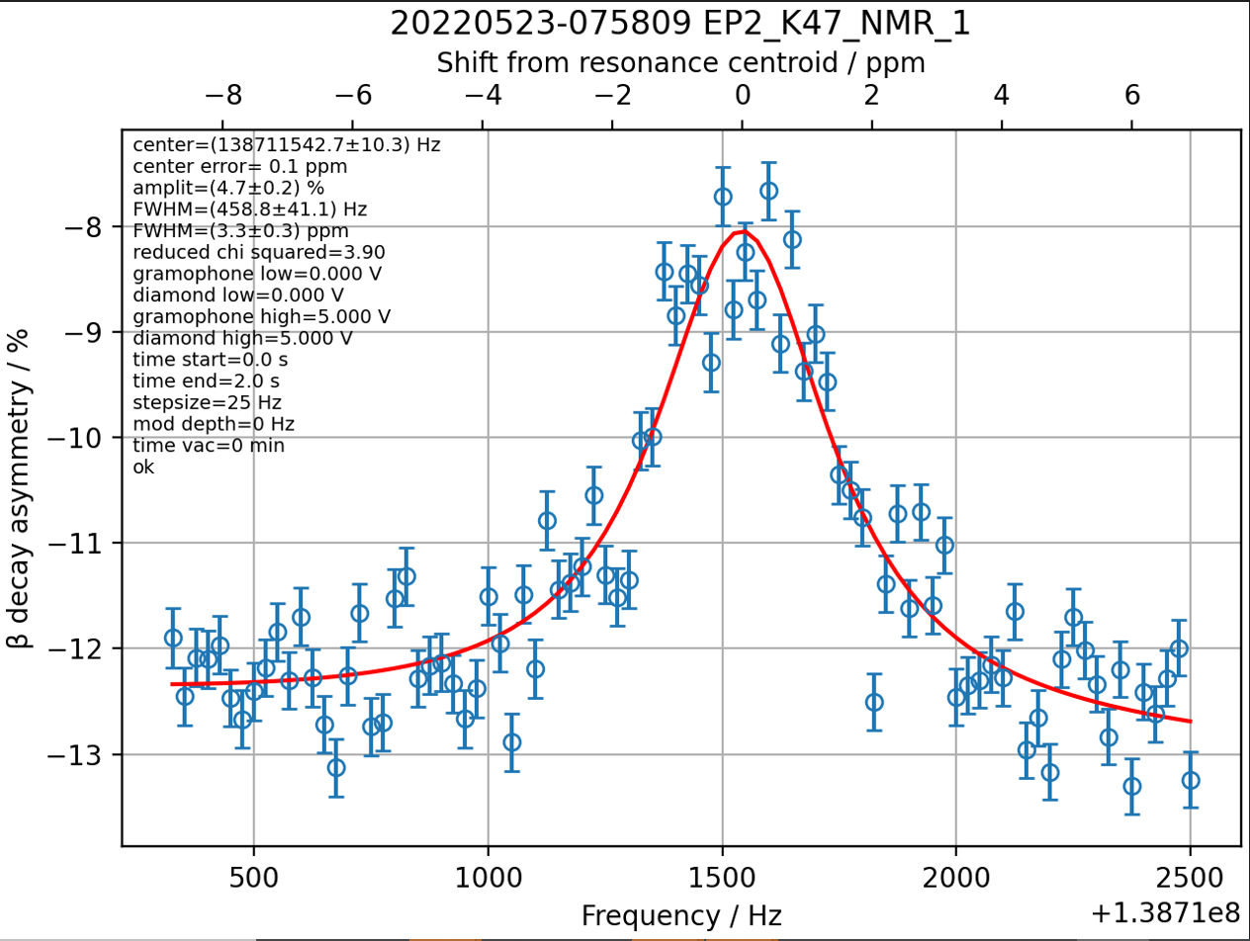

Sensitivity and new nuclei
Stable K NMR: usually ³⁹K (I=3/2), low receptivity and Q line broadening
In ionic liquids and deep eutectic solvent (glycholine) -> almost no signal
β-NMR:
9.4 T
0.1 M KCl in D₂O
128 scans,
acquisition time ~10 min
KCl in EMIM-DCA (+ H₂O traces)
16 000 scans, acquisition time >10 h
EMIM-DCA IL,
10⁹ nuclei of ⁴⁷K
30 min
acquisition
=> shorter measuring time
=> studies not possible before

Slide 12
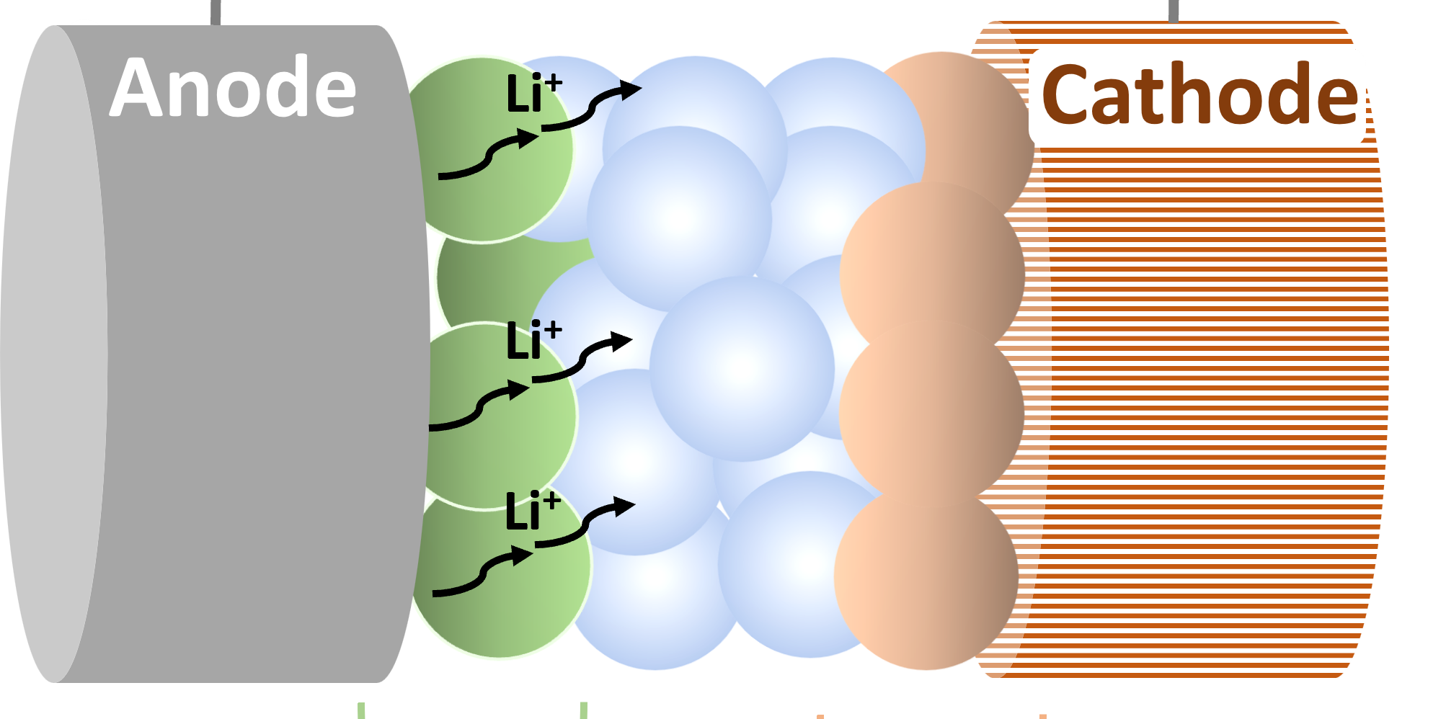
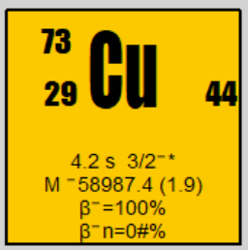
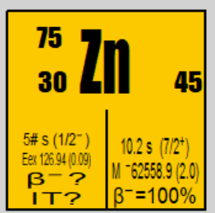
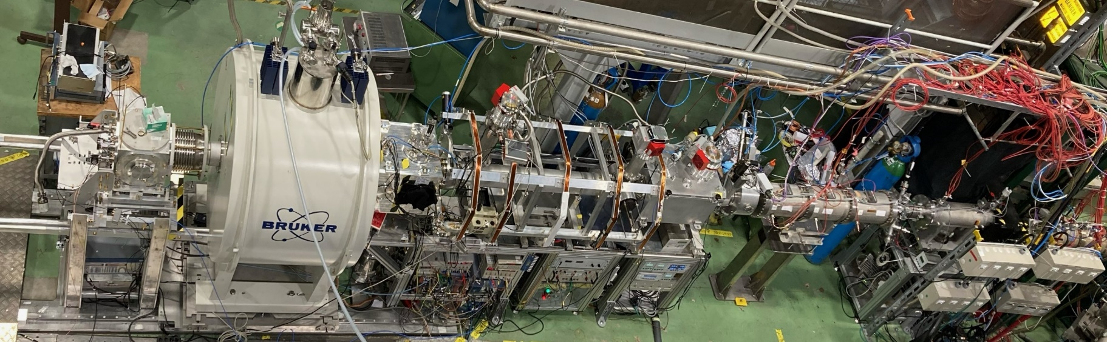
Sub-micrometer resolution
Beam of polarized nuclei -> implanted into sample at defined depth
Observe environment in layers and measure diffusion
Example:
  Lithium diffusion in solid-state battery materials
  Other laser-polarized short-lived nuclei
-More elements feasible
=> Studies of thin layers and interfaces in bulk material

Slide 13
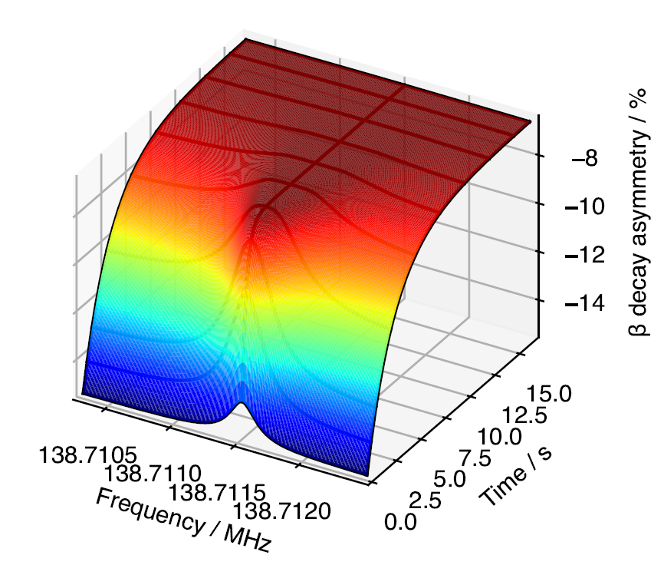
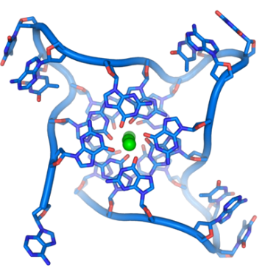
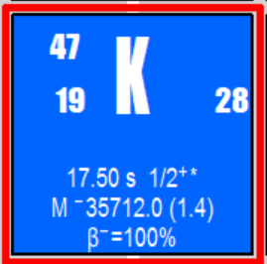
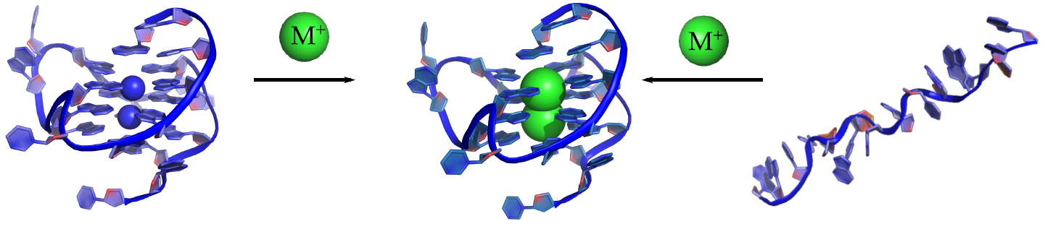
Real-time measurement
Ion implantation into sample defines t0
Study of dynamic processes
Examples:
  DNA G-quadruplex interaction with Na and K
  Protein binding to metal ions (e.g. Cu)
0 3.6 7.2 ppm
ERC Grant 2015-21, collaboration with: Poznan, Ljubljana, Geneva

Slide 14
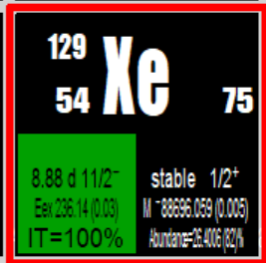
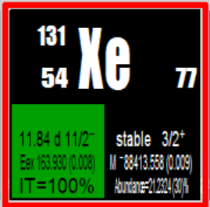
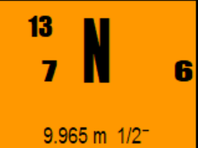
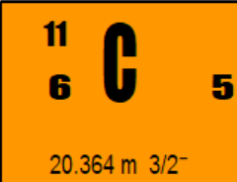
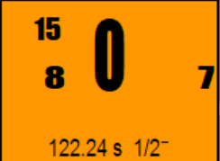
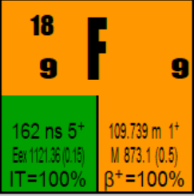
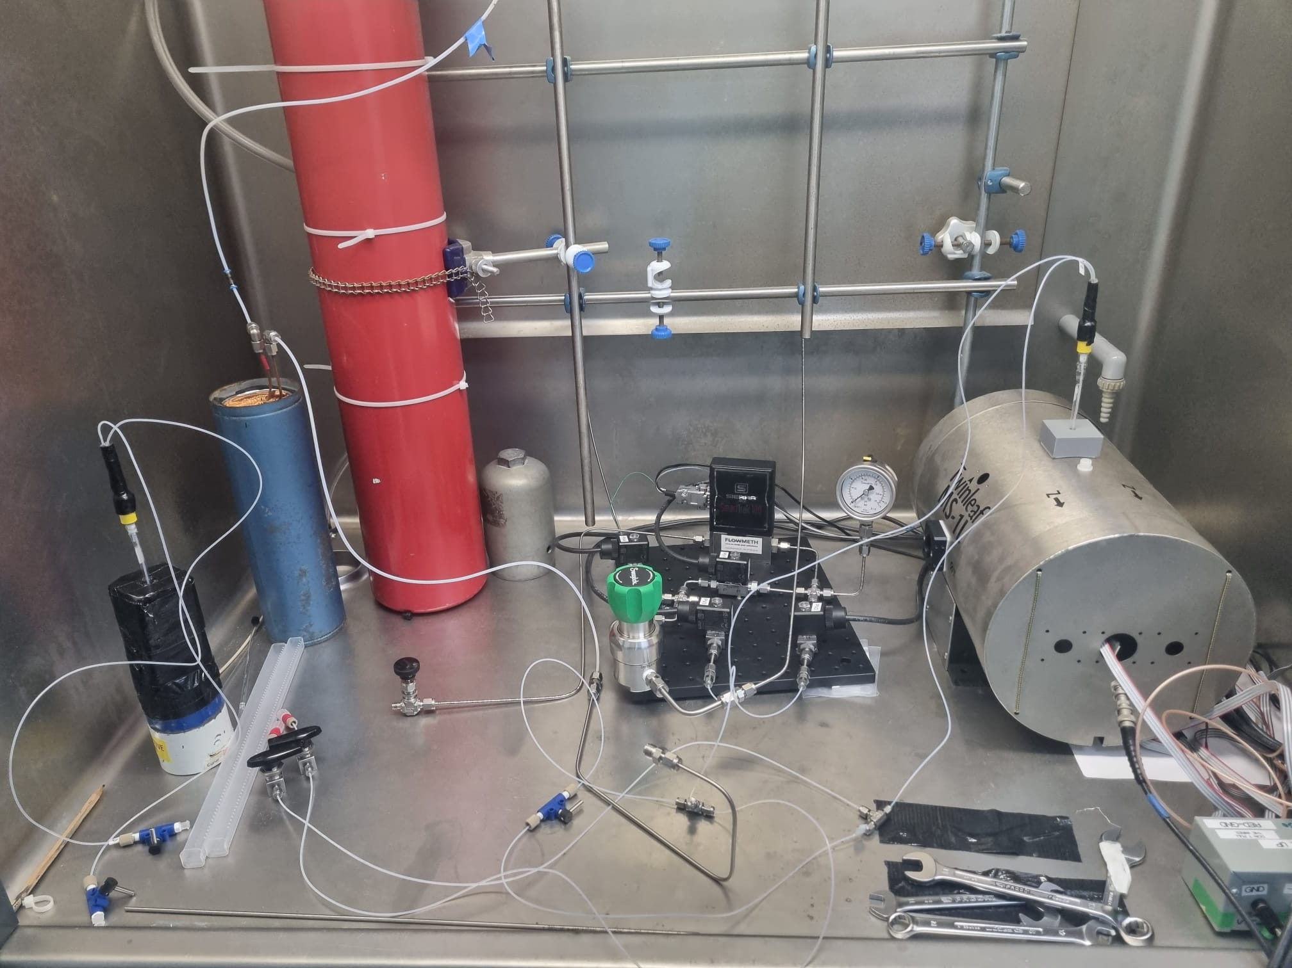
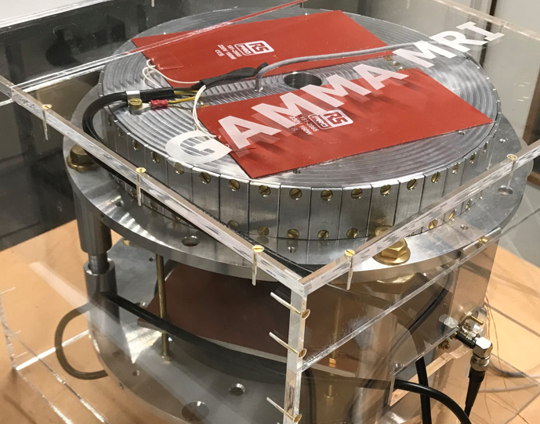
Portable and cost-efficient setups
Polarisation inside sample => para-hydrogen, dynamic nuclear polarization, SEOP
No need for superconducting magnet => compact setup
Longer-lived nuclei, e.g. PET isotopes
RD-ZULF-NMR setup
Gamma-MRI setup
  pH2 created at LN2 temperature
  300 ul of SABRE Ir catalyst
  300 ul of ¹³ N [Ammonia] in H₂O
CERN Medical Applications Fund: With Mainz, HUG-Geneva
FET-OPEN project: with HEPIA, Madrid, RS2D, Maastricht, Leuven

Slide 15

Team and expertise
Team:
  Nuclear and atomic physicists
  Chemical engineers
  Engineers
Expertise: hyperpolarization techniques, NMR and RD-NMR, detectors, rf

Slide 16



β-NMR: metal ions in chemistry and biology
NMR can provide info on location & evolution of metal-ion binding to (bio)molecules
  Challenges: almost invisible signals due to small abundance, spin >1/2, and small sensitivity
  Result: metal-ion-NMR used very rarely => sensitive NMR approach is needed
‘green solvents’: ionic liquids and prospects for car battery material
Na and K binding to DNA G-quadruplexes (present e.g. in telomeres):
  Binding crucial to their formation, stability, and polymorphism
With:
Geneva
Leipzig
Bratislava
Poznan
EMIM-DCA IL,
10⁹ nuclei of ⁴⁷K
With:
Ljubljana
Geneva
Leipzig
Poznan

Slide 17





RD-ZULF-NMR
Zero to Ultra-Low Field NMR (ZULF-NMR):
  Studies in μT fields -> Very portable
  Excitations with Hz frequencies -> signals from samples in metallic containers
  Hyperpolarisation needed, e.g. para-H2, Dynamic Nuclear Polarisation (DNP)
  Relatively low sensitivity
Radiation-detected NMR (RD-NMR):
  Unstable probe nuclei (often short-lived)
  Extremely high sensitivity
  Studies in > 0.1 to several T fields -> large setups
RD-ZULF-NMR: combine advantages of both techniques
  Proof-of-principle:
  Parahydrogen hyperpolarisation
  (SABRE) of ¹³N-labelled NH₃
  solution (used for PET)
With:
Mainz
Postdoc from Prag
Student from Tampere

Slide 18



γ-MRI with long-lived polarised nuclei
EU FET-OPEN
Addressing limitations of present molecular imaging:
  Low MRI sensitivity
  Low PET/SPECT spatial resolution
Simultaneous exploitation of gamma (γ) detection sensitivity + spatial resolution and flexibility of MRI
  Use of polarised unstable tracers
  Increase MRI sensitivity and nuclear medicine resolution
  positioning given by MRI sequences
  tracer amount given by degree of asymmetry of γ-emission
Work on prototype MRI device ongoing

Slide 19

γ-MRI and lung & brain imaging with Xe isomers
Imaging using long-lived ^{129m,131m,133m}Xe long-lived nuclear states (isomers):
Xe: biologically neutral, yet binding to biomolecules and passing blood-brain barrier
Stable ¹²⁹Xe used for MRI lung (and brain) imaging
Unstable ¹³³Xe used for SPECT brain imaging
Gain: higher MRI sensitivity or higher nuclear-medicine resolution
Polarisation using spin-exchange optical pumping (SEOP) known from stable 129Xe studies

Slide 20


Radiation-detected (RD-)NMR
RD-NMR: NMR detected via decay radiation emitted by unstable probe nuclei
Principle: spin-oriented unstable nuclei emit decay radiation that is anisotropic
- signal proportional to degree of polarisation (M_{z})
-> ingredients: radioactive nuclei with spin > 0 + hyperpolarisation
β detector
beta-NMR
gamma-NMR
$$\overset{→}{I}$$
Gamma decay,
spin >1/2
$$\overset{→}{I}$$
Beta decay, I>0
B₀
γ detector
$$β$$
$$γ$$
γ detector
β detector
NMR signals from only 10⁶ unstable probe nuclei already recorded
Use of single nuclei feasible in principle

Slide 21

ISOLDE radionuclei
Nearly 1300 isotopes available from over 75 chemical elements
Over 1000 used for experiments
-> by far largest choice among such facilities
Production
(ions/s)
protons
neutrons

Slide 22

Isotope production for RD-NMR
Short- and long-lived nuclei: ISOLDE - CERN’s lab for production and studies of unstable nuclei (> 1300 ion beams produced)
(at SC, 1956-91)
Longer-lived nuclei: nuclear reactors (e.g. ILL, MARIA) or medical cyclotrons (e.g. HUG in Geneva)

Slide 23
Hyperpolarisation for RD-NMR
Criteria (element-dependent) :
  Speed and degree of polarisation
  Type of production facility
Optical pumping:
laser
Spin Exchange Optical pumping
(SEOP): laser + atomic collisions
Capture of polarised neutrons
Short-lived nuclei
(t1/2 = ms to s):
In-beam polarisation at production side
Long-lived nuclei (t1/2 = min to day):
polarisation decoupled from production
Low temperature (mK) nuclear orientation
Production mechanism
(heavy-ion reactions)
being explored:
‘Chemical’ methods
(pH₂, DNP)

Slide 24
Use of polarised unstable nuclei
Material science
?
Chemistry
  Nuclear structure
Biology
Spin and parity of
nuclear states connected by
emitted radiation
Spin relaxation and
beta-NMR
Polarised
radioactive
nuclei
β decay
γ decay
  Decay asymmetry parameter:
  Unitarity of CKM
  quark mixing matrix
beta-MRI
gamma-MRI
  Fundamental interactions
Cell on a chip, preclinical studies,
medical diagnosis

Slide 25
Chemistry, biology, and material science with beta-NMR on optically-pumped short-lived nuclei

Slide 26


β-NMR on optically-pumped short-lived nuclei
At the radioactive-ion beam facility ISOLDE at CERN
β-NMR at 0.1, 0.5, 1.2 or 4.7 T
Laser beam
neutralisation (optional)
SC magnet
sample + rf coil
betaDropNMR
+
+
+
B
B
Short-lived ions from ISOLDE
β detectors
Optical pumping
β-asymmetry + β-NMR
J. Croese et al., Nucl. Inst. Meth. A, 1020 (‘21) 165862
M. Jankowski et al, to be submitted
M. Kowalska et al., J. Phys. G: Nucl. Part. Phys. 44 (2017) 084005
W. Gins et al., Nucl. Instrum. Meth. A 925 (2019) 24

Slide 27

RD-NMR nuclei for optical pumping
β-NMR, betaDropNMR:
ERC Starting Grant
ERC Proof of Concept application
RD-ZULF-NMR (with Mainz):
Patent applications filed
CERN MA project, 2022-
  Already polarized or Planned, considered
γ-MRI (with Geneva, Madrid, Leuven, Strasbourg, Maastricht):
CERN MA project, 2017-2021
EU FET-Open project, 2022-
β-NMR, PreSOBEN:
ERC Consolidator Grant

Slide 28
RD-NMR probe nuclei
300 stable nuclei
3000 known unstable nuclei
protons
neutrons

Slide 29

Liquid β-NMR on I=1/2 potassium nuclei
Stable K NMR: usually ³⁹K (I=3/2), low receptivity and Q line broadening
In ionic liquids and deep eutectic solvent (glycholine) -> almost no signal
β-NMR:
9.4 T
0.1 M KCl in D₂O
128 scans,
acquisition time ~10 min
KCl in EMIM-DCA (+ H₂O traces)
16 000 scans, acquisition time >10 h
KCl crystal,
10¹⁰ nuclei of ⁴⁷K
EMIM-DCA IL,
10⁹ nuclei of ⁴⁷K
30 min
acquisition
M. Jankowski et al.,
in preparation

Slide 30
DNA G-quadruplex binding to potassium
DNA G-quadruplexes:
  present e.g in telomers, crucial: binding to alkali metals
β-NMR advantages:
  Sensitivity: metal ions are easily visible, cleaner spectra
  Smaller or no quadrupole moments -> longer T1 and narrower spectra
  Real-time: folding intermediates
Our study:
  Beamline- (vacuum-) compatible solvent: glycholine
  Liquid dispenser in vacuum
  Short G-rich DNA strands (ht, c-myc)
B. Karg

Slide 31




DNA G-quadruplex binding to ⁴⁷K
beam
container
RF coils
Design:
10⁷ of ⁴⁷K nuclei
30 min scan
Pure glycholine
Glycholine + c-MYC folded around Na+
After 3h
in vacuum
In collaboration with M. Baranowski, M. Kozak (Poznan), J. Plavec (Ljiubliana); funded by ERC (2015-21)

Slide 32

Li diffusion in all solid-state batteries
Lithium diffusion in solid-state battery materials
  Depth-controlled implantation
  Measurement of T1 relaxation time for implantation in different layers
Beamline upgrades ongoing, 1st measurements planned for 2025
load-lock
LN₂ trap
Bellow system to
load/remove sample
Sample exchange point
Sample temp control:
-30 to 200 deg
  Triggered by G. Rees, Oxford; collaboration with Z. Salman (PSI); funded by CERN Knowledge Transfer Fund (2024-26)

Slide 33





Distribution of B field & neutrons in unstable nuclei
Compare nuclear magnetic moment derived from NMR & atomic hyperfine structure
B
Offset in magnetic moment from HFS (hyperfine anomaly)
Very small, down to 10⁻⁶
Required: accurate μ from NMR and HFS
$$μ$$
HFS
$$μ$$
PreSOBEN
NMR
M. Bissell
⁴⁷K β-NMR
in EMIM-DCA
Combined with atomic (J. Ginges, Brisbane) and nuclear (J. Dobaczewski, York) theory:
Combined with atomic (J. Ginges, Brisbane) and nuclear (J. Dobaczewski, York) theory:
Radius of
magnetic field distribution
in ⁴⁷K vs stable ³⁹K
+ NMR shielding from quantum chemistry (A. Antusek, Bratislava)
M. Bissell, in preparation
=> μ (ratio) from HFS: 0.364(9) % difference

Slide 34



Distribution of magnetic field & neutrons in nuclei
Determined through Magnetic Hyperfine Anomaly (Bohr-Weisskopf effect):
Effect of finite nuclear magnetisation on atomic hyperfine structure
Very small effect, down to 10⁻⁶ (up to 10⁻² in rare cases)
Required:
Larmor frequency and magnetic moment with 10⁻⁵-10⁻⁶ accuracy (done)
  Precision: β-NMR in liquid hosts
  Absolute magnetic field: in-situ ¹H or ²H probe
  Accuracy: ab initio quantum chemistry calculation of chemical shifts
magnetic hyperfine structure constant with 10⁻⁴-10⁻⁵ accuracy (upcoming)
  In-flight rf excitations within hyperfine structure
PreSOBEN
B
Differential anomaly
NMR
HFS
Δ= $\frac{A_{1}}{A_{2}}$/ $\frac{ν_{1}}{ν_{2}}−1$
$$μ$$
$$μ$$
from M. Bissell

Slide 35


Distribution of magnetisation in ⁴⁷K vs stable ³⁹K
Accessed through its effect on atomic hyperfine structure vs Larmor frequency
K chemical shift of EMIM-DCA to H₂O
ca. 35 ppm (A. Antusek, Bratislava)
Hyperfine structure ratio:
Effect for ⁴⁷K vs ³⁹K
Δ = 0.364(9) %
⁴⁷K β-NMR
in EMIM-DCA
Combined with atomic (J. Ginges, Brisbane) and nuclear (J. Dobaczewski, York) theory:
$$\frac{ν\left(47K,EMIM DCA\right)}{ν\left(39K, H2O\right)} = 14.83852\left(3\right)$$
$$\frac{A\left(47K\right)}{A \left(39K\right)} = 14.78500(100)$$
M. Bissell and M. Jankowski
M. Bissell et al., in preparation

Slide 36
Chemistry and biology on PET isotopes with para-hydrogen and DNP polarisation

Slide 37


RD-ZULF-NMR on long-lived PET isotopes
RD-ZULF-NMR: radiation-detected + zero-to-ultralow-field NMR:
  Combine ZULF-NMR portability with RD-NMR sensitivity
  Use easily available unstable isotopes
  Hyperopolarisation with SABRE (para-hydrogen)
  Suitable PET isotopes:
Medical Applications
Proof of Concept
Isotope production
as aqueous solution (like for PET)
Parahydrogen prepared from small H2 bottle
pH₂ hyperpolarising chemical reaction
inside ZULF apparatus
Magnetic field pulse and signal acquisition via change of beta-decay asymmetry
In collaboration with U Mainz: D. Budker, D. Barskiy, R. Kircher, and Geneva University Hospital (V. Bonvin, V. Garibotto, A. Grotzky)
Funded by CERN Medical Applications Fund (2022-24)
beta-particle detectors

Slide 38

SABRE optimization with natural-abundance ¹⁵N
At 1T
In SABRE-SHEATH
[¹⁵N]-NH₃
(8 Scans)
Kircher, Xu, Barskiy. J. Am. Chem. Soc. 146 (2024), 514
D. Barskiy, R. Kircher

Slide 39

Setup for RD-ZULF-NMR
In the lab at Geneva University Hospital cyclotron:
  Twinleaf SHEATH
  2 thin beta detectors + SiPM, easy DAQ
  pH₂ created at LN₂ temperature
  Semi-automatic liquid shuttling setup
  pH2 created at LN2 temperature
  300 ul of SABRE Ir catalyst
  300 ul of ¹³ N [Ammonia] in H₂O

Slide 40



First SABRE polarization tests on ¹³N
Tests with no polarisation
H₂ bubbling with too much liquid
1st polarization tests
Preliminary
Data analysis ongoing

Slide 41
PET isotopes polarized with DNP
DNP = dynamic nuclear polarization
Polarisation of electron spins at mK temperatures + polarization transfer to nuclei with microwaves
Invented for nuclear and particle physics for polarized targets
Discovered by NMR community later on
Polarisation of 18F using a portable DNP polarizer
  Polariser under design
  18F from medical cyclotron
Project funded with CERN knowledge transfer fund (2024-25)

Slide 42

γ-detected MRI
Aim: combine advantages of nuclear medicine and MRI in one modality
Record MRI signals from PET/SPECT-type nuclei
Hyperpolarize spins and observe asymmetry of gamma decay
Result - high efficiency (γ detection) and high resolution (MRI)
Gamma-MRI Equipment:
  I>1/2 gamma-emitting nuclei
  Spin-polarizer
  MRI magnet
  Gamma detectors inside B field
Shown to work in 2D by:
Y. Zheng, G.W. Miller, W.A. Tobias, G.D. Cates, Nature 537, 652 (2016)
http://science.mq.edu.au/~dyves/research/hyper.html

Slide 43
Stable ¹²⁹Xe MRI
Provides information on:
  pulmonary ventilation
  tissue microstructure
  gas exchange
Features:
  Sensitive
  Fast (< 10 s)
  Precise (3 mm)
  No proton background
  Chemical information
Applications:
  Respiratory diseases
  Emerging: functional images of highly perfused organs: kidneys, brain
J. Chacon-Caldera, Magn Reson Med. 2020;83(1):262
Y. Shepelytskyi, Magn Reson Med. 2022;88:83
R.L. Eddy, G. Parraga, Eur. Resp. J. 2020 55: 1901987

Slide 44

γ-MRI with long-lived Xe isomers
EU FET-OPEN
Simultaneous exploitation of gamma (γ) detection sensitivity + spatial resolution and flexibility of MRI
  Use of polarised unstable tracers
  Increase MRI sensitivity and nuclear medicine resolution
  positioning given by MRI sequences
  tracer amount given by degree of asymmetry of γ-emission
Work on 0.1 T Gamma-MRI prototype ongoing

Slide 45

γ-detected MRI – spatial resolution
Gamma-MRI
  Higher sensitivity than conventional MRI: signal detection via gamma radiation
  Higher resolution than nuclear medicine techniques: position via rf pulses
Polarisation
Rf excitation in resonance with 1 voxel
No polarisation
Plot by K. Kulesz

Slide 46


Acknowledgements
CERN team:
N. Azaryan, M. Becvar, M. Bissell, M. Chojnacki, D. Havranek, B. Karg, M. Jankowski, K. Vitulova, W. Lindberg, I. Michelon, D. Paulitsch, M. Pesek, M. Piersa-Silkowska, A. Sparks, S. Warren, T. Treczoks
Collaborators:
β-NMR at CERN: L. Vazquez, CERN; M. Baranowski, M. Kozak, Poznan; G. Rees, Oxford, M. Madurga, Knoxville; D. Zakoucky, Rez
RD-ZULF: D. Budker, D. Barskiy, R. Kircher, Mainz; A. Grotzky, V. Bonvin, V. Garibotto, Geneva Hospital
Conventional NMR: J Gravier, M Pupier, UNIGE
Theory: quantum chemistry: A. Wesolowski, UNIGE, A. Antusek, Bratislava; atomic physics: J. Ginges, B. Roberts, Brisbane; nuclear theory: J. Dobaczewski, York, M. Kortalainen, Jyvaskyla
Thank you for your attention
Funding:

Slide 47


More studies planned for 2024
Distribution of magnetic field and ‘halo’ neutron in ¹¹Be
  ‘halo nucleus’ where magnetisation is carried by last neutron -> determination of neutron-halo radius
  Optical pumping and β-NMR at ISOLDE
  M. Bissell, D. Paulitsch
Lithium diffusion in solid-state battery materials
  Optical pumping and β-NMR at ISOLDE
  Triggered by G. Rees, Oxford
  A. Sparks, N. Azaryan
β-NMR on PET isotope ¹⁸F
  18F shipped from Geneva Hospital Cyclotron
  DNP polarization at 2 K
  In collaboration with G. Reichertz, Bochum
  M. Pesek

Slide 48
Radiation-detected NMR
Unstable probe nuclei with spin > 0 in magnetic field
Spin hyperpolarisation
+ signal detection via decay anisotropy
$$\overset{→}{I}$$
Beta decay, I>0
$$\overset{→}{I}$$
Gamma decay, I>1/2
B₀
Beta-NMR
$$β$$
$$γ$$
gamma-NMR
Observed decay asymmetry can be used to:
  Probe underlying decay mechanism
  Determine properties of involved nuclear states
  Derive differences in nuclear energy levels

Slide 49
Hyperpolarisation for RD-NMR
Criteria (element-dependent) :
  Speed and degree of polarisation
  Type of production site
Optical pumping:
laser
Spin Exchange Optical pumping
(SEOP): laser + atomic collisions
Capture of polarised neutrons
Short-lived nuclei
(t1/2 = ms to s):
In-beam polarisation at production side
Long-lived nuclei (t1/2 = min to day):
polarisation decoupled from production
Low temperature nuclear orientation
Production mechanism
(heavy-ion reactions)
To be explored:
‘Chemical’ methods
(pH₂, DNP)

Slide 50

β-NMR on optically-pumped short-lived nuclei
Experimental setup at the radioactive-ion beam facility ISOLDE at CERN
  Polarisation online via optical-pumping (e.g. on alkali, alkali earths, excited noble gases)
Laser beam
neutralisation (optional)
SC magnet
sample + rf coil
betaDropNMR
PresOben
+
+
+
B
B
Short-lived ions from ISOLDE
β detectors
Optical pumping
β-asymmetry + β-NMR
J. Croese et al.,
Nucl. Inst. Meth. A (2022)
M. Jankowski et al.,
To be submitted

Slide 51



ppm magnetic moments of unstable nuclei
Nuclear magnetic dipole moments:
- Determine orbits of last neutrons and protons
- Very sensitive to nuclear wavefunction
Experiments:
  stable isotopes: ppm precision from NMR
  short-lived nuclei: 10⁻³ – 10⁻⁴ precision
    Hyperfine structure from laser spectroscopy
    β-NMR in solid hosts
Calculations of shielding by electrons in B field:
  All nuclei => till recently: per-mill level
  Since recently: ab initio, coupled cluster approaches
Per-mill accuracy
  Enough to compare with nuclear-structure theory
  Not enough for fundamental tests
  Not enough to study the ‘magnetic radii’ of nuclei
  Not enough to combine β-NMR with NMR
Spin 3/2
Half-life: 9 ms
1000 ions/s
μ
β-NMR
β-
E. Arnold et al., Phys. Lett. B 197, 311 (1987)
R. Neugart et al., Phys. Rev. Lett. 101, 132502 (2008)

Slide 52




Potassium binding to DNA G-quadruplexes
Beamtime on 18-22 November
Sample with DNA pre-folded with ²³Na
Fresh glycholine
Signal from 10⁷ ⁴⁷K nuclei in total
Glycholine after 3h in vacuum
Signal from 10⁷ ⁴⁷K nuclei in total
Data analysis ongoing by M. Jankowski

Slide 53
Backup

Slide 54
RD-NMR measurement
Polarisation + destruction of polarisation with rf -> decrease in decay asymmetry
Measurement principle,
example of beta-detected NMR
RF coil
β particles
B₀
β asymmetry
Frequency
M. Jankowski
β detectors

Slide 55
Spin polarization via optical pumping
Multiple excitation cycles with circularly-polarized laser light
Photon angular momentum transferred to electrons and then nuclei
  Works best for 1 valence electron
  nuclear spin-polarization of 10-90%
  Polarization buildup time < us
fine
structure
hyperfine
structure
Magnetic sublevels
3p ²P_{3/2}
3
-3
-2
-1
0
1
2
3
2
1
0
29
Mg
+
I =3/2
F
D2-line
σ+ light
2
-2
-1
0
1
2
3s ²S_{1/2}
1
frequency

Slide 56

Radiation-detected NMR at CERN
ISOLDE: CERN’s laboratory for production and studies of radioactive nuclei

Slide 57
Elements polarized with lasers
Laser polarization works best for alkali and alkali-earth metals
  Radioactive half-lives: dozen ms to several s
Laser-polarized at ISOLDE:
  Already polarized
  Planned

Slide 58

β-NMR setup at ISOLDE
Laser-polarization and β-NMR beamline at ISOLDE/CERN
magnetic mass
separator
target
1.4 GeV protons
Radioactive ion beam at 60keV

Slide 59


Experimental setup 2016 - 2019
Design: F. Wienholtz, W. Gins, R. Harding
β-asymmetry and β-NMR measurements at 0.5 and 1.2 T
9
4
Polarisation detection
(scintillators + SiPMs)
M. Kowalska et al., J. Phys. G: Nucl. Part. Phys. 44 (2017) 084005
W. Gins et al., Nucl. Instrum. Meth. A 925 (2019) 24
R. Harding et al., Phys. Rev. X Phys. Rev. X 10, 041061
J. Croese et al., Nucl. Inst. Meth. A (2022)

Slide 60




Experimental setup since 2021
2021 : 4.7 T superconducting magnet from ETHZ
4
Sample + rf coil
+ B-field probe
Detection:
Scintillators + SiPMs
polarisation via optical pumping
Beam neutralisation (optional)
Circularly polarised laser light
Ion beam from ISOLDE
J. Croese et al., Nucl. Instr. and Meth. A (2021), M. Jankowski et al., in preparation

Slide 61
Projects

Slide 62
ppm magnetic moments of unstable nuclei
Two orders of magnitude improvement over literature thanks to:
Extremely narrow resonances => liquid samples
In-situ NMR measurement of stable reference => vacuum-compatible 1H or 2H NMR probe
Increased field stability => 1H NMR feedback loop
Increased field homogeneity => shimming coils
ppm NMR shielding and reference moment => ab initio calculations (A. Antusek)
R. Harding et al., Phys. Rev. X 10, 041061 (2020)

Slide 63

Magnetic dipole moments of stable nuclei
1H (proton): ppb accuracy
Heavier than 1H: ppm precision quoted in tables, but accuracy at per-mill level:
Experimental data at ppm level:
  NMR
  Atomic Beam Magnetic Resonance
Calculation of shielding by electrons in magnetic field:
  Problematic: most calculations from 60’s or 70’s – per-mill accuracy
  Only recently: ab initio calculations (coupled cluster approach), ppm accuracy
Recent example, highly-charged ²⁰⁸Bi and tests of QED in strong fields at GSI:
  7-sigma difference between measured and predicted HFS splitting
  discrepancy resolved by more accurate μ(209Bi) with ab initio NMR shielding calculations
  => QED works even at such strong fields
M. G. H. Gustavsson, A.-M. Mårtensson-Pendrill, Phys. Rev. A 58 (1998)
K. Jackowski et al., J. Phys. Chem. A 114, 2471 (2010)
J. Ullmann et al., Nat. Comm. 8, 15484 (2017)
L. V. Skripnikov, Phys. Rev. Lett. 120, 093001 (2018)
A. Antusek et al., Phys. Rev. A 98, 052509 (2018)

Slide 64




ppm-accuracy in nuclear magnetic moments
Molecular tumbling in liquids => over 100 x narrower resonances than in solid hosts
26Na
t1/2=1.1 s
about 1e8 nuclei
vacuum-compatible liquid hosts:
ionic liquids
β decay
[MHz]
R. Harding et al., Phys. Rev. X 10, 041061 (2020)

Slide 65



Ab initio quantum chemistry calculations
New ab initio chemical calculations of Na shielding for reference μ(23Na):
  μ(23Na) from NMR measurement of NaCl in H₂O:
  μ(23Na) value from ABMR (atomic beam magnetic resonance) of Na atom beam in B-field:
A. Antušek,
Bratislava
Coupled cluster theory
NMR shielding: 582.0 +/- 2.6 ppm
relativistic DHF
paramagnetic shielding = 637.1+/- 0.1 ppm
μ(23Na) [μ_{N}]
With old shielding
With new shielding
Previous corrections inaccurate, as in e.g. 209Bi
A. Antušek et al., Chem. Phys. Letters 532, 1 (2012)
R. Harding et al., Phys. Rev. X 10, 041061 (2020)

Slide 66


ppm accuracy in frequency ratio & reference
26Na relative to stable 23Na
Accurate frequency ratio:
Accurate reference:
μ(23Na) /μ_{N}
A. Antusek, Bratislava
R. Harding et al., Phys. Rev. X 10, 041061 (2020)

Slide 67


Moments of radio-nuclei with ppm accuracy
2 orders of magnitude more precise than previously: ppm accuracy
Improved precision and accuracy for 27-31Na using 26Na moment as reference (β-NMR in solid hosts)
Magnetic dipole moments:
Direct comparison to conventional NMR
Experimental approach – speeds up β-NMR measurements
Next nucleus: ¹¹Be
Will require reference merasurement of stable ⁹Be in ionic liquid
R. Harding et al., Phys. Rev. X (2020)

Slide 68


New probe nuclei for NMR studies
Complementary NMR properties
Half-live
μ_{I} = +2.217494(5) μ_{N}
Q (b): 106 mb
+2.849378(20) μ_{N}
- 5 mb
+3.89211(11) μ_{N}
- 7 mb
+2.41843(9) μ_{N}
+ 40 mb
+2.45534(8) μ_{N}
+ 86 mb
+2.0681(5) μ_{N}
+2.29668(8) μ_{N}

Slide 69

Liquid β-NMR on I=1/2 potassium nuclei
Stable K NMR: usually ³⁹K (I=3/2), low receptivity and Q line broadening
In ionic liquids and deep eutectic solvent (glycholine) -> almost no signal
β-NMR:
9.4 T
0.1 M KCl in D₂O
128 scans,
acquisition time ~10 min
KCl in EMIM-DCA (+ H₂O traces)
16 000 scans, acquisition time >10 h
M. Jankowski et al.,
in preparation
KCl crystal,
10¹⁰ nuclei of ⁴⁷K
EMIM-DCA IL,
10⁹ nuclei of ⁴⁷K

Slide 70
β-NMR and DNA G-Quadruplexes
DNA G-quadruplexes:
  present e.g in telomers, crucial: binding to alkali metals
β-NMR advantages:
  Sensitivity: metal ions are easily visible, cleaner spectra
  Smaller quadrupole moments -> longer relaxation and narrower spectra
  Real-time: folding intermediates
B. Karg

Slide 71
Potassium binding to DNA G-quadruplexes
Suitable vacuum-compatible solvent to fold G-quadruplex:
  Ionic liquids not suitable
  Deep Eutetic Solvent glycholine (glycerol + choline chloride) shown to fold GQ
β-NMR experiments in 2022: ⁴⁷K implanted into glycholine + DNA
B. Karg
Pure glycholine
Glycholine + c-MYC folded around Na+
In presence of DNA: K resonance shifted and broadened: implanted K replaces Na inside G-quadruplex?

Slide 72
Liquid dispenser system at high vacuum
Fresh droplet → avoid peak broadening
  Container with liquid sample inside beamline, but open from outside
beam
container
RF coils
Photos: M. Jankowski
T. Treczoks, N. Azaryan

Slide 73
β-ZULF-NMR on long-lived PET nuclei
RD-ZULF-NMR: radiation-detected + zero-to-ultralow-field NMR:
  Combine ZULF-NMR portability with RD-NMR sensitivity
  Proof-of-principle polarisation experiment in May 2023
  Suitable candidates:
Medical Applications Fund and ERC PoC
Isotope production
as aqueous solution (like for PET)
Parahydrogen prepared from small H2 bottle
pH₂ hyperpolarising chemical reaction
inside ZULF apparatus
Magnetic field pulse and signal acquisition in beta-decay asymmetry
beta-particle detectors
In collaboration with U Mainz: D. Budker, D. Barskyi and HUG (V. Garibotto, A. Grotzky)

Slide 74
γ-detected MRI
Aim: combine advantages of nuclear medicine and MRI in one modality
Record MRI signals from PET/SPECT-type nuclei
Hyperpolarize spins and observe asymmetry of gamma decay
Result - high efficiency (γ detection) and high resolution (MRI)
Gamma-MRI Equipment:
  I>1/2 gamma-emitting nuclei
  Spin-polarizer
  MRI magnet
  Gamma detectors inside B field
Shown to work in 2D by:
Y. Zheng, G.W. Miller, W.A. Tobias, G.D. Cates, Nature 537, 652 (2016)
http://science.mq.edu.au/~dyves/research/hyper.html

Slide 75
Stable ¹²⁹Xe MRI
Provides information on:
  pulmonary ventilation
  tissue microstructure
  gas exchange
Features:
  Sensitive
  Fast (< 10 s)
  Precise (3 mm)
  No proton background
  Chemical information
Applications:
  Respiratory diseases
  Emerging: functional images of highly perfused organs: kidneys, brain
J. Chacon-Caldera, Magn Reson Med. 2020;83(1):262
Y. Shepelytskyi, Magn Reson Med. 2022;88:83
R.L. Eddy, G. Parraga, Eur. Resp. J. 2020 55: 1901987

Slide 76
γ-MRI with long-lived Xe isomers
EU FET-OPEN
Simultaneous exploitation of gamma (γ) detection sensitivity + spatial resolution and flexibility of MRI
  Use of polarised unstable tracers
  Increase MRI sensitivity and nuclear medicine resolution
  positioning given by MRI sequences
  tracer amount given by degree of asymmetry of γ-emission
Work on 0.1 T Gamma-MRI prototype ongoing

Slide 77
γ-detected MRI – spatial resolution
Gamma-MRI
  Higher sensitivity than conventional MRI: signal detection via gamma radiation
  Higher resolution than nuclear medicine techniques: position via rf pulses
Polarisation
Rf excitation in resonance with 1 voxel
No polarisation
Plot by K. Kulesz

Slide 78
Summary and outlook
Radiation-detected NMR:
  Extremely sensitive
  Offering new (unstable) NMR nuclei
Interesting for:
  Physics – magnetic moments
  Chemistry – in zero-to-low magnetic field
  Biology: metal ions and biomolecules
  Medicine: new imaging technique
Many developments ongoing
  Collaboration with theory and across fields crucial

Slide 79

Acknowledgements
Team: N. Azaryan, M. Bissell, M. Chojnacki,
M. Jankowski, I. Michelon, M. Pesek, M. Piersa,
T. Treczoks
Alumni: J. Croese, L. Dupond, K. Dziubinska,
R. Engel, W. Gins, R. Harding, B. Karg, K. Kulesz,
S. Warren, F. Wienholtz, E. Wistrom
Scientific collaborators:
β-NMR on short lived-isotopes
  UNIGE: NMR: J. Viger-Gravel, M. Pupier; Vzz calculations: T. Wesolowski, Y. Gimball-Zofka
  Slovak Academy of Sciences: NMR shieldings: A. Antusek, A. Hurajt
  Poznan U.: NMR: M. Baranowski, M. Kozak, J. Wolak
  Czech Academy of Sciences: online setups: D. Zakoucky
  Teheran U.: molecular dynamics: M. Maddah
  Leipzig U.: NMR: J. Matysik
  U. Tennessee: b-detectors: M. Madurga
Gamma-MRI
  CERN: isotope production: U. Koester, J. Schell, A. Mokhles Gerami
  HESSO/HEPIA: J-N. Hyacinthe, S. Pallada + team: Xe hyperpolarization
  U Complutense Madrid: J-M. Udias, L. Fraile + team: g-detectors
  RS2D: J. Rivoire + team: NMR console
  KU Leuven: D. Sakalariou + team: MRI magnet + gradients
  U Maastricht: simulations + encapsulation: R. Jolivet, K. Dziubinska-Kuehn
RD-ZULF-NMR:
  Mainz: ZULF-NMR: D. Budker, D. Barskyi
  HUG: isotope production: A. Grotzky
Funding:
BetaDropNMR
PreSoBEN

Slide 80

liquid β-NMR to understand short-lived nuclei
Liquid β-NMR at ISOLDE facility + NMR shielding calculations:
  Accurate magnetic moments of short-lived nuclei
  + rf-laser spectroscopy => first precise studies of distribution of magnetisation and neutrons in unstable nuclei
Project just started:
  Planned studies on Be, Na, Mg, K, Rn, Fr, Ra isotopes
PreSOBEN

Slide 81

Idea
PreSOBEN
Measure Hyperfine Anomaly in unstable nuclei, not neglect it
What is Magnetic Hyperfine Anomaly? = Bohr-Weisskopf effect (ε)
Effect of finite nuclear magnetisation on hyperfine structure
Probes distribution of nuclear magnetisation and, via it, unpaired neutrons
Very small effect, down to 10⁻⁶ (up to 10⁻² in rare cases)
What do we require to determine it experimentally?
magnetic dipole moment down to 10⁻⁵-10⁻⁶ accuracy
magnetic hyperfine structure constant down to 10⁻⁴-10⁻⁵ accuracy
2 orders of magnitude higher accuracy
than previously reachable for unstable nuclei
81

Slide 82

Ingredients
PreSOBEN
Spin polarisation and asymmetric decay: Optical pumping
$$\overset{→}{I}$$
2
-2
-1
0
1
2
$$\overset{→}{I}$$
F
m_{F}
σ-
$${10}^{2}−{10}^{3} THz$$
I>0
$$γ$$
$$β$$
I>1/2
1
-1
0
1
Accurate magnetic moments: Radiation-detected NMR in liquids
  Rf-induced flip of nuclear spin in strong magnetic field
  Resonance detection: change in decay anisotropy
Accurate HFS constant A: Rf-laser double resonance
  Excitation within hyperfine multiplet in no or weak magnetic field
betaDropNMR
82

Slide 83



rf-laser double resonance spectroscopy
Optical pumping into defined states
Transition to atomic excited state
Circular or linear light polarisation
Rf excitation within hyperfine (HF) multiplet
Rf excitation => narrow resonance
HF splitting measured directly not as a difference optical frequencies
Detection: fluorescence or change in decay asymmetry
kHz-wide resonance => hyperfine structure constant with 10²-10³ higher accuracy
0
-5
-10
-15
26Na, rf transition,
aim
simulation
26Na,
589-nm
laser
excitation,
Dec 2018
rf transition probability
β-decay asymmetry
-300 -100 100 300 500
Frequency offset (MHz)
Frequency offset (MHz)

Slide 84


Slide 85

Beta-detected NMR
ultra-sensitive real-time NMR with short-lived nuclei
Hyperpolarisation via optical pumping: atomic hyperfine structure
= > up to 100 % of spin polarisation
Resonance detection in β decay asymmetry: property of the weak force
=> Every β particle hitting detectors counted
Atomic magnetic sublevels
B0
-3
-2
-1
0
1
2
3
-2
-1
0
1
2
Result:
NMR spectra possible on 10⁷ active nuclei
Probe nuclei with other NMR properties than stable ones
Real-time observation with time 0 = beam entering sample

Slide 86

Liquid-NMR chamber
Challenge: maintain liquid samples with high vacuum in polarization section
B-field direction (0.5 T)
+
+
+
+
  Polarized radioactive metal ions/ atoms
Notes:
Detector solid angle coverage ~ 10%
100mW CW dye laser 10-15mm in diameter, degree of polarization 20-60%
Spins undergo adiabatic rotation

Slide 87

β-NMR spectra recording
Same principles as continuous wave NMR
Short-lived I>0 beta-decaying nuclei brought from outside
Resonance: Change in beta decay asymmetry
β-detectors
RF Coil
From
J. Croese
β-decay asymmetry
β particles
RF
B₀

Slide 88

Accurate μ of radio-nuclei
26Na relative to stable 23Na
Accurate frequency ratio:
26Na/23Na Larmor
Old precise experimental data: Atomic Beam Mag. Res. & NMR
NMR: New coupled cluster calculations of solvated 23Na+
ABMR: New DHF calculations of free Na atom
Accurate reference:
μ(23Na) /μ_{N}
A. Antusek, Bratislava

Slide 89
Experiment at ISOLDE-CERN
ISOLDE: CERN facility for production and research with radioactive nuclei
magnetic mass
separator
target
1.4 GeV protons

