Slide 1
Project Update
Investigating Four-Top Production with ATLAS
Dean Reiter
Cornell University
Advisor: Nedaa-Alexandra Asbah
July 25, 2024

Slide 2

Progress
Learning how to use machine learning model SPANet
Currently training model on $t\overline{t}$ tutorial data
Writing script to format n-tuple data for training

Slide 3
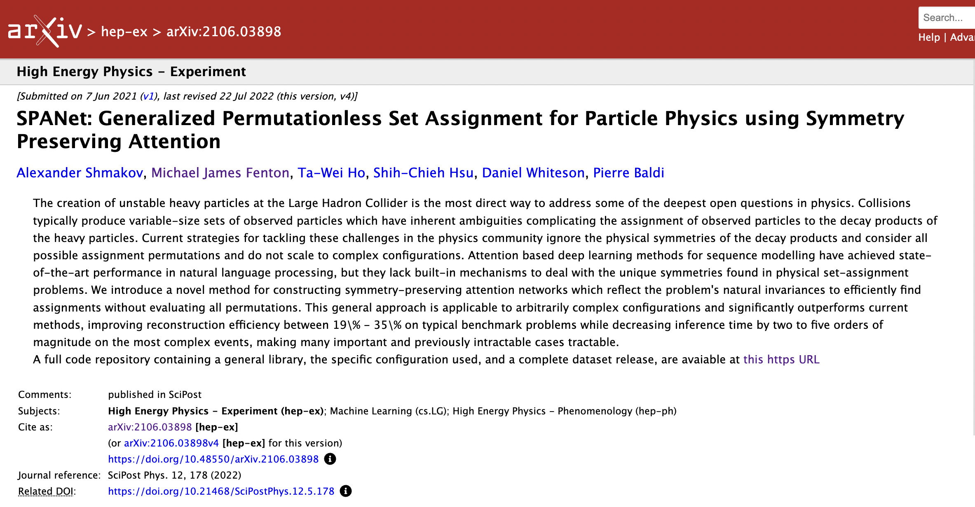
What is SPANet?

Slide 4

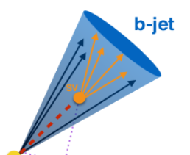
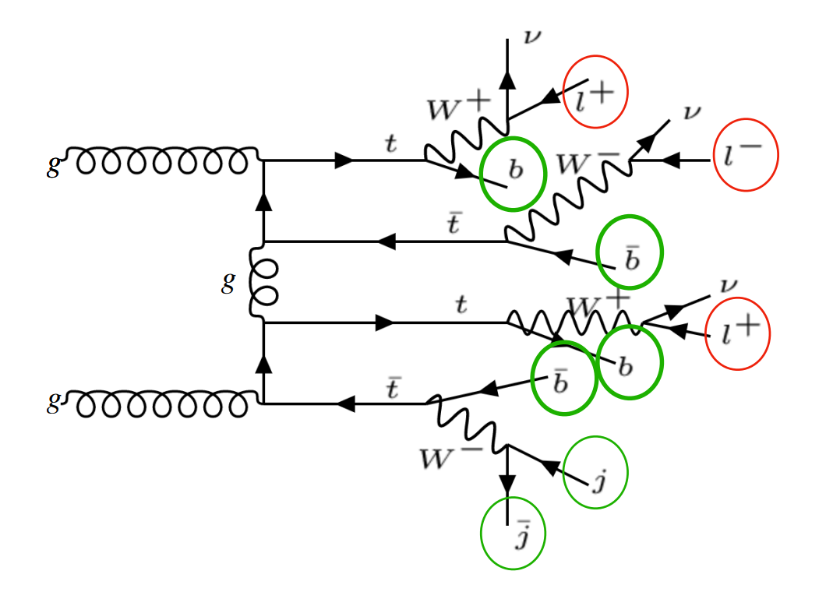
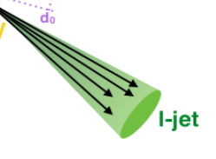

“Set Assignment Problem”
Ex: 3-lepton (3L) channel

Slide 5
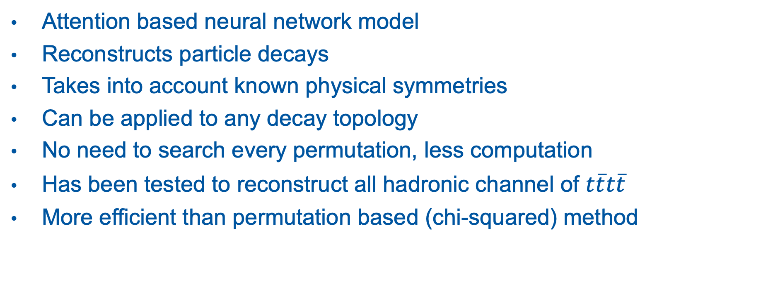
SPANet
Attention based neural network model
Reconstructs particle decays
Takes into account known physical symmetries
Can be applied to any decay topology
No need to search every permutation, less computation
Has been tested to reconstruct all hadronic channel of $t\overline{t}t\overline{t}$
More efficient than permutation based (chi-squared) method

Slide 6
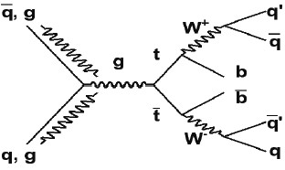

Example: $t\overline{t}$

Slide 7
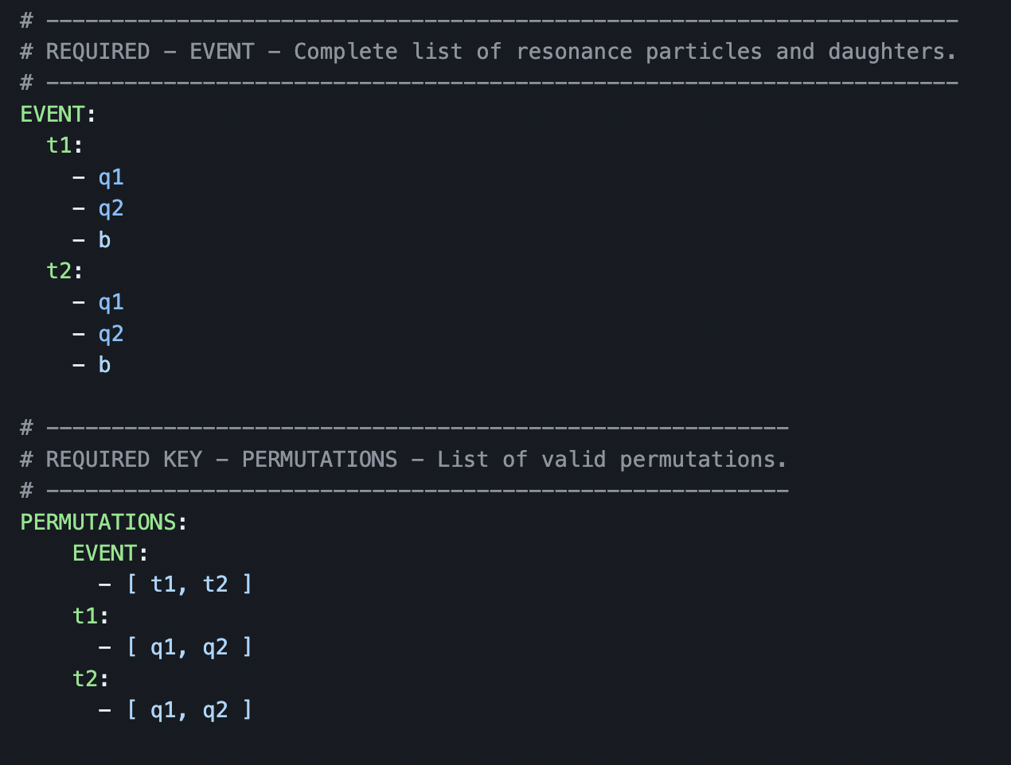
Configuration
Part of configuration file for training
Define decay topology

Slide 8
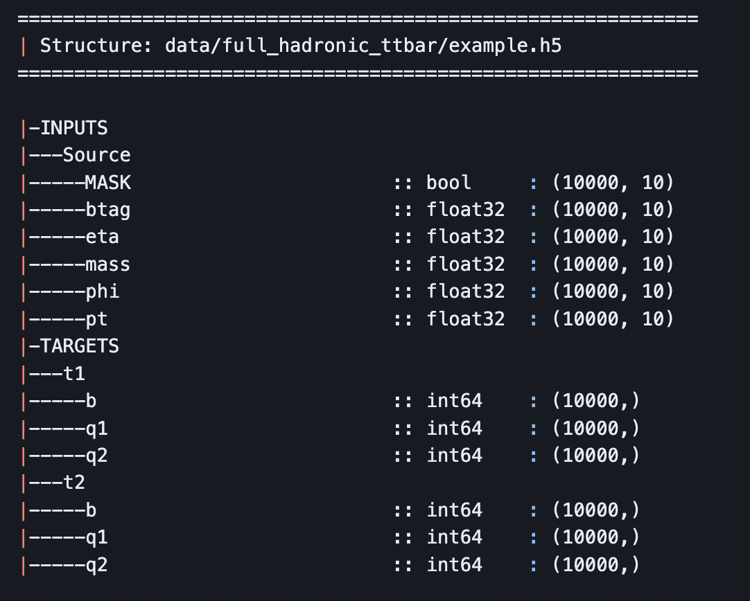
Training Data Structure
Inputs
  Kinematic information about particles in final state
Targets
  Indices of correct decay products
  Which particles in final states are which

Slide 9
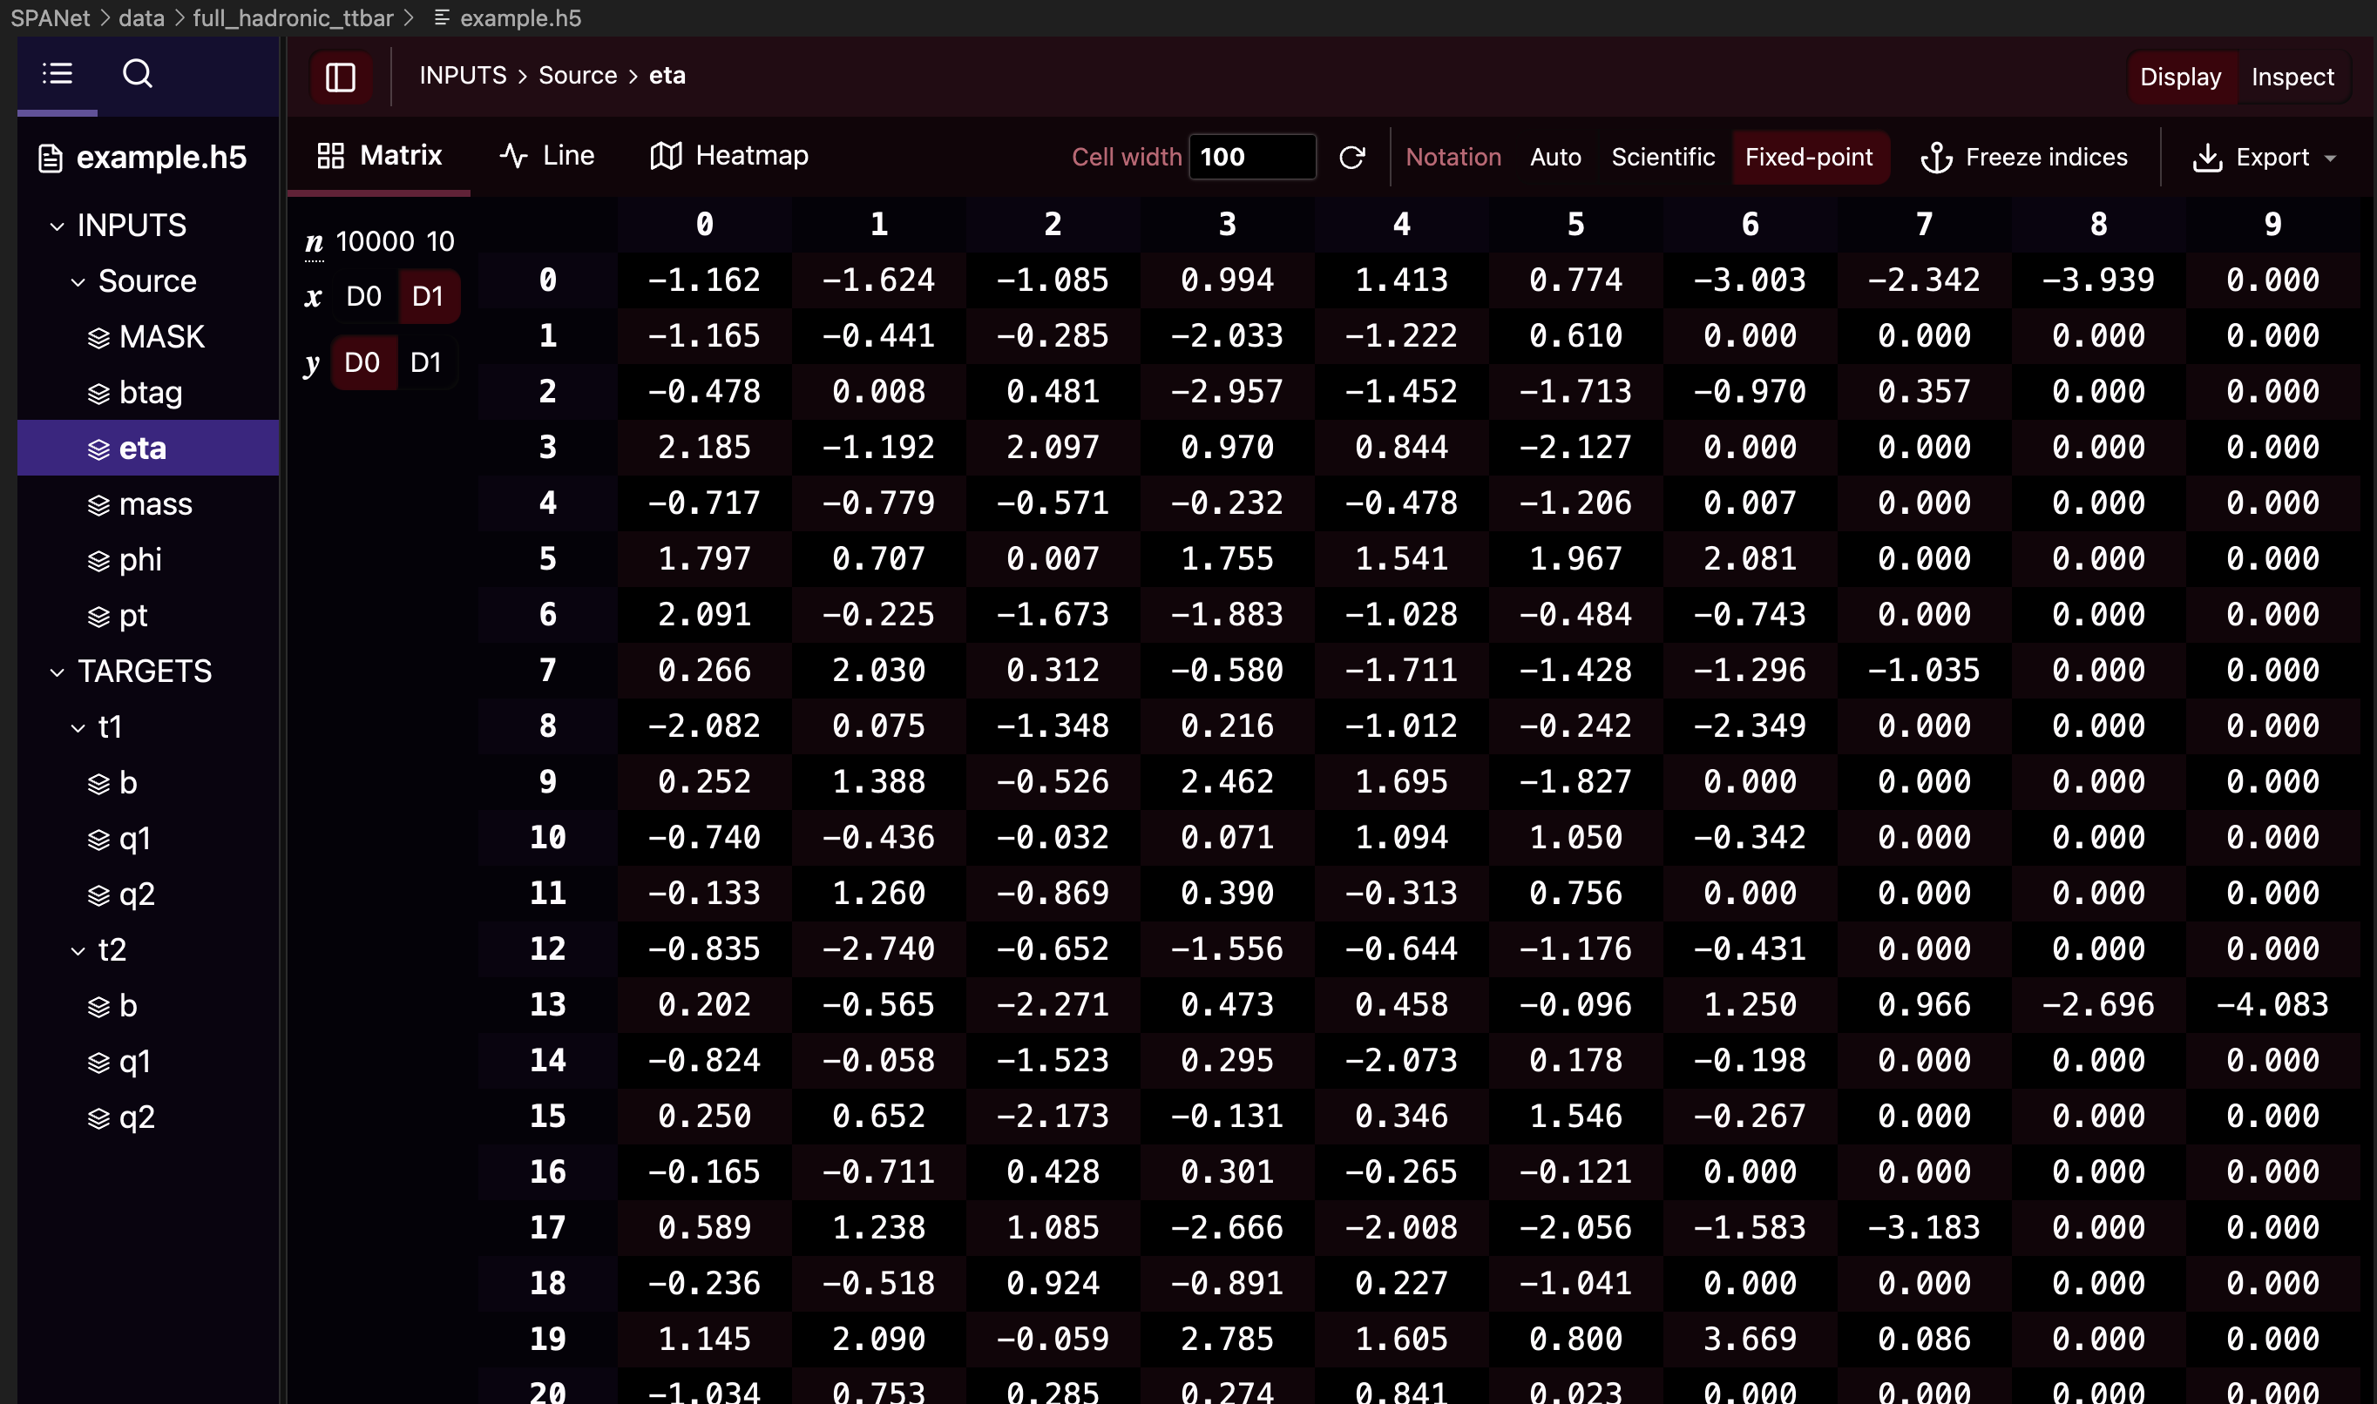
Input Data

Slide 10
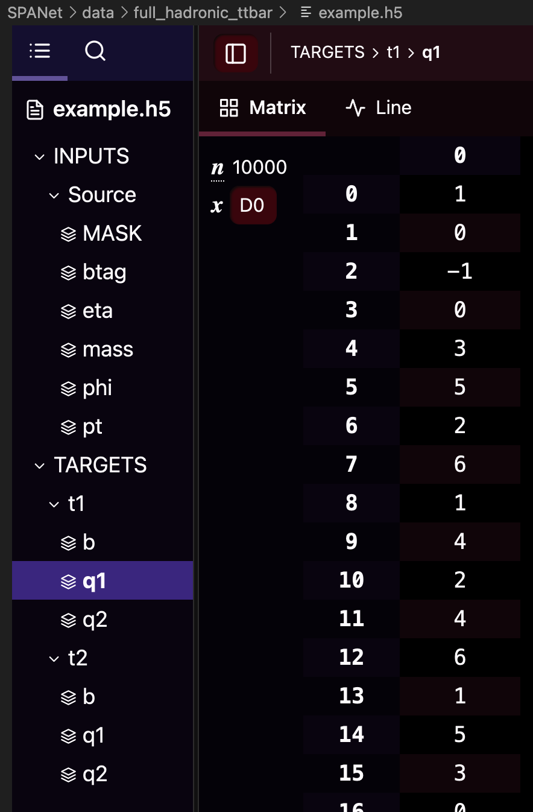
Target Data
Contains indices of correct assignments
-1 means there is a missing jet
  Impossible to fully reconstruct

Slide 11
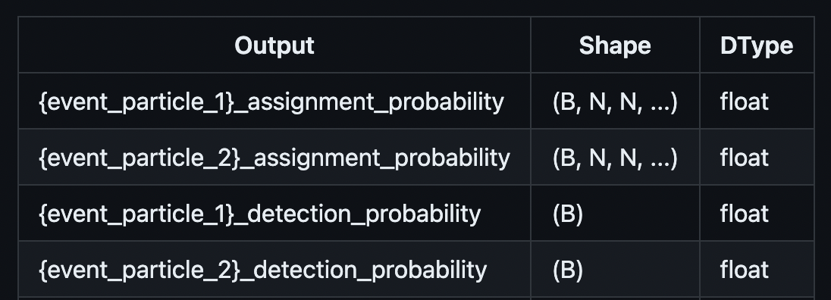
Output
Most likely assignment for each event and “Assignment probability”
  How likely the assignment is correct
“Detection probability” for each target
  How likely the parent particle is “reconstructable”
  How likely all decay products were detected (not missing)

Slide 12
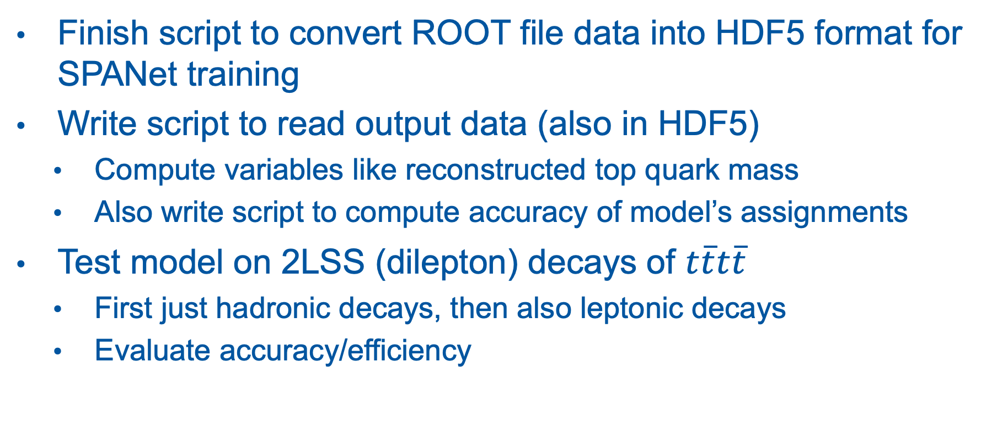
Next Steps
Finish script to convert ROOT file data into HDF5 format for SPANet training
Write script to read output data (also in HDF5)
  Compute variables like reconstructed top quark mass
  Also write script to compute accuracy of model’s assignments
Test model on 2LSS (dilepton) decays of $t\overline{t}t\overline{t}$
  First just hadronic decays, then also leptonic decays
  Evaluate accuracy/efficiency

Slide 13
If there is time…
Test model on 3L, 4L decay channels
Train and test models on data including backgrounds
  Evaluate ability to separate signal from background

Slide 14
Thank you

Slide 15
Backup Slides

Slide 16
Summer Goals
Try to use SPANet to reconstruct multileptonic four top quark decay
  Try to determine the accuracy and efficiency of this method
  Determine whether the reconstruction yields any kinematic variables which can be input into an MVA and improve signal-background separation
Finalize study on chi-squared reconstruction algorithm
If time, look into using these reconstruction techniques to identify background decays (e.g. ttH, ttW)

Slide 17
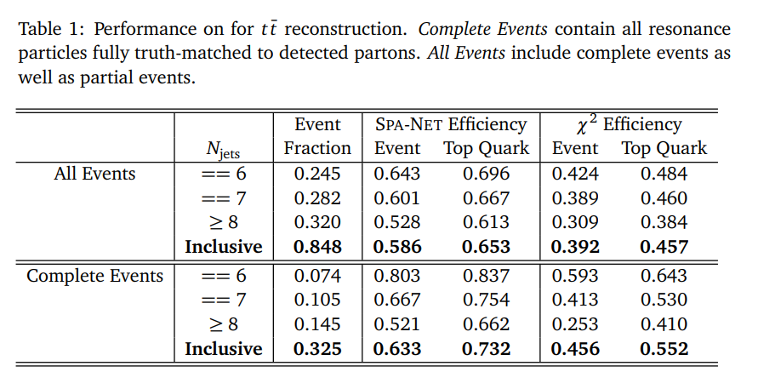
SPANet
Was tested on hadronic top quark decays in 2022 paper
  https://arxiv.org/abs/2106.03898
SPANet reconstructed 19.4% more tt bar events
19.6% more top quarks

Slide 18
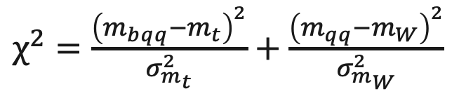
Chi-Squared Reconstruction
Algorithm searches every combination of jets in a final state
Scores combinations based on the known invariant mass of the top quark and W boson
Computationally expensive
$χ^{2}=\frac{{\left(m_{bqq}−m_{t}\right)}^{2}}{σ_{m_{t}}^{2}}+\frac{{\left(m_{qq}−m_{W}\right)}^{2}}{σ_{m_{W}}^{2}}$

Slide 19
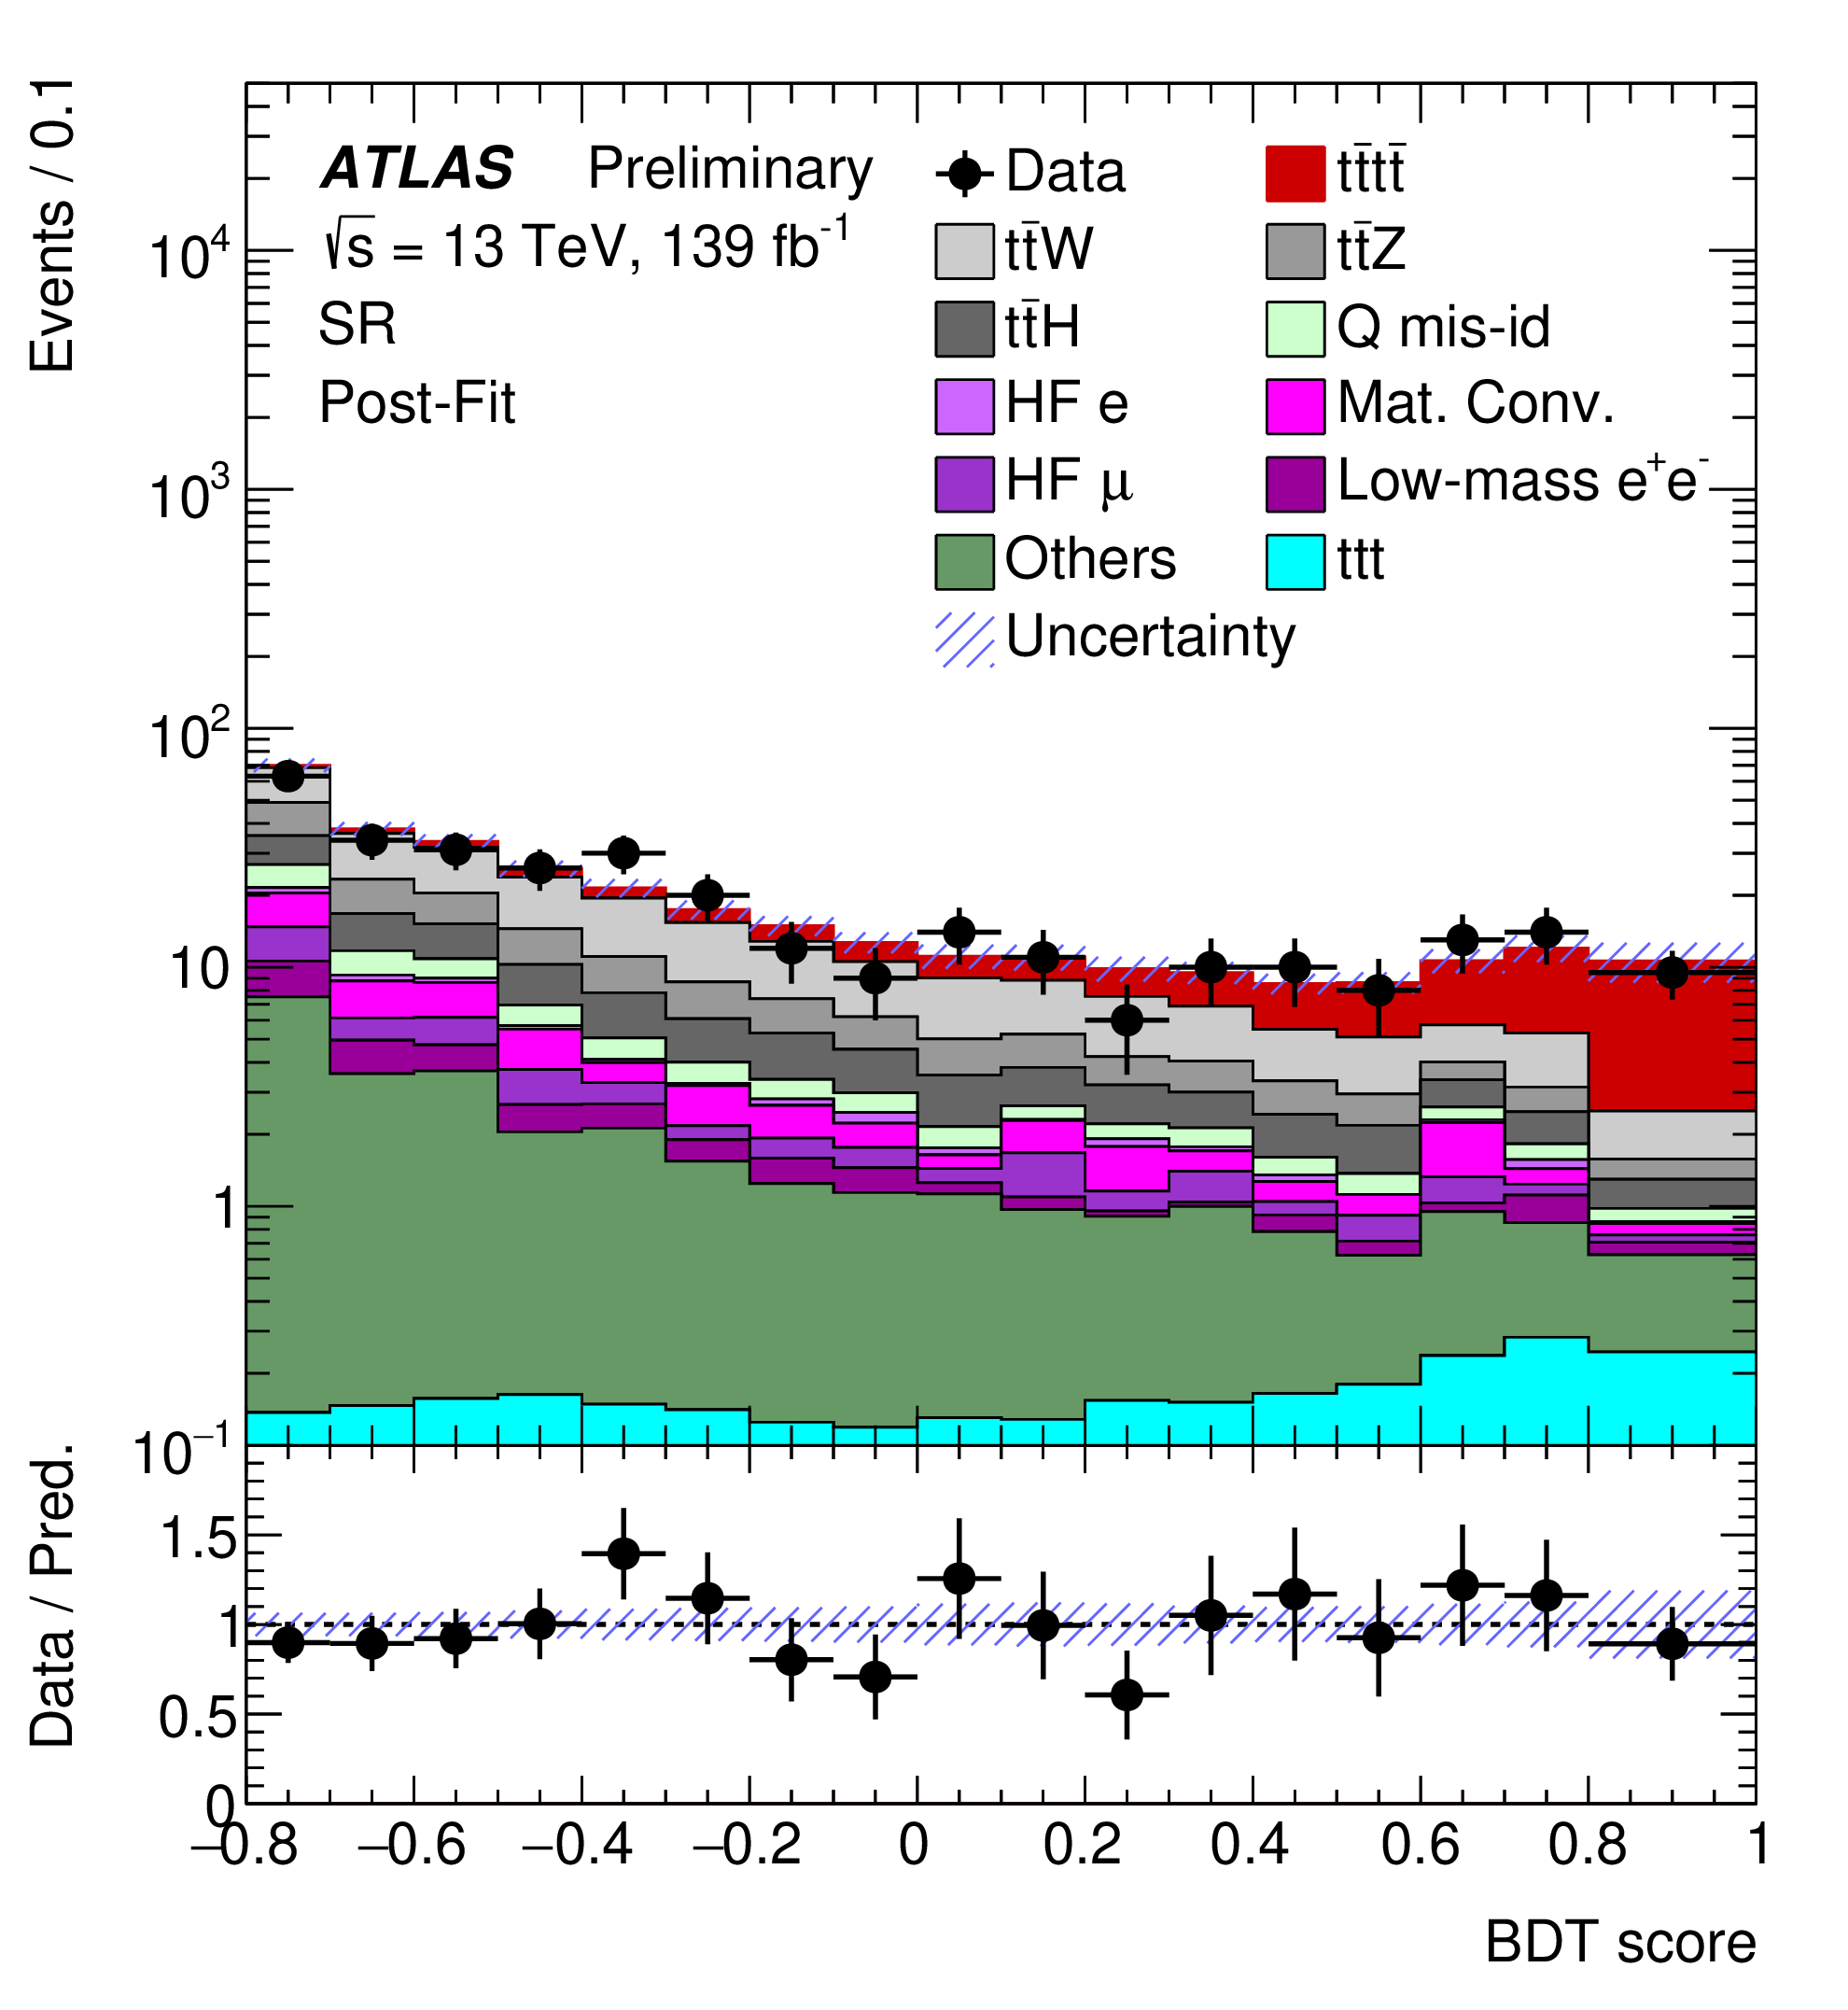
Past Observation of 4 Tops
2020/2023 Papers
Used Run 2 Data @13 TeV
Observed 4 Tops with ~ 6 sigma
Now looking at Run 3 Data @13.6 TeV
Need to update analysis framework and code
  Also helps prepare for HL-LHC

Slide 20
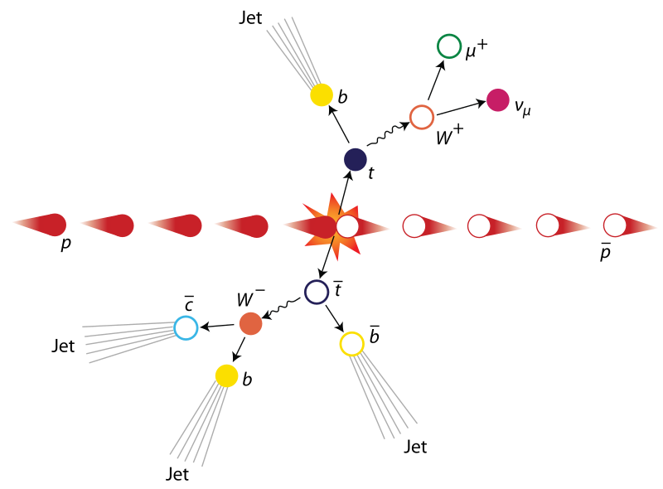

Example: $t\overline{t}$ Production

Slide 21
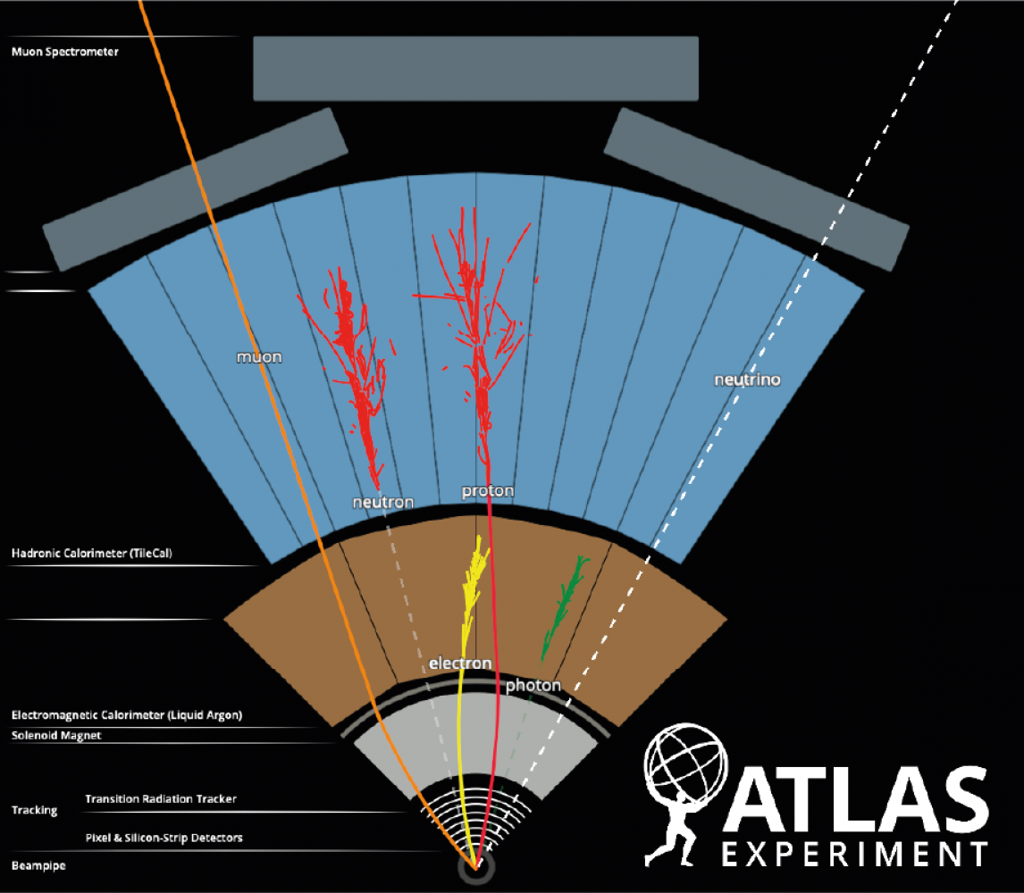
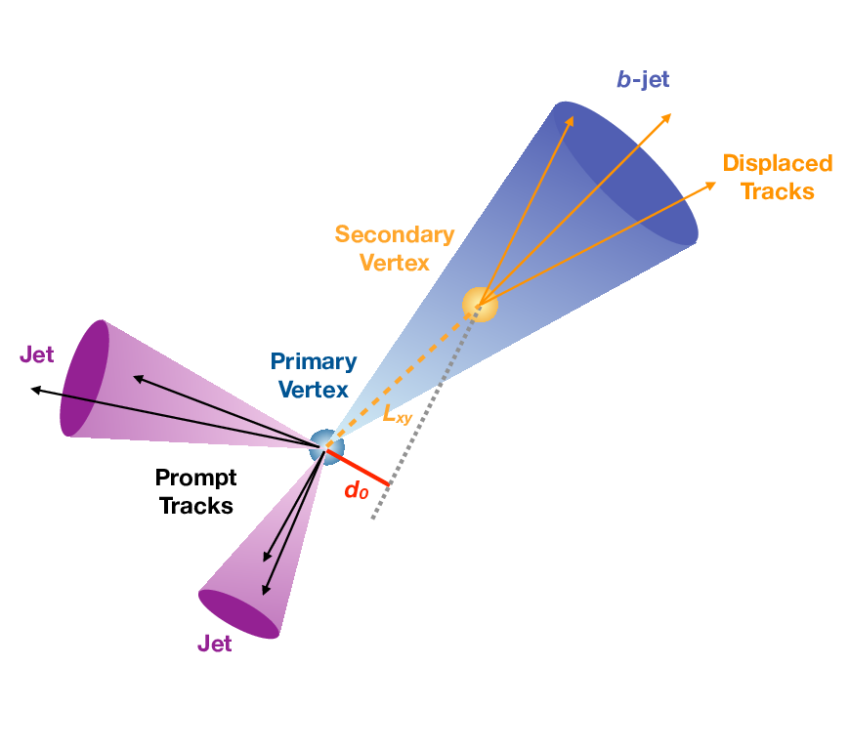
B-Jet Tagging vs Leptons

Slide 22
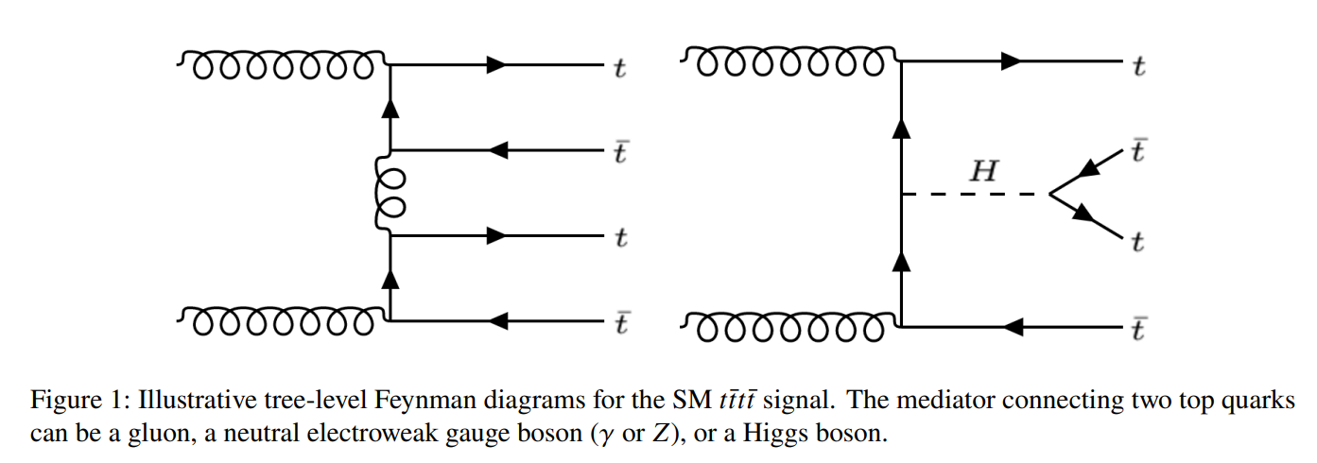
Four Tops

Slide 23
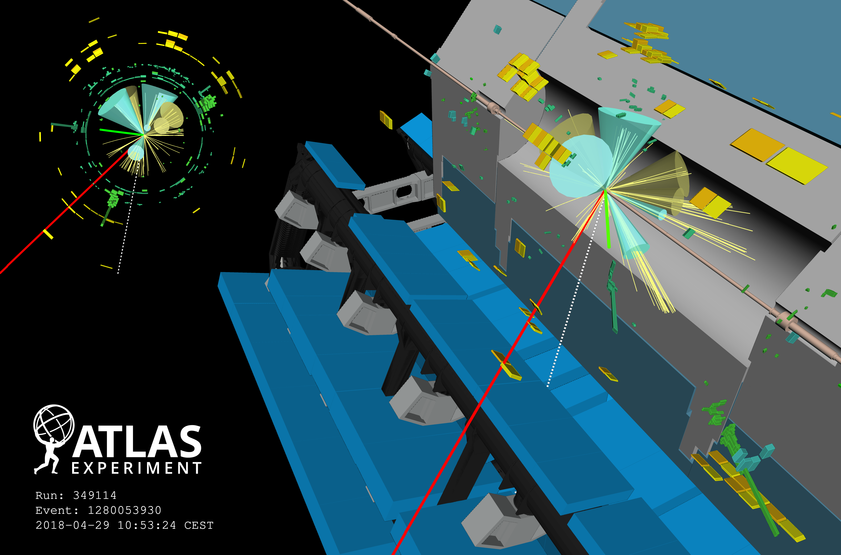
Notes:
Four-top candidate from 2018. Event display of a candidate four-top-quark event (Run 349114, Event 1280053930) with seven jets (four of them are b-tagged); two of the top quarks decay leptonically (one with a resulting muon, shown in red, and one with an electron, shown in green), and two top quarks decay hadronically. Green rectangles correspond to energy deposits in cells of the electromagnetic calorimeter, while yellow rectangles correspond to energy deposits in cells of the hadron calorimeter. The jets (b-tagged jets) are shown as yellow (blue) cones. The direction of the missing transverse momentum is indicated by a dotted line.

Slide 24
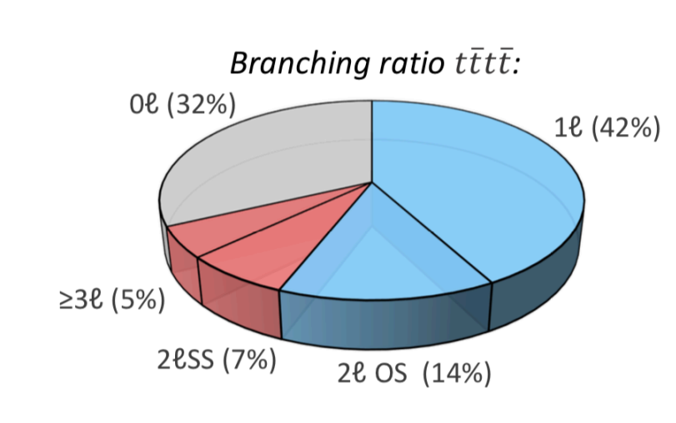
Branching ratios
Most 4 Tops decay into all hadrons
2 and 3 lepton channels (3l, 2lss) are cleanest

Slide 25
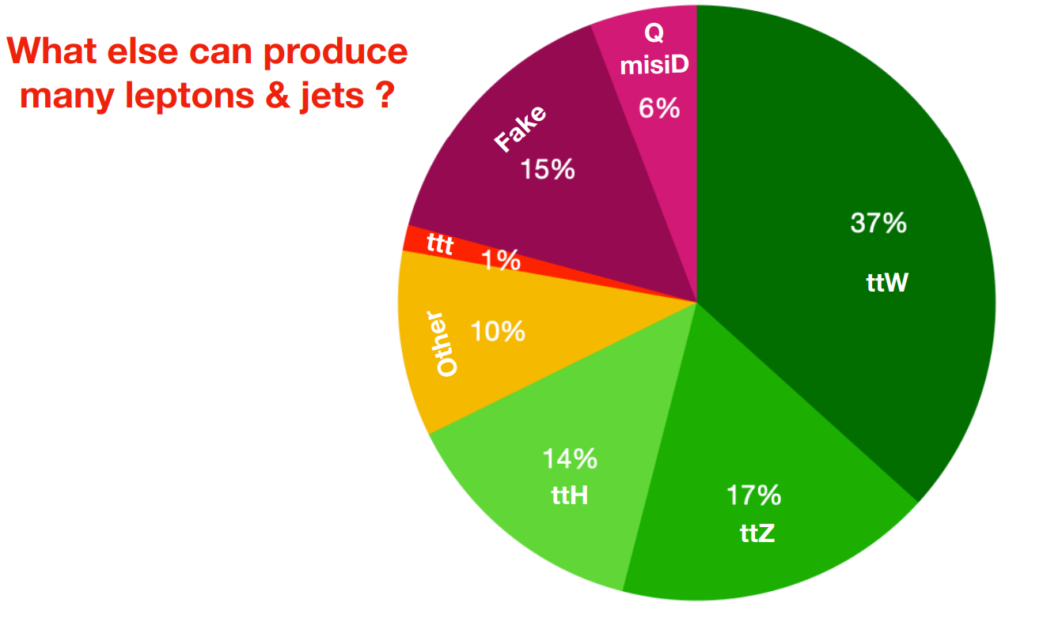
Backgrounds

Slide 26
Example of 3L Channel Signal

Slide 27
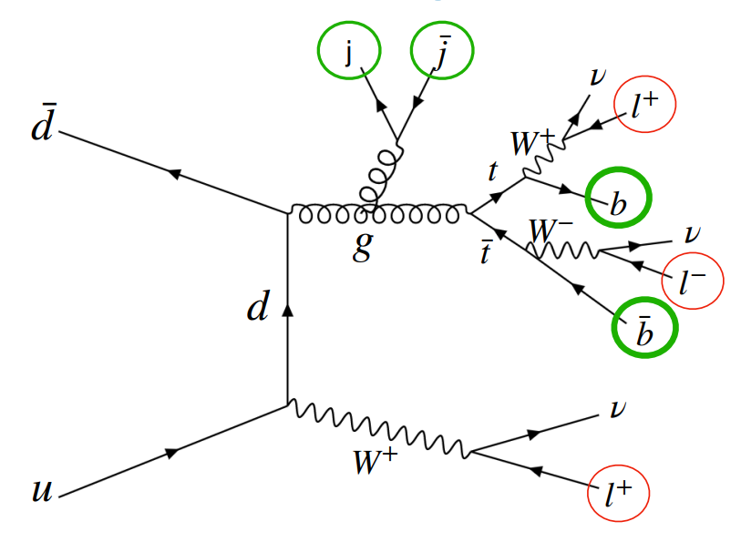
Example of 3L Background

Slide 28
Recap: Top Quark Reconstruction
You can reconstruct a top quark by finding its decay products
Gives us more kinematic information to separate signal from background
  More input for multivariate analysis algorithm
Need to study whether this is feasible, effective

Slide 29
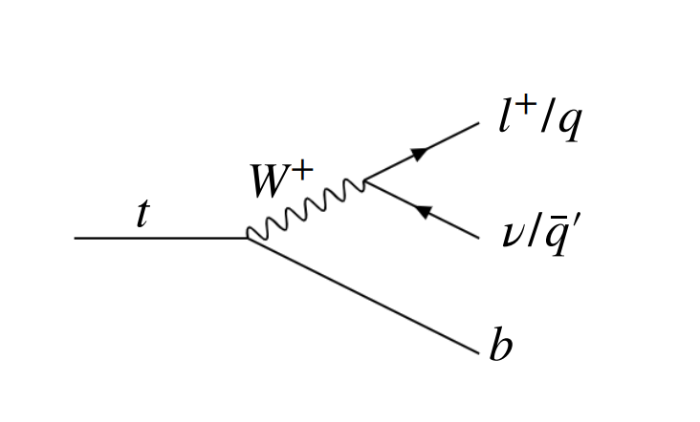
Recap: Top Quark Decay
Top quark decay is hadronic or leptonic
Hadronic
  3 jets (at least 1 b-jet)
Leptonic
  1 b-jet
  1 lepton (electron, muon, tau)
  1 neutrino

Slide 30
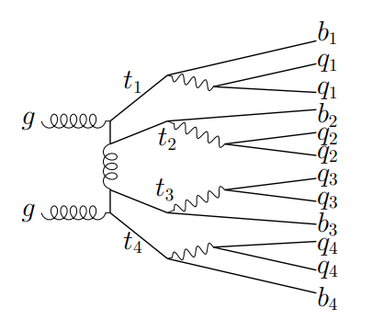
Recap: Four Tops
Much more complex topologies
Most 4 tops decay into all hadrons
2 and 3 lepton channels (3L, 2LSS) are cleanest
Ex: All hadronic (0L) channel

Slide 31


“Set Assignment Problem”
p_{T}^{miss}
Ex: 3-lepton (3L) channel

Slide 32
What are our final states?
2-Lepton Same Sign (2LSS)
3-Lepton (3L)
2 hadronic tops
2 leptonic tops
Final State
  2 Leptons (same charge)
  8 Jets
      At least 4 b-jets
  Missing energy
      2 neutrinos
1 hadronic top
3 leptonic tops
Final State
  3 Leptons
  6 Jets
      At least 4 b-jets
  Missing energy
      3 neutrinos

Slide 33
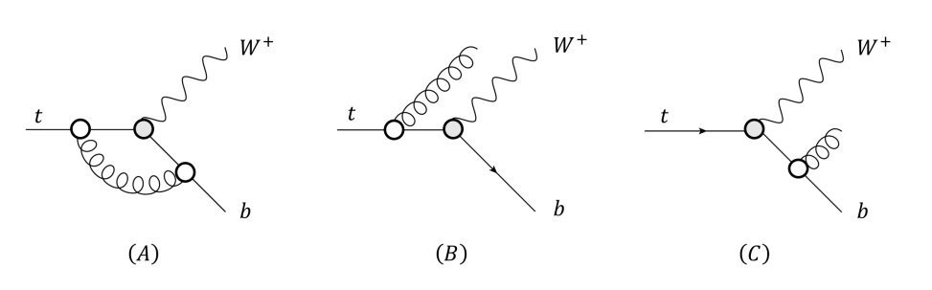
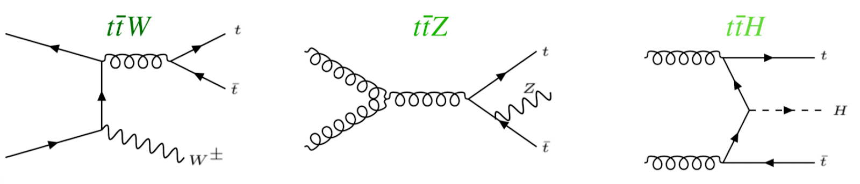
What are our backgrounds?
Largest backgrounds are ttW, ttZ, ttH
Can look like four tops signal
  Possibility of gluon splitting

Slide 34
Hadronic Top Reconstruction, cont.
Kinematic Fitting
  KLFitter: https://doi.org/10.1016/j.nima.2014.02.029 (semi-leptonic tt)
Boosted Decision Trees
Deep Neural Networks
  https://arxiv.org/abs/1907.11181 (semi-leptonic tt)
Graph Neural Networks
  Briefly investigated in 2023 ATLAS four tops observation study
  Did not manage to increase sensitivity over background
  https://cds.cern.ch/record/2765538/files/ATL-COM-PHYS-2021-195.pdf
Other: SPA-NET
  Attention based network which preserves physical symmetries
  20% improved efficiency over chi-squared method
  Was able to reconstruct 0L tttt events
  https://arxiv.org/abs/2106.03898

Slide 35
Leptonic Top Reconstruction
Mass reconstruction is non-trivial
  System is kinematically unconstrained
  Missing transverse momentum is the sum from 2+ neutrinos
  Cannot determine momenta of individual neutrinos
Possible solutions (constraining m_{t} and m_{W})
      https://pdg.lbl.gov/2019/reviews/rpp2019-rev-top-quark.pdf
  Analytic solutions
  Neutrino weighting methods
      https://arxiv.org/abs/hep-ex/9808029
  Neutrino reconstruction with deep neural networks (2023)
      https://arxiv.org/abs/2307.02405
      Can recover full neutrino momenta in multi-neutrino final states

Slide 36
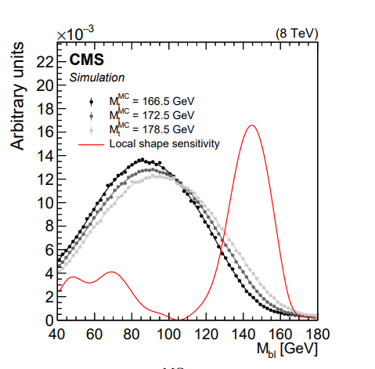
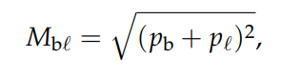
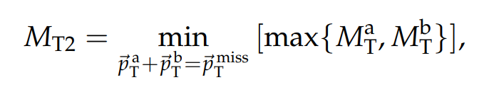
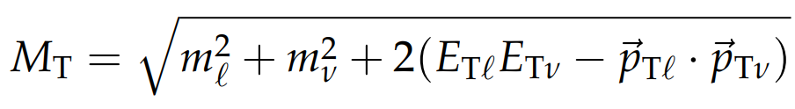
Leptonic Top Reconstruction, cont.
Other observables sensitive to top quark mass
  Invariant mass of bottom jet and lepton system is theoretically limited by top quark mass
  Other transverse-mass-like variables
  Maybe can be fitted to known distributions to reconstruct leptonic tops? Maybe can be used as discriminating variables
https://arxiv.org/abs/1704.06142

