Slide 1
L1T Upgrade Update #8
Brock Ewing
7.2.2024

Slide 2
Project Recap
Upgrade the L1T system to look for new Higgs signatures in background HL-LHC data
Analyze and select events from simulated data to train an NN for implementation onto the HL-LHC hardware
Create NN and generate accuracy and efficiency graphs, ROC graphs to show the ability of our NN.
Use Qkeras and hls4ml to reduce the size of our NN and transfer it onto FPGA hardware.

Slide 3
Progress
Created Hls4ml model
Fixed the Hls4ml model’s performance
Created a Github repository and pushed all of my code

Slide 4
Hls4ml
Hls4ml is a python package for machine learning in FPGAs. The package is equipped with tools to convert networks into an FPGA readable formats.
In my case, I would like to use it to convert my quantized Deepsets network into an FPGA readable format and evaluate its performance.

Slide 5
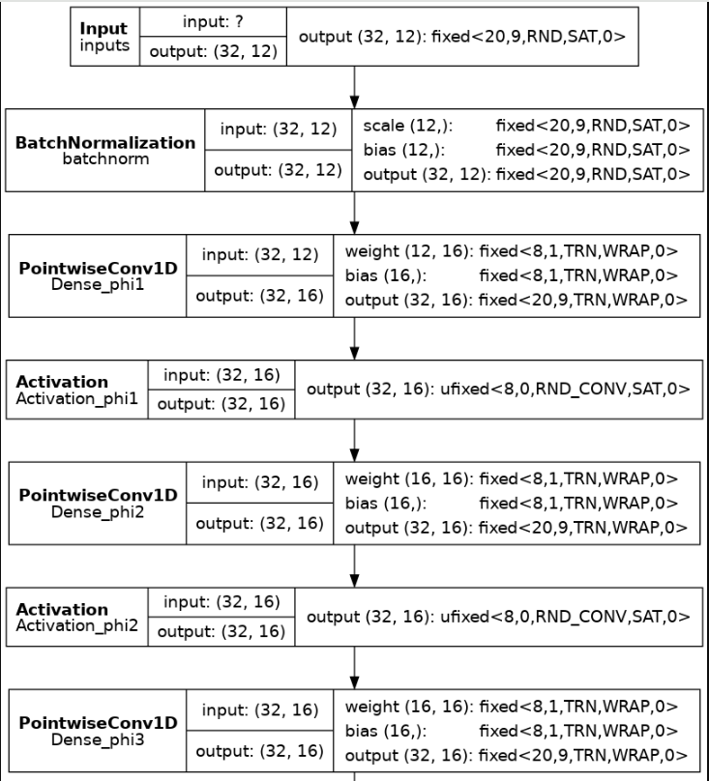
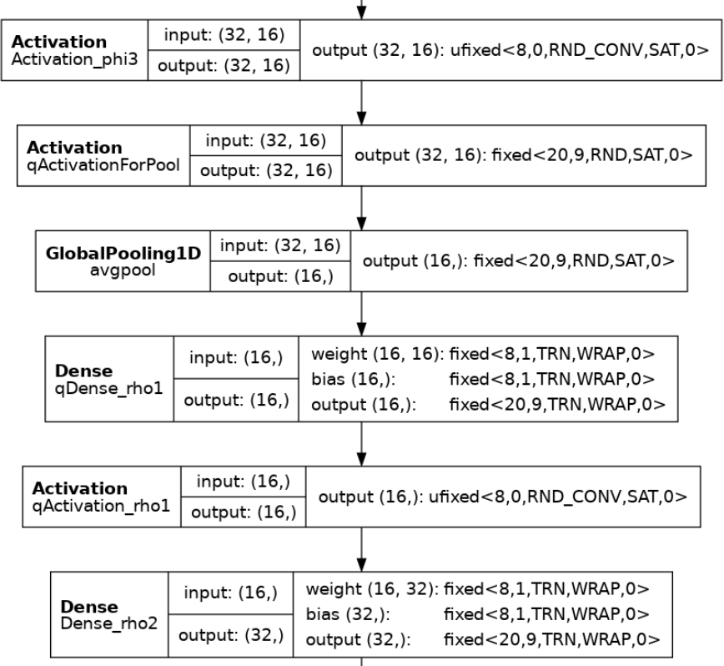
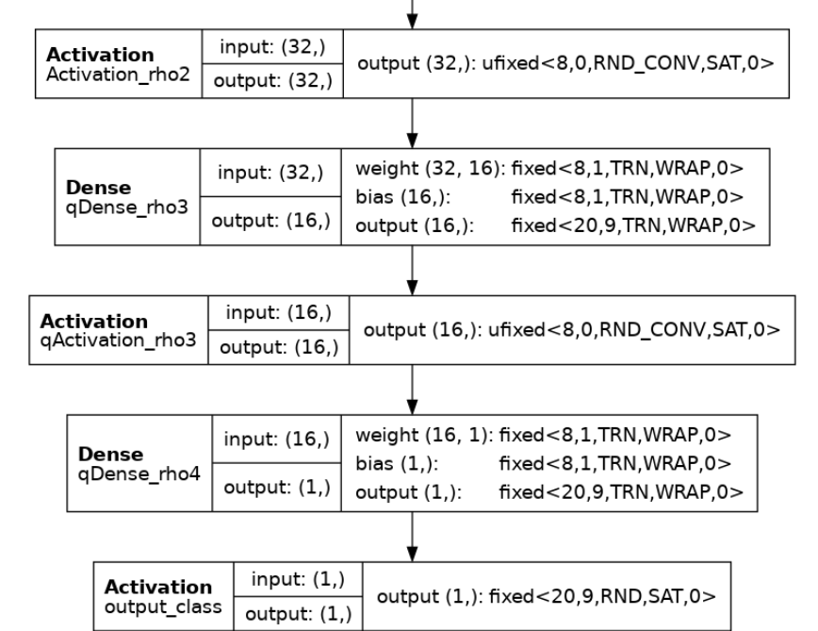
Hls4ml
Printed Hls4ml model

Slide 6
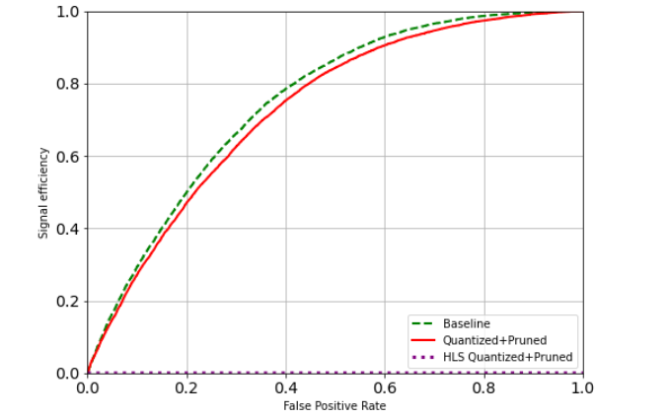
Previous Performance
Can see here that the baseline Deepsets model performs well.
The Quantized and Pruned shows an expected drop in performance that is acceptable.

Slide 7
Solutions
Trying Different versions of the machine learning packages
Performing Tracing on the conversion to see which layer causes an issue

Slide 8
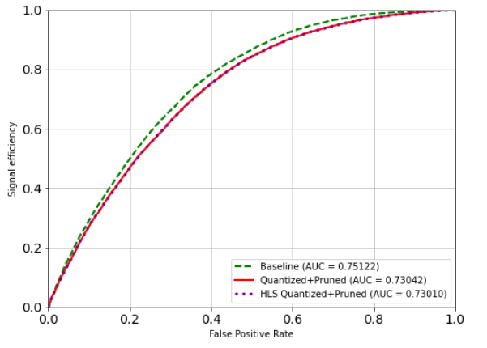
Fixed Hls4ml Model

Slide 9
Next Steps
Run synthesis on hls4ml model to estimate needed FPGA resources
Create Emulator to test network performance on FPGA

