Slide 1



Tuning studies with pyAT
1
Elaf Musa
Jul 23th, 2024
FCCIS – The Future Circular Collider Innovation Study. This INFRADEV Research and Innovation Action project receives funding from the European Union’s H2020 Framework Programme under grant agreement no. 951754.

Slide 2
2
Table of content
Tuning simulations with SR:
- w & w/o zero crabbing
- Including:
    Dipole misalignments
    BPM misalignments
Z& tt bar lattice sensitivity to errors.
Notes:
Ttbar, 4IP lattice. These are the main results.
%$\epsilon_{x, \textrm{median}} = 1.509$ nm rad \\
%$\epsilon_{y, \textrm{median}} = 0.353$ pm rad \\
$\frac{\epsilon_{y}}{\epsilon_{x}} = 0.023$ $\%$ \\
\begin{table}[htb!]
\centering
\begin{tabular}{p{3cm}cccccc}
\hline
Type & $\Delta$X & $\Delta$Y & $\Delta$PSI & $\Delta$S & $\Delta$THETA & $\Delta$PHI \\
& ($\mu$m) & ($\mu$m) & ($\mu$rad) & ($\mu$m) & ($\mu$rad) & ($\mu$rad) \\
\vspace{.1cm} \\
\hline
Arc quadrupole* & 100 & 100 & 300 & 150 & 70 & 70 \\
Arc sextupoles* & 100 & 100 & 300 & 150 & 70 & 70 \\
\hline
Dipoles & 1000 & 1000 & 300 & 1000 & 0 & 0 \\
\hline
Girders & 200 & 200 & - & 1000 & 0 & 0 \\
\hline
IR quadrupole & 100 & 100 & 250 & 200 & 70 & 70 \\
IR sextupoles & 25 & 25 & 250 & 200 & 70 & 70 \\
%\hline
% BPM** & 40 & 40 & 100 & - \\
\hline
\end{tabular}
\end{table}

Slide 3
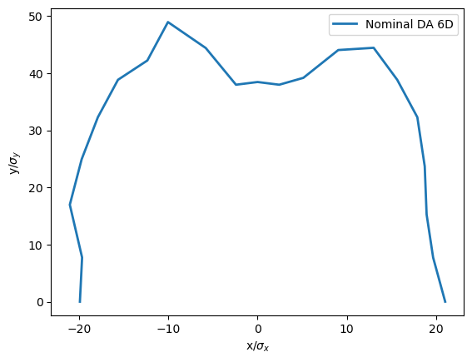
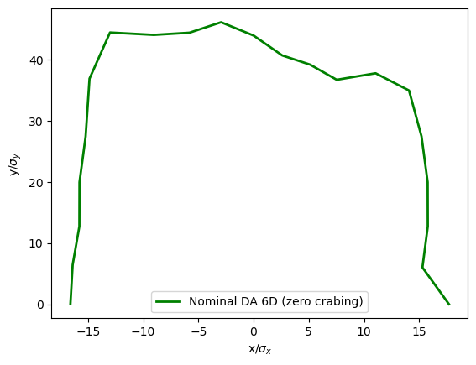
3
For V22 @ Z lattice
Nominal DA with synchrotron radiation
Since last tuning meeting 28th June:
Adjusting proper RF parameters.
Iterations of Phase/RDT correction.
Constant correction of orbit and tune.
Zero crabbing :
k2sy2l=k2sy1l
k2sy2r=k2sy1r
k2 of left sy is 6.291 while for right is -5.940
(AT sextupole strength notation is half the K2
values from MAD-X file)
DA @ ca1.1
512 turns
sigma_x = 0.000452
sigma_y = 0.000018
Nominal chroma.=
[-0.01448, -0.060 , -0.0705]
Notes:
Ttbar, 4IP lattice. These are the main results.
%$\epsilon_{x, \textrm{median}} = 1.509$ nm rad \\
%$\epsilon_{y, \textrm{median}} = 0.353$ pm rad \\
$\frac{\epsilon_{y}}{\epsilon_{x}} = 0.023$ $\%$ \\
\begin{table}[htb!]
\centering
\begin{tabular}{p{3cm}cccccc}
\hline
Type & $\Delta$X & $\Delta$Y & $\Delta$PSI & $\Delta$S & $\Delta$THETA & $\Delta$PHI \\
& ($\mu$m) & ($\mu$m) & ($\mu$rad) & ($\mu$m) & ($\mu$rad) & ($\mu$rad) \\
\vspace{.1cm} \\
\hline
Arc quadrupole* & 100 & 50 & 300 & 150 & 70 & 70 \\
Arc sextupoles* & 100 & 50 & 300 & 150 & 70 & 70 \\
\hline
Dipoles & 1000 & 1000 & 300 & 1000 & 0 & 0 \\
\hline
Girders & 200 & 200 & - & 1000 & 0 & 0 \\
\hline
IR quadrupole & 100 & 100 & 250 & 200 & 70 & 70 \\
IR sextupoles & 100 & 100 & 250 & 200 & 70 & 70 \\
%\hline
% BPM** & 40 & 40 & 100 & - \\
\hline
\end{tabular}
\end{table}

Slide 4
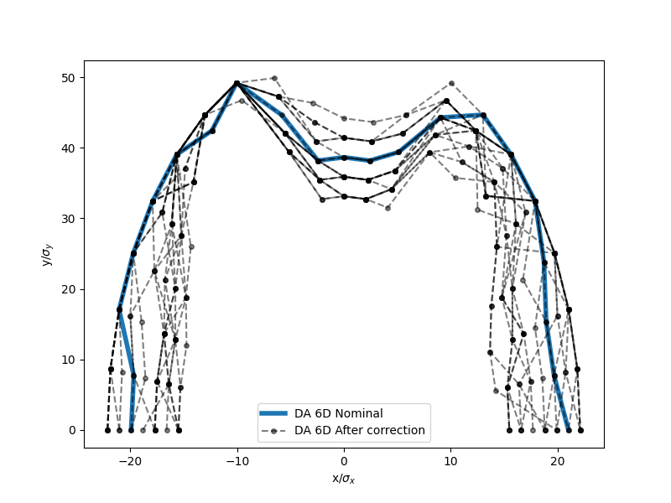
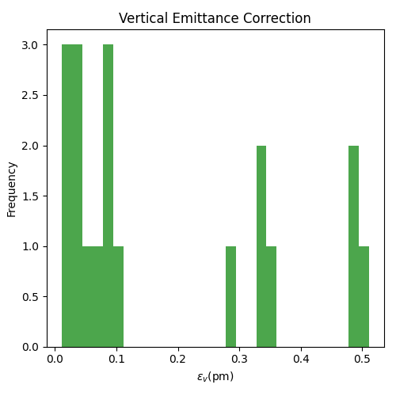
4
elements | Hor. & Ver. displacement | Tilt θ
Arc quads and sext | 100 μm | 100 μrad
All dipoles | 150 μm | 150 μrad
After correction of alignment errors
20 seeds/ 1 failed seed
median εy = 0.091 pm
Notes:
Ttbar, 4IP lattice. These are the main results.
%$\epsilon_{x, \textrm{median}} = 1.509$ nm rad \\
%$\epsilon_{y, \textrm{median}} = 0.353$ pm rad \\
$\frac{\epsilon_{y}}{\epsilon_{x}} = 0.023$ $\%$ \\
\begin{table}[htb!]
\centering
\begin{tabular}{p{3cm}cccccc}
\hline
Type & $\Delta$X & $\Delta$Y & $\Delta$PSI & $\Delta$S & $\Delta$THETA & $\Delta$PHI \\
& ($\mu$m) & ($\mu$m) & ($\mu$rad) & ($\mu$m) & ($\mu$rad) & ($\mu$rad) \\
\vspace{.1cm} \\
\hline
Arc quadrupole* & 100 & 50 & 300 & 150 & 70 & 70 \\
Arc sextupoles* & 100 & 50 & 300 & 150 & 70 & 70 \\
\hline
Dipoles & 1000 & 1000 & 300 & 1000 & 0 & 0 \\
\hline
Girders & 200 & 200 & - & 1000 & 0 & 0 \\
\hline
IR quadrupole & 100 & 100 & 250 & 200 & 70 & 70 \\
IR sextupoles & 100 & 100 & 250 & 200 & 70 & 70 \\
%\hline
% BPM** & 40 & 40 & 100 & - \\
\hline
\end{tabular}
\end{table}

Slide 5
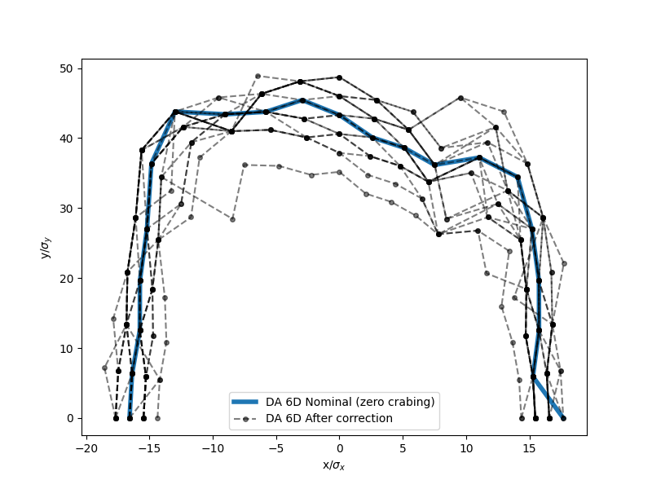
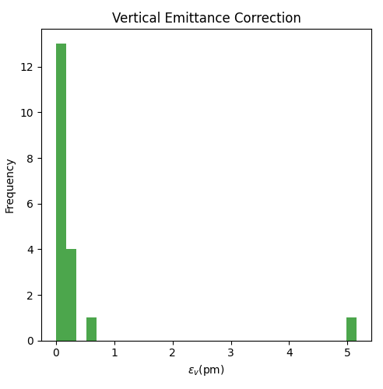
5
elements | Hor. & Ver. displacement | Tilt θ
Arc quads andsext | 100 μm | 100 μrad
All dipoles | 150 μm | 150 μrad
After correction of alignment errors
Zero crabbing
20 seeds/ 1 failed seed
median εy = 0.06 pm
Notes:
Ttbar, 4IP lattice. These are the main results.
%$\epsilon_{x, \textrm{median}} = 1.509$ nm rad \\
%$\epsilon_{y, \textrm{median}} = 0.353$ pm rad \\
$\frac{\epsilon_{y}}{\epsilon_{x}} = 0.023$ $\%$ \\
\begin{table}[htb!]
\centering
\begin{tabular}{p{3cm}cccccc}
\hline
Type & $\Delta$X & $\Delta$Y & $\Delta$PSI & $\Delta$S & $\Delta$THETA & $\Delta$PHI \\
& ($\mu$m) & ($\mu$m) & ($\mu$rad) & ($\mu$m) & ($\mu$rad) & ($\mu$rad) \\
\vspace{.1cm} \\
\hline
Arc quadrupole* & 100 & 50 & 300 & 150 & 70 & 70 \\
Arc sextupoles* & 100 & 50 & 300 & 150 & 70 & 70 \\
\hline
Dipoles & 1000 & 1000 & 300 & 1000 & 0 & 0 \\
\hline
Girders & 200 & 200 & - & 1000 & 0 & 0 \\
\hline
IR quadrupole & 100 & 100 & 250 & 200 & 70 & 70 \\
IR sextupoles & 100 & 100 & 250 & 200 & 70 & 70 \\
%\hline
% BPM** & 40 & 40 & 100 & - \\
\hline
\end{tabular}
\end{table}

Slide 6
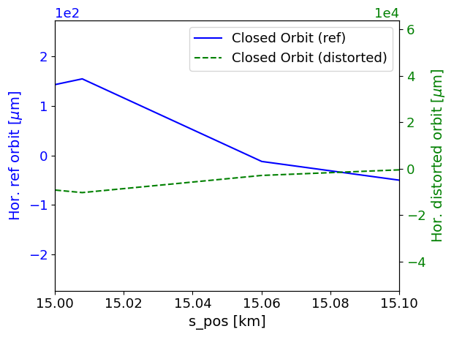
BPM
6
New Ref orbit = T2[0]
Adding BPM misalignments
T2[0]
Ref orbit =0
x
Appling BPM misalignments in PyAT
BPMs are attached to each quadrupole or to each sextupole.
Defining “Offset” field to BPM elements.
The values of each BPM offset are equal to the assigned offset errors to the corresponding quadrupole or sextupole
The hor. & ver. BPM offsets represent the new hor. & ver. reference orbit.
Orbit to be corrected = distorted orbit (At get optics function) – new reference orbit.
Quad/sext
s
Notes:
Ttbar, 4IP lattice. These are the main results.
%$\epsilon_{x, \textrm{median}} = 1.509$ nm rad \\
%$\epsilon_{y, \textrm{median}} = 0.353$ pm rad \\
$\frac{\epsilon_{y}}{\epsilon_{x}} = 0.023$ $\%$ \\
\begin{table}[htb!]
\centering
\begin{tabular}{p{3cm}cccccc}
\hline
Type & $\Delta$X & $\Delta$Y & $\Delta$PSI & $\Delta$S & $\Delta$THETA & $\Delta$PHI \\
& ($\mu$m) & ($\mu$m) & ($\mu$rad) & ($\mu$m) & ($\mu$rad) & ($\mu$rad) \\
\vspace{.1cm} \\
\hline
Arc quadrupole* & 100 & 50 & 300 & 150 & 70 & 70 \\
Arc sextupoles* & 100 & 50 & 300 & 150 & 70 & 70 \\
\hline
Dipoles & 1000 & 1000 & 300 & 1000 & 0 & 0 \\
\hline
Girders & 200 & 200 & - & 1000 & 0 & 0 \\
\hline
IR quadrupole & 100 & 100 & 250 & 200 & 70 & 70 \\
IR sextupoles & 100 & 100 & 250 & 200 & 70 & 70 \\
%\hline
% BPM** & 40 & 40 & 100 & - \\
\hline
\end{tabular}
\end{table}

Slide 7
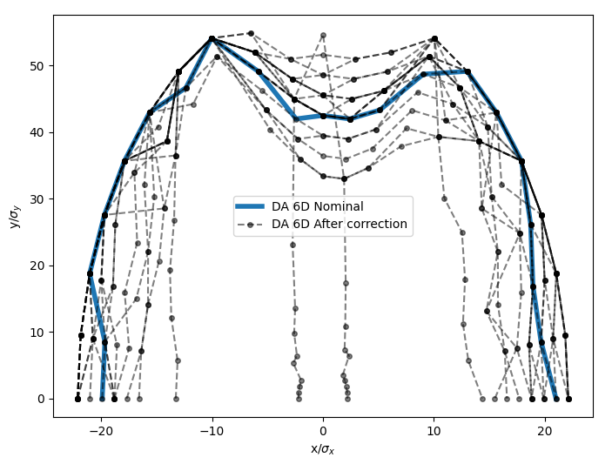
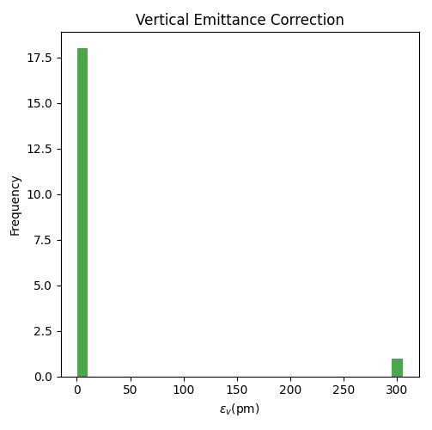
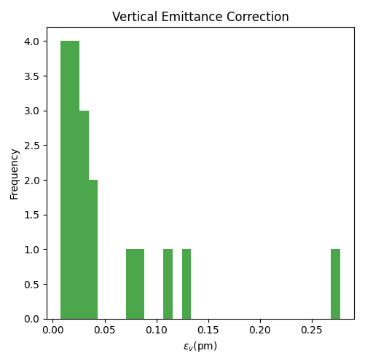
7
elements | Hor. & Ver. displacement | Tilt θ
Arc quads and sext | 100 μm | 100 μrad
All dipoles | 150 μm | 150 μrad
BPMs | Same as quads. | -
After correction of alignment errors
BPMs aligned to quadrupoles
20 seeds/ 1 failed seed
median εy = 0.029 pm
Notes:
Ttbar, 4IP lattice. These are the main results.
%$\epsilon_{x, \textrm{median}} = 1.509$ nm rad \\
%$\epsilon_{y, \textrm{median}} = 0.353$ pm rad \\
$\frac{\epsilon_{y}}{\epsilon_{x}} = 0.023$ $\%$ \\
\begin{table}[htb!]
\centering
\begin{tabular}{p{3cm}cccccc}
\hline
Type & $\Delta$X & $\Delta$Y & $\Delta$PSI & $\Delta$S & $\Delta$THETA & $\Delta$PHI \\
& ($\mu$m) & ($\mu$m) & ($\mu$rad) & ($\mu$m) & ($\mu$rad) & ($\mu$rad) \\
\vspace{.1cm} \\
\hline
Arc quadrupole* & 100 & 50 & 300 & 150 & 70 & 70 \\
Arc sextupoles* & 100 & 50 & 300 & 150 & 70 & 70 \\
\hline
Dipoles & 1000 & 1000 & 300 & 1000 & 0 & 0 \\
\hline
Girders & 200 & 200 & - & 1000 & 0 & 0 \\
\hline
IR quadrupole & 100 & 100 & 250 & 200 & 70 & 70 \\
IR sextupoles & 100 & 100 & 250 & 200 & 70 & 70 \\
%\hline
% BPM** & 40 & 40 & 100 & - \\
\hline
\end{tabular}
\end{table}

Slide 8
8
Z & tt lattice sensitivity to errors
Notes:
Ttbar, 4IP lattice. These are the main results.
%$\epsilon_{x, \textrm{median}} = 1.509$ nm rad \\
%$\epsilon_{y, \textrm{median}} = 0.353$ pm rad \\
$\frac{\epsilon_{y}}{\epsilon_{x}} = 0.023$ $\%$ \\
\begin{table}[htb!]
\centering
\begin{tabular}{p{3cm}cccccc}
\hline
Type & $\Delta$X & $\Delta$Y & $\Delta$PSI & $\Delta$S & $\Delta$THETA & $\Delta$PHI \\
& ($\mu$m) & ($\mu$m) & ($\mu$rad) & ($\mu$m) & ($\mu$rad) & ($\mu$rad) \\
\vspace{.1cm} \\
\hline
Arc quadrupole* & 100 & 50 & 300 & 150 & 70 & 70 \\
Arc sextupoles* & 100 & 50 & 300 & 150 & 70 & 70 \\
\hline
Dipoles & 1000 & 1000 & 300 & 1000 & 0 & 0 \\
\hline
Girders & 200 & 200 & - & 1000 & 0 & 0 \\
\hline
IR quadrupole & 100 & 100 & 250 & 200 & 70 & 70 \\
IR sextupoles & 100 & 100 & 250 & 200 & 70 & 70 \\
%\hline
% BPM** & 40 & 40 & 100 & - \\
\hline
\end{tabular}
\end{table}

Slide 9
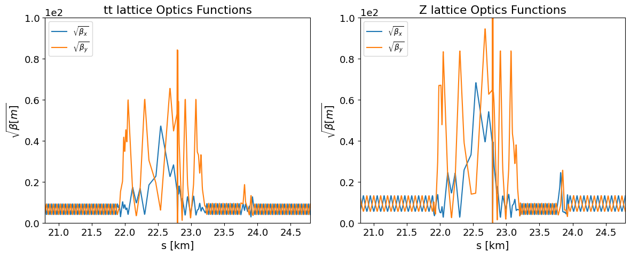


9
IR
$β_{x/y}^{∗}[mm]=$ 1000.07 / 1.599
$β_{x/y}^{∗}[mm]=$ 99.898 / 0.7934
Notes:
Ttbar, 4IP lattice. These are the main results.
%$\epsilon_{x, \textrm{median}} = 1.509$ nm rad \\
%$\epsilon_{y, \textrm{median}} = 0.353$ pm rad \\
$\frac{\epsilon_{y}}{\epsilon_{x}} = 0.023$ $\%$ \\
\begin{table}[htb!]
\centering
\begin{tabular}{p{3cm}cccccc}
\hline
Type & $\Delta$X & $\Delta$Y & $\Delta$PSI & $\Delta$S & $\Delta$THETA & $\Delta$PHI \\
& ($\mu$m) & ($\mu$m) & ($\mu$rad) & ($\mu$m) & ($\mu$rad) & ($\mu$rad) \\
\vspace{.1cm} \\
\hline
Arc quadrupole* & 100 & 50 & 300 & 150 & 70 & 70 \\
Arc sextupoles* & 100 & 50 & 300 & 150 & 70 & 70 \\
\hline
Dipoles & 1000 & 1000 & 300 & 1000 & 0 & 0 \\
\hline
Girders & 200 & 200 & - & 1000 & 0 & 0 \\
\hline
IR quadrupole & 100 & 100 & 250 & 200 & 70 & 70 \\
IR sextupoles & 100 & 100 & 250 & 200 & 70 & 70 \\
%\hline
% BPM** & 40 & 40 & 100 & - \\
\hline
\end{tabular}
\end{table}

Slide 10
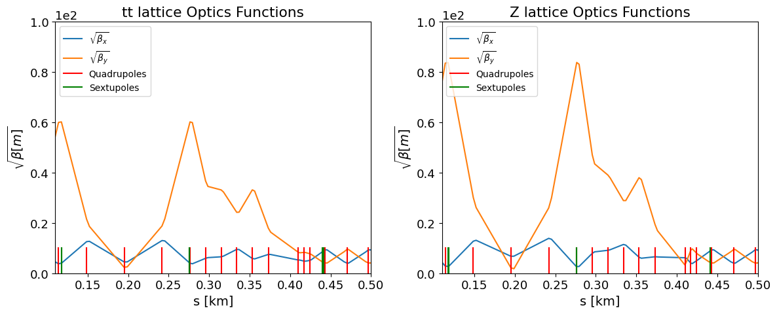
10
IR
Notes:
Ttbar, 4IP lattice. These are the main results.
%$\epsilon_{x, \textrm{median}} = 1.509$ nm rad \\
%$\epsilon_{y, \textrm{median}} = 0.353$ pm rad \\
$\frac{\epsilon_{y}}{\epsilon_{x}} = 0.023$ $\%$ \\
\begin{table}[htb!]
\centering
\begin{tabular}{p{3cm}cccccc}
\hline
Type & $\Delta$X & $\Delta$Y & $\Delta$PSI & $\Delta$S & $\Delta$THETA & $\Delta$PHI \\
& ($\mu$m) & ($\mu$m) & ($\mu$rad) & ($\mu$m) & ($\mu$rad) & ($\mu$rad) \\
\vspace{.1cm} \\
\hline
Arc quadrupole* & 100 & 50 & 300 & 150 & 70 & 70 \\
Arc sextupoles* & 100 & 50 & 300 & 150 & 70 & 70 \\
\hline
Dipoles & 1000 & 1000 & 300 & 1000 & 0 & 0 \\
\hline
Girders & 200 & 200 & - & 1000 & 0 & 0 \\
\hline
IR quadrupole & 100 & 100 & 250 & 200 & 70 & 70 \\
IR sextupoles & 100 & 100 & 250 & 200 & 70 & 70 \\
%\hline
% BPM** & 40 & 40 & 100 & - \\
\hline
\end{tabular}
\end{table}

Slide 11
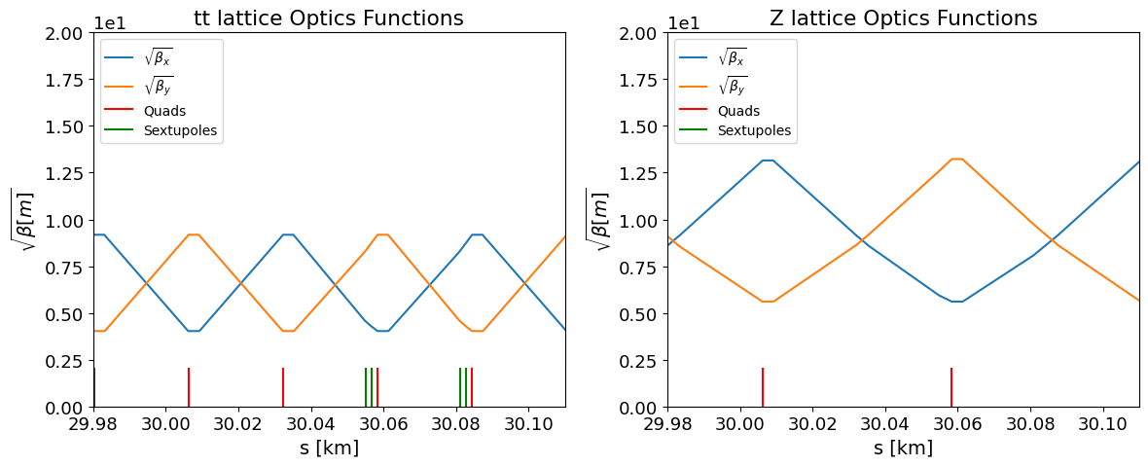
11
Arc region
Notes:
Ttbar, 4IP lattice. These are the main results.
%$\epsilon_{x, \textrm{median}} = 1.509$ nm rad \\
%$\epsilon_{y, \textrm{median}} = 0.353$ pm rad \\
$\frac{\epsilon_{y}}{\epsilon_{x}} = 0.023$ $\%$ \\
\begin{table}[htb!]
\centering
\begin{tabular}{p{3cm}cccccc}
\hline
Type & $\Delta$X & $\Delta$Y & $\Delta$PSI & $\Delta$S & $\Delta$THETA & $\Delta$PHI \\
& ($\mu$m) & ($\mu$m) & ($\mu$rad) & ($\mu$m) & ($\mu$rad) & ($\mu$rad) \\
\vspace{.1cm} \\
\hline
Arc quadrupole* & 100 & 50 & 300 & 150 & 70 & 70 \\
Arc sextupoles* & 100 & 50 & 300 & 150 & 70 & 70 \\
\hline
Dipoles & 1000 & 1000 & 300 & 1000 & 0 & 0 \\
\hline
Girders & 200 & 200 & - & 1000 & 0 & 0 \\
\hline
IR quadrupole & 100 & 100 & 250 & 200 & 70 & 70 \\
IR sextupoles & 100 & 100 & 250 & 200 & 70 & 70 \\
%\hline
% BPM** & 40 & 40 & 100 & - \\
\hline
\end{tabular}
\end{table}

Slide 12
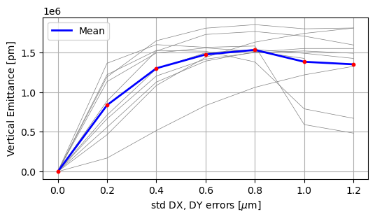
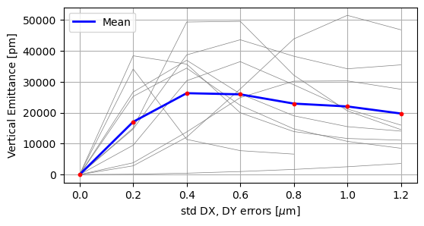
12
Change of optics with alignment errors (tt bar vs. z)
DX, DY misalignment errors assigned to all quadrupoles, sextupoles and dipoles.
tt bar
Z
Notes:
Ttbar, 4IP lattice. These are the main results.
%$\epsilon_{x, \textrm{median}} = 1.509$ nm rad \\
%$\epsilon_{y, \textrm{median}} = 0.353$ pm rad \\
$\frac{\epsilon_{y}}{\epsilon_{x}} = 0.023$ $\%$ \\
\begin{table}[htb!]
\centering
\begin{tabular}{p{3cm}cccccc}
\hline
Type & $\Delta$X & $\Delta$Y & $\Delta$PSI & $\Delta$S & $\Delta$THETA & $\Delta$PHI \\
& ($\mu$m) & ($\mu$m) & ($\mu$rad) & ($\mu$m) & ($\mu$rad) & ($\mu$rad) \\
\vspace{.1cm} \\
\hline
Arc quadrupole* & 100 & 50 & 300 & 150 & 70 & 70 \\
Arc sextupoles* & 100 & 50 & 300 & 150 & 70 & 70 \\
\hline
Dipoles & 1000 & 1000 & 300 & 1000 & 0 & 0 \\
\hline
Girders & 200 & 200 & - & 1000 & 0 & 0 \\
\hline
IR quadrupole & 100 & 100 & 250 & 200 & 70 & 70 \\
IR sextupoles & 100 & 100 & 250 & 200 & 70 & 70 \\
%\hline
% BPM** & 40 & 40 & 100 & - \\
\hline
\end{tabular}
\end{table}

Slide 13
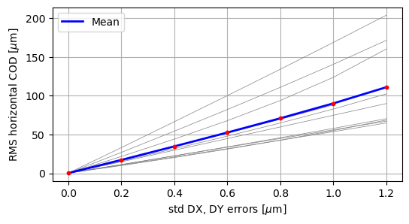
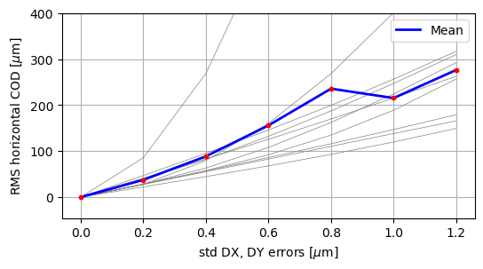
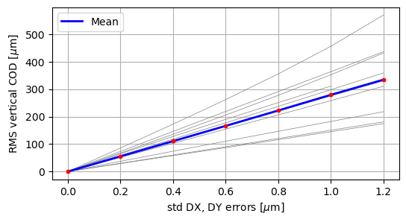
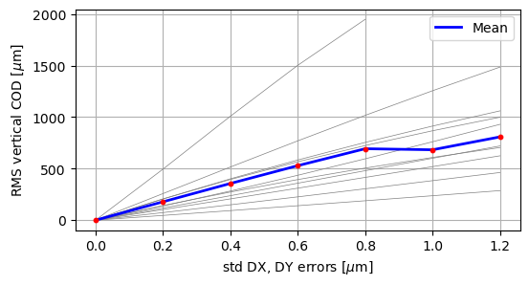
13
tt bar
Z
Notes:
Ttbar, 4IP lattice. These are the main results.
%$\epsilon_{x, \textrm{median}} = 1.509$ nm rad \\
%$\epsilon_{y, \textrm{median}} = 0.353$ pm rad \\
$\frac{\epsilon_{y}}{\epsilon_{x}} = 0.023$ $\%$ \\
\begin{table}[htb!]
\centering
\begin{tabular}{p{3cm}cccccc}
\hline
Type & $\Delta$X & $\Delta$Y & $\Delta$PSI & $\Delta$S & $\Delta$THETA & $\Delta$PHI \\
& ($\mu$m) & ($\mu$m) & ($\mu$rad) & ($\mu$m) & ($\mu$rad) & ($\mu$rad) \\
\vspace{.1cm} \\
\hline
Arc quadrupole* & 100 & 50 & 300 & 150 & 70 & 70 \\
Arc sextupoles* & 100 & 50 & 300 & 150 & 70 & 70 \\
\hline
Dipoles & 1000 & 1000 & 300 & 1000 & 0 & 0 \\
\hline
Girders & 200 & 200 & - & 1000 & 0 & 0 \\
\hline
IR quadrupole & 100 & 100 & 250 & 200 & 70 & 70 \\
IR sextupoles & 100 & 100 & 250 & 200 & 70 & 70 \\
%\hline
% BPM** & 40 & 40 & 100 & - \\
\hline
\end{tabular}
\end{table}

Slide 14
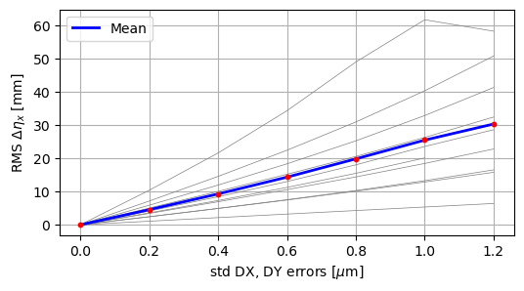
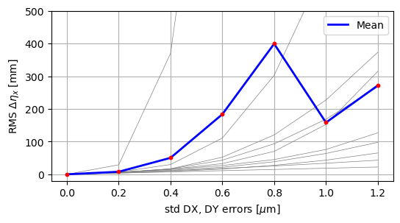
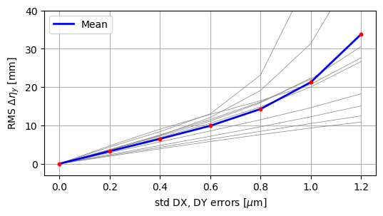
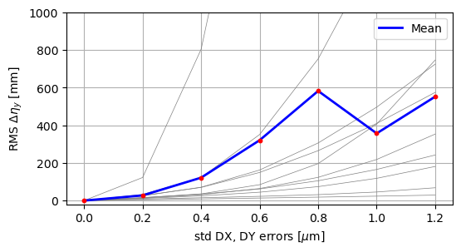
14
tt bar
Z
Notes:
Ttbar, 4IP lattice. These are the main results.
%$\epsilon_{x, \textrm{median}} = 1.509$ nm rad \\
%$\epsilon_{y, \textrm{median}} = 0.353$ pm rad \\
$\frac{\epsilon_{y}}{\epsilon_{x}} = 0.023$ $\%$ \\
\begin{table}[htb!]
\centering
\begin{tabular}{p{3cm}cccccc}
\hline
Type & $\Delta$X & $\Delta$Y & $\Delta$PSI & $\Delta$S & $\Delta$THETA & $\Delta$PHI \\
& ($\mu$m) & ($\mu$m) & ($\mu$rad) & ($\mu$m) & ($\mu$rad) & ($\mu$rad) \\
\vspace{.1cm} \\
\hline
Arc quadrupole* & 100 & 50 & 300 & 150 & 70 & 70 \\
Arc sextupoles* & 100 & 50 & 300 & 150 & 70 & 70 \\
\hline
Dipoles & 1000 & 1000 & 300 & 1000 & 0 & 0 \\
\hline
Girders & 200 & 200 & - & 1000 & 0 & 0 \\
\hline
IR quadrupole & 100 & 100 & 250 & 200 & 70 & 70 \\
IR sextupoles & 100 & 100 & 250 & 200 & 70 & 70 \\
%\hline
% BPM** & 40 & 40 & 100 & - \\
\hline
\end{tabular}
\end{table}

Slide 15
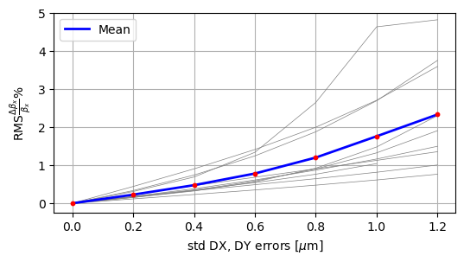
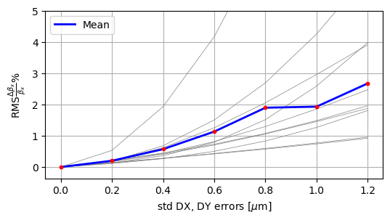
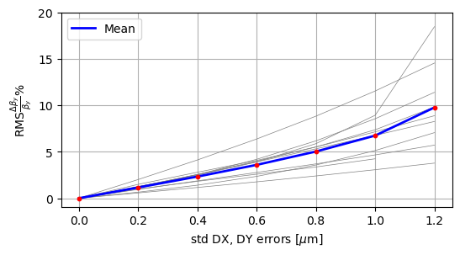
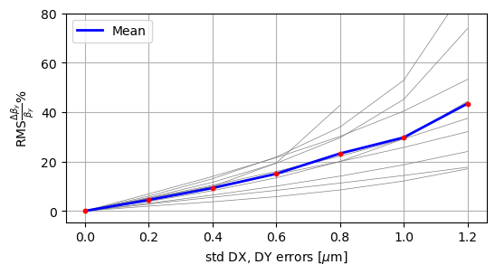
15
tt bar
Z
Notes:
Ttbar, 4IP lattice. These are the main results.
%$\epsilon_{x, \textrm{median}} = 1.509$ nm rad \\
%$\epsilon_{y, \textrm{median}} = 0.353$ pm rad \\
$\frac{\epsilon_{y}}{\epsilon_{x}} = 0.023$ $\%$ \\
\begin{table}[htb!]
\centering
\begin{tabular}{p{3cm}cccccc}
\hline
Type & $\Delta$X & $\Delta$Y & $\Delta$PSI & $\Delta$S & $\Delta$THETA & $\Delta$PHI \\
& ($\mu$m) & ($\mu$m) & ($\mu$rad) & ($\mu$m) & ($\mu$rad) & ($\mu$rad) \\
\vspace{.1cm} \\
\hline
Arc quadrupole* & 100 & 50 & 300 & 150 & 70 & 70 \\
Arc sextupoles* & 100 & 50 & 300 & 150 & 70 & 70 \\
\hline
Dipoles & 1000 & 1000 & 300 & 1000 & 0 & 0 \\
\hline
Girders & 200 & 200 & - & 1000 & 0 & 0 \\
\hline
IR quadrupole & 100 & 100 & 250 & 200 & 70 & 70 \\
IR sextupoles & 100 & 100 & 250 & 200 & 70 & 70 \\
%\hline
% BPM** & 40 & 40 & 100 & - \\
\hline
\end{tabular}
\end{table}

Slide 16
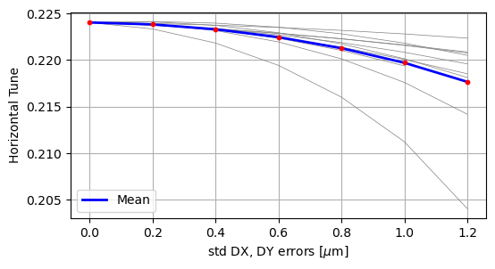
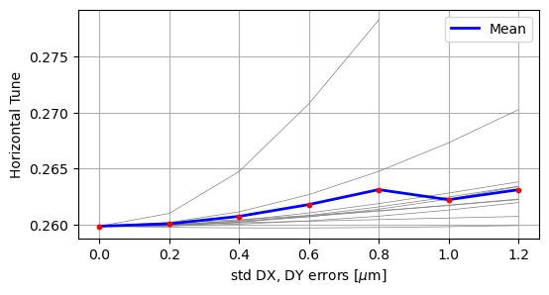
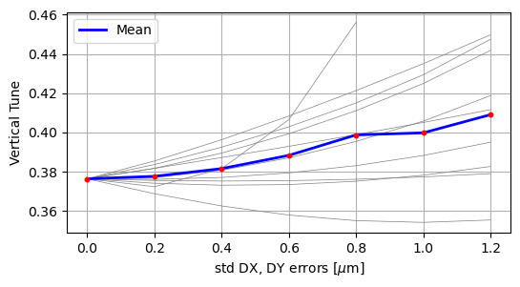
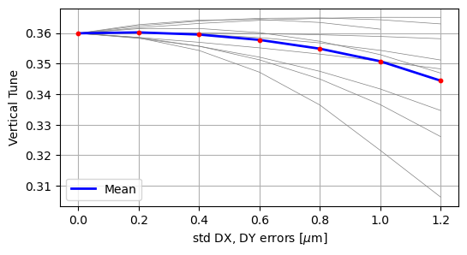
16
tt bar
Z
Notes:
Ttbar, 4IP lattice. These are the main results.
%$\epsilon_{x, \textrm{median}} = 1.509$ nm rad \\
%$\epsilon_{y, \textrm{median}} = 0.353$ pm rad \\
$\frac{\epsilon_{y}}{\epsilon_{x}} = 0.023$ $\%$ \\
\begin{table}[htb!]
\centering
\begin{tabular}{p{3cm}cccccc}
\hline
Type & $\Delta$X & $\Delta$Y & $\Delta$PSI & $\Delta$S & $\Delta$THETA & $\Delta$PHI \\
& ($\mu$m) & ($\mu$m) & ($\mu$rad) & ($\mu$m) & ($\mu$rad) & ($\mu$rad) \\
\vspace{.1cm} \\
\hline
Arc quadrupole* & 100 & 50 & 300 & 150 & 70 & 70 \\
Arc sextupoles* & 100 & 50 & 300 & 150 & 70 & 70 \\
\hline
Dipoles & 1000 & 1000 & 300 & 1000 & 0 & 0 \\
\hline
Girders & 200 & 200 & - & 1000 & 0 & 0 \\
\hline
IR quadrupole & 100 & 100 & 250 & 200 & 70 & 70 \\
IR sextupoles & 100 & 100 & 250 & 200 & 70 & 70 \\
%\hline
% BPM** & 40 & 40 & 100 & - \\
\hline
\end{tabular}
\end{table}

Slide 17
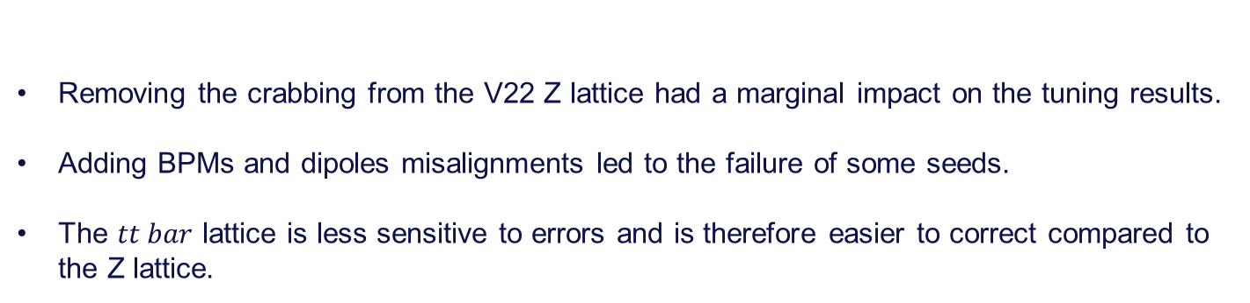
17
Summary
Removing the crabbing from the V22 Z lattice had a marginal impact on the tuning results.
Adding BPMs and dipoles misalignments led to the failure of some seeds.
The $tt bar$ lattice is less sensitive to errors and is therefore easier to correct compared to the Z lattice.
Notes:
Ttbar, 4IP lattice. These are the main results.
%$\epsilon_{x, \textrm{median}} = 1.509$ nm rad \\
%$\epsilon_{y, \textrm{median}} = 0.353$ pm rad \\
$\frac{\epsilon_{y}}{\epsilon_{x}} = 0.023$ $\%$ \\
\begin{table}[htb!]
\centering
\begin{tabular}{p{3cm}cccccc}
\hline
Type & $\Delta$X & $\Delta$Y & $\Delta$PSI & $\Delta$S & $\Delta$THETA & $\Delta$PHI \\
& ($\mu$m) & ($\mu$m) & ($\mu$rad) & ($\mu$m) & ($\mu$rad) & ($\mu$rad) \\
\vspace{.1cm} \\
\hline
Arc quadrupole* & 100 & 50 & 300 & 150 & 70 & 70 \\
Arc sextupoles* & 100 & 50 & 300 & 150 & 70 & 70 \\
\hline
Dipoles & 1000 & 1000 & 300 & 1000 & 0 & 0 \\
\hline
Girders & 200 & 200 & - & 1000 & 0 & 0 \\
\hline
IR quadrupole & 100 & 100 & 250 & 200 & 70 & 70 \\
IR sextupoles & 100 & 100 & 250 & 200 & 70 & 70 \\
%\hline
% BPM** & 40 & 40 & 100 & - \\
\hline
\end{tabular}
\end{table}

Slide 18
Thank you for your attention

Slide 19
Backups

Slide 20
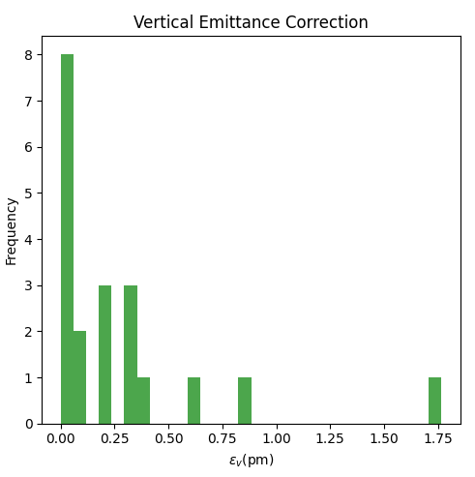
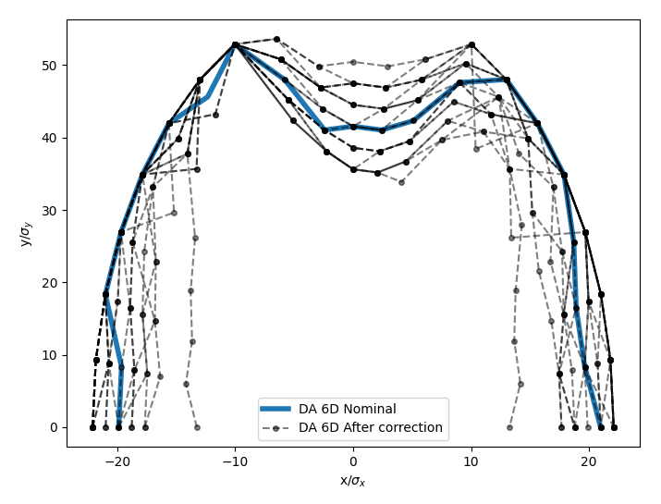
20
After correction of alignment errors :
Elements | Hor. & Ver. displacement
Arc quads and sext | 100 μm
All dipoles | 150 μm
20 seeds
median εy = 0.159 pm
Notes:
Ttbar, 4IP lattice. These are the main results.
%$\epsilon_{x, \textrm{median}} = 1.509$ nm rad \\
%$\epsilon_{y, \textrm{median}} = 0.353$ pm rad \\
$\frac{\epsilon_{y}}{\epsilon_{x}} = 0.023$ $\%$ \\
\begin{table}[htb!]
\centering
\begin{tabular}{p{3cm}cccccc}
\hline
Type & $\Delta$X & $\Delta$Y & $\Delta$PSI & $\Delta$S & $\Delta$THETA & $\Delta$PHI \\
& ($\mu$m) & ($\mu$m) & ($\mu$rad) & ($\mu$m) & ($\mu$rad) & ($\mu$rad) \\
\vspace{.1cm} \\
\hline
Arc quadrupole* & 100 & 50 & 300 & 150 & 70 & 70 \\
Arc sextupoles* & 100 & 50 & 300 & 150 & 70 & 70 \\
\hline
Dipoles & 1000 & 1000 & 300 & 1000 & 0 & 0 \\
\hline
Girders & 200 & 200 & - & 1000 & 0 & 0 \\
\hline
IR quadrupole & 100 & 100 & 250 & 200 & 70 & 70 \\
IR sextupoles & 100 & 100 & 250 & 200 & 70 & 70 \\
%\hline
% BPM** & 40 & 40 & 100 & - \\
\hline
\end{tabular}
\end{table}

Slide 21
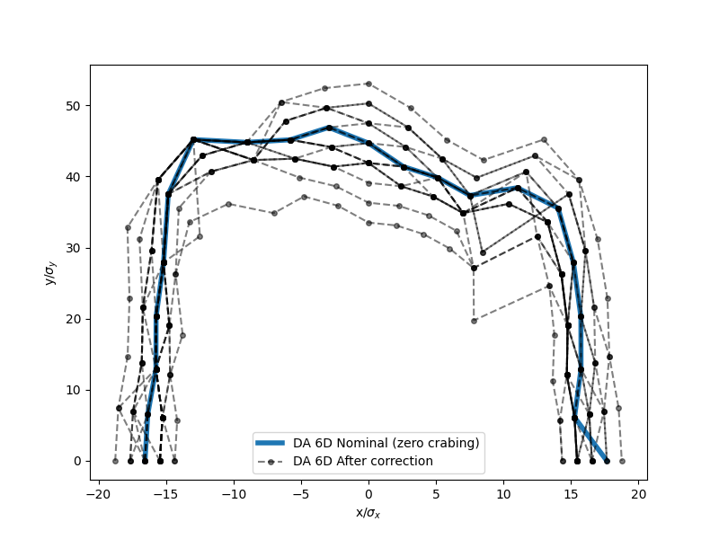
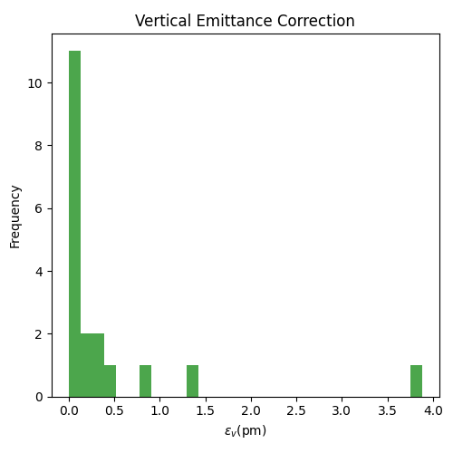
21
Elements | Hor. & Ver. displacement
Arc quads and sext | 100 μm
All dipoles | 150 μm
After correction of alignment errors
Zero crabing
20 seeds/ 1 failed seed
median εy = 0.10 pm
Notes:
Ttbar, 4IP lattice. These are the main results.
%$\epsilon_{x, \textrm{median}} = 1.509$ nm rad \\
%$\epsilon_{y, \textrm{median}} = 0.353$ pm rad \\
$\frac{\epsilon_{y}}{\epsilon_{x}} = 0.023$ $\%$ \\
\begin{table}[htb!]
\centering
\begin{tabular}{p{3cm}cccccc}
\hline
Type & $\Delta$X & $\Delta$Y & $\Delta$PSI & $\Delta$S & $\Delta$THETA & $\Delta$PHI \\
& ($\mu$m) & ($\mu$m) & ($\mu$rad) & ($\mu$m) & ($\mu$rad) & ($\mu$rad) \\
\vspace{.1cm} \\
\hline
Arc quadrupole* & 100 & 50 & 300 & 150 & 70 & 70 \\
Arc sextupoles* & 100 & 50 & 300 & 150 & 70 & 70 \\
\hline
Dipoles & 1000 & 1000 & 300 & 1000 & 0 & 0 \\
\hline
Girders & 200 & 200 & - & 1000 & 0 & 0 \\
\hline
IR quadrupole & 100 & 100 & 250 & 200 & 70 & 70 \\
IR sextupoles & 100 & 100 & 250 & 200 & 70 & 70 \\
%\hline
% BPM** & 40 & 40 & 100 & - \\
\hline
\end{tabular}
\end{table}

Slide 22
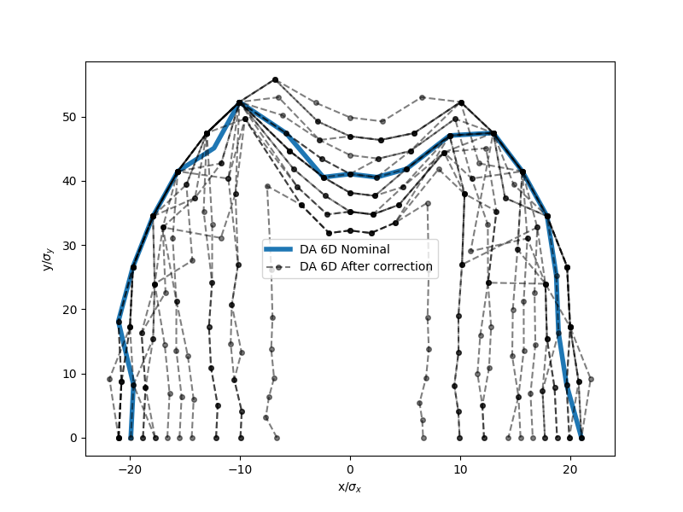
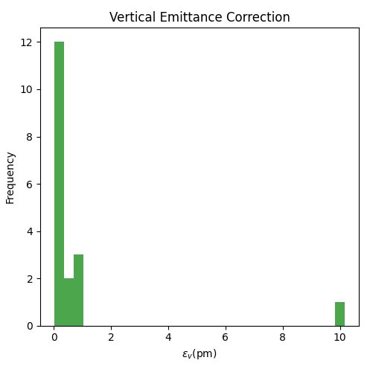
22
Elements | Hor. & Ver. displacement
Arc quads and sext | 100 μm
All dipoles | 150 μm
BPMs | Same as sext.
After correction of alignment errors
BPM aligned to sextupoles
20 seeds/ 2 failed seed
median εy = 0.81 pm
Notes:
Ttbar, 4IP lattice. These are the main results.
%$\epsilon_{x, \textrm{median}} = 1.509$ nm rad \\
%$\epsilon_{y, \textrm{median}} = 0.353$ pm rad \\
$\frac{\epsilon_{y}}{\epsilon_{x}} = 0.023$ $\%$ \\
\begin{table}[htb!]
\centering
\begin{tabular}{p{3cm}cccccc}
\hline
Type & $\Delta$X & $\Delta$Y & $\Delta$PSI & $\Delta$S & $\Delta$THETA & $\Delta$PHI \\
& ($\mu$m) & ($\mu$m) & ($\mu$rad) & ($\mu$m) & ($\mu$rad) & ($\mu$rad) \\
\vspace{.1cm} \\
\hline
Arc quadrupole* & 100 & 50 & 300 & 150 & 70 & 70 \\
Arc sextupoles* & 100 & 50 & 300 & 150 & 70 & 70 \\
\hline
Dipoles & 1000 & 1000 & 300 & 1000 & 0 & 0 \\
\hline
Girders & 200 & 200 & - & 1000 & 0 & 0 \\
\hline
IR quadrupole & 100 & 100 & 250 & 200 & 70 & 70 \\
IR sextupoles & 100 & 100 & 250 & 200 & 70 & 70 \\
%\hline
% BPM** & 40 & 40 & 100 & - \\
\hline
\end{tabular}
\end{table}

Slide 23
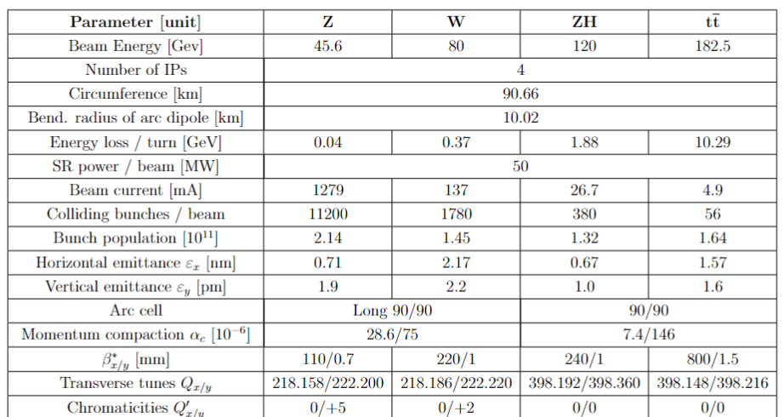
23
Z and ttbar parameters
Number of Elements | z | Tt bar
IR quads | 436 | 488
IR sext | 64 | 96
Arc quads | 1856 | 3324
Arc sext. | 632 | 2368
Dipoles | 3056 | 3056
Notes:
Ttbar, 4IP lattice. These are the main results.
%$\epsilon_{x, \textrm{median}} = 1.509$ nm rad \\
%$\epsilon_{y, \textrm{median}} = 0.353$ pm rad \\
$\frac{\epsilon_{y}}{\epsilon_{x}} = 0.023$ $\%$ \\
\begin{table}[htb!]
\centering
\begin{tabular}{p{3cm}cccccc}
\hline
Type & $\Delta$X & $\Delta$Y & $\Delta$PSI & $\Delta$S & $\Delta$THETA & $\Delta$PHI \\
& ($\mu$m) & ($\mu$m) & ($\mu$rad) & ($\mu$m) & ($\mu$rad) & ($\mu$rad) \\
\vspace{.1cm} \\
\hline
Arc quadrupole* & 100 & 50 & 300 & 150 & 70 & 70 \\
Arc sextupoles* & 100 & 50 & 300 & 150 & 70 & 70 \\
\hline
Dipoles & 1000 & 1000 & 300 & 1000 & 0 & 0 \\
\hline
Girders & 200 & 200 & - & 1000 & 0 & 0 \\
\hline
IR quadrupole & 100 & 100 & 250 & 200 & 70 & 70 \\
IR sextupoles & 100 & 100 & 250 & 200 & 70 & 70 \\
%\hline
% BPM** & 40 & 40 & 100 & - \\
\hline
\end{tabular}
\end{table}

