Slide 1
DA with beam-beam and imperfections
Leon van Riesen-Haupt, Peter Kicsiny, Yi Wu, Xavier Buffat, Tatiana Pieloni, Rogelio Tomas

Slide 2
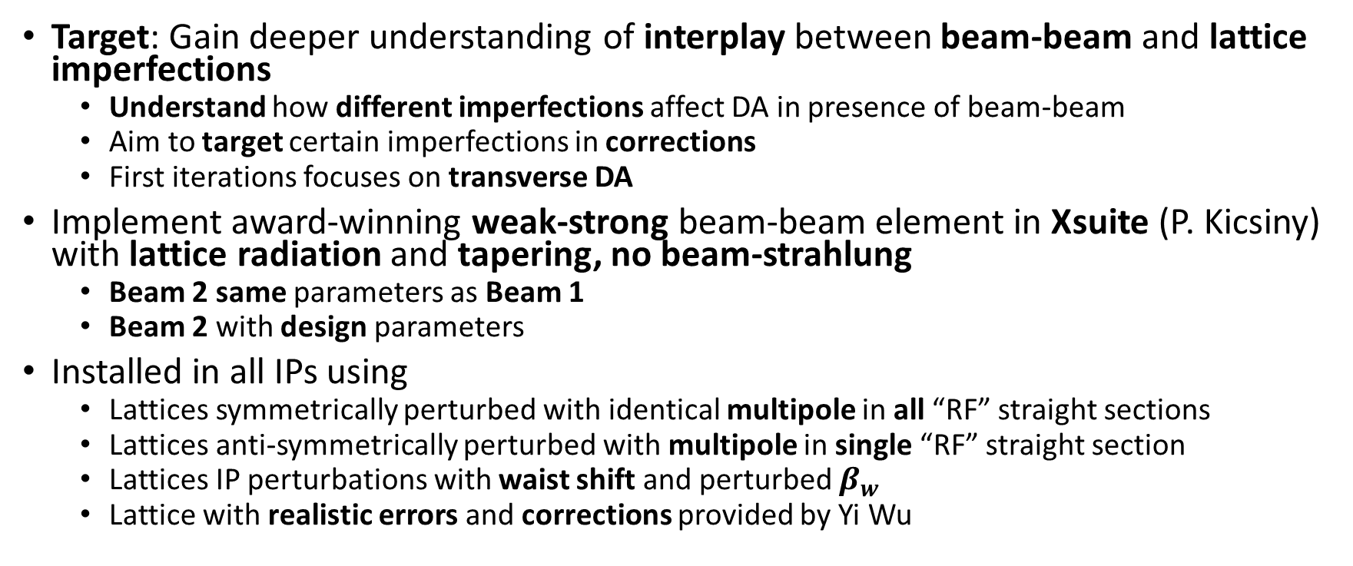
Introduction
Target: Gain deeper understanding of interplay between beam-beam and lattice imperfections
  Understand how different imperfections affect DA in presence of beam-beam
  Aim to target certain imperfections in corrections
  First iterations focuses on transverse DA
Implement award-winning weak-strong beam-beam element in Xsuite (P. Kicsiny) with lattice radiation and tapering, no beam-strahlung
  Beam 2 same parameters as Beam 1
  Beam 2 with design parameters
Installed in all IPs using
  Lattices symmetrically perturbed with identical multipole in all “RF” straight sections
  Lattices anti-symmetrically perturbed with multipole in single “RF” straight section
  Lattices IP perturbations with waist shift and perturbed $β_{w}$
  Lattice with realistic errors and corrections provided by Yi Wu

Slide 3
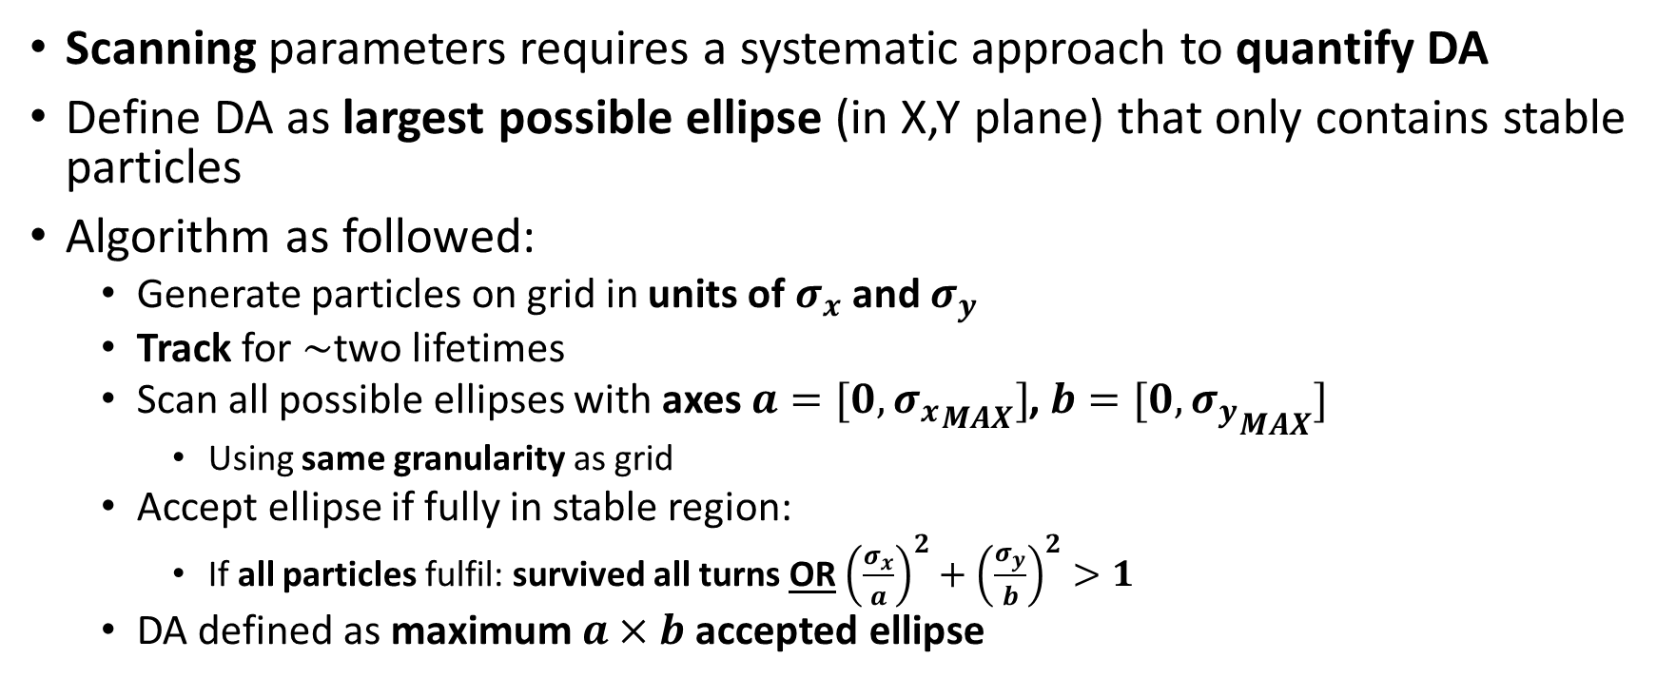
Dynamic Aperture: Largest Ellipse
Scanning parameters requires a systematic approach to quantify DA
Define DA as largest possible ellipse (in X,Y plane) that only contains stable particles
Algorithm as followed:
  Generate particles on grid in units of $σ_{x}$and $σ_{y}$
  Track for $\sim$two lifetimes
  Scan all possible ellipses with axes $a=[0,{σ_{x}}_{MAX}]$, $b=[0,{σ_{y}}_{MAX}]$
    Using same granularity as grid
  Accept ellipse if fully in stable region:
    If all particles fulfil: survived all turns OR ${\left(\frac{σ_{x}}{a}\right)}^{2}+{\left(\frac{σ_{y}}{b}\right)}^{2}>1$
  DA defined as maximum $a×b$ accepted ellipse

Slide 4
    survived all turns OR ${\left(\frac{σ_{x}}{a}\right)}^{2}+{\left(\frac{σ_{y}}{b}\right)}^{2}>1$

Slide 5


$$b$$
$$a$$
    survived all turns OR ${\left(\frac{σ_{x}}{a}\right)}^{2}+{\left(\frac{σ_{y}}{b}\right)}^{2}>1$

Slide 6
$$b$$
$$a$$
NEITHER survived all turns NOR outside ellipse
    survived all turns OR ${\left(\frac{σ_{x}}{a}\right)}^{2}+{\left(\frac{σ_{y}}{b}\right)}^{2}>1$

Slide 7
$$b$$
$$a$$
NEITHER survived all turns NOR outside ellipse
    survived all turns OR ${\left(\frac{σ_{x}}{a}\right)}^{2}+{\left(\frac{σ_{y}}{b}\right)}^{2}>1$

Slide 8
Distant Perturbation and Beam-Beam
Install multipole in “RF-insertions” of tt lattice
  Separate studies: In one insertion, in all insertions
Separately excite dipole, quadrupole, sextupole and octupole fields
  Gradually increase multipole strengths (arbitrary units)
  And their skew equivalents
Taper lattice and install beam-beam elements in Xsuite
  Separate studies: B2 same parameters as B1, B2 unperturbed
Initiate particles on grid and track for 200 turns (tt) and establish ellipse DA
Repeat without beam-beam

Slide 9
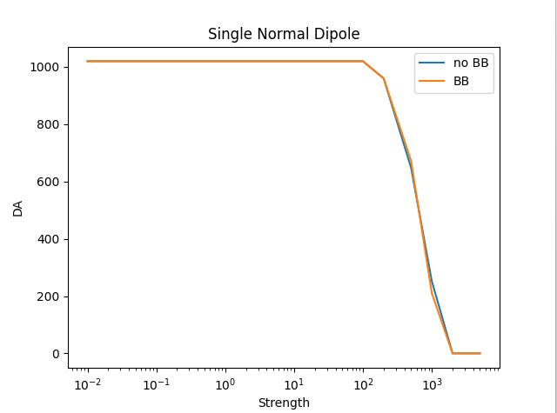
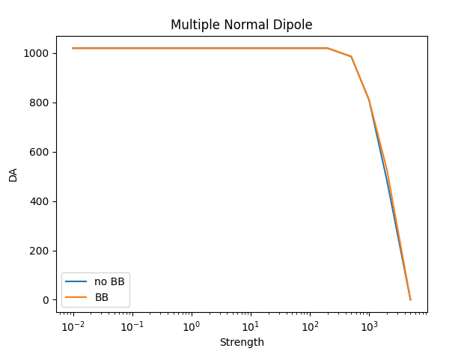
Dipole (Kicker)

Slide 10
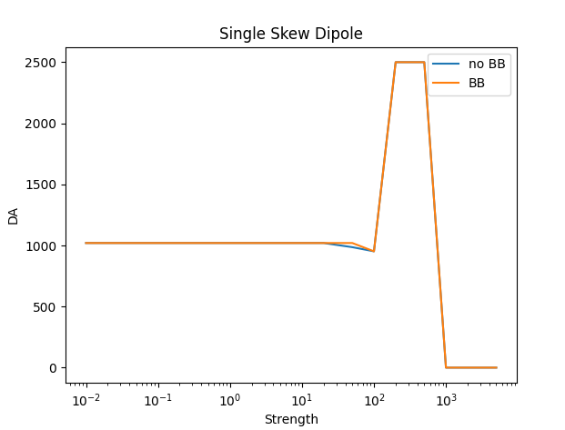
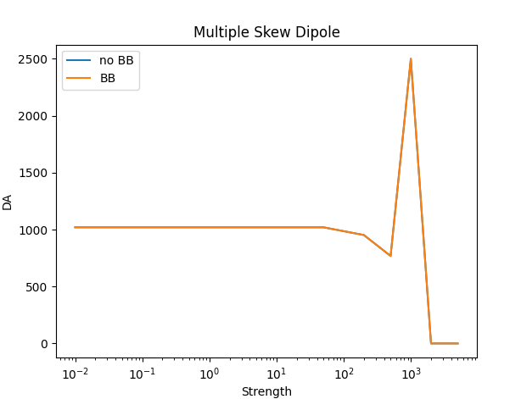
Skew Dipole (Kicker)

Slide 11
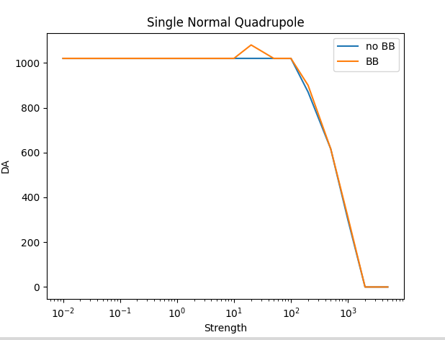
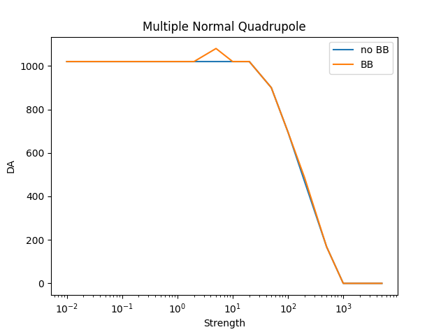
Quadrupole

Slide 12
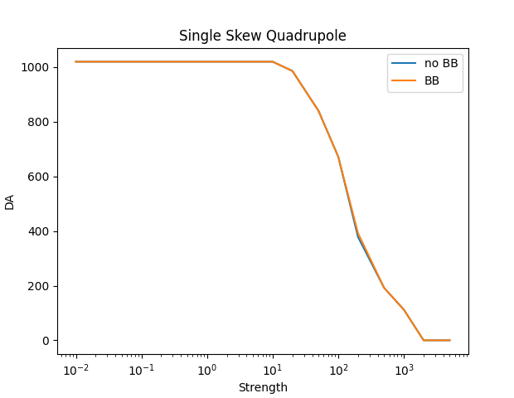
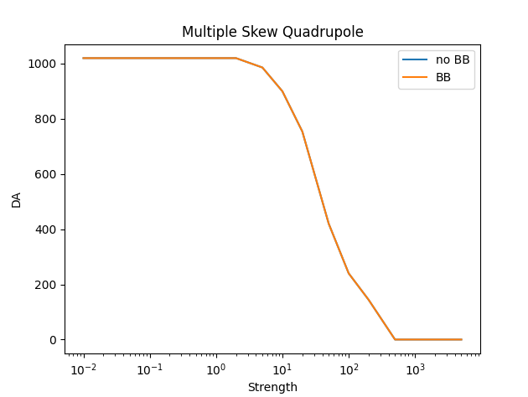
Skew Quadrupole

Slide 13
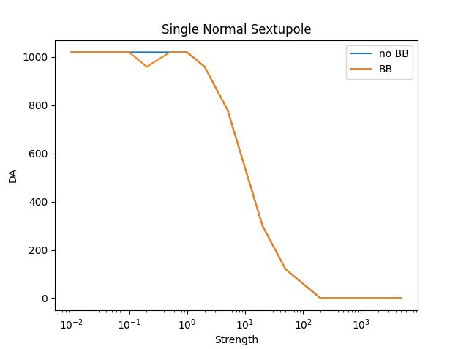
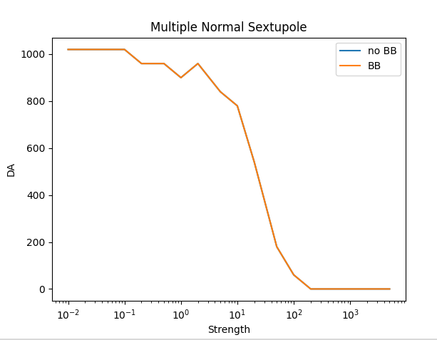
Sextupole

Slide 14
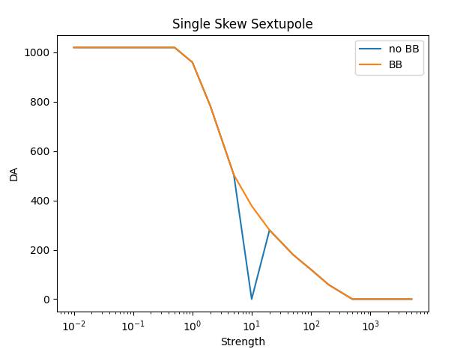
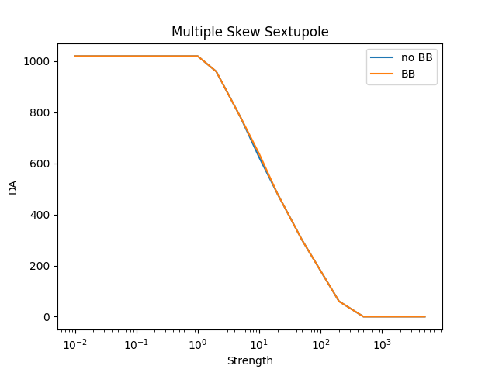
Skew Sextupole

Slide 15
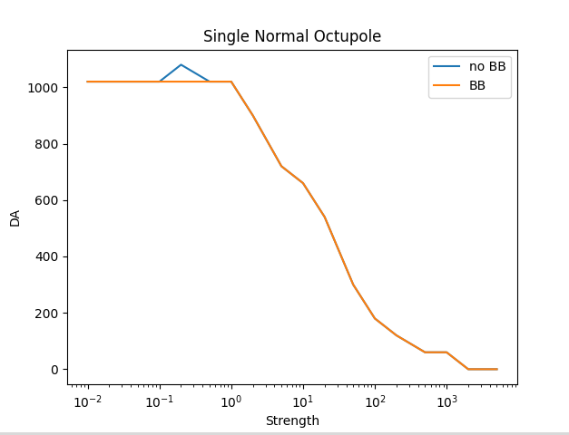
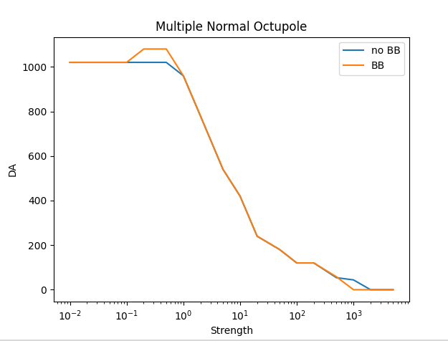
Octupole

Slide 16
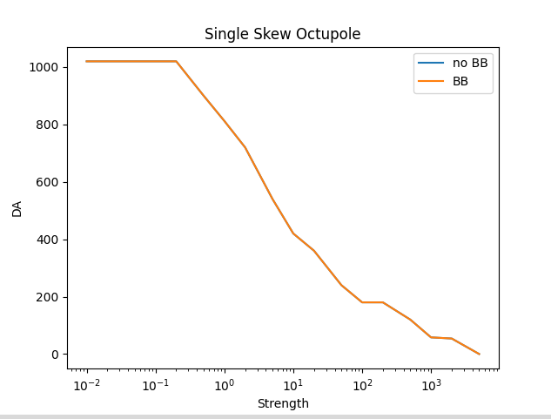
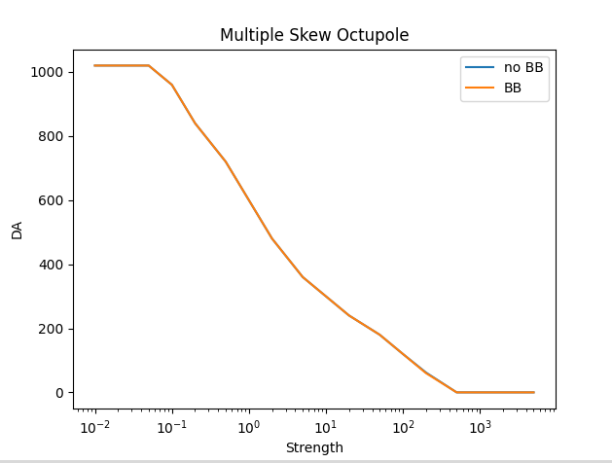
Skew Octupole

Slide 17
Discussion on Distant Perturbations
Multipole perturbations chosen to have a response in DA
  Sufficient steps in between full and zero DA
Beam-beam causes some small fluctuations but not significant
Future studies might include:
  Perturbations introduced to all arc magnets
    Misalignment and magnetic
  Introduction of single RDTs rather than simple multipoles
  Studies of longitudinal DA

Slide 18
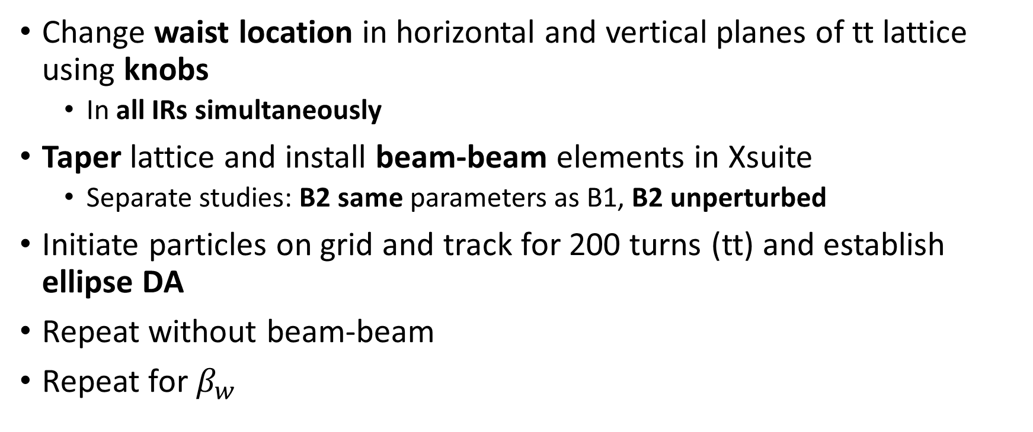
Lattice with IR Perturbations
Change waist location in horizontal and vertical planes of tt lattice using knobs
  In all IRs simultaneously
Taper lattice and install beam-beam elements in Xsuite
  Separate studies: B2 same parameters as B1, B2 unperturbed
Initiate particles on grid and track for 200 turns (tt) and establish ellipse DA
Repeat without beam-beam
Repeat for $β_{w}$

Slide 19
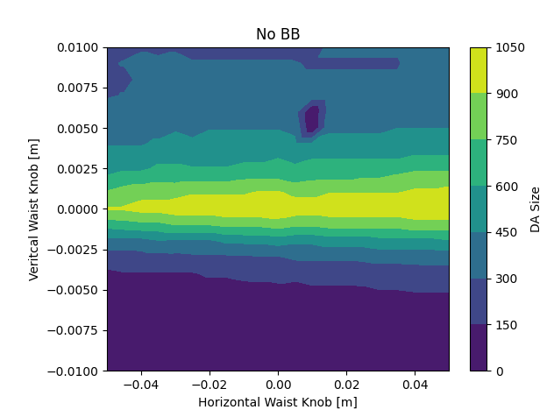
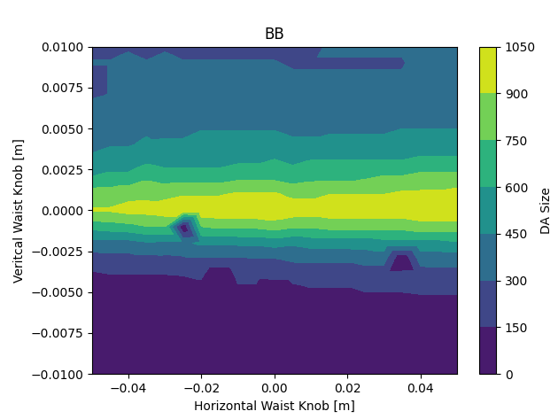
Waist Scan (B2 unperturbed)

Slide 20
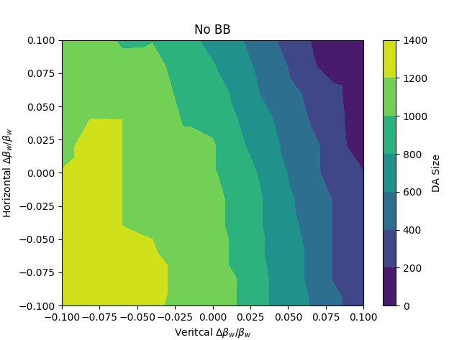

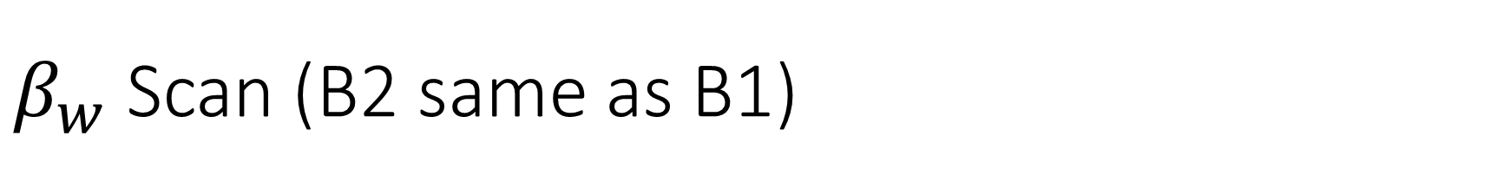
$β_{w}$ Scan (B2 same as B1)

Slide 21
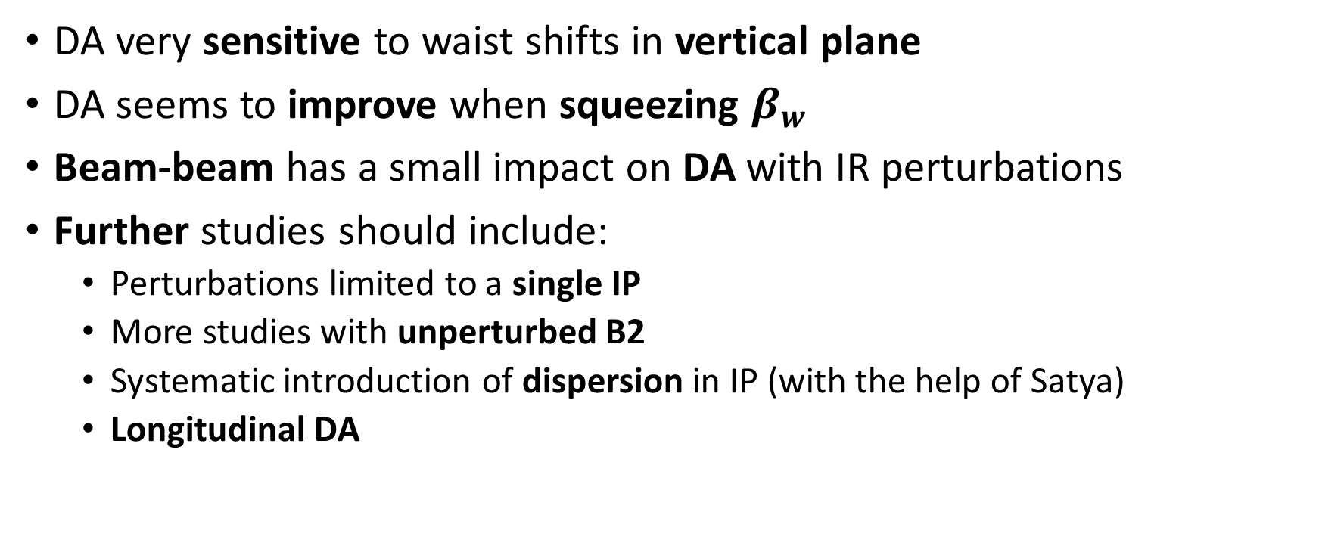
Discussion on IR Perturbations
DA very sensitive to waist shifts in vertical plane
DA seems to improve when squeezing $β_{w}$
Beam-beam has a small impact on DA with IR perturbations
Further studies should include:
  Perturbations limited to a single IP
  More studies with unperturbed B2
  Systematic introduction of dispersion in IP (with the help of Satya)
  Longitudinal DA

Slide 22
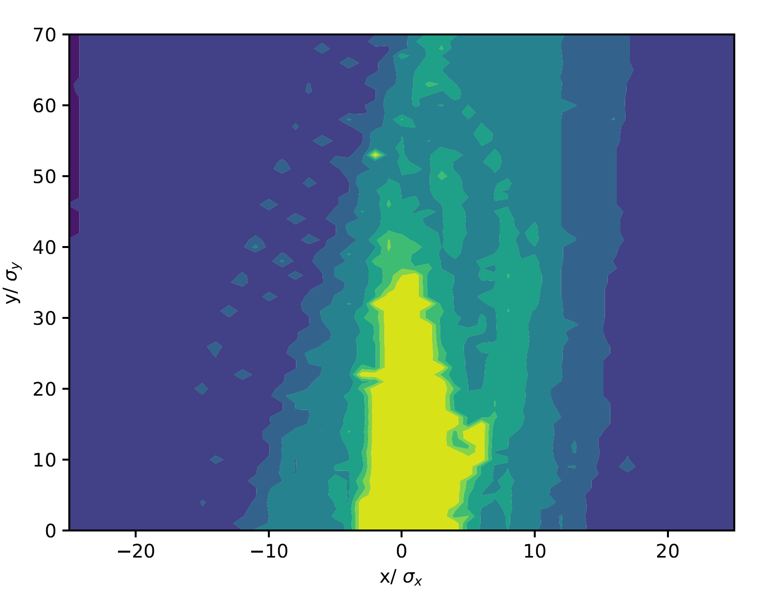
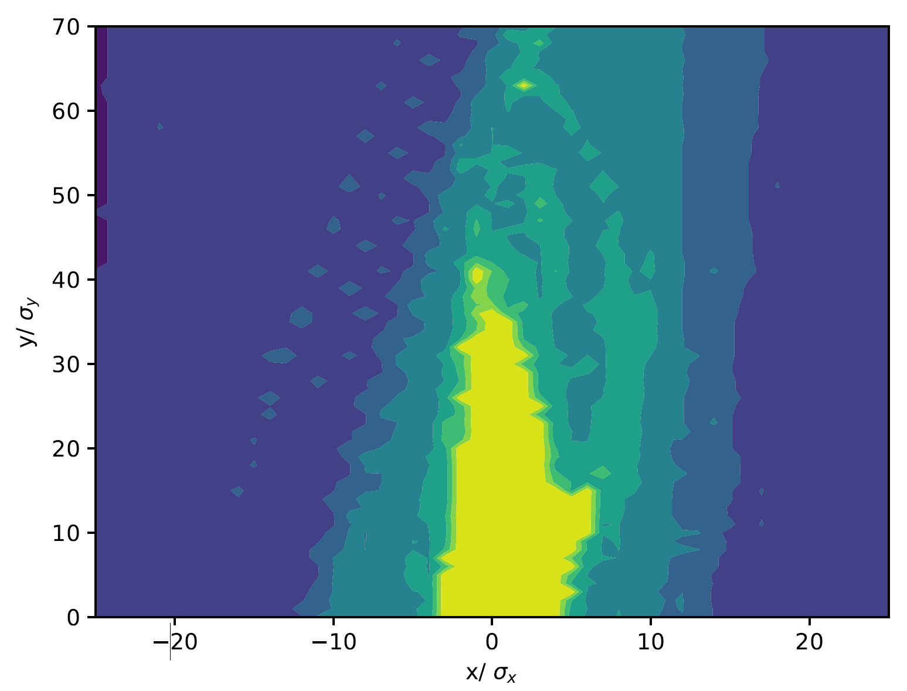
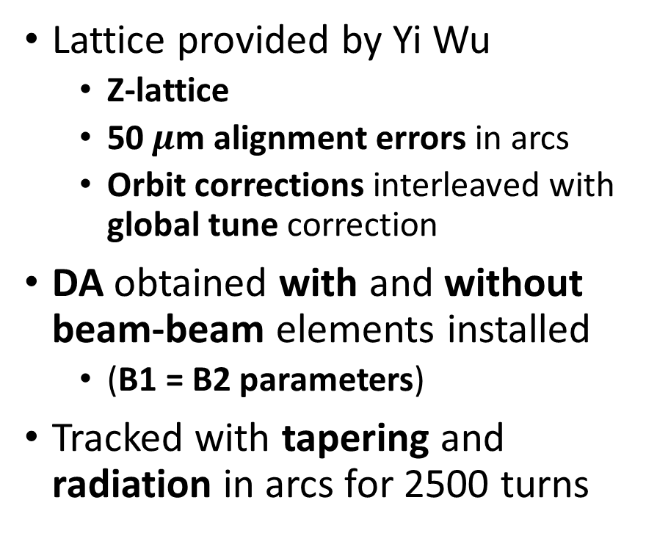
Realistic Errors and Correction
Without Beam-Beam
Lattice provided by Yi Wu
  Z-lattice
  50$μ$m alignment errors in arcs
  Orbit corrections interleaved with global tune correction
DA obtained with and without beam-beam elements installed
  (B1 = B2 parameters)
Tracked with tapering and radiation in arcs for 2500 turns
With Beam-Beam

Slide 23
Conclusions and Next Step
Beam-beam without beam strahlung seems to have a low impact on transverse DA with lattice perturbations for
  controlled multipole perturbation
  IP waist perturbations
  “realistic” lattices with errors and corrections
Next steps:
  Check footprint and FMA with errors and with and without beam-beam
  Explore DA with beam strahlung: quantum beam strahlung possible, require multiple simulations at each point and averaging
  Study of longitudinal acceptance with beam-beam

