Slide 1
1
Energy, luminosity, operation scenarios
Frank Zimmermann
FCC-hh Studies for the next European Strategy: kickoff meeting, 3 September 2024
Thanks to Michael Benedikt, Michelangelo Mangano, Ezio Todesco

Slide 2
Assumptions & possible parameter range
With present layout of the FCC, and after diligent optimization (by Massimo, Gustavo, and Thys), the following energies can be reached according to the dipole field:
Dipole field [T] | c.m. energy | Comment
12 | 72 | not far above peak field of HL-LHC Nb₃Sn quadrupoles
14 | 84 | Nb₃Sn or HTS
17 | 102 | HTS
20 | 120 | HTS
Increasing the c.m. energy beyond ~100 TeV, we will assume that the synchrotron-radiation power could not increase, beyond a total of about 4 MW (which must be removed from inside the cold magnets)
On the other hand, when decreasing the beam energy, one can hold either the synchrotron-radiation power (increasing current up to HL-LHC values) or the beam current constant. Also, the pile-up might need to be limited, e.g. to ~1000 events/crossing. We thus consider three scenarios for 12 T (0.5 A and 1.12 A beam current, the latter without or with pile-up levelling).
Finally, further overall lowering the synchrotron radiation power, by reducing the number of bunches, in order to restrict the total power consumption of the future FCC-hh, would decrease peak and integrated luminosity by the same factor.

Slide 3
Six scenarios
A machine based on 12 T dipoles, with a beam current of 0.5 A as considered for the 16 T FCC-hh machine (F12LL).
A machine based on the same 12 T technology close to deployment, but with a higher beam current of 1.1 A, as considered for the HL-LHC (F12HL).
The same case as F12HL but limiting the pile up not to exceed a value of 1000 (F12PU).
A machine based on 14 T dipoles, and 0.5 A current (F14).
A machine based on High Temperature Superconductor (HTS) dipole magnets with a field of 17 T, just exceeding 100 TeV c.m., still with 0.5 A (F17).
A machine also based on High Temperature Superconductor (HTS) dipole magnets with a field of 20 T, and a beam current of 0.2 A, so that the synchrotron-radiation power is limited to about 2 MW / beam (F20).

Slide 4
Parameter | Unit | F12LL | F12HL | F12PU | F14 | F17 | F20 | (HL-)LHC
c.m. energy | TeV | 72 | 72 | 72 | 84 | 102 | 120 | 14
dipole field | T | 12 | 12 | 12 | 14 | 17 | 20 | 8.33
beam current | A | 0.5 | 1.12 | 1.12 | 0.5 | 0.5 | 0.2 | (1.12) 0.58
bunch popul. | 10¹¹ | 1.0 | 2.2 | 2.2 | 1.0 | 1.0 | 0.4 | (2.2) 1.15
bunches/beam |  | 9500 | 9500 | 9500 | 9500 | 9500 | 9500 | (2760) 2808
rf voltage | MV | 30 | 30 | 30 | 35 | 43 | 50 | (16) 16
longit. emit. | eVs | 6.9 | 6.9 | 6.9 | 8.1 | 9.7 | 11.4 | 2.5
norm. tr. emit. | μm | 2.5 | 2.5 | 2.5 | 2.5 | 2.5 | 2.5 | (2.5) 3.75
IP beta* | m | 0.22 | 0.22 | 0.65 | 0.26 | 0.31 | 0.37 | (0.15) 0.55
initial σ* | μm | 3.8 | 3.8 | 6.5 | 3.8 | 3.8 | 3.8 | (7.1 min) 16.7
initial L | nb⁻¹s⁻¹ | 175 | 845 | 286 | 172 | 209 | 39 | (50, lev’d) 10
initial pile up |  | 580 | 2820 | 955 | 590 | 732 | 141 | (135) 27
ΔE / turn | MeV | 1.3 | 1.3 | 1.3 | 2.4 | 5.3 | 10.1 | 0.0067
SR power/beam | kW | 650 | 1450 | 1450 | 1200 | 2670 | 2020 | (7.3) 3.6
tr.ε damp’g time | h | 0.68 | 0.68 | 0.68 | 0.43 | 0.24 | 0.15 | 25.8
init p-burnoff time | h | 5.1 | 2.3 | 6.9 | 5.1 | 4.0 | 8.4 | (15) 40
Key parameters

Slide 5
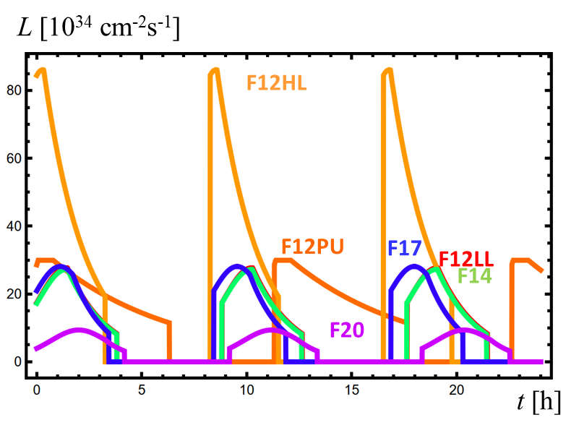
Luminosity over 24 h
Parameter | Unit | F12LL | F12HL | F12PU | F14 | F17 | F20 | (HL-)LHC
initial L | nb⁻¹s⁻¹ | 175 | 845 | 286 | 172 | 209 | 39 | (50, lev’d) 10
initial pile up |  | 580 | 2820 | 955 | 590 | 732 | 141 | (135) 27
opt. run time | h | 3.8 | 3.3 | 6.3 | 3.8 | 3.4 | 4.2 | (18-13) ~10

Slide 6
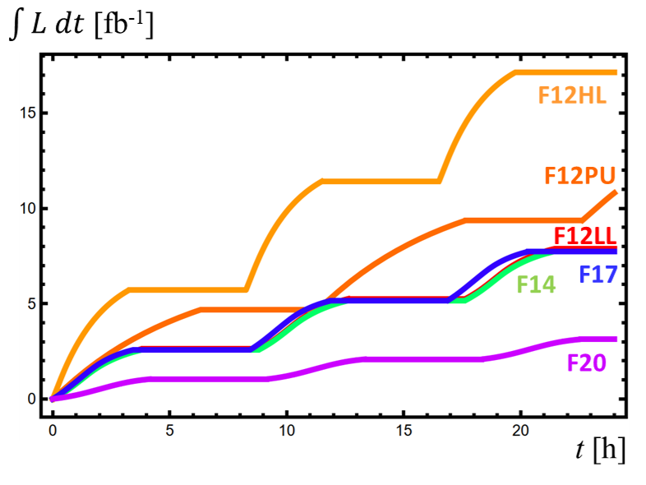
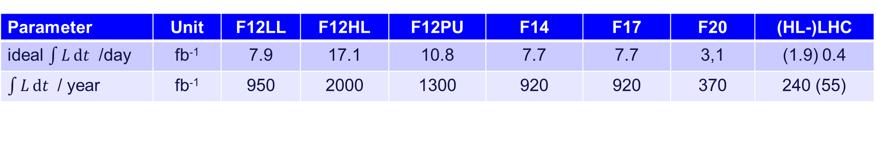
Ideal integrated luminosity per day
Parameter | Unit | F12LL | F12HL | F12PU | F14 | F17 | F20 | (HL-)LHC
ideal $\int{L}dt$ /day | fb⁻¹ | 7.9 | 17.1 | 10.8 | 7.7 | 7.7 | 3,1 | (1.9) 0.4
$\int{L}dt$ / year | fb⁻¹ | 950 | 2000 | 1300 | 920 | 920 | 370 | 240 (55)

