Slide 1
Signal formation in LGAD detectors
Initial Ionization process and Landau distribution in PiN diodes
(bare with me in this step, it is interesting)
Space charge effects during e/h drift
Gain quenching in LGAD
Temporal resolution in LGADs
Landau distribution in LGADs
A novel method to measure LGAD gains
N. Cartiglia
Laboratory Innovative Silicon Sensors
Torino

Slide 2
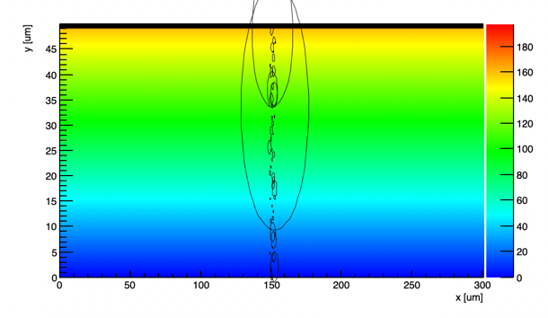
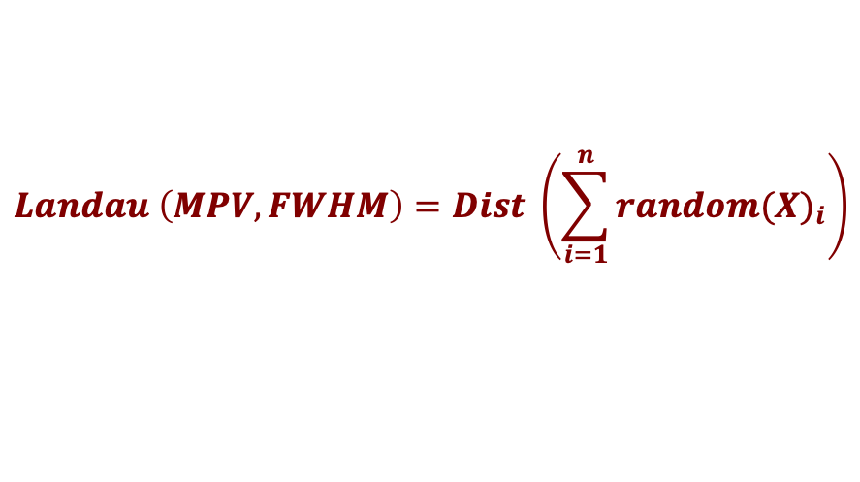
Landau distribution in PIN diodes
In each event, the impinging particle creates clusters of charges along its path.
These localized energy deposits follow some unknown “elemental distribution X”.
The sum of the energy deposits is the total energy deposition.
The total energy deposition follows a Landau distribution
The total deposition follows a
Landau distribution
Each local deposition follows an “elemental distribution X”
(to be determined)
?
$$Landau \left(MPV, FWHM\right)=Dist \left(\sum_{i=1}^{n}{{random(X)}_{i}}\right)$$
Question: which distribution X is such that the sum of random numbers from this distribution is a Landau?
n = number of draws
Suppose: n = thickness in micron

Slide 3
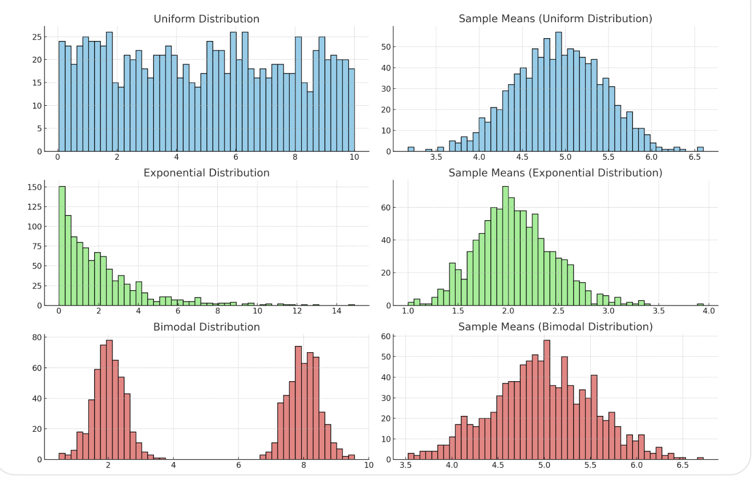
The central limit theorem does not apply
The sum (or average) of a large number of independent and identically distributed random variables, regardless of the original distribution of the data, as the sample size becomes large, will approach a normal (Gaussian) distribution,
provided that the variables have a finite mean and variance.
Since the resulting distribution is a Landau and not a Gaussian,
the elemental distribution X does not have finite mean and variance.

Slide 4
Stable distributions
For a special class of functions, stable distributions, the sums of random variables result in a distribution of the same type.
The Landau distribution is a stable distributions, therefore:
the sum of random numbers from a Landau distribution is also distributed as a Landau distribution.
Properties of the $Landau(MPV, FWHM)$ distribution obtained by drawing n random numbers from a ${Landau}_{o} ({MPV}_{o}, {FWHM}_{o})$
$$MPV={MPV}_{o}∗ln\left(n\right)$$
$$FWHM={FWHM}_{o}$$
The MPV increases proportionally to ln(n)
The FWHM remains constant
How does this compare with the measured results?

Slide 5
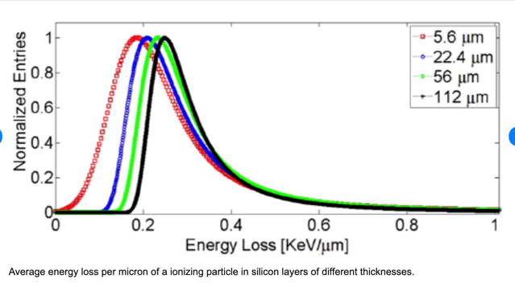
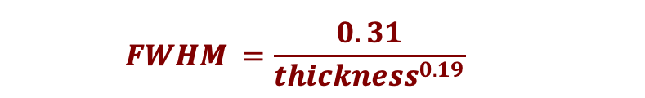
The measured Landau distribution in PiN diodes
Meroli S., Passeri D., Servoli. L. (2011). Energy loss measurement for charged particles in very thin silicon layers. JOURNAL OF INSTRUMENTATION, vol. 6 / 2011
The MPV scales logarithmically:
This is consistent with the elemental distribution X to be a Landau
$$MPV=0.027∗ln\left(thickness\right)+0.126)$$
The FWHM decreases with thickness:
$$FWHM =\frac{0.31}{{thickness}^{0.19}}$$
This is not consistent with the elemental distribution X to be a Landau.
==> Convolution of a Landau with a Gaussian of mean = 0.
The correct choice of the elemental distribution X is the convolution of a Landau with a Gaussian
(approx. of the Vavilov distribution)

Slide 6
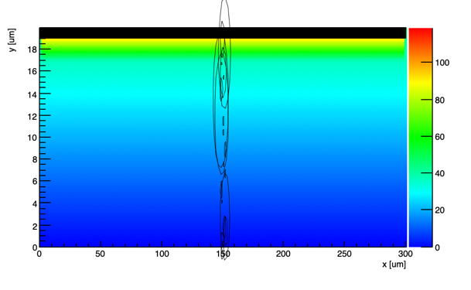
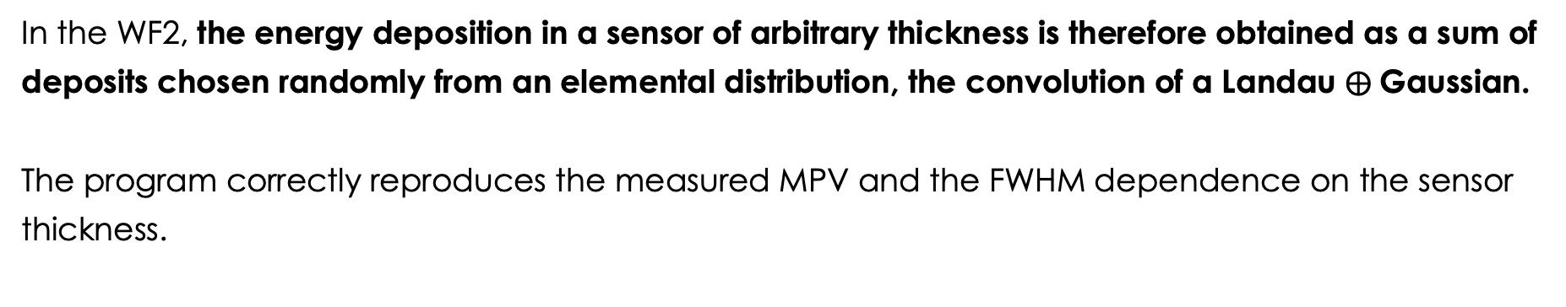

Starting point
In the WF2, the energy deposition in a sensor of arbitrary thickness is therefore obtained as a sum of deposits chosen randomly from an elemental distribution, the convolution of a Landau $⨁$Gaussian.
The program correctly reproduces the measured MPV and the FWHM dependence on the sensor thickness.
Local deposition follows a Landau$⨁$Gaussian distribution
The total deposition follows a
Landau distribution
WF2 program:
https://www.to.infn.it/~cartigli/Weightfield2/index.html
6

Slide 7
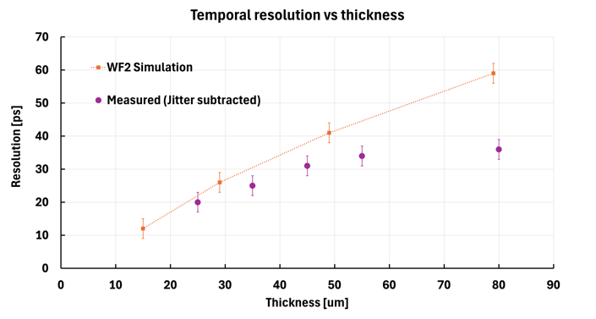
LGAD Temporal resolution vs sensor thickness
Let’s compare the measured temporal resolution of sensors of various thicknesses with the WF2 predictions
?
Problem: the predicted temporal resolution is much worse than the measured resolution.
This discrepancy increases with thickness.
The root of the problem: events in the high tail of the Landau distribution degrades the resolution.
This plot reports the resolution due to non-uniform charge deposition; jitter is subtracted.
The correct simulation of the initial Landau distribution leads to the wrong prediction of the temporal resolution
Data from: "Beam test results of 25 um and 35 um thick UFSD", F. Carnesecchi, S. Strazzi et al, Eur. Phys. J. Plus (2023) 138:99
"Optimization of the gain layer design of Ultra-Fast Silicon Detectors", F. Siviero et al, NIMA 1033 (2022) 166739

Slide 8
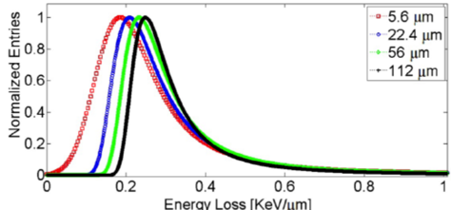
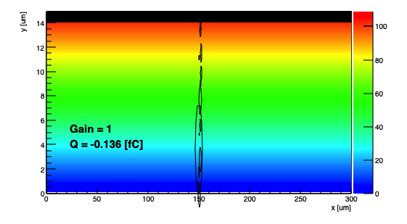
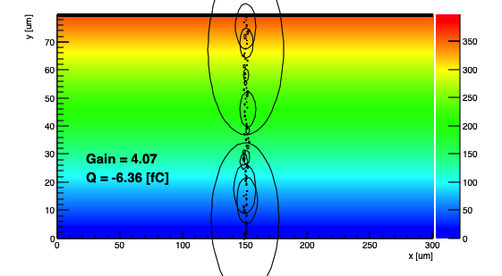
Landau distribution and temporal resolution
The temporal resolution is degraded if one energy deposit is much larger than the average.
Thick sensors have worse temporal resolution because it is more likely that at least one energy deposit is much larger.
The events in the Landau tail spoil the temporal resolution.
WF2 Simulated energy deposits
15-micron thick sensor
80-micron thick sensor
Large energy deposits are more likely in thicker sensors

Slide 9
What are we missing in the simulation?
Space charge effects
Gain saturation

Slide 10
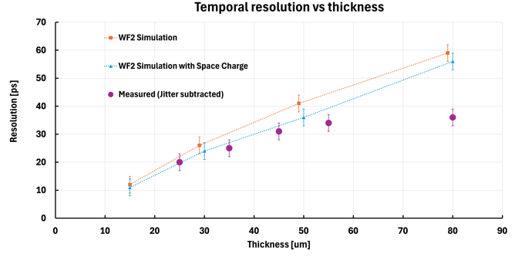
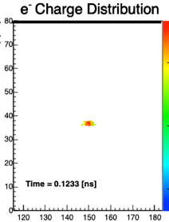
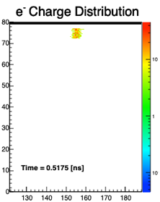
Space charge effects
During the e/h drift, the charge density decreases due to space charge effects
WF2 simulation of a charge cloud drifting toward the electrode
y [um]
y [um]
Electron drift
Longer distribution
x [um]
x [um]
With Space charge repulsion, the temporal resolution in WF2 is slightly closer to the measured resolution
Charge density decreases during drift, equalizing the current
(connected with the talk “Finding sharks..” M. Moll)

Slide 11
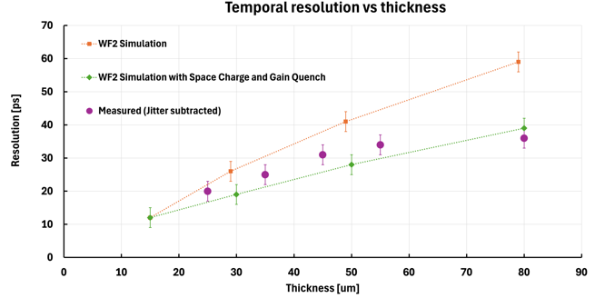
Gain quenching
The LGAD gain is not constant, it is smaller for large charge clusters
The charge carriers in the gain layer produce a field that is opposite to the LGAD field, lowering the gain.
n++ electrode
-
-
-
-
-
-
-
LGAD
Efield
Carriers
Efield
+
+
+
+
+
+
+
p+ gain implant
Due to gain quench, the gain is lower for large charge depositions
Gain quenching acts as a dumper, equalizing the current
The WF2 simulation with Space charge repulsion and gain quench agrees well the measured resolution
With Space charge repulsion and gain quench, the temporal resolution in WF2 is very similar to the measured resolution

Slide 12
LGAD signal formation: pictorial rappresentation
LGAD signal formation needs to include these three mechanisms:
An initial non-uniform energy deposition obtained as sum of elemental deposits
Space Charge effects during the particle drift.
Gain Quench during multiplication.
n++ electrode
n++ electrode
n++ electrode
p+ gain implant
p+ gain implant
p+ gain implant
Electrons drift
Holes drift
Initial energy deposition
Space Charge effects
Gain Quenching

Slide 13
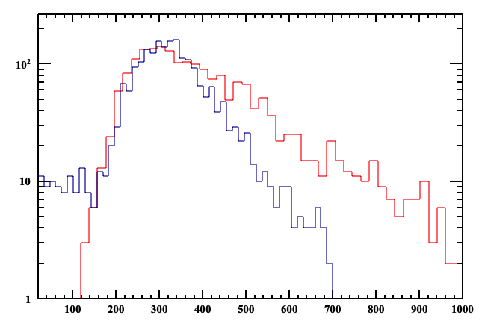
Effect of gain quench on the LGAD Landau distribution
Since the gain is lower for large charge deposits, the gain mechanism distorts the initial Landau distribution, decreasing the Landau high tail.
HPK2 beta measurement
Low
Gain
High
Entries
Entries
Gain 9, rescaled by 7
Distortion
Signal [mV]
Gain 62
Distortion
Initial Landau
Measured Landau
Reduced tail ==> smaller FWHM
Signal [mV]

Slide 14
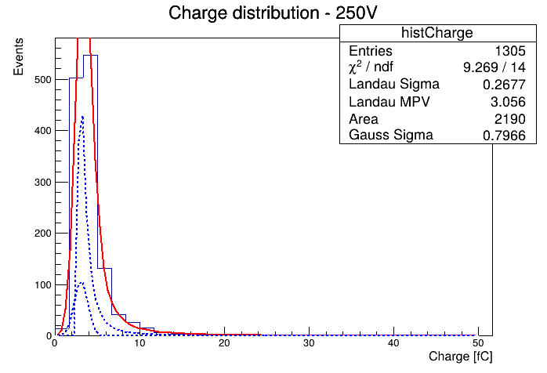
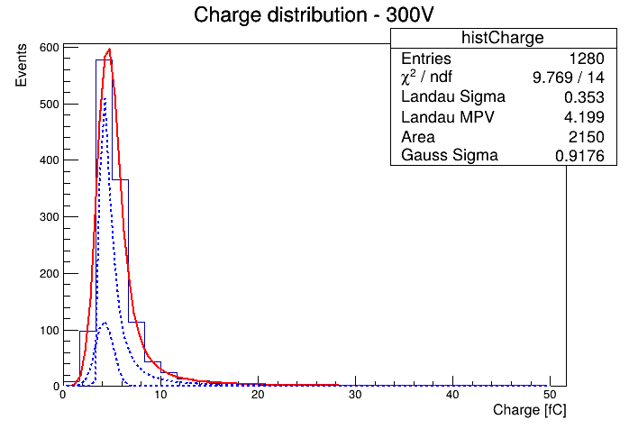
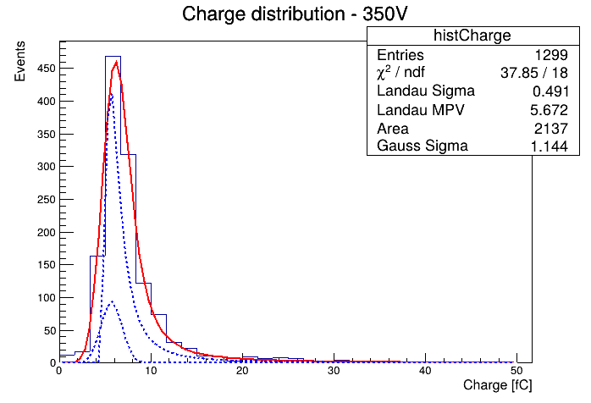
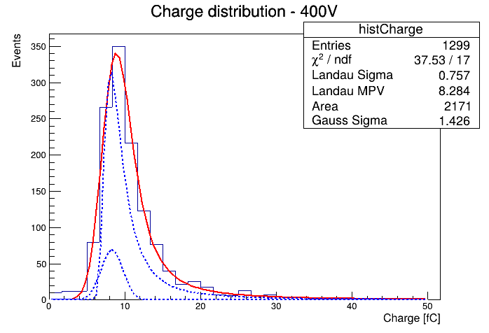
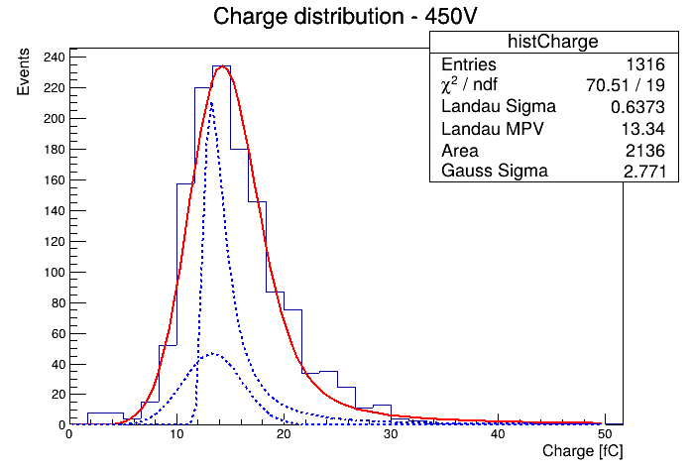
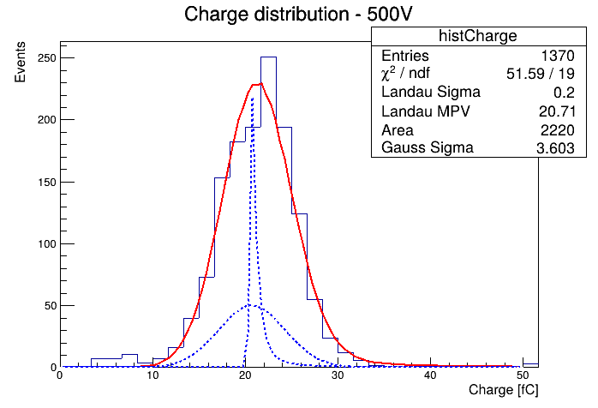
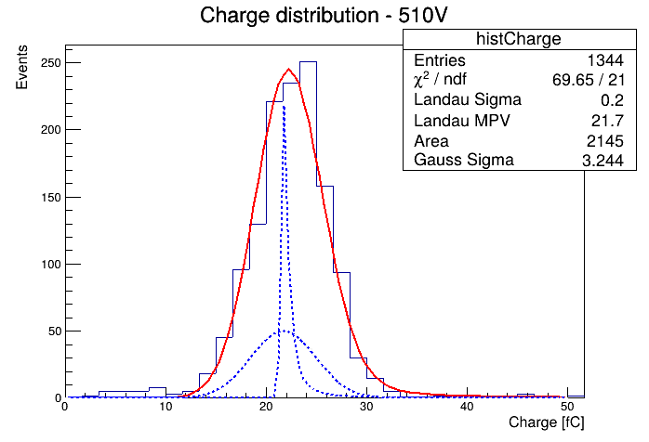
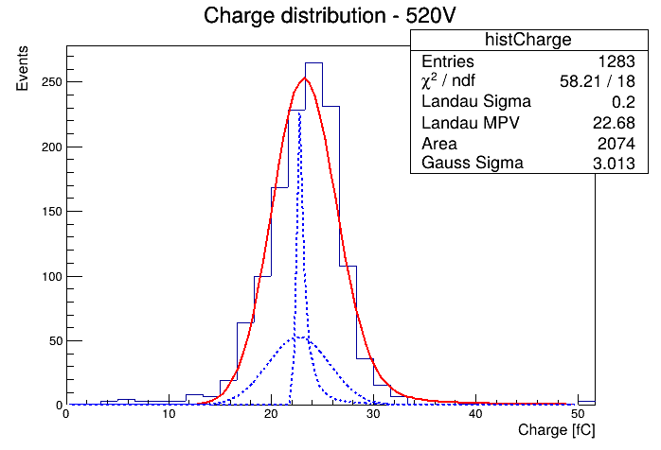
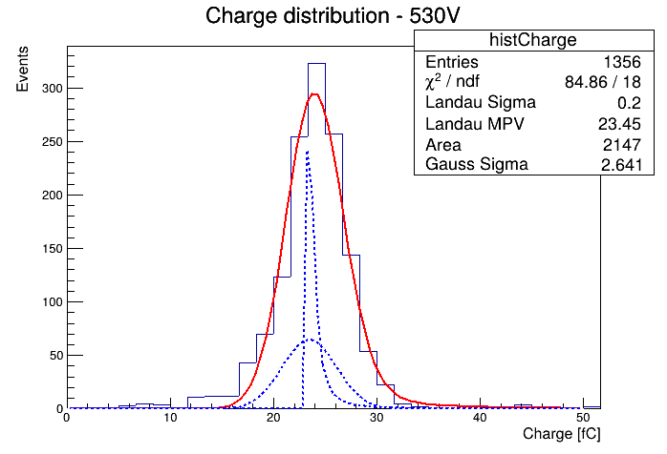
Measured LGAD Landau distribution as a function of gain
Gain quenching transforms the initial Landau distribution into a Gaussian distribution
Landau
200V
300V
350V
400V
450V
500V
510V
520V
530V
Gaussian

Slide 15
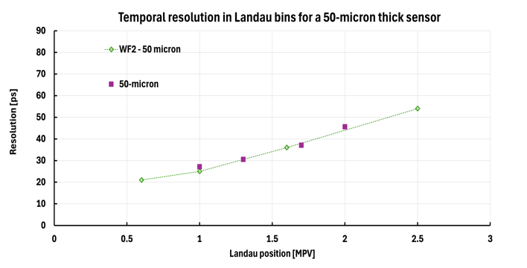
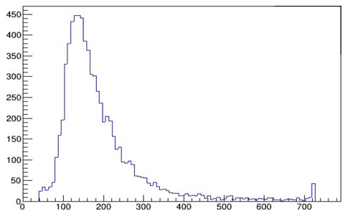
LGAD Temporal resolution vs Landau position
What is the temporal resolution as a function of the event position in the Landau?
Landau distribution
Entries
Signal (mV)
MPV
Events in the tail have a worse temporal resolution ( as expected)
Data from: Ongoing study, C. Marinuzzi et al
"Optimization of the gain layer design of Ultra-Fast Silicon Detectors", F. Siviero et al, NIMA 1033 (2022) 166739

Slide 16
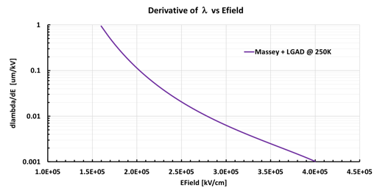
Can we use gain quenching to our advantage?
Gain layers with deeper implant work at lower values of the electric field and the change of the mean free path with Efield is higher.
Therefore, the field generated by the e/h has a more significant impact on Lambda.
n++ electrode
n++ electrode
-
-
-
-
-
-
-
Higher LGAD
Efield
-
-
-
-
-
-
-
Lower
LGAD
Efield
Carriers
Efield
Carriers
Efield
+
+
+
+
+
+
+
p+ gain implant
+
+
+
+
+
+
+
p+ gain implant
Can we exploit this aspect to design LGADs that perform better?
Deep GL
Shallow GL

Slide 17
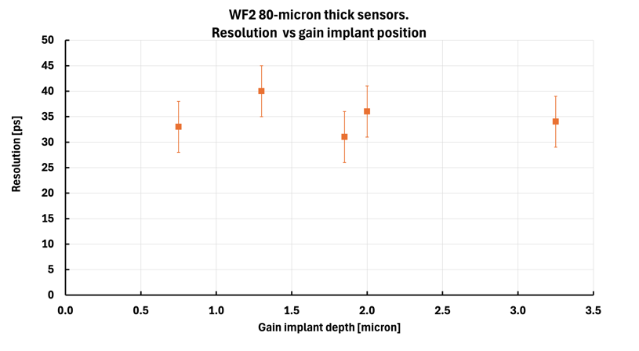
Temporal resolution vs gain implant position
(signals with amplitude > 2*MPV in 80-micron thick sensors)
gain ~ 16
Jitter = 0 in this study
Unfortunately
WF2 predicts that, in our regime of operation, the gain implant depth does not affect the LGAD temporal resolution

Slide 18
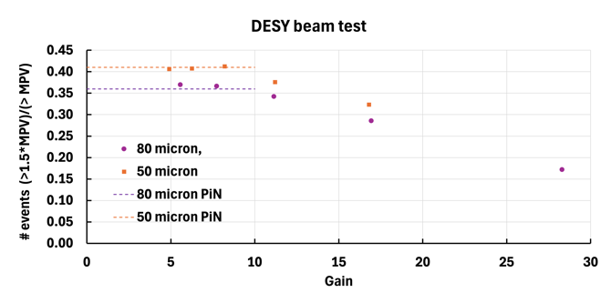
Landau method to measure gain
Can we use the distortion of the LGAD Landau to measure the LGAD gain?
# events > MPV
Entries
# events > 1.5 MPV
Signal [mV]
Consider a quantity that is sensitive to the magnitude of the Landau tail, for example
  (# of events >1.5*MPV)/(# of events >MPV)
Up to gain ~ 7-10, the ratio remains similar to that of the PiN Landau
At higher gain, there is a linear dependence from the gain
Self calibrating, no need to know anything about the electronics (it just needs to be linear)

Slide 19
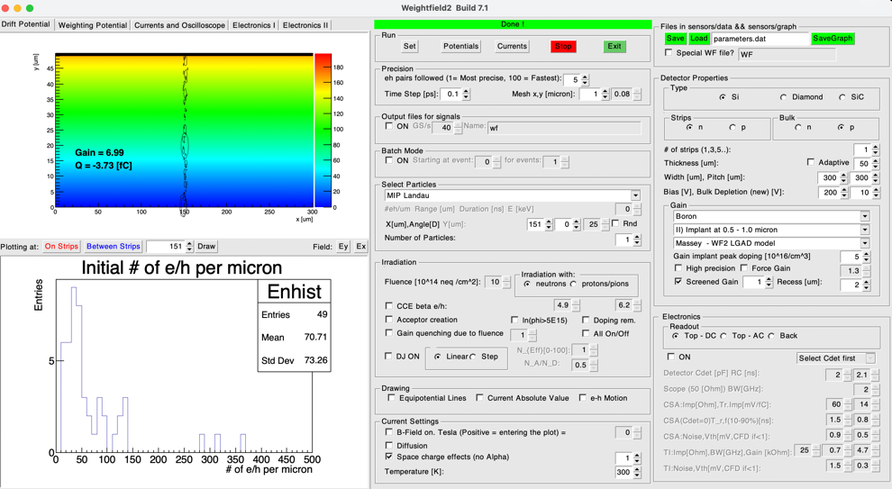
WF2 control panel
If you use WF2, be aware of these two options

Slide 20
Summary
Seemingly uncorrelated effects find an explanation in the shared underlying process of gain quench and space charge repulsion.
The following experimental quantities have been considered and correctly simulated in this study:
The initial energy deposition by a MIP
  The MPV and FWHM dependence upon sensor thickness
The reduction of the Landau tail as a function of the LGAD gain
The LGAD temporal resolution as a function of sensor thickness
The temporal resolution in bins of the Landau distribution

Slide 21
Extra

Slide 22
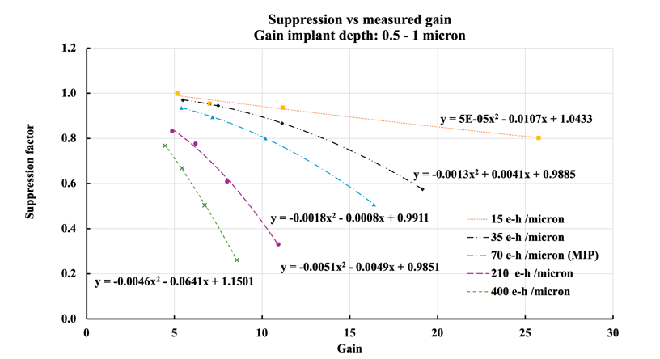
WF2 Gain quench simulation
n++ electrode
Gain quench increases:
When the gain increases
When the number of incoming electrons increases
-
-
-
-
-
-
-
LGAD
Efield
Charge
Efield
+
+
+
+
+
+
+
p+ gain implant
Increasing signal charge
Increasing gain

Slide 23
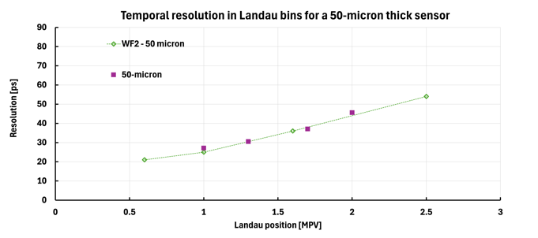
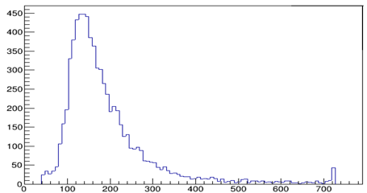
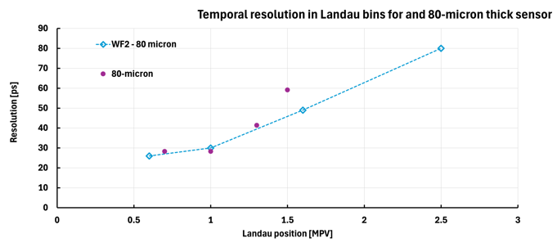
LGAD Temporal resolution vs Landau position
Landau distribution
Entries
Signal (mV)
MPV
Events in the tail have a worse time resolution ( as expected)
Data from: Ongoing study, C. Marinuzzi et al
"Optimization of the gain layer design of Ultra-Fast Silicon Detectors", F. Siviero et al, NIMA 1033 (2022) 166739

Slide 24

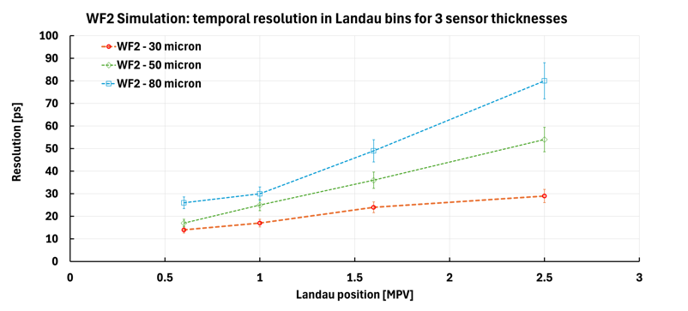
WF2 prediction: LGAD Temporal resolution vs Landau position
Landau distribution
The events in the tail of the distribution contains very large localized energy depositions.
The signal shape is irregular, so the temporal resolution is degraded.
Entries
Signal (mV)
MPV
In thicker sensors, the temporal resolution degradation for events in the tail of the Landau distribution is more severe.
This is “simply” because is more likely to have large energy deposits

Slide 25
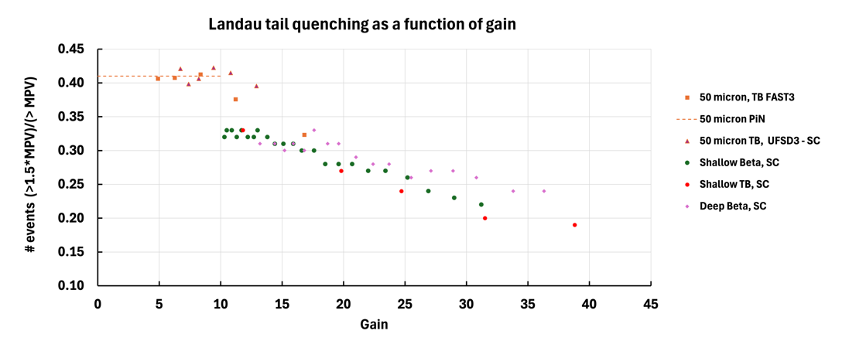
Additional data on quenching

Slide 26
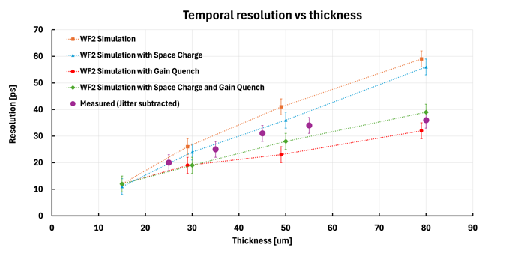
LGAD Temporal resolution vs sensor thickness
Let’s compare the measured temporal resolution with the WF2 predictions, including:
Space charge
Gain quench
In the simulation,
Gain quench, making the signal smoother, has a very strong effect on the temporal resolution.
Space charge effects improve slightly the temporal resolution with respect of the initial deposition
Space charge effects, when added to gain quench, degrade slightly the resolution.
Gain Quench
Including Gain Quench (and Space Charge effects to a lesser extent) in the simulation brings the predictions much closer to the measured values.

Slide 27
Signal formation in LGAD detectors
This contribution examines several PIN Diodes & LGAD properties and searches for the shared underlying physical processes at their root.
Observables:
The shape of the Landau distribution in PiN diodes
  The MPV and FWHM dependence upon the sensor thickness
The shape of the Landau distribution in LGAD as a function of gain
The temporal resolution of LGADs as a function of the sensor thickness
The temporal resolution in bins of the Landau distribution
The Weightfield2 program has been used to validate/confute various hypotheses.
WF2 program:
https://www.to.infn.it/~cartigli/Weightfield2/index.html

Slide 28
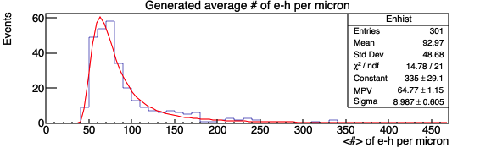
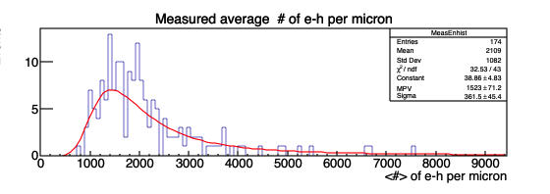
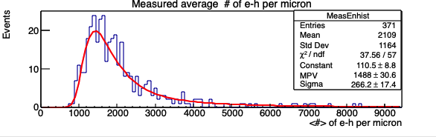
WF2: LGAD Landau distribution as a function of gain
WF2 simulation for an 80-micron thick sensors
Sigma/MPV can be used to describe the importance of the Landau tail.
LGAD Landau distribution without gain quench
LGAD Landau distribution with gain quench
WF2:
Gain = 17
WF2:
Gain = 17
Due to gain quench, the tail is reduced
Sigma/MPV = 0.23
Sigma/MPV = 0.18

Slide 29
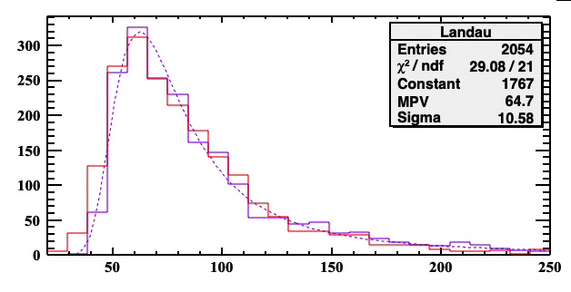
Effect of gain quench on the LGAD Landau distribution
At low gain, the LGAD Landau distribution is compatible with the parametrization of the Landau for PIN diodes
Red: HPK2, beta run, gain 9
PiN prediction (Meroli et al.)

Slide 30
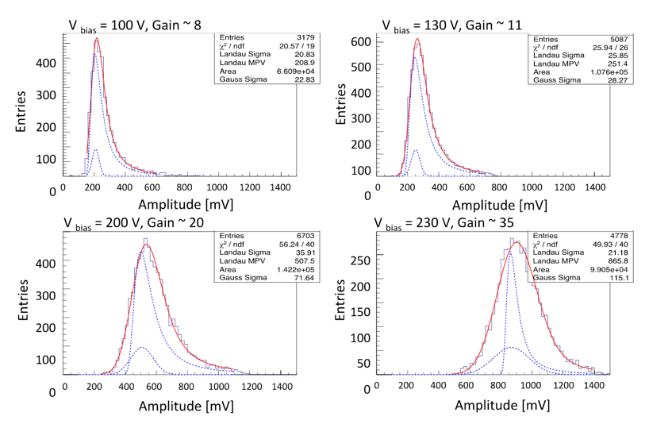
Measured LGAD Landau distribution as a function of gain
50-micron thick sensors, CERN beam test
TI amplifier (SC board)
“Beam test results of a 16 ps timing system based on ultra-fast silicon detectors”,
N. Cartiglia et al, NIMA 850 (2017) 83 - 88

Slide 31
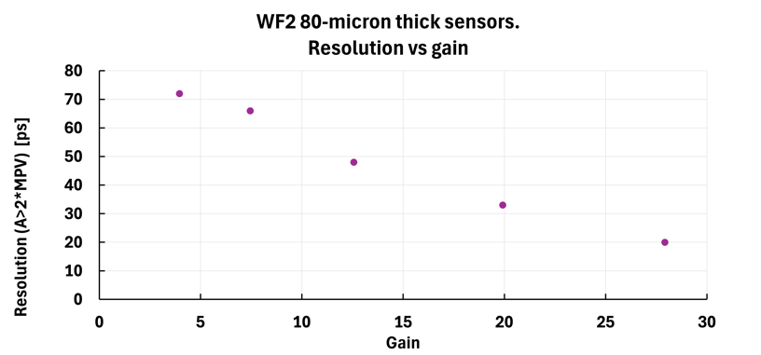
Temporal resolution vs gain
Consider the temporal resolution for signals with amplitude > 2*MPV in 80-micron thick sensors. (these events are very irregular, so they are a good testing ground)
As the gain increases, quenching smooths the signal shape more and more, and the resolution improves.
Jitter = 0 in this study

Slide 32
Properties of the Landau - II
The next step is to connect Landau's mathematical properties and the measured results.
In the following, the number of random numbers n and the sensor thickness play the same role, n = sensor thickness in micron
This will allow us to determine the elemental distribution to build any measured Landau.

Slide 33
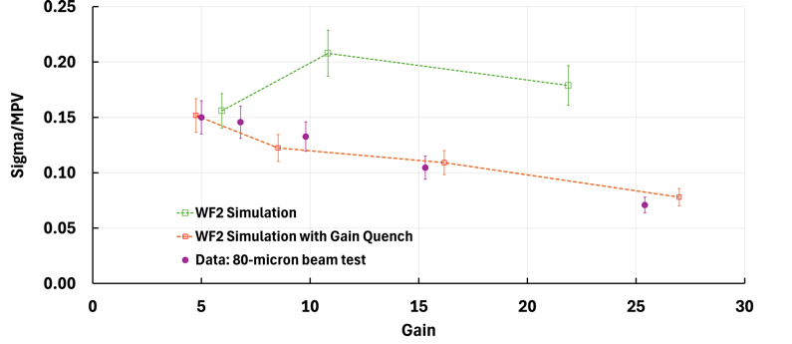
LGAD Landau distribution as a function of gain
Comparison Data - WF2 simulation
Simulation without Gain Quench
Gain increases the tail
Simulation with Gain Quench
With Gain Quench, WF2 reproduces well the evolution of the ratio Sigma/MPV.
Without gain quench, Sigma/MPV is roughly constant, not matching the data.

Slide 34
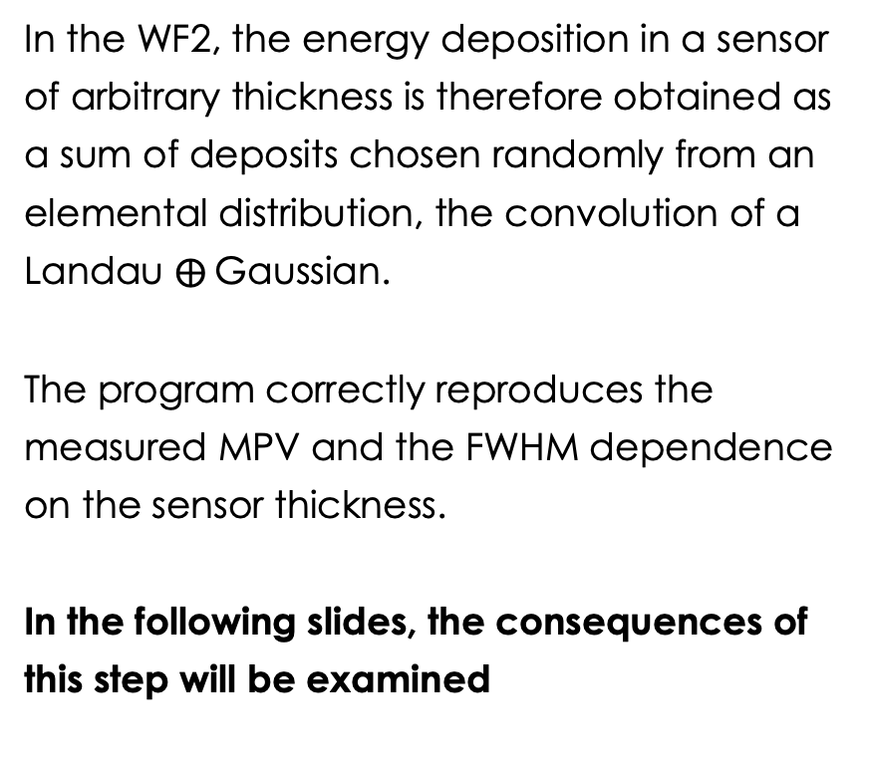

Starting point of the WF2 simulation
The correct choice of the elemental distribution X is the convolution of a Landau with a Gaussian
==> This distribution is a good approximation of the Vavilov distribution, which is known to reproduce the energy deposits in thin sensors.
In the WF2, the energy deposition in a sensor of arbitrary thickness is therefore obtained as a sum of deposits chosen randomly from an elemental distribution, the convolution of a Landau $⨁$Gaussian.
The program correctly reproduces the measured MPV and the FWHM dependence on the sensor thickness.
In the following slides, the consequences of this step will be examined
Local deposition follows a Landau$⨁$Gaussian distribution
The total deposition follows a
Landau distribution
34

Slide 35
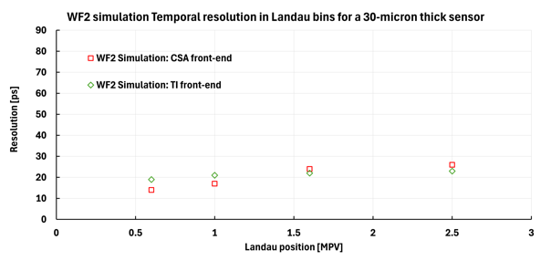
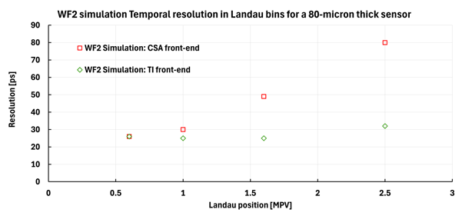
What read-out architecture is a better for LGADs?
These two plots compare the temporal resolution due to non-uniform ionization for a Trans-Impedance (TI) or Charge Sensitive Amplifier (CSA) for two different sensor thicknesses (30-micron and 80-micron).
For signals around the MPV (regular shape), the resolution is the same
In thin sensors (that have relatively uniform signals), the resolution is the same
In the tail of thick sensors (irregular signals), the TI architecture is much better
Large difference between TI and CSA
30-micron
80-micron

Slide 36
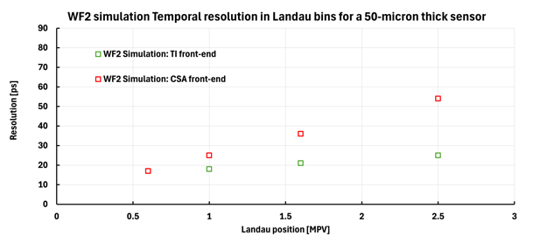
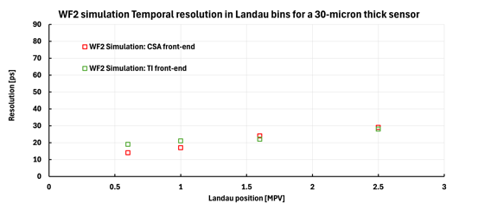

LGAD Read-out architecture

