Slide 1
Readout Software
Jüri Jõul
03.09.2024

Slide 2
What will not be covered
Some software on FECs:
  BGIPXL FESA class (next presentation)
  FESA classes related to slow control:
    Power supplies
    Cooling
    Temperature probes
PLC software
  A complexity in its own right!
Slow control GUI
Operator GUI
Vistar
Beam loss removal / post-processing

Slide 3
Introduction
Overview of the BGI software stack

Slide 4
Simple overview
HTTP
PyJapc
OP GUI
IPbus
OP
Three main groupings
  SoC
  FEC
  User applications (expert and OP)
Three main communication channels
  HTTP/REST
  PyJapc
  IPbus
Two languages
  C++
  Python
Data flow
Expert GUI (Python)
BIPXL Expert API (Pybind11 + Python)
VM
FESA (C++)
BIPXL API (C++)
nginx reverse proxy
BIPXL Software Driver (C++)
IPbus ControlHub
FEC
PS
Event Processing Application (C++)
REST server (Python)
Pybind11 Python wrapper (C++)
Custom Wishbone module (Python)
BIPXL Internal Driver (C++)
PL-FPGA
SoC

Slide 5
SoC software
A more detailed look into software components

Slide 6
Internal Driver (C++)
HTTP
PyJapc
OP GUI
IPbus
OP
Purpose
  Library to abstract register level functionality
  Provides unified interface for hardware access
Technologies
  Standard libraries
  CMake
Key features
  Quasi-object-oriented
    Organised by functionality:
      Readout, Detectors, Acquisition
Interactions
  Gateware: UIO and DMA
  REST server: via Python bindings
Expert GUI (Python)
BIPXL Expert API (Pybind11 + Python)
VM
FESA (C++)
BIPXL API (C++)
nginx reverse proxy
BIPXL Software Driver (C++)
IPbus ControlHub
FEC
PS
Event Processing Application (C++)
REST server (Python)
Pybind11 Python wrapper (C++)
Custom Wishbone module (Python)
BIPXL Internal Driver (C++)
PL-FPGA
SoC

Slide 7
Pybind (C++/Python) and Python
HTTP
PyJapc
OP GUI
IPbus
OP
Purpose
  Wraps C++ Internal Driver for Python
  Provides direct Python access to hardware using UIO
    Legacy functionality, to be removed
Technologies
  Pybind11 library for wrapping C++ code
  NumPy for both pure-Python implementation of memory mapping, but also arrays, etc, in the wrapper
Key features
  Organised similarly to the Internal Driver
  Enables scripting on the SoC
    Still, C++ is preferable
Interactions
  Internal Driver
  REST server
Expert GUI (Python)
BIPXL Expert API (Pybind11 + Python)
VM
FESA (C++)
BIPXL API (C++)
nginx reverse proxy
BIPXL Software Driver (C++)
IPbus ControlHub
FEC
PS
Event Processing Application (C++)
REST server (Python)
Pybind11 Python wrapper (C++)
Custom Wishbone module (Python)
BIPXL Internal Driver (C++)
PL-FPGA
SoC

Slide 8
REST server (Python)
HTTP
PyJapc
OP GUI
IPbus
OP
Purpose
  Exposes a unified interface of the readout system
    Language agnostic: different clients
  Brings complexity from client to server
    Compared to IPbus
Technologies
  Flask-RESTX as the web framework
Key features
  Organisation of resources similar to the underlying layers
  User input validation
  Error propagation
  Web UI for debugging/testing/exploration (next slide)
Interactions
  Python C++ wrappers and pure-Python implementations
  Clients via HTTP
Expert GUI (Python)
BIPXL Expert API (Pybind11 + Python)
VM
FESA (C++)
BIPXL API (C++)
nginx reverse proxy
BIPXL Software Driver (C++)
IPbus ControlHub
FEC
PS
Event Processing Application (C++)
REST server (Python)
Pybind11 Python wrapper (C++)
Custom Wishbone module (Python)
BIPXL Internal Driver (C++)
PL-FPGA
SoC

Slide 9
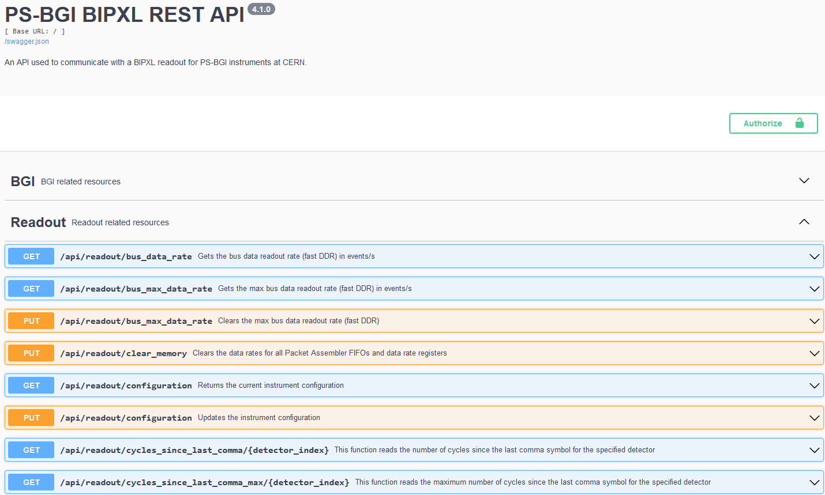

Slide 10
Event Processing Application (C++)
HTTP
PyJapc
OP GUI
IPbus
OP
Purpose
  Processes Timepix3 data according to timing events
  Produces beam profiles
Technologies
  Standard libraries
  CMake
Key features
  Standalone application
  Minimal hardware configuration
    Might be removed
  Utilises interrupts
Interactions
  REST server via shared memory (metadata)
  REST server via DMA buffer (profiles)
  REST server via HTTP (configuration)
Expert GUI (Python)
BIPXL Expert API (Pybind11 + Python)
VM
FESA (C++)
BIPXL API (C++)
nginx reverse proxy
BIPXL Software Driver (C++)
IPbus ControlHub
FEC
PS
Event Processing Application (C++)
REST server (Python)
Pybind11 Python wrapper (C++)
Custom Wishbone module (Python)
BIPXL Internal Driver (C++)
PL-FPGA
SoC

Slide 11
FEC software
A more detailed look into software components

Slide 12
BIPXL API (and the software driver)
HTTP
PyJapc
OP GUI
IPbus
OP
Purpose
  Provide a simple interface for the FESA class
  Include high-level business logic that does not fit into the Internal Driver
Technologies
  IPbus (raw data)
  nlohmann::json
  httplib (communication with REST server)
  Makefile Generic
Key features
  Even higher level than previous layers
  Automated configuration and masking
  Raw data readout
Interactions
  REST server via HTTP
  FESA class
  Filesystem for saving raw data
Expert GUI (Python)
BIPXL Expert API (Pybind11 + Python)
VM
FESA (C++)
BIPXL API (C++)
nginx reverse proxy
BIPXL Software Driver (C++)
IPbus ControlHub
FEC
PS
Event Processing Application (C++)
REST server (Python)
Pybind11 Python wrapper (C++)
Custom Wishbone module (Python)
BIPXL Internal Driver (C++)
PL-FPGA
SoC

Slide 13
Client-side software
A more detailed look into software components

Slide 14
Expert GUI
HTTP
PyJapc
OP GUI
IPbus
OP
Purpose
  Enables expert users to set up and monitor the instrument
Technologies
  PyQt5 and related dependencies
  AccWidgets
  Qt Designer for UI design
  PyJapc
  PyCCDA
Key features
  Configuration and control of detectors, acquisition, various displays, masking, etc…
Interaction
  FESA via PyJapc
  CCDB via PyCCDA
  REST server via HTTP requests
Expert GUI (Python)
BIPXL Expert API (Pybind11 + Python)
VM
FESA (C++)
BIPXL API (C++)
nginx reverse proxy
BIPXL Software Driver (C++)
IPbus ControlHub
FEC
PS
Event Processing Application (C++)
REST server (Python)
Pybind11 Python wrapper (C++)
Custom Wishbone module (Python)
BIPXL Internal Driver (C++)
PL-FPGA
SoC

Slide 15
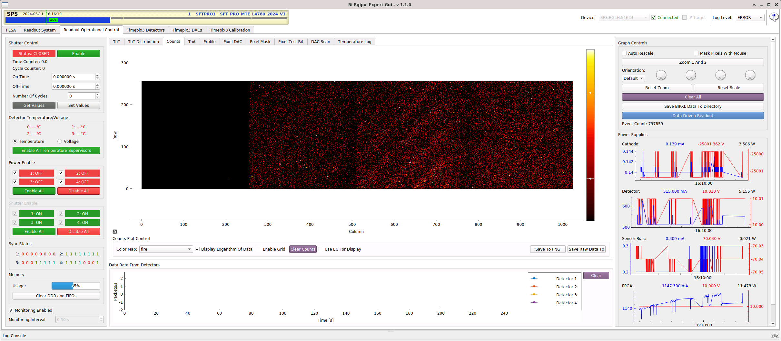
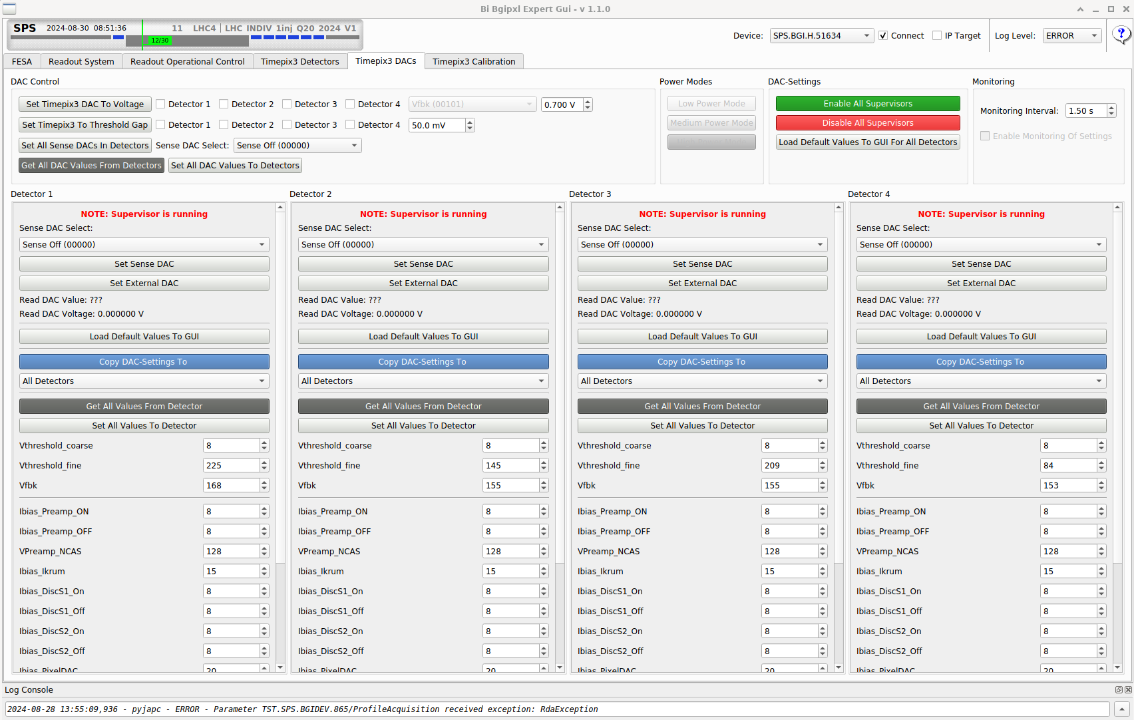
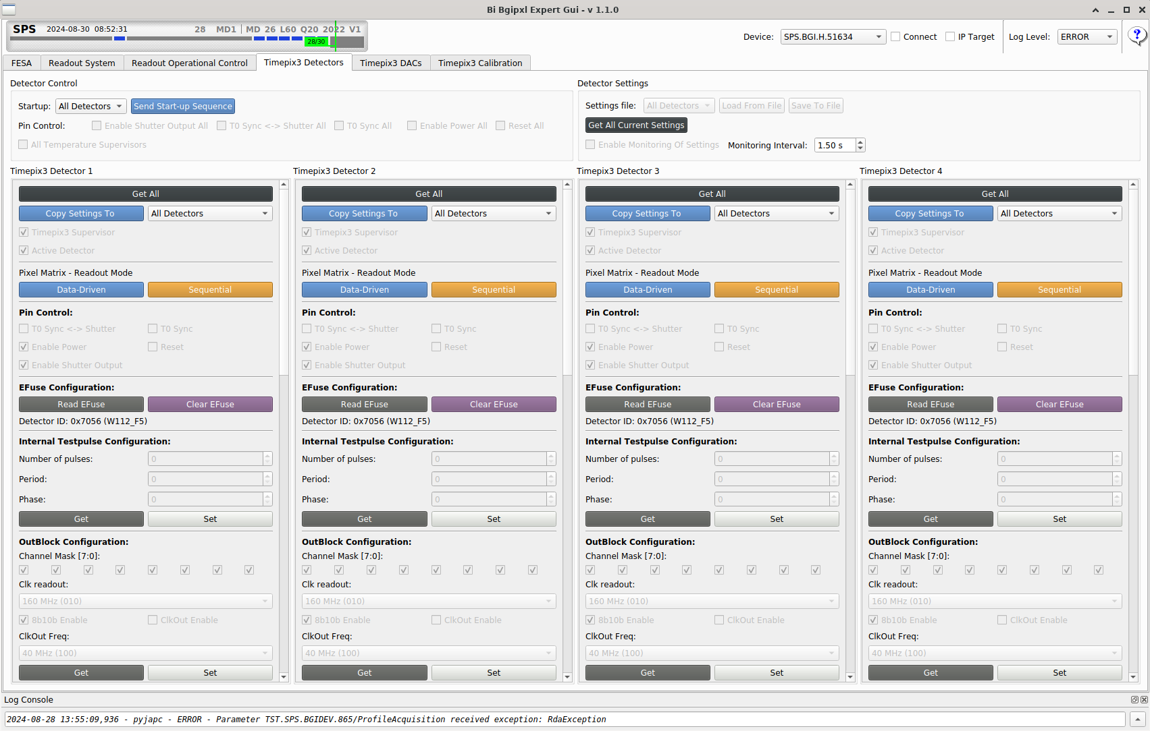

Slide 16
Improvements
In the past year and ongoing

Slide 17
Stability of the readout system
Identified and fixed multiple memory leaks and memory-related issues in our software
  Avoiding manual memory management in C++
  More correct usage of shared memory
    No more leaks
  Hidden complexity: C++ and Pybind11 interplay
    E.g. double freeing of memory
Result: more stability, better understanding of our system
  In future, we know how to avoid potential dangers/gotchas

Slide 18
Reworking error handling
Previously, problems with propagating errors between different layers
  Example: REST server → various clients (FESA, Expert API)
  In some cases, invalid states / errors were not detected
Solutions
  Using Flask-RESTX’s built-in exception handling capabilities in combination with rethrowing exceptions on the client side.
  We have also added further user input validation to different layers (at the interfaces) of the software, so that we would discover problems as early as possible, and not let them propagate through the system.
Result: more responsive and reliable system
Additionally, reduced cost of software maintenance (less duplication of custom checks / error handling)
  Also easier to understand and reason about the code

Slide 19
Settings management (I)
Identified problem: disjointed settings files
Proposal: centralised settings management
  FESA as the single source of truth
  Including the possibility of InCA/LSA
  In line with BI-TB recommendations
Involved reworking all parts of the software stack
  Eradicating dependencies on settings files
  Settings can instead be accessed via FESA or via REST, which gets its settings directly from FESA
  Among other things, almost complete redesign of BIPXL API

Slide 20
Settings management (II)
Related changes:
Automated pixel masking
  Easier to implement than before
  Leads to fewer expert interventions on operational instruments
Faster reconfiguring of the detectors
  Due to some redesign, we can more easily configure the detector periphery in parallel
  Can also load the pixel masks more quickly
  This leads to better effective radiation hardness and robustness

Slide 21
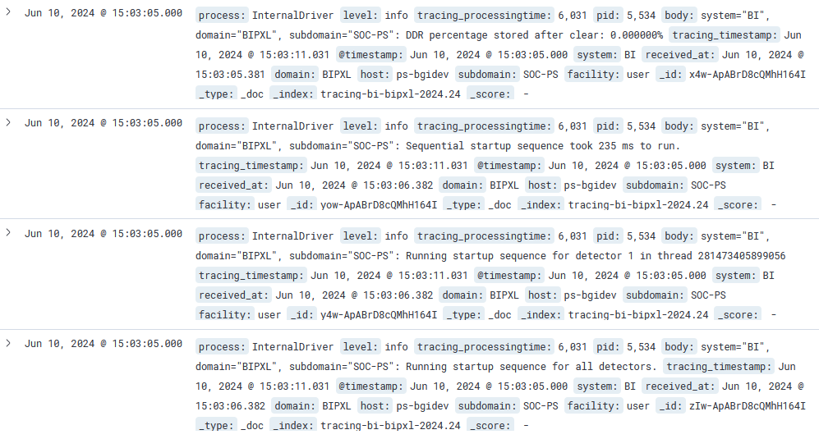
Logging
Previously, no logging on SoC
With the help of the tracing team (BE-CSS-CPA), we have now implemented logging functionality in our software stack
  Including LUMENS-based configuration of the FECs
This enables us to detect and investigate problems with much more ease, leading to increasing system reliability over time
We can also monitor chosen parameters of our system (e.g. memory usage), further helping us in analysing our system’s performance

Slide 22
Quality of life (and code) improvements
Reducing technical debt (in addition to better memory management)
  Removing code duplication
  Avoiding global state
  Increasing cohesion and modularity
  Adding tests
  Partial support for cross-compilation and testing
  All of the above improve the software and reduce maintenance cost!
Better access to software on the SoC
  GitLab access – leads to quicker development and updates
Reverse proxy
  Easier access to instruments
Revived equalization procedure
  As script
Long list of small improvements/modifications…

Slide 23
Current problems
And complexities

Slide 24
Internal Driver + Python + REST server
Problems:
  Non-uniform hardware access
    Via Internal Driver or Python module
  Global state
    Difficult to understand and test
Solutions:
  Remove standalone Python module
  Rework/refactor to reduce global state

Slide 25
Event Processing Application
Problems:
  Inefficient – waits too long to start processing
  Not well-behaved
    When signals arrive out of order
    When there is no injection
  Mixed control and data readout – race conditions
  Duplication of raw data processing (REST server)
Solutions:
  Review and improve the processing logic
    Start processing as early as possible
  Create a state machine more tolerant towards missing events
    Utilise logging and status flags to notify users of issues
  Move hardware control to REST server
  Move all event processing functionality to REST server?

Slide 26
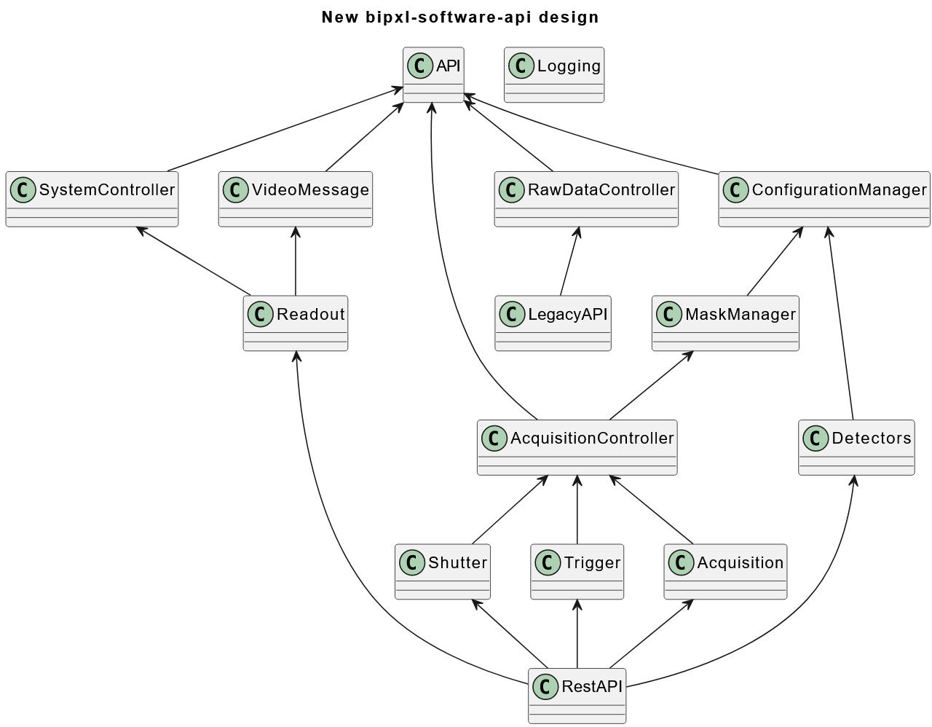
BIPXL API
Problems:
  Legacy dependencies
    BIPXL Software Driver
  Two communication channels
    HTTP/REST
    IPbus
  Complicated and inflexible build system
  Complicated testing – meant to run on TN-trusted machines
Solutions:
  New raw data readout
  Remove one channel?
    Or FESA-on-SoC
  Use CMake instead?
  Extract platform independent functionality

Slide 27
Expert GUI
Problems:
  Very high complexity
    Rarely used functionality also needs maintenance
    High coupling
  Non-standard components
    Mutually exclusive dependencies with new GUI initiatives
  Multiple communication channels and paradigms
    HTTP/REST – get/set
    PyJapc – get/set/subscribe
Solutions:
  Reduce complexity by
    Move supporting functionality to scripts?
    GUI design patterns (MVP)
  New implementation from ground up?
  Everything via PyJapc?

Slide 28
Stack-wide problems
Problems:
  Non-standard solutions – more development effort
    Communication channels/protocols
    Development tools
    Linux
  Overall stack complexity
Solutions:
  FECOS and FESA-on-SoC
  Diligent refactoring/redesigning

Slide 29
Outlook
Future of the software stack

Slide 30
Consolidation of FEC and SoC software
HTTP
HTTP
PyJapc
PyJapc
IPbus
OP GUI
IPbus
OP GUI
OP
OP
FECOS and the FESA-on-SoC project
  Simplifies software stack
  Provides common standard functionality, such as logging capabilities, CI/CD, etc
  No need for custom Linux
Expert GUI (Python)
Expert GUI (Python)
BIPXL Expert API (Pybind11 + Python)
VM
VM
FESA (C++)
BIPXL API (C++)
nginx reverse proxy
BIPXL Software Driver (C++)
IPbus ControlHub
FEC
PS
PS
FESA (C++)
Event Processing Application (C++)
REST server (Python)
Event Processing Application (C++)
Pybind11 Python wrapper (C++)
BIPXL API (C++)
Custom Wishbone module (Python)
BIPXL Internal Driver (C++)
BIPXL Internal Driver (C++)
PL-FPGA
PL-FPGA
SoC
SoC

Slide 31
Alternative architecture
HTTP
Data processing server + NXCALS
PyJapc
OP GUI
IPbus
OP
Standalone data processing server
SoC readout for fast data transfer
  No on-board processing
Raw data available for everybody
Expert GUI (Python)
BIPXL Expert API (Pybind11 + Python)
VM
FESA (C++)
BIPXL API (C++)
nginx reverse proxy
BIPXL Software Driver (C++)
IPbus ControlHub
FEC
PS
Event Processing Application (C++)
REST server (Python)
Pybind11 Python wrapper (C++)
Custom Wishbone module (Python)
BIPXL Internal Driver (C++)
PL-FPGA
SoC

Slide 32
Conclusion

Slide 33
Conclusion
Many problems already identified
Actively working on improving software
Eagerly awaiting FECOS / FESA-on-SoC
Alternative architectures possible – up for discussion

