Slide 1



Anomaly Detection in the CMSWEB Services
CERN SUMMER STUDENT 2024
QUAID-I-AZAM UNIVERSITY
DEPARTMENT OF COMPUTER SCIENCE
NASIR HUSSAIN
SUPERVISOR: DR. MUHAMMAD IMRAN

Slide 2
Project Overview
Objective:
Develop a robust application for anomaly detection within the CMSWEB cluster, leveraging machine/deep learning to ensure the reliability and security of critical web services.
Key Components:
Infrastructure:
  Built on Kubernetes (k8s) technology.
  Hosts over 24 critical web services (e.g., DBS, DAS, CRAB, WMarchive, WMCore).
Approach:
  Utilize machine/deep learning techniques to analyze service parameters.
  Continuously monitor for deviations from expected behavior.
Functionality:
  Identify and discern anomalies indicative of security breaches or performance issues.
  Record detected anomalies and generate alerts.
Alerting Mechanism:
  Intelligent routing of alerts to relevant service developers or administrators.
  Proactive issue resolution to minimize disruptions.
Outcome:
Enhance the reliability and security of the CMSWEB cluster, ensuring seamless operation of critical services through timely anomaly detection and response.
Nasir Hussain | Anomaly Detection in CMSWEB Services | CMS CERN
August 08, 2024

Slide 3
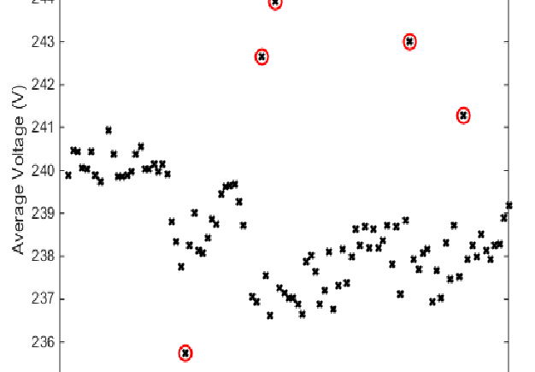
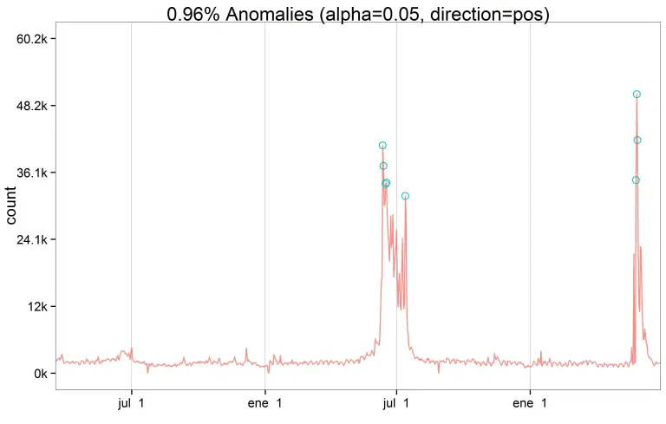
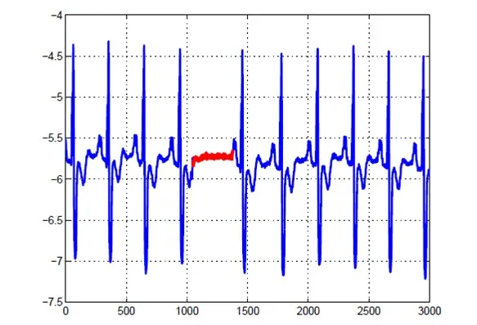
Understanding Anomalies
An anomaly is an irregularity or deviation from the expected behavior in a system, which may indicate potential issues such as performance degradation, security breaches, or operational failures.
Point Anomalies
A point anomaly is where a single datapoint stands out from the expected pattern, range, or norm. In other words, the datapoint is unexpected.
Contextual Anomalies
Instead of looking at specific datapoints or groups of data, an algorithm looking for contextual anomalies will be interested in unexpected results that come from what appears to be normal activity.
Collective Anomalies
A collective anomaly occurs where single datapoints looked at in isolation appear normal. When you look at a group of these datapoints, however, unexpected patterns, behaviors, or results become clear.
Nasir Hussain | Anomaly Detection in CMSWEB Services | CMS CERN
August 08, 2024

Slide 4
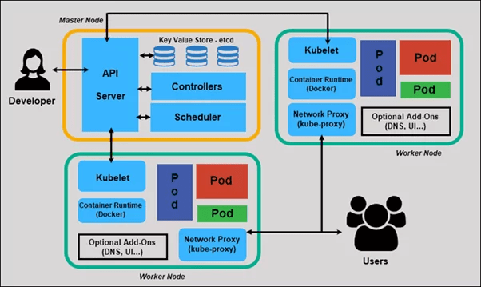
Overview of Kubernetes (k8s)
Master Node
The master node is the control plane of a Kubernetes cluster, responsible for managing the worker nodes and orchestrating the deployment and scaling of applications.
Worker Node
Worker nodes listen to the API Server for new work assignments; they execute the work assignments and then report the results to the Kubernetes Master node.
Pods
Pods are the smallest deployable units in Kubernetes, encapsulating one or more containers that share storage and network resources. They ensure that the containers within them operate together and can communicate easily.
Namespace
Namespaces provide a way to divide cluster resources between multiple users or applications, creating virtual clusters within a physical cluster. This helps in organizing resources and managing access control effectively.
Nasir Hussain | Anomaly Detection in CMSWEB Services | CMS CERN
August 08, 2024

Slide 5
Data Collection
command
Load config.json
Generate Query
call
Prometheus
(cms-monitoring)
Result.csv
Result.json
Data
Preprocessing
return
Nasir Hussain | Anomaly Detection in CMSWEB Services | CMS CERN
August 08, 2024

Slide 6
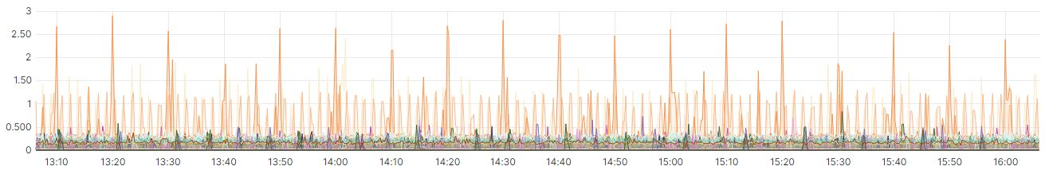
Data Collection – Parameters
Filtration
Env = k8s-prod
App = kube-eagle
Namespace & Container
Metrics
CPU Usage
Memory Usage
Requests
Time
Start = 1718398800
End = 1720990800
Step = 15s
Nasir Hussain | Anomaly Detection in CMSWEB Services | CMS CERN
August 08, 2024

Slide 7
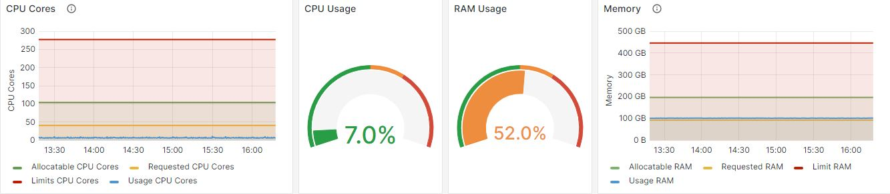
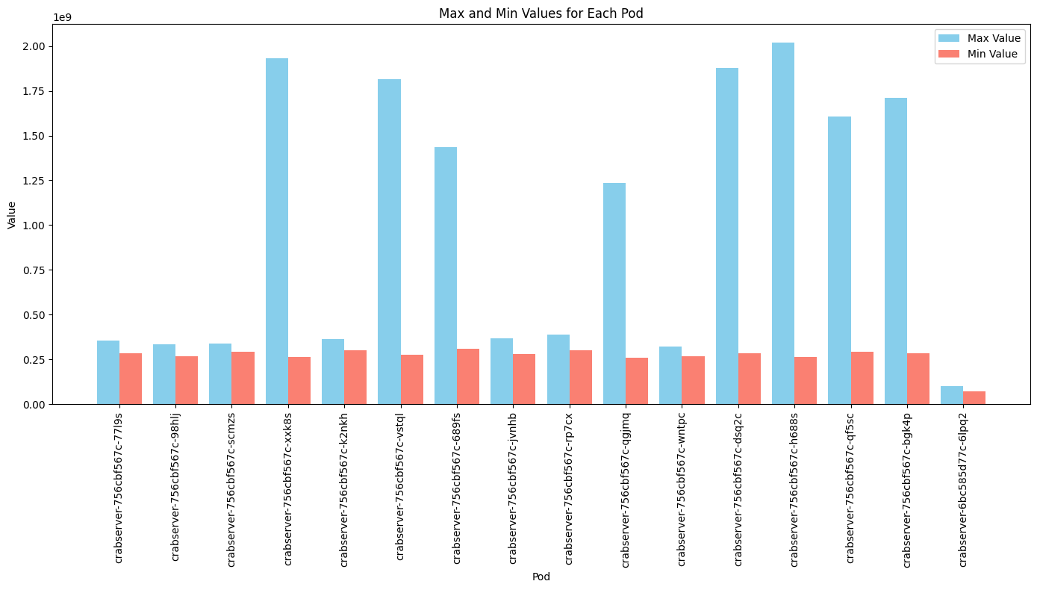
Data Collection – Insight & Optimize Code
python3 dataCollectorCurl.py --config config.json --start 2024-06-15T00:00:00Z --end 2024-07-15T00:00:00Z --step 15s --output_dir outputCSV
config.json
"prometheus_url": "http://cms-monitoring-ha1.cern.ch:30428/prometheus/api/v1/query_range",
"metrices": [
"eagle_pod_container_resource_usage_memory_bytes",
"eagle_pod_container_resource_usage_cpu_cores"
],
Nasir Hussain | Anomaly Detection in CMSWEB Services | CMS CERN
August 08, 2024

Slide 8
LSTM Autoencoder
Training Phase:
Trained on time series data representing normal operational behavior from CMSWEB services.
Learns to encode and decode sequences, minimizing reconstruction errors on normal data.
Encoding:
Time series data is encoded into a lower-dimensional representation, capturing essential features.
Decoding:
Encoded data is decoded back to its original time series form.
Reconstruction Error:
The difference between the original and reconstructed time series is calculated.
Low error indicates normal behavior; high error suggests an anomaly.
Anomaly Detection:
During operation, the system reconstructs new time series data.
Anomalies are detected when reconstruction errors exceed a predefined threshold.
Nasir Hussain | Anomaly Detection in CMSWEB Services | CMS CERN
August 08, 2024

Slide 9
Goal
AELSTM
AEFC
AECNN
FORCNN
Performance Evaluation and Computational Efficiency
Detecting anomalies on live data
Alert Mechanism
Deployment
Nasir Hussain | Anomaly Detection in CMSWEB Services | CMS CERN
August 08, 2024

Slide 10
Thank You!
Q/A nasir.hussain@cern.ch
Nasir Hussain | Anomaly Detection in CMSWEB Services | CMS CERN
August 08, 2024

