Slide 1
Cuts for Target Yield Estimates
J. Scott Berg, Brookhaven National Laboratory
IMCC Target Meeting
July 16, 2024

Slide 2
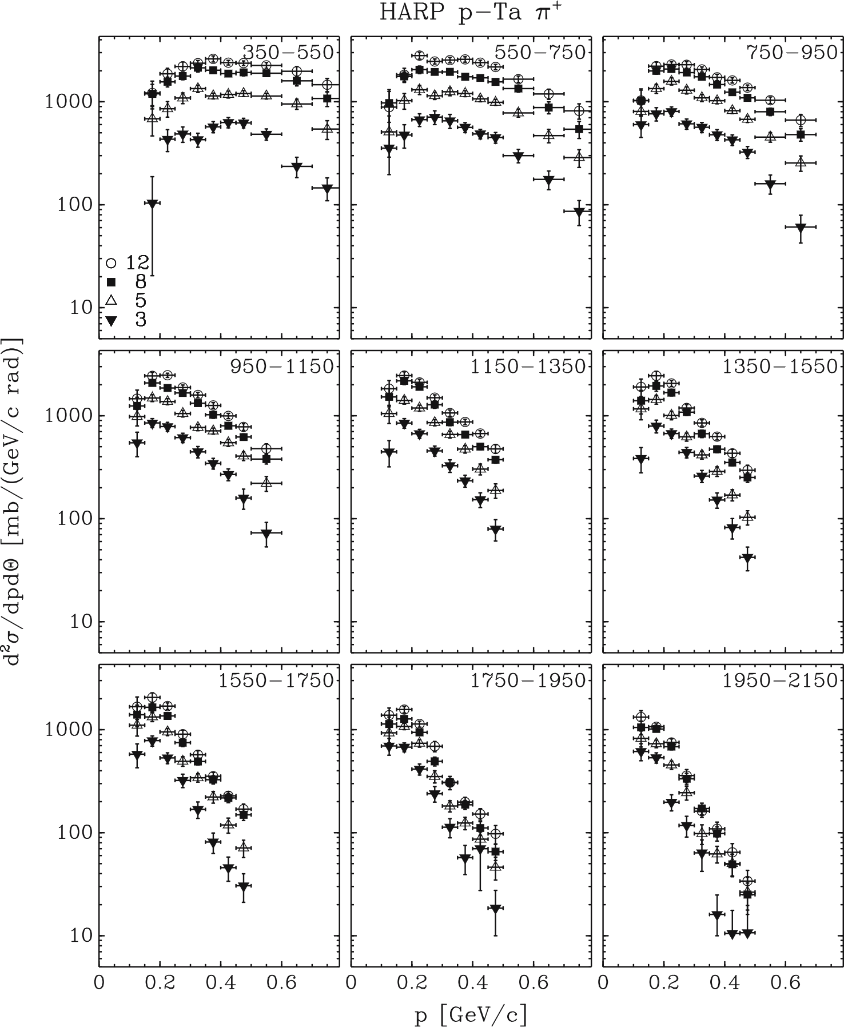
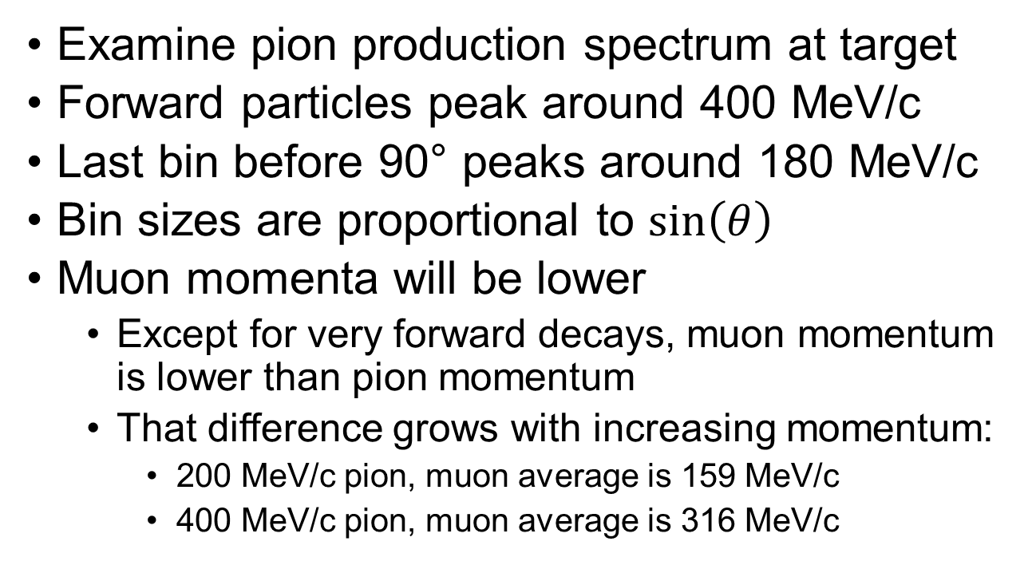
Production of Pions
Examine pion production spectrum at target
Forward particles peak around 400 MeV/c
Last bin before 90° peaks around 180 MeV/c
Bin sizes are proportional to $\sin\left(θ\right)$
Muon momenta will be lower
  Except for very forward decays, muon momentum is lower than pion momentum
  That difference grows with increasing momentum:
    200 MeV/c pion, muon average is 159 MeV/c
    400 MeV/c pion, muon average is 316 MeV/c
Catanesi et al., Eur. Phys. J. C 51, 787 (2007)

Slide 3
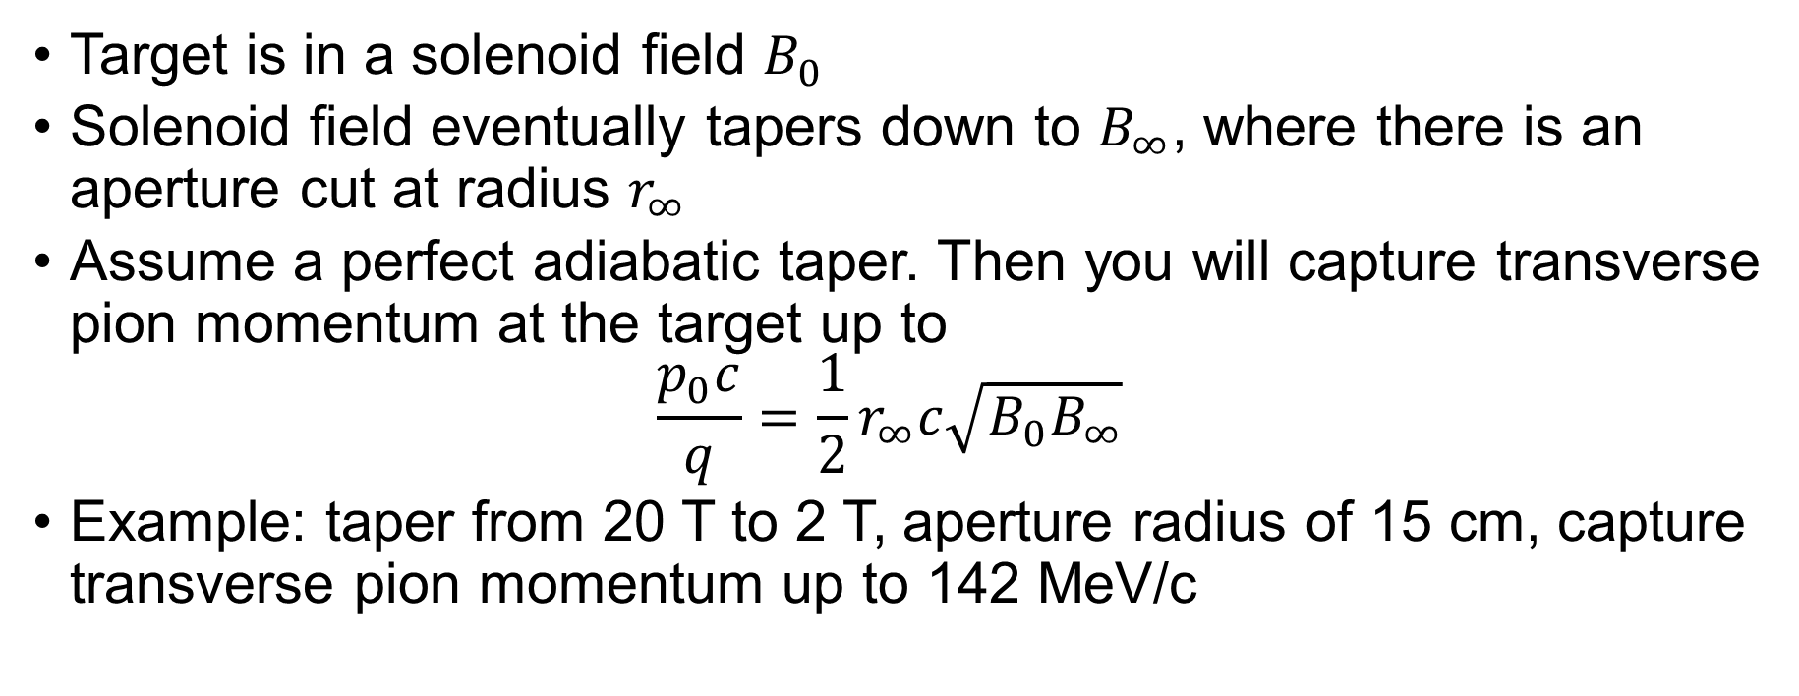
Transverse Momentum Captured
Target is in a solenoid field $B_{0}$
Solenoid field eventually tapers down to $B_{∞}$, where there is an aperture cut at radius $r_{∞}$
Assume a perfect adiabatic taper. Then you will capture transverse pion momentum at the target up to
$\frac{p_{0}c}{q}=\frac{1}{2}r_{∞}c\sqrt{B_{0}B_{∞}}$
Example: taper from 20 T to 2 T, aperture radius of 15 cm, capture transverse pion momentum up to 142 MeV/c

Slide 4
Production of Pions
Assume that 142 MeV transverse cutoff, look at the first 3 bins:
  450 mrad, capture momenta below 327 MeV/c
  650 mrad, capture momenta below 235 MeV/c
  850 mrad, capture momenta below 189 MeV/c
  Larger radius downstream would capture higher transverse momenta
Distributions at lower angles peak at higher momenta, and we capture higher up to higher momenta as well, but there is less solid angle there.
Higher energy protons, more particles at higher momenta
Catanesi et al., Eur. Phys. J. C 51, 787 (2007)

Slide 5
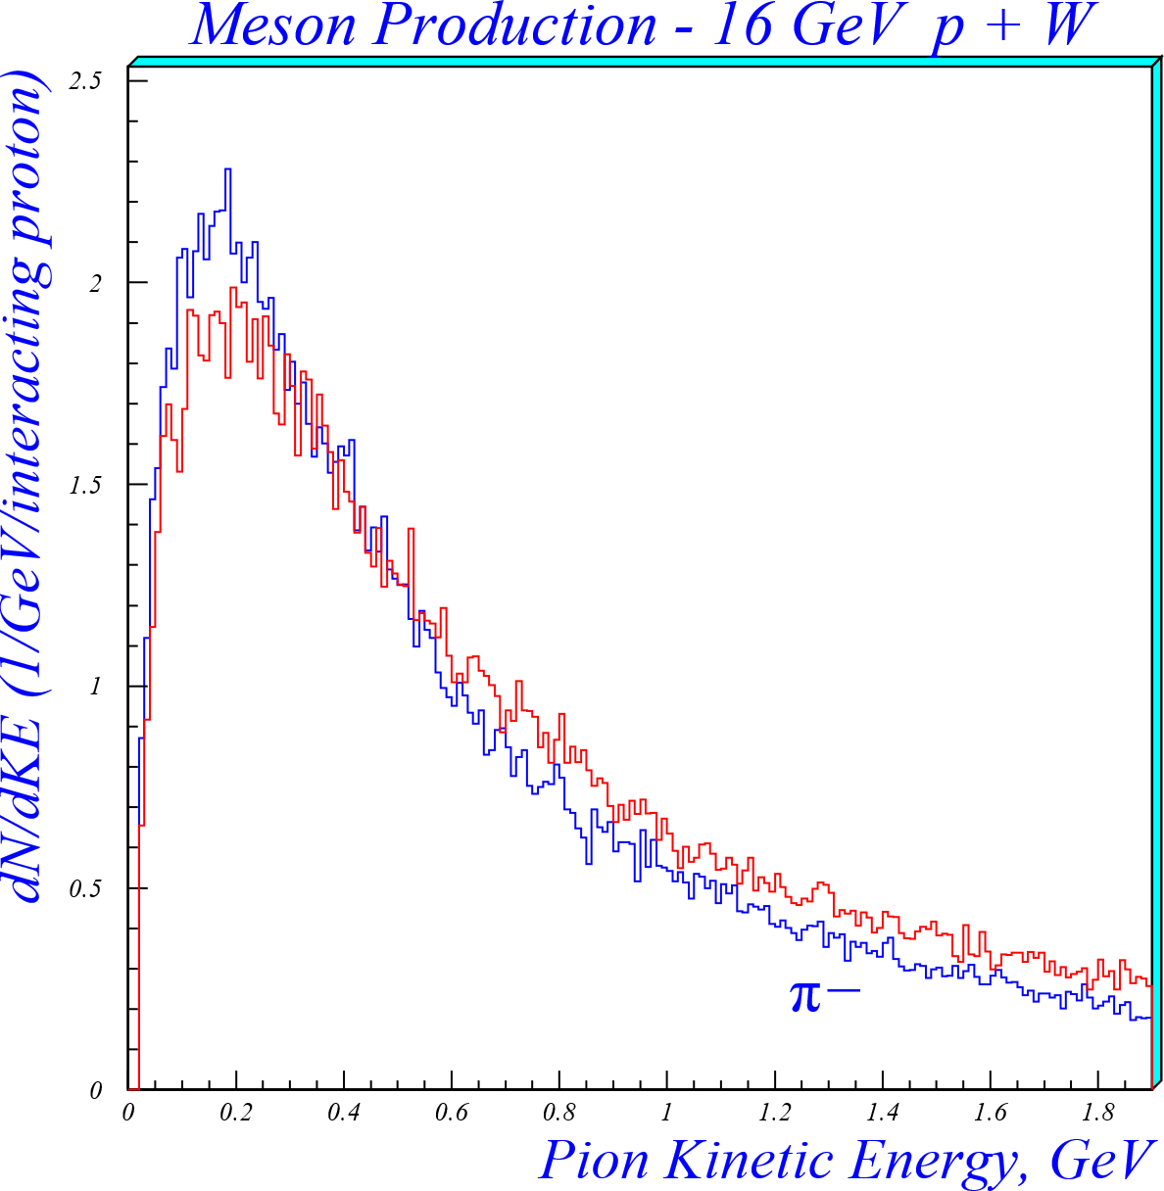
Production of Pions
Total production found in MARS simulation (1999)
  Note 16 GeV proton energy; above data was for maximum 12 GeV, and different material
Still significant pions available at higher energies
Peak here is at 175 MeV kinetic energy, corresponds to about 280 MeV/c momentum

Slide 6
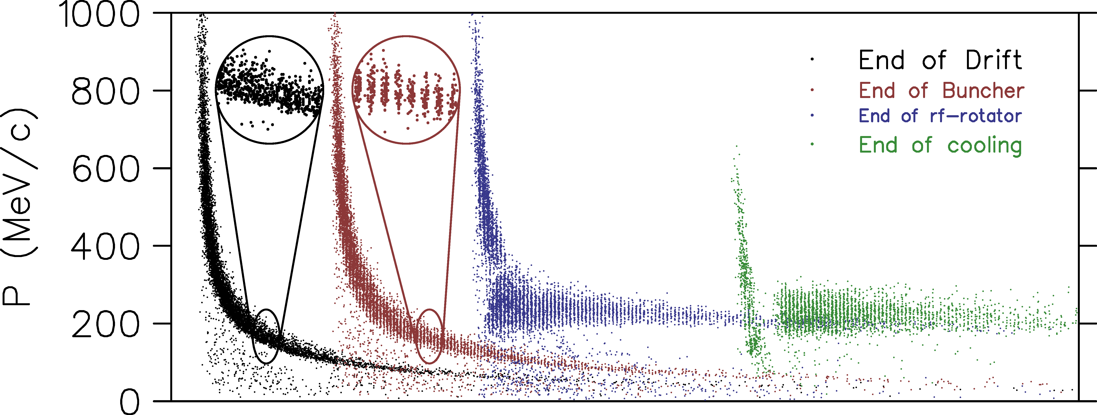
Neuffer’s Capture System
Allow distribution to drift. Low energy particles are later than high energy particles
Slowly apply RF, varying frequency down the channel, to create bunches
Shift the RF phase to
reduce the energy
spread
Chicane not shown
here

Slide 7
Neuffer’s Capture System
The capture system can be tuned to get any range you want
Capture will work best if the average of your incoming distribution is close to what you want for your downstream cooling channel
  The cooling channel wants a central momentum very near 200 MeV/c
The system works better for lower energies
Capturing higher energies will require a longer system
Proton absorber near chicane will shift energies down slightly, and chicane will clip off the high energy tail
  Chicane should also be a part of the tuning process

Slide 8
Target Optimization Studies
The US target optimization studies from 2009 to 2015 used the following:
  Transport particles to 50 m from the target
    Have mostly muons at this point
  Aperture at 50 m was 30 cm radius
  Take kinetic energy cuts from 40 to 180 MeV
    Muon momenta from 100 to 265 MeV/c
Run the particles through a neutrino
factory cooling channel
  Relative production same with both methods
  Always used the same Neuffer capture

Slide 9
Putting it all Together
The bulk of the available pions that we can capture have momenta from about 180 to 300 MeV/c
There are particles at higher momenta as well, more for higher energy proton beams, but we do not capture them very effectively
We can tune our capture system somewhat to capture different energy ranges, and ideally we would do that for different proton energies and target materials
We found that muon kinetic energy cuts from 40 to 180 MeV at 50 m from the target gave a good reflection of what went through the cooling channel
  But maybe our capture system was designed to capture that range…

