Slide 1
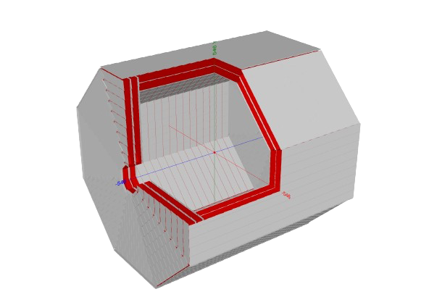




Standalone muon-system reconstruction in idea
Mahmoud Ali
8th FCC Physics workshop, 16 January 2025.

Slide 2



8th FCC Physics workshop
Mahmoud Ali
Standalone Muon-system reconstruction in IDEA
Aim of the study: Is standalone Muon-system able to detect LLPs ?
To answer this question a simulation studies are being done in parallel two tracks:
Fast-SIM: Using Delphes by adopting the track covariance matrix
- Study with varying number of layers, level-arm distances between every two layers and space resolutions how the signal reconstruction and vertex fitting is impacted.
- Study of reconstructing Long Lived Particles (LLP), which have a displaced vertices, with information only from the muon system.
Full-SIM: By using DD4hep geometry of IDEA, and adopting CLD tracking on our IDEA muon-system.

Slide 3
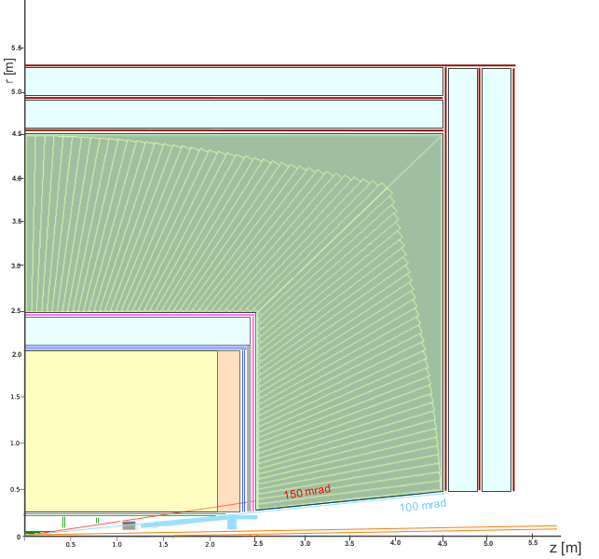
8th FCC Physics workshop
Mahmoud Ali
Innovative Detector for e+ e− Accelerator (IDEA)
IDEA detector concept consists of:
Silicon pixel vertex detector, R = 1.2 : 34 cm.
Large-volume extremely light drift wire chamber, 112 layers, 4m long, R = 35:200 cm.
Surrounded by a layer of silicon micro-strip detectors, R = 200:~210 cm.
Thin low-mass superconducting solenoid coil, R = 210:240 cm.
Pre-shower detector based on μRWELL technology, R = 240:~250 cm.
Dual readout fiber calorimeter, R = 250:450 cm.
Muon chambers based on μRWELL technology
inside the magnet return yoke, R = 450:~540 cm.
Yoke
IDEA detector layout

Slide 4
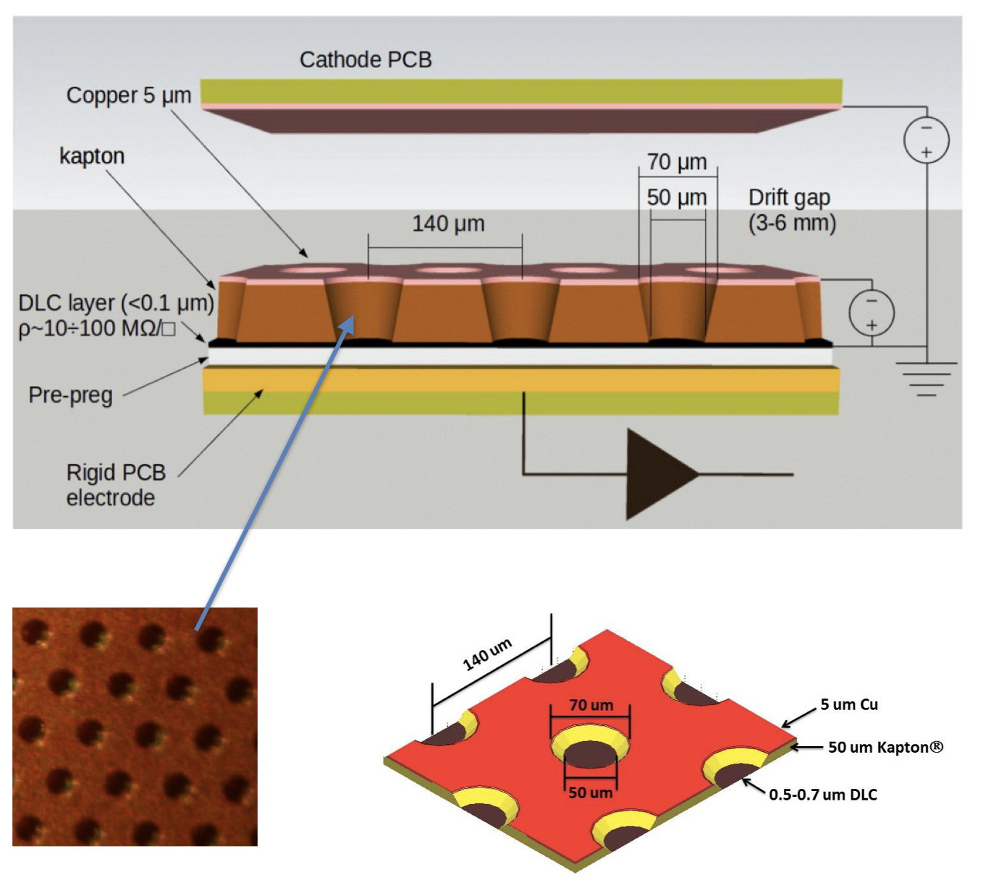
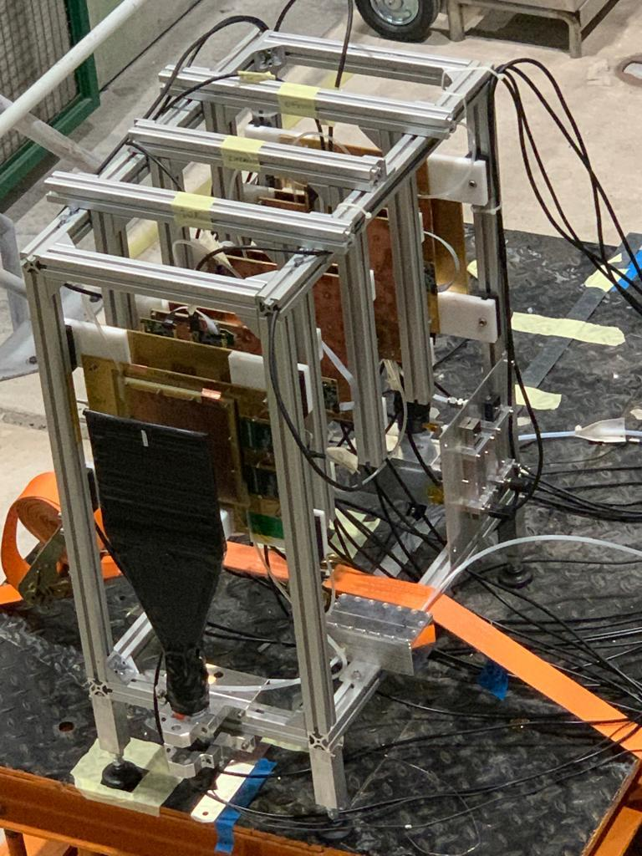
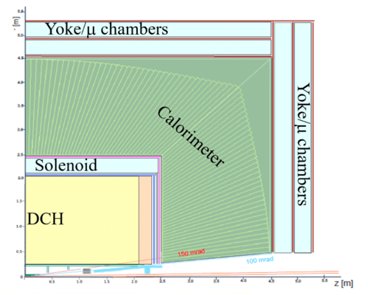
8th FCC Physics workshop
Mahmoud Ali
IDEA: Muon system based on μRWELL technology
The μ-RWELL [JINST] is a Micro Pattern Gaseous Detector (MPGD) composed of only two elements:
The μ-RWELL_PCB and the cathode.
The core is the μ-RWELL_PCB, realized by coupling three different elements:
1. A WELL patterned kapton foil acting as amplification stage (GEM-like)
2. Resistive DLC layer (Diamond-Like-Carbon) for discharge suppression with surface resistivity ~ 50÷100 MΩ/□
3. Standard readout PCB

Slide 5
8th FCC Physics workshop
Mahmoud Ali
IDEA: Muon system based on μRWELL technology
IDEA muon system primarily composed of 3 sensitive stations. Each station will consist of a large mosaic of μRWELL detectors.
The basic μRWELL ”tile” will have an active area of 50 × 50 cm².
The layers are placed between layers of the iron yoke that closes the magnetic field.
A strip pitch ~ 1.2 mm and 500 mm length.
A 2D readout system for each individual chamber.
Space resolution ~ 400 μm
DD4hep implementation of IDEA muon system

Slide 6
8th FCC Physics workshop
Mahmoud Ali
  see talk@Oxford [*]
  https://indico.cern.ch/event/783429/contributions/3376675/attachments/1829951/2996531/Oxford_April2019_V1.pdf
Delphes study: Tracks from Standalone Muon-system
Detector layer
Usually in Delphes, we can’t work with standalone sub-detector, but thanks to track covariance module by Franco Bedeschi, a standalone muon-system IDEA card has been obtained by adopting IDEA card to use only muon system layers as sensitive and other sub-detectors as non-sensitive (For multiple scattering use)
        Simple tracker geometry implementation, including material multiple scattering
        Computes full covariance matrix (depend on p_{T}, θ)
        Computes smeared track (including off-diagonal terms)
Return-yoke
So, the study will investigate different apparatuses and characteristics of the muon-system trying to observe the best performance by:
Varying the number of layers.
Varying the level-arm distance.
Varying the space resolution of the detector.

Slide 7
8th FCC Physics workshop
Mahmoud Ali
Delphes study: Tracks from Standalone Muon-system
Tests have been done by emulating LLPs decays in two muons in the calorimeter volume @ 3.5 m away from the IP, muon maximum P_{T} =45 GeV.
10 K events → 20 k muons.
Cuts on the selected events:
- Choosing only events have two muons at final states.
- Maximum P_{T} =100 GeV for combined two muons.

Slide 8
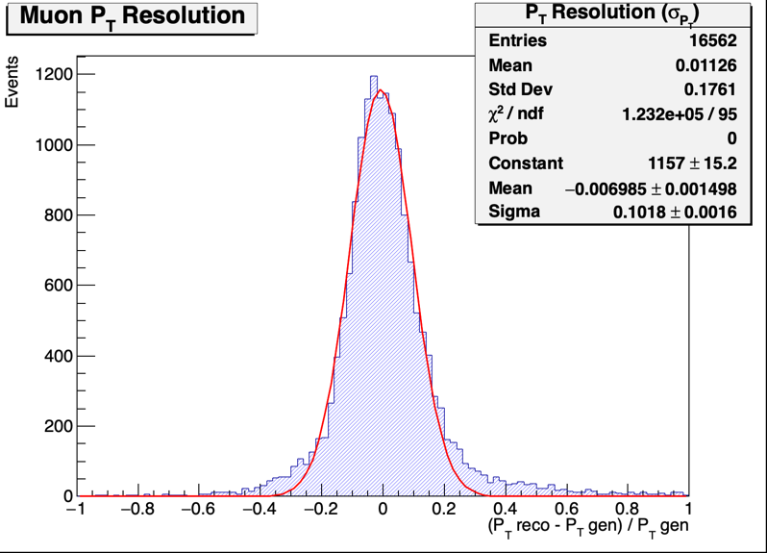
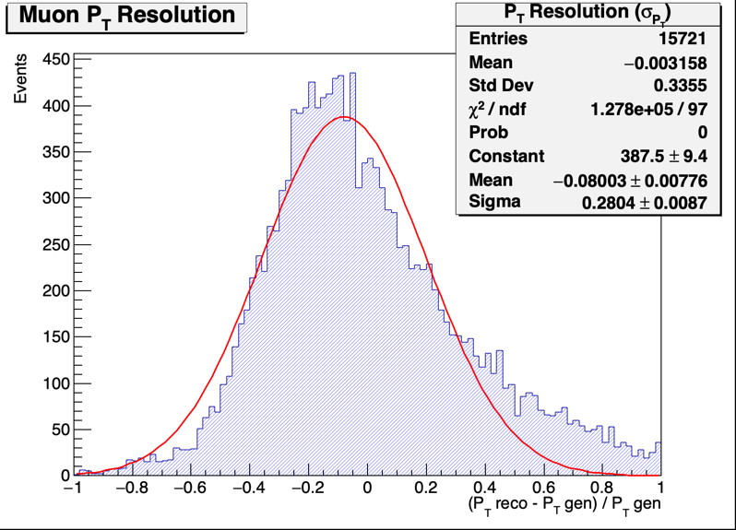
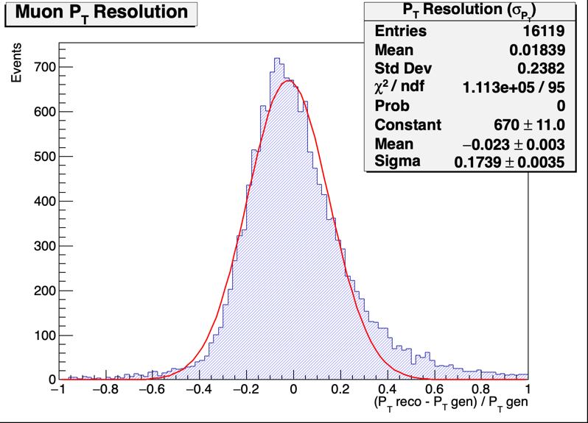
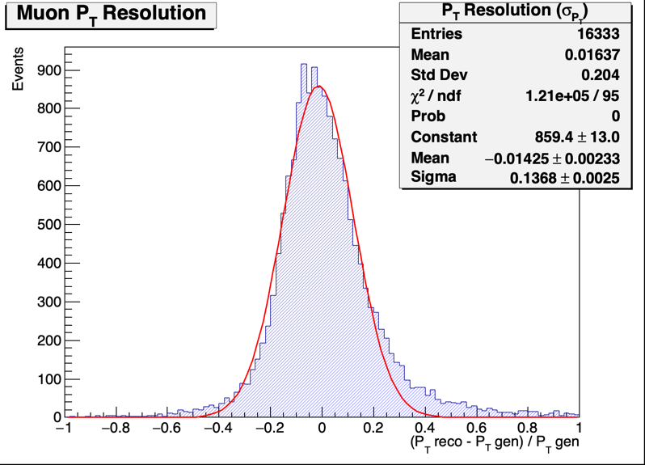
8th FCC Physics workshop
Mahmoud Ali
Delphes study: Tracks from Standalone Muon-system Varying number of Detector layers:
All 400 µm space resolution
The primarly design of IDEA muon-system consists of 3 detector layers and 2 return yokes.
6 Layers
10 cm
30 cm
3 Layers
4 Layers
5 Layers

Slide 9
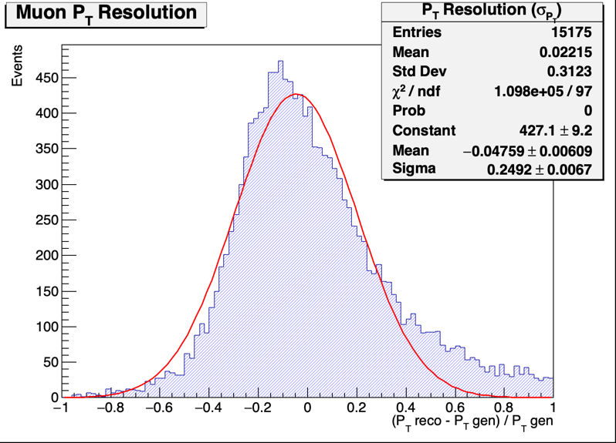
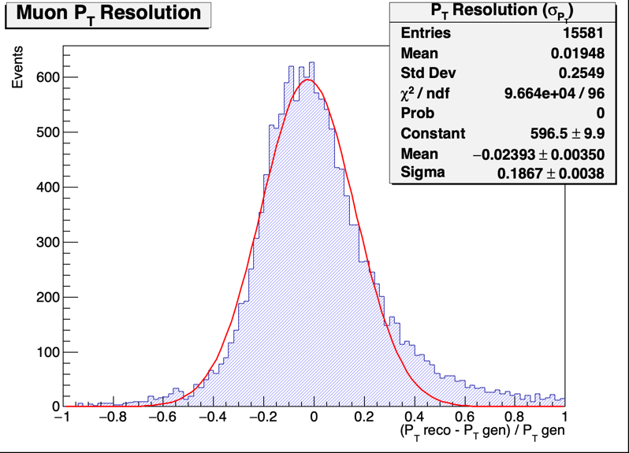
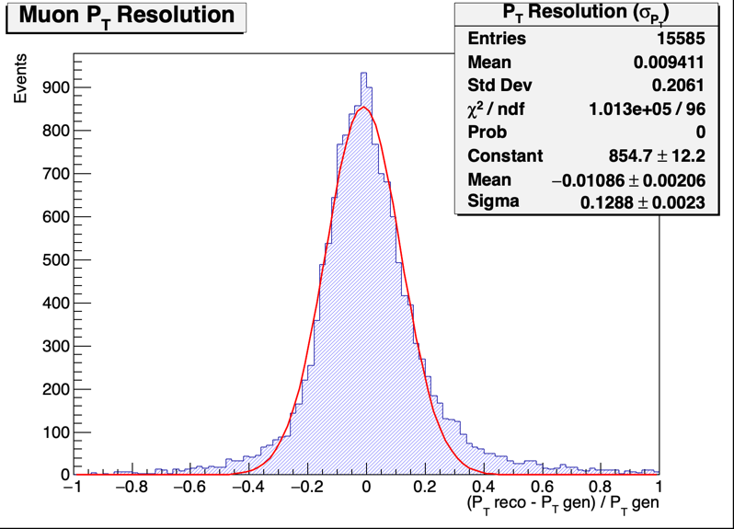
8th FCC Physics workshop
Mahmoud Ali
Delphes study: Tracks from Standalone Muon-system
Varying level arm distance:
All 400 µm space resolution
The distance between every two detectors layers
10 cm
50 cm

Slide 10
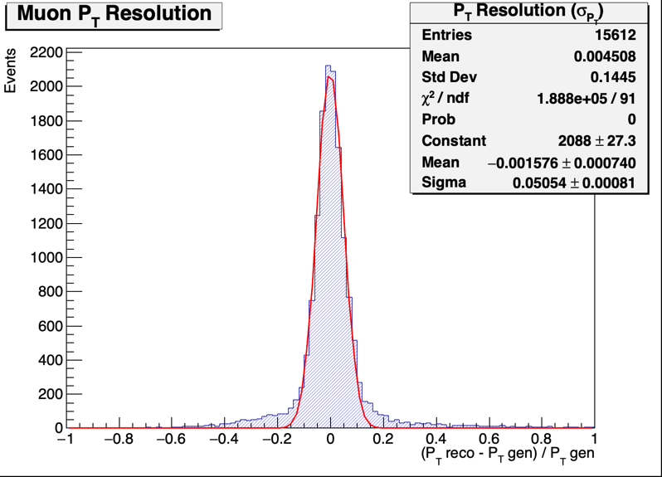
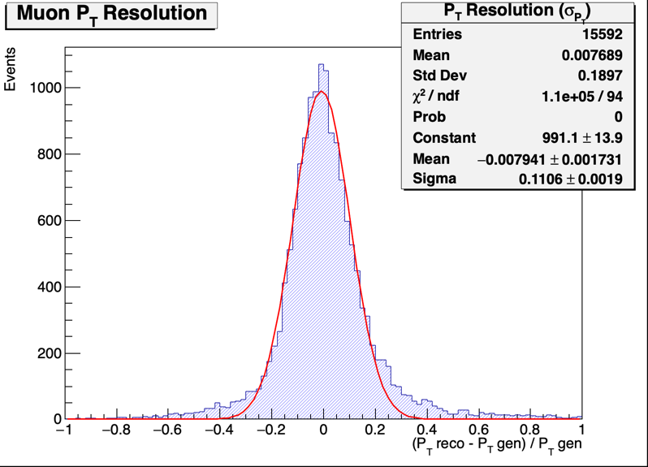
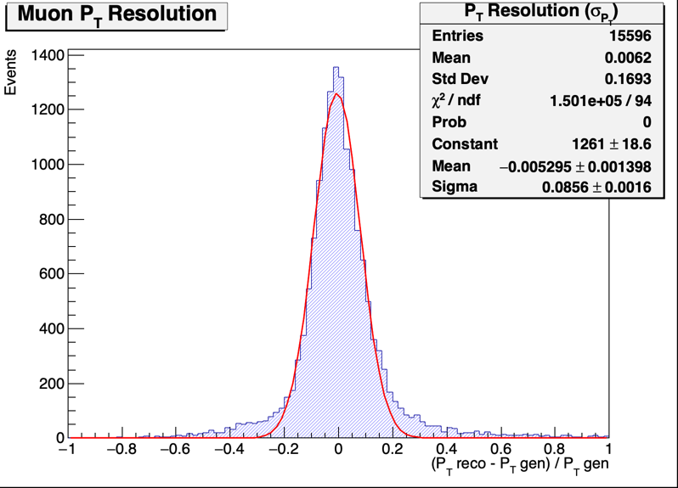
8th FCC Physics workshop
Mahmoud Ali
Delphes study: Tracks from Standalone Muon-system
Varying detector space resolution:
4 Layers with level-arm = 50 cm, and only two yokes.
100 µm
400 µm
300 µm
200 µm

Slide 11
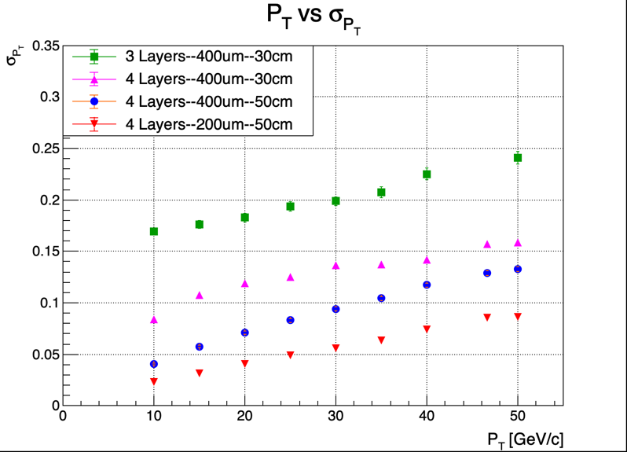
8th FCC Physics workshop
Mahmoud Ali
Scanning over transverse momentum:
To summarize, 4 different muon-system apparatuses in comparison.
# Layers – detector space resolution- level-arm distance(cm).
Full-SIM: Standalone Muon-system Reconstruction
The plan is to start from the dd4hep implementation of IDEA detector and adopting CLD tracking on our IDEA muon-system.
Applying surface plugin to be able to use it in DDPlanarDigi. Which will smear the hit positions.
The using the output as an input to SiliconTracking_MarlinTrk.

Slide 12
Thank you for your attention.
8th FCC Physics workshop
Mahmoud Ali
12
Mahmoud.ali@bo.infn.it

Slide 13
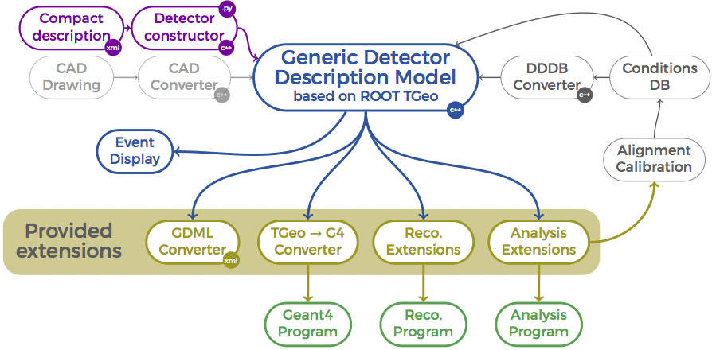
8th FCC Physics workshop
Mahmoud Ali
Full Simulation for FCC:
MC Event Generation
Reconstruction
Analysis
Detector description in DD4hep
Readout simulation (Digitization)
The FCC Software fully adopts Key4hep;
Key4hep: Complete data processing framework, from generation to data analysis
Data format is EDM4hep.
Detector description is DD4hep.
Algorithm orchestration done by Gaudi.
Full-SIM goes in 3 stages:
Detector description.
Digitization.
Reconstruction (if available).
For each IDEA sub-detector.

Slide 14
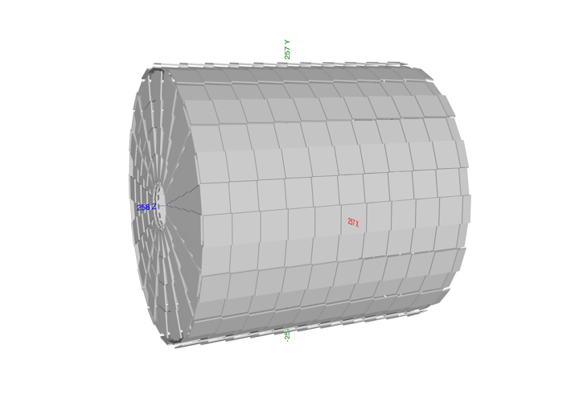
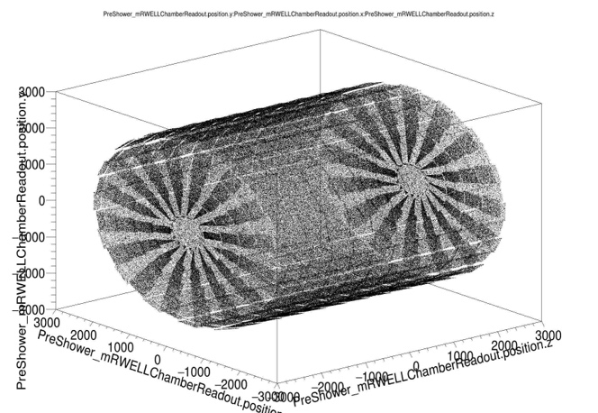
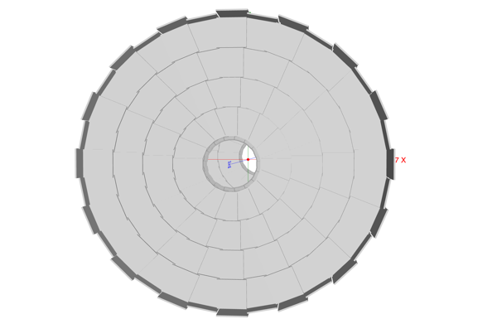
8th FCC Physics workshop
Mahmoud Ali
IDEA: Preshower based on μRWELL technology
IDEA detector envisages one layer preshower system utilizing µRWELL technology. Both the preshower and muon systems have a modular design, with both sharing the same builder file.
Pitch between readout strips: 400 μm
A 2D readout system for each individual chamber.
Space resolution ~ 100 μm.
One layer encapsulate the solenoid

