Slide 1
Comparing the performance of the anti-kt and Durham-kt jet clustering algorithms in ZH fully hadronic Final state events
Anna Elizabeth A. Connelly
gratefully acknowledging the contributions of the FCC Infrastructure
and Operation WG and sub-WGs, all FCC study teams
and the collaborating partners
as well as the Bard College Office of Undergraduate Research for funding my trip to CERN

Slide 2
Motivation
Investigating fully hadronic final state events
Durham-kt algorithm in n-jets mode is not infrared safe
Want to test if another algorithm can improve jet clustering accuracy
Durham-kt n-jets– d_{ij}= 2 min(E_{i}² , E_{j}²)(1− cos θ_{ij}) Recombine smallest d_{ij} Algorithm stops when there are n-jets | Anti-kt– d_{ij} = 2 min(E_{i}⁻² , E_{j}⁻²)(1−cos θ_{ij})(1−cosR) d_{iB} = E_{i}⁻² If d_{ij} is smallest combine i and j If d_{iB} is smallest i becomes a jet
Notes:
before slide 3, `

Slide 3
Comparing anti-kt and durham-kt algorithms
Basic guidance on jet algorithms (& FastJet) for FCC-ee FCC Physics Performance meeting, 27 June 2022, Cacciari, Salem, Soyez
  Their study looks at H(bb)Z(vv) example process
  anti-kt algorithm with energy recovery shows indistinguishable results from Durham
  n-jet algorithm in their study
  apply this method to fully hadronic final state events
    using H(bb)Z(cc) as a sample process

Slide 4
Anti-kt R=0.4 and 0.7 N jets before recovery
Notes:
comment - 2 plots per slide
0.4 and 0.7
one plot with 1.0 and 1.1

Slide 5
Anti-kt R=1.0 N jets before recovery

Slide 6
Energy recovery algorithm for anti-kt
1. Jets are sorted by energy
2. Four highest energy jets are selected
3. Each extra jet recombines with high energy jet closest in angle
minimum energy 10 GeV – also applied to Durham-kt for consistency
Once there are four jets – correction applied assuming 240 GeV C.O.M. energy
(same correction is applied to Durham-kt jets)
Notes:
A jet algorithm is infrared safe if it yields the same set of jets after modifying an event to add a soft radiation.
following the basic guidance gudiance on jet algorithms - z to nunu higgs to bb showed promising results with antikt, we wanted to show how this would perform in fully hadronic
for consistency, applied the same the 10 GeV cut was applied to the Durham-kt
distance measure on the right for
the study add

Slide 7
Comparing reconstructed Higgs mass
Comparing Durham-kt with anti-kt masses at R=0.4, 0.7, 1.0, and 1.1
H(bb)Z(cc) sample process
Events selected to plot have exactly 2 b and 2 c quarks
  Truth flavor of the jet determined by closest truth quark

Slide 8
Anti-kt and Excl. Durham-kt Higgs mean mass
8
Normalized events
Normalized events
Mass [GeV]
Mass [GeV]
ER – Energy recovery
Choosing smaller R for the anti-kt algo results is worse mass resolution
Notes:
R increases, the anti-kt Higgs mass becomes closer to truth mass
Higgs mass is overestimated with correction
square brackets for unit
change font to black
normalized events on y axis
quality -- better resolution, more peaked
quite big tails

Slide 9
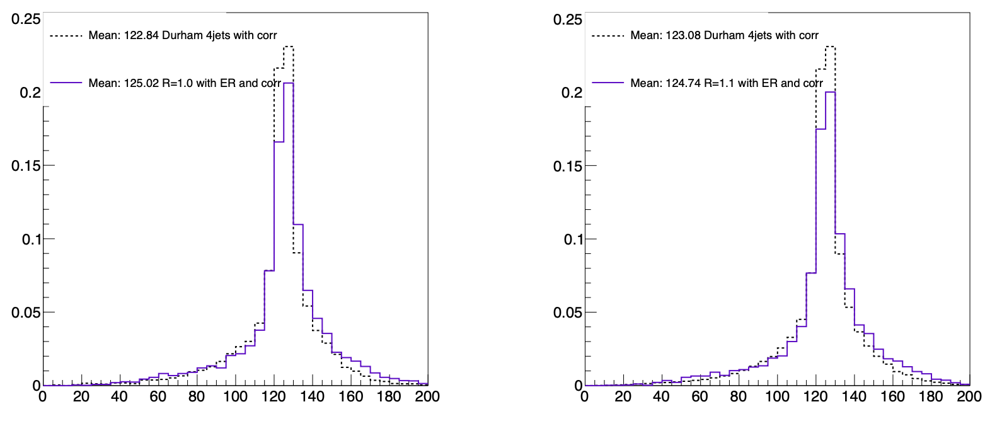
9
Anti-kt and Excl. Durham-kt Higgs mean mass
Normalized Events
1.0
Normalized Events
1.1
Mass [GeV]
Mass [GeV]
At jet radius 1.0-1.1 anti-kt algorithm performs comparably to Durham-kt
Notes:
R increases, the anti-kt Higgs mass becomes closer to truth mass
Higgs mass is overestimated with correction

Slide 10
Comparing reconstructed Higgs masses
Mean Higgs mass with anti-kt algorithm and energy recovery and energy correction
Jet Radius | Higgs mass [GeV] | Z mass [GeV]
0.4 | 129.29 | 91.39
0.7 | 126.36 | 92.53
1.0 | 125.02 | 92.06
1.1 | 124.74 | 91.82
Excl. Durham n-jet | 123.08 | 92.22

Slide 11
Higgs truth energy and momentum

Slide 12
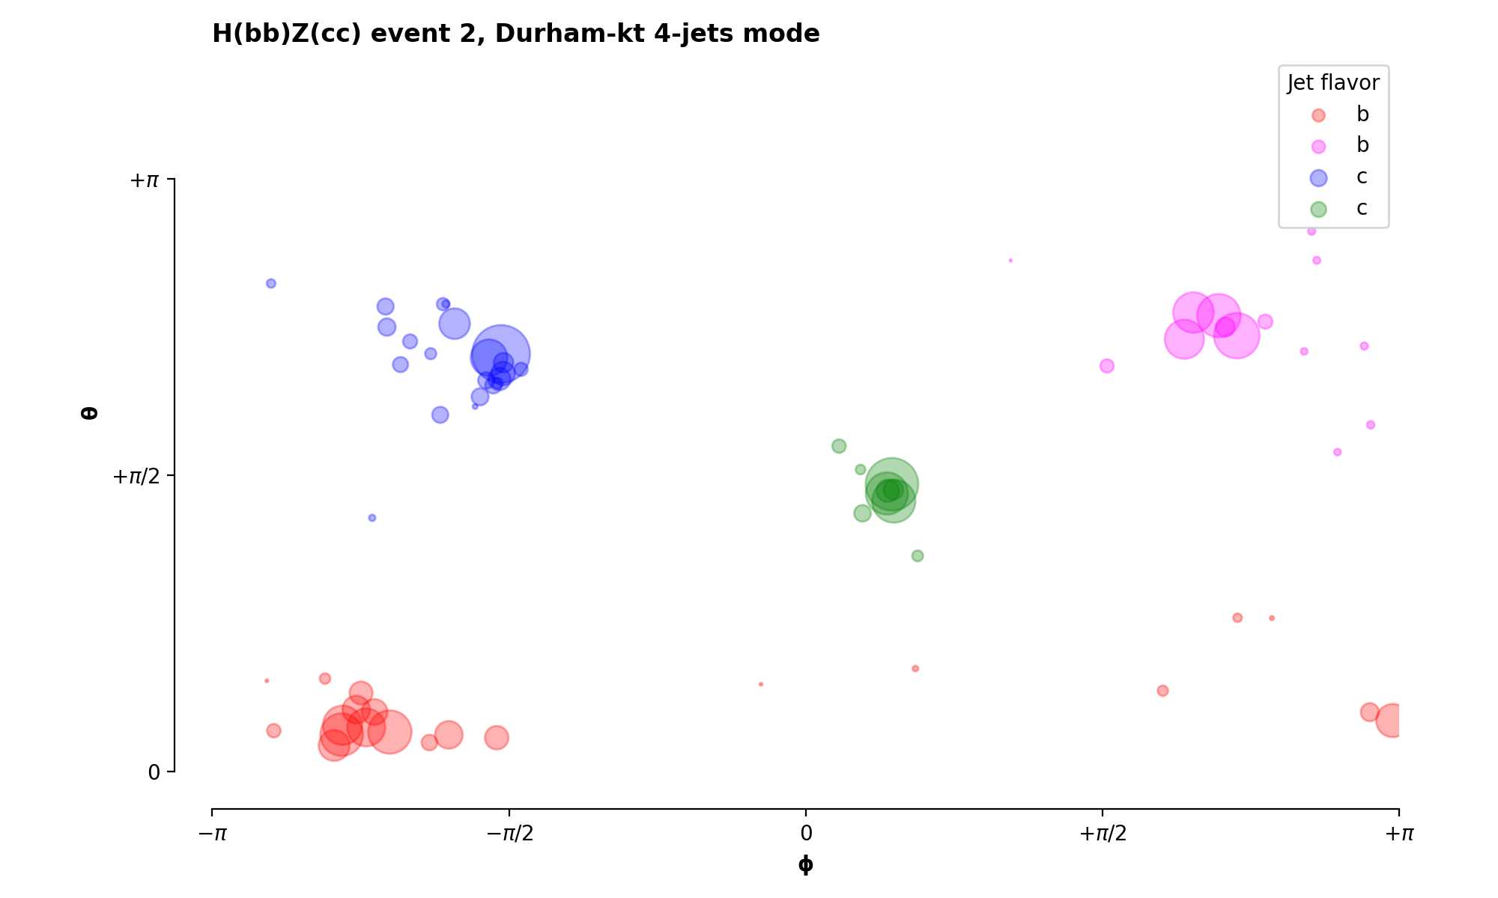
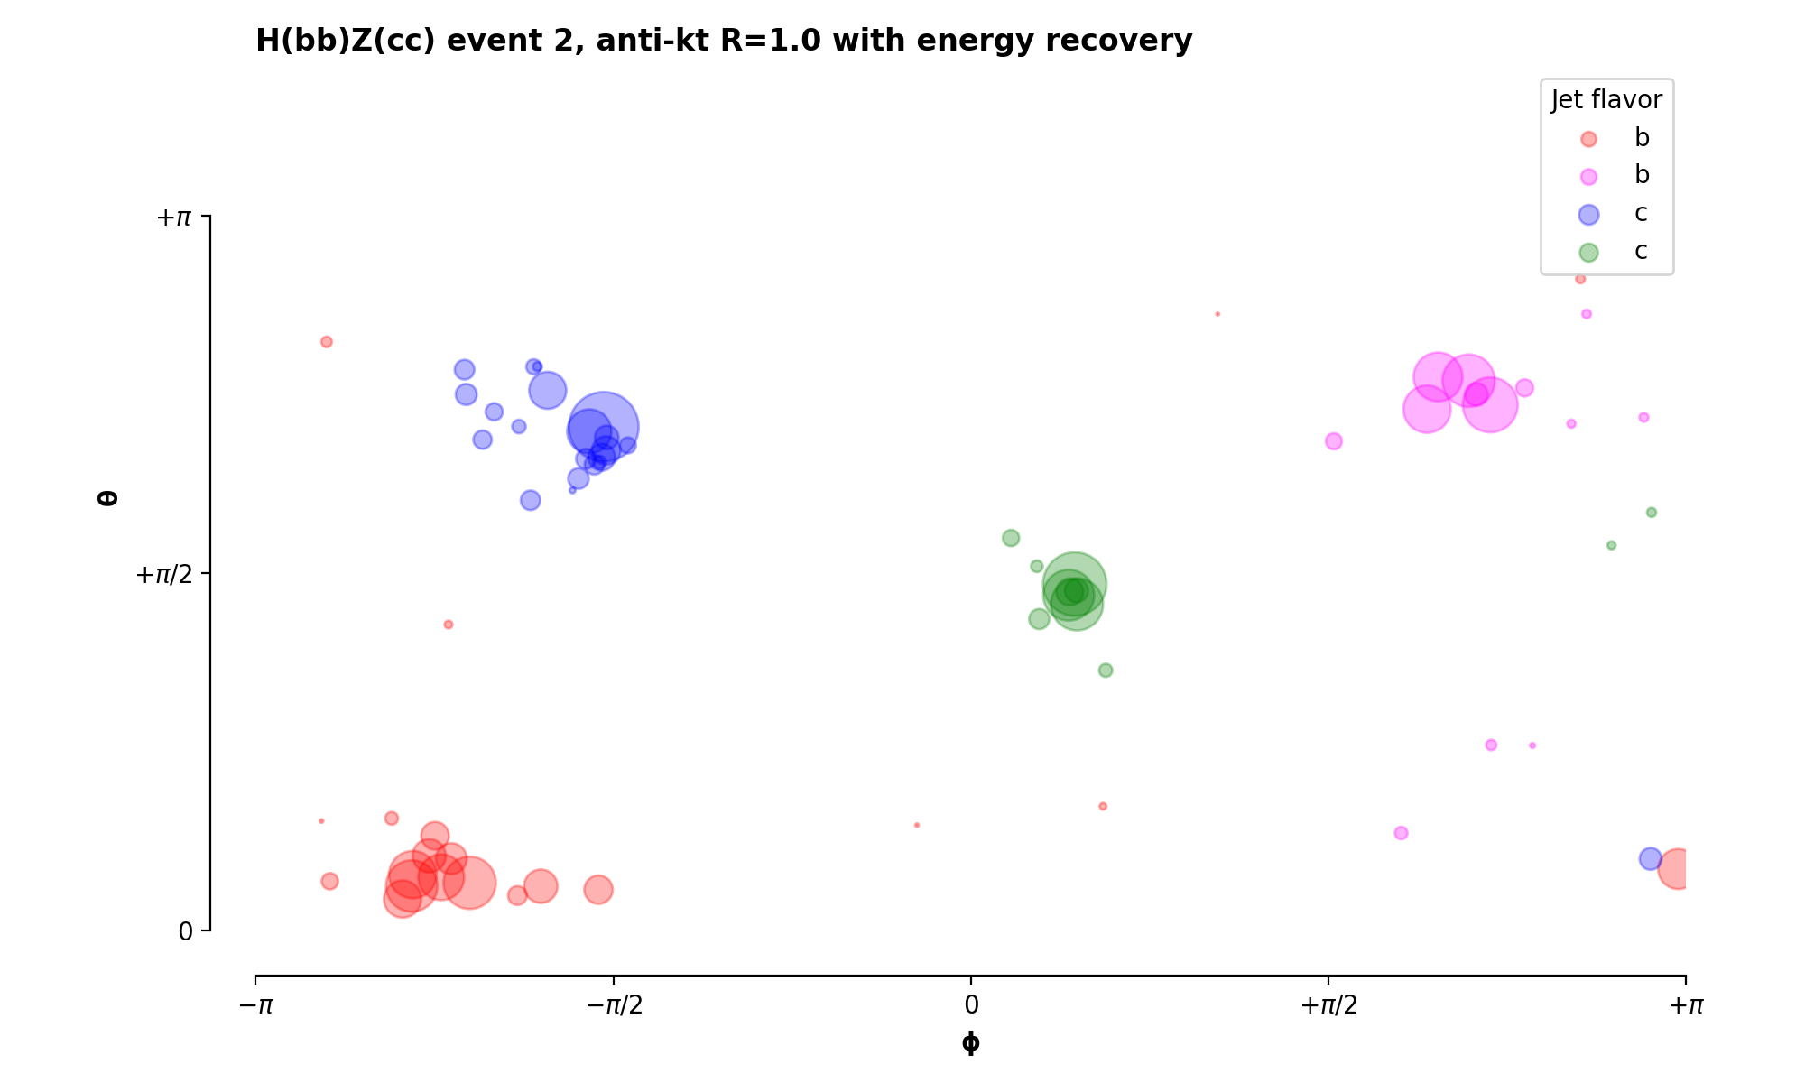
Durham-kt and anti-kt theta-phi event displays
Durham-kt 4-jets mode
anti-kt R=1.0 with energy recovery
Thank you to N. Morange for the initial event display code from Measurement of the Higgs width presented at 7th FCC Physics Week
Mo

Slide 13

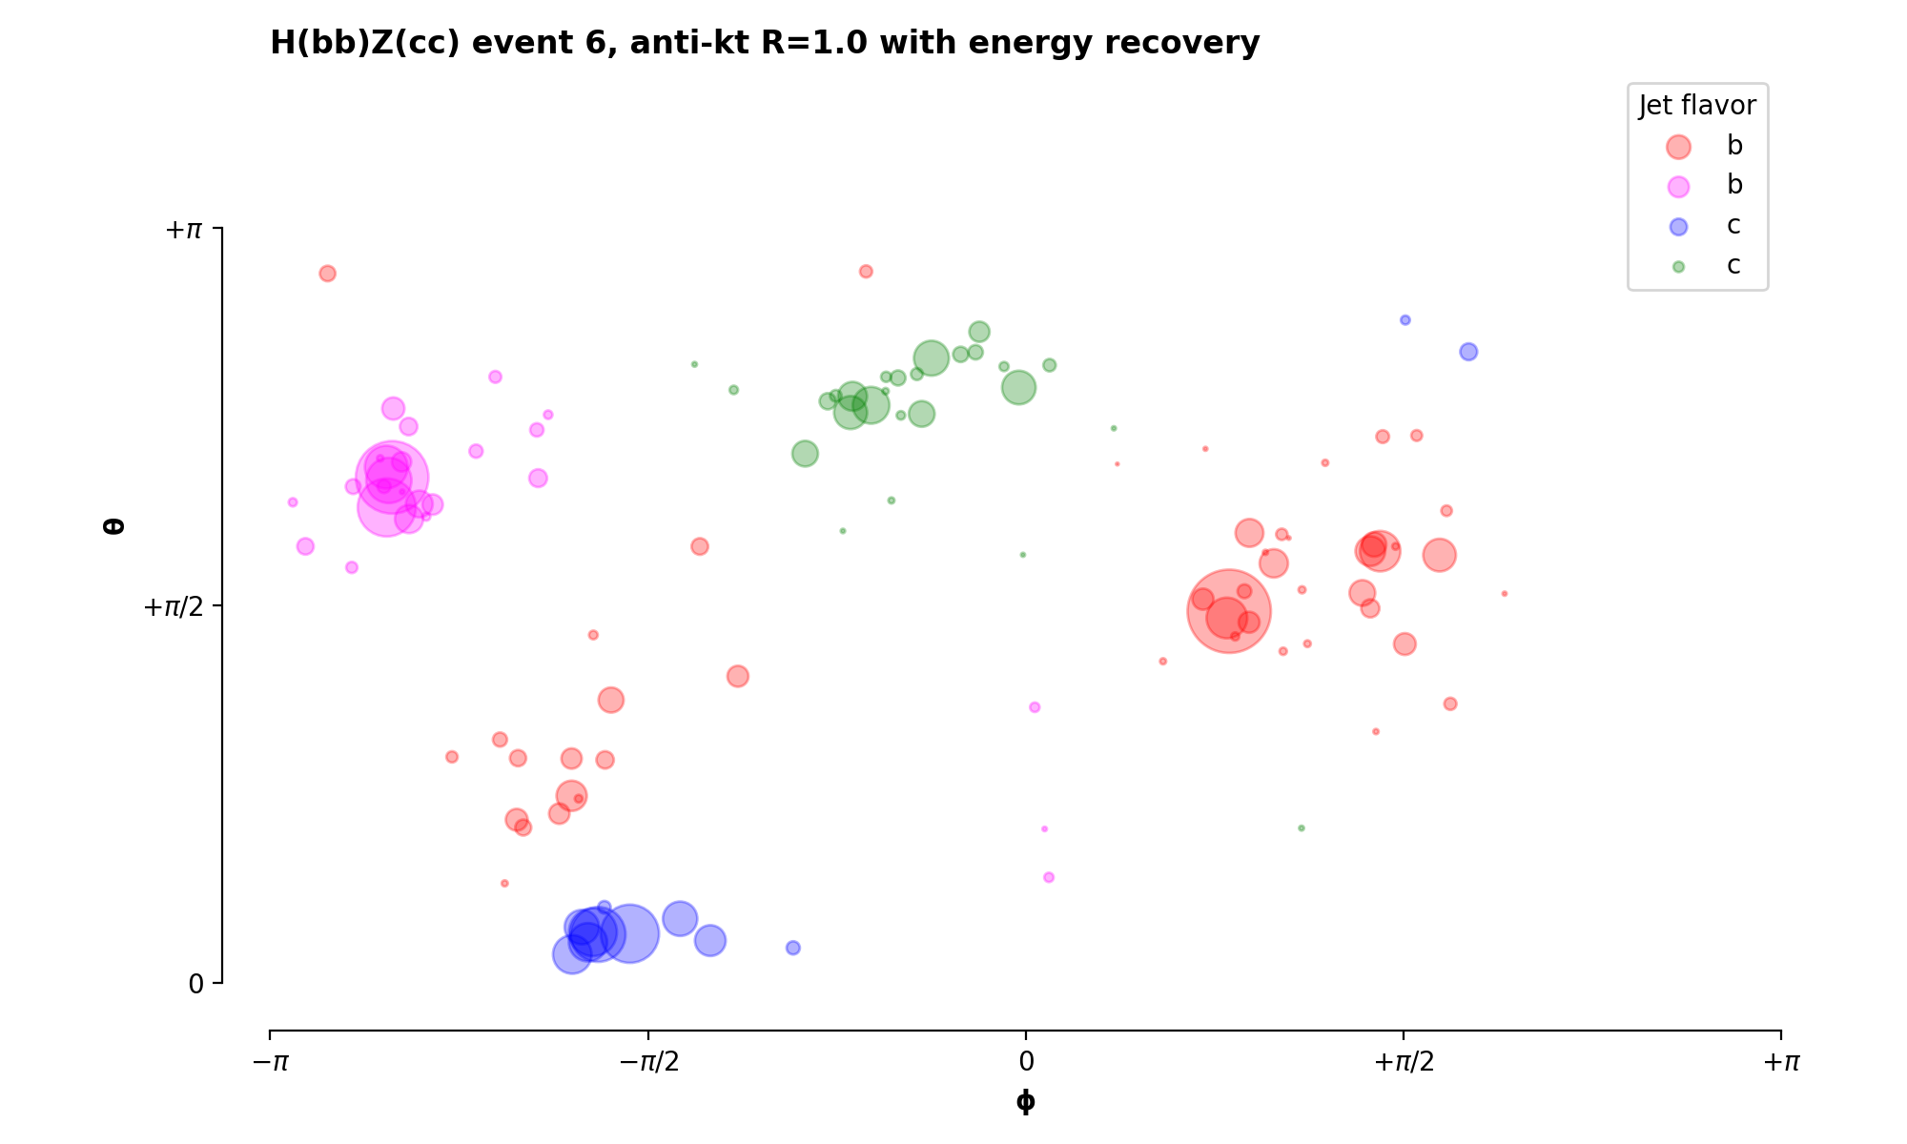
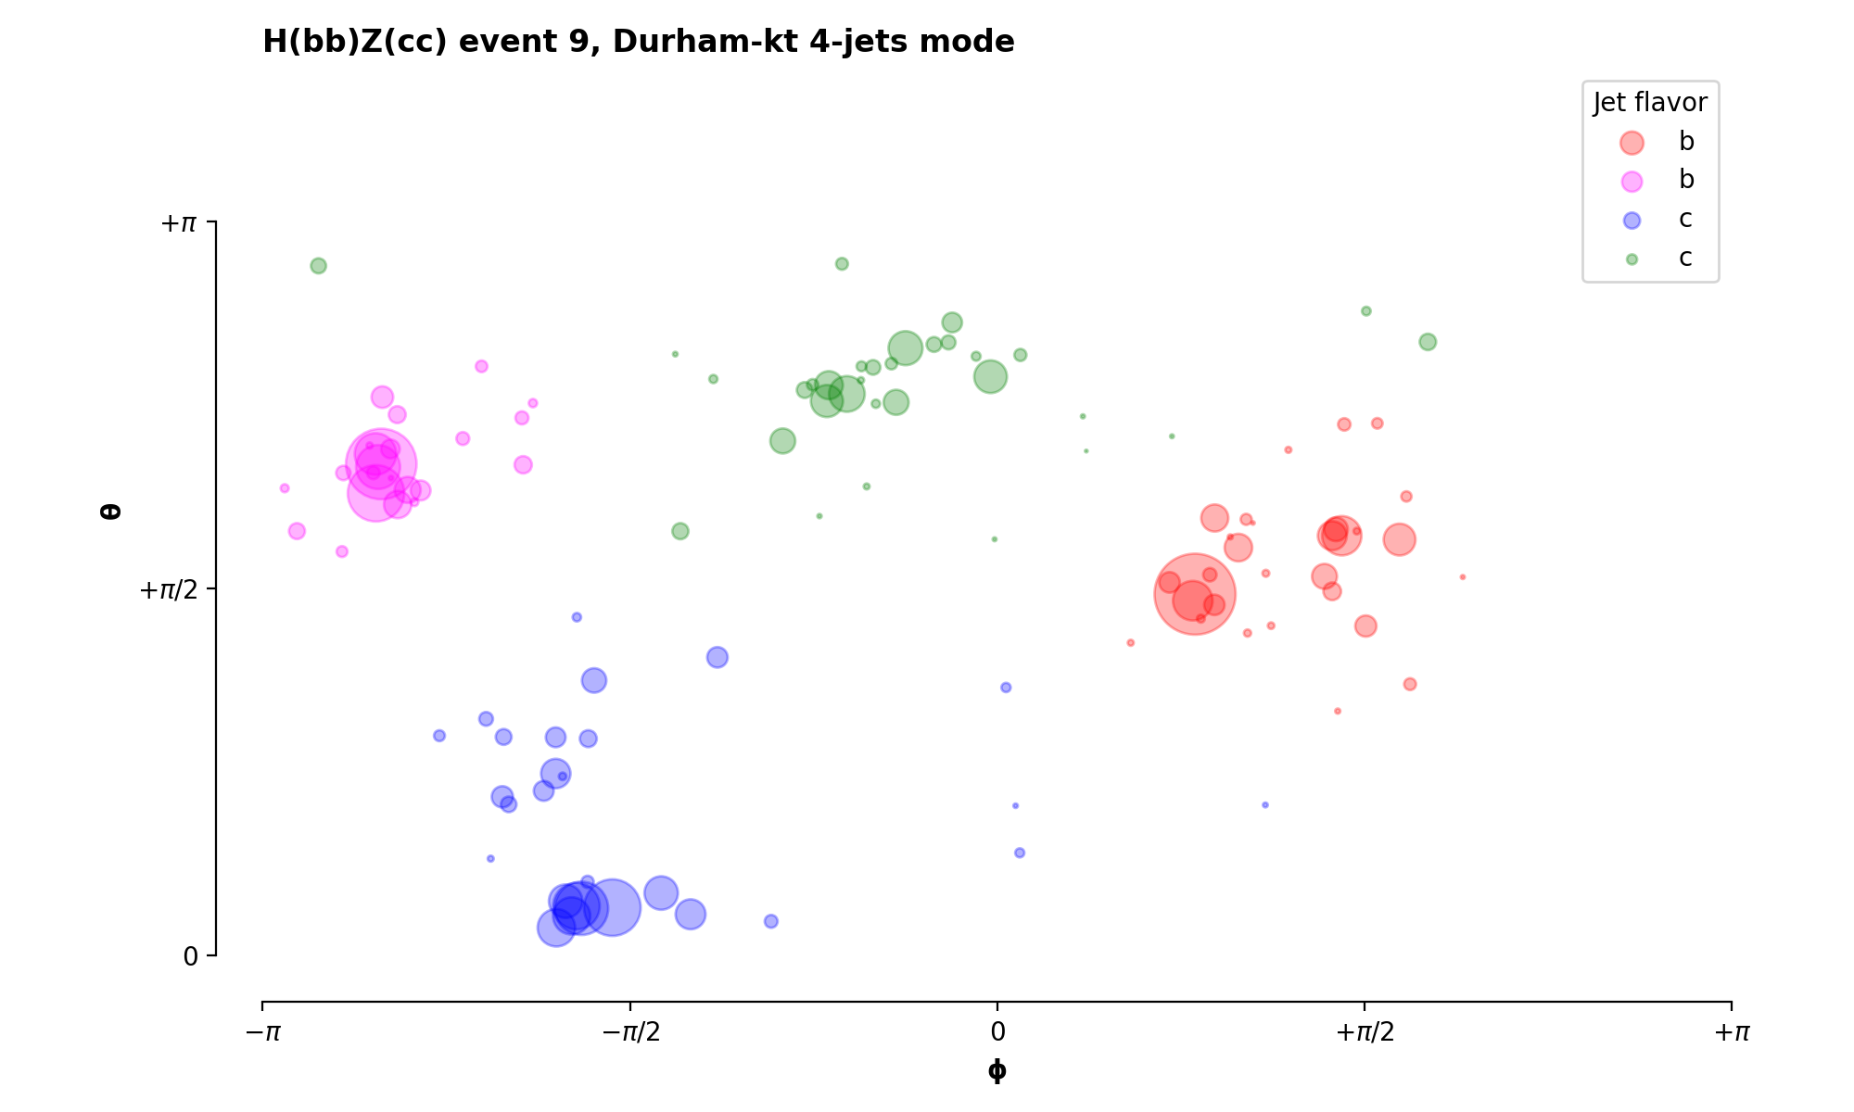
Durham-kt and anti-kt theta-phi event displays
13
Durham-kt 4-jets mode
anti-kt R=1.0 with energy recovery
Notes:
Add reference to other person

Slide 14
Conclusions
The Durham-kt in n-jet mode performs comparably to the anti-kt when jet radius is set to 1.0-1.1
Follow up:
  investigating the edge cases
  performing a full analysis chain with anti-kt algorithm to see if there is an impact on the limit of the Higgs coupling
Notes:
the durhamkt in the njet mode performs comparably to the antikt clustering when radius is set to 1.1
follow up: understanding edge cases as shown in the display
next step will be to perform a full analysis chain with the anti-kt algorithm to see if there is an impact on the limit of the higgs coupling

Slide 15
Thank you for your attention.
Thank you again to the Bard College
Office of Undergraduate Research.
Date / Name of the event

