Slide 1

ML-based Jet Flavor Tagging in Fast and Full Simulation
8th FCC Physics Workshop
16. January 2025
Sara Aumiller, Dolores Garcia, Michele Selvaggi

Slide 2
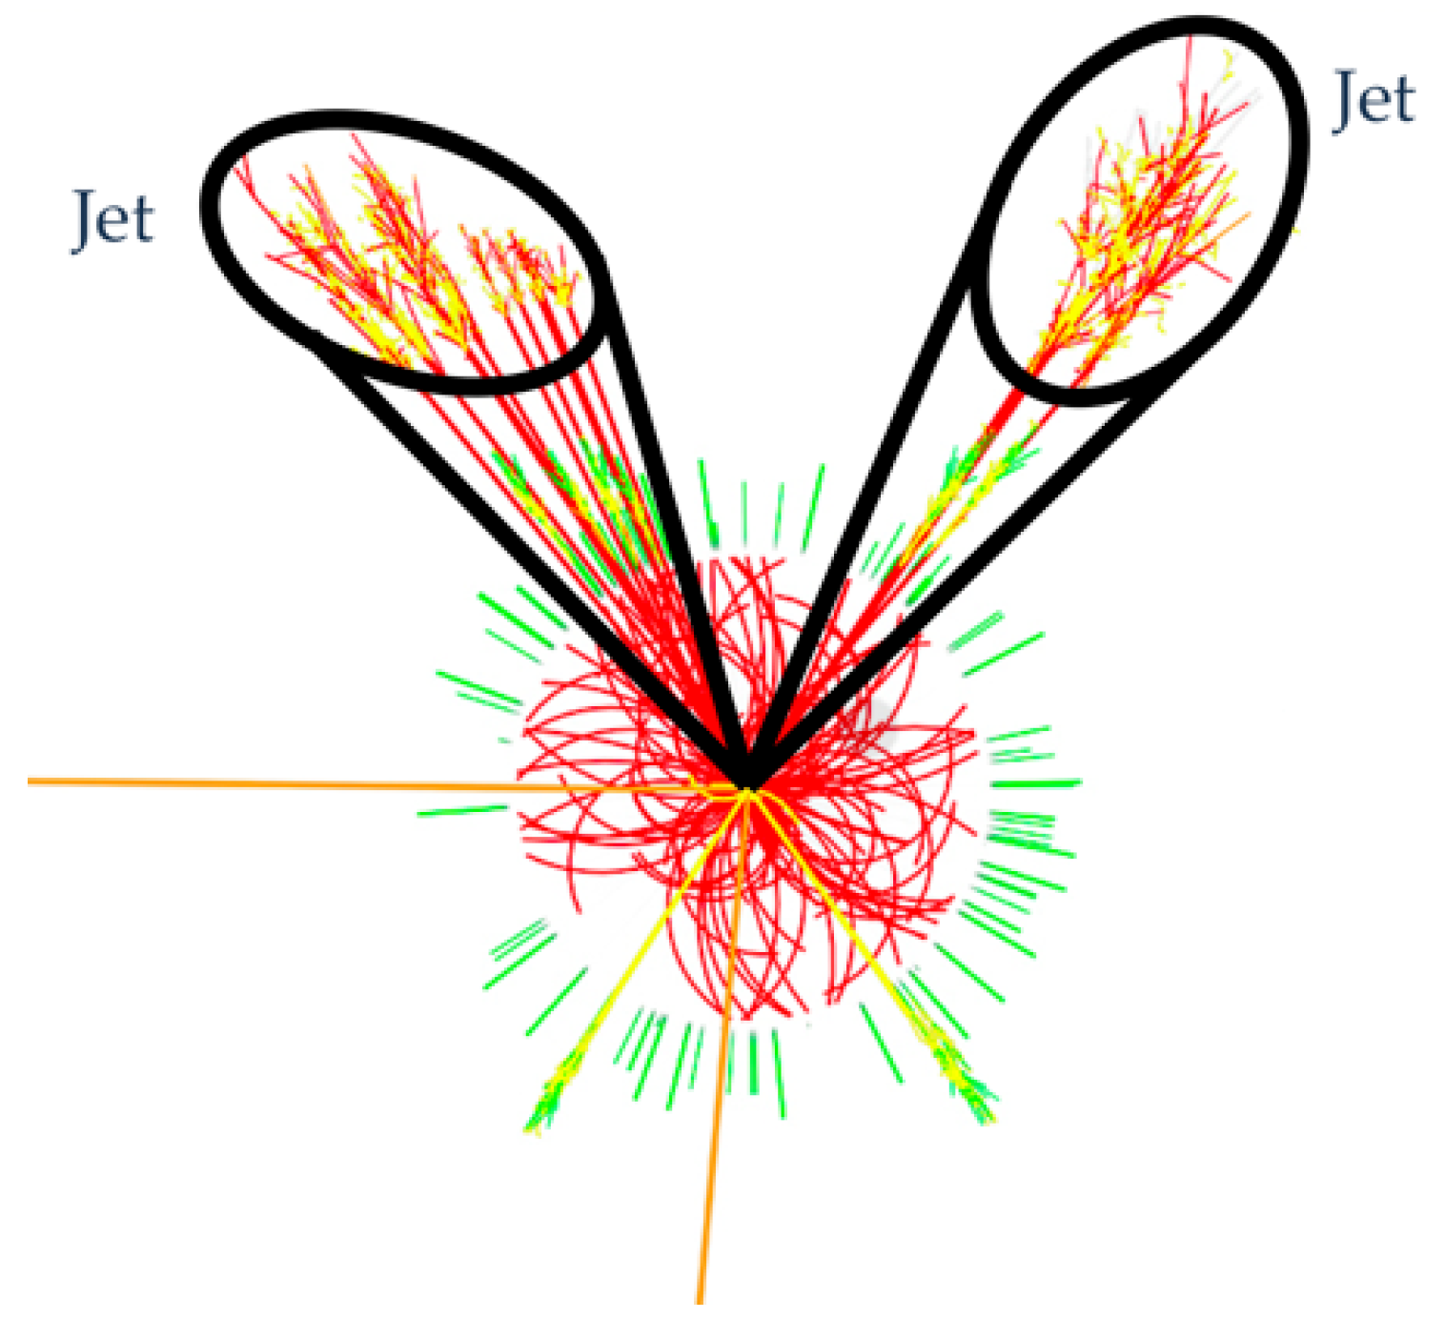
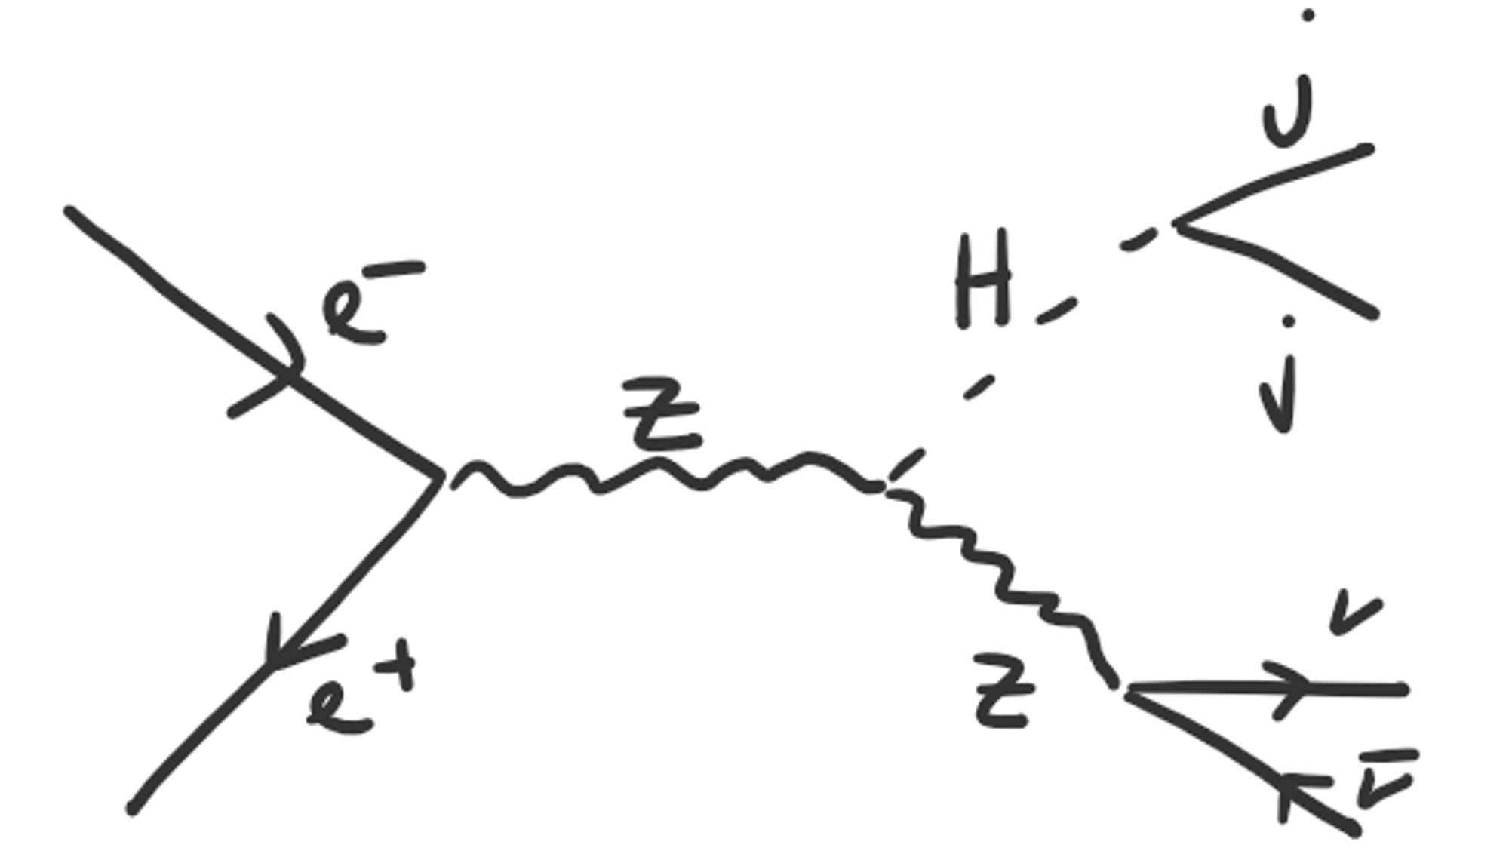
Why Jet-Flavor Tagging?
at 240 GeV
Future Colliders
=
Higgs factories for precious measurements
Particles causing jets:
quarks (u,d,s,c,b)
gluons (g)
leptons (τ)

Slide 3
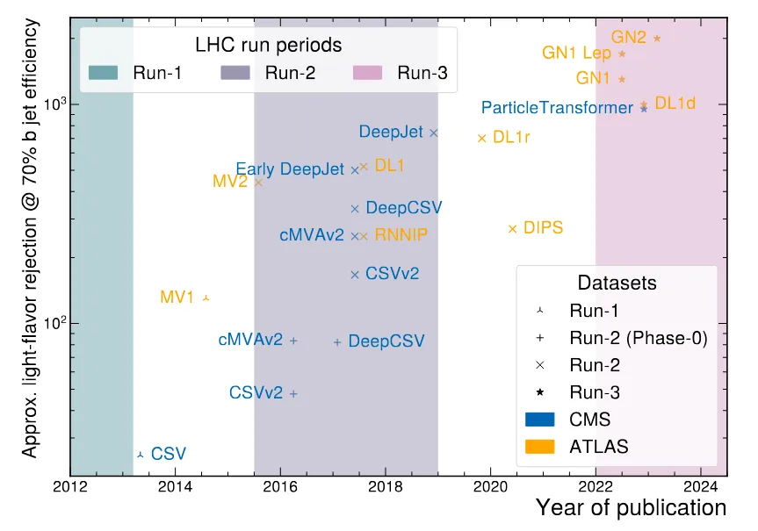
Why use Machine Learning (ML)?
2045?
Stunning improvement of jet-flavor tagging through ML over the last decade
better
Performance of the tagger
https://doi.org/10.1140/epjs/s11734-024-01234-y
Notes:
CSV = combined secondary vertex algorithm uses a likelihood ratio method to optimally use different variables (like SIP, SV)
“They have also enabled development of methods to measure the Higgs-charm coupling [131, 240] to a degree of accuracy that was earlier predicted to be achievable only at the HL-LHC”

Slide 4
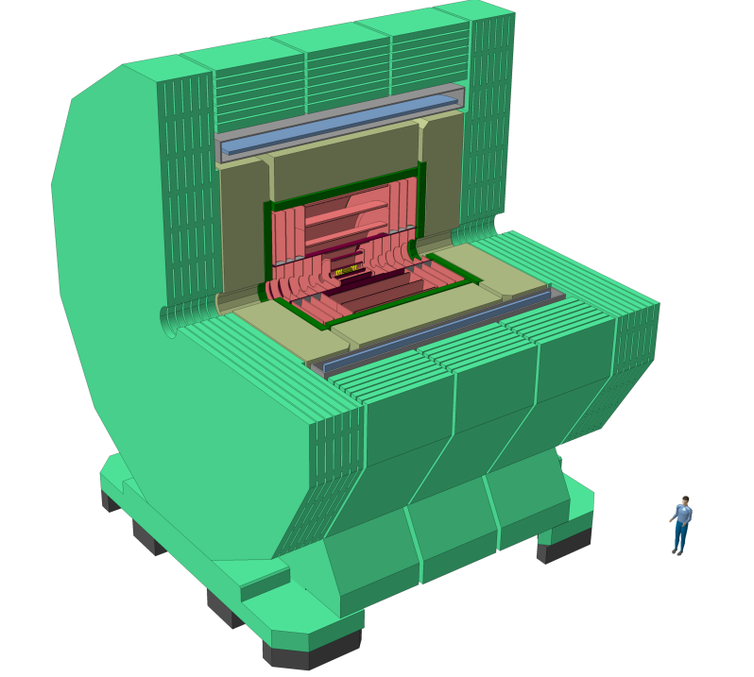

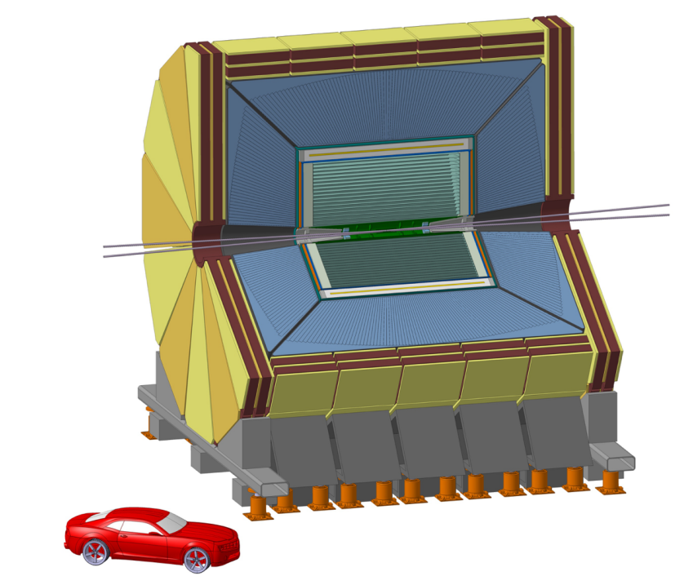
Fast & Full Simulation at FCC-ee
 | Fast simulation | Full simulation
 | time & computational efficient early-stage feasibility studies | more realistic description of detector concept and reconstruction algorithms
CLD | IDEA fast simulation with silicon tracker | Using GEANT4 and Marlin
IDEA | Using DELPHES | -
https://arxiv.org/pdf/1911.12230
https://doi.org/10.22323/1.414.0337

Slide 5

Fast & Full Simulation at FCC-ee
 | Fast simulation | Full simulation
 | time & computational efficient early-stage feasibility studies | more realistic description of detector concept and reconstruction algorithms
CLD | IDEA fast simulation with silicon tracker | Using GEANT4 and Marlin
IDEA | Using DELPHES | -
https://arxiv.org/pdf/1911.12230
https://doi.org/10.22323/1.414.0337
Major difference between CLD & IDEA: IDEA can retreive PID via dNdx & ToF

Slide 6
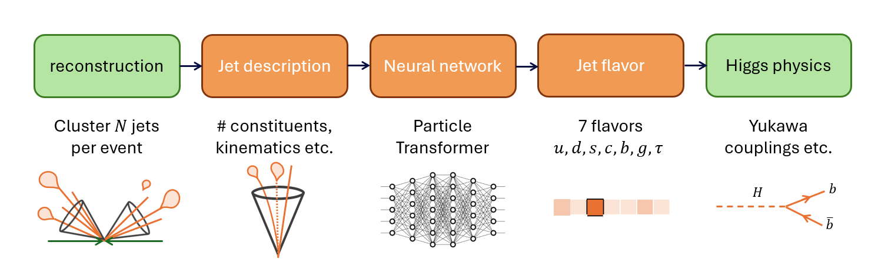
Jet-Flavor Tagging Set-Up
Focus of this work

Slide 7

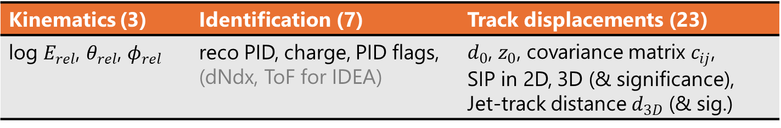
Jet Description
We characterize the jet constituents:
Kinematics (3) | Identification (7) | Track displacements (23)
log $E_{rel}$, $θ_{rel}$, $φ_{rel}$ | reco PID, charge, PID flags, (dNdx, ToF for IDEA) | $d_{0}$, $z_{0}$, covariance matrix $c_{ij}$, SIP in 2D, 3D (& significance), Jet-track distance $d_{3D}$ (& sig.)

Slide 8
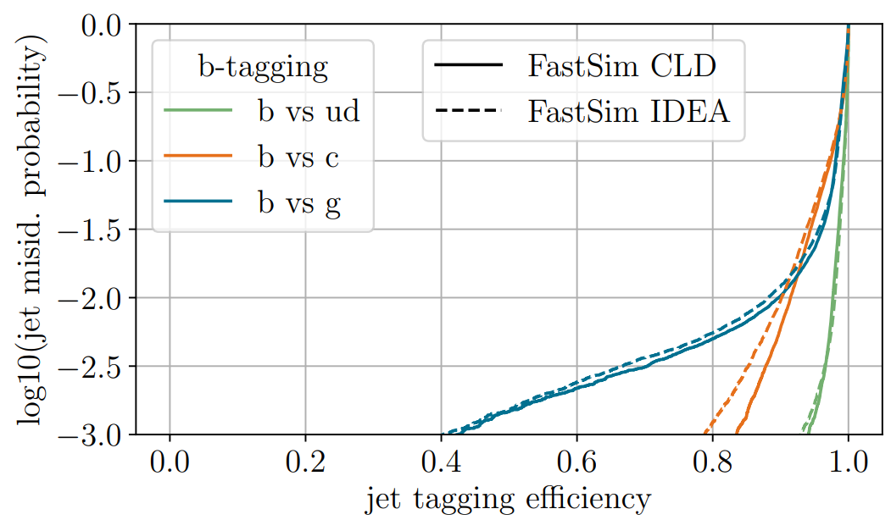
Jet Tagging in Fast Simulation
Good agreement in performance between CLD and IDEA
work in progress
better

Slide 9
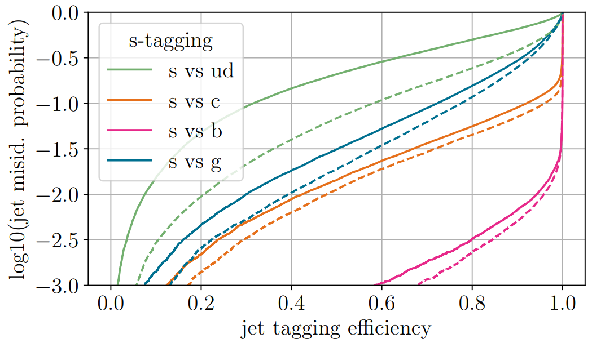
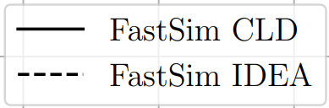
Jet Tagging in Fast Simulation
better
As expected:
IDEA outperforms CLD in s-tagging through access to PID!
work in progress

Slide 10
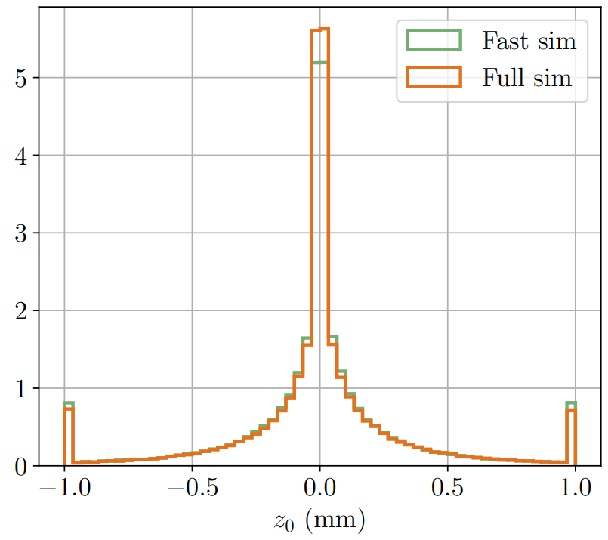

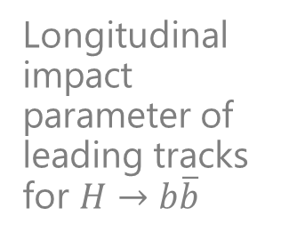
Jet Description in Full Simulation
We need to validate the jet description in full simulation comparing it to fast simulation!
$→$ Comparison shows mostly good agreement:
Longitudinal impact parameter of leading tracks for $H→b\overline{b}$
Two major differences in full simulation:
Fake neutrals
Unassociated tracks to PFOs

Slide 11
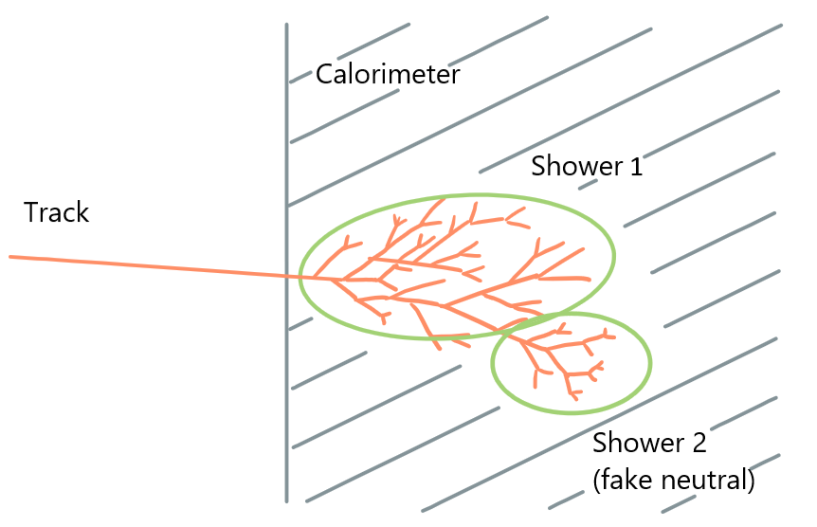
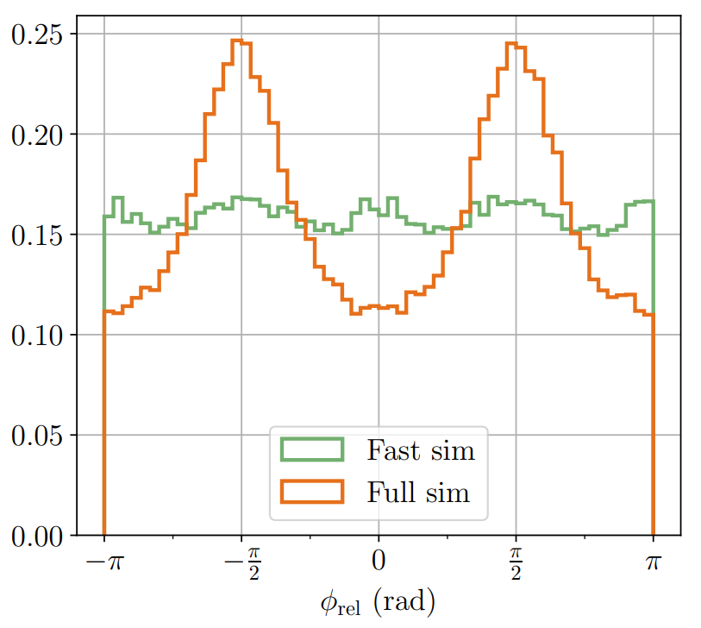
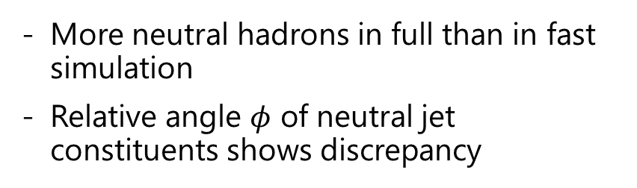
(1) Fake neutrals in full sim
More neutral hadrons in full than in fast simulation
Relative angle $φ$ of neutral jet constituents shows discrepancy
Artificially split cluster of high-energy charged particles (at MC level) creates fake neutral.
leading neutral hadronic jet constituents

Slide 12
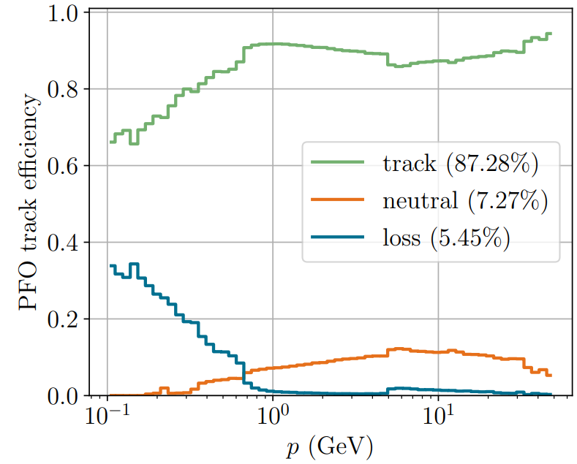
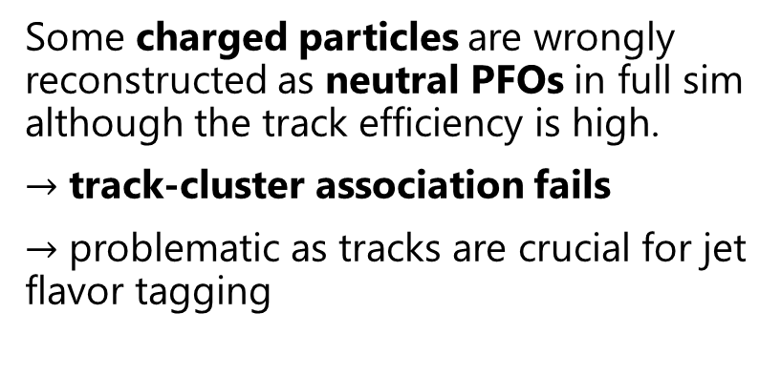
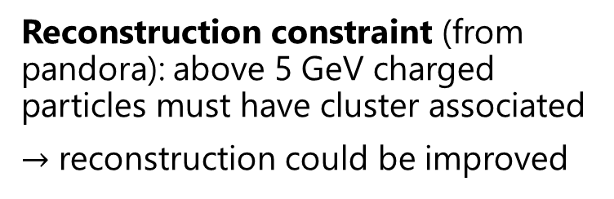

(2) Unassociated tracks to PFOs in full simulation
MC charged hadrons ($H→b\overline{b}$)
Some charged particles are wrongly reconstructed as neutral PFOs in full sim although the track efficiency is high.
$→$ track-cluster association fails
$→$ problematic as tracks are crucial for jet flavor tagging
Reconstruction constraint (from pandora): above 5 GeV charged particles must have cluster associated
$→$ reconstruction could be improved
See Anna Zaborowska talk!

Slide 13
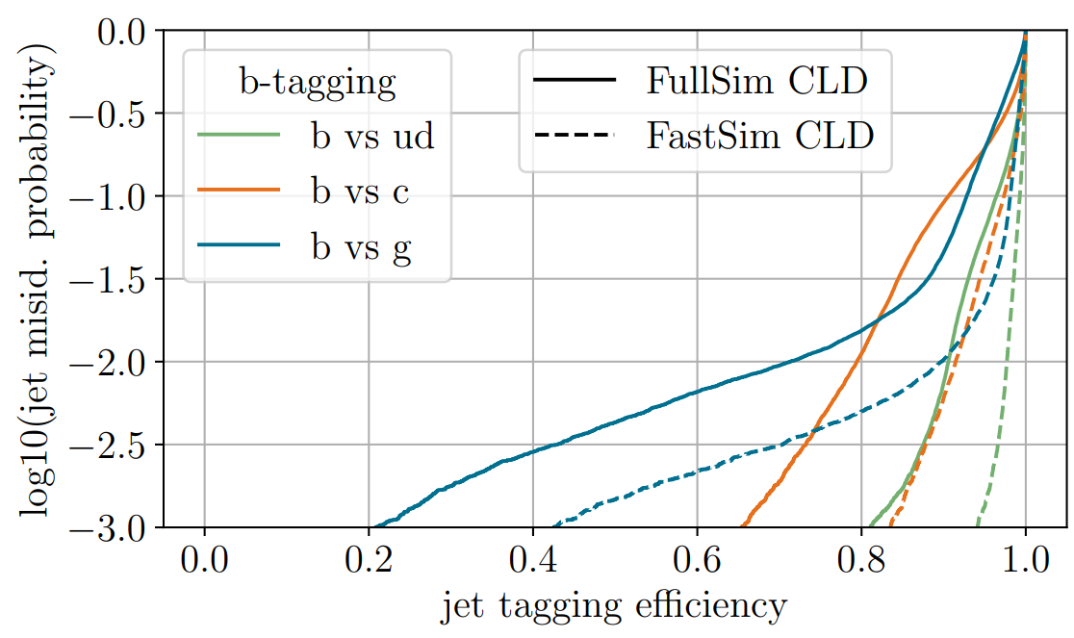
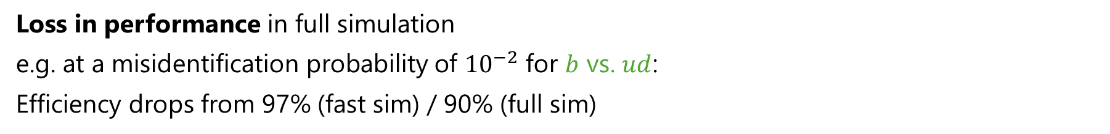
Full vs. Fast Simulation CLD
better
work in progress
Loss in performance in full simulation
e.g. at a misidentification probability of ${10}^{−2}$ for $b$ vs. $ud$:
Efficiency drops from 97% (fast sim) / 90% (full sim)
Notes:
Jet tagging efficiency = how many MC c-jet were classified as c-jets
Jet misid. Prob = how high is the probability that a g/ug/b quark is mistaken for a c quark.

Slide 14
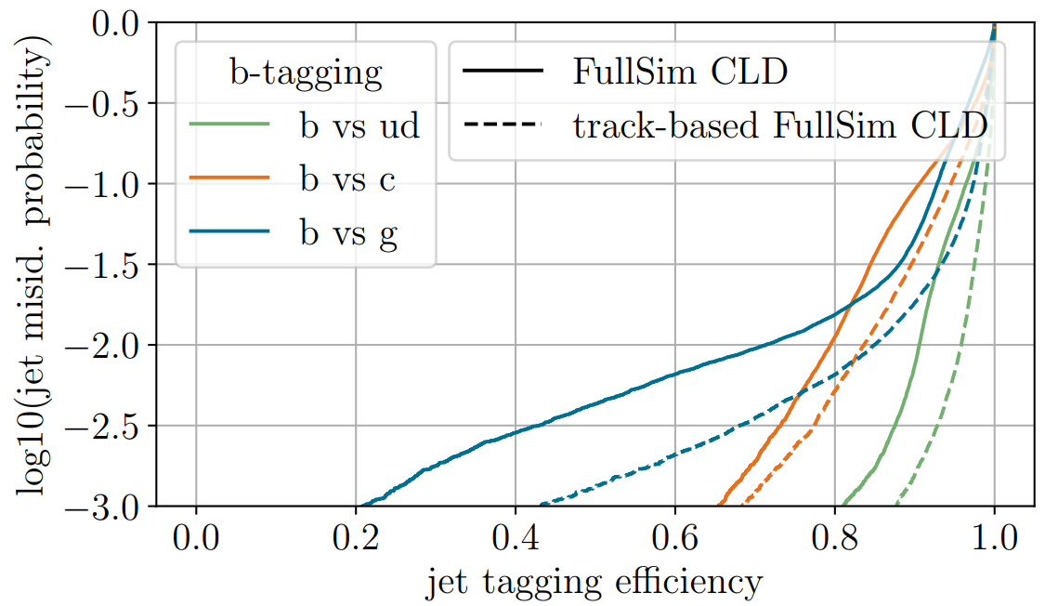
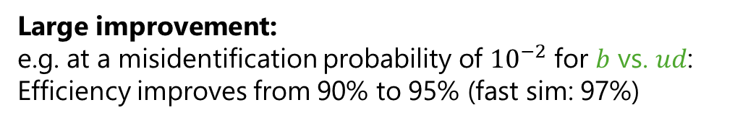
Improving Full Sim Tagging
Improve input data to neural network
Use all tracks available!
Ignore fake neutrals
Idea:
Instead of PFOs (particle flow objects) use
Tracks for charged particles
PFOs for neutral particles but check MC PID to avoid double counting
work in progress
Large improvement:
e.g. at a misidentification probability of ${10}^{−2}$ for $b$ vs. $ud$:
Efficiency improves from 90% to 95% (fast sim: 97%)
Notes:
Reconstruction??? Call pandora like that?

Slide 15
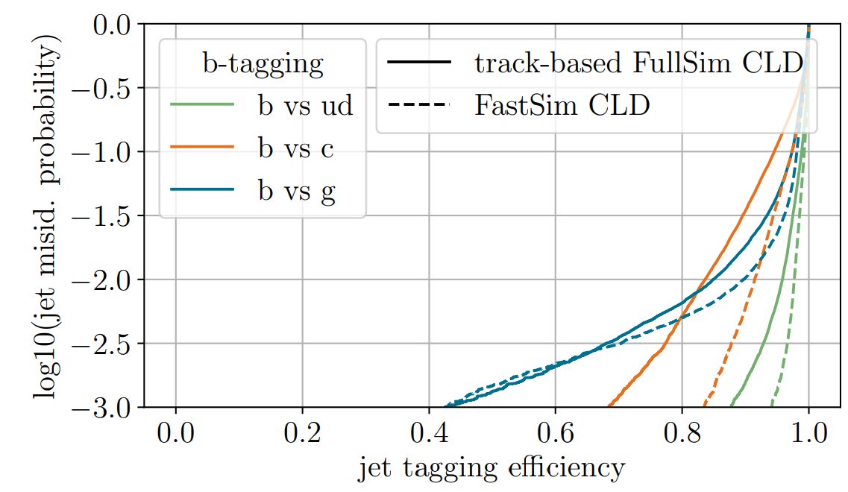
Fast vs. track-based Full Sim
Using
Tracks for charged particles
PFOs for neutral particles
Plus some MC checking
Before:
- Purely PFO based
work in progress

Slide 16
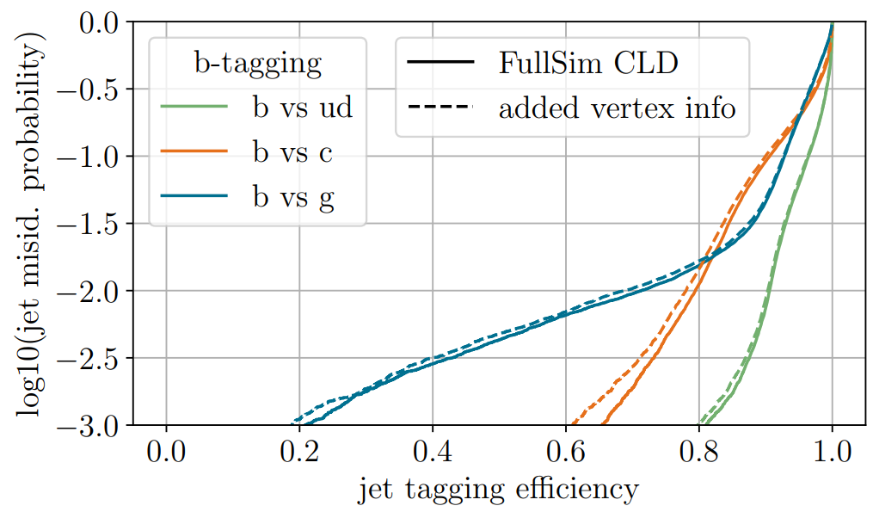
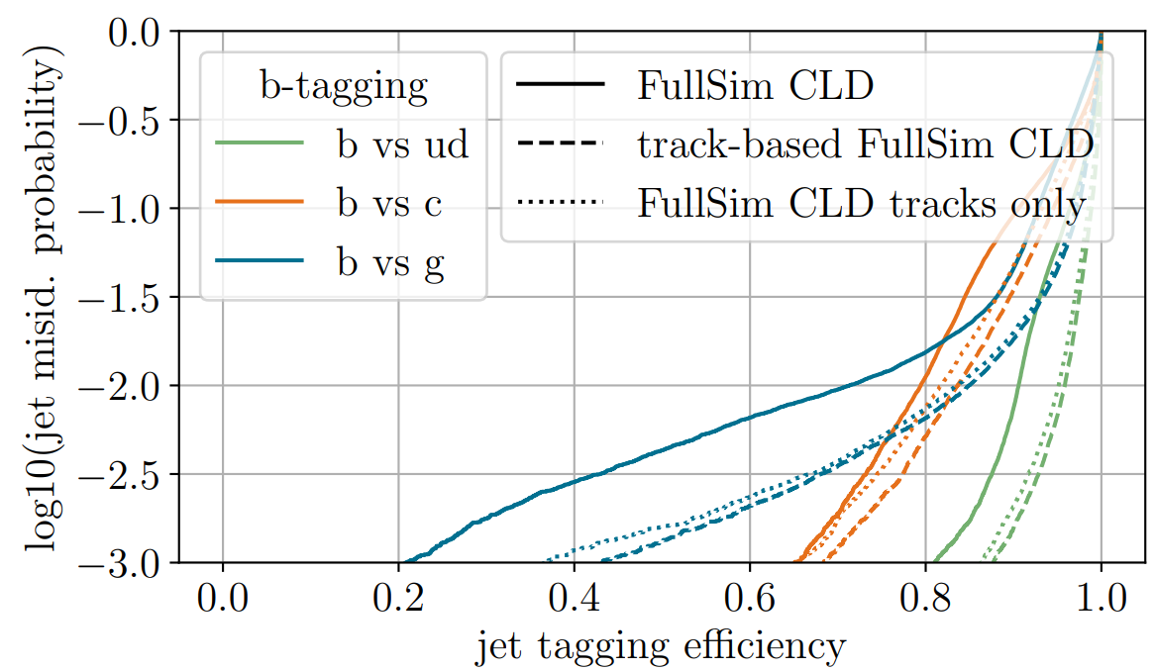
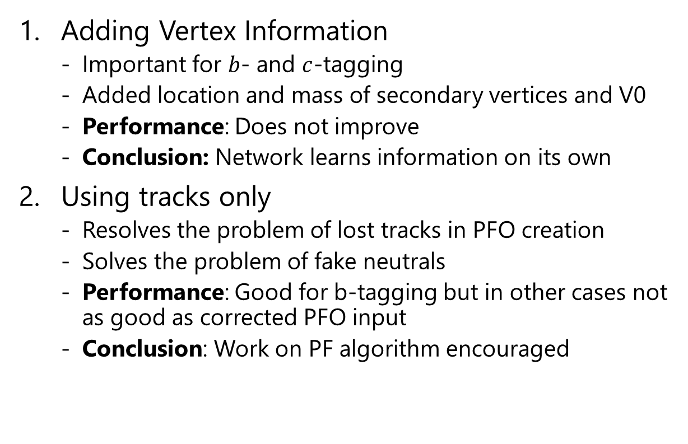
Other Studies
Adding Vertex Information
  Important for $b$- and $c$-tagging
  Added location and mass of secondary vertices and V0
  Performance: Does not improve
  Conclusion: Network learns information on its own
Using tracks only
  Resolves the problem of lost tracks in PFO creation
  Solves the problem of fake neutrals
  Performance: Good for b-tagging but in other cases not as good as corrected PFO input
  Conclusion: Work on PF algorithm encouraged
work in progress
work in progress
Further details in FCC note

Slide 17
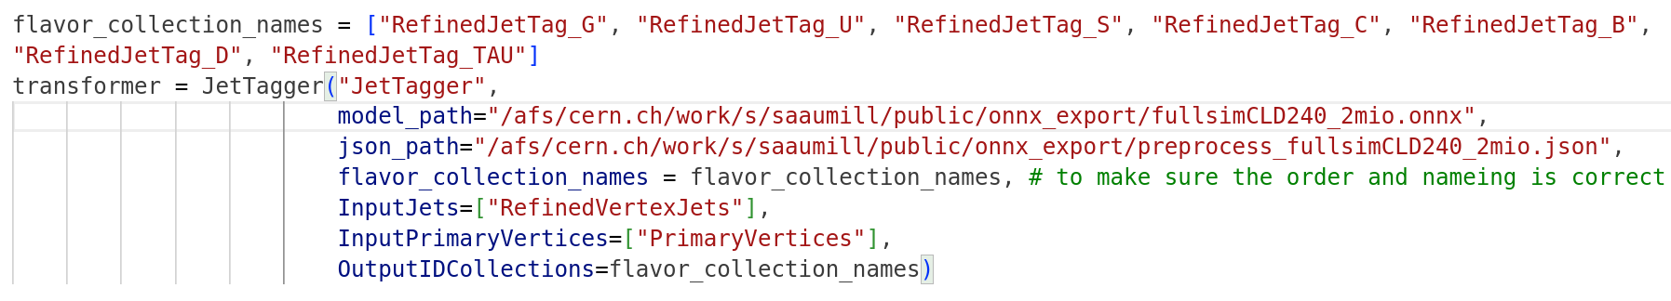
Full Sim Key4Hep Implementation
We want to make full simulation tagging at CLD available to everyone by implementing it to key4hep.
https://github.com/saracreates/JetTagging
Include the JetTagger in the steering file:
Adds 7 PID collections “RefindJetTag_X” with flavors X
Uses a k4FWCore Transformer

Slide 18

Full Sim Key4Hep Implementation
We want to make full simulation tagging at CLD available to everyone by implementing it to key4hep.
https://github.com/saracreates/JetTagging
Special thanks to
Brieuc Francois,
Thomas Madlener
and especially
Leonhard Reichenbach
for their support!
Status:
Implementation is done!
Currently: Validating the performance
  run inference on the key4hep pipeline
  Recreate ROC curves and compare performance
Outlook: Implementing full life cycle of tagging for quick adjustments in the future
  Retrieve jet constituent variables / network input conveniently from key4hep for easy retraining of a neural network
  Validate whole life cycle
  Add thorough documentation

Slide 19
Full cycle for the future
Flavor tags
JetObservablesRetriever (key4hep)
JetTagger
(key4hep)
Observables
Trained Network (ONNX format)
Root File
fixed
Might change
Weaver
(framework for training)
Network Architecture

Slide 20
Summary
work in progress
Studied jet tagging in full (CLD) and fast (CLD, IDEA) simulation
Crystalized two main challenges in full simulation:
  Fake neutrals
  Unassociated tracks to PFOs
Studied options to improve tagging performance in full simulation: improvement of Pandora Particle Flow is curcial
Work-in-progress key4hep implementation of CLD full simulation jet tagging for 7 flavors

Slide 21
Backup

Slide 22
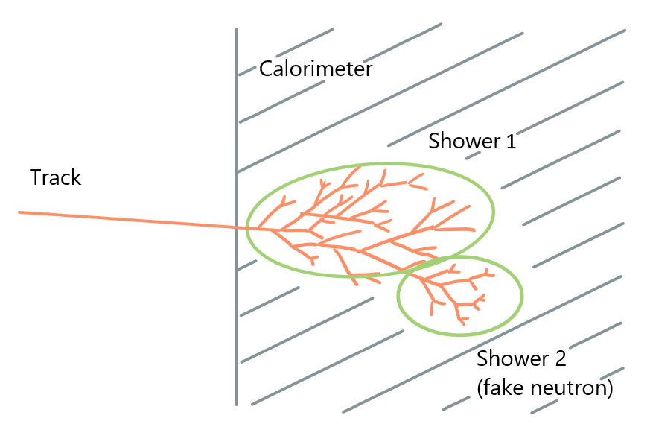
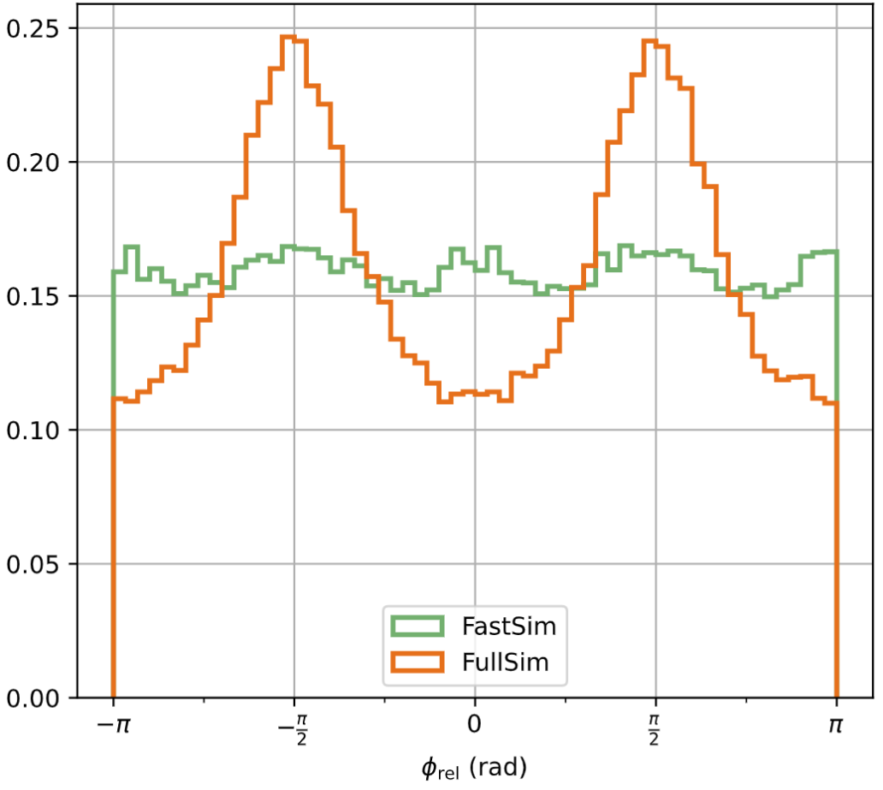

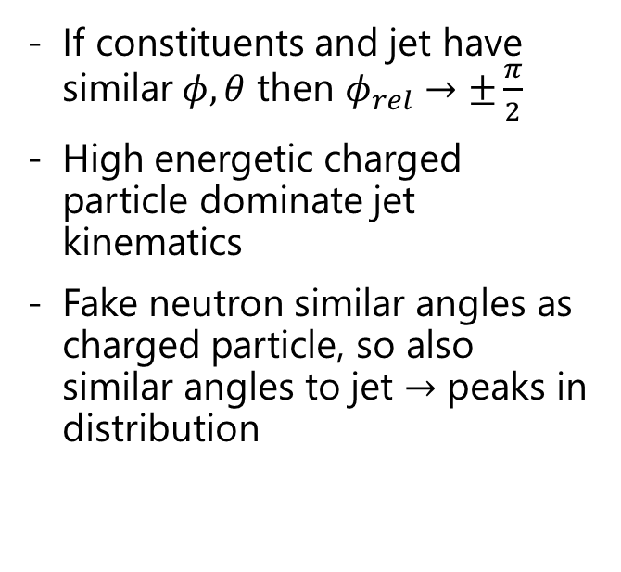
From $φ_{rel}$ to fake neutrons
If constituents and jet have similar$φ, θ$ then $φ_{rel}→±\frac{π}{2}$
High energetic charged particle dominate jet kinematics
Fake neutron similar angles as charged particle, so also similar angles to jet $→$ peaks in distribution

Slide 23
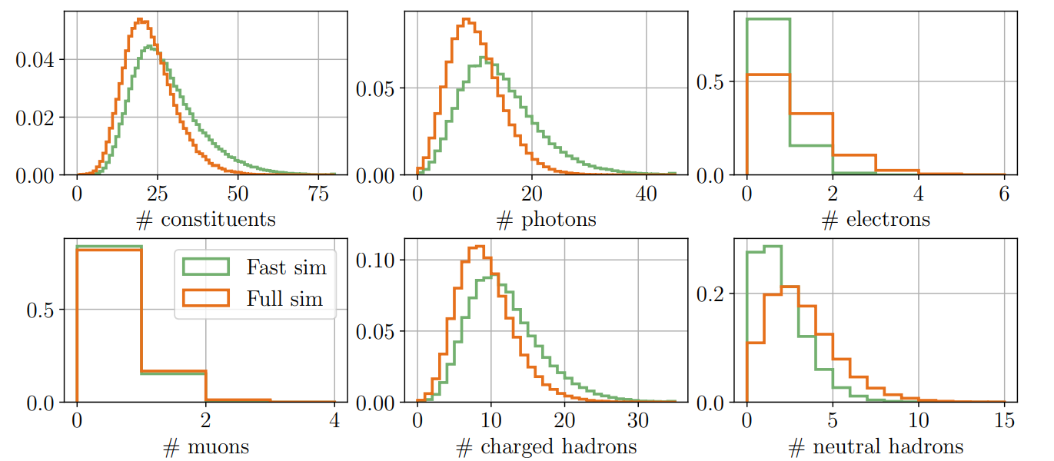
Multiplicities

Slide 24
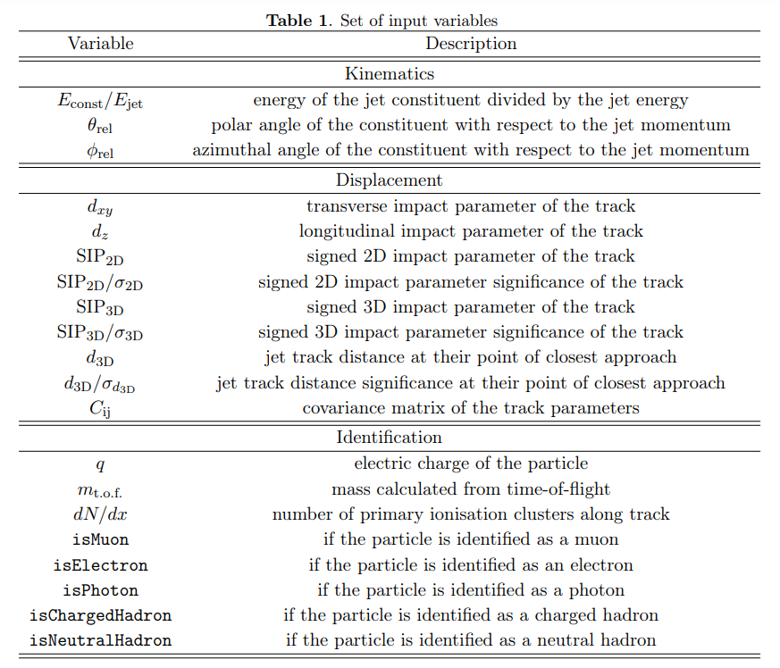
Input parameters to the network
from IDEA fast sim tagging

Slide 25
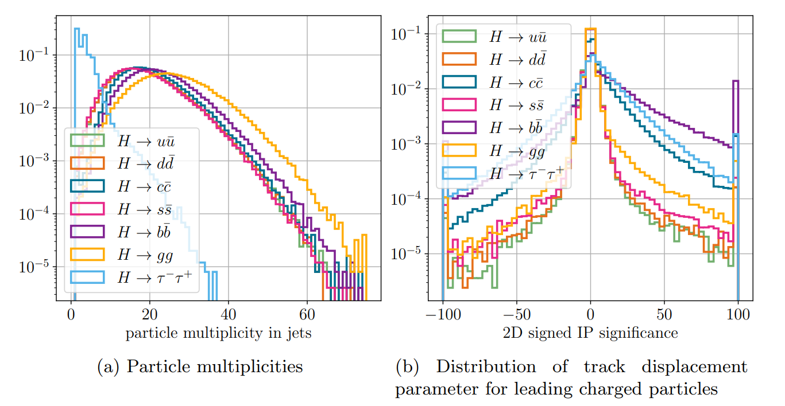
Comparison of Higgs channels

