Slide 1





Beam losses in the IR
G. Broggi ^{1,2,3}, A. Abramov ², M. Boscolo ³, R. Bruce ², S. Redaelli ²
¹ Sapienza University of Rome, Italy ² CERN, Meyrin, Switzerland ³ INFN-LNF, Frascati, Italy
8th FCC physics workshop, CERN, Meyrin, Switzerland, 14/11/2025
Acknowledgements:
K. Andre, X. Buffat, H. Burkhardt, A. Ciarma, M. Hofer, G. Iadarola, P. Kicsiny, A. Lechner, S. Marin, M. Migliorati, L. Nevay, G. Nigrelli, K. Oide, F. Palla, A. Perillo-Marcone, F. Van der Veken, F. Zimmermann

Slide 2
Outline
Introduction
  FCC-ee beam losses simulations: overview
  FCC-ee collimation system
Studies and simulations of beam losses in the FCC-ee
  FCC-ee beam loss scenarios
  FCC-ee collimation simulations
Results
  Generic beam halo losses
  Beam-gas beam losses
Outlook and next steps
14/11/2025
G. Broggi | Beam losses in the IR

Slide 3
Outline
Introduction
  FCC-ee beam losses simulations: overview
  FCC-ee collimation system
Studies and simulations of beam losses in the FCC-ee
  FCC-ee beam loss scenarios
  FCC-ee collimation simulations
Results
  Generic beam halo losses
  Beam-gas beam losses
Outlook and next steps
14/11/2025
G. Broggi | Beam losses in the IR

Slide 4
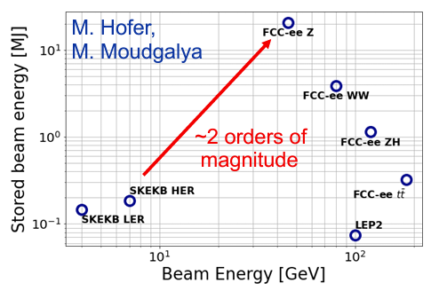
FCC-ee beam losses simulations: overview
Simulations of beam losses in the FCC-ee are being performed to study:
FCC-ee presents unique challenges:
  17.5 MJ stored beam energy in the Z mode (45.6 GeV)
  New regime for collimation of e± beams (highly destructive beams)
Two types of collimation currently foreseen for the FCC-ee
  Beam halo (global) collimation (+ local protection collimators)
  Synchrotron radiation (SR) collimation – upstream of each IP
Secondary particle shower absorbers under study (CERN FLUKA team)
Optimization of the FCC-ee collimation system design
Minimization of beam losses on sensitive components (e.g. superconducting magnets)
Minimization of beam losses in the experimental interaction regions (IRs): can be source of backgrounds
Comparison of lepton colliders
14/11/2025
G. Broggi | Beam losses in the IR

Slide 5
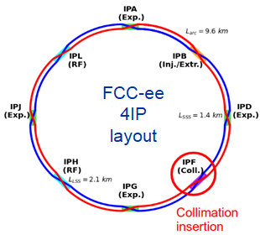
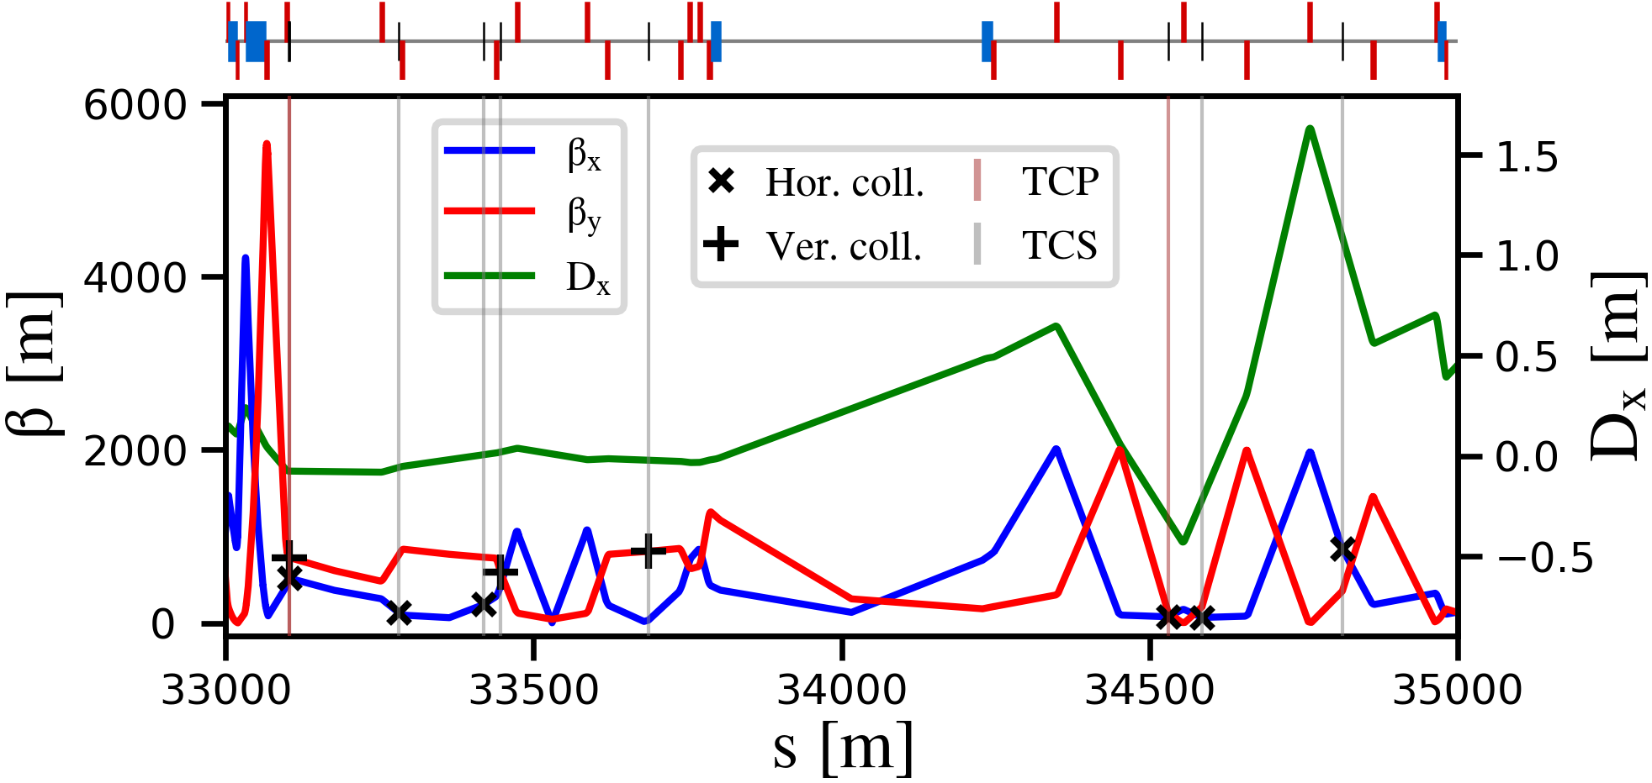
FCC-ee halo collimation system
Dedicated halo collimation system in PF
  Two-stage betatron and off-momentum collimation system in one insertion
  Ensure protection of the aperture bottlenecks in different conditions
    Aperture bottleneck at Z: 14.6σ (H plane), 84.2σ (V plane)
First collimator design for cleaning performance
  Ongoing studies to further optimize the collimator design (IPAC’24 paper)
  Crystal collimation being explored (CHANNELING’24 talk)
betatron
off-momentum
FCC-ee beam halo collimator parameters and settings
Name | Plane | Material | Length [cm] | Gap [σ] | Gap [mm] | δ_{cut} [%]
TCP.H.B1 | H | MoGr | 25 | 11 | 6.7 | 8.9
TCP.V.B1 | V | MoGr | 25 | 65 | 2.4 | -
TCS.H1.B1 | H | Mo | 30 | 12 | 5.0 | 6.0
TCS.V1.B1 | V | Mo | 30 | 75 | 2.5 | -
TCS.H2.B1 | H | Mo | 30 | 12 | 7.0 | 22.8
TCS.V2.B1 | V | Mo | 30 | 75 | 3.0 | -
TCP.HP.B1 | H | MoGr | 25 | 18.5 | 4.2 | 1.3
TCS.HP1.B1 | H | Mo | 30 | 21.5 | 4.6 | 2.1
TCS.HP2.B1 | H | Mo | 30 | 21.5 | 16.8 | 1.6
Other materials being considered (C-based for TCP, Mo-based for TCS)
14/11/2025
G. Broggi | Beam losses in the IR

Slide 6
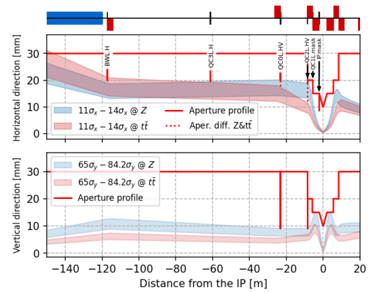
FCC-ee SR collimation system
Synchrotron radiation collimators around the IPs
  6 collimators and 2 masks upstream of the IPs
  Designed to reduce detector backgrounds and power loads in the inner beampipe due to photon losses
FCC-ee SR collimators parameters and settings
Name | Plane | Material | Length [cm] | Gap [σ] | Gap [mm]
TCR.H.WL.B1 | H | Inermet180 | 10 | 14.0 | 17.0
TCR.H.C3.B1 | V | Inermet180 | 10 | 14.0 | 16.5
TCR.V.C0.B1 | V | Inermet180 | 10 | 84.2 | 8.0
TCR.H.C0.B1 | H | Inermet180 | 10 | 14.0 | 16.2
TCR.V.C2.B1 | V | Inermet180 | 10 | 84.2 | 8.0
TCR.H.C2.B1 | H | Inermet180 | 10 | 14.0 | 16.0
Inermet180: tungsten heavy alloy
More details in K. Andre’s talk, this workshop
14/11/2025
G. Broggi | Beam losses in the IR

Slide 7
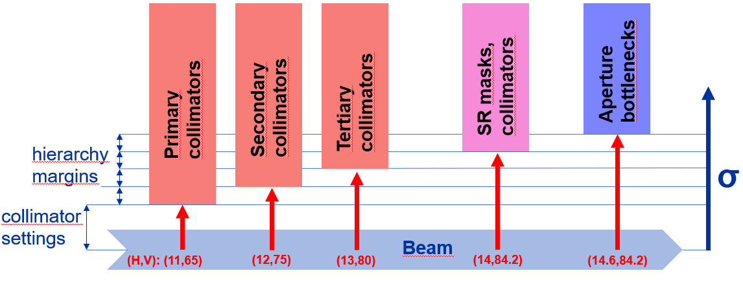
Tertiary collimators for local protection
Studying different beam loss processes, sizeable beam losses on SR collimators observed
SR collimators not primarly designed to intercept large beam losses: risk of damages/background
Two (H+V) tertiary collimators (TCTs) for local protection added
  Placed ~690 m (H) ~420 m (V) upstream of each IP
  s-location optimized for optimal phase-advance (multiple of π) between TCTs and
Collimation hierarchy must be respected:
SR collimators
aperture bottlenecks
Name | Plane | Material | Length [cm] | Gap [σ] | Gap [mm]
TCT.H.B1 | H | MoGr | 25 | 13 | 3.4
TCT.V.B1 | V | MoGr | 25 | 80 | 6.1
FCC-ee tertiary local protection collimator parameters and settings
Other C-based materials are being considered
14/11/2025
G. Broggi | Beam losses in the IR

Slide 8
Outline
Introduction
  FCC-ee beam losses simulations: overview
  FCC-ee collimation system
Studies and simulations of beam losses in the FCC-ee
  FCC-ee beam loss scenarios
  FCC-ee collimation simulations
Results
  Generic beam halo losses
  Beam-gas beam losses
Outlook and next steps
14/11/2025
G. Broggi | Beam losses in the IR

Slide 9
FCC-ee beam loss scenarios
The FCC-ee Z mode is the current focus: has the highest stored beam energy 17.5 MJ
Important to identify different beam loss scenarios and define the ones to protect against
Current selection of beam loss scenarios to study and simulate:
  Generic beam halo losses
  Beam losses from interactions with residual gas
  Beam losses from spent beam due to the collision processes (BB’24 talk – detailed checks ongoing)
  Beam losses from Touschek scattering
    Most likely negligible at FCC-ee beam energies
    Interesting in the view of benchmarking simulation tools with operating e+e- colliders
  Beam losses due to fast instabilities: first results in G. Nigrelli’s talk, this workshop
  Beam losses from top-up injection
  Beam losses from interactions with thermal photons
  Accidental scenarios (inj. failure, asynchronous dump, others): waiting for inputs to set up models
In this talk
Work in progress
Studies planned for 2025
14/11/2025
G. Broggi | Beam losses in the IR

Slide 10
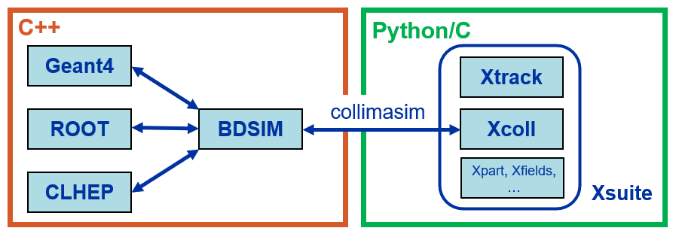
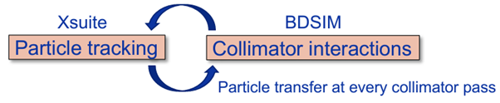
FCC-ee collimation simulations
FCC-ee presents unique challenges for collimation simulations
  Synchrotron radiation and magnet strength adjustment (tapering) to compensate it
  Complex beam dynamics – strong sextupoles in the lattice and strong beam-beam effects
  Detailed aperture and collimator geometry modelling
  Electron/positron beam particle-matter interactions
  Large accelerator system – 90+ km beamline
Ongoing effort to benchmark Xsuite-BDSIM with data from e+e- colliders (SuperKEKB, DAΦNE)
Xsuite + BDSIM (Geant4) coupling (JINST paper)
  Developed for FCC collimation simulations
  Benchmarked against
  Other tools available (e.g., Xsuite-FLUKA coupling)
other simulation codes: MAD-X, pyAT, Sixtrack-FLUKA
measured data from proton machines: SPS, LHC
14/11/2025
G. Broggi | Beam losses in the IR

Slide 11
Outline
Introduction
  FCC-ee beam losses simulations: overview
  FCC-ee collimation system
Studies and simulations of beam losses in the FCC-ee
  FCC-ee beam loss scenarios
  FCC-ee collimation simulations
Results
  Generic beam halo losses
  Beam-gas beam losses
Outlook and next steps
14/11/2025
G. Broggi | Beam losses in the IR

Slide 12
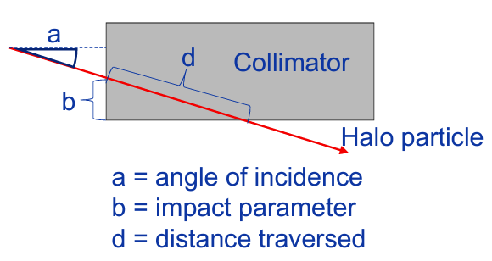
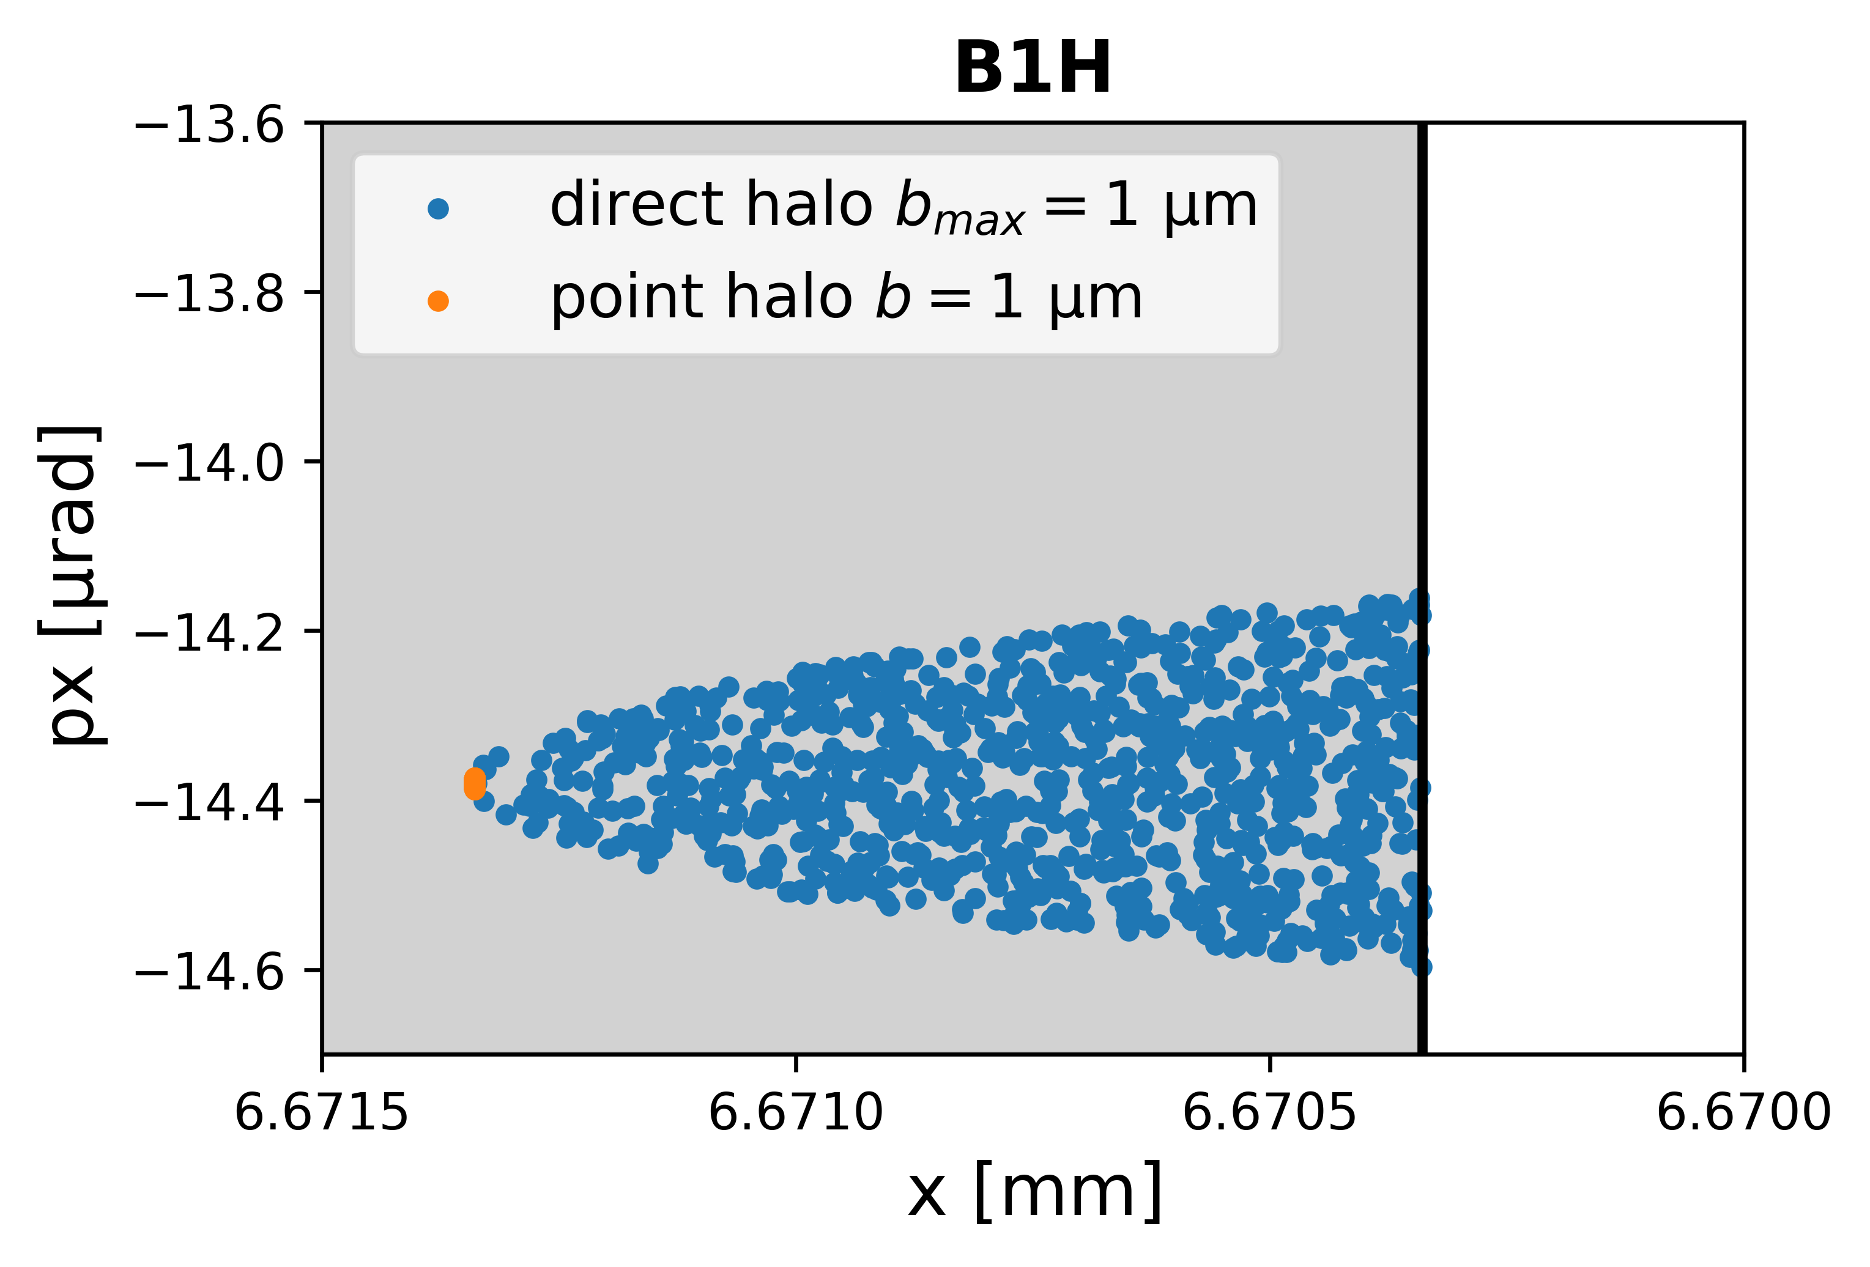
Generic beam halo losses
«Generic beam halo» beam loss scenario
  Specify a minimum beam lifetime that must be sustained during normal operation - preliminary specification of a 5 min lifetime
  Assume a slow loss process – halo particles always intercepted by the primary collimators
  Loss process not simulated: all particles start impacting a collimator from the collimator edge to a maximum impact parameter b_{max} (direct halo)
  Currently assuming b_{max} = 1 μm
  Studies needed to asses the most realistic b_{max} value
    Impact parameter scans showed monotonically worsening collimation performance with decreasing impact parameters
  Particles scattered out from the collimator tracked for a given number of turns (∼500), and losses on the aperture are recorded → loss maps
  b_{max} = 1 μm
14/11/2025
G. Broggi | Beam losses in the IR

Slide 13



Generic beam halo losses: simulation parameters
FCC-ee Z operation mode
  Clockwise positron beam (B1) - 45.6 GeV beam energy
  Initial conditions (SR: synchrotron radiation; BS: beamstrahlung)
  Equilibrium vertical emittance from SR + BS kept constant with addition of vertical wiggler in the lattice
  Full nonlinear lattice
  Crab-waist
  Detailed aperture and collimator (BDSIM-Geant4) model
  SR emission («quantum» model)
    Radiation damping
    Quantum excitations
$$ε_{x}=0.71 nm$$
$$ε_{y}=1.9 pm$$
$$σ_{z}=15.5 mm$$
equilibrium horizontal emittance from SR
equilibrium vertical emittance from SR+BS
equilibrium bunch length from SR+BS
  10 x 10⁶ macroparticles tracked for 500 machine turns
14/11/2025
G. Broggi | Beam losses in the IR

Slide 14
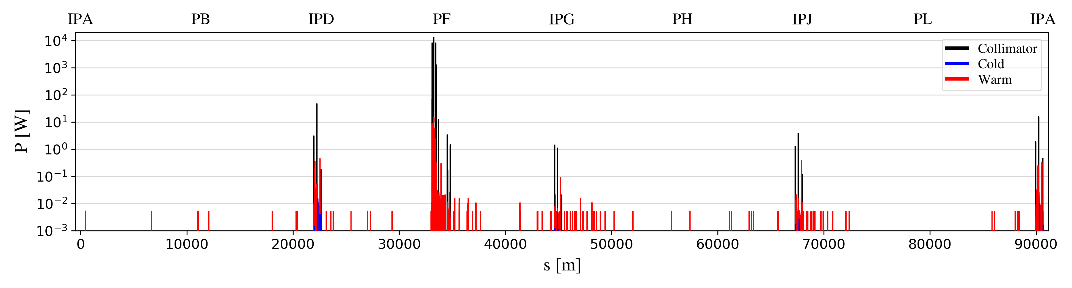
Generic beam halo losses: results
FCC-ee Z loss map for horizontal (B1H) betatron collimation losses:
Power loads evaluated assuming a lifetime drop to 5 min
Losses well contained in the collimation insertion PF (>99.6%)
Losses leaking out the collimation insertion PF mostly intercepted by the local protection TCTs
  Nearly absence of losses reaching the detector regions / final focus superconducting quadrupoles
14/11/2025
G. Broggi | Beam losses in the IR

Slide 15
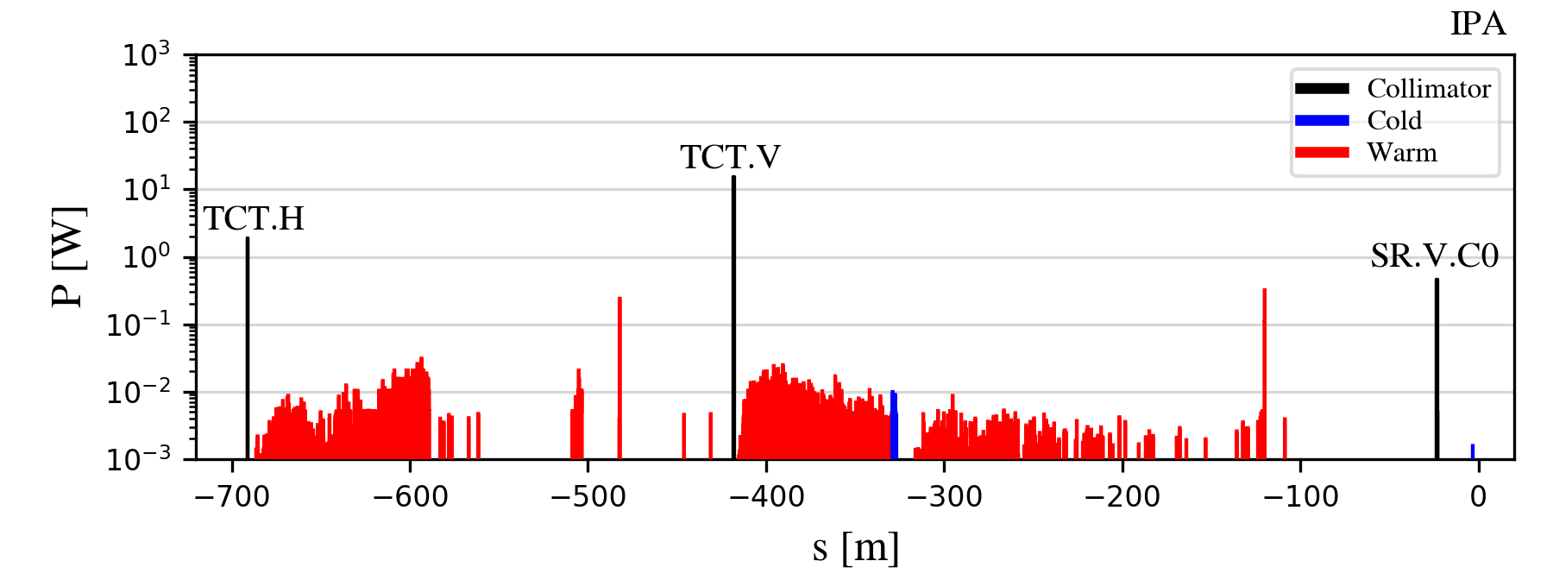
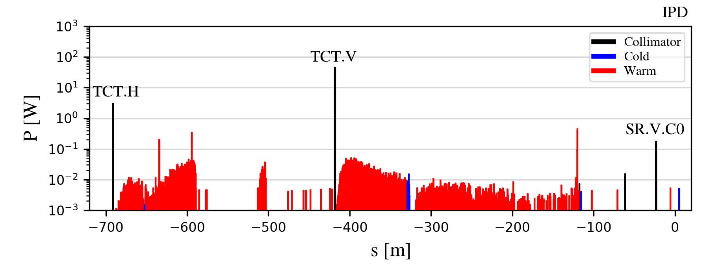
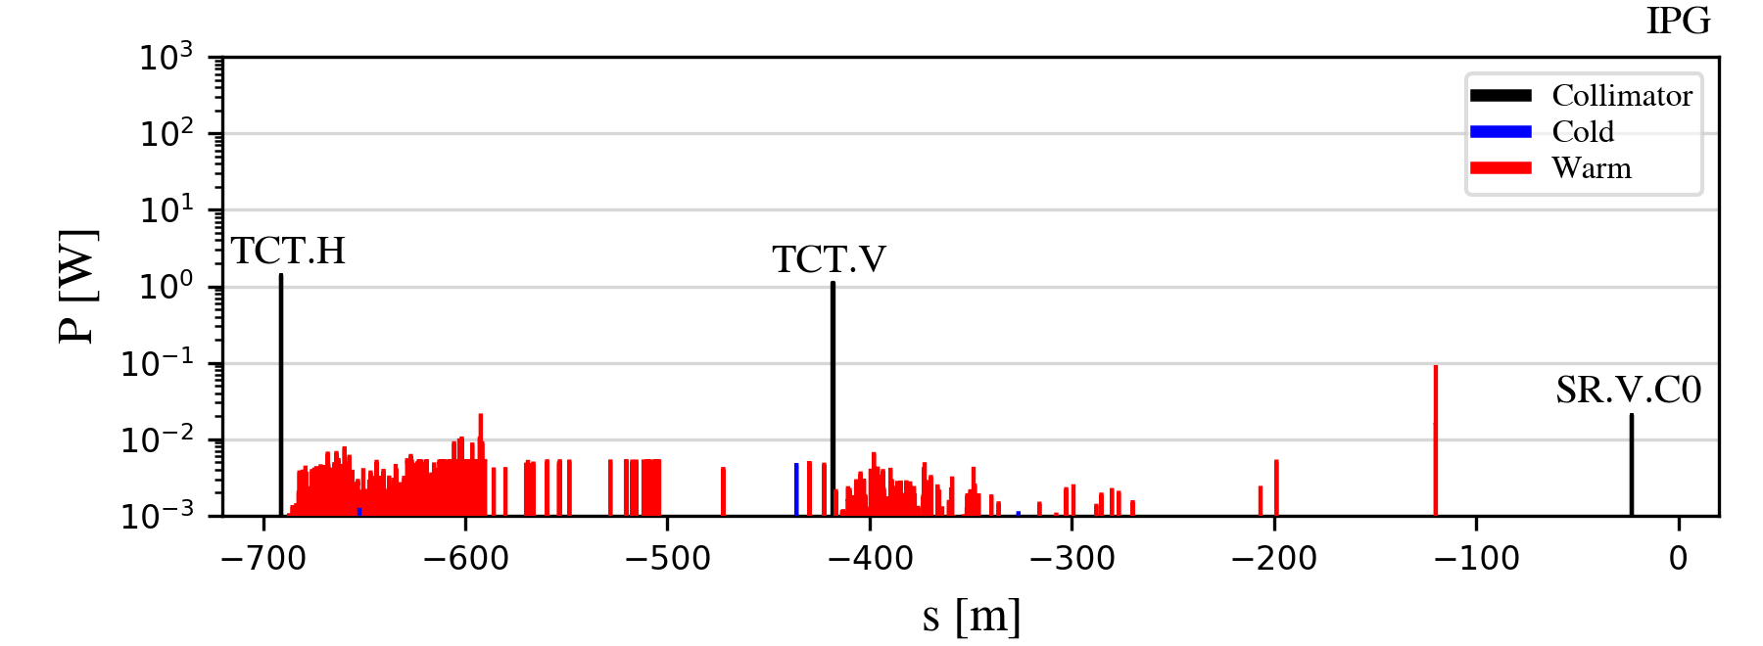
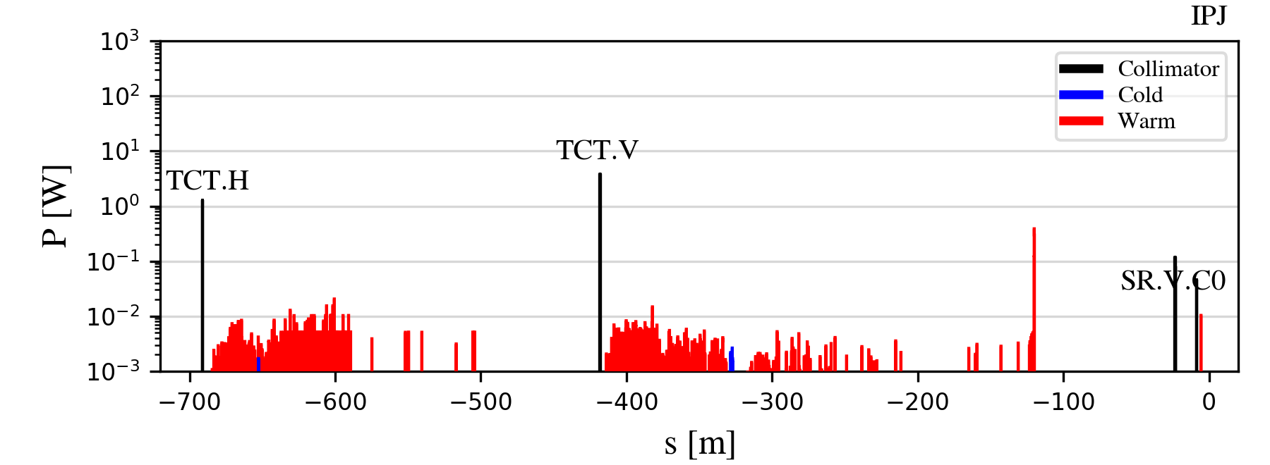
Generic beam halo losses: IR beam losses
FCC-ee Z IR loss maps for horizontal (B1H) betatron collimation losses:
IR beam losses efficiently intercepted by the local protection TCTs (Pmax ~50 W)
Dedicated shower simulations needed to assess backgrounds from these beam losses
  FLUKA IR model + impacting distributions on IR collimators and aperture as input
14/11/2025
G. Broggi | Beam losses in the IR

Slide 16
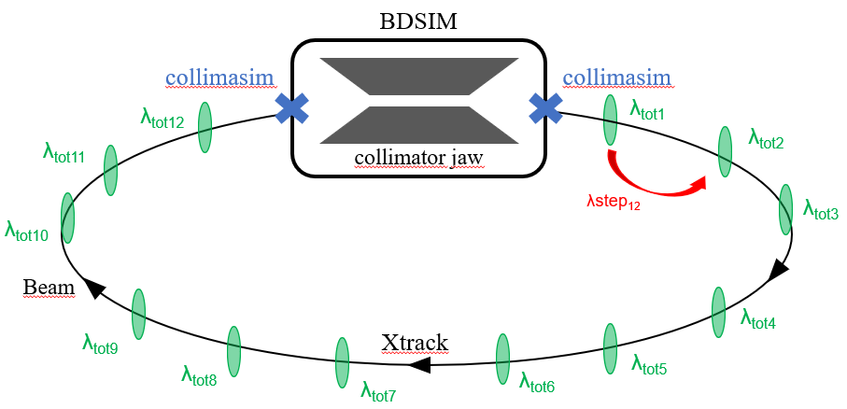
Beam losses from beam-residual gas interactions
The interaction between the beam and residual gas in the vacuum chamber is an important aspect to study
  Can produce distinct beam loss distributions
  Can be source of lifetime/luminosity degradation and background in the experimental interaction regions
Pressure profile in the FCC-ee (Z) provided by the vacuum team (85% H₂, 10% CO, 5% CO₂)
  NEG coated vacuum pipe, 1h beam conditioning at full nominal current (1.27 A)
  Main focus on beam-gas bremsstrahlung interactions (dominant process in determining beam-gas losses)
  First preliminary results for beam-gas Coulomb scattering interactions
Beam-gas elements implemented in Xsuite-BDSIM to model the interaction with residual gas in the vacuum pipe
beam-gas element
14/11/2025
G. Broggi | Beam losses in the IR
Notes:
Stress the difference between global and local beam-gas.

Slide 17
Beam-gas beam losses: simulation parameters
FCC-ee Z operation mode
  Clockwise positron beam (B1) - 45.6 GeV beam energy
  Initial conditions (SR: synchrotron radiation; BS: beamstrahlung)
  Equilibrium vertical emittance from SR + BS kept constant with addition of vertical wiggler in the lattice
  Full nonlinear lattice
  Crab-waist
  Detailed aperture and collimator (BDSIM-Geant4) model
  SR emission («quantum» model)
    Radiation damping
    Quantum excitations
  + 10000 equispaced (~9 m spacing) beam-gas elements to model beam-gas interactions
$$ε_{x}=0.71 nm$$
$$ε_{y}=1.9 pm$$
$$σ_{z}=15.5 mm$$
equilibrium horizontal emittance from SR
equilibrium vertical emittance from SR+BS
equilibrium bunch length from SR+BS
  eBrem: 45x10⁶ macroparticles tracked for 17x10⁶ equivalent turns
  CoulombScat: 40x10⁶ macroparticles tracked for 17x10⁷ equivalent turns
14/11/2025
G. Broggi | Beam losses in the IR

Slide 18
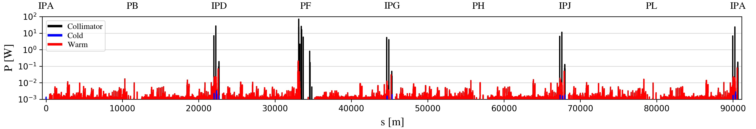
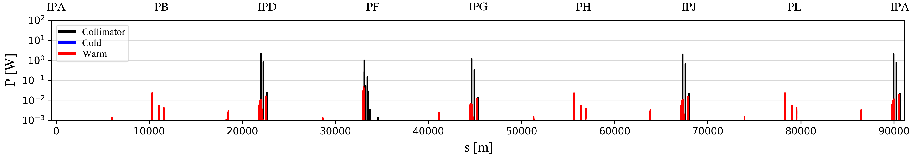


*1h beam conditioning at full nominal current (1.27 A): pressure is expected to condition down further (up to a factor ~100) over time
FCC-ee Z beam-gas loss map
  Power loads evaluated considering the estimated beam-gas lifetime τ from the simulations:
$$τ_{eBrem} \sim {5h}^{∗}$$
bremsstrahlung
$$τ_{Coulomb} \sim {44h}^{∗}$$
PRELIMINARY
Coulomb scattering
  Low power loads (<0.1 W) on the vast majority of elements and minimal cold power loads
  Highest loads on halo collimators (∼10-100 W) and SR collimators (∼1 W) – no show stoppers identified
14/11/2025
G. Broggi | Beam losses in the IR

Slide 19
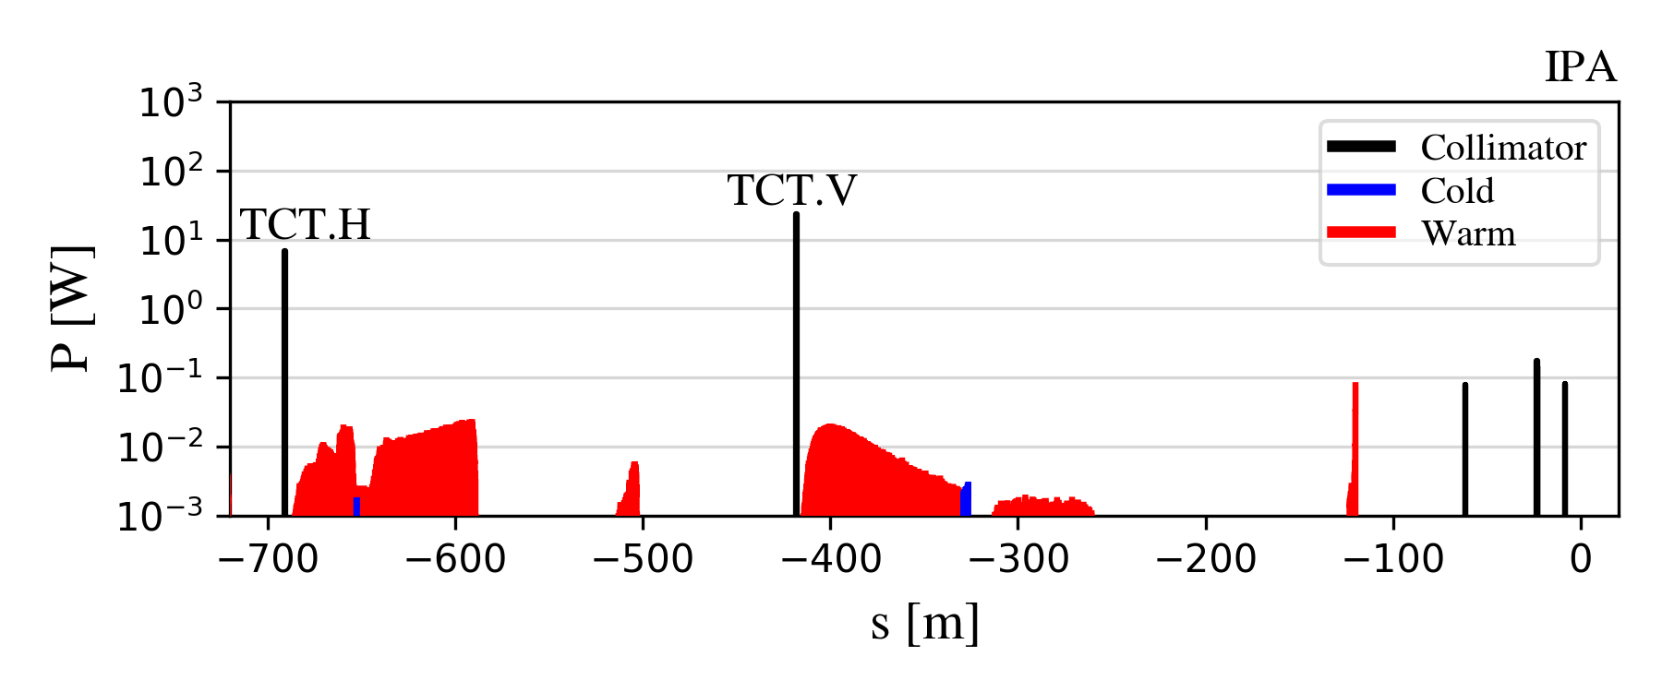
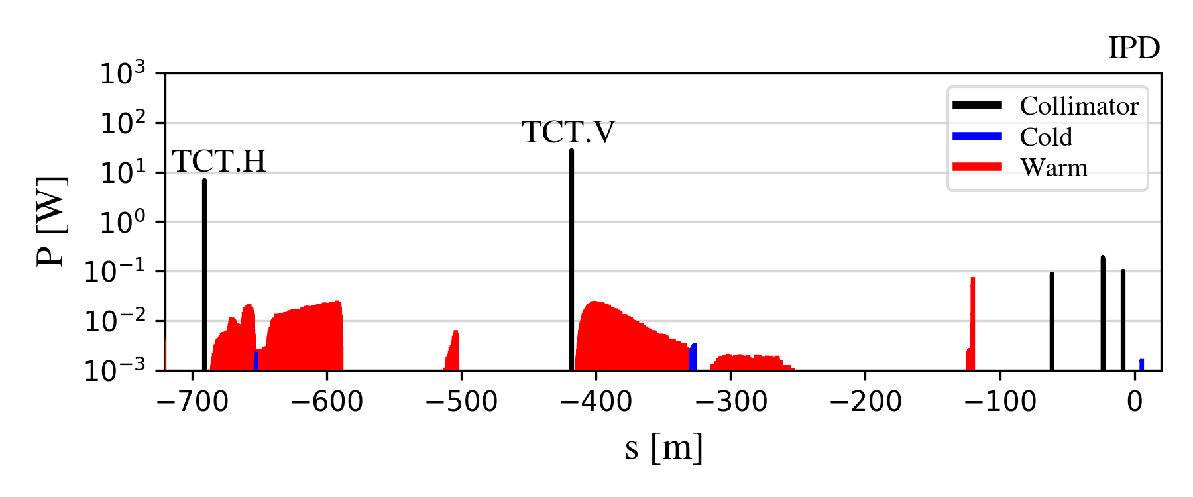
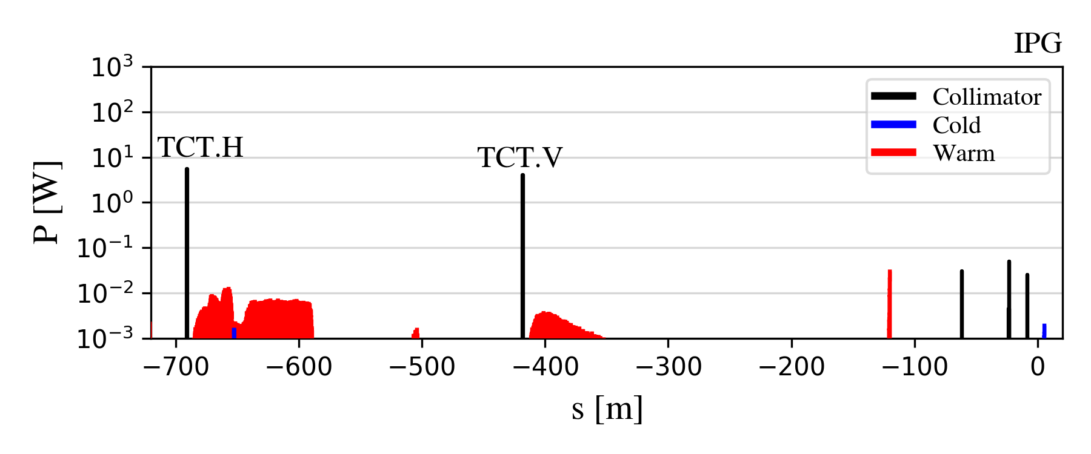
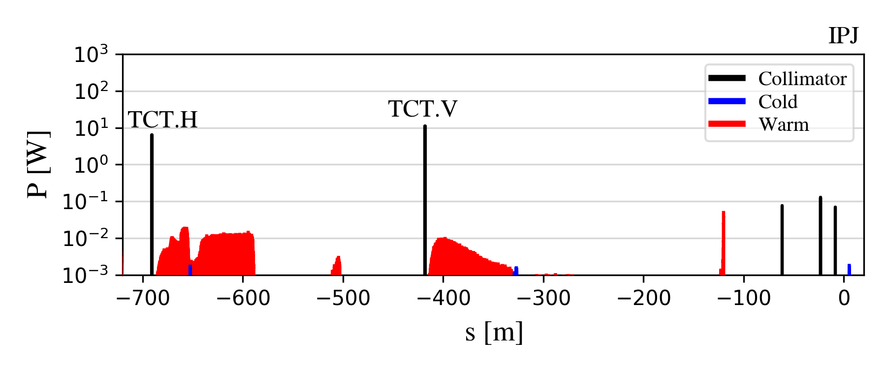
Beam-gas bremsstrahlung IR losses
FCC-ee Z IR loss maps for beam-gas bremsstrahlung losses:
IR beam-gas bremsstrahlung losses efficiently intercepted by the local protection TCTs (Pmax ~30 W)
Dedicated shower simulations needed to assess backgrounds from these beam losses
  FLUKA IR model + impacting distributions on IR collimators and aperture as input
14/11/2025
G. Broggi | Beam losses in the IR

Slide 20
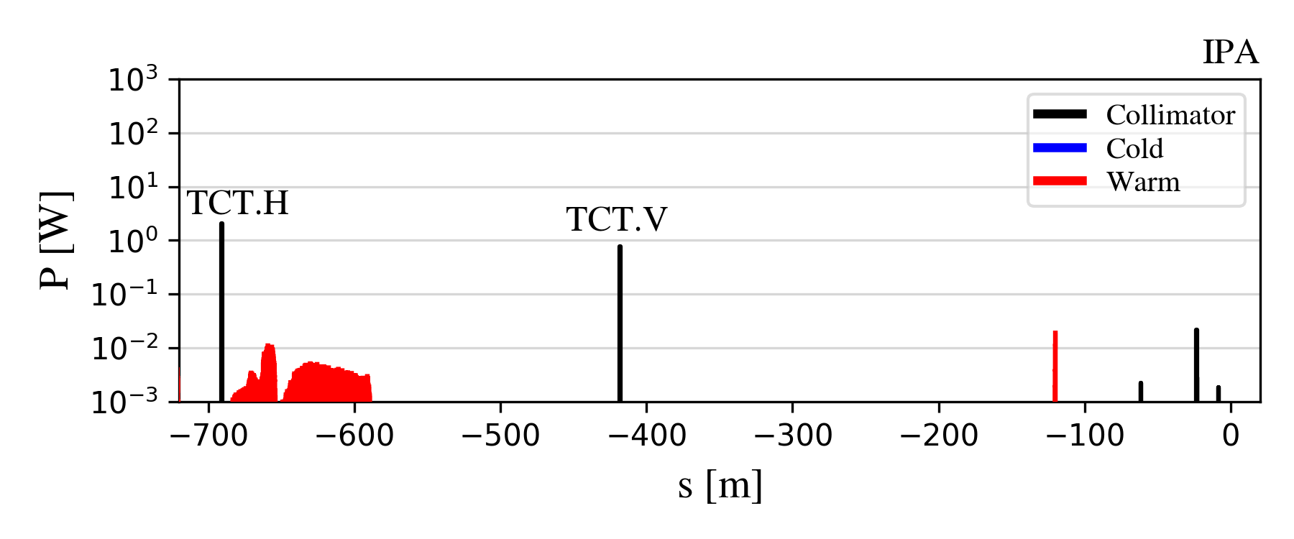
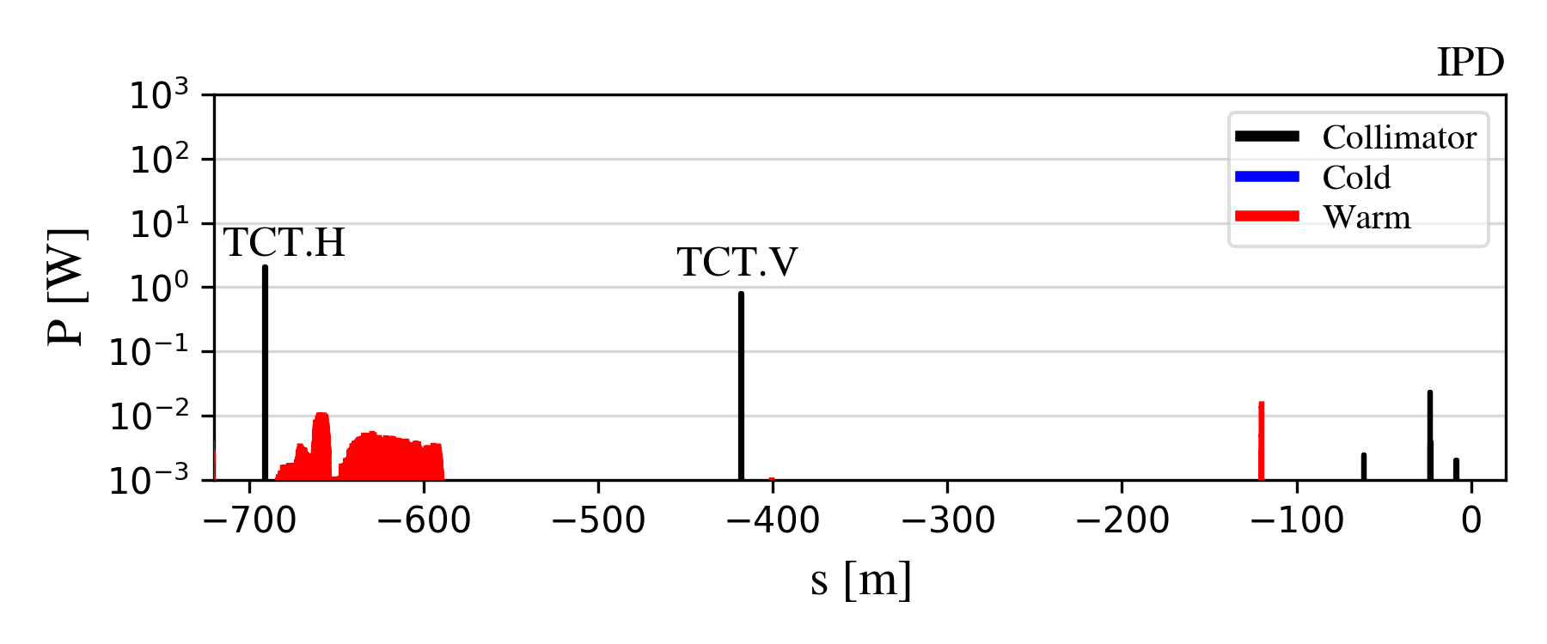
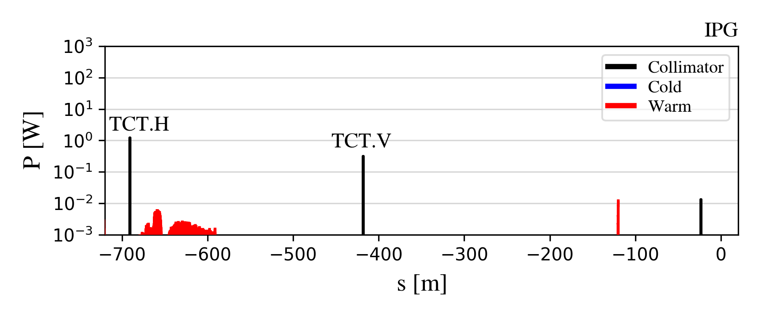

Beam-gas Coulomb scattering IR losses
PRELIMINARY
FCC-ee Z IR loss maps for beam-gas Coulomb scattering losses:
IR beam-gas Coulomb scattering losses efficiently intercepted by the local protection TCTs (Pmax ~1 W)
Dedicated shower simulations needed to assess backgrounds from these beam losses
  FLUKA IR model + impacting distributions on IR collimators and aperture as input
14/11/2025
G. Broggi | Beam losses in the IR

Slide 21
Outline
Introduction
  FCC-ee beam losses simulations: overview
  FCC-ee collimation system
Studies and simulations of beam losses in the FCC-ee
  FCC-ee beam loss scenarios
  FCC-ee collimation simulations
Results
  Generic beam halo losses
  Beam-gas beam losses
Outlook and next steps
14/11/2025
G. Broggi | Beam losses in the IR

Slide 22
*1h beam conditioning at full nominal current (1.27 A): pressure is expected to condition down further (up to a factor ~100) over time
Outlook and next steps
Simulations of FCC-ee beam loss scenarios ongoing. In this talk:
  Beam halo losses studied for the most critical Z mode
  Beam-gas beam losses studied for the most critical Z mode
    Estimated beam-gas bremsstrahlung lifetime ~5 h*
    Estimated beam-gas Coulomb scattering lifetime ~44 h* (PRELIMINARY)
To be studied in the future: top-up injection, thermal photons, accidental scenarios…
The impact of these beam losses on detector backgrounds need to be assessed:
  It can’t be directly assessed from collimation tracking simulations: dedicated shower simulations are needed
NO show stoppers identified
Multi-turn collimation tracking
(Xsuite-BDSIM, Xsuite-FLUKA, …)
Dedicated shower simulations
(FLUKA)
Detector simulations (DDSim)
Beam loss distributions impacting IR collimators and aperture
Particle showers reaching the detectors
Background assessment
IR model
(FLUKA)
Detector model
(DDSim)
14/11/2025
G. Broggi | Beam losses in the IR

Slide 23
Thank you!
24/10/2024
G. Broggi | FCC-ee collimation system design

Slide 24
Backup
24/10/2024
G. Broggi | FCC-ee collimation system design

Slide 25
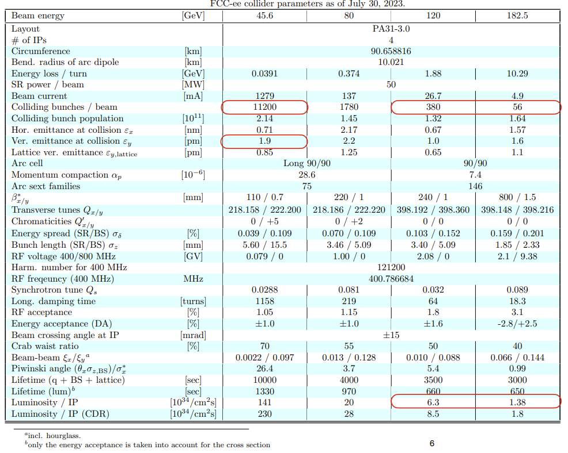
FCC-ee collider parameters

Slide 26
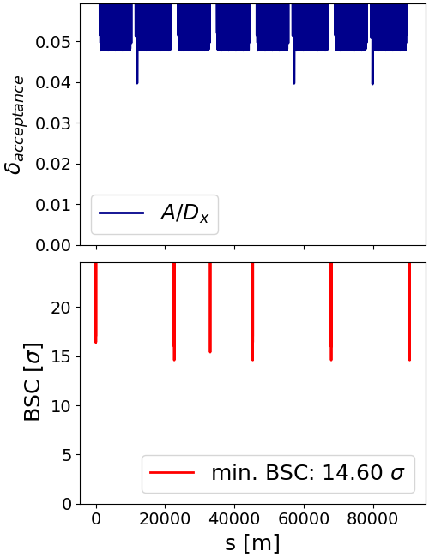
FCC-ee aperture
Aperture bottleneck for Z operation mode
Closed orbit tolerance: 250 μm
Maximum beta-beating: 10%
The momentum acceptance is the δ=A/D_{x}, where A is the mechanical aperture and D_{x} is the dispersion
The Beam-Stay-Clear (BSC) is the beam-to-aperture distance in units of beam size

Slide 27
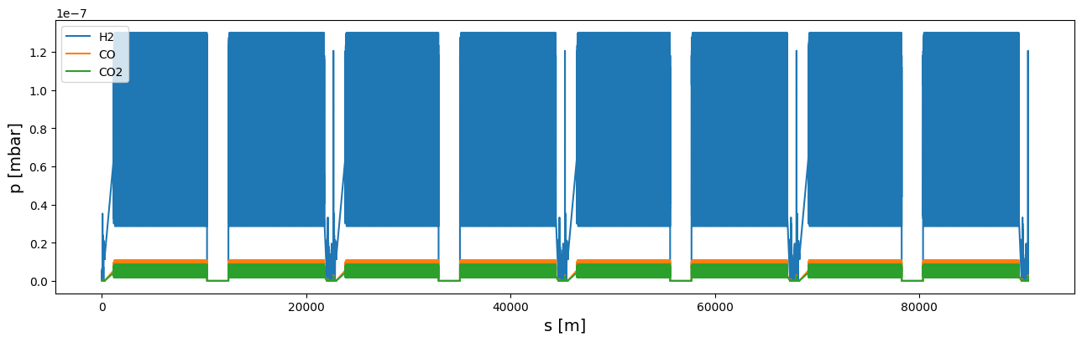
FCC-ee Z full ring pressure profile
*1h beam conditioning at full nominal current (1.27 A): pressure is expected to condition down further over time
Pressure profile for an arc section and for the MDI region provided by the vacuum team (R. Kersevan)*
Gas species and composition: 85% H₂, 10% CO and 5% CO₂
Arc section pressure profile repeated multiple times to cover the whole arc length
Because of the absence of dipoles generating SR the pressure in the straight sections is much lower compared to the pressure in the MDI and in the arcs
Arc pressure profile merged with the MDI and straight section pressure profiles to get a full ring pressure profile
Notes:
5°-10 in long straight sections
100^0.67

Slide 28
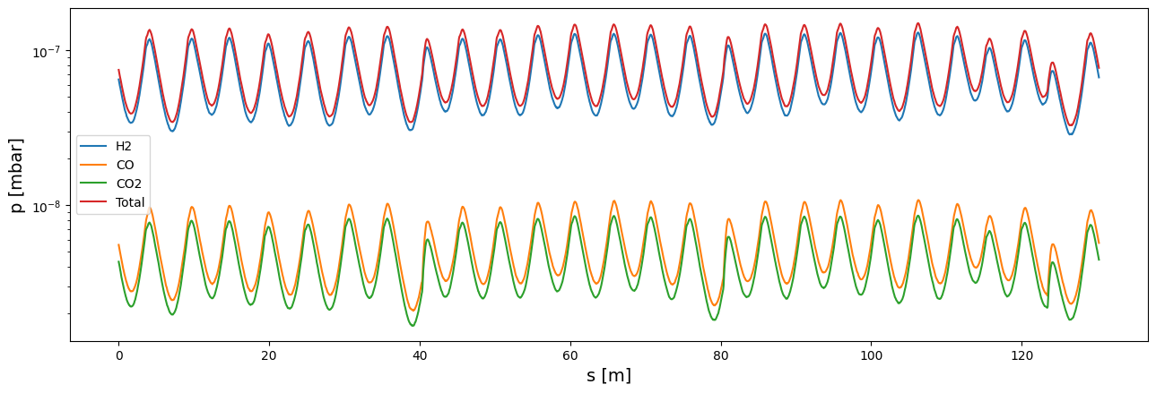
Arc pressure profile in the FCC-ee
Provided by the vacuum team (R. Kersevan)
FCC-ee (Z mode) – beam 1 (B1): 45.6 GeV positron beam, 1270 mA current
Gas species and composition: 85% H₂, 10% CO and 5% CO₂
Pressure profiles for 1h beam conditioning at full nominal current

Slide 29
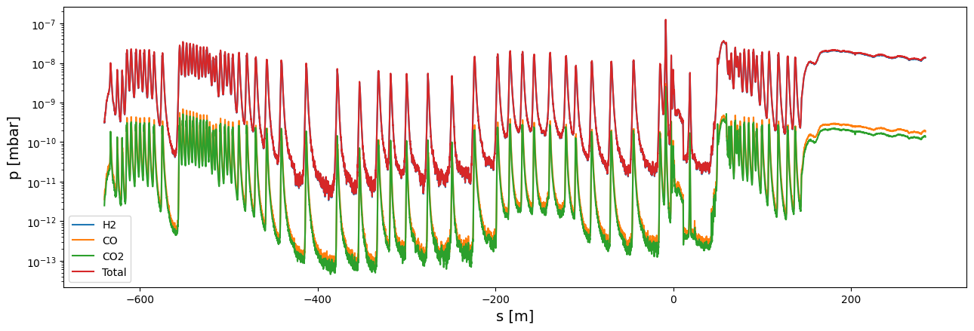
MDI pressure profile in the FCC-ee
Provided by the vacuum team (R. Kersevan)
FCC-ee (Z mode) – beam 1 (B1): 45.6 GeV positron beam, 1270 mA current
Gas species and composition: 85% H₂, 10% CO and 5% CO₂
Pressure profiles for 1h beam conditioning at full nominal current
IP

Slide 30
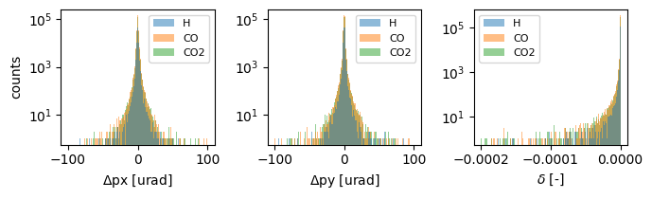
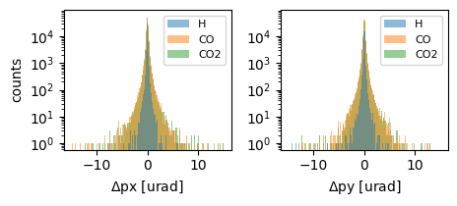
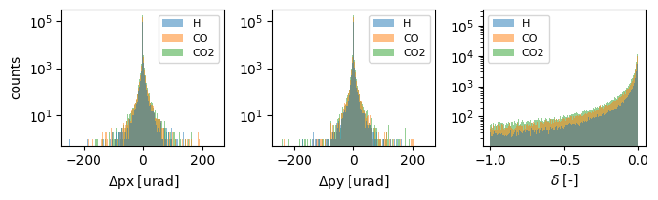
FCC-ee Z beam-gas interactions: interaction effect
Ionisation, bremsstrahlung and Coulomb scattering produce rather different effects
Interactions of 45.6 GeV e+ with H, CO and CO2 studied performing BDSIM (Geant4) thin target simulations
Ionisation (G4StandardEM_SS physics list)
Coulomb scattering (G4StandardEM_SS physics list)
Bremsstrahlung (G4StandardEM_SS physics list)
NOTE: Annihilation is currently not considered due to the much lower cross-section

Slide 31
Simulation workflow
Xsuite-BDSIM simulation tool (already used for FCC-ee collimation studies) with addition of arbitrary number of newly implemented beam-gas elements (based on local gas parameters from FCC-ee full ring pressure profile)
beam-gas element
At each beam-gas element
  The mean free path is computed from cross sections and local gas densities
  Random number compared to mean free path to determine if beam-gas interaction takes place
  If interaction takes place, further sampling of which gas species and which interaction type
  Kicks in angle and energy, taken from the pre-sampled interactions, applied to particle coordinates

Slide 32
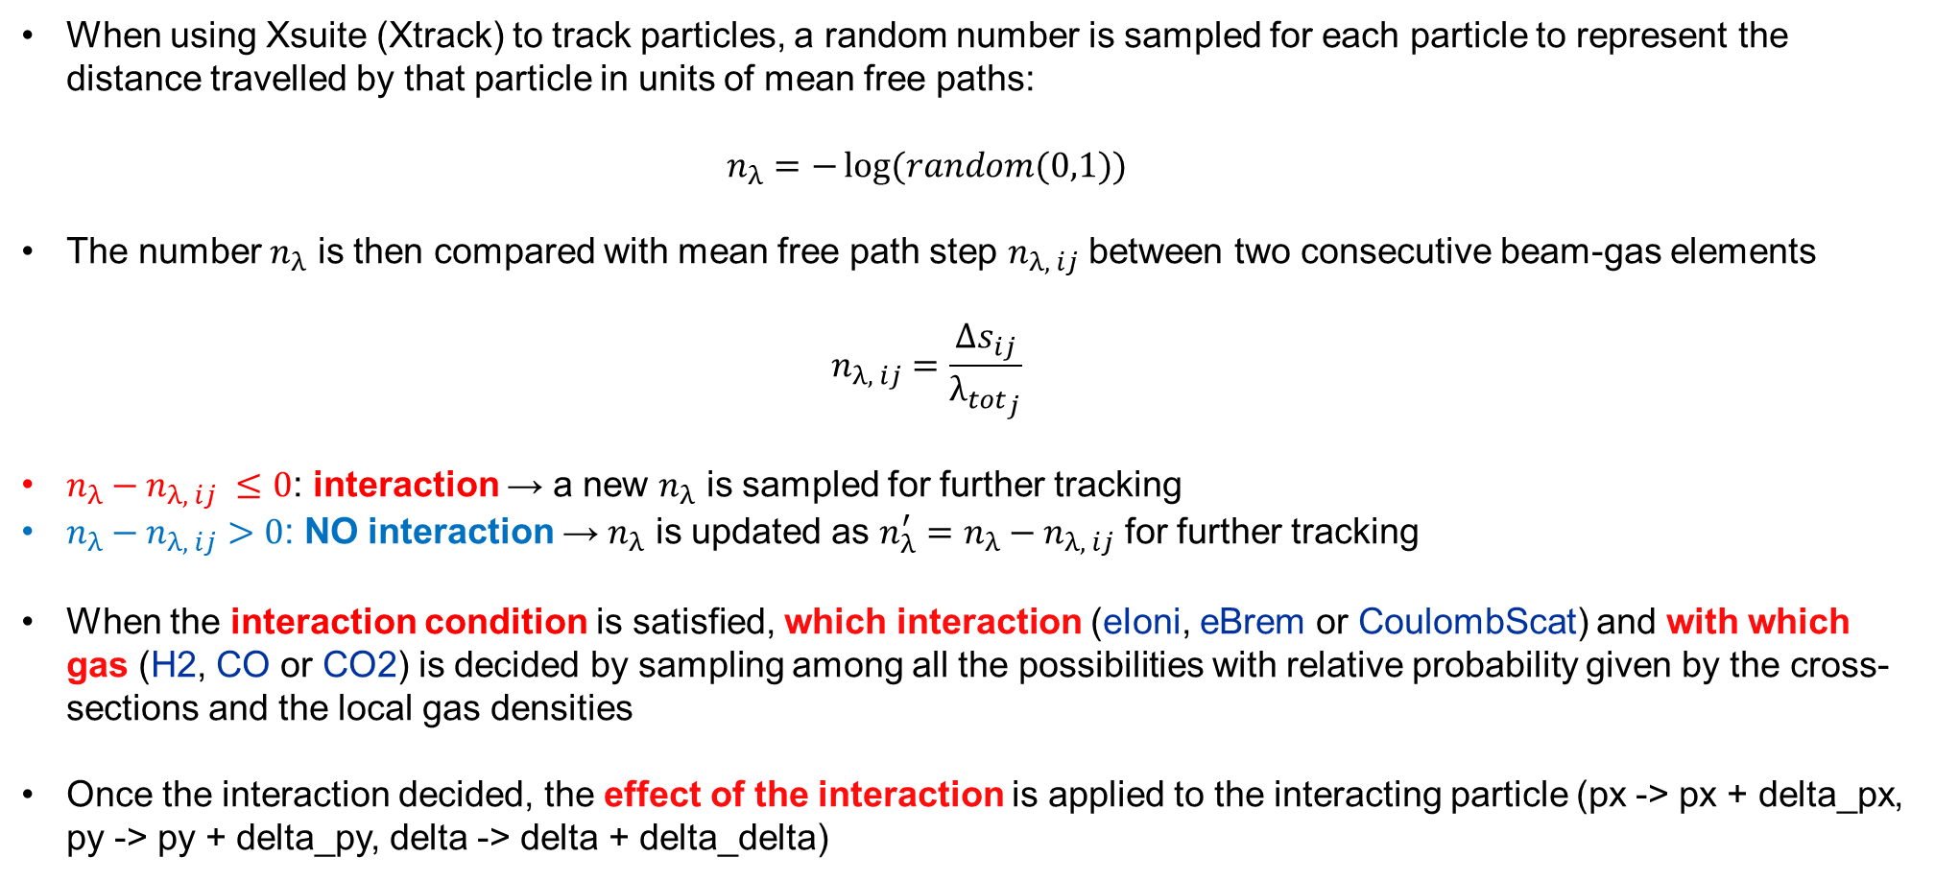
Simulation workflow: more details
When using Xsuite (Xtrack) to track particles, a random number is sampled for each particle to represent the distance travelled by that particle in units of mean free paths:
  $$n_{λ}=−\log{(random(0,1))}$$
The number $n_{λ}$ is then compared with mean free path step $n_{λ, ij}$ between two consecutive beam-gas elements
  $$n_{λ, ij}=\frac{{∆s}_{ij}}{{λ_{tot}}_{j}}$$
$n_{λ}−n_{λ, ij} ≤0$: interaction → a new $n_{λ}$ is sampled for further tracking
$n_{λ}−n_{λ, ij}>0$: NO interaction → $n_{λ}$ is updated as $n_{λ}^{′}=n_{λ}−n_{λ, ij}$ for further tracking
When the interaction condition is satisfied, which interaction (eIoni, eBrem or CoulombScat) and with which gas (H2, CO or CO2) is decided by sampling among all the possibilities with relative probability given by the cross-sections and the local gas densities
Once the interaction decided, the effect of the interaction is applied to the interacting particle (px -> px + delta_px, py -> py + delta_py, delta -> delta + delta_delta)
NOTE: interaction takes place at the beam-gas elements, precision can be increased by adding more elements

