Slide 1
IR Beam pipes
On behalf of the MDI study group

Slide 2
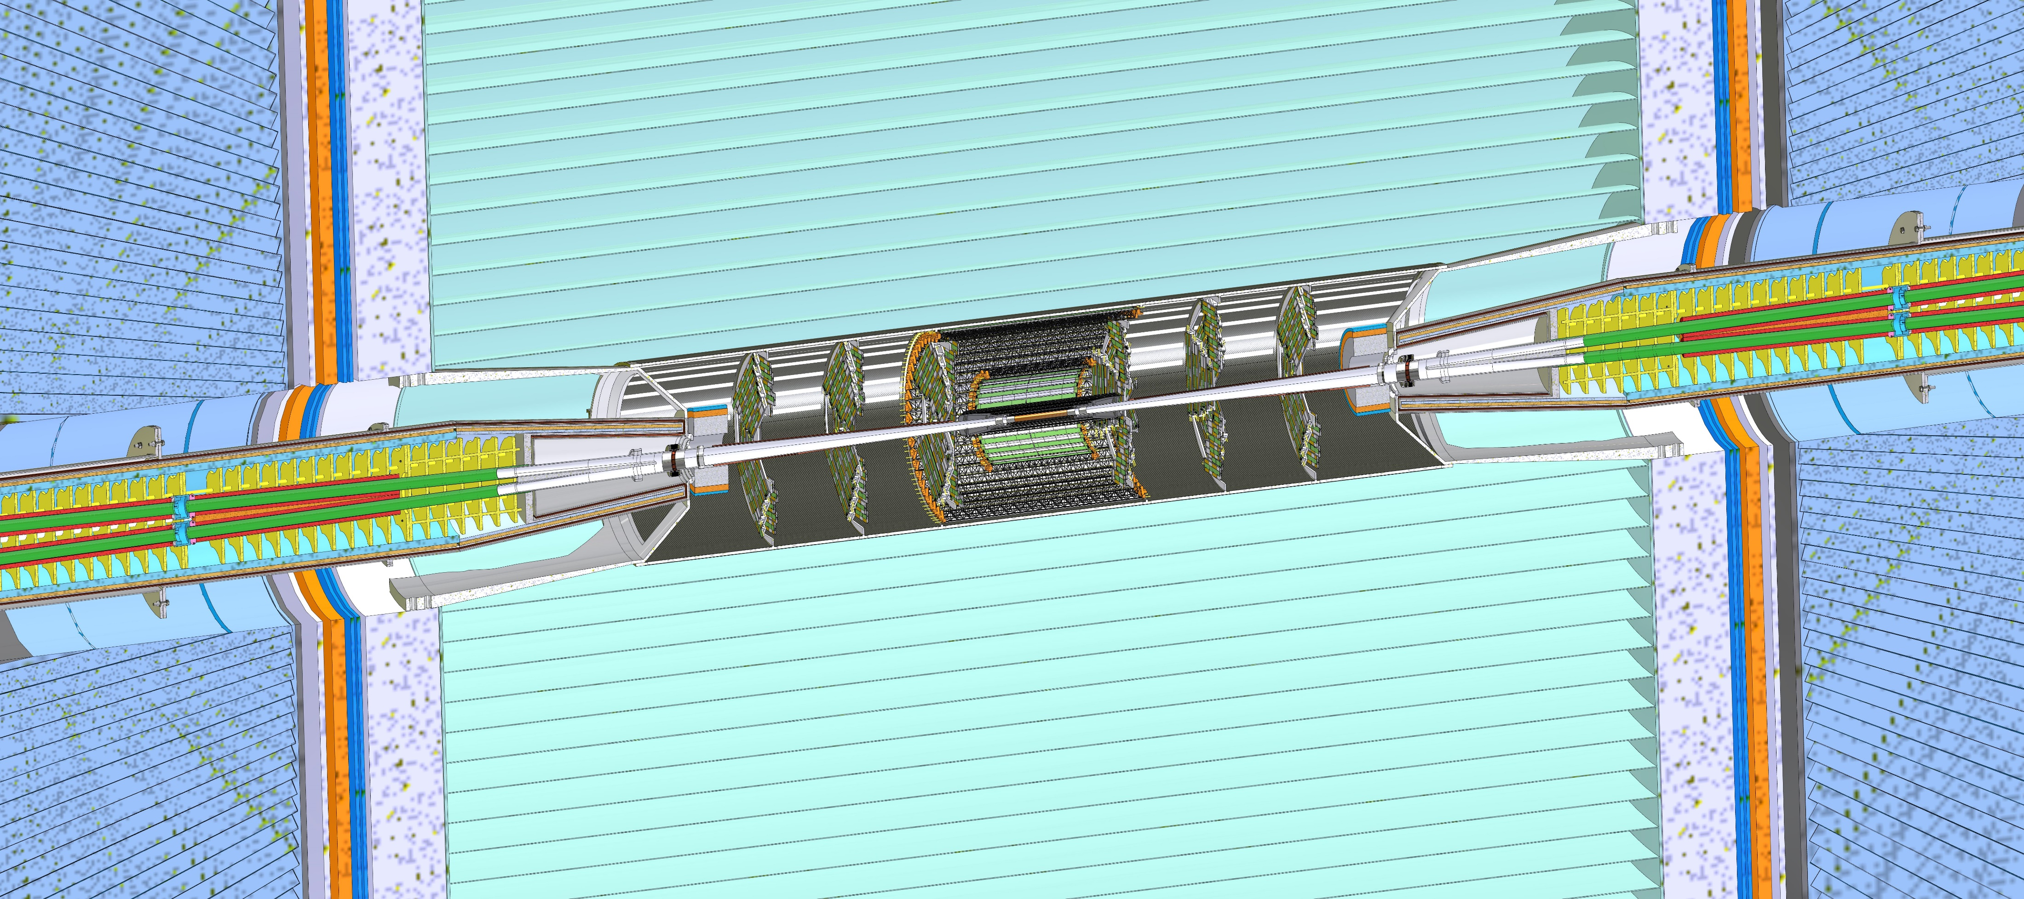
MDI mechanical model
This design is based on the IDEA detector concept.
3 m
Cooling
Inner vertex
Bellows
Cryomagnet
IP
LumiCal
Disks
Ellipto-Conical chamber
Remote vacuum connection
Support tube
Outer and middle vertex
L* = 2.2 m
Central chamber
IDEA detector

Slide 3
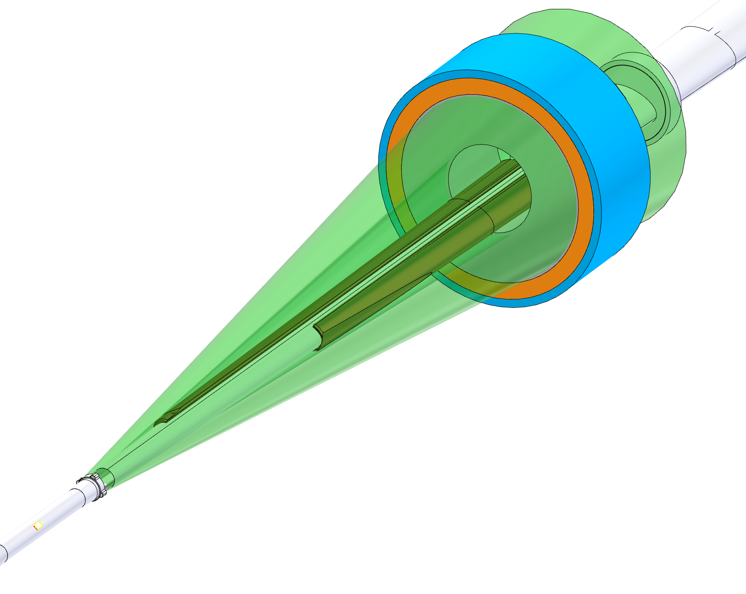
Spatial constraints
To achieve the required performance, it is necessary to have low material budget within the LumiCal acceptance (between 50 mrad and 105 mrad centered on the outgoing beam pipe).
Every component of the MDI must stay inside the 100 mrad detector acceptance cone.
105 mrad
50 mrad
100 mrad
Notes:
The components integration and each component (i.e. the conical chamber) have been designed to keep everything out of this range, or the thickness has been optimized to achieve the maximum transparency possible.
This constraint is symmetric and, therefore, is less problematic if compared with the Lumical Constraint

Slide 4
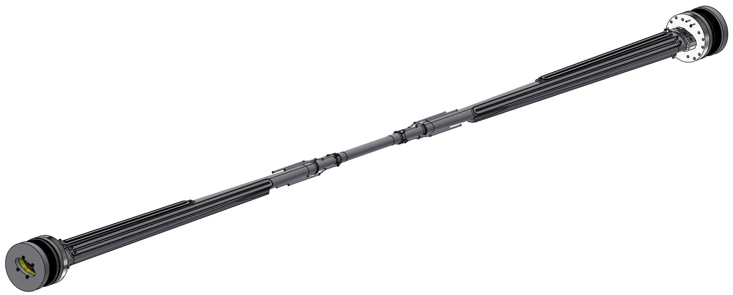
Engineered Chambers
Engineered design
Thermal simulation
Structural simulation
Ready for the manufacturing phase
Conical chamber
Central chamber
IP
1020 mm
Conical chamber
310 mm
1020 mm

Slide 5
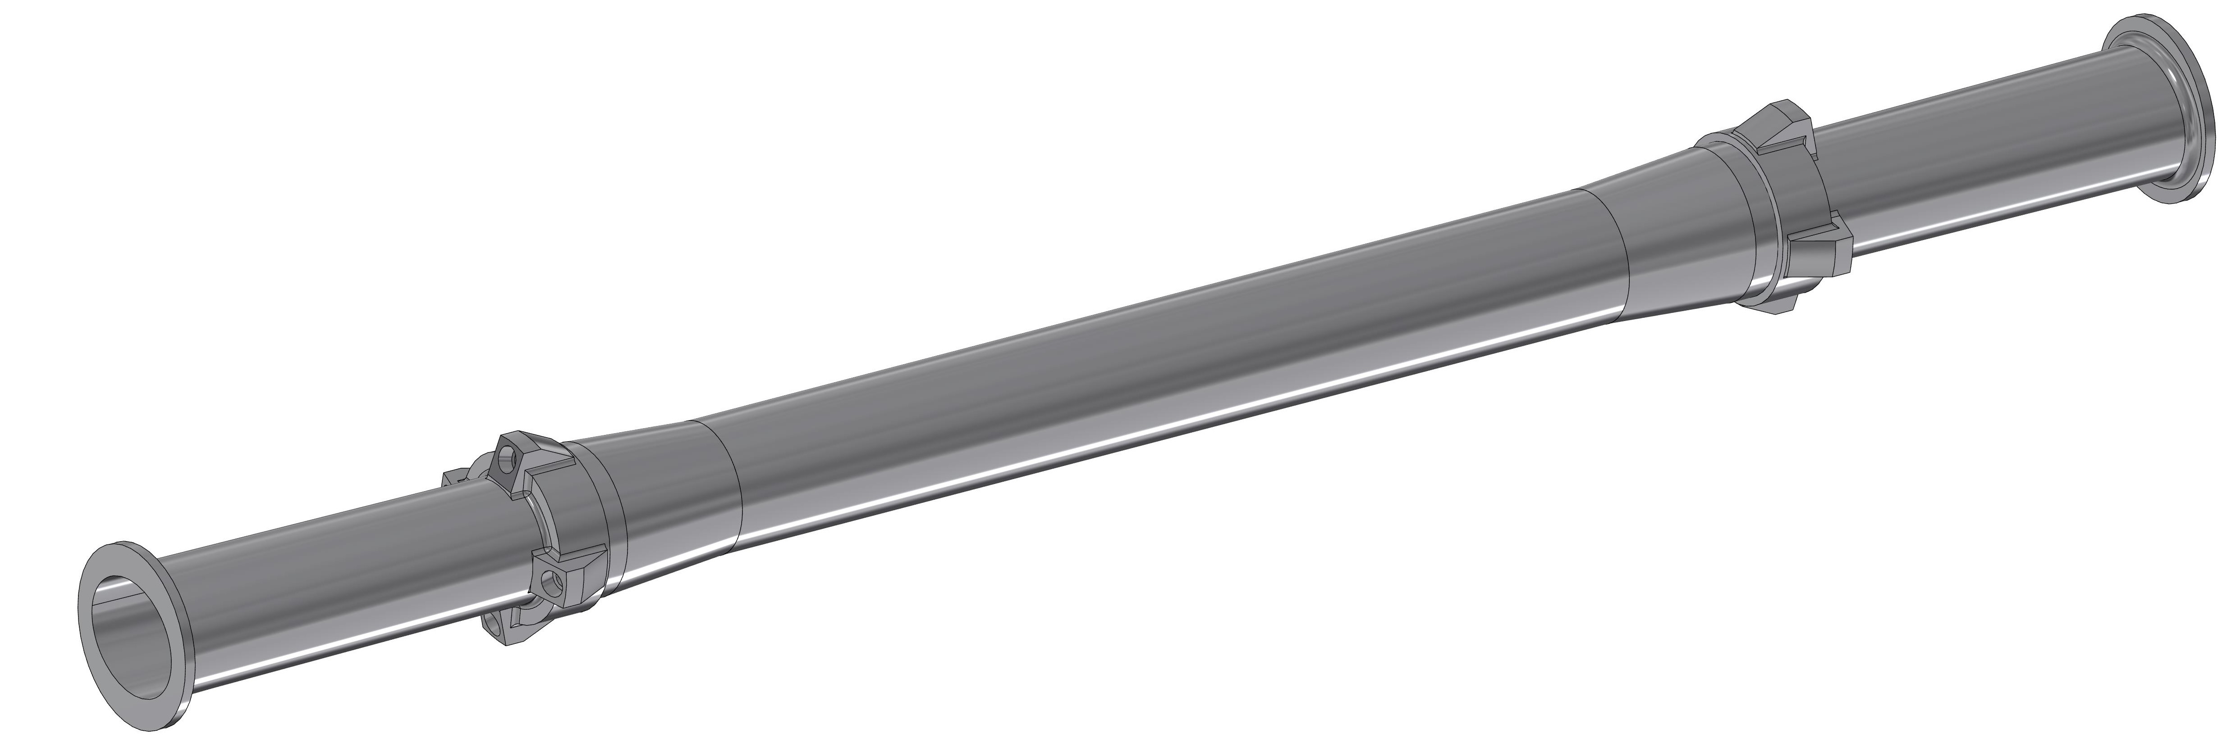
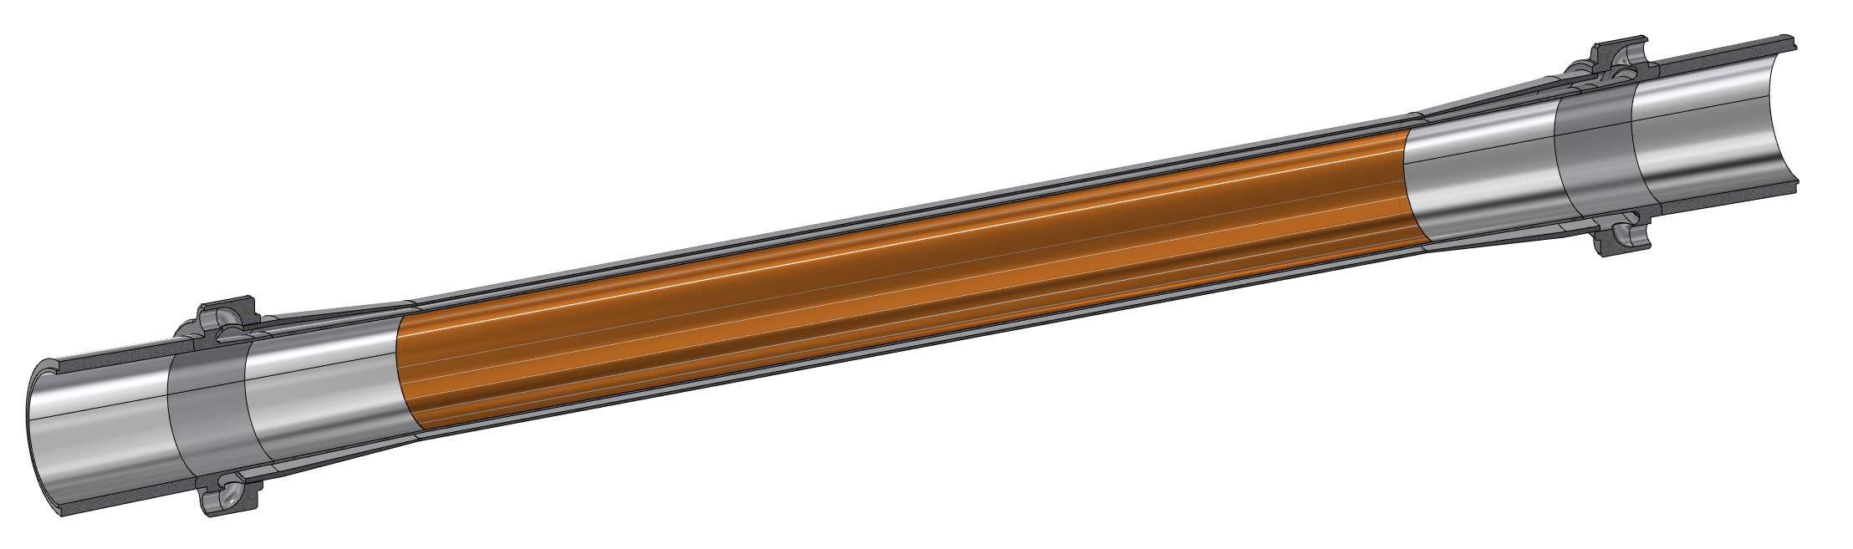
Central chamber
The main characteristics:
AlBeMet 162 as main material
Three layers from 0-90 mm from IP
0.35 mm of AlBeMet162 (62% Be, 38% Al)
1 mm gap for Paraffin
0.35 mm of AlBeMet162
Paraffin as coolant
Geometry studied to integrate the central chamber with the vertex detector
Cooling channel
Paraffin cooling system
Inlet for paraffin
5 μm gold coating to increase the electrical conductivity
Outlet for paraffin
Double layer of AlBeMet162
Section view

Slide 6
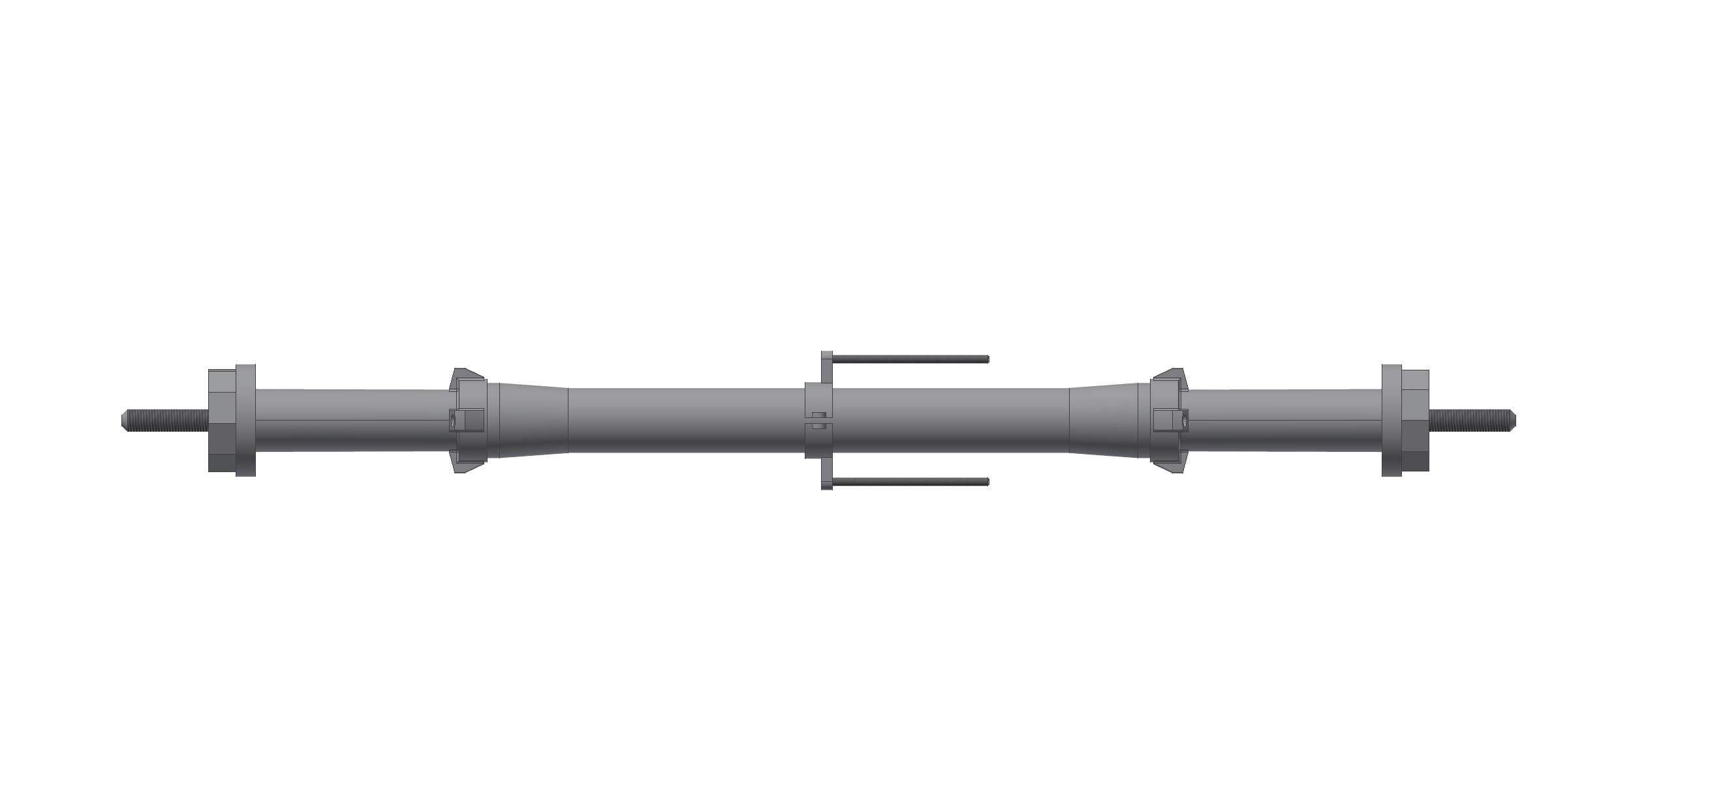
Assembly procedure
Tool for welding

Slide 7
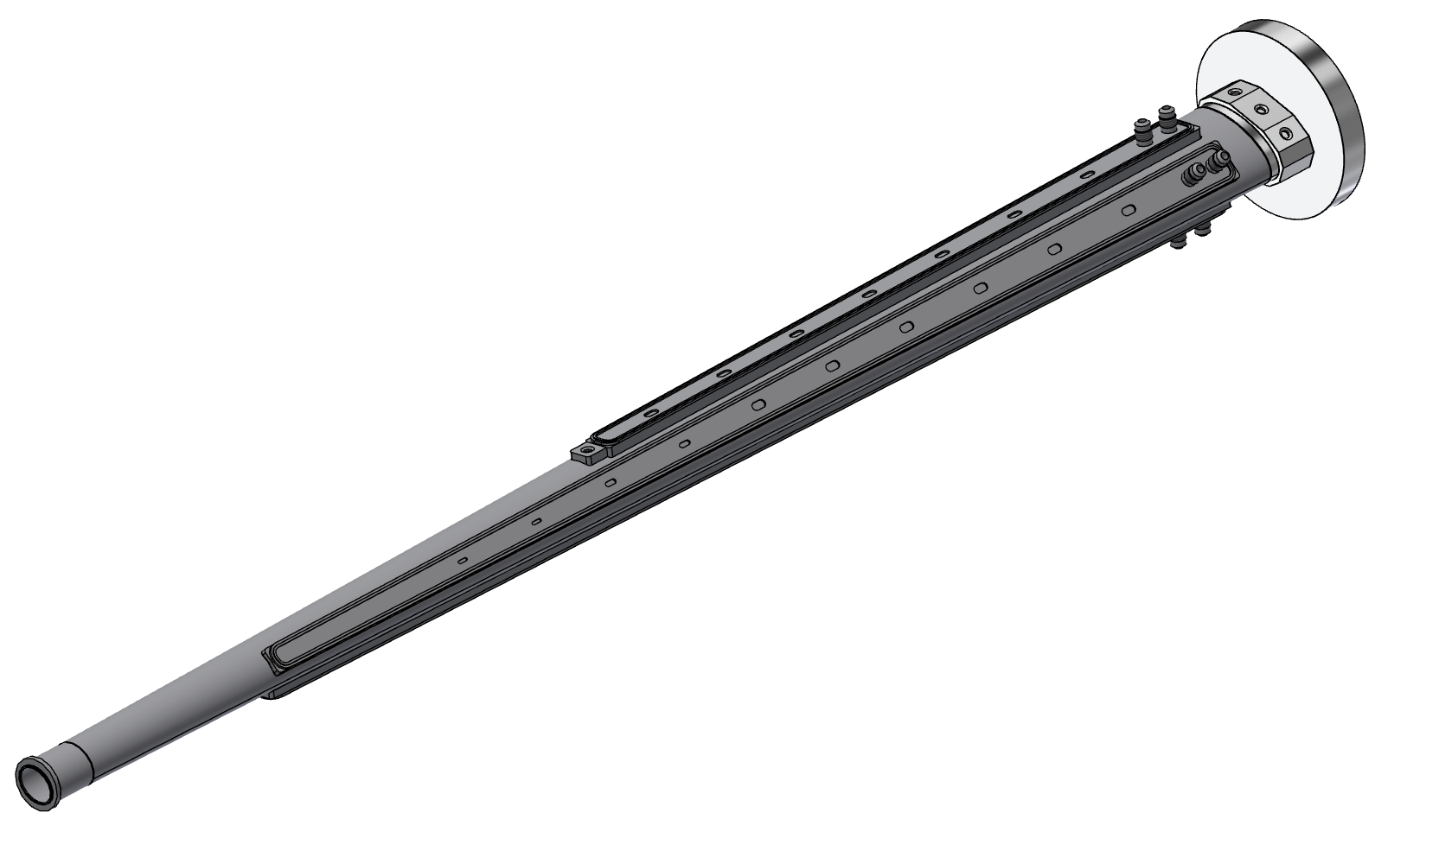
Ellipto-Conical chamber
Flange for the bellows
Spot welding to limit the leakages between inlet and outlet
Main characteristics:
AlBeMet162 is the main material.
The chamber consists of two halves, machined considering the internal shape of the chamber, and assembled using EBW (Electron Beam Welding).
The cooling is based on an asymmetric solution, using the 50 mrad Lumical acceptance cone as the cutting profile.
Reference for alignment
Reference for alignment
Hydraulic connection for the inlet and outlet pipes
Machined cooling system over the chamber, creating 4 channels
Flange for the central chamber

Slide 8
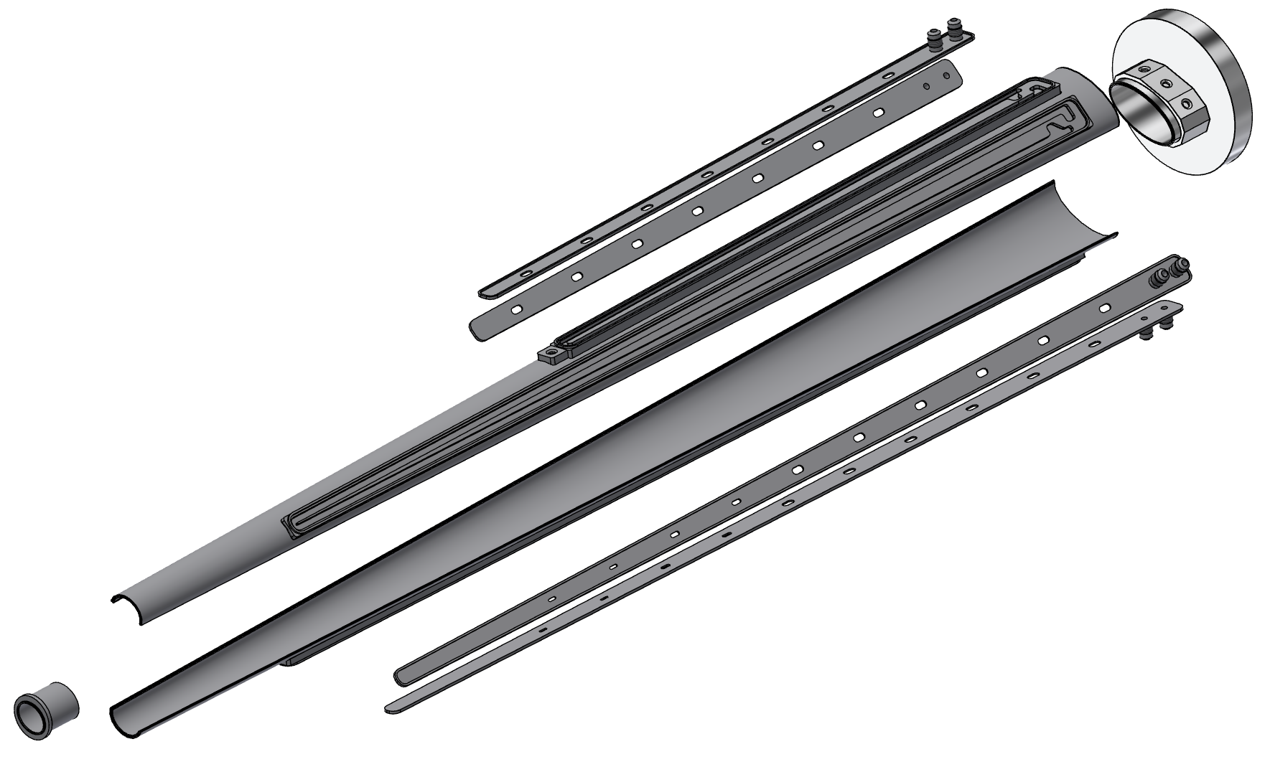
Elliptical welding
Covers
Longitudinal welding
Perimetral welding for the covers
Covers
1st half
2nd half

Slide 9
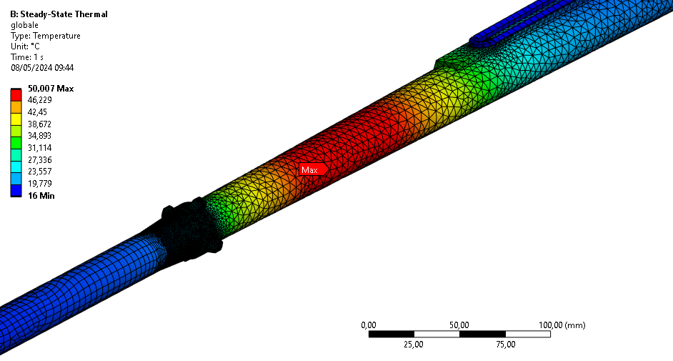
Thermo-structural analysis
From CST calculations (Alexander Novokhatski (SLAC))
Paraffin flow (central chamber)
Flow rate: 0,015 kg/s
Section:68,17 mm²
Velocity: 0,3 m/s
Inlet temperature: 18°C
Convective coefficient: 900 W/m²K
Water flow (Ellipto-Conical chamber)
Flow rate: 0,01 kg/s (4 channels per side)
Total flow rate per side: 0,04 kg/s
Section: 12,25 mm²
Velocity: 1 m/s
Inlet temperature: 16°C
Convective coefficient: 1200 W/m²K
Heat load
54 W central
130 W AlBeMet162 for each part
Weight
chamber
Inner Vertex first layer
Constraint
Cantilevered, simply supported configuration
 | Conical chamber | Central chamber
Coolant | Water | Paraffin
Maximum chamber temperature [°C] | 50 | 29
T_out coolant [°C] | 18 | 20.5
Chamber design (until the bellows)
 | Conical chamber | Central chamber
Maximum Von Mises stress | 16 MPa | 20 MPa
Maximum displacement | 0.45 mm | 0.5 mm

Slide 10
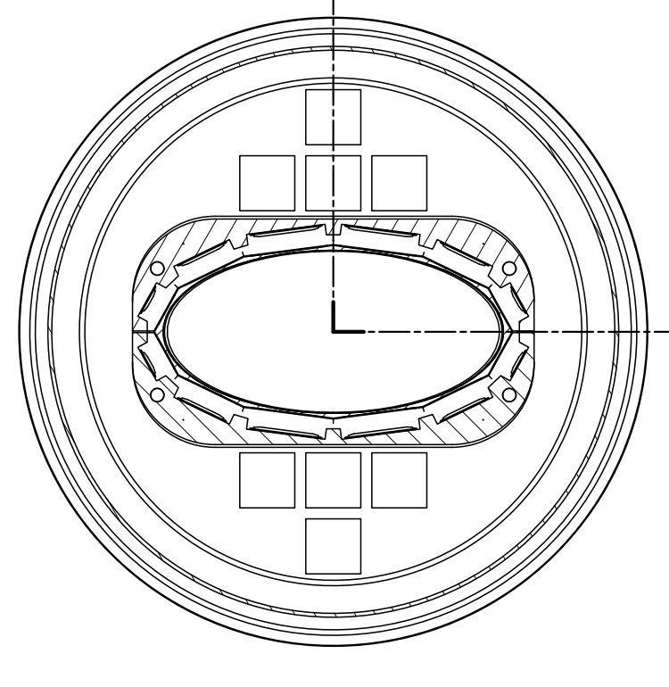
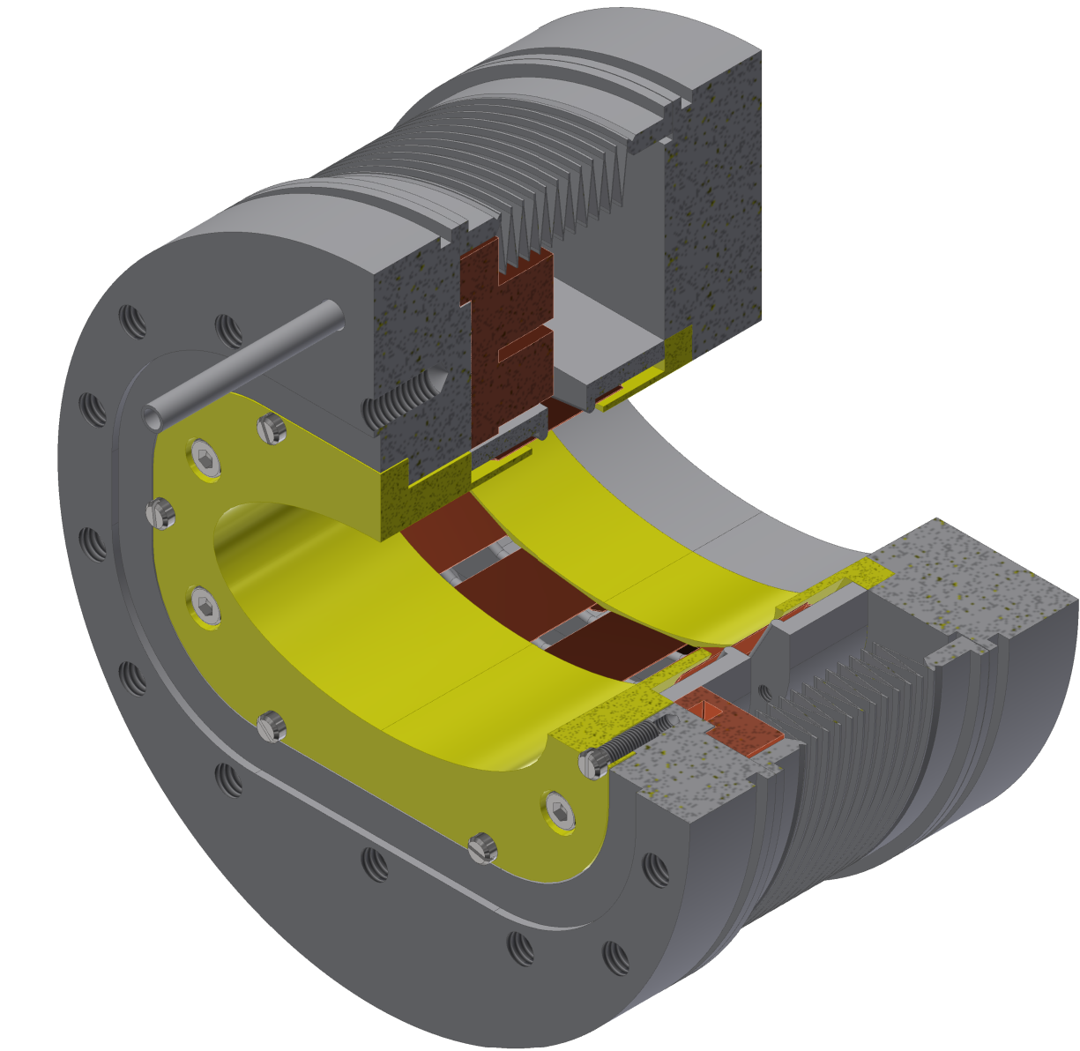
Bellows with HOM absorber
The bellows is needed to:
Protect the central chamber during the assembly procedure.
Support properly the chamber bellows-to-bellows, containing the deformation.
Allow the thermal deformation without compromising the chamber.
The high order mode (HOM) absorber have been inserted on the bellows and a prototype will be manufactured and tested at INFN-LNF.
The cooling has been designed and included in the design.
The HOM absorber currently are an envelope included as space holder: the number and the shape will be defined after dedicated simulation.
Flange
Main characteristics:
Cylindrical envelope, to find the space for the HOM absorber.
Dismountable flanges: to simplify the assembly procedure.
Convolutions
Convolutions details:
internal diameter: 90.3 mm
external diameter: 110.3 mm
free length: 23.21 mm
compressed length: 7.26 mm
extended length: 35.1 mm
material: AISI 316l
thickness: 0.15 mm
Stroke:
axial stroke: 27.83 mm
compression stroke: 15.95 mm
extension stroke: 11.88 mm
maximum angle: 14.45°
radial offset: 1.33 mm
spring rate: 4-8 n/mm
HOM absorber
Springs
The distribution of the springs can be modified according to the simulation.
Cooling

Slide 11
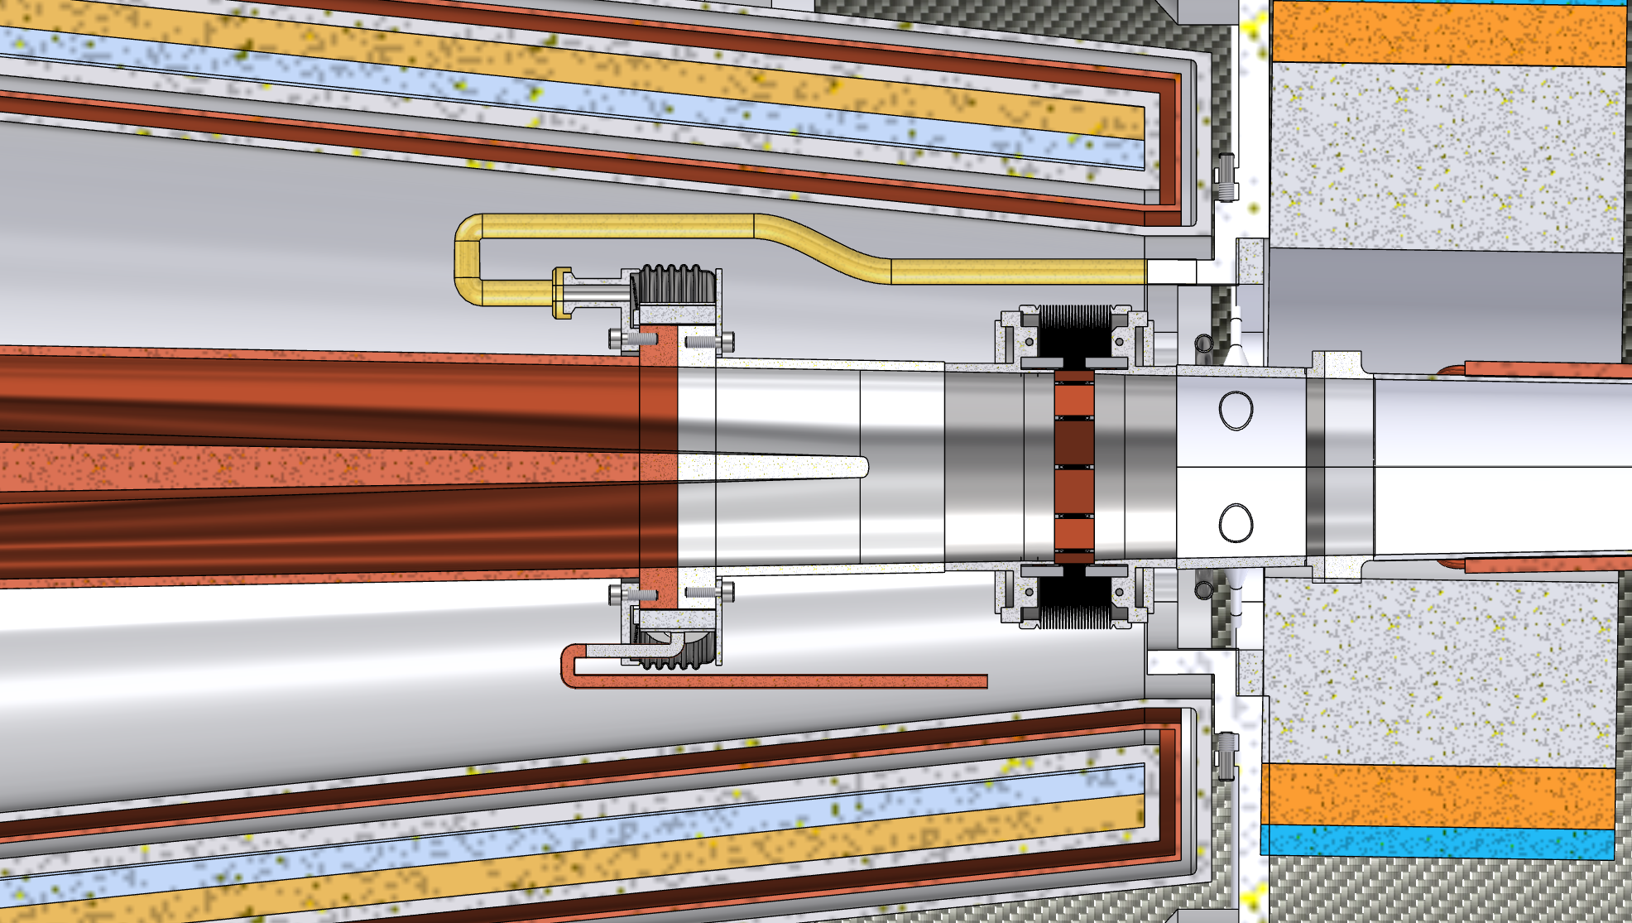
Remote vacuum connection
The remote vacuum connection it is necessary for the assembly procedure.
The vacuum chamber mounted on the Support Tube has to be connected to the vacuum chamber from the cryomagnetic system.
The connection has to be remote, indeed it is not possible to reach the inner part of the detector to connect the flanges.
Two options
Mechanical connection (as designed by DESY for SuperKEKB)
Shape memory alloy connection (SMA)
CERN-TE/VSC
University of Calabria, Italy
Remote vacuum connection
More Compact and compatible with the space available

Slide 12
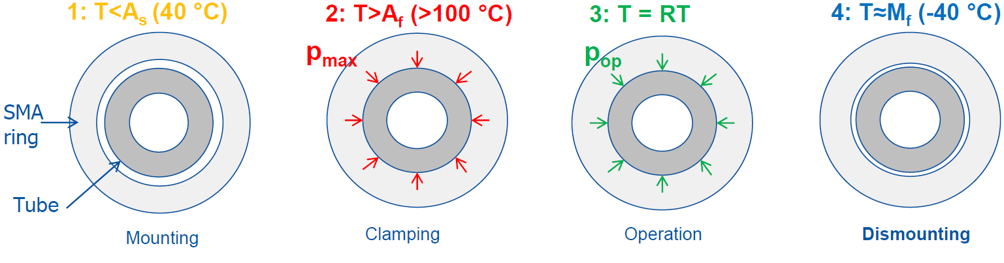
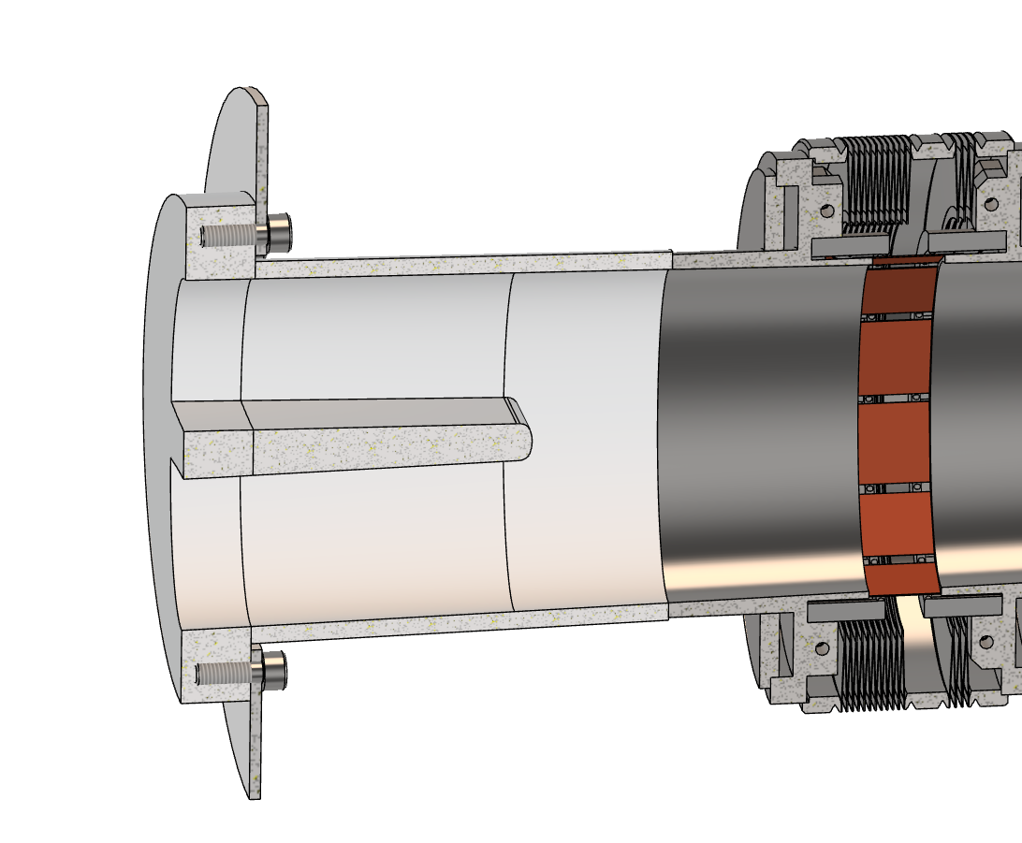
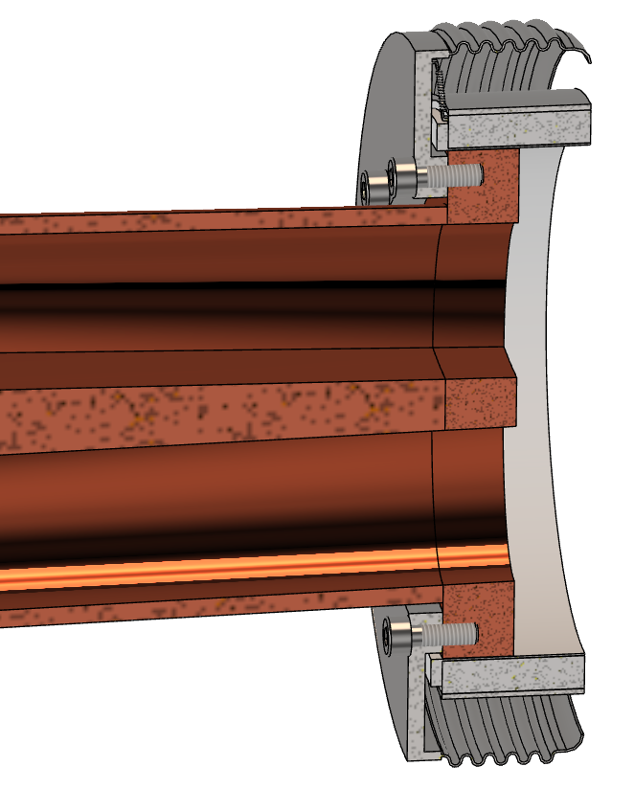
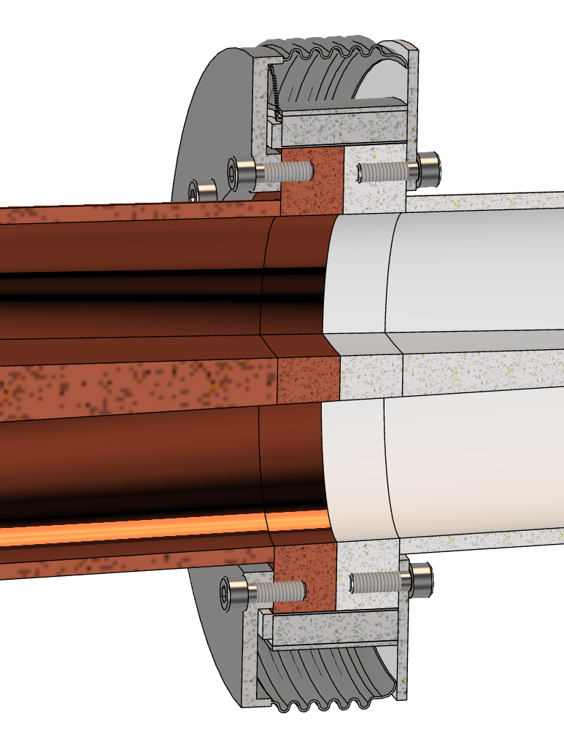
Remote vacuum connection (1)
Work made with Fabrizio Niccoli (University of Calabria, CERN-TE/VSC)
A shape memory alloy (SMA) is a material that can recover a large pseudoplastic deformation through heating. This process can be reversable using two-way shape memory alloy, this material can switch between two different shape simply by heating and cooling. In this way is possible to create a connection dismountable between two parts.
B
Nitrogen channel for cooling
A-side slided
Gasket
B-side flange
A-side flange
NiTi SMA
Vacuum chamber
A
B
B-side mounted on the Support Tube
A
In progress:
Positioning system design (in order to reach the tolerances needed for the gasket mounting)
Dismounting system (cooling system for SMA ring expansion + easy gasket removal)
Evaluation of the possibility to use a bellows flange as the B-side flange, in order to reduce the space needed for the connection
Resistive collar for heating
[1] Niccoli, Fabrizio & Garion, Cedric & Maletta, Carmine & Chiggiato, Paolo. (2017). Shape-memory alloy rings as tight couplers between ultrahigh-vacuum pipes: Design and experimental assessment. Journal of Vacuum Science & Technology A: Vacuum, Surfaces, and Films. 35. 10.1116/1.4978044.
[2] F. Niccoli, C. Garion, C. Maletta, E. Sgambitterra, F. Furgiuele, P. Chiggiato, Beam-pipe coupling in particle accelerators by shape memory alloy rings, Materials & Design, Volume 114, 2017, Pages 603-611, ISSN 0264-1275, https://doi.org/10.1016/j.matdes.2016.11.101.

Slide 13
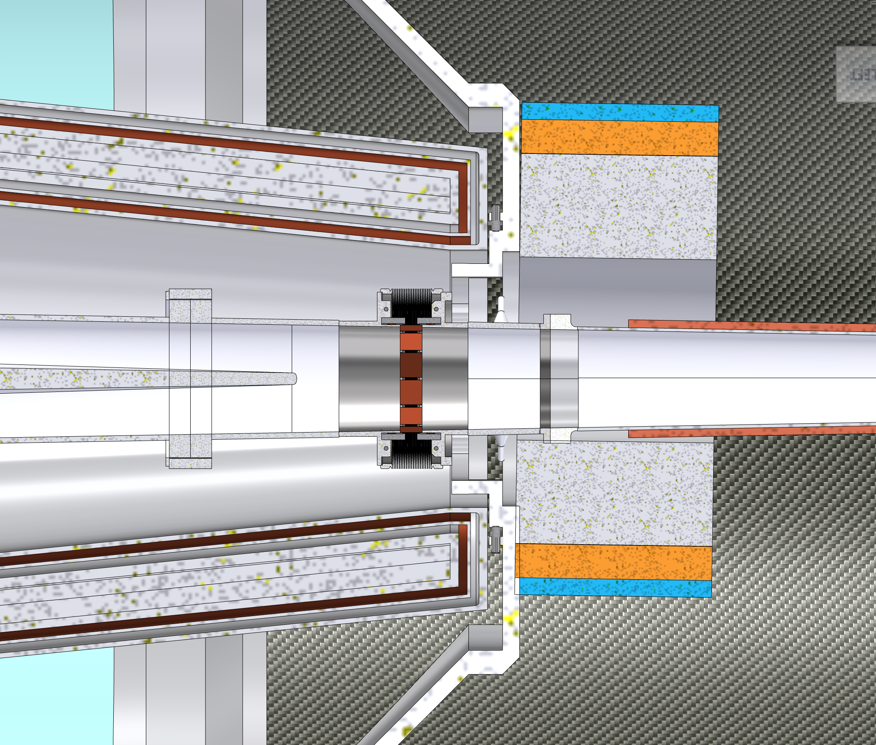
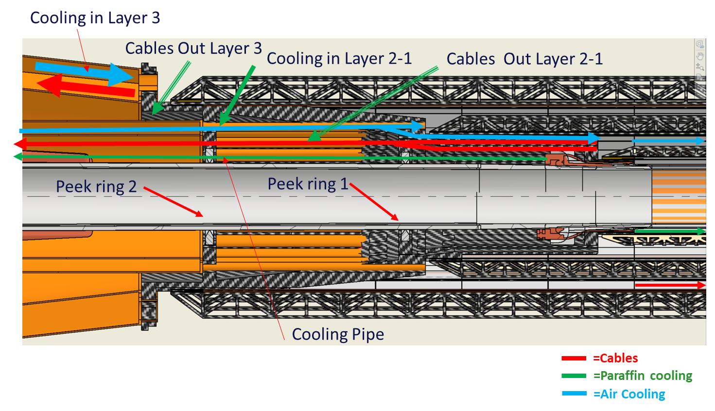
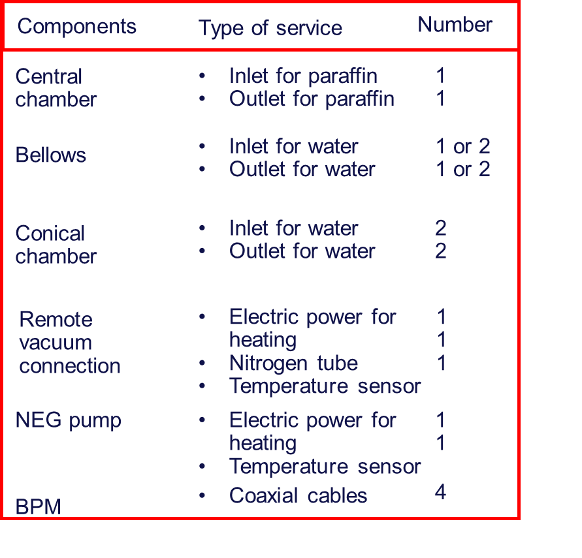
Services integration challenges
There are two problematic areas for the services integration:
Interface with the cryomagnetic system.
Interface between the vacuum chamber and the vertex detector.
NEG PUMP
= Outlet cooling
= Inlet cooling
= Electric cables
= Nitrogen pipe
= Coaxial cable
= Signal cable

Slide 14
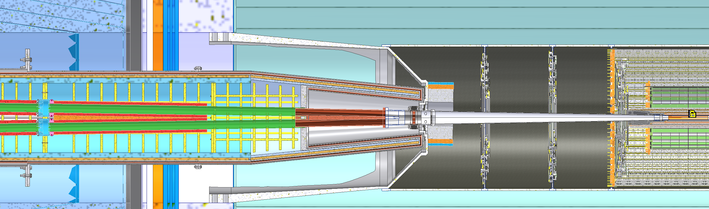
1190 mm
End of LumiCal
1074 mm
Start of LumiCal
1154.5 mm
Transition from AlBeMet162 to Stainless steel
1200 mm
BPM position
1227 mm
Bellows start
1279 mm
Bellows finish

Slide 15
1500 mm
1320 mm
Crotch
1383 mm
Remote vacuum connection
1735 mm
End of hole inside solenoid
2200 mm
Start of QC1

Slide 16
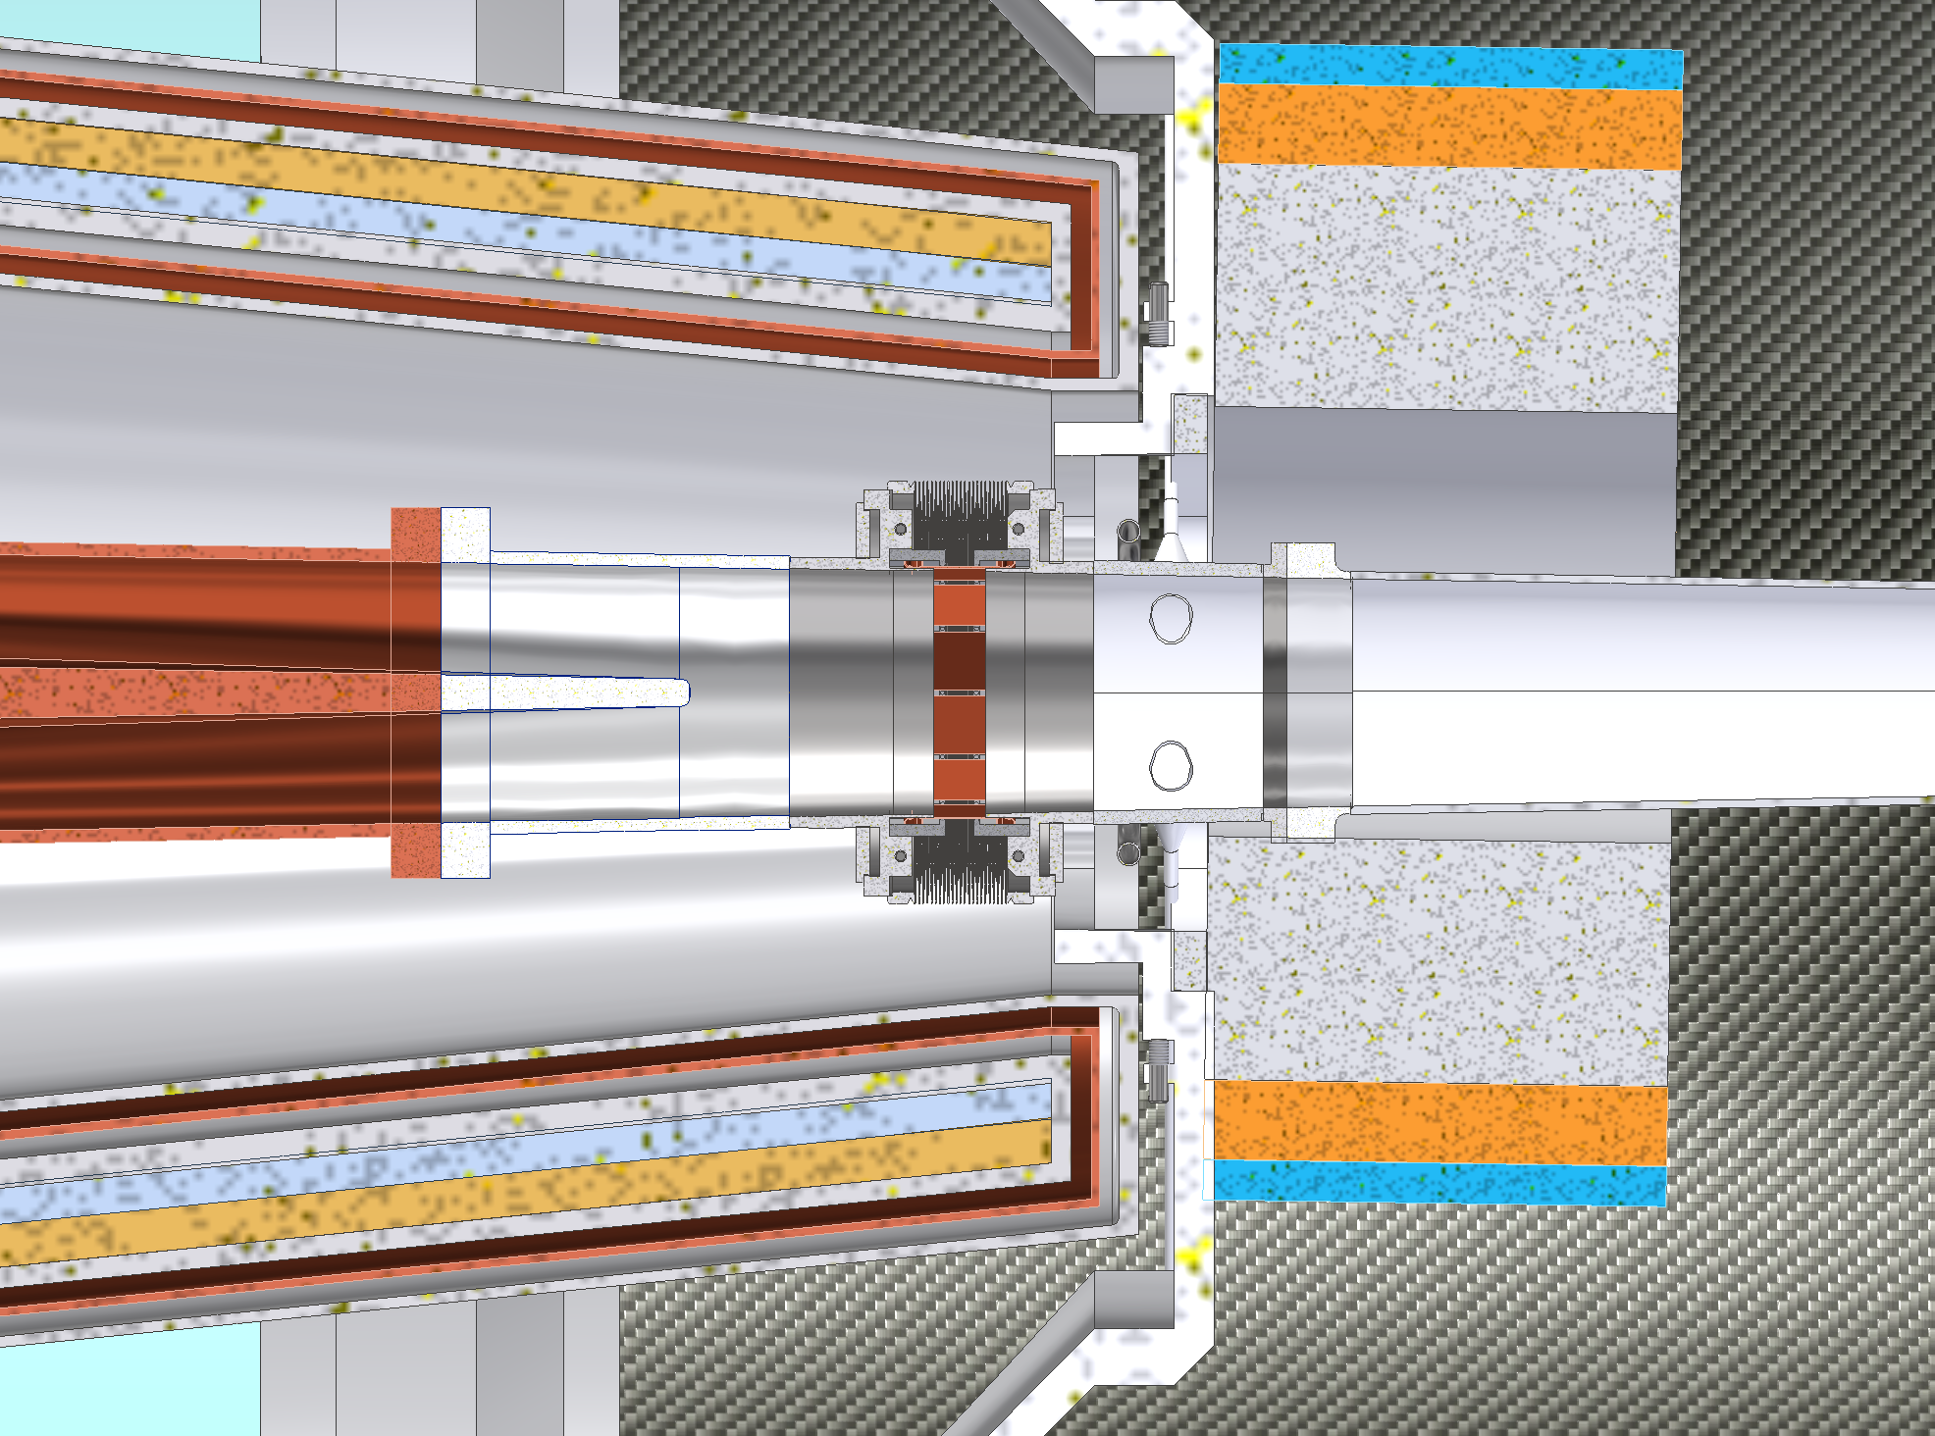
15 mm
32 mm
151 mm
44mm

Slide 17
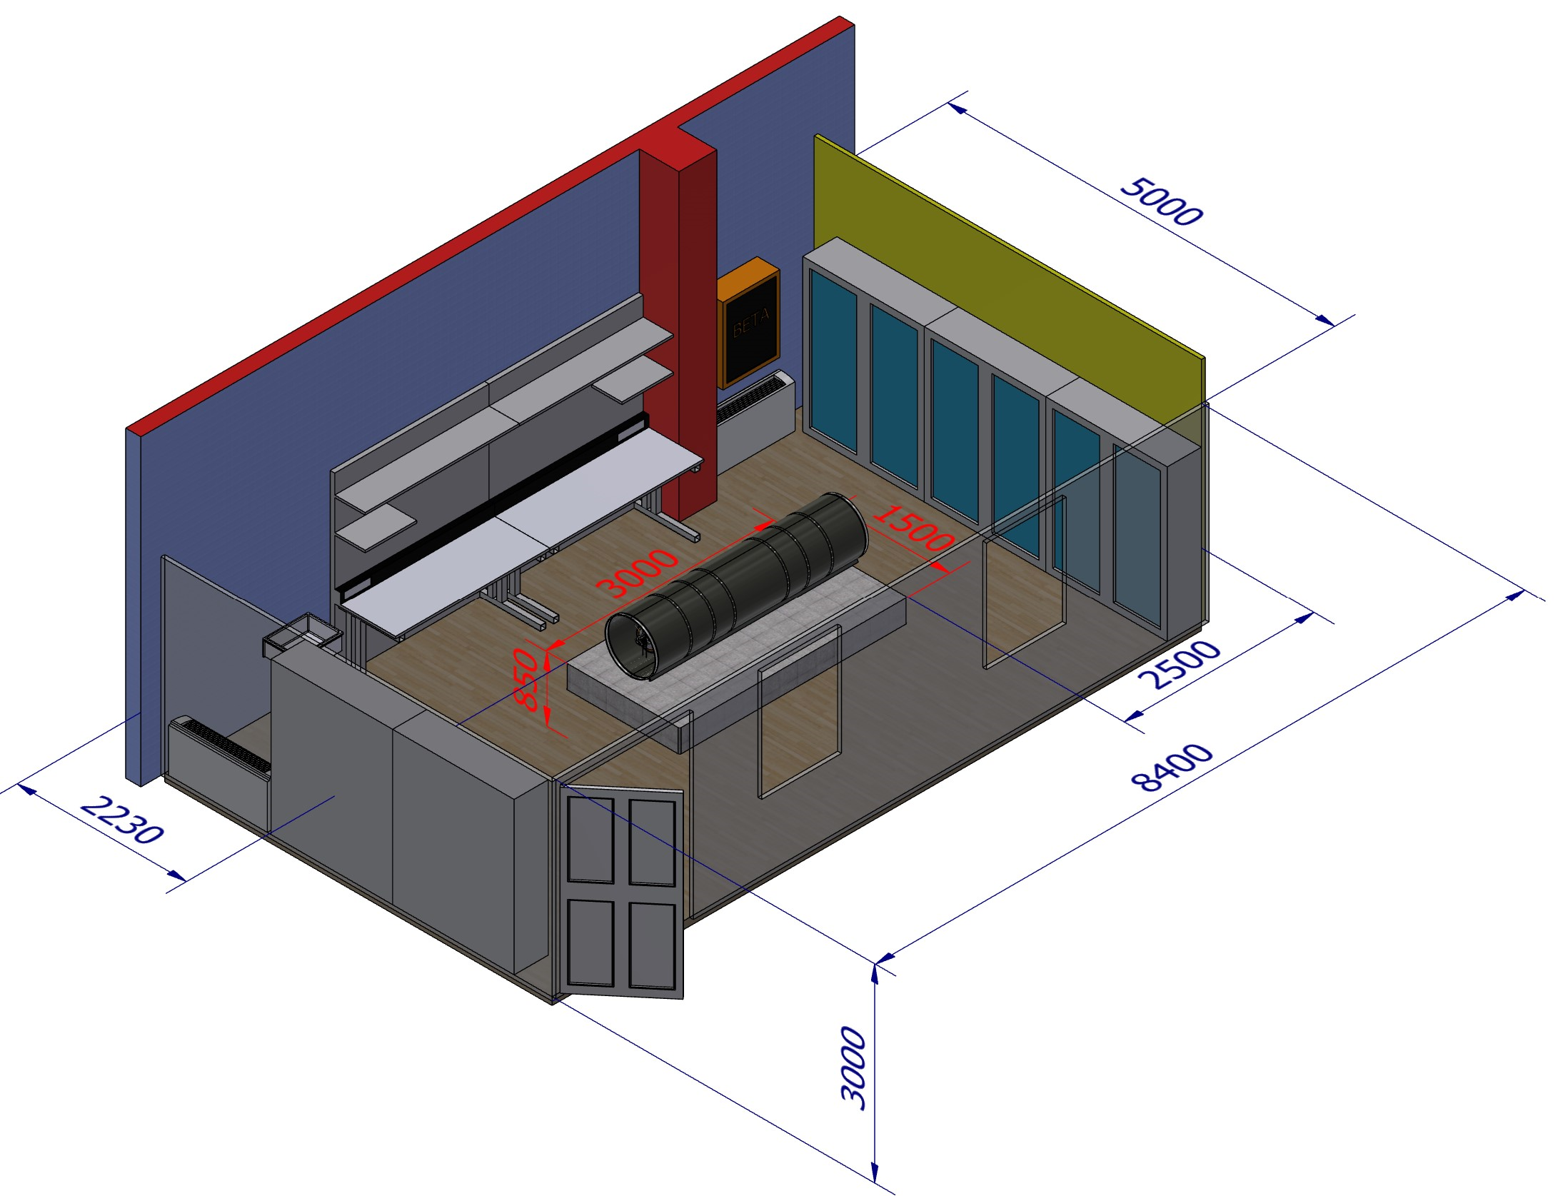
MDI R&D IR Mockup
Activities started for FCC-ee IR mockup to be built at INFN-LNF.
Check assembly strategy feasibility for the single parts of the chamber (central, ellipto-conical) and of whole system (chamber, bellows, inner vertex, outer vertex, middle vertex, disks).
Check the feasibility of the Electron Beam Welding along an elliptical shape.
Test of the cooling systems.
Test the constraint schema and the stiffness of bellows with CuBe blades.
Study of cables and cooling pipes fitting.
In December we started the cooling test with the paraffin on the central chamber realised in Al6082.

Slide 18
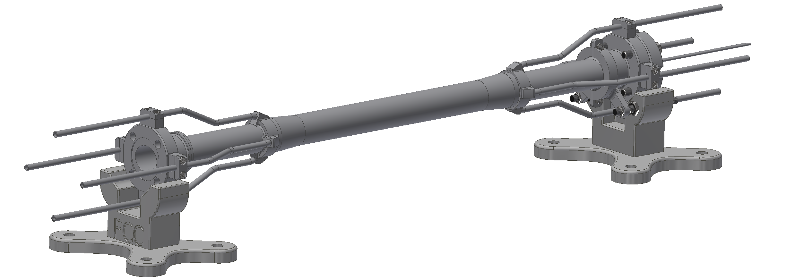
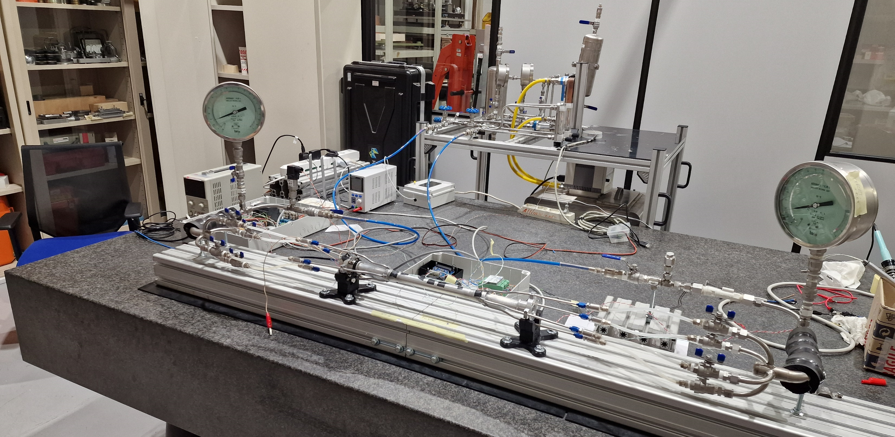
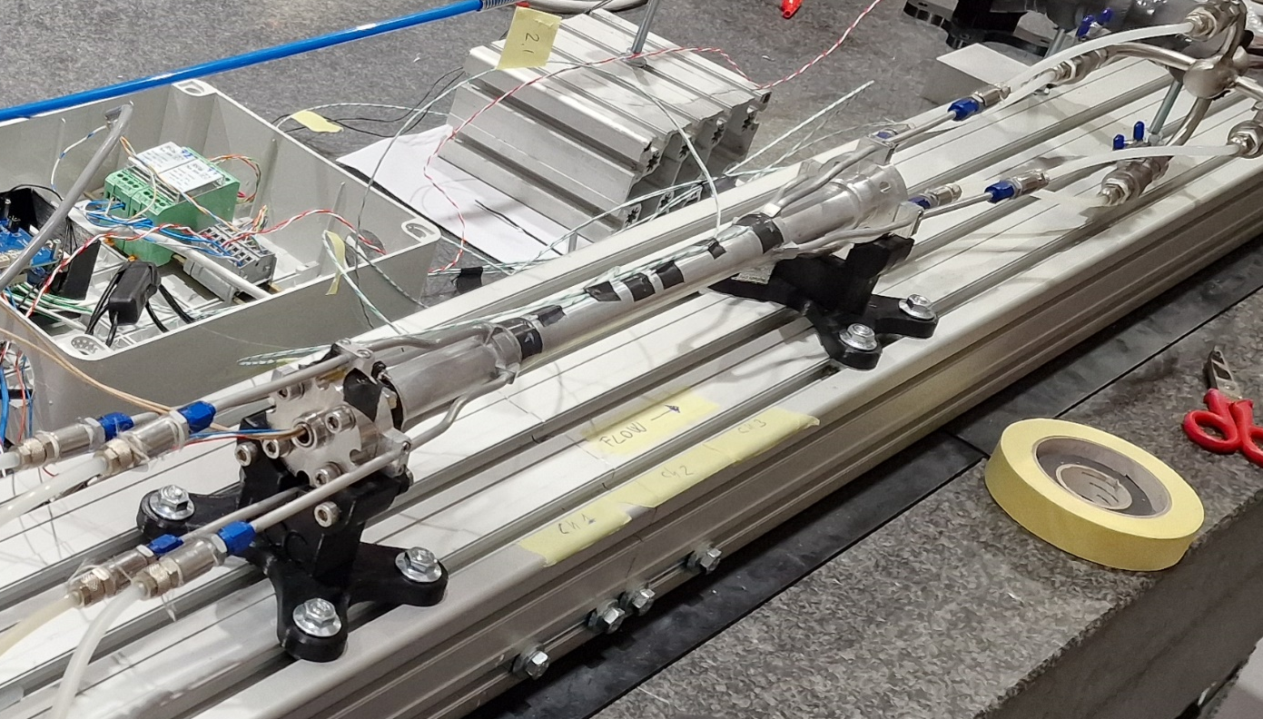
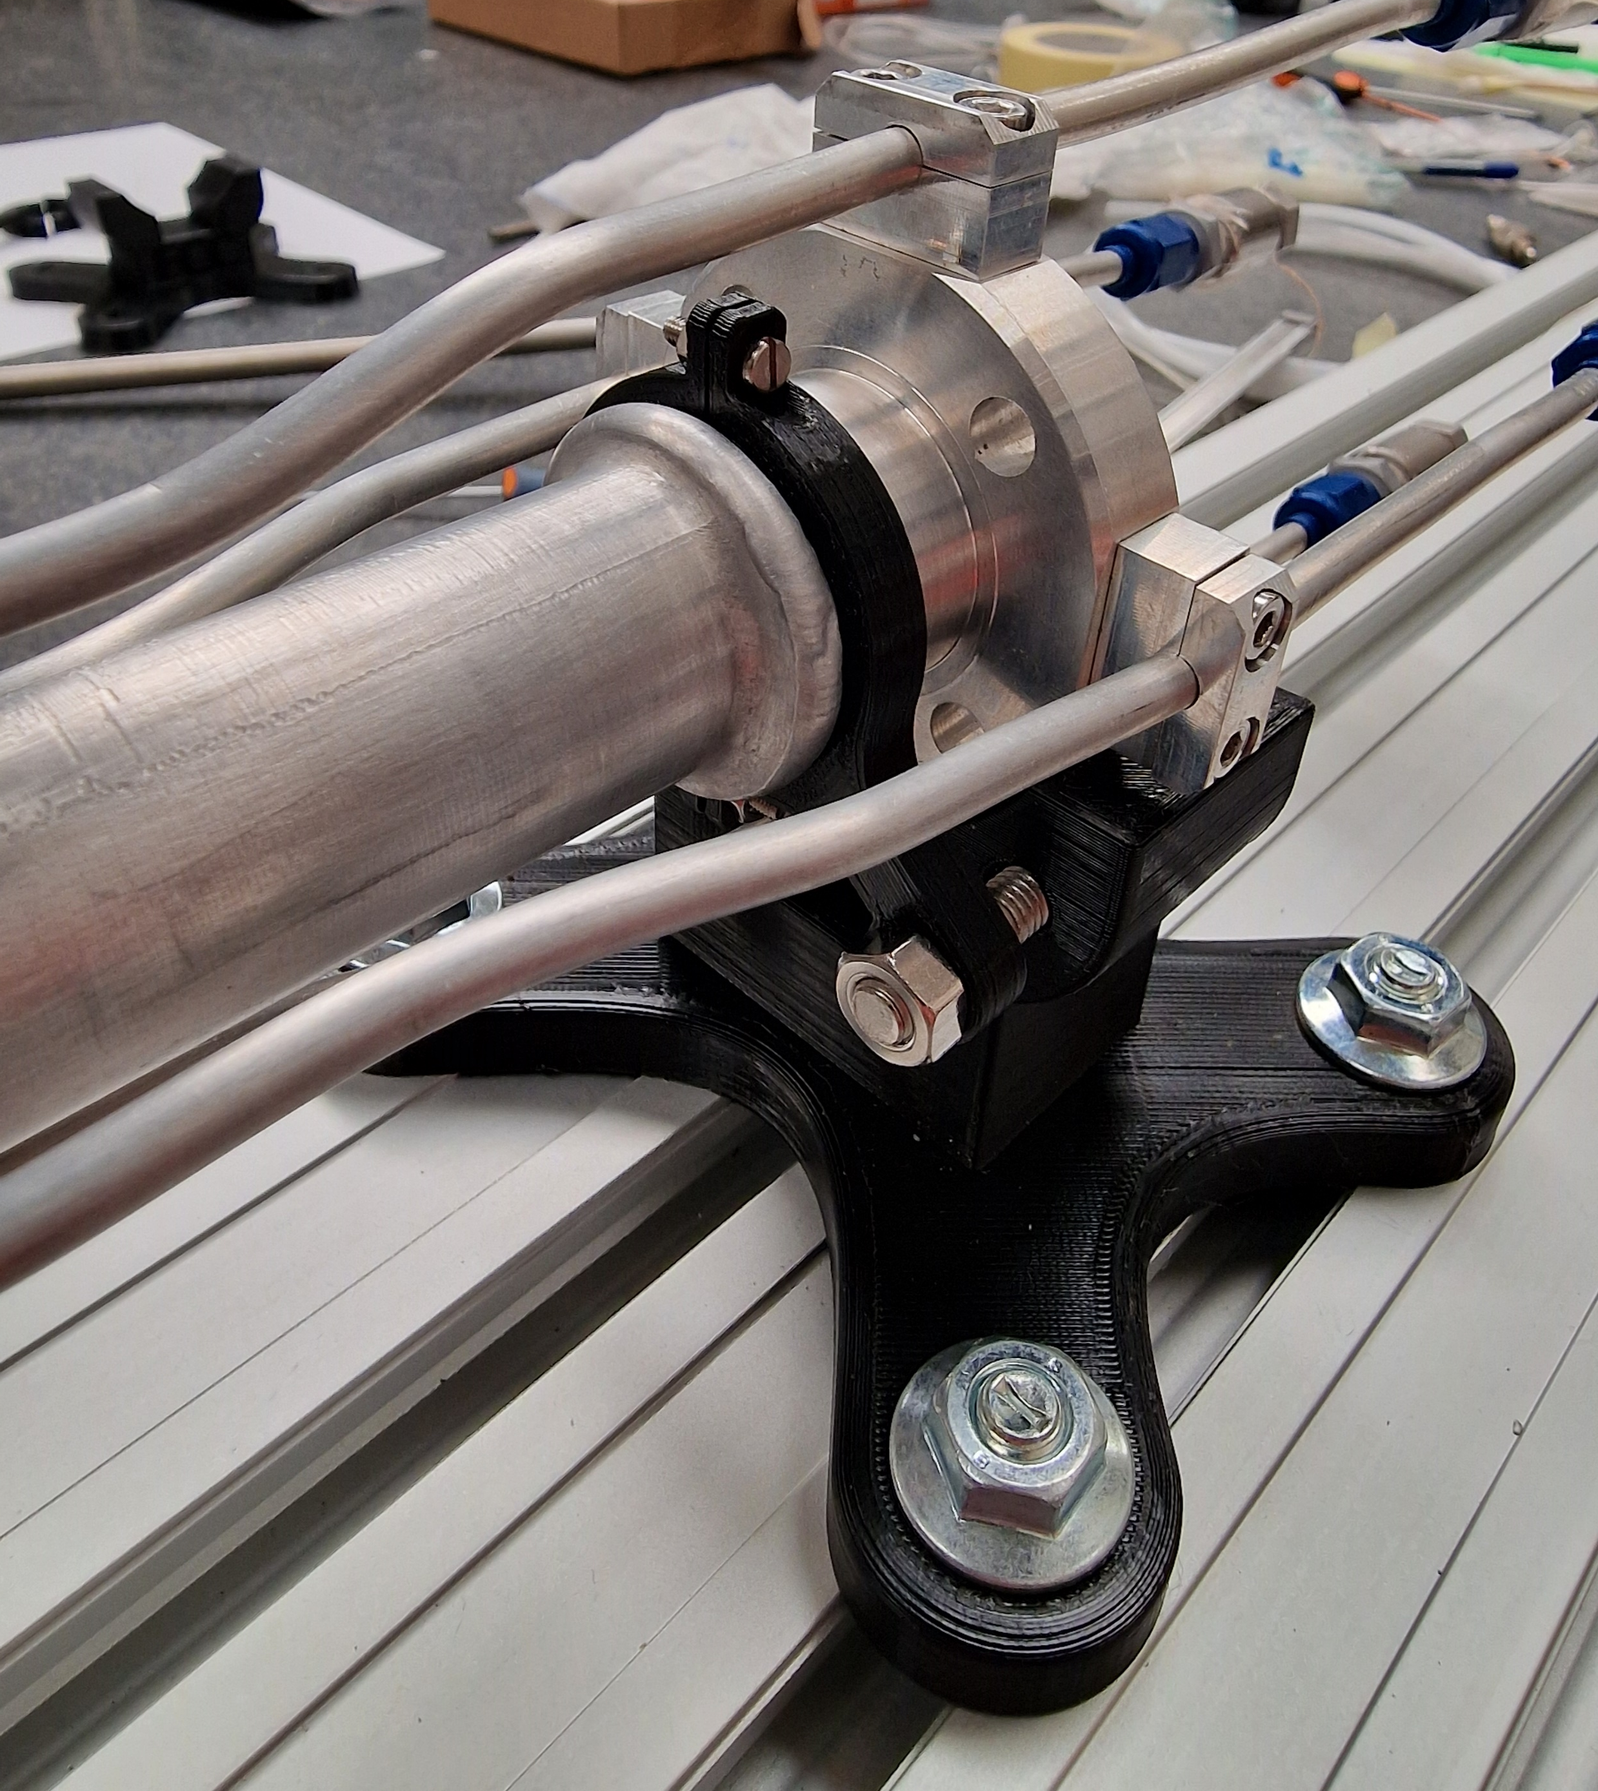
Mockup activities for central chamber
A first prototype has been realized.
The central chamber is now connected to an hydraulic circuit to test the thermal behaviour of the chamber under thermal load.
3d printed support structure

Slide 19
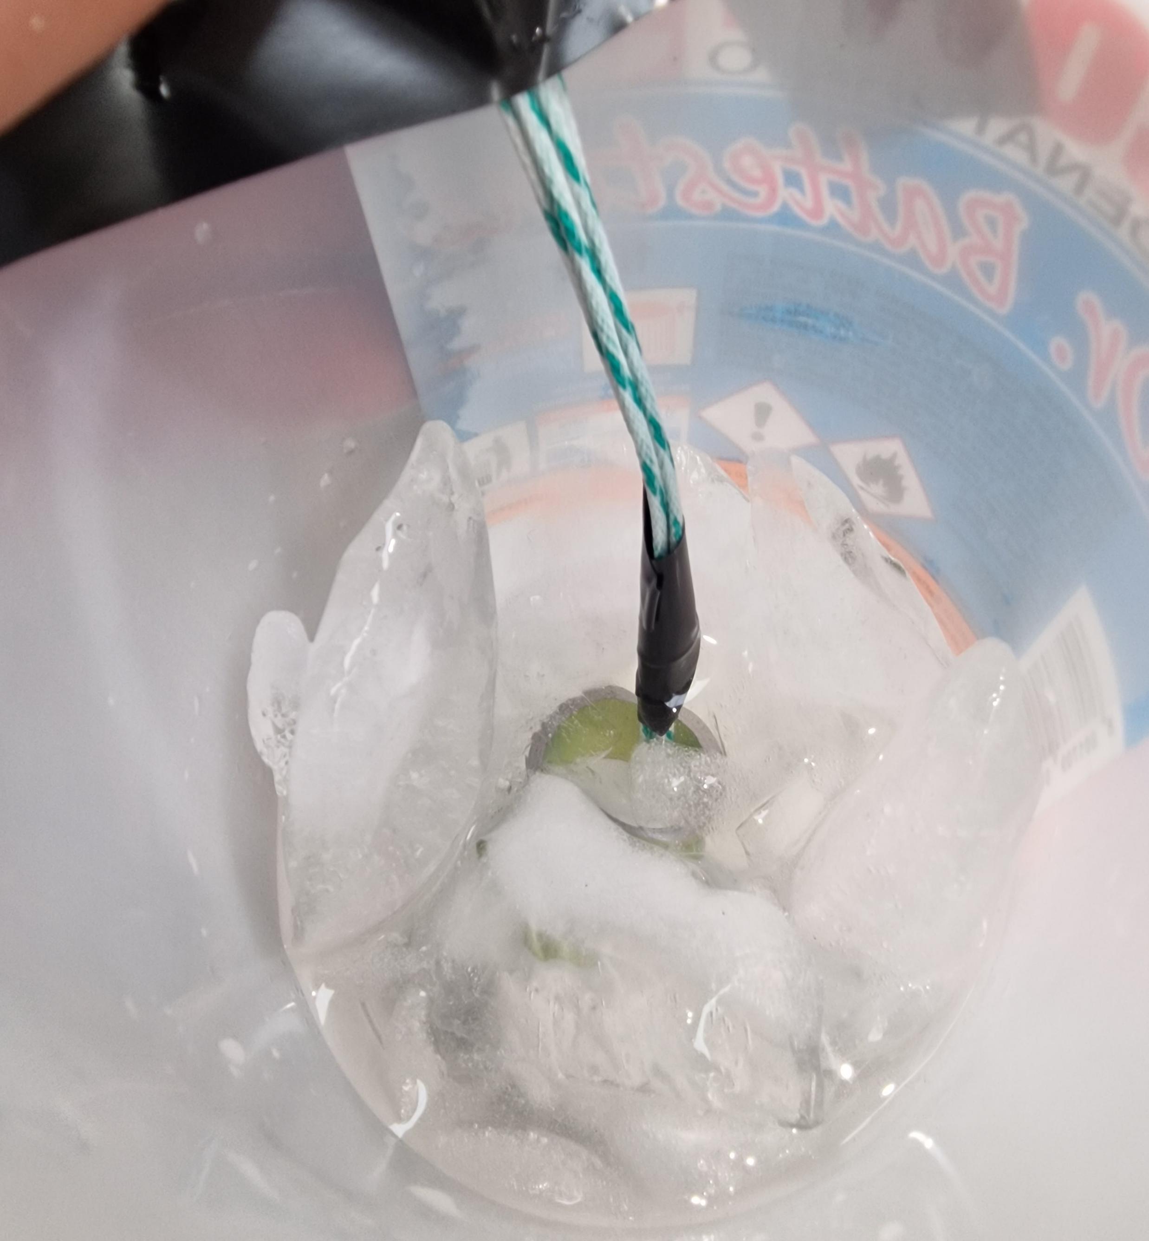
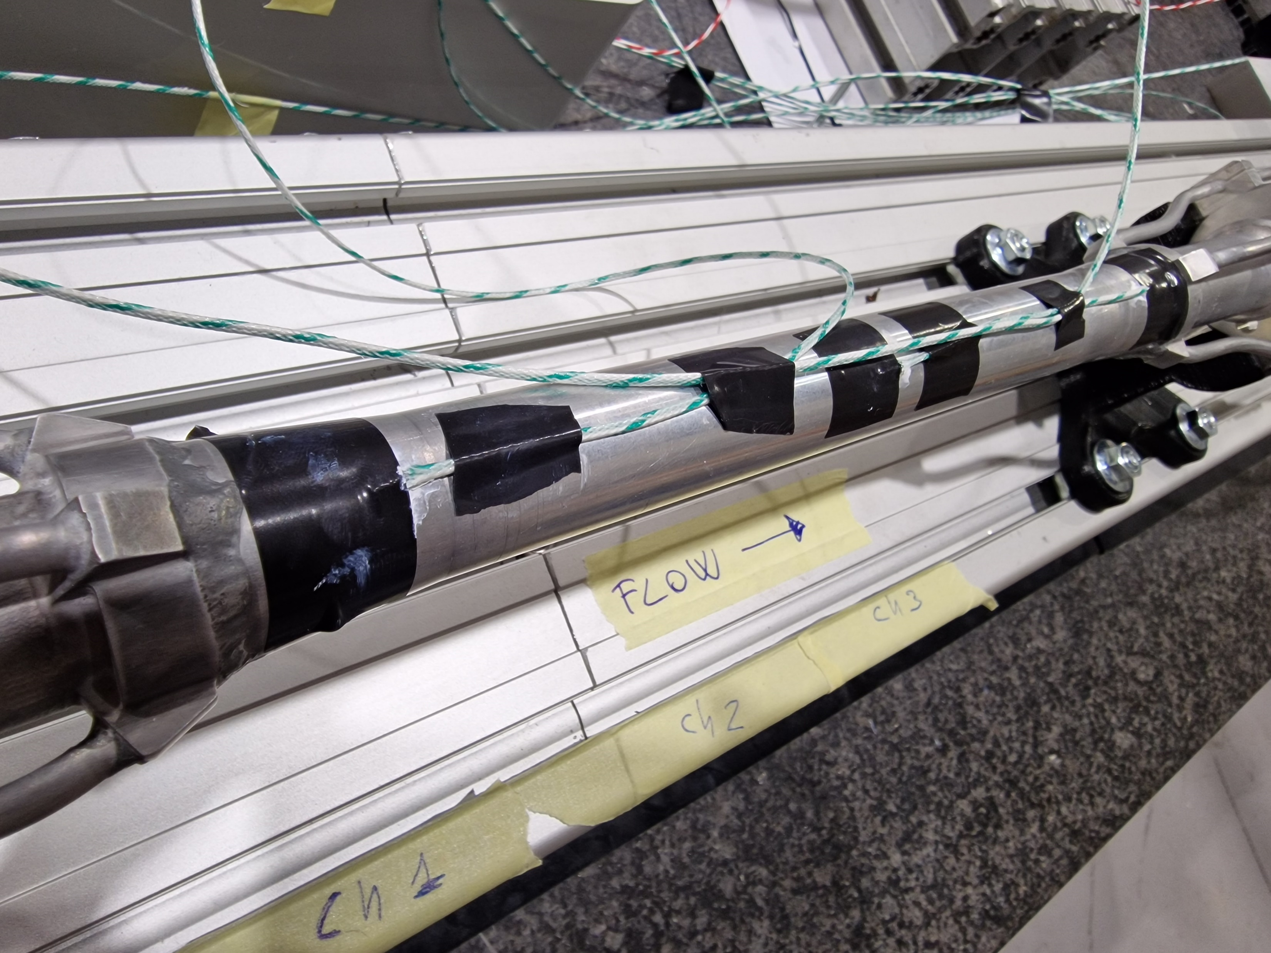
We set up the system for the thermal test.
Four thermocouples are mounted (3 on the chamber and 1 for the environment).
The thermocouples have been calibrated using a mixture of ice and water, to recreate the 0°C condition.
The thermocouples are managed using a Raspberry pi 4 with 8GB RAM and the acquisition is made using a Python script.
After the tuning, the thermocouple have been mounted using a thermal paste, in order to optimize the thermal contact between the chamber and the thermocouple.

Slide 20
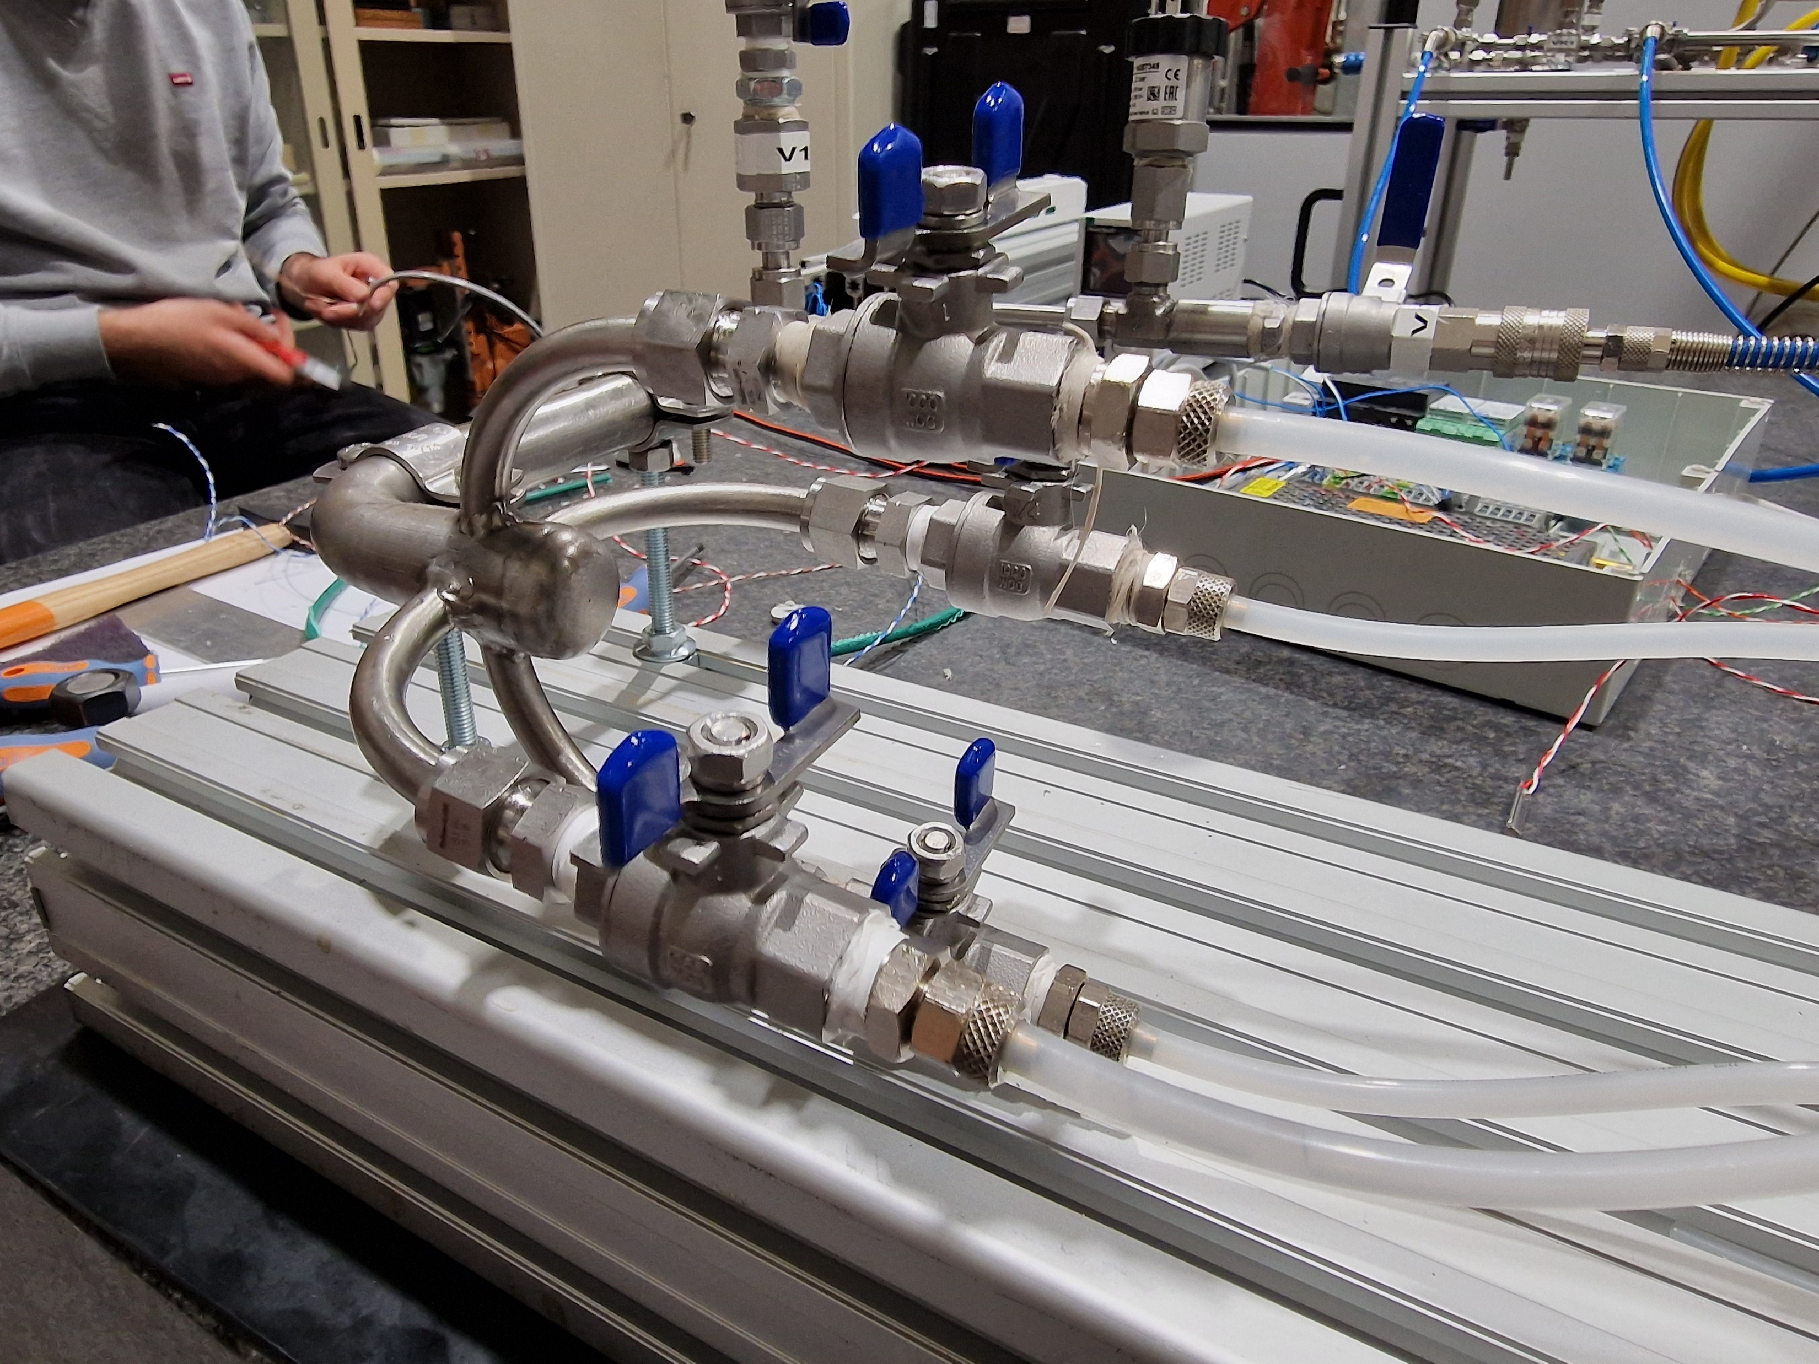
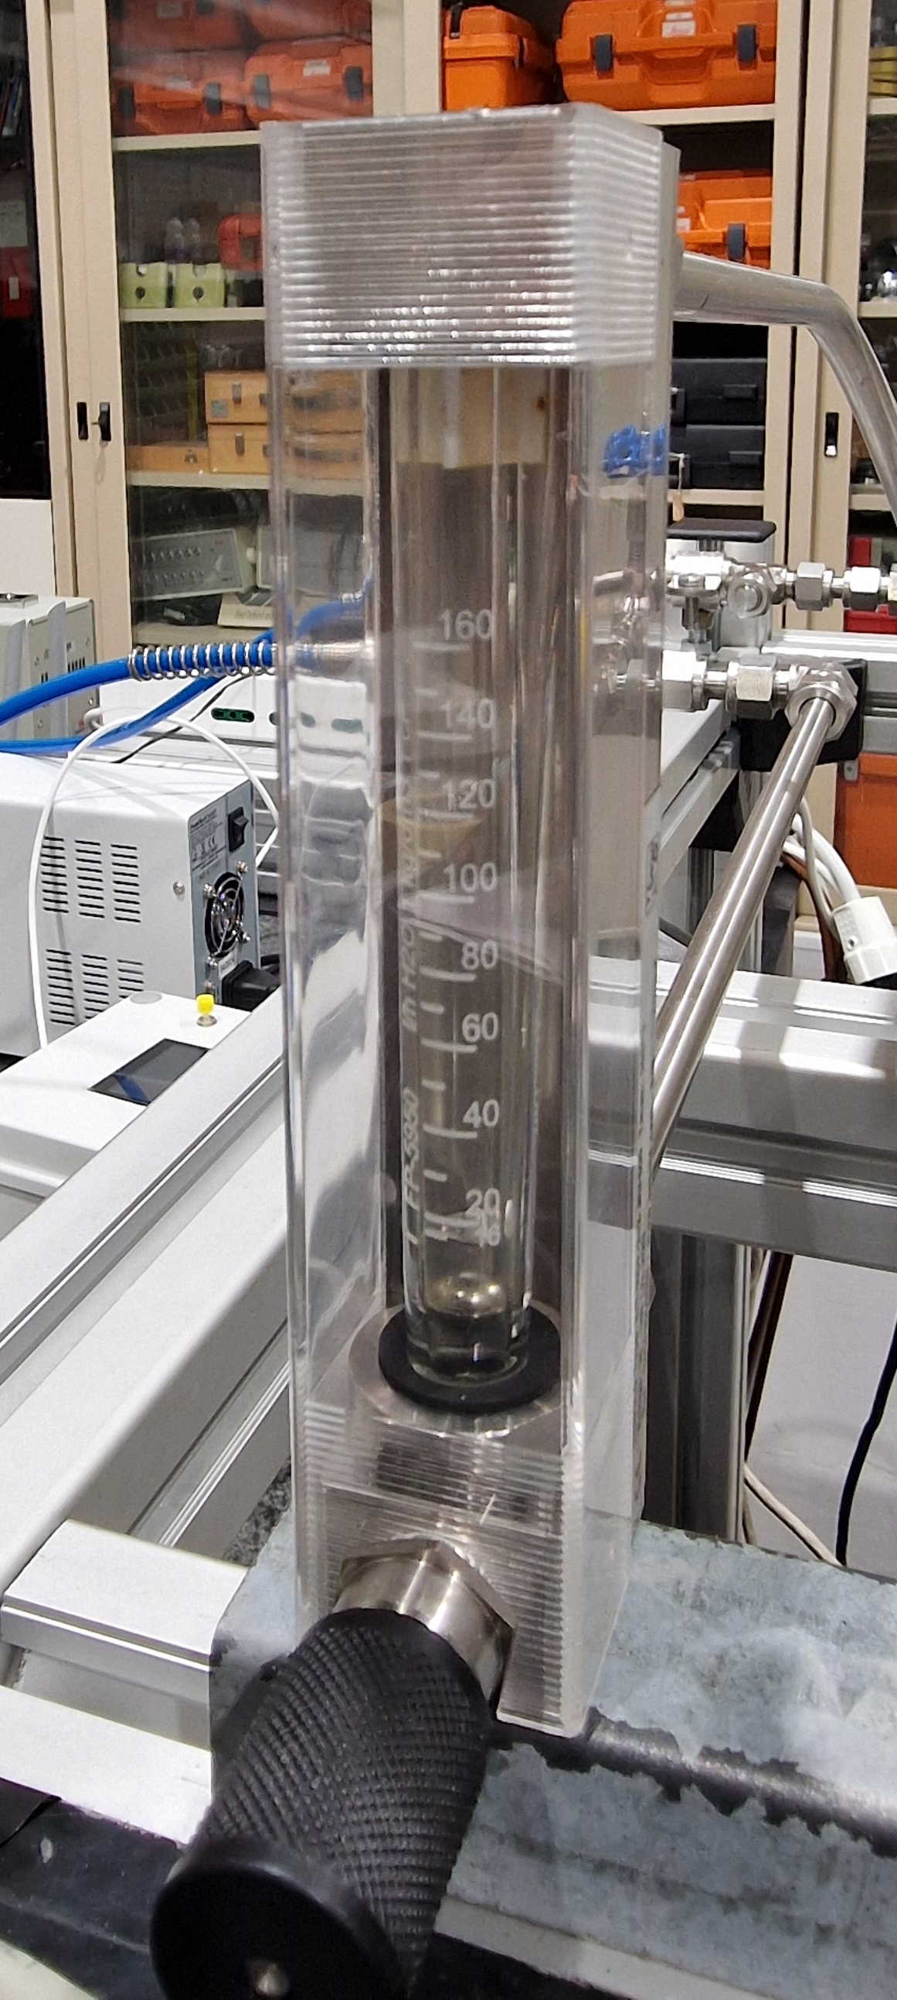
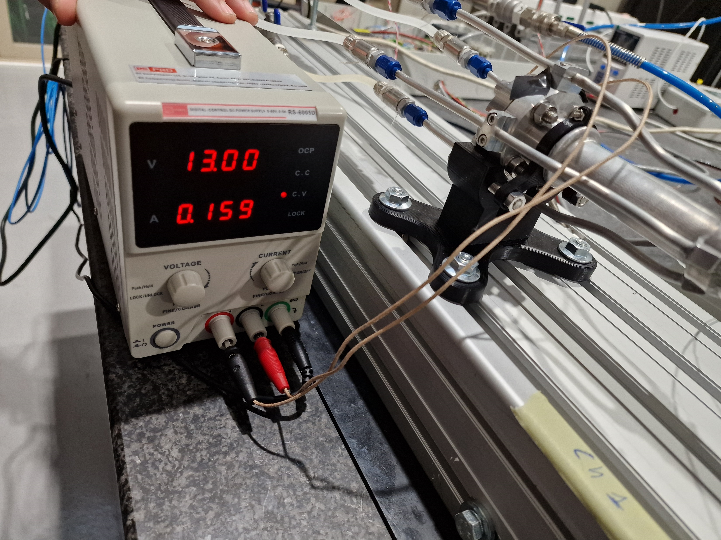
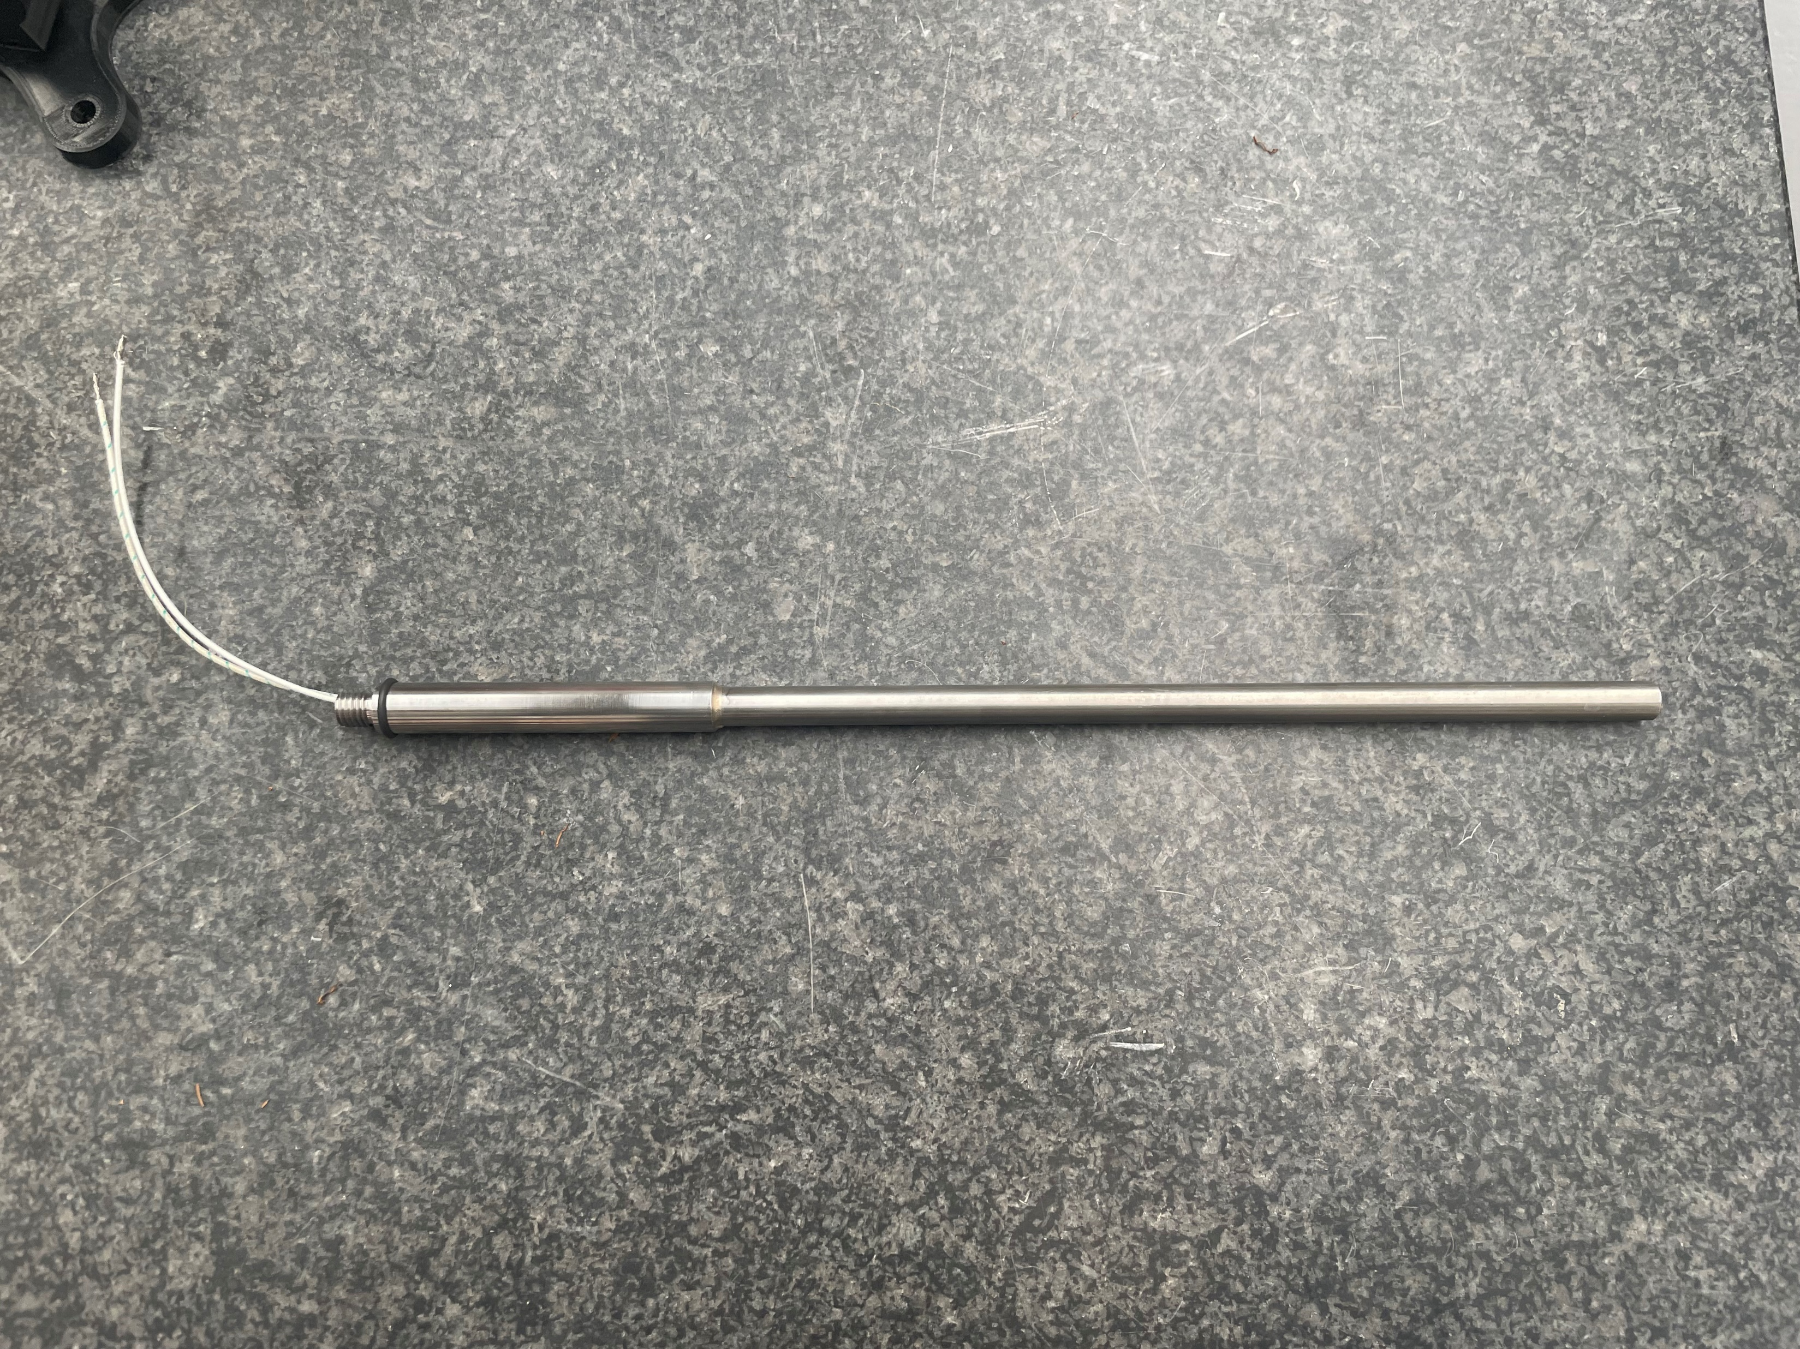
The central chamber is connected to the hydraulic circuit using a handmade connector, in order to distribute properly the coolant.
In this system are controlled the inlet temperature, the flow rate and the pressure of the coolant.
The coolant outlet temperature, the chamber temperature, the pressure drop and the flow rate are precisely measured.
An electrical heater is used to simulate the heat load.
The power is controlled using a variable power supply.

Slide 21
Conclusions
The engineered design of the chambers has been presented. The current design is the result of iterations with the company, in order to optimise the fabricating process.
We received the central chamber manufactured in Al 6068, and we are working on the ellipto-conical chamber realisation.
The engineered design of the bellows has been presented, showing the insertion of HOM absorber and cooling. We have just started the procedure for the procurement, working in parallel with the company that will make the flanges.
The mock-up activities are started in the central chamber; before the Christmas holyday, we tested different scenarios and we are now analysing data.
Future steps
As soon as we receive the ellipto-conical chamber, the mockup will be extended, including the two ellitpo-conical chambers with the cooling system.
We continue the test data analysis and the same will be done using the test results after the ellipto-conical chamber mounting.
The bellows simulation will be done in order to finalize the design with the HOM absorber.

Slide 23
BACKup SLIDES

Slide 24



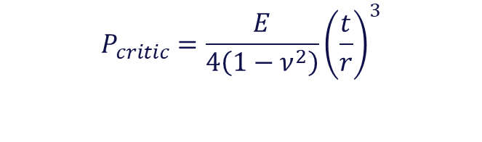


Central chamber buckling analysis and comparison with Beryllium
Properties | AlBeMet162 (AMS 7911) | Beryllium S200F (AMS 7906)
Density [g/cm³] | 2.10 | 1.85
Composition | Al-62 wt% Be | Be
Modulus [GPa] | 193 | 290
Poisson’s Ratio | 0.17 | 0.18
CTE @ 25ºC [ppm/˚C] | 13.9 | 11.4
Yield strength [MPa] | 193 | 241
Radiation length [cm] | 19.1 | 35.24
Thermal Conductivity [W/mK] | 210 | 216
The buckling analysis of the thin internal cylinder has been performed using the analytic formulation and Finite Element Analysis.
The critical pressure for the collapse of the thin wall cylinder under external pressure can be calculated with the following simplified formula:
$$E=Young^{′}s Modulus$$
$$P_{critic}=\frac{E}{4\left(1−ν^{2}\right)}{\left(\frac{t}{r}\right)}^{3}$$
$$ν=Poisson^{′}s ratio$$
$$r=medium radius$$
$$P_{critic}∝E$$
$$P_{critic}∝1/ν$$
$$P_{critic}∝t$$
$$P_{critic}∝1/r$$
$$t=cylinder^{′}s thickness$$
Material |  | Analytic model | FEM | Difference
AlBeMet162 | Critical pressure | 20 bar | 18 bar | 11 %
 | Maximal pressure allowable (S.F. =5) | 4 bar | 3.6 bar
Beryllium S200F | Critical pressure | 30 bar | 28 bar | 7 %
 | Maximal pressure allowable (S.F. =5) | 6 bar | 5.6 bar
Material independent
In order to reduce the material budget of the central chamber we are considering to use Beryllium as the main material.
$$E_{Be}>E_{AlBeMet162}→{{ P}_{critic}}_{Be}>{P_{critic}}_{AlBeMet162}$$
Considering the better performance in mechanical resistance, the low coefficient of thermal expansion and the higher radiation length, the beryllium is the best candidate material for the chamber fabrication.
The feasibility of the Beryllium design in terms manufacturability technique has to be checked.

