Slide 1
FCC-ee MDI
Alignment System update
14/01/2025, FCC Physics workshop
Léonard WATRELOT, BE-GM-HPA

Slide 2
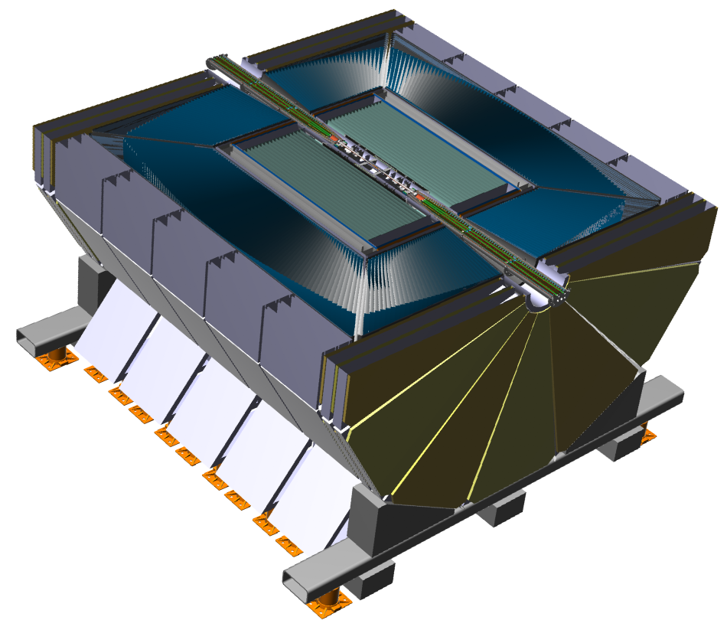
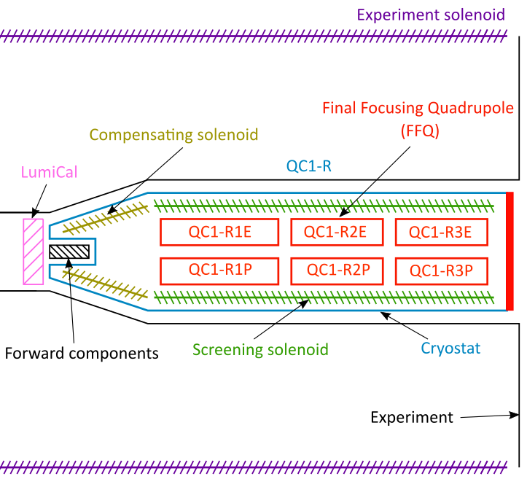
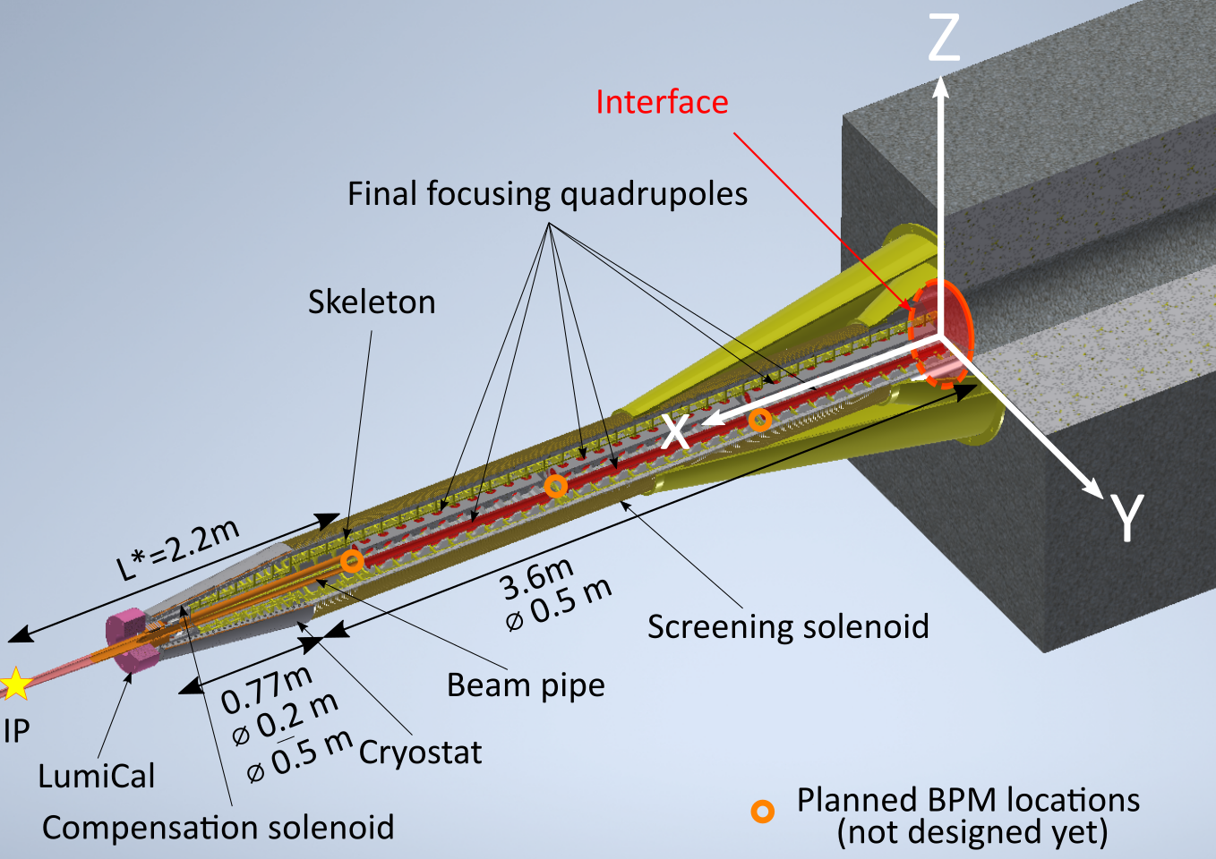
14/01/2025, FCC Physics workshop
Léonard WATRELOT, BE-GM-HPA
2
Reminder of the FCC-ee MDI region
10 m

Slide 3
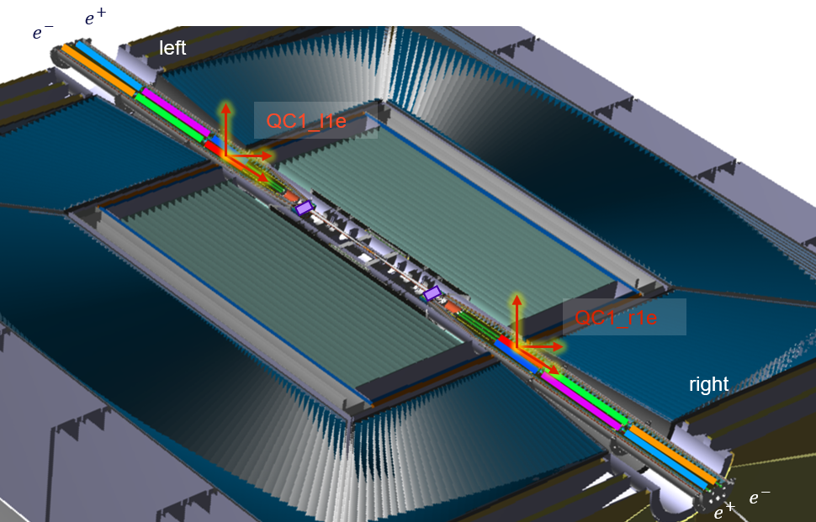
14/01/2025, FCC Physics workshop
Léonard WATRELOT, BE-GM-HPA
3
The access challenge
Only access available
Only access available

Slide 4
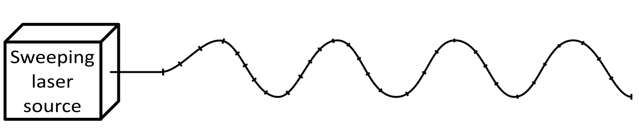
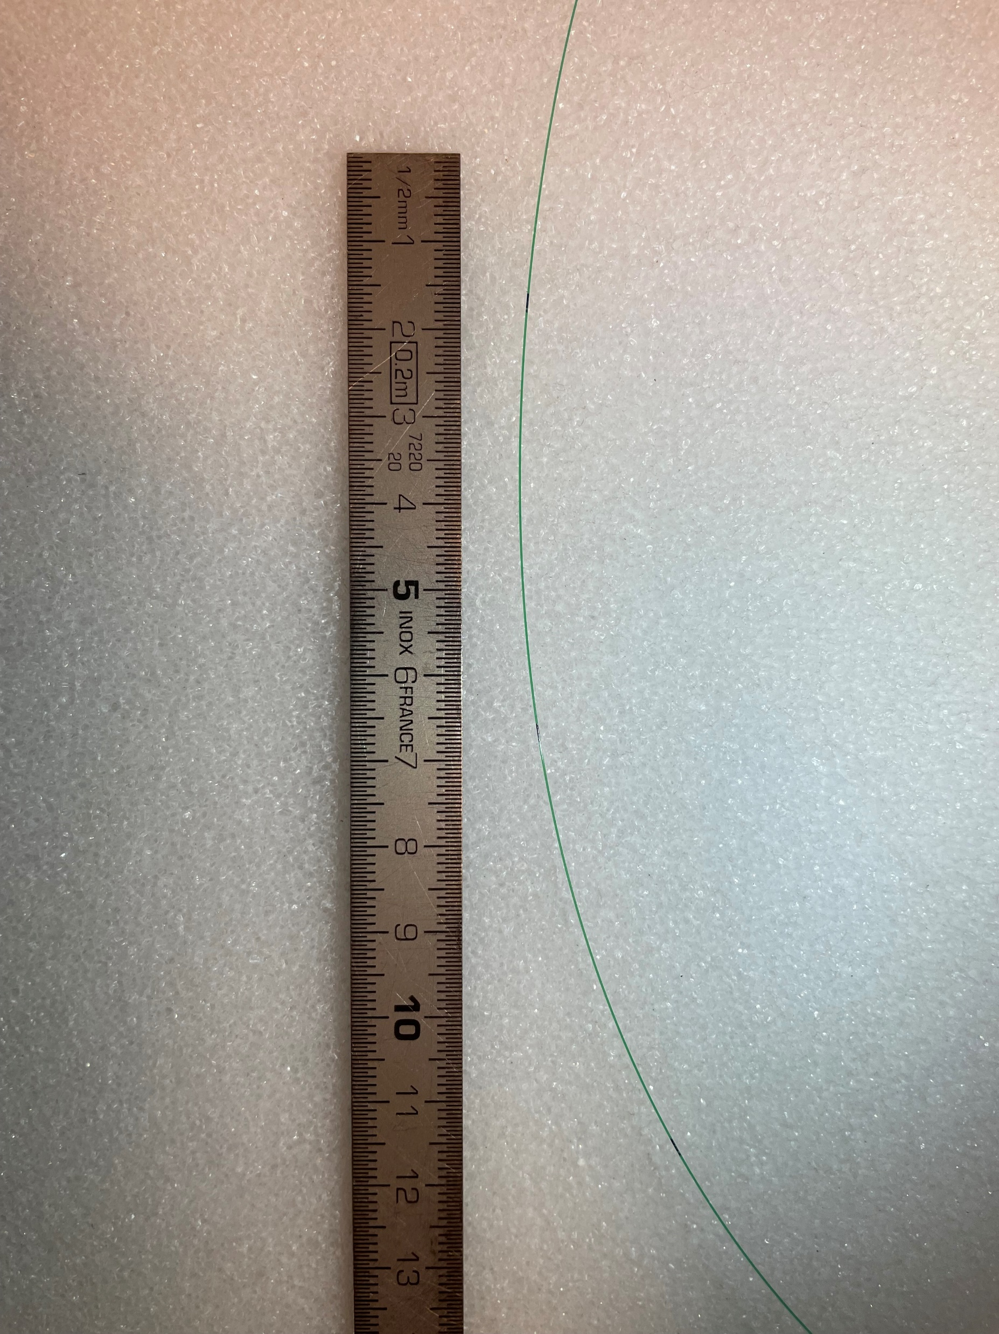
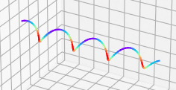
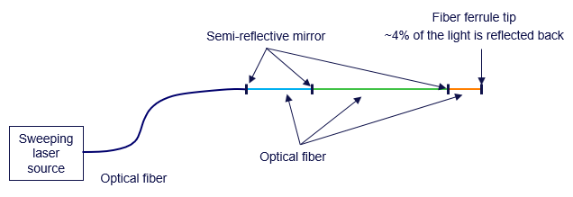
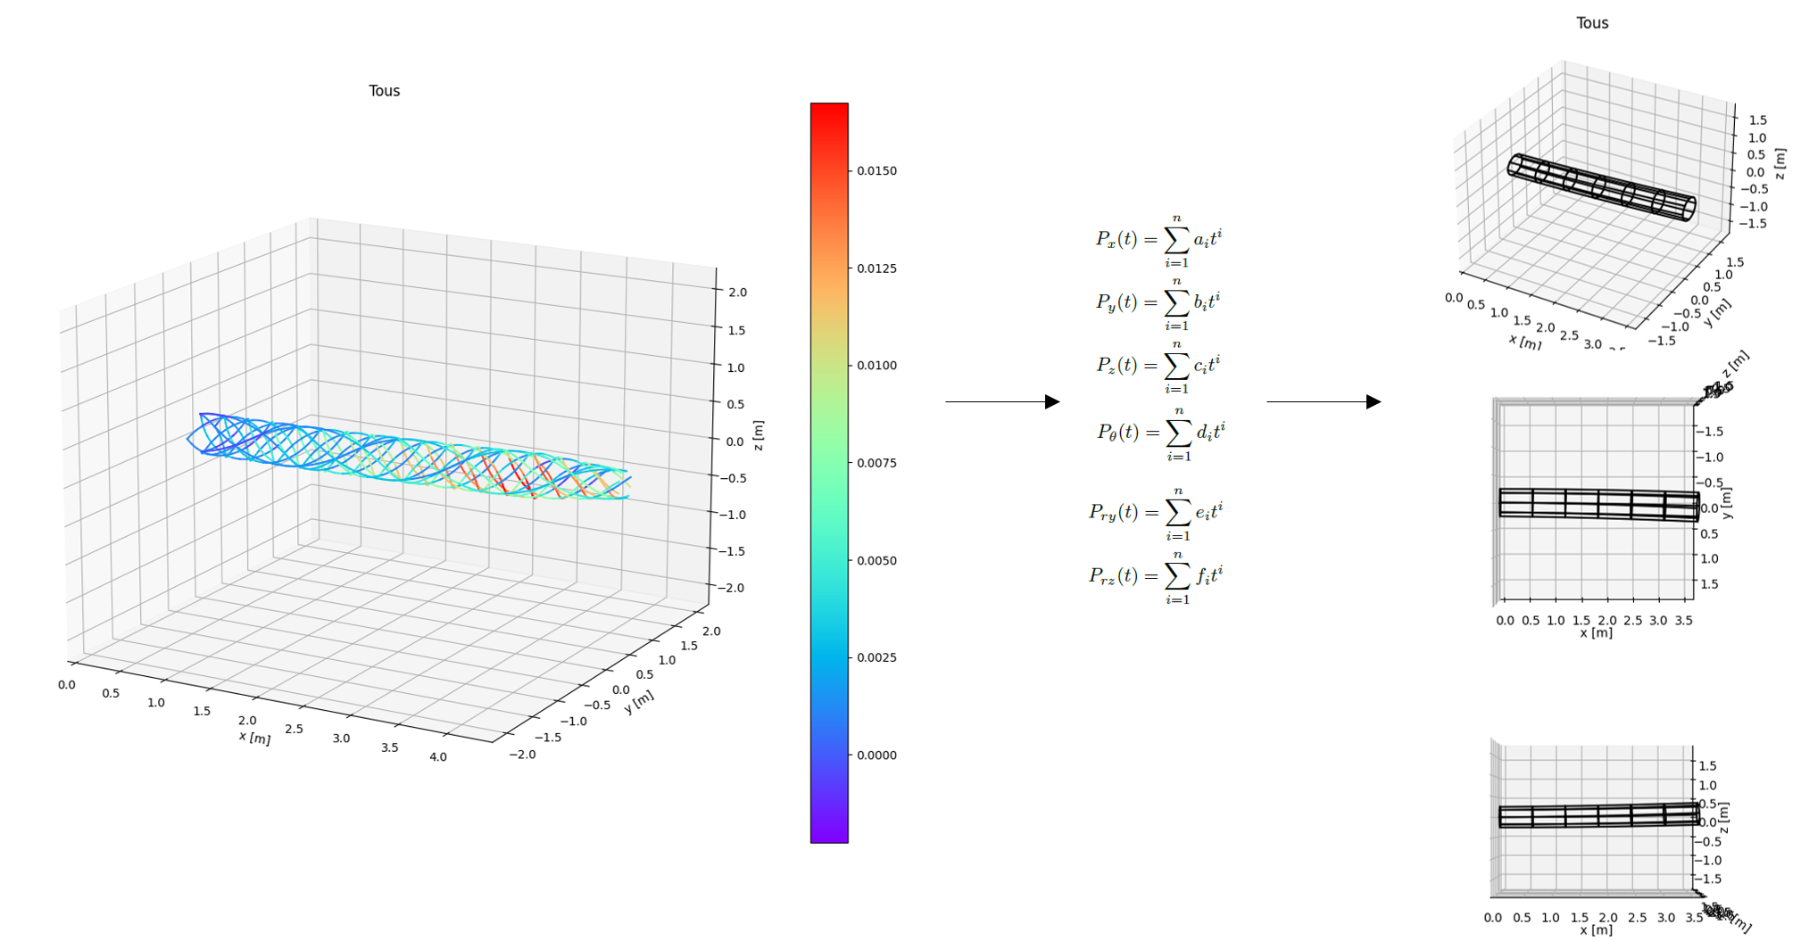
14/01/2025, FCC Physics workshop
Léonard WATRELOT, BE-GM-HPA
4
Reaching the end of the assembly from the extremity thanks to optical fibers
Optical fiber
Impact of deformation on a singular fiber
Optical fiber placed in a helix shape, separated in portion by semi-reflective mirrors, which can be simultaneously and independently measured
Helixes defined by their length, radius, step, number and position of portions
Technology used : In-line multiplexed and distributed FSI measurement (in development at CERN)
Impact of deformation on a network of fibers
https://iopscience.iop.org/article/10.1088/1361-6501/acc6e3

Slide 5
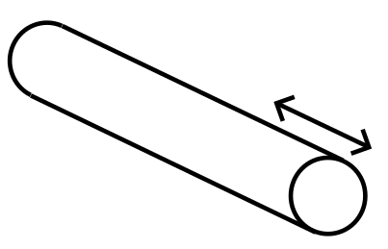
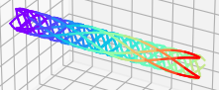
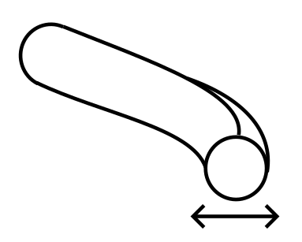
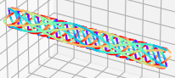
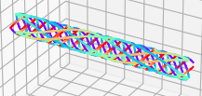
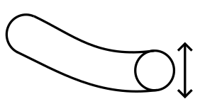
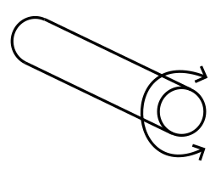
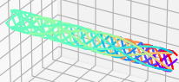
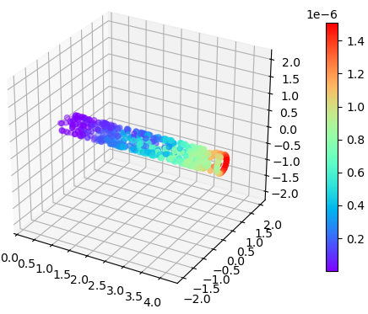
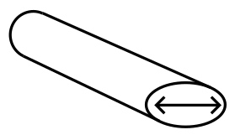
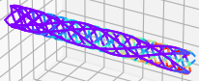
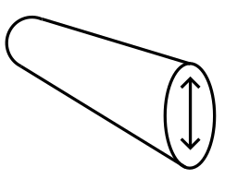

14/01/2025, FCC Physics workshop
Léonard WATRELOT, BE-GM-HPA
5
Establishing a reference to measure the final focusing quadrupoles
Least square computation of the deformation from the measurements
Fiber optic helix network deformation simulations
Point offsets due to deformations
https://iopscience.iop.org/article/10.1088/1361-6501/acc6e3

Slide 6
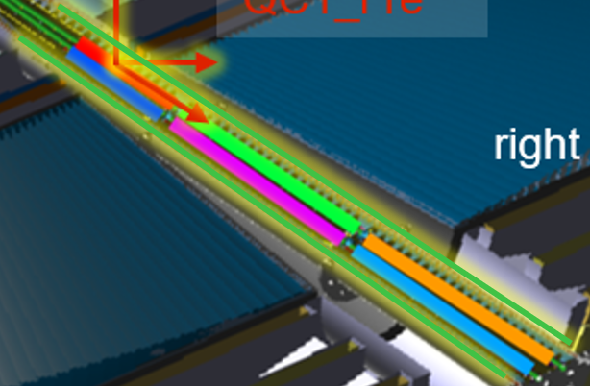
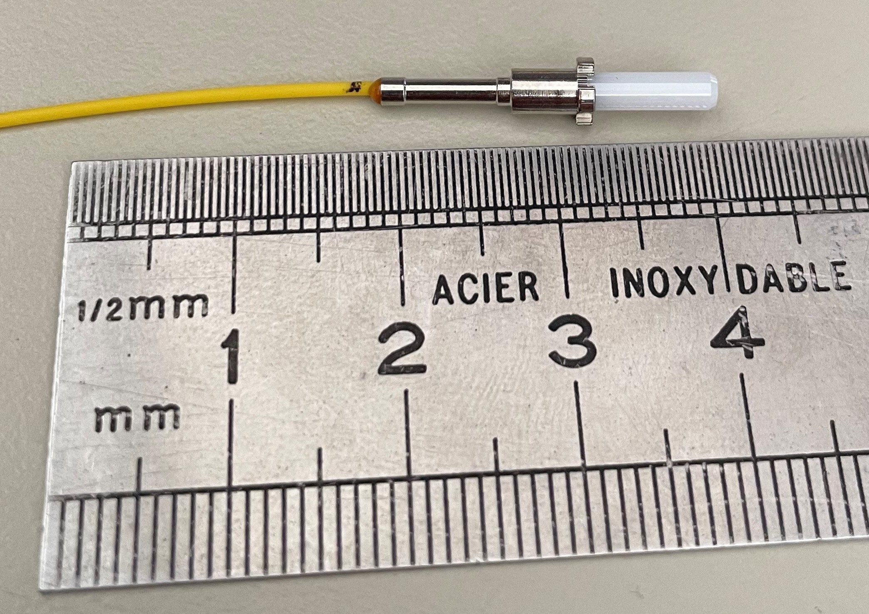
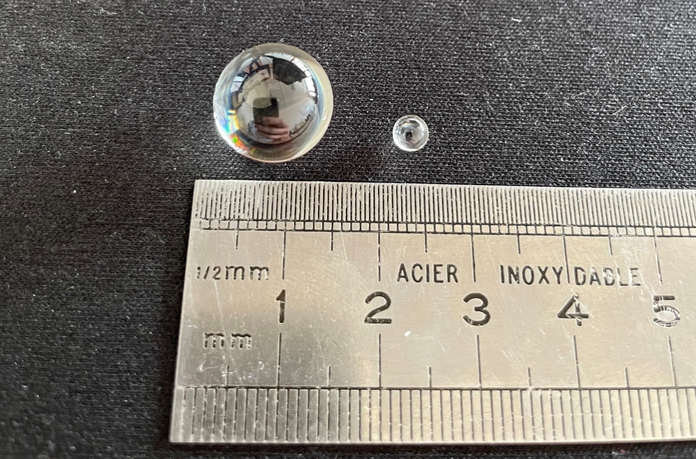
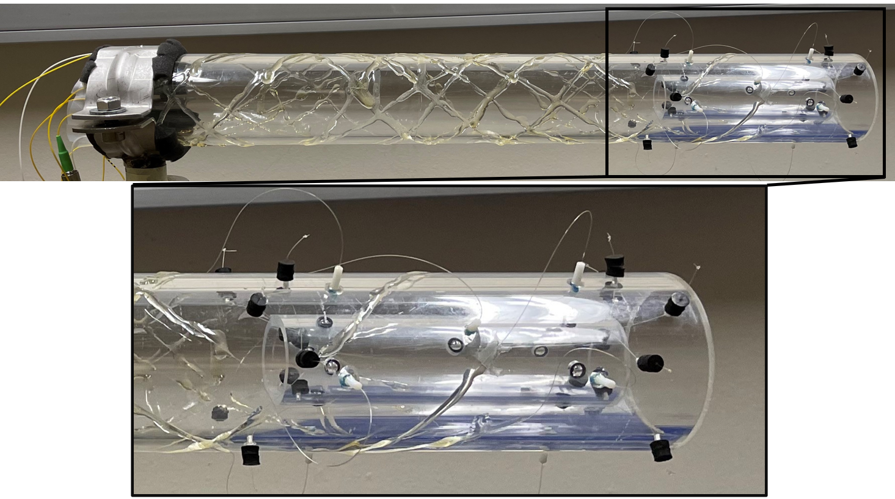
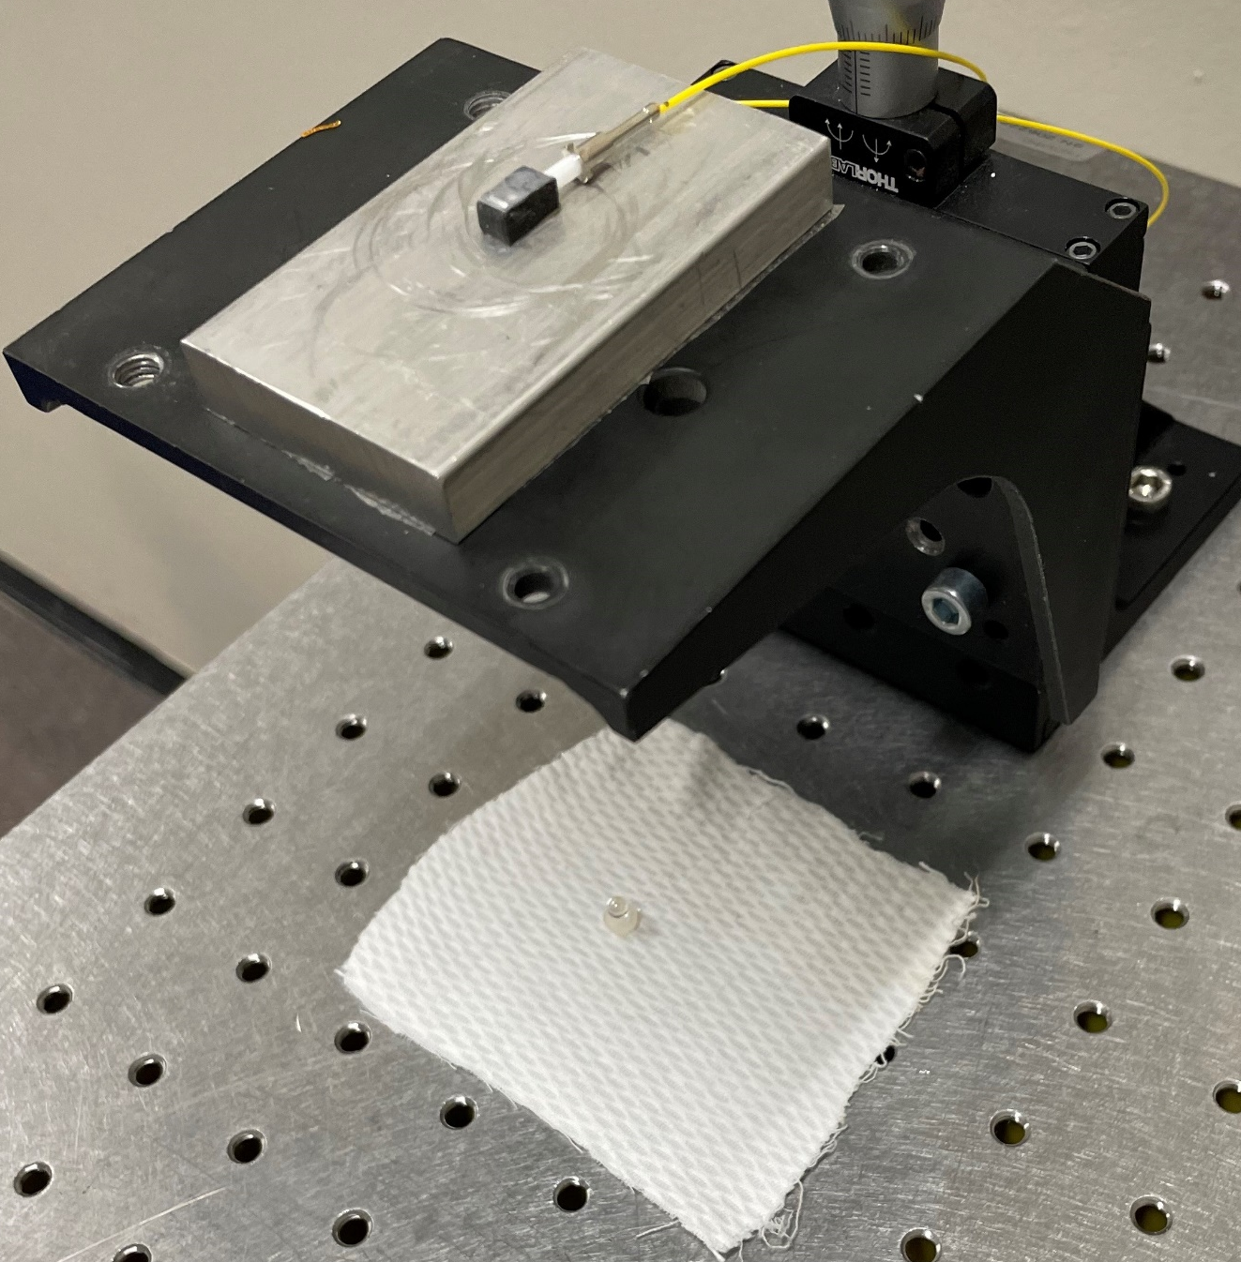
14/01/2025, FCC Physics workshop
Léonard WATRELOT, BE-GM-HPA
6
Measurement of the final focusing quadrupoles
Laser emitting ferrule
Glass bead reflectors
Prototype
Prism for compact laser delivery
Article link

Slide 7
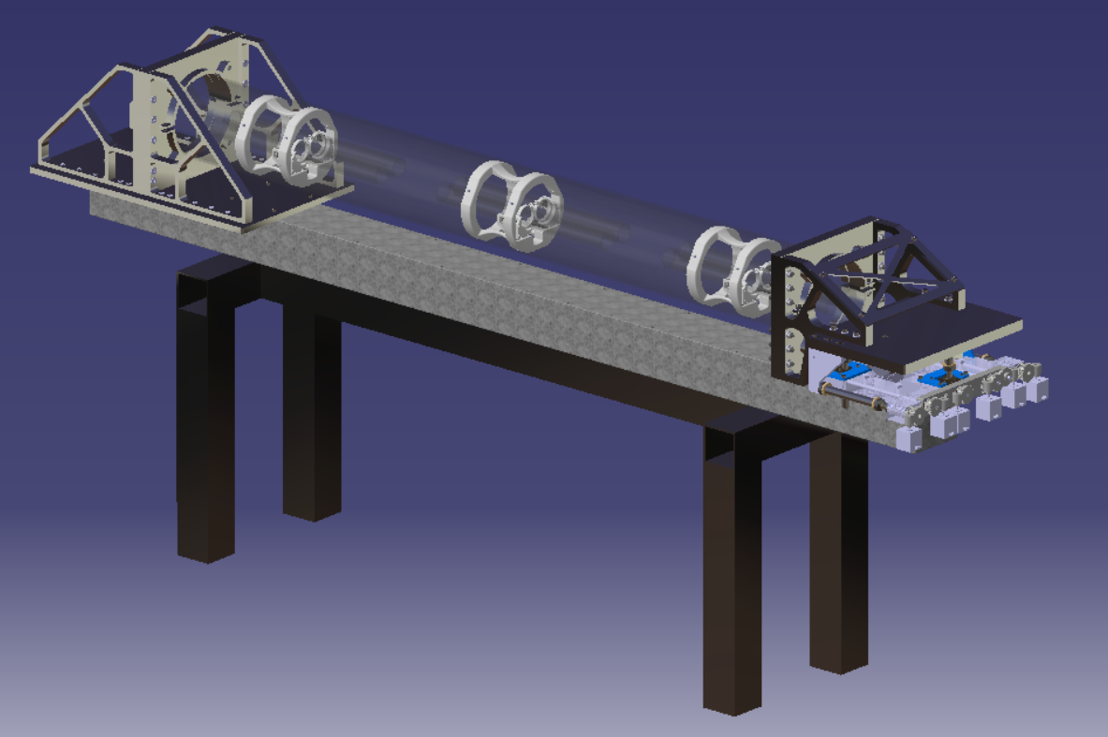
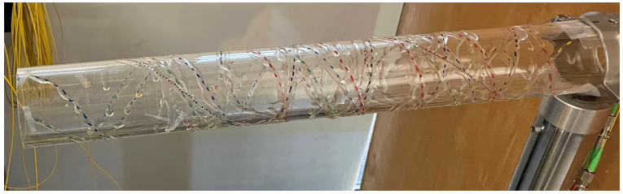
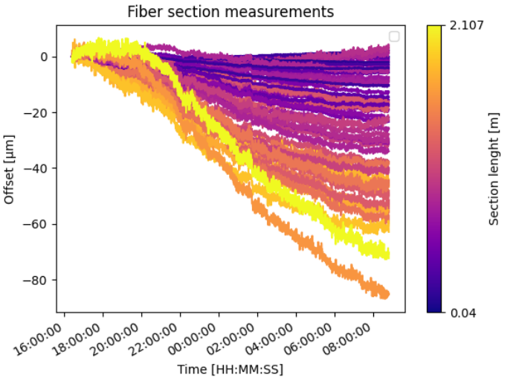
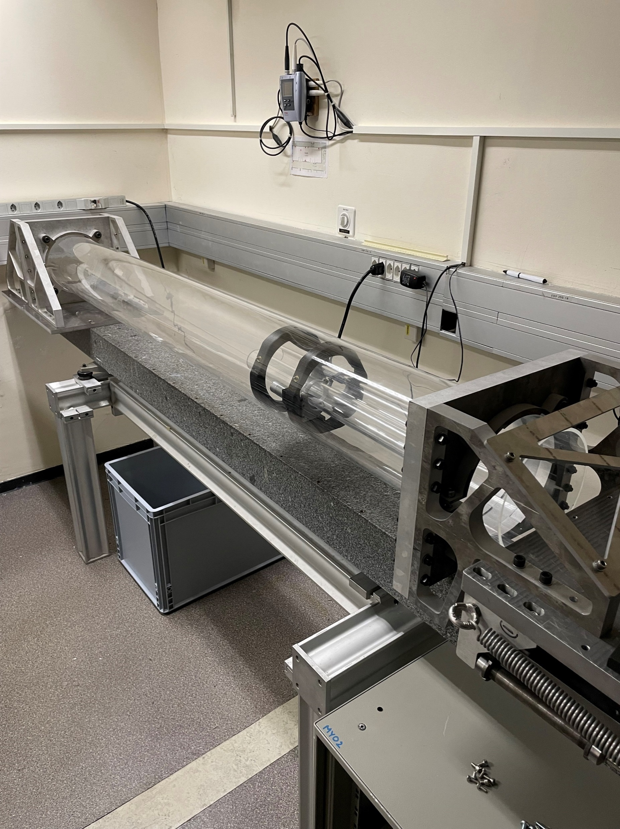
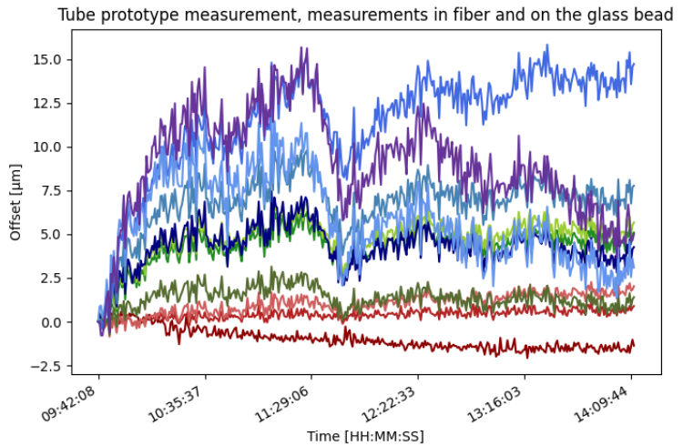
14/01/2025, FCC Physics workshop
Léonard WATRELOT, BE-GM-HPA
7
Prototype implementing the fiber measurement and the FSI measurement on reflector
Latest and ongoing prototypes
Ongoing ½ scale prototype being built
First prototype with helix fibers
Monitoring of the glue curing
Measurements performed by a single fiber fiber
Article link

Slide 8

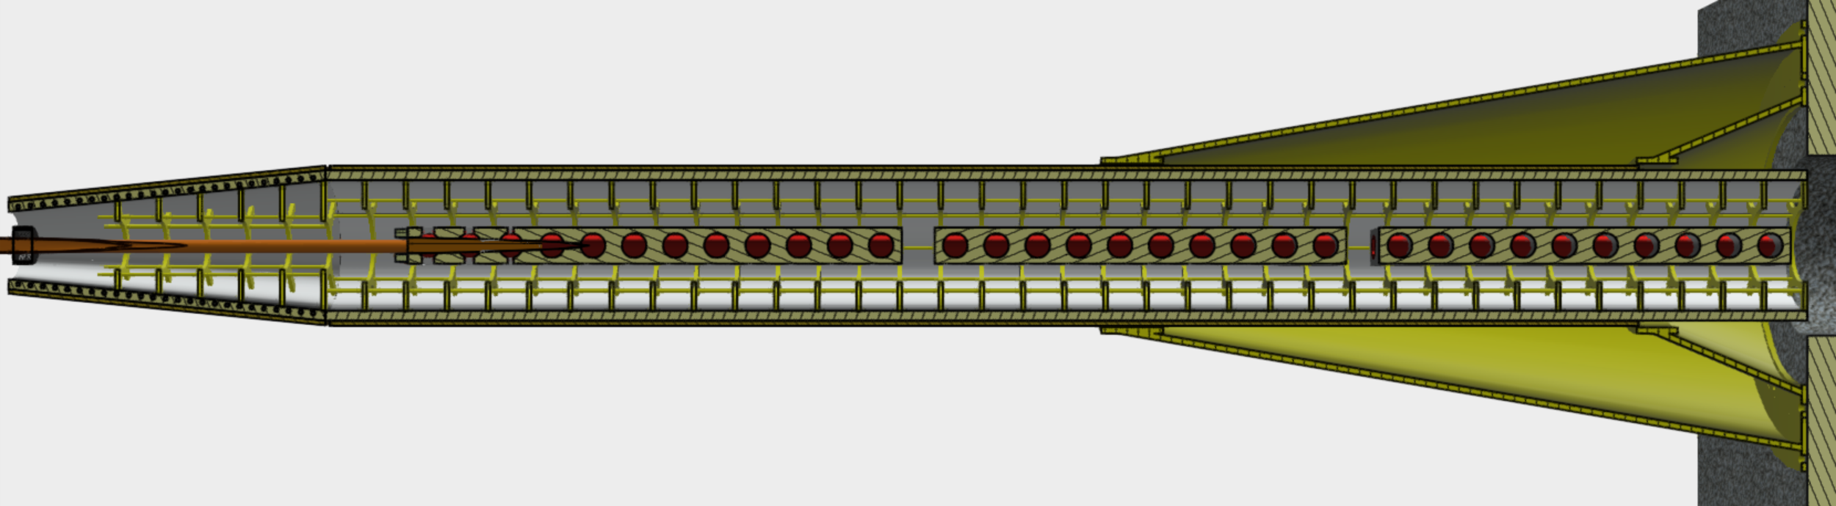
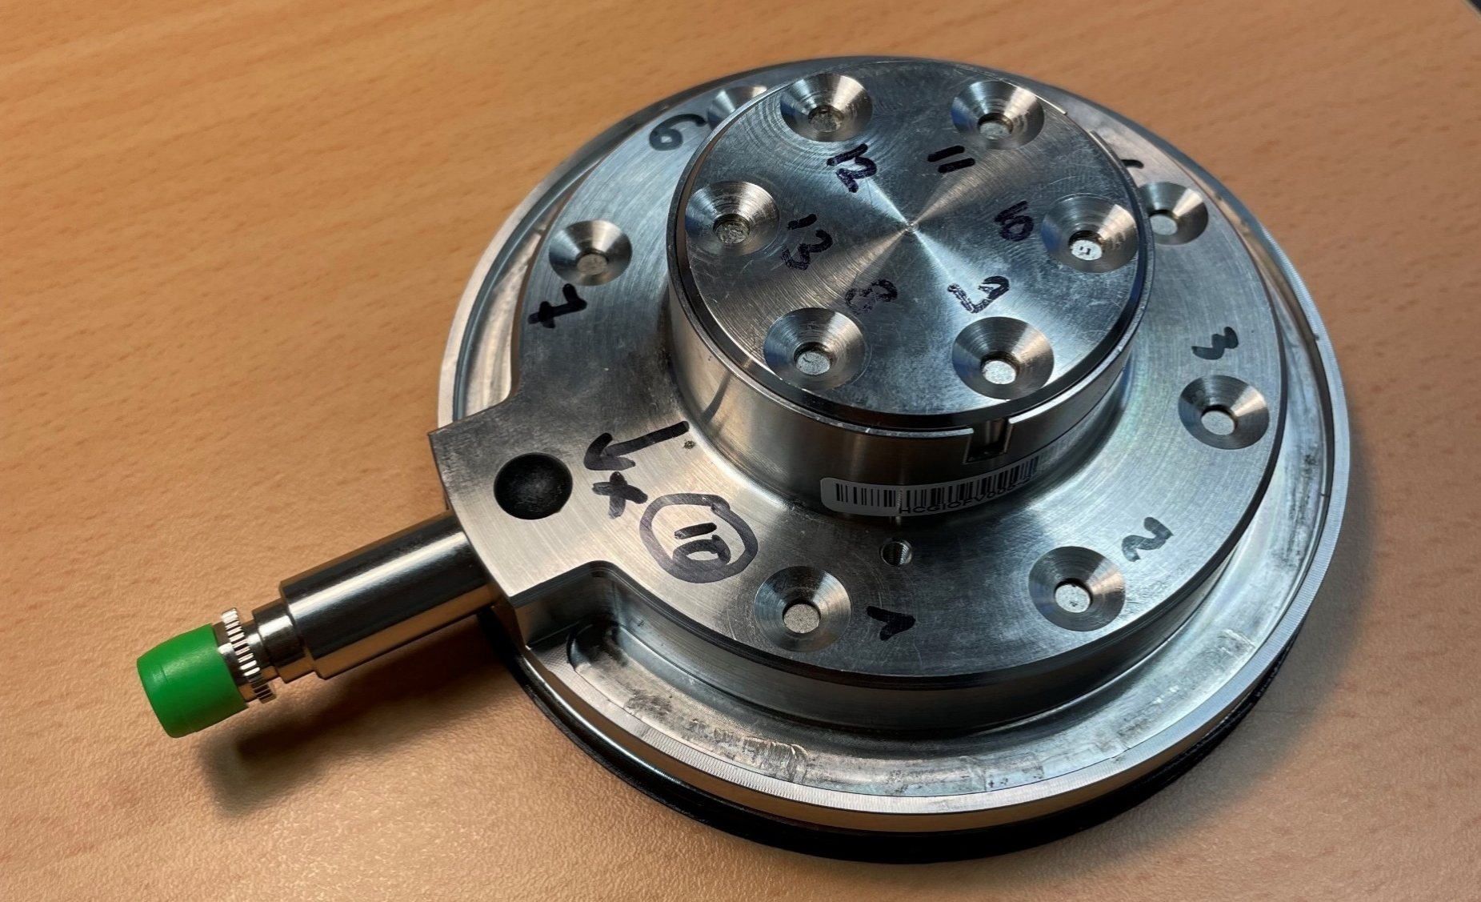
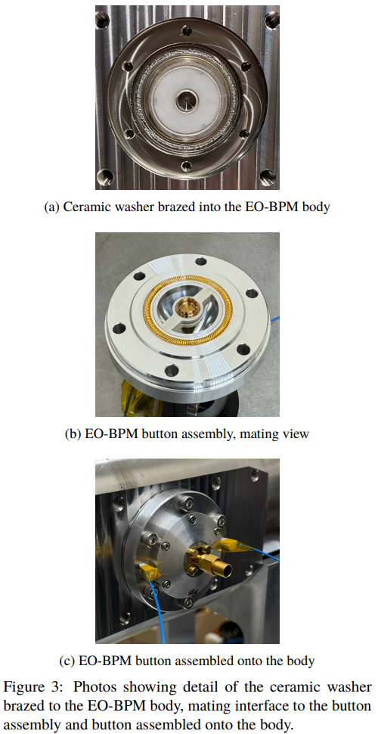
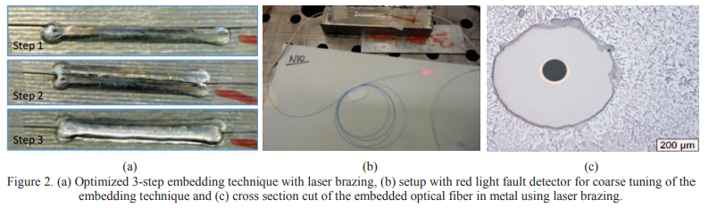
14/01/2025, FCC Physics workshop
Léonard WATRELOT, BE-GM-HPA
8
Recovering the data from the fibers
Epoxy glued optical fiber for installation on low-beta quadrupole cryostat for HL-LHC
Design by M. Koratzinos
All the information from the fibers will go through there.
Challenges due to conditions (space, temperature gradient, radiations, vacuum …) -> interface with fibers brazed or glued using epoxy.
Grandal, Tania, et al. "Laser brazing metallic embedding technique for fiber optic sensors." 2017 25th Optical Fiber Sensors Conference (OFS). IEEE, 2017.
Bosman, M. Z. C., et al. "DESIGN AND DEPLOYMENT OF AN IN-VACUUM ELECTRO-OPTIC BPM AT THE CERN SPS."

Slide 9
14/01/2025, FCC Physics workshop
Léonard WATRELOT, BE-GM-HPA
9
External alignment system

Slide 10
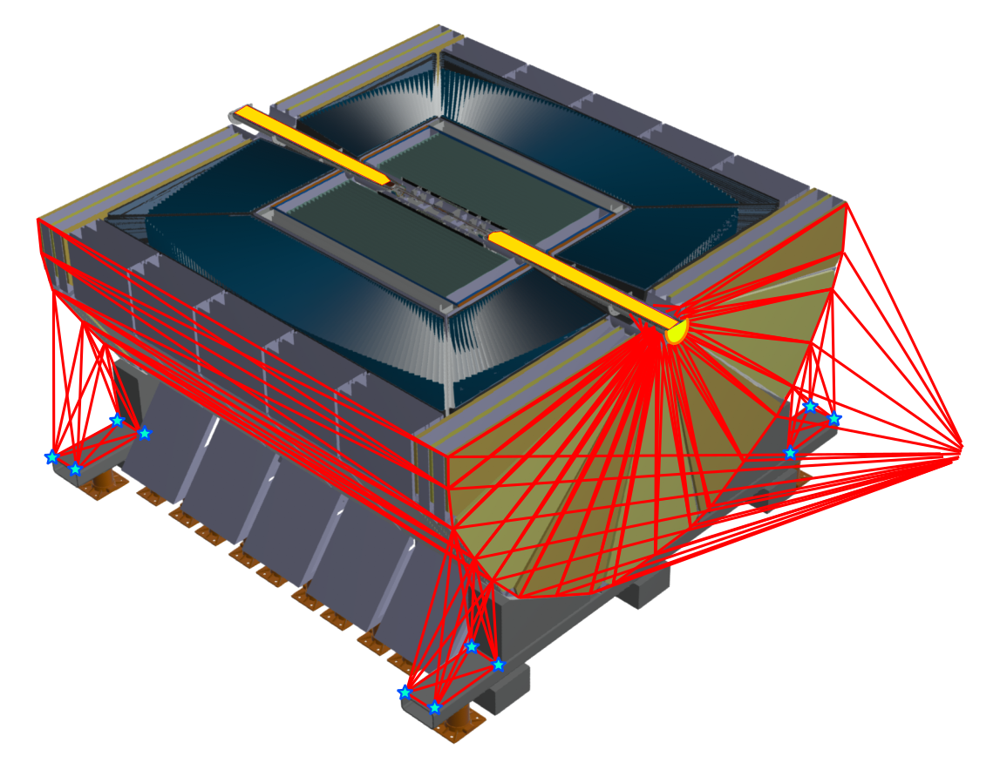
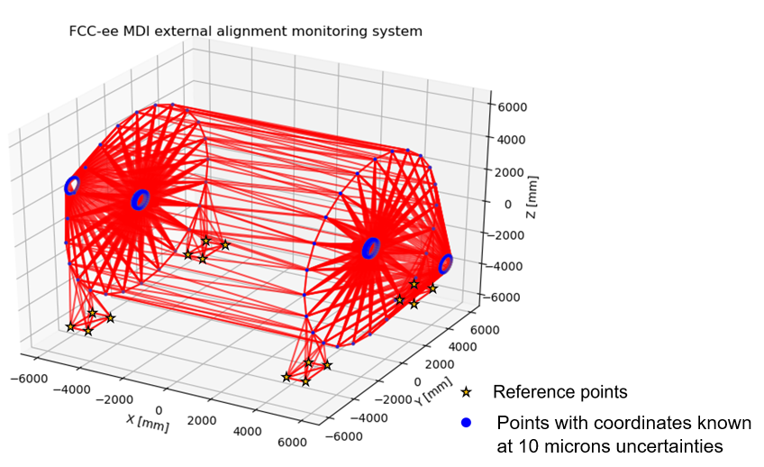
14/01/2025, FCC Physics workshop
Léonard WATRELOT, BE-GM-HPA
9
External alignment system proposition
In parallel, currently looking at an alignment monitoring system for the inner tracker
Interferometric distance measurement network
Notes:
Difficult conditions
Radiations, magnetic fields, cryogenic temperature …
Need for an alignment system
A robust and redundant one as conditions will be very difficults and the access impossible

Slide 11
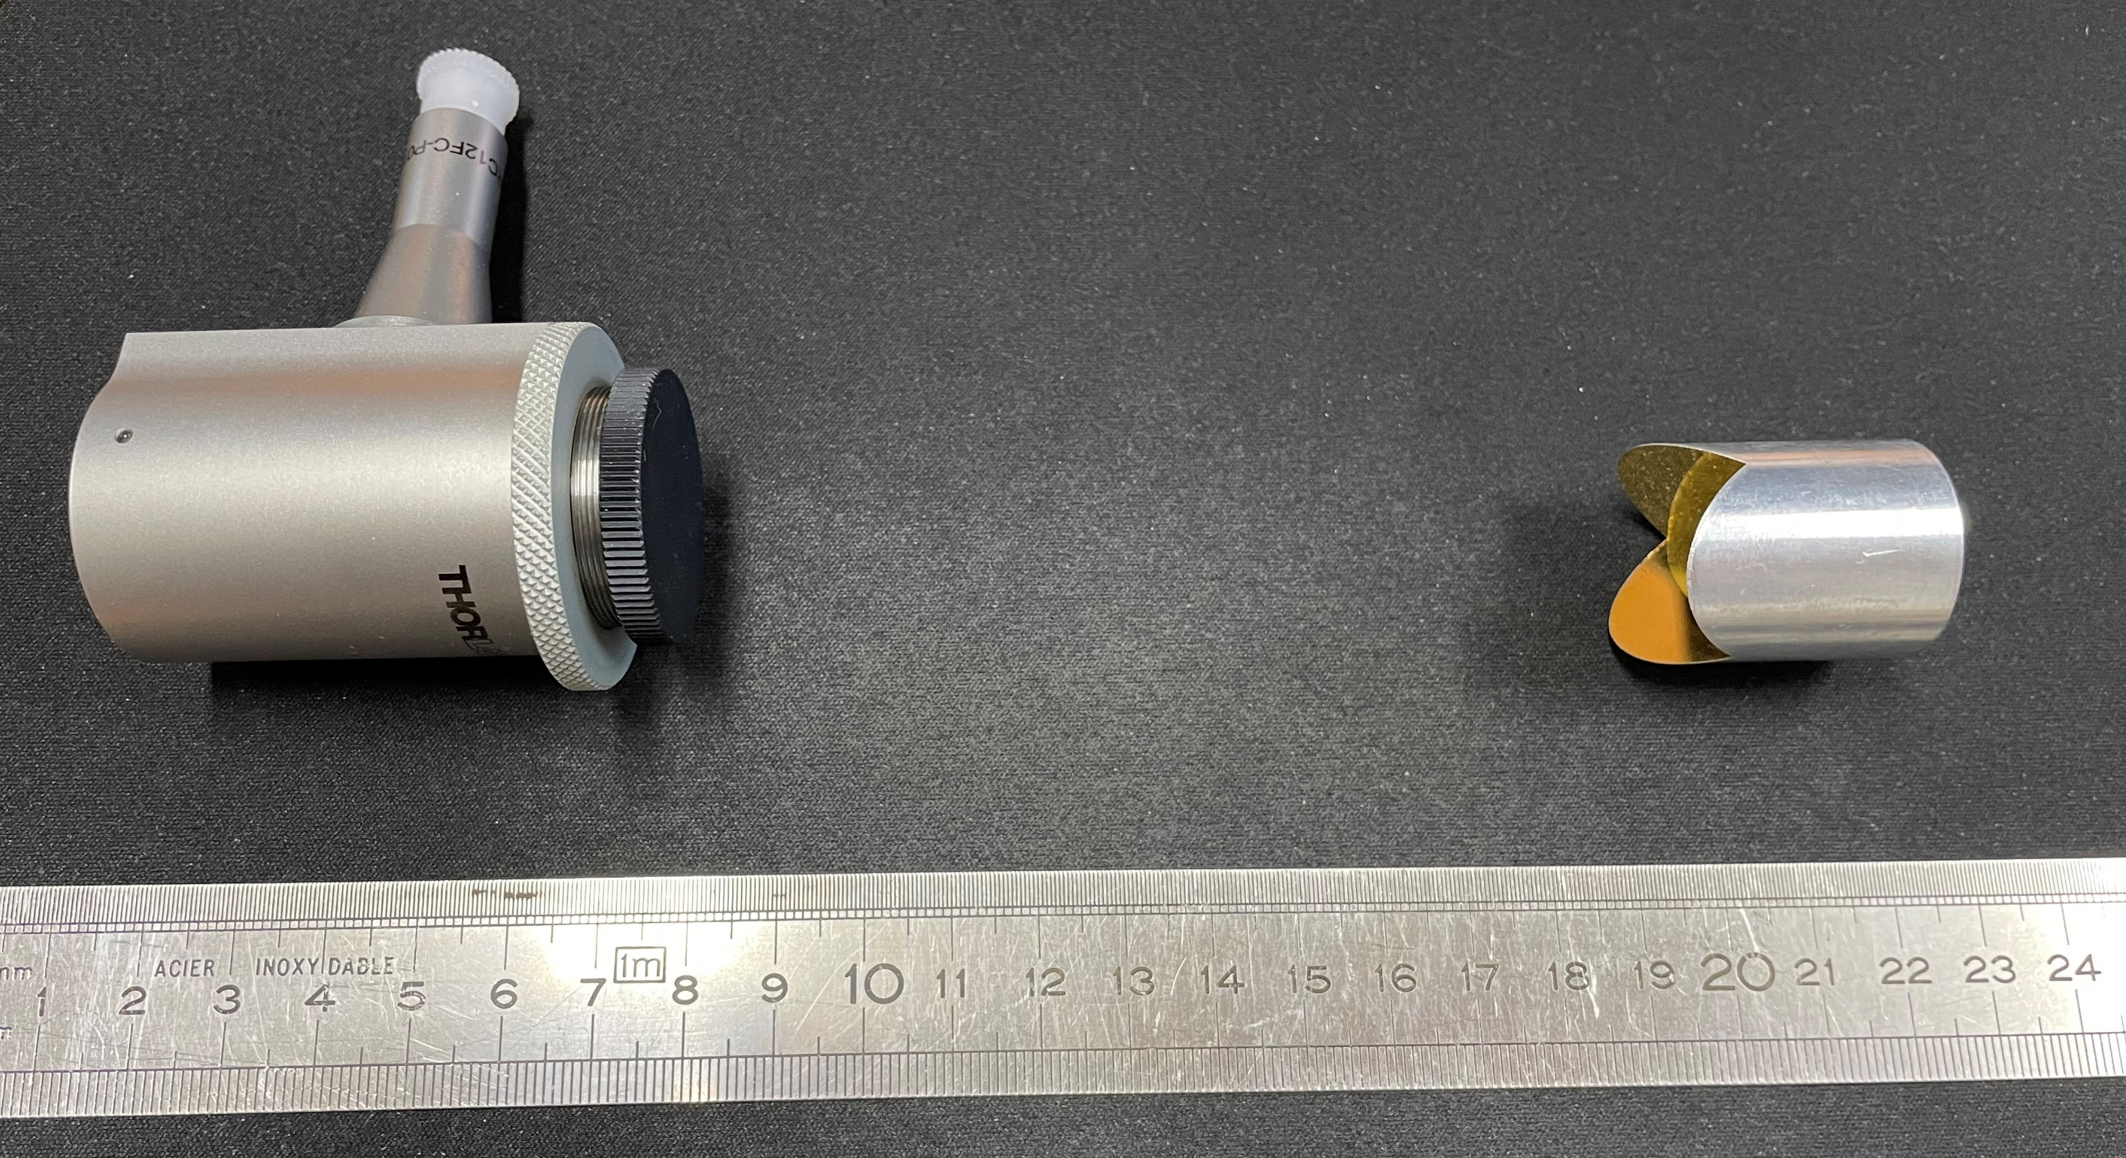
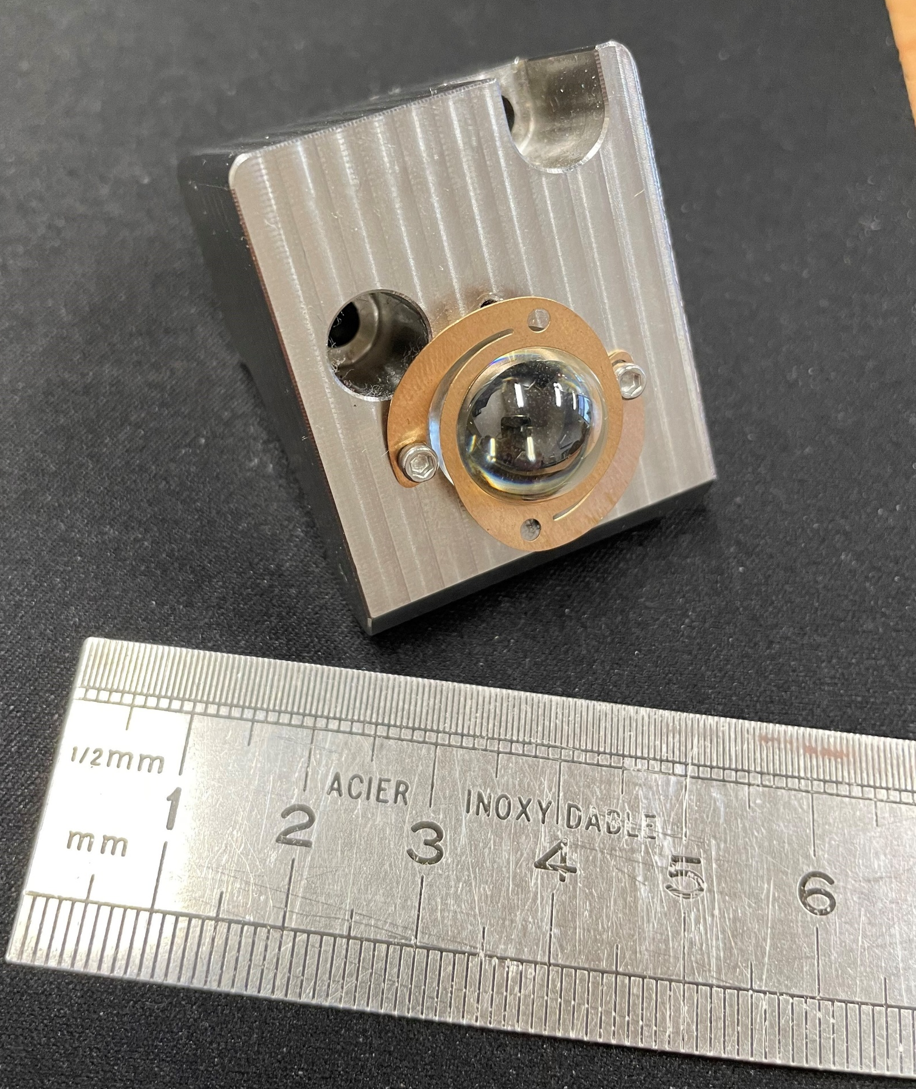

14/01/2025, FCC Physics workshop
Léonard WATRELOT, BE-GM-HPA
10
External alignment system sensors
Collimator and Corner Cube retroreflector
Glass bead supports
Glass beads
Line of sight number will depend on the latest requirements
Their position will depend on the detector design
The system is versatile, lines of sight can be easily moved if necessary
Notes:
Difficult conditions
Radiations, magnetic fields, cryogenic temperature …
Need for an alignment system
A robust and redundant one as conditions will be very difficults and the access impossible

Slide 12
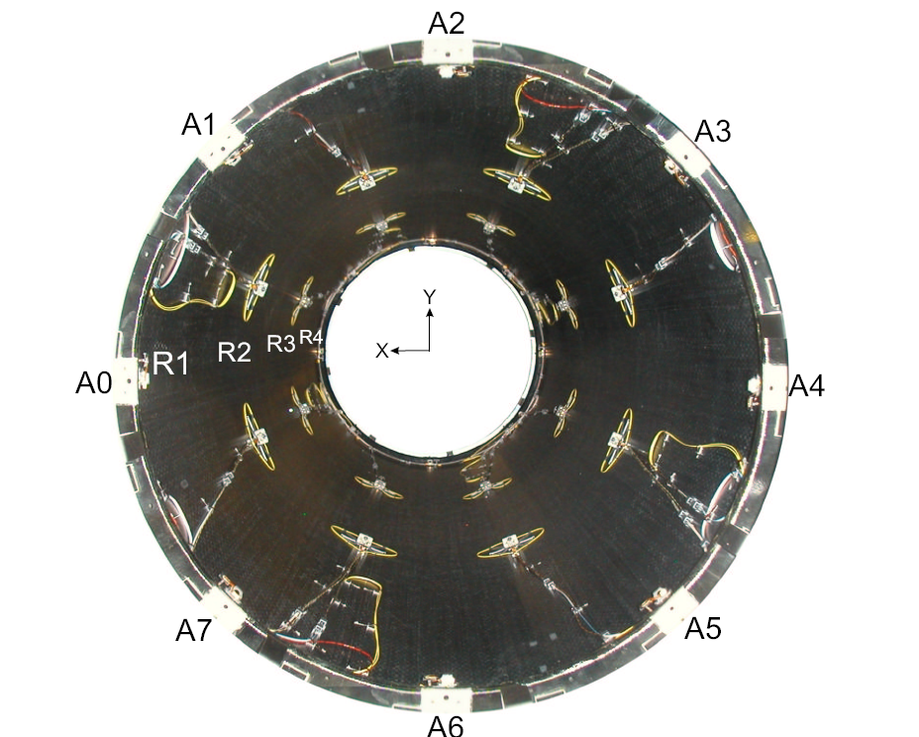
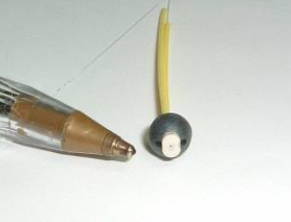
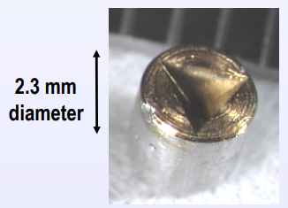
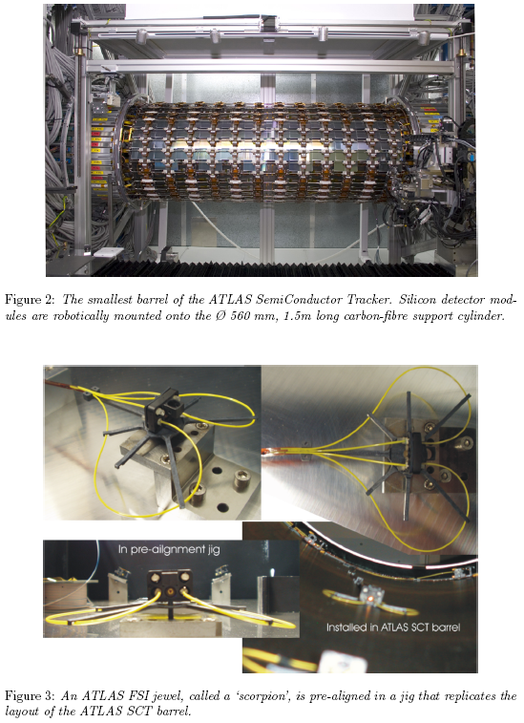
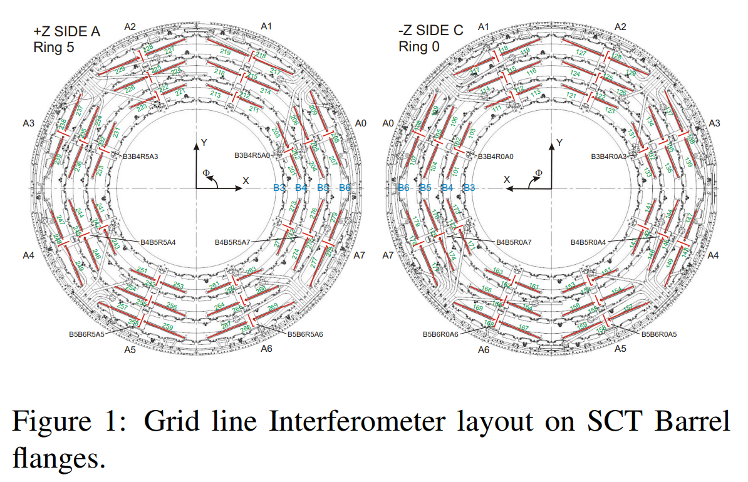
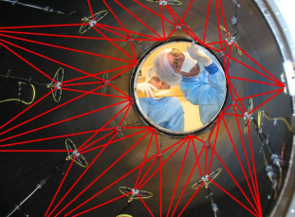
14/01/2025, FCC Physics workshop
Léonard WATRELOT, BE-GM-HPA
11
To put to perspective : subdetector monitoring systems installed inside ATLAS
Cf. presentation
Gibson, S. M., et al. "Monitoring the heart of ATLAS using Frequency Scanning Interferometry." Proceedings of the Eighth International Workshop on Accelerator Alignment, CERN, Geneva. 2004.

Slide 13
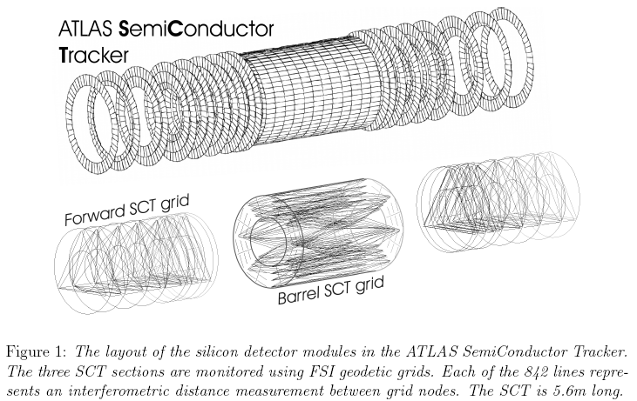
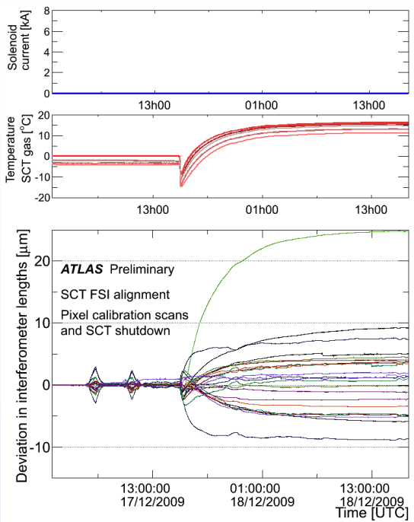
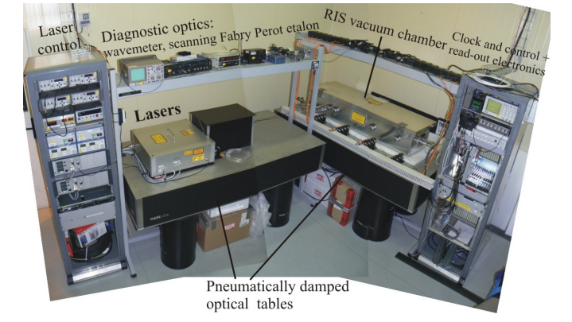
14/01/2025, FCC Physics workshop
Léonard WATRELOT, BE-GM-HPA
12
To put to perspective : subdetector monitoring systems installed inside ATLAS
Example of movement justifying a monitoring system
Cf. presentation
FSI laser room
Gibson, S. M., et al. "First Data from the ATLAS Inner Detector FSI alignment system." proc. The 10th International Workshop on Accelerator Alignment, KEK, Tsukuba. 2008.

Slide 14
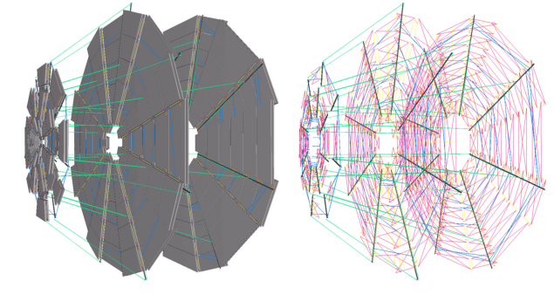
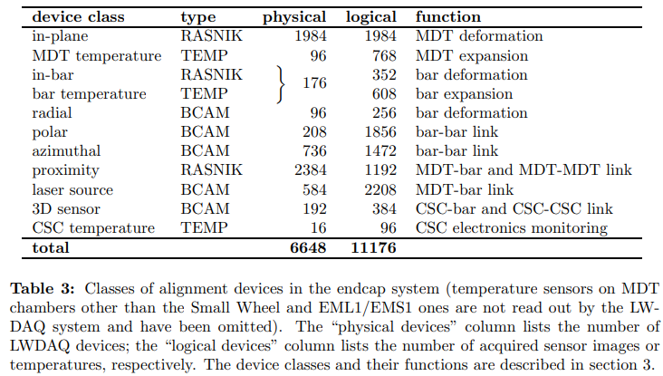



14/01/2025, FCC Physics workshop
Léonard WATRELOT, BE-GM-HPA
13
To put to perspective : subdetector monitoring systems installed inside ATLAS
Lines of sight
BCAM
Amelung, Christoph, et al. "The Optical Alignment System of the ATLAS Muon Spectrometer Endcaps." ATL-MUON-PUB-2008-003 (2008).

Slide 15



14/01/2025, FCC Physics workshop
Léonard WATRELOT, BE-GM-HPA
14
External alignment perspectives
Could be interesting to link the alignment with the alignments systems of the subdetectors.
Win/win situation as it would densify the alignment network, making it more robust while also giving precious information of subdetectors relative positions. It will give also the information on the position before the start of the collider, speeding up the initialization.
This link could be also very helpful for assembly and opening procedures, providing a continuous monitoring and validating the position.
Notes:
In parallel, a requirement was to have the information of the alignment between the two sides of the detector, a link between the two sides was thought about
On that point, solutions are existing (LHC is the most obvious example).
But the FCC was the occasion to push the R&D in that direction too.
The goal was to propose a system even more versatile:
More precise
Allowing a measurement of the detector (for alignment between the detector solenoid and the screening and compensation solenoid for example)
Being some kind of standalone backbone on which independent subdetector alignment system could attach to have a better knowledge of the alignment in the detector
Be used for the installation and closing of the detector, during openings and closings during shutdowns.

Slide 16
Thank you for your attention
14/01/2025, FCC Physics workshop
Léonard WATRELOT, BE-GM-HPA

Slide 17

14/01/2025, FCC Physics workshop
Léonard WATRELOT, BE-GM-HPA
15
https://iopscience.iop.org/article/10.1088/1361-6501/acc6e3
Cylinder deformations
Deformation monitoring
Least square adjustment
Helixes observations
(= 3D lengths of portions)
+ equation of portion length as function of the deformation polynomials
3
Simulations shown micrometric accuracy
To be confirmed by a prototype
Total : 3600 measurements and ≈ 3 cm space taken by the sensing system in the assembly.

Slide 18






14/01/2025, FCC Physics workshop
Léonard WATRELOT, BE-GM-HPA
18
More info on the FSI monitoring of the SCT in ATLAS
Fox-Murphy, A. F., et al. "Frequency scanned interferometry (FSI): the basis of a survey system for ATLAS using fast automated remote interferometry." Nuclear Instruments and Methods in Physics Research Section A: Accelerators, Spectrometers, Detectors and Associated Equipment 383.1 (1996): 229-237.
Coe, Paul Andrew. An Investigation of Frequency Scanning Interferometry for the alignment of the ATLAS semiconductor tracker. Diss. University of Oxford, 2001.

Slide 19



14/01/2025, FCC Physics workshop
Léonard WATRELOT, BE-GM-HPA
10
Summary of the FCC-ee MDI design
Notes:
Difficult conditions
Radiations, magnetic fields, cryogenic temperature …
Need for an alignment system
A robust and redundant one as conditions will be very difficults and the access impossible

