Slide 2
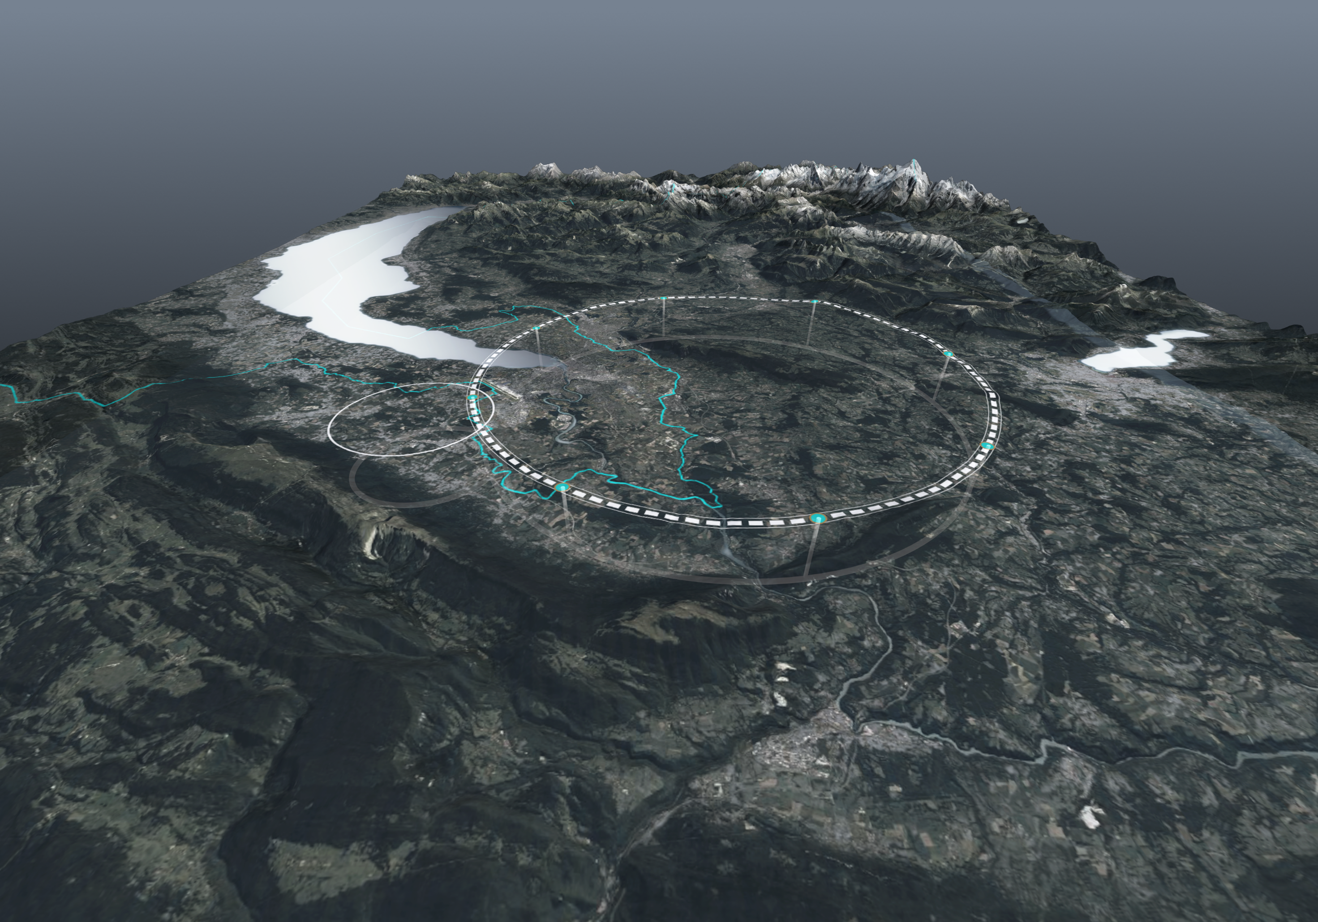
Thoughts on injecting polarized beams
Jorg Wenninger
BE-OP-LHC

Slide 3
Motivation for injection of polarized beams
Very accurate beam energy calibration is driving the interest in transverse P at FCCee.
A polarization of ~10% should be sufficient but should be confirmed by a full depolarization process simulation including measurement errors of the polarimeter.
The very long polarization build-up time can only be overcome in the collider itself with strong asymmetric wigglers and an operation model that requires a ~2h period to polarize low intensity bunches (synch. radiation power !) before injecting the main beam (wigglers off).
Frequent beam aborts can render this process quite inefficient.
Consider injection of e+/e- polarized ‘close to the source’ and transported through linac, transfer lines and transfer channels as well as through the booster.
Challenge lies in preserving the polarization through the chain.

Slide 4


Spontaneous polarization in e+/e- rings
Spontaneous build-up of transverse polarization in planar e+/e- rings (Sokolov-Ternov) due to emission of synchrotron radiation.
  Small asymmetry in the cross for synch radiation emission for ending up with magnetic moment // or anti-// to the guiding dipole field.
  Asymptotic polarization level: P_{ST} = 92.4%
  The polarization is aligned in the vertical direction (along bending field).
  Build-up time τ_{ST}: or
  At 45.6 GeV : LEP τ_{ST} ≈ 5.5h, FCCee τ_{ST} ≈ 220h
C = circumference
R = radius
ρ = bending radius
B = bending field

Slide 5

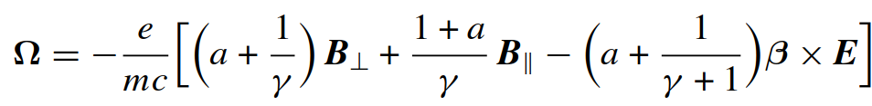
Spin precession
Spin/polarization vector precession in EM fields is described by the Thomas-BMT equation:
E represents the electric field
For γ >> 1:
B⊥ / B|| correspond the field components orthogonal / parallel to the particle velocity.
a is the anomalous magnetic moment, a ~ 10⁻³ for e.
~ independent of γ for transverse B-fields !
~ 1/γ for longitudinal B-fields (solenoids)

Slide 6


Spin tune
y
If the beam trajectory is perturbed by a kick θ_{kick} due to a transverse magnetic field, the associated spin precession angle θ_{spin} around the axis of the perturbing B-field is:
s
B
θ_{kick}
x
In a perfectly planar ring, the number of spin precessions per turn around the vertical bending field is proportional to the integrated magnetic field which defines the beam energy:
ν_{s} = no of precessions / turn = θ_{spin}(1-turn)/2π = spin tune
ν_{s} = 103.5 @ Z pole, ν_{s} = 45.4 at 20 GeV

Slide 7



Machine imperfections and resonance - depolarization
In the presence of machine imperfections (misalignments, field errors.. ) build-up of polarization can be perturbed. The impact can be characterized by a depolarization time τ_{D}.
The asymptotic P and the build-up time are reduced.
with
If a polarized beam is injected with polarization P_{inj}, the polarization will evolve towards P∞ with time constant τ_{pol}.
Observation: even for injection of polarized beams, P∞ / τ_{pol} should be sufficiently “large” for a depolarization measurement to take place under good conditions.

Slide 8
General comment for rings
The stable P direction is always the vertical direction (the direction of the bending field).
  The P component in the x-s plane will decohere due to energy spread (→ spin tune spread) and synchrotron radiation.
Polarized beams should (must) be injected with a vertical polarization.
If the injected P level does not match the equilibrium polarization P∞ , it will evolve towards P∞ with time-constant τ_{pol}.
  τ_{pol} should be significantly larger than the time span that the beam will spend in the ring.
  Example: 20 polarized bunches are injected for energy calibration, to be performed every 5 mins. The bunches will last 100 mins before fresh bunches are needed. τ_{pol} should be significantly longer than 2 hours.
Periodic injection of a few polarized bunches that spend only a “short” time in the ring relaxes constraints on P∞ and τ_{pol} .
  The depolarized bunches must be ‘eliminated’ from the ring before replacing them by fresh polarized bunches.

Slide 9
Spins and rotation matrices
The spin (polarization) vector evolution is described by rotation matrices ℜ _{u}(θ) around axis u (=x,y,s) of the B-field.
The fact that rotations do not commute has important consequences.
  ℜ _{x}(-90) ℜ _{x}(90) = I and ℜ _{y}(-90) ℜ _{y}(90) = I
  But: ℜ _{y}(-90) ℜ _{x}(-90) ℜ _{y}(90) ℜ _{x}(90) ≠ I
y
y
ℜ _{y}(90)
x
ℜ _{x}(-90)
x
initial
ℜ _{x}(90)
s
ℜ _{y}(-90)
s
Non-commutation of rotations has a deep impact on spin dynamics.
The spin orientation can be manipulated locally without affecting the beam trajectory outside a defined region: spin rotators, (Siberian) snakes – see later.
This effect can also break the relation between spin tune and energy !
final

Slide 10
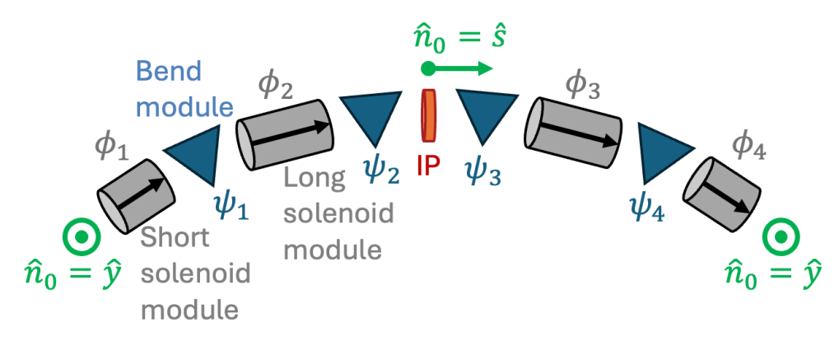
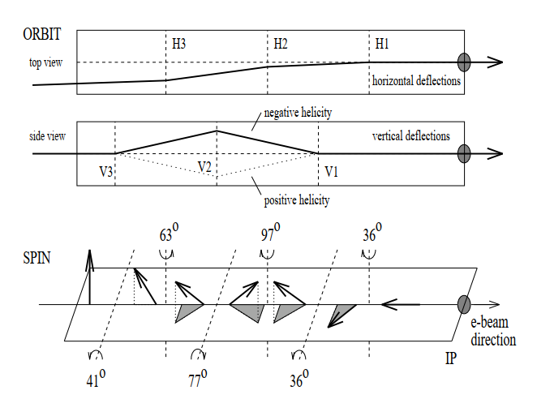
Spin rotators - example
n₀ = direction of polarization
Solenoids: alone or in combination with dipole fields can be used to rotate the spin vectors.
  Very large (many Tm) solenoids are required at high(er) energy.
  Betatron coupling must be corrected by skew quads.
EIC spin rotator design: 2 solenoids + 2 dipole strings on both sides of the interaction point
HERA-e spin rotator: from vertical polarization in the arc to longitudinal polarization at the collision point with interleaved horizontal and vertical dipoles, on both sides of the IPs.
D. Barber, EPAC 96

Slide 11
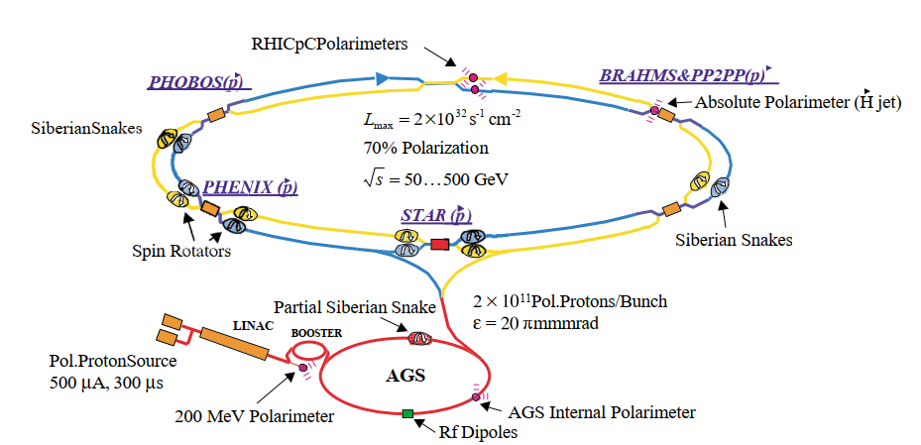
RHIC
RHIC operated periodically with polarized proton beams.
The polarized protons were transported and accelerated through a linac, booster and the AGS to RHIC where the final acceleration took place.
  ~90% source polarization → ~70% polarization in RHIC

Slide 12
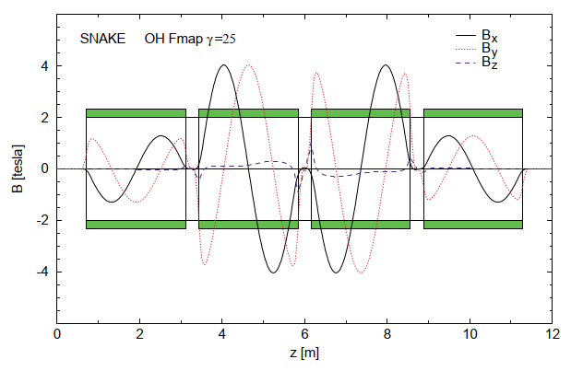
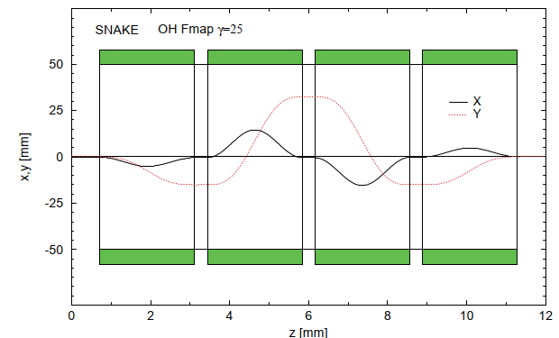
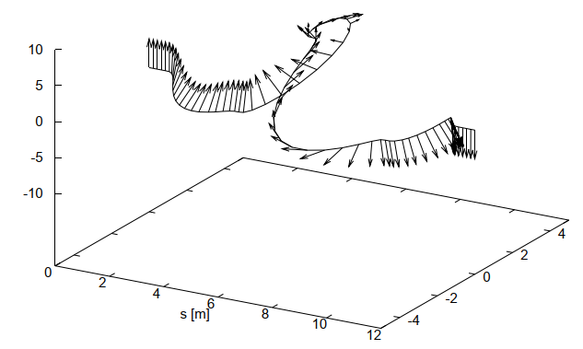
RHIC spin rotators and snakes
Polarized beam operation relied on spin rotators and snakes (full polarization flip) composed of superconducting helical dipoles.
  Transverse B_{x} and B_{y} fields of helical shape, with N periods (N = 1 for RHIC).
A combination of 4 helical dipoles provides full control of the spin orientation.
B fields
Beam orbits
Spin flip in a snake
Injection energy
10 m
I. Alekseev et al, NIMA 499 (2003) p 392

Slide 13
Production of polarized beams for FCCee
For e- beams, there are two options:
  Production of polarized e- at the source (SLC, EIC).
  Building up transverse polarization in a damping ring by the Sokolov-Ternov effect.
For e+ beams, only the second option applies.

Slide 14
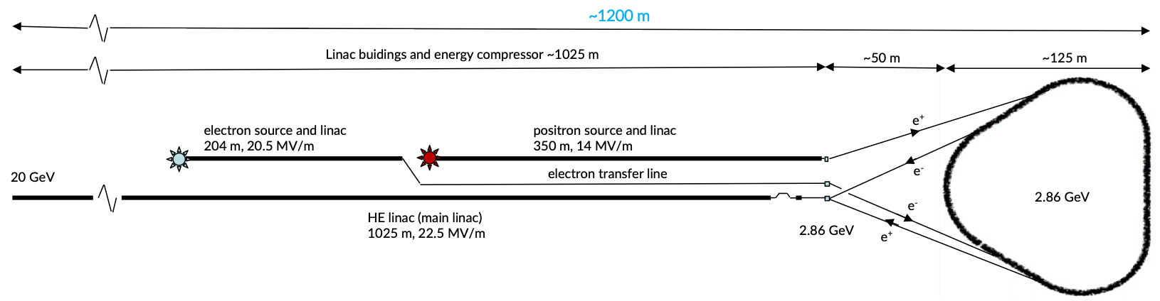
Polarized beams in a damping ring
Energy scaling of τ_{pol} requires a large B field (small bending radius ρ) to achieve a sufficiently short τ_{pol} ~few mins:
At E = 2.86 GeV, B = 1.5 T (ρ = 6.4 m), C = 80 m → τ_{pol} ~4 mins
And/or strong asymmetric wigglers.
The current FCCee damping ring design would require strong asymmetric wigglers to reduce τ_{pol} to reasonable values (TBC).
It may not be compatible with regular top-up for collisions.
Consider a dedicated DR for polarized beam production !

Slide 15
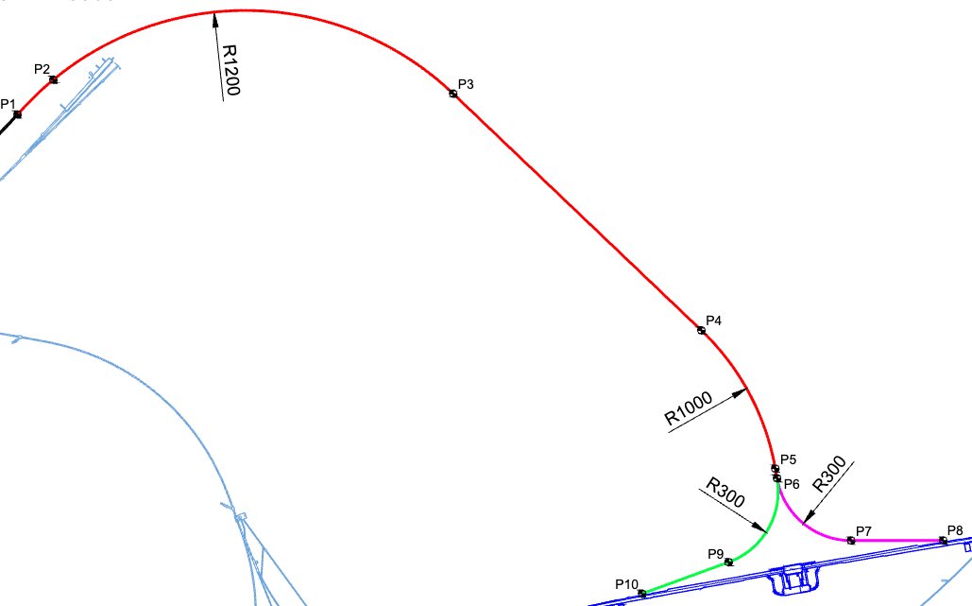
Linac to booster
Vertical
Vertical P of DR to be kept vertical in LINAC.
The transfer from LINAC to booster involves vertical and horizontal bending: a spin rotator.
  E = 20 GeV, aγ = ~ 45.4
  The initial downward bend of ~3° rotates the P vector by ~140° → precession of H component in the TL by ~25.5 / 5.3 turns for e-/e+.
  Vertical bending at end of line unlikely to restore vertical P.
Horizontal
y
s
x
P. Arutia et al, ATDC #11
Adapt TL design and/or install spin rotators before booster injection to restore vertical P.

Slide 16
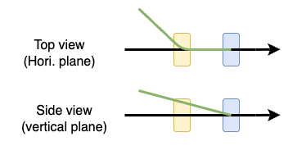
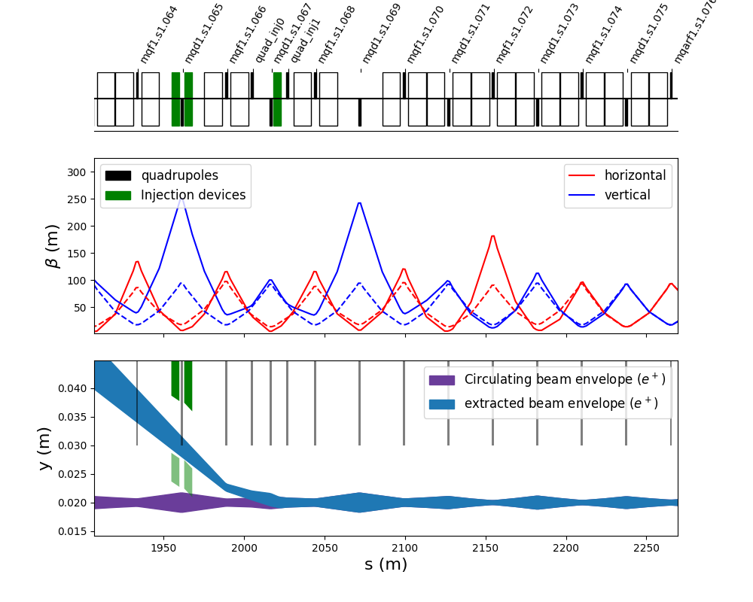
Booster injection
~150 mrad
~0.25 mrad
The horizontal injection dipoles + septum add a little over one complete turn: rotation of ~1.07 [2π].
The vertical deflections (quad + kicker) contribute very little, rotation ~0.002 [2π].
Little concern if P is vertical when the beams enter this region.

Slide 17
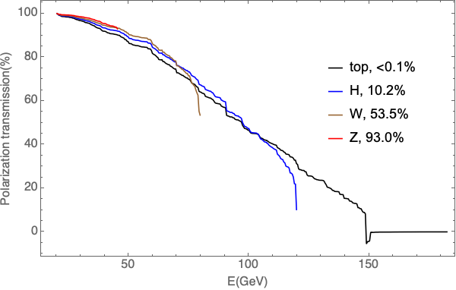
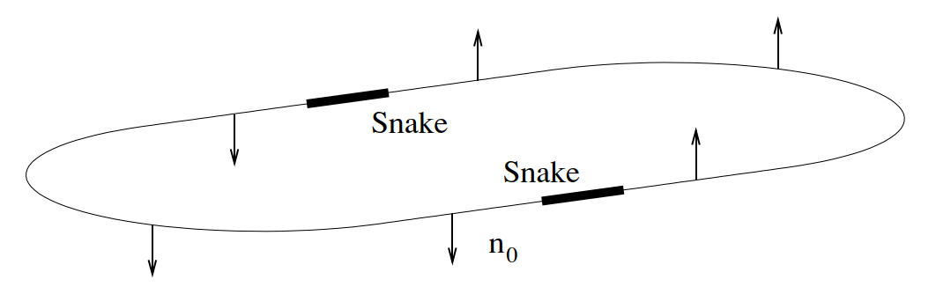
Booster ramp
Z. Duan, 182nd FCC-ee Optics Design Meeting
Injection into the booster of bunch with vertical polarization.
The polarization must be maintained throughout the ramp. A study by Z Duan seemed to indicate good preservation for the booster – to be confirmed.
The installation of 2 snakes (180° polarization flip, RHIC, ν_{s} = 1/2 !) or of a partial snake (AGS) could boost preservation of polarization by making it less sensitive to resonances.
Ring with 2 snakes: polarization is up in one half and down in the other half of the ring.

Slide 18
Booster to collider transfer
No detailed design available for this presentation.
It is planned to:
  Deflect the beam out of the booster horizontally.
  Use vertical bends to bring the beam into the plane of the collider.
  Inject horizontally into the collider.
This order (no interleaved of H/V bending) will preserve the vertical P from booster → collider.
booster
collider

Slide 19
Polarimetry, depolarization
Injection of polarized bunches requires polarimeters along the chain from source to collider for tuning and diagnostics.
Rough inventory:
  2 polarimeters in the collider (e+ and e-).
  2 polarimeters in the booster, able to measure from injection to flat top.
    But not necessarily continuously along the ramp?
  1 polarimeter at the end of the LINAC.
  1 polarimeter per damping ring. Rely on Touchek lifetime?
Needs to be backed by a design study.
Depolarizers will also be required in all rings – DR, booster, collider – to determine the spin tune and calibrate the polarimeters.

Slide 20
Summary
Based on experience at SLC and RHIC for example, production and injection of polarized e+e- seems feasible.
Production and injection of polarized beams must be integrated into the design from the beginning since it may require:
Dedicated sources of polarized e+/e-,
Optics and transfer design that integrate polarization aspects,
Devices to control and preserve the polarization (rotators, snakes),
Dedicated diagnostics.
There is however a need for a significant design effort which requires expertise and simulation tools on polarization.

Slide 22
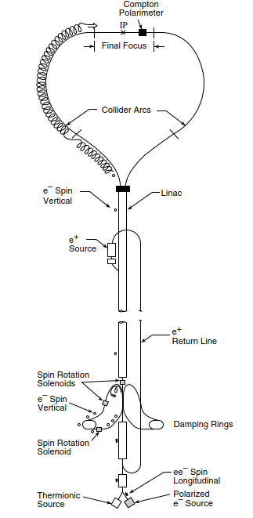
SLC
The SLC at Stanford operated with longitudinally polarized e- beams.
The e- source produced ~80% longitudinally polarized e- that were accelerated to ~1.2 GeV, injected for 8 ms into a damping ring, then transported to the IP.
  The P was rotated into the vertical plane before entering the RD with bends and solenoids. ST P build up was negligible.
  The P was vertical at the exit of the DR.
Vertical trajectory bumps were used to rotate the spin orientation in the SLC arcs from vertical to longitudinal (see LEP solenoid compensation).
  Solenoids were abandoned when SLC switched to flat beams (quality would have been compromised).

