Slide 2
JAP24
Injectors performance overview and highlights in 2024
Kevin Li
with contributions from P. Arrutia, F. Asvesta, H. Bartosik, E. De La Fuente Garcia, G. Kotzian, G. Rumolo, M. Schenk, G. Papotti, T. Prebibaj, L. Sito, I. Mases Sole, F. Velotti, C. Zannini and many more

Slide 3
Setting the scene
Operation
Modelling
EquipmenT
Controls
Equipment in operation
Taming equipment with modeling and control
Team COMET for better beams:
LHC Protons
LIU Protons
LHC Ions
Fixed Target
A peak into the future

Slide 4


Setting the scene
COMET
Operation
Modelling
EquipmenT
Controls

Slide 5
Setting the scene
COMET
Operation
EquipmenT
Controls
Modeling
Is this the slightly different manifestation of the long sought for “Avengers” squad mentioned by Ben Todd 2 years ago at the ‘22 JAP workshop?
Working united they may be able to perform miracles! We will touch upon some of these during this venture!

Slide 6
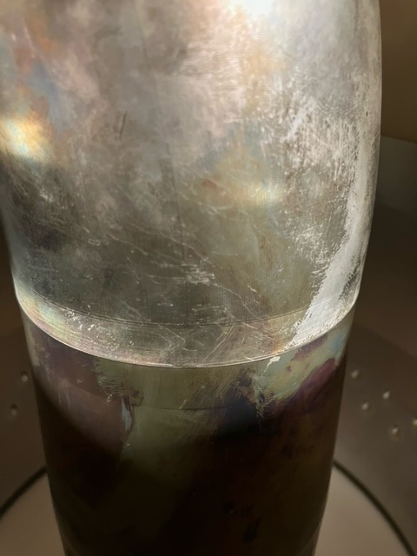
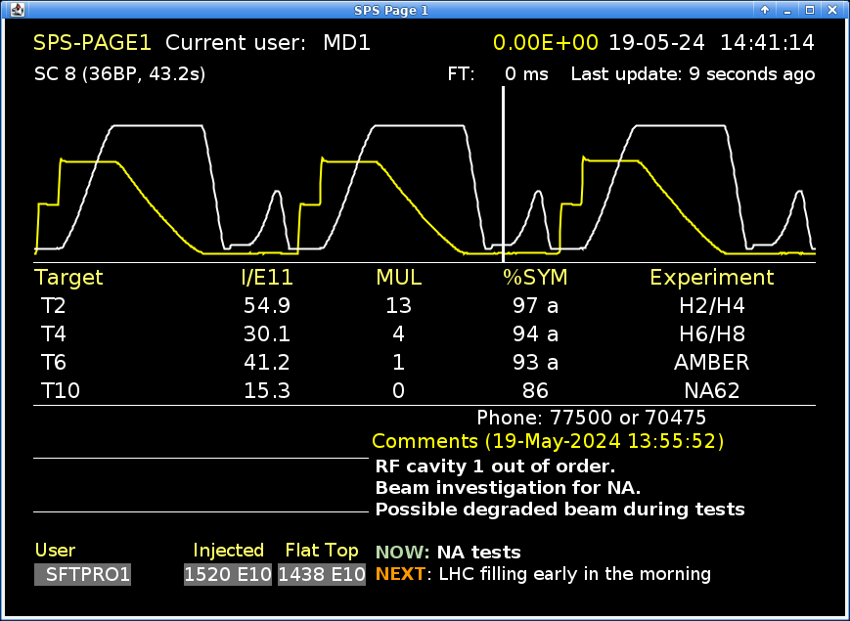
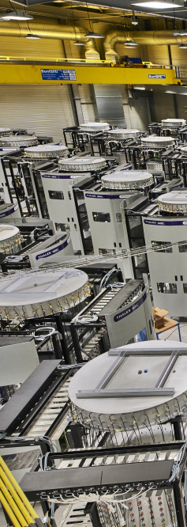
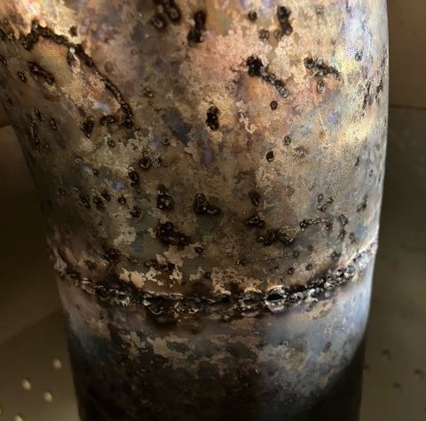
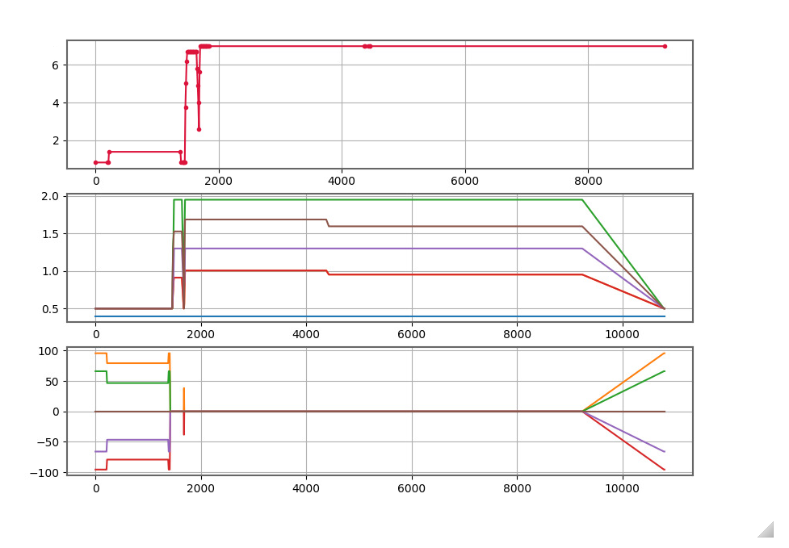
‘24 critical equipment events
SPS RF power:
  Failures of cavity 1 (arcing in feed line), 3 (HOM coupler) and 6 (disbalanced powering) with extended downtimes each!
  High module breakage rate in Thales towers
  But also gained:
    Understanding in improved system protection and interlocking
    Understanding of module breakage and potential mitigations
    Understanding on how to operate in degraded mode
S2: Experience with SPS RF and outlook
S. Pittman

Slide 7
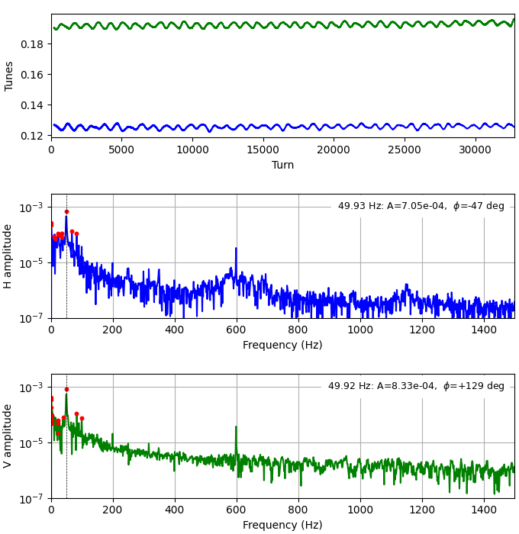
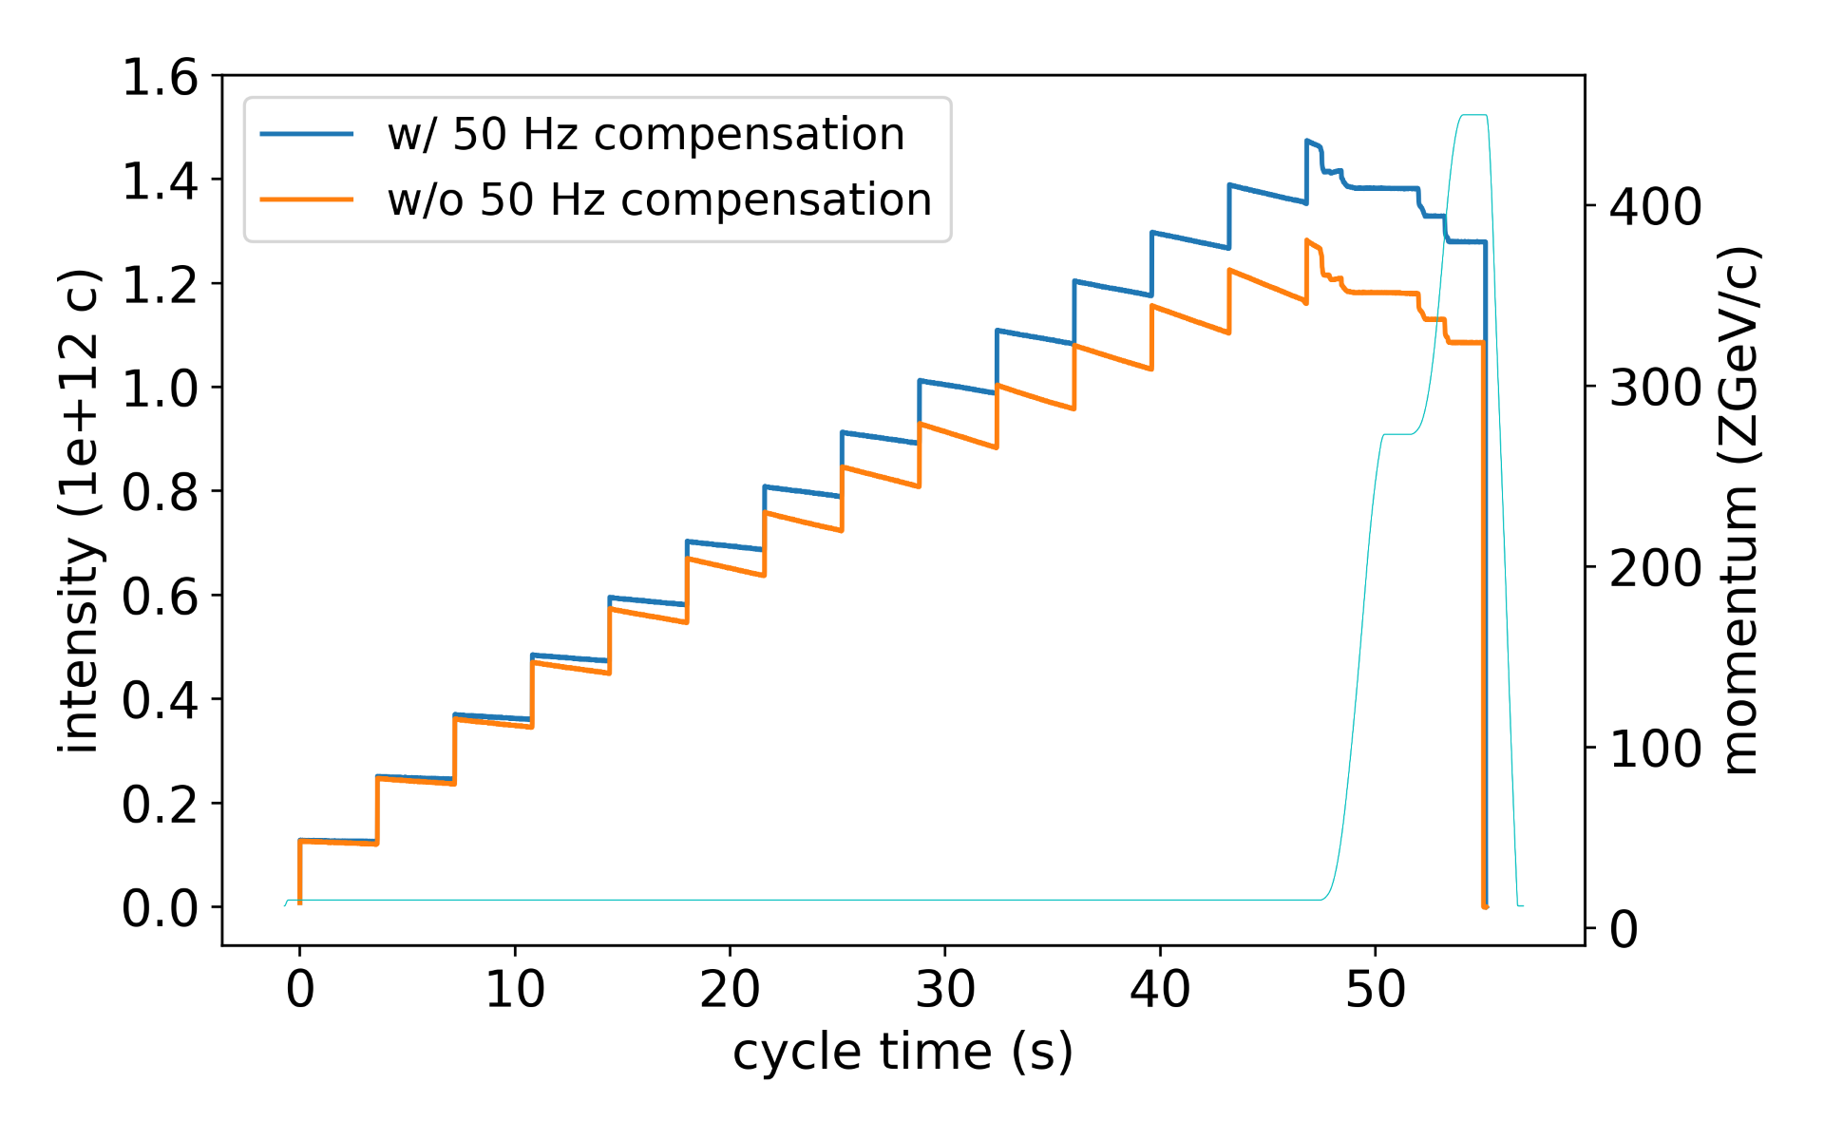
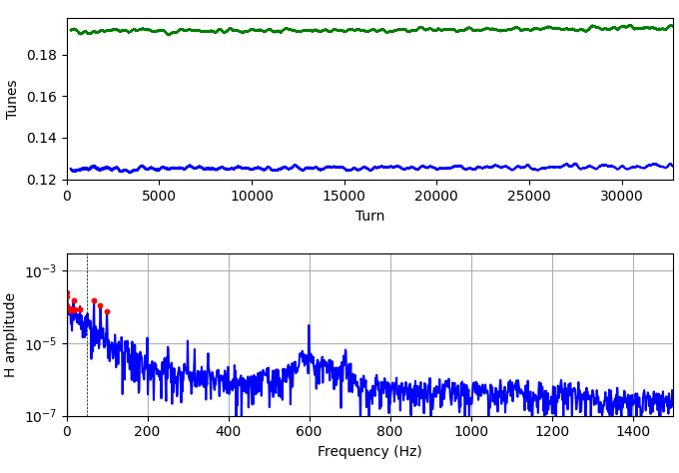
‘24 critical equipment events
H. Bartosik, K. Paraschou, et al.
SPS RF power:
  Failures of cavity 1 (arcing in feed line), 3 (HOM coupler) and 6 (disbalanced powering) with extended downtimes each!
  High module breakage rate in Thales towers
SPS mains noise ripple:
  Presence of 50 Hz + harmonics noise on PCs
  Already known from slow extraction spill noise
  Massive impact on general beam quality!
S2: Experience with SPS RF and outlook
S. Pittman
Substantial impact of 50 Hz correction on power converters → transmission +17.8 %!
S2: Noise and regulation on power converters
C.-M. Genton

Slide 8
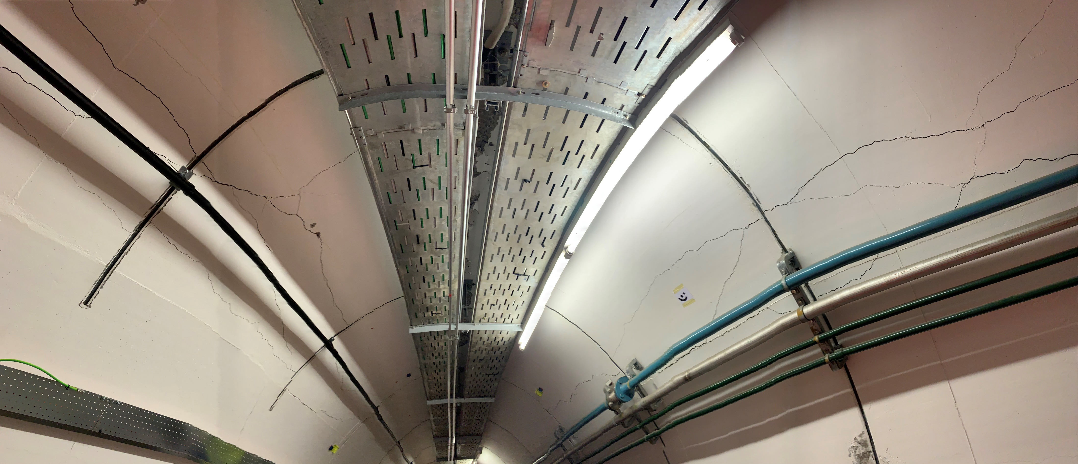
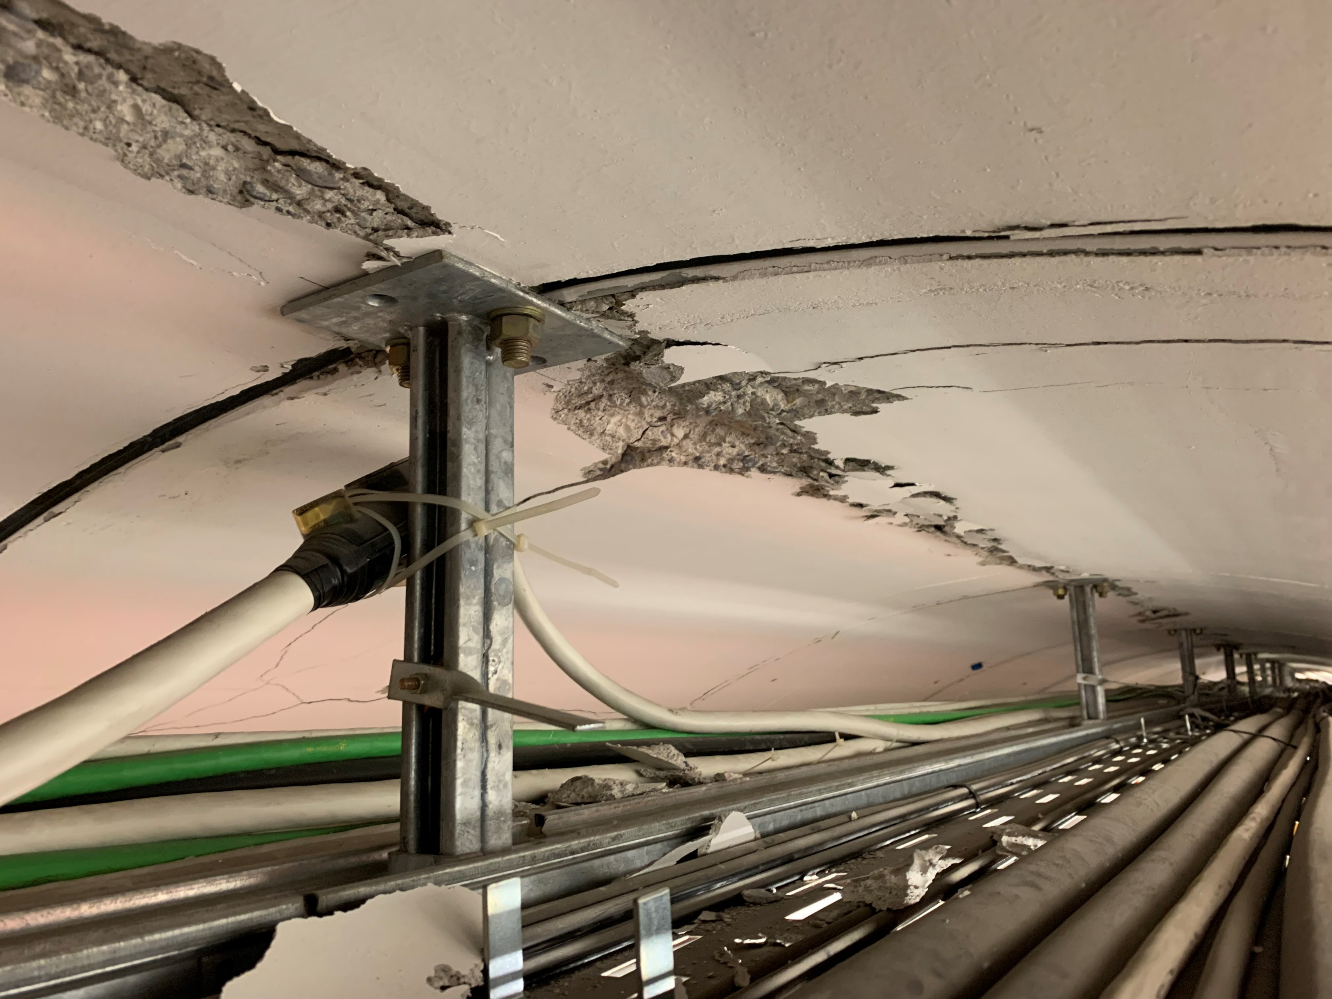
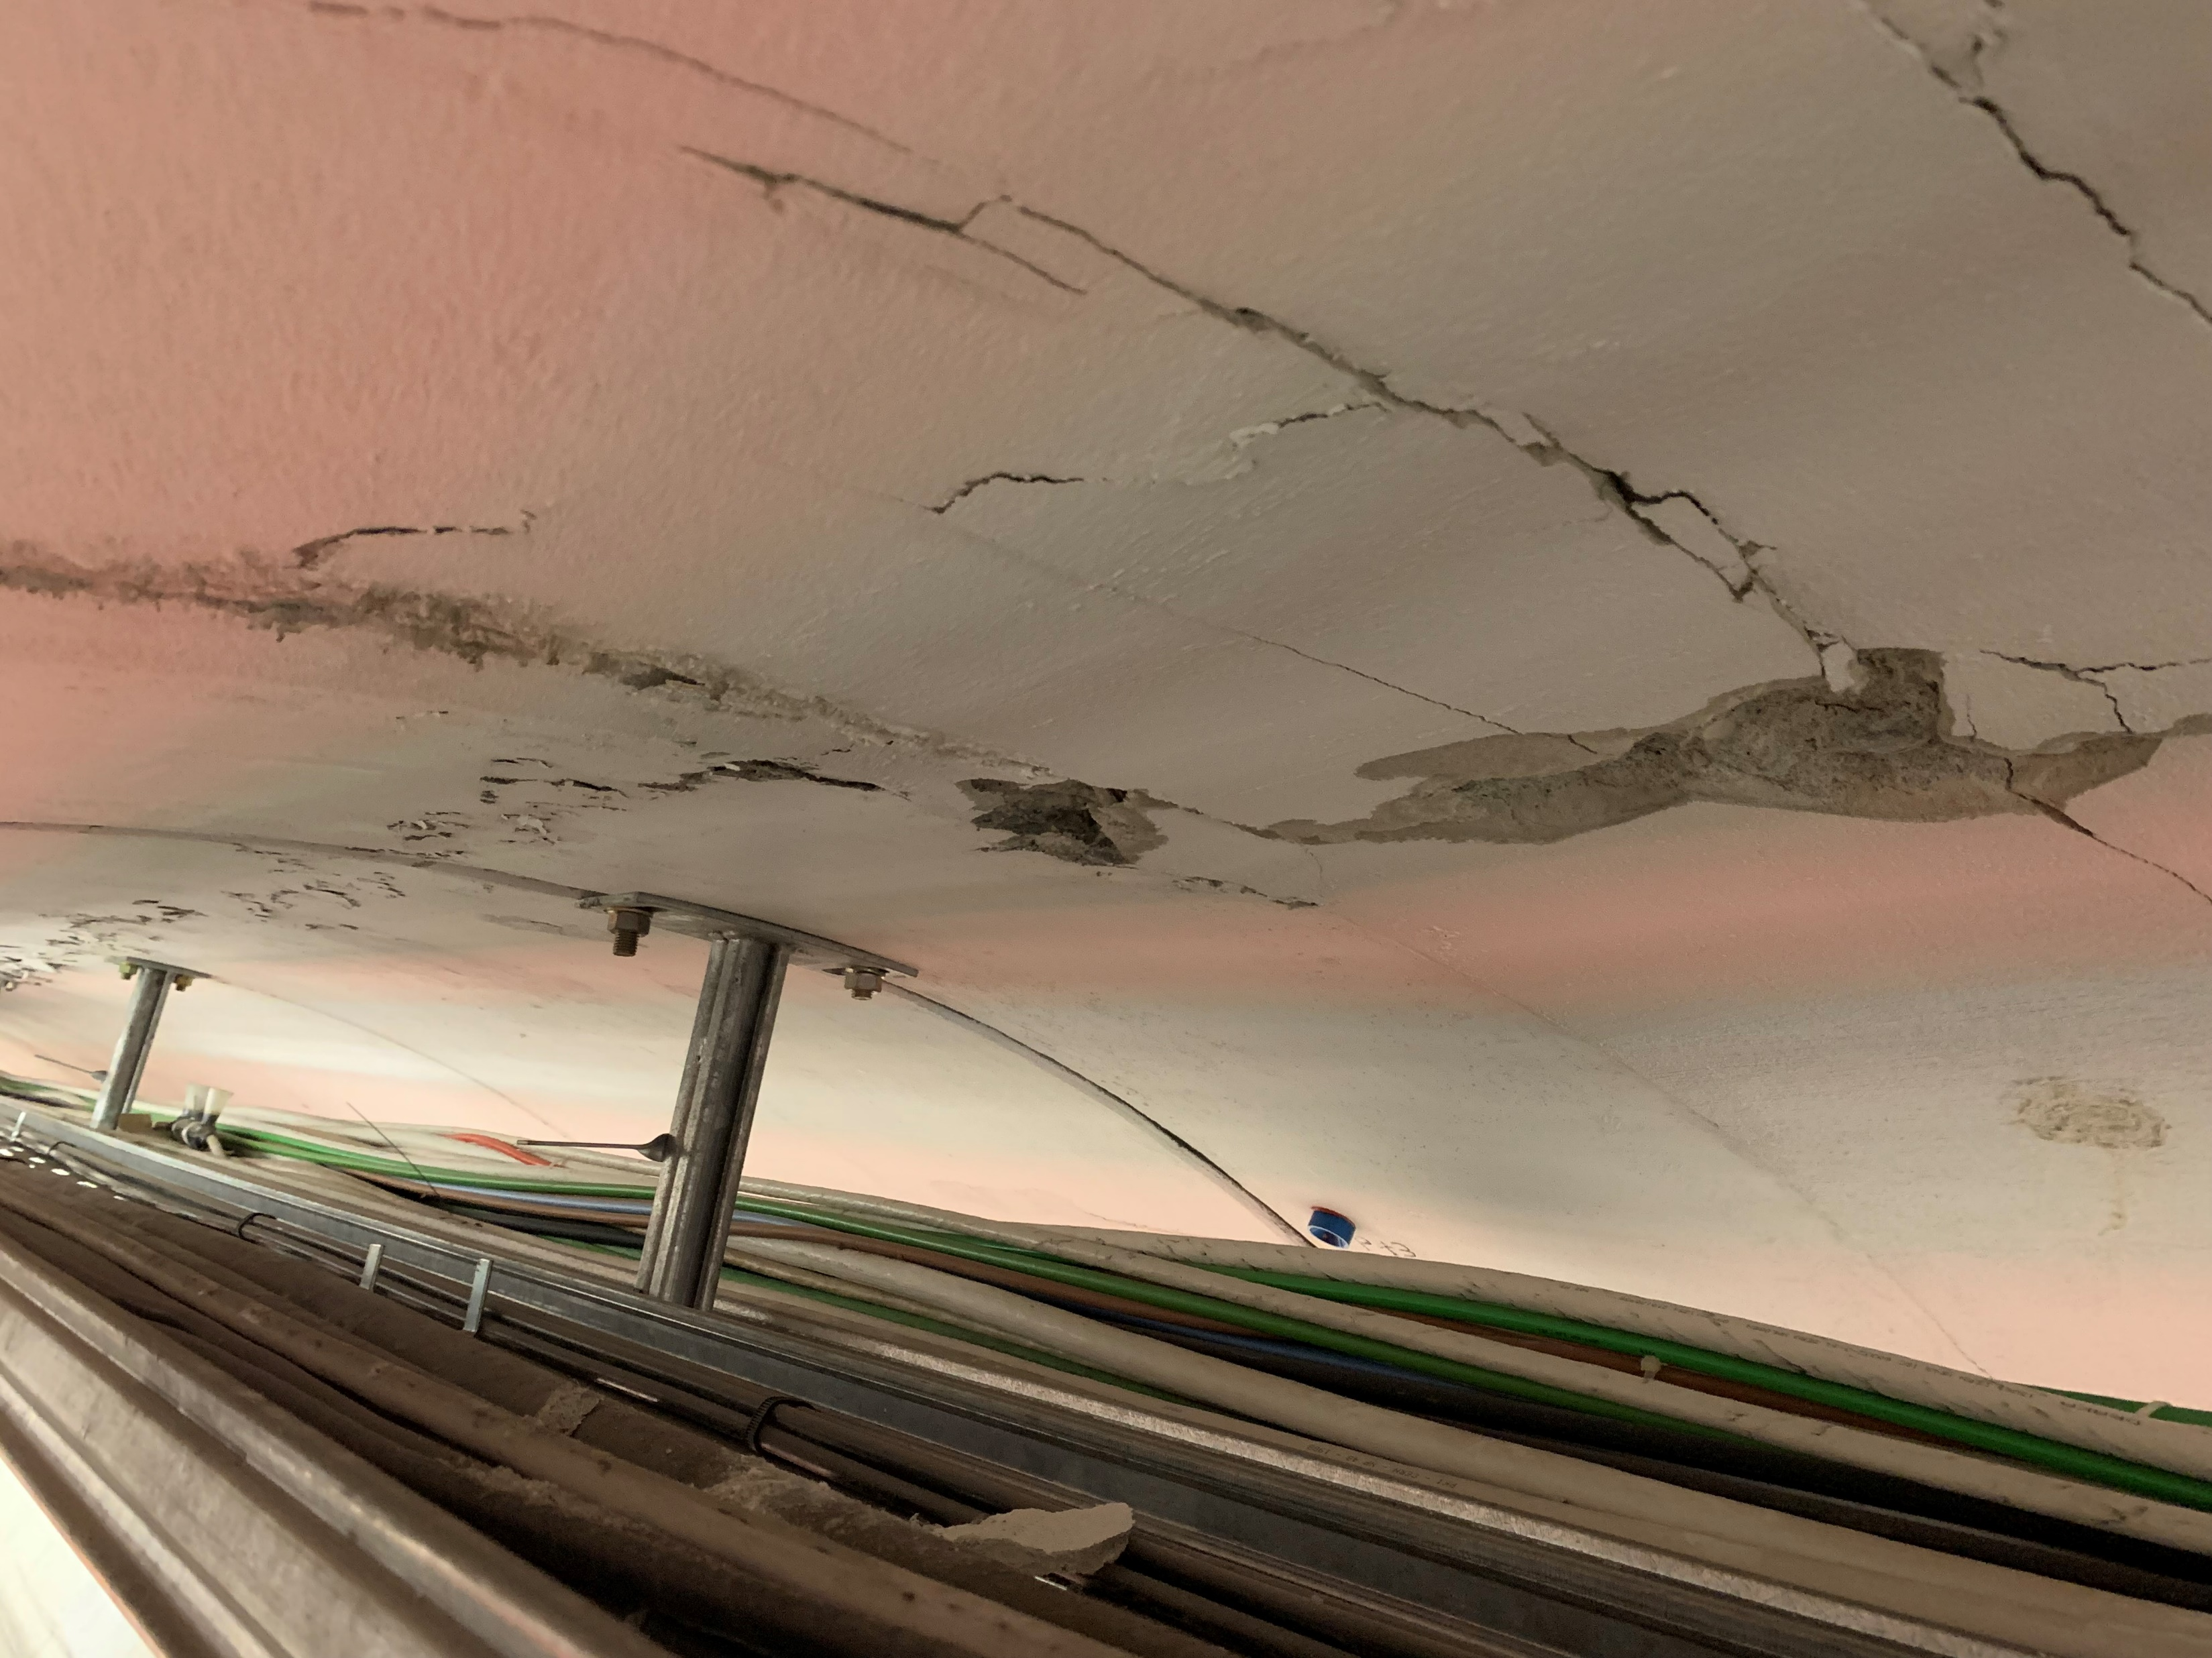
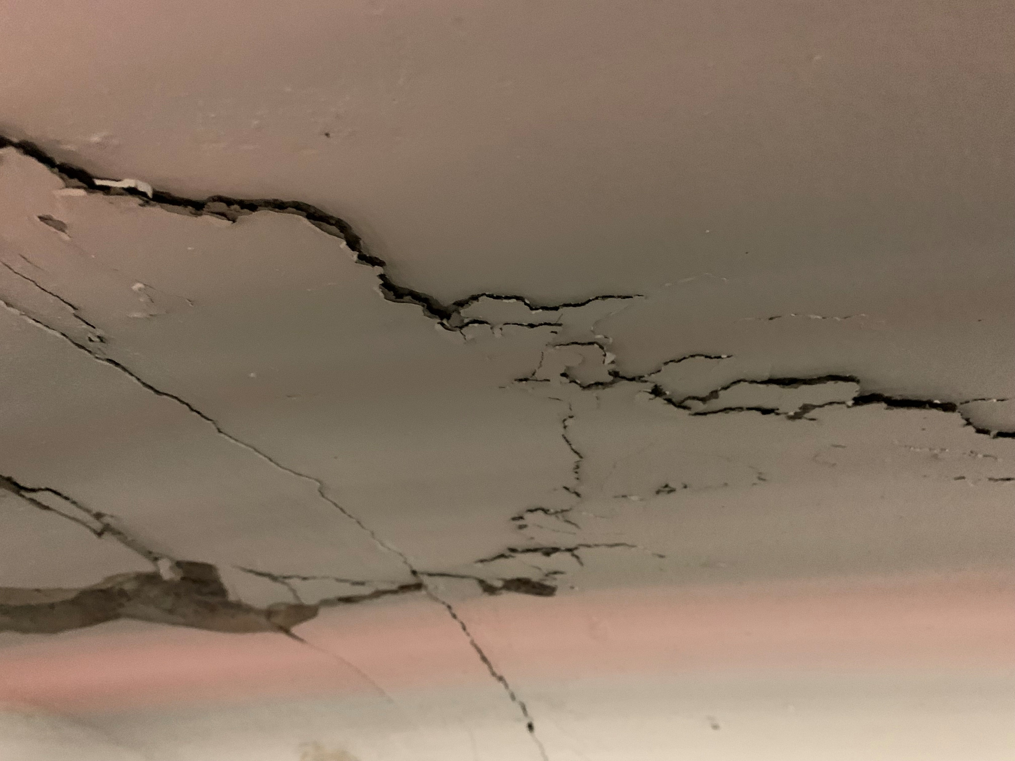
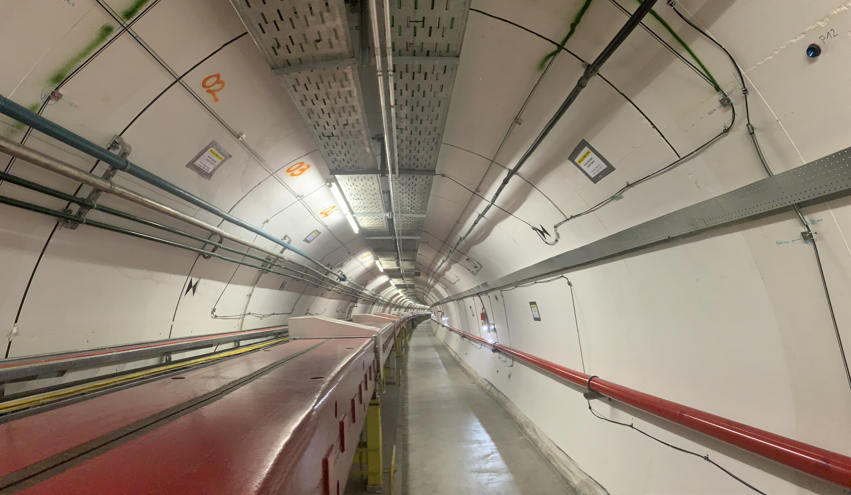
‘24 critical equipment events
Before
PSB quadrupole water leaks
  Leak found on in R4 on BR.QDE11 during TS; patched to sump water away from the live parts; actively monitored
Main dipoles:
  4 failures → 4 refurbished dipoles in the SPS tunnel; followed up and treated in the SPS MPC
Mains transformers:
  Fire due to fault in LV windings – report in IEFC
SPS tunnel:
  Tunnel cracking in TS16
  Serious consolidation done during YETS lead by SCE
Consolidation planned
Spares strategy in place
Spares strategy in place
After
No spares!

Slide 9

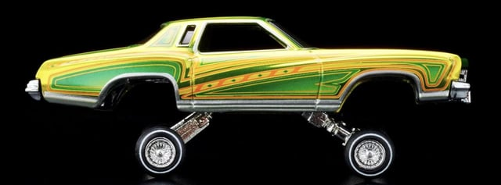
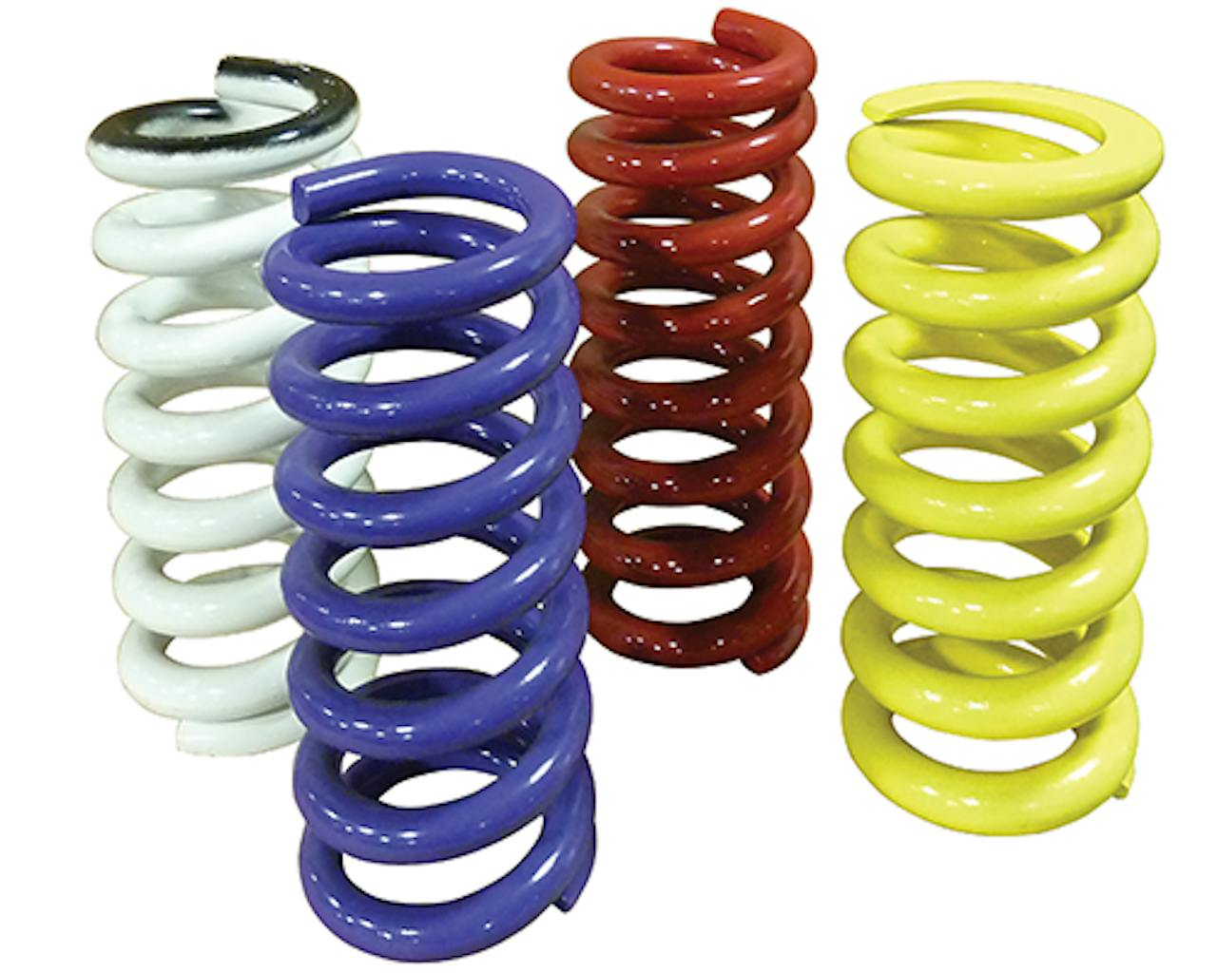
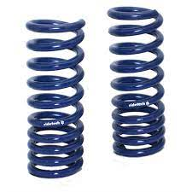
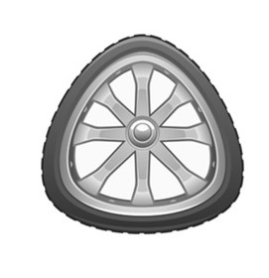
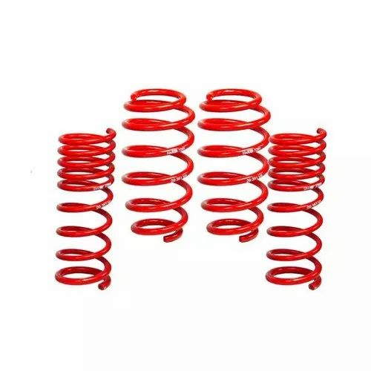
Critical equipment – pushing performance
Still quite a few construction sited to meld equipment and operations:
  PC ripples – where do all the noises come from?
  RF – still struggling, when can we have the power?
  To see or not to see! BGI, wirescanners, secondary emission…
  Are we really ready to operate our equipment at the highest possible performance → LIU reliability run for equipment validation, beam setting up, diagnostics and monitoring, etc.
Different methods for taming the equipment:
Controlling equipment – effective approach where understanding is (too) complex or secondary, and priority is control for stable beam delivery
Modeling equipment – robust and sustainable solution by understanding and fixing the problem at the source
Insight
Control
Learning
Model
S2: Consequences and opportunities of Run 3 extension
(for commissioning) – P. Zisopoulos

Slide 10
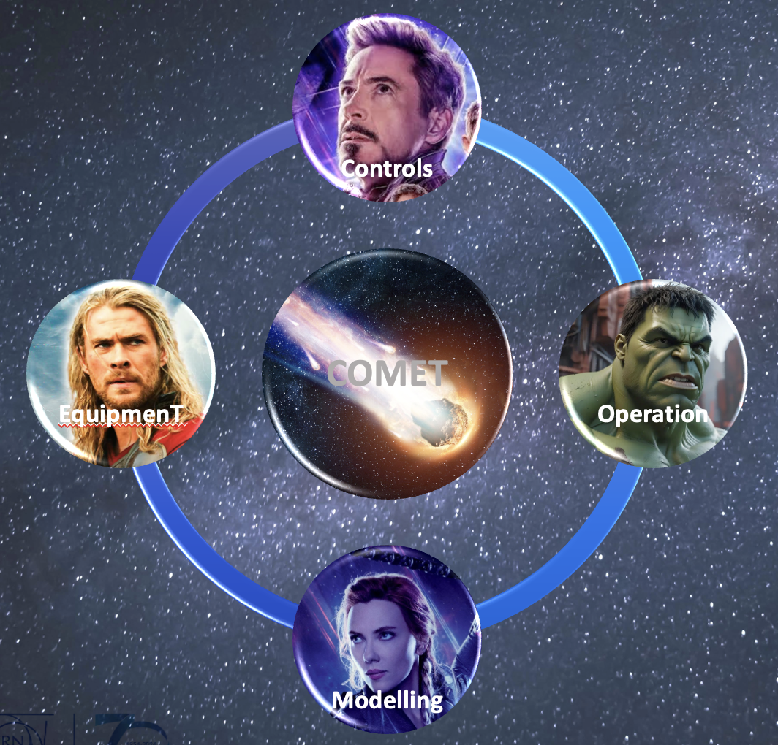
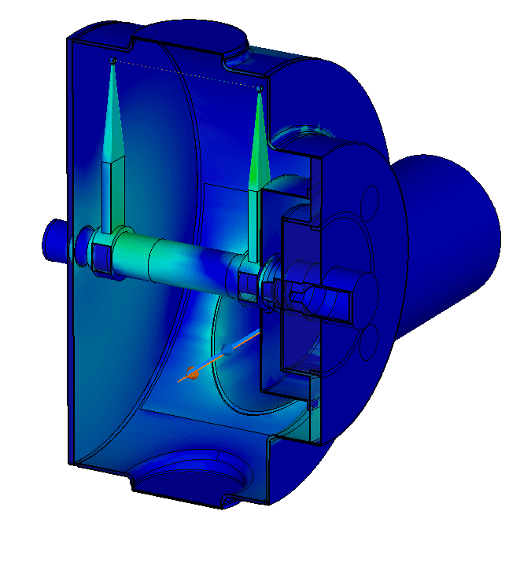
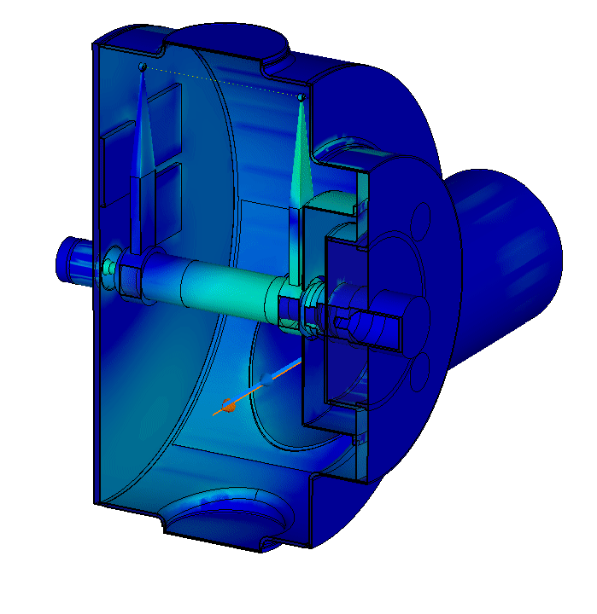
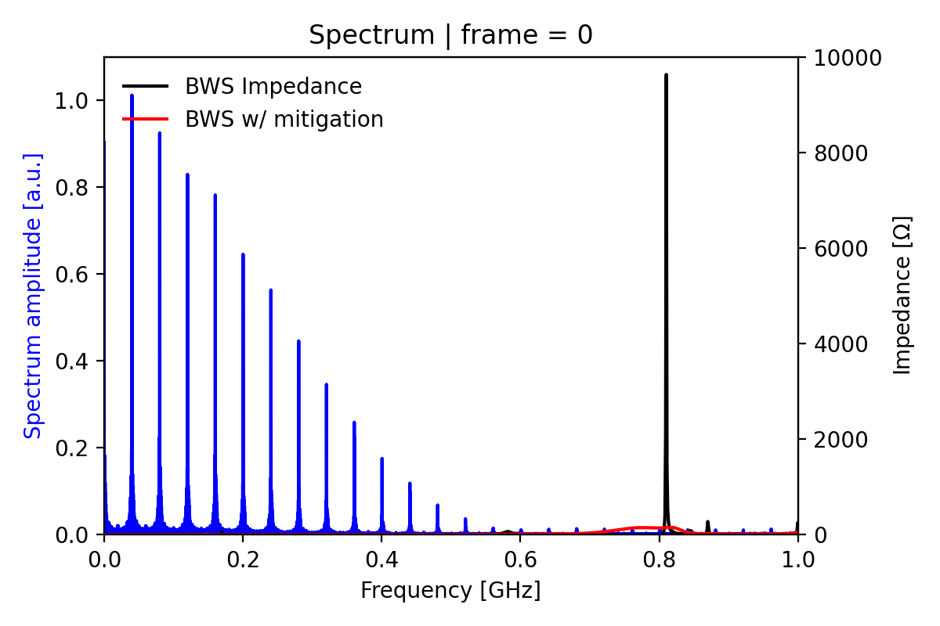
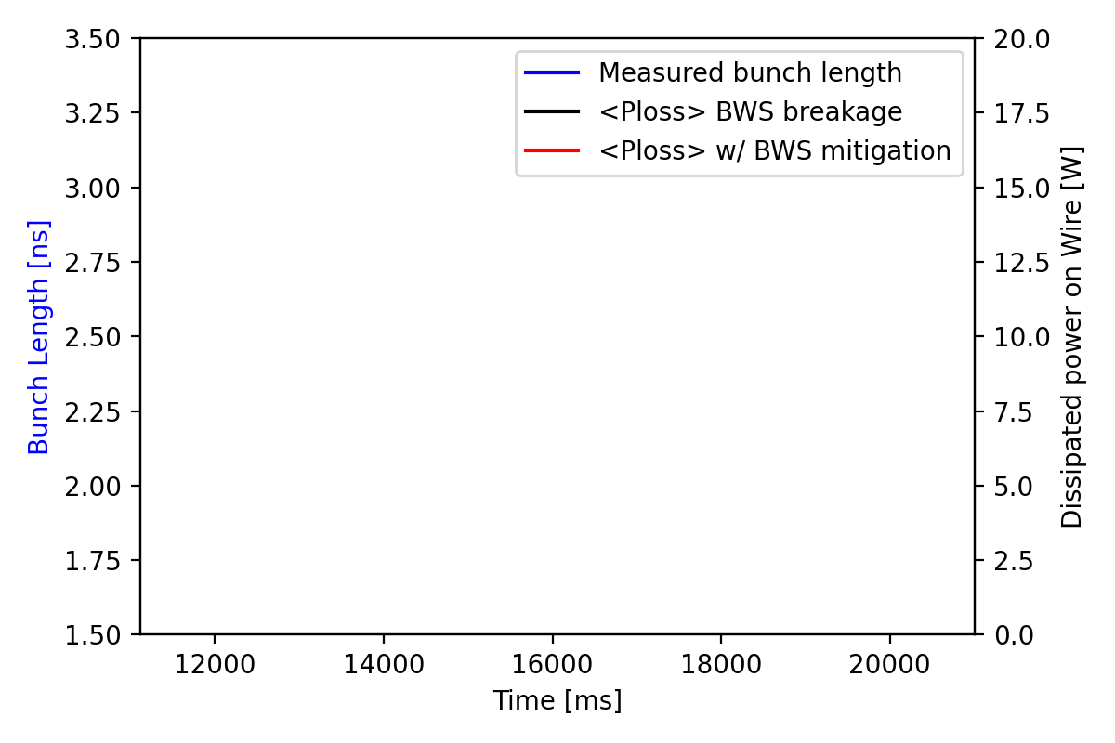
Equipment tamed via modeling – wirescanner impedance
SPS wirescanners:
  Extensive simulation and measurement campaign to understand equipment limitations
  Modeling brought mitigation concept to be applied directly at the source
E. De La Fuente Garcia, L. Sito, et al.
Highlight
In ‘24 no more issues with wirescanners even at full LIU beam parameters

Slide 11
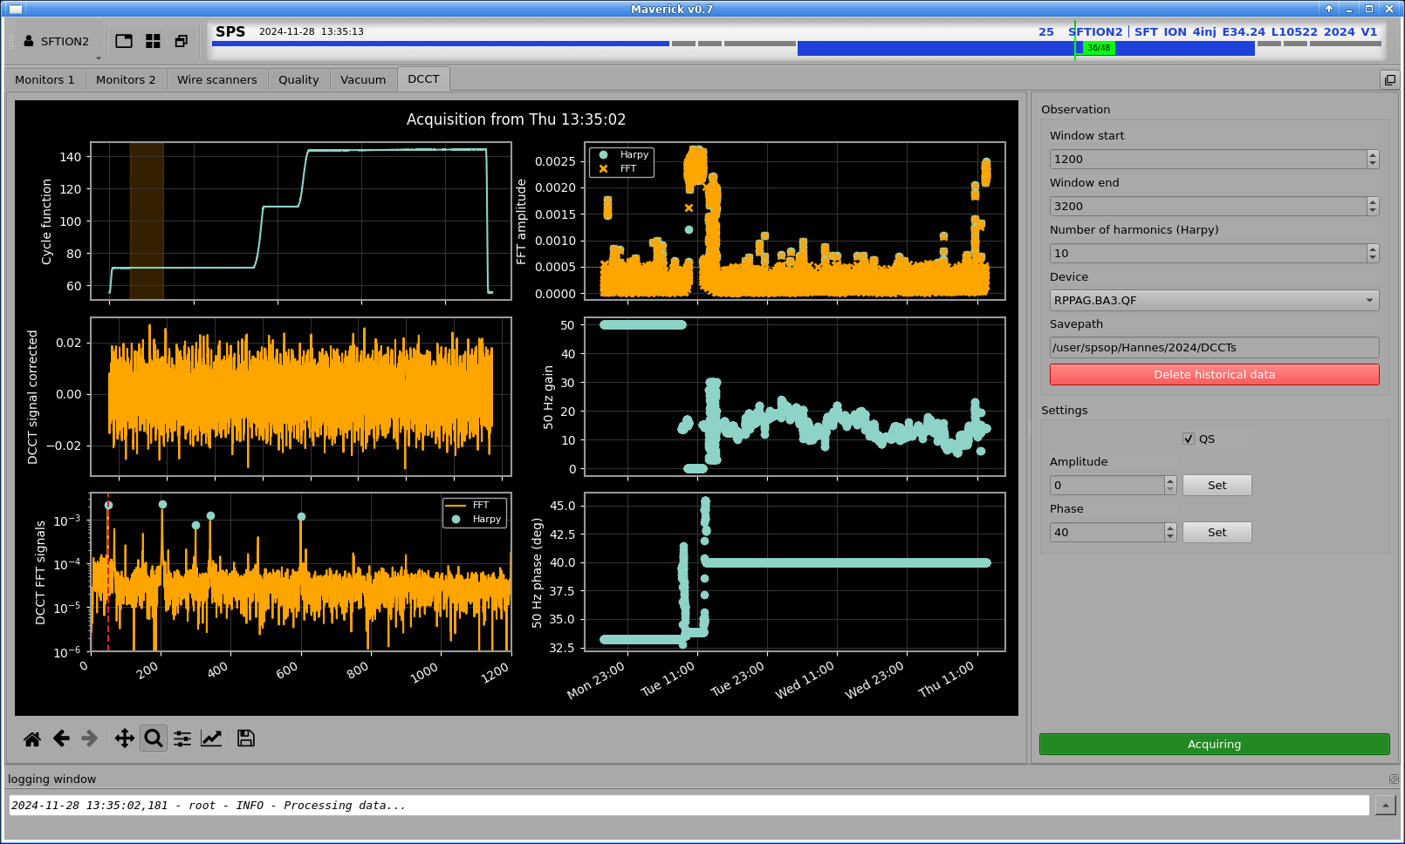
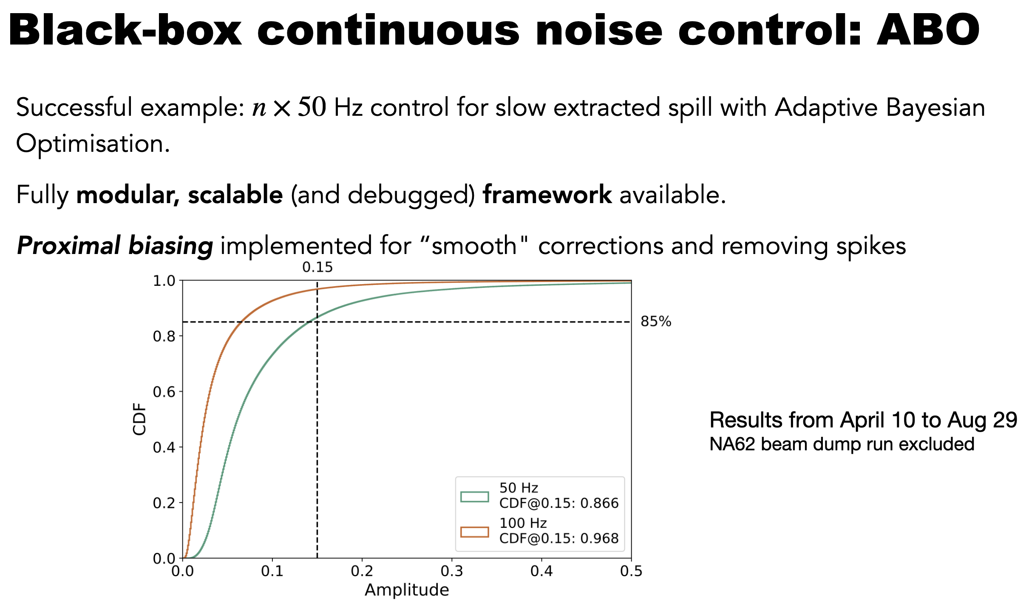
Equipment tamed via control – noise on main PCs
Automatic equipment control:
  TL steering and correction
  LEIR optimizations – A, B, C
  50 Hz correction – controller, great learning curve!
50 Hz correction:
  Further optimization and consolidation of controls framework and infrastructure (algorithms tuning, UCAP nodes, monitoring and integration)
  Explored monitoring and control on QF/QD DCCT as direct observable; can derive gain factor for effective correction based on DCCT signals – to be tested on spill for next year!
Highlight
Consolidated controls and optimization framework and infrastructure
Discovered alternative potential action directly via DCCTs for understanding and correction
V. Kain
Started off with SIMPLEX / BOBYQA
Later moved to RL with ES
Now we are running ABO, possibly in conjunction with PB
Could also explore GP-MPC at some stage…
**
RL: Reinforcement Learning
ES: Extremum Seeking
ABO: Adaptive Bayesian Optimization
PB: Proximal Biasing
GP-MPC: Gaussian Processes Model Predictive Control

Slide 12
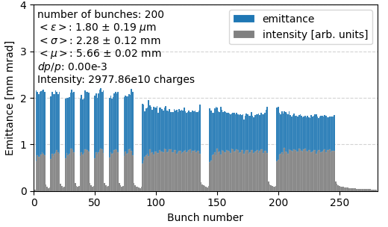
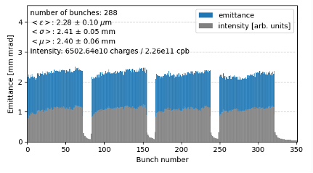
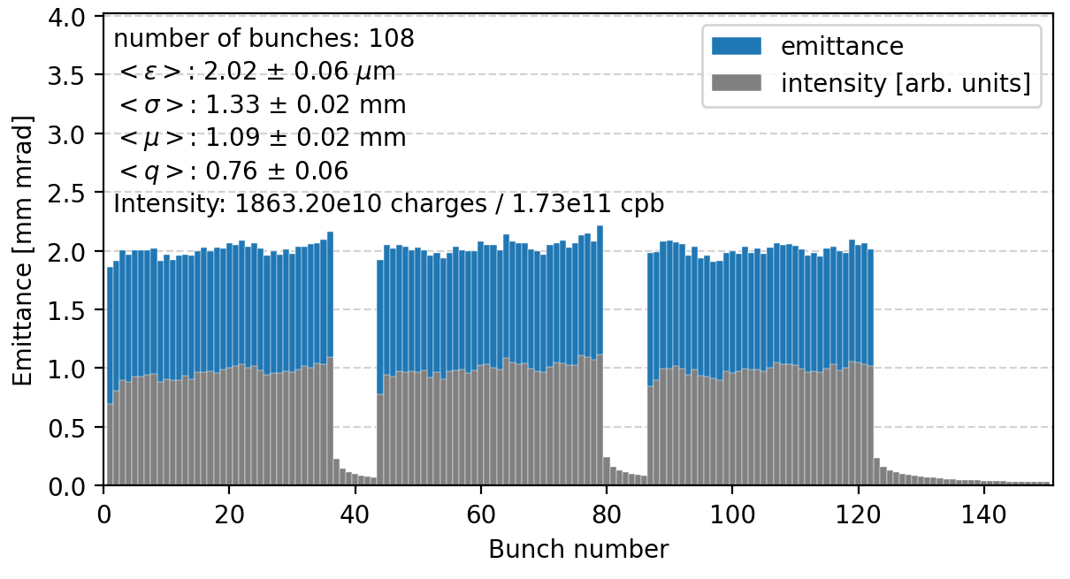
24: LHC proton beam performance
Hybrid complications: different steering, different splitting, disbalance of beam sizes and intensities, tails & scraping,…
Scrubbing and assumptions on the ‘24 cryo performance motivated switching to a much simpler scheme → the 2024 physics production beam has finally converged to be 3 x 36 bunches at 1.6e11 p+ per bunch
Both standard 25 ns as well as the BCMS variant were deployed in operations and for the first time compared back-to-back – several optimizations have been developed and put in place!
Standard 25ns BCMS

Slide 13
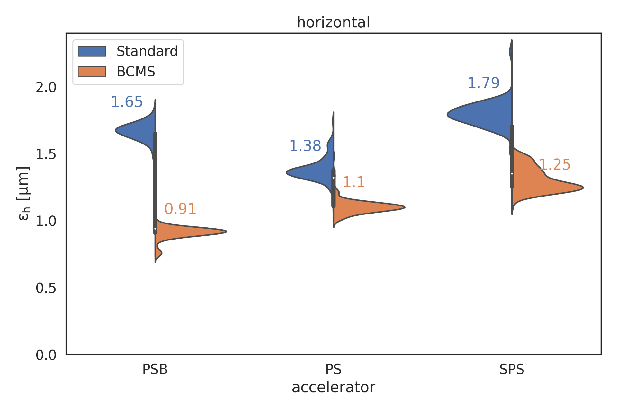
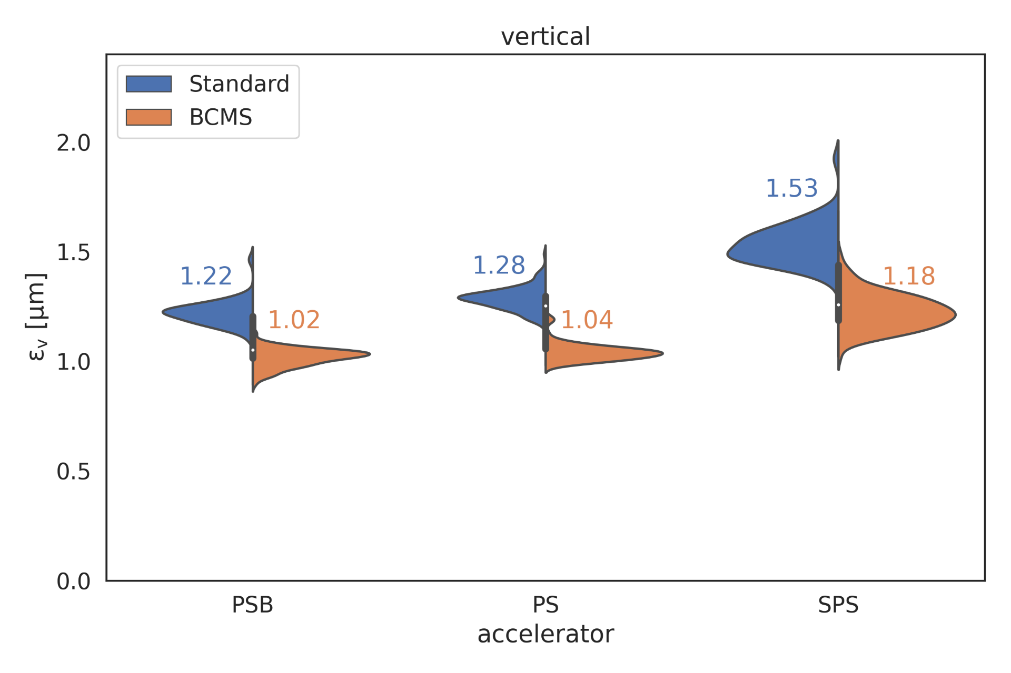
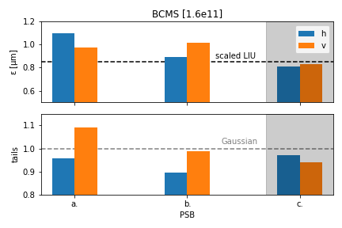
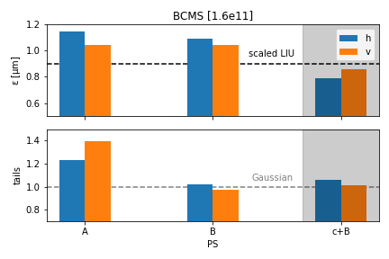
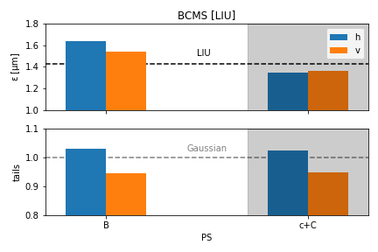
24: LHC &(LIU) proton beam performance: in the pre-injectors
Several optimizations of the operational user, BCMS, in terms of tail content & brightness along the year (Standard beam optimized in 2023)
PSB
  Initial BCMS user in the PSB optimized in terms of working point evolution & resonances (similar to 2022)
  Scraping at low energy introduced to make profiles Gaussian (tails → 1)
  Triple harmonic capture used to further improve brightness: available since August but not pushed to operations→ should become operational in 2025!
PS
  Improvements on working point evolution along the cycle: Intermediate plateau, around transition crossing & flat top
  Adjustments at transition crossing
    Tunes adjusted to avoid coupling
    Chromaticity adjusted for stability
  For LIU:
    Double harmonic transfer from PSB to PS & up to intermediate plateau
    Minor tune adjustments at flat bottom, intermediate plateau & transition crossing to avoid blow-up
LIU-PS
PSB
PS
F. Asvesta

Slide 14
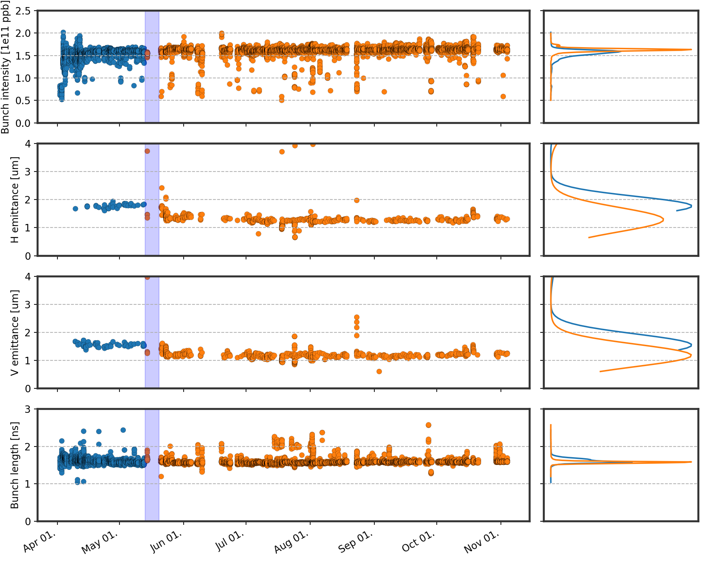

24: LHC proton beam performance
BCMS beam in the SPS on its way to the LHC…
Rock-solid and stable beam delivery along the year – yielding an integrated luminosity of ~ 125 1/fb
Ingredients for success:
  Simple and pragmatic beam setup – 3 x 36 bunches
  Running well below any known beam, equipment or machine limits
  Reduced complexity on steering, splitting, scraping, balancing – compare with hybrid scheme in ‘23!
  Several optimizations put in place across the chain – particular effort went into the BCMS
STANDARD
BCMS
S4: Evolution of beam quality in LHC – S. Kostoglou
Highlight
Regular and reliable delivery of both standard 25 ns and BCMS beams, close to the brightness curves, respectively!

Slide 15
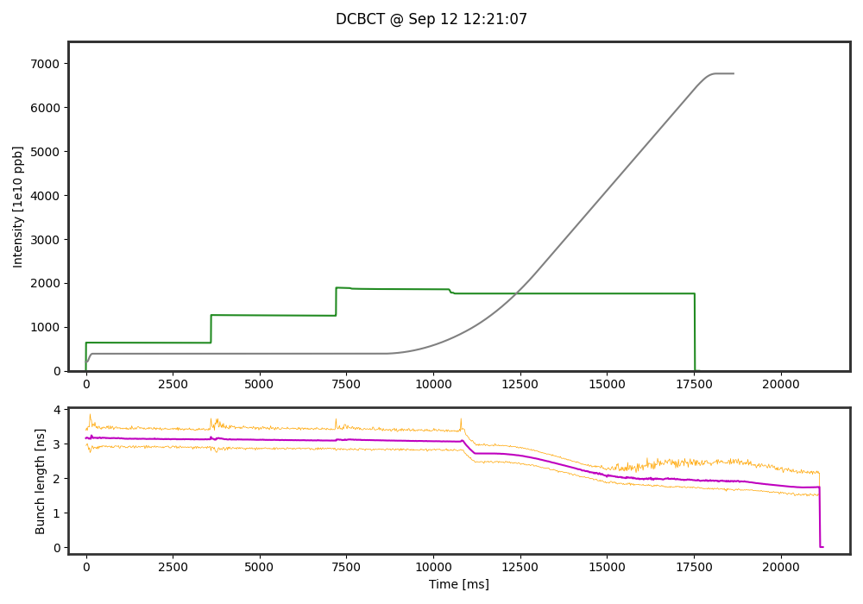
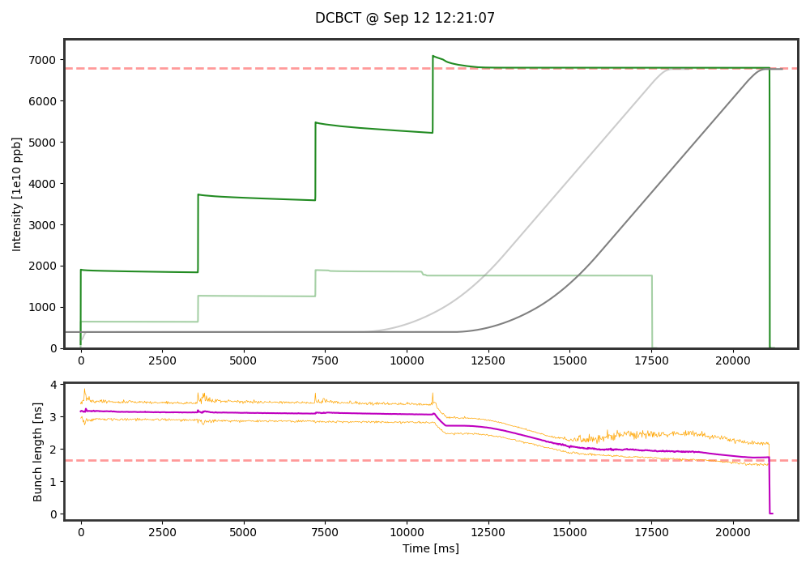
24: LIU beam performance
Operational BCMS beams in ‘24 reliable and reproducibly delivered well within quality specs
LIU beams taken semi-regularly as originally planned, to study reproducibility over a longer period of time
However, LIU beams are a whole different category of beams – still done in the scope of MDs, with full-time experts to study and tune:
  Stability
  Working points
  Beam quality preservation
  Tails optimization and evolution

Slide 16
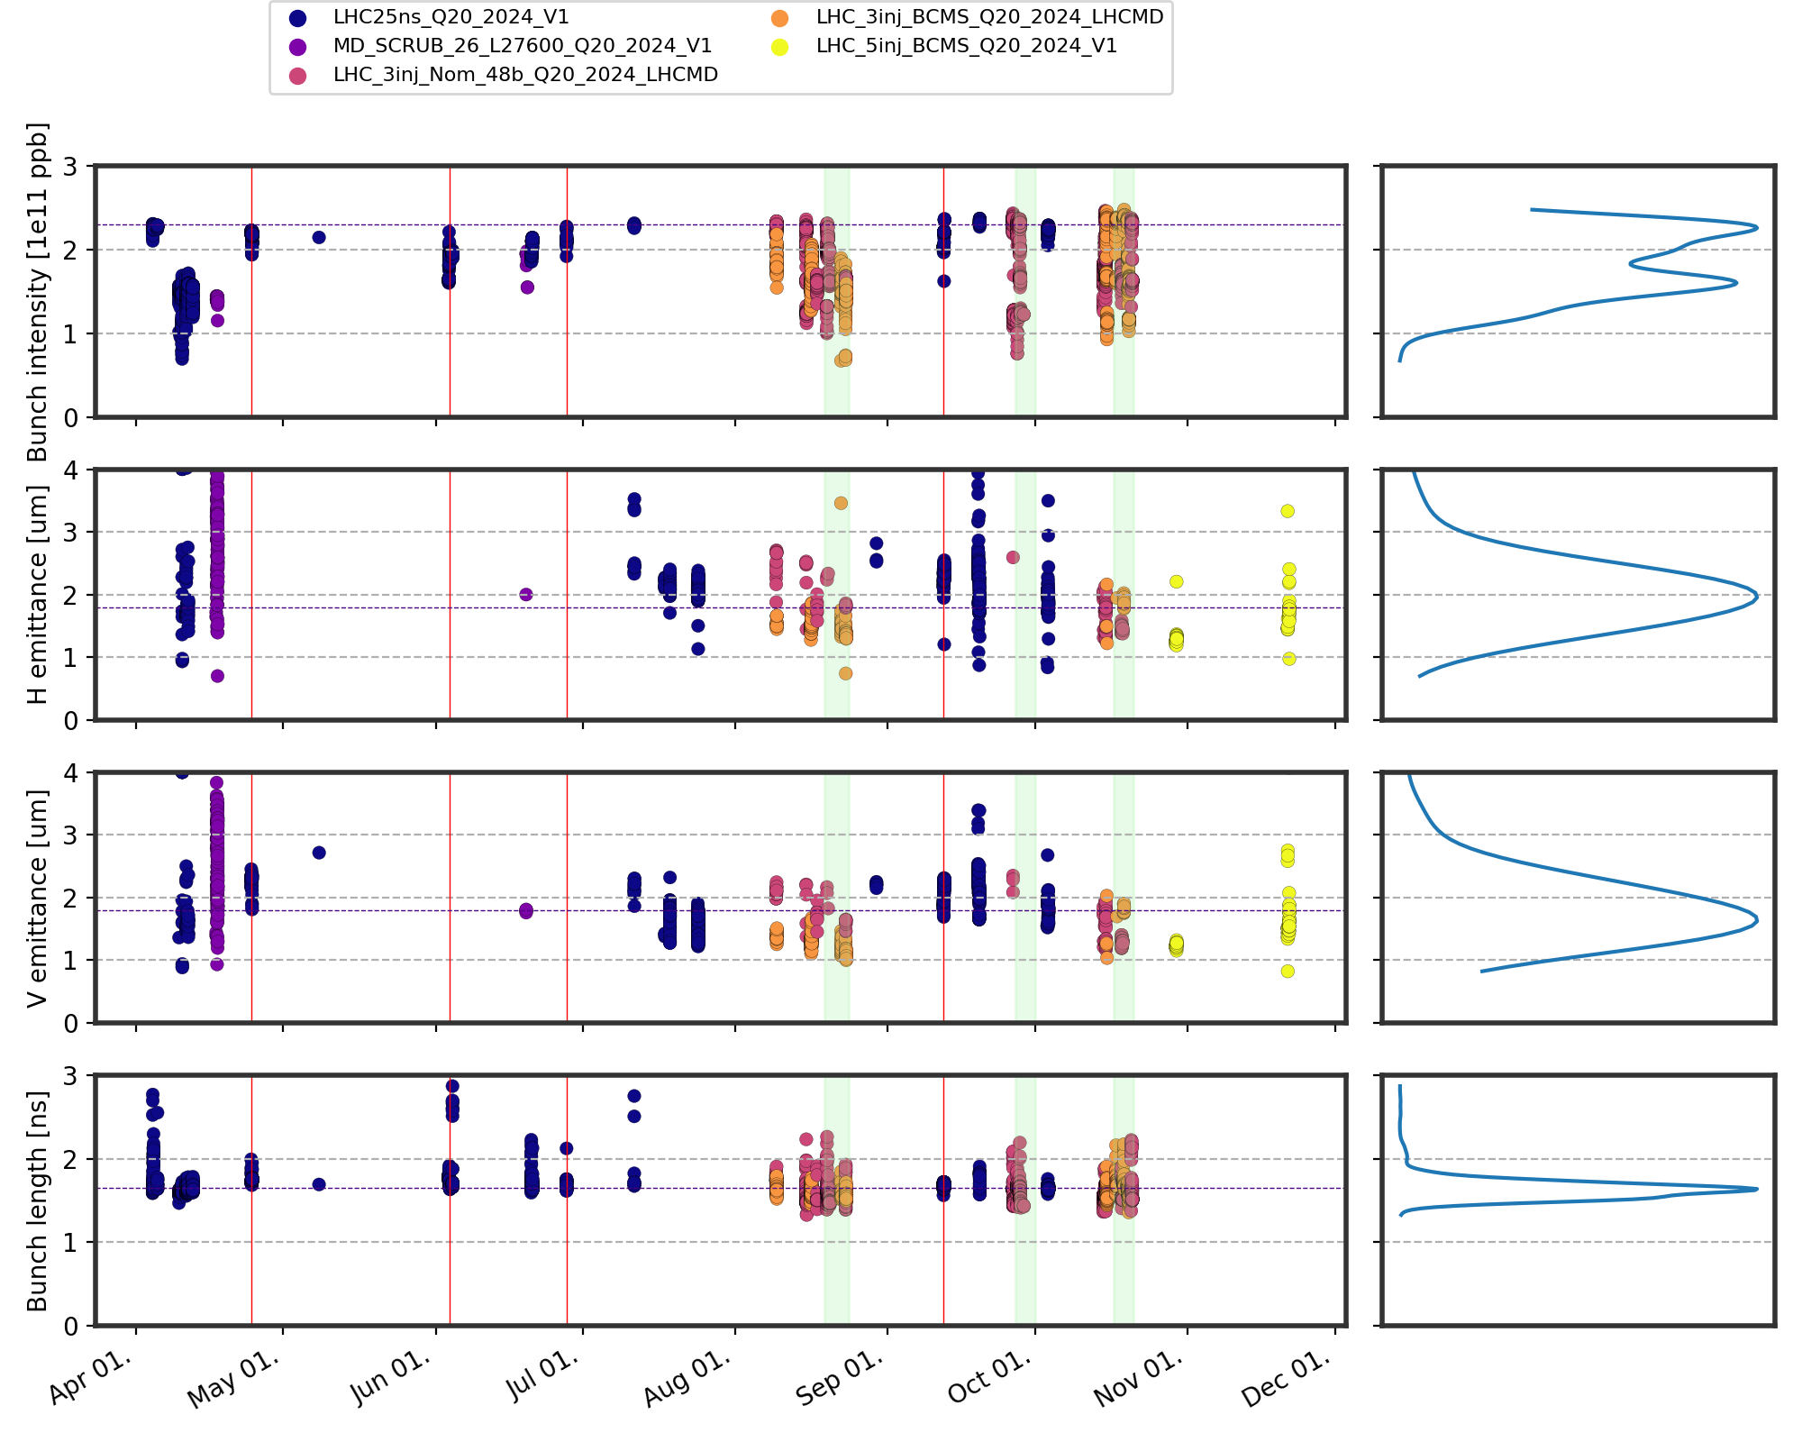
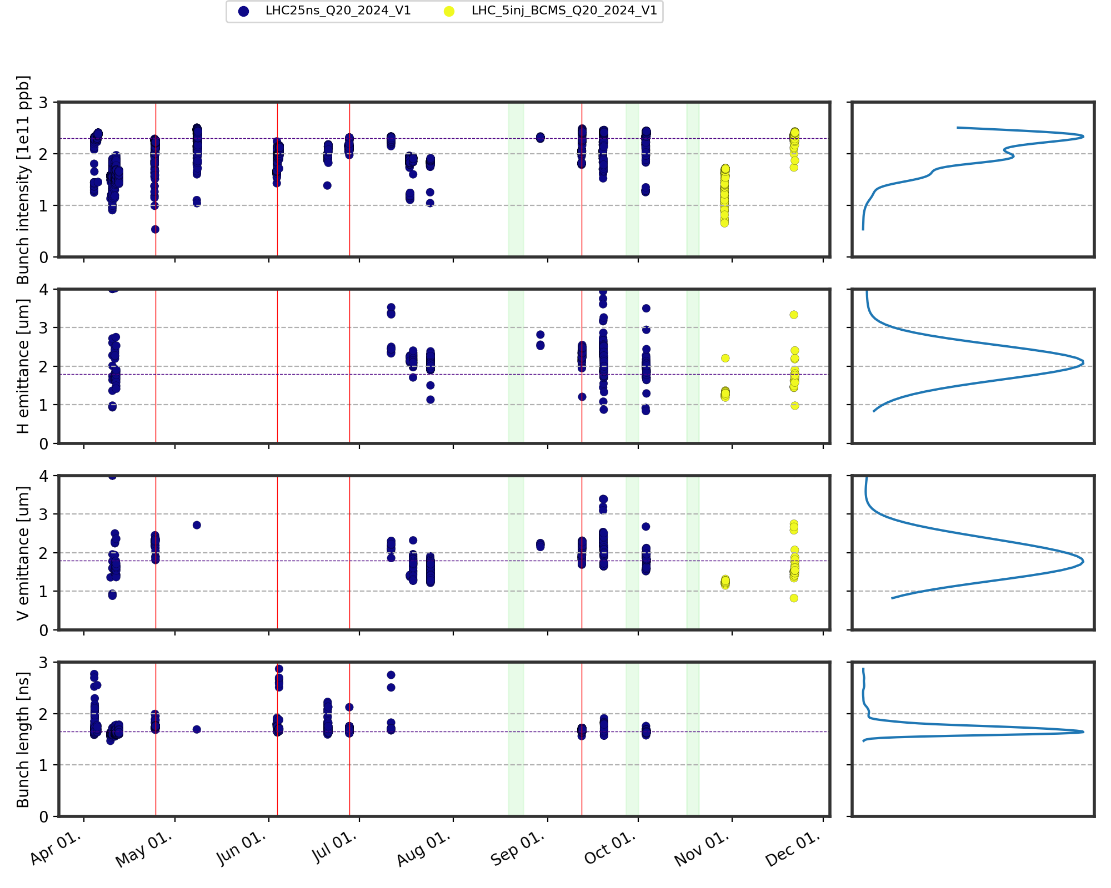
24: LIU beam performance
Operational BCMS beams in ‘24 reliable and reproducibly delivered well within quality specs
LIU beams taken semi-regularly as originally planned, to study reproducibility over a longer period of time
However, LIU beams are a whole different category of beams – still done in the scope of MDs, with full-time experts to study and tune:
  Stability
  Working points
  Beam quality preservation
  Tails optimization and evolution

Slide 17
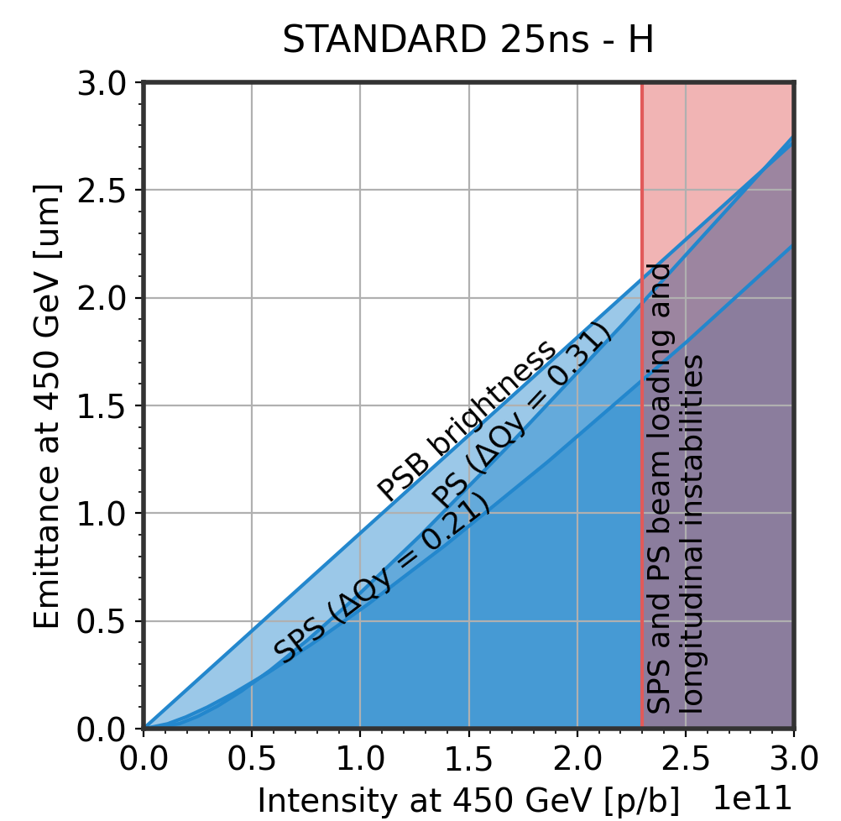
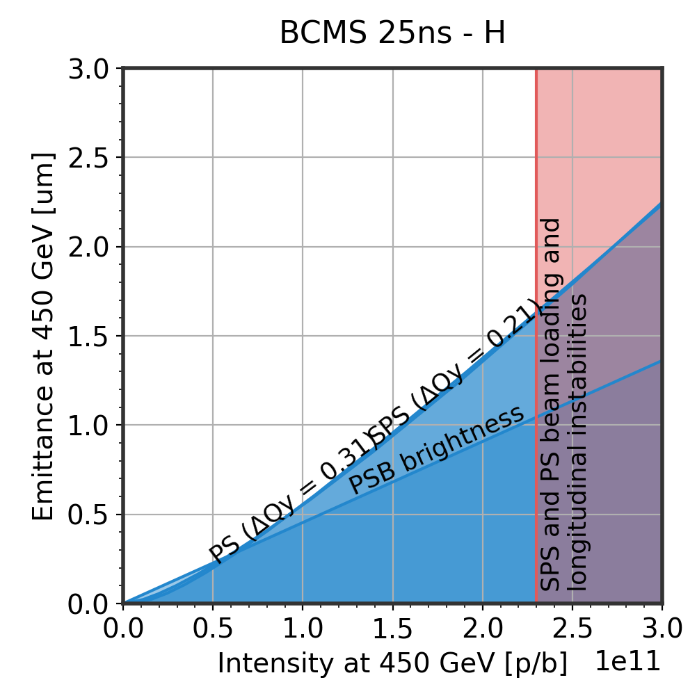
24: LIU beam performance
I_{FB} = 2.4e11; eps_{avg} = 2.25 um
Operational BCMS beams in ‘24 reliable and reproducibly delivered well within quality specs
LIU beams taken semi-regularly as originally planned, to study reproducibility over a longer period of time
However, LIU beams are a whole different category of beams – still done in the scope of MDs, with full-time experts to study and tune:
  Stability
  Working points
  Beam quality preservation
  Tails optimization and evolution
Highlight
Established close-to LIU parameters, repeatedly, with 25 ns standard beam @ 4 x 72 bunches – scrubbing effective!
Established LIU parameters
with BCMS @ 5 x 48 bunches
I_{FB} = 2.45e11; eps_{avg} = 1.66 um

Slide 18
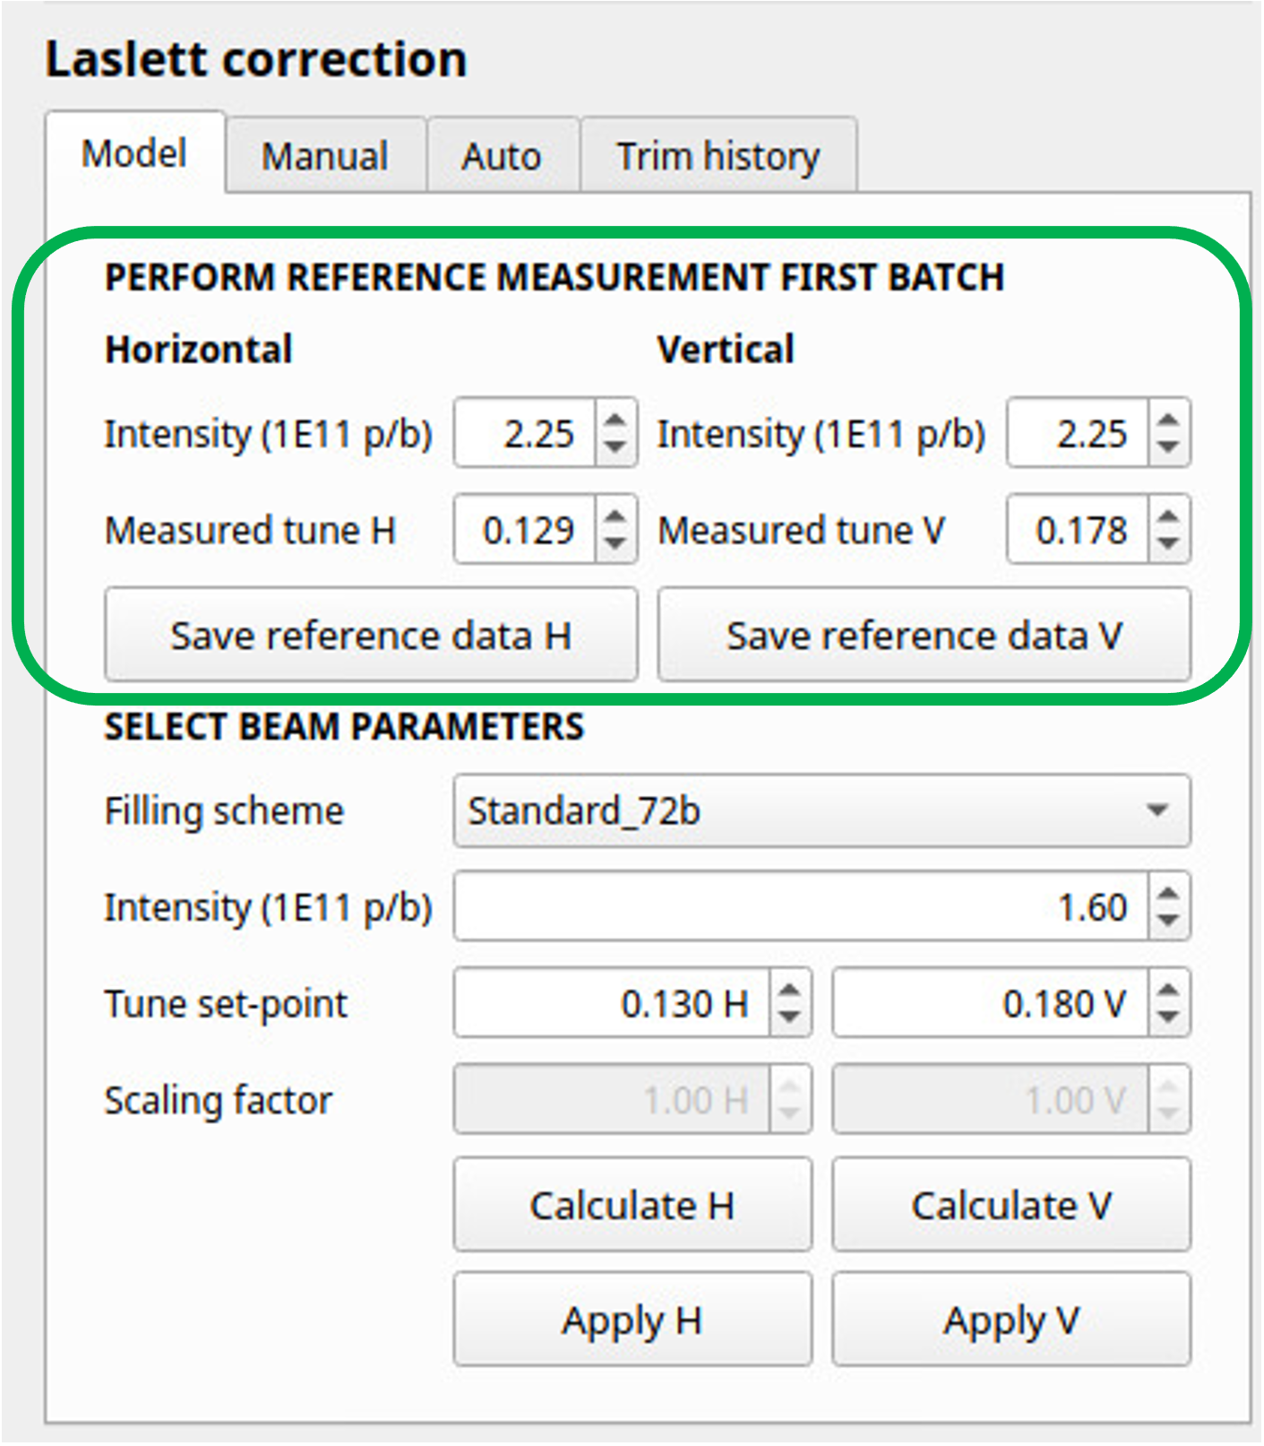
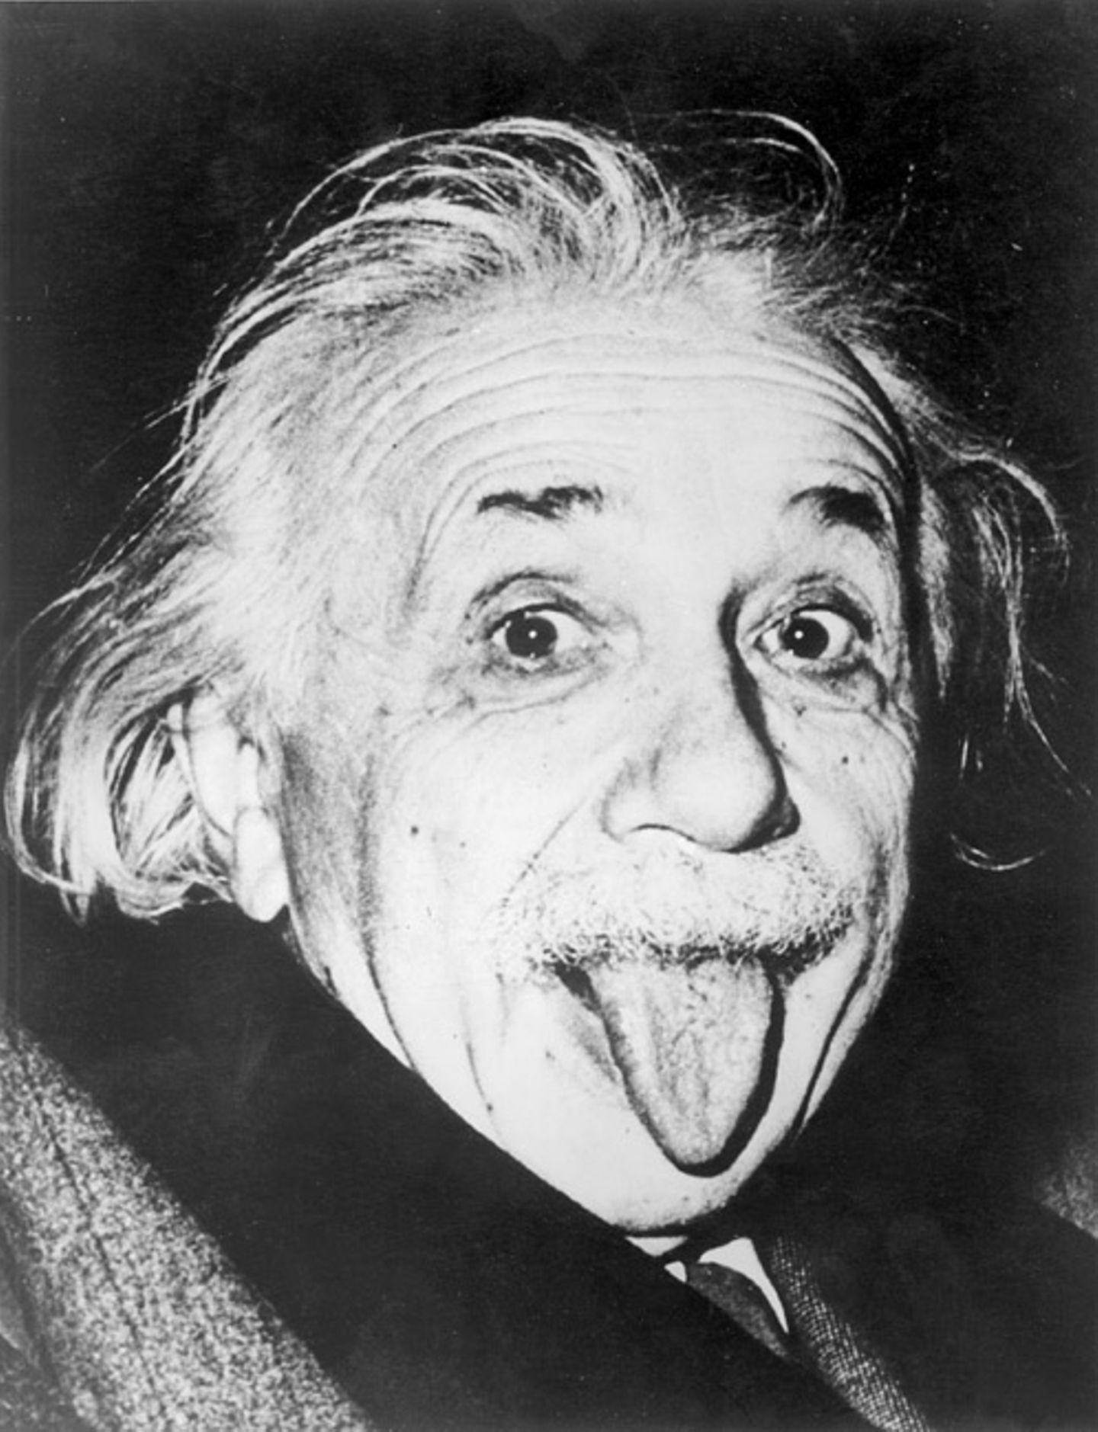
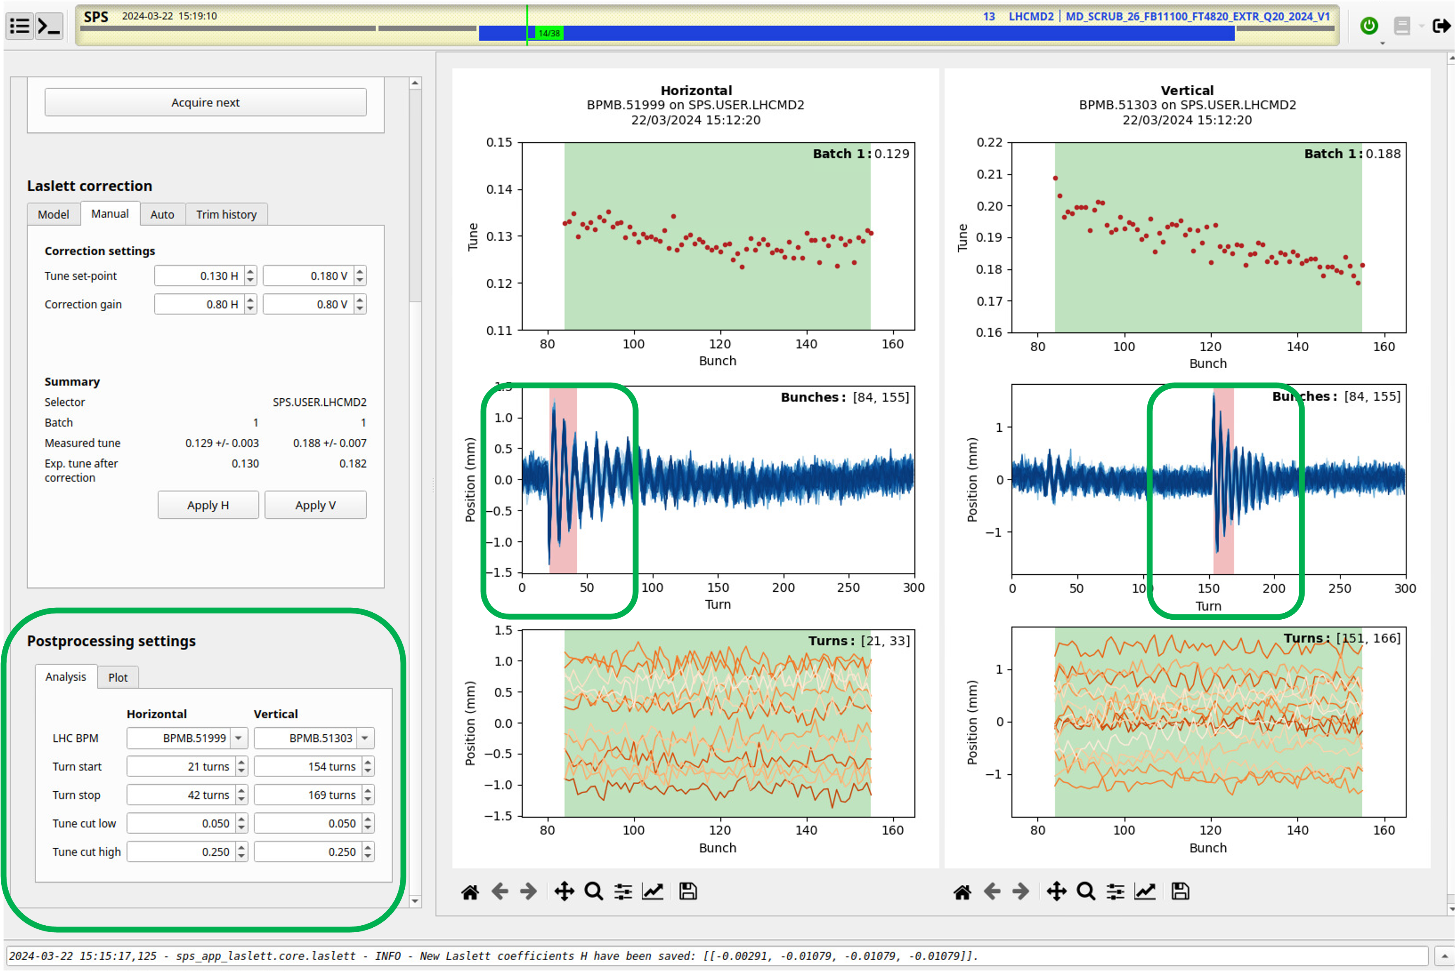


24: LIU beam performance
Correcting the Laslett tune shift in the SPS
Understanding how to reasonably avoid being out-of-policy in Egencia
Einstein’s General Relativity Theory
Have been able to identify further potential week points (i.e., RF coupler) and to consolidate the mitigations that have been put in place (i.e., wirescanners)
Humongous efforts in modeling, measurement and optimization have been made to push the brightness limits in the SPS towards the LIU target
Beam quality from PS is essential (brightness, bunch splitting balance, bunch length at extraction,…)
But not yet solid reproducible… see setting up and tuning, PS splitting,…
We need a reliability run to demonstrate LIU beams are actually operational!
Egencia
Laslett
General Relativity
2
1
3

Slide 19
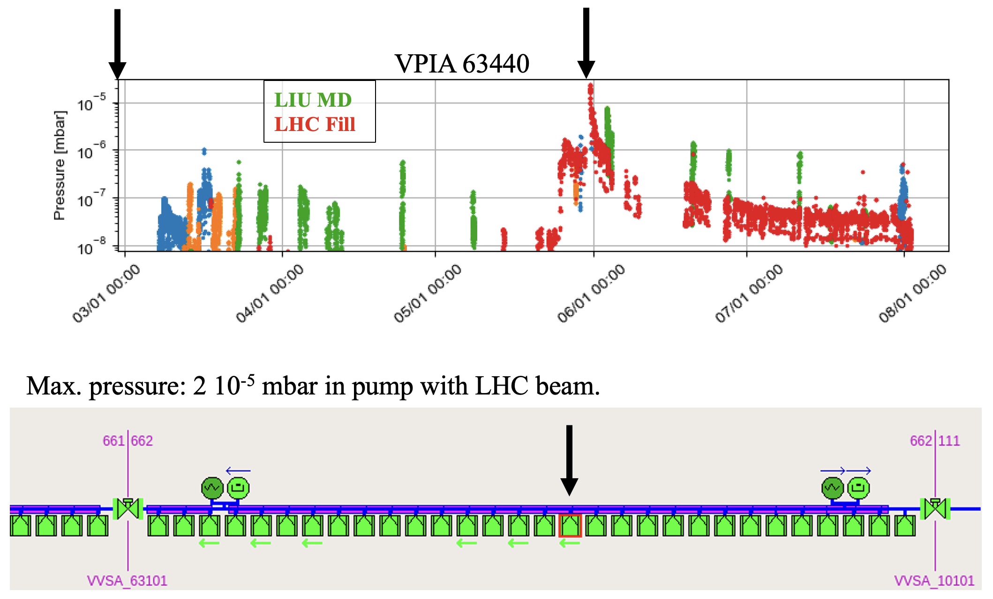
24: LIU beam performance
Beam-induced vacuum pressures after exchange of magnets have not prevented operation of LHC or LIU beams; a-C coating of new magnets + relaxed thresholds (1e-5 mbar) appear sufficient
Pressures could still be larger than 2e-5 mbar if exchanged magnet is closer to valves and/or if beam has a higher intensity; scrubbing would take a few hours if thresholds cannot be relaxed…
Essentially no issues with MKDH, MKDV or MKPs – completed scrubbing of MKDH and MKP-L using the long flat top cycle
Had the chance to test recovery times after opening the machine, thanks to various dipole exchanges and RF interventions!
K. Paraschou
Highlight
Yearly scrubbing does the job with tailored scrubbing strategy!
Demonstrated re-establishing LIU performance after machine opening
‘24 magnet exchanges:
01/03/2024, MBA 61390 (VPIA_61380, VGHB_61340)
  1e-5 mbar in pump and gauge
30/05/2024, MBA 63450 (VPIA_63440)
  2e-5 mbar in pump with LHC beam
10/06/2024, MBB 63530 (VPIA_63520)
  < 1e-6 mbar in pump (both LIU and LHC beams)
17/06/2024, MBA 41050 (VPIA_41040)
  2e-5 mbar with LHC beam, 1e-5 mbar in pump with LIU beam, decreased to 5e-6 mbar in 8 hours
Notes:
Potentially backup

Slide 20
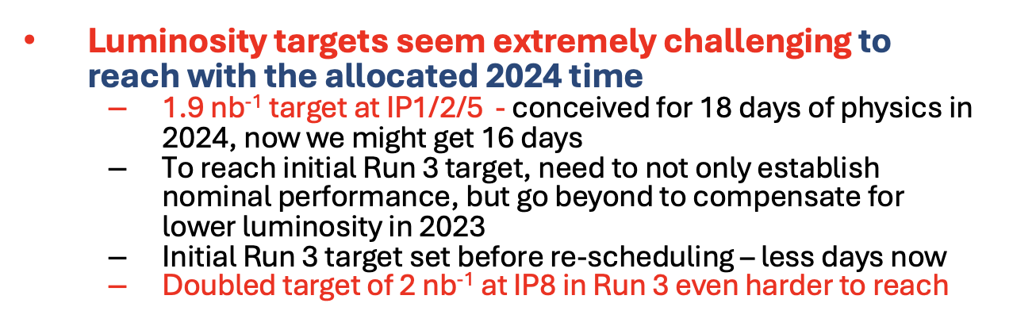
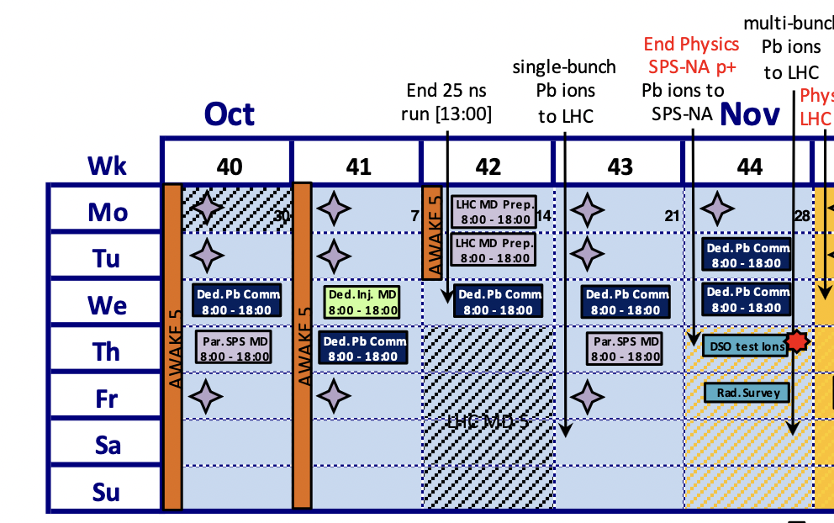
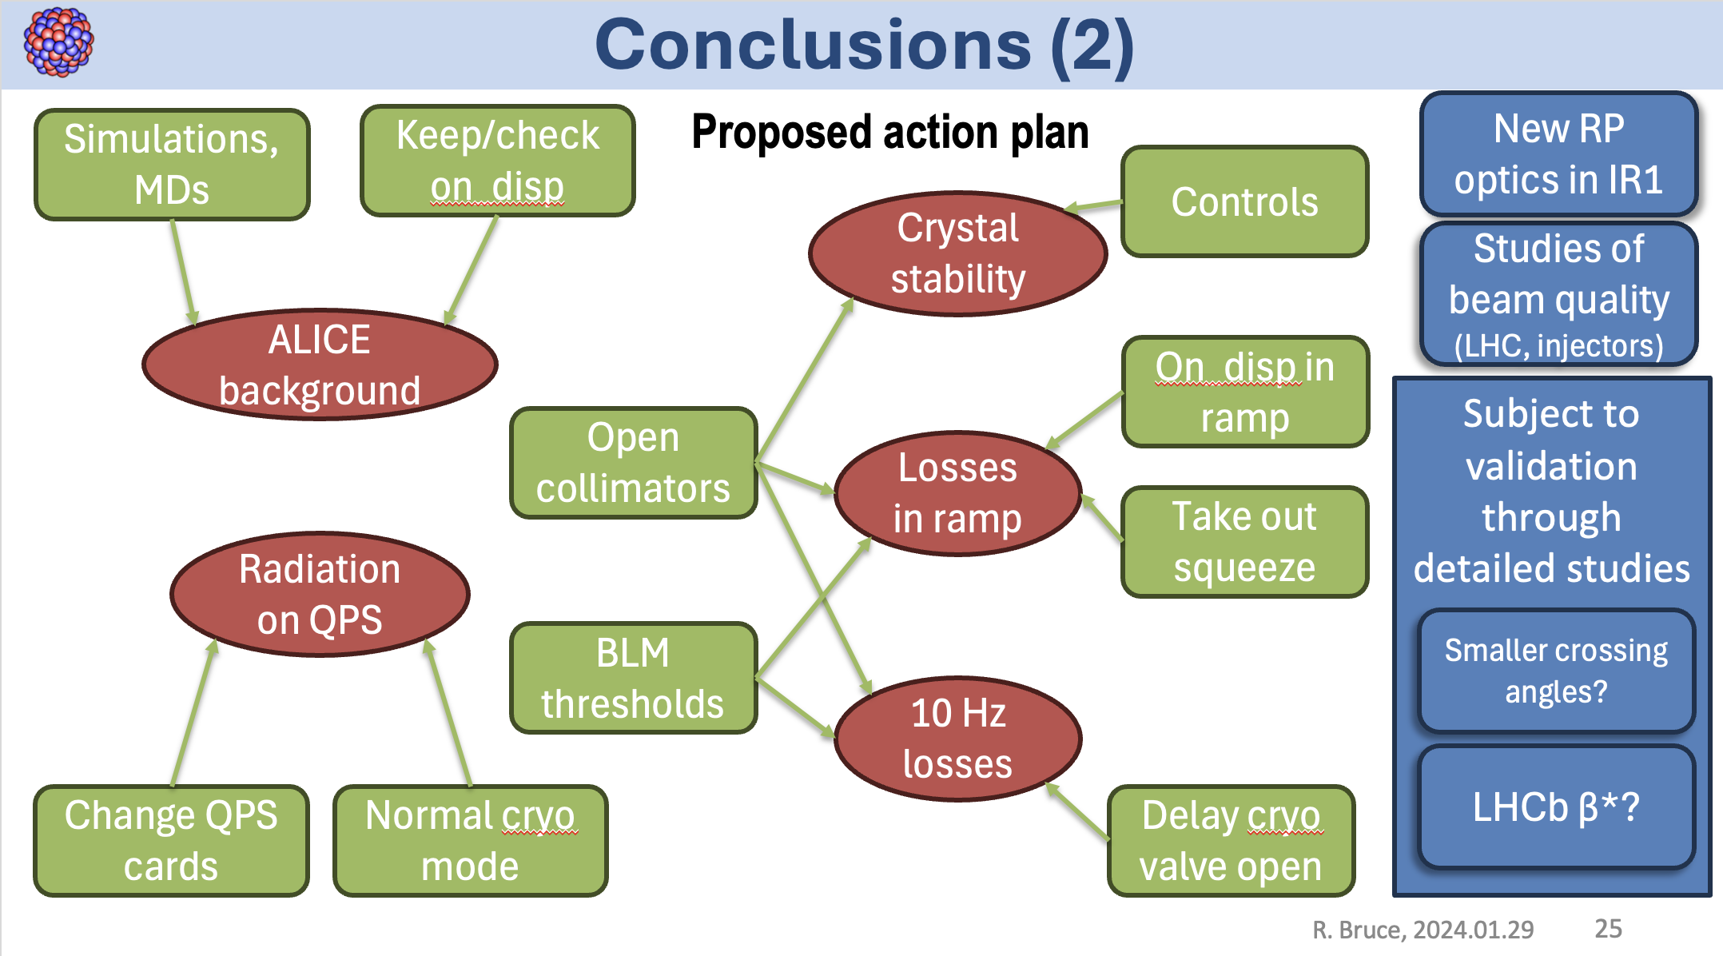
24: LHC ion beam performance
R. Bruce @ Chamonix ‘24
All LHC items tackled…
+ thorough and dedicated work in injectors for beam quality optimization
Notes:
Cut out better! Delpine will speak bout it

Slide 21
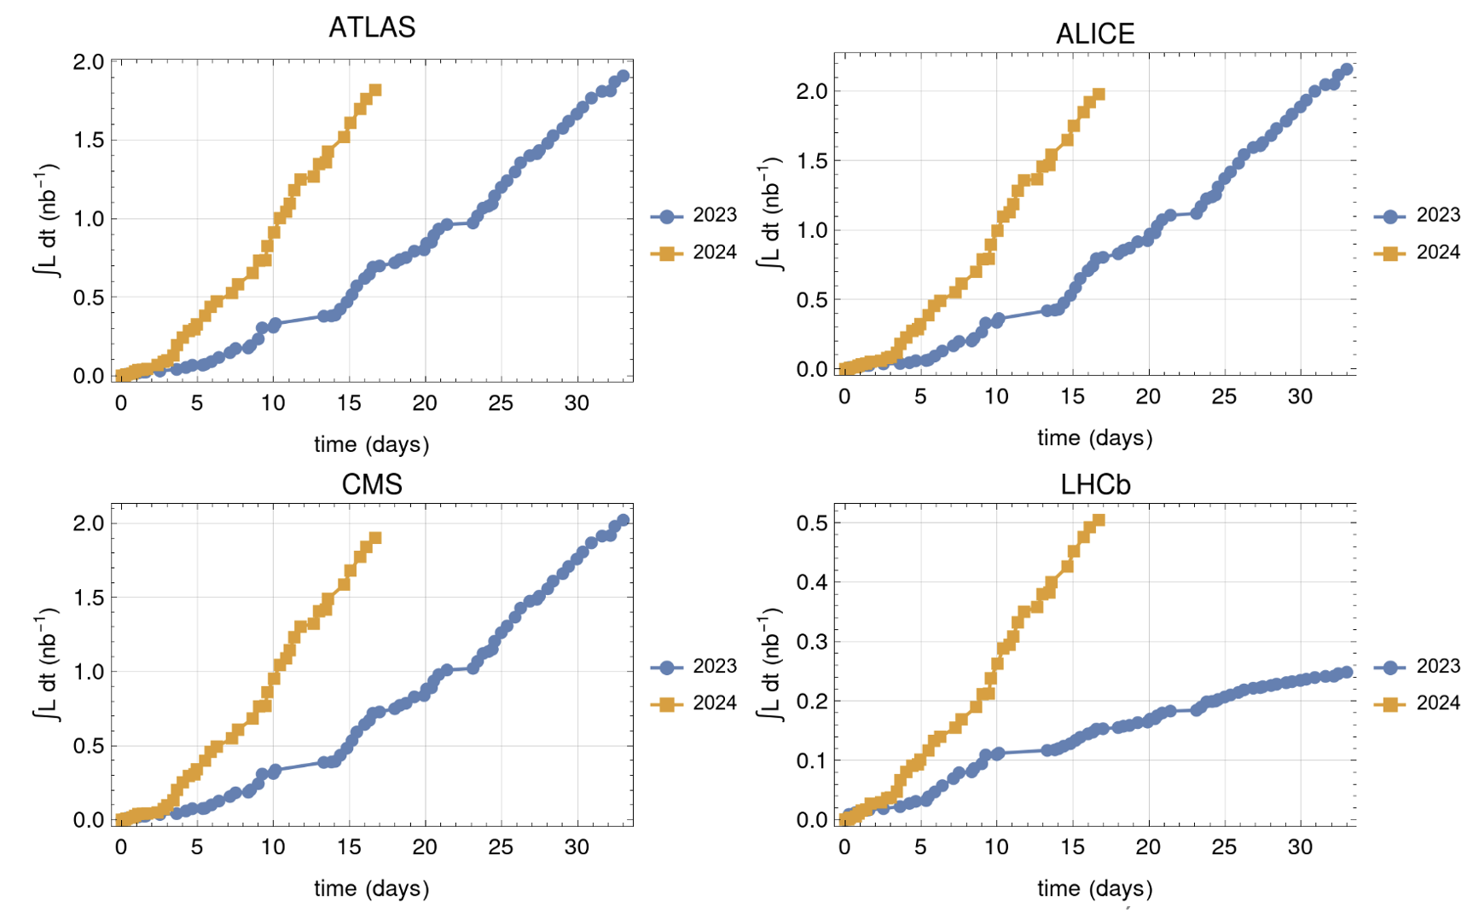
24: LHC ion beam performance
R. Bruce @ Chamonix ‘24
All LHC items tackled…
+ thorough and dedicated work in injectors for beam quality optimization
… resulted in unprecedented intensities – which could actually be handled by the LHC…
… and reaching the ‘impossible’ goal of 1.9 nb-1
R. Bruce
Notes:
Take plots from Roderik

Slide 22
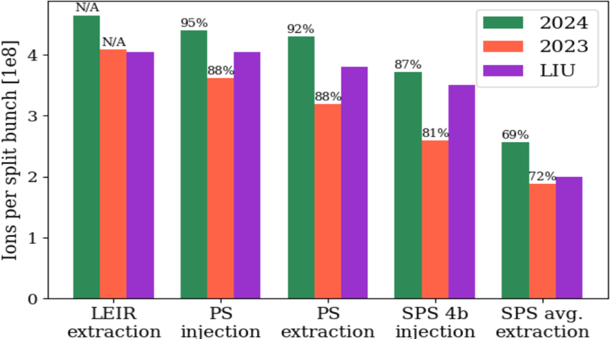
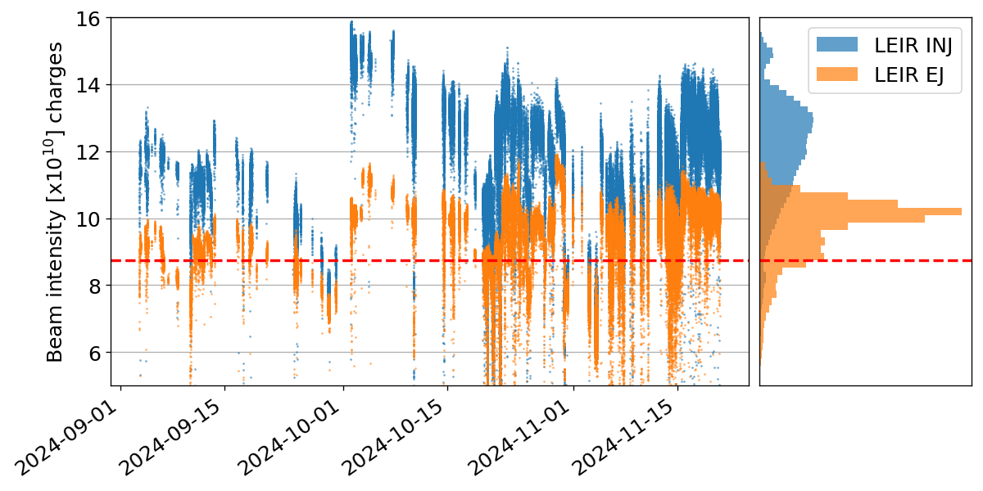
24: LHC ion beam performance
How was it possible?
  Developed LEIR intensities – 8 injections and improved transmission
  Further optimization of slip stacking process, working point optimization, and…
T. Argyropoulos
Notes:
LEIR – PS, 4 basr and have percentages on axes

Slide 23

24: LHC ion beam performance
How was it possible?
  Developed LEIR intensities – 8 injections and improved transmission
  Further optimization of slip stacking process, working point optimization, and…
  … 50 Hz compensation – improved transmission by almost 20%!
Record intensities, well beyond LIU target
Highlight
Fixed all the shortcomings from 2023 and outperformed LIU target:
LEIR by ~17%
SPS by ~40 %
LHC by ~30% @ LHC injection
S4: Ions: overview and outlook across the complex
M. Slupecki

Slide 24


24: FT beams performance
Continued pushing FT beams performance across the complex! Several records and consolidation achieved!
Isolde
  For >50% of experiments yield is much higher at 2 GeV, which will be the preferred extraction energy when available after upgrades
  Typically running with 800e10 p/ring (3200e10 p/pulse)
  Limits encountered around 1250e10 p/ring (5000e10 p/pulse)
    Cavity protection interlocks; limits to be investigated in the coming years; assessment also to be done for 2 GeV
    Unmatched kicker termination still reactivates – also when pushing towards 2 GeV
    High intensity test run imaginable for next year?
  1.6e13 p/ring demonstrated after LS2 with <2% losses in PSB (requires 100-140 turns injected depending on Linac4 current) and masked cavity interlocks
HRS
GPS
S. Rothe
F. Asvesta

Slide 25


24: FT beams performance
Continued pushing FT beams performance across the complex! Several records and consolidation achieved!
nTOF – high-flux with highest PoT ever within a year:
  Intensity increase on the dedicated cycles – loss reduction was prerequisite
    Usually running at 850E10 p/bunch, target limited at 1000E10 p / bunch
    Tested up to 1010E10 p/bunch with some additional losses especially at transition
  Intensity increase on the parasitic bunches with 44 ns
    High-intensity parasitic bunch required reworking of the EAST cycle – BIGTOF established at 800E10 p/bunch
    Some margin to operate reliably somewhat above 350e10 p/pulse, exact figure to be established
A. Huschauer

Slide 26



24: FT beams performance
Continued pushing FT beams performance across the complex! Several records and consolidation achieved!
SFTPRO:
  Transfer functions:
    New TFs for QTL, QNL and QTA make up for the main difference to the model observed in TT20 in 2021
    Propagate change into operation next year during commissioning
  FT Laslett:
    Extensive intensity scans done in 2024 for a new FF-Laslett correction
    Promising results and the potential to significantly simplify setting up of HI FT beams in the future!
  Empty Bucket Channeling + noise control
    EBC put into operation in 2024! Important impact seen on 100 Hz; noise controllers further developed
Fixed target beams and challenges for the future
P. Arrutia

Slide 27



Equipment automation
Automatic equipment control:
  LEIR optimizations
  TL steering and correction
  50 Hz correction – controller
Automatic equipment monitoring:
  Notification, resets, i.e., SPS cavity resets (not ready in ‘24 – still evaluating potential)
  PS cavities, undirected warning via acoustic signals, but not yet used routinely in operations…
Automatic equipment commissioning:
  Test sequences, status reports
“Cavity 6 – overdrive protection!”
– potentially intelligent equipment still perceived with a certain level of anxiety
Notes:
Get rid of session structure…

Slide 28


Process automation
Auto-pilots in YASP for symmetry and sharing
Automatic splitting control:
  Double splitting basically ready
  Triple splitting more challenging
  MTE splitting efficiency – improved understanding of parameter space; nice example of controller guided model insight
Automatic TL steering
Latest projects:
  Automatic LHC filling
  Sequencer v2
  …
M. Schenk
S7: Results and plans for integration of
automation and optimization in operation – G. Trad

Slide 29
Summary and conclusions
2024 for the accelerator complex a marvelous year
Record-breaking results and achievements on various fronts
LIU beams – knocking on the door
LHC beams – pushing performance with optimized BCSM beams
LHC ions – novel optimization techniques, unprecedented intensities
FT beams – intensity and proton delivery records
Cross-discipline collaboration makes the unimaginable happen
Wire scanner resilience renovation
50 Hz noise cancellation
Kicker conditioning
Surpassing the challenging goals for luminosity
Aligning towards the future with several visionary initiatives across the sector
All integrated simulation suites
Distributed machine learning frameworks
Global cross-accelerators initiatives for enhanced performance

Slide 31


24: LHC ion beam performance
How was it possible?
  Developed LEIR intensities
  Further optimization of slip stacking process, working point optimization, and…
  … 50 Hz compensation!
Record intensities, well beyond LIU target
Highlight
Fixed all the shortcomings from 2023 and outperformed LIU target:
LEIR by ~17%
SPS by ~40 %
LHC by ~30% @ LHC injection
S4: Ions: overview and outlook across the complex
M. Slupecki

Slide 32


24: LHC proton beam performance
Hybrid complications: different steering, different splitting, disbalance of beam sizes and intensities, tails & scraping,…
Scrubbing and assumptions on the ‘24 cryo performance motivated switching to a much simpler scheme → the 2024 physics production beam has finally converged to be 3 x 36 bunches at 1.6e11 p+ per bunch
Both standard 25 ns as well as the BCMS variant were deployed in operations and for the first time compared back-to-back – several optimizations have been developed and put in place!
2023
2024
No more issues with
scraper in ’24
→ boost in injection
efficiency!

Slide 33



24: LHC proton beam performance
BCMS beam in the SPS on its way to the LHC…
Rock-solid and stable beam delivery along the year – yielding an integrated luminosity of ~ 125 1/fb
Ingredients for success:
  Simple and pragmatic beam setup – 3 x 36 bunches
  Running well below any known beam, equipment or machine limits
  Reduced complexity on steering, splitting, scraping, balancing – compare with hybrid scheme in ‘23!
  Several optimizations put in place across the chain – particular effort went into the BCMS

Slide 34


24: LHC proton beam performance
BCMS beam in the SPS on its way to the LHC…
Rock-solid and stable beam delivery along the year – yielding an integrated luminosity of ~ 125 1/fb
Ingredients for success:
  Simple and pragmatic beam setup – 3 x 36 bunches
  Running well below any known beam, equipment or machine limits
  Reduced complexity on steering, splitting, scraping, balancing – compare with hybrid scheme in ‘23!
  Several optimizations put in place across the chain – particular effort went into the BCMS
S4: Evolution of beam quality in LHC – S. Kostoglou
Highlight
Regular and reliable delivery of both standard 25 ns and BCMS beams, close to the brightness curves, respectively!

Slide 35


24: LHC proton beam performance
Hybrid complications: different steering, different splitting, disbalance of beam sizes and intensities, tails & scraping,…
Scrubbing and assumptions on the ‘24 cryo performance motivated switching to a much simpler scheme → the 2024 physics production beam has finally converged to be 3 x 36 bunches at 1.6e11 p+ per bunch
Both standard 25 ns as well as the BCMS variant were deployed in operations and for the first time compared back-to-back – several optimizations have been developed and put in place!

Slide 36

24: LHC proton beam performance
Luminosity gain estimated from moving to BCMS: +8.2% + operational efficiency → stayed with the BCMS beam for remainder of 2024!
S4: Evolution of beam quality in LHC – S. Kostoglou
S. Kostoglou
Notes:
Remove this one

Slide 37

24: LIU beam performance
I_{inj} = 2.4e11; eps_{avg} = 2.25 um
Operational BCMS beams in ‘24 reliable and reproducibly delivered well within quality specs
LIU beams taken semi-regularly as originally planned, to study reproducibility over a longer period of time
However, LIU beams are a whole different category of beams – still done in the scope of MDs, with full-time experts to study and tune:
  Stability
  Working points
  Beam quality preservation
  Tails optimization and evolution
Highlight
I_{FB} = 2.45e11; eps_{avg} = 1.66 um

Slide 38
24: LHC ion beam performance
How was it possible?
  Developed LEIR intensities
  Further optimization of slip stacking process, working point optimization, and…
  … 50 Hz compensation!
+17.8%!
H. Bartosik

Slide 39

‘24 critical equipment events
SPS transformers:
  Fire due to fault in LV windings – report in IEFC
Spares strategy in place

Slide 40


‘24 critical equipment events
SPS transformers:
  Fire due to fault in LV windings – report in IEFC
SPS dipoles:
  4 failures → 4 sparkling new dipoles in the SPS tunnel; followed up and treated in the SPS MPC
Spares strategy in place
Spares strategy in place

Slide 41



‘24 critical equipment events
SPS transformers:
  Fire due to fault in LV windings – report in IEFC
SPS dipoles:
  4 failures → 4 sparkling new dipoles in the SPS tunnel; followed up and treated in the SPS MPC
BA3 water cooling circuit:
  Ruptured membrane of the non-return valve → collaborative EQ-OP cleaning campaign
Spares strategy in place
Spares strategy in place
Replacement during YETS

Slide 42

S2: equipment wielded by operations
The equipment is the backbone of the accelerator complex, operations is its executing engine
  Functional, operable and reliable equipment translates directly to beam delivery and luminosity – monitored by AFT
  Equipment and operations collaboration is crucial for maximizing efficiency and harvesting the technological potential contained within – requires careful monitoring of equipment performance and roadmap for consolidation
  Collection of some of the most critical equipment events across the accelerator complex in 2024…
S2: Fault tracking in 2024, analysis of input from groups
J. Heron

Slide 43

S3: equipment tamed via modeling
In a more direct approach, we can try actively modeling the equipment behavior, thus taming the equipment via actual understanding – some examples:
  Beam to equipment interactions: beam losses, electron cloud and heat loads, impedance and beam induced heating
  Equipment to beam interactions: beam dynamics, electron cloud, impedance and instabilities, magnetic modeling and optics, losses and loss profiles

Slide 44

S4: modeling impacts on operations
Integrating modeling knowledge into operation & adding augmented controls and equipment yield unprecedented performance:
  Importance of implementing modeling results into operations – beam centered
    Fixed target beams
    LHC beams
    Ion beams
  Importance of implementing modeling results into operations – scenario centered
    Operational scenarios
    Collimation
    Optics
  Under engagement of controls and equipment

Slide 45

S5: modeling and controls united
Where modeling is still too complex, or the inclusion of all details becomes too cumbersome, we can in turn exploit controls to provide an empirical and pragmatically abstracted version of a model derived from controls!
  Model or Monte-Carlo based: abstraction via advanced simulation concepts, frameworks and tools
  Data-based: training and applying learned models for boosted simulation speed
  Data-based: training and applying learned models for enhanced control
  Big-data controls infrastructure for large-scale data analytics
Beam physics/simulation software evolution:
challenges, opportunities – S. Lopaciuk
Surrogate models
F. Velotti
Hysteresis modeling: experience from SPS
and prospects for other machines – A. Lu

Slide 46

S6: equipment with some extra control
Automatic equipment control:
  TL steering and correction
  50 Hz correction – controller
  LEIR optimizations – A, B, C
Automatic equipment monitoring:
  Notification, resets, i.e., SPS cavity resets (not ready in ‘24 – still waiting for RF controls, hope to be commissioned in ‘25)
  PS cavities, undirected warning via acoustic signals, but not used in operations…
Automatic equipment commissioning:
  Test sequences, status reports

Slide 47

S7: controls for operation – a peak into the future
Static settings management: enhanced abstraction and high-level control are key for efficient operation – see, e.g., LSA framework
Dynamic settings management: UCAP for creation and linking of on-demand mini-servers allow for real time data acquisition and processing to enable sophisticated live control options
Automatic control: these more-or-less modern concepts and frameworks are paving the path for future implementation and deployment of automated processes and procedures

Slide 48

Equipment tamed via modeling – BGI failures
SPS wirescanners:
  Extensive simulation and measurement campaign to understand equipment limitations
  Modeling brought mitigation concept to be applied directly at the source
PS / SPS BGI – LHC
  Issues encountered during operation on both PS and SPS sides
  Beam – device interaction led to regular freezing of readout chips
  Dedicated studies to evaluate beam coupling impedance under way
E. De La Fuente Garcia, L. Sito, et al.
Not to mention beam losses, cryogenics, electron cloud, optics, beam dynamics, etc.
– mostly treated in session 3

Slide 49


Equipment tamed via control – ‘24 hysteresis modeling
The injectors complex has evolved to a cycle-based operations paradigm – this should make them strictly PPM, highly flexible and modular to be able to react easily and quickly to the variety of user requests
In reality, none of the machines is actually strictly PPM – this is due to remanent effects such as eddy currents and hysteresis; as such, cycle-to-cycle reproducibility is not at all guaranteed!
A. Lu

Slide 50

Equipment tamed via control – ‘24 hysteresis modeling
The injectors complex has evolved to a cycle-based operations paradigm – this should make them strictly PPM, highly flexible and modular to be able to react easily and quickly to the variety of user requests
In reality, none of the machines is actually PPM – this is due to remanent effects such as eddy currents and hysteresis; as such, cycle-to-cycle reproducibility is not at all guaranteed!
Measured field subtracted by $I→B$ modified calibration function
SFTPRO1
LHCPILOT
Typical example where analytical or numerical modeling becomes overly complex, and a data-driven approach can give a pragmatic and robust solution; the potential yield for operational efficiency and facilitation is considerable!
Ability to inspect and reverse-engineer the learned model!
Flat bottom eddy
current decays
MD1
Lagging eddy currents
Magnetization direction
SFT flat top eddy
current decays
Hysteresis
Eddy current decays
Lagging eddy current effects
A. Lu

