Slide 1


Fixed Target Secondary beamlines
Feedback from operations
D. Banerjee, M. Brugger, J. Bernhard, N. Charitonidis, L. Nevay, B. Rae, S. Schuh-Erhard, M. Van Dijk, M. Andre Jebramcik, L. Dyks, E. Giulia Parozzi, A. Marie Goillot, F. Metzger (BE-EA-LE) on behalf of the operations team
Date: 10.12.2024

Slide 2
Scope of the presentation
The slides are organised as per the four pillars aimed in the workshop.
Operation
Equipment
Beam Dynamics Modelling
Controls, Data & Automation

Slide 3
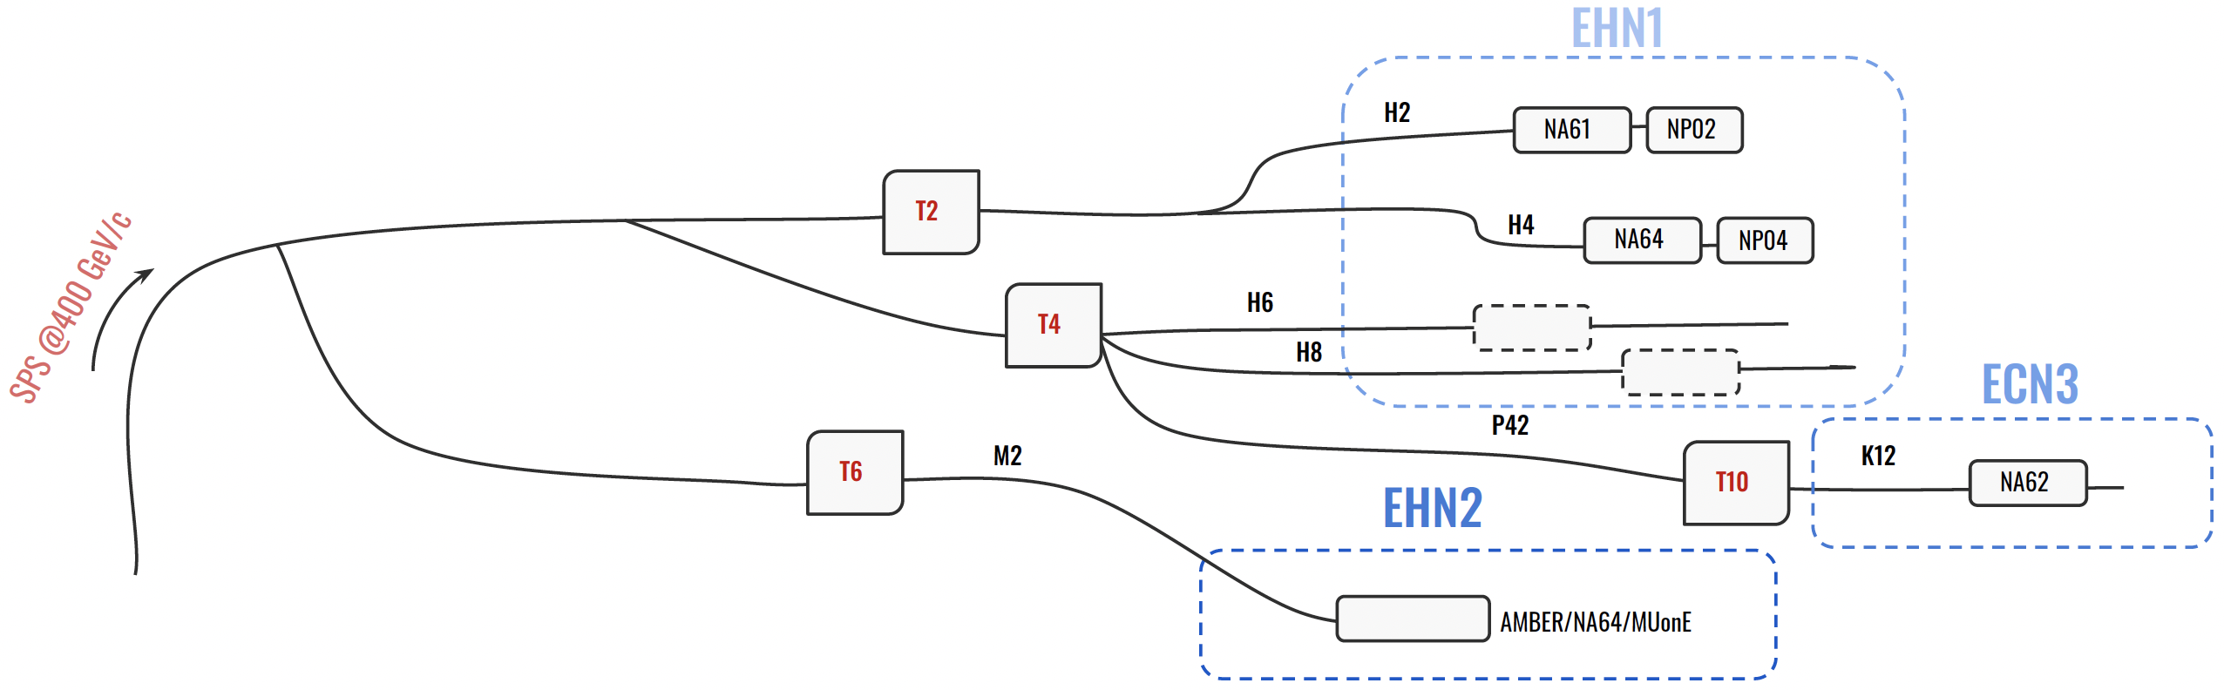
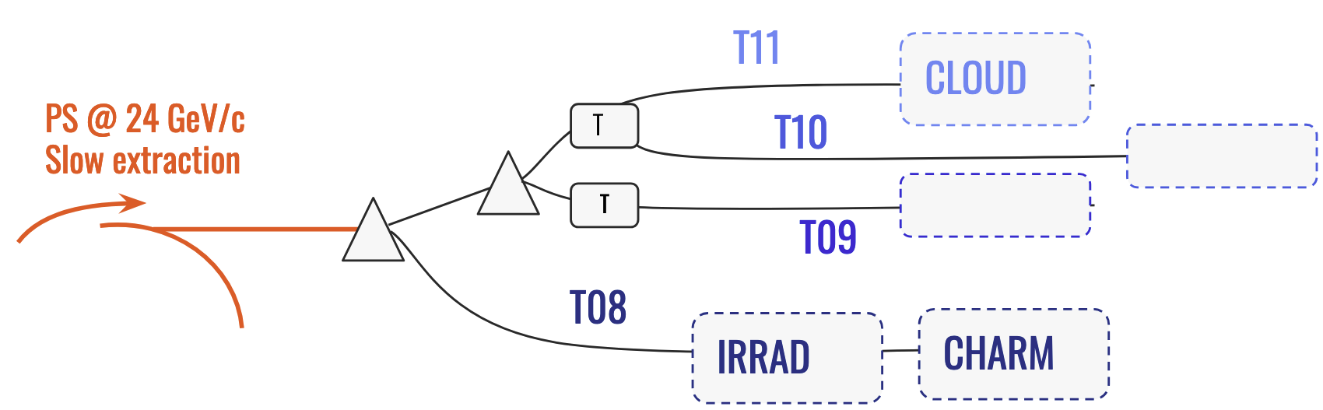
The North and East Area
The SPS North and the PS East Area are one of the most diverse experimental facilities, serving primary and secondary proton, hadron, electron, muon, and ion beams to yearly over 200 user teams for fixed target experiments (currently NA61, NA62, NA64e/µ, AMBER), the two large neutrino platform cryostats, to the GIF++, IRRAD/CHARM and CERF irradiation facilities, and to several experimental areas used for detector R&D.
There are a total of seven beam lines in the North Area and 4 beam lines in the East Area with attached experimental areas for a combined more than 2000 users.

Slide 4
Operation
(Highlights)

Slide 5
Beamline Users
Record-high number of test beams and experiments in the North and East Area in 2024.
High flexibility required: About 10% of the users ask for substantial last-minute changes. In addition, new user additions and cancellations make life interesting!
Communication is key: A strong collaboration between equipment teams, SPS/PS physics coordination, BE-OP, safety, and the beam physicists is essential for successful operation of such an amount of test beams.
Process of Test Beam User Changes
Users Meeting:
Thursday morning
SBA Meeting:
Thursday afternoon
NA and EA Coordination Meetings:
Monday morning
Implementation / User Changes:
Wednesday

Slide 6
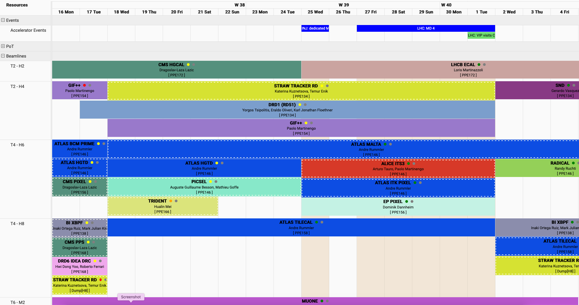
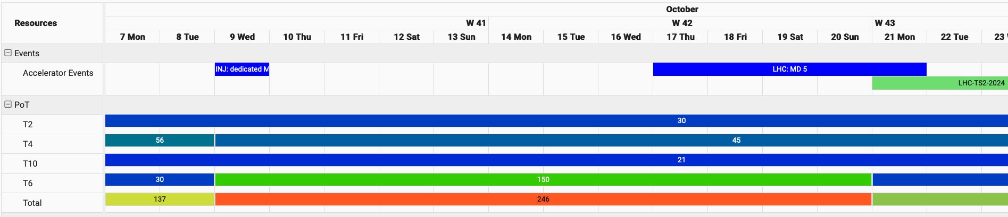
ASM – Accelerator Scheduling Management
Extension of the ATS-wide scheduling
tool towards all experimental areas, fully available since the 2024 run.
The idea is to organize and streamline all aspects of all North and East Area infrastructure, user installations, and beam operation in one spot.
The tool includes all experiment and test beam infrastructure needs, installation and de-installation tasks, allowing for storage of all user communication with the technical teams and the beam physicists
A weekly overview of all configurations and tasks is available, including MDs.
Management of requests for protons on target by beam physicists available, allowing for forecasts and coordination with the accelerator operators.
Very good collaboration with BE-CSS!!

Slide 7
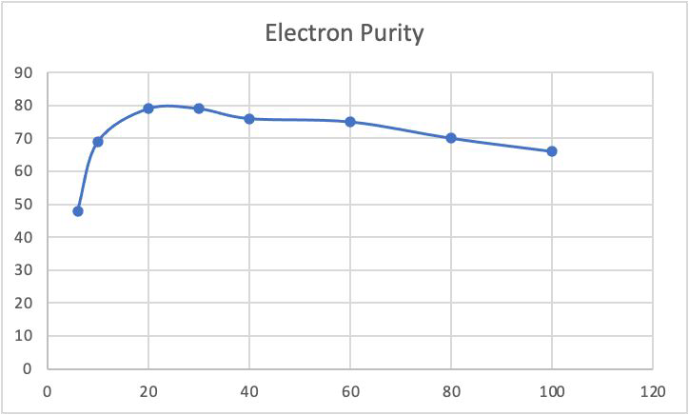
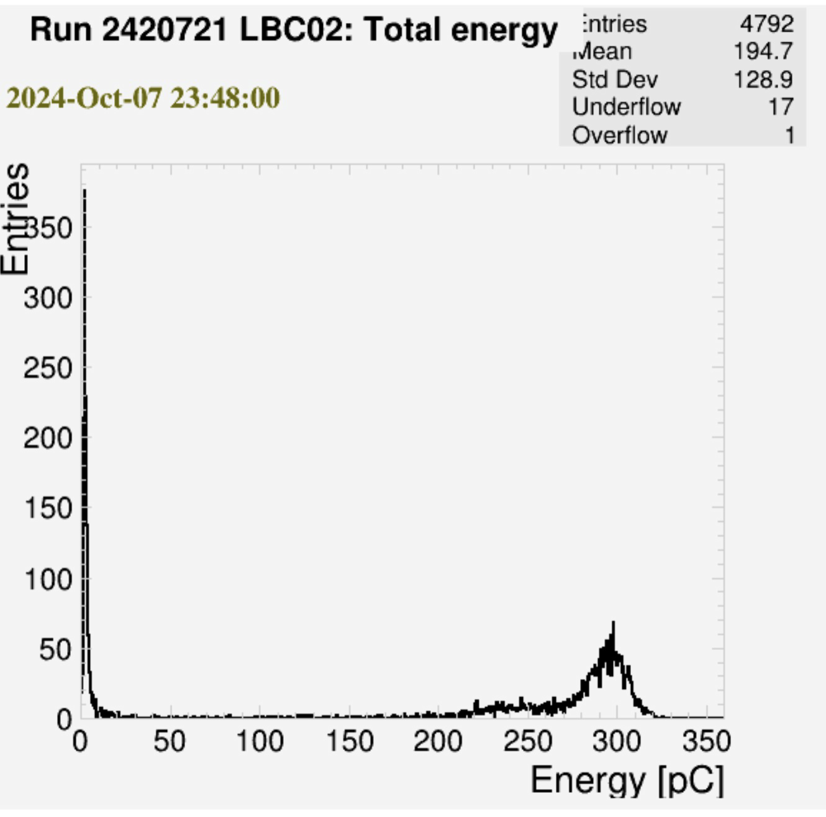
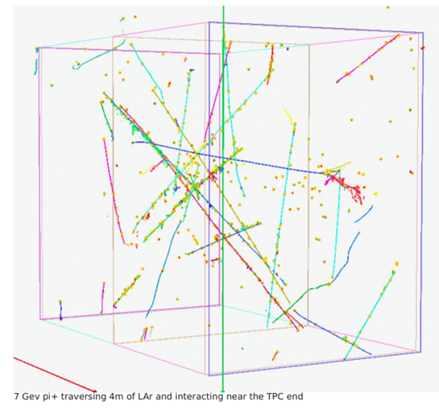
North Area Proton operation
Electron beam users in H6 and H8:
  Following the improvements in the electron beam qualities in H6 and H8, many electron users could be scheduled → helping in the overbooking of H2 and H4 beamlines.
  Electron beam was provided between 10 and 300 GeV with very positive feedback!
First operation of the H4 VLE line for NP04 after LS2.
  NP04 reported good agreement with the MC performed by BE-EA in 2018, and first-time measurement of anti-proton cross-section with Argon done.
IDEA DRC
ATLAS TileCal

Slide 8
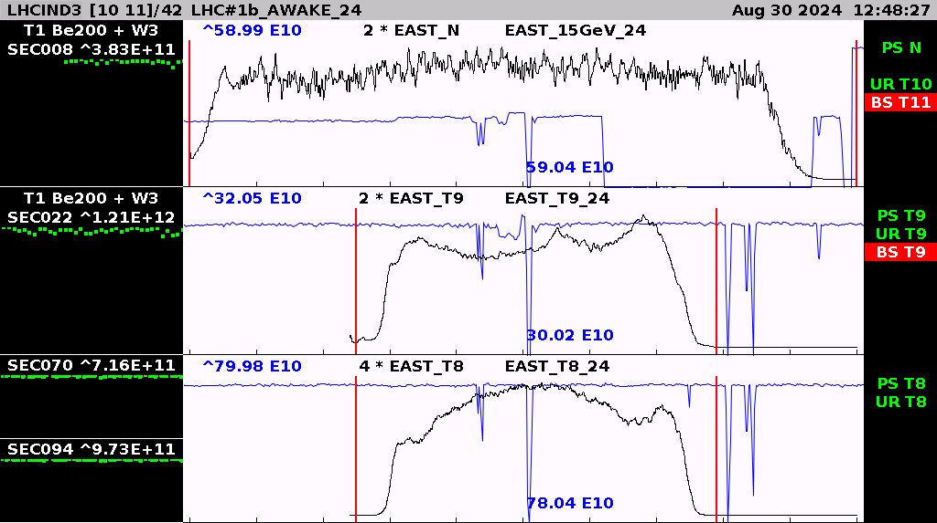
East Area Low momentum
Request for low momentum primary proton and longer spills to the East Area.
  15 GeV primary proton beam with 0.8 s flat top tested in both T09 and T10. Many thanks to BE-OP!
  Beam composition studies performed in T10 → Lower primary beam momentum helps in hadrons at lower momentum. A very important improvement in the flexibility of the lines.
  Provided to users with positive feedback.
preliminary

Slide 9
Higher intensity requests post-LS3
Category | Exp. |  | Beam line | Target(s) | 2021 | 2022 | 2023 | 2024 | 2025 | 2026 | 2027 | 2028 | 2029 | 2030 | 2031 | 2032 | 2033 | 2034 | 2035 | 2036 | 2037 | 2038 | 2039 | 2040
R&D | HL-LHC, FCC, DRDs, muon collider |  | H2 | T2 | 30 | 30 | 30 | 30 | 30 | 30 |  |  | 30 | 30 | 30 | 30 | 30 |  |  | 30 | 30 | 30 | 30 | 30
 |  |  | H4 & GIF++ | T2 | 30 | 30 | 30 | 30 | 30 | 30 |  |  | 30 | 30 | 30 | 30 | 30 |  |  | 30 | 30 | 30 | 30 | 30
 |  |  | H6 | T4 | 30 | 30 | 30 | 30 | 30 | 30 |  |  | 30 | 30 | 30 | 30 | 30 |  |  | 30 | 30 | 30 | 30 | 30
 |  |  | H8 | T4 | 30 | 30 | 30 | 30 | 30 | 30 |  |  | 30 | 30 | 30 | 30 | 30 |  |  | 30 | 30 | 30 | 30 | 30
 |  |  | H8 electrons | T4 | 30 | 30 | 30 | 50 | 50 | 50 |  |  | 50 | 50 | 50 | 50 | 50 |  |  | 50 | 50 | 50 | 50 | 50
 |  |  | T09 | East_T09 | 0.3 | 0.3 | 0.3 | 0.3 | 0.3 | 0.3 |  |  | 0.3 | 0.3 | 0.3 | 0.3 | 0.3 |  |  | 0.3 | 0.3 | 0.3 | 0.3 | 0.3
 |  |  | T10 | East_N | 0.3 | 0.3 | 0.3 | 0.3 | 0.3 | 0.3 |  |  | 0.3 | 0.3 | 0.3 | 0.3 | 0.3 |  |  | 0.3 | 0.3 | 0.3 | 0.3 | 0.3
Dark Matter and FIPS | NA64-e |  | H4 | T2 | 80 | 80 | 80 | 90 | 100 | 100 |  |  | ≥150 | ≥150 | ≥150 | ≥150 | ≥150 |  |  | ≥150 | ≥150 | ≥150 | ≥150 | ≥150
 | NA64-h |  | NA/T09/T10 | NA/East |  |  |  |  |  |  |  | Test | 25 | 25 | 25 | 25 | 25
 | NA64-µ |  | M2 | T6 | 50 | 50 | 50 | 50 |  | 50 |  |  | 100 | 100 | 100 | 100 | 100 |  |  | 150 | 150 | 150 | 150 | 150
 | BDF/SHiP |  | P42 | dedicated |  |  |  |  |  |  |  |  |  | Test | ≤400 | ≤400 | ≤400 |  |  | ≥400 | ≥400 | ≥400 | ≥400 | ≥400
 | MADMAX |  | H8, w/o beam, only YETS/LS |  |  | 0 | 0 | 0 |  | 0 | 0 | 0
Precision Physics | NA62 |  | K12 | T4/T10 | 75/40 | 75/40 | 56/30 | 40/22 | 40/22 | 40/22
 | MUonE |  | M2 | T6 |  | 135 | 150 | 150 | 150 | 150 |  |  | ≥150 | ≥150 | ≥150 | ≥150 | ≥150
 | NA63 |  | H4 | T2 | 50 | 60
 | DsTau |  | H2 | T2 | 25 | 25 | 50
QCD | COMPASS |  | M2 | T6 | 130 | 135
 | AMBER | Rp | M2 | T6 | Test | Test | Test | Test | 100 | 100 |  |  |  |  |  |  |  |  |  | AMBER Phase 2 (in preparation)
 |  | DY | M2 | T6 |  |  | Test | 150 | 150 | 150 |  |  | ≥150 | ≥150 | ≥150 | ≥150 | 150
 |  | spectroscopy | M2 | T6 |  |  |  |  |  |  |  |  | 100 | 100 | 100 | 100 | 100
 | NA61 & NA61++ |  | H2 | T2 | 35 | 35 | 50 | 50 | 50 | 50 |  |  | 50 | 50 | 50 | 50 | 50
 | NA60+ |  | H8 prot. (x 1e8) | T4 |  |  |  |  |  | Test |  |  | 1 | 1 | 1 | 1 | 1 |  |  | 1 | 1 | 1 | 1 | 1
 | NA60+ |  | H8 ions (x 1e8) | T4 |  |  | Test | Test | Test | Test |  |  | 5 | 5 | 5 | 5 | 5 |  |  | 5 | 5 | 5 | 5 | 5
Neutrino-related Beams | ProtoDUNE-SP |  | H4 | T2 |  |  |  | 50 | 50 | 50
 | ProtoDUNE-VD |  | H2 | T2 |  |  |  |  | 50 | 50
 | WCTE |  | T9 | T9 |  |  |  | 0.3 | 0.3 | 0.3
 | NA61 low energy |  | H2/H4 | T2 |  |  |  |  |  |  |  |  | 50 | 50 | 50
 | SBN (ENUBET+NUTAG) |  | new | new |  |  |  |  |  |  |  |  |  |  |  |  |  |  |  | ≤100 | ≤100 | ≤100 | ≤100 | ≤100
Others (astroparticle physics, atmospheric chemistry, …) | AMBER antip |  | M2 | T6 |  | 50 | 50 | 50
 | NA61 antip |  | H2 | T2 |  |  |  |  | 50 | 50 |  |  | 50
 | CLOUD |  | T11 | T10/T11 | 0.3 | 0.3 | 0.3 | 0.3 | 0.3 | 0.3 | 0 | 0.3 | 0.3 | 0.3 | 0.3 | 0.3 | 0.3
Numbers are needed units on target (= 1e11 protons). 0 = running without beam. More dark = more likely / approved experiment. Less dark = less likely / test. This table is not official and not approved.

Slide 10
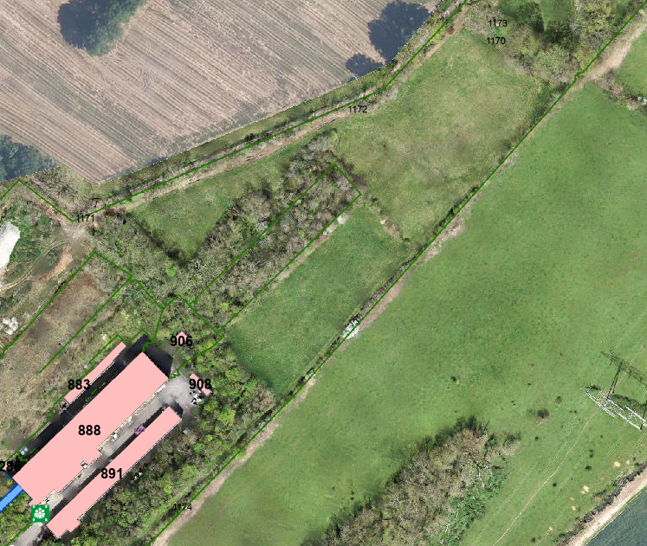
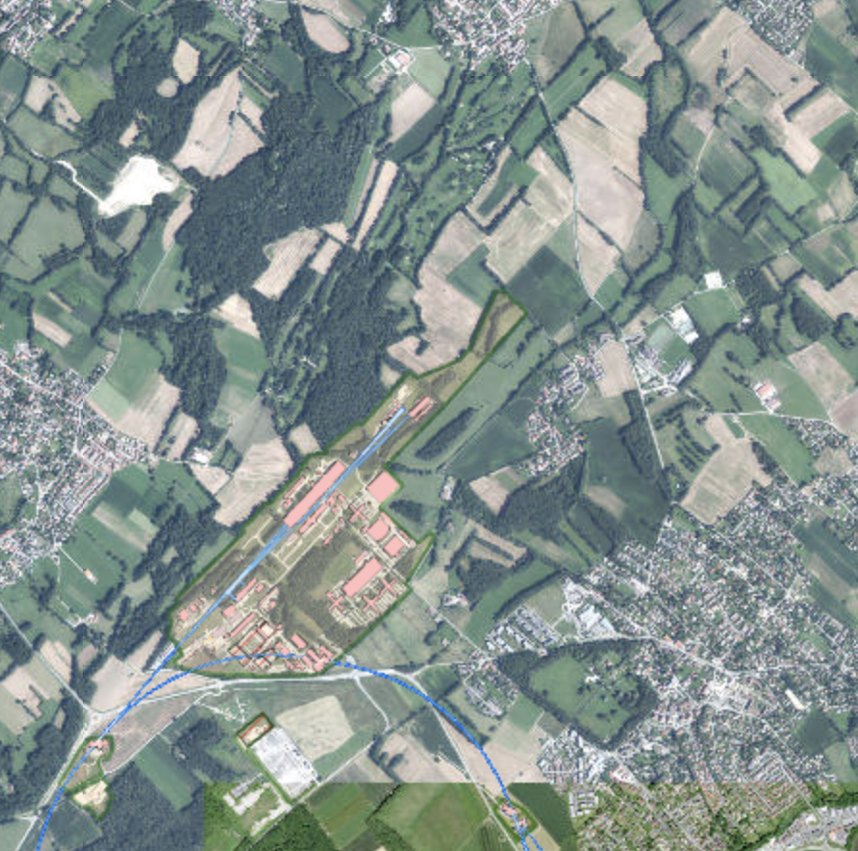
Higher intensity tests for post-LS3
RP monitor locations
PMSG823
RP5
Many users request high intensity beams post-LS3 including fixed target experiments like AMBER, MUonE and NA64.
To potentially increase the muon intensity in M2 a high intensity test was conducted successfully together with RP:
  Currently, the limitation comes from radiation protection at the CERN fence.
  Unlike for COMPASS / AMBER and their required beam height, the M2 beam can be deflected slightly downwards for MUonE.
  During the test, the beam was deflected downwards by about 5 mrad, concluding that deflection of the beam can reduce the dose rate due to the muon beam at the fence by almost a factor of three.
  Further studies including optimising the transmission and acceptance of the beamline as well as location and integration of the magnet are planned for next year.
RP7
EHN2
PAXNA21101

Slide 11
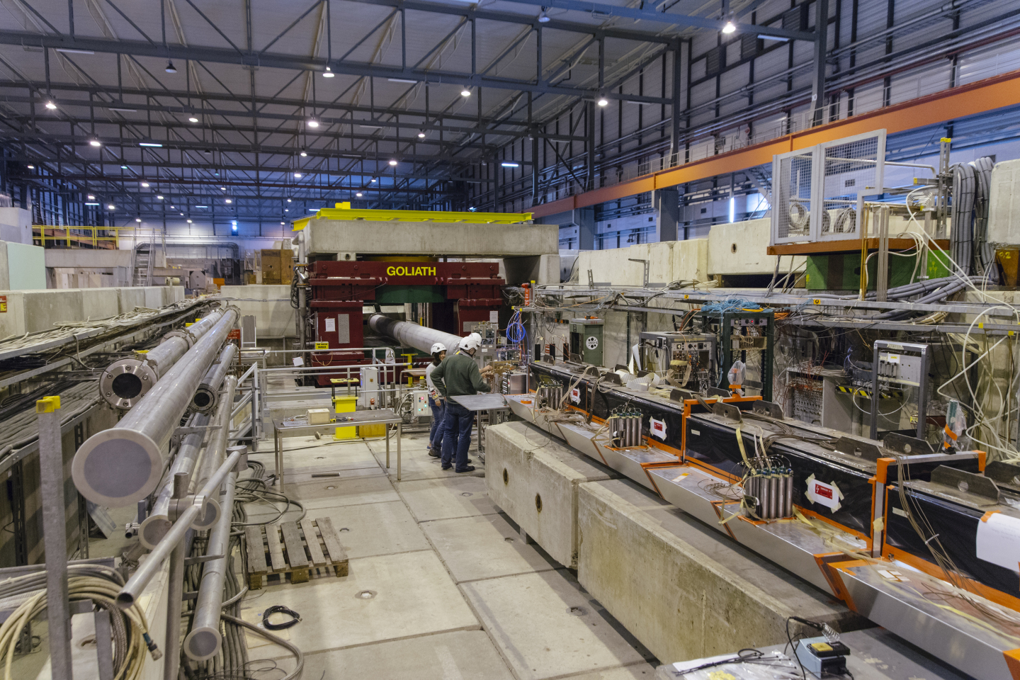
Higher intensity tests for post-LS3
Many users request high intensity beams post-LS3 including fixed target experiments like AMBER, MUonE and NA64.
To meet the request of NA64 to increase their statistics by more than an order of magnitude and continue Light Dark Matter searches with world leading sensitivities:
  Tests performed to send high intensity up to 1.3x10⁷ electrons / spill with 100 units on T2 by adjusting collimators.
  Upto 1x10⁷ electrons/spill beam quality remained the same.
  For higher intensities background and halo starts to increase.
  Increasing intensity on T2 will aid in better collimation and further reduction of beam halo.
Beamline modifications for further reduction of the spot-size and improving the particle ID are being studied for implementation during run 4.

Slide 12
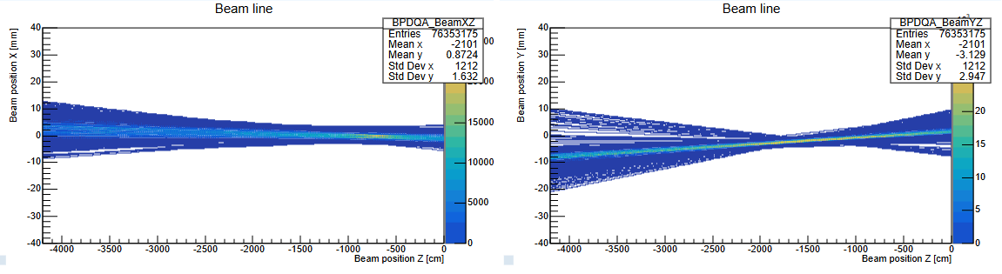
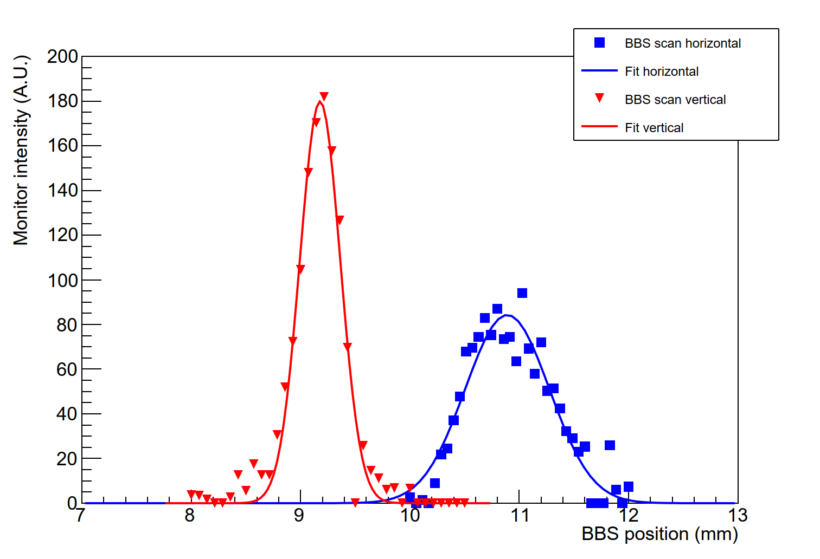
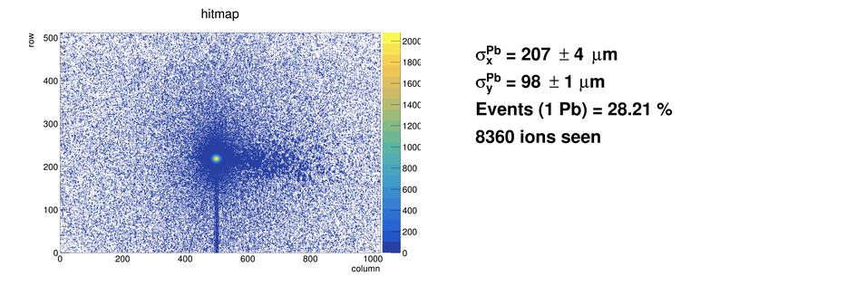
Ion Operation - 150 AGeV/c
Quick ion beam commissioning allowed NA61 to start the ion run two days in advance.
Still, ion beam users suffered for some time from transverse beam position fluctuations, in particular due to hysteresis effects when going to and coming back from LHC filling.
Collimator settings had to be adapted frequently to keep a constant intensity for the NA61 experiment due to source fluctuations.
For NA60+ measurements for beam size and divergence done at T4 which will serve as an input for H8 beamline simulation. Many thanks to BE-OP!
The required ion beam intensity for 150 AGeV/c has been reached, with a good spot size for NA60+.
  In 2023 2.4 x 10⁶ Pb ions were reached while in 2024 10⁷ achieved in collaboration with RP.
NA61
NA61
Pb 150 AGeV/c horizontal
Pb 150 AGeV/c vertical
Beam size
at T4 target
Courtesy: NA60+

Slide 13
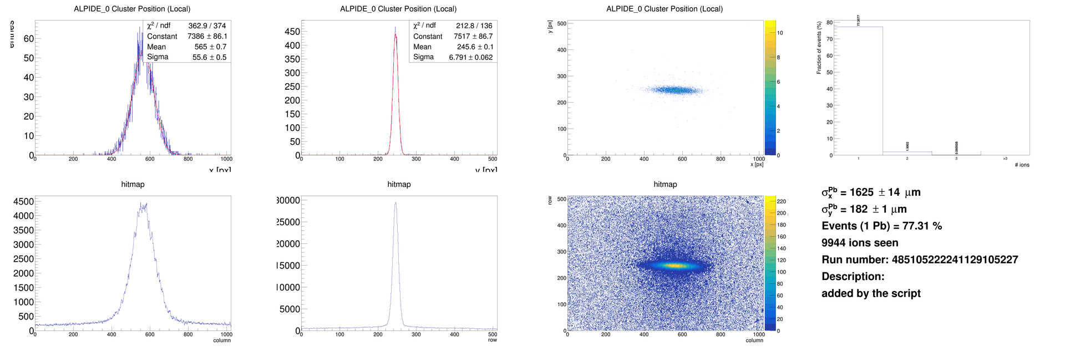
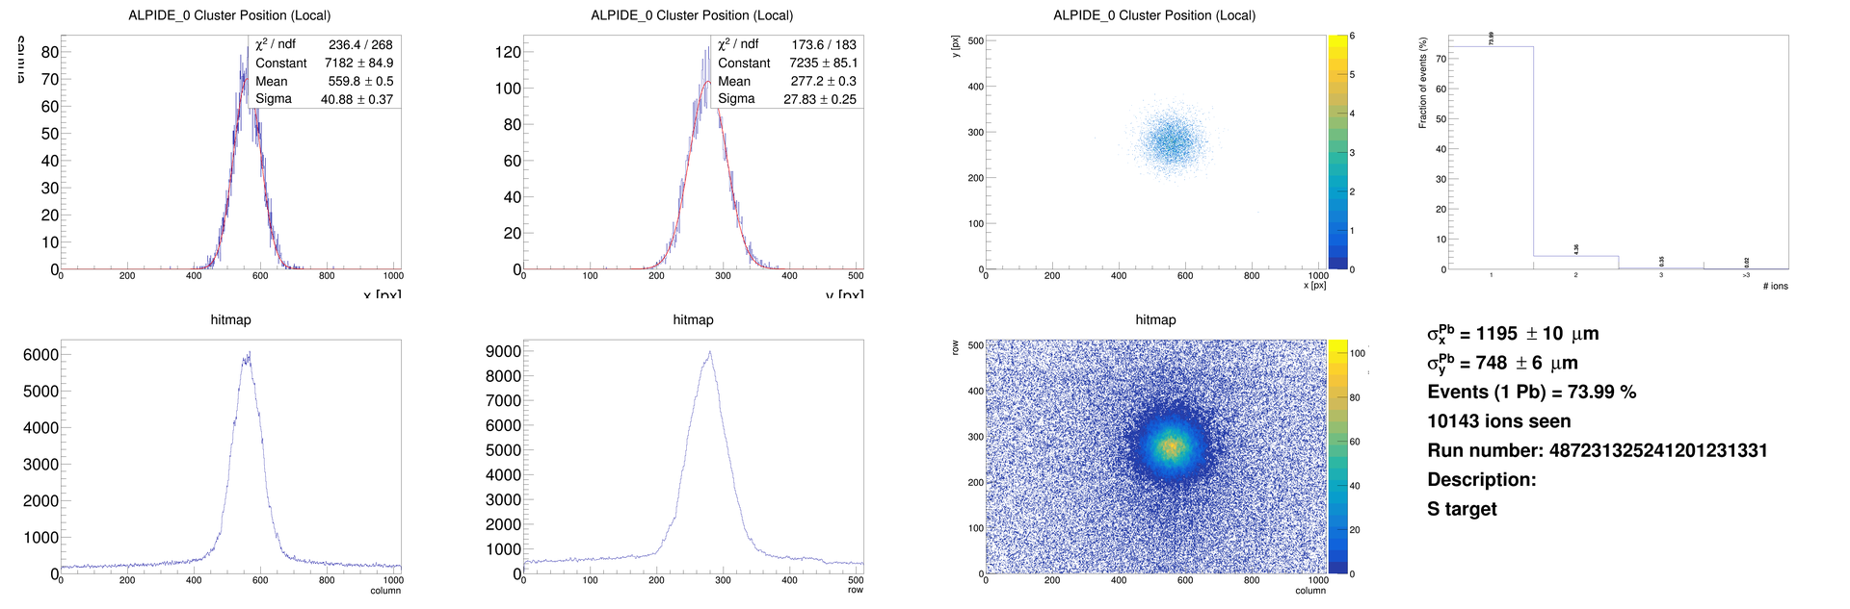
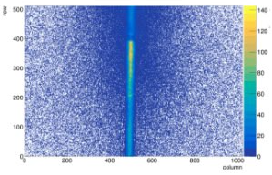
Ion Operation - 13.5 AGeV/c
At low momentum, 13.5 AGeV/c, NA60+ request: beam spot σ <0.6mm in both planes
Different optics tested at this momentum. Requires further development of optics, possibly movement or addition of a quadrupole, to be investigated.
Minimisation of material critical for low momentum beam. Removal of a single scintillator and related vacuum windows (~1.8% X0) at a key point reduced the vertical beam size from 900 µm to 200 µm. Further improvement of vacuum (VXSS) would be beneficial.
(σ_{x} , σ_{y}) = (1.6, 0.18) mm
(σ_{x} , σ_{y}) = (1.2, 0.75) mm
(σ_{x} , σ_{y}) = (0.24, >2.3) mm

Slide 14
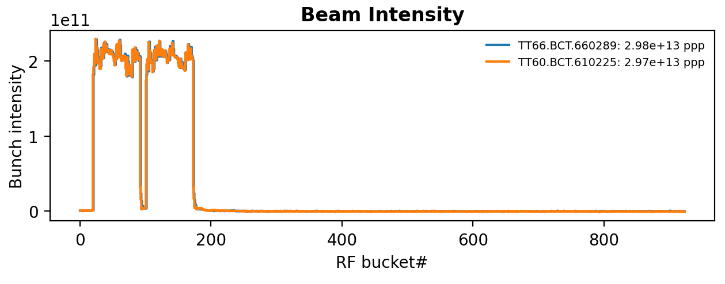
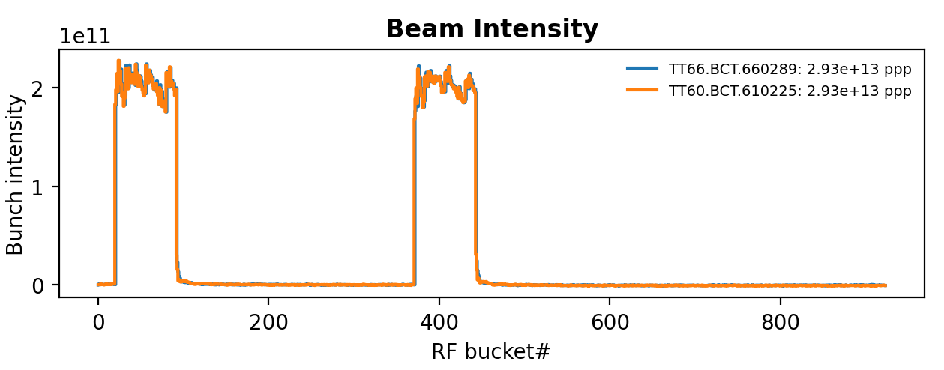
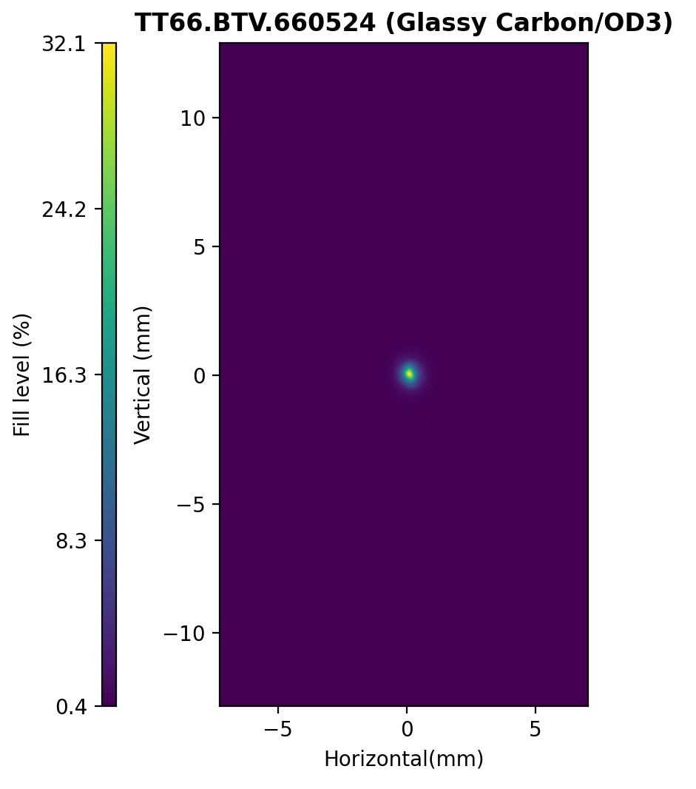
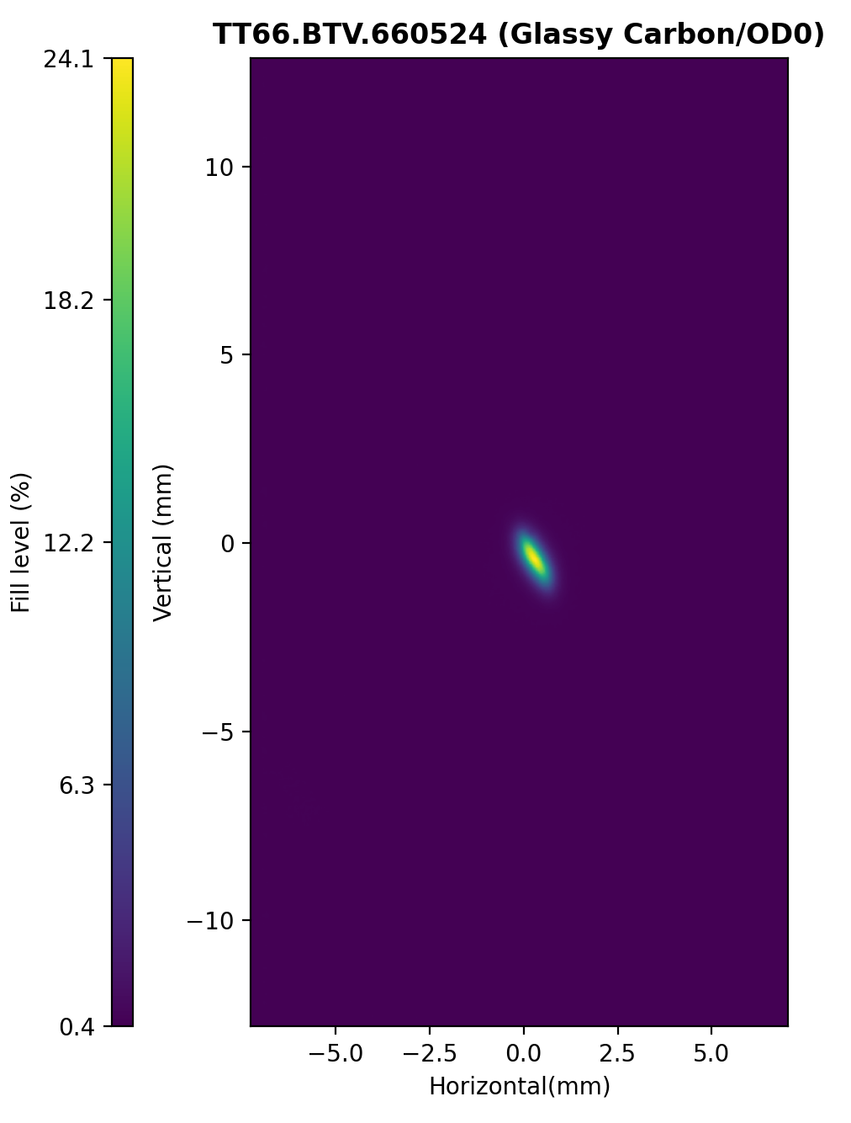
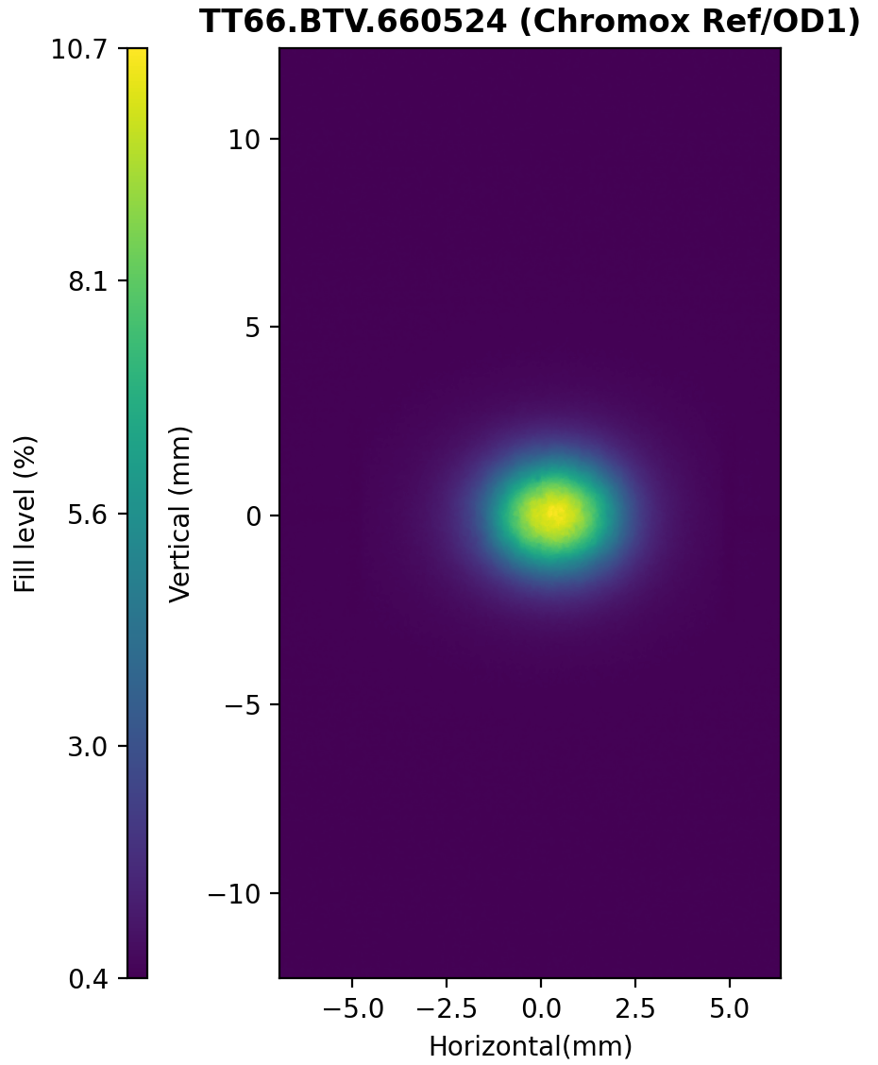
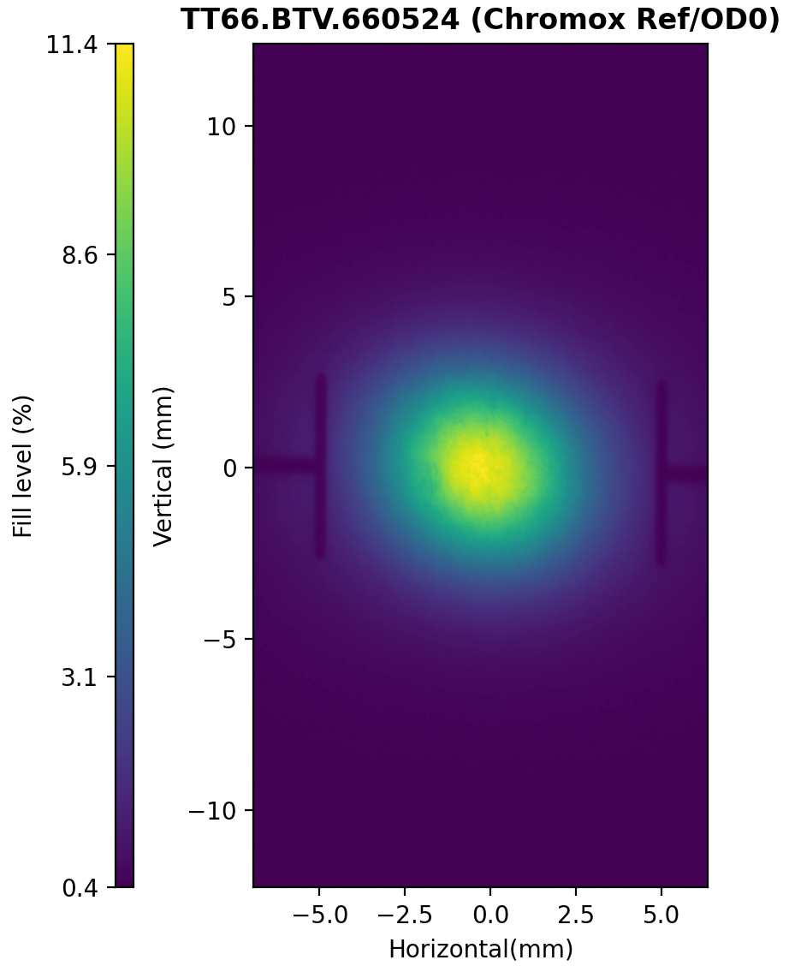
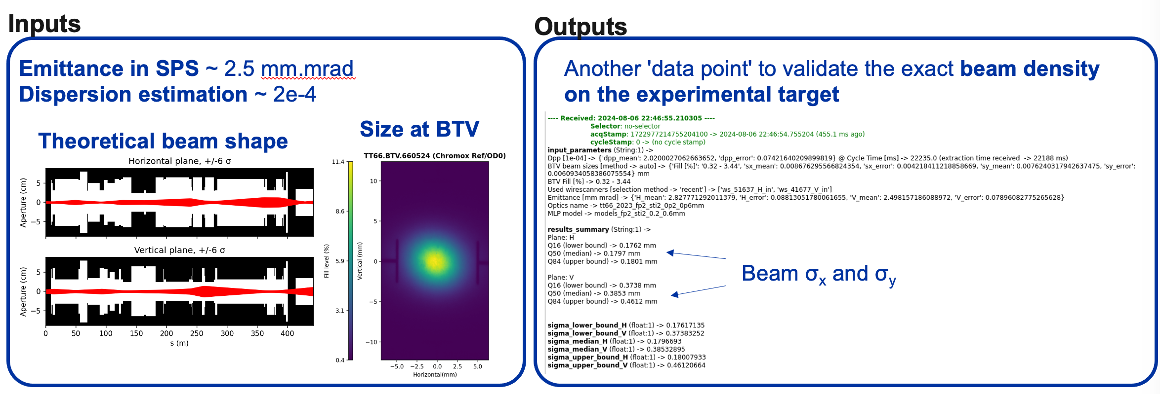
HiRadMat Operation
Usual batch spacing (225ns)
Maximum batch spacing (7 µs)
HiRadMat operated 4 experiments.
  Running without parallel activities favourable for everyone.
  Pre-commissioning time slot a few days before actual physics time extremely beneficial.
  All experiment finished before the end of the scheduled week, all weekends returned to physics. AWAKE and MDs also recuperated days from the HiRadMat weeks.
  Nonetheless, stakes are high: experiments need to complete their program within one week and have no contingency.
288 bunches @ 1.9E11 ppb with a 0.25 mm x 0.25 mm beam size operated. Maximum density achieved so far. Versatile beam size and shape.
New live tool developed by BE-OP and SY-ABT (F. Velotti & P. Zisopoulos) that provides a more realistic estimation of the beam size on the experiment based on parameters from the machine.
BTV performance & optimisation to be studied further in 2025 in collaboration with SY-BI.
0.25x0.25 mm
0.15x0.3 mm
1x1 mm
3x3 mm

Slide 15
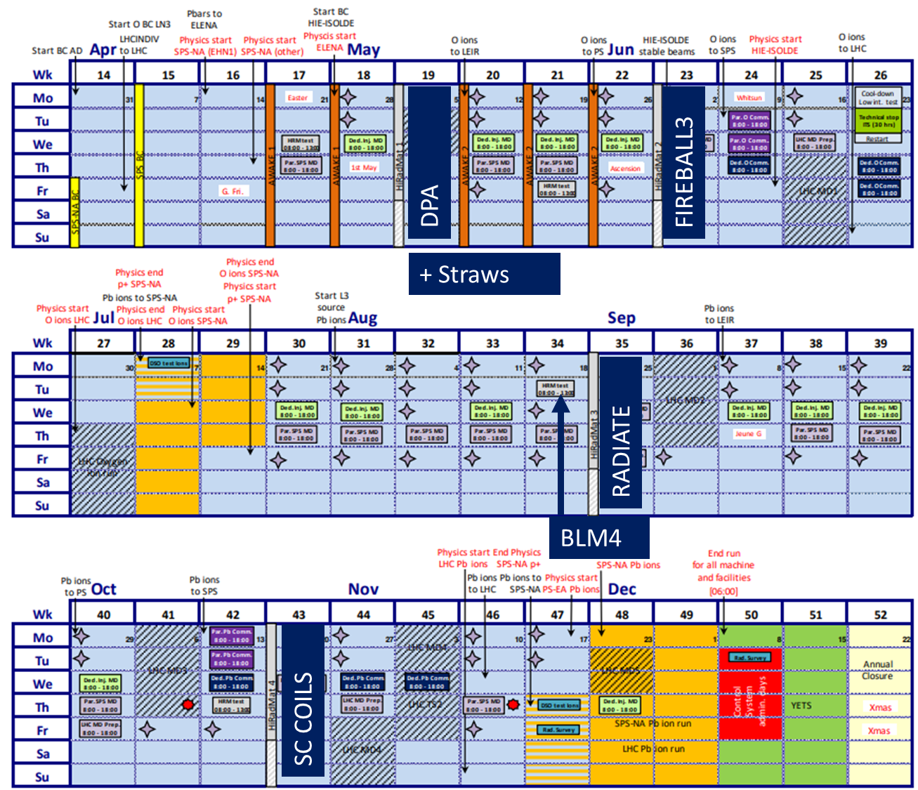
HiRadMat Outlook for 2025+
6 experiments for 2025
  HRMT63 DPA – JPARC
    Measurement of displacement cross-sections.
  HRMT69 StrawRad – SY/BI
    Straw BPM devices in high radiation environments characterisation.
  HRMT68 Fireball-III – Oxford University
    Follow-up of measured instability with further improved setup.
  HRMT67 RaDIATE-II – Fermilab (RaDIATE collaboration
    Test of various materials for future target systems.
  HRMT70 SCcoils-II – TE/MPE
    Study of damage limit in SC coils for HL-LHC magnets.
  HRMT71 BLM4 – SY/BI
    Test and validate multiple types and production runs of BLMs.
DRAFT SCHEDULE​
ENLARGE THE POSSIBILITIES
Letter of intent for ion beams in 2026 ; MD to prepare it to be requested for 2025
MD to study lower momenta for HiRadMat (injection energy ?)
New materials for the BTV (preparation of an experiment in 2026)

Slide 16
Equipment

Slide 17
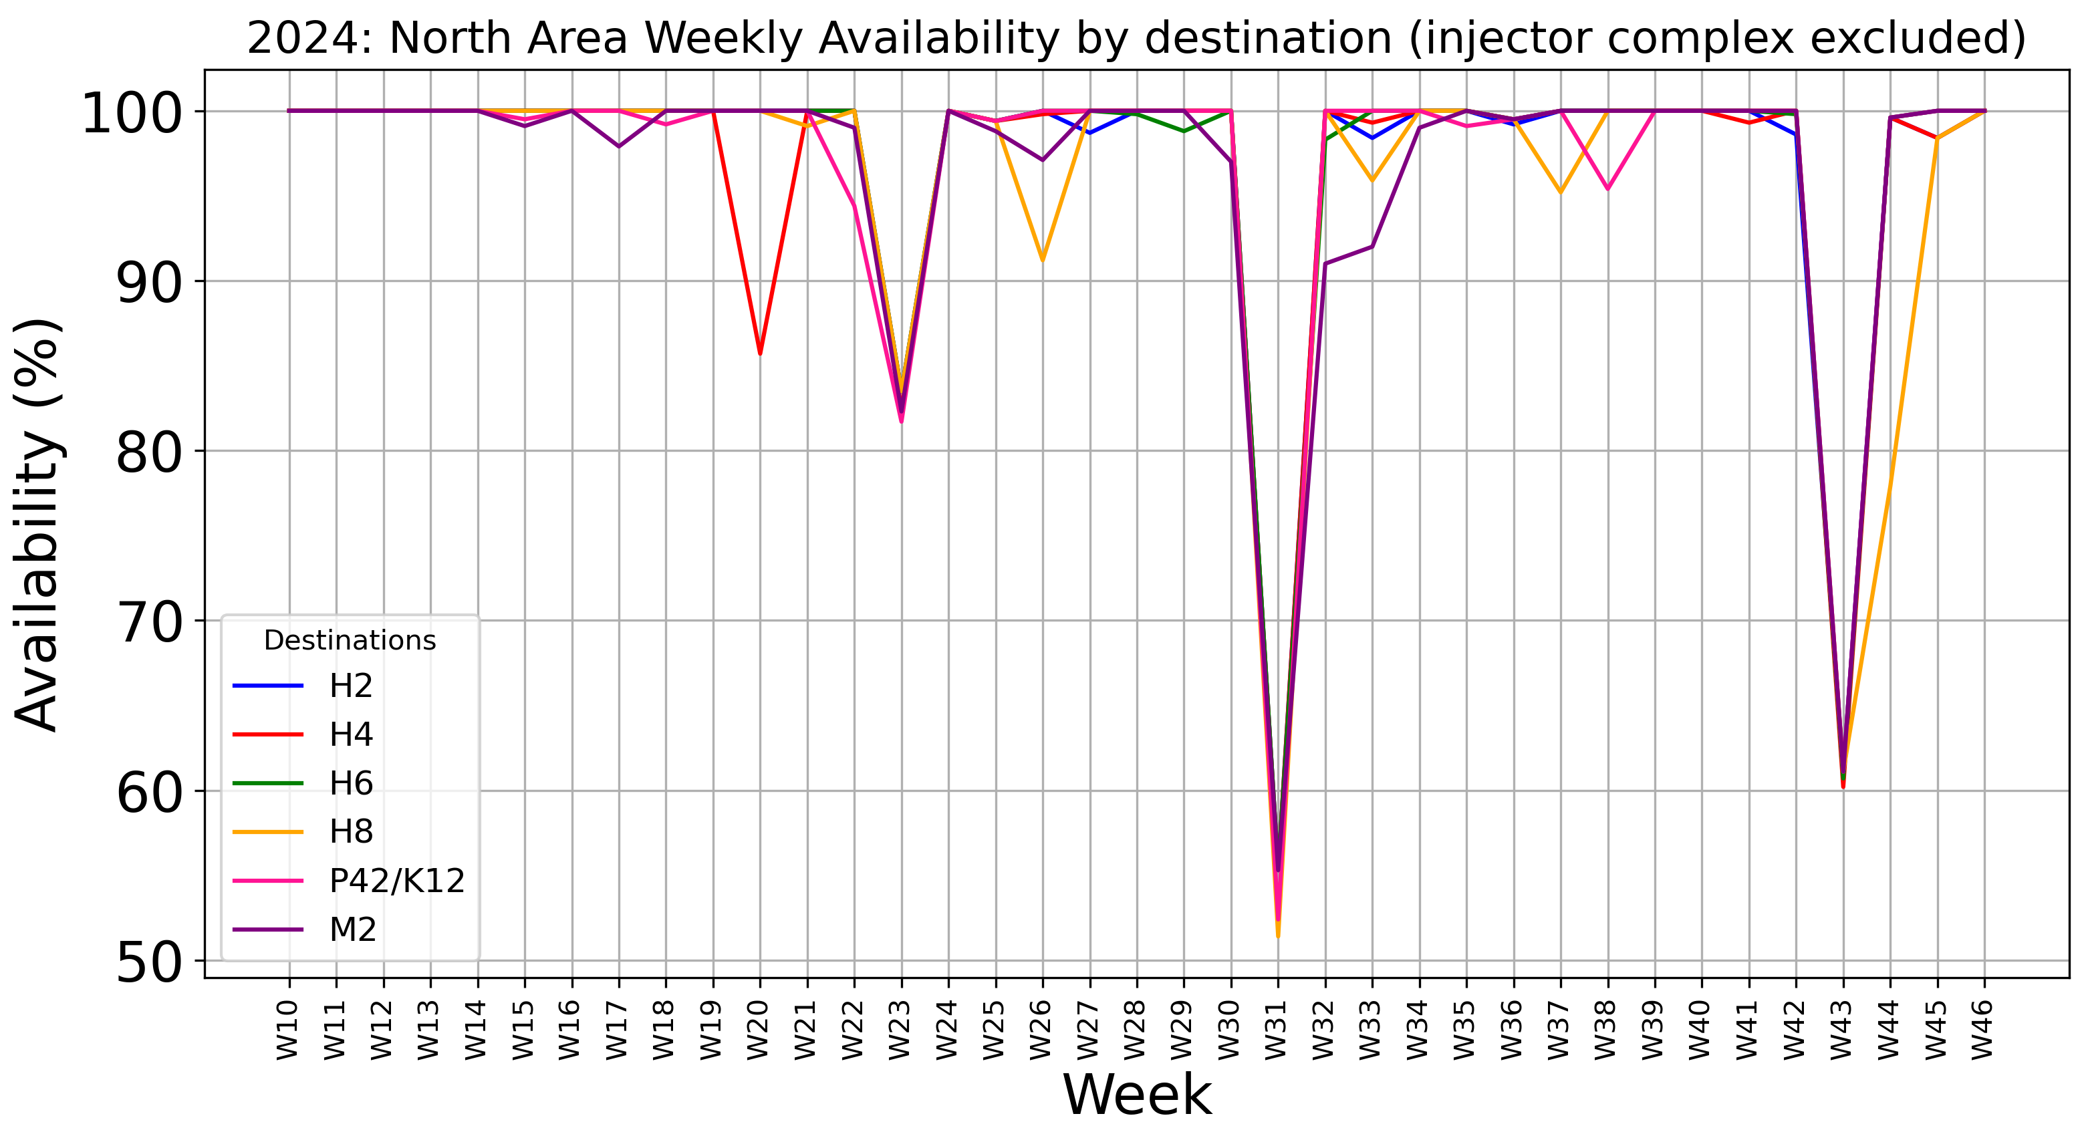
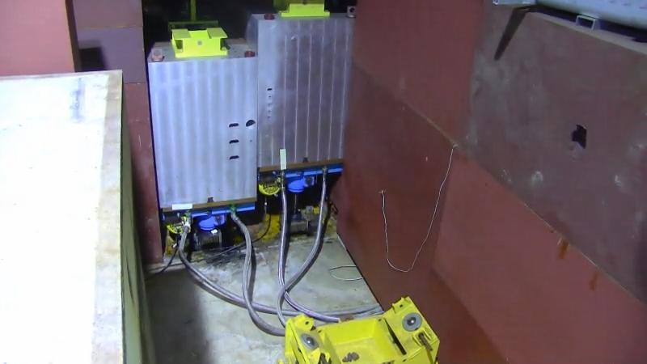
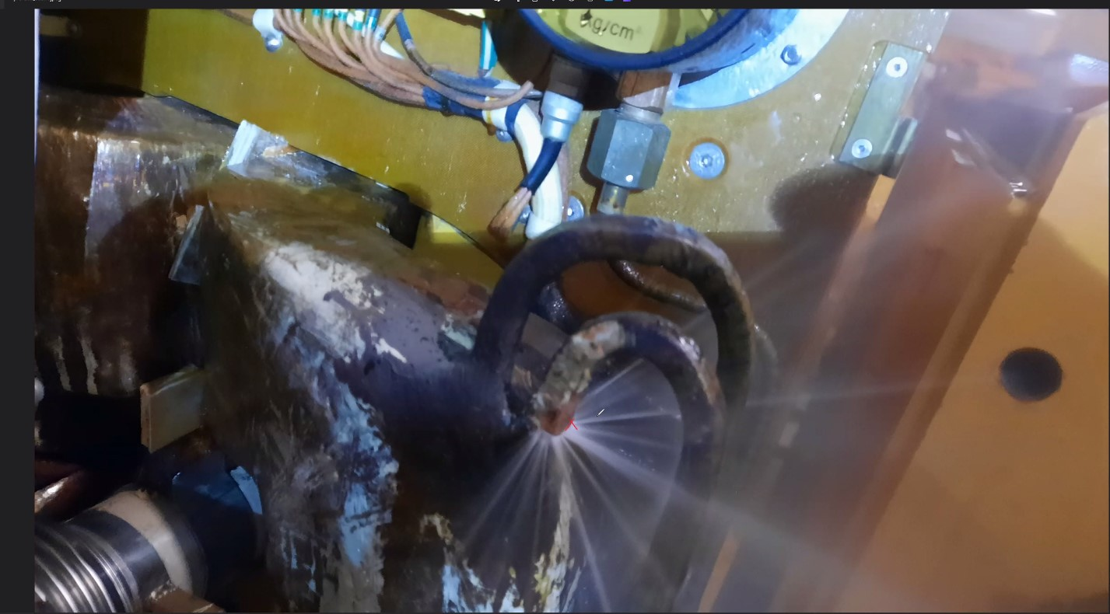
Availability 2024 (Automatic Fault Tracking)
Power converter issue quadrupole QSL.X0420033 (TCC2/BA80)
H4 and H8 XTAX control issues (TCC2)
Power converter issues quadrupole QSL.X0420033 (TCC2/BA80)
Power converter issue dipole
MBN.X0220053 (TCC2/BA80)
P42 and H8 XTAX moving issue (TCC2)
Water leak quadrupole QNL.X0210049 (TCC2)
Leak on water circuit of dipole MTN.241128 (TCC2)
Exchange of QNL.X0210049 (TCC2)
  This year, most of the North Area downtime stems from faults in the TCC2 target area or from the attached service building.
  Many faults will be addressed by the North Area Consolidation project, but due to the high activation levels in TCC2, we will have to survive at least until LS3 to get better reliability.
  The P42 XTAX fault nearly caused an extremely long downtime for the North Area, but thanks to the quick and efficient reaction of all involved teams (BE-DSO, BE-CEM, BE-CSS, HSE-RP, BE-EA), we were able to continue operation.

Slide 18
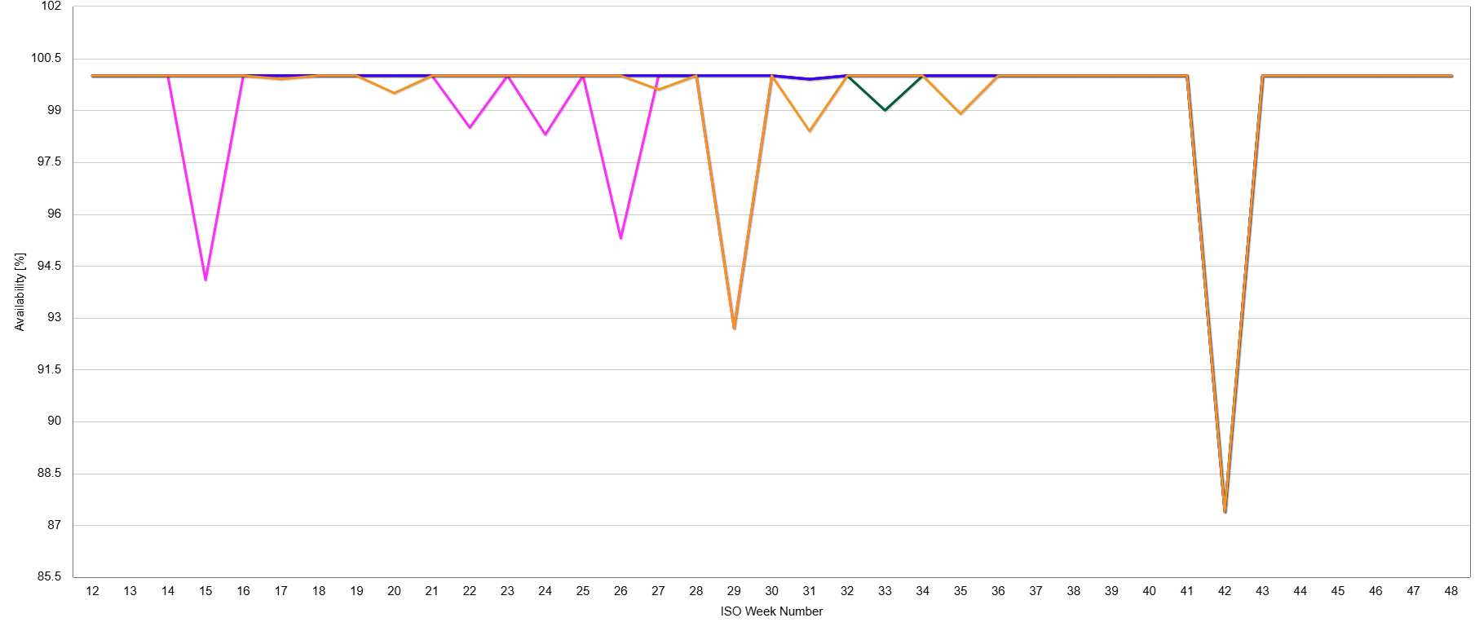
Availability 2024 (Automatic Fault Tracking)
  Very good availability of East Area beams thanks to the LS2 renovation.
Power converter issues dipole T10.BHZ027
AUG (emergency stop) pressed by accident + recovery
T08
T09
T10
T11
Fire in 18kV cell in East Area power converter building

Slide 19
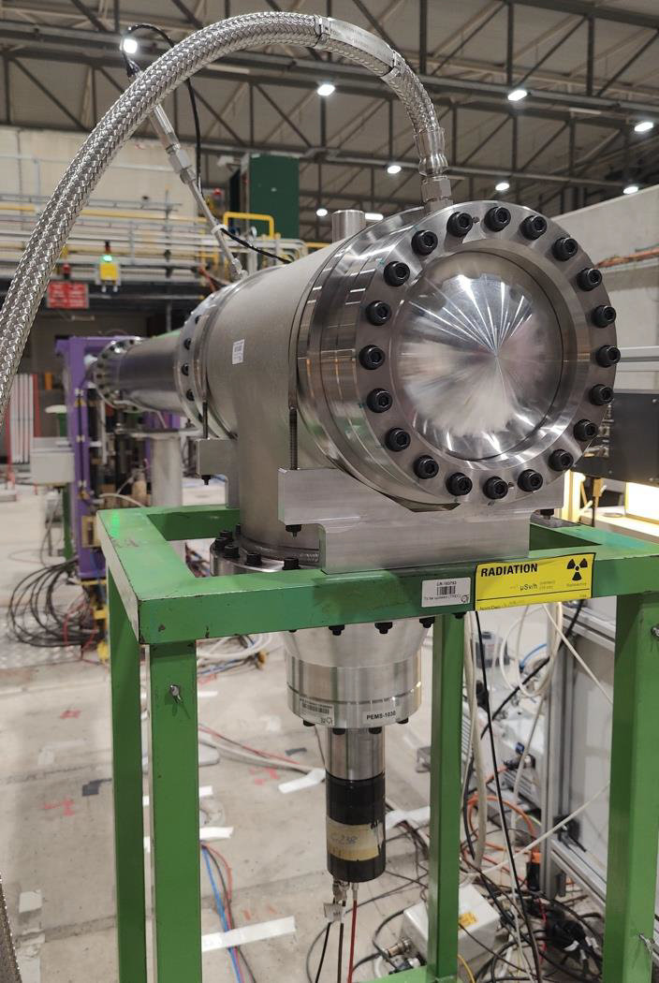
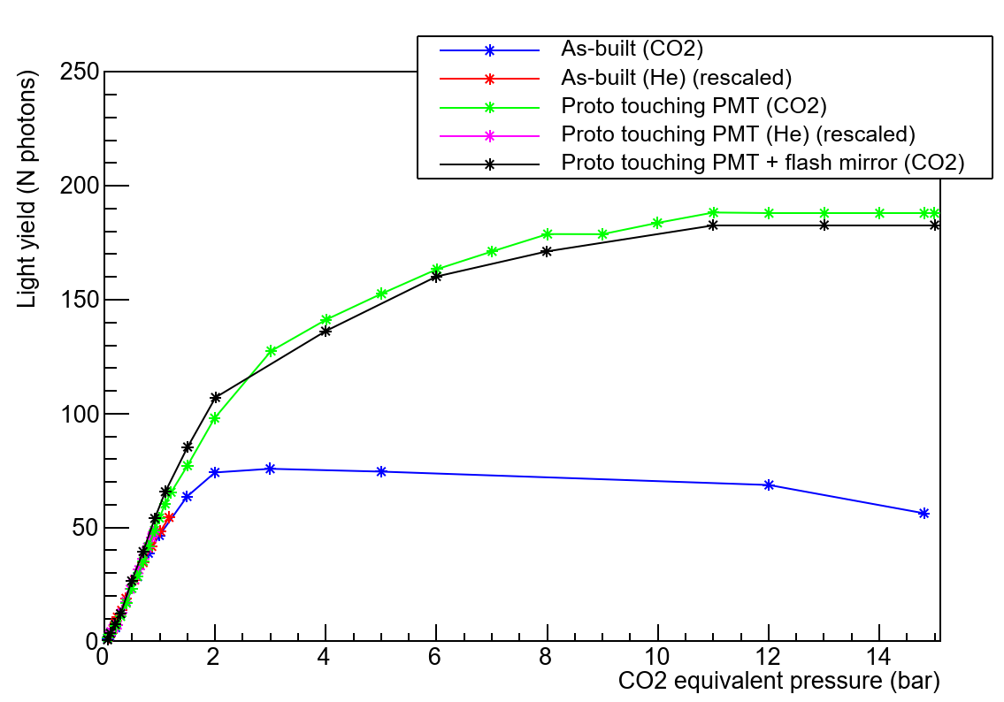
Particle ID detector improvements
Experiments and test beams rely heavily on particle identification cherenkov detectors (XCET, XCED).
As part of NACONS many refurbishment efforts have been completed and many are still ongoing.
New bodies and mirror have been manufactured and tested in the H8 beamline for the XCET detectors.
  For the same 45-degree mirror, parabolic mirror prototype increases photon collection an extra 50% at 2 bar to 320% at 15 bar
  The new XCET detector prototype has been designed, manufactured, inspected and tested according to the European standard EN-13445 (unfired pressure vessels)
  HSE has validated the body, lifting access restrictions with new prototype
Successful collaboration with HSE, EN-MME, EP-DT, SY-STI and BE-EA!

Slide 20
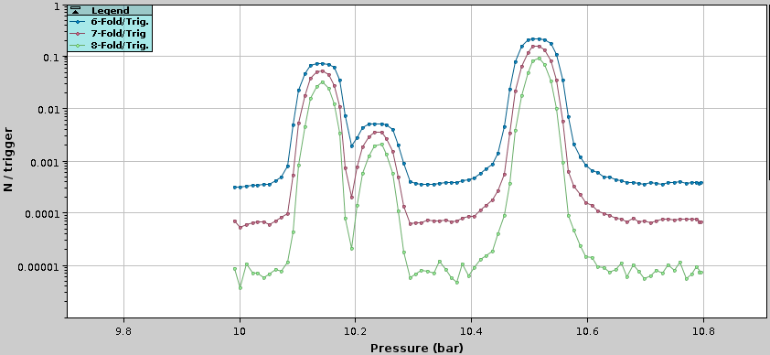
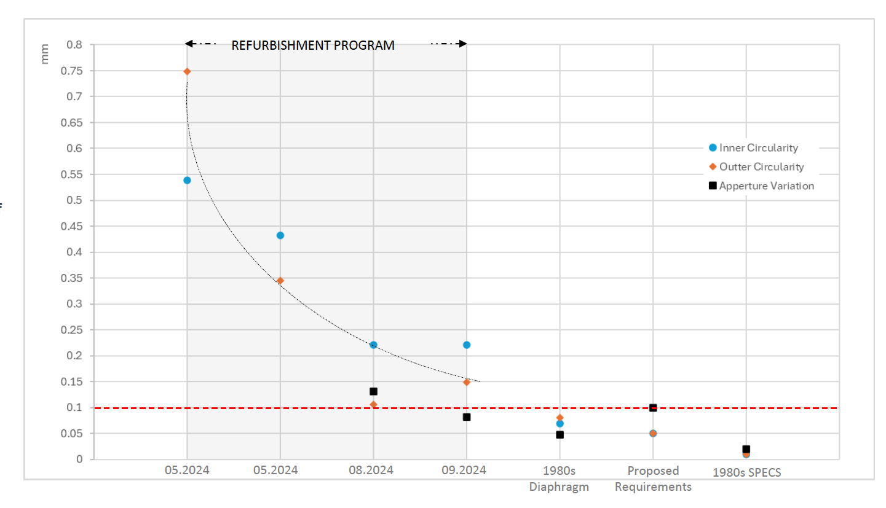
Particle ID detector improvements
Experiments and test beams rely heavily on particle identification cherenkov detectors (XCET, XCED).
As part of NACONS many refurbishment efforts have been completed and many are still ongoing.
Refurbished XCED detectors were installed in M2 for AMBER with improved motor control precision, diaphragm alignment and convergent algorithm for the motor controls in collaboration between BE-EA and SY-BI.
Current performance still not according to the specifications but approaching the needed precision with each iteration.
Procedure also being updated for the installation and commissioning.

Slide 21
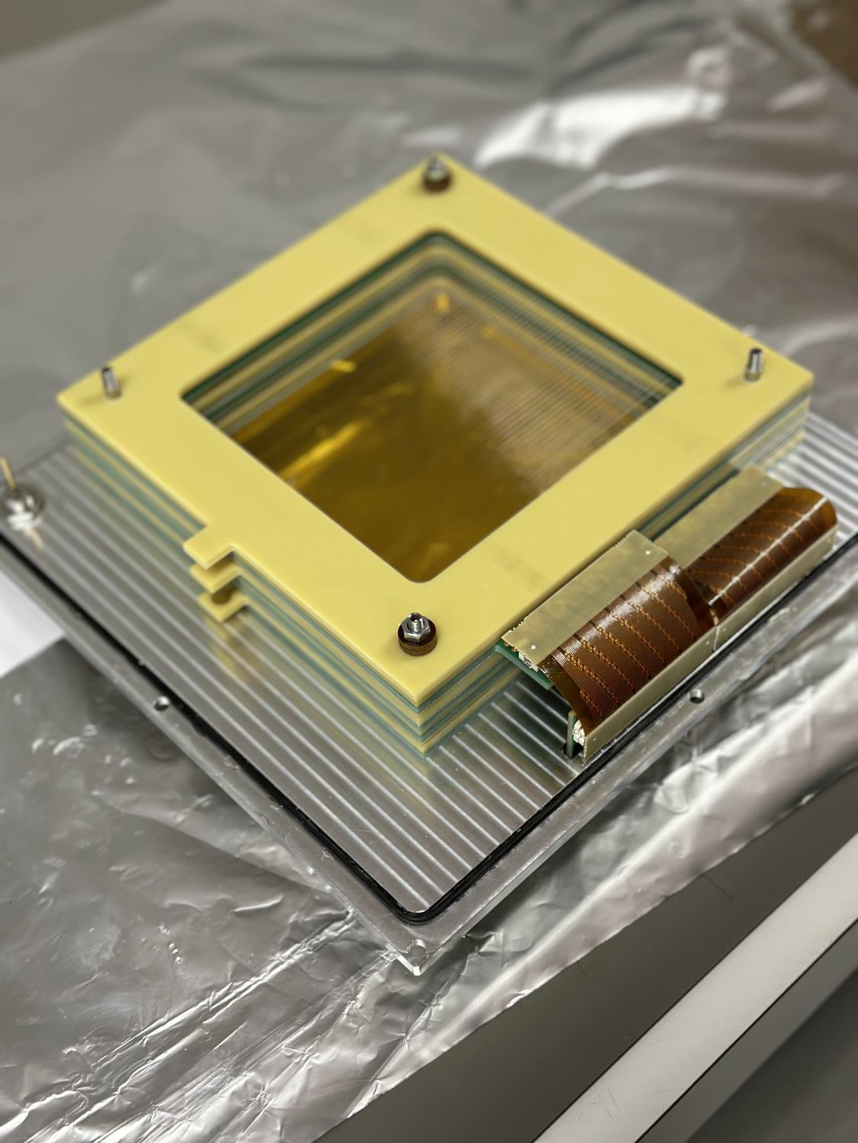
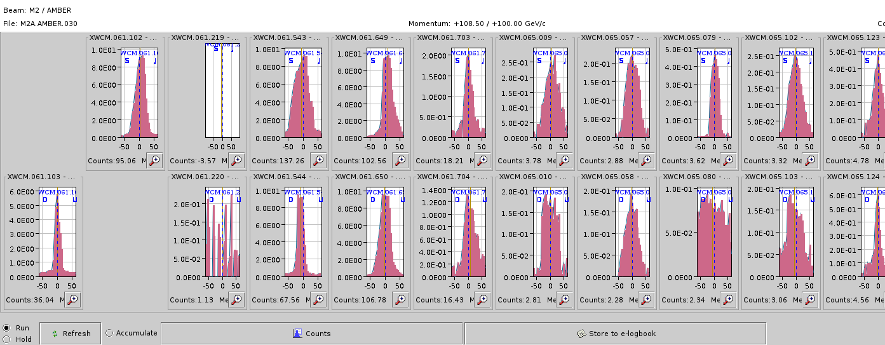
XWCM Critical Spares
Spare situation critical for Large MWPCs (XWCM 20 cm x 20 cm) with only 1 spare available (recently repaired, although with a few dead channels) → M2, K12, CHARM operation depend on it.
Spare situation for smaller chambers (XWCA 10 cm x 10 cm) is not critical with a few spares available and lower failure rates. They are not installed in high radiation areas.
First 10 cm x 10 cm prototype (XWCA) tested in July 2024 with some unexpected delays with the weaving machine and other small problems with the prototype that were all solved.
A second prototype is aimed for April 2025.
During October already one XWCM found not working in M2. To be checked during YETS.
In case of any further faults and unavailability of spares, the 2025 and 2026 operation will be compromised.

Slide 22
Future requests
Critical devices like XCET and CEDARs are actively used for physics data taking by experiments. Faults can cause long downtimes and loss of physics if not treated quickly. Availability of experts outside working hours for such devices is critical.
No spares available for the pressure sensor electronics for XCET/CEDARs.
  NACONS was able to advance the money to buy new sensors with possible deployment planned for the YETS. This is critical for operation.
BBS scans at target extremely difficult for low momentum ion beam with large beam size and small filament. Signal is very small and noisy.
  Future requested upgrade to BSGs in target instrumentation is a likely solution.

Slide 23
Beam Dynamics Modelling

Slide 24
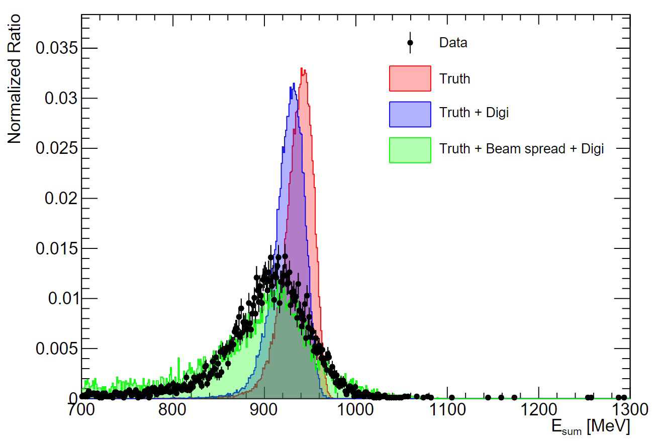
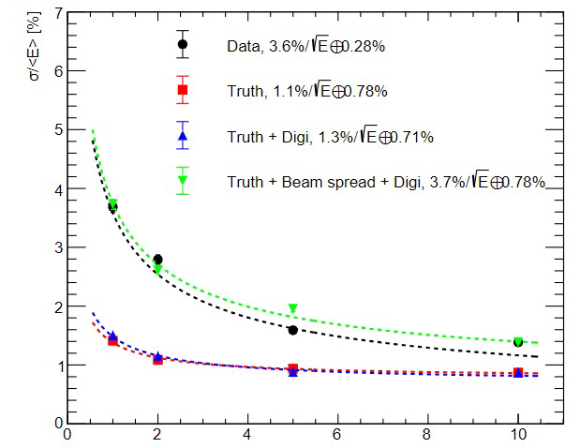
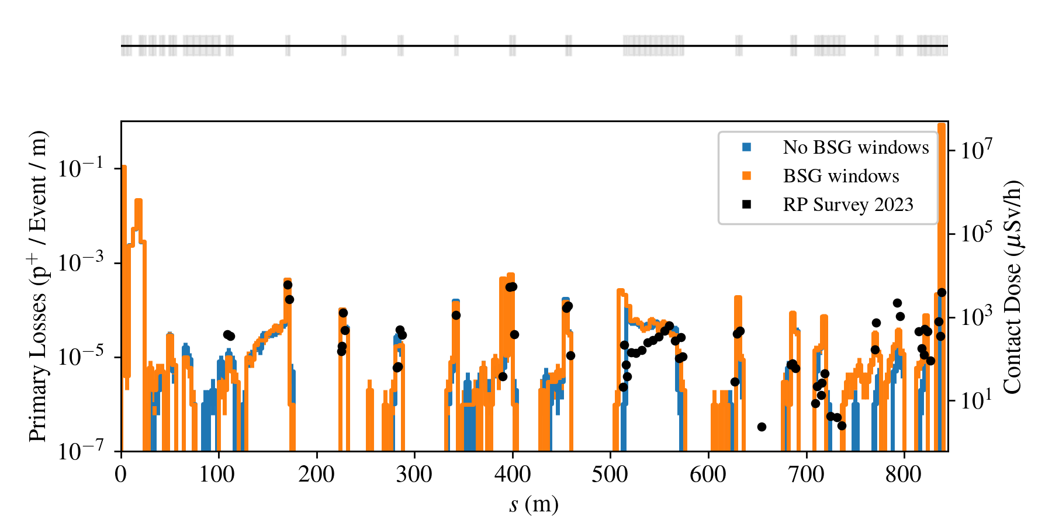
Beamline Modelling
T9: 1 GeV electron beam
A lot of progress done to implement all beamlines in Geant4 based simulation package BDSIM as well as FLUKA.
Ideal to share models and input for users for their simulations.
Detailed simulation for T9 low momentum electron beam to validate detector response for CALICE/DRD6.
P42 BDSIM model with all beamline material finalised
  Validation with activation pattern. Very good agreement!
  Verified with FLUKA model of XTAX region
  Informing engineering decisions for the HI-ECN3 project.
  To be used for muon background studies for SHiP.
Energy resolution for CALICE crystal calorimeter
Simulated proton losses and 2023 RP survey

Slide 25
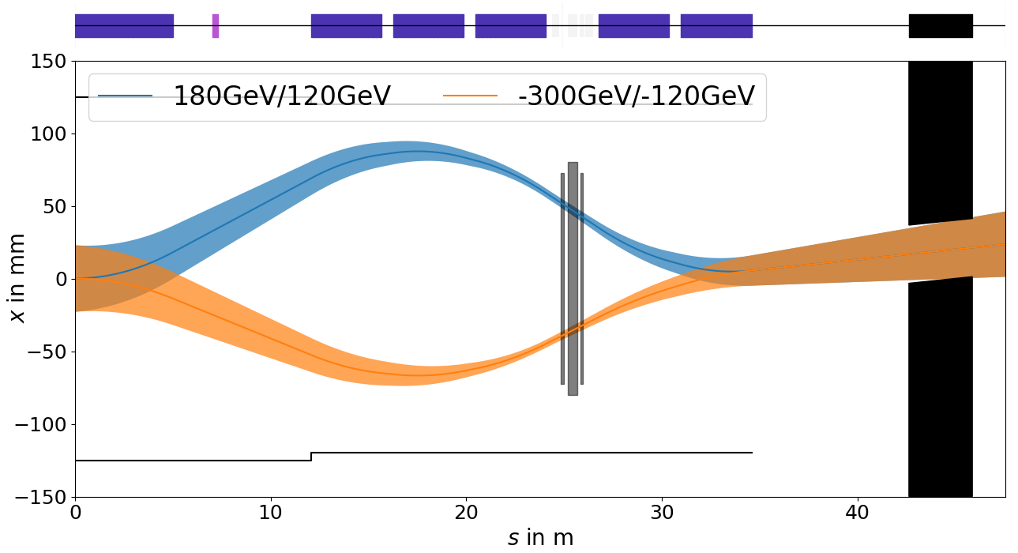
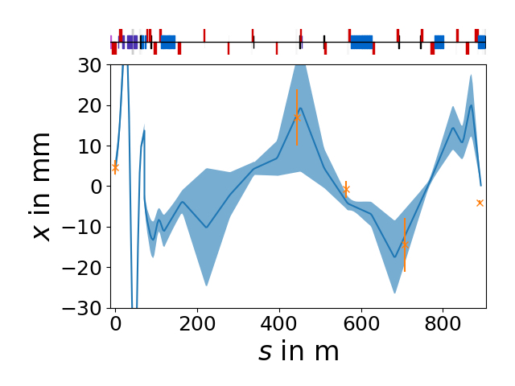
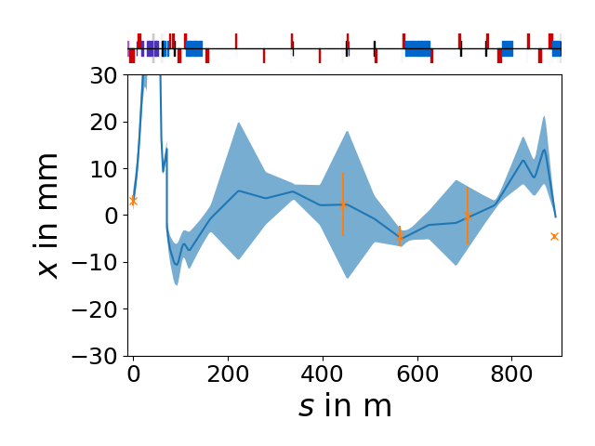
Beam Trajectory through T4 and along P42
Negative Wobbling
Orange: Mean position with 1σ obtained from profile fit to grid data
Blue: SFTPRO optics in TT24; mean position with 1σ envelope obtained from fit of intial angle to match grid data
Positive Wobbling
Investigated impact of T4 Wobbling on beam trajectory in P42.
Beam distributions measured with BSGs in TT24 and P42.
Constrained mean position in TT24 through measurement. Horizontal angle obtained through fit to grid data
Result is sensitive to auto-steering on T4
  Important to move TBIU/D to horizontal position of split foils.
  Test will be redone in 2025 with correct TBIU/D position and without auto-pilot and adding a degaussing of wobbling magnets between different wobbling settings.

Slide 26
Controls, Data & Automation

Slide 27
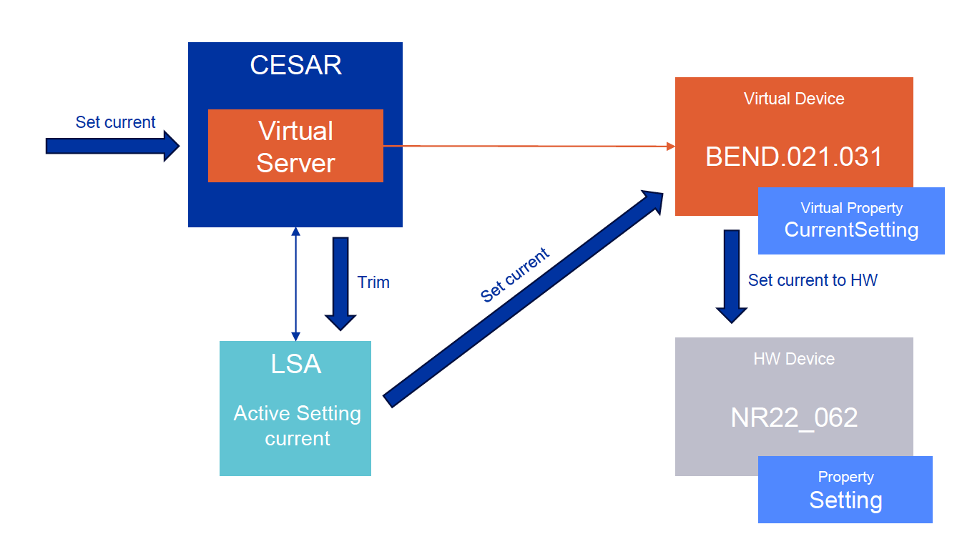
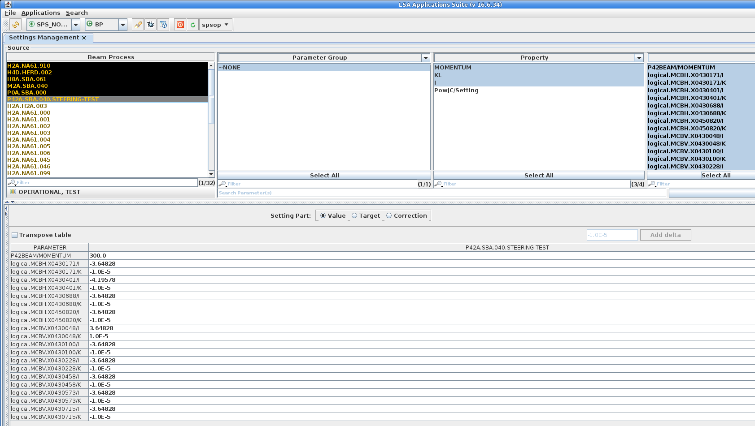
CESAR-LSA Integration
M. Peryt, T. Oliveira
In frame of NACONS aim to bring CESAR closer to Accelerator Controls with possible introduction of high-level parameters.
CESAR stays in maintenance mode until its end of life planned for LS3.
Highlights of 2024:
  LSA has been adapted to handle Experimental Areas settings management.
  LSA for model-based controls, with the first model of North Area P42 (control of steerers tested).
    Currents set and verified without beam. Set ±10µrad in all Trims.
    Momentum scaling verified (important for NA)
    Can now be used for steering MDs
  InCA instances for East Area/North Area are in place.
  Ongoing collaborative effort (BE-CSS, SY-BI, BE-CEM, BE-EA), to replace CESAR Virtual server with UCAP, https://edms.cern.ch/document/3095571.
  Prototyping with Sequencer to automate LSA beam process loading and more.
Momentum Scaling with LSA

Slide 28
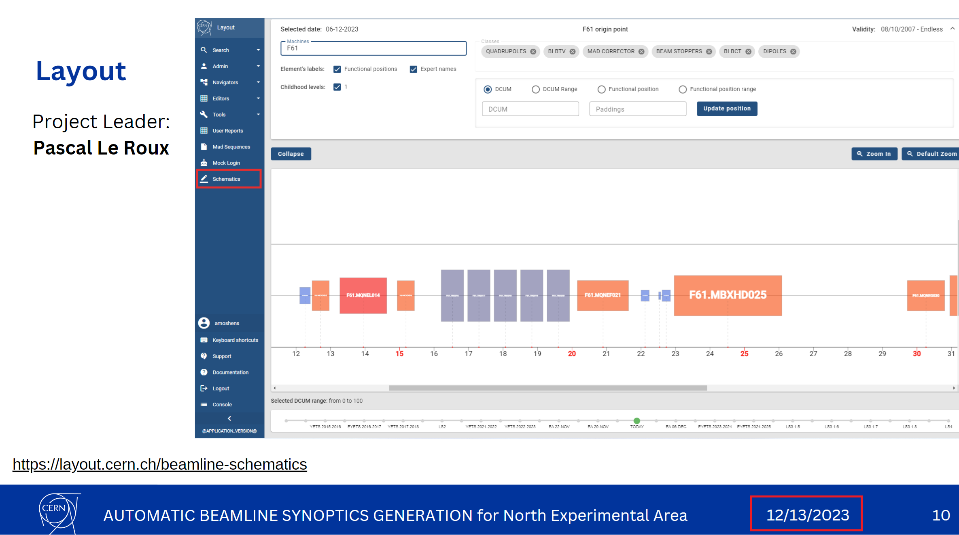
Experimental Areas Controls – next steps
M. Peryt, T. Oliveira
Work on Accelerator Controls for EA is on track: data-driven Synoptics with WRAP + Controls services.
End of Q3 2025: MVP* as initial version to validate with the expert users.
  Data-driven (CCS and Layout).
  LSA for model-based controls and settings management.
  RBAC for authorization.
  UCAP/FESA as device servers.
  Sequencer integration for settings loading and access commands.
End of 2025: first PRO version aimed at the end-user
Staged deployment one beamline at a time
  Progressively replacing CESAR instances
  Careful deployment to be transparent to operation.
YASP Steering to be tested in 2025:
  Stitched TT24-P42 optics model now included in YASP.
  Patched BSG names showed system worked correctly – awaiting full BSG name update.

Slide 29
Summary
A very productive and intense year with many highlights and challenges.
A year full of excellent collaborations and achievements. Heartfelt thanks to all groups involved!
Thank you

