Slide 1
MDs in the CERN accelerator complex
Foteini Asvesta, Gianni Iadarola, Benoit Salvant, Georges Trad, Jan Uythoven
for the injector and LHC MD coordination teams
With inputs from so many colleagues!

Slide 2
Agenda
Why do we do MDs?
Organization of MDs
Outcome of 2024
Incoming in 2025
Critical MDs to be done before LS3
Outlook

Slide 3
Why do we do MDs?
Study new R&D concepts and test new hardware
  Empty bucket channeling → improvement of operational spill quality
  Crystal extraction and shadowing
  New equipment for HL-LHC (Crab cavities, wire compensation, TWOCRYST, BGC, BGV, BSRT, COLDEX
  New theories: 4D resonance structures in SPS
Studies to increase performance to reach global goals set by projects
  LIU
  HL-LHC
  SHIP
Better understanding of the machine and its limitations
  Tail studies throughout the complex → reduction of losses in LHC operation
  Optimization of LHC RF voltage at injection for ions → large increase of lifetime in operation
  Resonance compensation in PSB → improved transmission for ISOLDE in operation
  TOF instability studies in PSB → gained transmission and lower emittance by change of working point
Solve operational problems and hardware issues
  Optimization of LHC longitudinal blow-up → gained margin in operation
  North Area spill quality issues → large gain in operation
  50 Hz component impact on SPS ion beam (and protons?) → large gain for LHC operation
Improve tunability, reliability and reproducibility of the machines
  Automation for MTE splitting
  Automation for bunch splitting
  Automation for 50 Hz components
  Hysteresis compensation automation
→ Decisive impact of MDs on recent operational performance

Slide 4
Agenda
Why do we do MDs?
Organization of MDs
Outcome of 2024
Incoming in 2025
Critical MDs to be done before LS3
Outlook

Slide 5
Organization of MDs
LHC MDs
  Coordination: Georges, Gianni and Jan
  LHC-OP as well as all injector teams
  rMPP
  Injector beam request linkperson since Fall: Panos
Injector MDs
→ coordination of MDs in Linac4, PSB, PS and SPS
→ MDs also going on in Linac3, LEIR, AD/ELENA, but coordination has not been needed
  Coordination: Foteini and Benoit
  OP linkpersons:
    PSB: Fabrice
    PS: Gil and Oliver
    SPS: Chris and Johan
ASM support: Emanuele

Slide 6
LHC MD workflow (example of MD3 - 2024)
By week 26 [-8]
MD requests are submitted by users
Candidate MDs for the upcoming block
are selected and are discussed at LSWG meeting
Week 28 [-6]
Week 30 [-4]
MD users are asked to prepare detailed procedures
Procedure review by MD coord., rMPP, OP
Week 32 [-2]
Beam requests passed to injectors teams
Week 32 [-2]
rMPP review + meeting
Preparation work (by MD users, injectors OP, equip. teams)
Week 31 [-3]
Plan presented at LMC
Week 32 [-2]
MD schedule for upcoming block is prepared
Week 34 [0]
MD takes place!
Long process taking ~ 8 weeks
Beam preparation in the injectors difficult when several special beams
are requested in the same LHC MD block → procedure changed after MD3
Results are presented at LSWG meeting
and reported in MD note

Slide 7
Injector MD workflow
Injector schedule
MD users
Produce
MD request
Priorities from
- IPP
- IEFC
- Projects (HL-LHC, PBC)
ASM request
MD coordinators
Produce
MD schedule
ASM schedule
OP linkpersons
Check beam requests and plans
for preparing beams
operators
MD execution

Slide 8
Injector MD workflow
Injector schedule
MD users
Produce
MD request
Priorities from
- IPP
- IEFC
- Projects (HL-LHC, PBC)
ASM request
MD coordinators
Produce
MD schedule
By Wednesday Week -1
ASM schedule
OP linkpersons
By Thursday Week -1
Check beam requests and plans
for preparing beams
By Monday Week 0
operators
MD execution
→works well, except when beams names in ASM are not correctly filled → to be worked on for next year

Slide 9
Agenda
Why do we do MDs?
Organization of MDs
Outcome of 2024
  News in 2024
  Main points
  Areas for improvement for the future
Incoming in 2025
Critical MDs to be done before LS3
Outlook

Slide 10
News this year
Injector MD coordination coffees every Friday
Tag more clearly MDs that go beyond operational parameters
Short parallel MDs allowed after 20:00
Short parallel MDs also on Fridays

Slide 11
Agenda
Why do we do MDs?
Organization of MDs
Outcome of 2024
  News in 2024
  Main points
  Areas for improvement for the future
Incoming in 2025
Critical MDs to be done before LS3
Outlook

Slide 12
Main points for MDs in 2024
LHC
  High intensity studies left for the last proton MD blocks (intensity limitation from SPS RF)
  Good availability except for MD3 and ions
  Clear shift in focus from Run 3 studies to HL-LHC studies
SPS
  Very dynamic schedule due to issues with North Area magnets → very good collaboration!
  Dedicated MDs: extraction studies, COLDEX, hysteresis compensation (no crab cavities or SHIP)
  Long parallel MDs: LIU beams optimization, constraints due to intensity limitations from SPS RF
  Short parallel MDs: not enough MDs towards the end of the year and ion run
PS
  Went smoothly!
  No impact from high intensity MDs in 2024
PSB
  Went smoothly!
Linac4/PSB
  Smooth transparent switch to high current during MDs
  High current reliability run for the two last weeks of the Run not approved
→ A very good year also for MDs!

Slide 13
Agenda
Why do we do MDs?
Organization of MDs
Outcome of 2024
  News in 2024
  Main points
  Areas for improvement for the future
Incoming in 2025
Critical MDs to be done before LS3
Outlook

Slide 14
Issues during injector MDs
Planning/coordination issues
Many dedicated MDs need to send beam to North Area
→ Mailing list set up to coordinate and communicate access requests to North Area during dedicated MDs
User change moved from Wednesday to Monday for SPS ion run
→ If communicated, we could have moved dedicated MDs from Wednesday to Monday to help users.
→ Will be solved next year
Difficult to tune fixed target performance when two different MD users in the supercycles
→ proposal from MD OP linkperson to simplify if the same MD is included twice in the supercycle
→ very successful, MDs are now much more transparent
Not enough MD slots towards the end of the year in the SPS (very busy schedule!)
Availability/beam issues
Start of LHC ion period almost effectively means the end of efficient MDs (and other activities in injectors)
→ 1 dedicated MD slot with LHC ion run is worth about half of a dedicated MD slot during LHC proton run
SPS sometimes idling during LHC fillings (e.g. waiting for pilot corrections or issue solving in LHC)
→ more dynamic switching of supercycle would help
Limitations to intensity during Summer (especially SPS RF)
→ High intensity tests pushed when there were very few long parallel MD slots
Settings not easy to restore from previous MDs
→ useful to schedule one short parallel MD slot before long parallel MD slots as “SPS MD prep”
→ important for MD users to identify in ASM the correct MD beam name in all machines

Slide 15
Issues during LHC MDs
Setting up of LHC beams in injectors
  Need tighter coordination for beam preparation across the injectors (before and during MD block)
  → Panos in charge of coordinating this activity since fall 2024
  Need to adapt length of the LHC MD prep and place it better
  → Proposal from LHC MDs: target Thursdays instead of Fridays, and use Fridays as contingency
Experts are required everywhere all the time during MDs
  Experts required for most MDs cannot stay all MD long (collimation and ADT)
  Lack of overlap of beam experts in injectors during Summer before MD3
LHC MDs used as cooldown before technical stops or VIP visits
  Constraints on intensity and luminosity
  → Do we have other activities that could be scheduled together with MDs during these cooldown periods?
  LHC MDs during the weekend: accelerator complex in “degraded” mode during 8 consecutive shifts while LHC MDs are the most demanding period
    Less (no) experts around in LHC and injectors to help on the spot and advise
    More difficult and longer to reach piquets and best effort than during the week
    2 operators in PS complex instead of 3
  → more difficult to set up beams, inefficient in solving issues, easier to make mistakes and waste precious MD time

Slide 16
Agenda
Why do we do MDs?
Organization of MDs
Outcome of 2024
Incoming in 2025
Critical MDs to be done before LS3
Outlook

Slide 17
Incoming next year
High current operation of Linac4
High intensity and high energy test for ISOLDE beams
Experience with partial operational tags has improved (to avoid reverting parameters that were changed in the meantime)
Large number of dedicated MD requests from SHIP and HL-LHC crab cavities in SPS in 2025/26
Request for large number of short SPS dedicated MDs (3h) for hysteresis compensation
Plan to set supercycles for the coming 2 weeks during PS/SPS users meeting to gain efficiency

Slide 18
Agenda
Why do we do MDs?
Organization of MDs
Outcome of 2024
Incoming in 2025
Critical MDs to be done before LS3
  LHC
  Injectors
Outlook

Slide 19
Critical MDs to be done before LS3: LHC
Quench test on B1 (to close the story of the 11T dipole)
Rematched IR3 and IR7 optics, to mitigate losses in DS and confirm global impedance budget
RF power studies (and longitudinal beam losses) at injection for HL parameters
Halo monitoring
Finish validation of HL round/flat optics cycle and optics correction strategies
Validation of nominal HL beam parameters [we cannot reach more than 1.8e11 p/b with full machine until LS3]
  Are there remaining intensity limits from RF, electron cloud, beam-beam and heating that we can check before LS3?
  Important checks before LS3:
  2.3e11 p/b with full machine at injection for beam induced heating and electron cloud
  2.3e11 p/b with full machine at start ramp for RF
  2.3e11 p/b with full machine with 8b4e up to flat top for beam induced heating and electron cloud (ok for TCDS according to STI in JAP 2023)
  2.3e11 with short bunch trains (12-24 tbc) in collisions to demonstrate beam-beam
  1.8e11 p/b with full machine with BCMS/standard beam (limit for TCDS)
  → When should we do these checks?
[Markus Zerlauth and Rogelio Tomas for HL-LHC]

Slide 20
Critical MDs to be done before LS3: injectors
LIU:
  Complete the push to LIU nominal performance for standard filling scheme
  Brightness & tail characterisation and optimisation
  Reliability and reproducibility
  Operational margin?
SHIP and high intensity fixed target beams
Automation and reliability (in particular MTE splitting and bunch splitting)
From HL-LHC: SPS RFD crab cavity
→ validation of performance, counter phasing, detuning, comb-filter
Once LIU parameter goals are reached, part of the long parallel MDs should change focus and may take a different form
→ shorter but more frequent checks of LIU beams on a quasi-daily basis?
→ see next talk of Panos
[IEFC#359 talk by Giovanni]

Slide 21
Agenda
Why do we do MDs?
Organization of MDs
Outcome of 2024
Incoming in 2025
Critical MDs to be done before LS3
Outlook

Slide 22
Outlook
MDs contributed to the operational success of the 2024 LHC Run
MDs went globally well and issues experienced during 2024 are being addressed in view of 2025
→ Introduction of OP linkpersons for injector and LHC MDs has been a clear success to facilitate communication
Important MDs in the pipeline for 2025/26 in both injectors and LHC
Strong impact of intensity limitations in SPS and LHC on 2024 MDs to prepare for HL-LHC
When is the best time to perform these high intensity tests?
New territory → involves known and unknown risks
Requirement from current users for maximum availability
→ Should be delayed until the end
But equipment and support groups will need enough time to find a solution in case of issue (and one should not wait until the very end as we could miss the opportunity)
→ Should be done as early as possible
→ high intensity should be tested (1) as soon as possible (2) when it hurts the complex less (for both current and future users)

Slide 23
Thank you very much for your attention!
IPP MD days on Feb 3rd to 5th 2025

Slide 24
Appendix

Slide 25
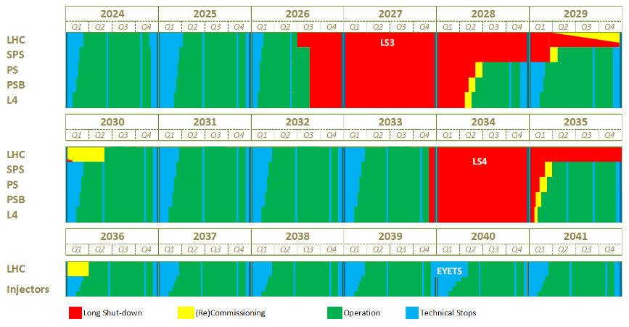
The Updated Long-term Schedule
NA Consolidation Phase 1
ISOLDE Beam Dump and CM1 Consolidation

Slide 26
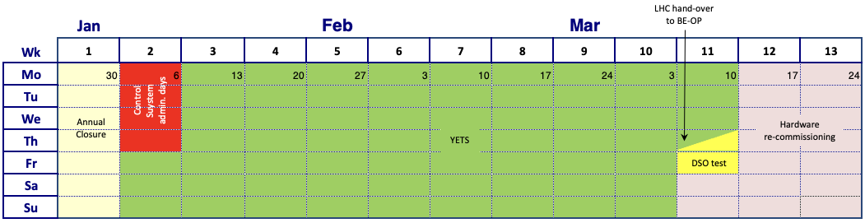
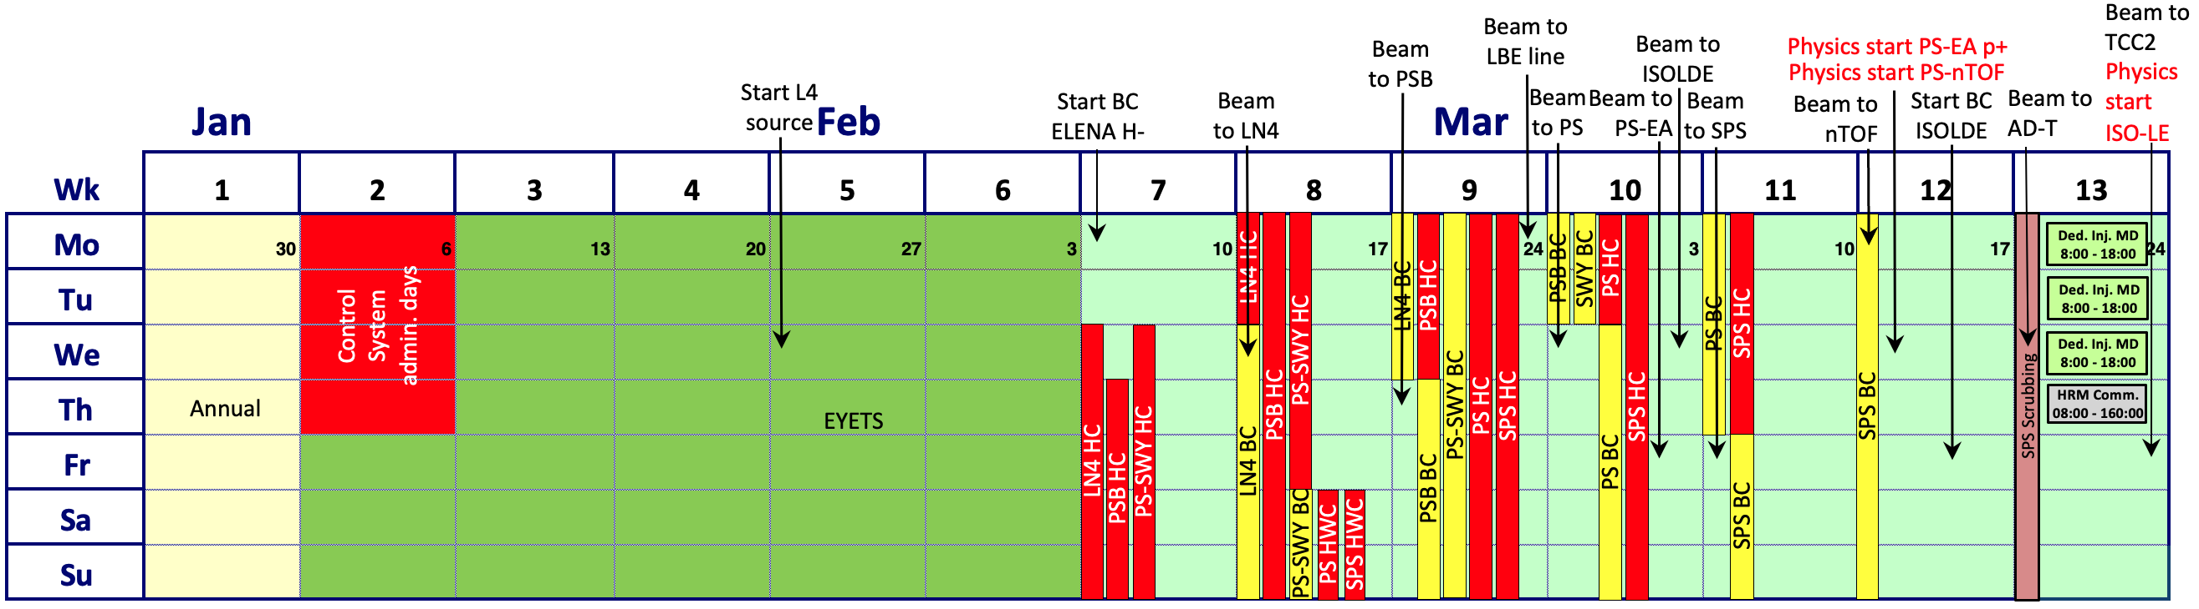
Approved Injectors and LHC Schedules 2025 – Q1
LHC
Commissioning
Injectors
Commissioning

Slide 27
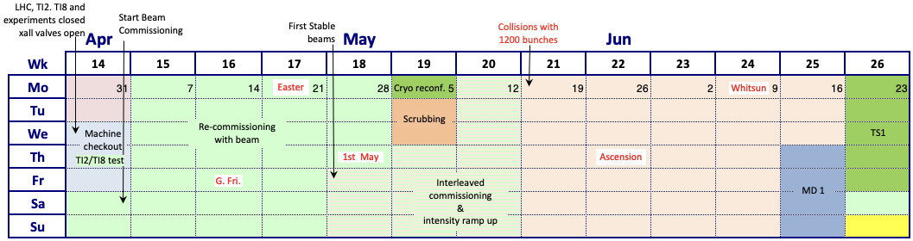
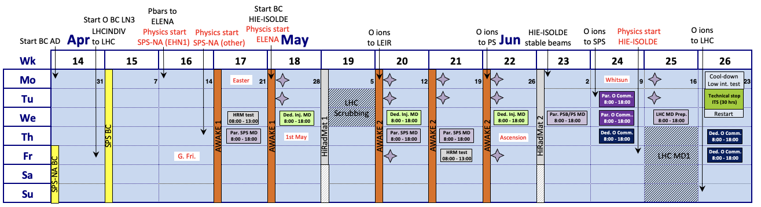
Approved Injectors and LHC Schedules 2025 – Q2
LHC
Commissioning
25 ns p+ physics
Injectors
physics

Slide 28
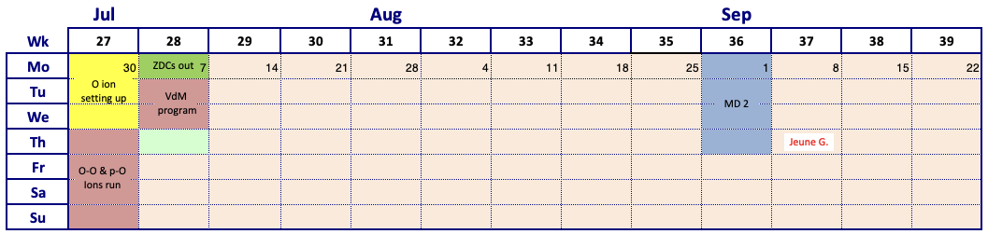
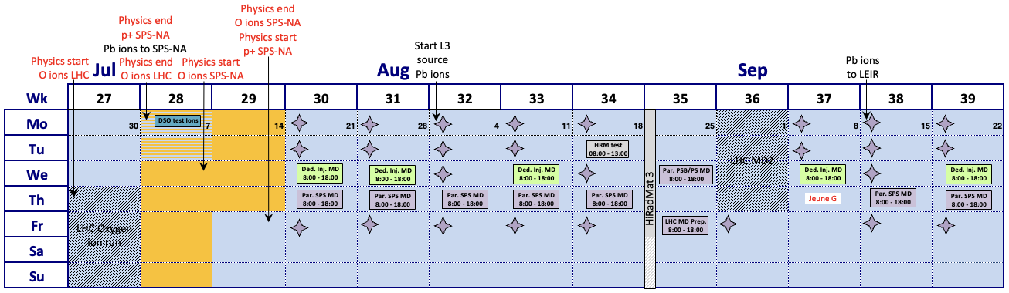
Approved Injectors and LHC Schedules 2025 – Q3
LHC
O ions
25 ns p+ physics
Injectors
physics

Slide 29
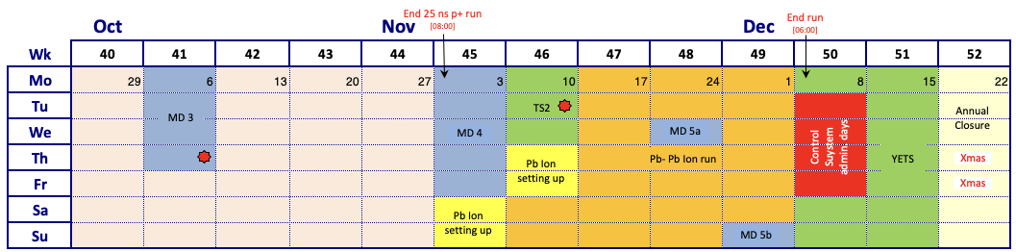
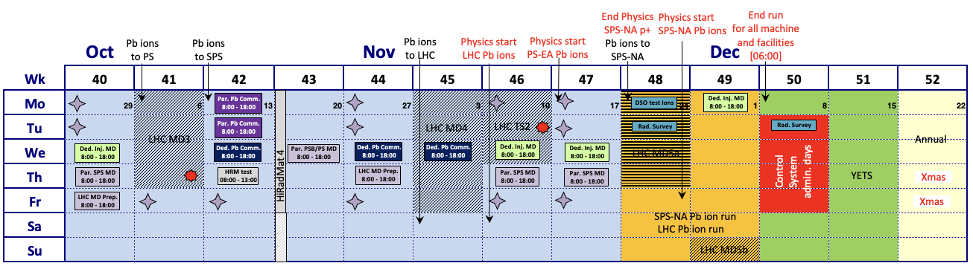
Approved Injectors and LHC Schedules 2025 – Q4
LHC
25 ns p+ physics
Pb ion physics
Injectors
physics

Slide 30
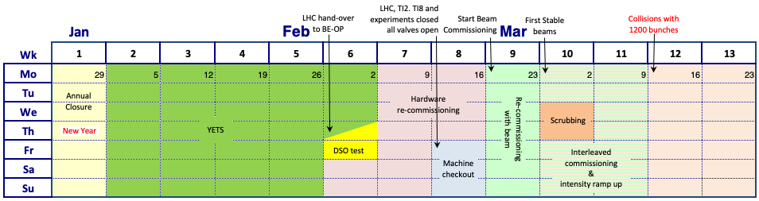
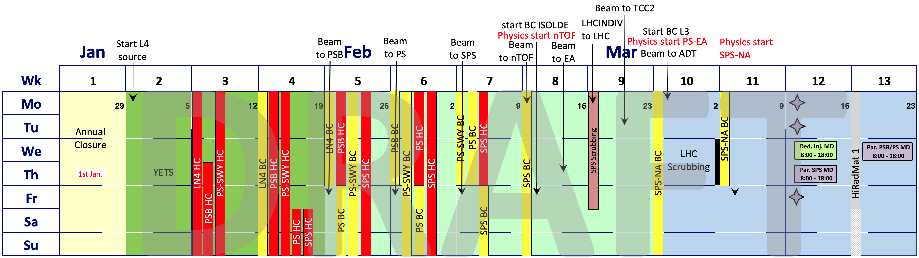
Draft Injectors and LHC Schedules 2026 – Q1
LHC
Commissioning
25 ns p+
Injectors
Remains to be optimised in view of a very short YETS

Slide 31
Draft Injectors and LHC Schedules 2026 – Q2
LHC
Commissioning
25 ns p+
Injectors
Remains to be optimised in view of a very short YETS

Slide 32
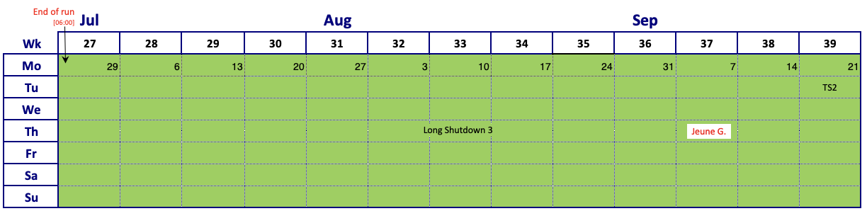
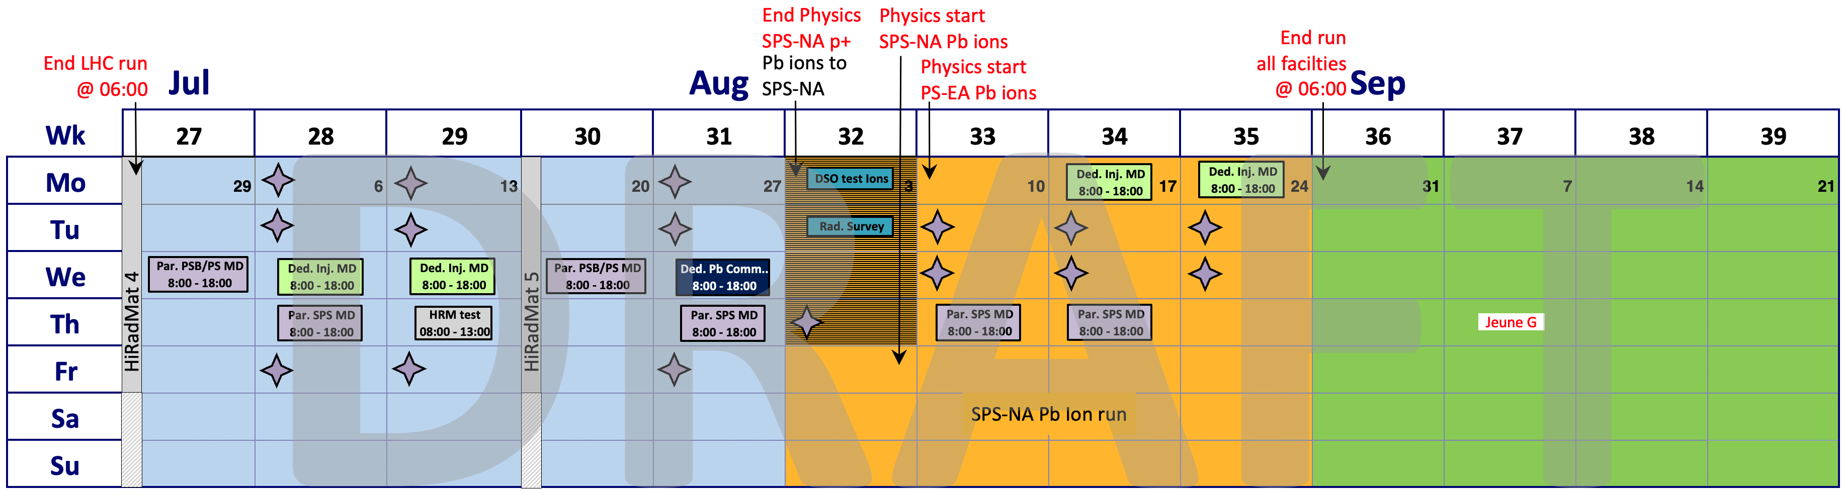
Draft Injectors and LHC Schedules 2026 – Q3
LHC
Injectors

