Slide 1
Fault Tracking in 2024
Jack Heron, Lukas Felsberger, Daniel Wollmann, Jan Uythoven, Bettina Mikulec, Anti Asko
Many thanks to inputs from OP colleagues, Machine Coordinators & System Experts
10.12.2024

Slide 2
Accelerator Fault Tracking (AFT)
More than 12,500 faults recorded and reviewed in 2024. Almost the whole CERN complex.
Many thanks to a tremendous effort from all contributors!
Numerous additional graphs and statistics (not in this presentation) can be found at:
https://aft-stats.web.cern.ch/
https://edms.cern.ch/ui/#!master/navigator/document?D:101732157:101732157:subDocs
Or please ask for specifics! - jack.heron@cern.ch lukas.Felsberger@cern.ch
Fault Tracking in 2024, Join Accelerator Performance Workshop (JAPW) 2024
07.03.2025
Notes:
(If AFT stats are needed, please get in touch)

Slide 3
Structure
Statistics:
  Proton injectors
  Ion injectors
  LHC
  AD/ELENA
  ISOLDE
  EA/NA
What is AFT “actually” offering the community?
Addressing Feedback from the Community
Fault Tracking in 2024, Join Accelerator Performance Workshop (JAPW) 2024
07.03.2025

Slide 4
Proton Injectors
Statistics:
  Proton injectors
  Ion injectors
  LHC
  AD/ELENA
  ISOLDE
  EA/NA
What is AFT “actually” offering?
Addressing Feedback from the Community
Acknowledgment: Gian Piero Di Giovanni, Bettina Mikulec, Kevin Li

Slide 5
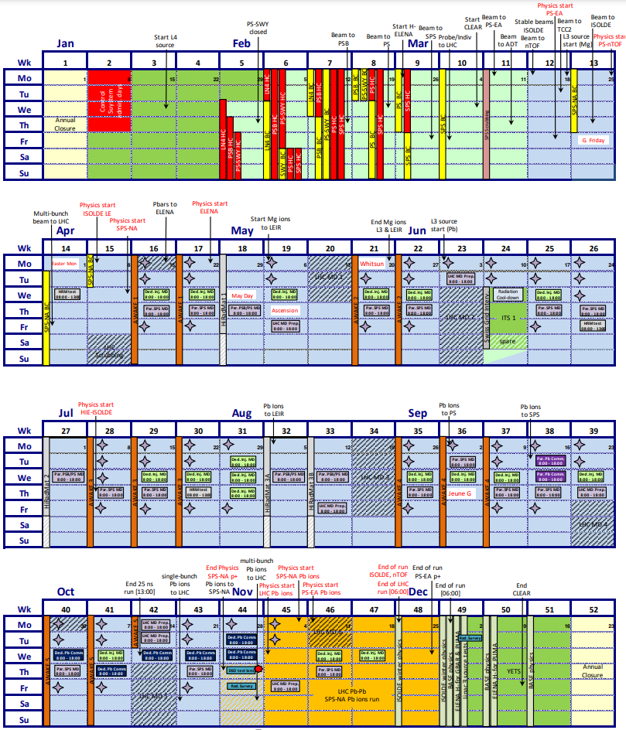
Injector Schedule
V2.2 – Oct 16th 2024
AFT fault recording starts once beam is required for a downstream machine (e.g. L4 AFT starts once PSB starts beam commissioning – Feb 15th 2024)
Dedicated MDs and TS are excluded from statistics (unless they cause delays of the physics periods)
Generally showing root-cause statistics: downtime attributed to system causing the downtime

Slide 6
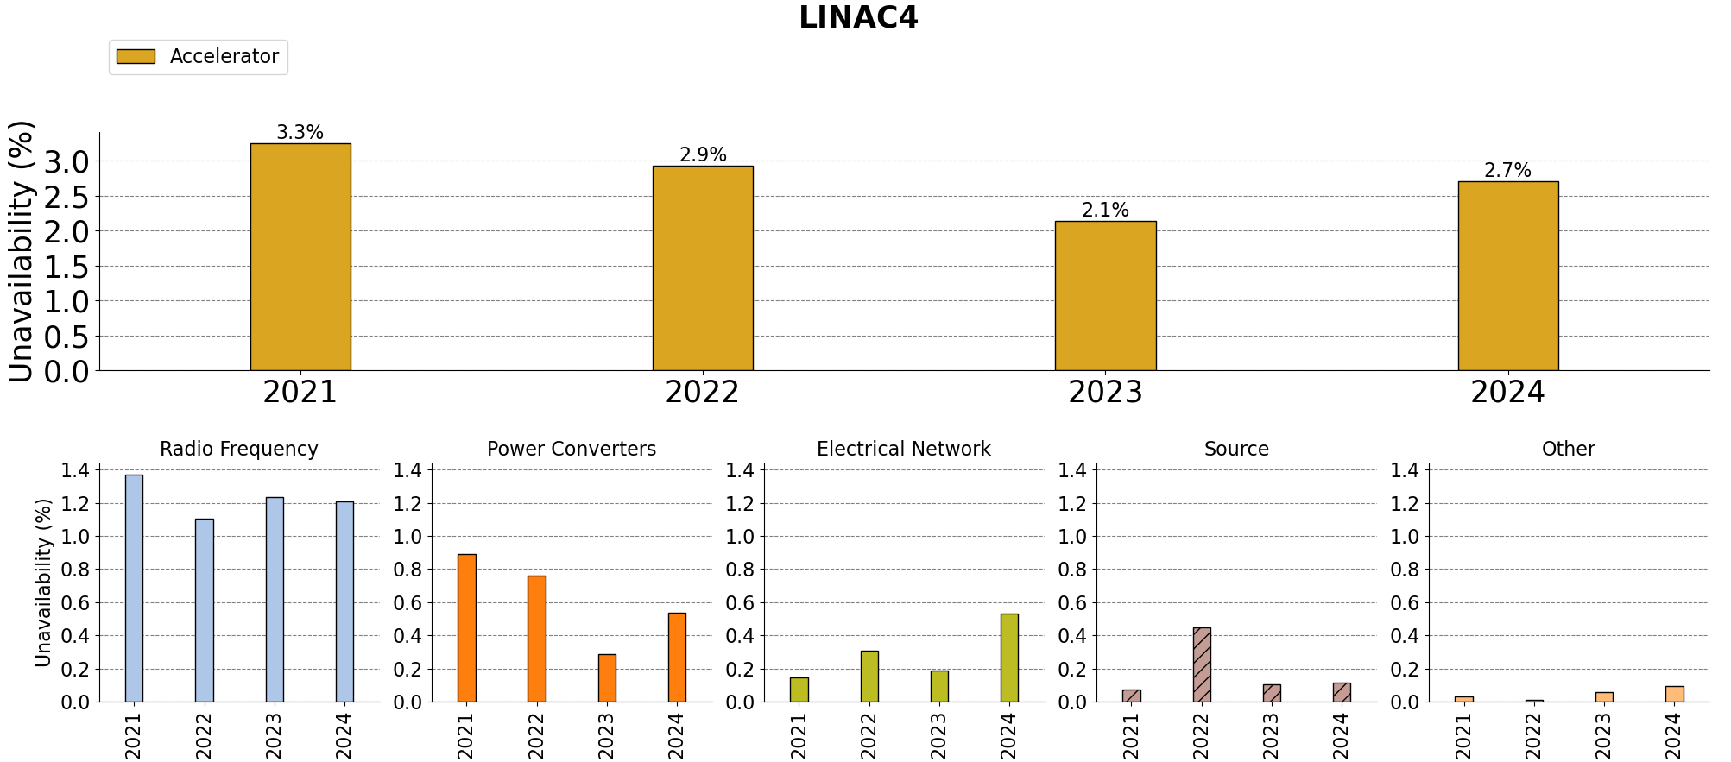
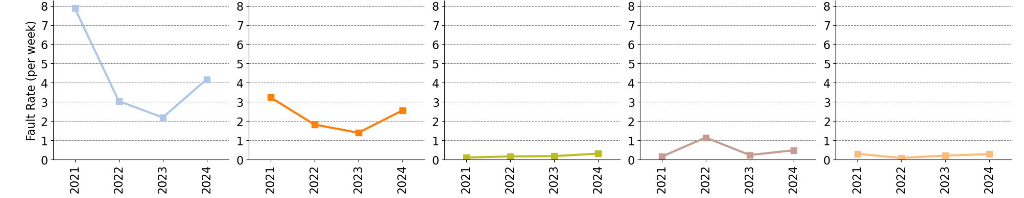
Slight rise since last year
RF: Increased cavity protection and mis-pulse identification
Some large power cuts
Two valve exchanges
AUG box destroyed
A second klystron was exchanged during TS. Possible sign of LEP klystron ageing. Root cause unclear.
Without the CCDTL3 klystron exchange, unavailability is the same as last year (see appendix)
CCDTL 3 Klystron exchange
Sharing of arc faults in klystron-modulator interface has affected statistics
Notes:
Unavailability of LINAC4 rose slightly since last year.
Main topic: klystron exchange possible sign of LEP klystron ageing. Root cause not understood.
This too: New agreement to share faults between RF and PC due to arc in the klystron-modulator system has affected statistics.

Slide 7
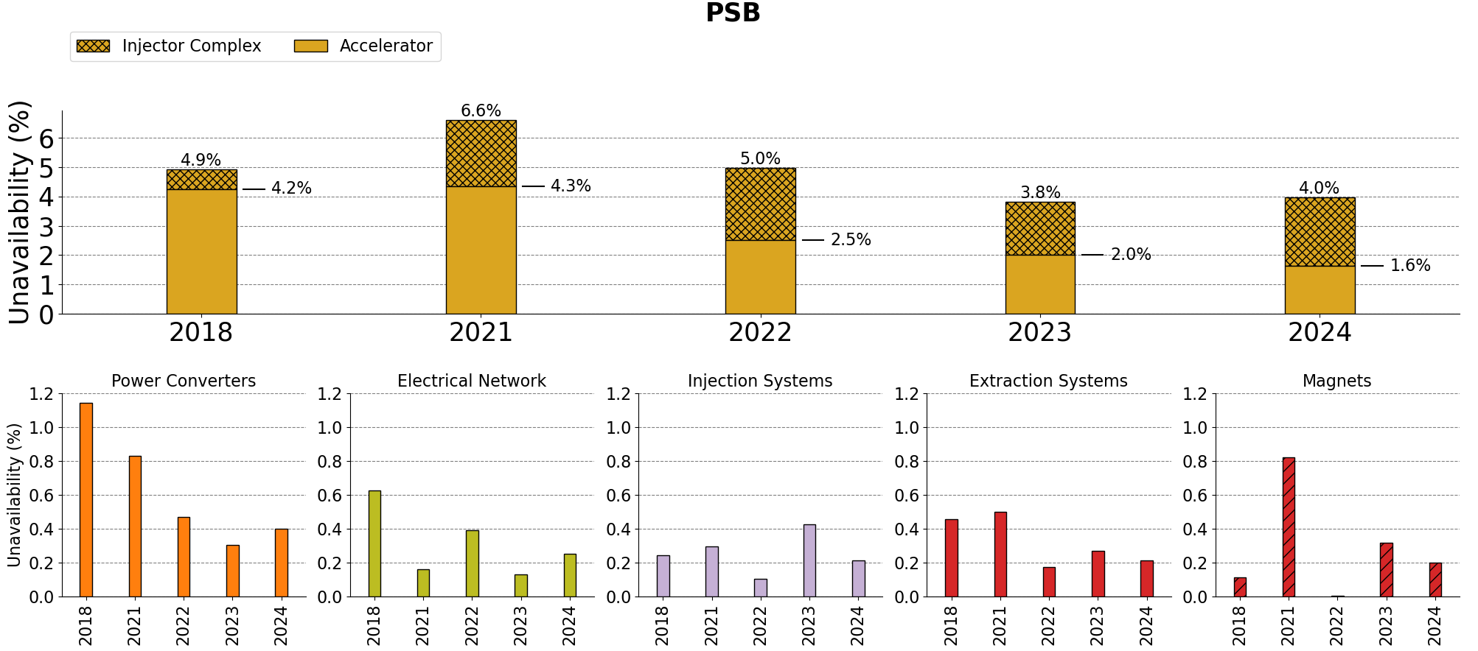
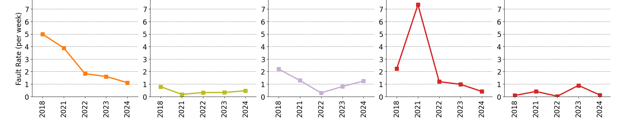
PC: Longer repair times due to ageing BTY electronics. One delayed repair as team stuck in SPS. Should improve post LS3 with ISOLDE 2 GeV upgrade
Injection: Improvement due to lack of BSW issues
Extraction: Got lucky as longest faults were during commissioning
Magnets: Enhanced monitoring minimised access for water leak. Magnets ageing concern has not manifested.
PSB has an availability advantage as full performance can often be gained with three of four rings. This is thanks to great work by the operations team!
Record high availability
BTY.QDE120 (only ISOLDE)
R2,3 SF holder
Many non-blocking kicker faults not shown
EA cubicle exploded
BSW issues
Enhanced monitoring
Work minimising losses and kicker voltage
Notes:
PSB has record high availability since we started monitoring.
Magnets magnets magnets

Slide 8
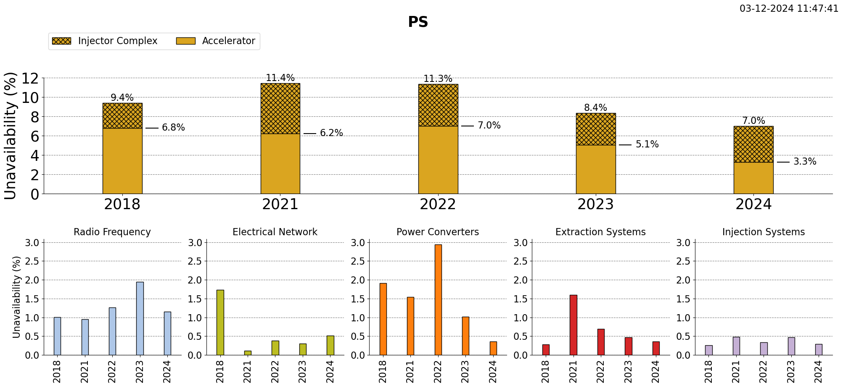
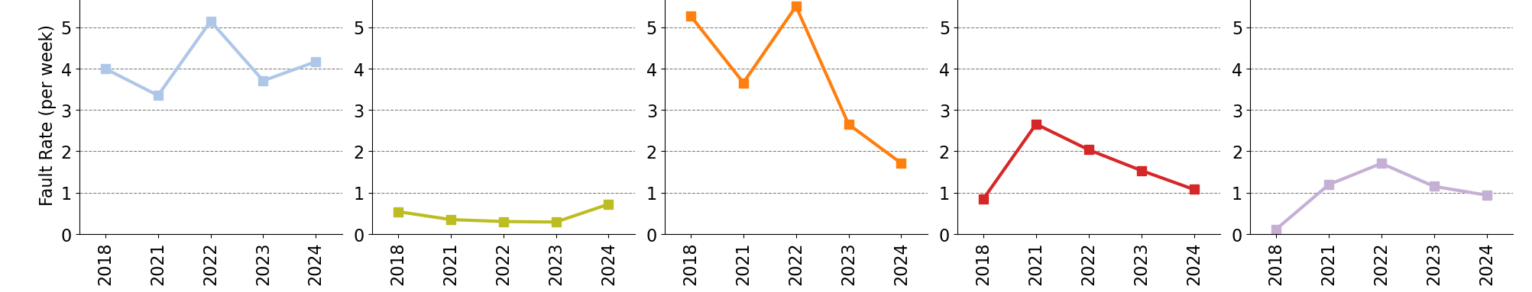
Continuous work and improvements from equipment experts and OP
Resolution of certain fault types (POPS, RF, ABT)
RF: Automatic reset and restart of cavities as well has hard work from RF team. This success has led to consideration for implementation in SPS.
Long faults (LLRF signal, gap relays) to be mitigated in LS3
Power Converters: accumulation of water-cooling faults for certain circuits will be followed up during YETS
Injection/Extraction: Mitigations planned during YETS. Contribution expected to continue decreasing.
Huge reduction in medium down time faults since 2022 (see appendix)
Record high availability
A few long
faults after
LS2 restart
POPS
issues
RF issues
Downward trend
POPS
Some long incidents
Downward trend
Notes:
PS has hit a record low for unavailability since we started recording faults. This has been consistently reducing since 2022.
Due to “continuous work and improvements from equipment experts and OP, combined with understanding and resolution of certain fault types (POPS, RF, ABT). Automatic restarts of cavities.
RF had ageing concerns but offset by automatic reset/restart. Consideration for implementation in SPS.

Slide 9
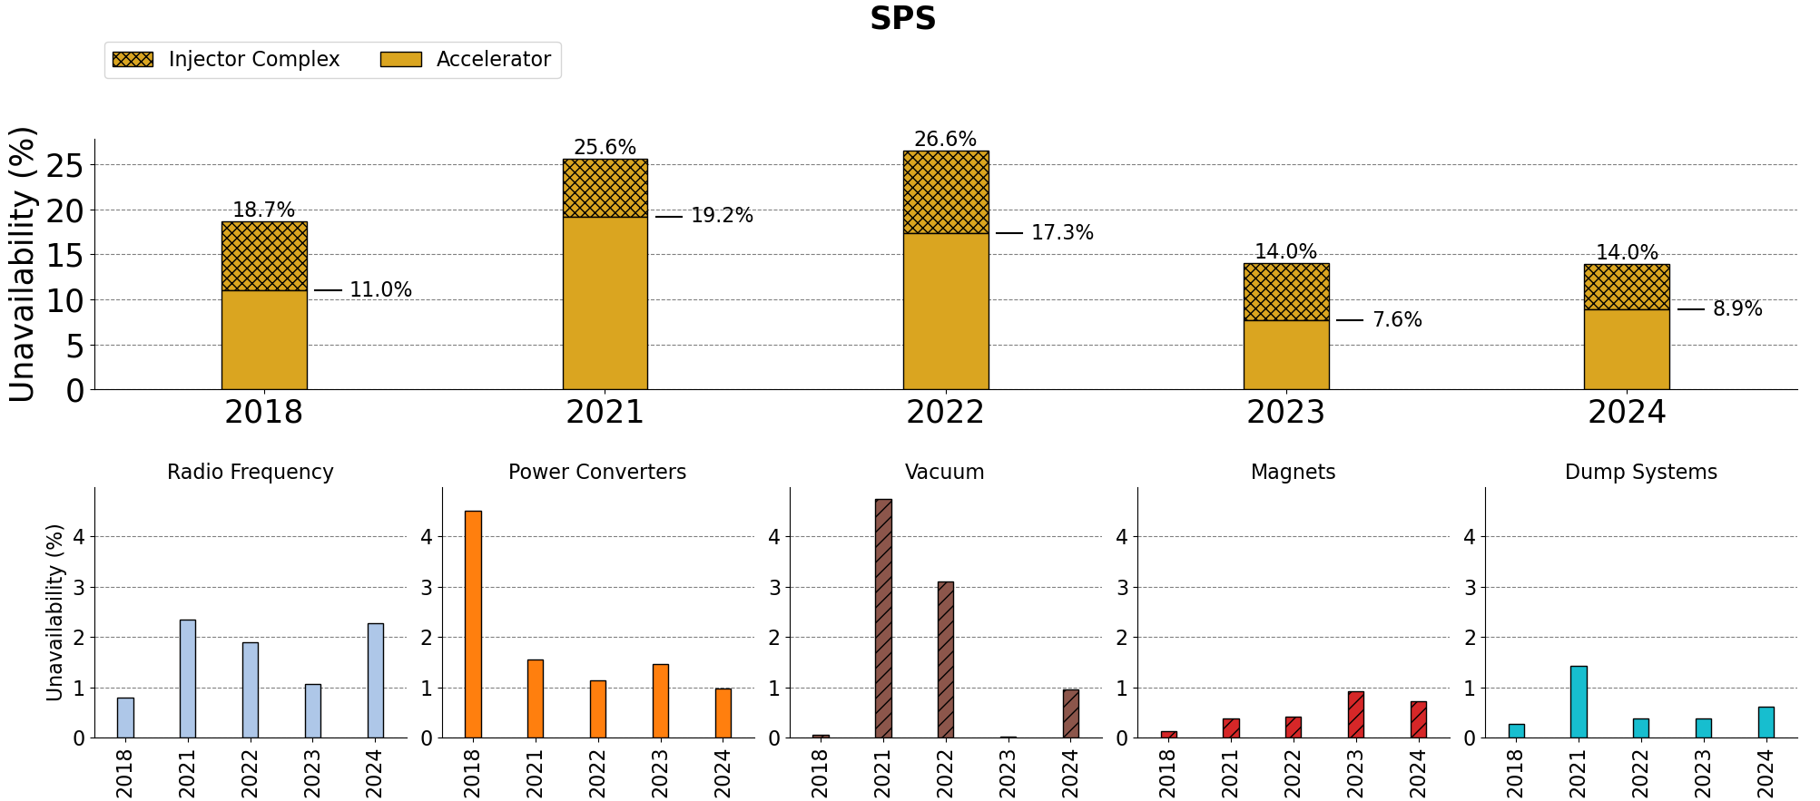
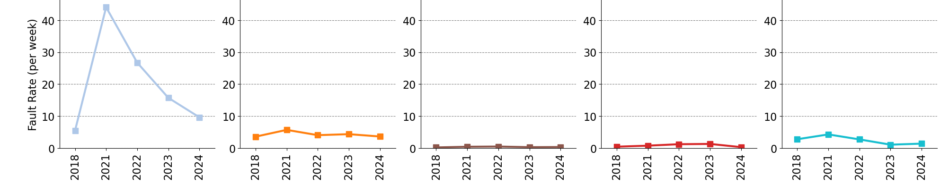
Overall not much change since last year
IC down, SPS up
RF and CV: Mitigations for long down time faults in YETS
Short faults (<2h) remain a significant contributor to down time (see Appendix)
Long MBB faults likely to continue
Exchange of dipoles
Leaking chamber led to exchange of MBA.63450
MBB 635.30 inter-turn short;
NA stop BEND02
Two faults > 5 days of down time
No extremely long faults
Many pulse trips on transformers, normally < 2h blocking
Notes:
SPS is overall the same as last year. The drop in contribution from the injector complex was compensated by a larger contribution from SPS itself.
RF had the largest down time due to a small number of long faults in cavities 1,3 and 6. Vacuum and magnets led to exchange of four dipoles.
Power Converters had no extremely long faults. Its 2nd place came as a surprise. Worth taking a closer look.

Slide 10
Proton Injectors - Conclusions
PSB and PS: Record high availability! ( 98.4 %, 96.7 % )
LINAC4 and SPS: Availability stable and high ( 97.3 %, 91.1 % )
Variations are mainly from single-event long-duration faults (see appendix)
Warm magnet consolidation effort is underway. Long down times may persist.
  See 360th IEFC meeting 13 Dec 2024 https://indico.cern.ch/event/1485823/

Slide 11
Ion Injectors
Statistics:
  Proton injectors
  Ion injectors
  LHC
  AD/ELENA
  ISOLDE
  EA/NA
What is AFT “actually” offering?
Addressing Feedback from the Community
Acknowledgment: Richard Scrivens, Richard Scrivens, Theodoros Argyropoulos, Oliver Hans

Slide 12
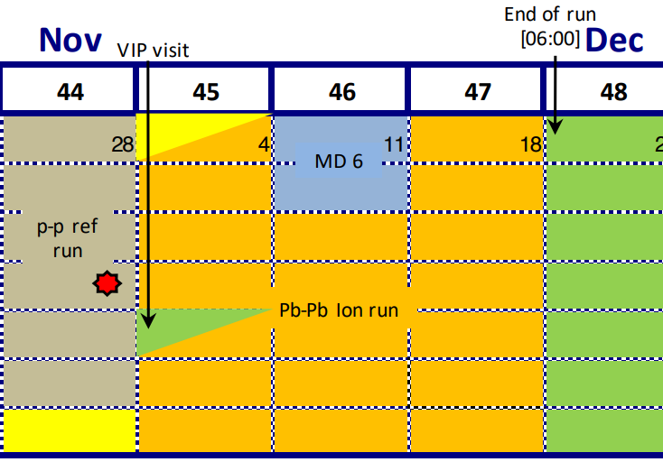
Ion Injectors – LINAC3 & LEIR
When LHC, North Area and East Area get ions
  only 4 weeks in 2024 → ‘weak’ statistics. Graphs are not to be overinterpreted.
  Review AFT periods for next year?

Slide 13
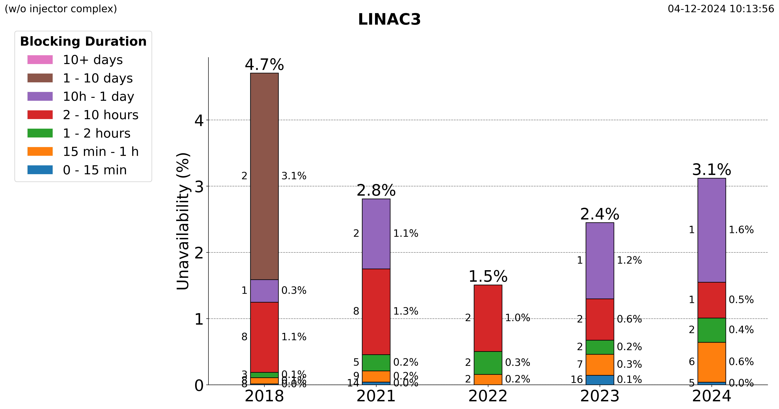
Source problems & Recovery from network glitch
RF cavity 1
‘Unplanned’ oven refill in last week of operation
Up to last week it was an excellent year
Long term strategy needed for long lead time spares in ion source
Notes:
Up to last week an excellent year, then the oven refill happened.

Slide 14
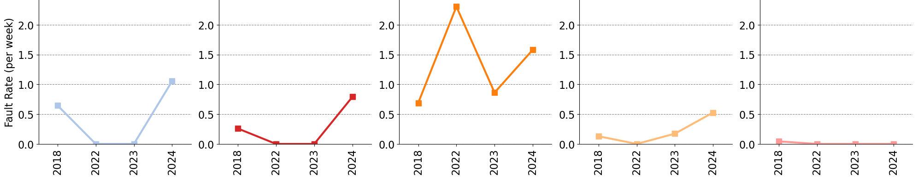
Mitigations foreseen in YETS
Almost all down time
Notes:
More issues on RF & Extraction Systems. Experts are aware in both cases and mitigations foreseen in YETS24/25

Slide 15
LINAC3, LEIR Conclusions
Overall strong performance ( 96.9 %, 98.4 % )
Only 4 weeks accounted in 2024 → statistics shouldn’t be over-scrutinised

Slide 16
LHC
Statistics:
  Proton injectors
  Ion injectors
  LHC
  AD/ELENA
  ISOLDE
  EA/NA
What is AFT “actually” offering?
Addressing Feedback from the Community
Acknowledgement: Matteo Solfaroli Camillocci

Slide 17
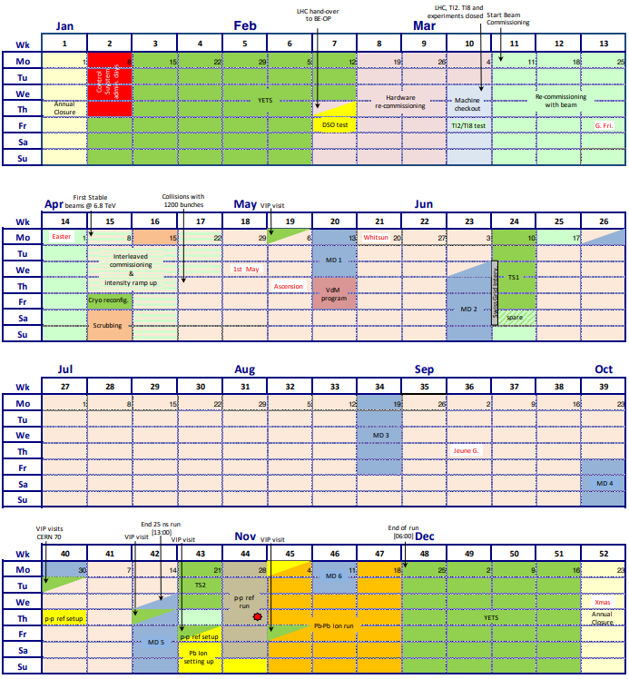
LHC Schedule
V2.2 – Oct 14th 2024
LHC “All Operation”:
From start of recommissioning with beam to start of annual shutdown
Includes MDs, excludes TSs
Permits tracking of all faults and delays
LHC Protons:
From first stable beams declaration to end of 25ns run
Dedicated MDs, set up periods, special physics, VIP visits and TS are excluded from statistics
LHC Ions:
From start to end of Pb-Pb Ion run
Dedicated MDs, set up periods, special physics, VIP visits and TS are excluded from statistics

Slide 18
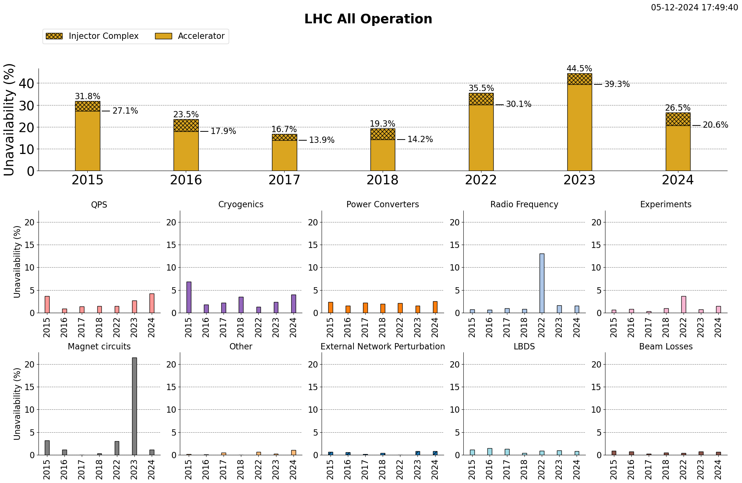
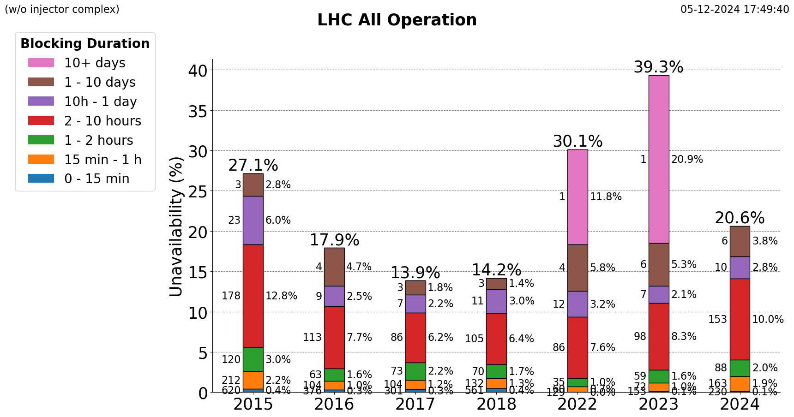
2024 had the best availability of Run 3
Not as strong as the best of Run 2, but we’re also pushing bunch intensity, heat load, beam energy, etc.
A lot of great work this year.
But for availability, the only real game-changer was missing one long fault.
Some trends:
Mid-range faults (2-10h) increasing
Overall faults <24h increasing
Explained by:
QPS
Other: Heat load issues + new categories (e.g. scheduled access)
Experiments emulsion changes
Best availability of Run 3
IT.L8 Vacuum Leak
RF burst disks
Notes:
This year there were many great achievements and a lot of really impressive work. (Exceeded integrated luminosity target, etc. etc.)
HOWEVER:
For availability, the only real game-changer was avoiding one extremely long fault.
Moreover, other underlying trends are visible:
Unavailability of medium-duration faults (2-10 h) have been steadily growing since 2017.
Unavailability overall (removing extremely long faults) is also steadily increasing.
QPS is big contributor. More faults recorded under “Other” has schedule access that was not previously considered down time, and heat load issues. Experiments has emulsion changes which did not previously exist.

Slide 19
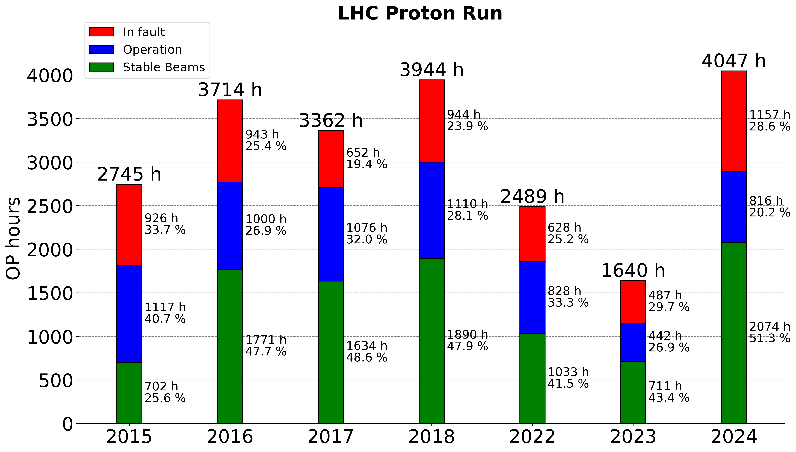
Longest proton run since 2015
2022 and 2023 proton physics schedules were reduced due to long faults and energy-saving measures
RF burst disks
IT.L8 vacuum leak
Highest % in stable beams
Notes:
Protons: We had the longest schedule in proton physics this year since 2015, and also landed the highest percent of time spent in stable beams.
Start counting proton run from first stable beams

Slide 20
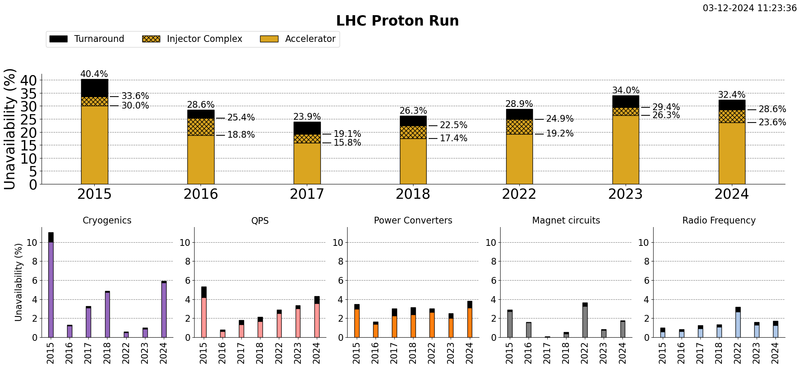
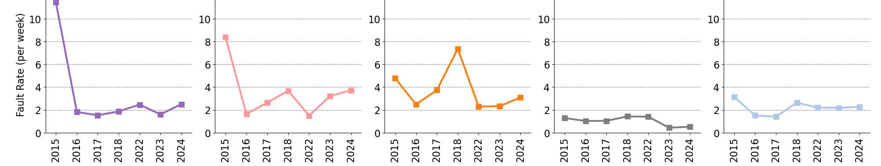
Stable since last year
Cryogenics bad year
3 faults > 132 h
Mitigations at IP8 planned during YETS
QPS concerning trend
Further bunch intensity increase could impact availability in 2025.
Change of beam type (25ns vs hybrid filling scheme) may also bring surprises.
3 faults in 1.8K production
Consistent upward trend since 2016
Notes:
For availability in the proton run, we at least didn’t do worse than last year.
Main contributing systems are Cryogenics and QPS.
Cryogenics has a bad year with 3 faults in total accounting for more than 132 h of down time.
Particularly concerning is QPS, with a consistent upward trend since 2016.

Slide 21
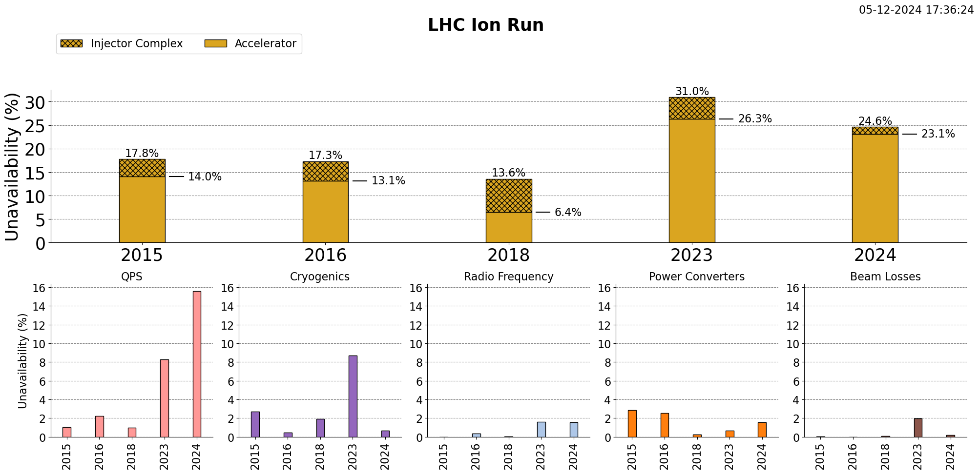
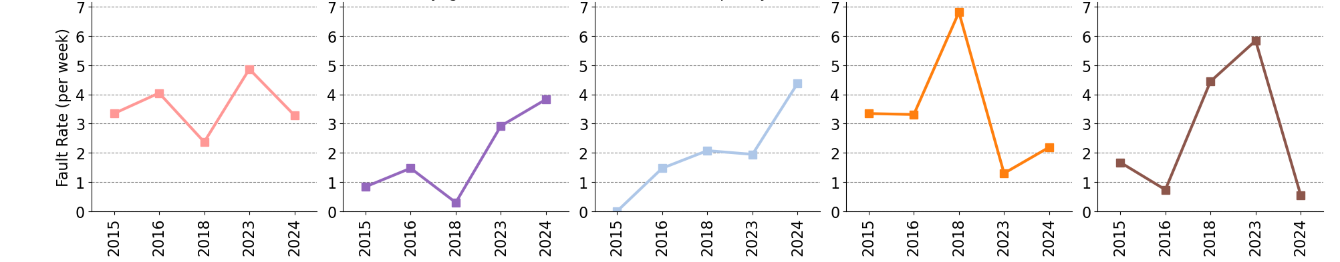
QPS: ion run problems https://indico.cern.ch/event/1484357/contributions/6255477/attachments/2980053/5246981/LMC04122024_Quenches_during_Ion_Run_2024_v2.pdf
Not running in cryogenics eco mode has paid off
Excellent luminosity production because of higher bunch intensities.
Turnaround penalty not yet included for Ion statistics.
Huge reduction in fault rate
Notes:
For availability we’re better than last year. But nothing ground-breaking.
QPS is the largest contributor to down time

Slide 22
LHC Conclusion
Best overall availability in Run 3 ( 80 % ).
Largest % of time in stable beams.
No long faults
Availability in physics is stable. Some trends are being following up.

Slide 23
AD/ELENA
ISOLDE
EA/NA
Statistics:
  Proton injectors
  Ion injectors
  LHC
  AD/ELENA
  ISOLDE
  EA/NA
What is AFT “actually” offering?
Addressing Feedback from the Community
Acknowledgement: Laurette Ponce, Emiliano Piselli, Bastien Rae, Nikolaos Charitonidis, Paraskevi Alexaki

Slide 24
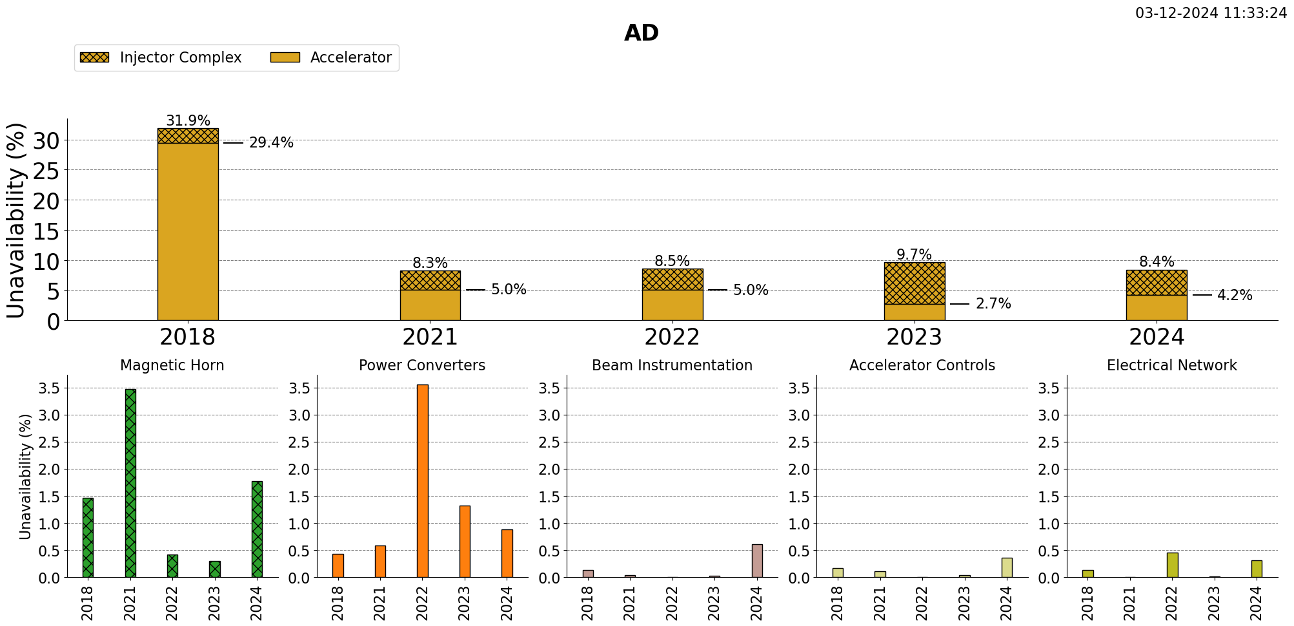
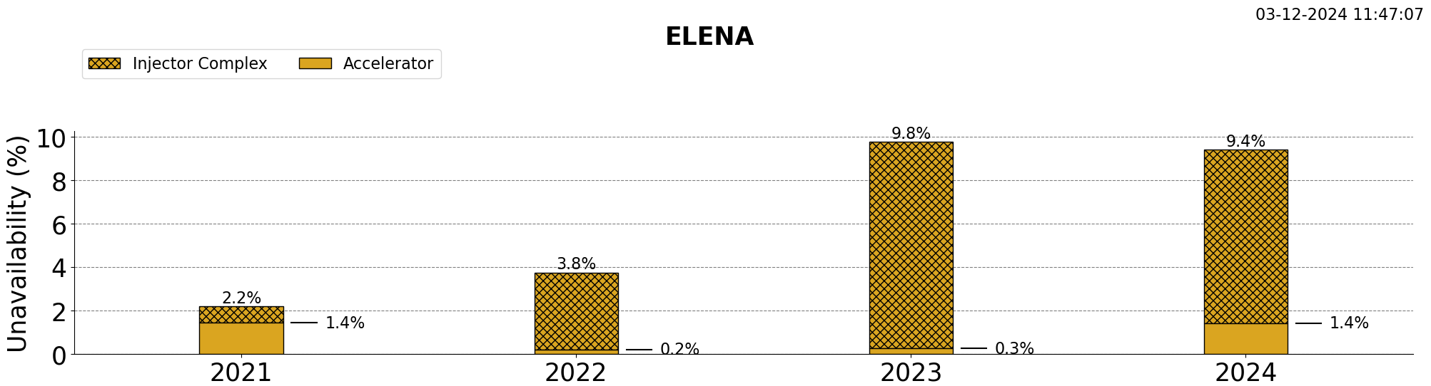
AD:
Issues not shown in statistics:
Many systems in degraded mode: target, magnetic horn
Non-blocking faults with stochastic cooling, instrumentation
Recurrent issues from last year:
Spark in Magnetic horn,
Cooling of the BCCCA (beam current monitor), 4h access needed to refill
PC & Elec. Net.:
Increasing number of trips of e-cooler solenoid PC
Increased number of power cut inducing filament trips → long recovery time
Still many trips of the main QUAD, but quick recovery compared to last year
Heavily delayed physics start date due to magnet fault
Recurrent fault from last year
E-cooler solenoid power supply trips
E-cooler filament trips
ELENA:
Most down time from upstream
Most down time is destination dependent
No piquet service – specialist repair only in work hours
Notes:
2023 heavily delayed physics start date due to magnet fault – not included in statistics
Does not take into account many systems in degraded mode: target, magnetic horn, non-availability of instruments. Also non-blocking faults with stochastic cooling.
Magnetic horn has recurrent fault in BCCCA He level, access needed to refill. Same problems as last year.
Trips of the e-cooler filament and solenoid power supply has big availability impact (>8 h of beam set up)

Slide 25
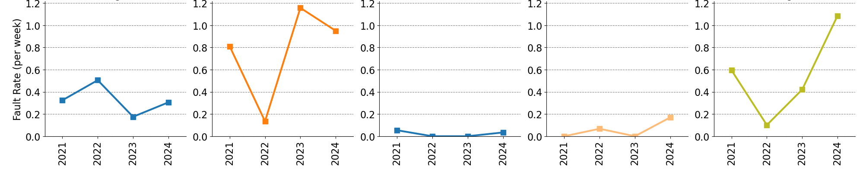
Slow upward trend
Sulfur dispenser heater not working - no miniball physics.
Oven filament problem.
Target line trip due to transformer.
Grounding rod of HRS Faraday cage in target zone moved during target installation.
Robot blocked at entrance to GPS Faraday cage. Impossible to establish beam conditions
ISOLDE:
Most of the down time due to target. New users conducting R&D.
Slow upward trend is accountable to a small number of long duration faults (see appendix).
Contribution from faults w/ blocking duration <10h is stable.

Slide 26
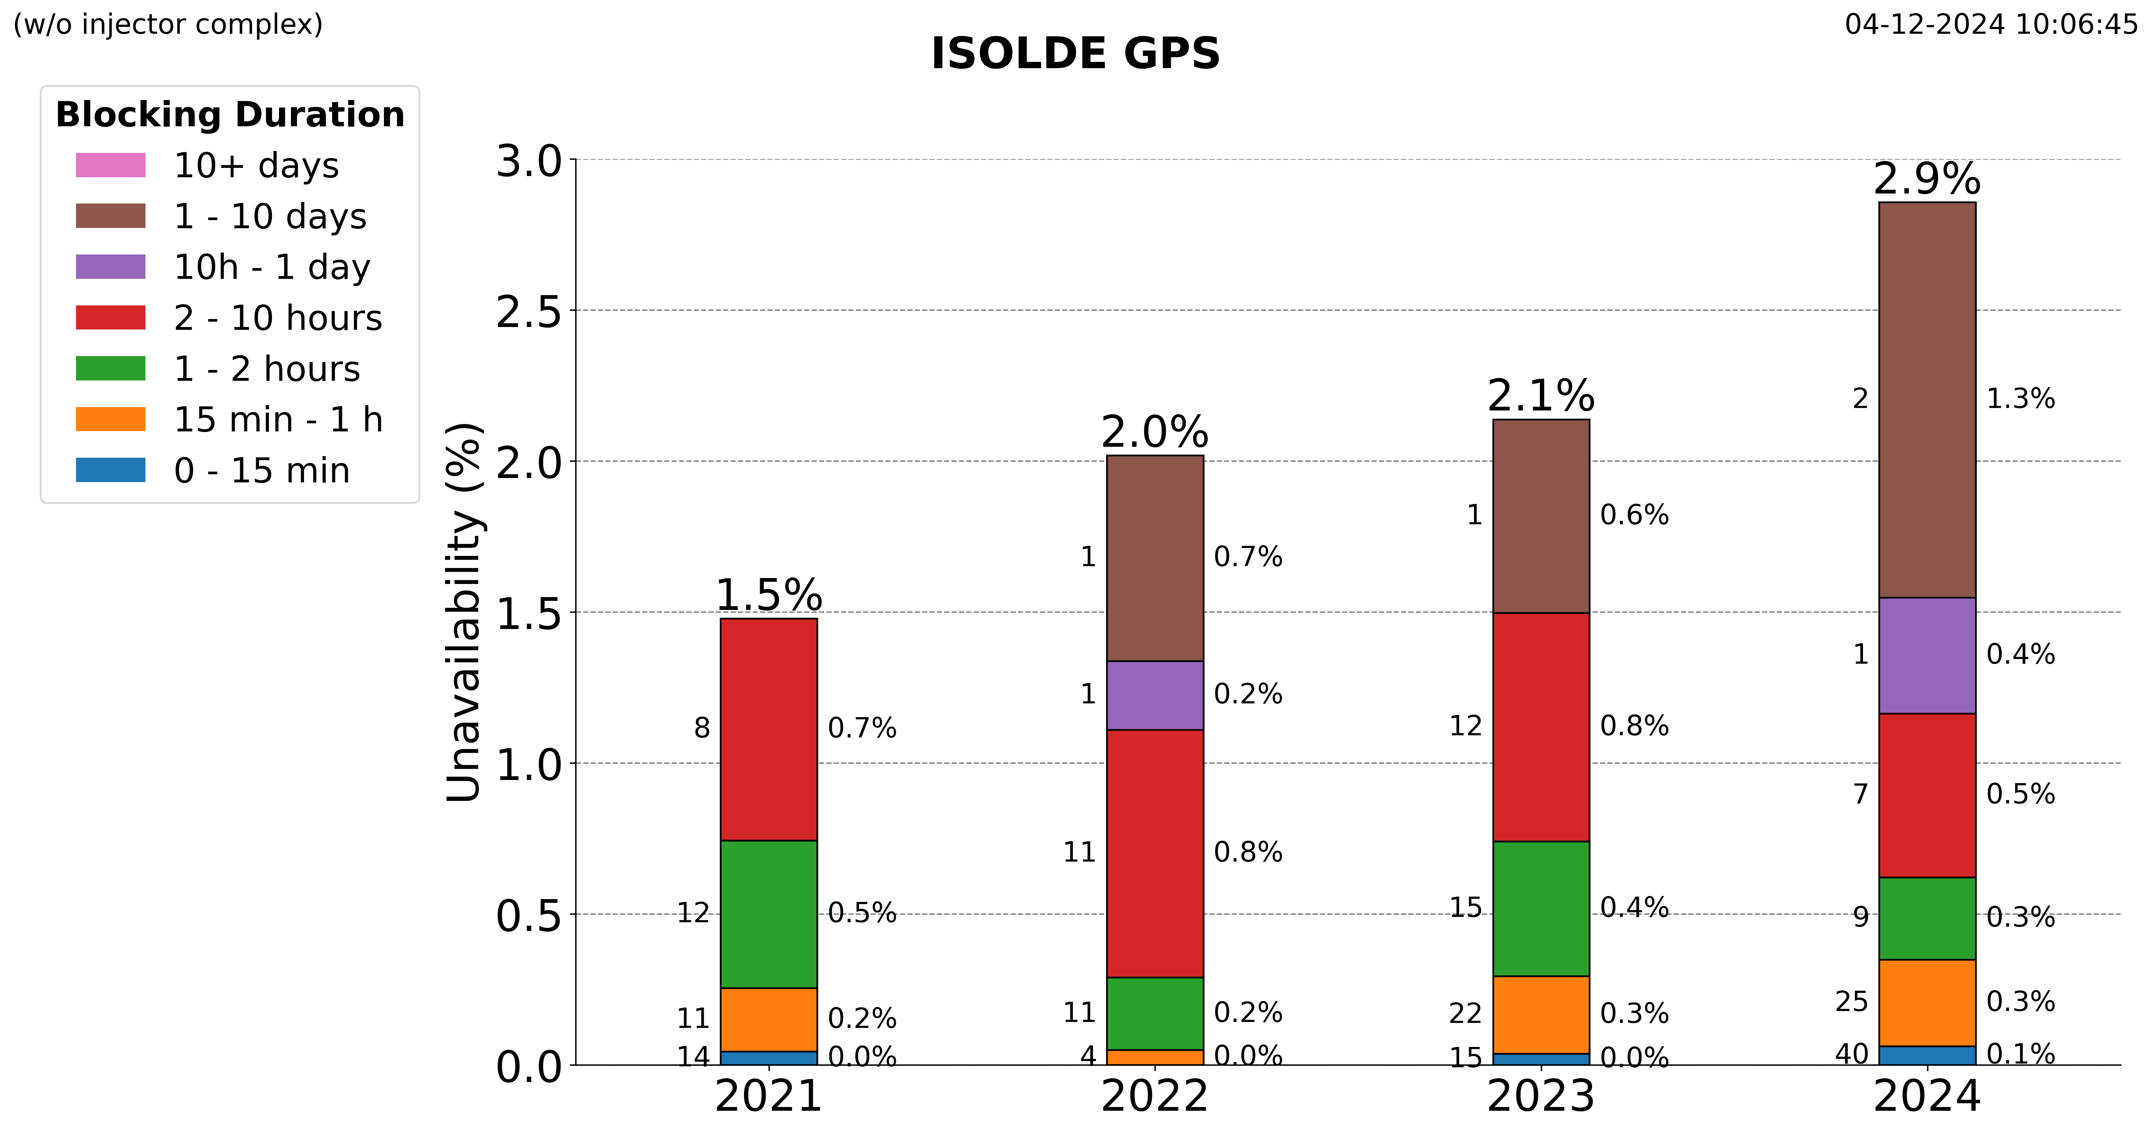
3 long duration faults
Contribution from faults < 10h is stable
Long faults (> 1 days) on the rise (possibly statistical effect). Short faults stable.

Slide 27
North Area:
Magnet issues (see e.g. IEFC 27 October 2023, 25 May 2021), mitigation strategies are foreseen
https://indico.cern.ch/event/1339773/
High contribution from magnets
East Area:
EA cubicle exploded
Many thanks to Paraskevi Alexaki for data extraction!

Slide 28
Conclusions AD/ELENA, ISOLDE, EA, NA
Availability good and stable:
  AD 95.8 %, ELENA 98.6 %,
  ISOLDE GPS 97.1%, HRS 94.8%, REX-HIE 87.9%
  EA >99%, NA 96-98%

Slide 29
What is AFT “actually” offering the community?
– answer “no”
JAPW 2023: “Is the LHC falling apart?”

Slide 30
“What is measured is improved”
This year we know:
PSB and PS had record high availability
LHC had best availability in Run 3
We know why
We agree on why
Check out plots for your own system at:
https://gitlab.cern.ch/mpe-reliability-tools/aft_processing/-/tree/v2/output?ref_type=heads
Input for:
Performance benchmarking
Consolidation priorities
Availability modelling of future accelerators

Slide 31
Addressing Feedback from the Community
Convenience and ease-of-use for operators & equipment groups
  Road map for AFT 2.0 is prepared
  Goal to launch for injector restart post-LS3
Integration w/ EAM asset management
  Prototype for EAM and AFT integration released, Nov 2024
Fault Tracking Automation
  “Automatic fault analysis and prognostics” – Anti Asko, Thursday 11:55
See for reference: https://indico.cern.ch/event/1466640/
Notes:
EAM – to support equipment groups more, and prevent double book keeping

Slide 32
Conclusion Overall
A good year:
  Proton and ion injectors are high performing
  LHC best availability of Run 3, highest percent in stable beams
  Experiments are performing well, no alarm bells
  This shows consolidation strategy is paying off well.
AFT data gives us valuable insight on equipment performance across the complex
  No small amount of effort - many thanks to all AFT contributors!
AFT is improving
  Feedback has been collected across the full spectrum of users
  Aiming for significant leaps post-LS3!

Slide 34
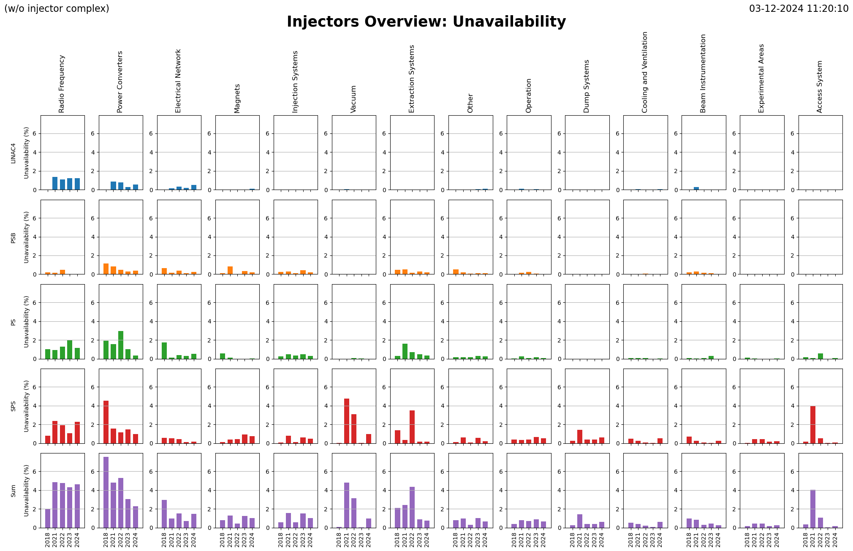

Slide 35
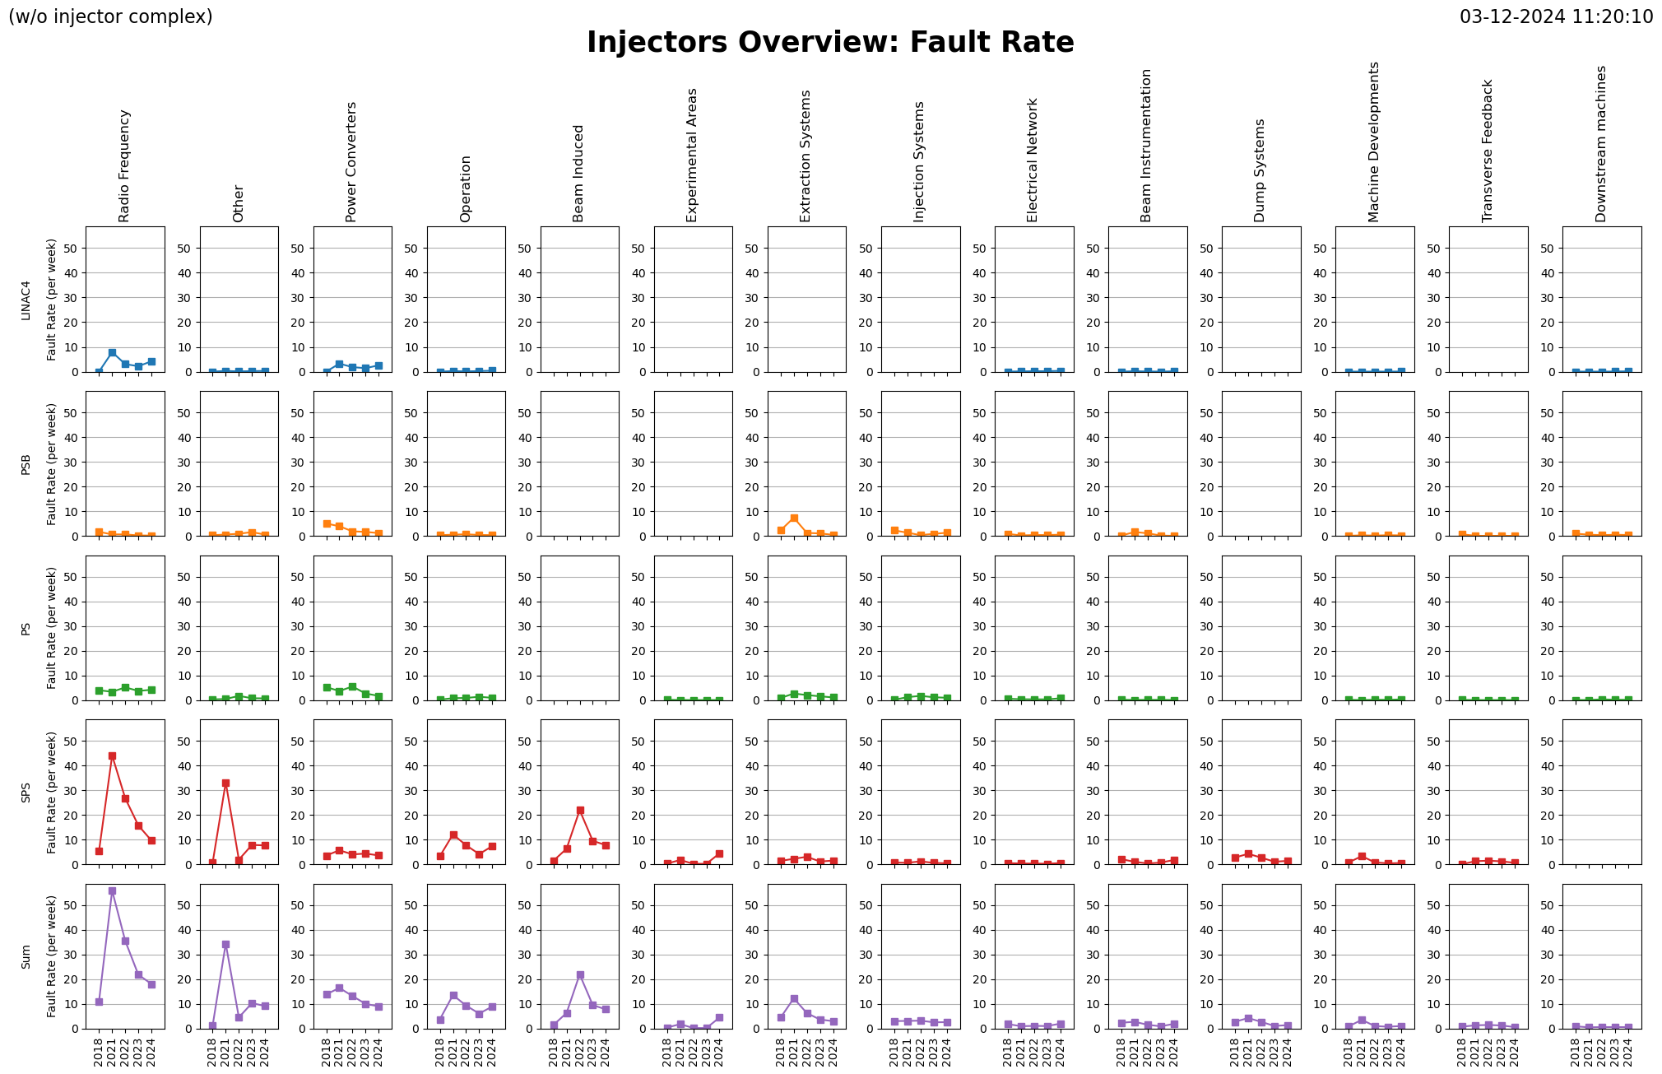

Slide 36
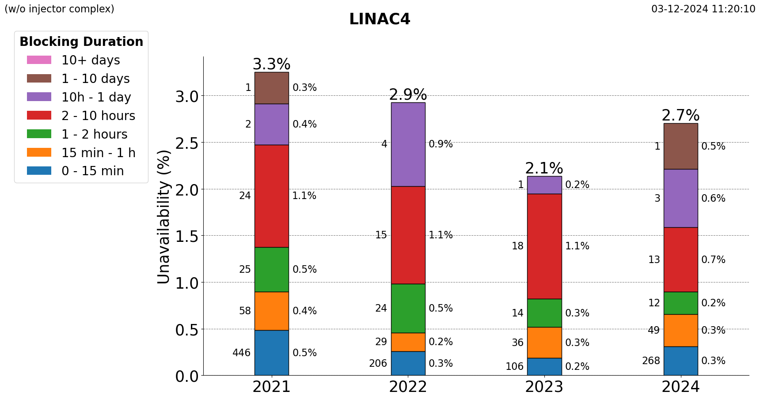
Without the klystron exchange, availability is static
CCDTL 3 Klystron exchange
Notes:
In fact, all of the extra down time compared to last year was the CCDTL 3 klystron exchange. Apart from that unavailability is constant since last year.

Slide 37
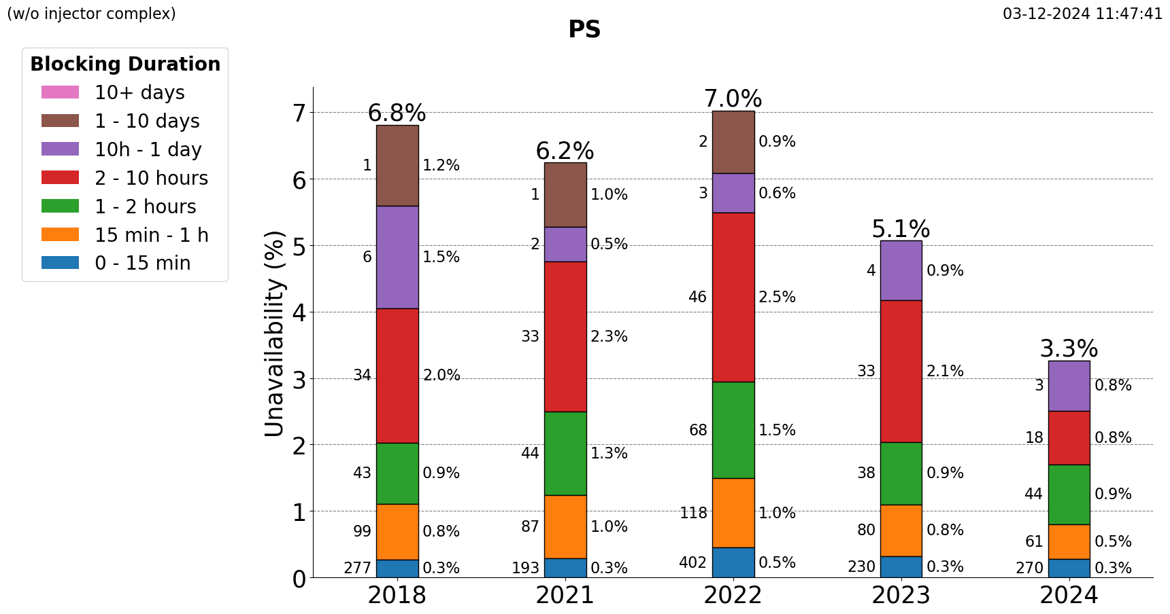
Electrical Network:
  Short circuit on HV cell
  Power cut
RF non pulsing C40/C80
Faults 2-10 h significantly reduced
331 faults w/ duration < 1 h
(Many from RF)

Slide 38
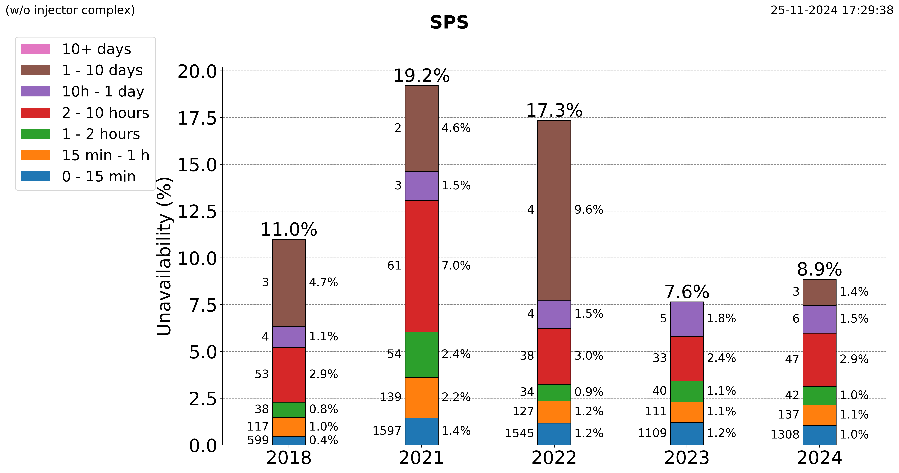
Magnets: MBB 635.30 inter-turn short
Vacuum: Exchange of magnet MBA.63450 with leaking vacuum chamber
CV: Water circuit blocked
Mitigations are foreseen in RF and CV.
Short faults (<2h) remain a significant contributor to down time.

Slide 39
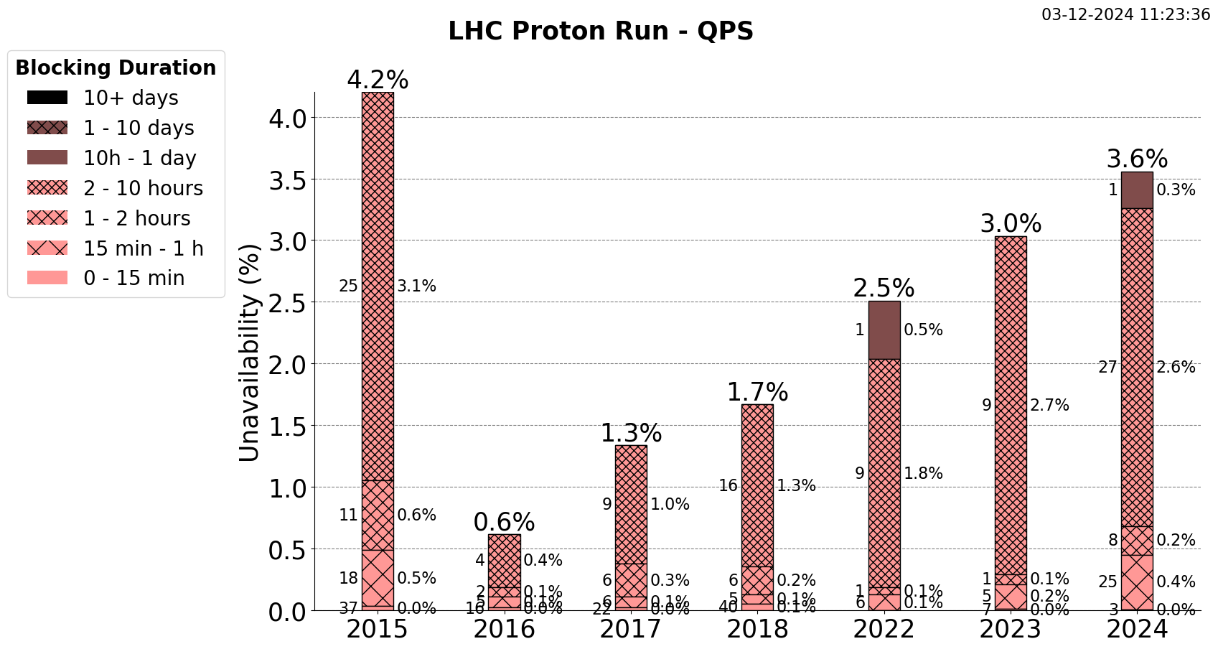
Notes:
By blocking duration, we see that it is primarily accounted for with 2-10 h repair times, of which there were 27 in 2024.

Slide 40
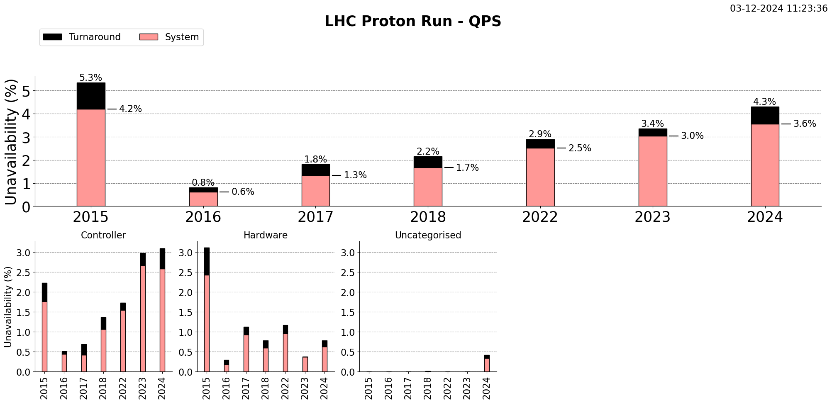
QPS board 11R2
RB23 issue with QPS board for B23R2
MB.B8L5 nQPS board 9L5 in fault, probably R2E, needed to be replaced.
Heaters fired on 4 IPQs (9L8, 10L8, 9R6, 10R6)
QPS fault on RQT13.R5B1
spurious quench heater firing
RB 56, board on 32.L6
QPS circuit breaker in UA43 (UA43.UNIT.B) tripped.
RQF fast abort triggered by QDS B16R5 in stable beams (possible SEU)
QPS RB78, C9L8
Suspected spurious QPS trigger still under investigation by MP3
Trip of RQ9.L8 leading to loss of S78 and Cryo conditions
QPS made RQT13.R5B1/2 trip
RQD.A23 QPS trip at 6.2 TeV - wrong configuration in nQPS 11R2
RCBXH1L8 trip
nQPS issue 23R2
Heater firing Q9.L8
suspect QPS board failure due to R2E (B9L8)
QPS tripped & fired heaters for RQ5.R5
Trigger of nQPS in sector12.
QPS resets after S23 quench recovery
R2E suspect communication issue on MB.B9R1
Lost communication with MB.C17L5
possible circuit breaker fault on RQ5.R4
bit flip (suspected R2E) in nQPS board 28R8
Blocked communication board type DQAMG, most likely by R2E
Notes:
Further, by subcategory, we see that this upward trend is driven by the Controller, which triggered 26 faults in the 2-10 h range this year.

Slide 41
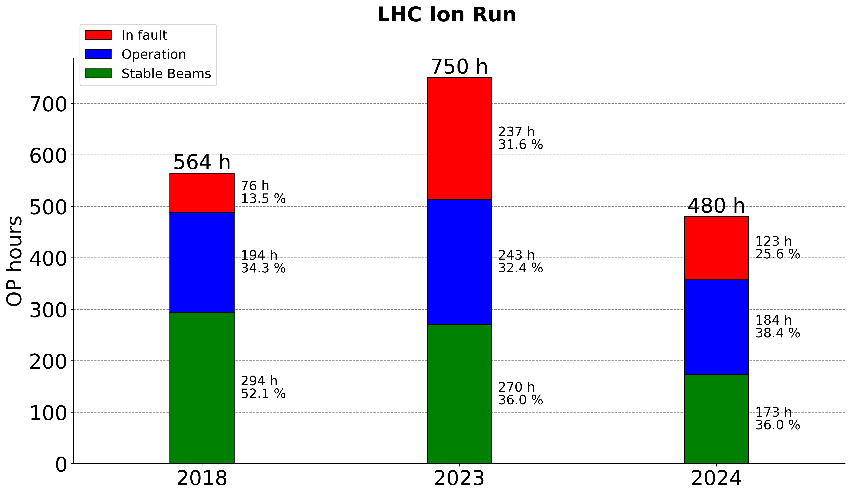
Same % in stable beams as last year
Notes:
The ion run had fewer scheduled hours than last year, but approximately the same fraction spent in stable beams.

Slide 42
Slow upward trend
Several long target problems.
E.g. target 813, 818, 861 broken
2024: Clamping not tight enough: Vacuum leak
18/09: Robot stuck in faraday cage (same problem as in GPS)
Wk21: Issues cycling HRS separator magnets.
19/06: Teslameter MAG90 failure.

Slide 43
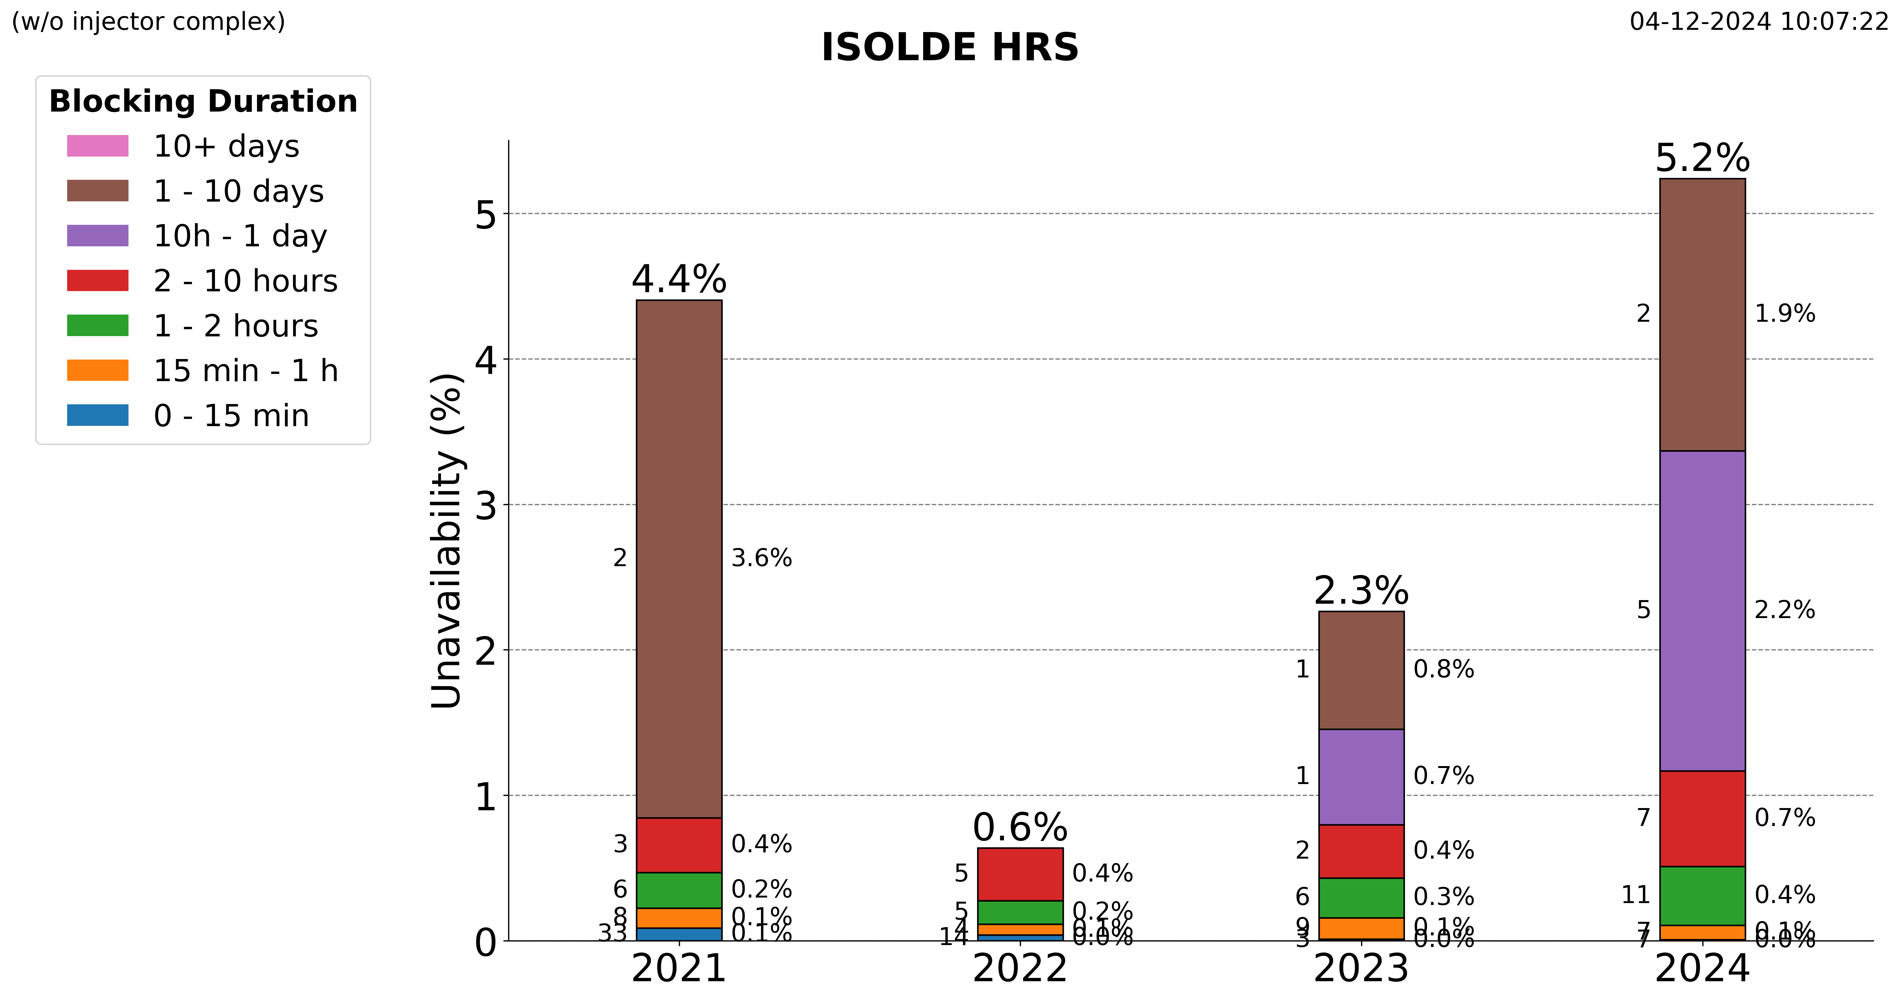
Volatility due to few long faults.

Slide 44
Slow upward trend
18/07/2024: Target #866 Sulfur dispenser heater on target not working
2024: mix of instabilities, trips & interventions
02/09/2024: 18KV Power cut in the Meyrin site
2024: dominated by SC cavity trips
Notes:
Lower share of target faults. More shorter faults significant

Slide 45
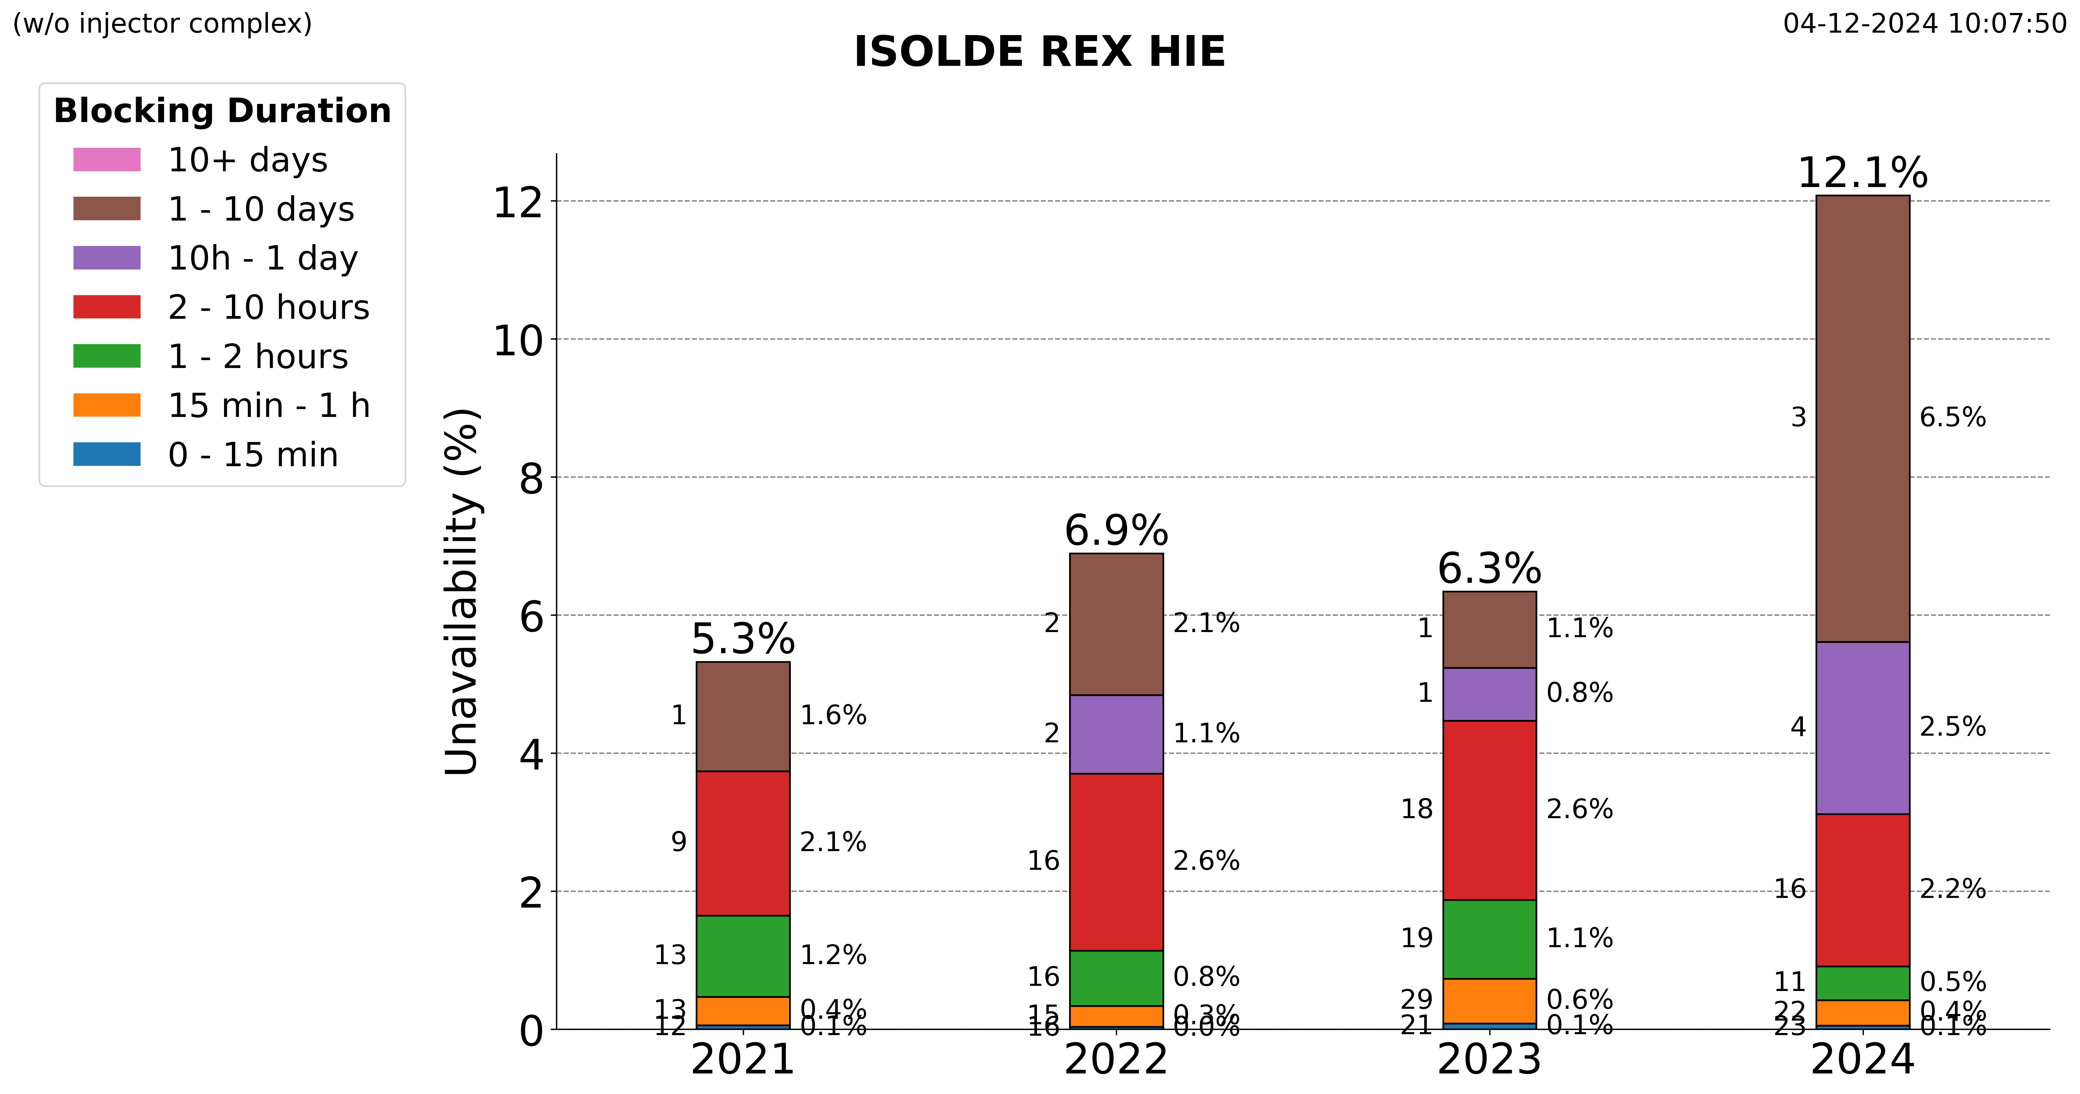
2024 main contribution is few long faults.
(SC cavity trips not recorded one by one, but by placeholder faults reflecting weekly downtime)

