Slide 1
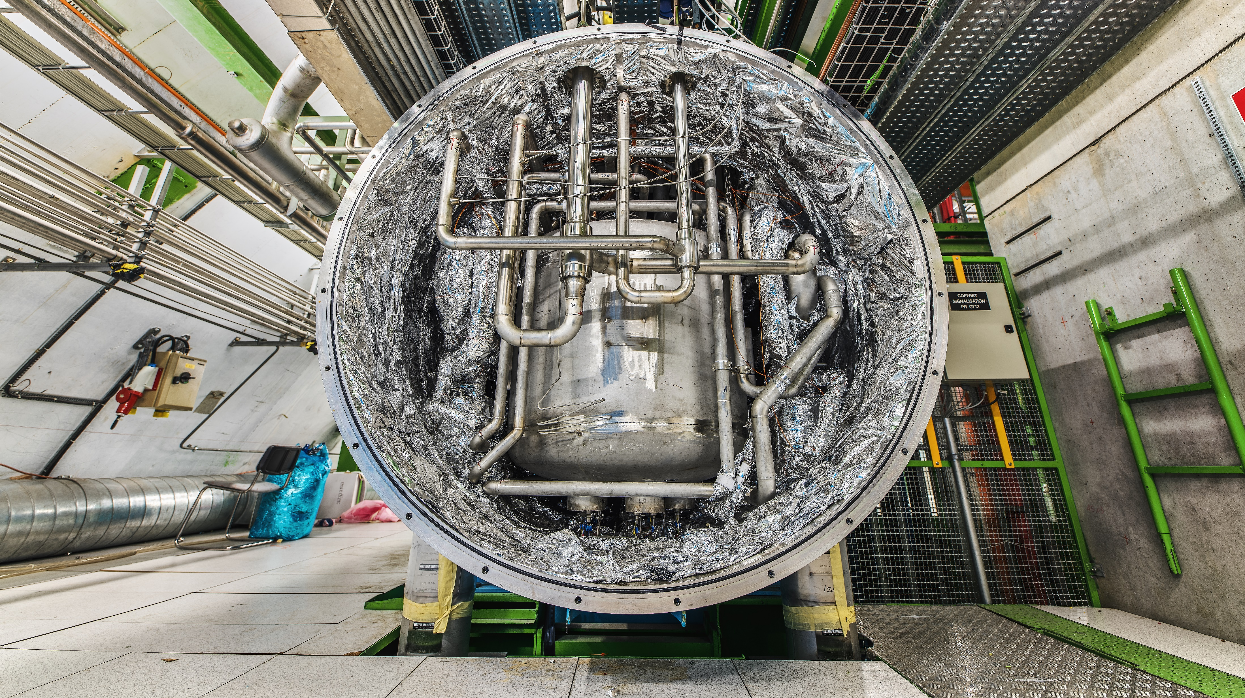
LHC cryogenics 2024
Performance, Limits and Outlook
Joint Accelerator Performance Workshop 2024, Montreux
December 10th, 2024
TE-CRG
B. Naydenov
https://indico.cern.ch/event/1439972
B. Bradu

Slide 2
Contents
Introduction
LHC cryogenics system 2024 performance overview
Focus on IR8 cooling capacity, margins and known limitations
  Cryoplant asymmetry
  Heat loads asymmetry
Follow up on valve opening induced fast growing orbit oscillations
Conclusions

Slide 3
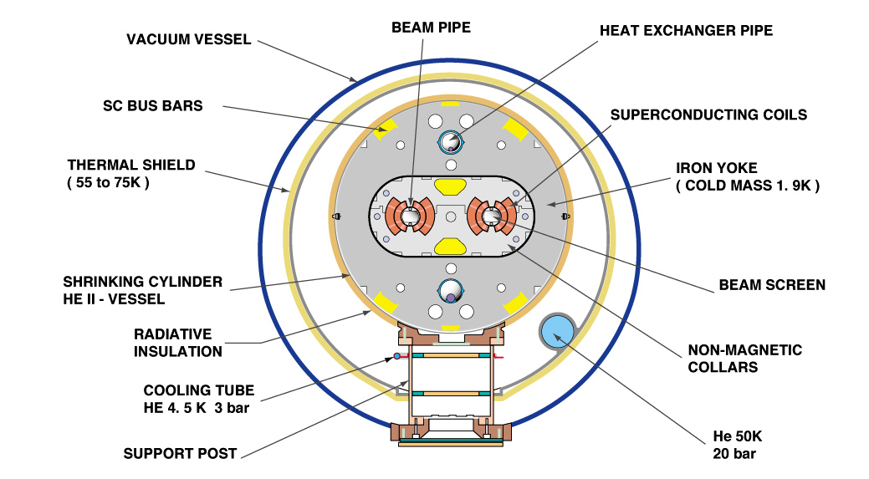
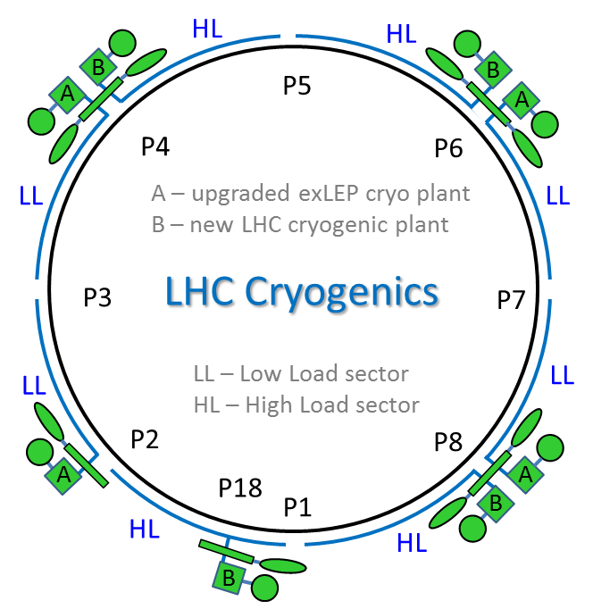
Introduction
LHC cryogenic system main task consists in keeping the required cryogenic conditions of the magnets, current leads and RF cavities.
1 - Bayonet HEX (~1.9K): Maintains the magnet under 2.05 K.
2 - Beam screen cooling (4.6-20 K): Protects the magnet from beam induced heat loads.
3 - Thermal shields (50-75K): Shields the magnets from outer heat inleaks.
2
1
Compressor station
4.5 K refrigerator
Interconnection box
1.8 K pumping unit (cold compressor)
3
8 cryoplants, 1 per sector, are supplying the 3 circuits with Helium at the right conditions.

Slide 4
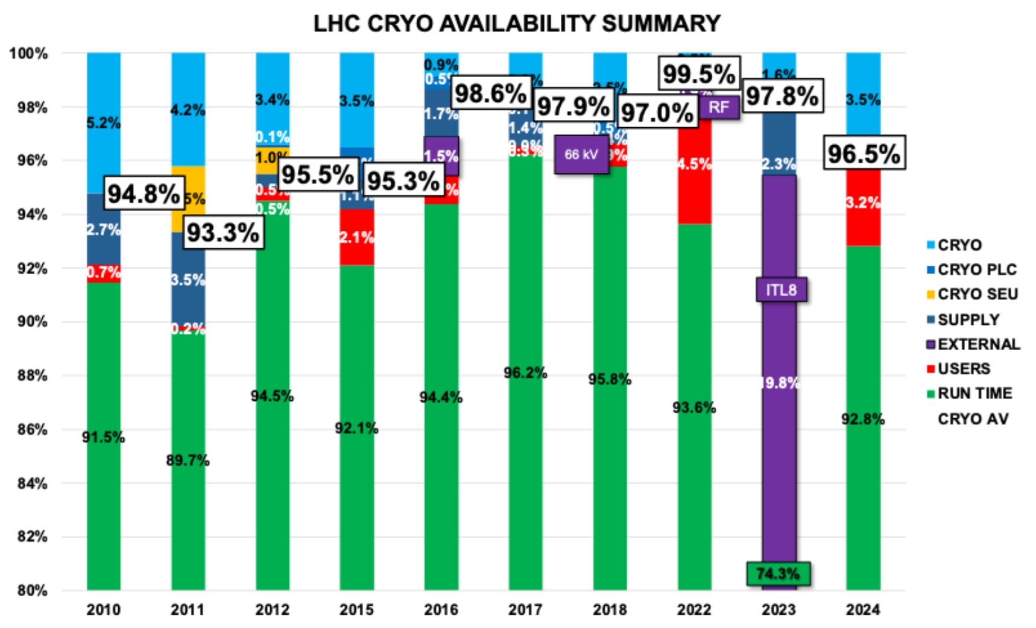
LHC Cryogenic System 2024 Performance
2024 Run was the highest integrated luminosity run so far.
It lasted 6026 hours, disturbed by 432 hours of downtime, by events:
  35 Users (192 hours):
    30 quenches
  7 Technical Services (31 hours):
    400 V glitch P6 (18h)
    Trip SVC P8 (6h)
  33 Cryo-related (209 hours or 3.5%):
    5x QURCA8 stops (~165h):
      2 Magnetic bearing controller trips (R2E).
      1 VFD trip (SVC).
      2 instrumentation failures.
    1x 400V perturbation trip.
    16x DFBMI loss (~3h).
LHC 2024 cryogenics availability – 96.5%.
Under consolidation during current YETS

Slide 5
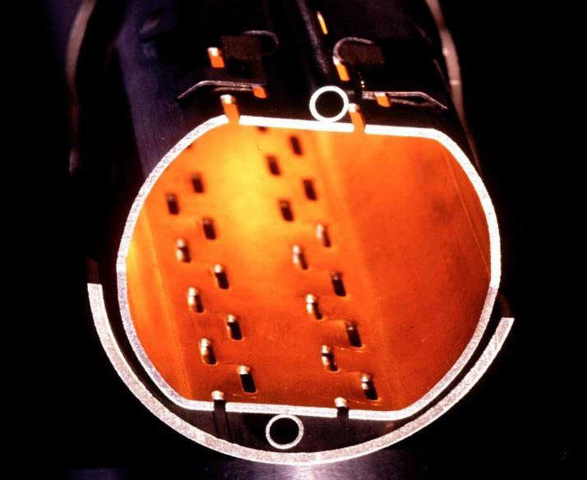
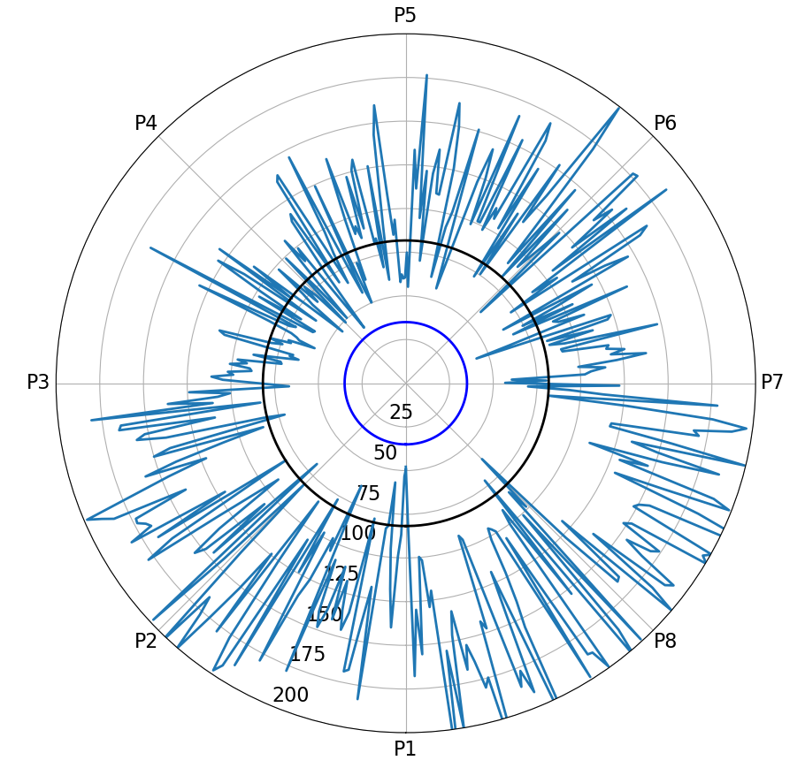
Focus on P8
What is special about P8?
  Since LS2, Beam screen heat loads are the highest on sector S78 and S81.
  Cryoplant-LHCA at P8 is an ex-LEP plant which has lower cooling capacity.
The 416 ARC half-cells are represented on the ring (53m each)
85 W/hc design load
Fill #10137 (22nd September 2024): 25ns_2352b_2340_2004_2133_108bpi_24inj

Slide 6
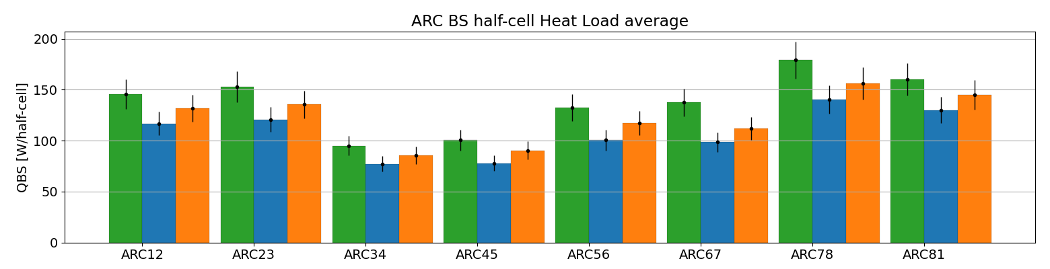
P8: Asymmetry of heat loads
2022 - 5x36 @ 3.62e14 p
2023 – Hybrid @ 3.89e14 p
2024 – 3x36 @ 3.84e14 p
DR
85 W/hc
In 2022, S78 receives the highest heat load levels reaching 180 W/hc compared to 160 W/hc on S81.
In 2023, Hybrid scheme (8b4e) + 5x36b reduces considerably the total induced heat load.
In 2024, a higher beam intensity was reached at lower induced heat loads thanks to filling scheme and beam conditioning.

Slide 7
P8: Asymmetry of cryoplants
Because a cryoplant is based on a thermodynamic cycle (Claude), all asymmetry needs to be rebalanced.
OptS78 conf.
LHCA
ex-LEP
LHCB
new LHC
HP
QSV
LP
E
300 K
E
C
F
F
C
1.8 K LHCCA
QURCA
1.8 K
LHCCB
QURCB
(stby)
D
D
B
S78
S81
Beam screens, SAM, DFB
Beam screens, SAM, DFB
Magnets @ 1.8 K
Magnets @ 1.8 K
Thermal Shields
Thermal Shields
Cryoplants were designed for 85 W/hc on the beam screen, and higher loads at 1.8 K.
Due to lower loads at 1.8K, only one cold compressor (LHCCx) is needed for both sectors and more BS loads can be taken.
LHCA is an upgraded ex-LEP plant with a lower refrigeration capacity.
LHCB is newer plant with higher refrigeration capacity.
LHCCA is used.
LHCCB is kept in STBY.
LHCA as economiser
LHCB as liquefier

Slide 8
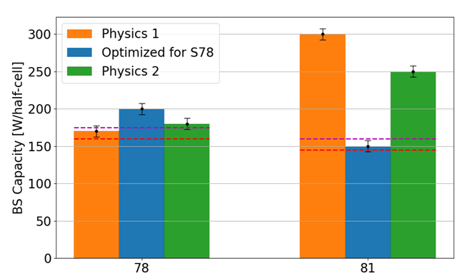
P8: Capacity tests
 | Cryo config. | S78 capacity | S81 capacity | Comments
Test 1 | Physics 1 (with line F return) | 170 W/hc | *300 W/hc | LHCA limited on LP LHCB TU4 inlet pressure delicate to operate
Test 2 | Optimized for S78 (shields decoupled) | *200 W/hc | 150 W/hc | LHCB suffering a lot with ADS80K at 120 K
Test 3 | Physics 2 (with RM81 return) | 180 W/hc (limited by LHCA LP) | *250 W/hc | LHCA & LHCB OK [Almost at the LP limit on LHCA ]
Selected configuration
for 2024 operation
-- begin 2024
-- end 2024
NB: there is no contingency in these numbers
and cryogenic needs margin to handle
properly the transients and the unexpected disturbances.
*estimates

Slide 9
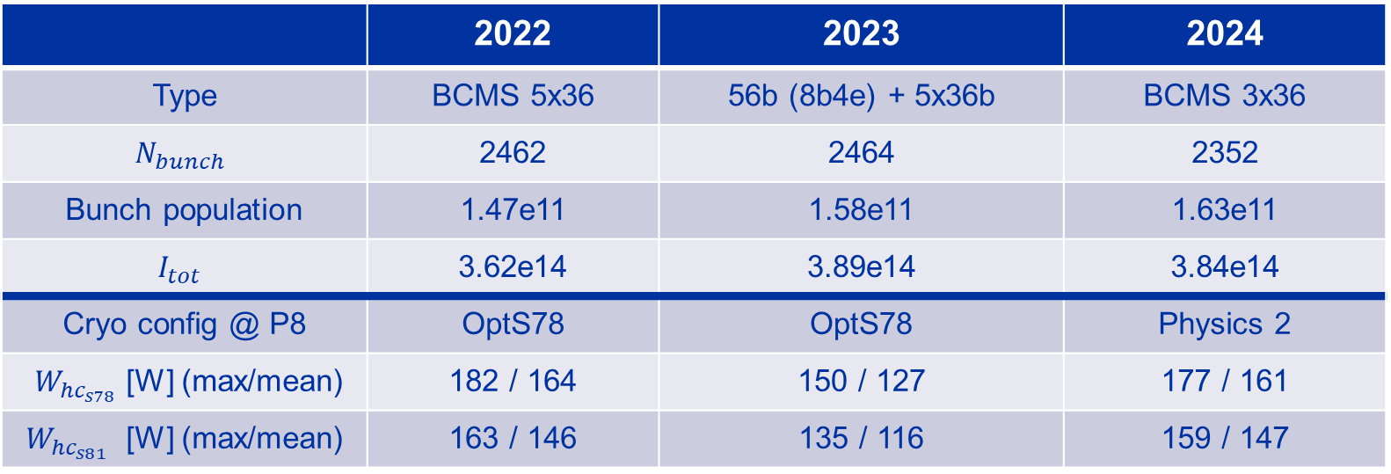
Run 3 summary and outlook
 | 2022 | 2023 | 2024
Type | BCMS 5x36 | 56b (8b4e) + 5x36b | BCMS 3x36
$$N_{bunch}$$ | 2462 | 2464 | 2352
Bunch population | 1.47e11 | 1.58e11 | 1.63e11
$$I_{tot}$$ | 3.62e14 | 3.89e14 | 3.84e14
Cryo config @ P8 | OptS78 | OptS78 | Physics 2
$W_{{hc}_{s78}}$[W] (max/mean) | 182 / 164 | 150 / 127 | 177 / 161
$W_{{hc}_{s81}}$ [W] (max/mean) | 163 / 146 | 135 / 116 | 159 / 147
Opt78 mode was used during 2022 and 2023, adding strong operational constraints.
Physics2 mode was successfully introduced during 2024 after a ‘CryoMD’ test window in Feb 2024.
  S78 heat loads are still the most constraining. Max limited to 170 W/hc, considering operation.
  Wrt to end of 2024, P8 should be compatible with an extra 10 W/hc of heat load in S78 for 2025.
Degraded mode with QURCB would limit the capacity to ~100 W/hc.
Notes:
No margin = instabilities = loss of availability.
2022 – Fill 8471
2023 – Fill 9072
2024 - Fill 10137

Slide 10
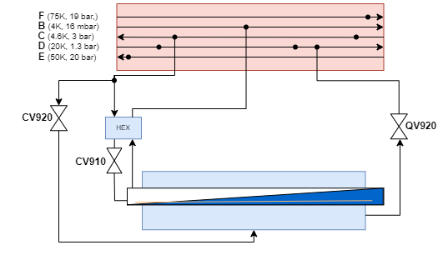
CV920 vibration induced beam dumps – follow up
CV920 keeps the magnet bath at 1.25 bar.
  Because of small leaks, pressure descends and it needs to open periodically.
  Mixture of warm He and superfluid He creates vibrations.
Perturbations correlated with a growing beam orbit oscillation during the ion run.
New control logic has been added to address the issue:
  During ion beam, selected critical cells (13L8 and 13L2) CV920 stay closed.
  After beam dump, CV920 repressurises the cells.
The solution was proven during the 2024 ion run.
Saturated He, keeping the pressurised bath cold.
Pressurised superfluid He bath.

Slide 11
CONCLUSIONS
Successful 2024 run has been completed with 96.5% availability.
Issues generating downtime have been identified, analysed, and mitigation measures are put in place during the current YETS.
2022 was very complicated to operate with high loads and OptS78 P8 configuration.
P8 cooling capacity has been tested in different configurations during a “CryoMD”. A new mode was found with good performance-operability balance – Physics2.
P8 limits have been identified for all modes. A margin of ~10 W/hc at S78 is still available for 2025/2026 run (leading to 170 W/hc).
  Exact beam configuration should be validated during the beam commissioning phase.
Cryogenic valve induced orbit oscillations has been resolved with a new simple control logic condition.

Slide 13
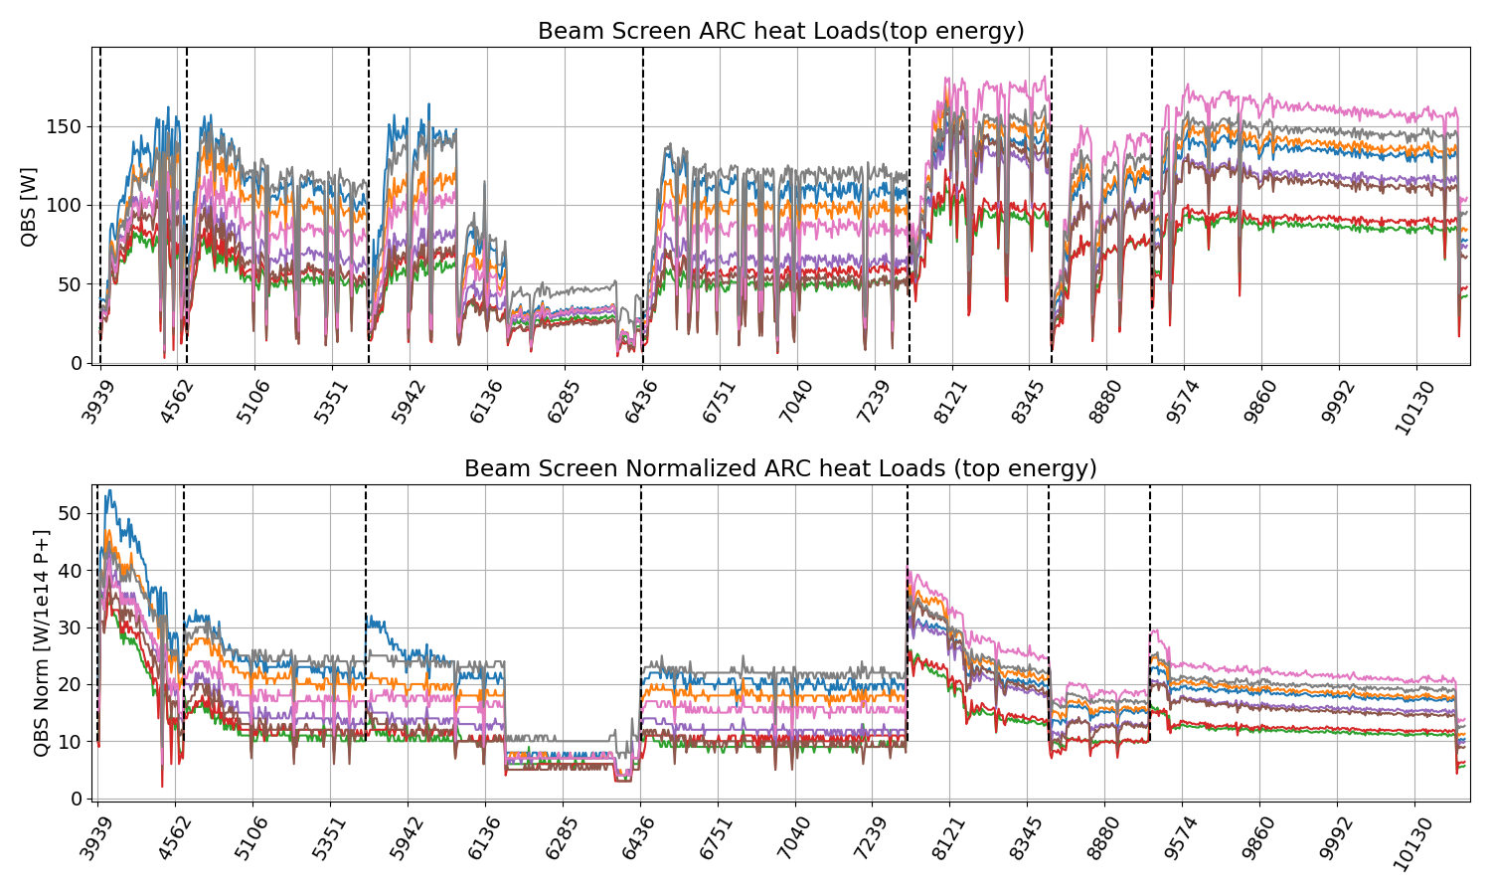
Beam screen heat loads Heat loads history @ top energy
LS1
2015
2016
2017
2018
LS2
2022
2023
2024
8b4e
Mixed

Slide 14
P8: Possible configurations – OptS78
Economiser
Liquefier
OptS78 conf.
50 g/s @ 300 K
LHCA
ex-LEP
LHCB
new LHC
HP
QSV
LP
E
E
C
F
F
C
LHCCA
LHCCB
(stby)
D
D
B
S78
S81
Beam screens, SAM, DFB
50 g/s @ 3 K
Beam screens, SAM, DFB
Magnets @ 1.8 K
Magnets @ 1.8 K
Thermal Shields
Thermal Shields
Operation mode of P8 during 2022 and 2023.
LHCB is in liquefaction as line D collects less than what line C supplies (due to LHCCA usage).
Rebalance LHCA-LHCB done at 300 K.
Uncertain performance and difficult operability.

Slide 15
P8: Possible configurations – Physics 1
Economiser
Liquefier
Physics1 conf.
LHCA
ex-LEP
LHCB
new LHC
E
50 g/s @ 80 K
E
C
F
F
C
LHCCA
LHCCB
(stby)
D
D
B
S78
S81
Beam screens, SAM, DFB
50 g/s @ 3 K
Beam screens, SAM, DFB
Magnets @ 1.8 K
Magnets @ 1.8 K
Thermal Shields
Thermal Shields
Standard mode currently used for all other LHC points.
Economiser/liquefier asymmetry appears due to usage of LHCCA.
All thermal shields supplied by LHCA. Rebalance of the two sides at 80 K.
Difficult to operate at P8 due to the absence of isolation valves in line F return. Hard operation constraint.
Good performance but constraint operability.

Slide 16
P8: Possible configurations – Physics 2
Economiser
Liquefier
Physics2 conf.
35 g/s @ 300 K
LHCA
ex-LEP
LHCB
new LHC
HP
QSV
LP
E
E
C
F
F
C
LHCCA
LHCCB
(stby)
D
D
B
S78
S81
Beam screens, SAM, DFB
50 g/s @ 3 K
Beam screens, SAM, DFB
Magnets @ 1.8 K
Magnets @ 1.8 K
Thermal Shields
15 g/s @ 80 K
Thermal Shields
New mode used at P8 during 2024.
LHCB still in liquefaction.
Rebalance LHCA-LHCB done at partly at 80 K and partly at 300 K.
Good performance-operability balance.

Slide 17
P8: Possible configurations – Degraded
Liquefier
35 g/s @ 300 K
Economiser
Degraded conf.
LHCA
ex-LEP
LHCB
new LHC
HP
QSV
LP
E
E
C
F
F
C
LHCCA
LHCCB
D
D
B
S78
S81
Beam screens, SAM, DFB
50 g/s @ 3 K
Beam screens, SAM, DFB
Magnets @ 1.8 K
Magnets @ 1.8 K
Thermal Shields
Thermal Shields
15 g/s @ 80 K
Degraded mode to be used if extended LHCCA downtime is expected.
LHCA is now in liquefaction – limited capacity.
Rebalance LHCA-LHCB done partly at 80 K and partly at 300 K.
Poor performance.

