Slide 1
SPS Main Power Converters Noise & Regulation
Joint Accelerator Performance 2024 Workshop
Charles Genton [SY-EPC-HPC]
10.12.2024

Slide 2
Content
SPS main power converters overview
SPS mains ripple and compensation measures
Regulation overshoots and possible mitigations
Current glitches and improved diagnostics

Slide 3
Content
SPS main power converters overview
SPS mains ripple and compensation measures
Regulation overshoots and possible mitigations
Current glitches and improved diagnostics

Slide 4
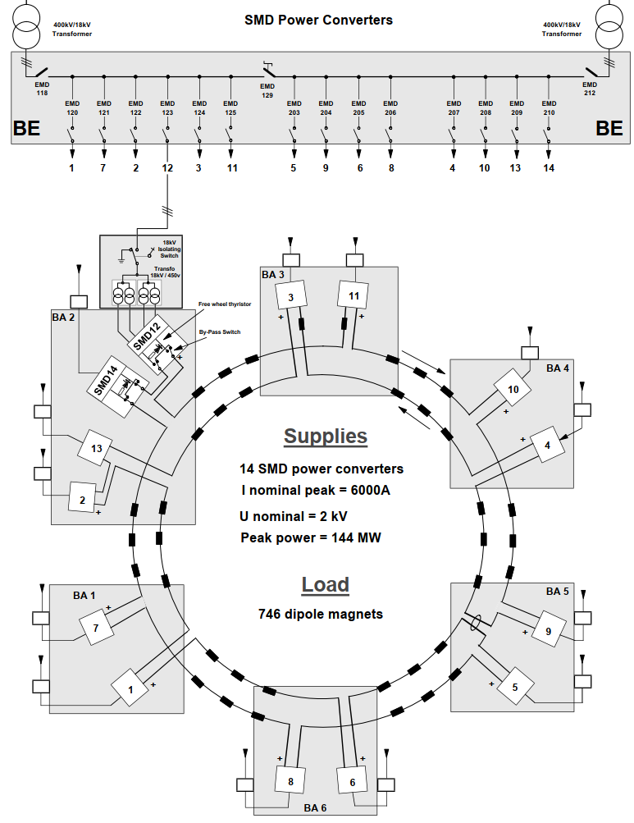
SPS main dipoles overview
Ratings: 6 kA / 25 kV, < 20 ppm
12 SMD stations in series + 2 spares
1 common digital current regulator (FGC3)
Analogue voltage regulation and firing in each SMD

Slide 5
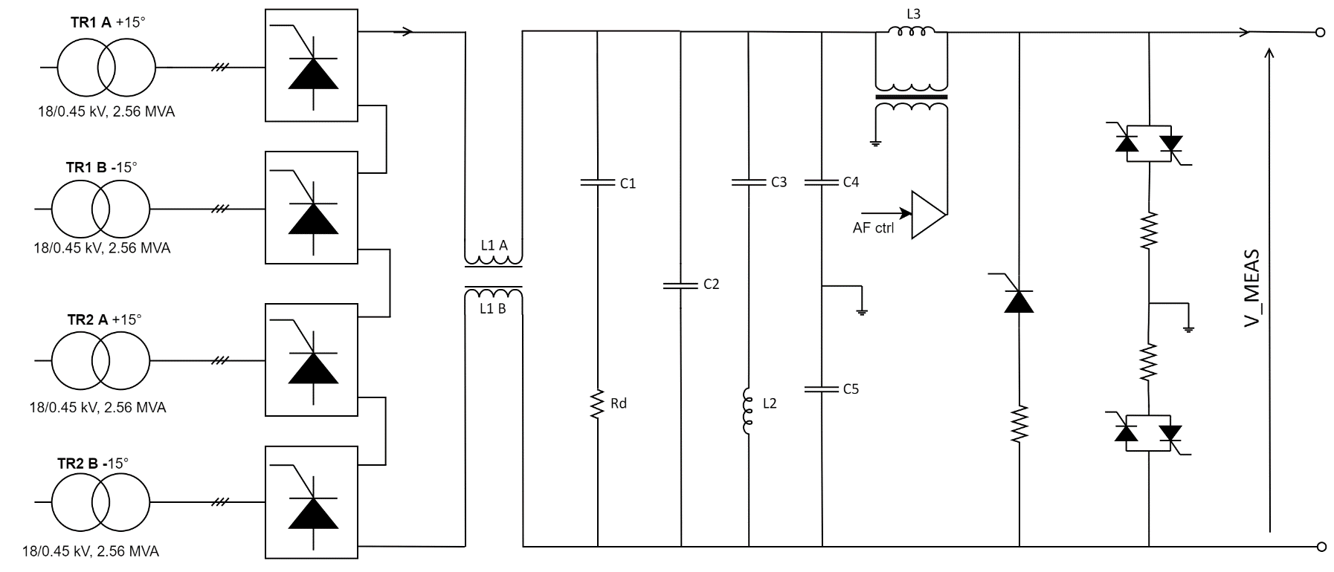
SMD power converter layout
Ratings: 6 kA / 2 kV
Passive filter
Active filter

Slide 6
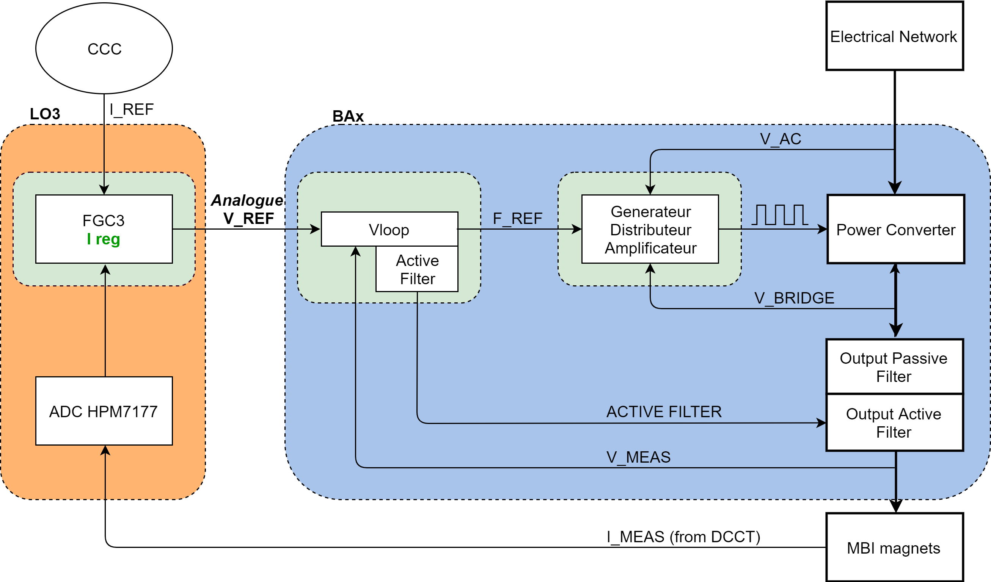
SMD regulation structure
x12

Slide 7
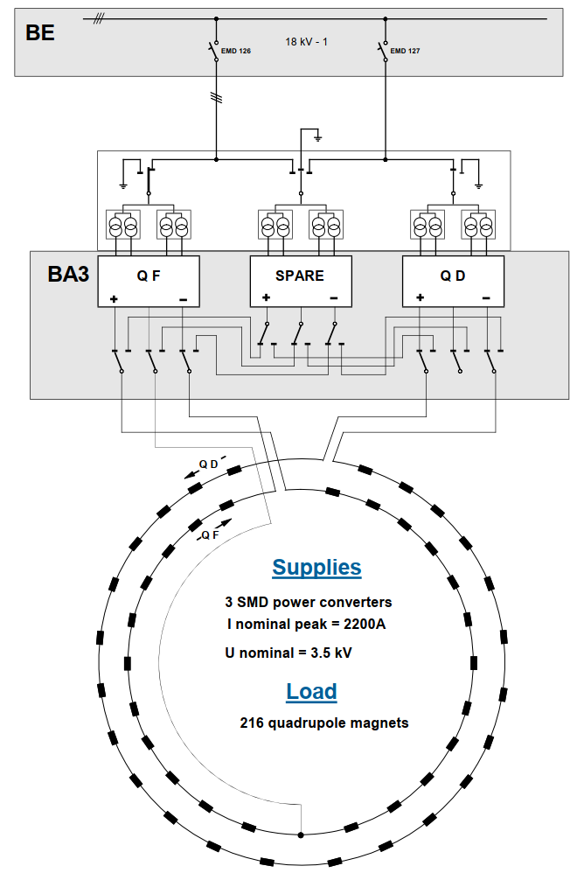
SPS main quadrupoles overview
Ratings: 2.2 kA / 4.0 kV, < 20 ppm
1 SMQ station per circuit (QF/QD) + 1 spare
Digital current and voltage regulators (FGC3)
Analogue firing

Slide 8
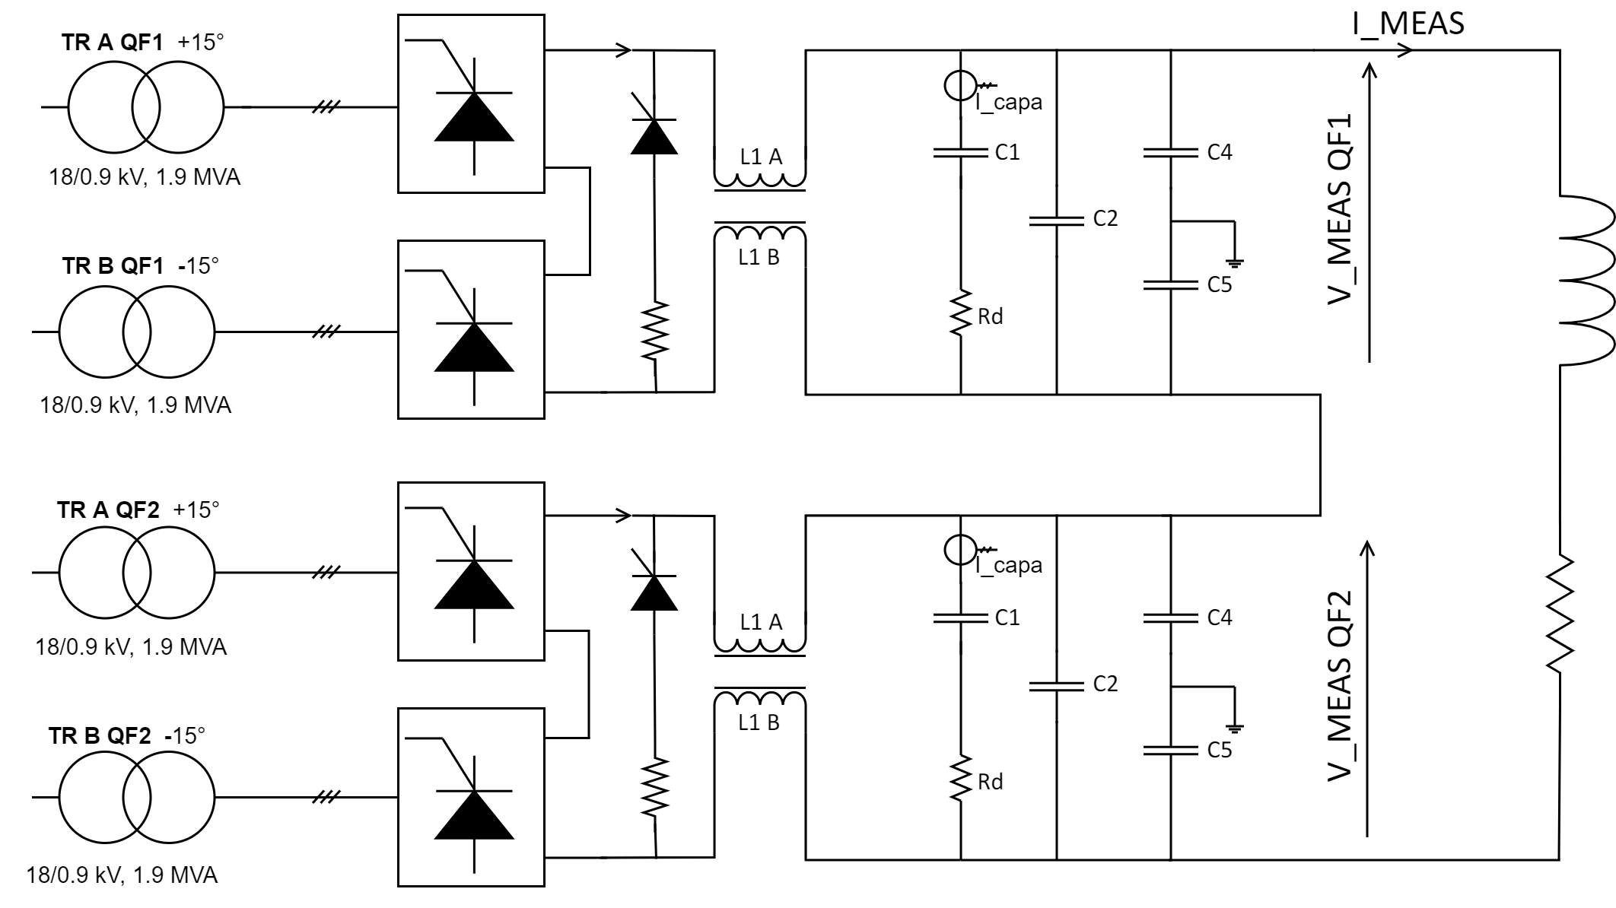
SMQ power converter layout
Ratings: 2.2 kA / 3.6 kV
Passive filter
Passive filter

Slide 9
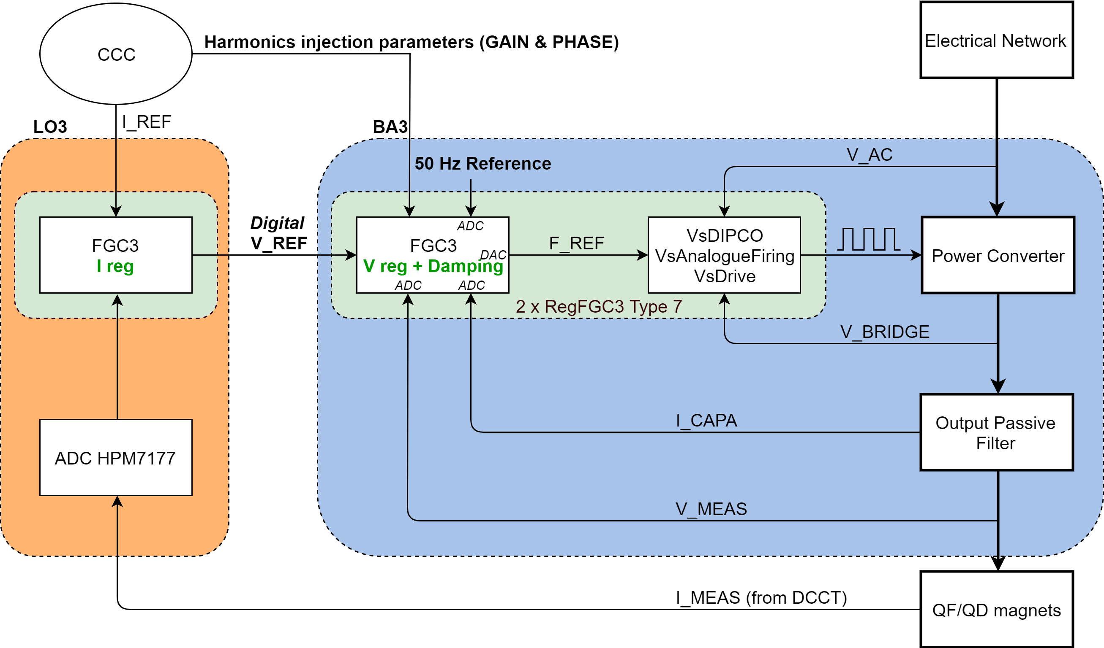
SMQ regulation structure

Slide 10
Content
SPS main power converters overview
SPS mains ripple and compensation measures
Regulation overshoots and possible mitigations
Current glitches and improved diagnostics

Slide 11
Thyristor Power Converter Noise (Part 1: Theory)
A few 100V…
A few V…
Balanced 50 Hz voltages
DC voltage with large 600 Hz
DC voltage with low 600 Hz

Slide 12
Thyristor Power Converter Noise (Part 2: Real life)
A few 100V…
Still A few V, but…
Unbalanced 50 Hz voltages
Just a few %...
DC voltage with large 600 Hz
+ 50 Hz, 100 Hz, 150 Hz…
DC voltage with low 600 Hz
+ 50 Hz, 100 Hz, 150 Hz…

Slide 13
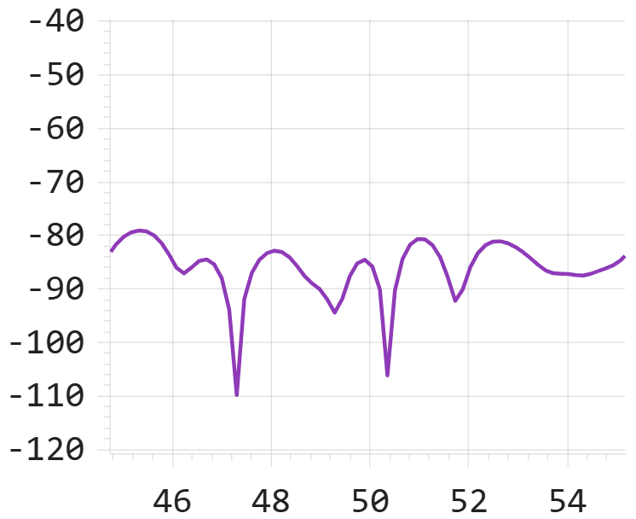
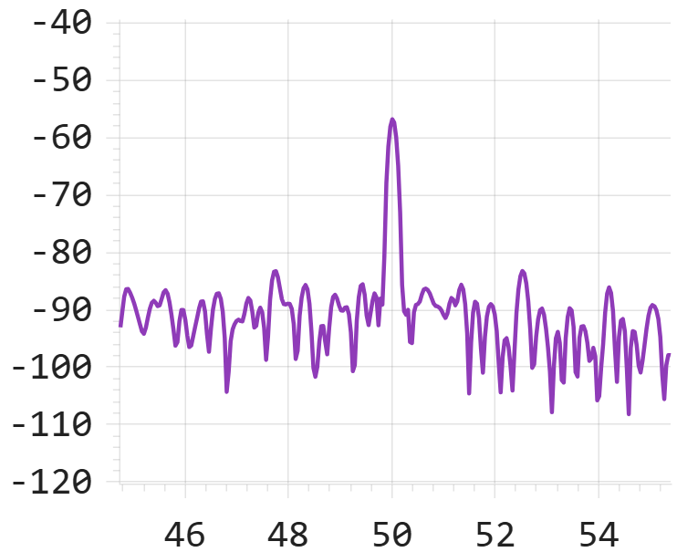
50 Hz
Origin of 50 Hz noise : typically comes from couplings with power circuits
I MEAS QF
Converters OFF – QF circuit open
Converters OFF – QF circuit closed
[dB]
[dB]
[Hz]
[Hz]
0 dB = 1.0 A RMS
There is inherently a 50 Hz current circulating in the magnets because of couplings

Slide 14
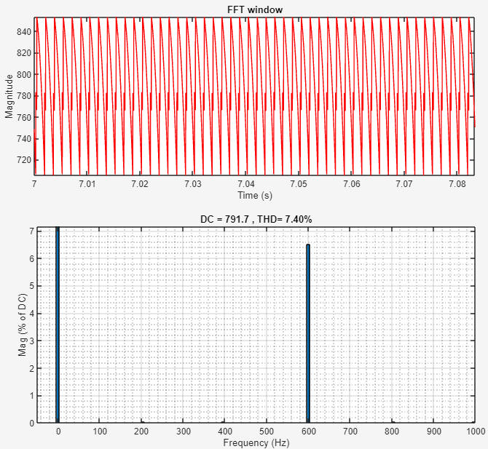
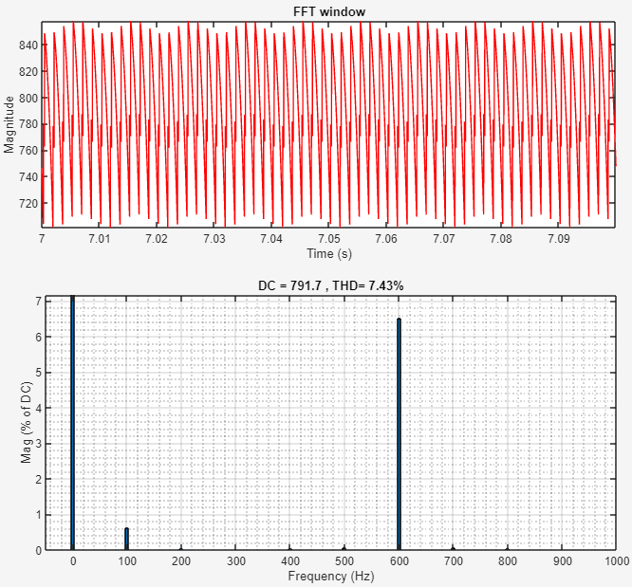
100 Hz
Ideal AC network (balanced phases)
Real AC network (unbalanced phases)
100 Hz noise comes from the rectification of (naturally) unbalanced phases

Slide 15
How to eliminate theses ripples?
By compensating them!
OP Tools
FGC Class 63
V REF
(from I LOOP)
V REF*
V LOOP
+ FIRING
POWER CONVERTER
HARMONICS COMPENSATION ALGORITHM
GAIN 50Hz
50 Hz Generator
PHASE 50 Hz
V MEAS
BSI
GAIN 100 Hz
100 Hz Generator
PHASE 100 Hz
DCCT
GAIN 150 Hz
150 Hz Generator
PHASE 150 Hz
Compensating BEAM noise VS. Compensating DCCT noise

Slide 16
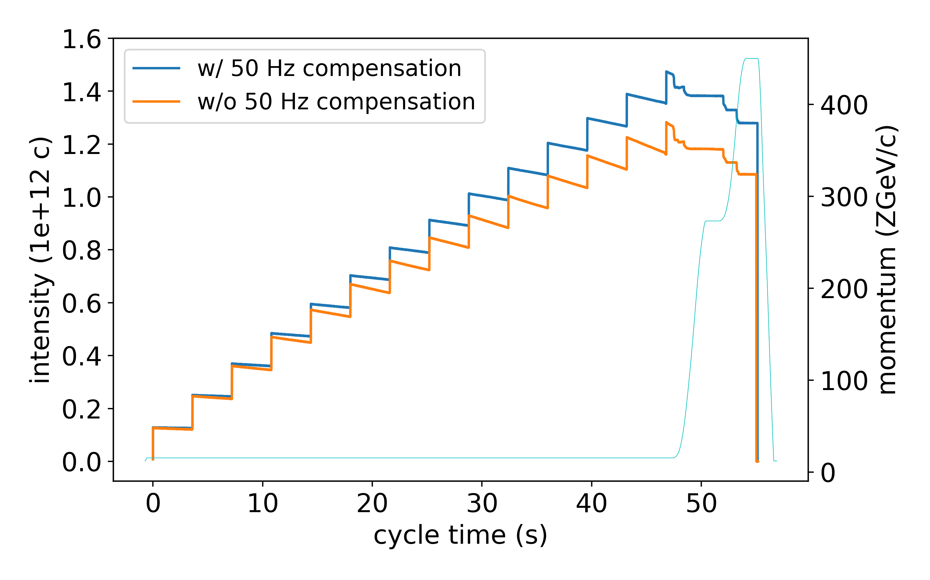
Benefits of the compensation - Example
Intensity increased by 15-20% for LHC ion beams at injection
Courtesy of Hannes Bartosik [BE-ABP]

Slide 17
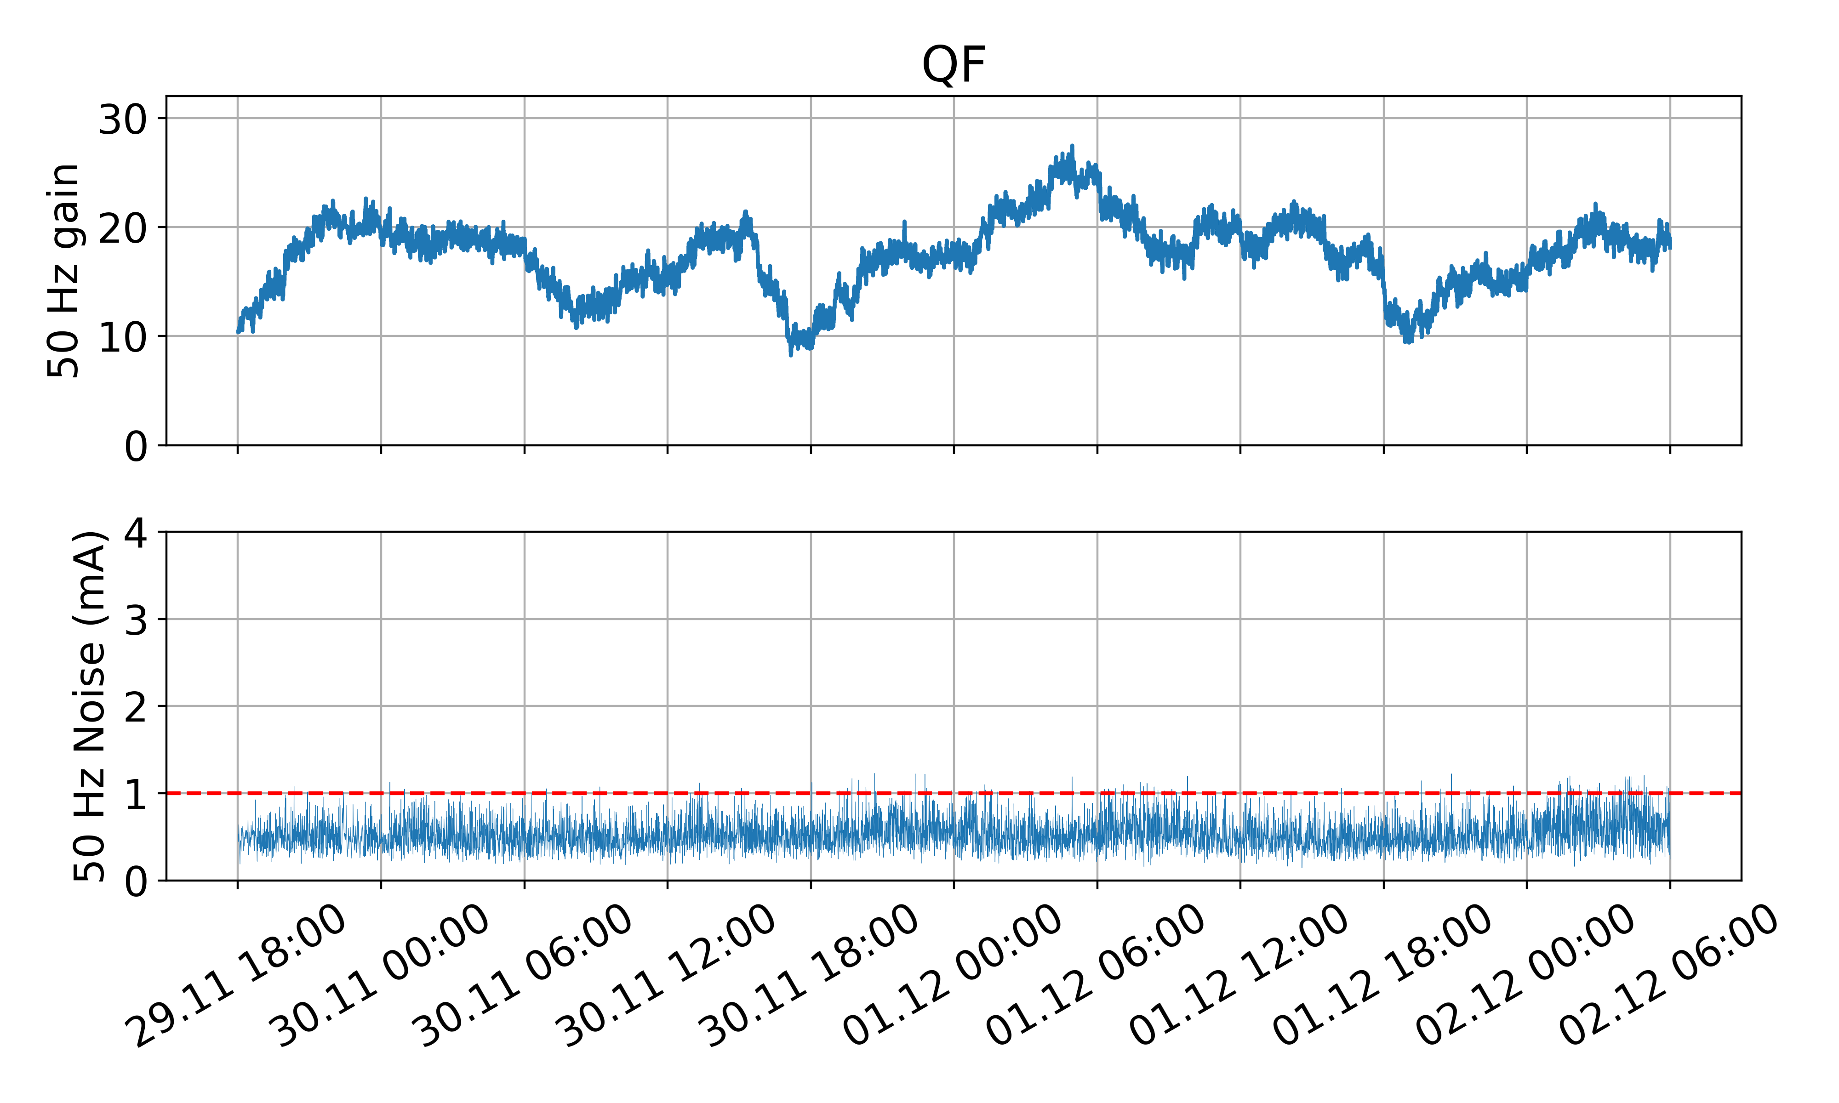
Confirmation in 2025
Promising results (just before the YETS…)
In 2025 Compensation also available in MBI (See https://indico.cern.ch/event/1447498/)
Questions to answer :
  Is it sufficient to compensate the noise on MBI, QF and QD?
  Effective compensation on the beam still required?
Compensation stable for > 48h !
Courtesy of Hannes Bartosik [BE-ABP]

Slide 18
Content
SPS main power converters overview
SPS mains ripple and compensation measures
Regulation overshoots and possible mitigations
Current glitches and improved diagnostics

Slide 19
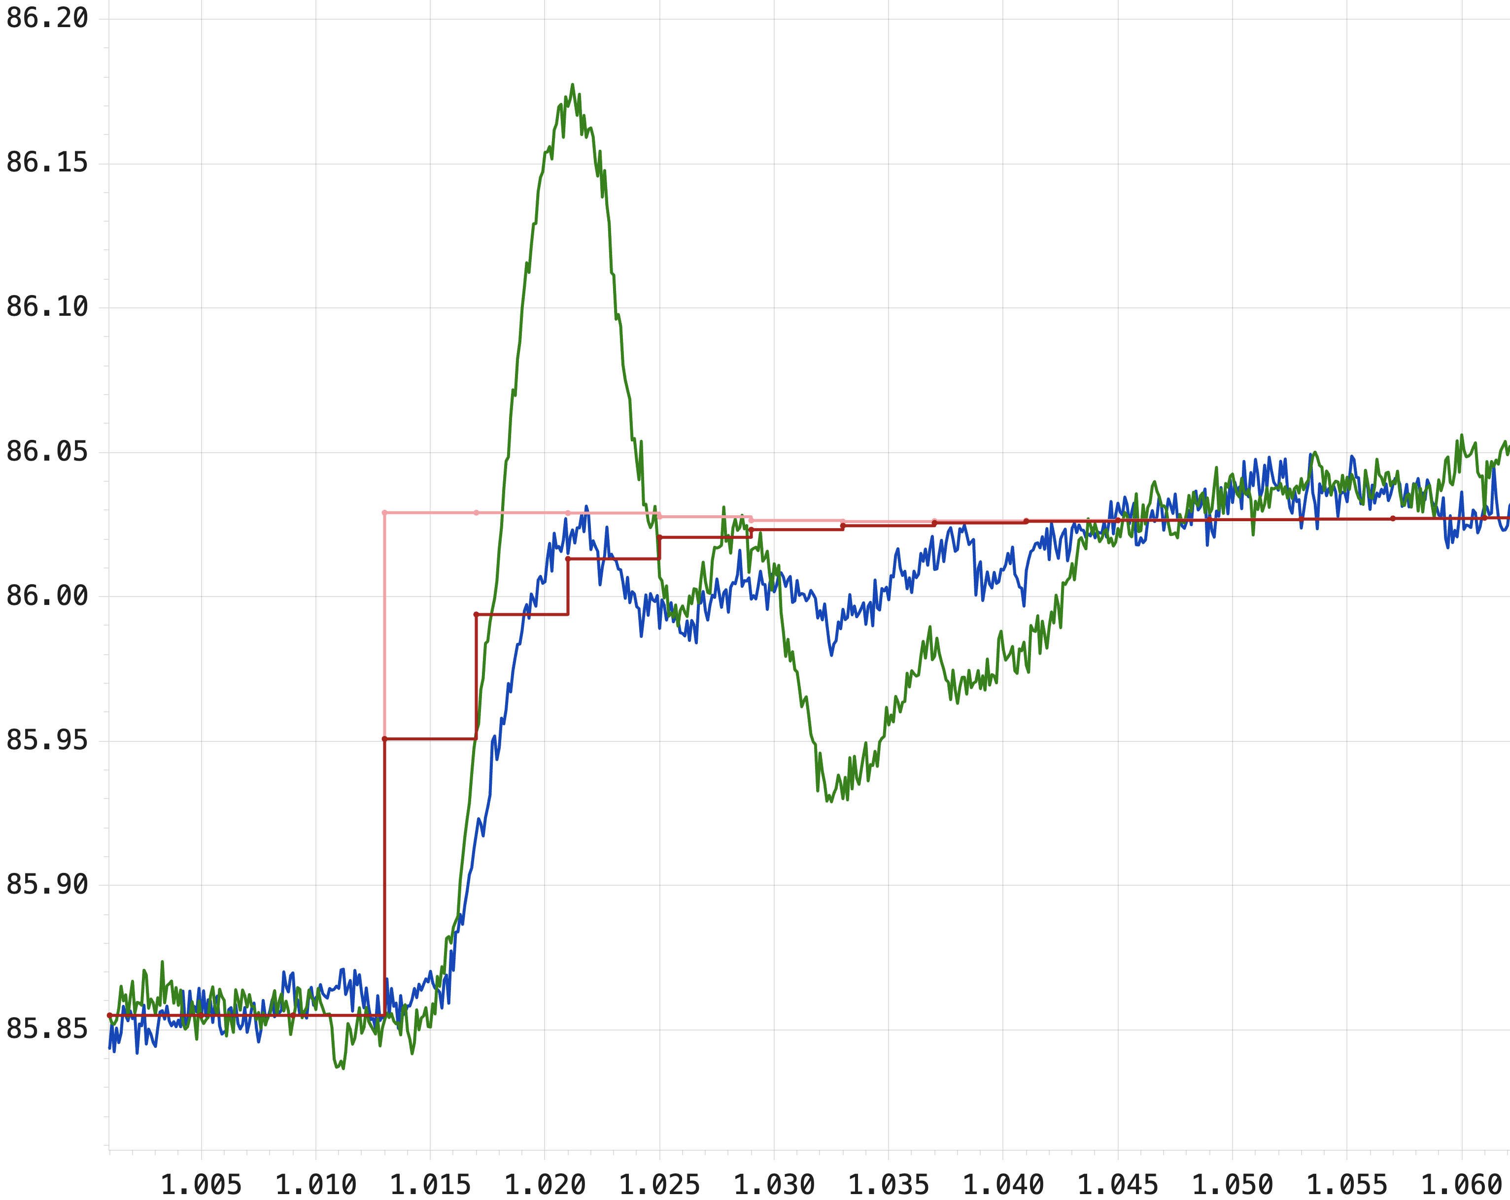
Auto-tune overshoots – April 2024
Current response to a 170 mA auto-tune step (pink/green)
Response to unfiltered step
Response to filtered step
Issue fixed with 1st order filter on autotune step (red/blue)

Slide 20
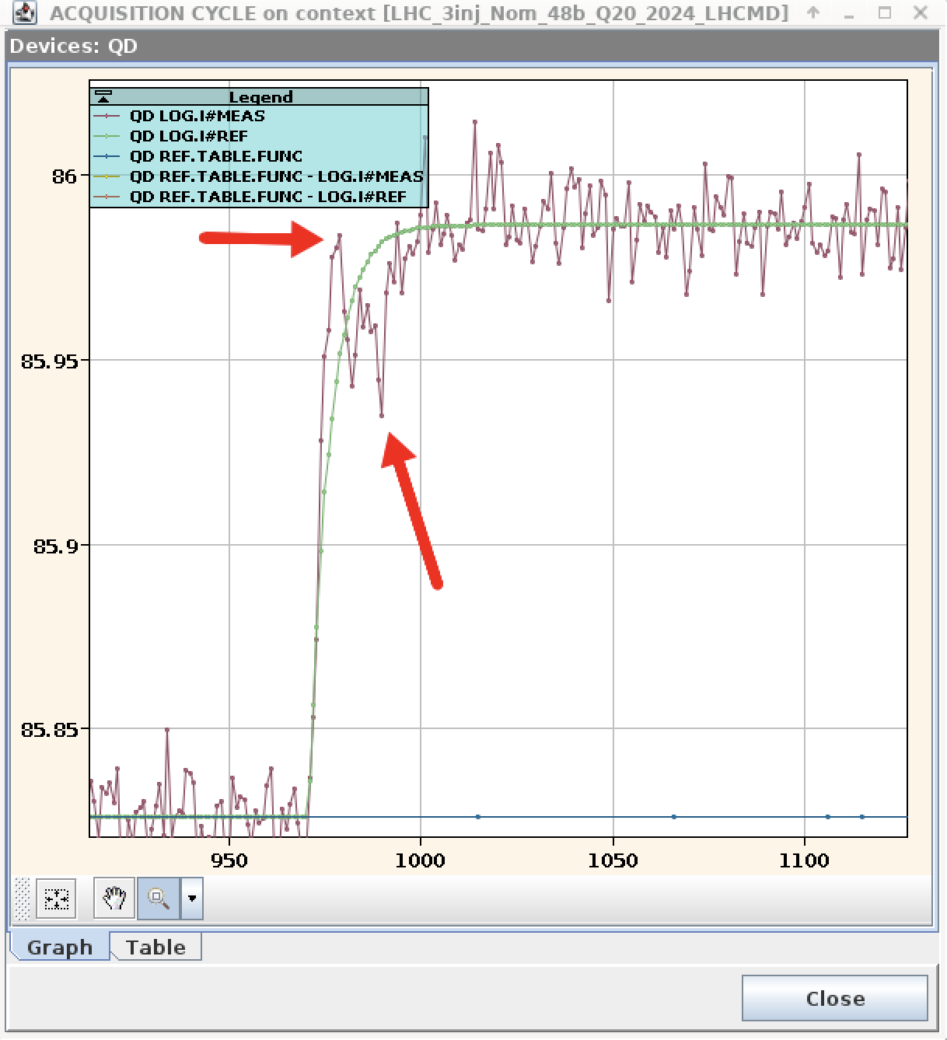
Auto-tune overshoots – September 2024
Current response to a 170 mA filtered auto-tune step
not sufficient anymore with improved beams
Possible solutions:
Use more sophisticated filtering
Retune the current controller
Issue to be addressed during HWC 2025 in close cooperation with OP

Slide 21
Content
SPS main power converters overview
SPS mains ripple and compensation measures
Regulation overshoots and possible mitigations
Current glitches and improved diagnostics

Slide 22
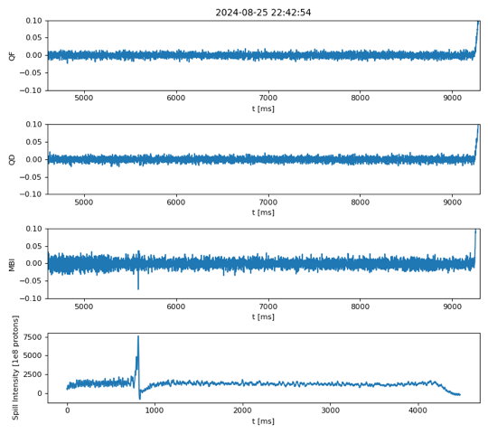
Regulation glitches
SFTPRO Flat top
Current Regulation Error
Current glitch on MBI
BSI
Automatic trigger of an oscilloscope not possible with such small perturbations

Slide 23
Glitch detector
Solution: software glitch detector to collect data for better diagnostic

Slide 24
Roadmap for 2025
Thank you for your attention!
1. Power converters ripple
  Enable harmonics compensation in MBI thanks to SMD13 consolidation
  Make the harmonics compensation properties ppm
2. Regulation overshoots
  Find the best solution with OP mitigate these overshoots
  For re-tuning the current regulators, 5 extra half-days required
3. Regulation glitches
  Understand and fix the glitches thanks to the glitch detector
Some final words:
  Very good cooperation with the SPS team, very interesting challenges to tackle
  Requires a lot of ressources from many persons in EPC!
  What is the priority of these improvements at the scale of CERN projects?

Slide 26
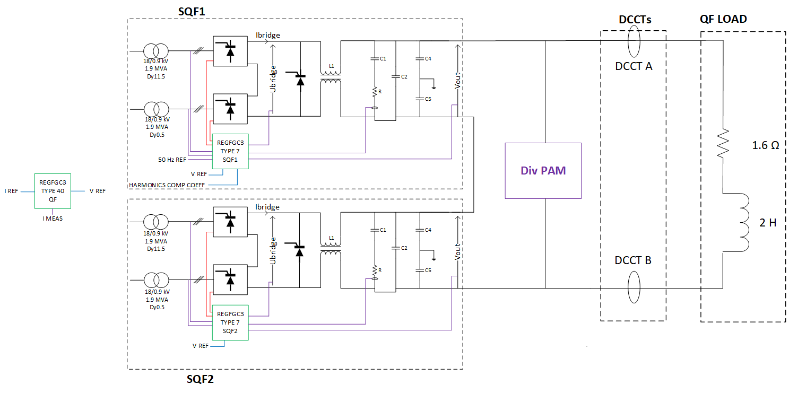
Additional measurement in QF

Slide 27
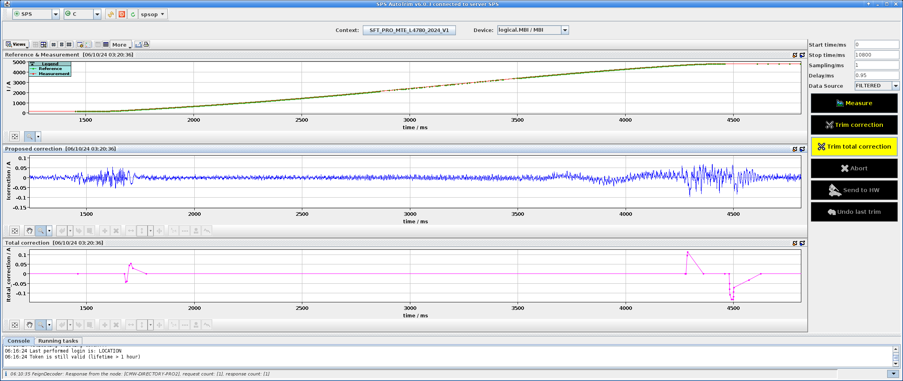
Oscillations during ramp-up

Slide 28
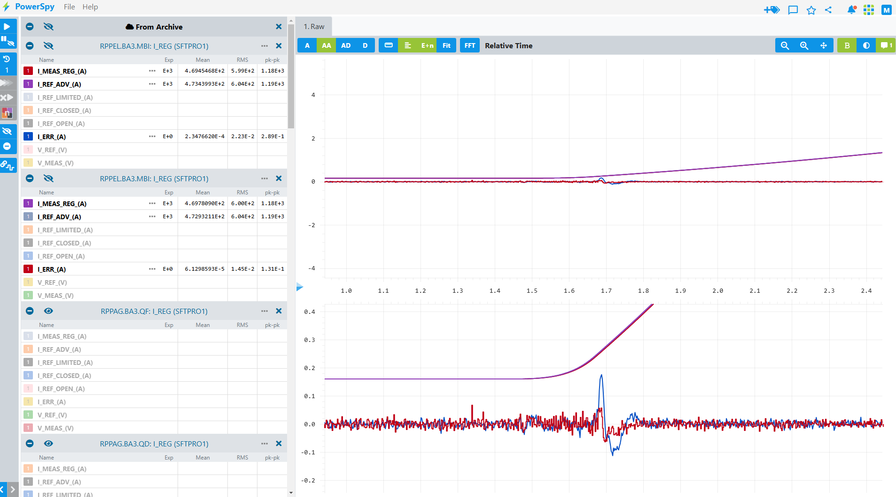
Oscillations during ramp-up – 2023 vs. 2024
I ERR 2023
I ERR 2024

