Slide 1
Beam instrumentation (present and short-term future)
Inaki Ortega (SY-BI), with input from operations and BI experts
Joint Accelerator Performance Workshop 2024 - Montreux
Notes:
In this talk I will give an overview about the performance of the beam instrumentation during 2024, the known limitations and the future plans. Due to the limited time for the talk and the big scope – instrumentation for all machines, I won’t probably be able to cover all points. This presentation has been made from the input from operations and many BI experts.

Slide 2
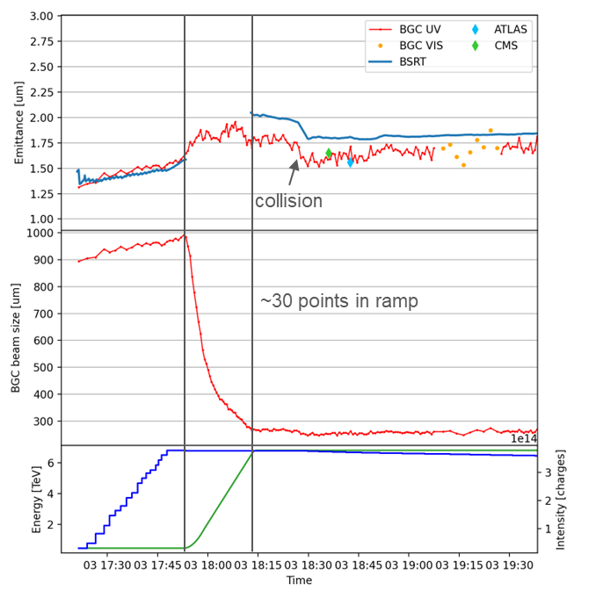
Beam Gas Curtain monitor
Status of existing BGC in P4 left
Successful data taking in 2024 both for Ions and Protons:
Emittance measurement during the whole cycle
Values consistent and reproducible
No jet thickness effect for the horizontal
OP-GUI implemented for live visualisation
Known limitations:
Not able to measure bunch by bunch
Gas injection not implemented yet in the sequencer
Optimisation of vertical BGC in progress – works during YETS24/25
YETS activities:​
Exchange of skimmers 3 and 4 to reduce curtain thickness and improve vertical profile measurement quality
BLM installation to analyse gas injection-induced losses to study feasibility as halo monitor
Reference: BGC CM: https://indico.cern.ch/event/1468706/
BGC measurement through cycle
Notes:
Positive results for the BGC
Agreement with BSRT at injection and flat top
Quantitative agreement with emittance scan
Smooth behaviour during ramp

Slide 3
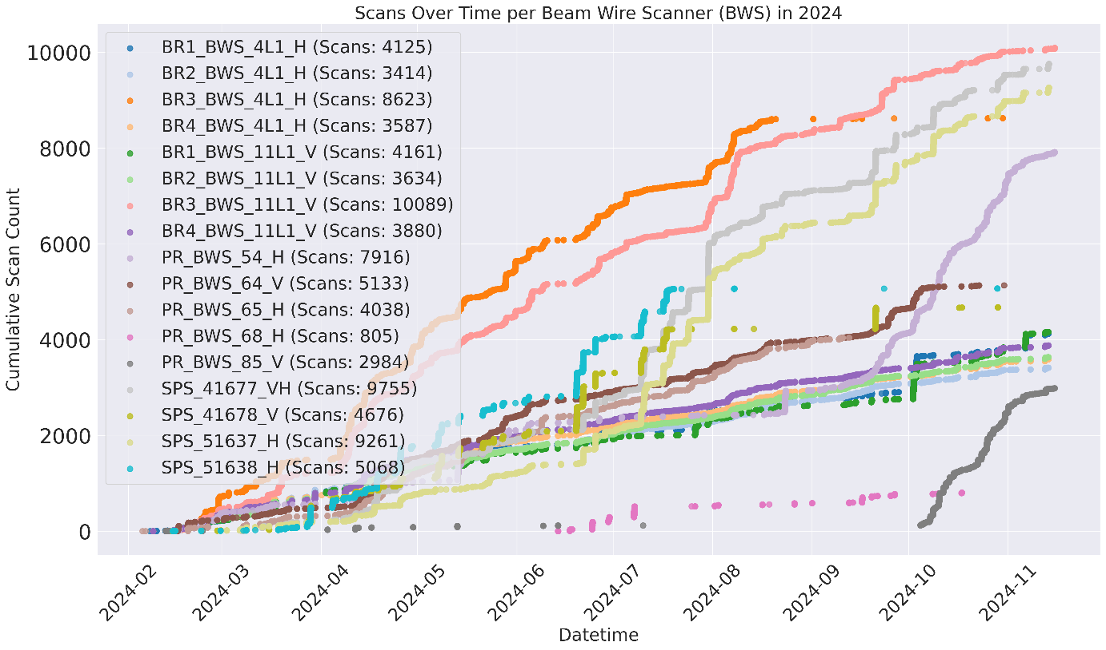
Injectors BWS Status & Plans
Current Status:
17 new rotary scanners installed in LS2: 214k scans since 2021
All features implemented –including SPS intensity limits to be fully tested in 2025
Impedance issues covered by Chiara Antuono on Wednesday morning
Main Challenge: Bearing Issues
Limited lifetime of the bearings –6 failures in 2024— with low impact on operation thanks to redundancy
Bearings behaviour being tested at CERN: custom solution being studied together with the supplier
YETS 24/25 Actions:
End-of-run inspection + IST procedure
Replace 4 broken scanners (1xPSB, 2×CPS, 1xSPS)
Injector’s rotative scanner

Slide 4
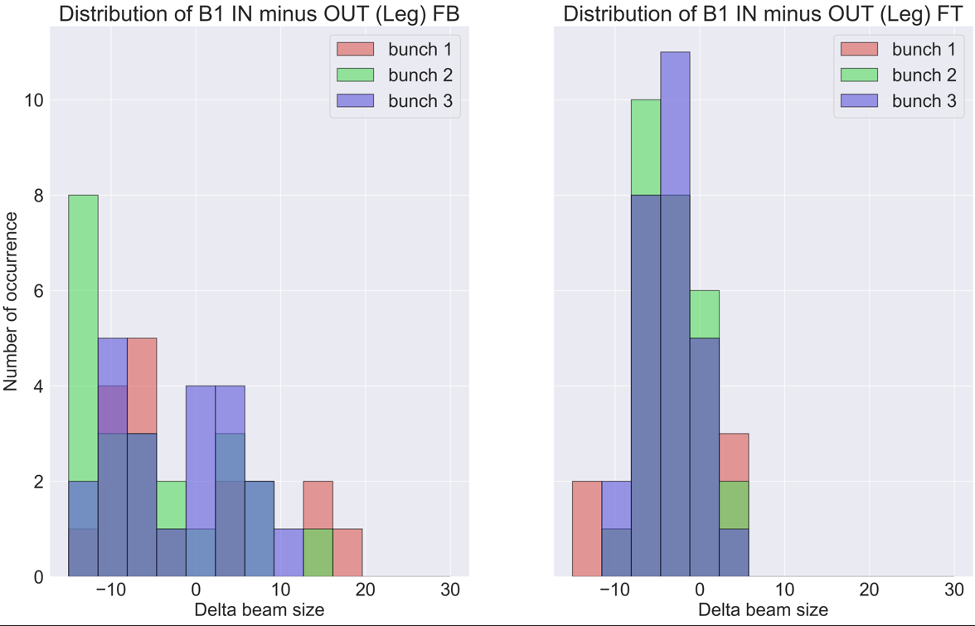
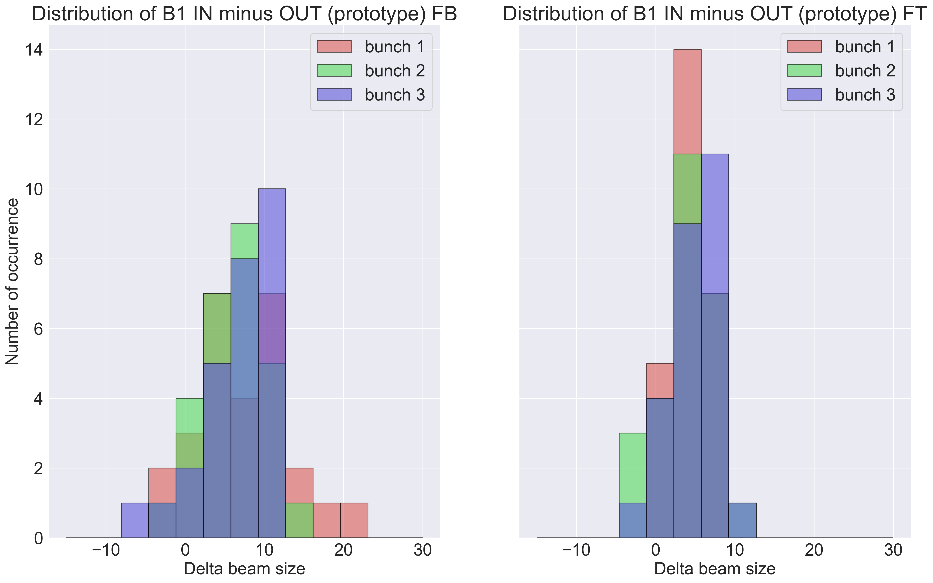
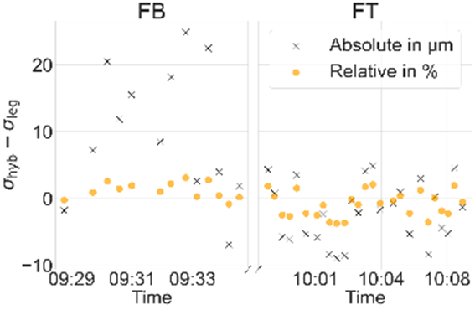
LHC BWS CONS
Sigma IN – OUT [um]
INJ
FT
INJ
FT
4 legacy units operational (10.3k scans in 2024)
Uses obsolete electronics and old bellows
4 ‘Hybrid+’ units (legacy with improved mechanics and electronics)
> 1k scans performed by BI experts
HW: Beam 1 ready for OP. Beam 2 with DAQ issue generating ‘noisy’ profiles being investigated
SW: FESA interface ready for integration in OP application
Ensures operation up to LS3 – more cons needed for later
Lots of efforts on new generation of linear BWS
YETS 24/25:
Refurbish 3 Legacy scanners with improved bellows
Fix Beam 2 Hybrid+ issue (likely related to DAQ FW)
HW and Beam commissioning by BI experts. Plan: handover to OP 4 Hybrid+ after commissioning
YETS 25/26: new linear scanner prototype for beam tests in 2026 – confirm plans for LS3 CONS
Legacy
Hybrid+
Hybrid+ vs Legacy comparison in beam sigma measured on same bunches
Injection energy
< +-20um in absolute
< +-2%in relative
Flat Top energy
< +-10um in absolute
< +-4 %in relative
Notes:
The Hybrid+ units have improved mechanics outside vacuum, control and DAQ

Slide 5
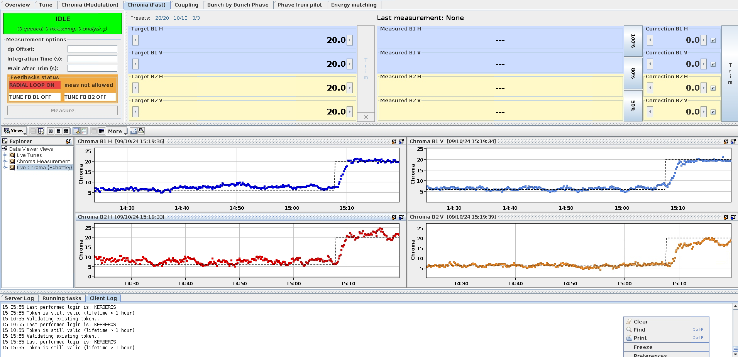
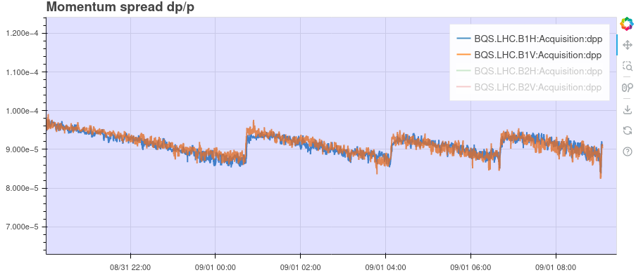
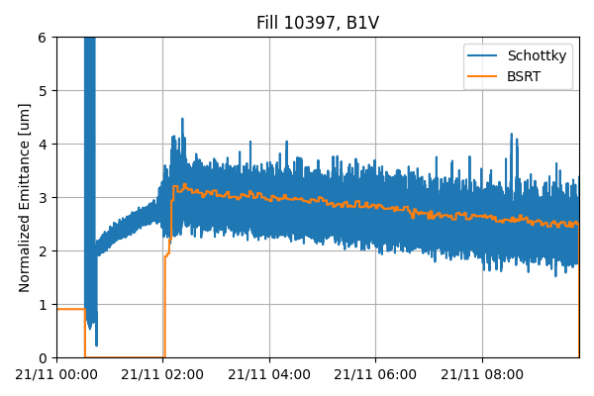
LHC Schottky
Schottky Monitor operational!
  Online Q' measurement with proton and ion beams
  Displayed in OP's LHC AccPit
Additional measurements:
  Betatron tune, RMS dp/p
  Transverse emittance of ion bunches along the whole cycle
Promising studies ongoing:
  Betatron coupling monitoring
  More realistic Schottky theory
  Machine-learning based analysis
Longitudinal blow-ups
  K. Lasocha et al. PRAB 27 (11), 112801
  C. Lannoy et al. JOI 19 (03), P03017
  K. Lasocha et al., IPAC 2024, WEPG30
  C. Lannoy et al., IPAC 2024, WEPG31
  C. Lannoy et al., IPAC 2024, WEPG32
  M. Bradicic, CERN-STUDENTS-Note-2024-224
INJPHYS
RAMP

Slide 6
Other LHC Diagnostics
BSRL 2024
DAQ (TDC) failures: new TDC family being procured
Degradation of signal on B1 due to limitation in collection options. Should be fixed during YETS 24
BRAN
Motorisation issues under study, fix planned for LS3
Improve calibration by performing systematic checks
BLMs
Very good availability – keeps improving since LS2
Several injection issues – more information on Sofia Kostoglou’s presentation on Wednesday morning
Extensive work on thresholds

Slide 7
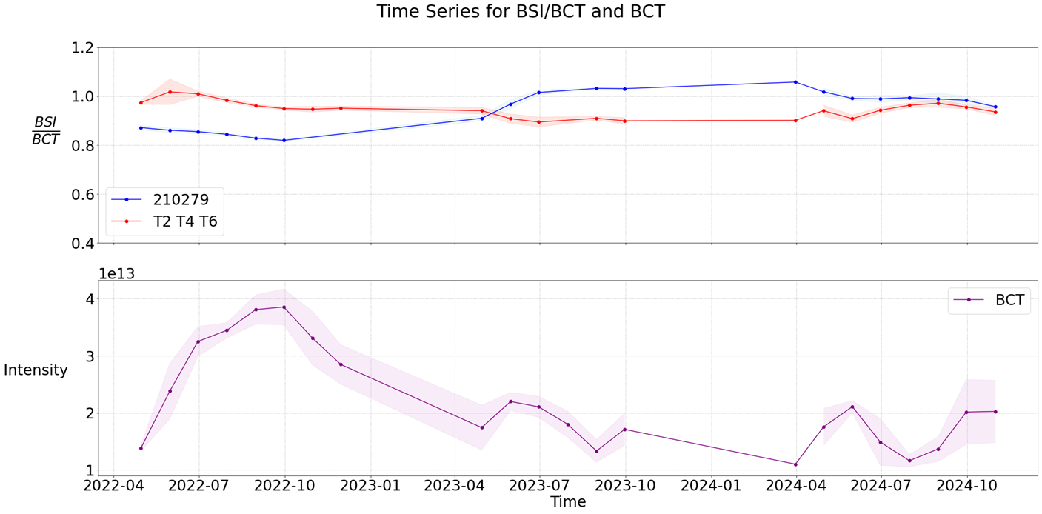
Beam Secondary Emission Intensity foils (BSI) calibration
Absolute calibration studies
Dependence on radiation and vacuum history: ongoing study
Dependence on BSI bias voltage levels: study finished in 2024
Effect of beam size on ‘hollow bias foil’: ongoing study
Calibration with activation foils
Only available method at present for absolute calibration
On-going analysis – see M. Van Dijk’s presentation on JAPW23 (https://indico.cern.ch/event/1337597)
On-going studies on type of foil
Request to establish systematic measurements at the beginning and end of the run
Outlook
Proposal of new BSI design (e.g. no hole in bias foil) along with calibration procedures as part of NA-CONS
Other options: BCT, CCC options discussed at BIFT and presented at 355th IEFC (https://indico.cern.ch/event/1460279/)
  Cryogenic Current Comparator needs allocation of resources and R&D
Average signals per week
Comparison of BCT and BSI needs detailed study of losses at extraction and splitting. Improvements planned for 2025-2026.

Slide 8
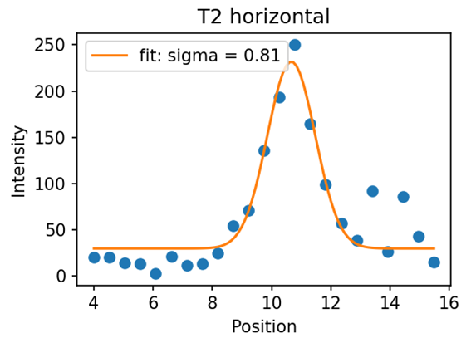
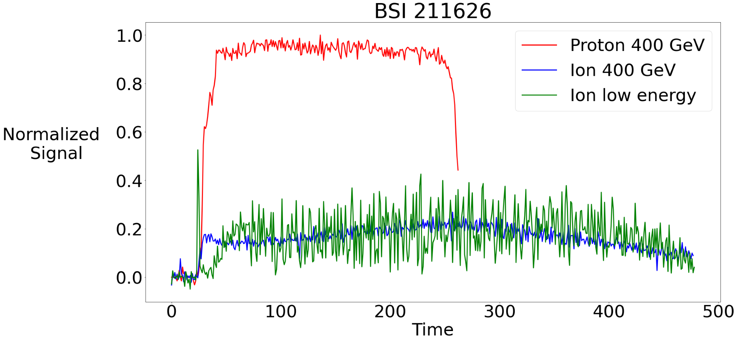
TT20 SEM detectors with ions 2024
2024 measurements
2024 Experience with ions: primary line SEMs could be used to steer the beam and validate optics despite ‘low’ signal
BSGs (fixed bands) used in one-shot analysis
BBS (scanning wire in TBIU) required multi-shots but allowed validating beam size at target expected by optics
Expected vs Measured BSI Signal Ratio (Ions/Protons):
  Expected: 10-15% (based on Z²-scaling and BCT normalisation)
  Measured: ~8% (comparing integrated spills)
  Discrepancy: can be due to reduced beam transmission with ions?
Outlook
It is necessary to understand the limitations, particularly for low-intensity beams
Find synergies with the upgrade project of the ion complex
New BSGs for TBIUs funded by NA-CONS
BBS profile
With ions
BSI 210279 showed same result

Slide 9
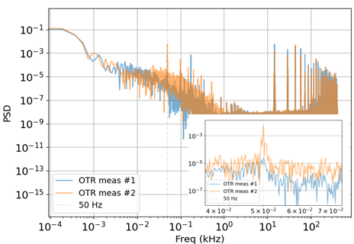
SPS Spill monitor
Spill monitor for NA-CONS
System based on OTR screen + Photomultiplier tube: https://indico.jacow.org/event/80/contributions/5769/
  Goal bandwidth of 800 MHz
DAQ now ready for tracking 200MHz and 800MHz harmonics.
Outlook for 2025:
  Make the system fully operational and be an alternative to BSI
  Reach maximum bandwidth
Plot courtesy of Pablo Arrutia

Slide 10
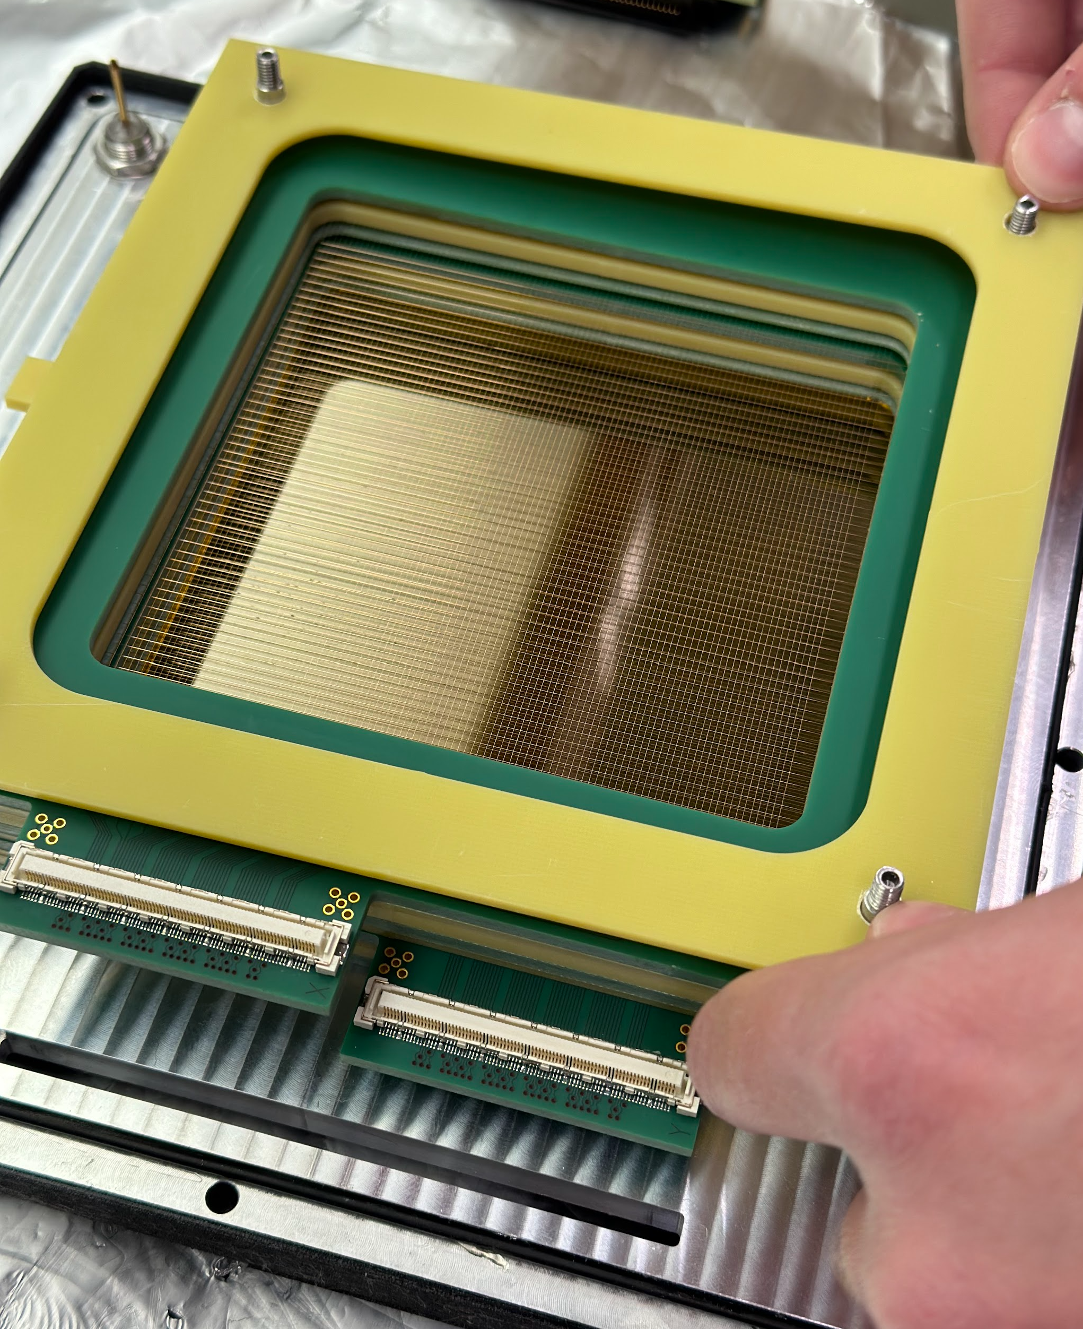
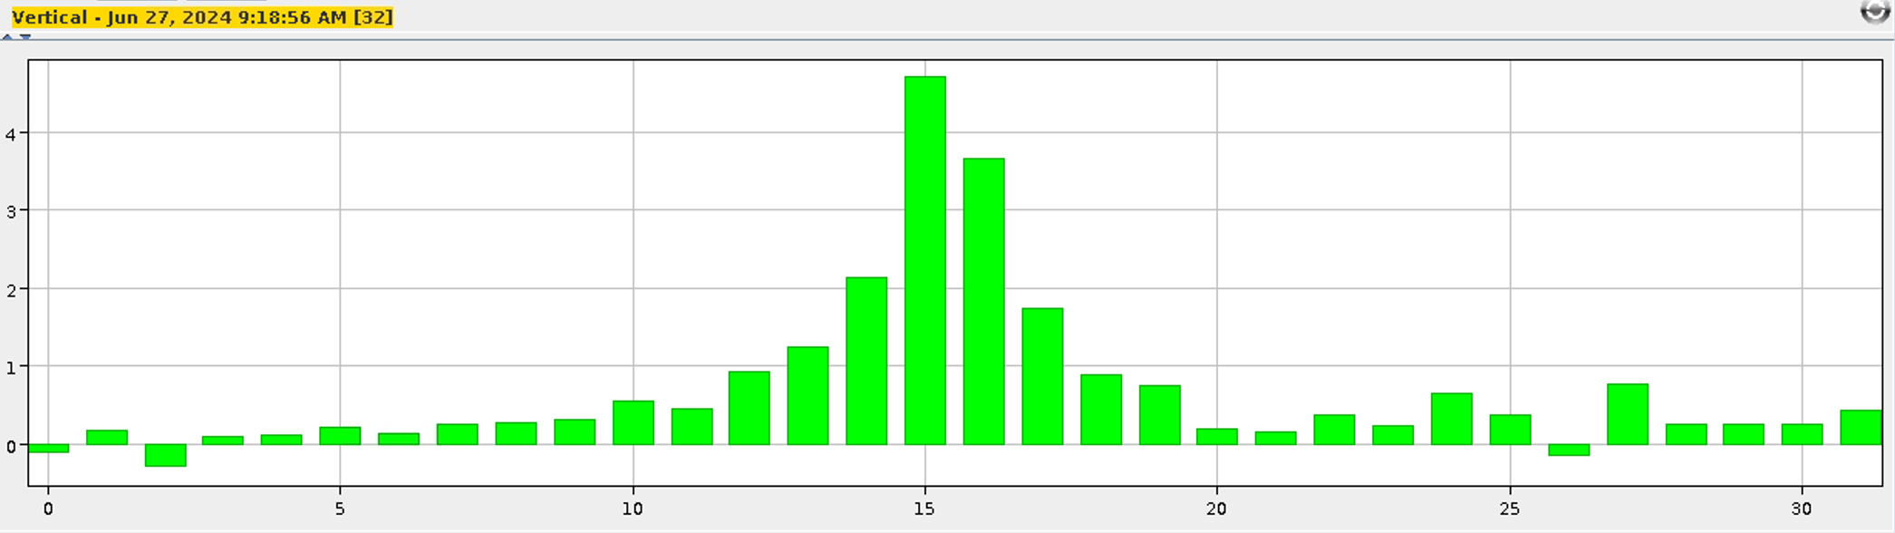
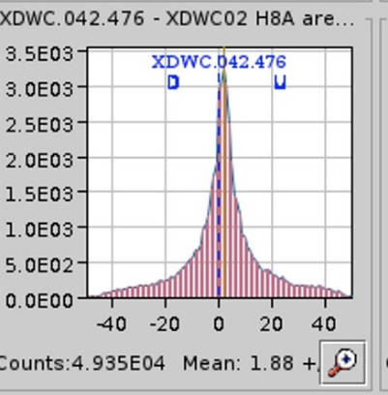

Experimental Areas - Secondary Beamlines
CEDAR (Cherenkov Differential Counter)
  Deployment of new pressure sensor
  Improved precision of diaphragm and motor movements
  Ongoing creation of a test bench for full detector characterisation
New Multi-Wire Proportional Chamber prototype
  Completed production and testing of new 10cm x 10cm prototype
  Aiming to produce several 20cm x 20cm units for 2025
New scintillating fibre monitor (XBPF) and other R&D beam tests
  North Area XBPF with in-vacuum in/out motorisation successfully tested and validated with beam
  Straw-tube detector for radiation-hard profile monitor and in-vacuum scintillator tile for North Area: several prototypes characterised with beam
New XCET (Cherenkov Threshold Counter) beam test
  New prototype produced and tested with beam – study still ongoing
FISC motor refurbishment
  Found replacement motor – integration work in progress
Assembly of the MWPC prototype
Profile from the first 10cm x 10cm MWPC prototype
Profile of a 10^6 hadron beam in the North Area measured by a DWC (left) and the XBPF (right)

Slide 11
Fixed target instrumentation: Limitations and future, feedback from BIFT on upcoming consolidation efforts and items not covered
AD-ELENA instrumentation issues and requests presented at BIFT #10 and being followed-up
  Examples: Ionisation Profile Monitors (IPM) refurbishment, Target BTV calibration issues (see Davide Gamba’s presentation on Monday)
ISOLDE: dedicated BIFT #16. Will need to clarify how to integrate ISOLDE requests and BI CONS plans in a common plan (schedule and resources)
ECN3 BI requests presented at BIFT number #12, including ultra-fast spill monitor for SHiP, target instrumentation and other …
Other items not (yet) covered in BIFT and requiring follow-up:
  Upgrade Project of the Ion Complex recently discussed
  Fully supported analytics tools to help improve performance
Feedback from EA operation
  Improve communication regarding HWC and IST completion
  Expert availability needed during commissioning periods and outside working hours
BIFT (Beam Instrumentation for Fixed Targets Working Group)
Indico: https://indico.cern.ch/category/16541/
Action list in Jira: https://its.cern.ch/jira/projects/BIFT/

Slide 12
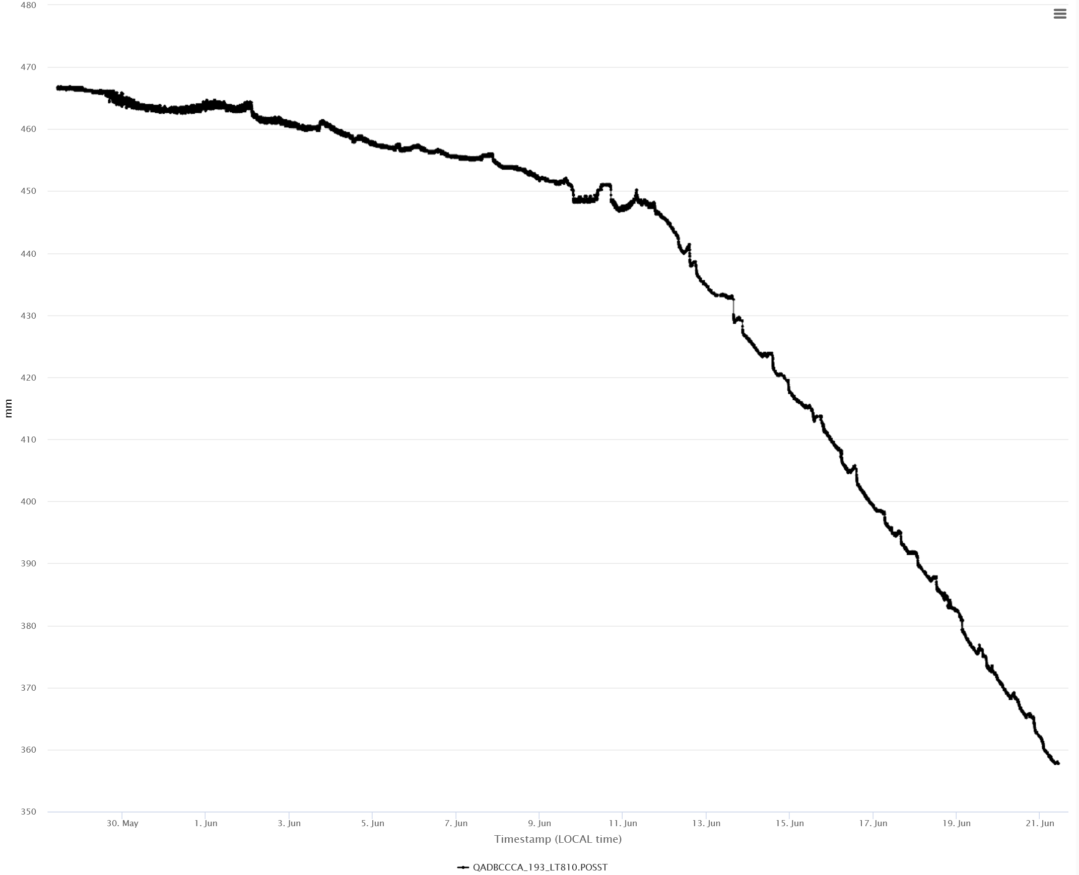
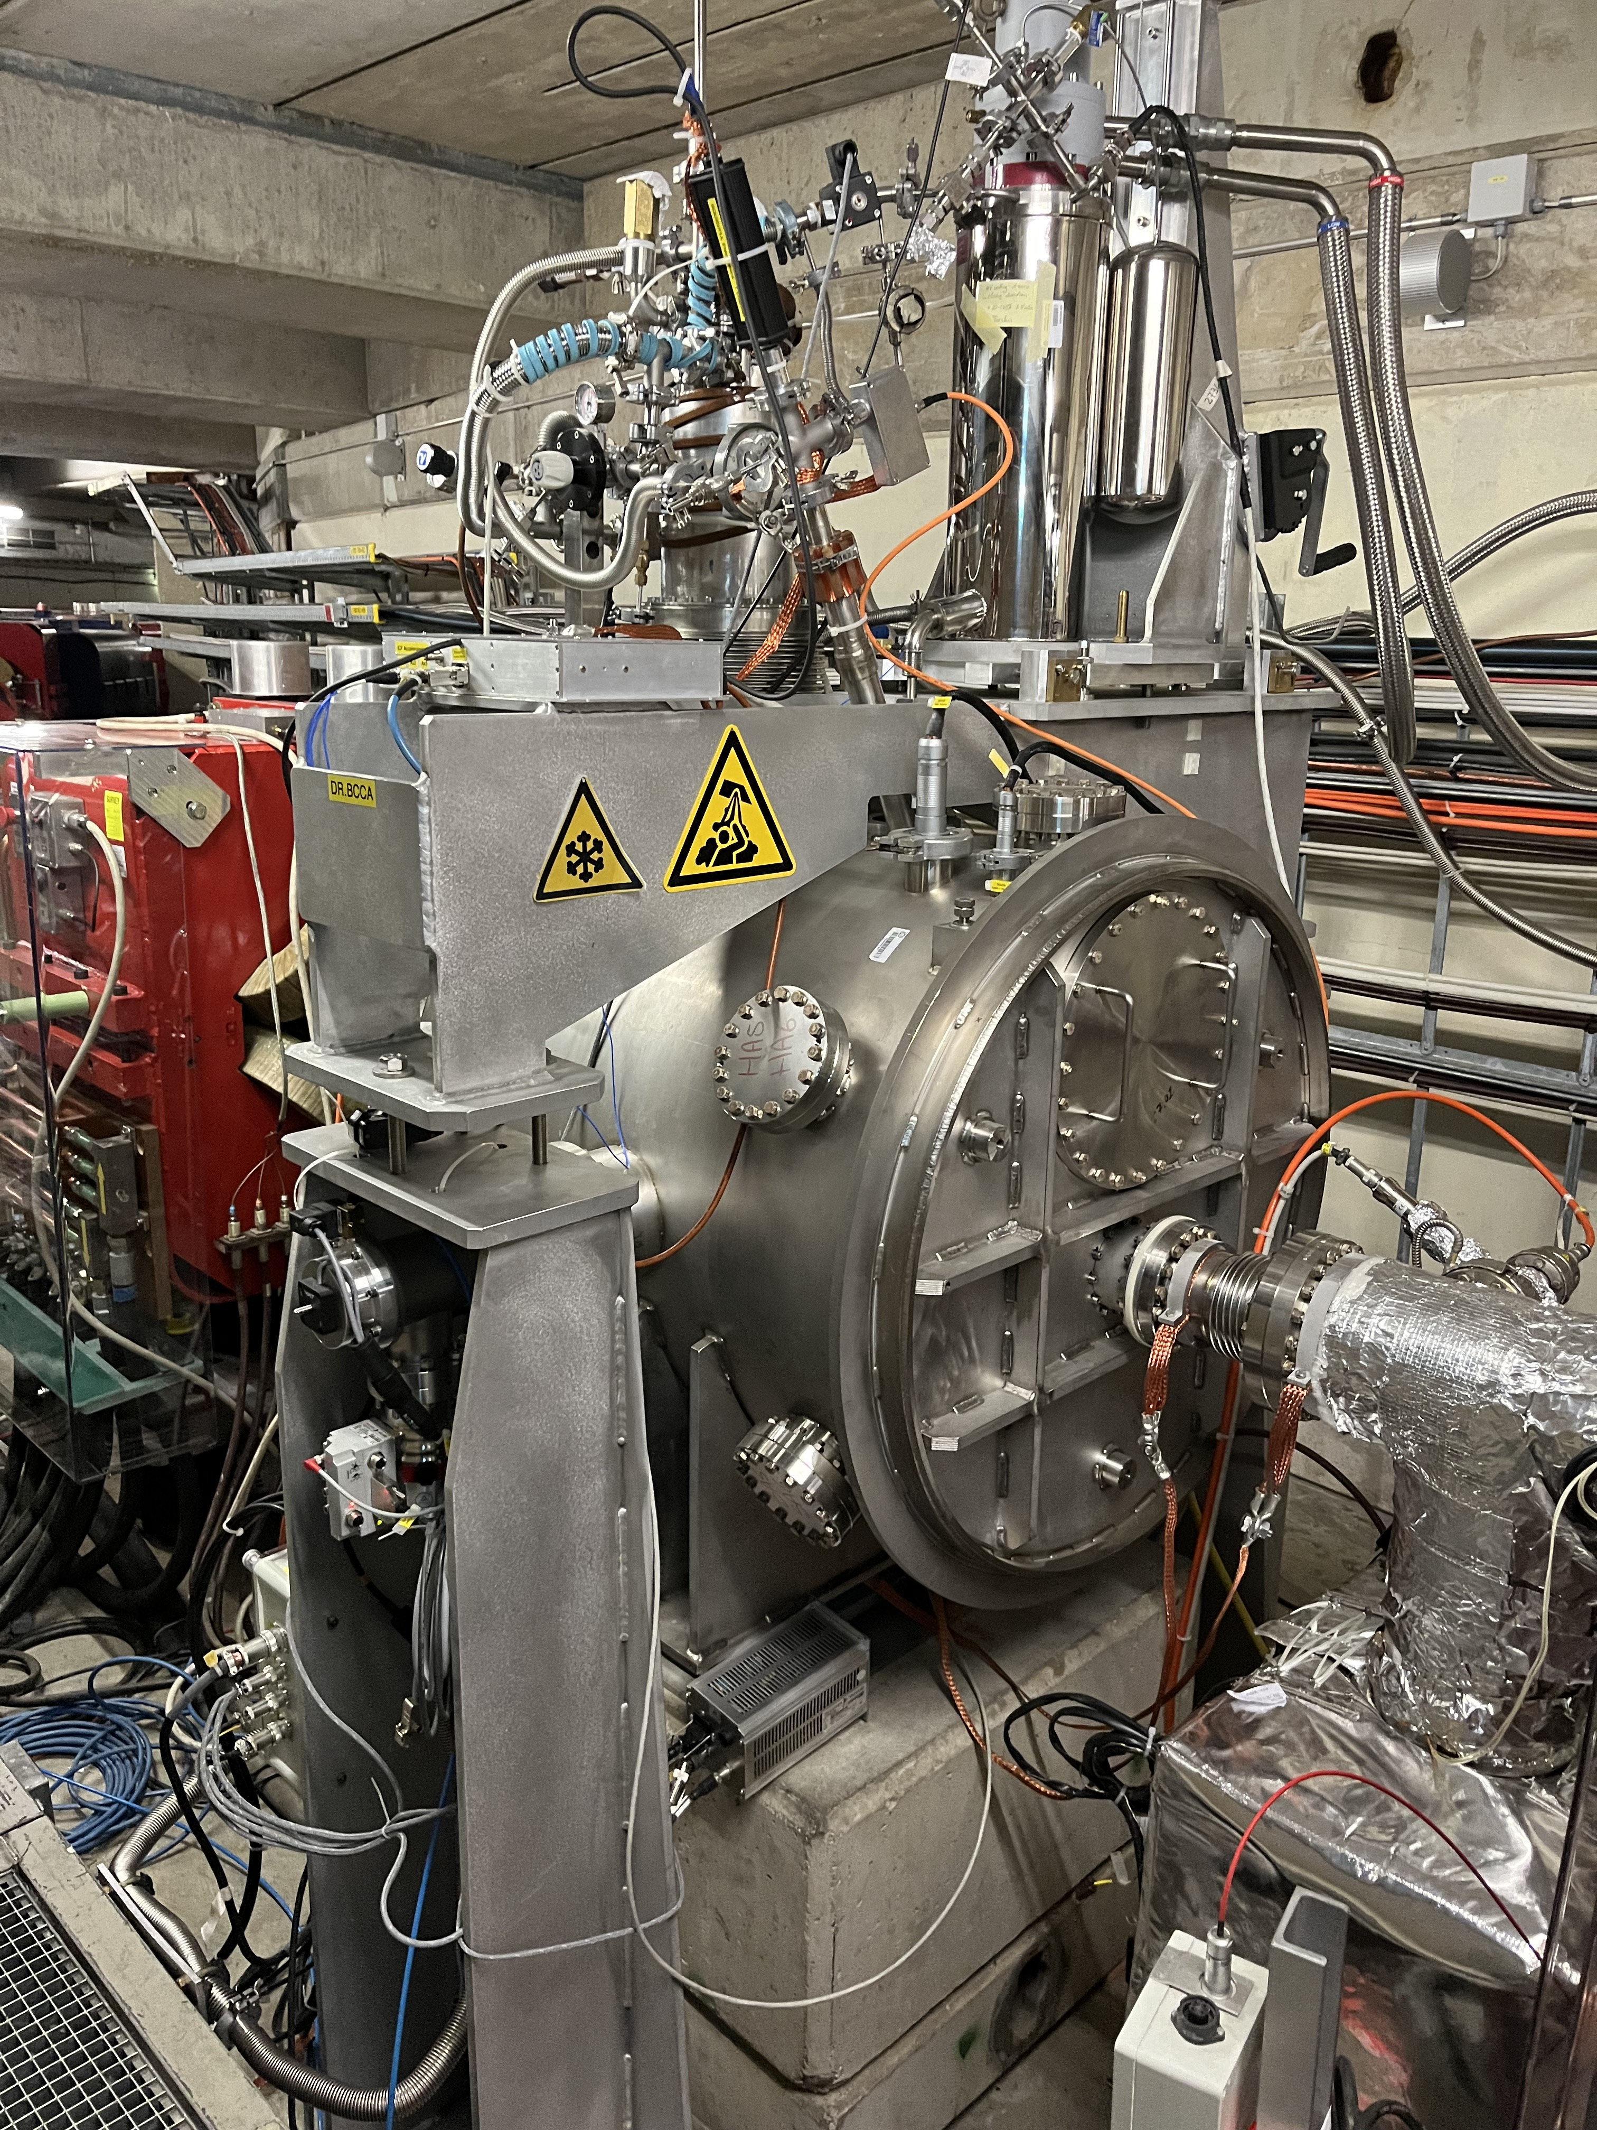
AD Cryogenic Current Comparator (BCCCA) and E-coolers
AD E-cooler
Cathode supply tripping issue
  Mitigated by increasing collector voltage by 3%
  Related to electron beam dynamics at entrance to collector
Solenoid power supply issue
  7 trips in 2024, took 10 hours to repair on 1 occasion
  CONS in LS3, until then a worrying trend...
BPM reading drifts being investigated
Good news: both H & V IPM working
LEIR and ELENA e-Coolers
Smooth pbar and Pb ion runs
1st time Mg ion cooling in LEIR
AD BCCCA (Cryogenic Current Comparator)
Pump on insulation vacuum failed -> loss of He
Temporary fix put in place. Definitive solution deployed during YETS24/25
Good news: improved reading after applying real B-train signal
AD BCCCA
~1.5 mm per day (vacuum 1E-6 mbar)
Lhe level in cryostat (mm)
TMP failure
pbar beam
pump
Time (days)

Slide 14
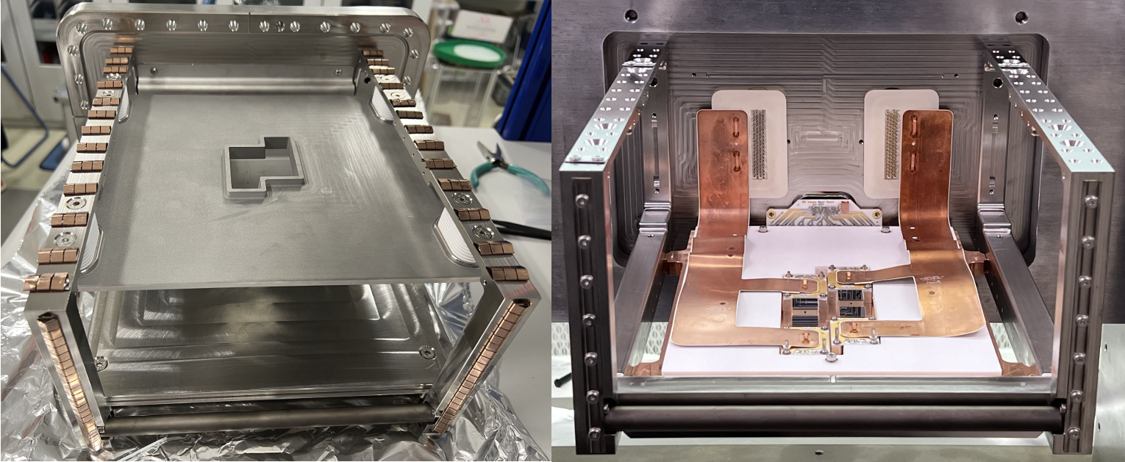
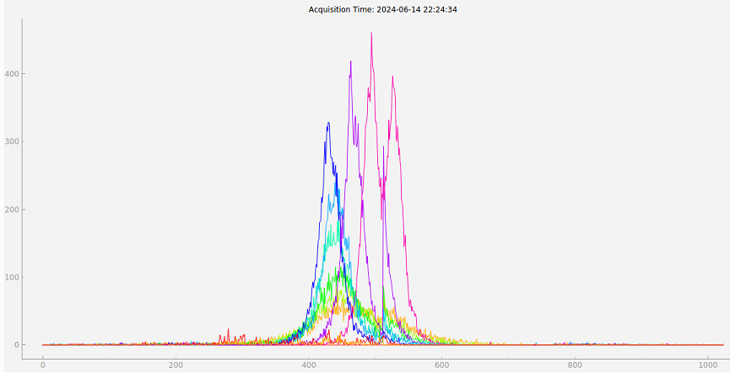
Beam Gas Ionisation (BGI) Profile Monitor
Continuous transverse beam profile measurement based on detection of residual ionisation electrons
Instruments installed in the PS (LIU) and SPS (CONS)
Hardware issues:
  EMC issue of SPS BGI instruments
  Low gain of PS BGI-Vertical at injection energy
  Saturation of Timepix3 due to beam loss & noisy pixels
  Software issues:
  Stability & complexity of current FEC + SoC readout system
  Limited analysis of Timepix3 data on SoC processor
  Summary of the BGI review
  Recommendation to proceed immediately to new Timepix3 readout architecture (ATS FESA-on-SoC + Server Event Processing), at the cost of reducing deliverables to OP in the short term -> ready by Q4 2025
  SPS EM issue is a significant problem, investigations underway with help of ATS EMC Lab -> SPS BGI-Vertical instrument to be installed in EYETS 24/25
BGI instrument - Field cage
BGI instrument - Timepix3 HPD’s
SPS BGI-H: Beam Profile Evolution of LHC3 Cycle
Transverse Position ( Col. # )

Slide 15
SPS BGI’s: Situation Today & After YETS 24/25
Situation Today
After YETS 24/25
BGI Horizontal
Instrument installed with “Diamond” RF shield
Magnets in doublet configuration
BGI Vertical
Prototype instrument installed
Magnets in doublet configuration
BGI Horizontal
Same instrument with “Diamond” RF shield
External HV countermeasures
Magnets in triplet configuration (*)
BGI Vertical
New instrument with “Denser” RF shield
External HV countermeasures
Magnets in triplet configuration (*)
(*) ECR 3168184 "Modification of magnetic bump for operation of the BGI profile monitors in SPS LSS5.

Slide 16
LHC BLM Thresholds
BLM Thresholds Working Group: https://indico.cern.ch/category/8964/
20 BLMTWG some combined with CollWG and/or MPP and13 ad-hoc meetings
  10 concentrated on ion run beam loss limitations
BLM ECRs 2024:
  LHC-BLM-ECR-0080 BLM thresholds for the new detectors in IP7 for Beam 1 on the passage wall
  LHC-BLM-ECR-0081 BLM thresholds increase of RS12 for collimation losses
  LHC-BLM-ECR-0082 BLM thresholds increase in IR3 at the start of beam energy ramp
  LHC-BLM-ECR-0083 BLM thresholds for Proton Quench Test at 6.8 TeV
  LHC-BLM-ECR-0084 BLM thresholds modifications for the proton-proton reference run at 2.68 TeV
  LHC-BLM-ECR-0085 BLM thresholds for the LHC Pb-Pb ion run at 6.8 TeV in 2024

Slide 17
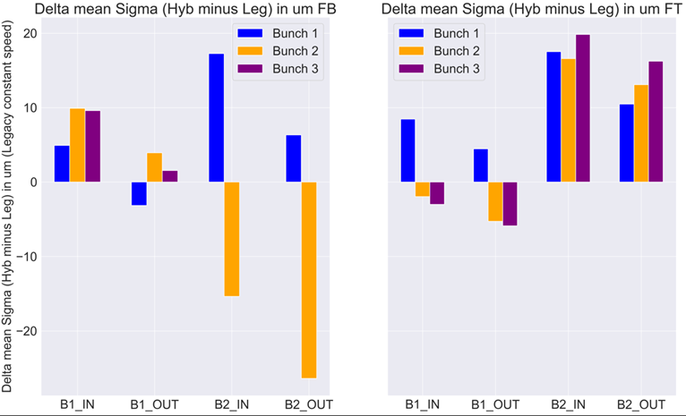
LHC BWS – Legacy vs Hybrid+
Hybrid – Legacy
Injection energy
< +-20um in absolute
< +-2%in relative
Flat Top energy
< +-10um in absolute
< +-4 %in relative

Slide 18
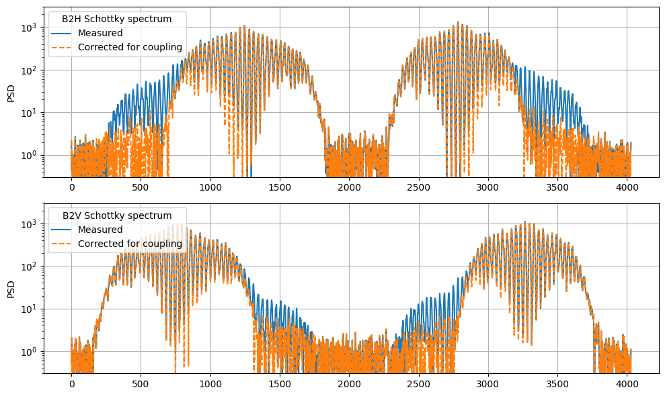
LHC Schottky
Schottky Monitor operational!
    Online Q' measurement with proton and ion beam
    Displayed in OP's LHC AccPit
Additionally measuring:
    Betatron tune, RMS dp/p
    Transverse emittance of ion bunches along the whole cycle
  K. Lasocha et al. PRAB 27 (11), 112801
  C. Lannoy et al. JOI 19 (03), P03017
  K. Lasocha et al., IPAC 2024, WEPG30
  C. Lannoy et al., IPAC 2024, WEPG31
  C. Lannoy et al., IPAC 2024, WEPG32
  M. Bradicic, CERN-STUDENTS-Note-2024-224
Promising studies ongoing:
    Betatron coupling monitoring
    More realistic Schottky theory
    Machine-learning based analysis
Longitudinal blow-ups
INJPHYS
RAMP

Slide 19
Original list of topics proposed by session chairs:
Focus up to 2026
BSI measurement status & overview
BGI plans after review
Experimental Areas: Limitations and future, feedback from BIFT on upcoming consolidation efforts and items not covered
Missing instrumentation (‘known unknowns’), where do we need R&D or resources?
Compatibility with future beams? Ions? ‘Attention needed’?

Slide 20
EA feedback to SY/BI (2024 + 2025)
More clear HWC and ISTs completion
XWCM spare strategy
In case of planned comissioning in the weekend / days off, expert availability to be regulated.
Strategy for intensity calibrations (include XSEC) - CCC (?)
Test bench for CEDAR/XCET optics commissioning without beam --> On EA
  But for pressure and BI/related --> SY/BI
Operational issues with XCEDs (pressure sensors …)
Possibility of interventions outside working hours for critical equipments like CEDAR or XCET that experiments rely on. Piquet service ?
Ion Beam Instrumentation for low-energy --> F. Roncarolo
FISCs

